Slide 1
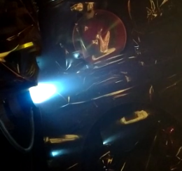
Radiofrequency Heating and AI Alvaro Sanchez-Villar June 11, 2025

Slide 2
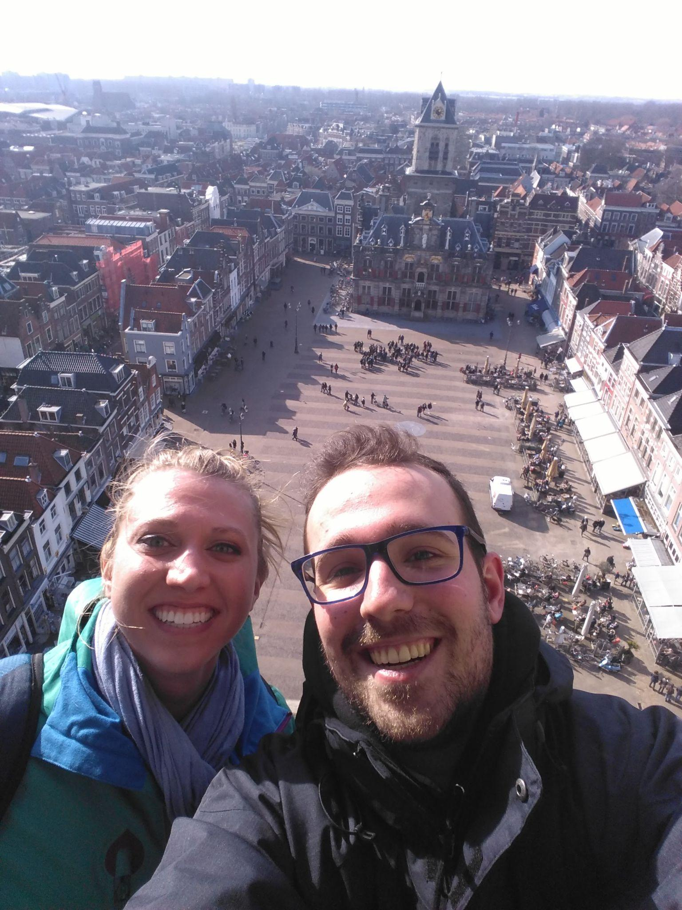
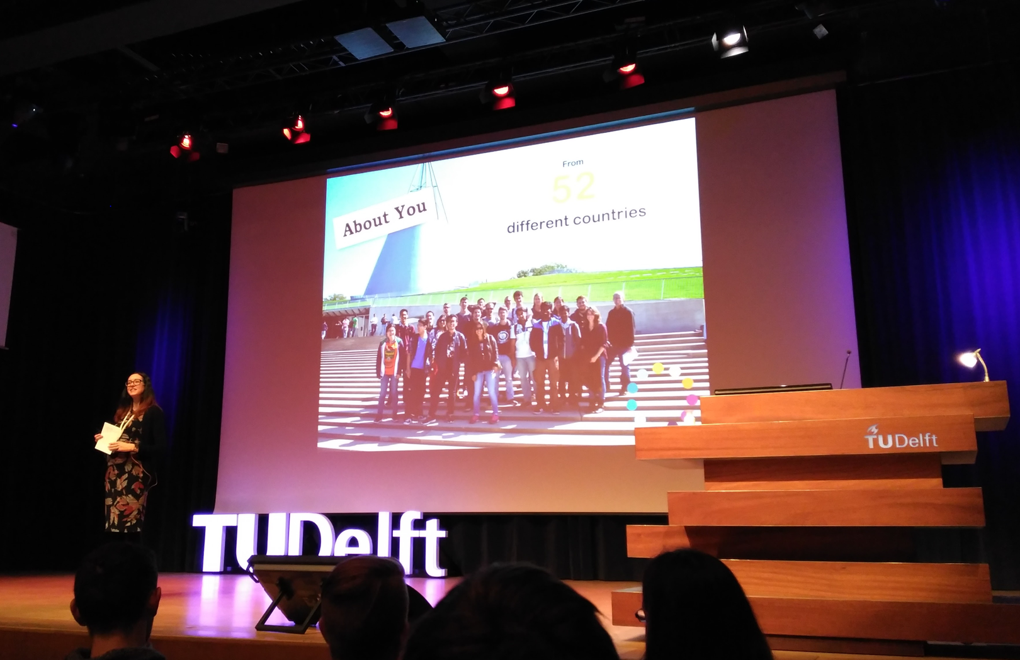
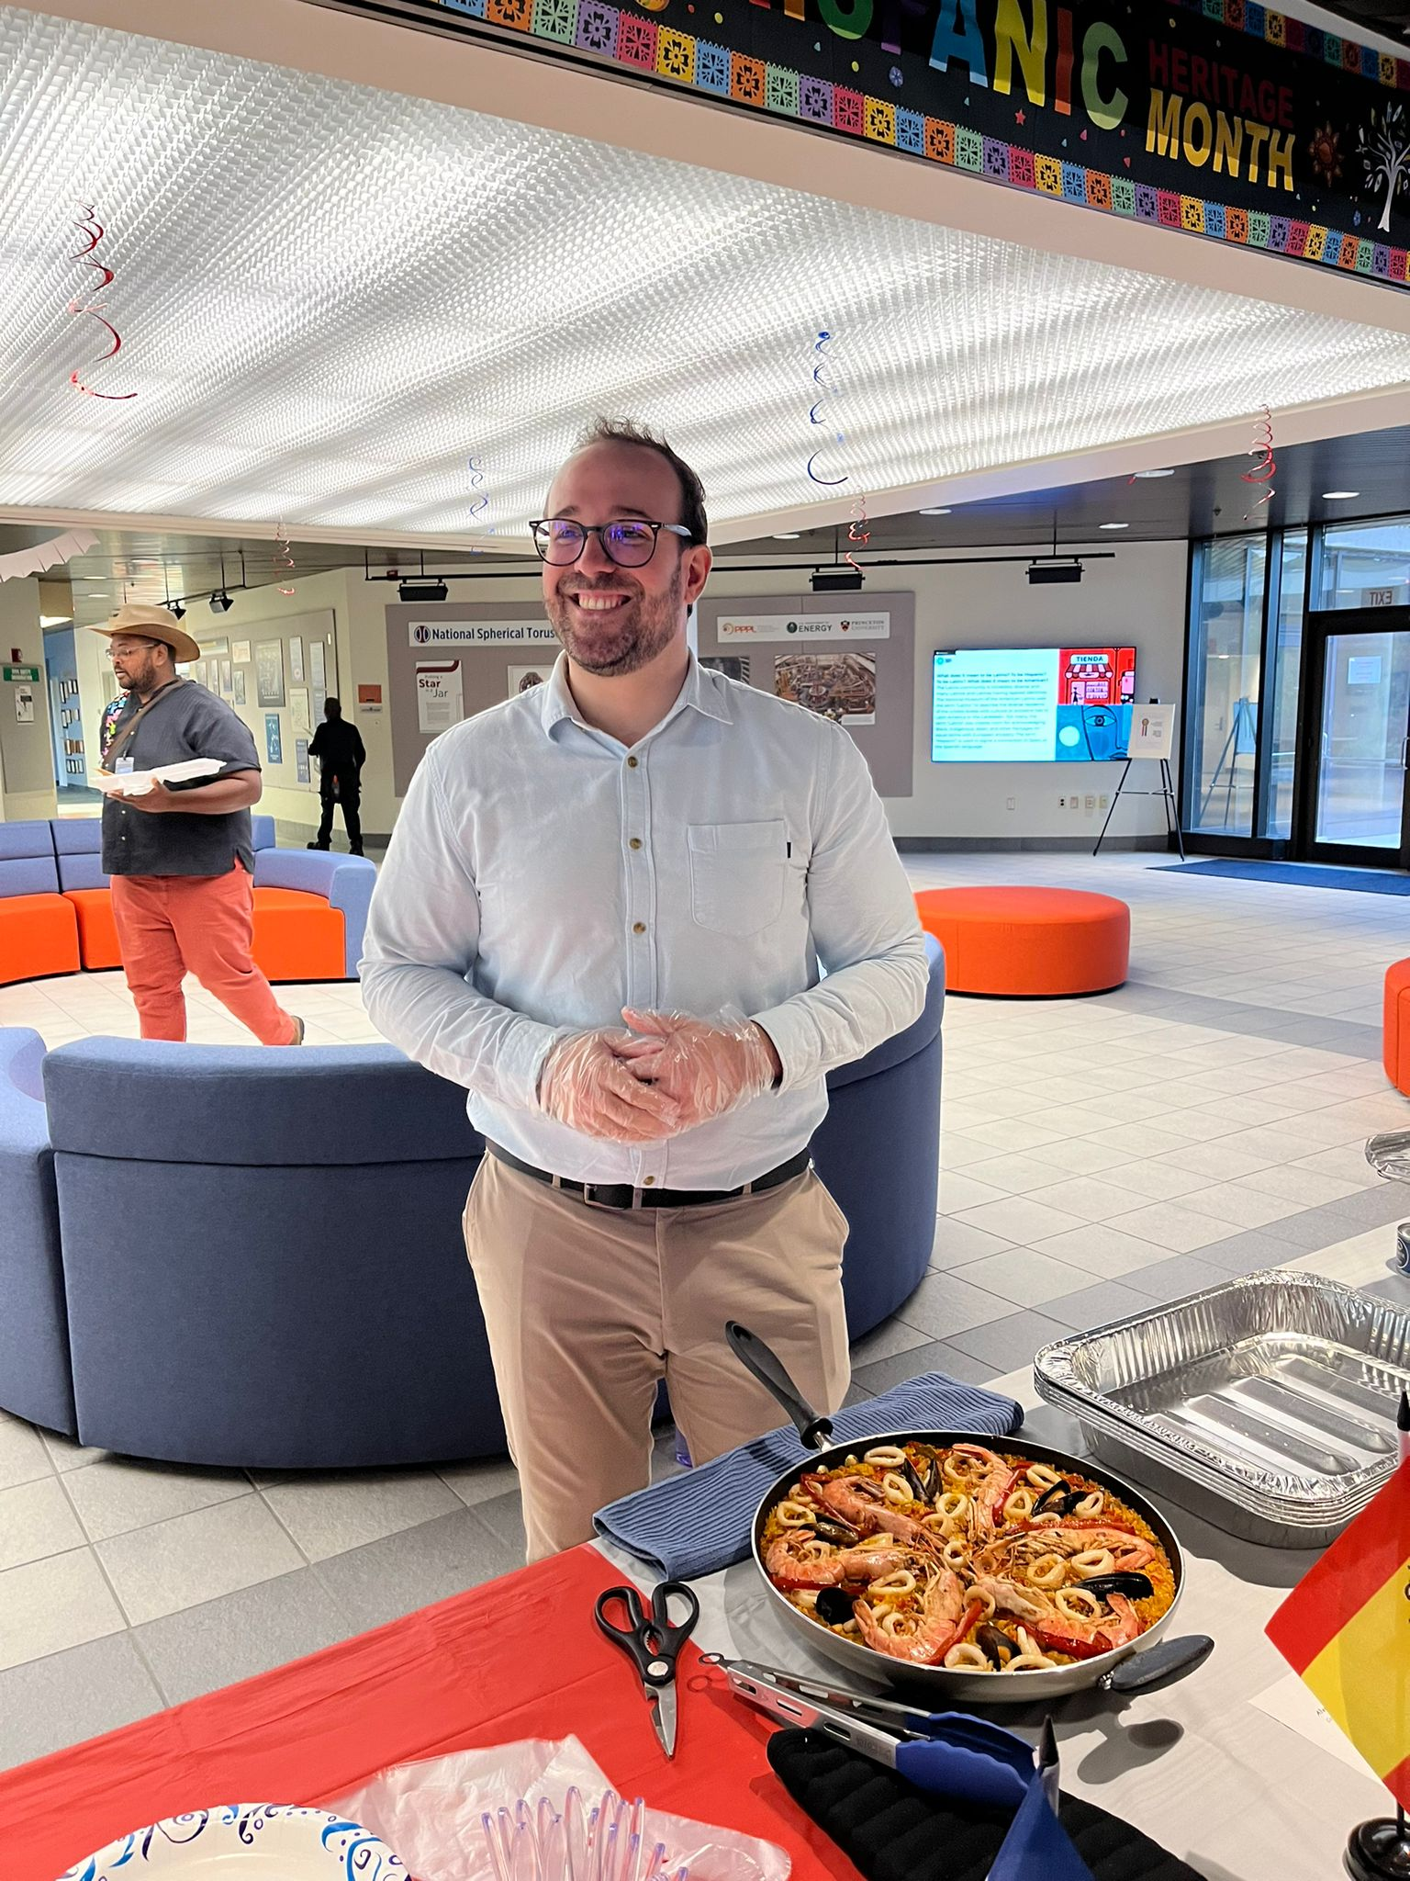
A bit about me and how I got here!
On a personal
note, I enjoy
painting, cooking
and basketball
B.S. Aerospace Engineering
M.S. Aeronautical Engineering
Ph.D. Fluid Mechanics (Plasma Physics)
Visiting Researcher at ONERA, France
Delft,
Nethelands
Spain

Slide 3
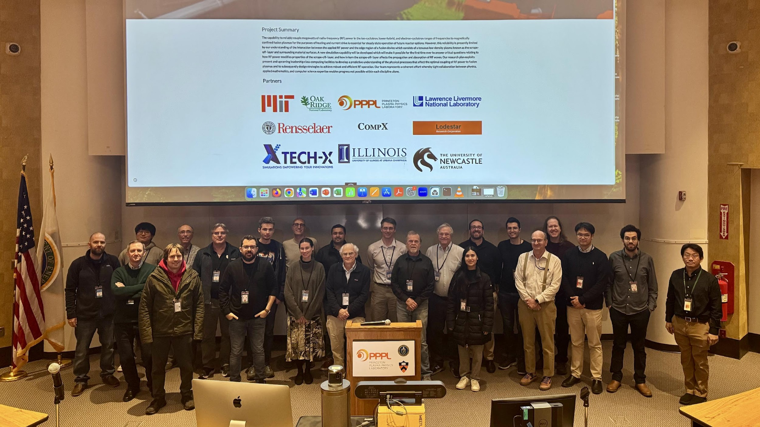
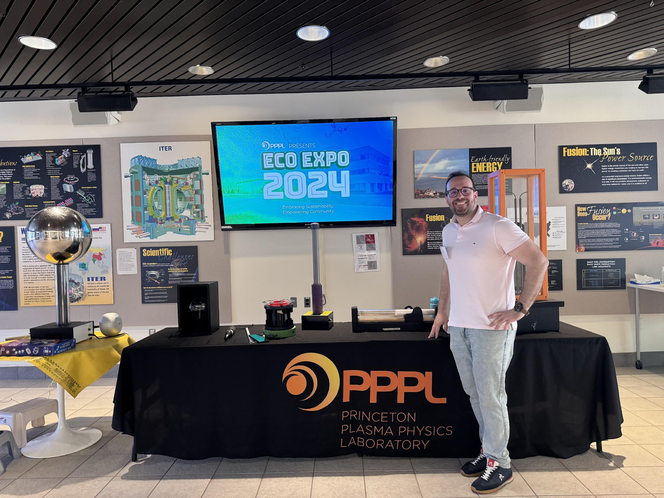
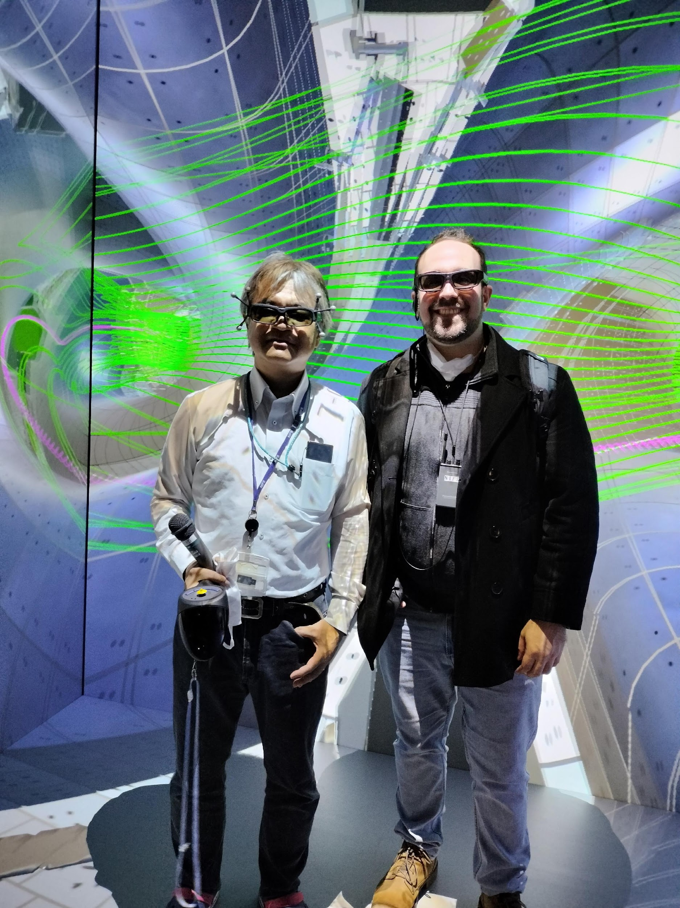
My role at PPPL
Associate Research Physicist
Computational Sciences Department
Research interests:
Artificial intelligence and Machine learning
Radio-frequency actuator modeling

Slide 4
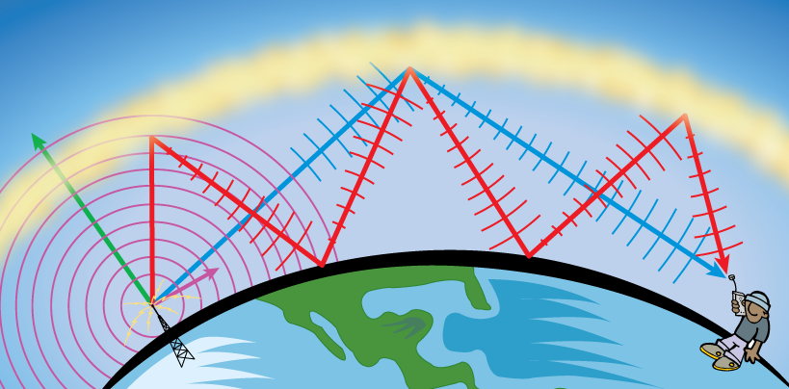
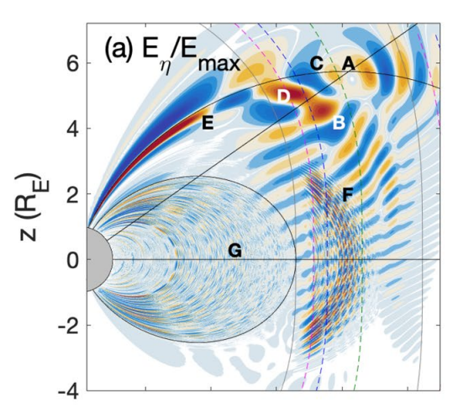
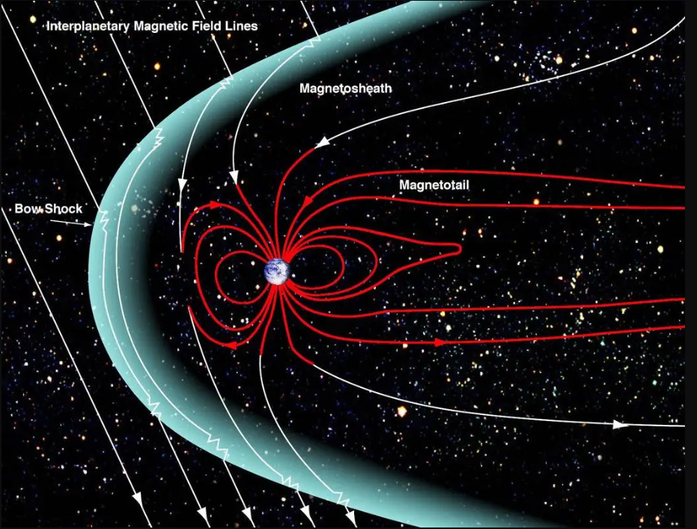
RF waves propagate in the ionosphere and magnetosphere
The propagation of radio waves relies in the reflection/transmission characteristics of the ionospheric plasma
Source: NOAA
Waves in the magnetosphere carry and couple energy, causing significant charged particle losses in Earth’s atmosphere
Source: NASA
Source: Kim et al. GRL (2023)

Slide 5
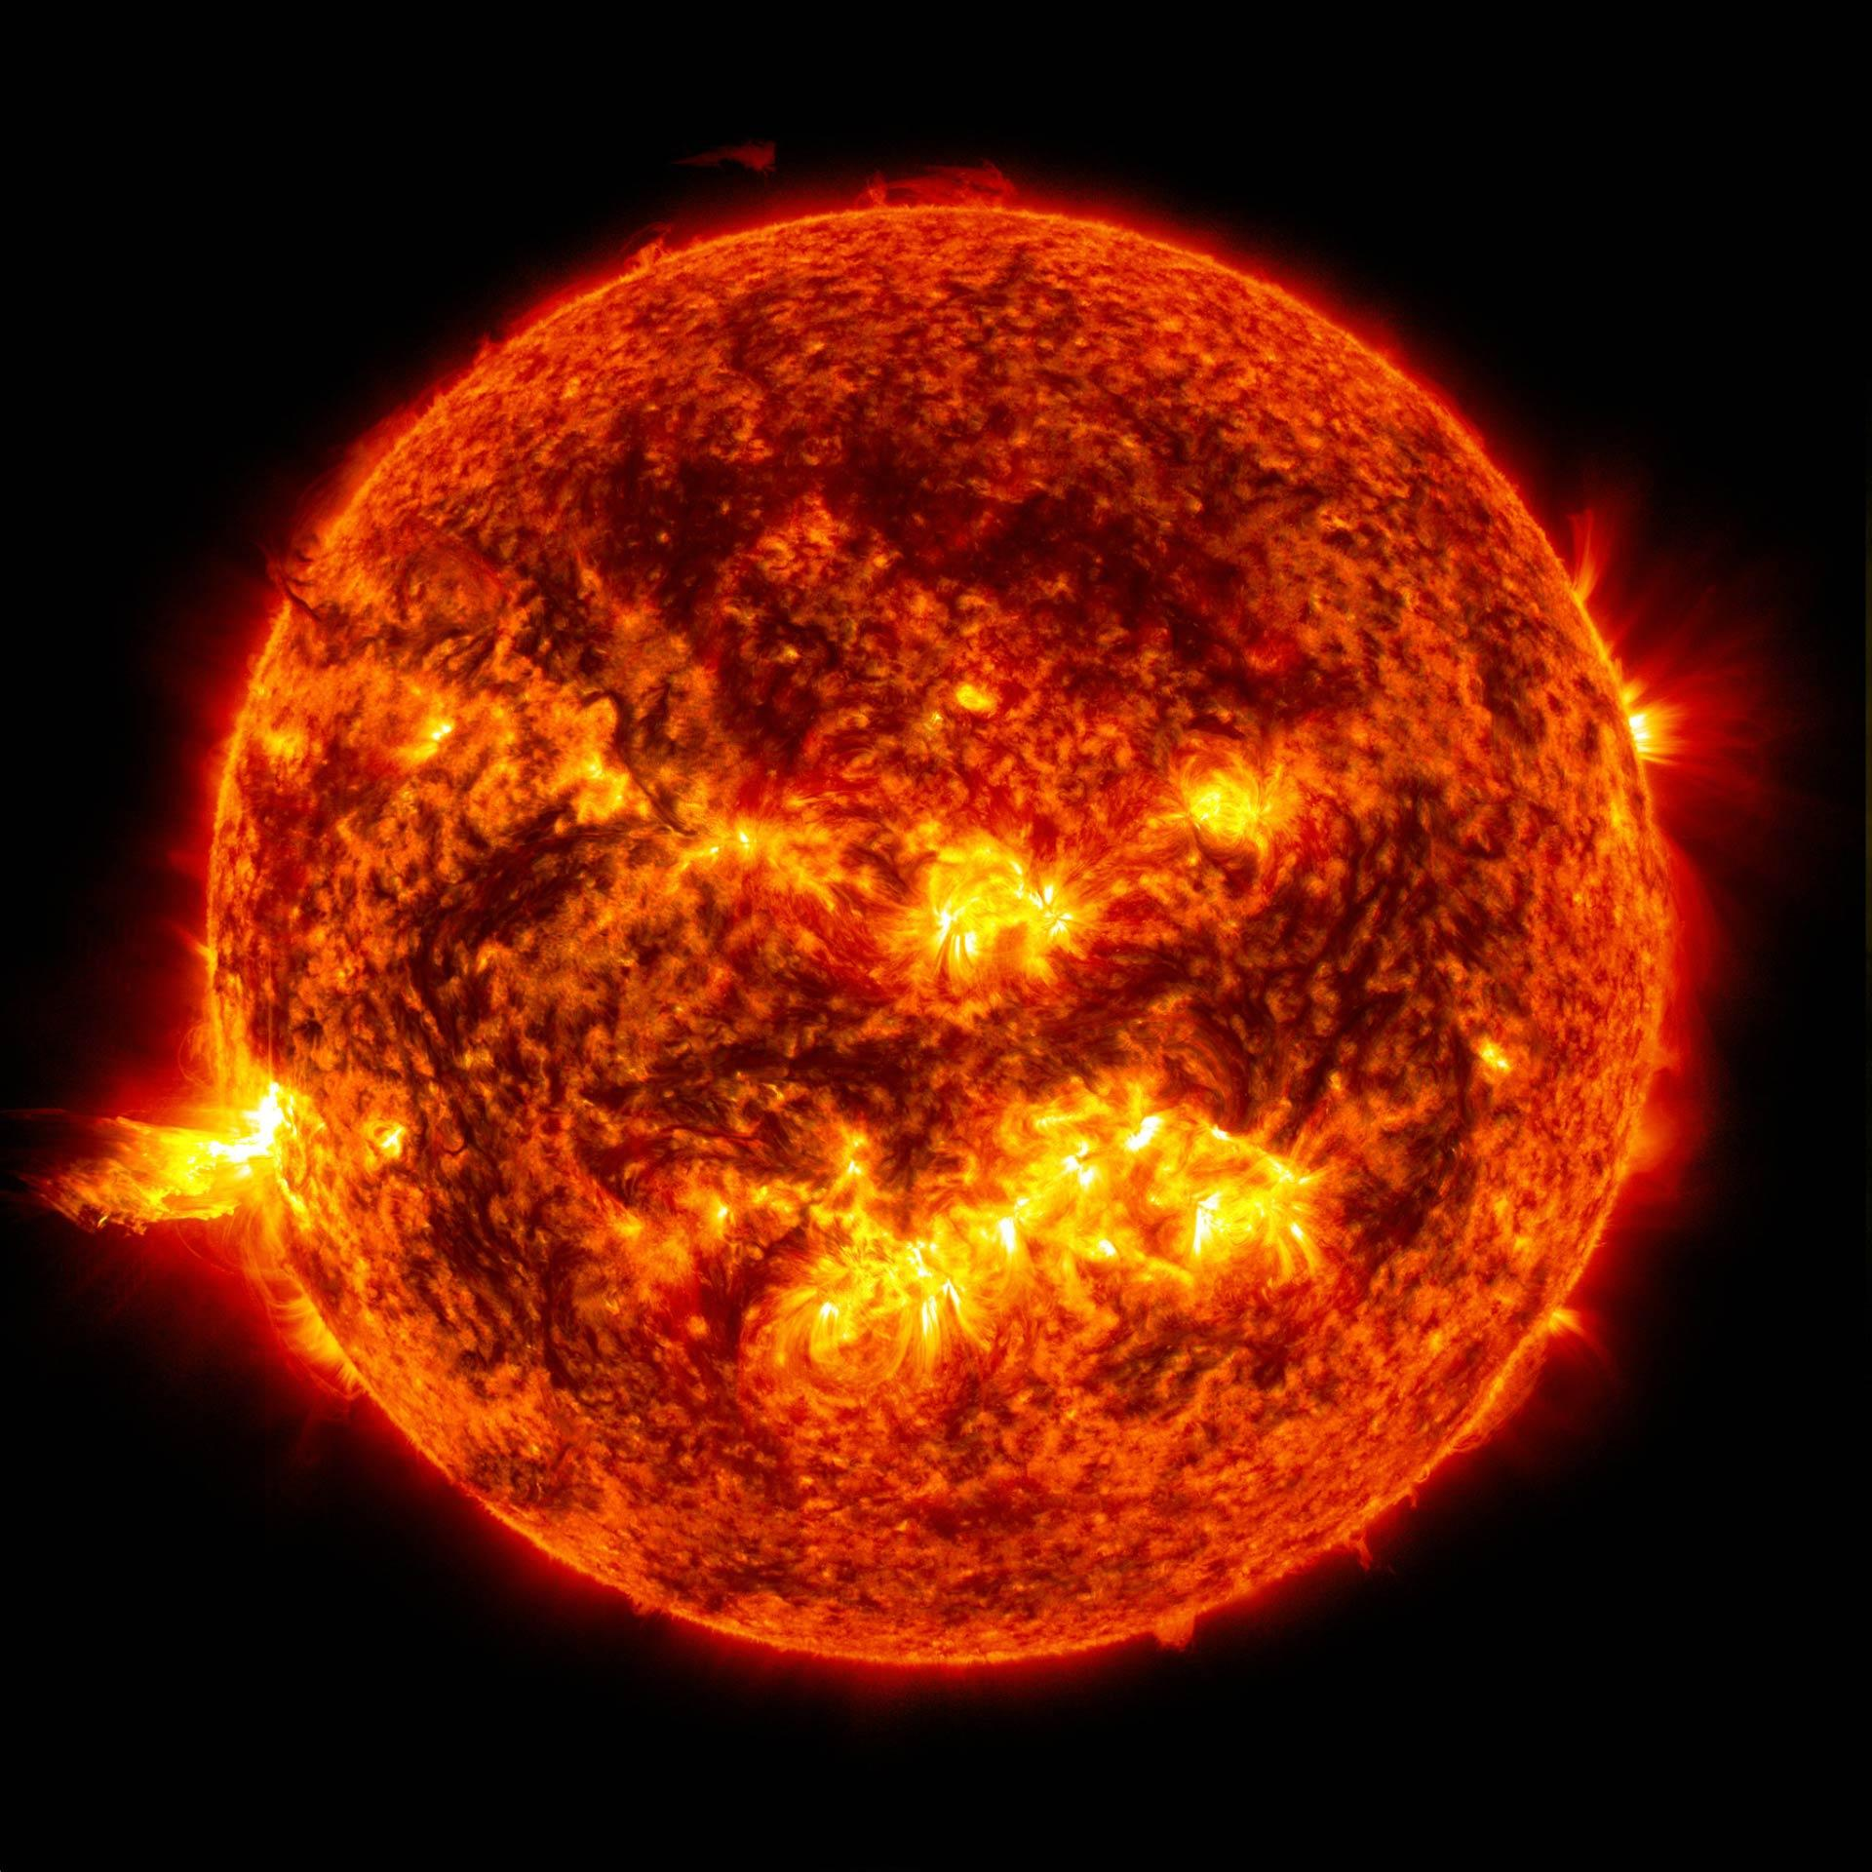
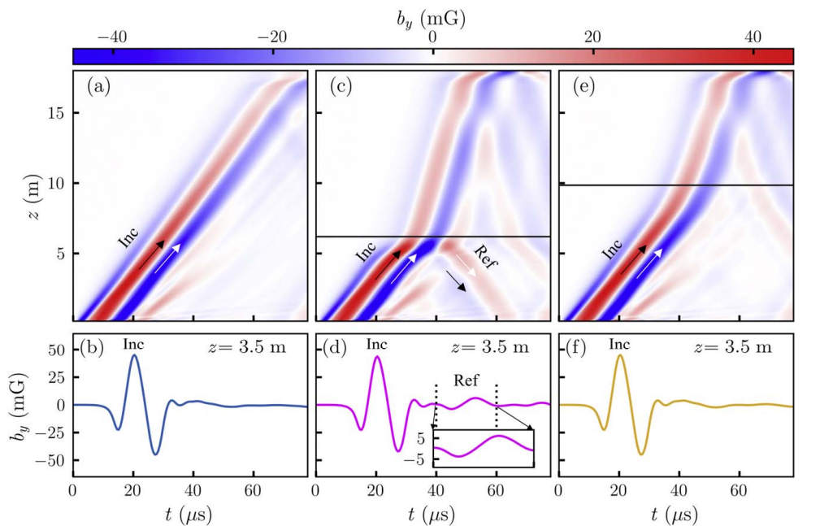
RF waves also in solar corona
Studies suggest that Alfvén wave propagation and reflection in the solar corona drive turbulence and help heat the solar corona
Source: NASA
Source: Bose et al. The Astrophysical Journal (2024)

Slide 6
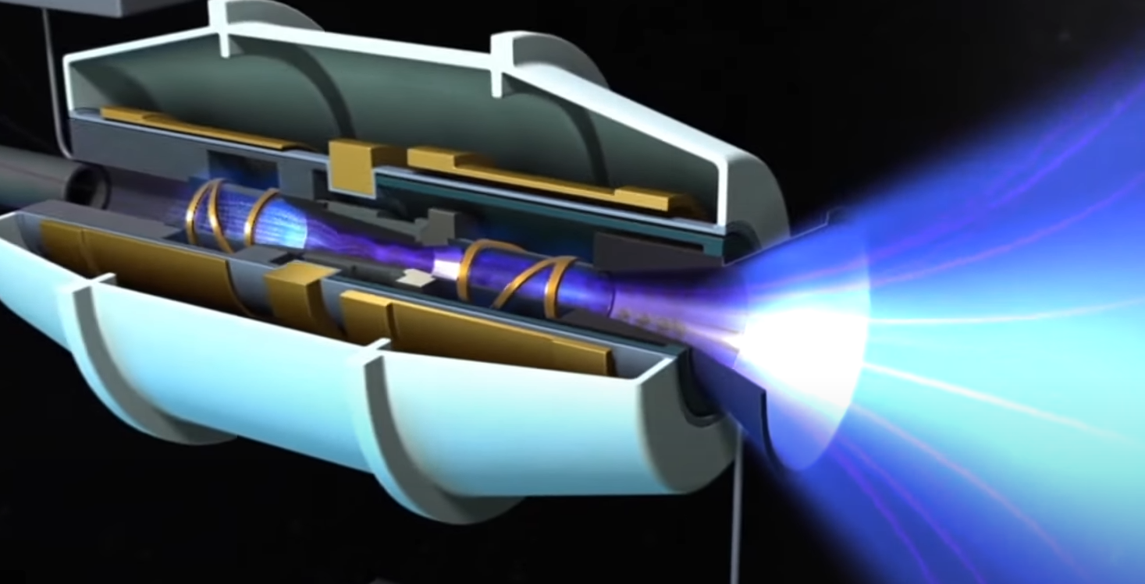
Also in space plasma thrusters!
Electrodeless Plasma Thrusters
RF HEATING SOURCE + MAGNETIC NOZZLE (MN) = PROPULSION
Helicon
antennas
VASIMIR
Helicon Thruster
ECR
MN
MN
MN
Helicon antenna
Coaxial + ECR

Slide 7
RF waves also exist in fusion devices: what is their role?
Transfer momentum and energy to plasmas
Applications:
Bulk heating
Non-inductive
current drive
Fast control of profiles, scenario & impurity
Wall conditioning
MHD-Instability suppression
Fast-ion tailoring
Start-up & breakdown
Etc…
RF WAVES
PLASMA
Notes:
local electron density and fluctuation
radial electron temperature
Absolute Te and ne at laser crossing points
Line integrated Te and impurity content
These diagnostics let us watch how RF waves and instabilities change density, temperature, and radiation in real time—so we can verify heating, spot trouble, and steer the plasma

Slide 8
RF waves also exist in fusion devices: what is their role?
Transfer momentum and energy to plasmas
Applications:
Bulk heating
Non-inductive
current drive
Fast control of profiles, scenario & impurity
Wall conditioning
MHD-Instability suppression
Fast-ion tailoring
Start-up & breakdown
Etc…
Emission/Instabilities
Diagnostics:
Microwave reflectometers
Electron Cyclotron Emisison
Thomson scattering
Soft X-rays diodes/cameras
Etc…
RF WAVES
PLASMA
Notes:
local electron density and fluctuation
radial electron temperature
Absolute Te and ne at laser crossing points
Line integrated Te and impurity content
These diagnostics let us watch how RF waves and instabilities change density, temperature, and radiation in real time—so we can verify heating, spot trouble, and steer the plasma

Slide 9
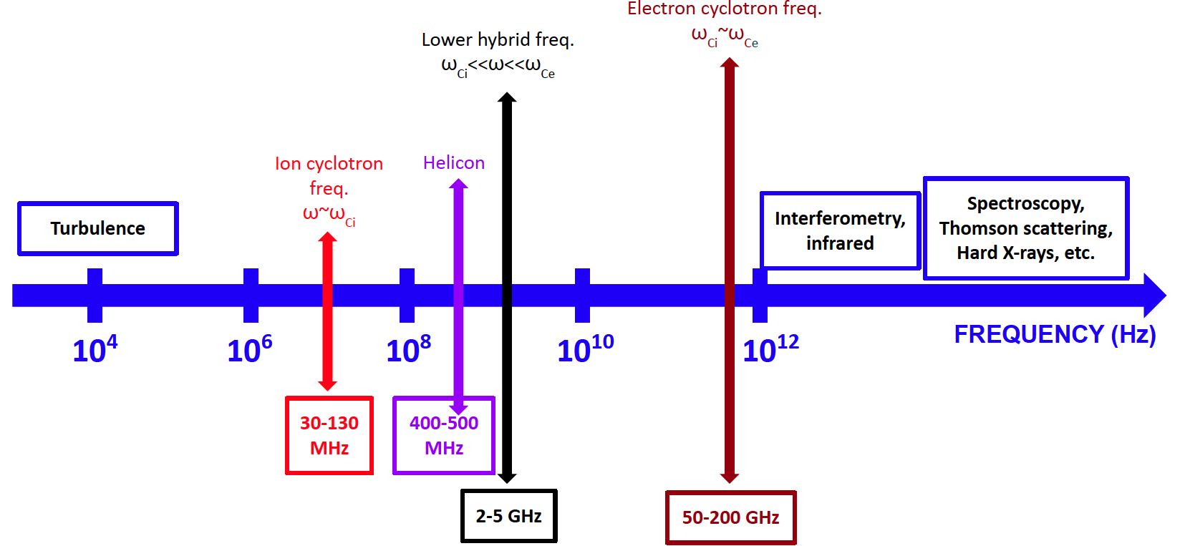
The key frequencies in fusion devices
Courtesy of N. Bertelli
Notes:
local electron density and fluctuation
radial electron temperature
Absolute Te and ne at laser crossing points
Line integrated Te and impurity content
These diagnostics let us watch how RF waves and instabilities change density, temperature, and radiation in real time—so we can verify heating, spot trouble, and steer the plasma

Slide 10
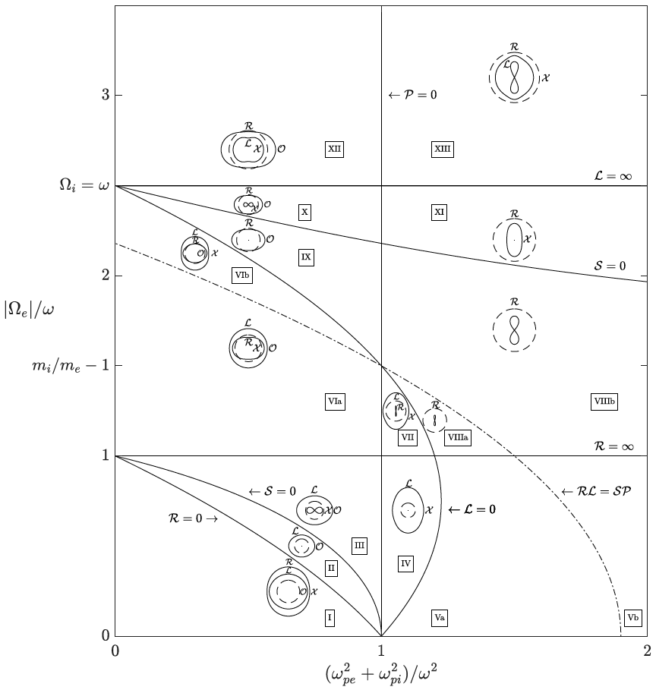
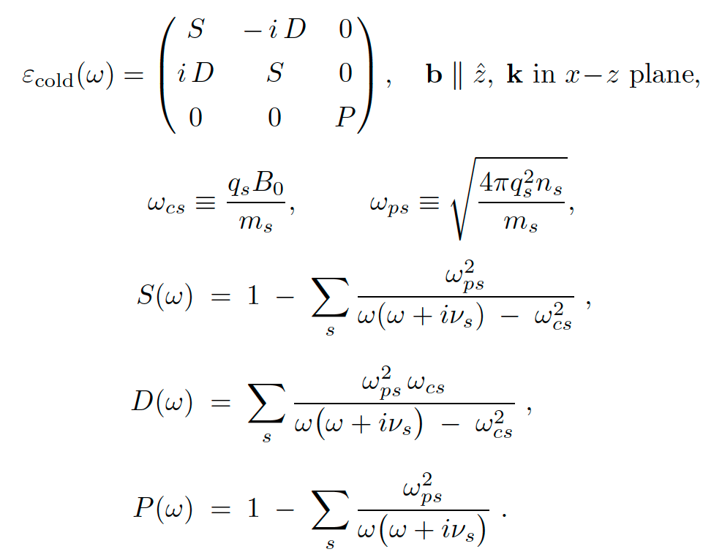
The RF modeling approaches are scenario dependent
Maxwell’s Equations + Plasma model
Fluid models (e.g. cold plasma approximation)
Local / simplified dispersion relation
wave propagation and absorption can be explained by the CMA diagram
Source: Stix

Slide 11
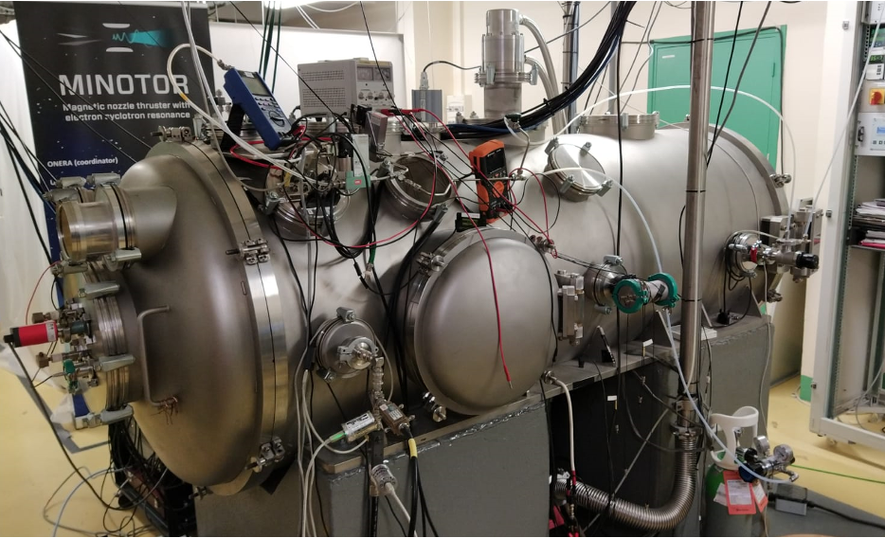
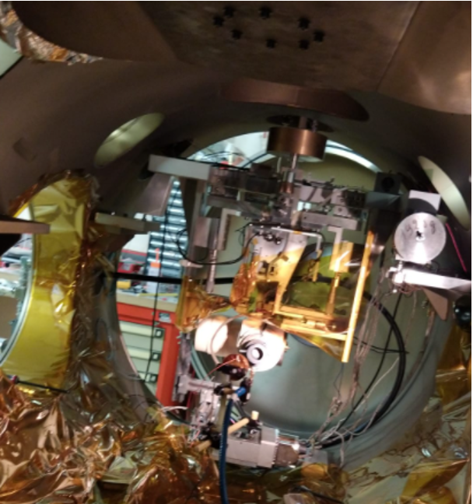
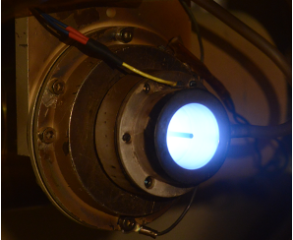
A scenario where the cold plasma model may suffice
The electron cyclotron resonance thruster ECRT, features a low temperature plasma discharge. Although the model cannot capture cyclotron damping, a cold-collisional model may suffice to provide reasonable damping.
ECRT prototype (ONERA)
Vacuum chamber (ONERA)
Magnetic nozzle
Plasma thrusters decimate mission cost of space missions
This ECRT:
Dimensions: few cm
Flow rate: 0.1 mg/s
Thrust: ~1N
Thrust efficiency ~10/15%

Slide 12
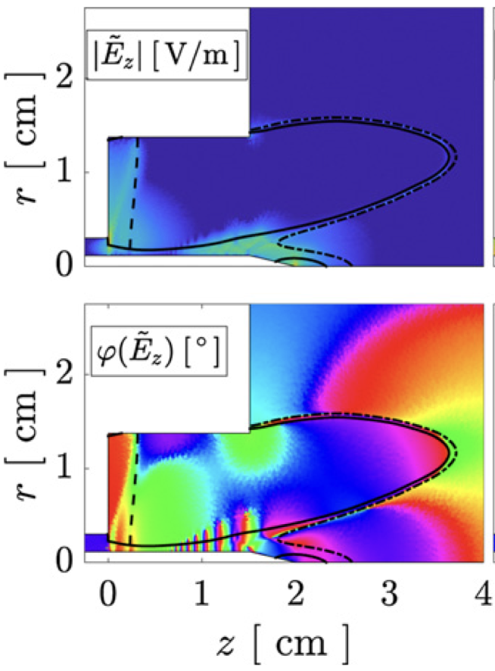
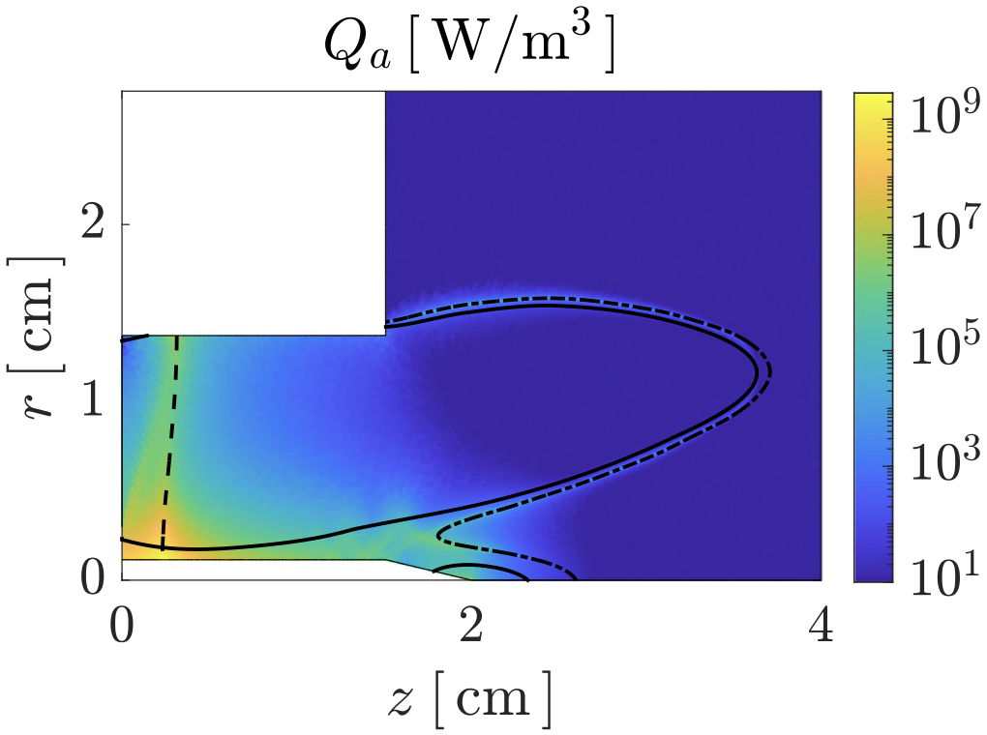
A scenario where the cold plasma model may suffice
Studies show that parametric bounding surfaces affecting wave propagation in cold plasmas suffice to explain the thruster heating mechanism.
UHR
ECR
Validation and verification campaign of the thruster against experiments shows models strengths and weaknesses
ECR
Sources: Sanchez-Villar et al. PSST (2021)
Sanchez-Villar et al. PSST (2023)

Slide 13
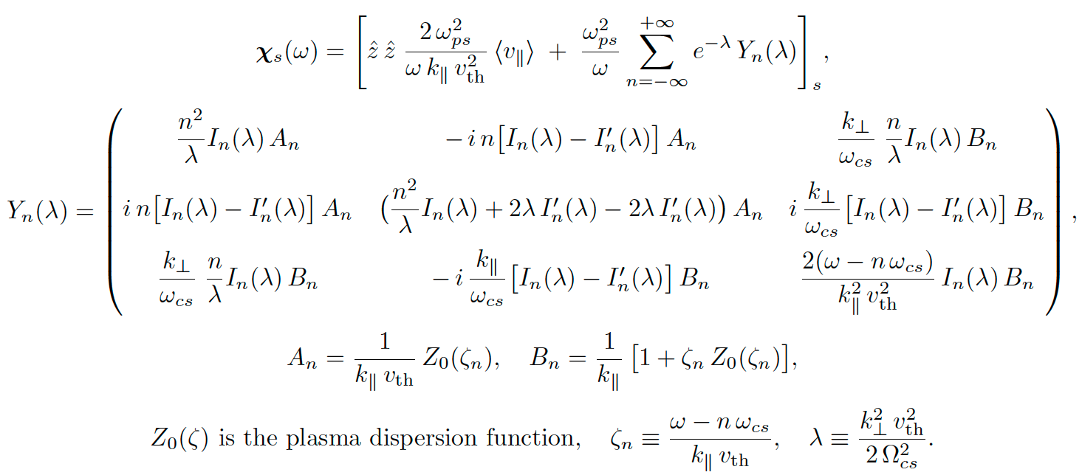
Plasmas in tokamaks are further complex to model
Kinetic approximation (e.g. hot plasma)
Vlasov, unperturbed orbit and then applies a 1st order perturbation to the distribution function.
The result is a set of integrals (expressions involving Bessel function and plasma dispersion function. For further information see Stix).

Slide 14
Methods to solve Maxwell’s equations?

Slide 15
Multiple RF heating schemes are available
Scheme | Name | Typical f-band
ICRF/ICRH | Ion Cyclotron Range of Frequencies | 25-120 MHz
ICRF-HHFW | High Harmonic Fast Wave | 30-60 MHz
LHCD/LHH | Lower Hybrid | 2-8 GHz
ECRH/ECCD | Electron Cyclotron Resonance | 70-200 GHz
HH/HCD | Helicon | 0.4 - 1 GHz
EBW (O-X-B/X-B ) | Electron Bernstein Wave | 2-30 GHz
Notes:
The main goal is to inject energy precisely and rapidly into the plasma, thus raising electron and ion temperatures to sustain fusion reactions

Slide 16
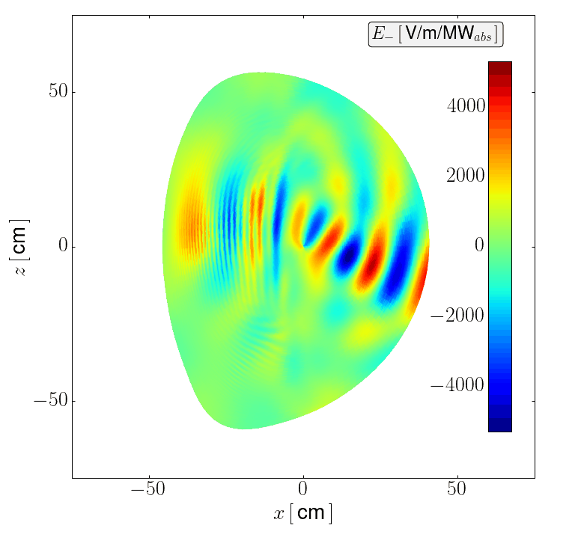
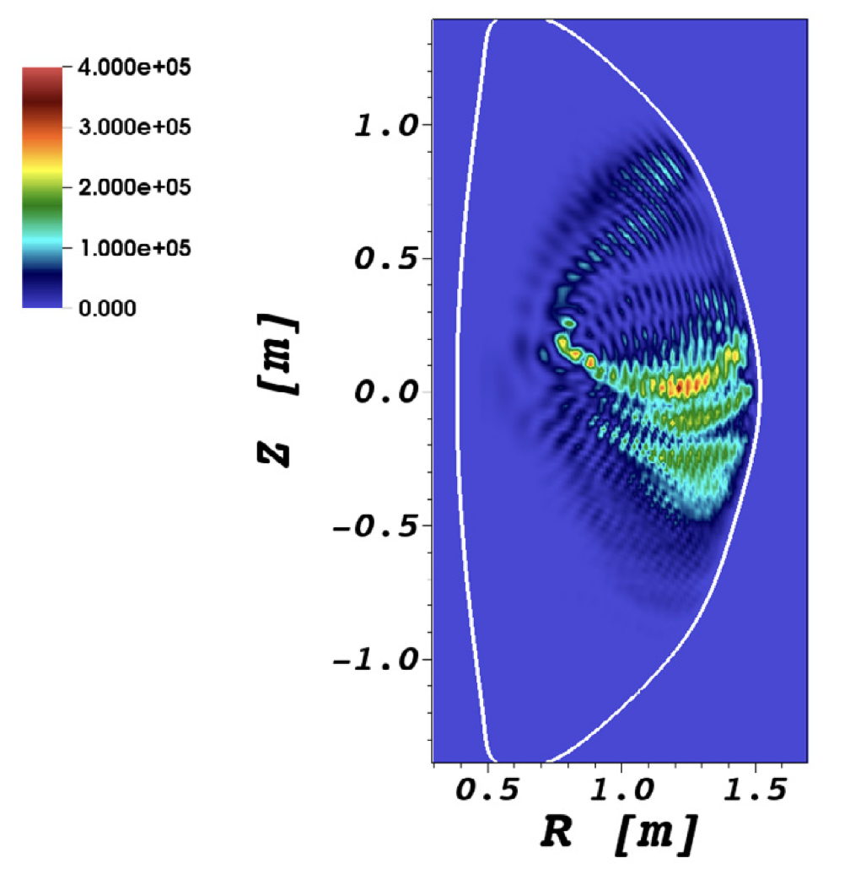
Some examples of ICRF heating codes
TORIC
AORSA
PETRA-M
Courtesy of S. Shiraiwa and N. Bertelli

Slide 17
ICRF heating schemes: Minority Ion Cyclotron (WEST)
IIH
FW
Mode conversion to a backward mode called the ion Bernstein wave (IBW). FW can still exist after the IIH. IBW absorbed by electrons via Landau damping.
Conversion sensitive to minority concentration.
IBW
(small
wavelength)
IC

Slide 18
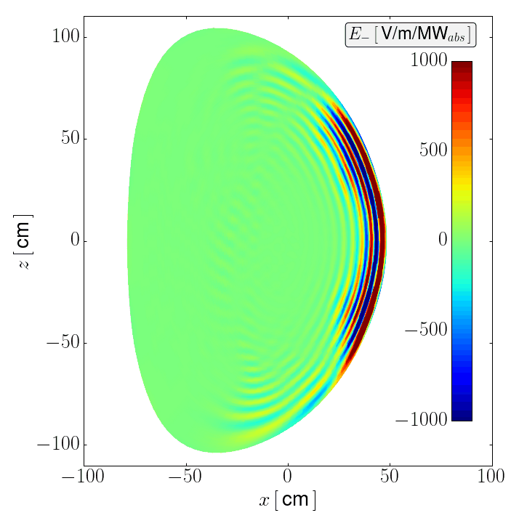
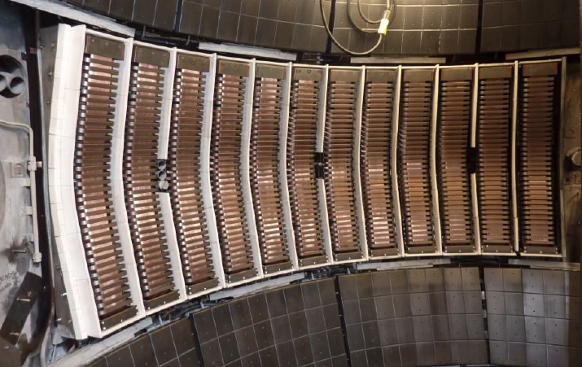
ICRF heating schemes: HHFW (NSTX-U)
Last Closed Flux Surface (LCFS)
FW is the main propagating mode
12 strap antenna located at the outboard midplane.
Absorption of ions (High-harmonic IC)
and electrons via Landau damping.
High field side
Low field side
Excitation
FW

Slide 19
Simulation capability with different physics fidelity
Physics Fidelity

Slide 20
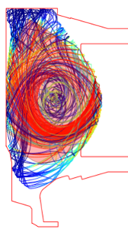
Simulation capability with different physics fidelity
Physics Fidelity
Computational Expenses

Slide 21
Simulation capability with different physics fidelity
Physics Fidelity
Computational Expenses

Slide 22
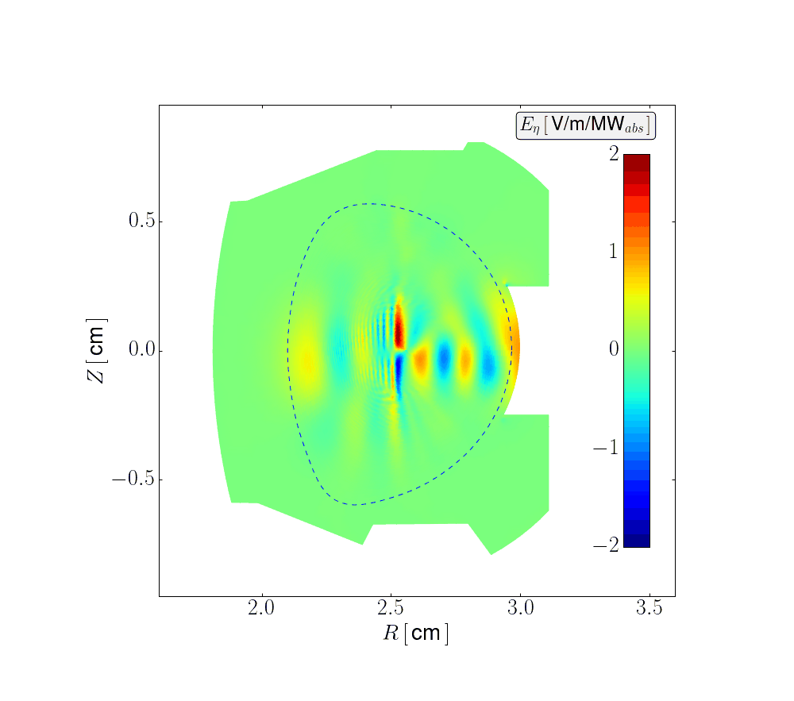
Simulation capability with different physics fidelity
Physics Fidelity
Computational Expenses

Slide 23
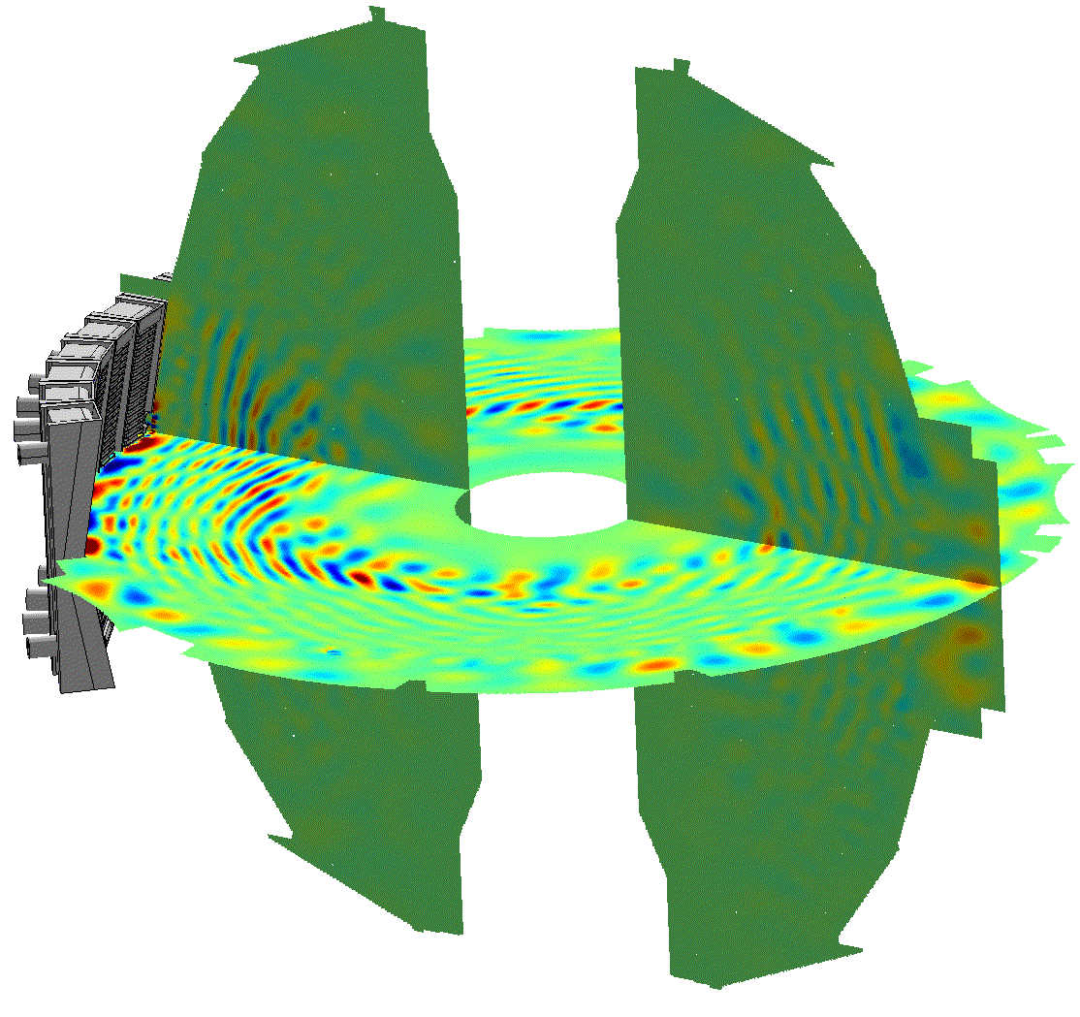
Simulation capability with different physics fidelity
Physics Fidelity
Computational Expenses

Slide 24
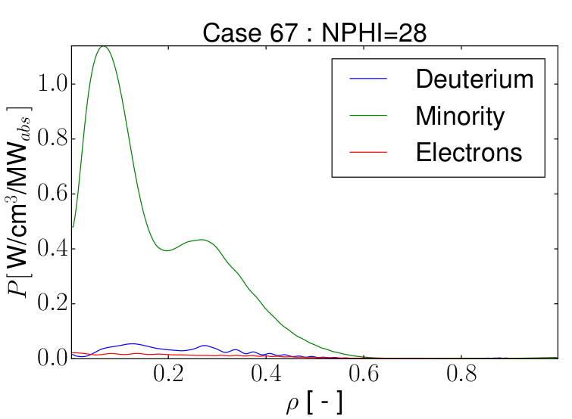
Heating profiles are critical outputs for integrated modeling
Physics Fidelity
Computational Expenses

Slide 25
Artificial intelligence to accelerate predictions
Physics Fidelity
TORIC
Simulation times unfeasible applications
Scenario optimization
Inter-shot predictive modeling
Real-time control
Computational Expenses

Slide 26
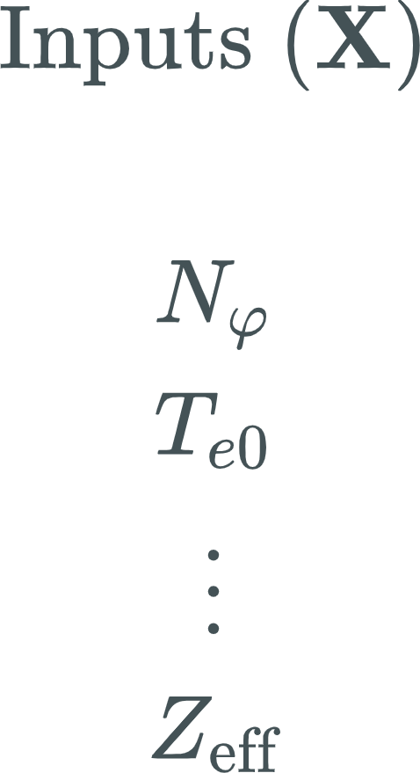
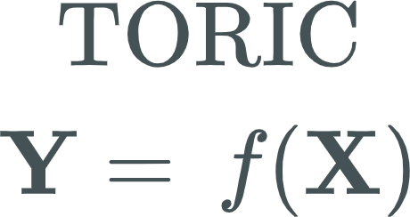
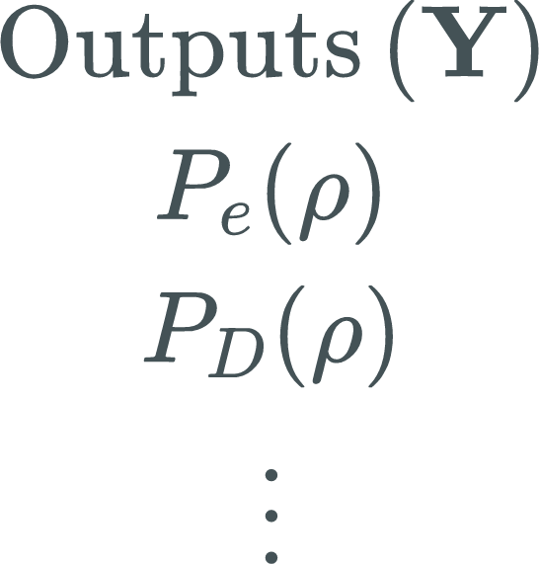
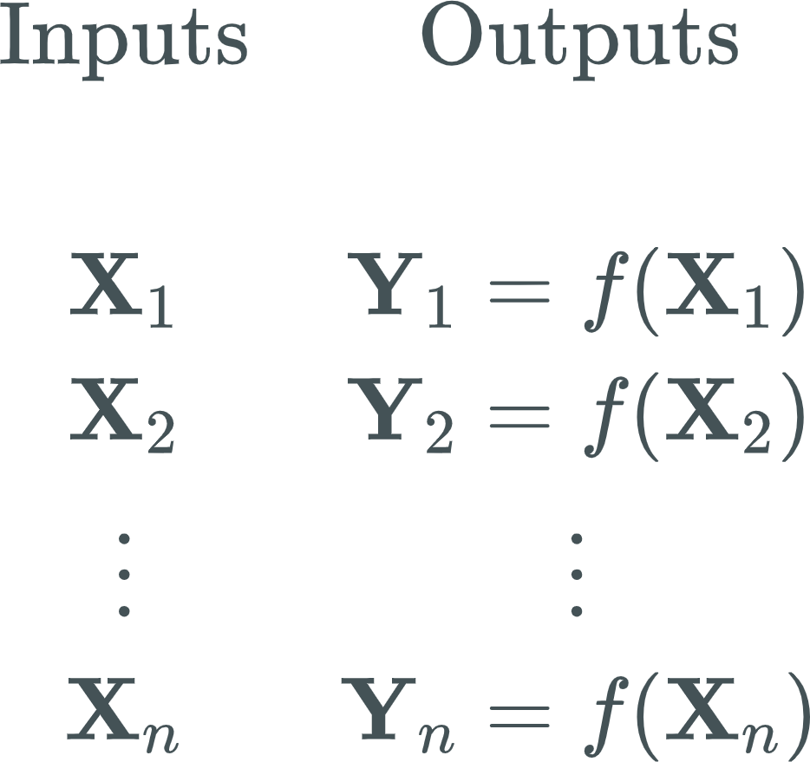
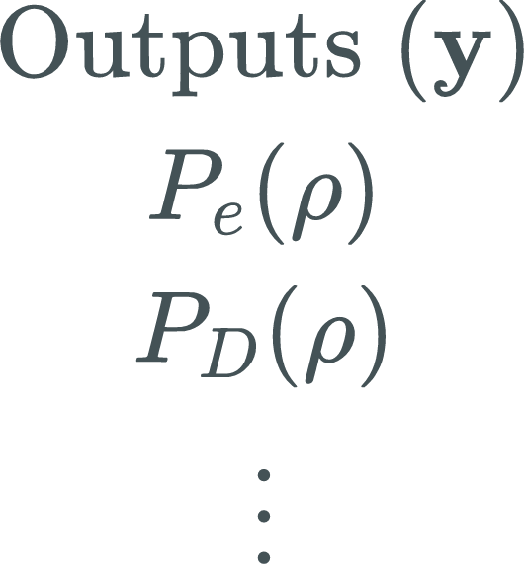
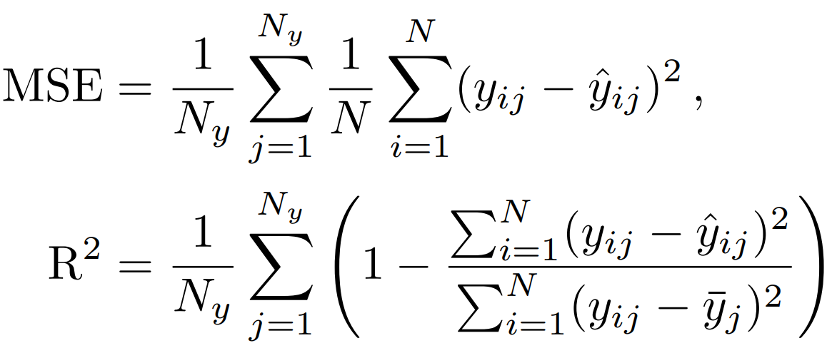
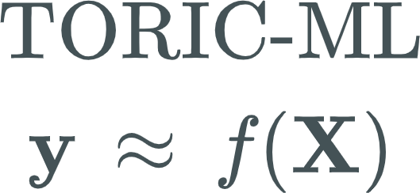
Methodology
TORIC ICRF SPECTRUM SOLVER: O(min)
M. Brambilla (1999) PPCF 41
M. Brambilla (2002) PPCF 44
“Ground truths” are TORIC electron and ion power absorption 1D profiles
Regression accuracy measured by:
1. Mean squared error (MSE)
2. Coefficient of determination(R2)
Generate a database of TORIC solutions representative of the parametric space of interest
SURROGATE MODEL FOR THE FORWARD PROBLEM: O(µs)

Slide 27
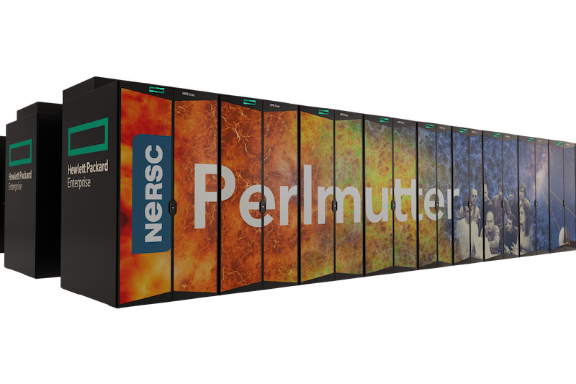
Artificial intelligence and machine learning (AI/ML)
Artificial Intelligence (AI):
Broad goal of creating system that can perform intelligent tasks
Machine Learning (ML):
A subset of AI where algorithms learn patterns from data rather than follow explicit rules
High-performance computing (HPC) be used to train and optimize the models and generate/manage the datasets

Slide 28
ML paradigms
Paradigms | General Goal | Examples of Algorithms
Supervised | Learn inputs->Outputs mapping | Linear, Random Forest, Gaussian Processes, Neural Networks
Unsupervised | Discover hidden structure | k-means, DBSCAN
Reinforcement | Learn to make sequences of decisions | Q-learning, Policy Gradients

Slide 29
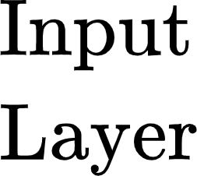
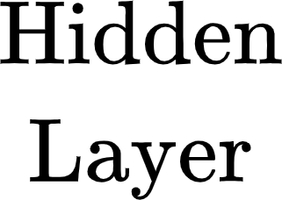
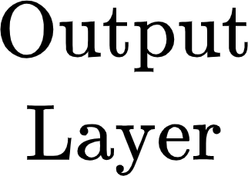
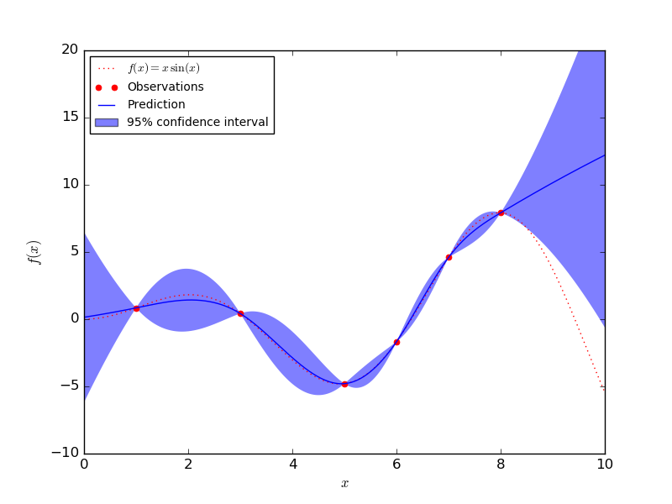
Supervised AI/ML models for Regression
RFR
Random Forest Regressor (RFR)
Ensemble of decision trees
Final prediction average of the trees
By splitting feature values to maximize information gain at each node, RFR can deal with nonlinear relationships
Available in scikit-learn
Multilayer perceptron (MLP)
Feed-forward neural network built of perceptrons that together can approximate highly nonlinear mappings
Careful hyperparameter tuning required
Bayesian optimization. PyTorch Recommended
Gaussian Process Regressor (GPR):
Bayesian regression method that treats predictions as distributions
Provides uncertainty quantification
Implementation with TensorFlow and GPflow
MLP
GPR

Slide 30
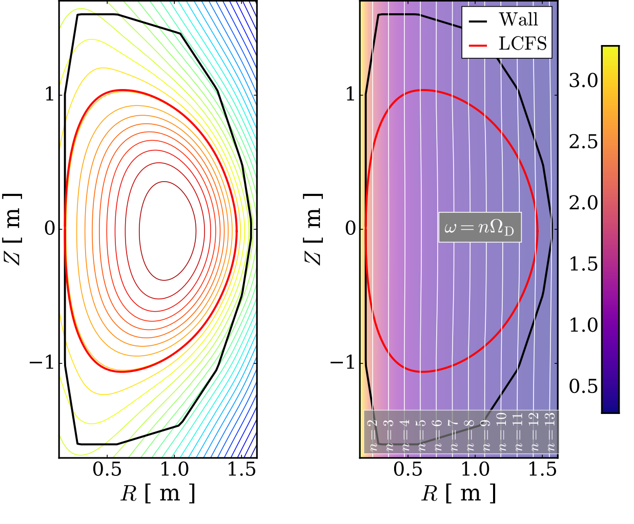
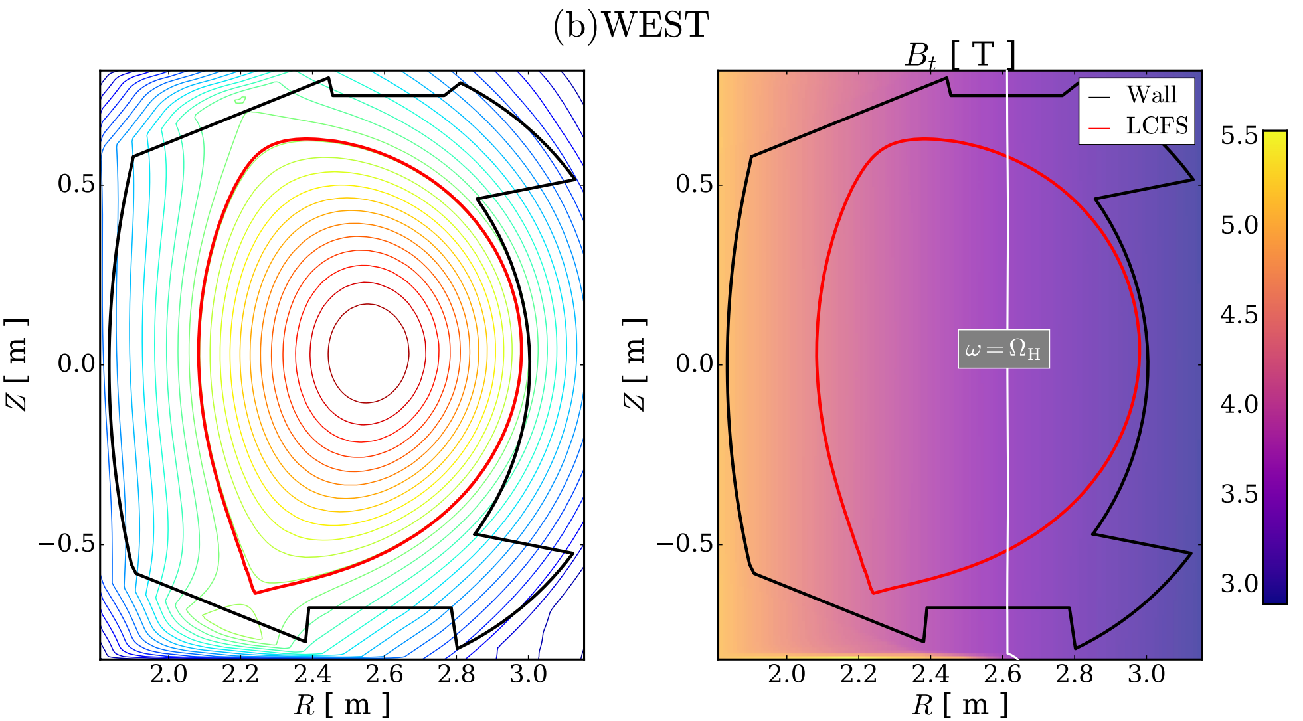
Two databases for flat-top operation of NSTX and WEST
Heating schemes:
HHFW:
IC minority:
Plasma species: D (D-H).
Equilibriums are assumed to be fixed to:
Flat-top scenario plasma properties (e.g. temperature, density, etc) as :
0/1 -> core/edge
𝛼 and 𝛽 : profile shape exponents
G. Taylor et al. (2012) PoP 19
J. Bucalossi et al. (2022) NF 62
WEST - Shot 56898
NSTX - Shot 138506

Slide 31
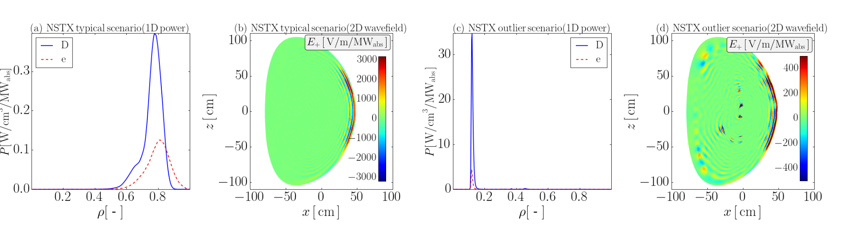
Data is standardized and then analyzed and refined
Standardization of data using training data, and principal component analysis on WEST outputs → dimensionality reduction, improved profile inference time and accuracy.
Exploratory analysis resulted in outlier identification in the NSTX database:
Power
Electric field
Power
Electric field
NSTX
TYPICAL SCENARIO
OUTLIER SCENARIO
22% outliers understood to be numerical.

Slide 32
Full-wave + ML enables robust real-time capable ICRF models
FAST: Inference time ⇨ TORIC O(min) | TORIC-ML O(µs)
ACCURATE: Regression accuracy ⇨ NSTX R²= 0.95 ; WEST R²= 0.7
Deuterium - NSTX
Hydrogen - WEST
TORIC
RFR
MLP
TORIC
RFR
MLP

Slide 33
Full-wave + ML enables robust real-time capable ICRF models
FAST: Inference time ⇨ TORIC O(min) | TORIC-ML O(µs)
ACCURATE: Regression accuracy ⇨ NSTX R²= 0.95 ; WEST R²= 0.7
ROBUST: Predict physical profiles beyond the original model capability, overcoming numerically challenging scenarios in HHFW
Deuterium - NSTX
Hydrogen - WEST
Deuterium - NSTX
TORIC
RFR
MLP
TORIC
RFR
MLP
TORIC
RFR
TORIC-fixed
TORIC
RFR (extrap.)

Slide 34
Full-wave + ML enables robust real-time capable ICRF models
FAST: Inference time ⇨ TORIC O(min) | TORIC-ML O(µs)
ACCURATE: Regression accuracy ⇨ NSTX R²= 0.95 ; WEST R²= 0.7
ROBUST: Predict physical profiles beyond the original model capability, overcoming numerically challenging scenarios in HHFW
Deuterium - NSTX
Hydrogen - WEST
Deuterium - NSTX
TORIC
RFR
MLP
TORIC
RFR
MLP
TORIC
RFR
TORIC-fixed
TORIC
RFR (extrap.)
Model limitation

Slide 35
Full-wave + ML enables robust real-time capable ICRF models
FAST: Inference time ⇨ TORIC O(min) | TORIC-ML O(µs)
ACCURATE: Regression accuracy ⇨ NSTX R²= 0.95 ; WEST R²= 0.7
ROBUST: Predict physical profiles beyond the original model capability, overcoming numerically challenging scenarios in HHFW
Deuterium - NSTX
Hydrogen - WEST
Deuterium - NSTX
TORIC
RFR
MLP
TORIC
RFR
MLP
TORIC
RFR
TORIC-fixed
TORIC
RFR (extrap.)
RFR corrects heating profile

Slide 36
Full-wave + ML enables robust real-time capable ICRF models
FAST: Inference time ⇨ TORIC O(min) | TORIC-ML O(µs)
ACCURATE: Regression accuracy ⇨ NSTX R²= 0.95 ; WEST R²= 0.7
ROBUST: Predict physical profiles beyond the original model capability, overcoming numerically challenging scenarios in HHFW
Deuterium - NSTX
Hydrogen - WEST
Deuterium - NSTX
TORIC
RFR
MLP
TORIC
RFR
MLP
TORIC
RFR
TORIC-fixed
TORIC
RFR (extrap.)
A. Sanchez-Villar et al
Nucl. Fusion, 64, 096039 (2024)
RFR corrects heating profile
Higher heating?

Slide 37
Full-wave + ML enables robust real-time capable ICRF models
FAST: Inference time ⇨ TORIC O(min) | TORIC-ML O(µs)
ACCURATE: Regression accuracy ⇨ NSTX R²= 0.95 ; WEST R²= 0.7
ROBUST: Predict physical profiles beyond the original model capability, overcoming numerically challenging scenarios in HHFW
Deuterium - NSTX
Hydrogen - WEST
Deuterium - NSTX
TORIC
RFR
MLP
TORIC
RFR
MLP
TORIC
RFR
TORIC-fixed
TORIC
RFR (extrap.)
TORIC (upgraded)
A. Sanchez-Villar et al
Phys. Plasmas (2025)
RFR- Physical prediction
Higher heating?

Slide 38
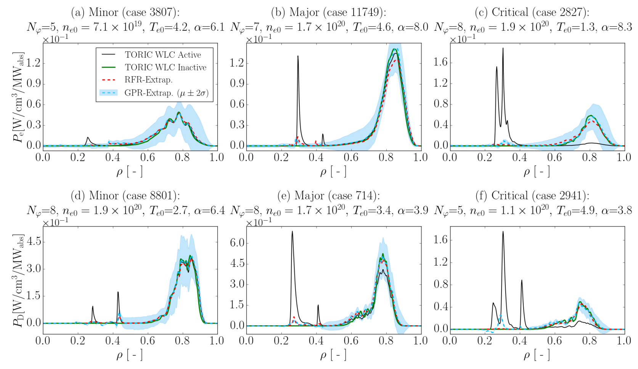
Comparison at extrapolated inference to HHFW outliers
Á. Sánchez-Villar et al
Phys. Plasmas (2025)

Slide 39
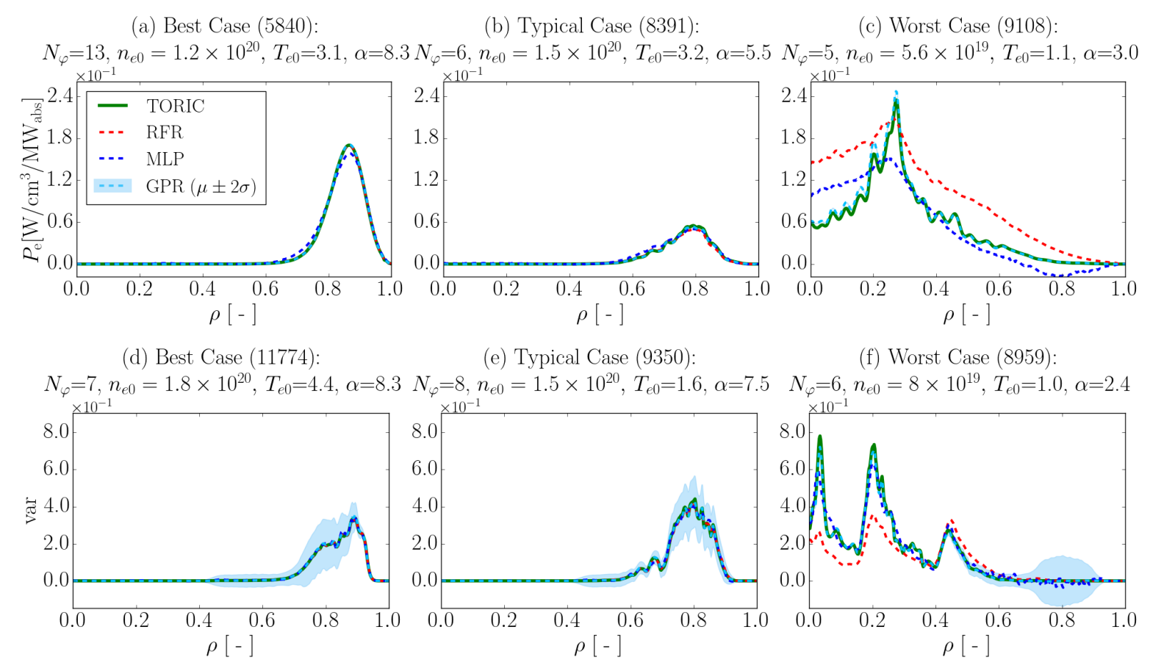
Final models for HHFW at NSTX (including GPR)
Á. Sánchez-Villar et al Phys. Plasmas (2025)

Slide 40
Bayesian Optimization Methods used to develop an Automated Surrogate Model Generator Suite
Train, test, save, load surrogates & results.
Automatically optimize the hyperparameters (including architecture) for the RFR, MLP and GPR models for a given dataset + final training.

Slide 41
Some final references
Email: asvillar@pppl.gov | asvillar@princeton.edu
Books RF:
Stix, Brambilla, Dawson, Bittencourt
Books AI/ML:
Bishop, Goodfellow, etc.
Some links:
www.github.com/piScope/piScope
www.github.com/piScope/PetraM_RF
www.scikit-learn.org
www.pytorch.org ; www.tensorflow.org
RF models:
TORIC, AORSA,
Petra-M, etc.
ML models:
PyTorch, TensorFlow, Sklearn, Gpflow, BoTorch
Special thanks: to N. Bertelli, S. Shiraiwa, and to the organizers and participants of the SULI
06/11/25 Princeton Plasma Physics Laboratory A. Sanchez-Villar - RF Heating and AI Introduction to Plasma and Fusion Course

