Slide 1
Plasma Control
Doménica Corona
June 12th 2025

Slide 2


About Doménica
lcoronar@pppl.gov
Posdoc at PPPL since 2022 → ML, Control, Real-time
Go check the CSD/PPPL webpage
https://www.pppl.gov/research/computational-sciences

Slide 3
Have you heard this words? Put your hand up!
PID controller
Magnetic Confinement
Plasma equilibrium
Poloidal Field Coils
Vertical Displacement Event (VDE)
State-Space models
Disruption
Surrogate model
Sensor-Actuator
Real-time Control

Slide 4
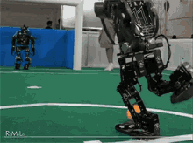
Let’s get started
Just like a robot can wreck your factory floor, an uncontrolled plasma can wreck your machine

Slide 5


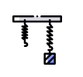



Control systems
Regulating a process or system in order to get a desired behavior.
The key components:
Plant: The system to be controlled. The current in a circuit. The velocity of a mass. The temperature of a liquid. A tokamak!
Sensor: Measures the plant’s outputs. )
Controller: Computes and action to be applied
Actuator: Applies the control signal … the voltage command to a power supply

Slide 6
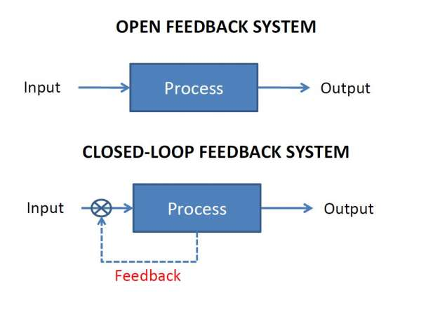

Open Loops vs Closed Loop
Open-Loop: Controller acts without any feedback, there is no correction of the error
Closed-Loop: Controller uses a sensor feedback to minimize the error
What are the control general objectives?
Stability: Prevent the system from diverging and becoming unstable
Tracking: Follow a reference accurately.
Disturbance Rejection: Reject external perturbations

Slide 7
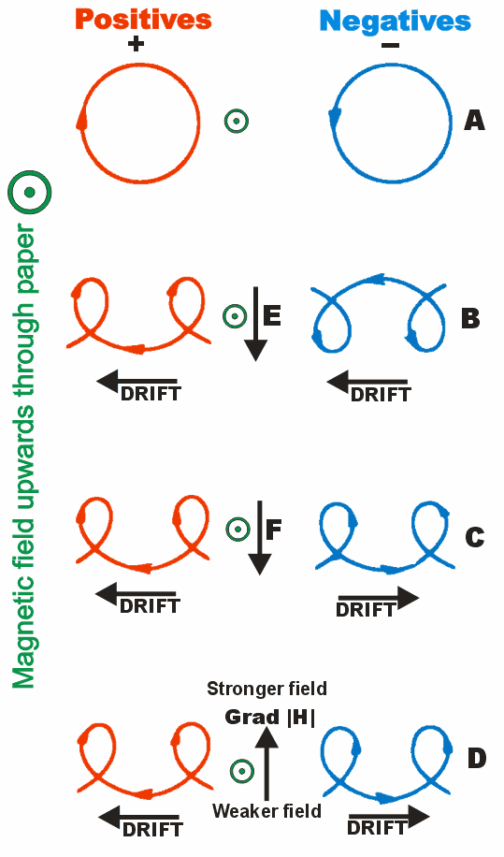
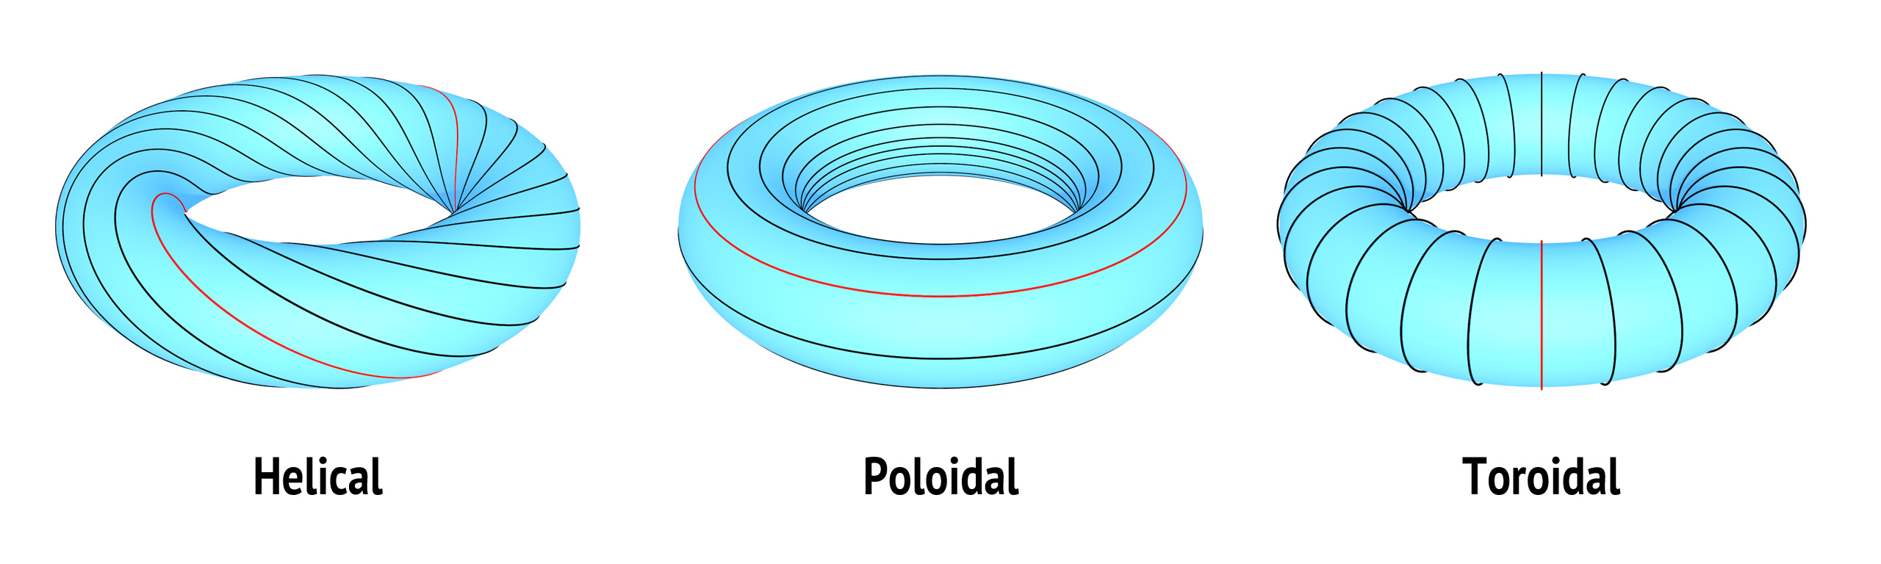
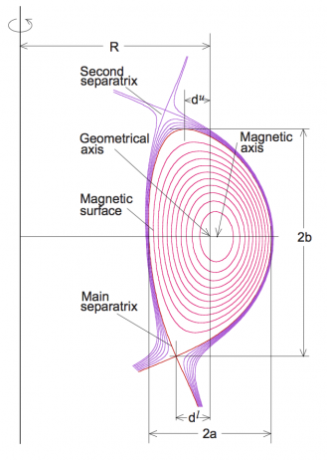
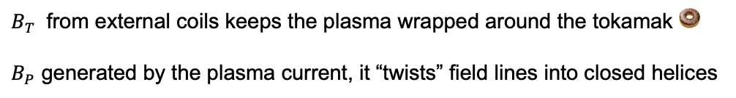
Magnetic confiment basics
How Magnetic Fields Confine Plasma?
In a uniform magnetic field, charged particles gyrate around field lines
Without field curvature: particles drift → they need field shaping
https://www.plasma-universe.com/
Toroidal & Poloidal Fields
$B_{T}$ from external coils keeps the plasma wrapped around the tokamak 🍩
$B_{P}$ generated by the plasma current, it “twists” field lines into closed helices
Freidberg, J. P., Plasma Physics and Fusion Energy

Slide 8
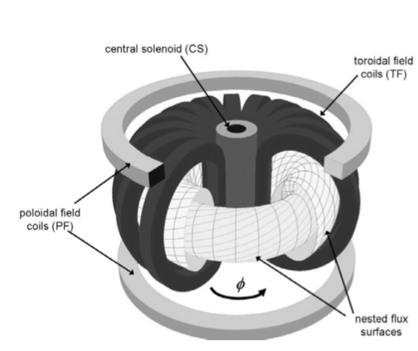
Why external PF coils are needed?
Plasma-generated Poloidal Field Is Insufficient
The field from the plasma current Ip alone cannot maintain desired equilibrium and shape
Equilibrium & Control position
External PF coils supply adjustable magnetic flux to hold the plasma column at the correct major radius and vertical position.
Shape & Stability Shaping
By varying PF coil currents, we can control elongation and triangularity of lux surfaces, improving confinement and suppressing instabilities

Slide 9
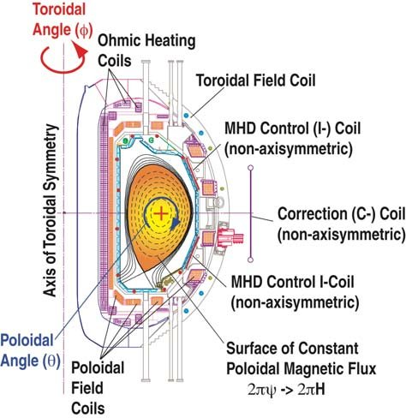
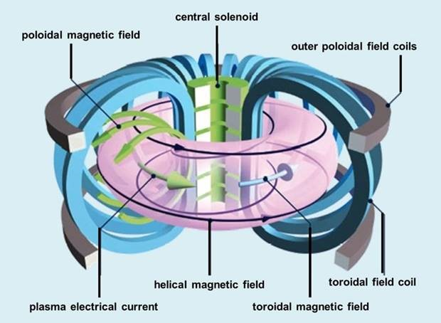
Why tokamak control matters?
Why do we need active control in a tokamak????
Plasma is confined by a combination of toroidal and poloidal magnetic fields
Small deviations in field balance can cause the plasma to drift!
DOI: 10.1142/9789812818805_0011

Slide 10
Why tokamak control matters?
What are the risks of having an uncontrolled plasma?
The so famous Vertical Displacements Events (VDEs) → Fast upward/downward drifts leading to a wall contact
Disruptions → Sudden loss of confinements, it causes thermal and electromagnetic loads on the vessel
Wall damage and lost of operations → Damage in the tiles, overstressing of the coils and time of our machine not operating
Small deviations in field balance can cause the plasma to drift!
Why is vertical position critical?
Vertical instabilities grow very fast → they must be detected almost instantly
Without stabilization, the plasma touches the top or bottom of the vessel → aborted discharge

Slide 11
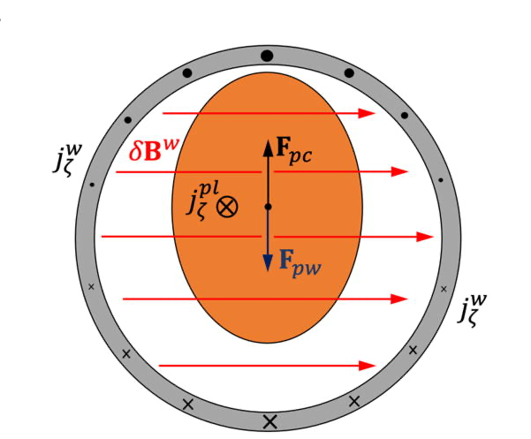
Vertical Instability in a tokamak
Inherent Unstable Equilibrium
An elongated plasma column has no natural restoring force in the vertical direction
Small vertical displacements grow exponentially without feedback
Requires detection and correction on less than one millisecond timescales
Dependence on Plasma Shape
Higer elongation κ → faster vertical growth
Triangularity δ and plasma current profile also influence stability
Need for active feedback
Analytical estimates of the vertical displacement growth rate in tokamaks with a resistive wall,” Physics of Plasmas 32, 032511
External PF coils + real-time controller can avoid the instability
Notes:
Schematic view of the elongated plasma displaced from the equilibrium point inside the “circular” vacuum vessel and the response of the latter to the VDE. The vector Fpw is the Ampère force (71) due to the plasma toroidal current j and uniform horizontal field celta_B produced by the eddy currents j ⁠, and Fpcis the force (72) attracting plasma to the outer shaping coils.

Slide 12
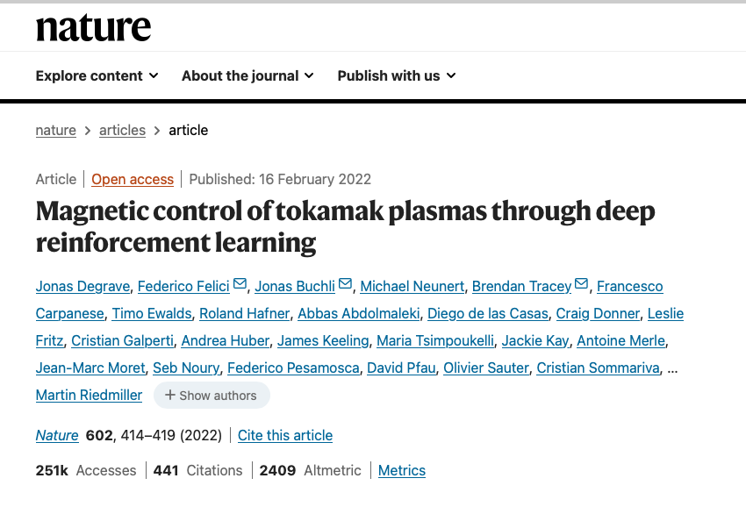
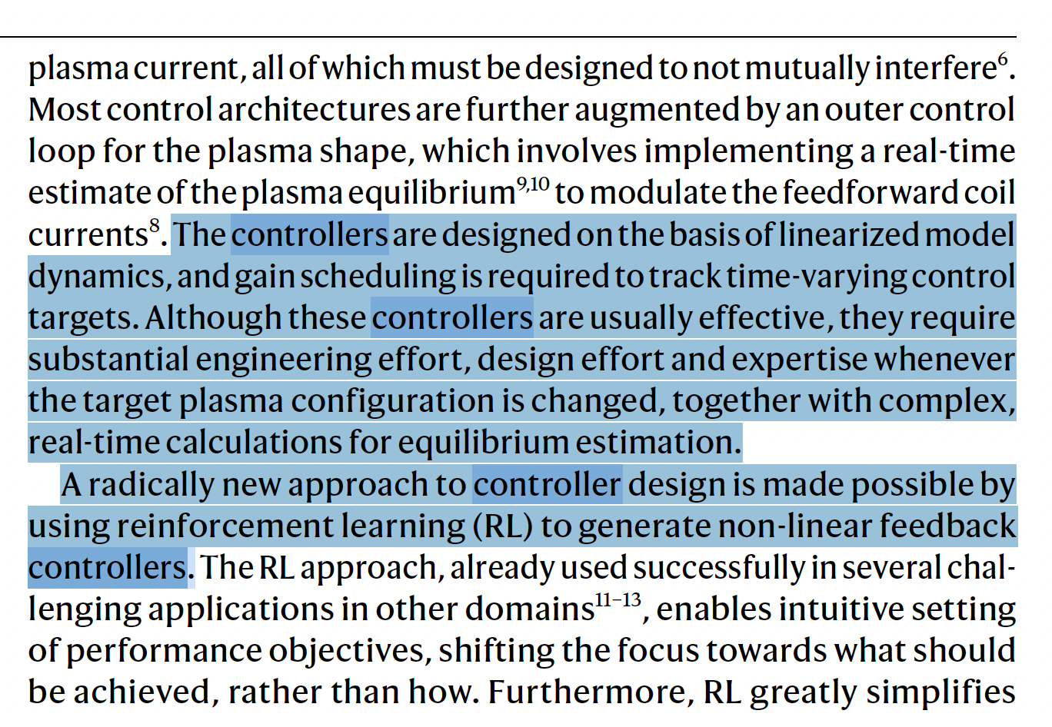
Magnetic Control of Tokamaks via Deep Reinforcement Learning
So.. What’s now the problem? 😪
Traditional controllers struggle with complex, time-varying plasma dynamics and MHD instabilities, engineers needed to tune a lot during operations
Reinforcement Learning solution 🧐
An agent “learns” coil-current policies by trial in a high-fidelity simulator, optimizing position & stability objectives.
Results
Tested on real-time achieving a faster suppression of the vertical drifts

Slide 13
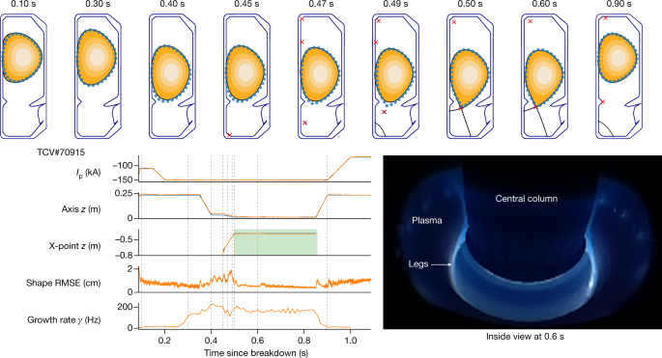
Notes:
Demonstration of plasma current, vertical stability, position and shape control. Top, target shape points with 2 cm radius (blue circles), compared with the post-experiment equilibrium reconstruction (black continuous line in contour plot). Bottom left, target time traces (blue traces) compared with reconstructed observation (orange traces), with the window of diverted plasma marked (green rectangle). Bottom right, picture inside the vessel at 0.6 s showing the diverted plasma with its
legs

Slide 14
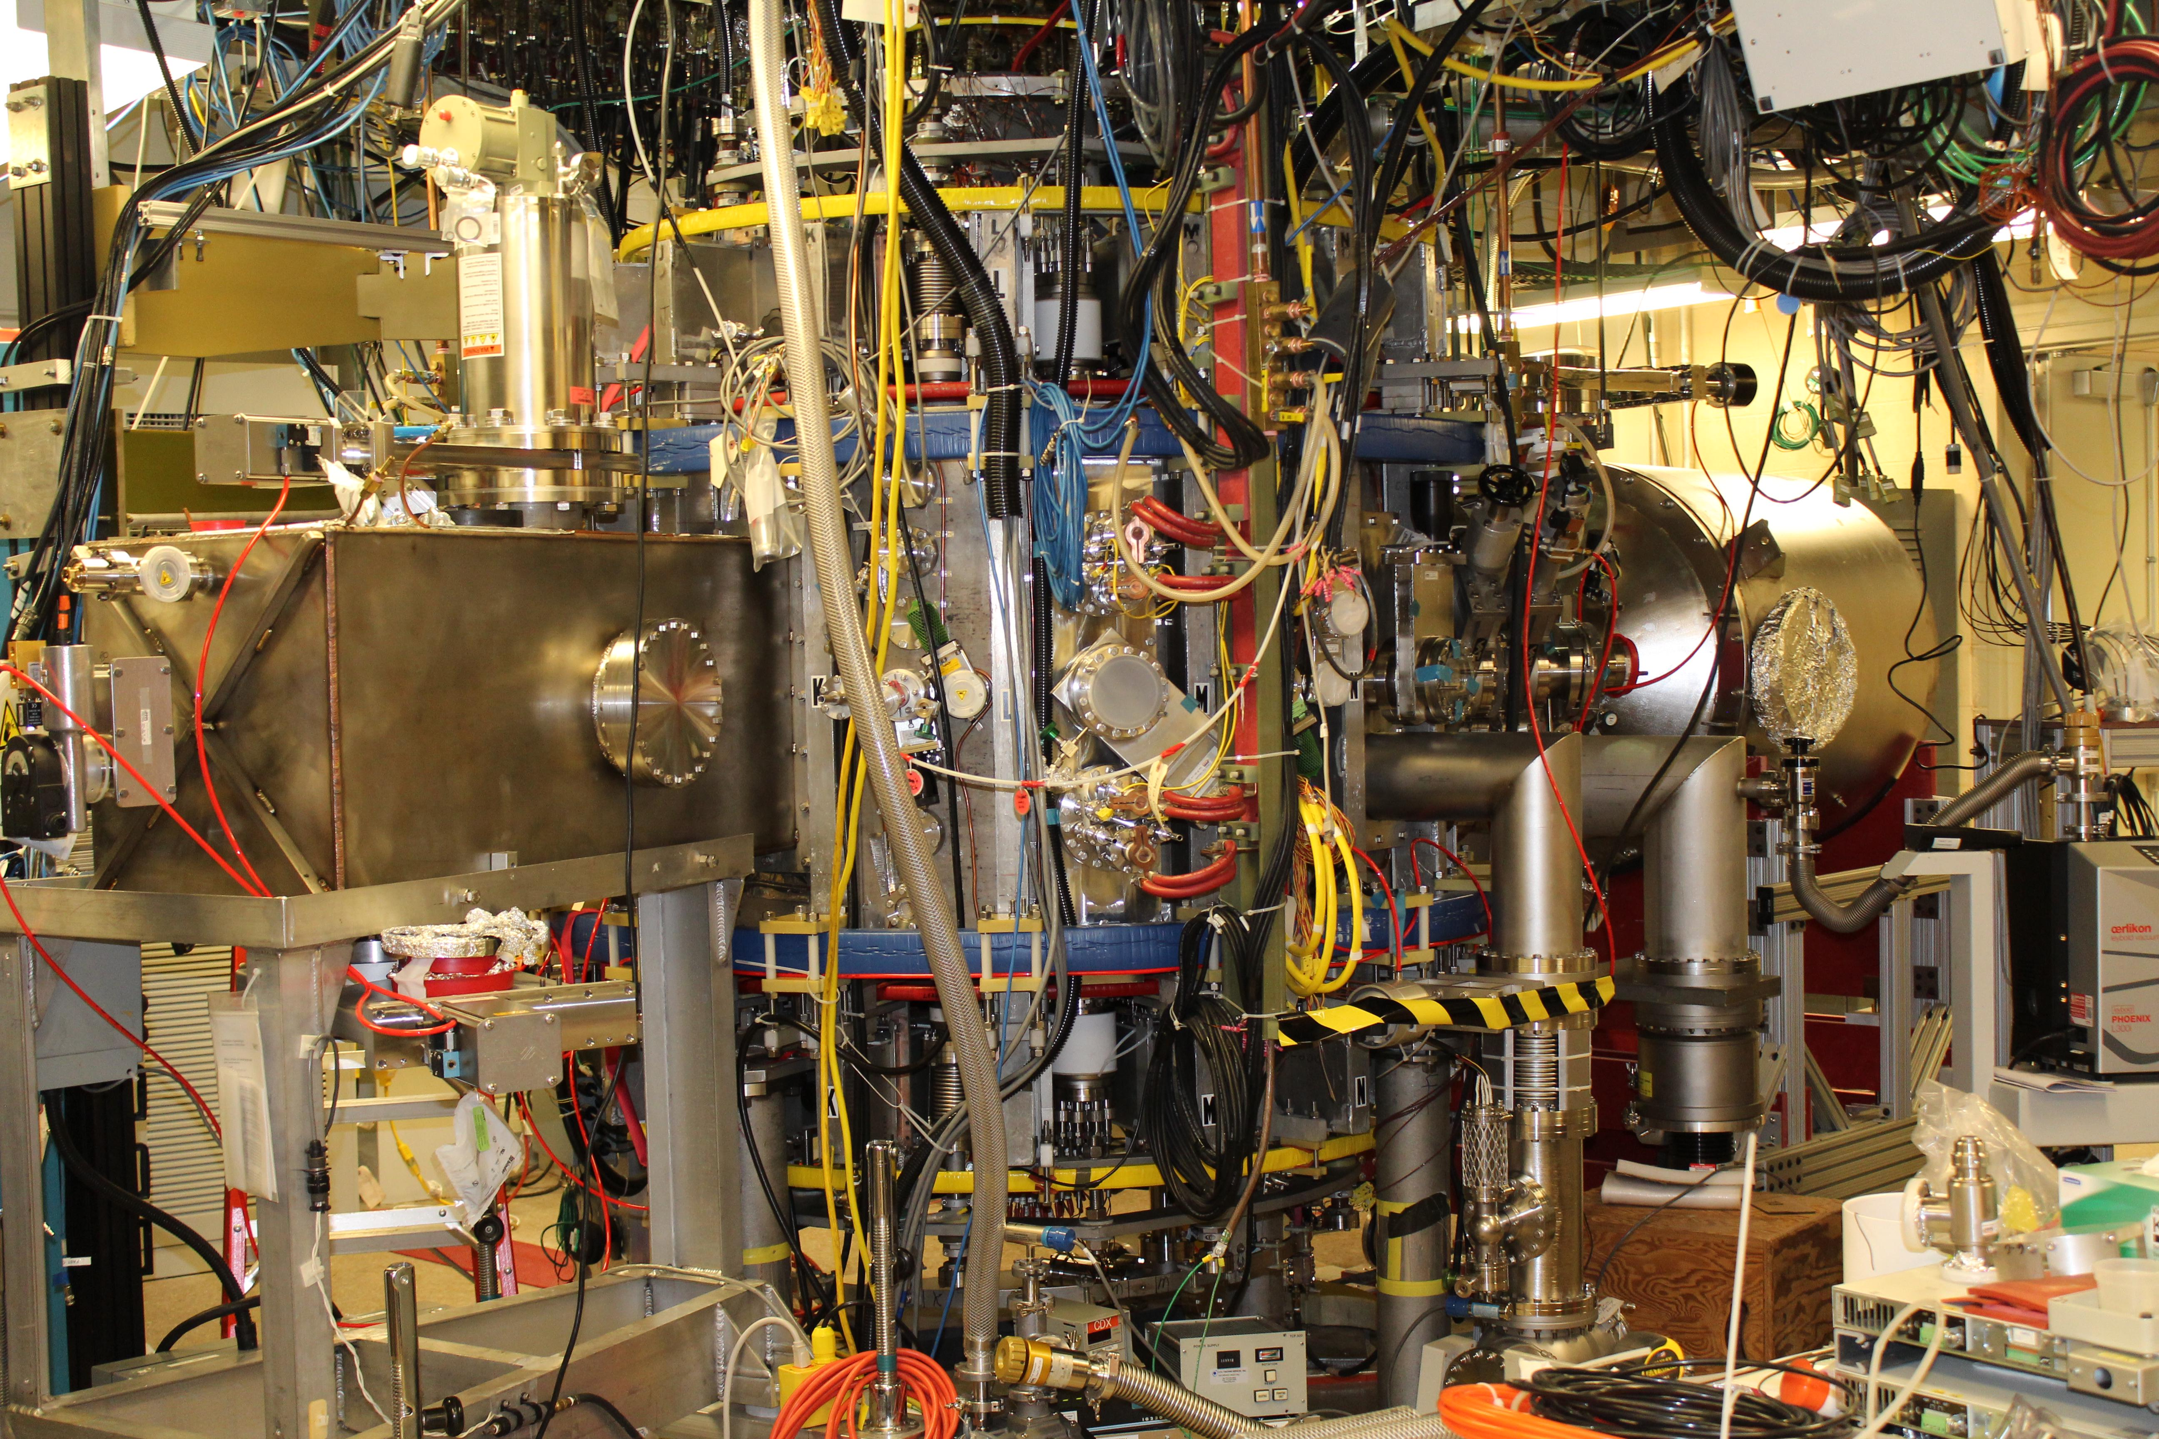
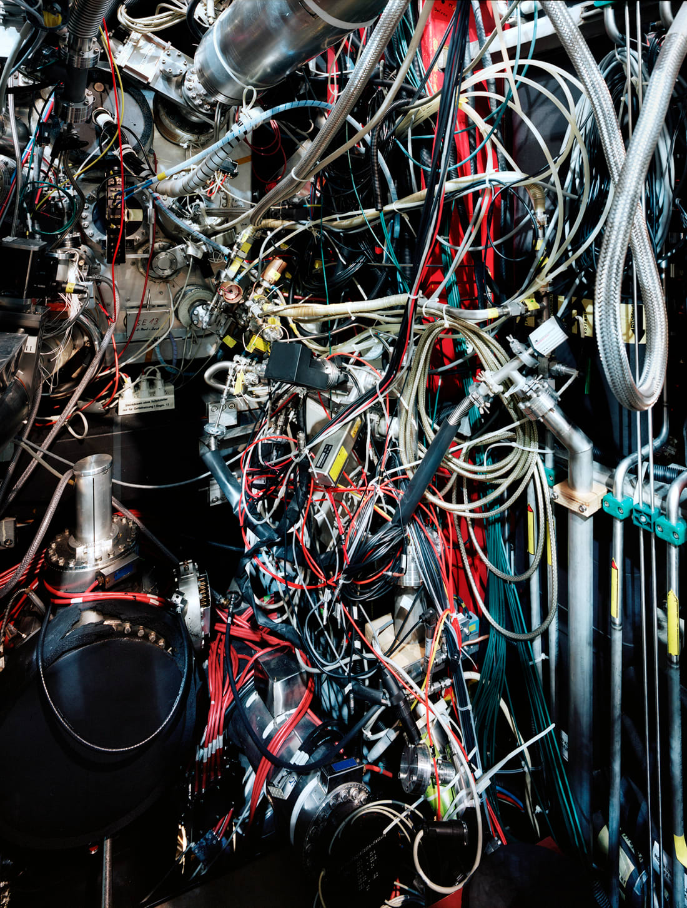
Engineering & Control approaches

Slide 15
When they talk about control in tokamak ….
Density control
Fueling and pumping
Magnetic Control
PF coils and plasma stabilization
Whenever someone says “control”, they really mean ” magnetic control”, density folks are a silent majority 🤭
Notes:
So yes, we do care about how much fuel goes in—but the real party trick is using PF coils to pinch, poke, and shape our giant glowing doughnu

Slide 16
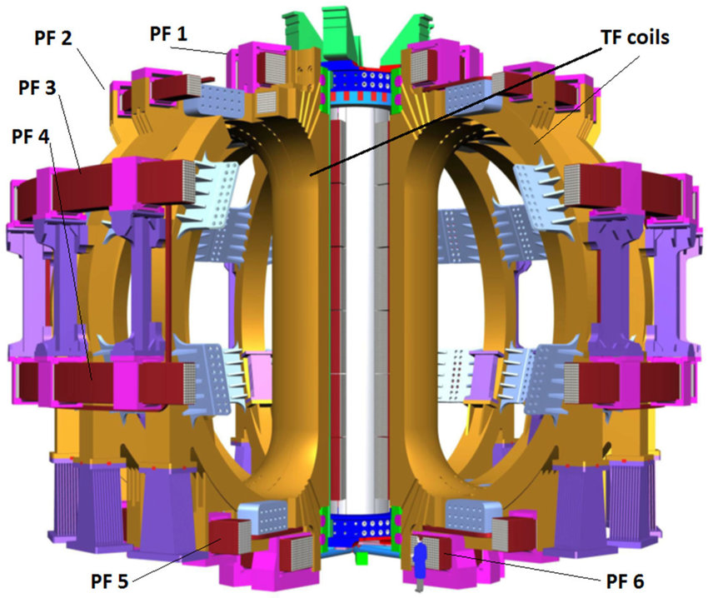
The PF coils … again 🙄 in case we forgot it
Equilibrium and position Control
ITER coils
Adjust coil currents to maintain the plasma major-radius and vertical position
Fast feedback loop: position → PF coils drive
Shaping & Stability Shaping
Vary coil currents to control elongation κ and triangularity δ
Tailor flux-surface geometry to suppress MHD modes
Inductive support & Ramp-rate
During current ramp-up/down, PF coils provide changing flux to drive plasma current too
Ensures smooth transition without large loop-voltage spikes
Notes:
Imagine the plasma as a current ring. Its self-field traps particles but doesn’t let us steer it. That’s where external PF coils come in—they ‘push’ or ‘pull’ the plasma to keep it centred and shaped.

Slide 17
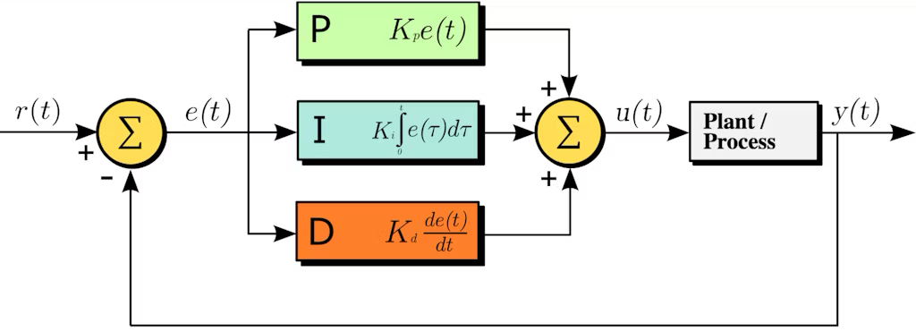
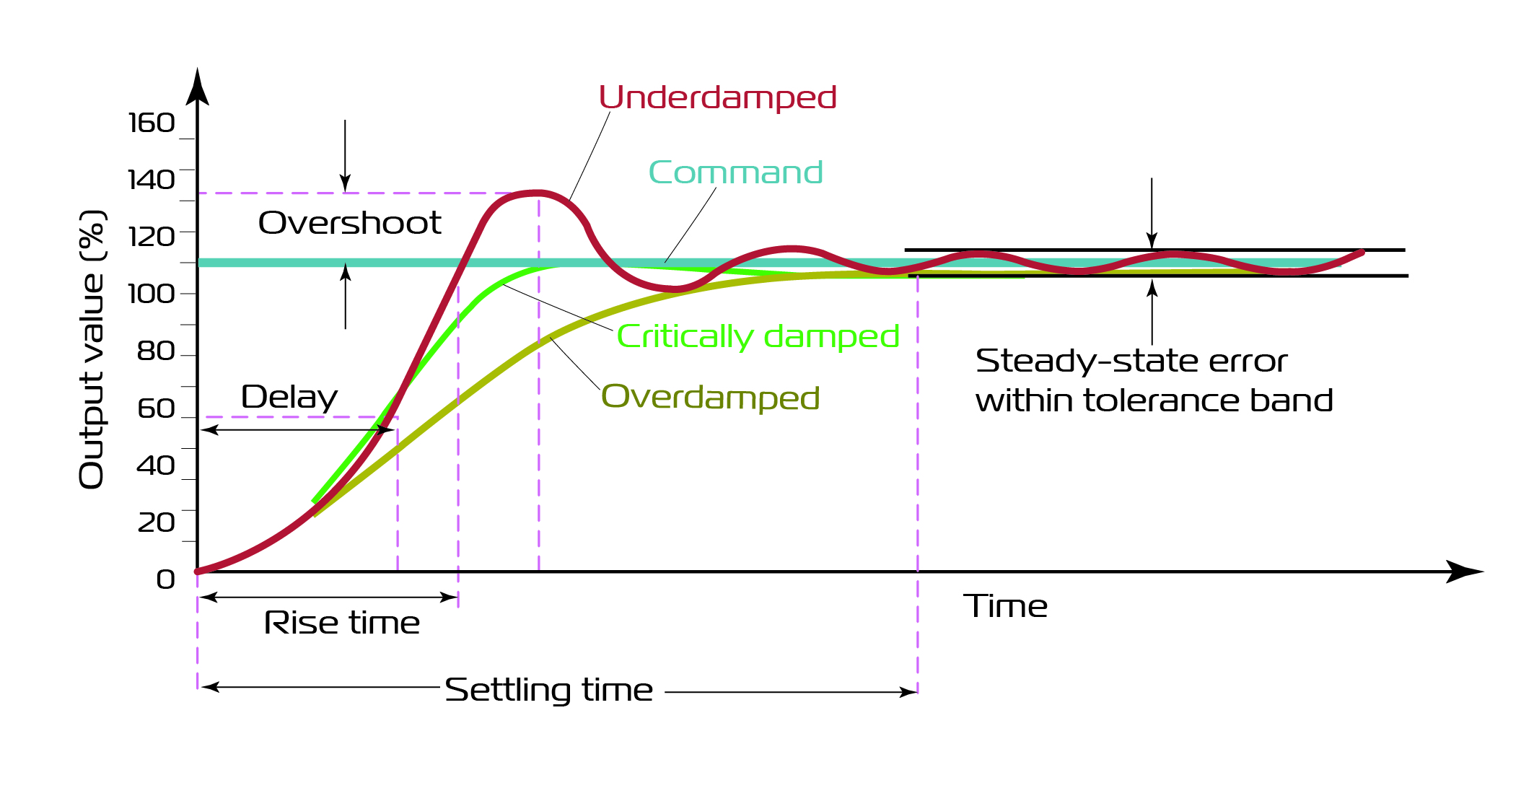
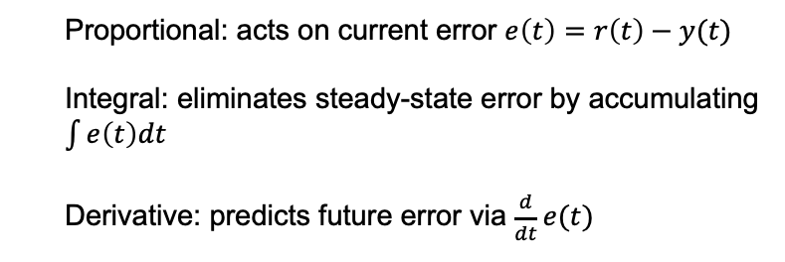
PID Controller
What is a PID controller?
Proportional: acts on current error $e\left(t\right)=r\left(t\right)−y(t)$
Integral: eliminates steady-state error by accumulating $\int{e\left(t\right)dt}$
Derivative: predicts future error via $\frac{d}{dt}e(t)$

Slide 18
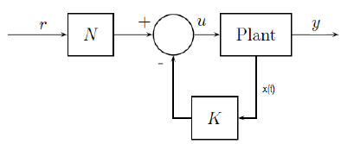
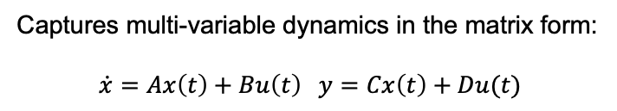

State-Space Feedback & MIMO control
Why State-Space?
Captures multi-variable dynamics in the matrix form:
$$\dot{x}=Ax\left(t\right)+Bu\left(t\right) y=Cx\left(t\right)+Du(t)$$
Full state feedback
Control law: $u\left(t\right)=−Kx\left(t\right)+r$
Places closed-loop poles for desired speed & damping
Notes:
State-space lets us handle multiple outputs and inputs simultaneously. We compute an optimal gain matrix K (via LQR) that shapes the entire system’s dynamics—far more powerful than independent SISO loops

Slide 19
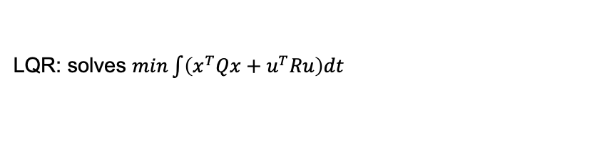
State-Space Feedback & MIMO control
Design Methods
LQR: solves $min\int{\left(x^{T}Qx+u^{T}Ru\right)dt}$
Kalman filter: estimates x from noisy sensors
Implementation in PCS
On a Real-time set up: state estimation → Gain x State → coil commands
But wait … what is a ”pole” what is a “PCS” ??? 🤔

Slide 20
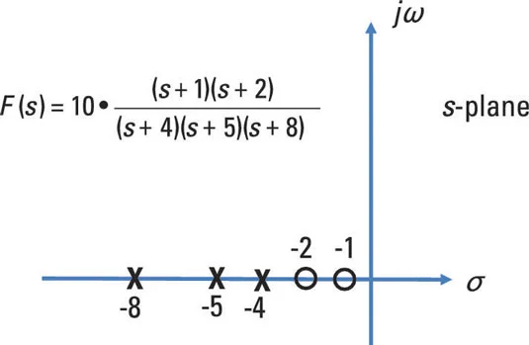
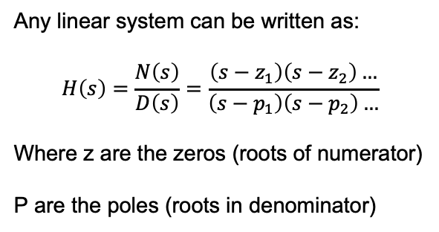
Poles and Zeros
Transfers function Basics
Any linear system can be written as:
$$H\left(s\right)=\frac{N\left(s\right)}{D\left(s\right)}=\frac{\left(s−z_{1}\right)\left(s−z_{2}\right)…}{\left(s−p_{1}\right)\left(s−p_{2}\right)…}$$
Where z are the zeros (roots of numerator)
P are the poles (roots in denominator)
Zeros→ Act like “notches” to the response, they block certain behaviors
Poles → Natural modes of the system, determine how fast or slow the system responds
Stability → If all poles lie in the left half of the s-plane $(Re\left\{p_{i}\right\}<0)$
Notes:
By moving poles left or right, up or down in the complex plane, we speed up or slow down responses and introduce or damp oscillatio
Even without heavy math, you can see that a few marks on a plane tell you everything about how a controller will behave

Slide 21
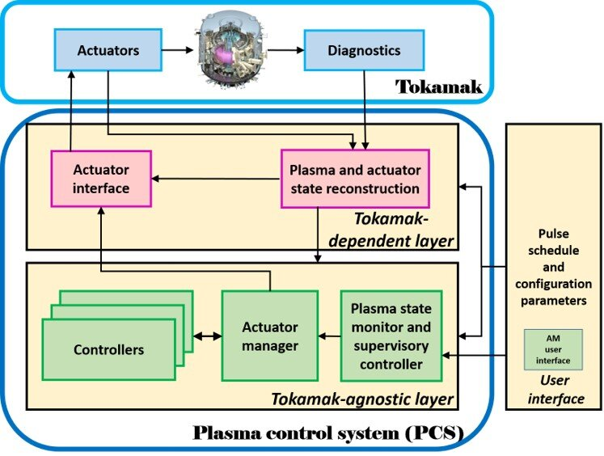
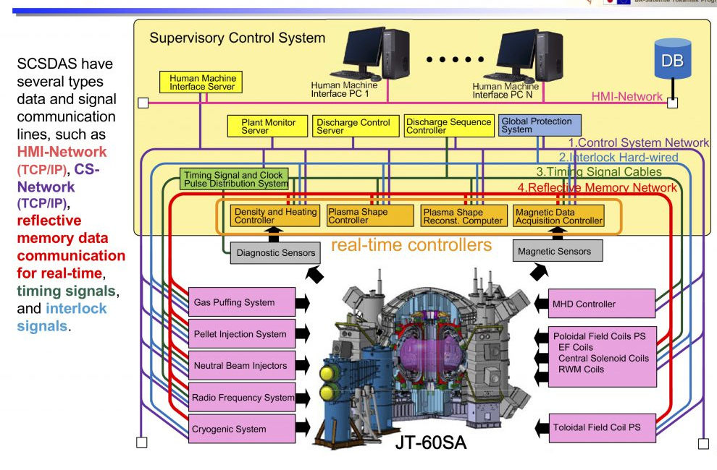
The plasma control systems
DOI: 10.48550/arXiv.2010.16145

Slide 22


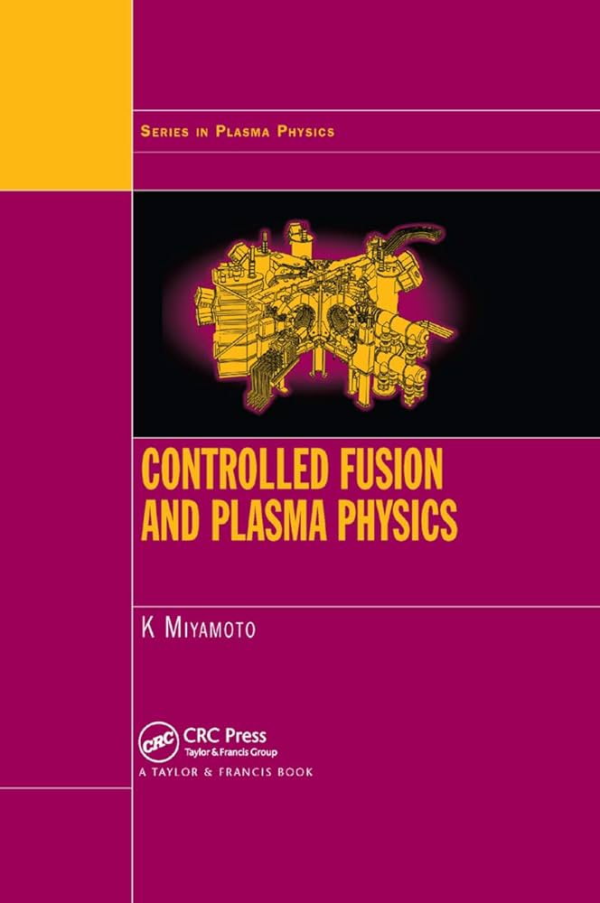

Personal favorite:
Wrote by PPPL folk 👆🏼

Slide 23
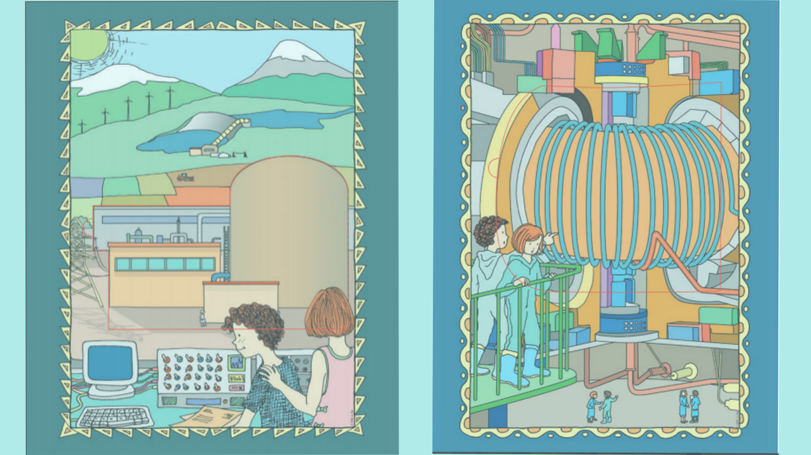
Question, comments , thoughts …..

Slide 25


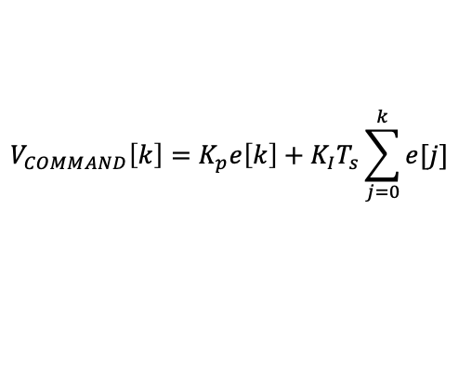
$$L\frac{dI_{MEAS}(t)}{dt}+RI_{MEAS}\left(t\right)=V_{COMMAND}(t)$$
$$I\left[k+1\right]=I\left[k\right]+\frac{T_{s}}{L}(V_{COMMAND}\left[k\right]−RI[k])$$
$$V_{COMMAND}\left[k\right]=K_{p}e\left[k\right]+K_{I}T_{s}\sum_{j=0}^{k}{e[j]}$$

