Slide 1
Introduction to waves in plasma
Dr. Nicolas Lopez
Tokamak Energy
SULI lecture series, 2025

Slide 2
About me
2011-2015: MIT Undergrad
  Started as Nuclear Engineer (22), added Physics (8) near end
  Informal exposure to fusion via talking with PSFC faculty
Summer 2014: NUF/SULI participant
  Attended these lectures at PPPL, then sent to DIII-D (General Atomics)
  Helped assess new upgrades to neutral beam source
2015 – 2022: PPPL Graduate student
  Started specializing in wave physics
  Studied wave heating & current drive in NSTX-U, mode-conversion models, and more accurate models for wave propagation (Thesis!)
2022 – 2024: U. Oxford postdoc
  Studied electron transport caused by whistler waves in lab-astro context
  But, talking w/ UK fusion microwave community made me get ‘back in the game’
Sept. 2024 – now: Tokamak Energy staff researcher
  Model wave heating & current drive in ST40 tokamak & fusion pilot plants

Slide 3
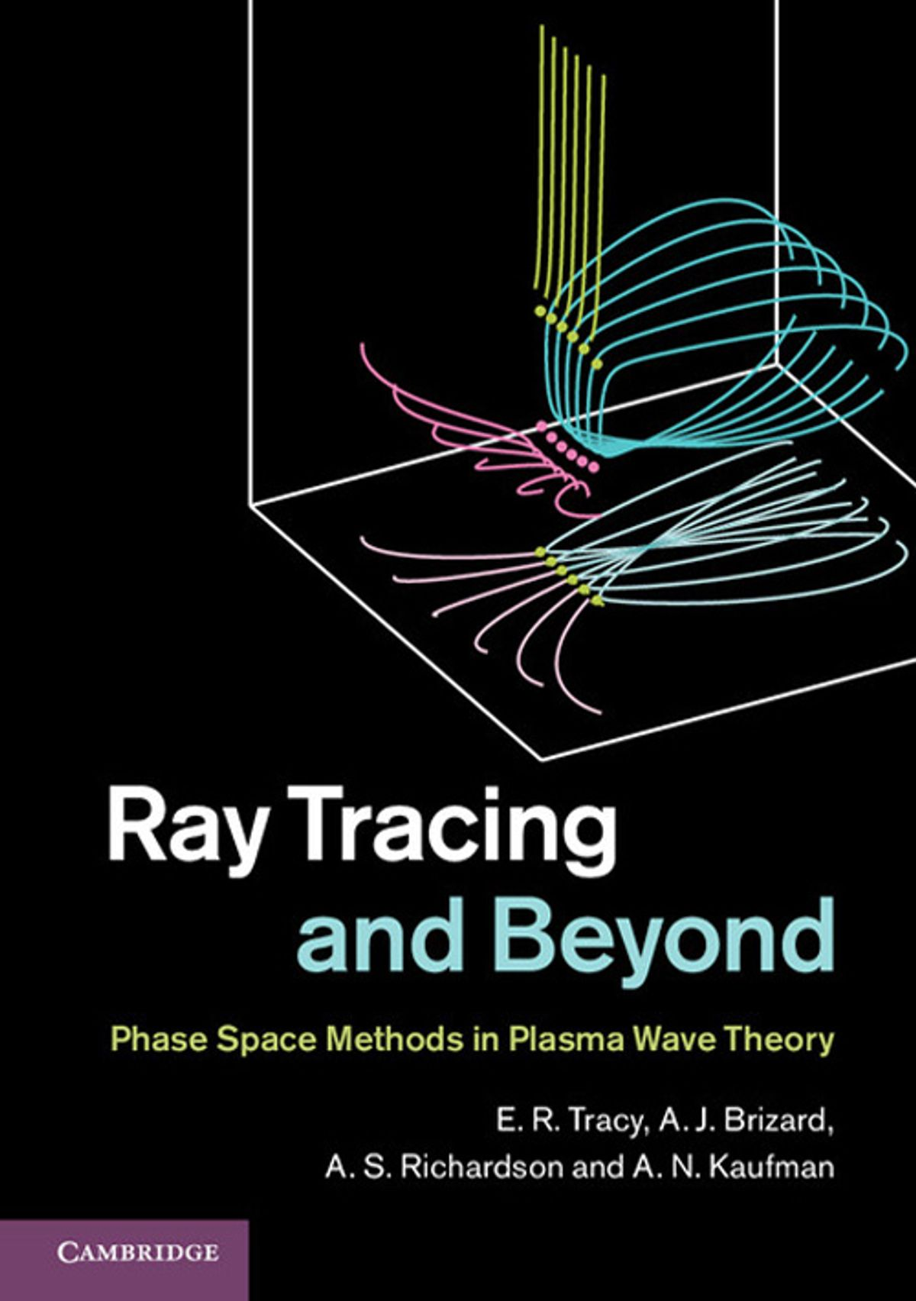
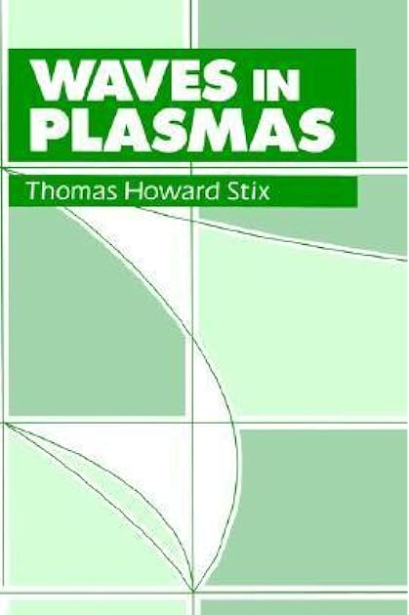
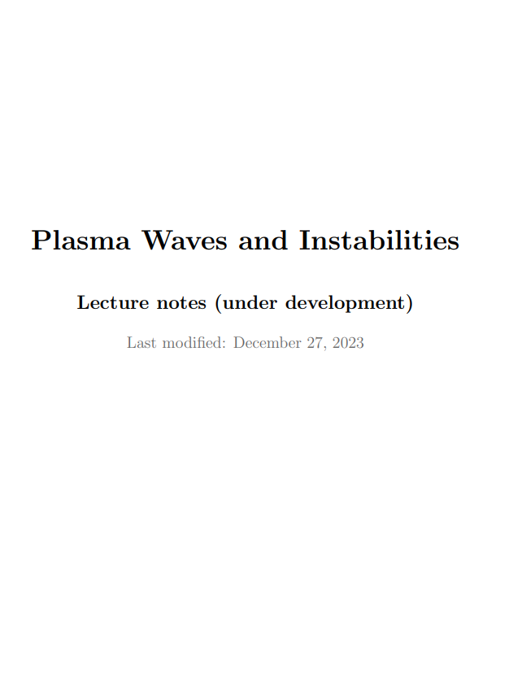
* Disclaimer: ‘Cartoon’ physics coming up *
Rigorous (grad-level) intros to plasma waves can be found in:
Ray tracing and beyond,
Tracy, Brizard, Richardson & Kaufman
Waves in Plasmas,
Stix
Plasma wave lecture notes,
Dodin
https://www.princeton.edu/~idodin/ast553/main.pdf

Slide 4
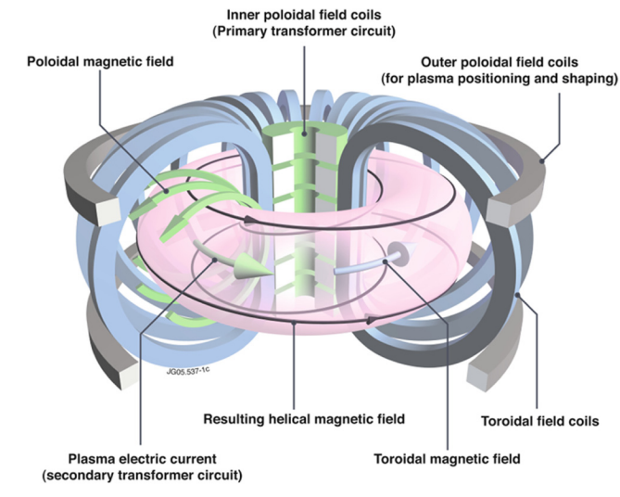
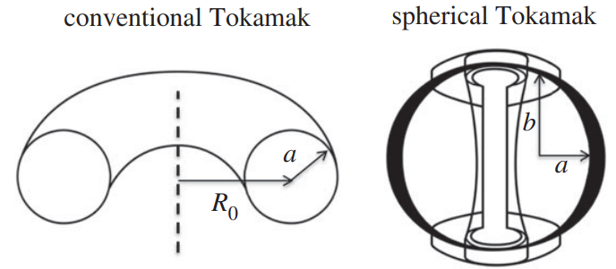
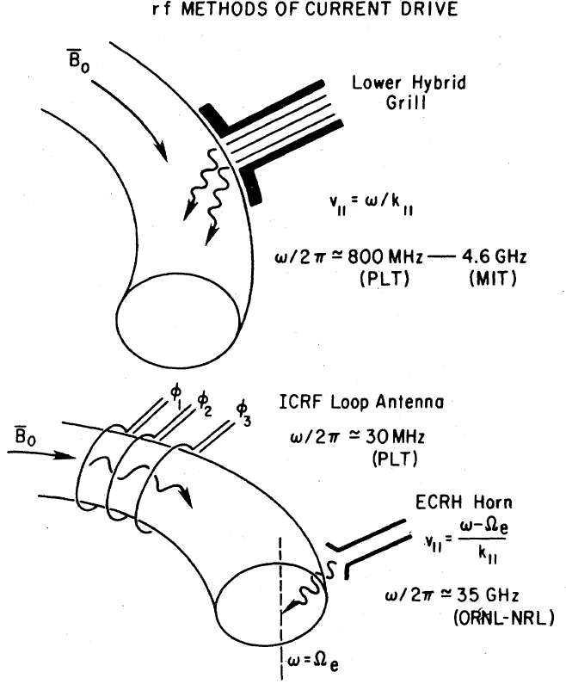
Motivation – RF heating & current drive in STs
[Costley Phil. Trans. R. Soc. A 377, 20170439 (2019)]
[Eurofusion (2011) & Poli PoP 25, 055602 (2018)]
Spherical tokamaks have little room for solenoid
  Even less space for reactors using HTS magnets because of neutron shielding
So auxiliary heating & current drive needed
  ‘Non-solenoidal’ operation has continued to be one of the most important topics in spherical tokamak research
[Fisch Rev. Mod. Phys. 59, 175 (1987)]

Slide 5
Wave propagation

Slide 6
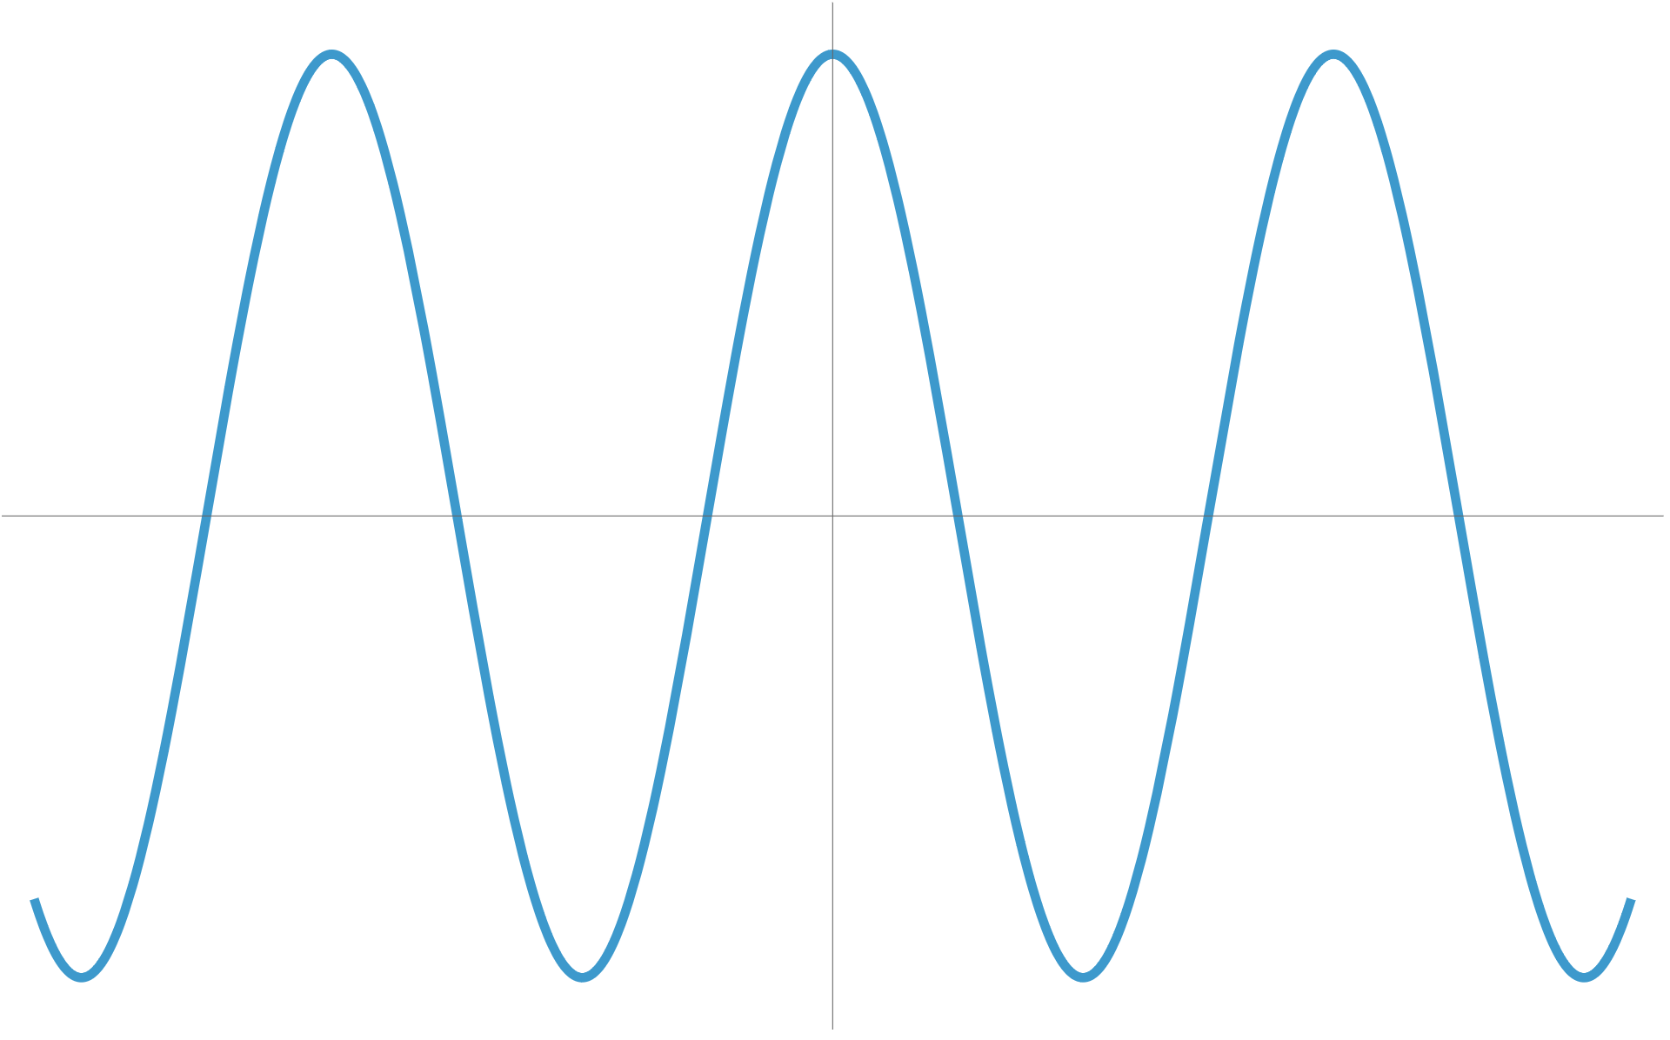
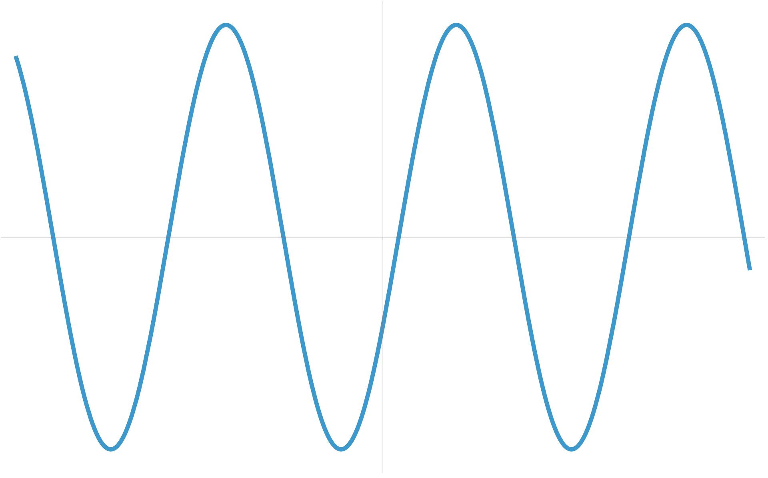
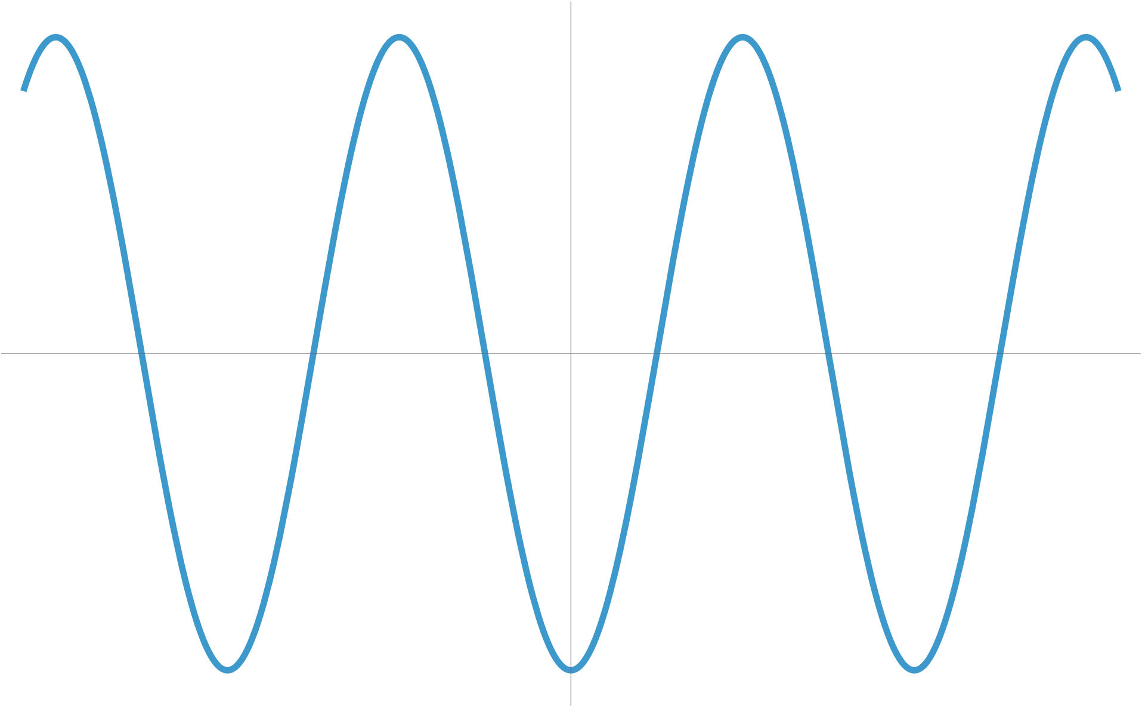
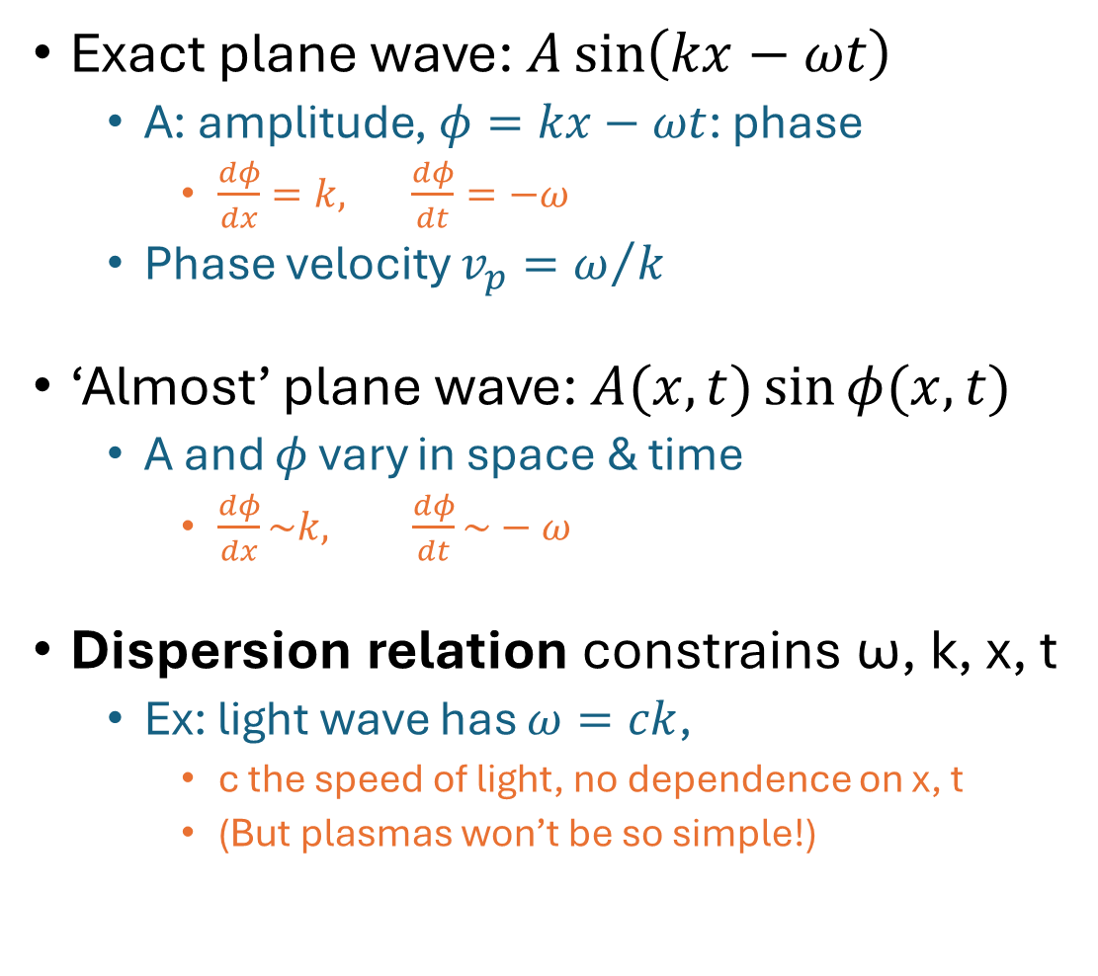


What is a wave?
t=0
A
Exact plane wave: $A\sin\left(kx−ωt\right)$
  A: amplitude, $φ=kx−ωt$: phase
    $\frac{dφ}{dx}=k, \frac{dφ}{dt}=−ω$
  Phase velocity $v_{p}=ω/k$
‘Almost’ plane wave: $A(x,t)\sin{φ(x,t)}$
  A and $φ$ vary in space & time
    $\frac{dφ}{dx}\sim k, \frac{dφ}{dt}\sim −ω$
Dispersion relation constrains ω, k, x, t
  Ex: light wave has $ω=ck$,
    c the speed of light, no dependence on x, t
    (But plasmas won’t be so simple!)
$$2π/k$$
t>0
t=$π/ω$

Slide 7

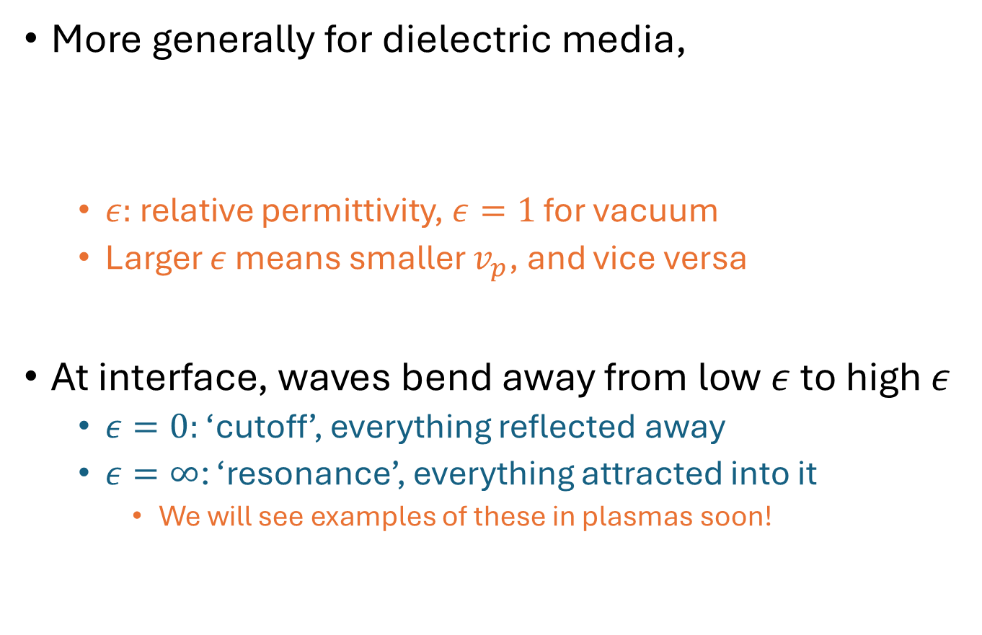


Refraction in dielectric media
High $ε$, slow
Low $ε$, fast
More generally for dielectric media,
  $ε:$ relative permittivity, $ε=1$ for vacuum
  Larger $ε$ means smaller $v_{p}$, and vice versa
At interface, waves bend away from low $ε$ to high $ε$
  $ε=0:$ ‘cutoff’, everything reflected away
  $ε=∞$: ‘resonance’, everything attracted into it
    We will see examples of these in plasmas soon!
$$N^{2}≡{\left(\frac{c}{v_{p}}\right)}^{2}=ε$$

Slide 8




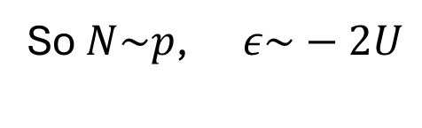
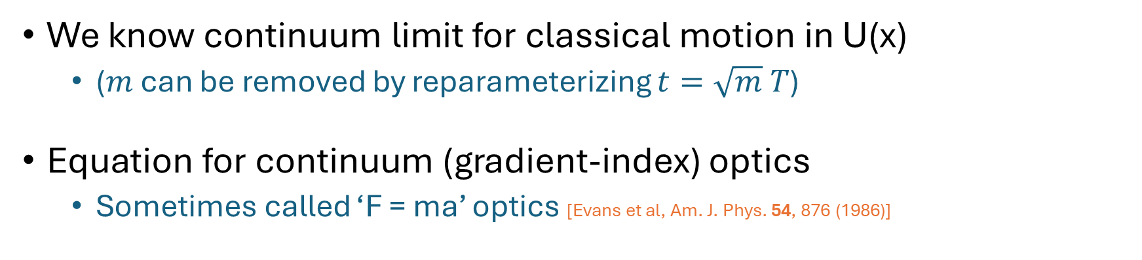







Refraction directly analogous to classical motion
$$θ_{2}$$
$$U_{2}$$
$$θ_{2}$$
$$ε_{2}$$
$$θ_{1}$$
$$U_{1}$$
$$θ_{1}$$
$$ε_{1}$$
Energy conservation: ${\left|p_{1,2}\right|}^{2}=2m\left(E−U_{1,2}\right)$
Dispersion relation: ${\left|N_{1,2}\right|}^{2}=ε_{1,2}$
Momentum conservation: $\left|p_{1}\right|\sin{θ_{1}}=\left|p_{2}\right|\sin{θ_{2}}$
Snell’s law of refraction: $\left|N_{1}\right|\sin{θ_{1}}=\left|N_{2}\right|\sin{θ_{2}}$
So $N\sim p$, $ε\sim −2U$
We know continuum limit for classical motion in U(x)
  ($m$ can be removed by reparameterizing $t=\sqrt{m} T$)
Equation for continuum (gradient-index) optics
  Sometimes called ‘F = ma’ optics [Evans et al, Am. J. Phys. 54, 876 (1986)]
$$m\ddot{x}=−∇U$$
$$x^{′′}=+\frac{1}{2}∇ε$$

Slide 9
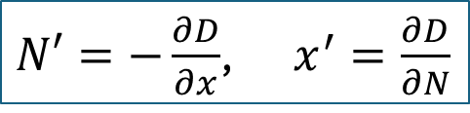

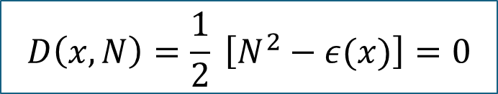

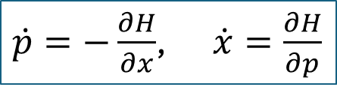
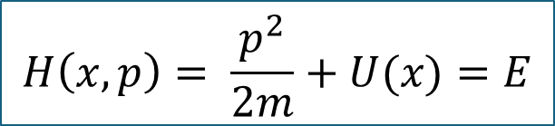
Ray-tracing in gradient-index media
Waves instead evolved using Hamilton’s Eqs of motion (EOM)
Newton’s EOM
Hamiltonian function
Hamilton’s EOM
$$H\left(x,p\right)= \frac{p^{2}}{2m}+U(x)=E$$
$\dot{p}=−\frac{∂H}{∂x}$, $\dot{x}=\frac{∂H}{∂p}$
$$m\ddot{x}=−∇U$$
Newton’s EOM
Dispersion function
Hamilton’s EOM
$$x^{′′}=+\frac{1}{2}∇ε$$
$$D\left(x,N\right)=\frac{1}{2} \left[N^{2}−ε(x)\right]=0$$
$N′=−\frac{∂D}{∂x}$, $x^{′}=\frac{∂D}{∂N}$
  (Can multiply $H→αH$, $D→αD$ without changing physics, just changing time units)
Simulating waves in plasmas requires good algorithms for solving classical equations of motion!

Slide 10
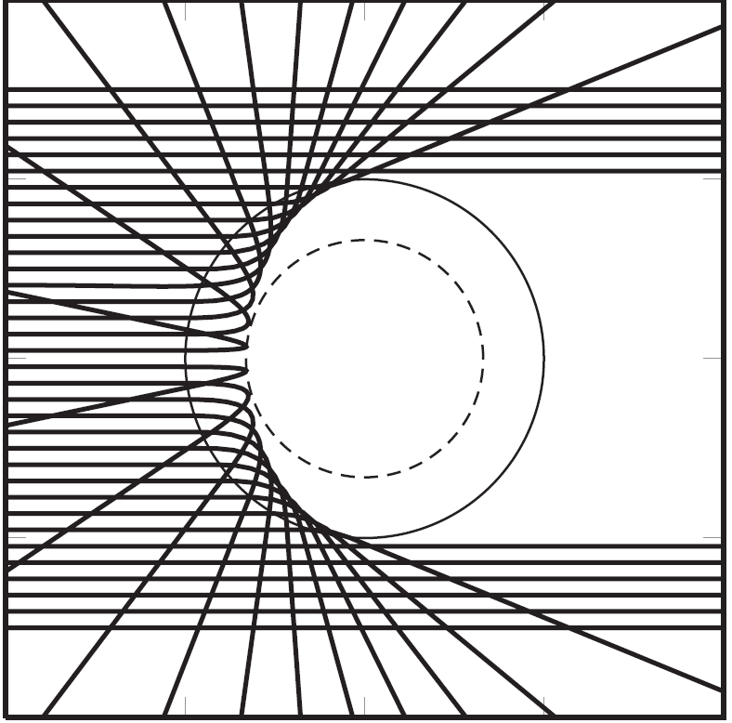
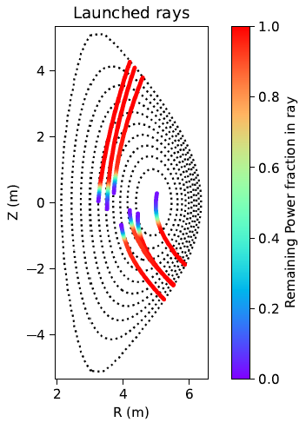
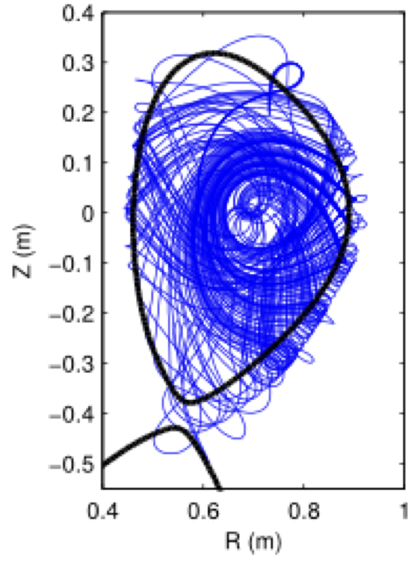
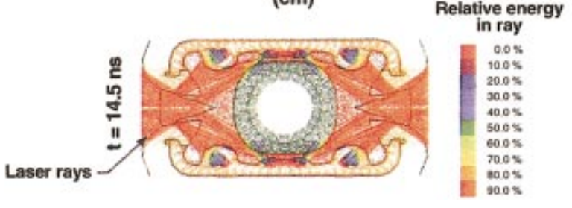
Examples of ray-tracing in fusion
Laser beam reflecting off spherical plasma
[Tracy et al, Ray-tracing & Beyond p. 160]
Electron-cyclotron waves in tokamak
[Lopez et al, PPCF 67, 055012 (2025)]
Lower-hybrid waves in tokamak
[F Poli, APS DPP meeting (2017)]
Laser beam propagation in hohlraum
[Lindl et al, PoP 11, 339 (2004)]

Slide 11
Plasma dispersion relation

Slide 12
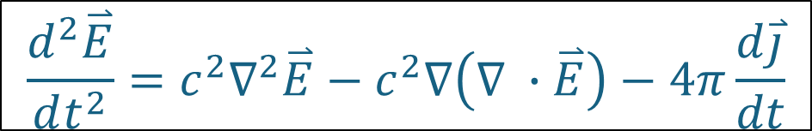
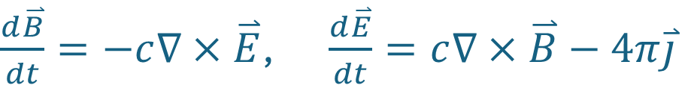
General Plasma wave equation
Time-dependent Maxwell equations:
Curl of B eq, d/dt of E equation, then substitution gives:
  Having response model for j as a function(al) of E then gives wave eq. for E
$\frac{d\overset{⃑}{B}}{dt}=−c∇×\overset{⃑}{E}$, $\frac{d\overset{⃑}{E}}{dt}=c∇×\overset{⃑}{B}−4π\overset{⃑}{j}$
$$\frac{d^{2}\overset{⃑}{E}}{dt^{2}}=c^{2}∇^{2}\overset{⃑}{E}−c^{2}∇\left(∇ ∙\overset{⃑}{E}\right)−4π\frac{d\overset{⃑}{j}}{dt}$$

Slide 13
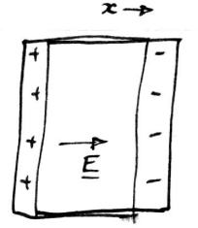
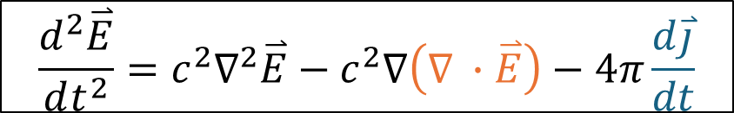
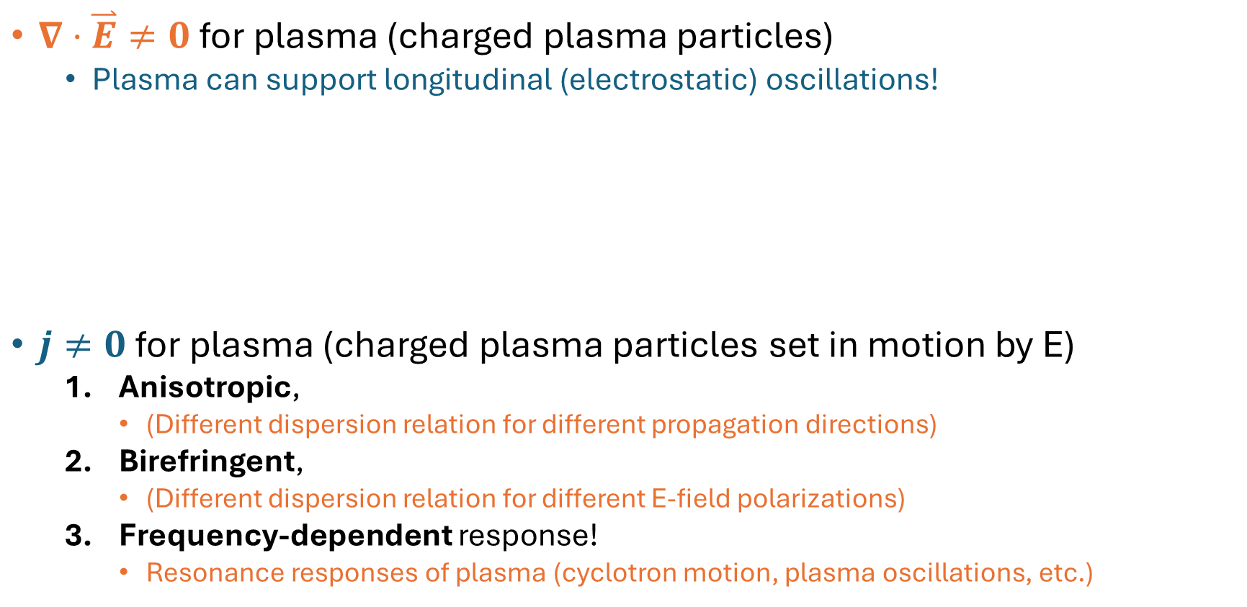
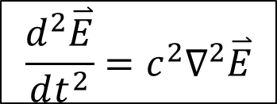
Plasma vs Vacuum
Plasma
Vacuum
$$\frac{d^{2}\overset{⃑}{E}}{dt^{2}}=c^{2}∇^{2}\overset{⃑}{E}−c^{2}∇\left(∇ ∙\overset{⃑}{E}\right)−4π\frac{d\overset{⃑}{j}}{dt}$$
$$\frac{d^{2}\overset{⃑}{E}}{dt^{2}}=c^{2}∇^{2}\overset{⃑}{E}$$
$∇⋅\overset{⃑}{E}≠0$ for plasma (charged plasma particles)
  Plasma can support longitudinal (electrostatic) oscillations!
$j≠0$ for plasma (charged plasma particles set in motion by E)
  Anisotropic,
    (Different dispersion relation for different propagation directions)
  Birefringent,
    (Different dispersion relation for different E-field polarizations)
  Frequency-dependent response!
    Resonance responses of plasma (cyclotron motion, plasma oscillations, etc.)
[Laqua, PPCF 49, R1 (2007)]
[MIT OCW course 22.611j]

Slide 14





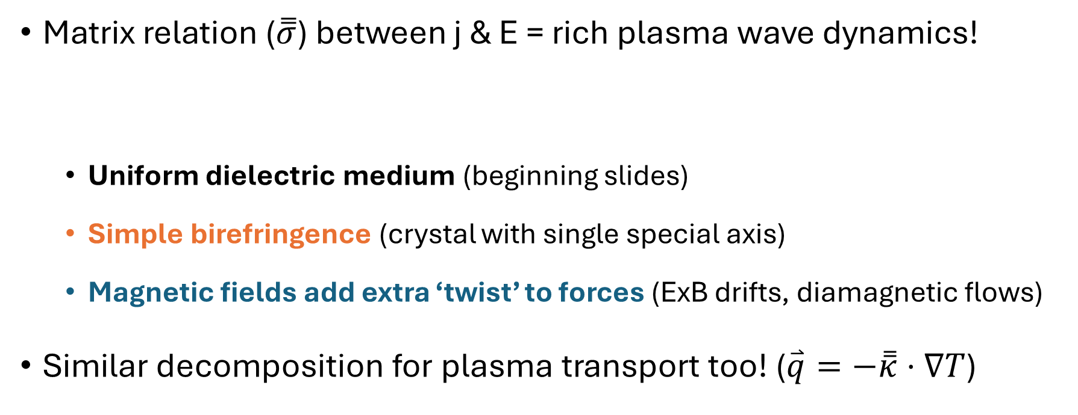
Magnetic fields make anisotropy, birefringence
Consider harmonic modes & Ohm’s law relation for j & E
$\overset{⃑}{j},\overset{⃑}{E}\sim e^{i\overset{⃑}{k}⋅\overset{⃑}{x}−iωt}$
$$\overset{⃑}{j}=\overset{̿}{σ}⋅\overset{⃑}{E}$$
(linear response)
(local response)
Matrix relation ($\overset{̿}{σ}$) between j & E = rich plasma wave dynamics!
  Uniform dielectric medium (beginning slides)
  Simple birefringence (crystal with single special axis)
  Magnetic fields add extra ‘twist’ to forces (ExB drifts, diamagnetic flows)
Similar decomposition for plasma transport too! ($\overset{⃑}{q}=−\overset{̿}{κ}⋅∇T$)
$$\overset{⃑}{j}=\left[σ\overset{̿}{I} \right] \overset{⃑}{E}$$
$$+Δσ\hat{b}\hat{b}$$
$$+σ_{×}\hat{b}×$$

Slide 15
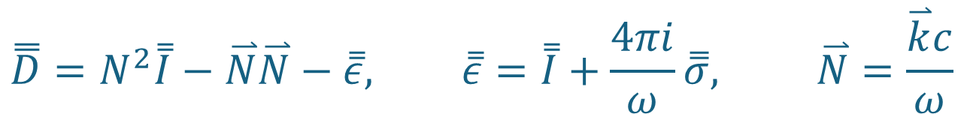
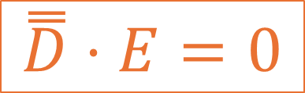
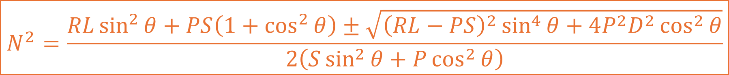

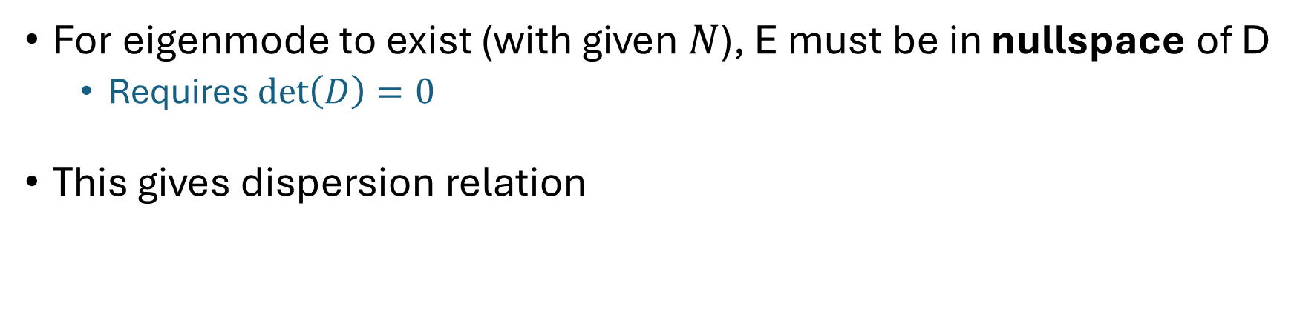
Cold plasma dispersion relation
Putting all that together gives wave equation
$$\overset{̿}{D}⋅E=0$$
$$\overset{̿}{D}=N^{2}\overset{̿}{I}−\overset{⃑}{N}\overset{⃑}{N}−\overset{̿}{ε}, \overset{̿}{ε}=\overset{̿}{I}+\frac{4πi}{ω}\overset{̿}{σ}, \overset{⃑}{N}=\frac{\overset{⃑}{k}c}{ω}$$
For eigenmode to exist (with given $N$), E must be in nullspace of D
  Requires $\text{det}\left(D\right)=0$
This gives dispersion relation
$$N^{2}=\frac{RL\sin^{2}{θ}+PS\left(1+\cos^{2}{θ}\right)±\sqrt{{\left(RL−PS\right)}^{2}\sin^{4}{θ}+4P^{2}D^{2}\cos^{2}{θ}}}{2\left(S\sin^{2}{θ+P\cos^{2}{θ}}\right)}$$
$$R,L=1−\sum_{species}{\frac{ω_{ps}^{2}}{ω\left(ω±Ω_{s}\right)}}, P=1−\sum_{species}{\frac{ω_{ps}^{2}}{ω^{2}}}, S=\frac{R+L}{2}, D=\frac{R−L}{2}$$
  Notably depends on angle $θ$ between $\overset{⃑}{N}$ & $\hat{b}$, and frequency $ω$

Slide 16
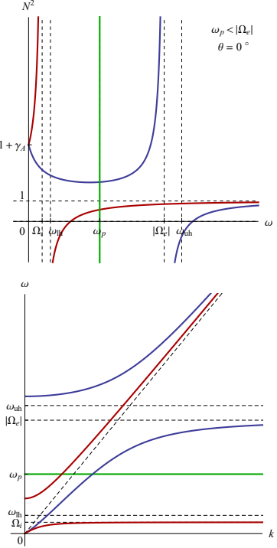
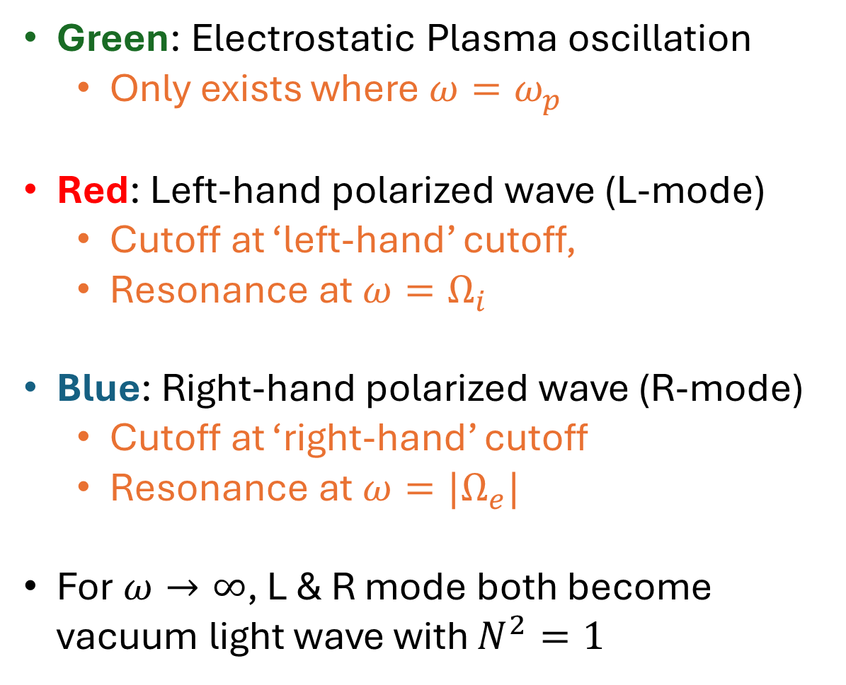
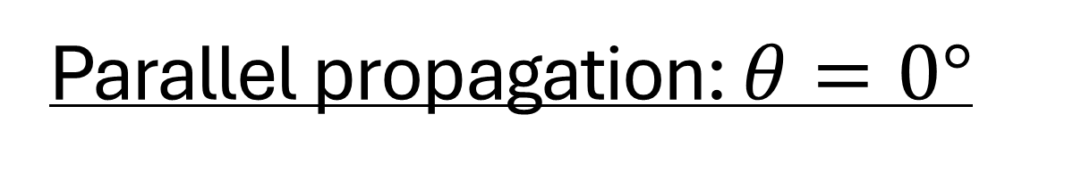
Parallel propagation: $θ=0°$
Green: Electrostatic Plasma oscillation
  Only exists where $ω=ω_{p}$
Red: Left-hand polarized wave (L-mode)
  Cutoff at ‘left-hand’ cutoff,
  Resonance at $ω=Ω_{i}$
Blue: Right-hand polarized wave (R-mode)
  Cutoff at ‘right-hand’ cutoff
  Resonance at $ω={|Ω}_{e}|$
For $ω→∞$, L & R mode both become vacuum light wave with $N^{2}=1$
[I. Dodin lecture notes]

Slide 17
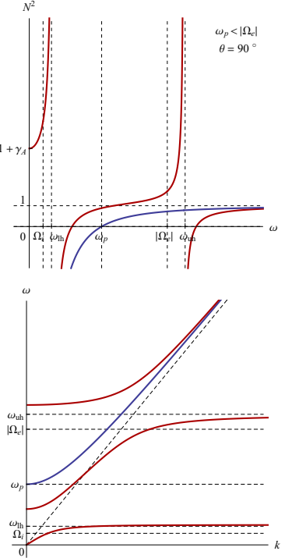
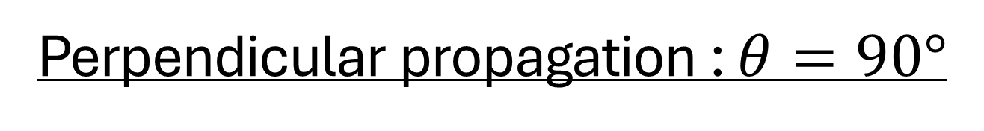
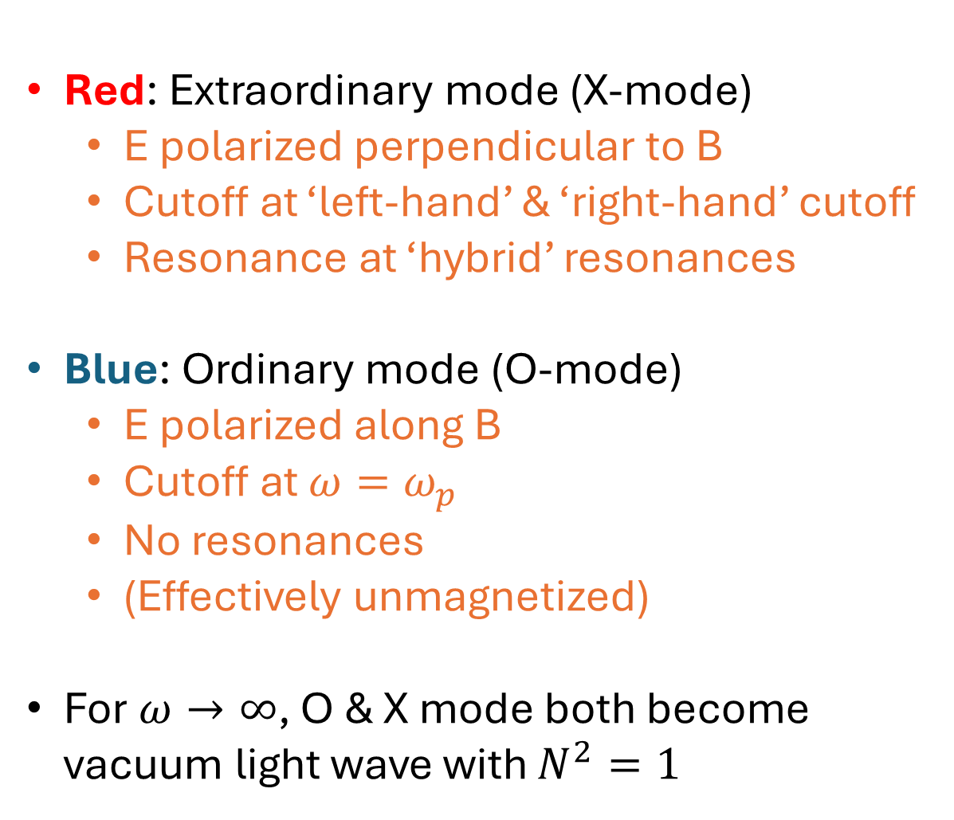
Perpendicular propagation : $θ=90°$
Red: Extraordinary mode (X-mode)
  E polarized perpendicular to B
  Cutoff at ‘left-hand’ & ‘right-hand’ cutoff
  Resonance at ‘hybrid’ resonances
Blue: Ordinary mode (O-mode)
  E polarized along B
  Cutoff at $ω=ω_{p}$
  No resonances
  (Effectively unmagnetized)
For $ω→∞$, O & X mode both become vacuum light wave with $N^{2}=1$
[I. Dodin lecture notes]

Slide 18
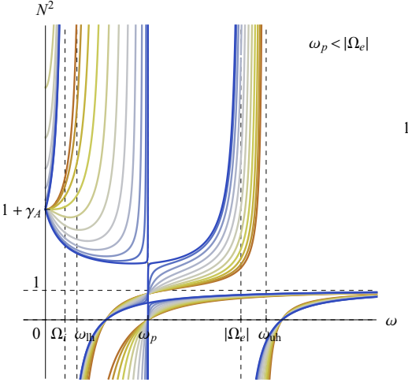
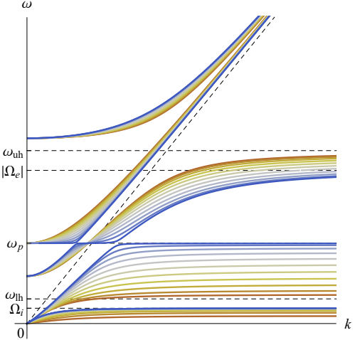
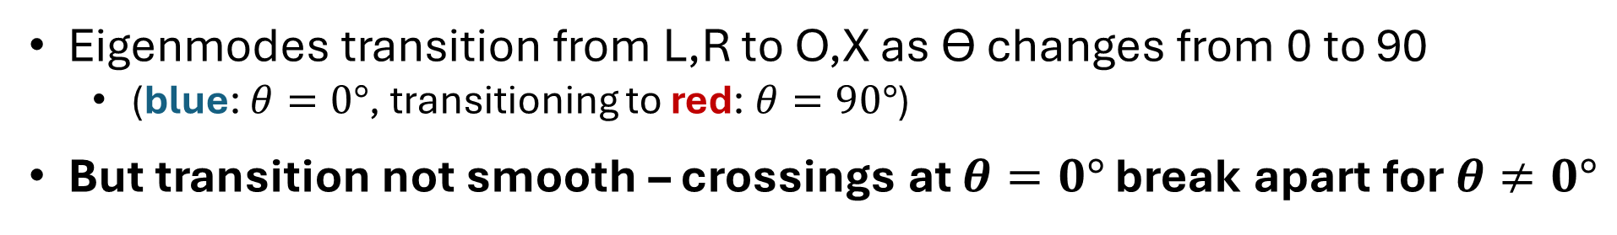
Intermediate angles – mode mixing
[I. Dodin lecture notes]
Eigenmodes transition from L,R to O,X as Ө changes from 0 to 90
  (blue: $θ=0°$, transitioning to red: $θ=90°$)
But transition not smooth – crossings at $θ=0°$ break apart for $θ≠0°$

Slide 19
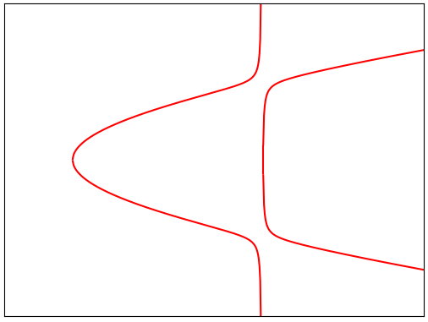
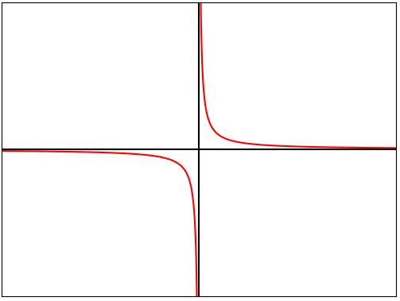








Mode-conversion
$$D=\left(\begin{matrix}ω−ω_{c} & η \\ η & k−k_{c}\end{matrix}\right)$$
$$η=0$$
$$η≠0$$
$$ω$$
$$ω$$
$$k$$
[I. Dodin lecture notes]
$$k$$
Dispersion curves only cross for exactly zero coupling between modes
  Nothing is ever exactly zero in reality, so generally curves cannot cross
If gap is small enough, power can be transferred across
  This is mode conversion!
    (But what you call the ‘converted’ wave is matter of convention!)
Rich global mode-conversion problems exist in plasmas
  Ex: cutoff-resonance-cutoff triplet has wave interference in conversion efficiency
$$\sim \text{exp}\left(−2πη^{2}\right)$$

Slide 20
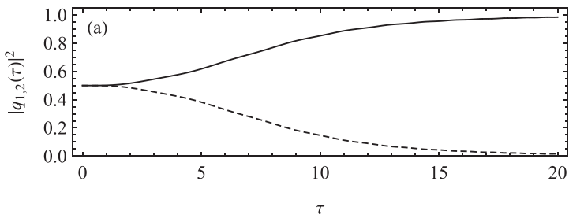
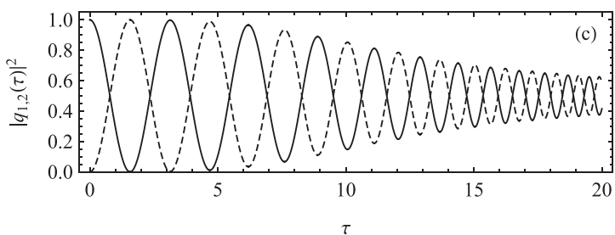
Mode-conversion
[I. Dodin lecture notes]
[Dodin et al, PoP 24, 122116 (2017)]
Mode-conversion can also occur when dispersion curves are close, but not necessarily trying to cross each other
  Can happen in low-density plasma (plasma edge!) where O & X are nearly identical (would be identical in vacuum)
Launch circularly polarized waves to get linear polarized O/X in plasma

Slide 21
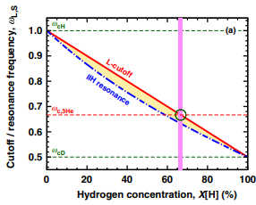
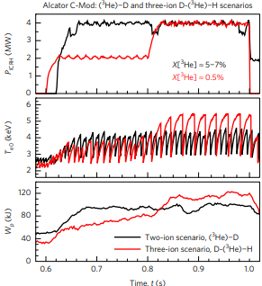
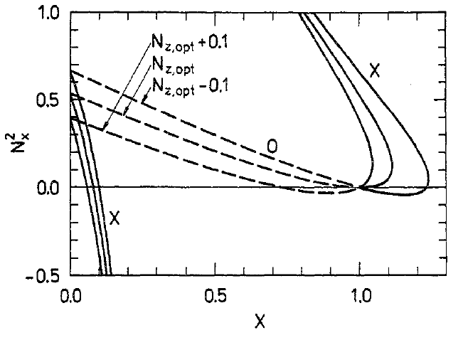

Getting waves to behave
[Kazakov et al Nat. Phys. 13, 973 (2017);
Nucl. Fusion 55, 032001 (2015)]
Must know reflections, resonances, & mode-conversion points to get waves where you want
  ‘Standard schemes’ to do this are well-established
New schemes continuing to be developed/refined:
  Adjust fuel composition to put wave resonance near cyclotron resonance (3-ion heating)
    Can deposit significant amounts of energy into fast ions
  Inject waves at special angle to overlap two cutoffs (O-X-B conversion)
    Allows EC waves to penetrate very dense plasma
[Hansen et al, PPCF 27, 1077 (1985)]
[Köhn et al, PoP 18, 082501 (2011)]

Slide 22
Wave heating & current drive

Slide 23


Heating plasmas with waves
Waves can transfer energy to particles if resonance condition met:
  Doppler-shifted frequency must be a harmonic of cyclotron motion
$$ω−k_{∥}V_{∥}=nΩ$$
Landau damping (n=0)
Cyclotron damping (n≠0)
Resonant kick
electron
X
Magnetic
field
Accelerates particles parallel to B
Accelerates particles perpendicular to B
‘Easy’ to heat plasma, but driving current requires heating in special way

Slide 24




Easier to push slow electrons, efficient to push fast ones
Kinetic energy: E = ½ m V²
  Thus, ‘Easier’ to push slow things
$$ΔE=m V ΔV$$
v
E
But faster plasma particles collide less, need less frequent pushing
  Thus, ‘Efficient’ to push fast things
  (Recall $ν\sim 1/V^{3}$ for plasma collisions)
$$ΔP=\frac{ΔE}{Δt}\sim νΔE∝\frac{ΔV}{V^{2}}, \frac{Δj}{ΔP}∝V^{2}$$

Slide 25






Landau & Cyclotron damping can drive current
Average $V_{∥}$=0
Average $V_{∥}>$0
$$V_{⊥}$$
$$V_{⊥}$$
Cyclotron
Heating
Landau
Damping
$$V_{∥}$$
Collisions
$$V_{∥}$$
Because hotter particles collide less, asymmetric heating drives current
  Landau damping (parallel pushes) directly drives current
  Cyclotron heating (perpendicular pushes) drives current after collision time
Landau (black) 4/3x better than Cyclotron (white)
[Fisch, RMP 59, 175 (1987)]

Slide 26




Ex: STEP
[Tholerus et al, NF 64, 106030 (2024)]

Slide 27


Ex: ITER
[ITER website]
Person!
[Barabaschi et al, FED 215, 114990 (2025)]
‘Plasma’ is only small fraction of total heating system! Also physics of:
  Sources (ex: gyrotron efficiency),
  Delivery system (ex: efficient waveguide bends)
  Launching system (ex: IC antenna designs)

Slide 28
Summary
Externally launched plasma waves will be an important actuator in future fusion devices to provide heating and current drive
Plasma is a rich medium that can support a variety of waves with complicated dispersion relations
  It can take some creativity to get waves to go where you want them to
    Dispersion relation depends on propagation angle, wave frequency, and plasma (density, magnetic field, temperature, fuel composition, etc.)
Mode conversion can transfer energy from one type of wave to another at special locations
  May be good (‘pass the baton’ to wave with better accessibility) or may be bad
Waves can transfer energy to particles when resonance condition is met
  If this transfer is given to particles moving preferentially in one direction versus the opposite direction, toroidal current can be driven as well

