Slide 1
Magnetic reconnection
Introduction to Plasma and Fusion
PPPL June 2024
Muni Zhou (Institute for Advanced Study)
Notes:
ojjo

Slide 2
Reconnection related phenomena
Credit: NASA, SDO

Slide 3
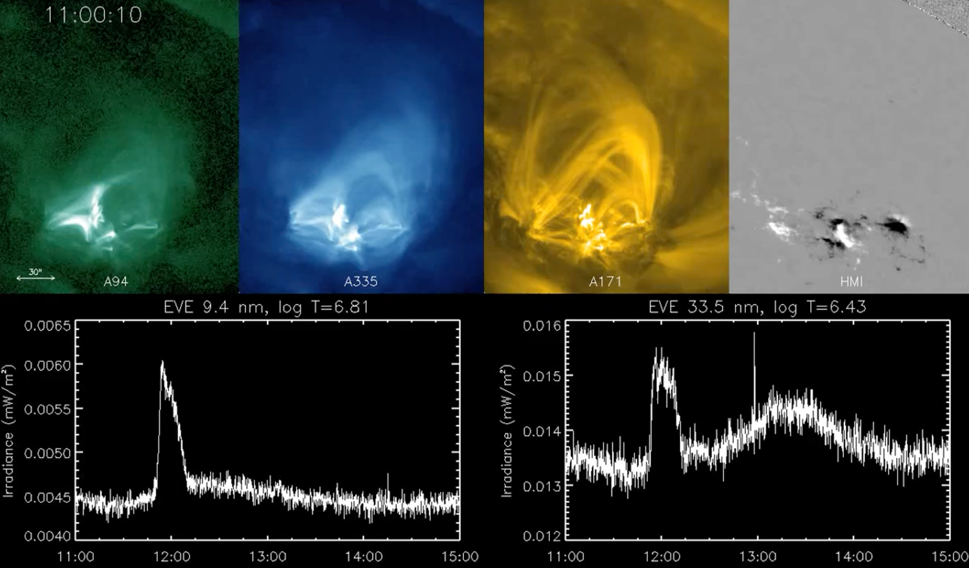
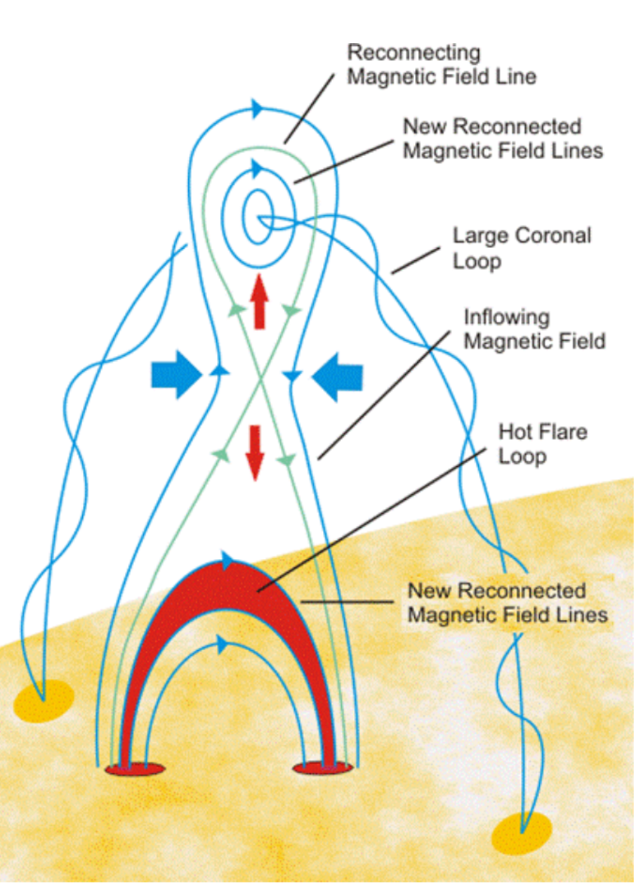
Reconnection related phenomena
Credit: NASA, SDO

Slide 4
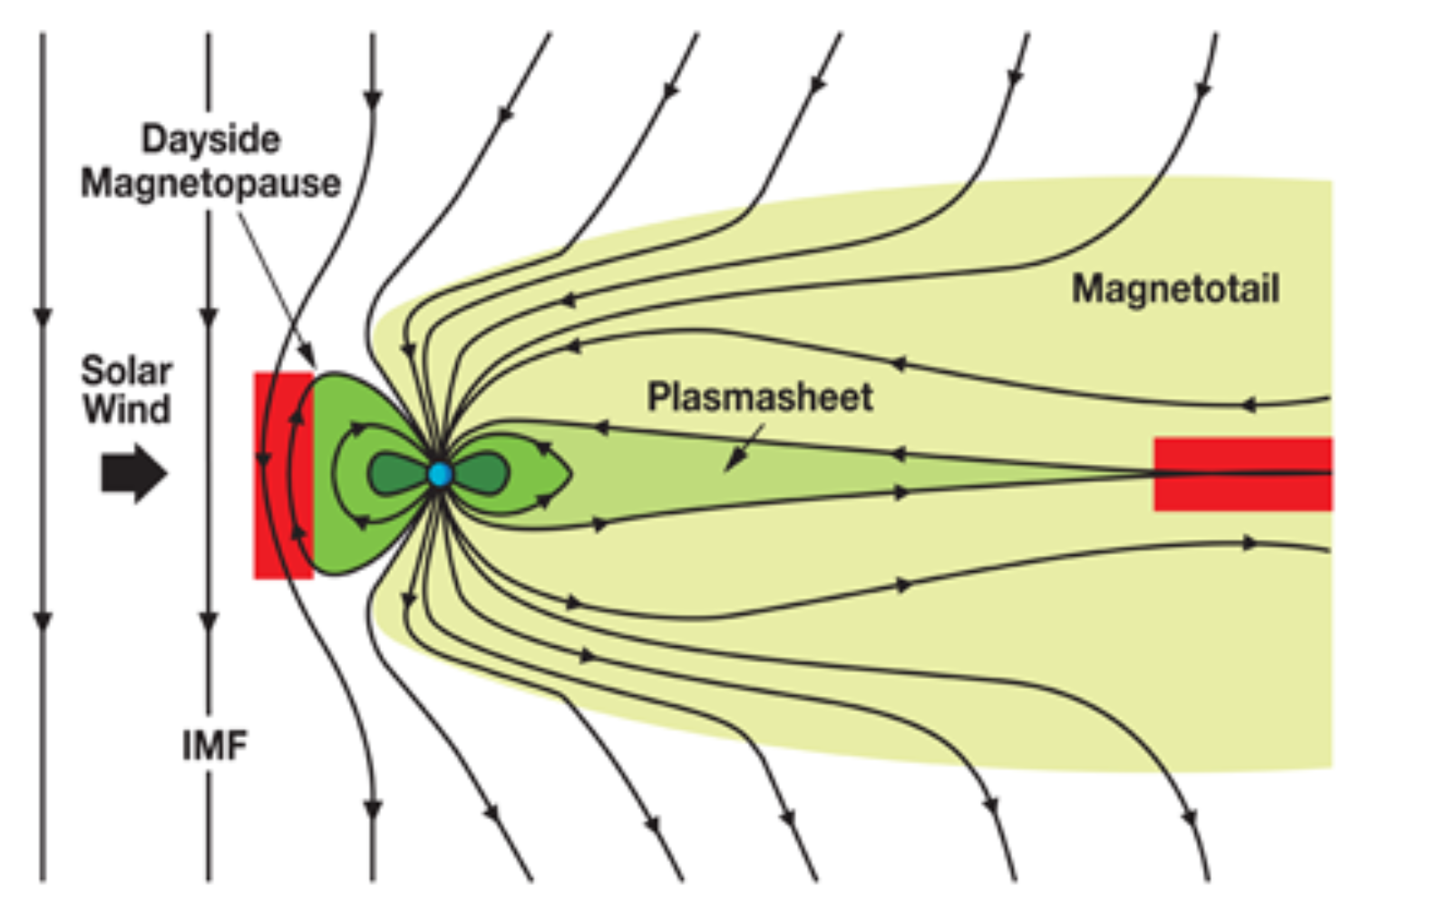
Reconnection related phenomena
Reconnection around Earth’s magnetosphere
Credit: NASA
Sawtooth instability in magnetically controlled fusion
e.g., Yamada+1994

Slide 5
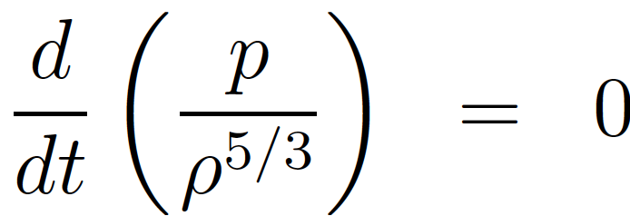
Let’s start from the MHD framework
Continuity:
Momentum:
Ohm’s law:
Equation of state:

Slide 6
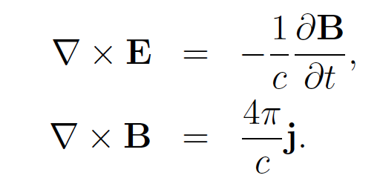
Let’s start from the MHD framework
Continuity:
Momentum:
Ohm’s law:
Equation of state:
(assuming incompressible flow) Induction equation:
Plasmas (that we are mostly interested in) are good conductors -- resistivity is small.

Slide 7
Dimensionless numbers
Induction equation:
Nonlinear term/Diffusion term
magnetic Reynolds number

Slide 8
Dimensionless numbers
Induction equation:
Nonlinear term/Diffusion term
magnetic Reynolds number
If estimating the relevant velocity as being the Alfven speed:
Lundquist number
Solar corona $S∼{10}^{13}$; ISM $S∼{10}^{18}$, typical tokamak $S∼{10}^{18}$.
At large (/system) scales, the diffusion of magnetic fields is negligible (compared to nonlinear effects)

Slide 9
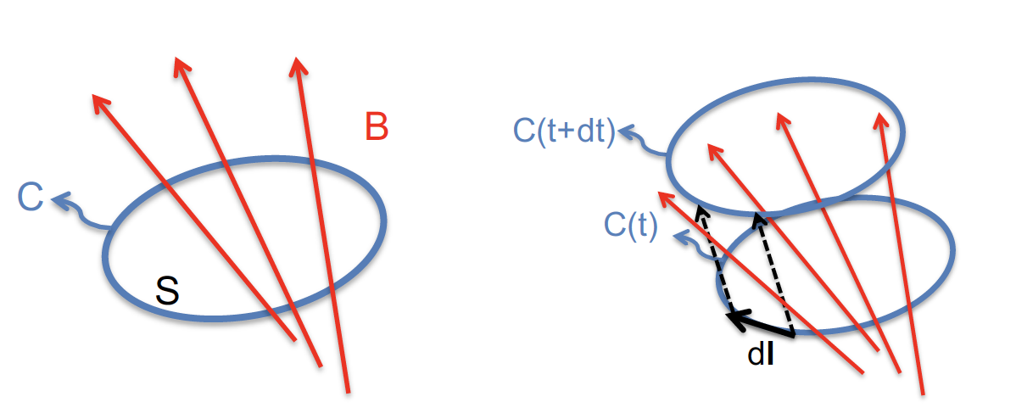
Frozen flux
Consider the magnetic flux through a surface $S$ bounded by a curve $C$, $Ψ=\int_{S}{B⋅dS}$.
Credit: N. Loureiro

Slide 10
Frozen flux
Consider the magnetic flux through a surface $S$ bounded by a curve $C$, $Ψ=\int_{S}{B⋅dS}$.
Let the surface move with the plasma fluid with velocity $u,$ the change of flux is
Change of $B$
Change of surface$S$
Credit: N. Loureiro
$$\frac{dΨ}{dt}=\int_{S}{\frac{∂B}{∂t}⋅dS+\int_{C}{B⋅u ×dl}}$$
$$=−c\int_{S}{∇×E dS−\int_{S}{∇×\left(u×B\right)dS}}$$

Slide 11
Frozen flux
Consider the magnetic flux through a surface $S$ bounded by a curve $C$, $Ψ=\int_{S}{B⋅dS}$.
Let the surface move with the plasma fluid with velocity $u,$ the change of flux is
Change of $B$
Change of surface$S$
Credit: N. Loureiro
$$\frac{dΨ}{dt}=\int_{S}{\frac{∂B}{∂t}⋅dS+\int_{C}{B⋅u ×dl}}$$
$$=−c\int_{S}{∇×E dS−\int_{S}{∇×\left(u×B\right)dS}}$$
Recall the Ohm’s law $E+\frac{u×B}{c}=ηJ$
$$\frac{dΨ}{dt}=−c\int_{S}{∇ ×\left(ηJ\right)dS}$$
$\frac{dΨ}{dt}=0$ for ideal plasma, flux is frozen in the flow

Slide 12
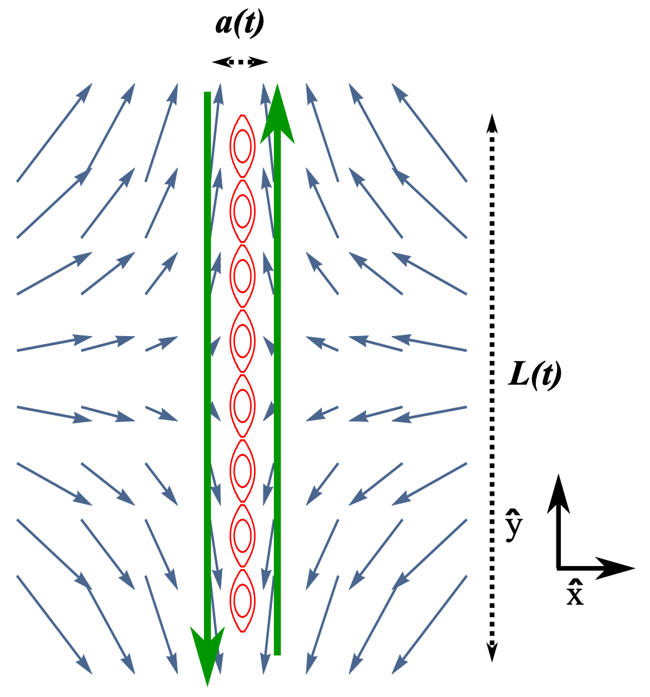
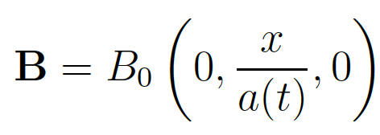
How can resistivity be important?
Momentum:
Induction:
Consider this configuration:
Adapted from E. Tolman+ (2018) JPP

Slide 13
How can resistivity be important?
Momentum:
Induction:
Consider this configuration:
The equilibrium the limit of zero resistivity:
The configuration has a shrinking width $a\left(t\right)=a_{0}e^{−2Γ_{0}t}$ -- the exponential collapse
And thus an exponential growth of current density $j_{z}\left(t\right)∝e^{2Γ_{0}t}$
Adapted from E. Tolman+ (2018) JPP

Slide 14
How can resistivity be important?
Momentum:
Induction:
Consider this configuration:
The equilibrium the limit of zero resistivity:
The configuration has a shrinking width $a\left(t\right)=a_{0}e^{−2Γ_{0}t}$ -- the exponential collapse
And thus an exponential growth of current density $j_{z}\left(t\right)∝e^{2Γ_{0}t}$
Adapted from E. Tolman+ (2018) JPP
$$\frac{dΨ}{dt}=−c\int_{S}{∇ ×\left(ηJ\right)dS}$$
The resistive term becomes locally important in a boundary layer

Slide 15
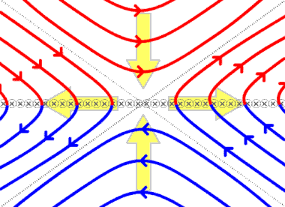
Reconnection can happen due to the resistivity
Resistivity $η$ is usually small, need strong current for a significant change of flux.
Reconnection:
change of magnetic fields’ topology
fast release of magnetic energy
Adapted from E. Tolman+ (2018) JPP
$$\frac{dΨ}{dt}=−c\int_{S}{∇ ×\left(ηJ\right)dS}$$
The resistive term becomes locally important in a boundary layer

Slide 16
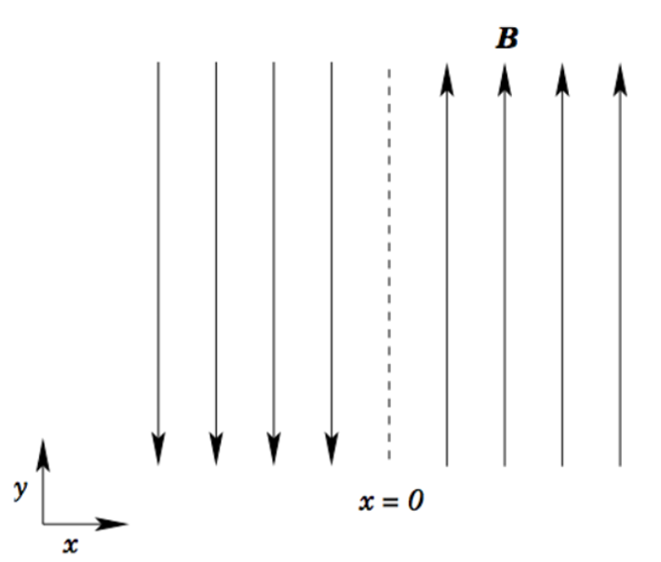
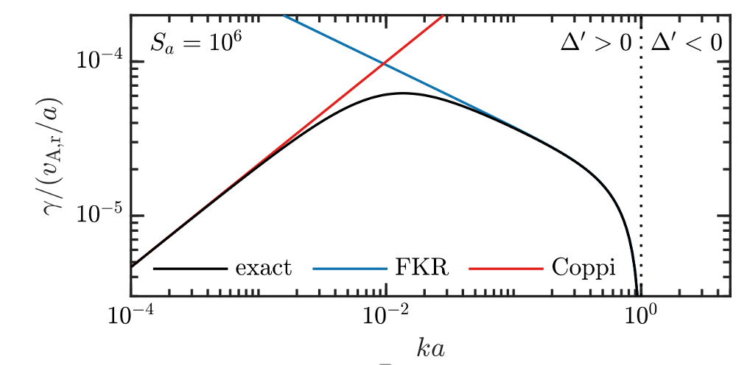
How to initiate reconnection? Linear regime
Momentum:
Induction:
Credit: Fitzpatrick
Credit: M. Kunz

Slide 17
How to initiate reconnection? Linear regime
Momentum:
Induction:
Performing linear perturbation analysis
Looking for the growth rate to be hybrid, i.e., intermediate between the resistive diffusion time scale (slow) and the ideal Alfven time scale (fast)
Assuming ideal MHD behavior away from the reconnection layer and diffusion/resistivity dominating in the reconnection layer
Credit: Fitzpatrick
Credit: M. Kunz

Slide 18
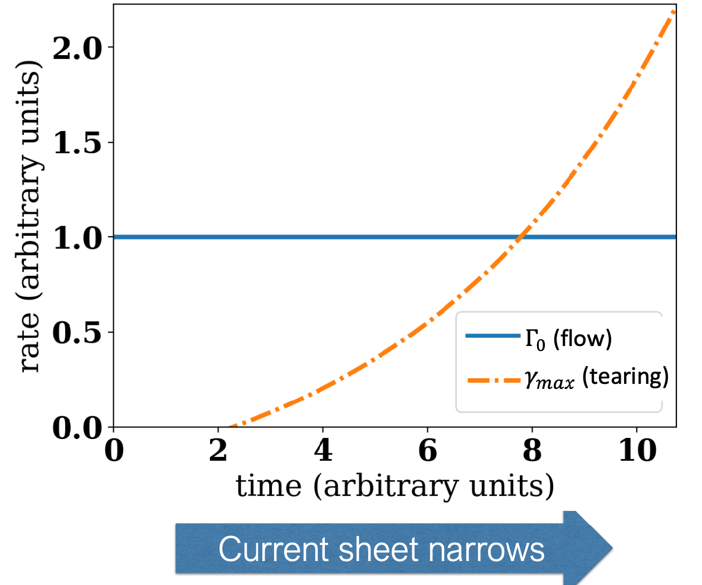
Onset of tearing
Linear tearing stage:
The current layer becomes sufficiently thin that the growth of tearing mode surpass the evolution of the flow.
Stage dominated by ideal dynamics
Configuration is shrinking, forming the current layer.
Tearing mode is weak.
Credit: E. Tolman
We will skip the discussion about the nonlinear evolution of tearing and X-point collapse. Please refer to Rutherford(1973), Militello&Porcelli (2004), Escande&Ottaviani (2004), Loureiro+(2005).

Slide 19
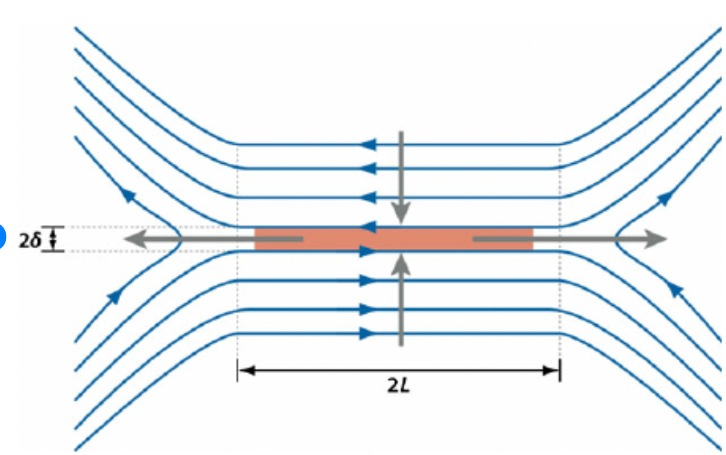
A classic nonlinear solution --- Sweet Parker Reconnection
$$B_{in}$$
Set up: 2D; Current sheet aspect ratio $\frac{δ}{L}≪1$;
steady state → uniform electric field ;
Outer regime: ideal plasma; $E_{away}≈u_{in}B_{in}/c$.
Current sheet: resistivity dominates; $E_{CS}≈ηj≈η\frac{c}{4π}\frac{{ B}_{in}}{δ}$
$$U_{in}$$
$$U_{out}$$

Slide 20
Classic model --- Sweet Parker Reconnection
$$B_{in}$$
Set up: 2D; Current sheet aspect ratio $\frac{δ}{L}≪1$;
steady state → uniform electric field ;
Outer regime: ideal plasma; $E_{away}≈u_{in}B_{in}/c$.
Current sheet: resistivity dominates; $E_{CS}≈ηj≈η\frac{c}{4π}\frac{{ B}_{in}}{δ}$
$$U_{in}$$
$$U_{out}$$
Lundquist number $S≡L\frac{v_{A}}{\overline{η}}∼\frac{\left|B⋅∇u\right|}{\left| \overline{η}\right|∇^{2}B|}$
Solar corona $S∼{10}^{12}$; Solar wind $S∼{10}^{15}$; ISM $S∼{10}^{18}$.
$$\frac{δ}{L}∼\frac{u_{in}}{u_{out}}∼S^{−1/2}$$
The flux reconnects at the rate $\frac{dψ}{dt}=cE_{z}$
Normalized reconnection rate $ε_{rec}≡\frac{cE_{z}}{V_{A}B_{in}}\sim \frac{u_{in}}{V_{A}}∼S^{−1/2}$

Slide 21
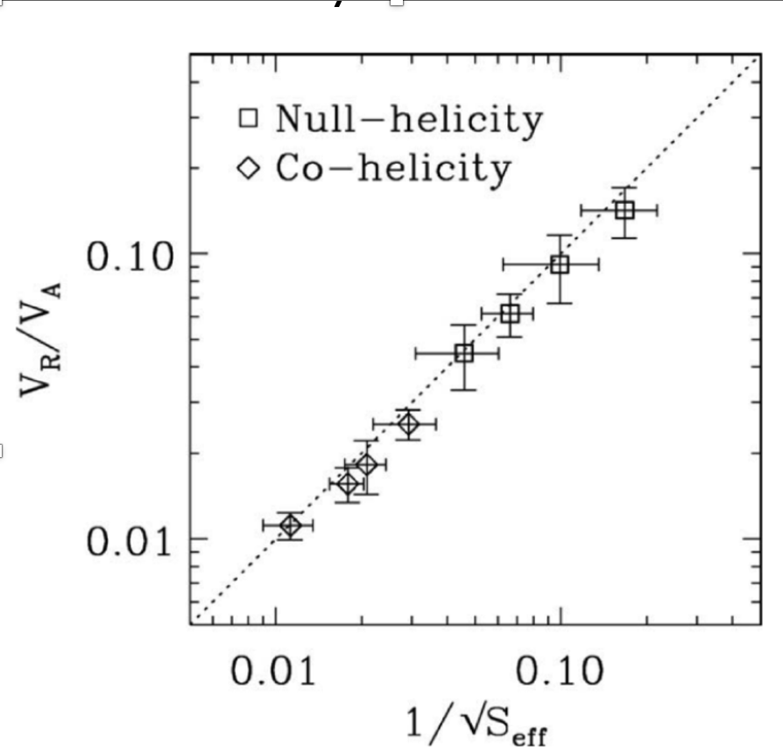
Classic model --- Sweet Parker Reconnection
Experiment confirmation by MRX
Set up: 2D; Current sheet aspect ratio $\frac{δ}{L}≪1$;
steady state → uniform electric field ;
Outer regime: ideal plasma; $E_{away}≈u_{in}B_{in}/c$.
Current sheet: resistivity dominates; $E_{CS}≈ηj≈η\frac{c}{4π}\frac{{ B}_{in}}{δ}$
Lundquist number $S≡L\frac{v_{A}}{\overline{η}}∼\frac{\left|B⋅∇u\right|}{\left| \overline{η}\right|∇^{2}B|}$
Solar corona $S∼{10}^{12}$; Solar wind $S∼{10}^{15}$; ISM $S∼{10}^{18}$.
$$\frac{δ}{L}∼\frac{u_{in}}{u_{out}}∼S^{−1/2}$$
[Ji+1999]
The flux reconnects at the rate $\frac{dψ}{dt}=cE_{z}$
Normalized reconnection rate $ε_{rec}≡\frac{cE_{z}}{V_{A}B_{in}}\sim \frac{u_{in}}{V_{A}}∼S^{−1/2}$

Slide 22
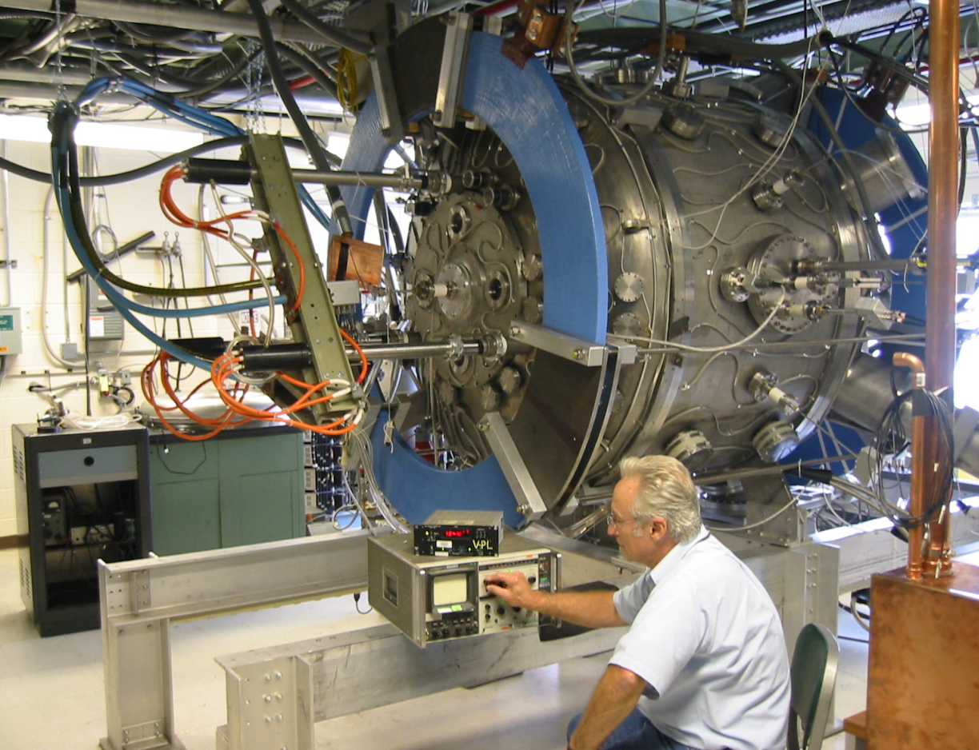
Does the Sweet Parker work? – Yes!
Experiment confirmation by MRX
Set up: 2D; Current sheet aspect ratio $\frac{δ}{L}≪1$;
steady state → uniform electric field ;
Outer regime: ideal plasma; $E_{away}≈u_{in}B_{in}/c$.
Current sheet: resistivity dominates; $E_{CS}≈ηj≈η\frac{c}{4π}\frac{{ B}_{in}}{δ}$
Lundquist number $S≡L\frac{v_{A}}{\overline{η}}∼\frac{\left|B⋅∇u\right|}{\left| \overline{η}\right|∇^{2}B|}$
$$\frac{δ}{L}∼\frac{u_{in}}{u_{out}}∼S^{−1/2}$$
[Ji+1999]
The flux reconnects at the rate $\frac{dψ}{dt}=cE_{z}$
Normalized reconnection rate $ε_{rec}≡\frac{cE_{z}}{V_{A}B_{in}}\sim \frac{u_{in}}{V_{A}}∼S^{−1/2}$

Slide 23
But…
Experiment confirmation by MRX
Set up: 2D; Current sheet aspect ratio $\frac{δ}{L}≪1$;
steady state → uniform electric field ;
Outer regime: ideal plasma; $E_{away}≈u_{in}B_{in}/c$.
Current sheet: resistivity dominates; $E_{CS}≈ηj≈η\frac{c}{4π}\frac{{ B}_{in}}{δ}$
Lundquist number $S≡L\frac{v_{A}}{\overline{η}}∼\frac{\left|B⋅∇u\right|}{\left| \overline{η}\right|∇^{2}B|}$
$$\frac{δ}{L}∼\frac{u_{in}}{u_{out}}∼S^{−1/2}$$
[Ji+1999]
The flux reconnects at the rate $\frac{dψ}{dt}=cE_{z}$
Normalized reconnection rate $ε_{rec}≡\frac{cE_{z}}{V_{A}B_{in}}\sim \frac{u_{in}}{V_{A}}∼S^{−1/2}$
In solar corona: $τ_{A}=\frac{L}{v_{A}}∼1s, τ_{sp}∼{10}^{6}s≫{10}^{2}s$ (solar flare). Too slow!!!
MRX at PPPL

Slide 24
Is the Sweet-Parker current sheet always stable?
At high S $,t$he SP sheet become unstable to the ``plasmoid instability’’ --- a tearing-like instability which gives rise to multiple magnetic islands (plasmoids)
(Biskamp 1986, Shibata&Tanuma 2001, Loureiro et al. 2007)
[Loureiro+ 2005]

Slide 25
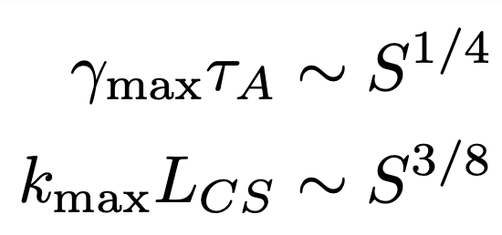
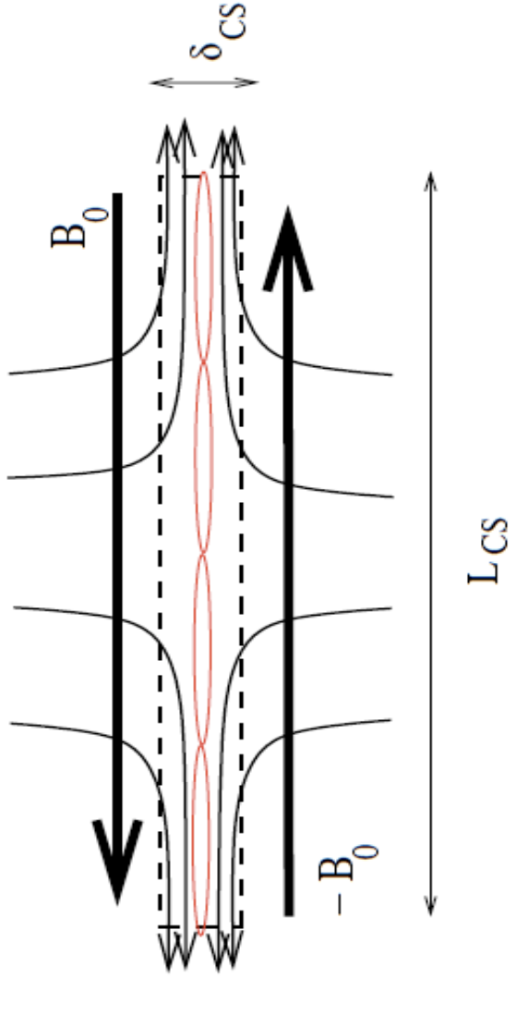
Tearing instability on Sweet-Parker current sheets
Loureiro et al. 2007, 2013 performed the first calculation of tearing modes on a SP-current-type of configuration:
Credit: N. Loureiro

Slide 26
Tearing instability on Sweet-Parker current sheets
Loureiro et al. 2007, 2013 performed the first calculation of tearing modes on a SP-current-type of configuration:
Threshold for the instability: $S≥{10}^{4}$
As S increases (from top to bottom, $S={10}^{4},{10}^{5},{10}^{6},{10}^{7}$), the number of plasmoids and their growth rate increase.
[Samtaney et al. 2009]
Credit: N. Loureiro

Slide 27
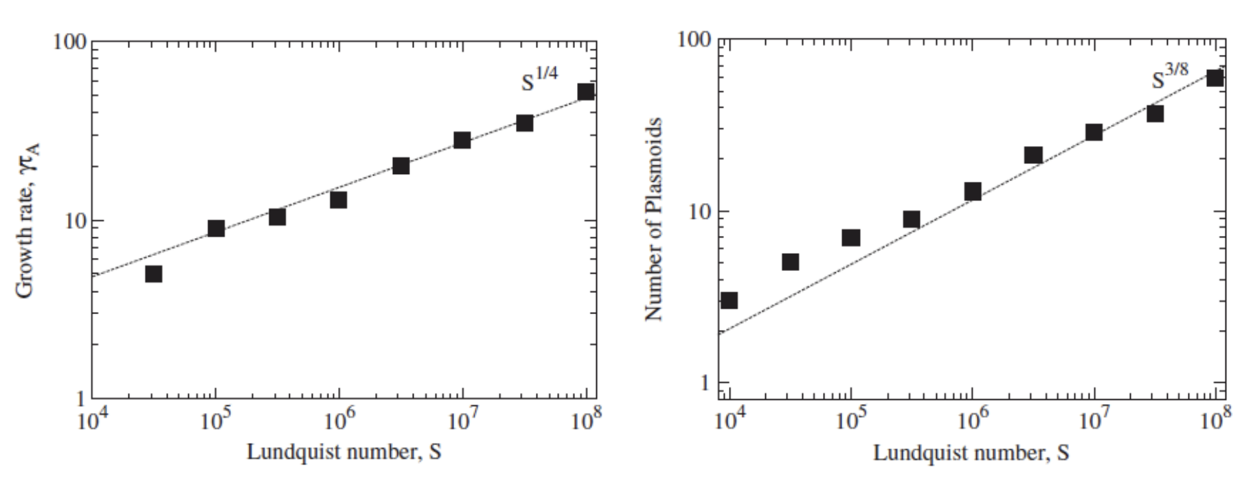
Tearing instability on Sweet-Parker current sheets
Loureiro et al. 2007, 2013 performed the first calculation of tearing modes on a SP-current-type of configuration:
Threshold for the instability: $S≥{10}^{4}$
As S increases (from top to bottom, $S={10}^{4},{10}^{5},{10}^{6},{10}^{7}$), the number of plasmoids and their growth rate increase.
[Samtaney et al. 2009]
Credit: N. Loureiro

Slide 28
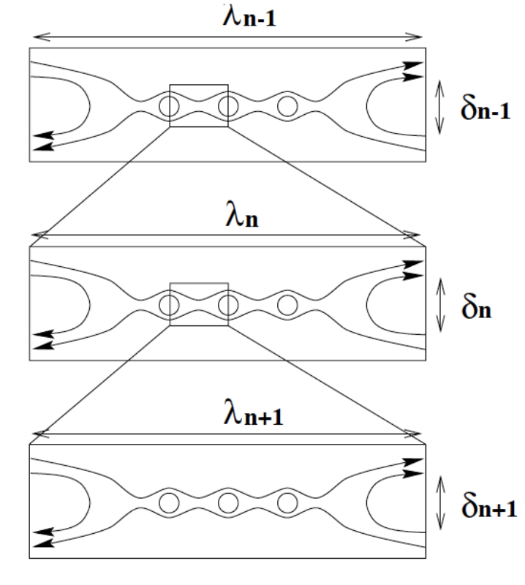
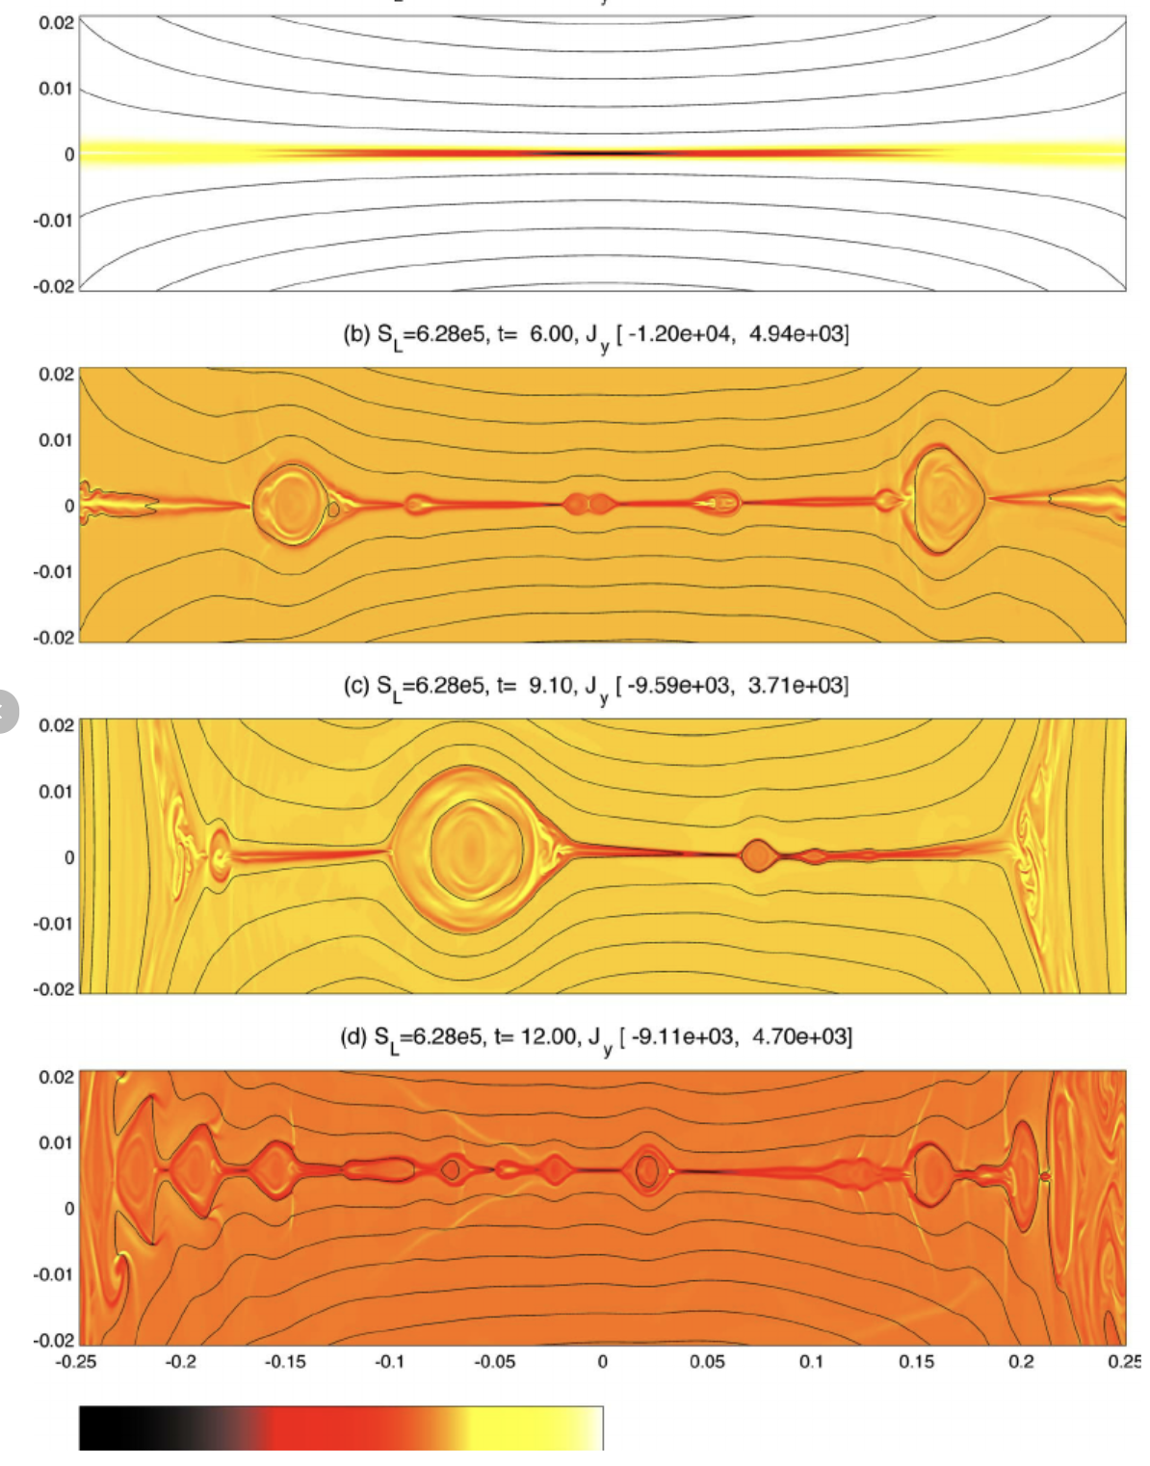
Nonlinear regime: hierarchical plasmoid chains
[Shibata & Tanuma 2001]
[Huang and Bhattacharje. 2012]

Slide 29
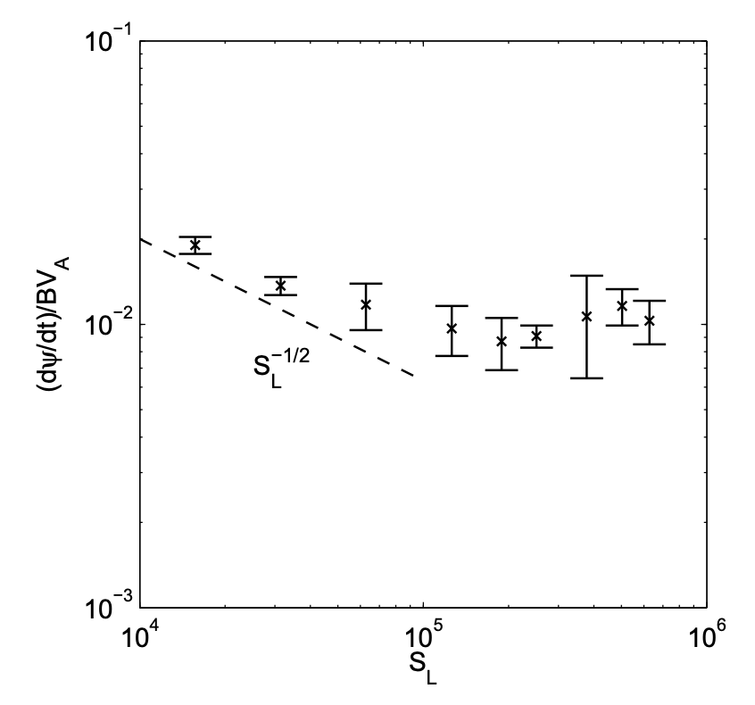
Nonlinear regime: hierarchical plasmoid chains
In the nonlinear statistical steady state, the reconnection rate is independent of Resistivity/Lundquist $ε_{rec}∼0.01$
[Uzdensky et al 2010]
[Shibata & Tanuma 2001]
[Huang and Bhattacharje. 2012]
[Bhattacharjee et al. 2009]

Slide 30
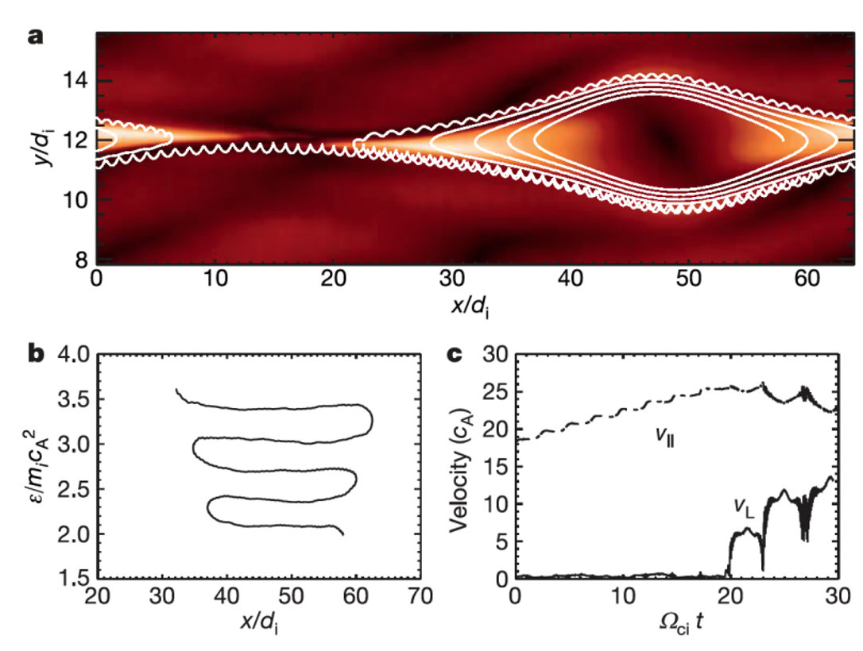
Implication of the plasmoid instability
The formation of plasmoids changes the structure of magnetic fields and particle energization
Particles are trapped and accelerated at/around plasmoids.
[Drake et al. 2006]

Slide 31
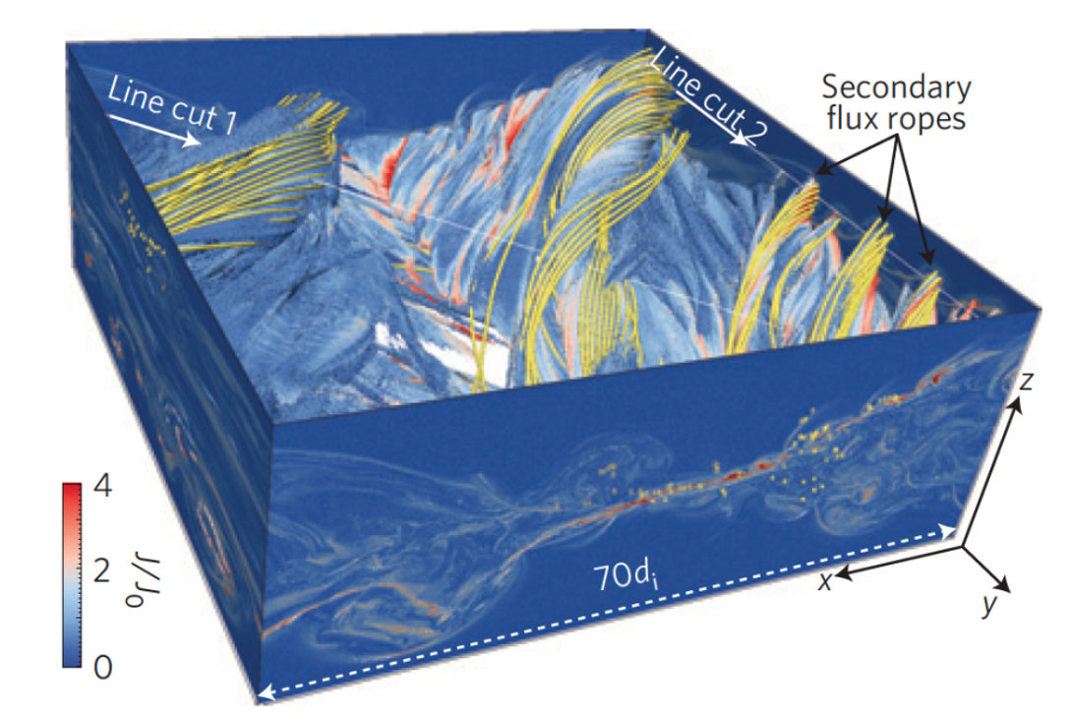
Implication of the plasmoid instability
The formation of plasmoids changes the structure of magnetic fields and particle energization
Particles are trapped and accelerated at/around plasmoids.
Instabilities and complex dynamics of plasmoids drive turbulence.
[Drake et al. 2006]
[Daughton et al. 2011]

Slide 32
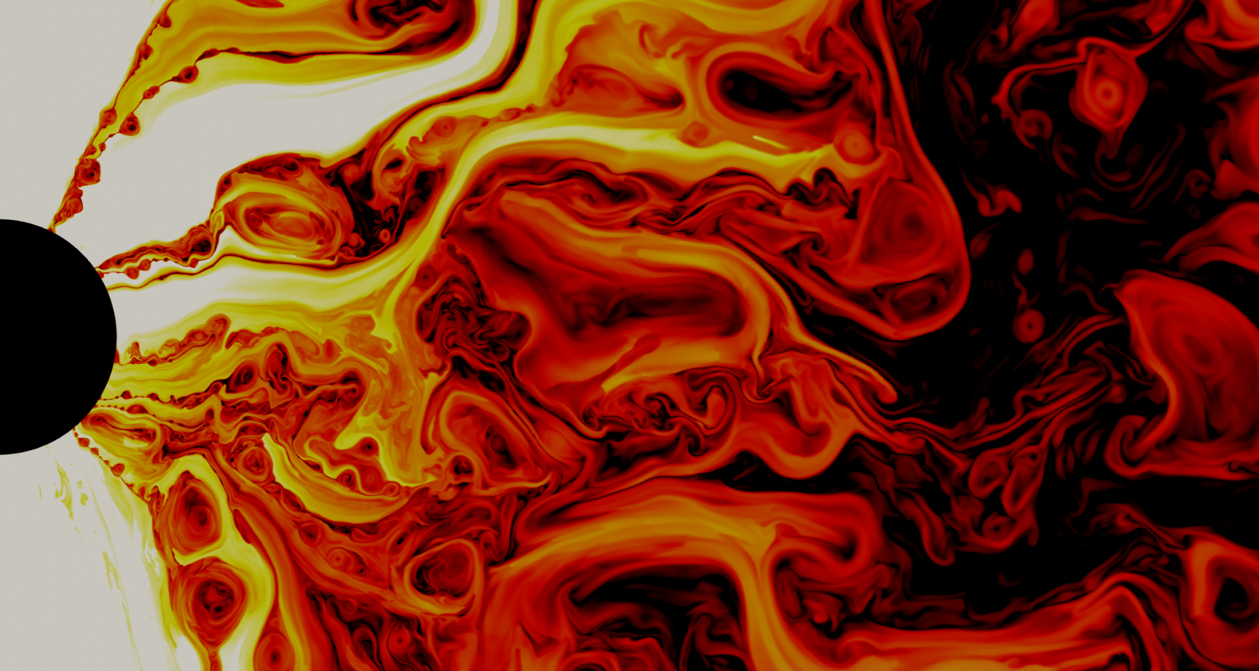
Implication of the plasmoid instability
The formation of plasmoids changes the structure of magnetic fields and particle energization
Particles are trapped and accelerated at/around plasmoids.
Instabilities and complex dynamics of plasmoids drive turbulence.
[Drake et al. 2006]
[Daughton et al. 2011]
The formation of plasmoids changes the global dynamics of accretion disks
[Ripperda et al. 2019]

Slide 33
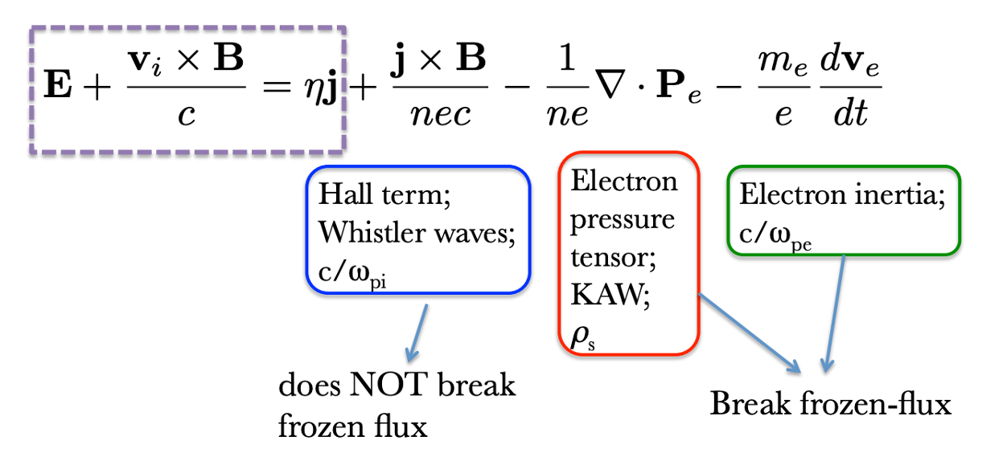
Collisionless reconnection
Non–ideal effects (hall effect, ambipolar diffusion, small-scale–turbulence, plasma instability) provide effective resistivity. Reconnection is fast with the rate $ε_{rec}\sim 0.1$ → an ongoing popular research topic
Credit: N. Loureiro

Slide 34
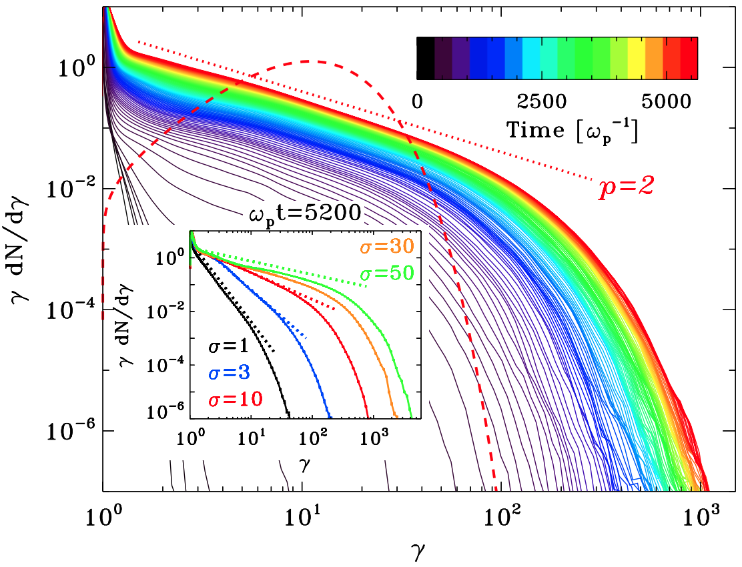
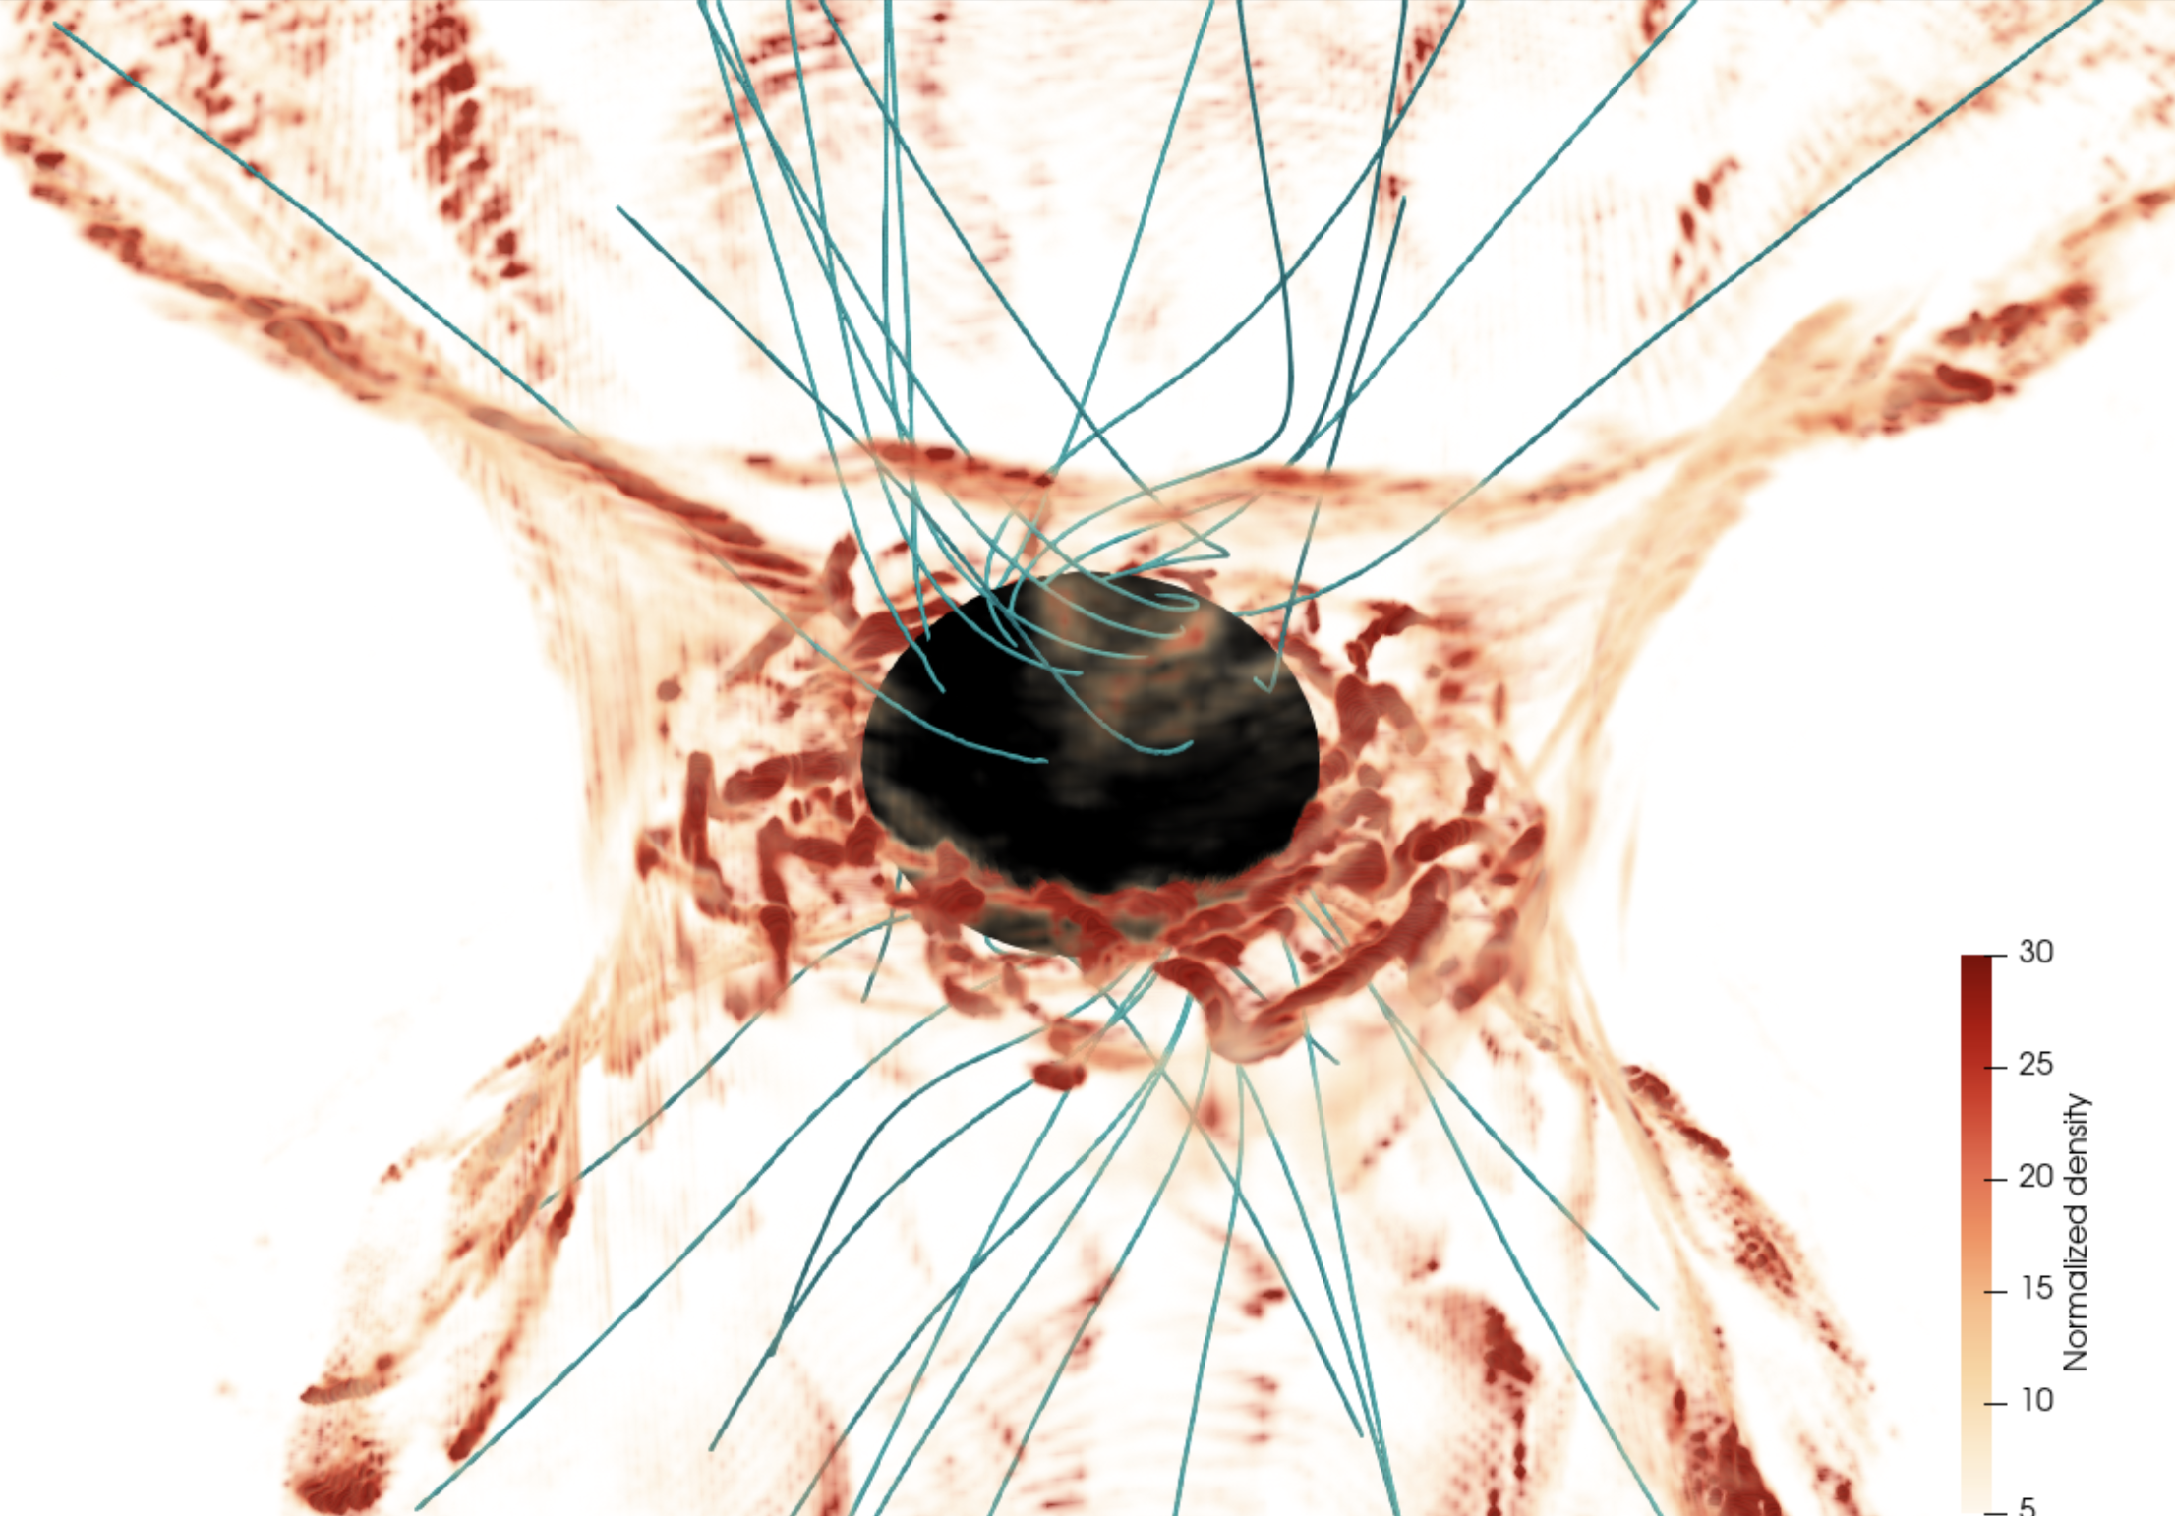
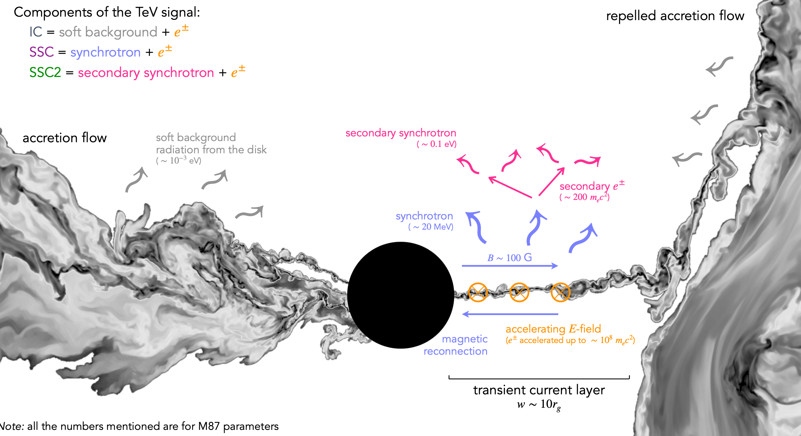
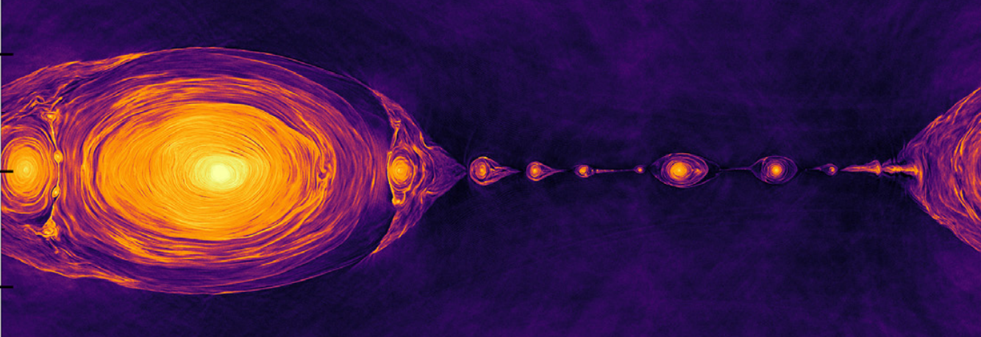
Reconnection in astrophysical phenomena
Plasmoid-mediated production of Fast radio bursts (FRBs) Mahlmann+ 2022
Reconnection is an efficient source of non-thermal particles.
[e.g., Sironi et al. 2014]
Reconnection around blackholes
Radiative kinetic reconnection
Reconnection-powered Tev flares around black holes
Crinquand+2022
Werner+2018
Hakobyan+2023

Slide 35
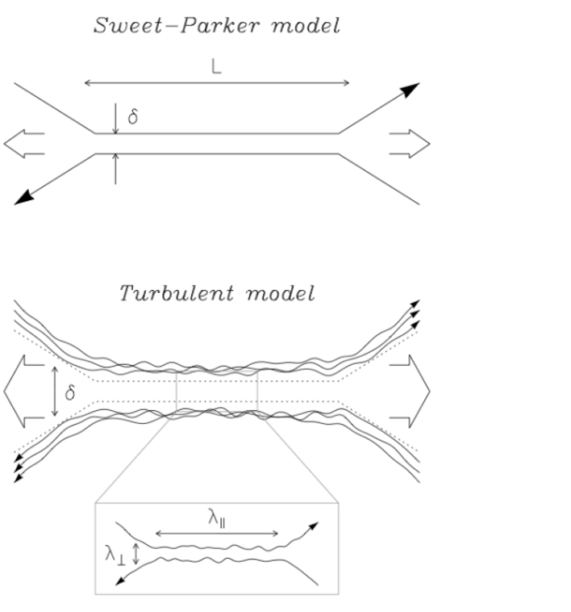
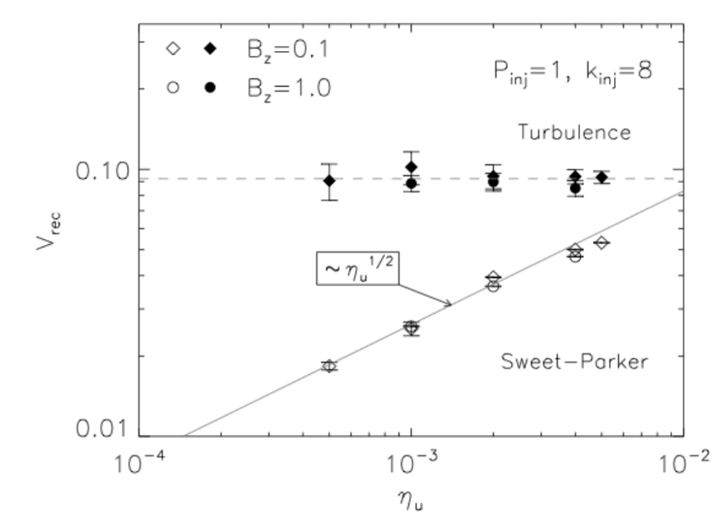
Interaction between reconnection and turbulence
Reconnection in a turbulent background
Thickness of the reconnection layer is determined by typical field line’s wandering
Lazarian & Vishniac 1999
Reconnection rate is close to 0.1 with the presence of the turbulent background
Kowal et al. 2009

Slide 36
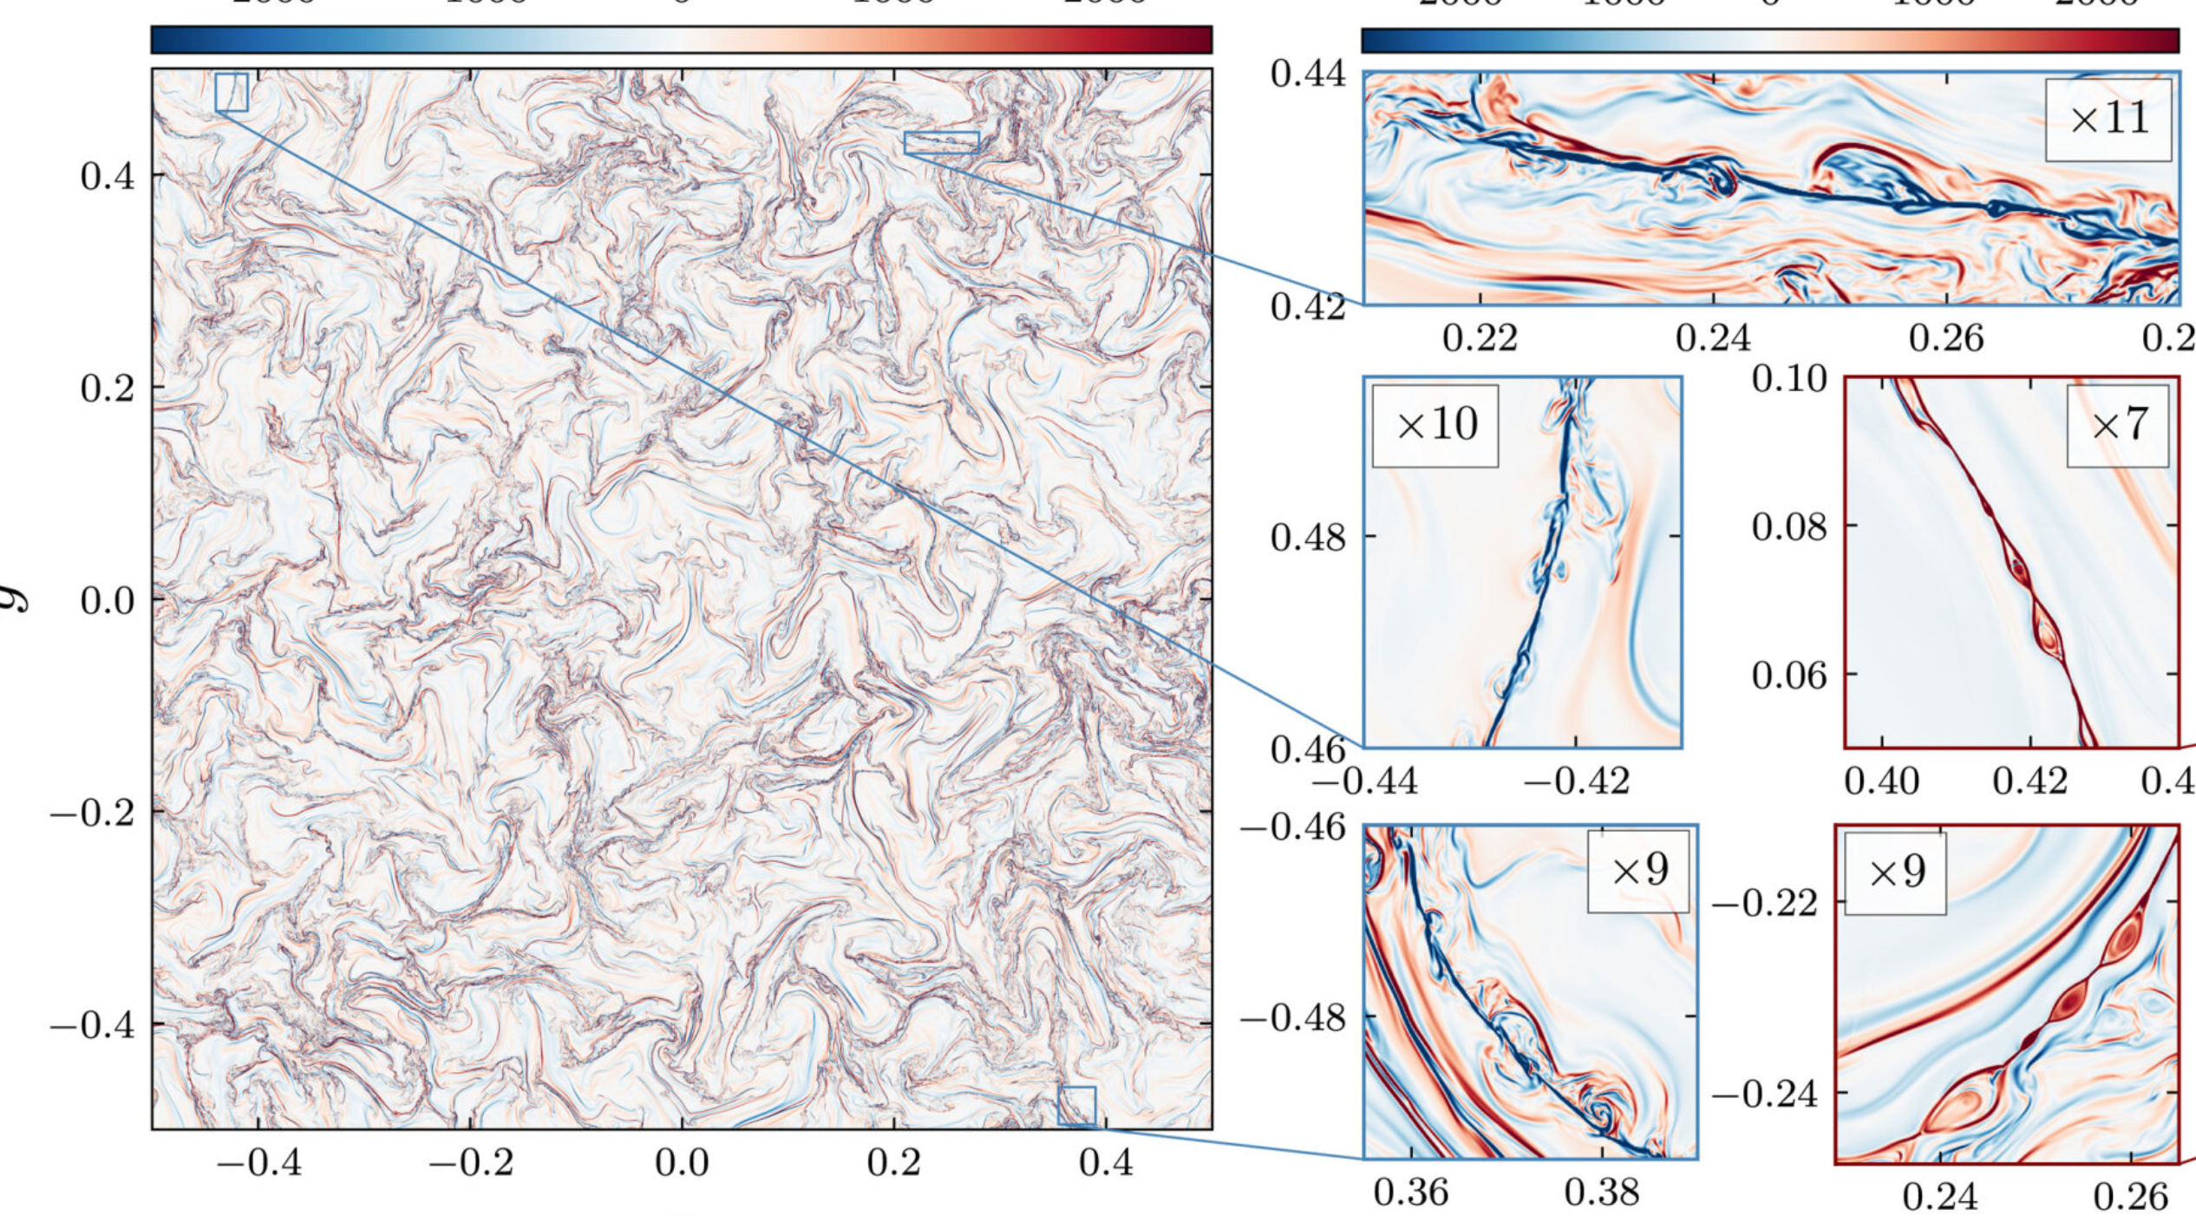
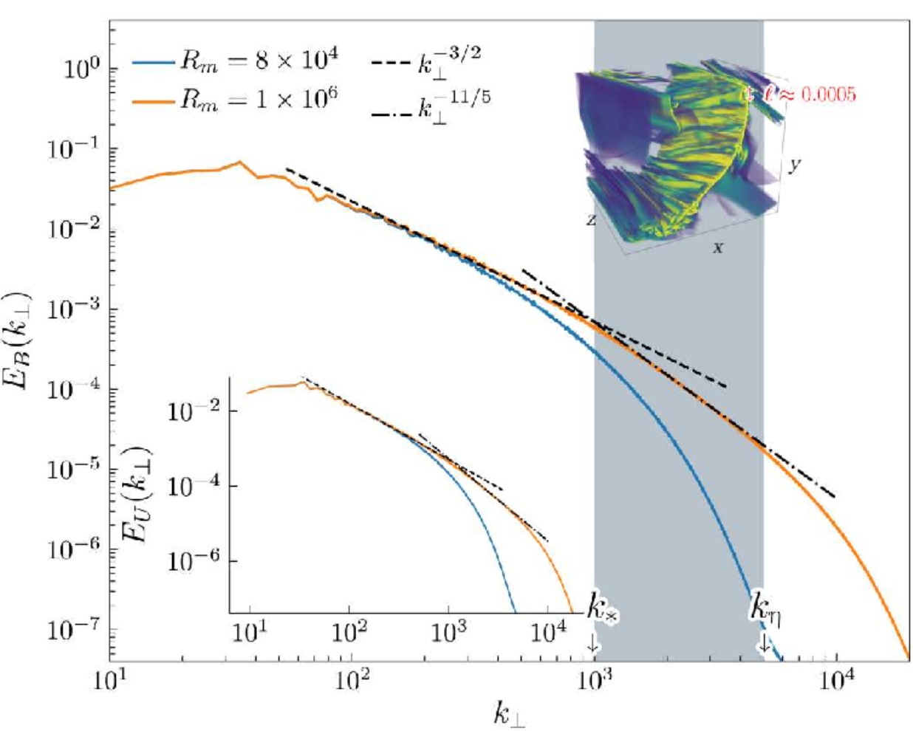
Reconnection-mediated turbulence
Theory: Loureiro & Boldyrev 2017, 2018
Simulation: Dong+2018, 2023
Biggest simulation on turbulence confirms that the mediation of reconnection changes the turbulent spectrum

Slide 37
Some references
This presentation adapt materials available at:
Fitzpatrick’s text book: https://farside.ph.utexas.edu/teaching/plasma/lectures/
Kunz’s lecture notes: https://www.astro.princeton.edu/%7Ekunz/Site/AST521/AST521_lecture_notes_Kunz.pdf
Loureiro’s presentation http://userpages.irap.omp.eu/%7Efrincon/houches/Loureiro.pdf
E. Tolman’s presentation: https://elizabethtolman.com//wp-content/uploads/2020/11/aps-dpp-6.pdf
For further reading about magnetic reconnection:
Zweibel and Yamada (2009) https://ui.adsabs.harvard.edu/abs/2009ARA%26A..47..291Z/abstract
Yamada et al (2010) https://journals.aps.org/rmp/abstract/10.1103/RevModPhys.82.603
Zweibel and Yamada (2016) https://royalsocietypublishing.org/doi/10.1098/rspa.2016.0479

