Slide 1
Plasma-Material Interactions Hanna Schamis (PPPL) Introduction to Plasma and Fusion, June 18, 2024

Slide 2
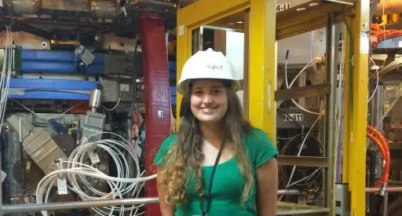
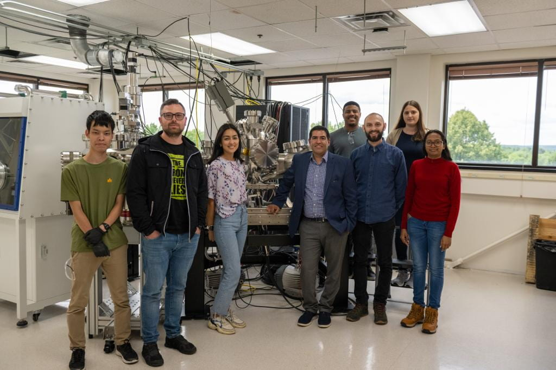
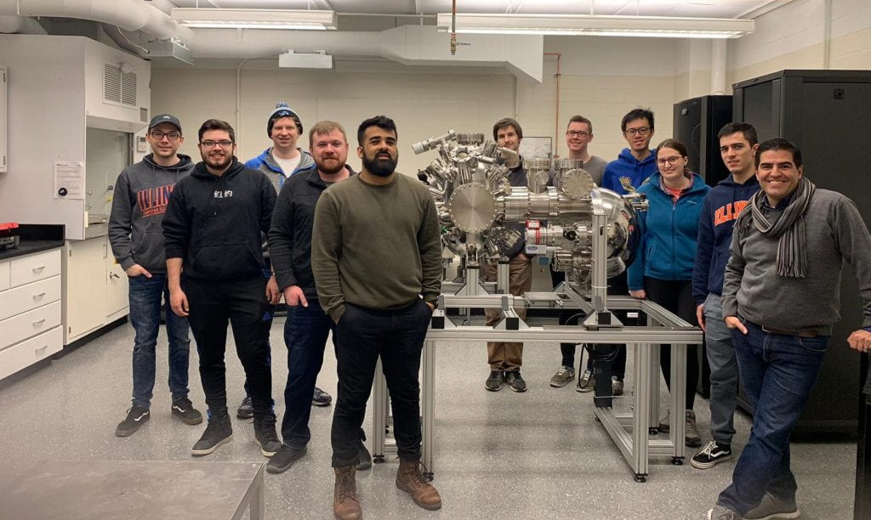
About me – how I got here
Grew up in Buenos Aires
University of Michigan (2016, BS Physics)
SULI at PPPL (x2!)
PPPL (2023 -- ??)
Penn State (PhD Nuclear Engineering)
University of Illinois (2019, MS Nuclear, Plasma, and Radiological Engineering)

Slide 3
Disclaimer
This talk focuses on plasma material interactions (PMI) for fusion applications
Other areas where PMI is important:
Semiconductor manufacturing
Electric propulsion
Solar wind/space weathering of asteroids
In this talk: “hydrogen” is short for “hydrogen isotopes” = H/D/T

Slide 4
Plasmas affect materials
and materials affect plasmas
Plasma
Wall
Heat, ion, and neutron fluxes
Melting
Cracking
Embrittlement
Transmutations
Erosion
Retention
Reflected particles
Sputtered atoms
Low or high recycling
Core impurities

Slide 5
Retention / Reflection / Recycling
describe different parts of the same process
High Recycling fuel atoms cooling down and re-entering the plasma
Wall
Plasma
Incoming fuel ion
+
0
Reflected fuel atom (lower energy)
C
C
C
C
C
0
Retained fuel atom
C
C
C
C
Low Recycling fuel atoms retained in wall
C
C
C
C
C

Slide 6
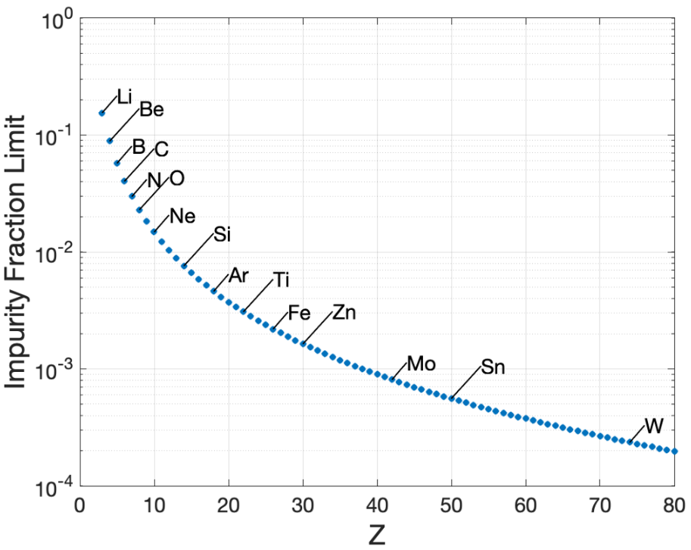
1950 1960 1970 1980 1990 2000 2010 2020
1951: Spitzer recognized impurities from PMI could be a threat to plasma purity
Plasma-facing materials
Wall conditioning
[G. Federici, Nucl. Fusion, 2001; M. S. Parsons, Dissertation, 2023]

Slide 7
1950 1960 1970 1980 1990 2000 2010 2020
1951: Spitzer recognized impurities from PMI could be a threat to plasma purity
1950s: early stellarators had severely contaminated plasmas due to vacuum conditions.
[G. Federici, Nucl. Fusion, 2001; M. S. Parsons, Dissertation, 2023]

Slide 8
1950 1960 1970 1980 1990 2000 2010 2020
1960s: Early tokamaks contained large amounts of carbon, oxygen and metallic impurities, despite reduction efforts.
Stainless steel vacuum vessel
All-metal seals
Baking
Discharge cleaning
Wall conditioning
Removing impurities to improve plasma performance
[G. Federici, Nucl. Fusion, 2001]

Slide 9
Wall conditioning – Baking
Wall
To pumps
Heat

Slide 10
Wall conditioning – Discharge Cleaning
Wall
Gas
(He, H)
Electrode →

Slide 11
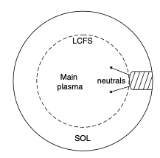
1950 1960 1970 1980 1990 2000 2010 2020
1960s: Early tokamaks contained large amounts of carbon, oxygen and metallic impurities, despite reduction efforts.
Late 1960s, early 1970s: Limiters are introduced
Stainless steel
Refractory metals (molybdenum, tungsten, titanium)
Ceramics (boron carbide, alumina)
[G. Federici, Nucl. Fusion, 2001; P. Stangeby “The Plasma Boundary of Magnetic Fusion Devices,” 2000 ]

Slide 12
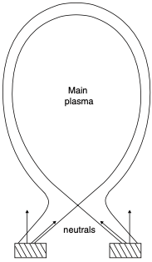
1950 1960 1970 1980 1990 2000 2010 2020
Mid-1970s: new divertors move contact surface further away from the core
Scrape-off-layer (SOL): buffer zone between core and materials
X-point
[G. Federici, Nucl. Fusion, 2001; P. Stangeby “The Plasma Boundary of Magnetic Fusion Devices,” 2000 ]

Slide 13
1950 1960 1970 1980 1990 2000 2010 2020
Mid-1970s: new divertors move contact surface further away from the core
Late 1970s: Auxiliary heating (neutral beams) results in hotter plasmas
Higher heat fluxes at the limiter, higher edge Te
Princeton Large Torus had a tungsten limiter switched to graphite, reduced core radiation
[G. Federici, Nucl. Fusion, 2001; P. Stangeby “The Plasma Boundary of Magnetic Fusion Devices,” 2000; M. S. Parsons, Dissertation, 2023]

Slide 14
1950 1960 1970 1980 1990 2000 2010 2020
Early laboratory experiments of D → C
High chemical sputtering
Trapping of hydrogen in co-deposited layers
[G. Federici, Nucl. Fusion, 2001]

Slide 15
Sputtering processes
Physical Sputtering
Chemical Sputtering
D
D
C
D
C
D
D
C
C
C
C
C
C
C
C
C
C
D
D
C
C
C
C
C
C
C
C
C
C
C
C
C
C
C
C
C
C

Slide 16
Material migration: re- and co-deposition
Redeposition
Co-Deposition
C
C
D
C
C
C
C
C
D
C
C
D
D
D
C
C
C
C
C
C
C
C
C
C
C
C
C
C
C
C
C
C
C
C
C
C
C
C
C
C
C
C

Slide 17
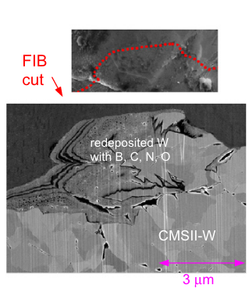
Co- and re-deposition happens constantly in tokamaks and leads to thick mixed-material layers
From ASDEX upgrade:
Note: H/D/T can’t be detected in most surface analysis techniques
[A. Kallenbach J. of Nucl. Mater. 2011]

Slide 18
1950 1960 1970 1980 1990 2000 2010 2020
Early laboratory experiments of D → C
First plasma-deposited coatings:
Boronization
Siliconization
Carbonization
[G. Federici, Nucl. Fusion, 2001]

Slide 19
Wall conditioning – coatings
Wall
Gas
(He + B₂D₆)
Anode →

Slide 20
1950 1960 1970 1980 1990 2000 2010 2020
Early laboratory experiments of D → C
First plasma-deposited coatings
Many tokamaks had graphite limiters/divertor plates
New tokamaks
TEXTOR 1980 – 2013
TFTR 1982 – 1997
JET 1983 – 2023
DIII-D 1986 – present
Tore Supra 1988 – 2010 / WEST 2016 – present
[G. Federici, Nucl. Fusion, 2001]

Slide 21
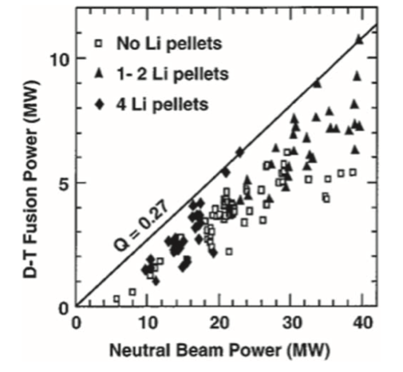
1950 1960 1970 1980 1990 2000 2010 2020
TFTR ”Supershot”
Q = 0.27
Higher neutron rate
Higher stored energy
Higher energy confinement time
Higher ion temperature
Less carbon in core
[J.A. Snipes et al JNM 1992

Slide 22
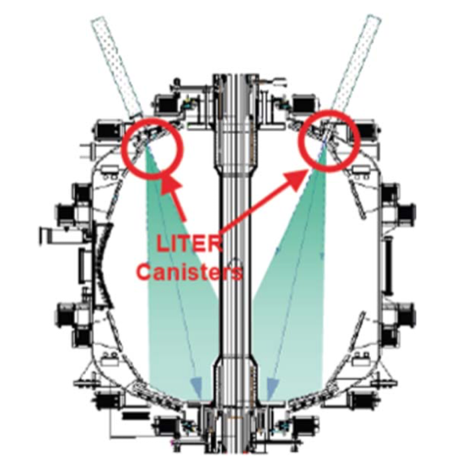
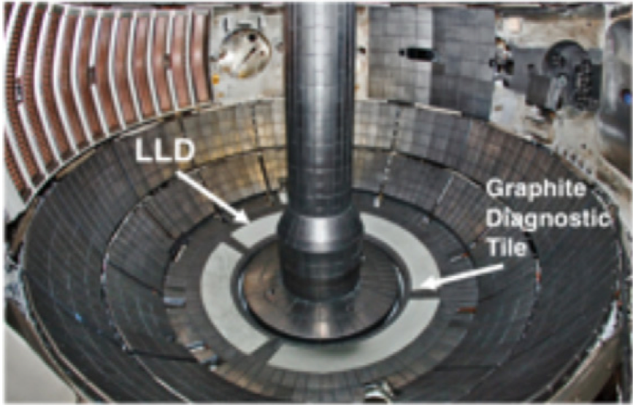
Lithium as the plasma-facing material
NSTX Liquid Lithium Divertor and Lithium Evaporators (LITER)
H. W. Kugel et al., Fusion Engineering and Design, 2012

Slide 23
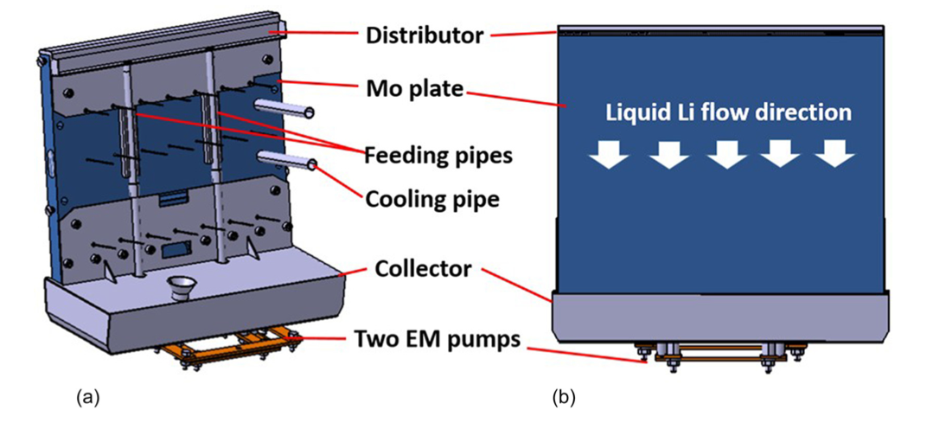
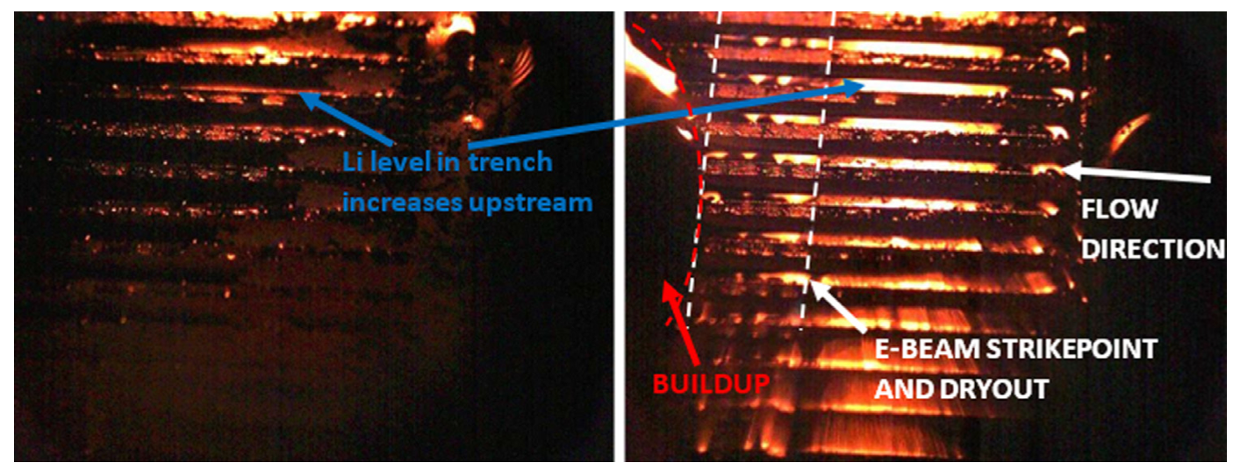
Lithium as the plasma-facing material
NSTX-U Liquid Lithium Divertor and Lithium Evaporators (LITER)
Flowing liquid lithium concepts:
Flowing liquid lithium (FLiLi) limiter
Lithium Metal Infused Trenches (LiMIT)
[G. Z. Zuo PoP 2020; D. N. Ruzic NME 2017]

Slide 24
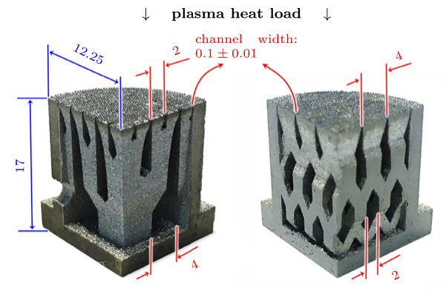
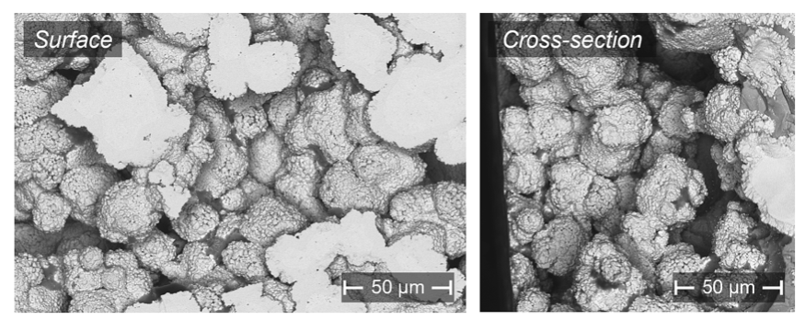
Lithium as the plasma-facing material
NSTX-U Liquid Lithium Divertor and Lithium Evaporators (LITER)
Flowing liquid lithium concepts
Capillary porous systems
[P. Rindt, Nucl. Fusion 2019; C. López Pérez, Nucl. Mater. Energy 2023]

Slide 25
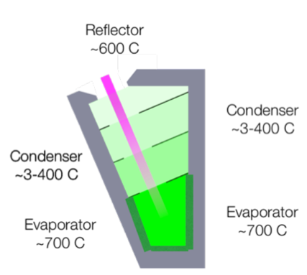
Lithium as the plasma-facing material
NSTX-U Liquid Lithium Divertor and Lithium Evaporators (LITER)
Flowing liquid lithium concepts
Capillary porous systems
Lithium vapor box
[E. D. Emdee NF 2019]

Slide 26
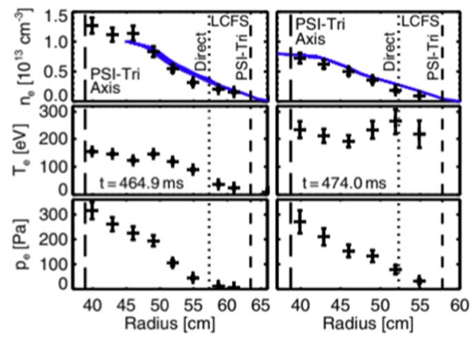
Lithium as the plasma-facing material
NSTX-U Liquid Lithium Divertor and Lithium Evaporators (LITER)
Flowing liquid lithium concepts
Capillary porous systems
Lithium vapor box
All-lithium walls: Lithium Tokamak eXperiment (LTX)
[D. P. Boyle, et al., PRL 2017]

Slide 27
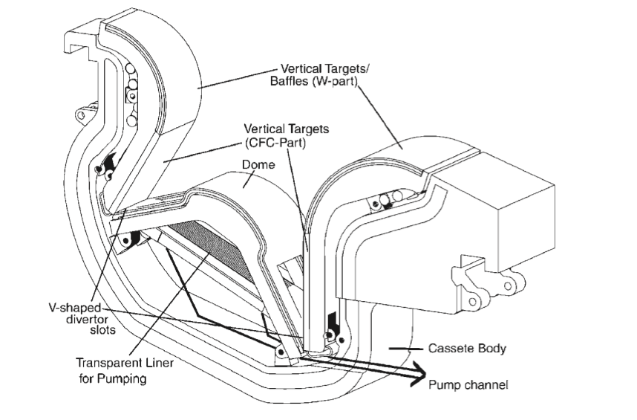
1950 1960 1970 1980 1990 2000 2010 2020
TFTR ”Supershot”
First ITER design
Goal: Q > 10
Divertor: CFC + W (later: just W)
First wall: Be
[R. Aymar, et al. Plasma Phys. Control. Fusion 44 2002]

Slide 28
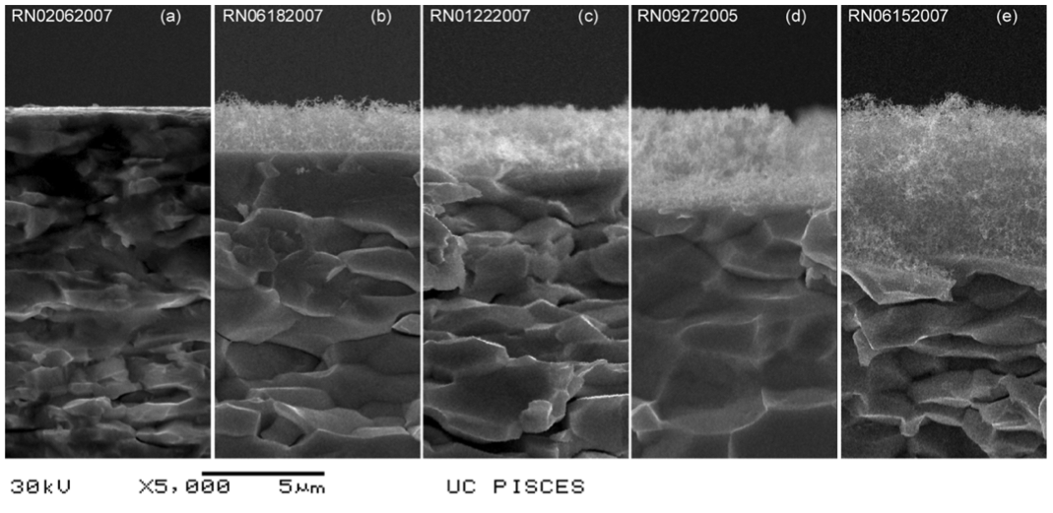
1950 1960 1970 1980 1990 2000 2010 2020
2008: tungsten fuzz
[M. J. Baldwin, et al., Nuclear Fusion 48 (2008)]

Slide 29
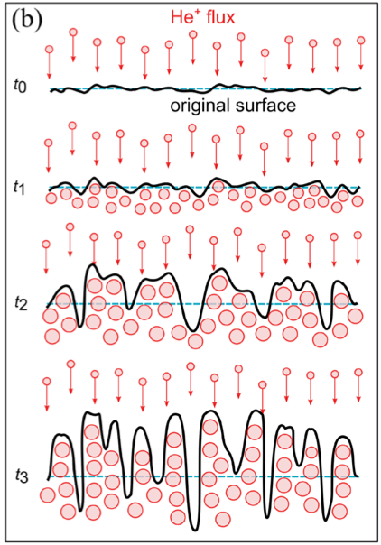
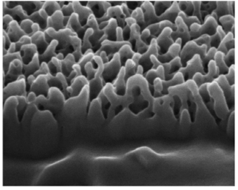
1950 1960 1970 1980 1990 2000 2010 2020
2008: tungsten fuzz
[D. Dasgupta, et al., Nuclear Fusion 59 (2019)]

Slide 30
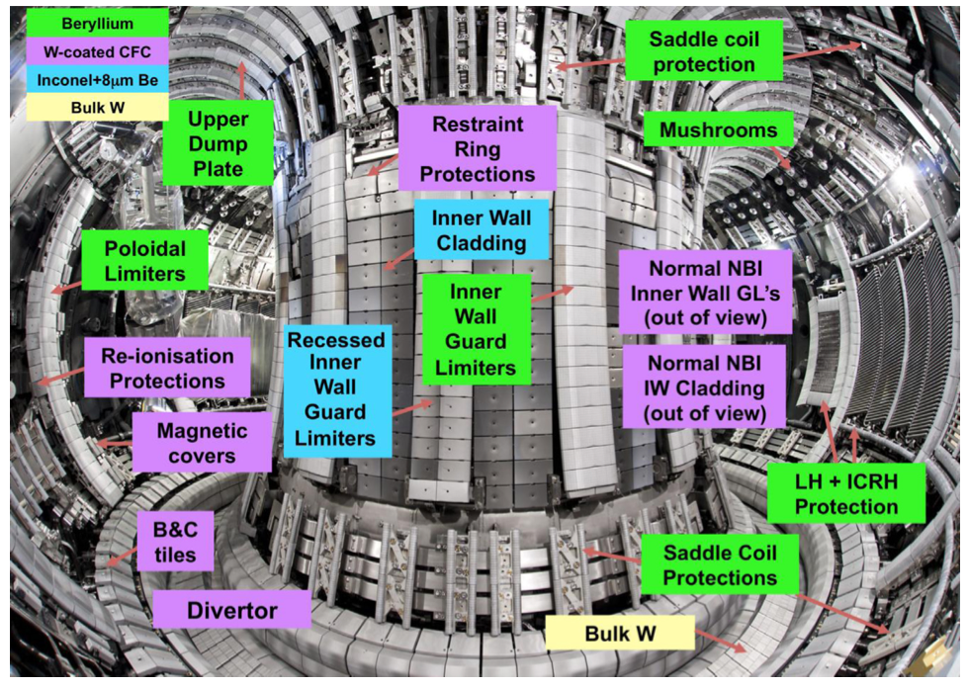
1950 1960 1970 1980 1990 2000 2010 2020
2011: JET ITER-like wall (ILW)
[L. Horton, et al., Fusion Engineering and Design, 2013]

Slide 31
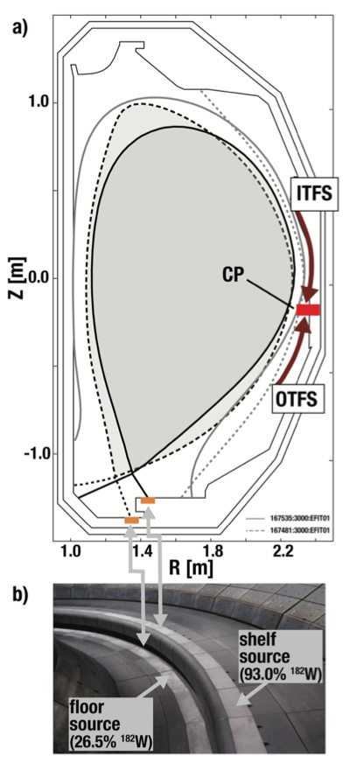
1950 1960 1970 1980 1990 2000 2010 2020
2011: JET ITER-like wall (ILW)
2015: DIII-D Metal Rings Campaign
[E. A. Unterberg, et al., Nuclear Materials and Energy, 2019]

Slide 32
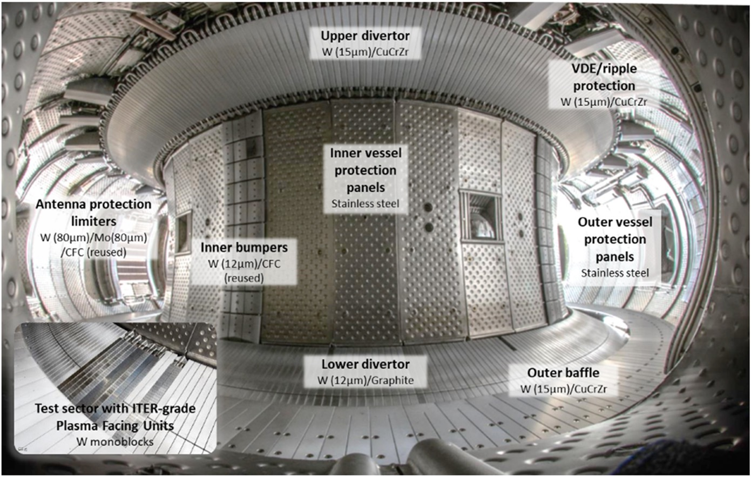
1950 1960 1970 1980 1990 2000 2010 2020
2011: JET ITER-like wall (ILW)
2015: DIII-D Metal Rings Campaign
2017: WEST operates with full W walls
[J. Bucalossi, et al., Nuclear Fusion, 2022]

Slide 33
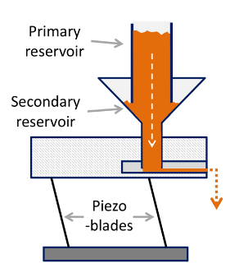
1950 1960 1970 1980 1990 2000 2010 2020
2011: JET ITER-like wall (ILW)
2015: DIII-D Metal Rings Campaign
2017: WEST operates with full W walls
2018: Impurity Powder Droppers
Insert powders into plasma during plasma discharges
Can be used with almost any powder (Li, Si, C)
Installed on DIII-D, ASDEX-Upgrade, WEST, W7X, LHD, KSTAR and EAST
Results: ELM suppression and mitigation, wall conditioning
[A. Nagy, et al., Rev. Sci. Instrum. 89 (2018)]

Slide 34
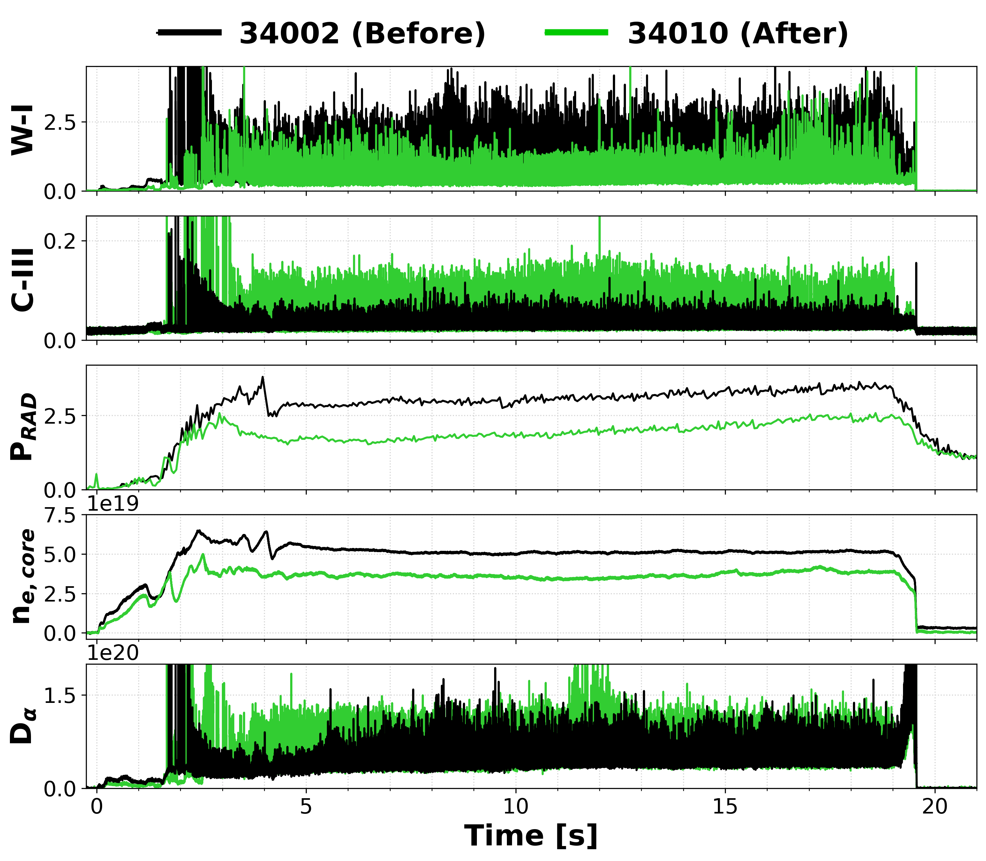
1950 1960 1970 1980 1990 2000 2010 2020
2023: ITER updates its baseline
Be first wall → W first wall
Needs boronization
[H. Schamis, in preparation]

Slide 35
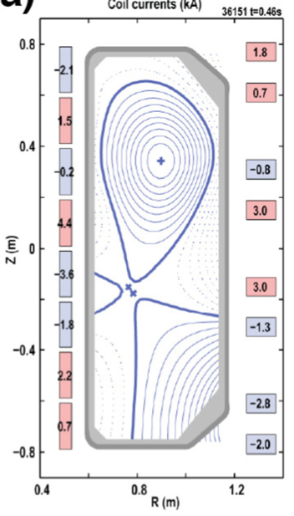
Brief overview of other PMI topics: Divertor geometry
Snowflake divertor
Additional null point
4 strike points instead of 2
[D. D. Ryutov PoP 2015]

Slide 36
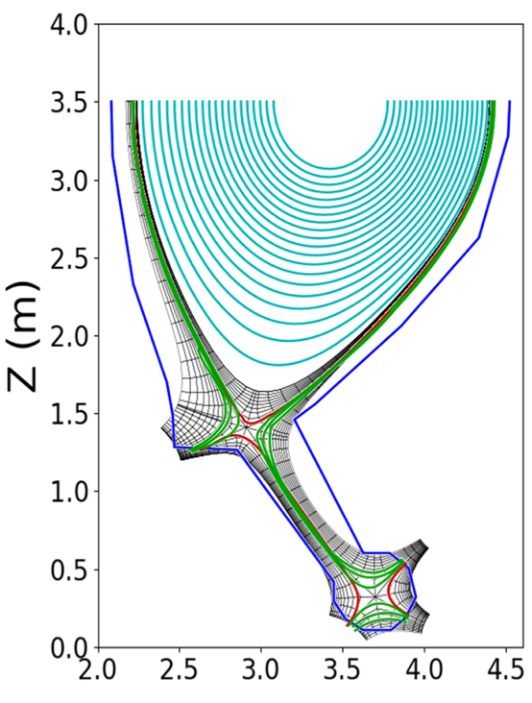
Brief overview of other PMI topics: Divertor geometry
Snowflake divertor
Additional null point
4 strike points instead of 2
Long legged divertor
Strike point further from X-point
[M.R.K. Wingram Nucl Fus 59 2019]

Slide 37
Brief overview of other PMI topics: Detachment
Impurity seeding (e.g., Ne gas puffing) increases neutral pressure in SOL:
Increases collisions and radiative losses
Decreases heat flux
Decreases Te
Decreases ion impact energy
Increases flux to the divertor plates
[R. Pitts, et al., Nuclear Materials and Energy 20 (2019)]

Slide 38
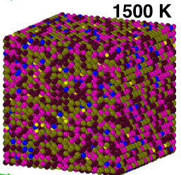
Brief overview of other PMI topics: Novel materials
High-entropy alloys (HEAs)
Example: W₃₁ Ta₃₄ Cr₅ V₂₇Hf₃
[ O. El Atwani et al. Nature 2023,

Slide 39
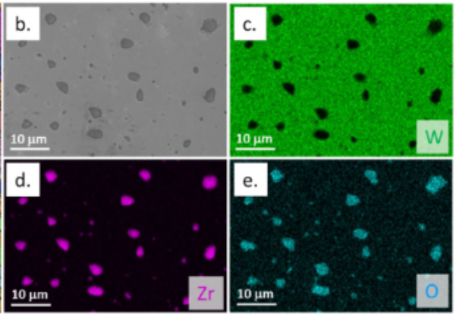
Brief overview of other PMI topics: Novel materials
High-entropy alloys (HEAs)
Dispersion-strengthened tungsten composites
Transition metal carbide or oxide dispersoids
[T. Marchhart, et al., Sci. Rep. 2024]

Slide 40
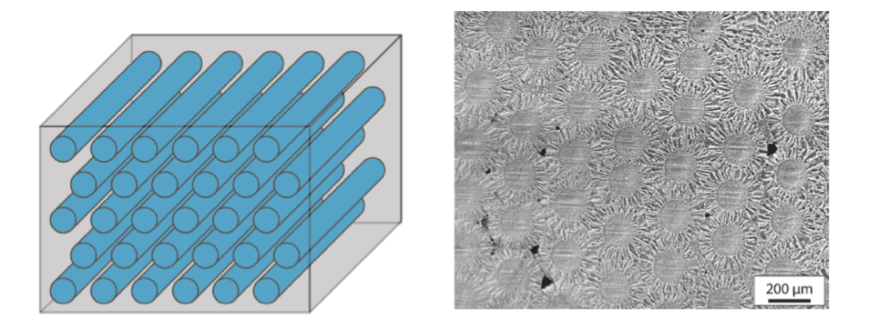
Brief overview of other PMI topics: Novel materials
High-entropy alloys (HEAs)
Dispersion-strengthened tungsten composites
Tungsten Fiber composites
Tungsten fiber embedded in a tungsten matrix
[A. Karcher, et al., Nucl. Mater. Energy, 2021]

Slide 41
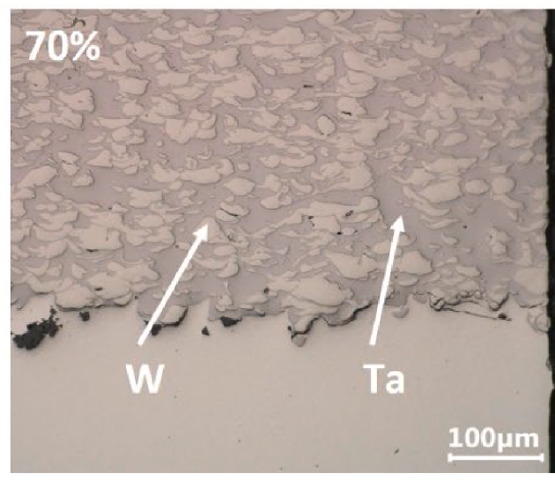
Brief overview of other PMI topics: Novel materials
High-entropy alloys (HEAs)
Dispersion-strengthened tungsten composites
Tungsten Fiber composites
Tungsten and/or Tantalum cold spray
[R. Neu, et al., Nucl. Mater. Energy, 2023

Slide 42
Semiconductors (aka the profitable plasma reactors)
Fine-tuned PMI processes are used for semiconductor manufacturing
Film deposition (e.g., chemical or physical vapor deposition)
Etching (chemical etching, or chemical or physical ion sputtering)
UV light
Mask
Deposited Film
Photoresist
Substrate
Etching

Slide 43
Summary
PMI, like all research, builds upon decades of previous knowledge
Some PMI has been “accidental” – lithium
Themes recur – W limiters replaced with C in 1980s, and now many present-day devices use W divertors
No magic solution for PMI in fusion reactors
Lots of out-of-the-box ideas!

Slide 44
What does PMI research look like? (or what it has looked like for me)
Small-scale laboratory experiments
Tokamak experiments
Computational PMI

Slide 45
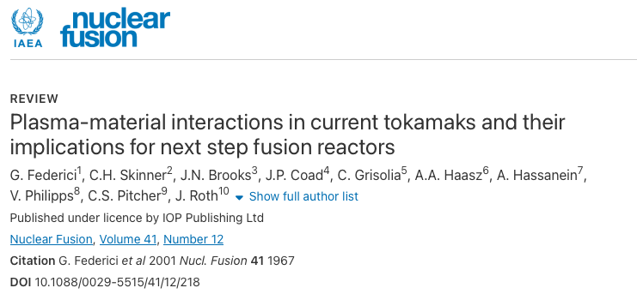
Useful References
General PMI
G. Federici et al 2001 Nucl. Fusion 41 1967 doi.org/10.1088/0029-5515/41/12/218

Slide 46
Useful References
General PMI
G. Federici et al 2001 Nucl. Fusion 41 1967 doi.org/10.1088/0029-5515/41/12/218
Covers every topic, look at the references within article
Tip: If article seems relevant, look at work citing it (“Cited by” on Google Scholar)

Slide 47
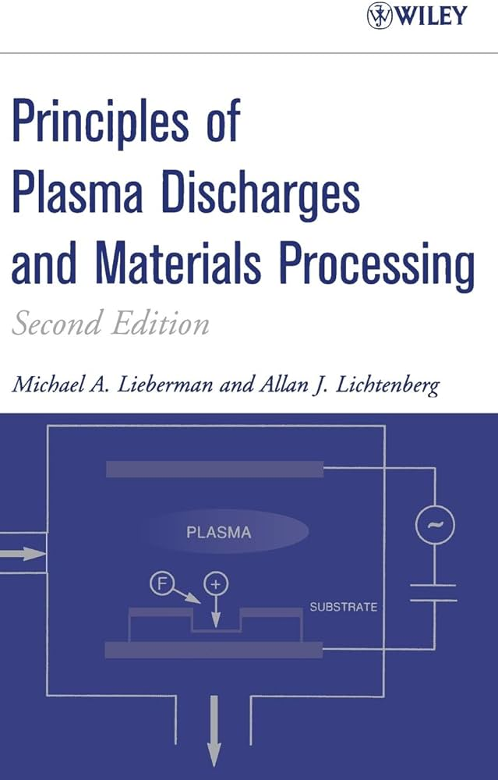
Useful References
General PMI
G. Federici et al 2001 Nucl. Fusion 41 1967 doi.org/10.1088/0029-5515/41/12/218
M. A. Lieberman and A. J. Lichtenberg, “Principles of Plasma Discharges and Materials Processing” (2005)

Slide 48
Useful References
General PMI
G. Federici et al 2001 Nucl. Fusion 41 1967 doi.org/10.1088/0029-5515/41/12/218
M. A. Lieberman and A. J. Lichtenberg, “Principles of Plasma Discharges and Materials Processing” (2005)
Scrape off Layers
P. Stangeby, “The Plasma Boundary of Magnetic Fusion Devices” (2000)
Wall Conditioning
J. Winter 1996 Plasma Phys. Control. Fusion 38 1503 doi.org/10.1088/0741-3335/38/9/001
Lithium:
R. Kaita 2019 Plasma Phys. Control. Fusion 61 113011 doi.org/10.1088/1361-6587/ab4156
Don’t overlook Theses and Dissertations! They often include long literature reviews on a topic

