Slide 1
Integrated modelling for fusion devices
Presented by: Yashika Ghai
Position: R&D Associate staff- Theory and computation plasma physicist
Email: ghaiy@ornl.gov

Slide 2



My background
Master’s- Summer internship at Institute of Plasma Physics (IPR), India
Ph.D. - Theoretical Plasma Physics –Space & astrophysical, Dusty plasmas
* Attended Lindau Nobel Laureates meeting 2016
ORNL post doc-
Started working on energetic particle physics in fusion plasmas
ORNL staff position- Theory and Computation Plasma physicist
2013 2014- 2019 2019-2021 May 2021- present

Slide 3
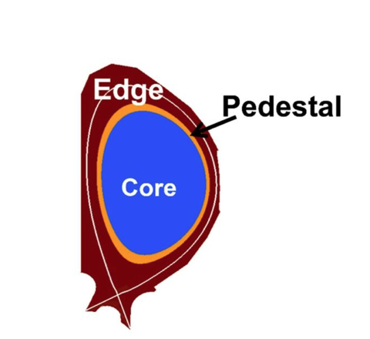
Key Takeaways
Different theoretical and numerical models are used to describe the distinct plasma properties in the core and edge regions.
Integrated modelling is needed to perform comprehensive simulations of various physical processes and interactions within a fusion reactor
Combination of multiple models to optimize performance and predict behavior of a future reactor-relevant fusion device.

Slide 4
Theoretical descriptions of Plasma
Plasma Models
Fluid Model
Magneto-hydrodynamics
Continuity Equation
Momentum Equation
Maxwell’s Equations (magnetized plasma)
Hybrid-models
Kinetic Model
Vlasov equation Maxwell’s Equations

Slide 5
Theoretical descriptions of Plasma
Plasma Models
Fluid Model
Magneto-hydrodynamics
Continuity Equation
Momentum Equation
Maxwell’s Equations (magnetized plasma)
Hybrid-models
Kinetic Model
Vlasov equation Maxwell’s Equations

Slide 6
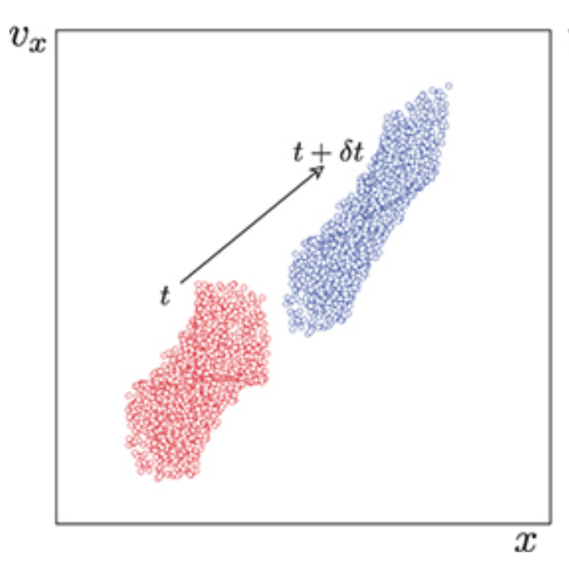
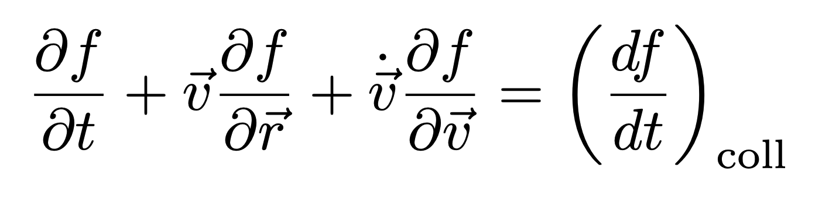
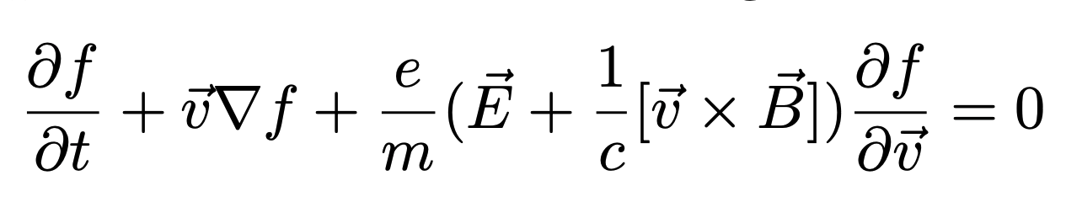
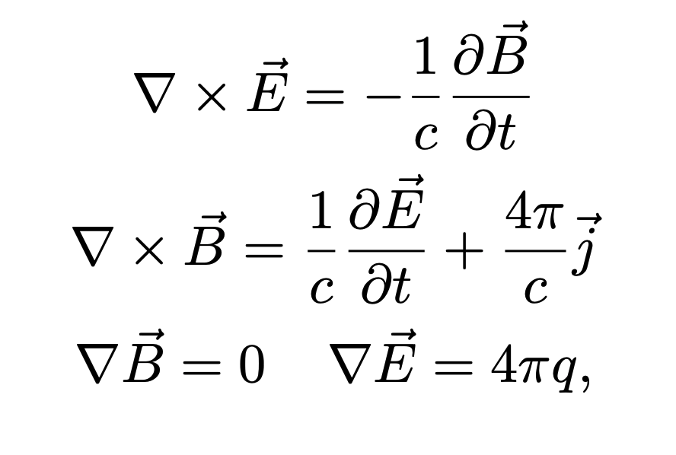

Kinetic description
Assumption: on average, behavior of each particle is the same and independent of other particles, following only the prescriptions of the self-consistent field – collisionless plasma
Boltzmann equation
Kinetic Vlasov-equation
Maxwell’s equations
Description of plasma in 2-D phase-space
is the charged particle distribution function in 6-D position momentum space
Notes:
assumption that on average behavior of each particle is the same and independent of other particles, following only the prescriptions of the self-consistent field

Slide 7
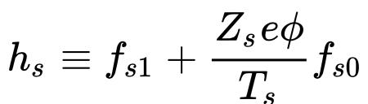
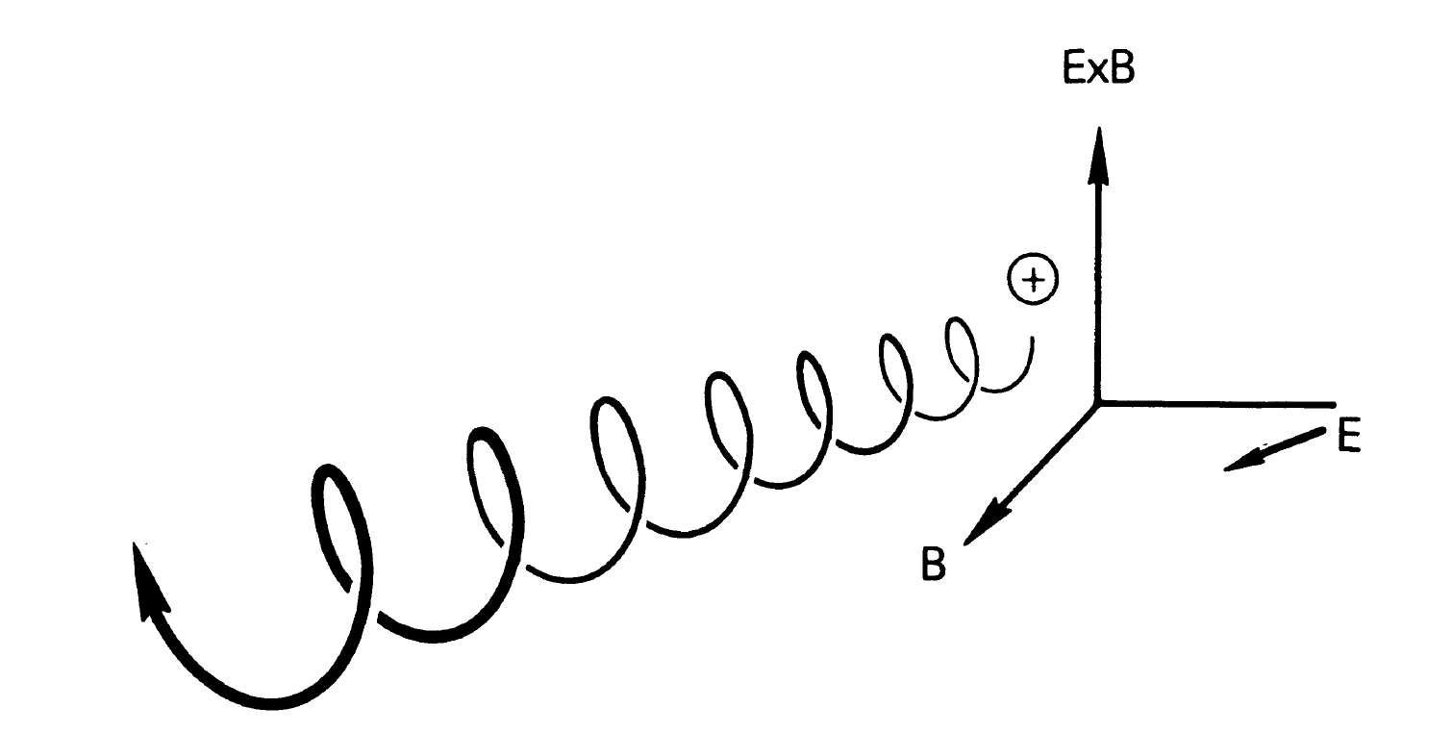
Gyrokinetic equation in fusion plasmas
Due to strong magnetic fields in fusion plasmas, we take average of the Vlasov equation over the fast gyromotion, which leads to gyrokinetic equation
Perturbed distribution function
Guiding center
+
Gyro-averaged Maxwell’s equation (Electromagnetic waves)
Gauss’s law (Electrostatic waves)
Full orbit
Notes:
The second term represents particle streaming along the magnetic field line. The third term contains the effects of cross-field particle drifts, including the curvature drift, the grad-B drift, and the lowest order E-cross-B drift. The fourth term represents the nonlinear effect of the perturbed E→×B→ drift interacting with the distribution function perturbation. The fifth term uses a collision operator to include the effects of collisions between particles. The sixth term represents the Maxwell–Boltzmann response to the perturbed electric potential. The last term includes temperature and density gradients of the background distribution function, which drive the perturbation. These gradients are only significant in the direction across flux surfaces, parameterized by ψ, the magnetic flux.

Slide 8
Theoretical descriptions of Plasma
Plasma Models
Fluid Model
Magneto-hydrodynamics
Continuity Equation
Momentum Equation
Maxwell’s Equations (magnetized plasma)
Hybrid-models
Kinetic Model
Vlasov equation Maxwell’s Equations

Slide 9
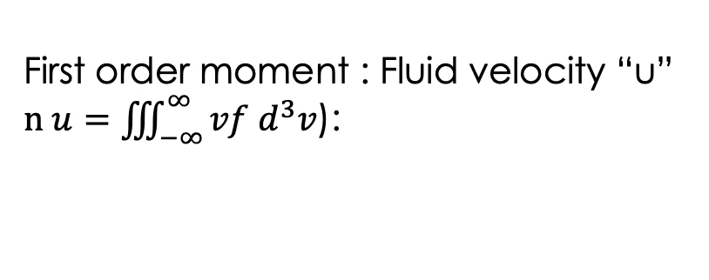
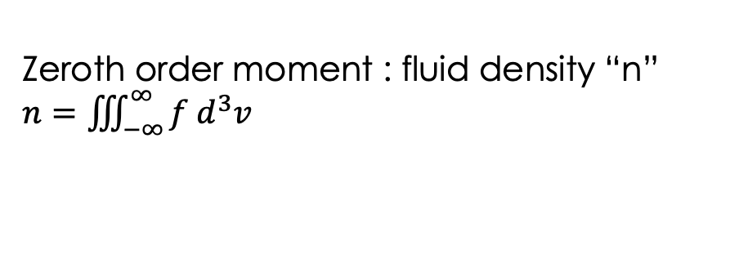
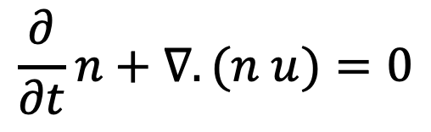
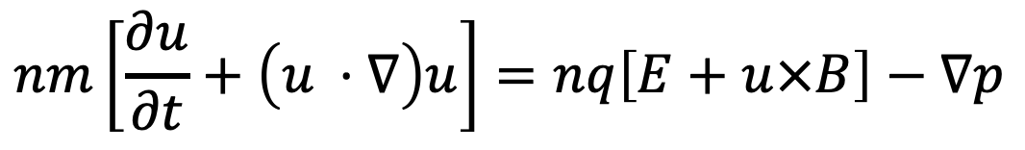
When we take moments of kinetic-Vlasov equation, we obtain fluid equations for plasma
Average behavior of each species is sufficient to describe plasma dynamics- collisional plasmas
Zeroth order moment : fluid density “n”
$n=\iiint_{−∞}^{∞}{f d^{3}v}$
$$\frac{∂}{∂t}n+∇.(n u)=0$$
First order moment : Fluid velocity “u”
$n u=\iiint_{−∞}^{∞}{vf d^{3}v}$):
$$nm\left[\frac{∂u}{∂t}+\left(u ⋅∇\right)u\right]=nq\left[E+u×B\right]−∇p$$
+
Maxwell’s equation (Electromagnetic waves)
Gauss’s law
(Electrostatic waves)

Slide 10
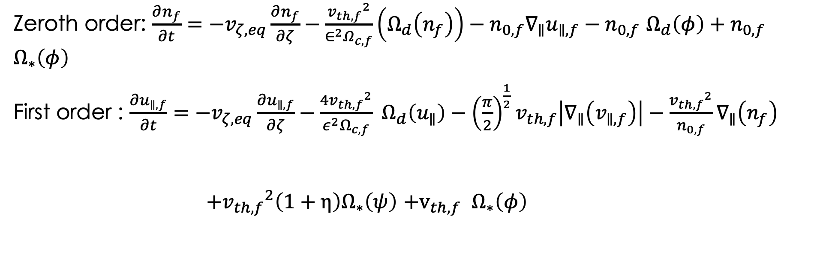
Moments of gyrokinetic equation lead to gyrofluid equations for strongly magnetized plasma
Zeroth order: $\frac{∂n_{f}}{∂t}=−v_{ζ,eq}\frac{∂n_{f}}{∂ζ}−\frac{{v_{th,f}}^{2}}{∈^{2}Ω_{c,f}}\left(Ω_{d}\left(n_{f}\right)\right)−n_{0,f}{∇_{∥}u}_{∥,f}−n_{0,f}$ $Ω_{d}\left(φ\right)+n_{0,f} Ω_{∗}\left(φ\right)$
First order : $\frac{∂u_{∥,f}}{∂t}=−v_{ζ,eq}\frac{∂u_{∥,f}}{∂ζ}−\frac{4{v_{th,f}}^{2}}{ε^{2}Ω_{c,f}} Ω_{d}\left(u_{∥}\right)−{\left(\frac{π}{2}\right)}^{\frac{1}{2}}v_{th,f}\left|∇_{∥}\left(v_{∥,f}\right)\right|−\frac{{v_{th,f}}^{2}}{n_{0,f}}∇_{∥}\left(n_{f}\right)$
$+{v_{th,f}}^{2}\left(1+η\right)Ω_{∗}\left(ψ\right)$ $+v_{th,f} Ω_{∗}\left(φ\right)$
Closure coefficient
Notes:
Mention Hammett and Perkins closures

Slide 11
Theoretical descriptions of Plasma
Plasma Models
Fluid Model
Magneto-hydrodynamics
Continuity Equation
Momentum Equation
Maxwell’s Equations (magnetized plasma)
Hybrid-models
Kinetic Model
Vlasov equation Maxwell’s Equations

Slide 12
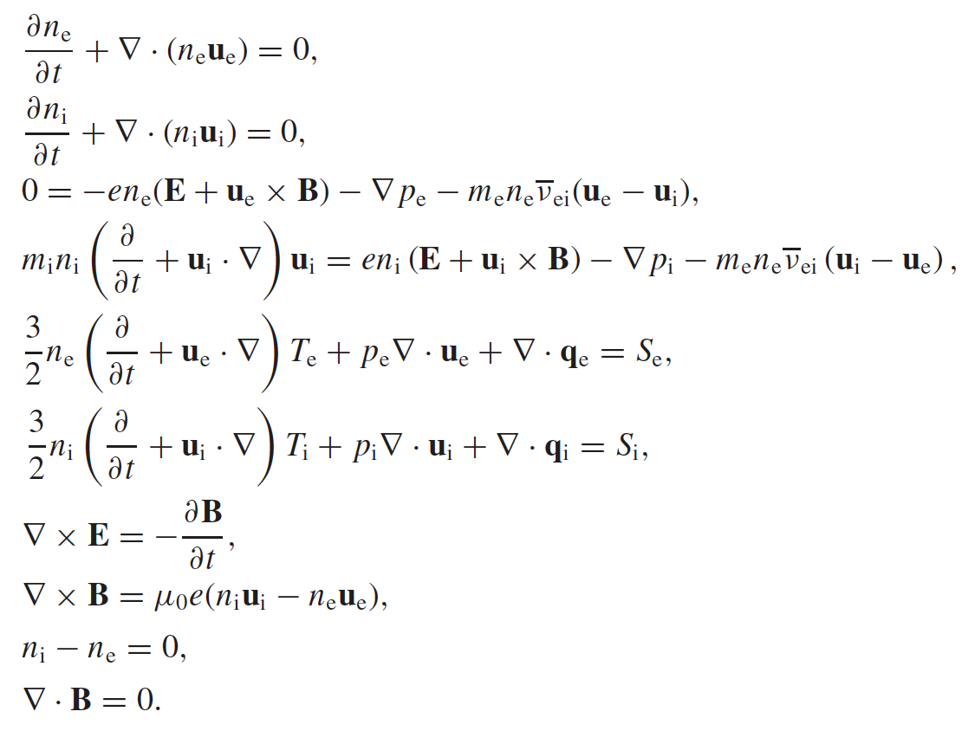
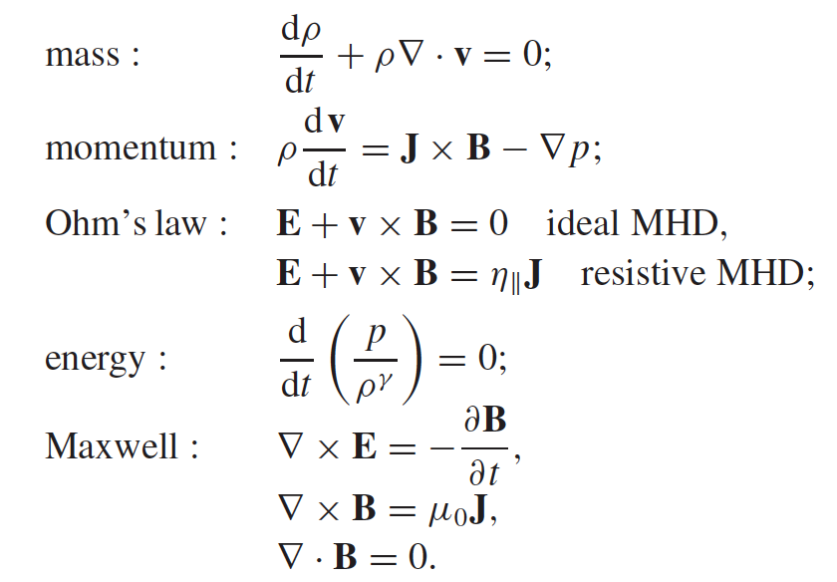
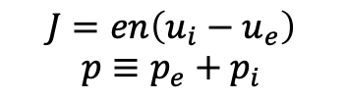
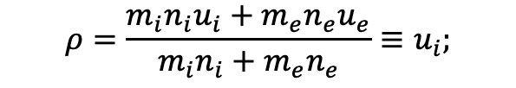
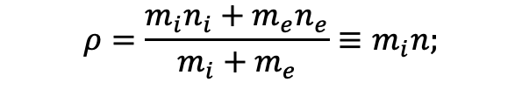
Fluid model in a magnetized plasma can be simplified to MHD model
2-Fluid model
Single fluid Magnetohydrodynamic model
$$ρ=\frac{m_{i}n_{i}+m_{e}n_{e}}{m_{i}+m_{e}}≡m_{i}n;$$
$$ρ=\frac{m_{i}n_{i}u_{i}+m_{e}n_{e}u_{e}}{m_{i}n_{i}+m_{e}n_{e}}≡u_{i};$$
$$J=en\left(u_{i}−u_{e}\right)$$
$$p≡p_{e}+p_{i}$$
Where,

Slide 13
Theoretical descriptions of Plasma
Plasma Models
Fluid Model
Magneto-hydrodynamics
Continuity Equation
Momentum Equation
Maxwell’s Equations (magnetized plasma)
Hybrid-models
Kinetic Model
Vlasov equation Maxwell’s Equations

Slide 14
Plasma modelling is to solve the differential equations and identify the spatiotemporal behavior of a plasma system
Depending upon the physics we want to resolve, we simplify our models by making assumptions
Discretize equations and use numerical techniques such as finite difference, finite elements for fluid equations
Runge-Kutta integrators for particle orbit following codes
PIC approach for solving kinetic equations
Finite difference, finite element/volume scheme for solving fluid equations

Slide 15
Core and edge plasma conditions are very different in a fusion device
Property | Fusion Plasma Core | Fusion Plasma edge
Temperature | Extremely high, ~keV | Much cooler compared to the core (1-100 eV)
Density | Higher particle density | Lower particle density
Magnetic fields | Stronger and more uniform | Weaker and more turbulent
Particle behavior | Highly energized and relatively stable | More turbulent and irregular
Confinement | Better confinement properties | Poorer confinement due to increased turbulence
Impurities | Relatively cleaner with fewer impurities | More impurities from interactions with reactor walls

Slide 16
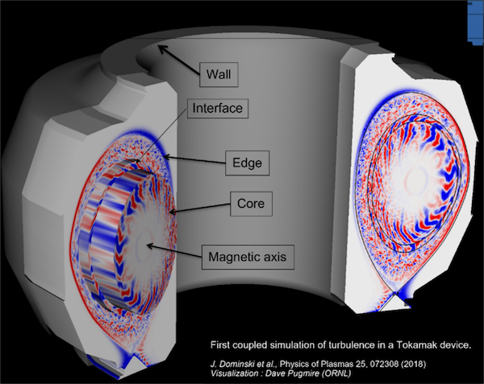
Dynamics of core plasmas are defined by gyrokinetic models whereas edge plasmas are defined by fluid models

Slide 17
Integrated Modelling for fusion reactor design

Slide 18
What is integrated modeling?
Coupled models of fusion plasma physics and engineering in an integrated workflow to perform self-consistent multi-physics, multi-fidelity, iterative calculations for a fusion reactor design

Slide 19
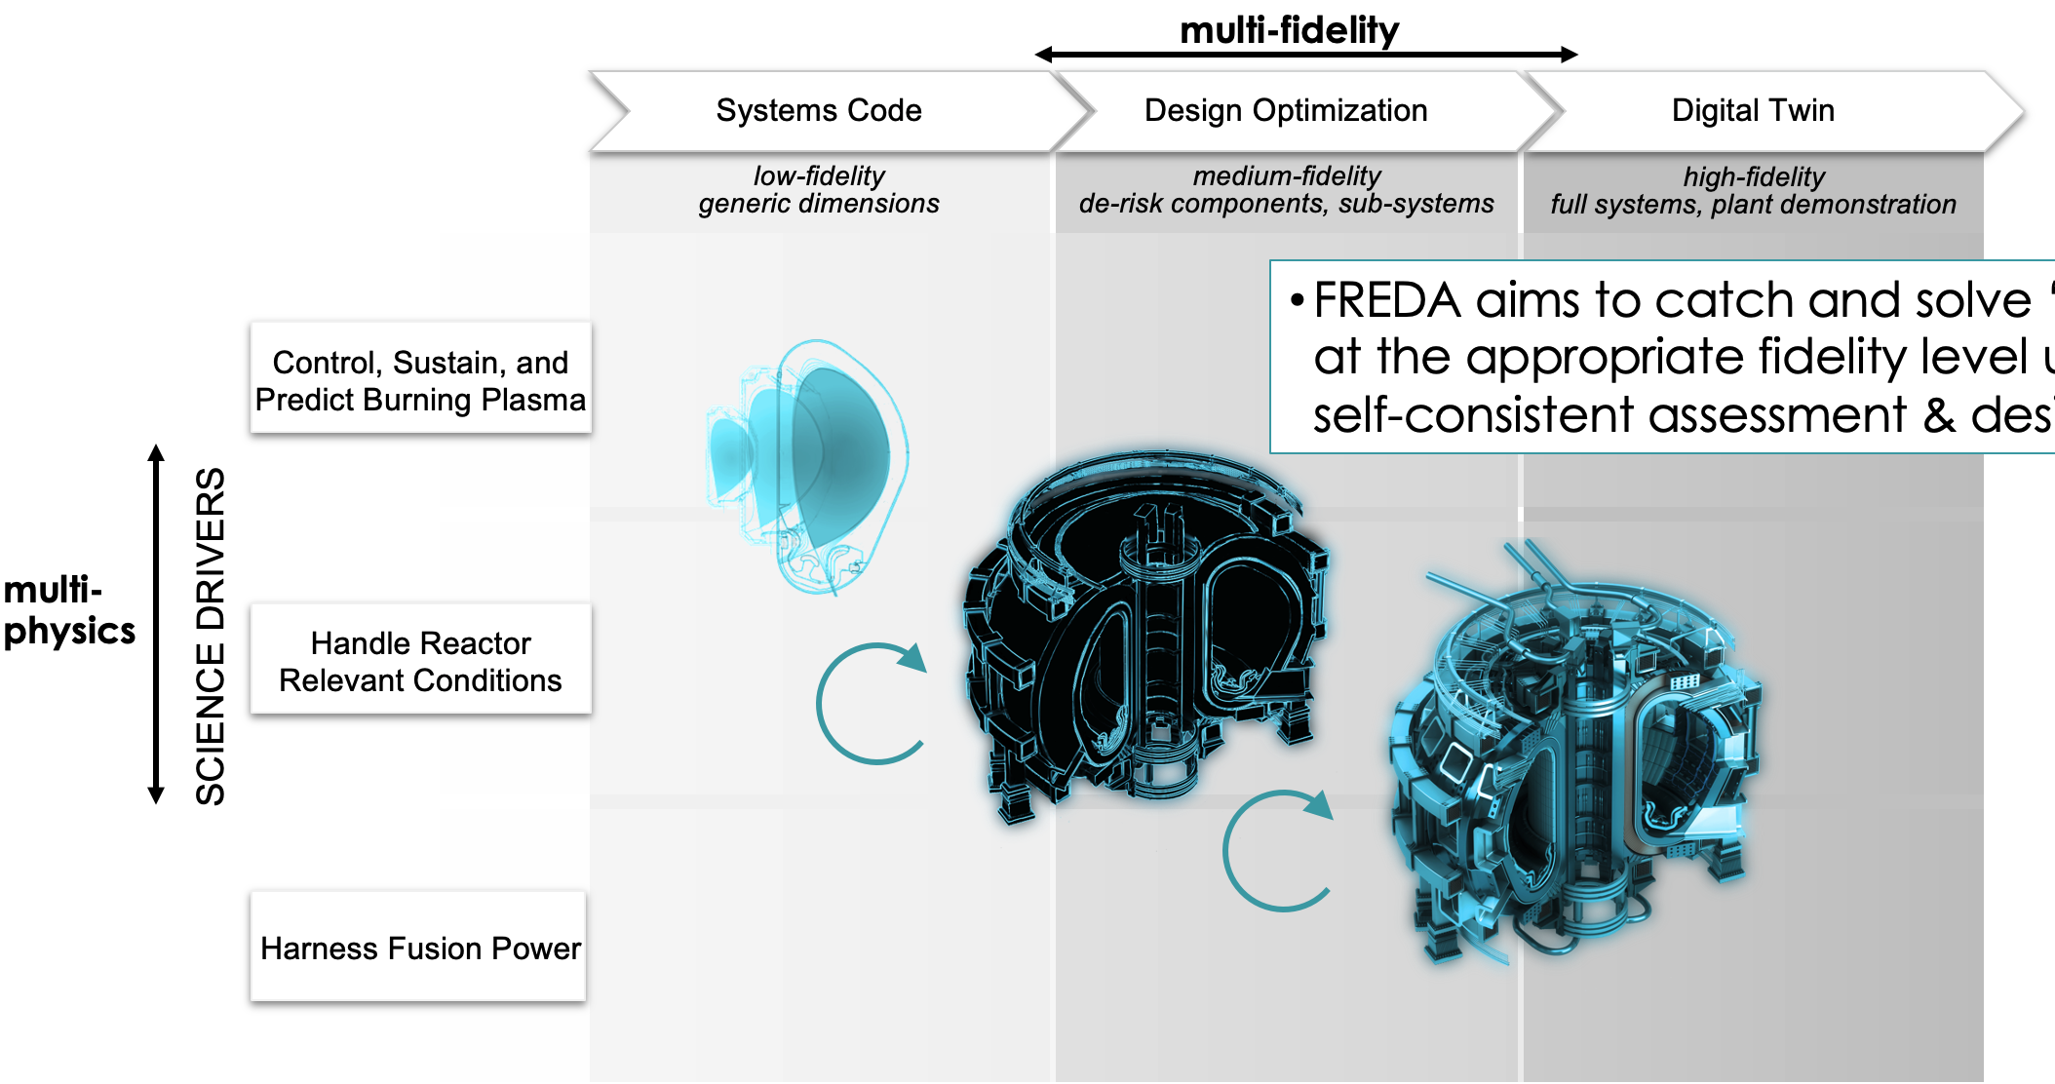
FREDA (Fusion Reactor Design and Assessment)-SciDAC is a purpose-built framework for multi-fidelity, iterative optimization- led by Cami Collins, ORNL
FREDA aims to catch and solve ‘show-stoppers’
at the appropriate fidelity level using
self-consistent assessment & design optimization
Will initially apply to tokamaks/STs, potential for expansion to stellarators
Notes:
FREDA consists of 3 main components, plasma, geometry generation, and engineering analysis

Slide 20

Approach: flexible component-based framework & data structure
Framework & Workflow
Capable of integrating swappable modules with diverse CPU/GPU requirements
System State File
Plasma State File
Geometry State File
Engineering State File
Core
SOL
Neutronics/
Tritium
Structural Mechanics
EM
FASTRAN
EFIT
NUBEAM
C1
First Wall
Blanket
MCNP
Elmer
TGLF
DCON
TORAY
C2
SHIFT
DIABLO
openFOAM
NCLASS
GATO
GENRAY
SOLPS
Divertor
CS coil
PF coil
TF coil
Thermal Hydraulics
CFD
Edge
openFOAM
EPED
openFOAM
Driver
Driver
Driver
Driver
Fusion-Plasma
Parametric Geometry
Fusion-Engineering
Based on the open-source
IPS (Integrated Plasma Simulator)
Includes systems codes and parameterized geometry representation
Includes Multiphysics simulation tools
Notes:
Feedback to statefile and run core transport codes to analyze how redistribution affects thermal profiles.

Slide 21
Approach: flexible component-based framework & data structure
Framework & Workflow
Capable of integrating swappable modules with diverse CPU/GPU requirements
System State File
Plasma State File
Geometry State File
Engineering State File
Where is energetic particle physics needed in an integrated framework?
Core
SOL
Neutronics/
Tritium
Structural Mechanics
EM
FASTRAN
EFIT
NUBEAM
C1
First Wall
Blanket
MCNP
Elmer
TGLF
DCON
TORAY
C2
SHIFT
DIABLO
openFOAM
NCLASS
GATO
GENRAY
SOLPS
Divertor
CS coil
PF coil
TF coil
Thermal Hydraulics
CFD
Edge
openFOAM
EPED
openFOAM
Driver
Driver
Driver
Driver
Fusion-Plasma
Parametric Geometry
Fusion-Engineering
Based on the open-source
IPS (Integrated Plasma Simulator) developed in AToM SciDAC
Includes systems codes and parameterized geometry representation
Includes multiphysics simulation tools based on Fusion Energy Reactor Models Integrator (FERMI)
Notes:
Feedback to statefile and run core transport codes to analyze how redistribution affects thermal profiles.

Slide 22
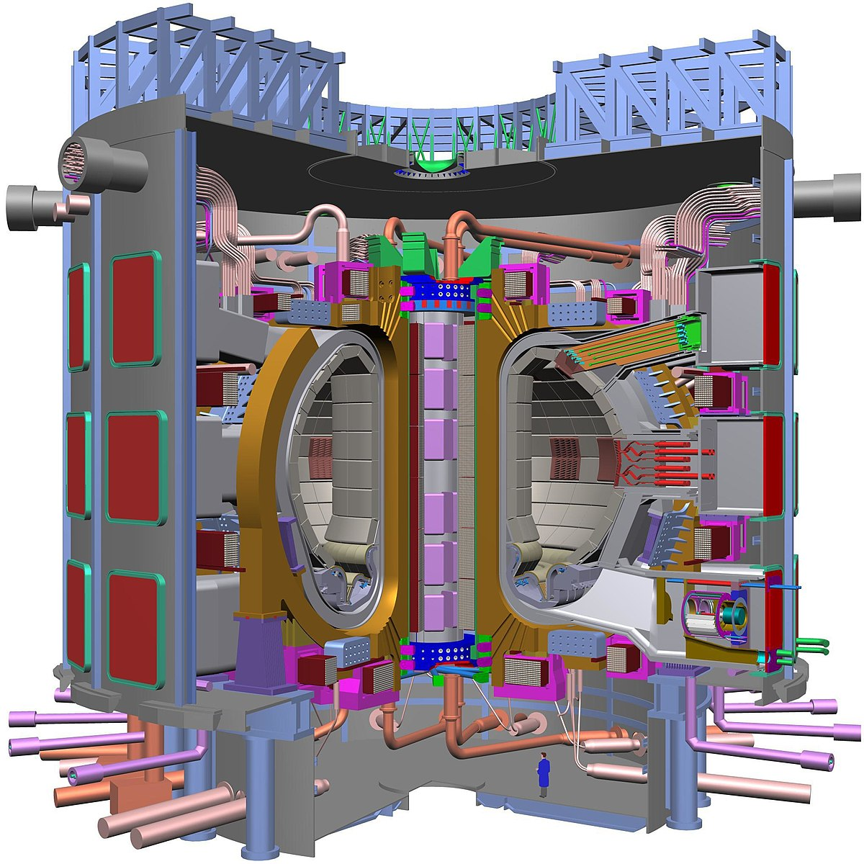
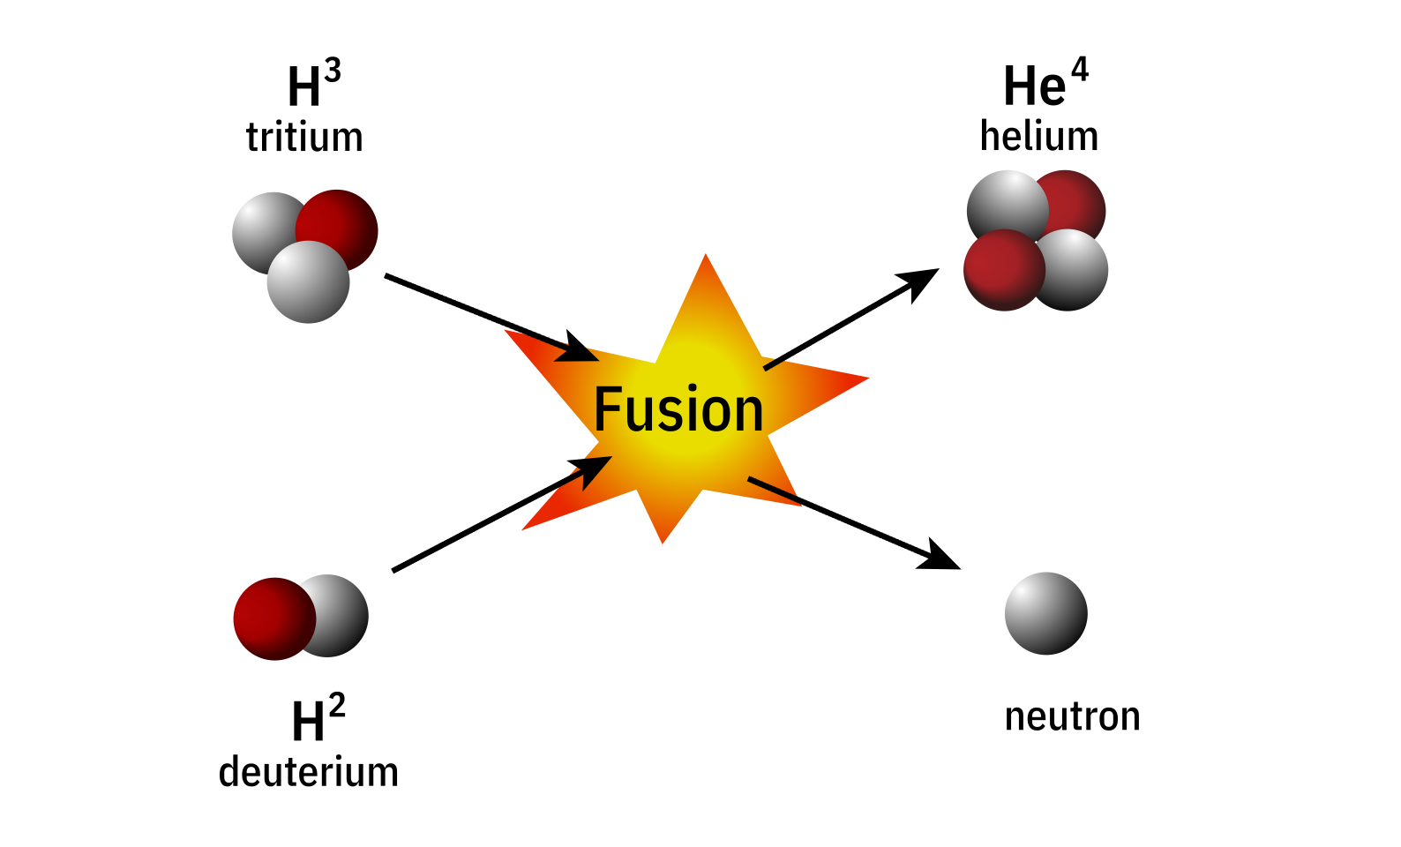

Energetic particles have higher temperature in comparison to thermal plasma
3.5MeV
14 MeV
$$T≈10 T_{Sun}$$
ITER- International Thermonuclear Experimental Reactor
Energetic particle sources:
Injecting high energy neutral particles (NBI) to heat plasma (NBI).
energetic alpha particles as by-product of fusion reactions.
High energy Runaway electrons produced during thermal quench in disruptions or Tritium beta decay
Alfvén instabilities
Whistler instabilities
https://www.atomicarchive.com/science/fusion/index.html,

Slide 23
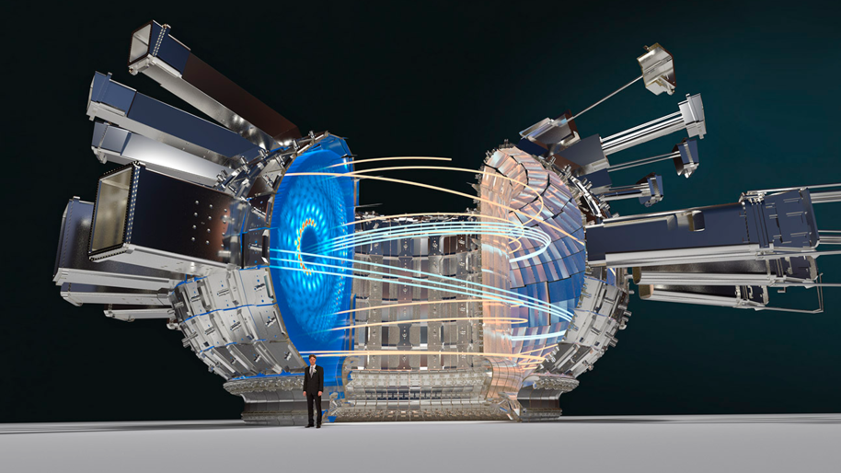
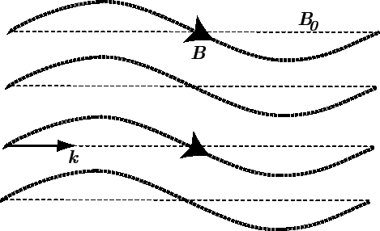
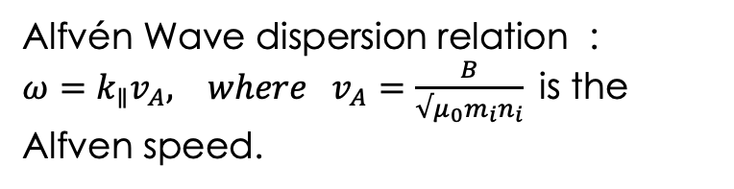
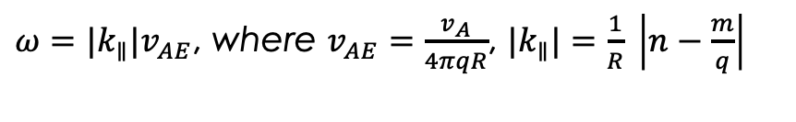
Alfvén waves are transverse electromagnetic waves created by perturbations in the magnetic field lines.
Alfvén eigenmodes in ITER
Perturbation
Alfvén Wave dispersion relation :
$ω=k_{∥}v_{A}, where v_{A}=\frac{B}{{√μ}_{0}m_{i}n_{i}}$is the Alfven speed.
$ω={|k}_{∥}|v_{AE}$, where $v_{AE}=\frac{v_{A}}{4πqR}$, ${|k}_{∥}|=\frac{1}{R} \left|n−\frac{m}{q}\right|$
Alfvén eigenmodes is a special class of Alfvén wave that exist in fusion devices due to periodic boundary conditions imposed by the machine’s geometry.

Slide 24
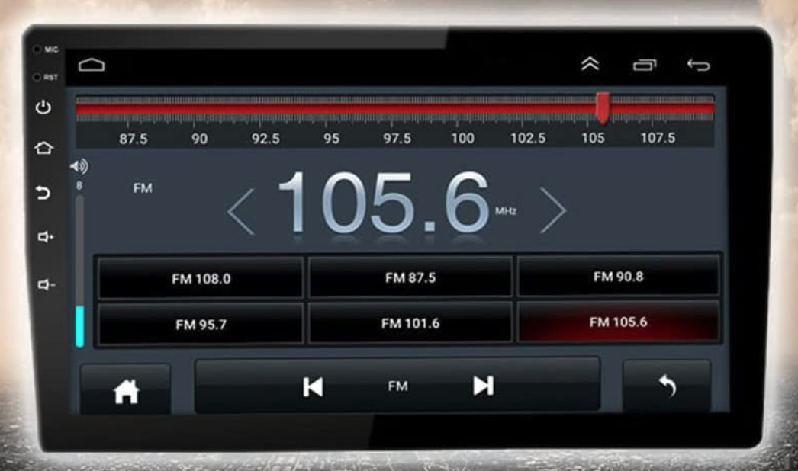
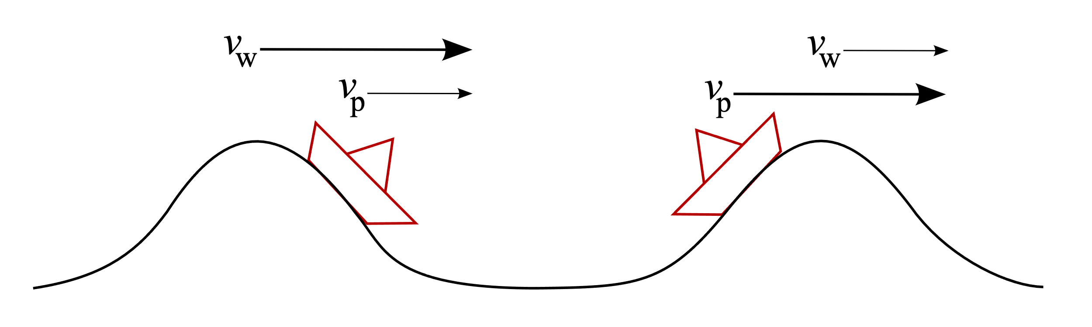
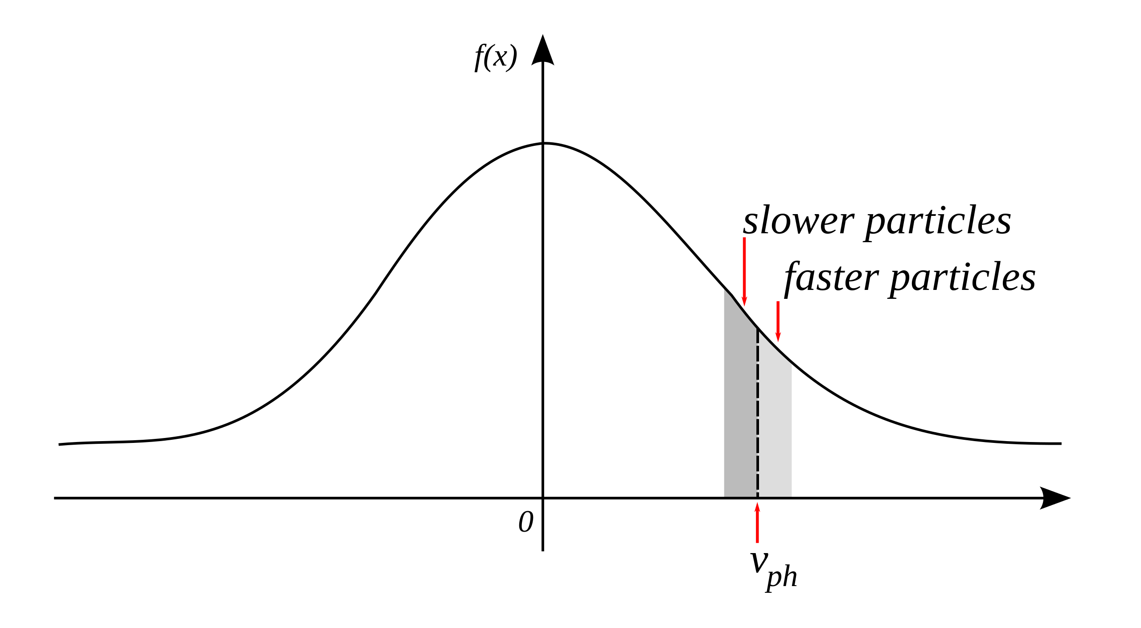
Challenge- Waves may interact resonantly with charged particles and can become unstable
FM radio is tuned to resonate with certain frequencies that correspond to a particular radio station/channel
In plasmas, surfer riding a wave picture demonstrates Landau resonance phenomena between charged particles and plasma waves
Source: https://en.wikipedia.org/wiki/Landau_damping

Slide 25
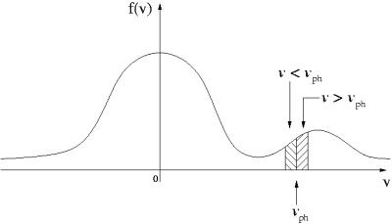
How do energetic particles cause Alfvén instabilities?
Bump-on tail distribution cause inverse Landau damping
[Pace, Physics Today (Oct. 2015)]
Energy exchange can occur via Landau resonance as the ion stays in phase with the wave as it traverses the mode.
Gradients in real space drive instability,
Can cause redistribution that affects core performance or loss of fast ions that damage the first wall materials.
Source: https://commons.wikimedia.org/wiki/File:Bump_on_tail_dist.png
[Pace, Physics Today (Oct. 2015)]
Notes:
Not just gradients in velocity space rather gradients in real space drive the instability, E.J power transfer

Slide 26
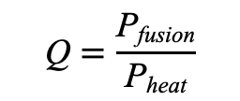
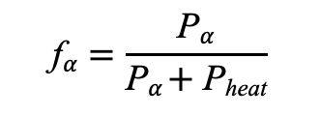
To demonstrate an economically viable fusion energy source energetic alpha particle confinement is necessary
 | Fusion Gain | α-Heating Fraction | Scientific Frontier
Scientific Breakeven | Q = 1 | 17% | Alpha confinement
Burning Plasma Regime | Q = 5 | 50% | Alpha heating; Alpha effects on energetic particle instabilities
 | Q = 10 | 67% | Strong alpha heating; Non-linear coupling effects
 | Q = 20 | 80% | Burn Control; potentially strong non-linear coupling
 | Q = ∞ | 100% | Ignition
$$\text{Q}=\frac{\text{P}\text{fusion}}{\text{P}\text{heat}}$$
$$\text{f}α=\frac{\text{P}α}{\text{P}α \text{+} \text{P}\text{heat}}$$

Slide 27
Theoretical Model for FAR3d code
Thermal Plasma
Reduced MHD equations-
Ohm’s law &
Vorticity
Compressibility effects-
Continuity & momentum equation
Energetic Particles
Gyrofluid Model with precise emulations of kinetic effects
Computationally efficient by truncating moments of gyrokinetic equation with appropriate closures for kinetic effects

Slide 28
FAR3d pseudo-spectral representation
Dynamical (time-evolving) variables:
Equilibrium (steady-state) quantities:
Axisymmetric tokamak
Stellarator with field period symmetry (N_{fp} field periods)
Uses finite-differences in the radial direction and Fourier expansions in two angular variables to evolve the dynamic physical variables until convergence is met.

Slide 29
Structure of FAR3d equations:
Solution vector evolution equations,
N is the nonlinear term
Semi-implicit approximation for N = 0
Semi-implicit solution for N = 0
Degrees of freedom (size of L, R, y): (number of equations) x radial grid points x number of Fourier modes x 2 Can be 10⁵ to 10⁶ for linear runs, 5 to 10 times larger for nonlinear runs.

Slide 30
Linear Solver
The linear system is solved at each time step.
This is done as a two-step process using the direct block tridiagonal solvers CDECBT and CSOLBT developed by Alan Hindmarsh.
A, B, C are square sub-matrices with dimensions of NxN where N = 2 x # Fourier modes x number of equations
L and R have bloc-tridiagonal structure:
mj block rows = # of radial grid points
Numerical schemes used: i) a semi-implicit initial value solver which calculates the dominant mode (having the largest growth rate) ii) an eigenvalue solver calculates the stable and unstable (sub-dominant modes).

Slide 31
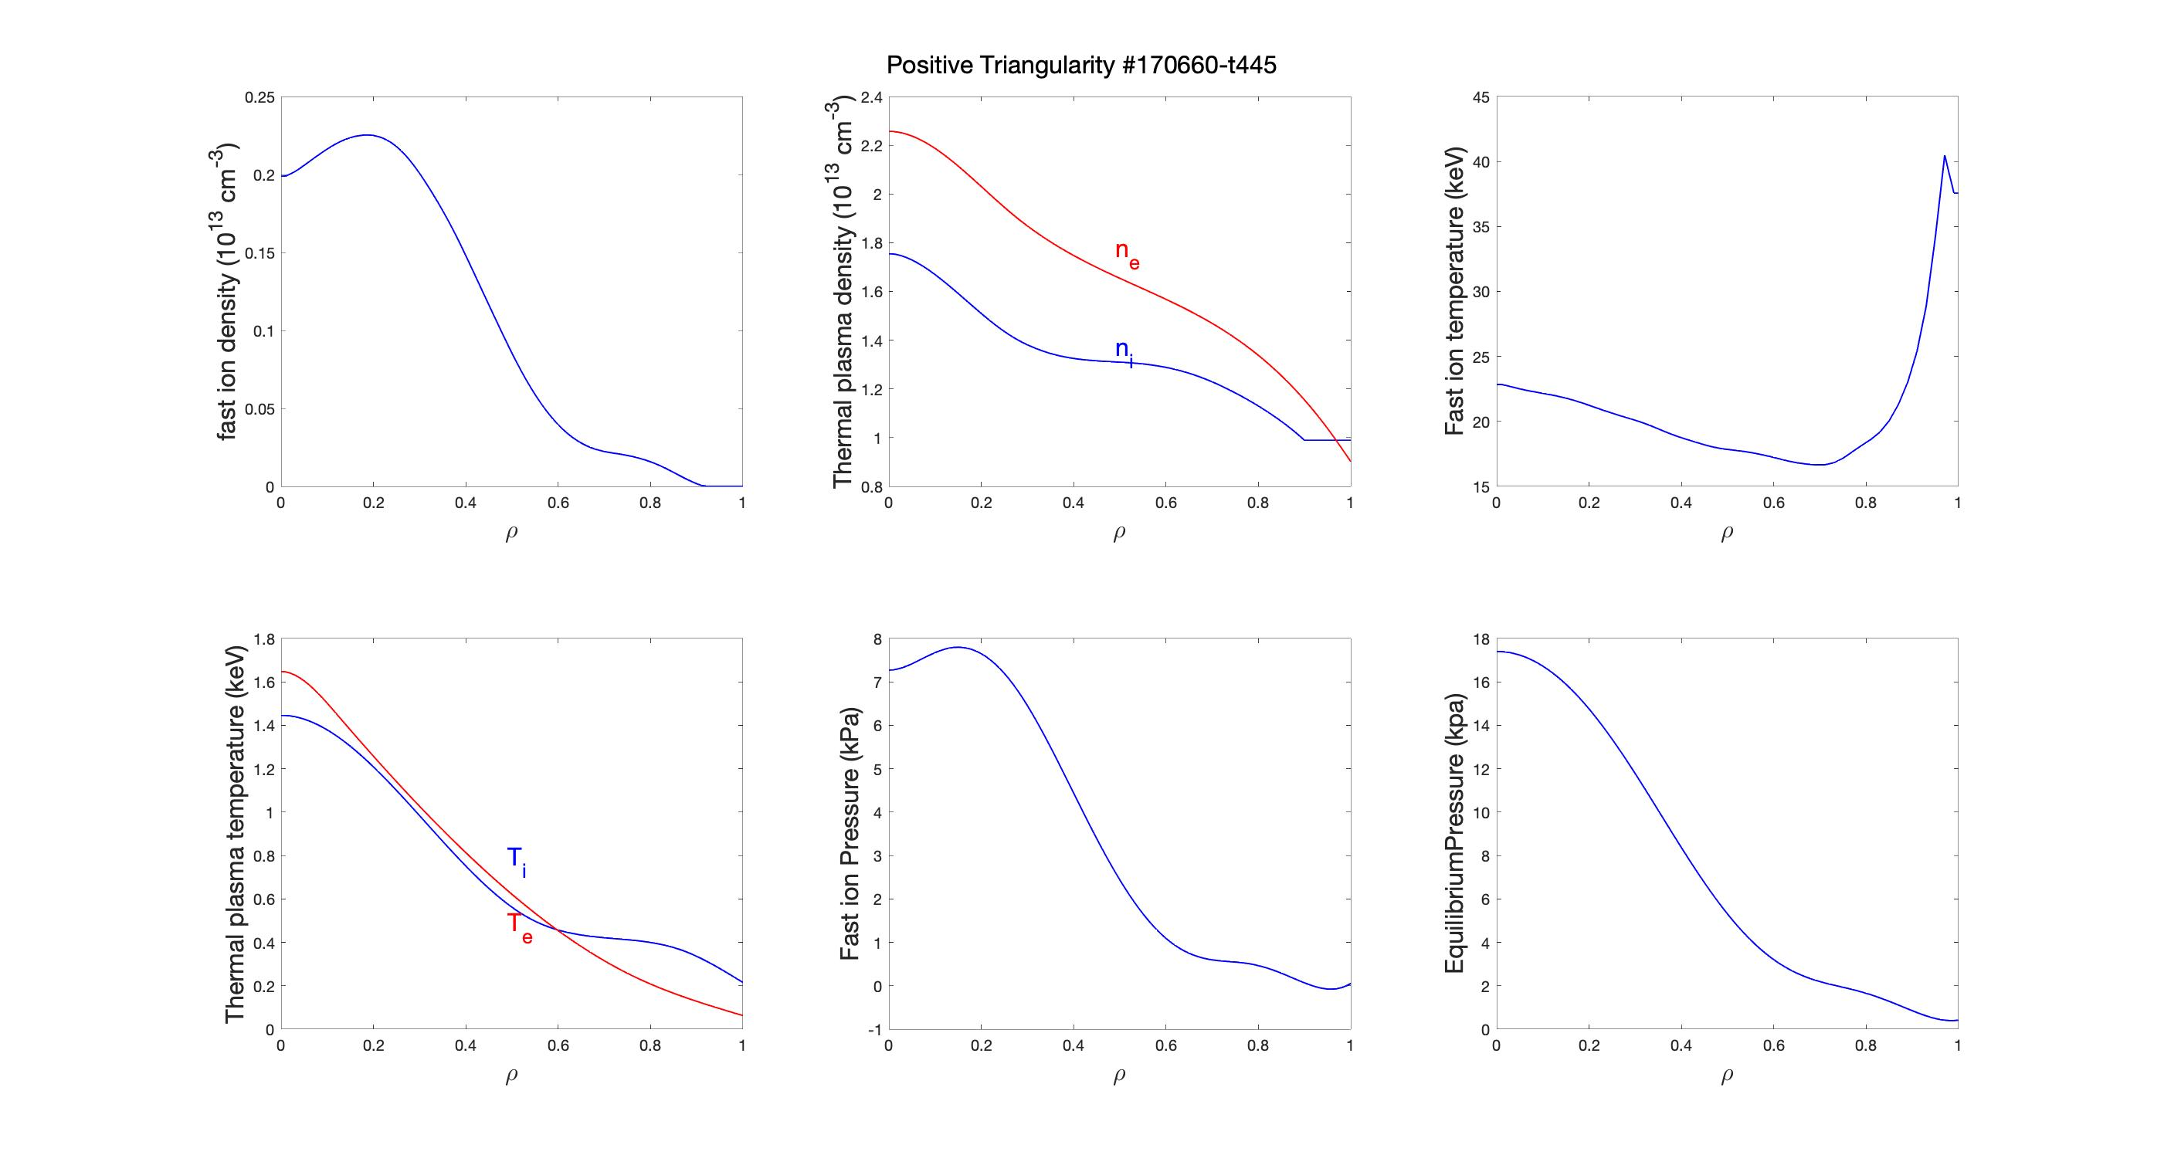
Alfven eigenmodes observed in DIII-D
Input profiles:

Slide 32
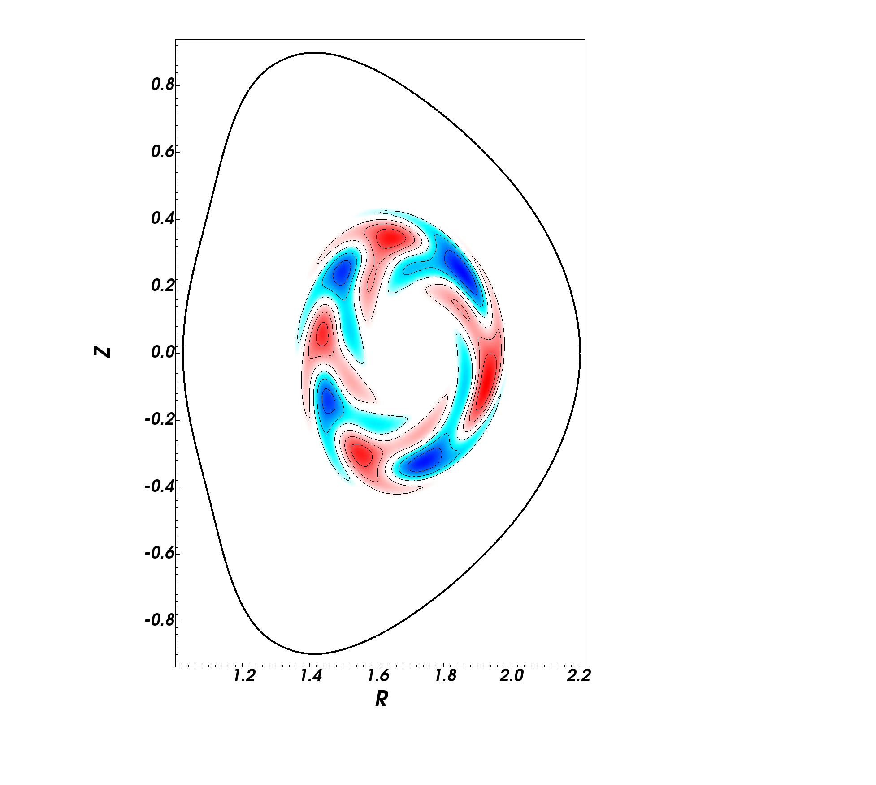
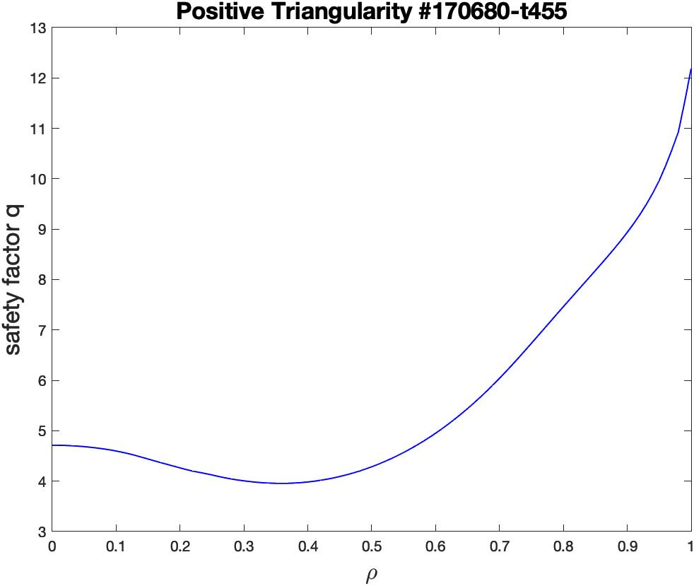
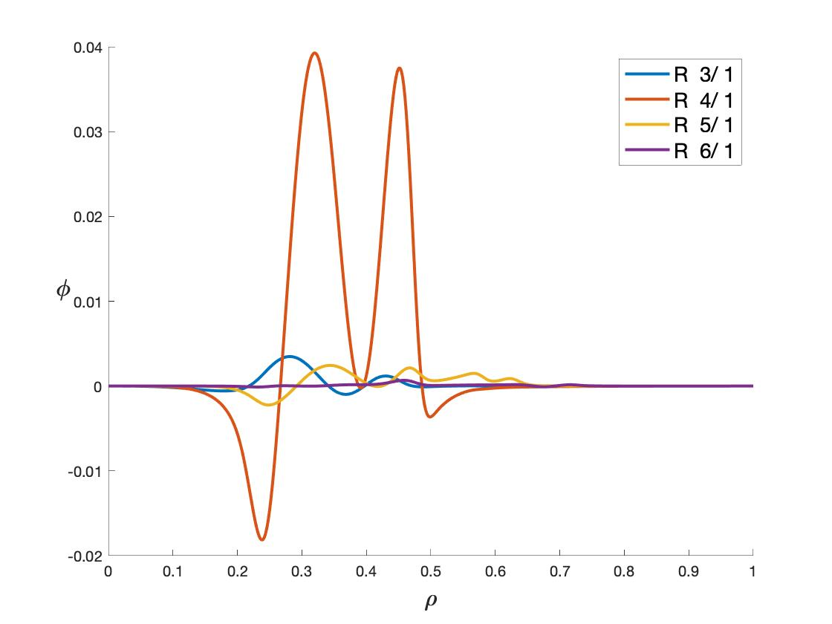
Reversed Shear Alfven Eigenmode (RSAE)
1-D eigenmode plot
poloidal cros-section plot
2-D eigenmode structure in DIIID tokamak.
Electrostatic potential eigenfunction plot for n=1 at fast particle beta=0.0042, v_{th,f}/v_{A}=0.14, showing an m=4 RSAE mode with frequency 35 KHz and growth rate=0.011 $τ_{A}^{−1}$.

Slide 33
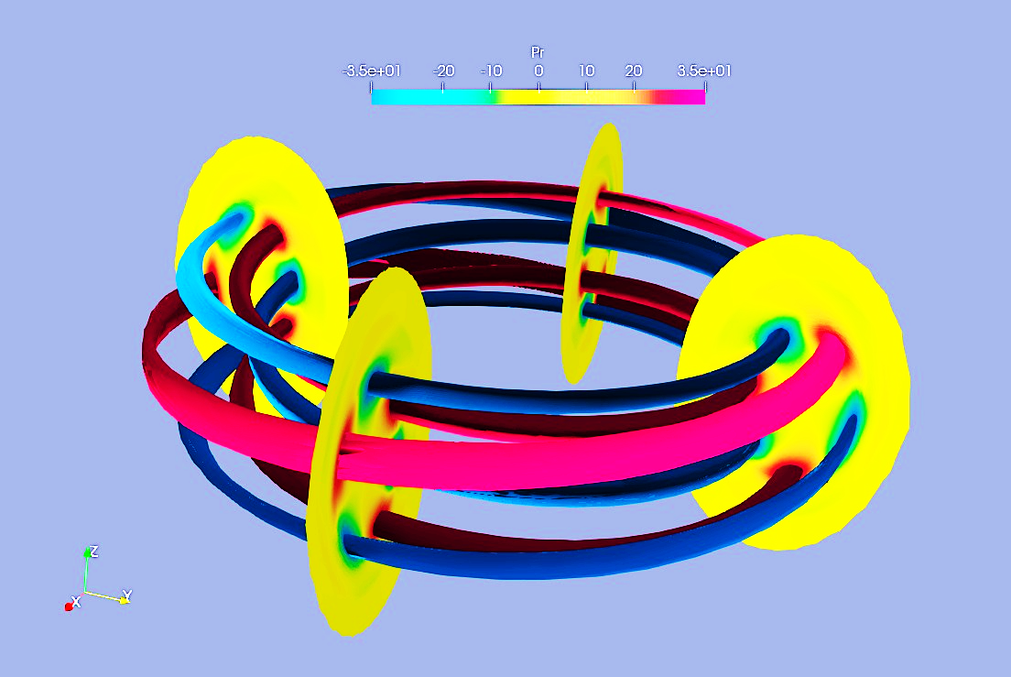
Reversed Shear Alfven Eigenmode (RSAE)
poloidal cros-section plot 3-D eigenmode structure in DIIID tokamak.
Electrostatic potential eigenfunction plot for n=1 at fast particle beta=0.0042, v_{th,f}/v_{A}=0.14, showing an m=4 RSAE mode with frequency 35 KHz and growth rate=0.011 $τ_{A}^{−1}$.

Slide 34
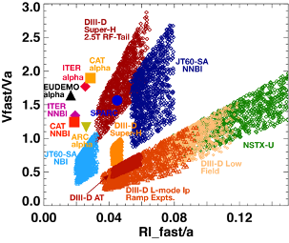
Challenge: Energetic alpha particle transport and losses may limit performance of a reactor-level fusion device
Future fusion
devices
Present experiments
How to study role of alpha particle transport on performance of a reactor-level fusion device?
Existing simulation codes take weeks on supercomputers to perform calculations of EP transport
Impractical to run in integrated scenarios for FPP design calculations

Slide 35
Goal: Develop a surrogate model of alpha transport using nonlinear FAR3d simulations
  Highly nonlinear transport depends on multiple profiles and parameters
  Need to use techniques such as deep neural networks, transfer learning, etc.
Output (EP transport flux)
Faster and accurate predictions of EP transport will be included in integrated framework for several applications, viz.
  Fusion pilot plant design and optimization
  Real-time prediction of burn control
Input (EP density gradient)
FAR3d simulations of ITER steady state case

Slide 36
Key Takeaways
Different theoretical approaches to describe plasma
  Fluid, kinetic, MHD, hybrid
Resonant interactions between energetic particles and plasma waves driven plasma instabilities
Plasma instabilities can in-turn transport and de-confine energetic particles-can be harmful or useful
To design a future fusion reactor, we need to couple the physics of different regions of plasma in a single integrated framework- including the alpha particle physics via developing machine learning based surrogates.

Slide 37
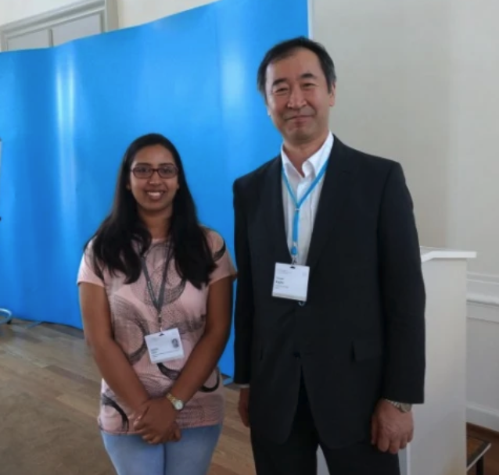
Picture with Prof. Takaki Kajita during Lindau meeting

Slide 38
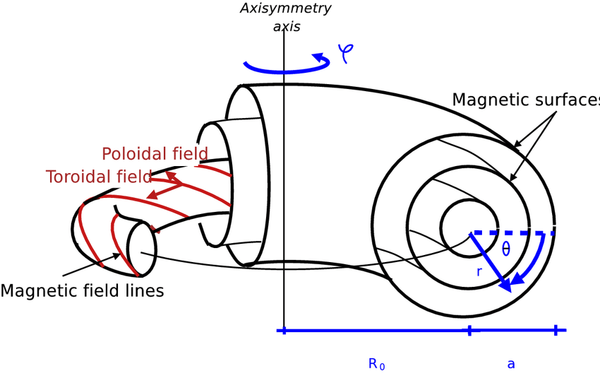

Toroidal coordinates
$$ζ$$

Slide 39
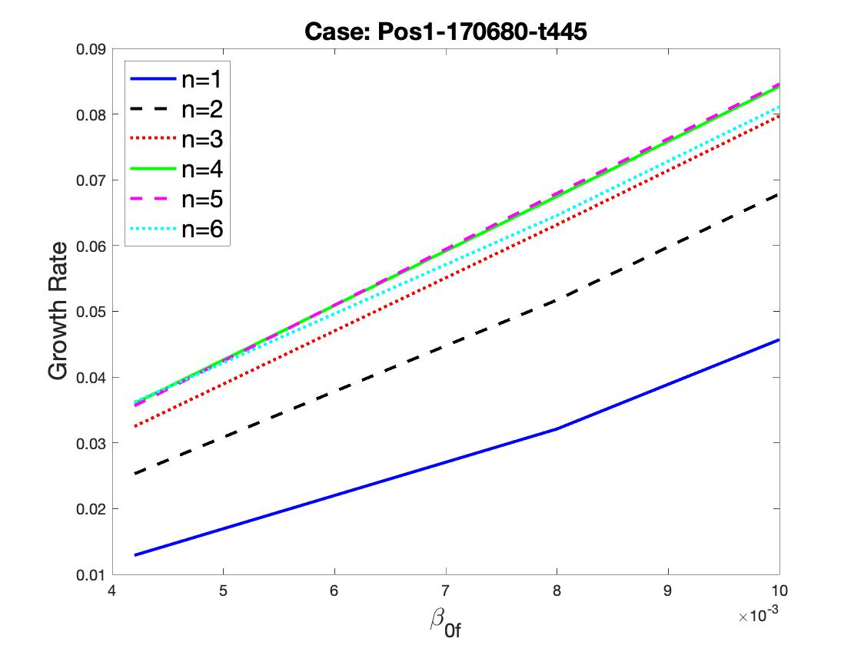
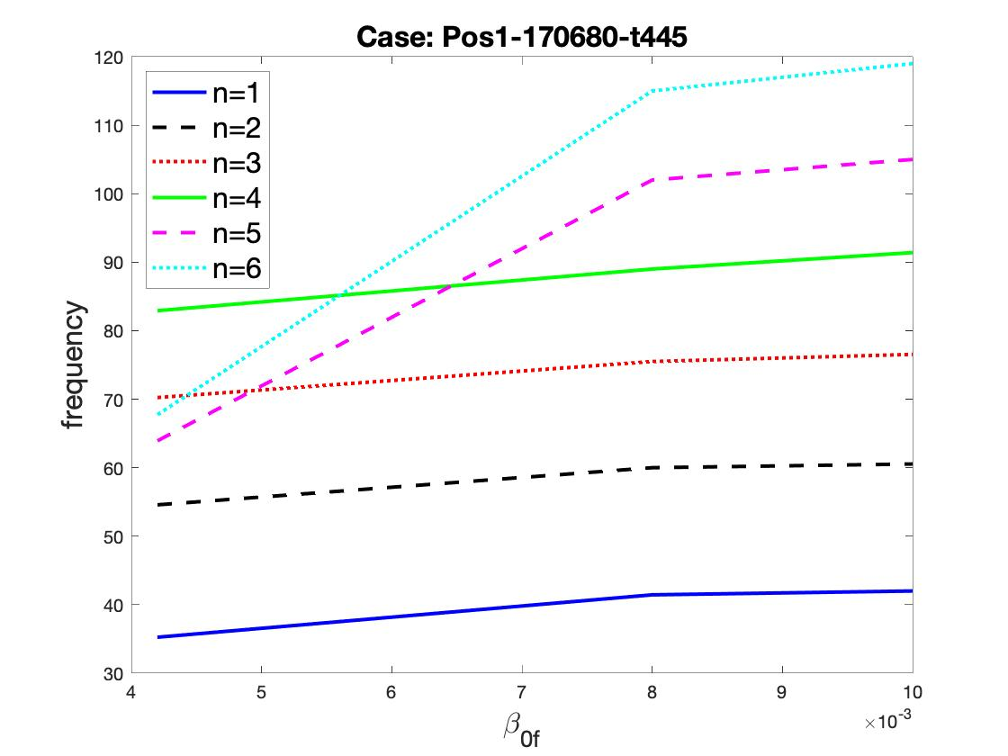
Effect of fast particle $β$
With increase in fast particle beta, no change in the type of eigenmode is observed.
However, an increase in growth rate is clearly indicated which due to increase in fast particle pressure and hence increased transfer of energy to Alfven eigenmode.

Slide 40
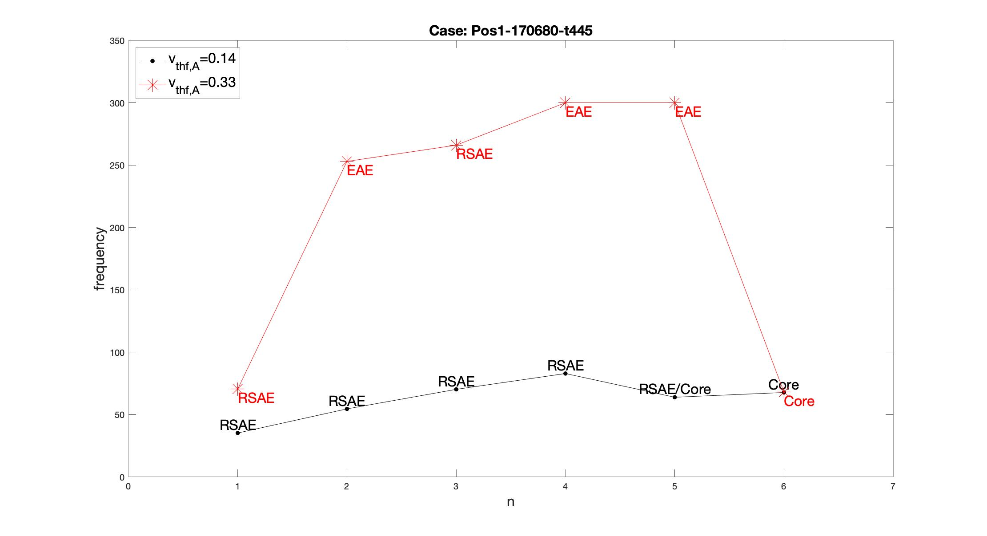
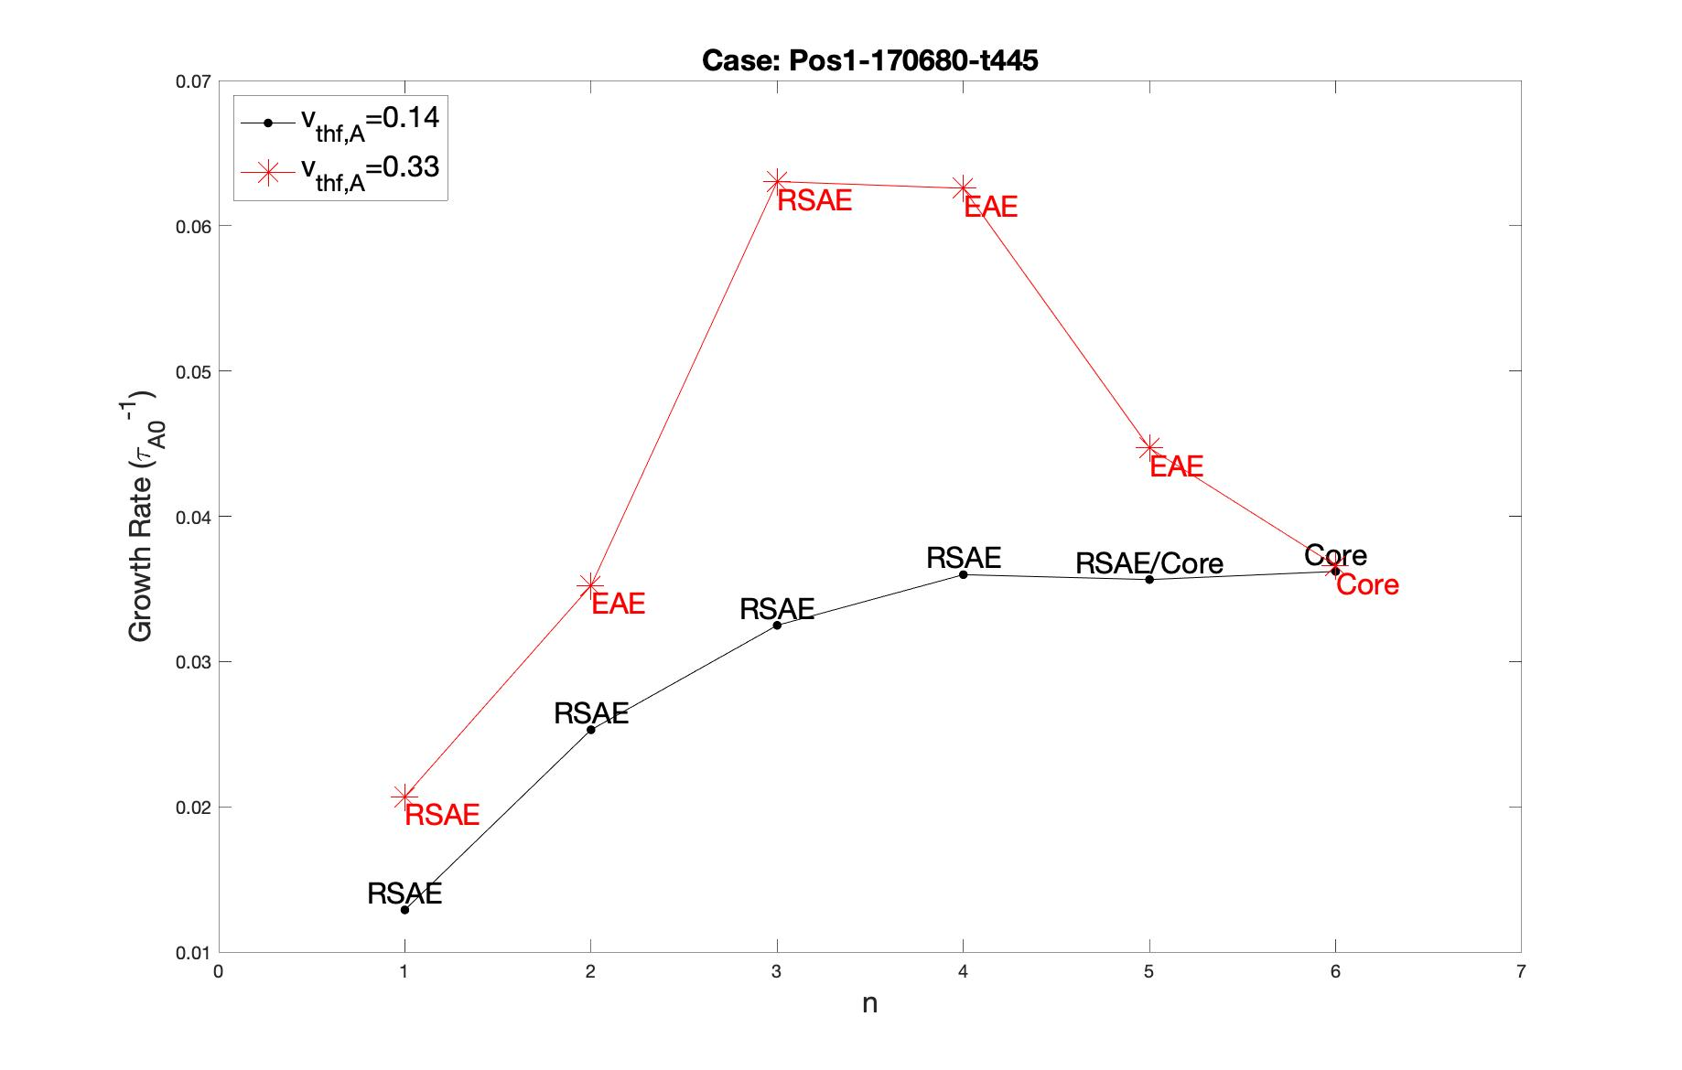
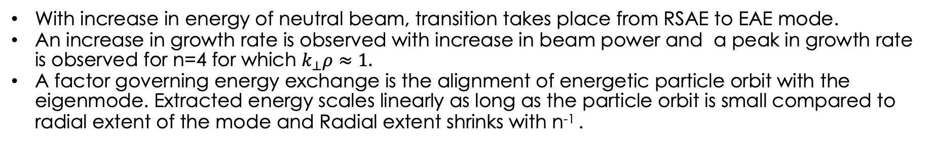
Effect of fast particle energy via v_{th,f}/v_{A}
With increase in energy of neutral beam, transition takes place from RSAE to EAE mode.
An increase in growth rate is observed with increase in beam power and a peak in growth rate is observed for n=4 for which $k_{⊥}ρ≈1.$
A factor governing energy exchange is the alignment of energetic particle orbit with the eigenmode. Extracted energy scales linearly as long as the particle orbit is small compared to radial extent of the mode and Radial extent shrinks with n⁻¹ .

