Slide 1
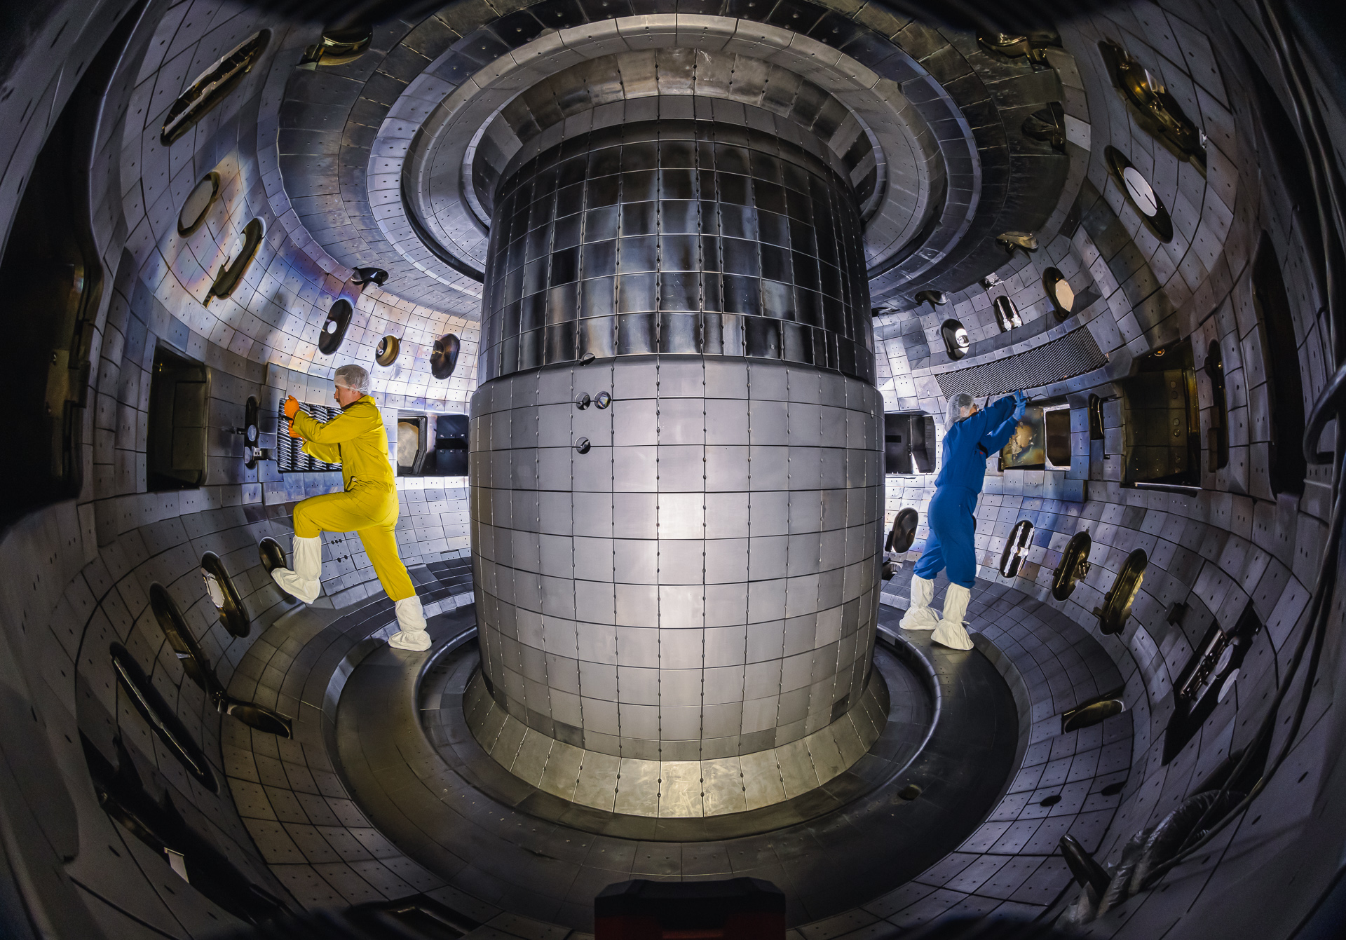

Introduction to tokamaks
Auna Moser
Presented virtually at the
2024 Intro to Plasma and
Fusion Course
June 13, 2024

Slide 2


Who am I?
Caltech, BS in Geology, 2002

Slide 3
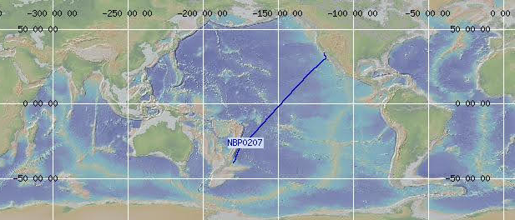

Who am I?
Caltech, BS in Geology, 2002
Two years off from school

Slide 4
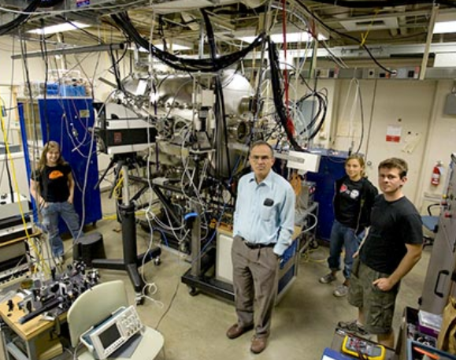
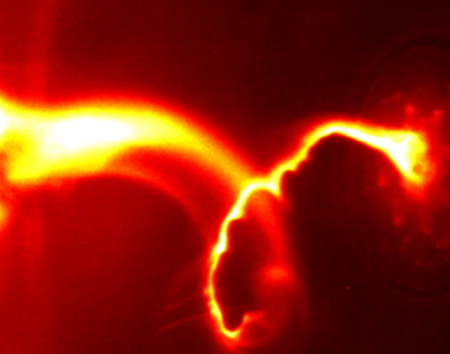
Who am I?
Caltech, PhD in Applied Physics, 2012
Caltech, BS in Geology, 2002
Two years off from school

Slide 5
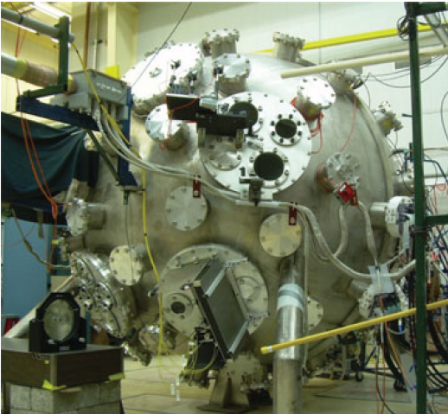

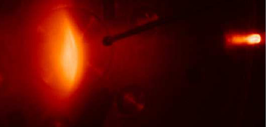
Who am I?
Caltech, PhD in Applied Physics, 2012
Caltech, BS in Geology, 2002
Two years off from school
LANL, Postdoc, 2012-2014

Slide 6
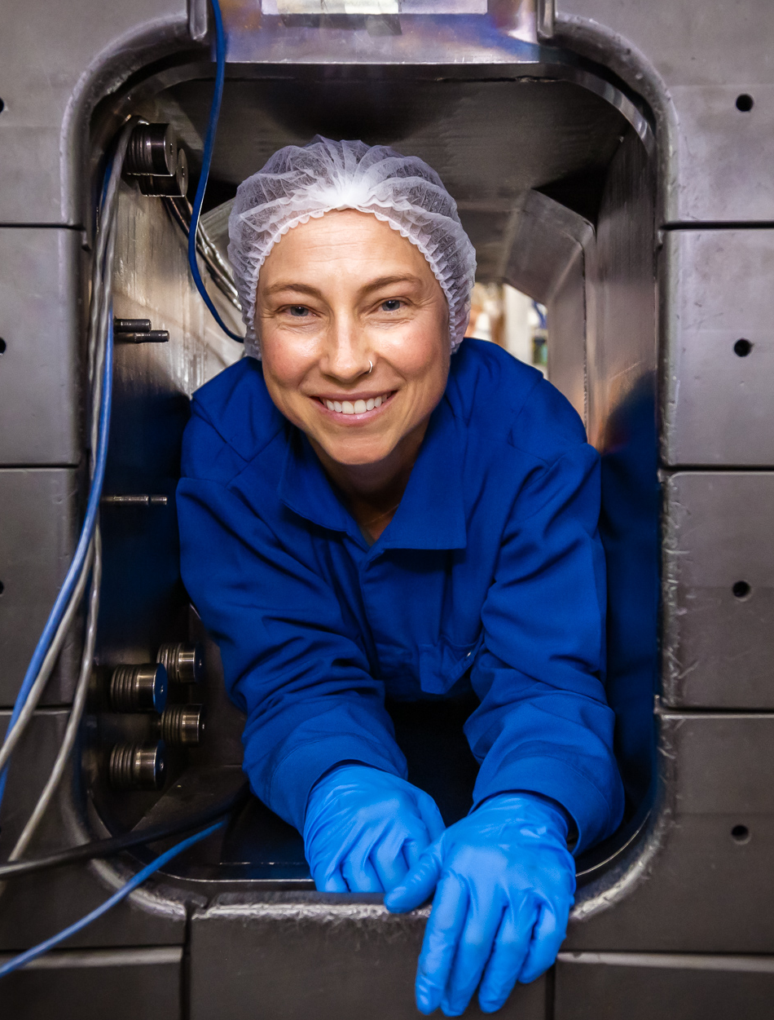
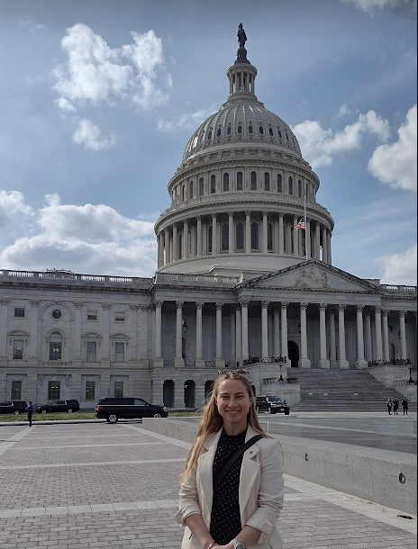
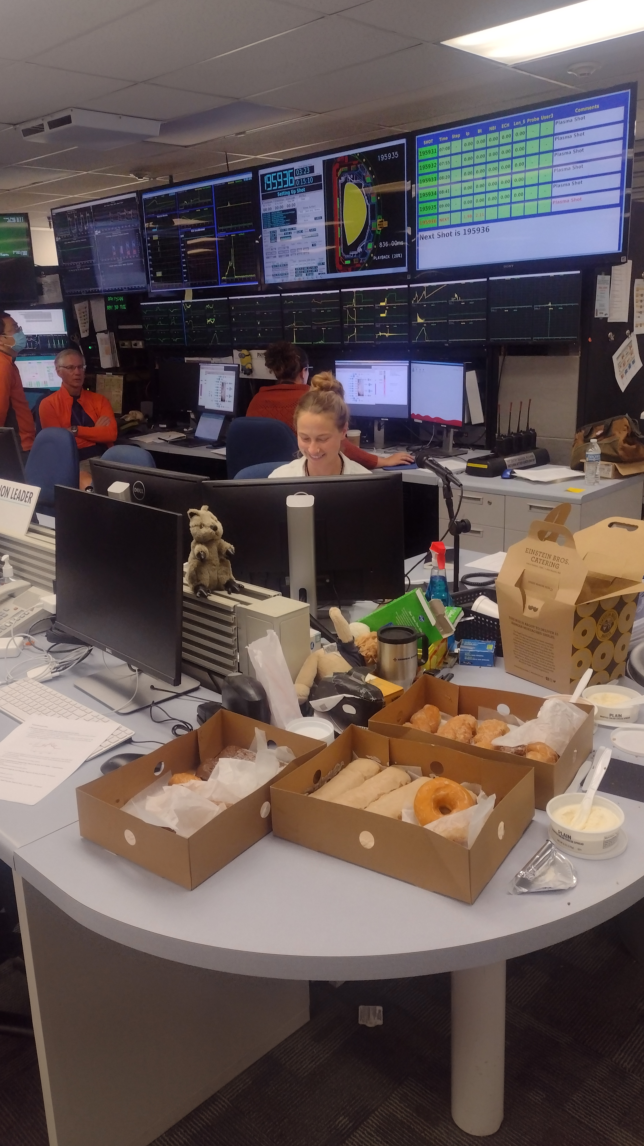
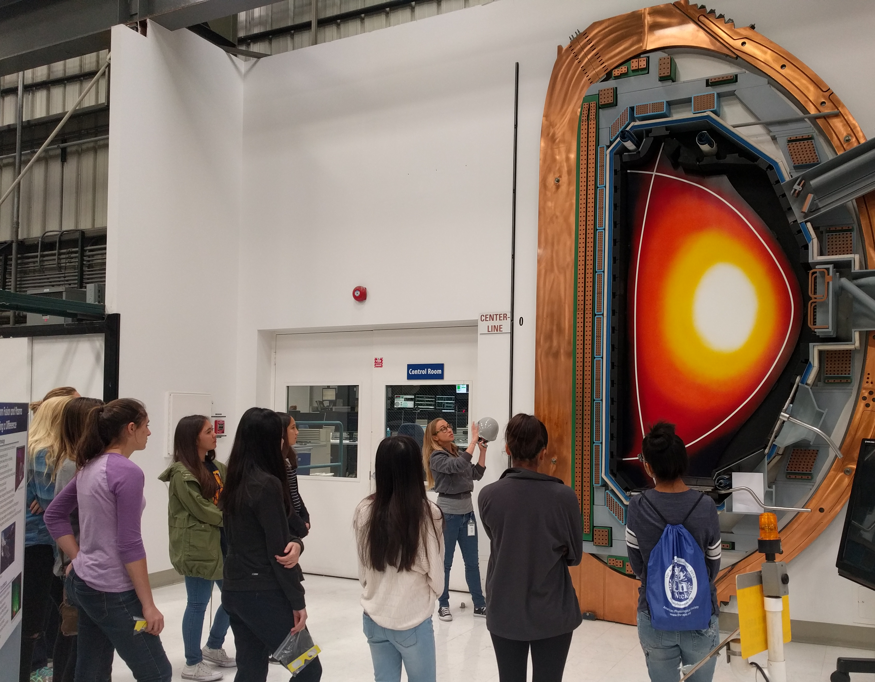
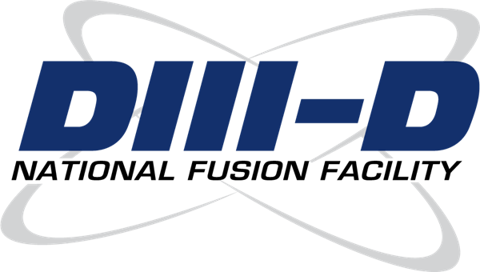
Who am I?
Caltech, PhD in Applied Physics, 2012
Caltech, BS in Geology, 2002
Two years off from school
LANL, Postdoc, 2012-2014
General Atomics,
Staff scientist at DIII-D,
2014-present

Slide 7
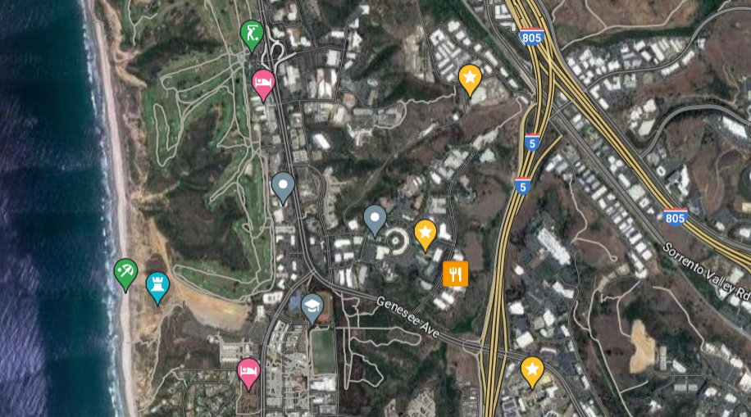
I didn’t get very far!
DIII-D
Office
Born here

Slide 8
Where are we going?
Overview/review of key ideas
How does a tokamak work?
  Nested flux surfaces
  Shaping
  Heating and current drive
Some current research areas
How can you get involved?
Notes:
I was very aware coming into the tokamak field from fundamental plasma science, and so as a relative outsider, that tokamak talks can be incredibly dense and difficult to follow. So the goals of this talk are give you an intuitive understanding of some of the key concepts in tokamak physics, and also to introduce some of the language so that you can potentially better understand other tokamak talks in the future.
I want to acknowledge my colleagues Kathreen Thome and Theresa Wilks, both of whom have given this lecture in past years and who let me steal and build upon their presentations.

Slide 9
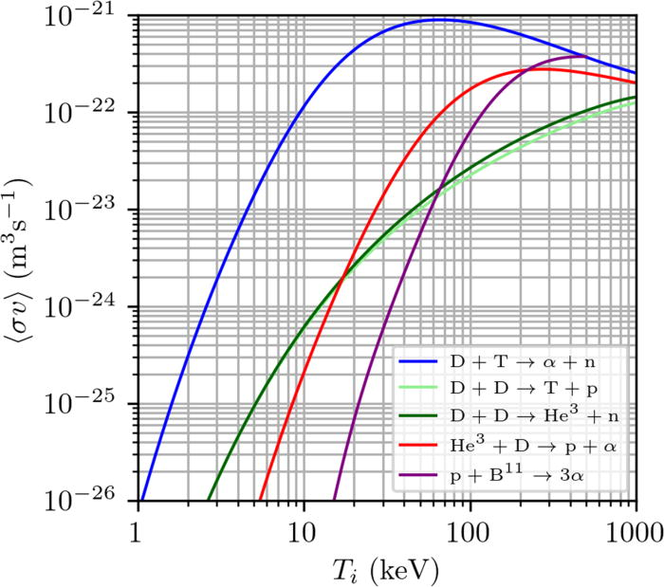
What have you learned so far about fusion?
Fusion is a clean, safe type of nuclear power with abundant fuel
“Easiest” reaction is D-T
See Srinivasan, 6/10
Wurzel et al, PoP 29, 062103 (2022)

Slide 10
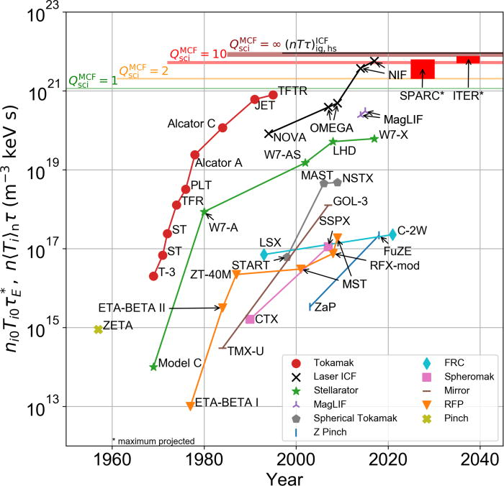
What have you learned so far about fusion?
Fusion is a clean, safe type of nuclear power with abundant fuel
“Easiest” reaction is D-T
Reaction requires a high enough
(Lawson criterion) triple product nTτ_{ε}
  We have made a ton of progress!
Ignition from 2022 on not shown here! See Simpson, 6/14
See Wurzel, 6/21
Wurzel et al, PoP 29, 062103 (2022)

Slide 11
What have you learned so far about fusion?
Ignition from 2022 on not shown here! See Simpson, 6/14
Fusion is a clean, safe type of nuclear power with abundant fuel
“Easiest” reaction is D-T
Reaction requires a high enough
(Lawson criterion) triple product nTτ_{ε}
  We have made a ton of progress!
There are different ways to confine a plasma to achieve fusion
  Gravitational, magnetic, inertial
  Stellarator
  Tokamak
  Reversed field pinch, field reversed configuration, magnetic mirror, z-pinch, spheromak....
Ignition from 12/22 not shown here! See Kritcher, 6/8
See Proll, 6/13 (previous talk)
This talk
Wurzel et al, PoP 29, 062103 (2022)
See Parke, 6/13 (next talk)

Slide 12
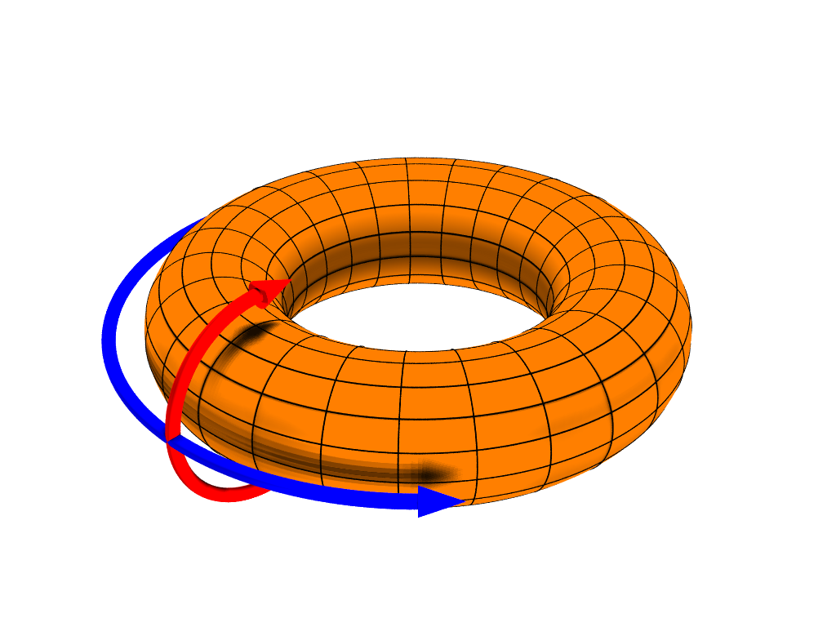
What are the basic ideas behind confinement in a tokamak?
Particles (mostly) stay along field lines
Close those field lines into a torus to confine them
Add twists to keep particles from drifting out
Confine plasma with toroidal and poloidal magnetic fields
See Duarte, Dominguez, 6/11
See Dominguez, 6/11
Toroidal
Poloidal
Notes:
Add a quick discussion of toroidal and poloidal.

Slide 13
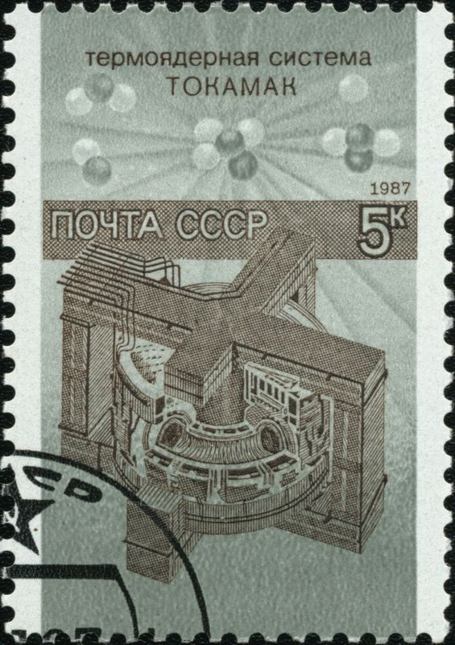
What is a tokamak?
Tokamaks confine with an externally produced
toroidal field and a plasma current produced
poloidal field
TOKAMAK is a Russian acronym:
(тороидальная камера с магнитными катушками)
“Toroidal Chamber with Magnetic Coils”
Leading magnetic confinement concept in terms of
number of facilities and funding
Caveat!: I only have personal experience with DIII-D, so what I present today will be heavily biased towards DIII-D

Slide 14
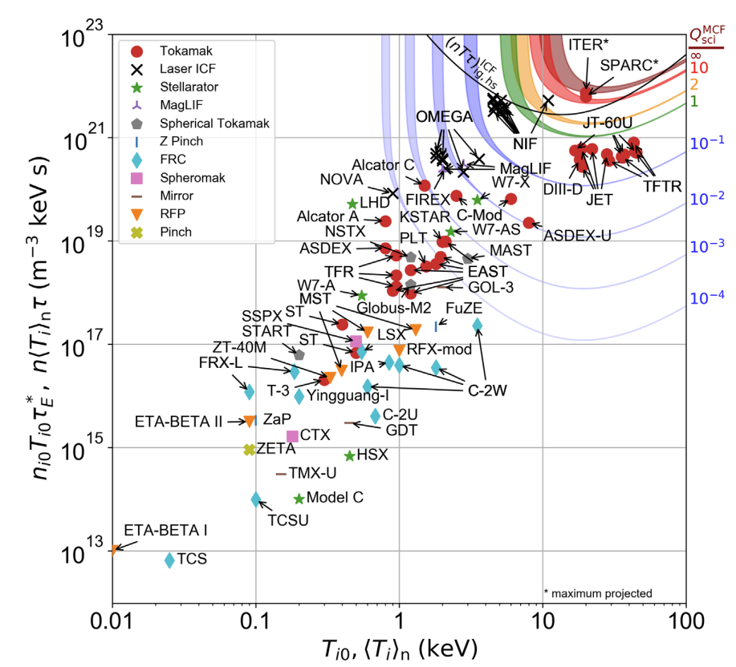
Many tokamaks around the world are making strides towards ignition
Ignition from 2022 on not shown here! See Simpson, 6/14
Copper magnetic field coils
  DIII-D (USA), JET (UK), ASDEX-U (Germany), COMPASS (Czech Republic), WEST (France), TCV (Switzerland)
Superconducting magnetic field coils
  EAST (China), KSTAR (Korea), JT60-SA (Japan)
Low aspect ratio
  NSTX-U (USA), MAST-U (UK)
Future public sector devices
  ITER (France)
  DEMO class devices: CFETR (China), EU-DEMO (EU), STEP (UK), FPP (US)
Many private sector companies entering the market
  Commonwealth Fusion Systems (SPARC/ARC, US)
  Tokamak Energy (ST40, UK)
  DOE awarded grant to eight companies advancing designs and research and development for fusion power plants
  And more!
Approaching ignition
(self-sustaining reaction)
Wurzel et al, PoP 29, 062103 (2022)
https://www.fusionenergybase.com
https://www.energy.gov/articles/doe-announces-46-million-commercial-fusion-energy-development
Notes:
International network of tokamaks that is greater than the sum of its parts, you can take physics you see on one tokamak and test it on other tokmaks. Allows us to get
Multi machine scalings and multi machine understanding that gives a deeper understanding and more robust result that we have more faith in extraqpolating to a future reactor.

Slide 15
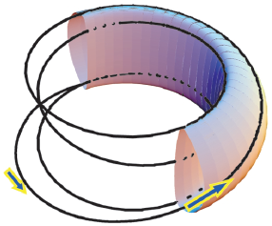
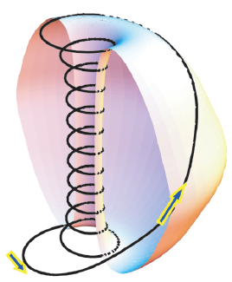
Two types of tokamaks: Conventional aspect ratio and spherical tokamaks
“Donut”
A ≥ 4
“Cored apple”
A ≥ 1.25
Conventional tokamaks
Usually A>2.5
Ex: ITER, ASDEX, JET, DIII-D, EAST, SPARC…
Spherical tokamaks
A=1-2.5
Ex: MAST, NSTX-U…
Peng, Phys. Plasmas, 7, 1681 (2000).
Notes:
Aspect ratio is the ratio of the major radius to the minor radius. This isn’t the ratio of the width to the height, but because the height and the minor radius usually have a similar ish ratio, it ends up being related to the width to the height. Doughnut vs cored apple. DIII-D aspect ratio is about 4.

Slide 16
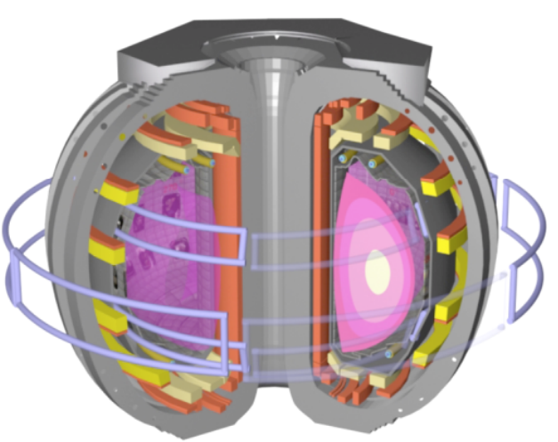
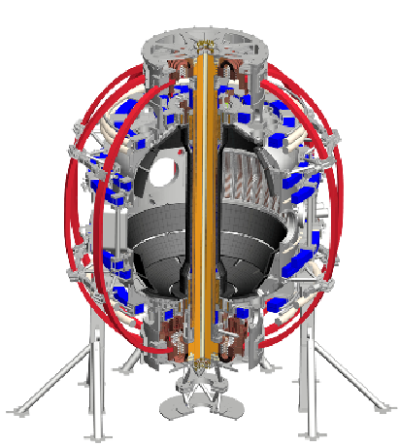
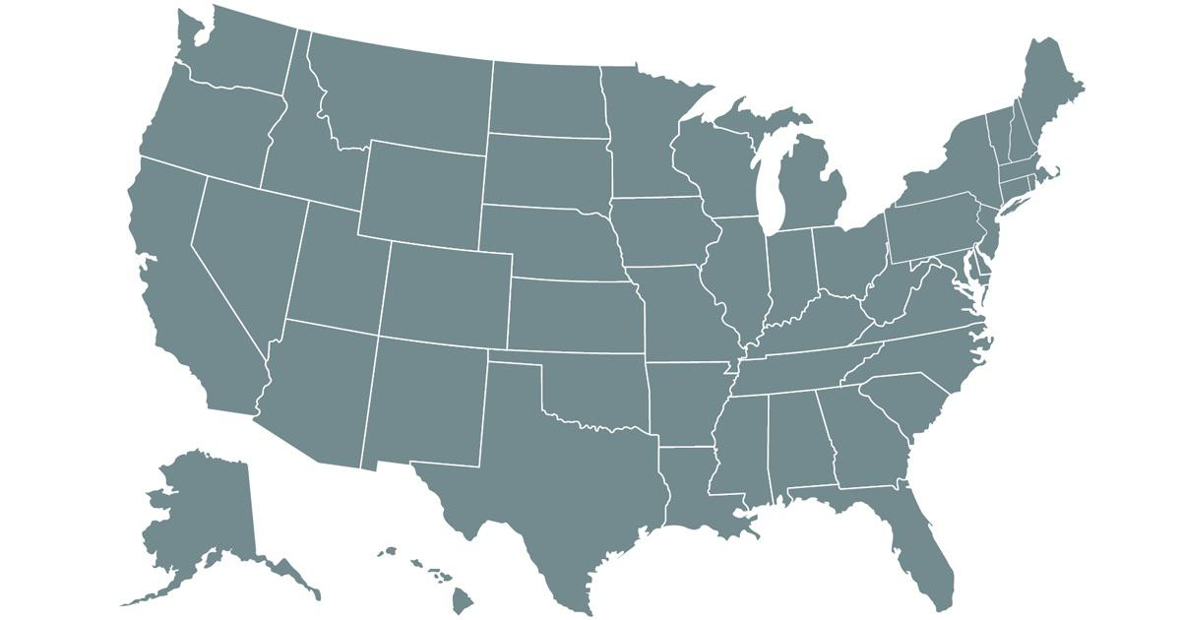
Two major U.S. facilities are DIII-D and NSTX-U, specializing in different aspect ratios
DIII-D,
Conventional tokamak
A=2.7
NSTX-U
Spherical tokamak
A=1.3
NSTX-U
DIII-D
Notes:
East cost West coast rivalry

Slide 17


Two major U.S. facilities are DIII-D and NSTX-U, specializing in different aspect ratios
DIII-D,
Conventional tokamak
A=2.7
NSTX-U
Spherical tokamak
A=1.3
NSTX-U
DIII-D

Slide 18
Where are we going?
Overview/review of key ideas
How does a tokamak work?
  Nested flux surfaces
  Shaping
  Heating and current drive
Some current research areas
How can you get involved?

Slide 19
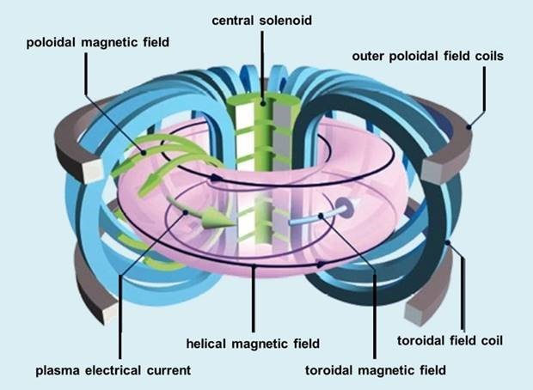
Tokamaks use magnetic fields to confine a plasma in a toroidal vacuum vessel
Notes:
(0) We start with an empty vacuum vessel. Into this we will introduce neutral gas and energy to generate a plasma.
Run a current in the central solenoid. The change of flux induces a toroidal electric field which breaks down the gas into a plasma, and drives a current through that plasma (Ip~1-2 MA) in the toridal direction. This is called ohmic or inductive startup.
We have current running in the toroidal field coils, which generates a toroidal magnetic field (BT~1-2 T) that confines the plasma.
The current in the toroidal direction generates a poloidal magnetic field, which is smaller than the toroidal field. This generates these twisted field lines that you see here.
We also have poloidal field coils that add poloidal field to shape and control the plasma.

Slide 20
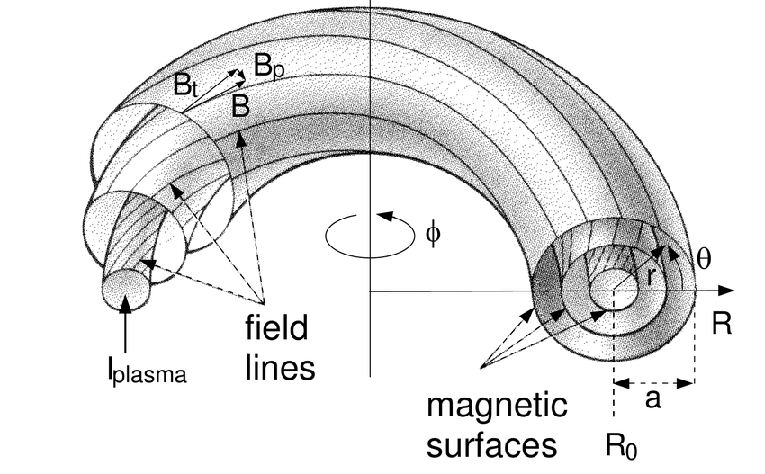

Tokamaks have nested magnetic surfaces
Two very important concepts:
Magnetic field lines lie on nested surfaces of constant magnetic flux, Ψ
Safety factor:
$$q=\frac{toroidal transits}{\begin{aligned}poloidal transits \\ =\frac{dφ}{dθ} or "pitch"\end{aligned}}$$
Tokamaks often use q₉₅ which is just inside
the last closed flux surface
Notes:
You have a current running through the plasma, distributed throughout the plasma, but in the toroidal direction. And you have the externally applied toroidal field. These give you the twisted field lines we saw in the previous slide. What you have here is nested surfaces on which the magnetic field lines lie. These are surfaces of constant magnetic flux. Each one of these surfaces have a different safety number q.
Called safety factor because it is related to the stability.. For higher values of q, the plasma is more stable. Poloidal transits are driven by currents. A higher current has a lower q.
Happens in tokamaks but also just happens in current carrying plasmas.
Q_95 is the value of q just inside the last closed flux surface.

Slide 21
Tokamaks have nested magnetic surfaces
Two very important concepts:
Magnetic field lines lie on nested surfaces of constant magnetic flux, Ψ
Safety factor:
$$q=\frac{toroidal transits}{\begin{aligned}poloidal transits \\ =\frac{dφ}{dθ} or "pitch"\end{aligned}}$$
Tokamaks often use q₉₅ which is just inside
the last closed flux surface

Slide 22
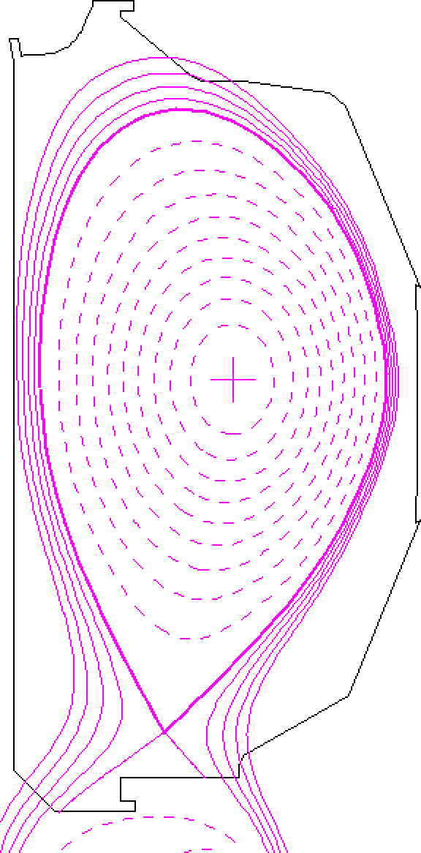
Surfaces described using ideal magnetohydrodynamics (Ideal MHD)
See Parsons, 6/11
MHD equilibrium in toroidally symmetric geometry:
Grad–Shafranov:
Equilibrium equation relates poloidal flux function (Ψ)
Pressure (p) and current flux function (F)
Notes:
MHD is treating plasma as single conducting fluid, Ideal MHD is treating it as a perfectly conducting fluid.
G-S eqn is an MHD equilibrium equation in toroidally symmetric geometry. This is what applies in tokamaks.
This is just force balance between magnetic force and plasma pressure.
What this does is relates poloidal flux function psi to the pressure and current flux function. SO we can solve for these surfaces, experimentally. On the r, cross section of DIII-D tokamak, these are the surfaces of constant flux.

Slide 23
Surfaces described using ideal magnetohydrodynamics (Ideal MHD)
See Parsons, 6/11
MHD equilibrium in toroidally symmetric geometry:
Grad–Shafranov:
Equilibrium equation relates poloidal flux function (Ψ),
pressure (p), and current flux function (F)
Ψ_{N}=0
Ψ_{N}=1
Nested magnetic surfaces of constant flux are called “flux surfaces”
  Pressure, current, q constant on a flux surface
We use flux coordinates to collapse to a 1D system, plotted vs. “normalized flux” Ψ_{N}
Last closed flux surface is called the “separatrix”
Notes:
More vocabulary.
An important concept is that a lot of things stay constant on a flux surface. Pressure, current, safety factor q. Magnetic field lines and current lines lie on these surfaces. We can often use flux coordinates to collapse to a 1D system. You can plot current, density, as a function of flux.
If you hear someone say an “efit”, this is what they are talking about.

Slide 24
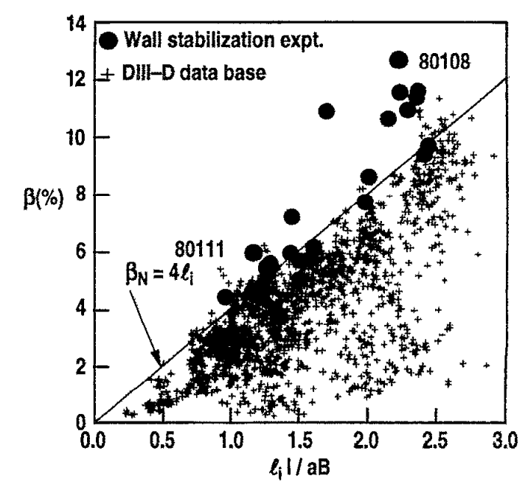

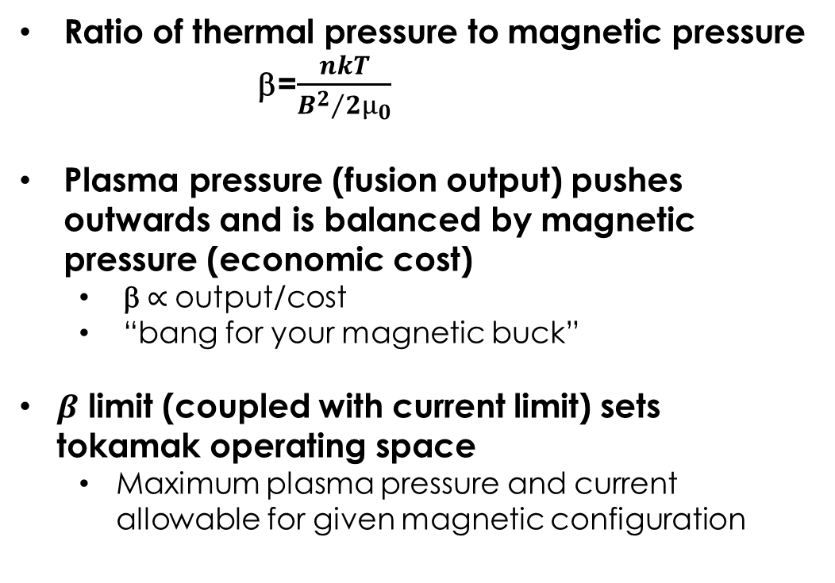
Pressure limit: Plasma “efficiency” can be defined by the parameter β
Ratio of thermal pressure to magnetic pressure
  β=$\frac{nkT}{{B^{2}}/{2μ_{0}}}$
Plasma pressure (fusion output) pushes outwards and is balanced by magnetic pressure (economic cost)
  β $∝$output/cost
  “bang for your magnetic buck”
$β$ limit (coupled with current limit) sets
tokamak operating space
  Maximum plasma pressure and current allowable for given magnetic configuration
Taylor et al, PoP 2, 2390 (1995)
Tokamaks normalize to an empirical current limit:
Notes:
Lets talk about pressure a little bit more. You can think of this as a measure of how magnetically confined it is. For an astrophysical

Slide 25
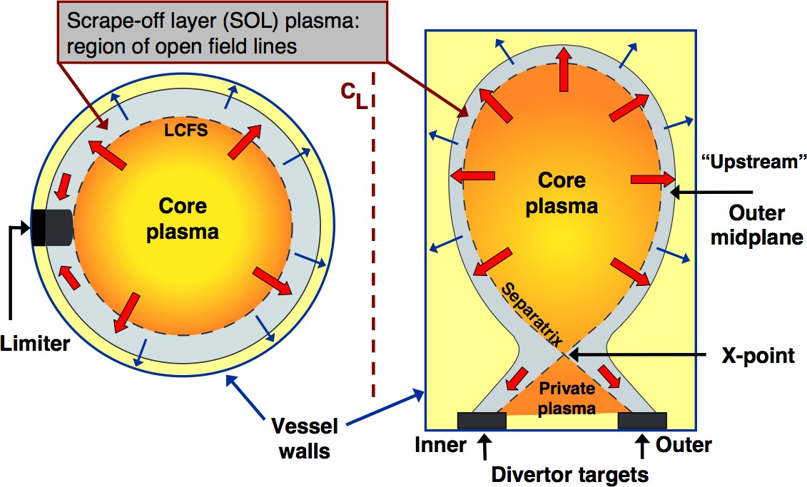
Two general types of tokamak magnetic topologies
Limiter:
A physical structure intentionally intersects a set of flux surfaces
Divertor:
Magnetic structure is created to localize exhaust
R. A. Pitts, “Tokamak edge physics and plasma surface interactions” 2007 https://crppwww.epfl.ch/~pitts/pitts/pitts_varenna_27_09_2007.pdf
Notes:
How do we do this?

Slide 26
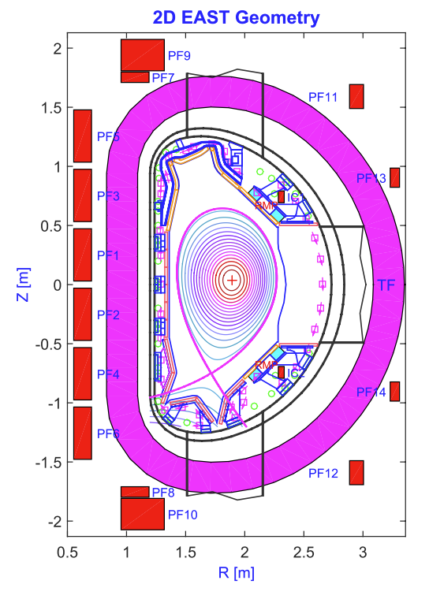
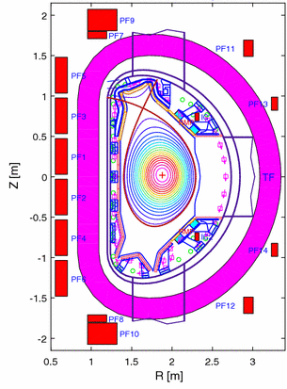
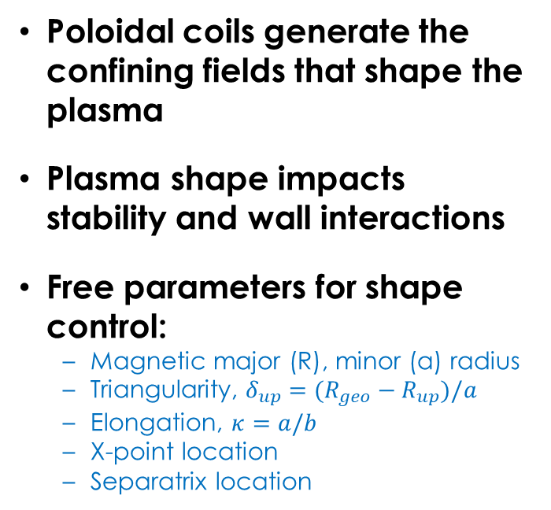


Poloidal field coils control plasma shape
Poloidal coils generate the confining fields that shape the plasma
Plasma shape impacts stability and wall interactions
Free parameters for shape control:
  Magnetic major (R), minor (a) radius
  Triangularity, $δ_{up}=(R_{geo}−R_{up})/a$
  Elongation, $κ=a/b$
  X-point location
  Separatrix location
EAST tokamak cross section
Lower Single Null (LSN)
Upper Single Null (USN)
Vacuum vessel
$$b$$
$$a$$
Poloidal field coils
Toroidal field coil

Slide 27
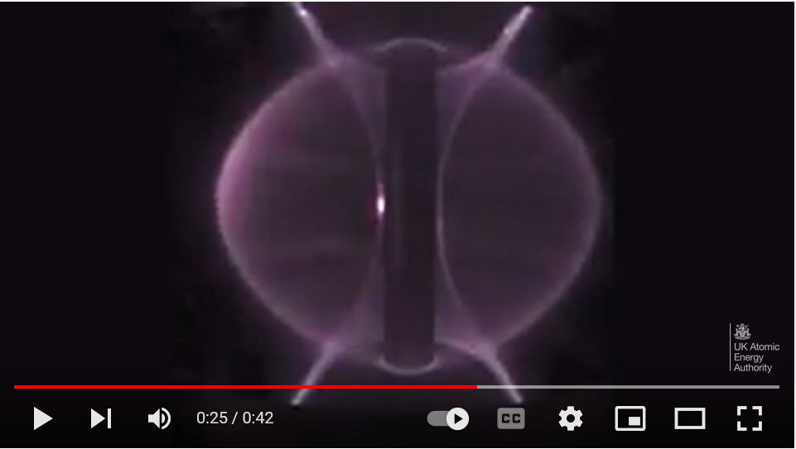
https://www.youtube.com/watch?v=Yu9C5TEhAdQ

Slide 28
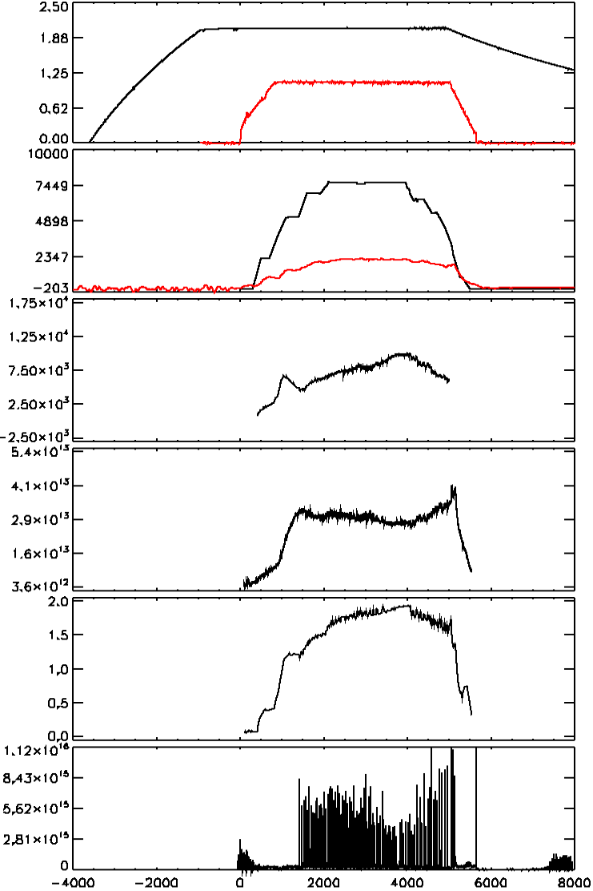

Example of a DIII-D plasma discharge
Toroidal magnetic field ramps up first
Central solenoid ohmically induces plasma current
Auxiliary systems required to heat the plasma and drive more current
Radiated power measures represents energy loss from the system (measured by bolometers)
Bt
“flat top”
Ip
Paux
Prad
Ion Temperature
Electron Density
$$β_{N}$$
Divertor Light
Notes:
That gives us a little bit of an idea of what’s going on but how do we know about the parameters that are important to us?
Before plasma starts, ramp up of magnetic field, then at t=0 inductive startup, we see current ramp up, reaches “flat top”
Auxiliary heating power, sum of NBI and ECH, also total radiated power

Slide 29
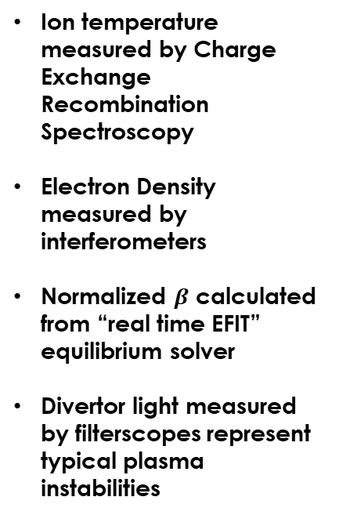
Example of a DIII-D plasma discharge
Toroidal magnetic field ramps up first
Central solenoid ohmically induces plasma current
Auxiliary systems required to heat the plasma and drive more current
Radiated power represents energy loss from the system (measured by bolometers)
Bt
“flat top”
Ip
Ion temperature measured by Charge Exchange Recombination Spectroscopy
Electron Density measured by interferometers
Normalized $β$ calculated from “real time EFIT” equilibrium solver
Divertor light measured by filterscopes represent typical plasma instabilities
Paux
Prad
Ion Temperature
Electron Density
$$β_{N}$$
Divertor Light

Slide 30
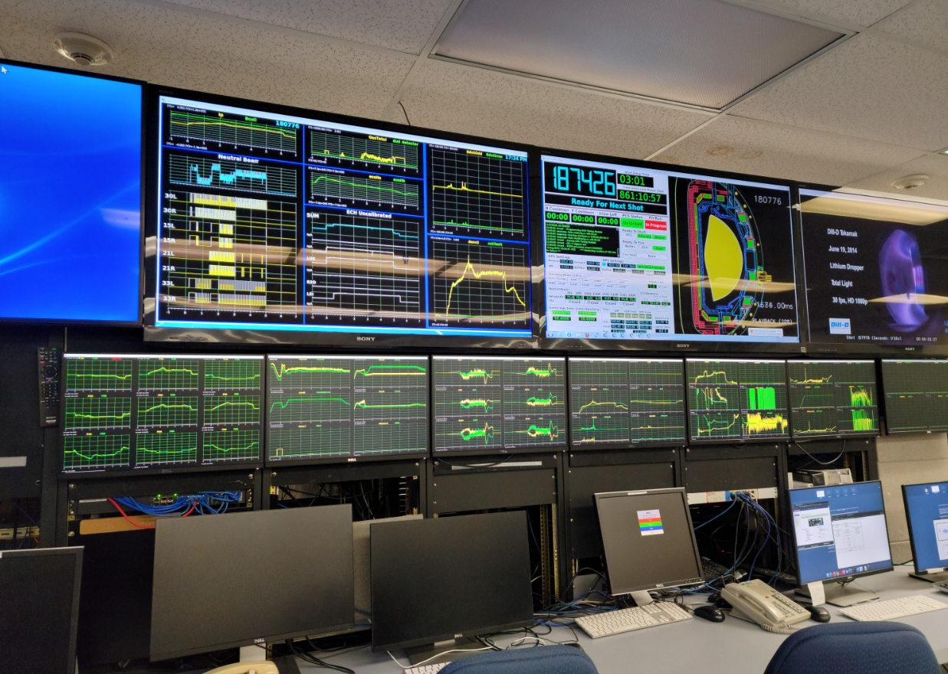
Example of a DIII-D plasma discharge
Toroidal magnetic field ramps up first
Central solenoid ohmically induces plasma current
Auxiliary systems required to heat the plasma and drive more current
Radiated power measures represents energy loss from the system (measured by bolometers)
Bt
“flat top”
Ip
Ion temperature measured by Charge Exchange Recombination Spectroscopy
Electron Density measured by interferometers
Normalized $β$ calculated from “real time EFIT” equilibrium solver
Divertor light measured by filterscopes represent typical plasma instabilities
Paux
Prad
Ion Temperature
Electron Density
$$β_{N}$$
Divertor Light
Notes:
Session leader
Physics operator
Chief operator
Console operator
30 ish people in the control room all working together to make experiment a success. Diagnosticians, theorists,

Slide 31
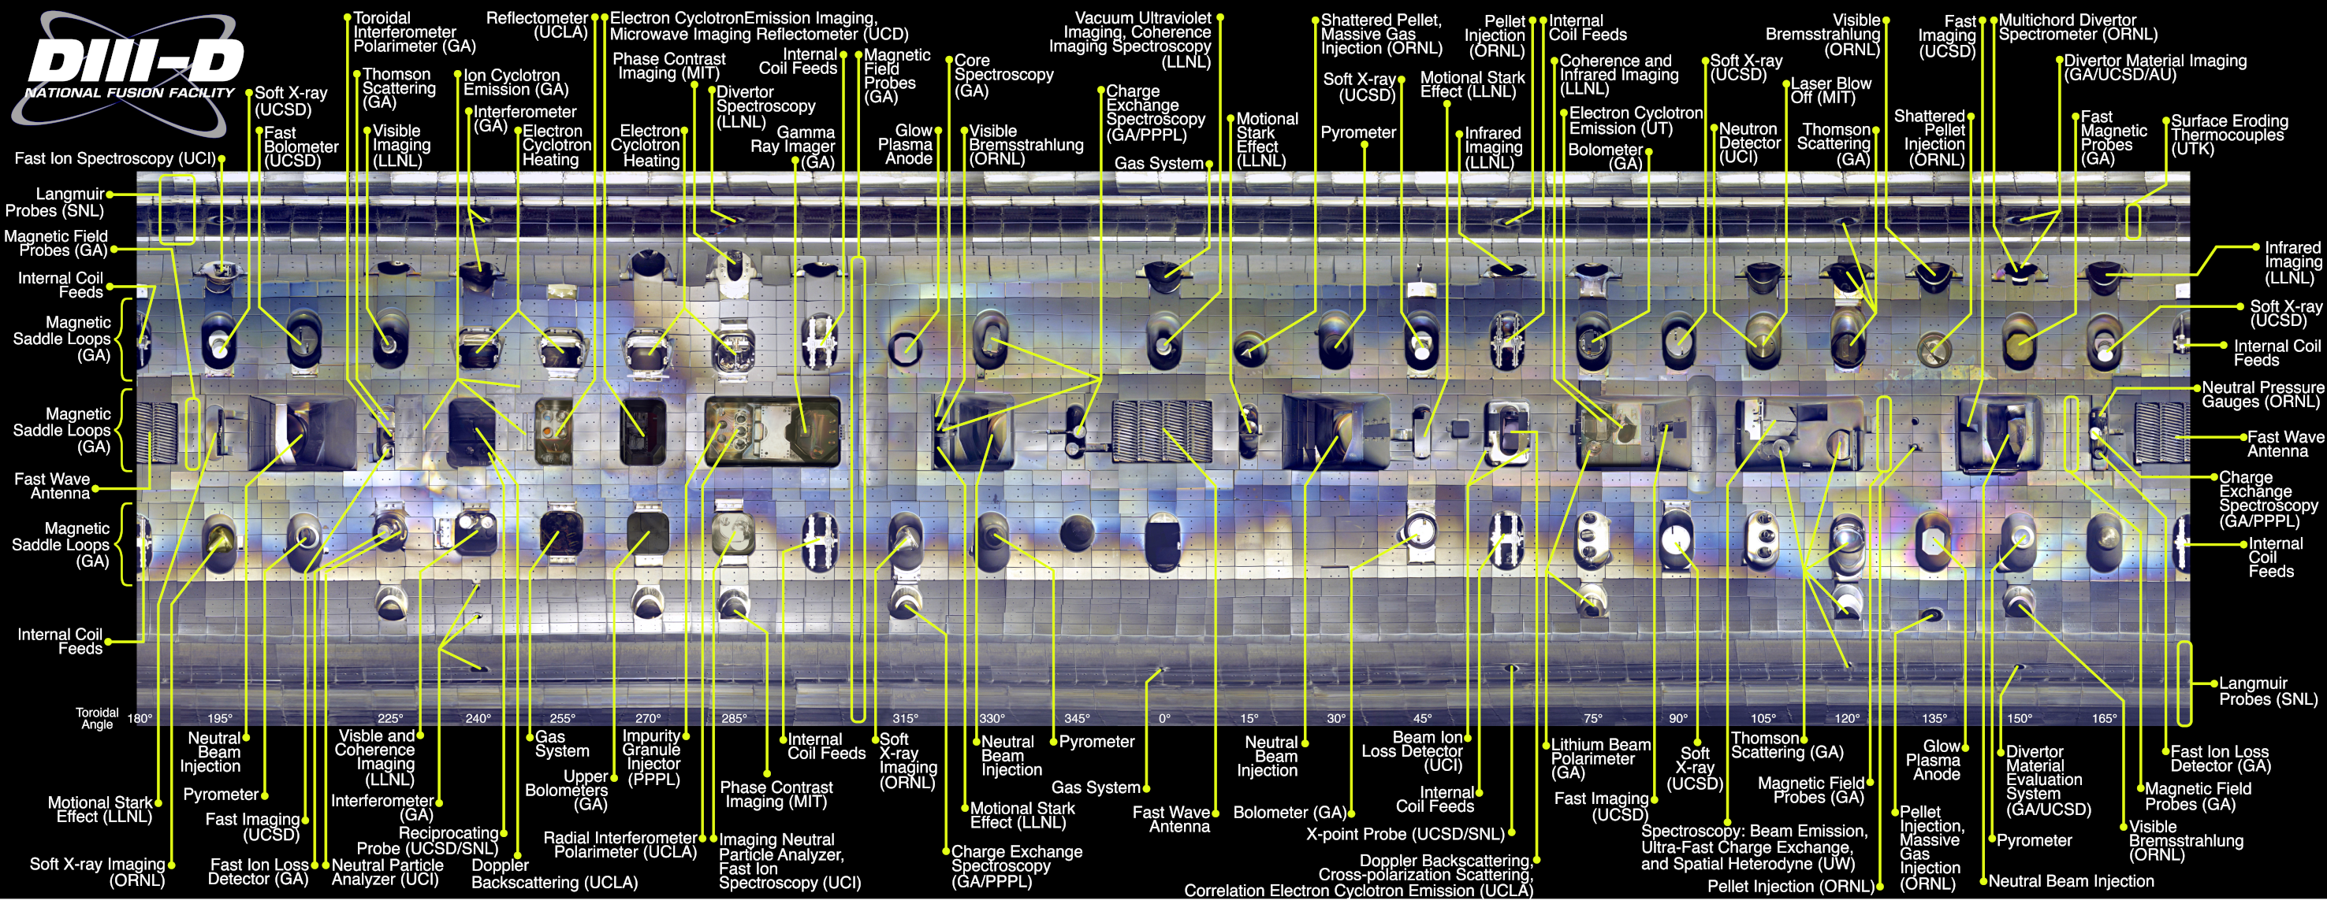
Diagnostics are a key part of tokamak research → How do you diagnose something that is so hot and in vacuum?
See Delgado-Aparicio, 6/21
Notes:
~160 ports

Slide 32
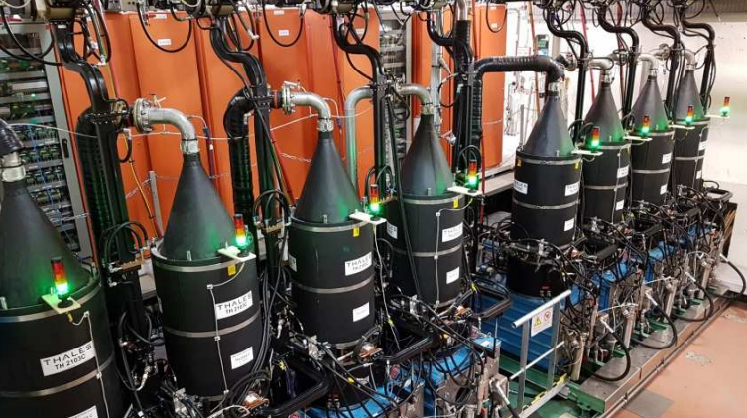
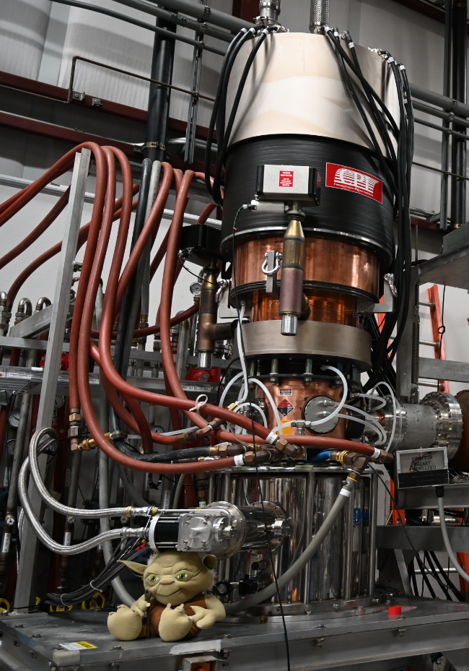
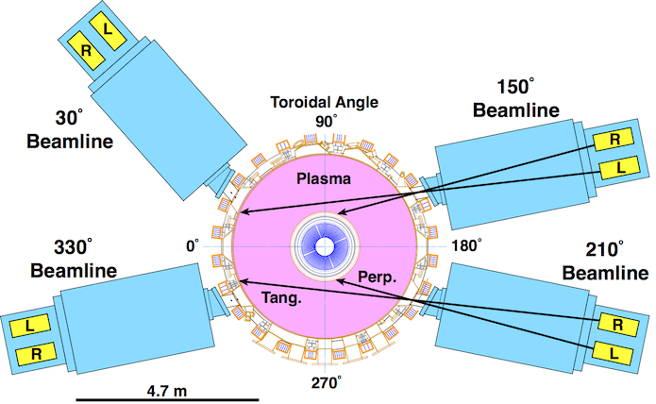
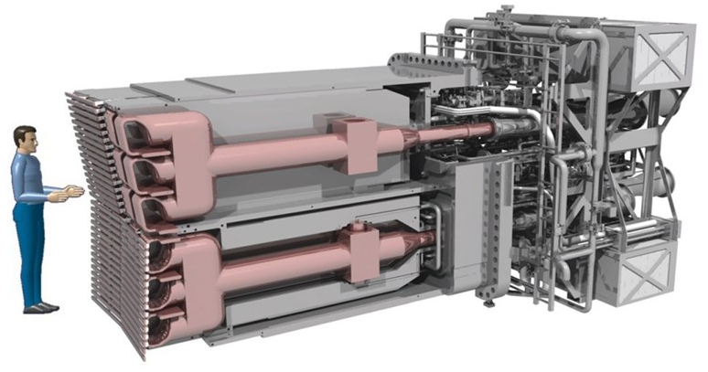
Need both current drive and heating in a tokamak
See Diem, 6/21
Heating is required in a reactor to ~15 keV
Non-inductive current drive is required for steady-state operation
Physics of heating and current drive is very similar
  If there is current drive, there is also heating
Wave heating
WEST Klystrons (lower hybrid)
DIII-D Gyrotron “Yoda” (electon cyclotron)
Neutral Beam Injection
DIII-D beamlines have 2 sources
Each source can deliver ~2MW
ITER’s ion cyclotron antenna

Slide 33
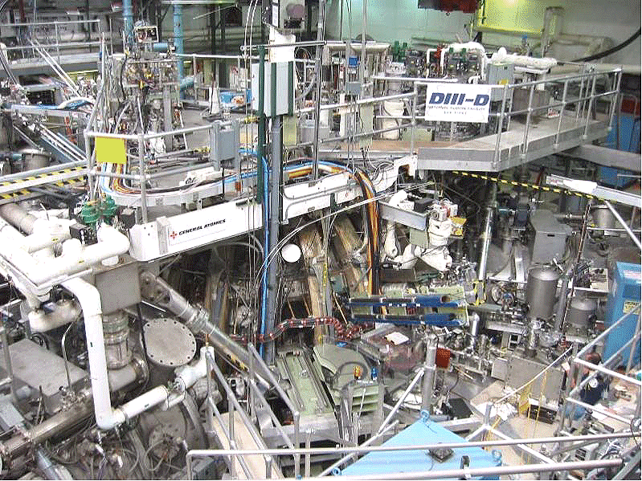
Tokamak is only one part of the machine hall
“The Pit”
Notes:
Tokamaks
Toroidal field coil: 24 of these, with a total of 144 turns
Take a large team to

Slide 34
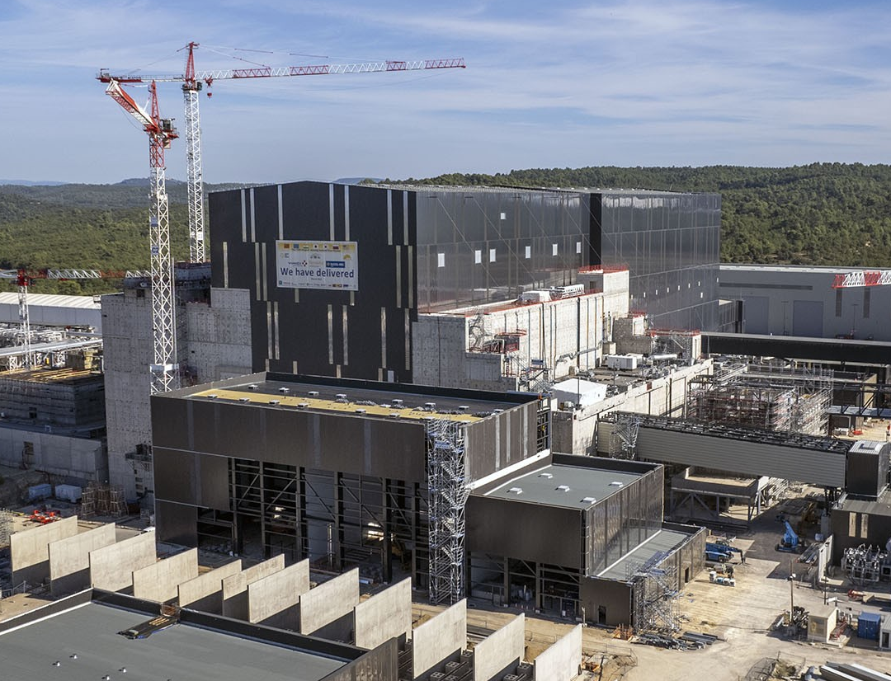
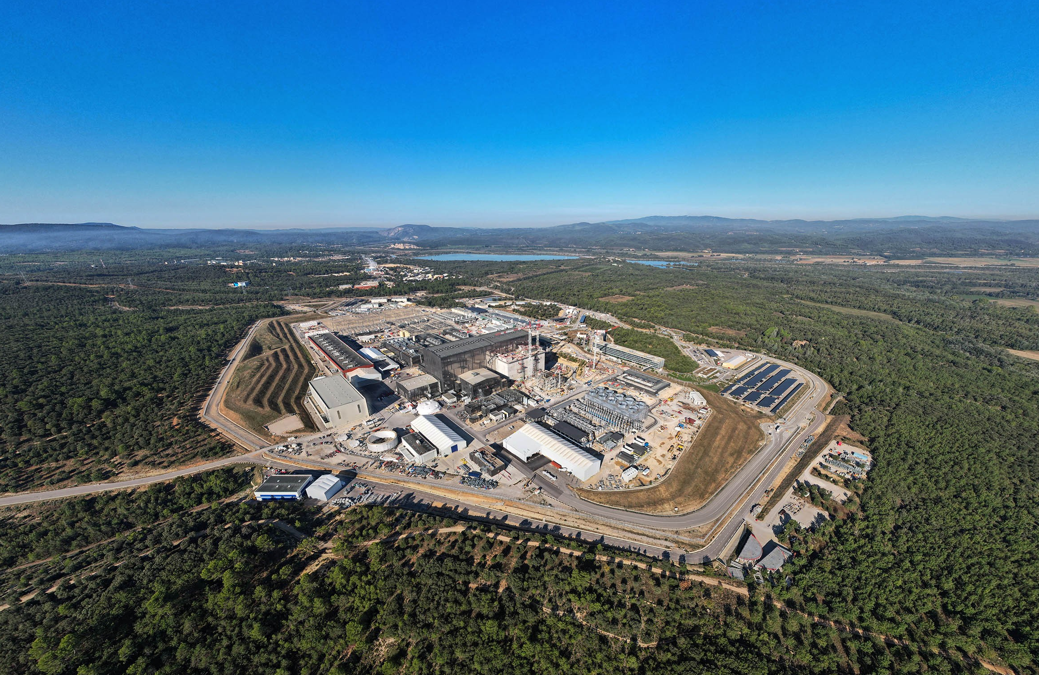
Iter will be the biggest tokamak yet
Iter machine hall, 9/2023
Iter site, 9/2023

Slide 35
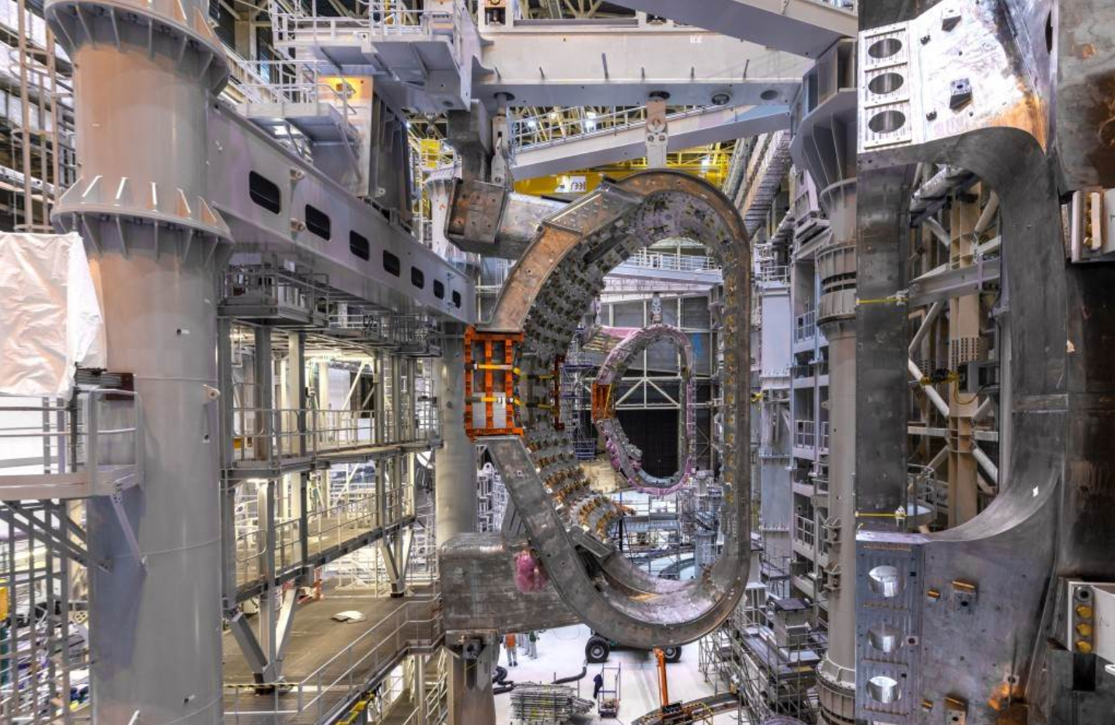
Iter will be the biggest tokamak yet
Iter vacuum vessel segment (1/9), 1/2023

Slide 36
What are some of the key ideas we’ve covered so far?
Tokamaks confine plasmas with toroidal and poloidal magnetic fields
Tokamaks have nested flux surfaces, important quantities are conserved on a flux surface
  Normalized flux coordinate ψ_{N}, safety factor q, pressure ratio β
External coils shape and control the plasma
  Separatrix, x-point, SOL, divertor
Tokamaks are complex, integrated facilities
  Heating and current drive, diagnostics
  Collaborative teams with diverse areas of expertise

Slide 37
Where are we going?
Overview/review of key ideas
How does a tokamak work?
  Nested flux surfaces
  Shaping
  Heating and current drive
Some current research areas
How can you get involved?

Slide 38
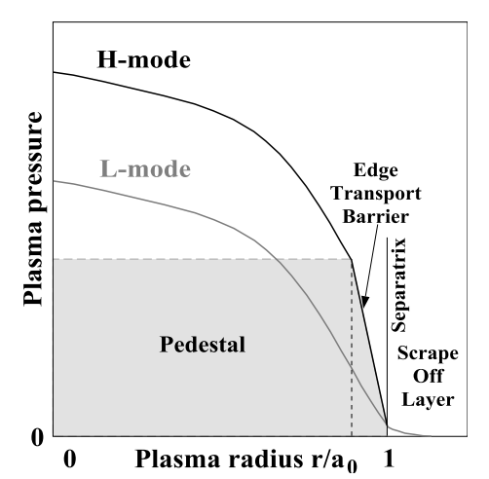
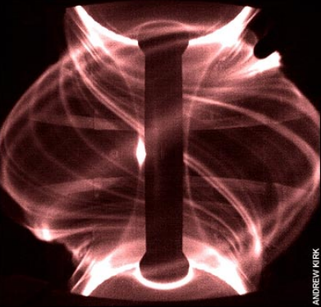
Varied levels of confinement of particles, momentum, and energy depending on the plasma regime
Two common plasma modes of operation
  L-mode = “low” energy confinement
  H-mode = “high” energy confinement, often associated w/ plasma instability called Edge Localized Mode (ELM)
H-mode extrapolates well to future devices because of energy confinement (due to enhanced pressure from pedestal)
Lang et al, NF 53, 043004 (2013)
MAST
Evans et al, Nonlinear Dynamics Ch 3 (image A. Kirk, Culham)

Slide 39
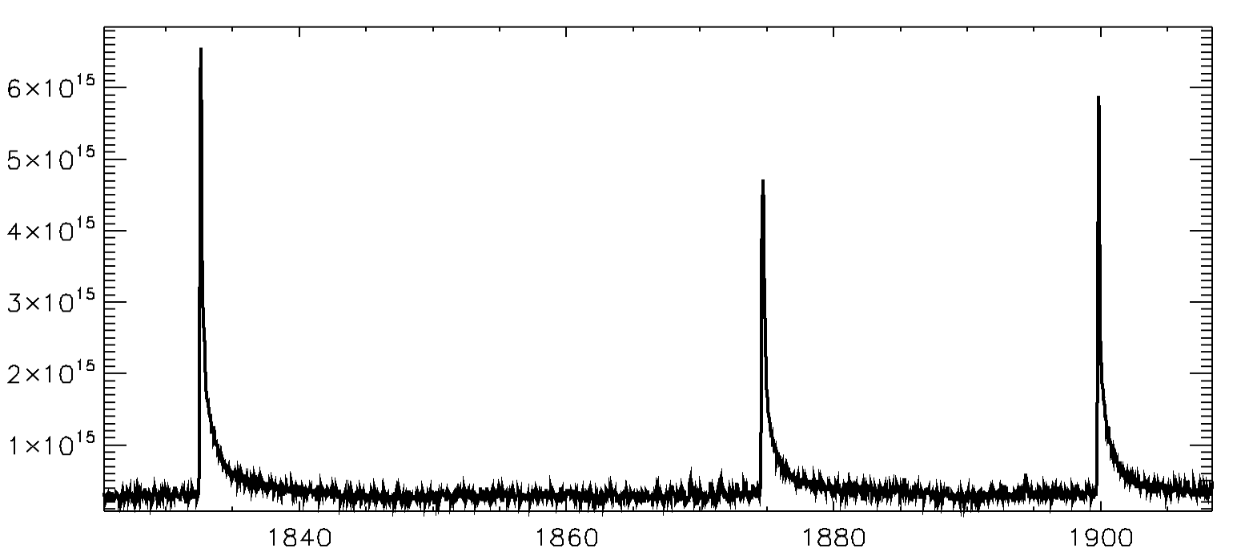
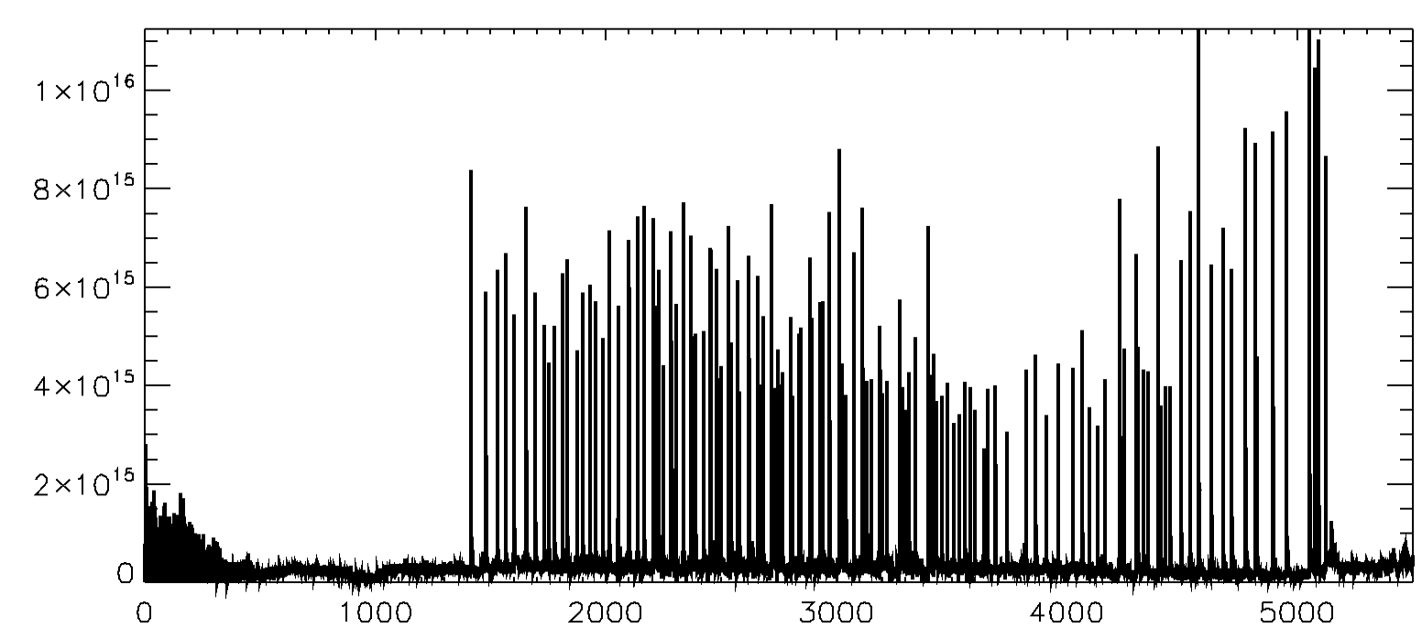
Varied levels of confinement of particles, momentum, and energy depending on the plasma regime
Two common plasma modes of operation
  L-mode = “low” energy confinement
  H-mode = “high” energy confinement, often associated w/ plasma instability called Edge Localized Mode (ELM)
H-mode extrapolates well to future devices because of energy confinement (due to enhanced pressure from pedestal)
ELMs deliver large transient heat fluxes to plasma facing components
Other types of modes are an active area of research → e.g. H-modes w/o ELMs or regimes w/ different confinement scalings
Lang et al, NF 53, 043004 (2013)
MAST
Evans et al, Nonlinear Dynamics Ch 3 (image A. Kirk, Culham)
ELMs
Divertor Light (filterscopes)

Slide 40
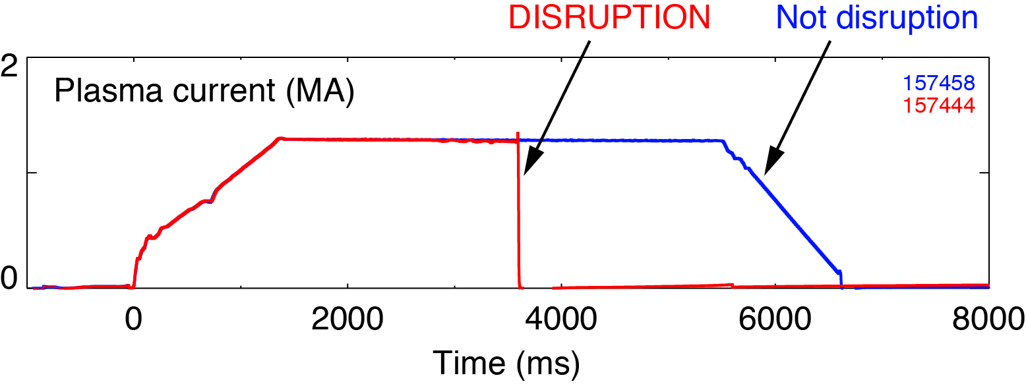
Disruptions are a rapid and complete loss of current and energy
Threat for a tokamak, possible disaster for a reactor
  High heat flux, large thermal load to divertor
  Large electromagnetic forces
  Runaway electrons
Disruption avoidance
  Prediction, active control to avoid
Disruption mitigation
  Shattered pellet injection, massive gas injection

Slide 41



High heat flux and narrow profile can damage divertor plates
Many strategies to reduce divertor heat flux
  Add impurities to increase radiation in SOL
  Shaping the divertor baffle
  Expand magnetic flux using snowflake and super-X configurations
Core–edge integration is grand challenge
  Have to mitigate heat flux without harming confinement
Plasma facing materials in the divertor and main chamber wall
^{Jaervinen et al NME 19 (2019)}
MAST-U
Morris et al IEEET rans. Plasma Sci. 46 (2018)
See Schamis, 6/18

Slide 42
Where are we going?
Overview/review of key ideas
How does a tokamak work?
  Nested flux surfaces
  Shaping
  Heating and current drive
Some current research areas
How can you get involved?

Slide 43
There are many tokamaks in the world you could work on!
Currently two big tokamak facilities in the US
  NSTX-U and LTX at Princeton Plasma Physics Laboratory (Princeton, NJ)
  DIII-D National Fusion Facility (San Diego, CA)
  Universities have collaborations with PPPL and DIII-D and have on-site grad students
Some US university tokamaks: Pegasus III (University of Wisconsin-Madison), HBT-EP (Columbia University)
International facilities
  Iter (France), JET (UK), ASDEX-U (Germany), COMPASS (Czech Republic), WEST (France), TCV (Switzerland), EAST (China), KSTAR (Korea), JT60-SA (Japan), MAST-U (UK)

Slide 44



Major topical areas of open research → You can be part of the team to meet these challenges!
Many open questions and challenges to address to put fusion on the grid
Recent community plan aligned goals and prioritized research objectives (Final report here: https://arxiv.org/abs/2011.04806)
Exciting new opportunities for engagement (ITER, SPARC, EXCITE proposed by NAS and CPP reports, milestone based DOE grants to 8 private companies, including 2 tokamak companies…)

Slide 45

Tokamaks represent a key path towards achieving fusion energy
Tokamaks are toroidal devices that use toroidal and poloidal magnetic fields to confine the plasma
Tokamaks can meet the energy challenge
Two tokamaks in the US (NSTX-U and DIII-D) used to study and model plasma physics for extrapolation to a fusion pilot plant
Complex environments with many integrated teams and exciting science

Slide 46
Thank you and good luck with your research!

