Slide 1
Introduction to Low Temperature Plasmas
Amanda M. Lietz
Department of Nuclear Engineering, North Carolina State University
2024 Introduction to Plasma and Fusion Course
June 17, 2024

Slide 2
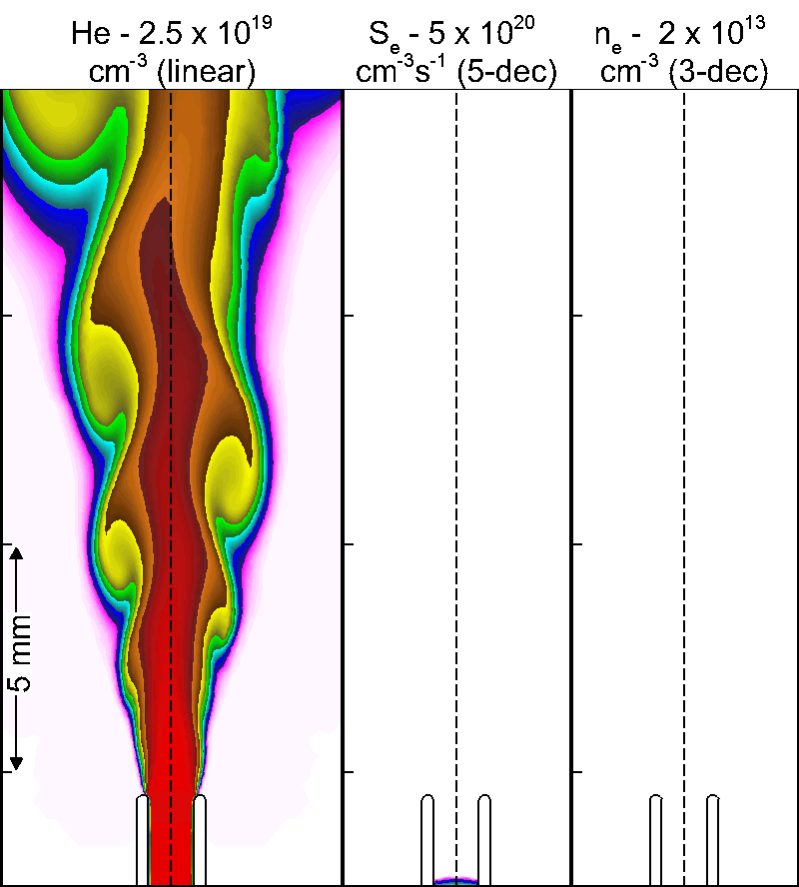
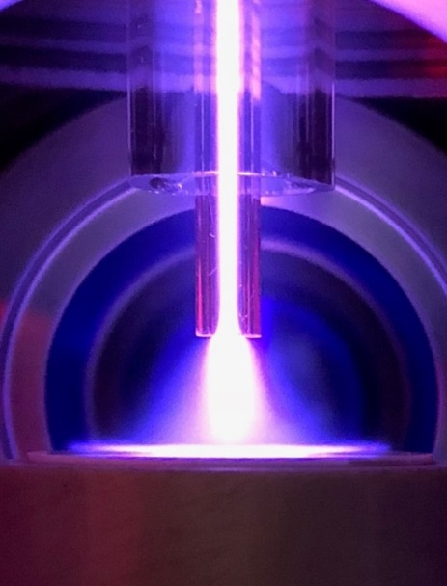
Dr. Lietz’s Technical Background
Assistant Professor in NCSU Nuclear Engineering Department since August 2022.
B.S., Nuclear Plasma and Radiological Engineering from University of Illinois at Urbana-Champaign
PhD, Nuclear Engineering and Radiological Sciences at University of Michigan
Atmospheric Pressure Plasma Sources for Plasma Medicine
Primarily fluid and global modeling
Laser diagnostics
Postdoctoral Appointee at Sandia National Laboratories
Thermionic energy converters, mass spectrometers, validation, semiconductor processing
Primarily particle-in-cell simulations
2

Slide 3
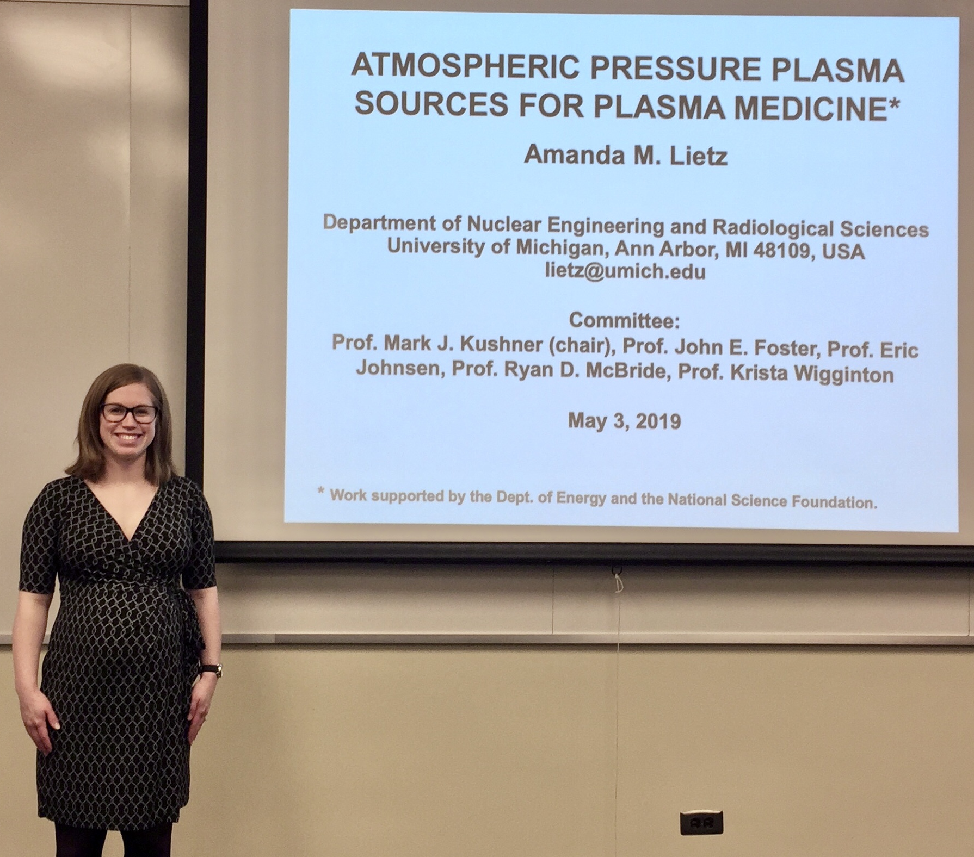
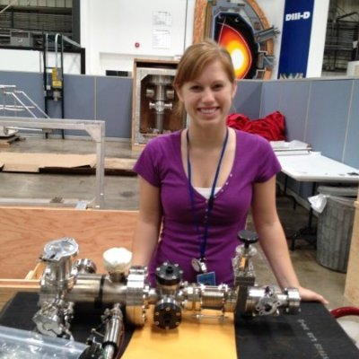
Dr. Lietz’s Personal Background
Participated in this course in 2012!
Notes:
Illinois hired first female faculty, pregnant on every job interview, kids

Slide 4
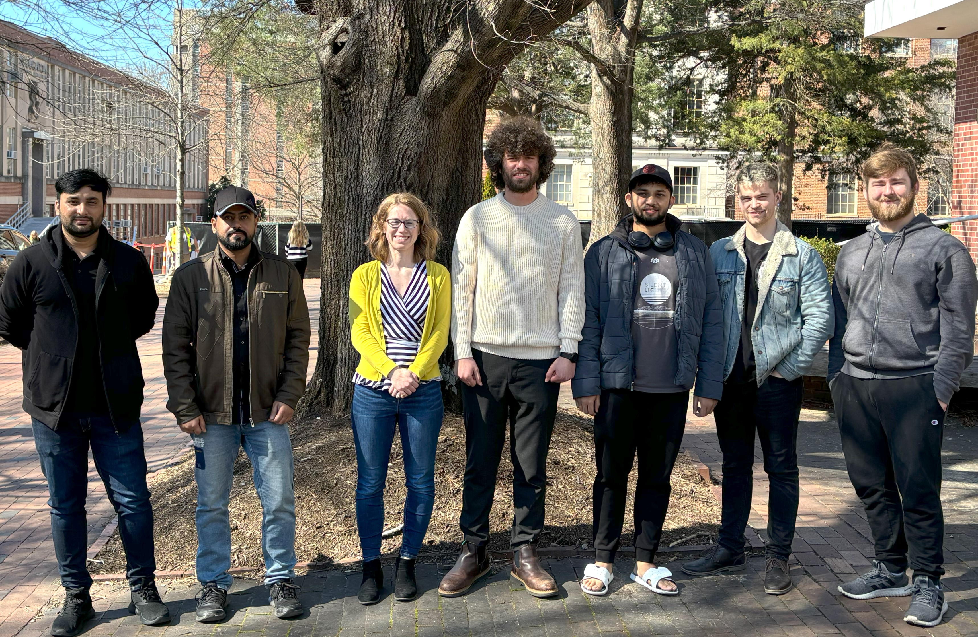
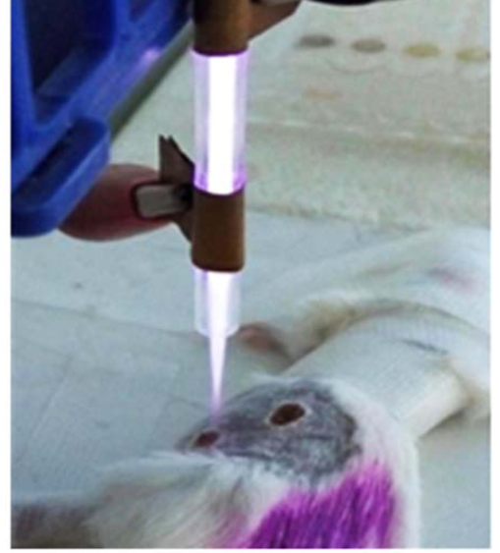
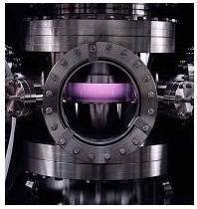
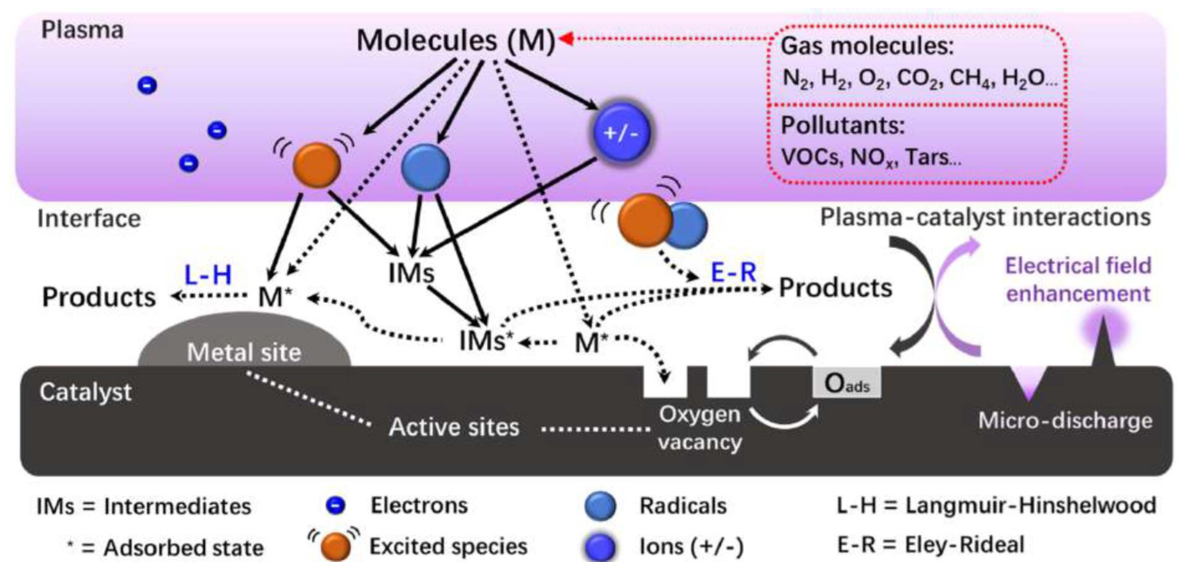
Computational Plasma Science (ComPS) Group
Application Areas of Interest:
Semiconductor Processing
Fusion Technologies
Biomedical Applications
Chemical Conversion
Laser-produced Plasmas
G. Xu, X. Shi, J. Cai, S. Chen and P. Li, Wound Repair Regen. 23, 878 (2015).
Modeling Low Temperature Plasmas.
Established in August 2022.
Tackling these problems involves using existing tools and developing new tools.
“Plasma Process Metrology” www.nist.gov

Slide 5
Agenda
Defining a Low Temperature Plasma (LTP)
Conceptual Derivation of a Sheath
Non-equilibrium and non-Maxwellian in LTPs
Applications of LTPs
The Role of Computational Modeling
Learning objectives:
Explain why T_{e} >> T_{gas}.
Name several applications of LTPs.
Describe a sheath.

Slide 6
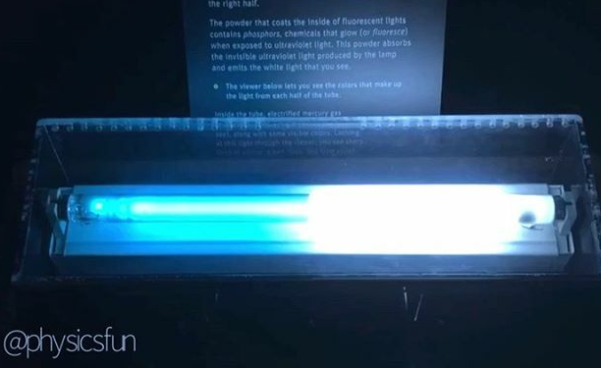
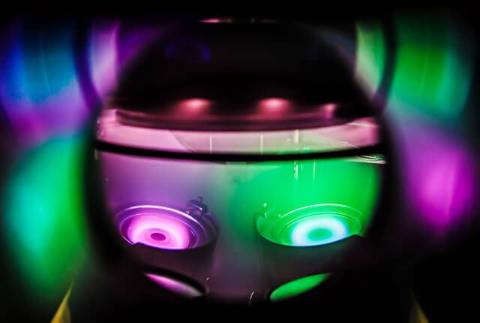
What is a Low-Temperature Plasma?
E
+
e⁻
-
e⁻
+
e⁻
+
e⁻
e⁻
e⁻
+
e⁻
Solvay
Low temperature plasma – plasmas with a gas temperature much less than what would cause ionization.
Electrons are heated by an electric field.
T_{e} >> T_{gas}
Sustained by electron-impact ionization.
e + M → M⁺ + e + e
Angstrom engineering
Notes:
Explain fluorescent light bulbs

Slide 7
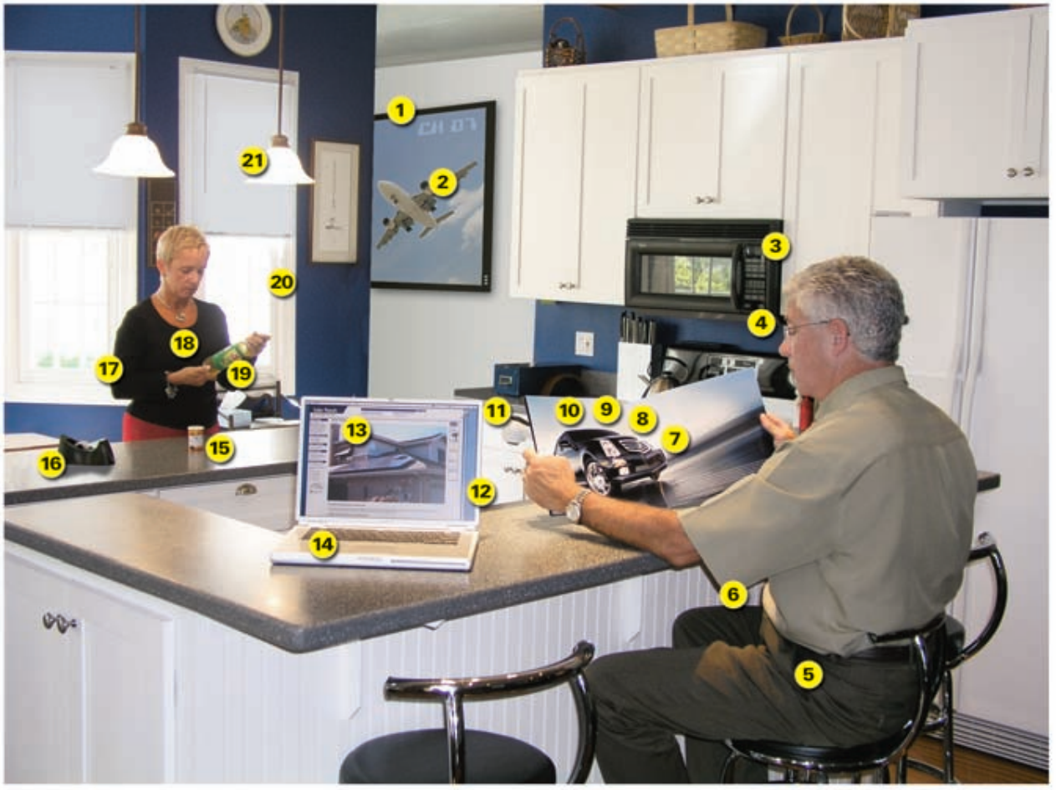
…
“Plasma Science: Advancing Knowledge in the National Interest” National Research Council of the National Academies Report (2007).

Slide 8
Low-Temperature Plasmas
In order to have a plasma, some energy needs to be high enough to cause an ionization.
In a thermal plasma (i.e. the sun) : T_{gas} ~ E_{iz} (10 eV, 110,000 K)
Low-temperature plasmas use E-fields, which selectively accelerate electrons.
m = mass,
v = velocity,
e = elementary charge,
E = constant electric field
Ignoring collisions.
Low temperature plasmas also tend to be weakly ionized – only a ppb/ppm is charged species.
Electrons
Ions
$m_{e}\frac{dv_{e}}{dt}=−eE$ $m_{i}\frac{dv_{i}}{dt}=eE$
$v_{e}=−\frac{eE}{m_{e}}t$ $v_{i}=\frac{eE}{m_{i}}t$
$$\frac{3}{2}k_{b}T=\frac{1}{2}m\left\langle v^{2}\right\rangle$$
$\frac{3}{2}k_{b}T_{e}=\frac{1}{2}m_{e}{\left(\frac{eE}{m_{e}}t\right)}^{2}$ $\frac{3}{2}k_{b}T_{i}=\frac{1}{2}m_{i}{\left(\frac{eE}{m_{i}}t\right)}^{2}$
$T_{e}∝\frac{1}{m_{e}}$ $T_{i}∝\frac{1}{m_{i}}$
$m_{e}≪m_{i}$ ∴ $T_{e}≫T_{i}$

Slide 9
Plasma Chemistry: Electron Impact Reactions
Energetic electrons collide with neutral atoms/molecules.
N
N
e⁻
N
N
Elastic Collision (all energies)
e + He → He + e
Billiard balls, electron loses energy to gas heating
Ionization (4 – 25 eV)
e + He → He⁺ + e + e
Electronic excitation (1-10 eV)
e + He → He* + e
Can emit a photon
Vibrational excitation (0.1-1 eV)
e + N₂(v=0) → e + N₂ (v≥0)
e⁻
Dissociation (1-15 eV)
e + N₂ → N + N + e
Dissociative ionization (10-20 eV)
e + N₂ → N + N⁺ + e + e
Attachment (low energy)
e + O₂ + M → O₂⁻ + M
Dissociative attachment (low energy)
e + O₂ → O⁻ + O
Superelastic collision (low energy)
e + He* → He + e

Slide 10
SHEATHS

Slide 11
Start with an “ideal” plasma
Let’s initialize a perfectly uniform plasma
In a gap between two infinite surfaces.
n_{e} = electron number density
n_{i} = ion number density
Potential
Number Density
n_{e} = n_{i}
V
Position
11

Slide 12
Fluxes to Surfaces
Flux – the number of particles passing through a surface, per unit area, per unit time.
The thermal flux in a gas is
$$Γ=\frac{1}{4}nv_{th}$$
n = number density
v_{th} = average thermal speed
$$v_{th}=\sqrt{\frac{8k_{B}T}{πm}}$$
Even if $T_{e}=T_{i}$,
$$m_{e}≪m_{i}∴v_{th,e}≫v_{th,i}$$
$$Γ_{e}≫Γ_{i}$$
Γ_{e}
Γ_{e}
Γ_{i}
Γ_{i}
Potential
Number Density
n_{e} = n_{i}
V
Position
Lose e⁻ faster because they’re moving faster!
12

Slide 13
Plasma Potential Develops
An instant later…
You only need to lose a very small fraction of the electrons to create a significant electric potential.
This electric field near the walls changes the fluxes.
Γ_{e}
Γ_{e}
Γ_{i}
Γ_{i}
Potential
n_{e} < n_{i}
n_{e} = n_{i}
n_{e} < n_{i}
Number Density
V
Position
13

Slide 14
Steady State – Sheath!
The self-generated electric field stops growing when the fluxes balance.
When a charged particle approaches the wall, this potential
Decelerates electrons
Accelerates ions
Plasma tends to be the most positive thing in the system.
If you apply a positive voltage, the plasma potential will increase above that.
Γ_{e}
Γ_{e}
Γ_{i}
Γ_{i}
Potential
n_{e} < n_{i}
n_{e} = n_{i}
n_{e} < n_{i}
Number Density
V
Position
14

Slide 15
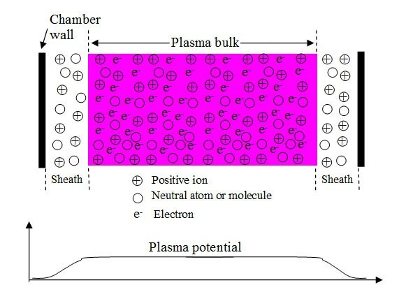
Now we have a sheath!
-
-
-
-
-
-
-
-
Sheath is a few λ_{D} thick
Sheaths form at all wall surfaces in contact with the plasma
The plasma is the most positive thing in the system (“Plasma potential”)
The potential profile accelerates ions and repels electrons.
Because electrons are hot, many of them have enough energy to overcome the potential gradient.
15

Slide 16
ELECTRON ENERGY DISTRIBUTIONS

Slide 17
Plasma Chemistry: Electron Impact Reactions
Energetic electrons collide with neutral atoms/molecules.
N
N
e⁻
N
N
Elastic Collision (all energies)
e + He → He + e
Billiard balls, electron loses energy to gas heating
Ionization (4 – 25 eV)
e + He → He⁺ + e + e
Electronic excitation (1-10 eV)
e + He → He* + e
Can emit a photon
Vibrational excitation (0.1-1 eV)
e + N₂(v=0) → e + N₂ (v≥0)
e⁻
Dissociation (1-15 eV)
e + N₂ → N + N + e
Dissociative ionization (10-20 eV)
e + N₂ → N + N⁺ + e + e
Attachment (low energy)
e + O₂ + M → O₂⁻ + M
Dissociative attachment (low energy)
e + O₂ → O⁻ + O
Superelastic collision (low energy)
e + He* → He + e

Slide 18
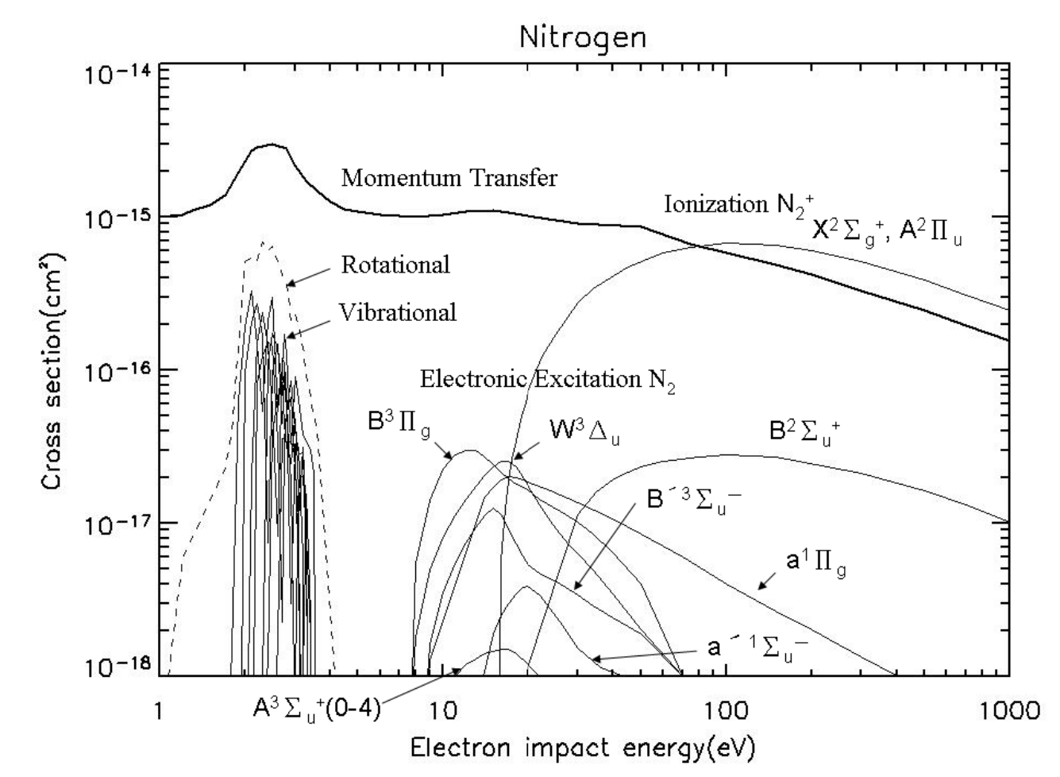
Electron Energy Distribution Functions (EEDFs)
Must use cross sections (instead of rates) for electron impact reactions.
Cheng Ling Kuo, Advances in Spacecraft Systems and Orbit Determination.

Slide 19
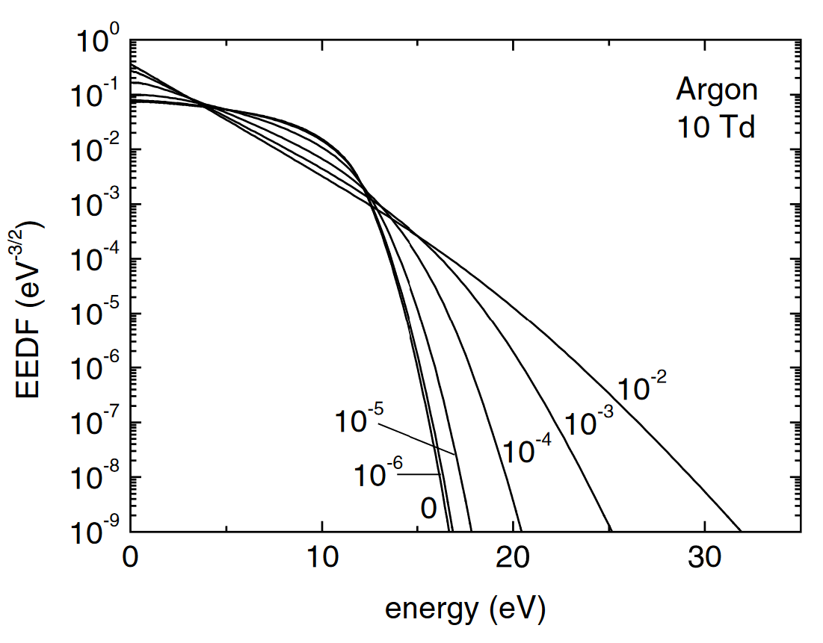
Electron Energy Distribution Functions (EEDFs)
Solve Boltzmann’s equation in 0D using a spherical harmonic expansion of the EEDF:
$$f\left(\overset{⃑}{x},\overset{⃑}{v},t\right)=f_{0}\left(v\right)+f_{1}\left(v\right)cos⁡(θ)$$
This is used to calculate reaction rates, k(T_{e}).
Sometimes fully kinetic (Monte Carlo) methods are required.
Maxwellian
Hagelaar, Pitchford. Plasma Sources Sci. Technol. 14, 722 (2005).
Cheng Ling Kuo, Advances in Spacecraft Systems and Orbit Determination.
Energy distributions can be significantly non-Maxwellian.
A Maxwellian distribution is linear in these units.
Must use cross sections (instead of rates) for electron impact reactions.

Slide 20
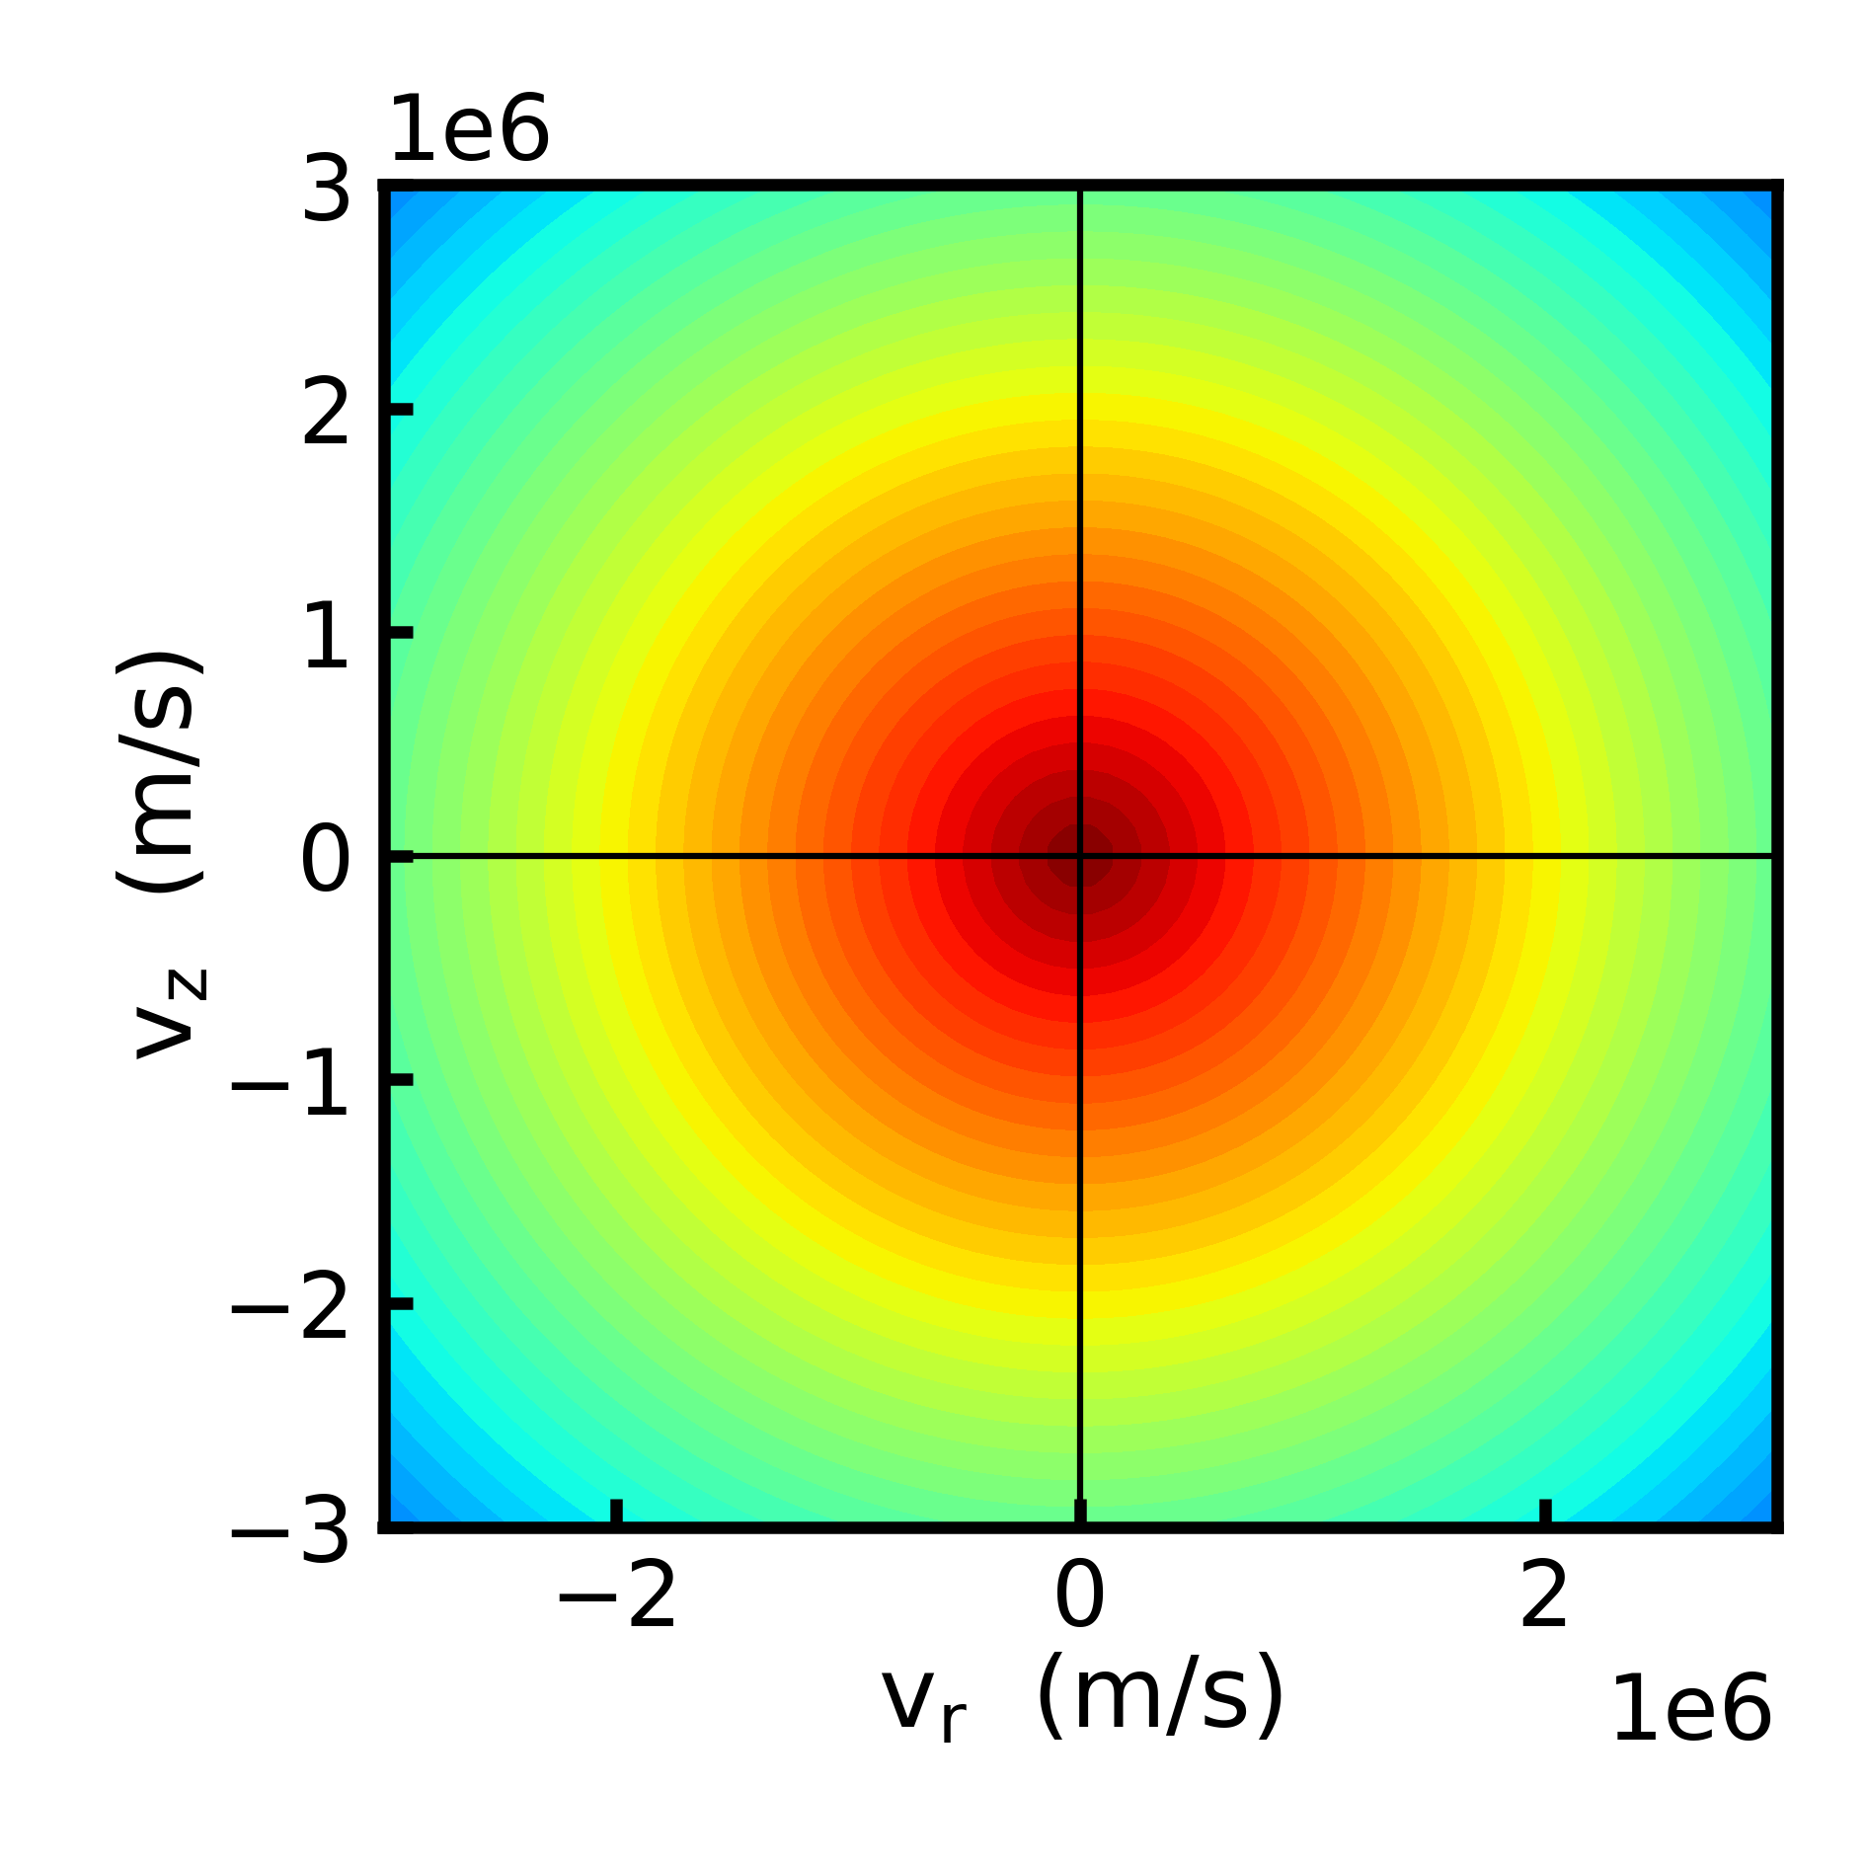
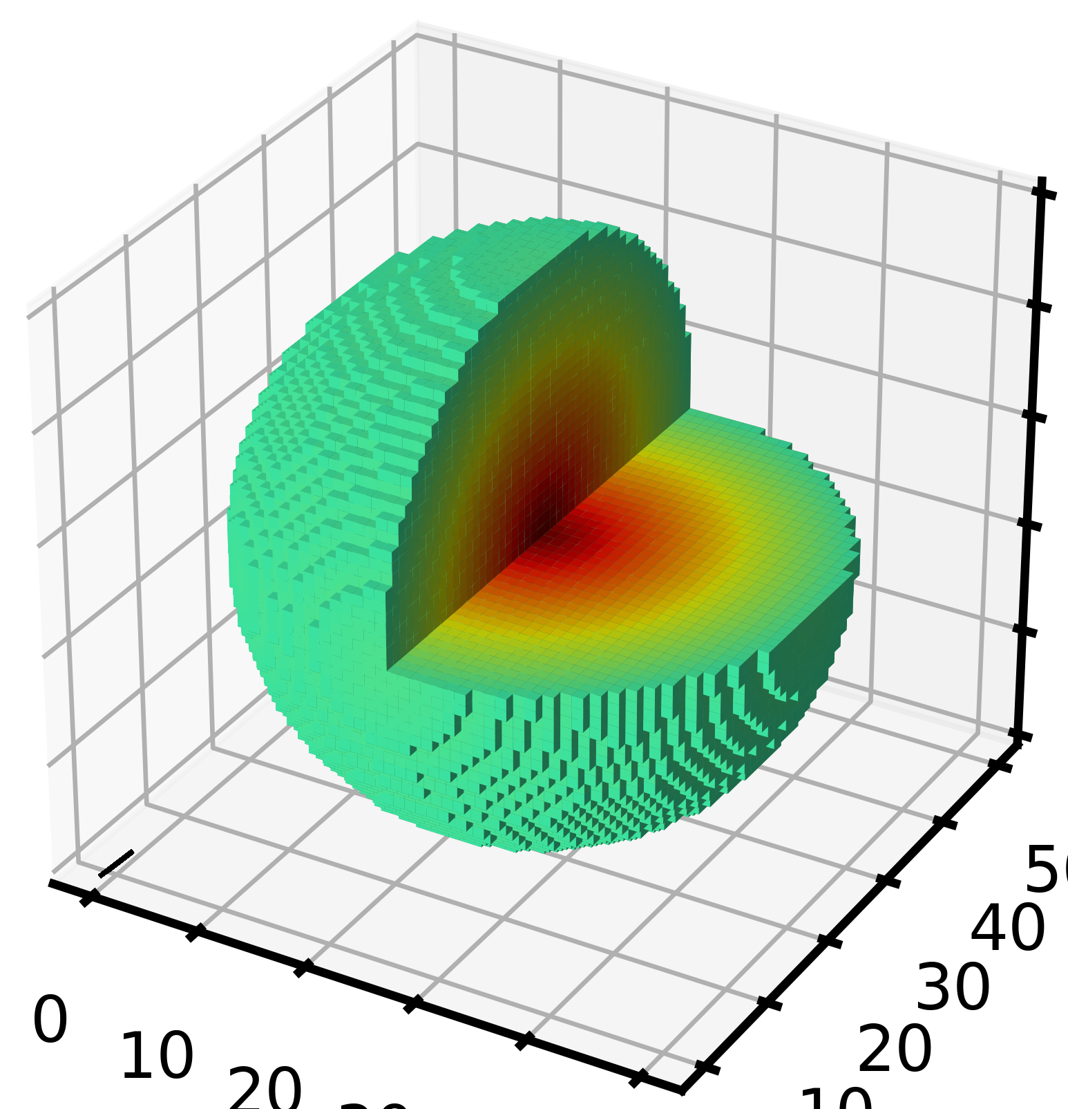
Maxwellian Distribution Function, f(v)
2.5 eV
Units : s³/m³
Same distribution, plotted in 3V space
Spherical symmetry

Slide 21
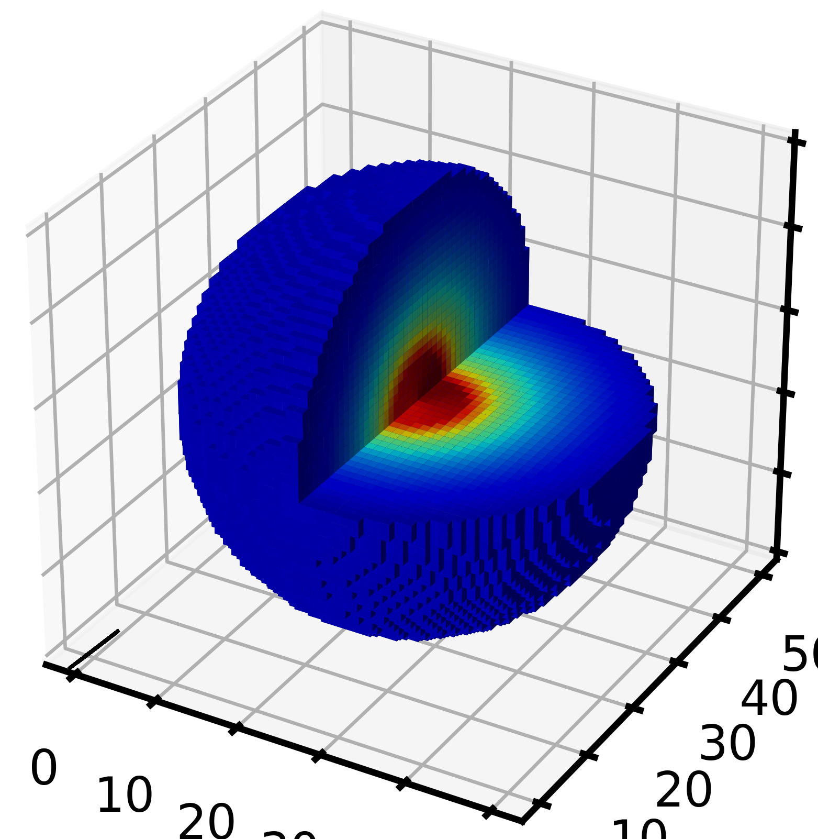
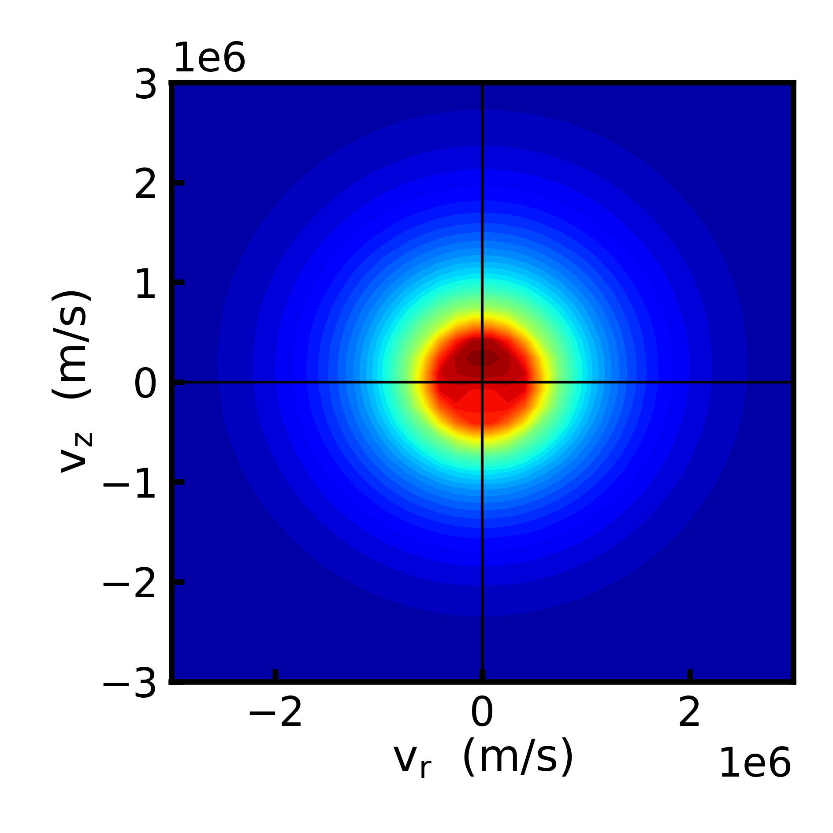
Anisotropic Distribution Functions
Add an electric field and neutral collisions
Multibolt simulations, 2-term
He, Biagi database, E/N = 100 Td
B = 0
Same distribution, plotted in 3V space
Symmetric about E-field axis
E_{z}
Notes:
Can you tell the direction of the drift?

Slide 22
What’s the Temperature of this?
E_{z}
Some say it doesn’t have one.
Convention in the field:
$$\frac{3}{2}k_{B}T_{e}≡\int{\frac{1}{2}m_{e}{\left|\overset{⃑}{v}\right|}^{2}f\left(\overset{⃑}{v}\right)d\overset{⃑}{v}}$$
For Maxwellian, this converges to the standard definition of temperature.
Notes:
Can you tell the direction of the drift?

Slide 23
Reduced Electric Field
E/N is an important parameter in low temperature plasmas.
E = electric field
N = gas number density
Electron energy equation
$$\frac{∂\frac{3}{2}n_{e}k_{b}T_{e}}{∂t}=\overset{⃑}{j}∙\overset{⃑}{E}−n_{e}Nk_{elastic}(T_{e})\left(\frac{2m_{e}}{M}\right)\frac{3}{2}k_{b}\left(T_{e}−T_{g}\right)−\sum_{i}{n_{e}Nk_{i}\left(T_{e}\right)Δε_{i}}$$
Power
Elastic collisions
Inelastic collisions
Notes:
Can you tell the direction of the drift?

Slide 24
Reduced Electric Field
E/N is an important parameter in low temperature plasmas.
E = electric field
N = gas number density
The electron energy is a function of E/N (independent of n_{e}).
Based on the assumption that electron neutral-collisions are the main electron energy loss.
We solve Boltzmann’s equation for electrons for a particular E/N in a given gas mixture.
1 Td = 10⁻¹⁷ Vcm²
Electron energy equation
$$\frac{∂\frac{3}{2}n_{e}k_{b}T_{e}}{∂t}=\overset{⃑}{j}∙\overset{⃑}{E}−n_{e}Nk_{elastic}(T_{e})\left(\frac{2m_{e}}{M}\right)\frac{3}{2}k_{b}\left(T_{e}−T_{g}\right)−\sum_{i}{n_{e}Nk_{i}\left(T_{e}\right)Δε_{i}}$$
Steady state, approximate conductivity
$$T_{e}=T_{g}+ \frac{2}{3k_{b}}\frac{M}{2m_{e}}\left[\frac{e^{2}}{m_{e}k_{elastic}^{2}(T_{e})}{\left(\frac{E}{N}\right)}^{2}−\sum_{i}{\frac{k_{i}\left(T_{e}\right)Δε}{k_{elastic}(T_{e})}}\right]$$
Notes:
Can you tell the direction of the drift?

Slide 25
NON-EQUILIBRIUM THERMODYNAMICS

Slide 26
Fighting Thermodynamics
In most LTPs,
T_{e} >> T_{i} ~ T_{gas}
How do we maintain this high T_{e}?
We keep heating the electrons.
This is much easier in atomic gases (He, Ar) than molecular gases.
Vibrational/rotation excitation has a low threshold energy, the second term is very large.
Electron energy equation
$$\frac{∂\frac{3}{2}n_{e}k_{b}T_{e}}{∂t}=\overset{⃑}{j}∙\overset{⃑}{E}−n_{e}Nk_{elastic}(T_{e})\left(\frac{2m_{e}}{M}\right)\frac{3}{2}k_{b}\left(T_{e}−T_{g}\right)−\sum_{i}{n_{e}Nk_{i}\left(T_{e}\right)Δε_{i}}$$
Decreasing T_{e}

Slide 27
Fighting Thermodynamics
Vibrational/rotation excitation has a low threshold energy, the second term is very large.
Vibrational-translational energy transfer rapidly converts electron energy into gas heating
N₂(v) + M → N₂ + M
Short pulses (nanoseconds) can keep T_{gas} >> T_{e}
Limits total energy deposition so natural heat transfer can keep T_{gas} low.
The plasma never reaches a steady state.
Electron energy equation
$$\frac{∂\frac{3}{2}n_{e}k_{b}T_{e}}{∂t}=\overset{⃑}{j}∙\overset{⃑}{E}−n_{e}Nk_{elastic}(T_{e})\left(\frac{2m_{e}}{M}\right)\frac{3}{2}k_{b}\left(T_{e}−T_{g}\right)−\sum_{i}{n_{e}Nk_{i}\left(T_{e}\right)Δε_{i}}$$

Slide 28
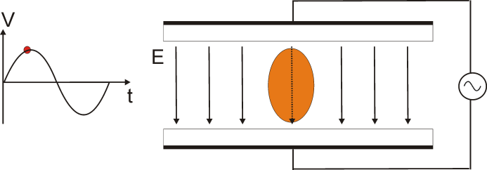
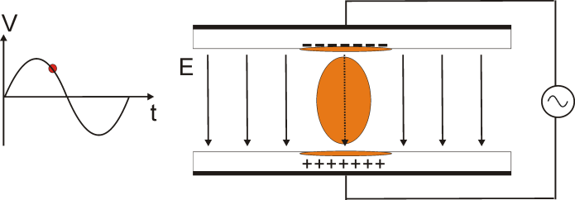
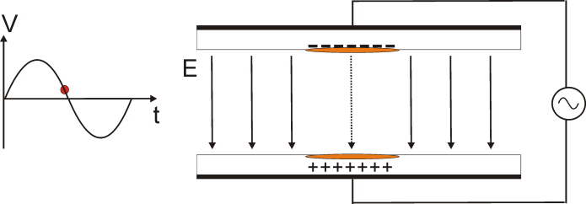
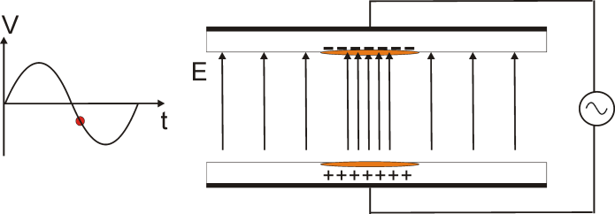
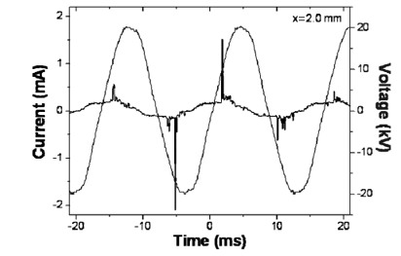
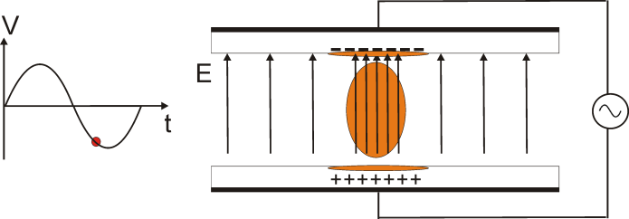
Dielectric Barrier Discharges (DBDs)
At atmospheric pressure, high collisionality results in short timescales and rapid evolution.
Need to limit the energy deposition, prevent arc formation and gas heating.
Dielectric barrier discharges (DBDs) – a pulsed discharge in which at least one electrode is covered by a dielectric.
Discharges last ~10⁻⁸ s, repeat every ~10⁻³ s.
J.-C. Wang, PhD Thesis, (Univ. of Michigan, 2014).
Y. Hosokawa et al., J. Phys. D: Appl. Phys., 41, 205418 (2008).
K. G. Kostov, et al., Brazilian J. of Phys. 39, 322 (2009).

Slide 29
LTP APPLICATIONS

Slide 30
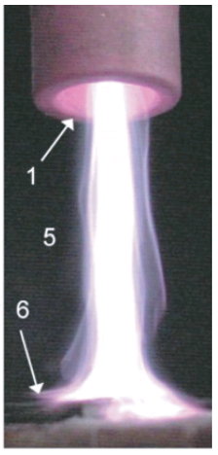
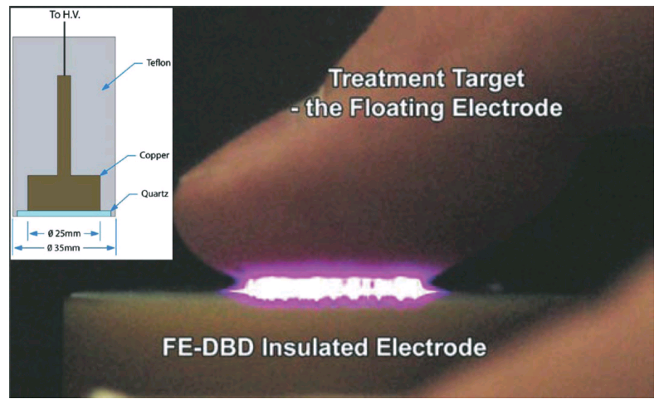
Plasma Medicine
Atmospheric pressure plasma treatment
Improves wound healing
Selectively kills cancer cells
Kill bacteria
Heal dermatological lesions
Reactive oxygen and nitrogen species are thought to be responsible: OH, O, HO₂, NO, etc.
Low temperatures are required.
Dielectric barrier discharges (DBD) and atmospheric pressure plasma jets (APPJs) are popular types of sources.
Tissue is generally covered in a thin liquid layer of biological liquid.
K. D. Weltmann et al., J. Phys. D: Appl. Phys. 41, 194008 (2008).
G. Xu, X. Shi, J. Cai, S. Chen and P. Li, Wound Repair Regen. 23, 878 (2015).
G. Fridman et al., Plasma Chem. Plasma Process. 26, 425 (2006).

Slide 31
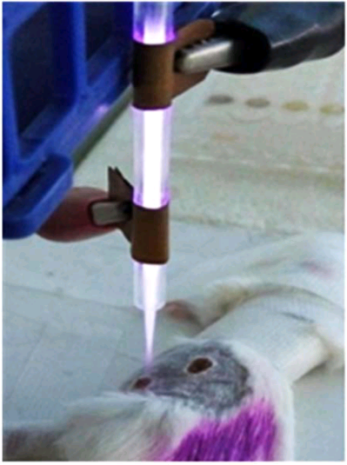
Wound Healing
An example of a typical plasma medicine study.
Two wounds were generated on each mouse, and one was plasma treated.
ΔS = area of plasma treated – area of control (averaged over all mice)
Optimal healing with 30 s of plasma treatment each day.
Currently these effects cannot be attributed to a single reactive species.
Day 1 Day 4 Day 7
Plasma Treated
Control
Plasma Treated
Control
G. Xu, X. Shi, J. Cai, S. Chen and P. Li, Wound Repair Regen. 23, 878 (2015).

Slide 32
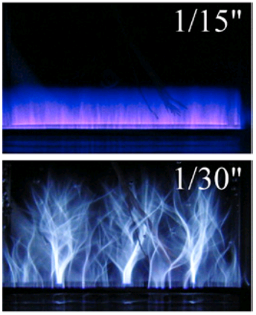
Water Treatment
water
J. E. Foster, Phys. Plasmas 24, 055501 (2017)
Plasmas have been used to create O₃ for water treatment since the 1800s.
Direct treatment of water with plasma is an emerging application.
Targeting removal of PFAS ‘forever chemicals’.
For must be extremely scalable, rapid, and inexpensive (usually in air).
water
O. Galmiz, et al., J. Phys. D. Appl. Phys. 49, 65201 (2016).

Slide 33
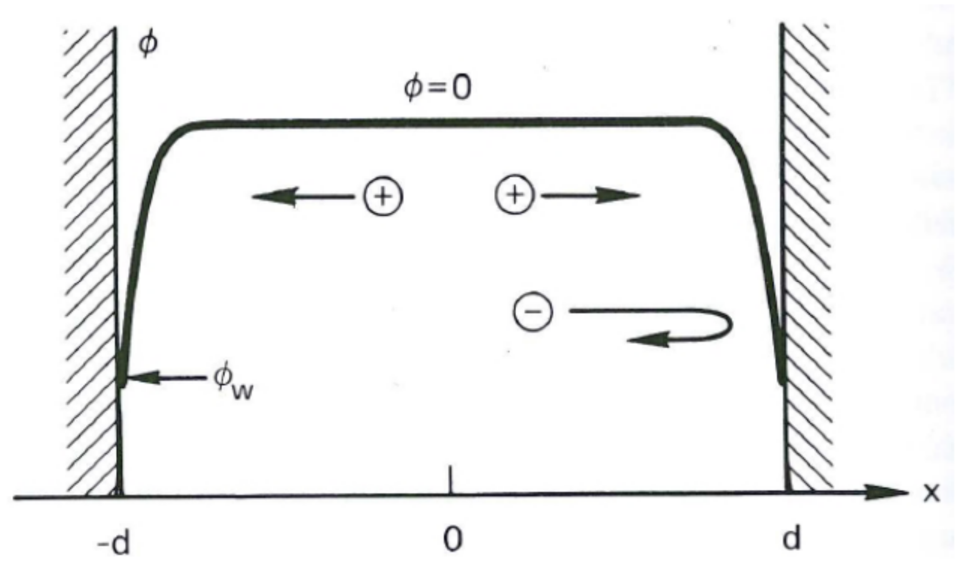
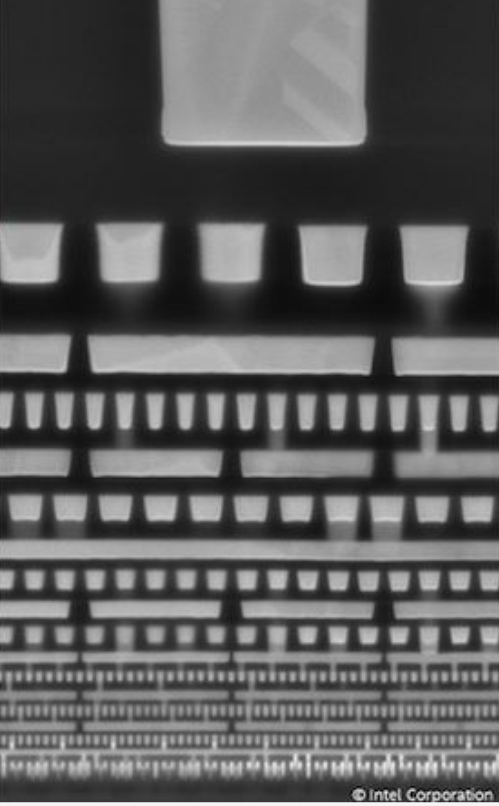
Semiconductor Processing
When a plasma contacts a surface, a sheath develops:
Electrons diffuse faster than ions.
Plasma potential becomes positive.
E-field develops which retains e-, accelerates ions.
This results in ions reaching the surface with significant energy (a few eV to keV).
Anisotropy occurs.
Reactive neutrals (e.g. Cl, F) formed from plasma chemistry work synergistically with ions for rapid etching.
Plasmas are also used to deposit thin films.
Without plasmas, computer chips would be stuck in the late 1980s or early 1990s.
Features are approaching atomic scales: atomic layer etching (ALE) and atomic layer deposition (ALD).
A. Galata, Physics and Technology of the SPES Charge Breeder (2005).
30 nm features
https://www.anandtech.com/show/17448/intel-4-process-node-in-detail-2x-density-scaling-20-improved-performance

Slide 34
Plasma for the Grand Challenges
Make Solar Energy Economical
Thin film deposition for photovoltaics.
Nanostructures.
Use solar power to produce chemical fuels.
Engineer Better Medicines
Killing drug-resistant pathogens.
Cancer treatments.
Wound healing.
Nanoparticle production.
Provide Access to Clean Water
Destruction of PFAS.
Ozone generation.
Provide Energy From Fusion
Temperatures of 10⁵ eV.
Low temperature plasmas occur near the walls in magnetic confinement fusion.
National Academy of Engineering
http://www.engineeringchallenges.org/challenges.aspx

Slide 35
Plasma for the Grand Challenges
Manage the Nitrogen Cycle
Plasma nitrogen fixation to produce ammonia.
Direct production of nitrate.
Develop Carbon Sequestration Methods
Plasma dissociation of CO₂ into CO.
Conversion of CO₂ into useful chemicals.
Engineer the Tools of Scientific Discovery
Mass spectrometers.
Plasma thrusters for space exploration.
Quantum computing.
Chips Impact EVERY Challenge
Advance Personalized Learning
Enhance Virtual Reality
Reverse Engineer the Brain
Advance Health Informatics
Restore and Improve Urban Infrastructure
Secure Cyberspace
Prevent Nuclear Terror

Slide 36
COMPUTATIONAL MODELING

Slide 37
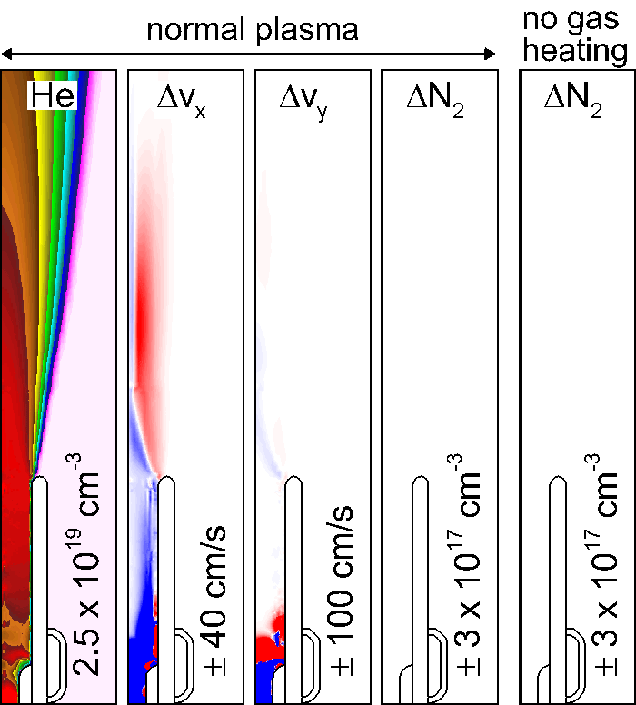
What can we really learn from modeling?
Helium atmospheric pressure plasma jet.
Cylindrical symmetry.
He flows into air.
Localized heating at the cathode expand launching an acoustic wave.
Perturbs shear flow.
We can turn off gas heating!
Without changing dissociation, buoyancy, ion wind.
Animation Slide

Slide 38
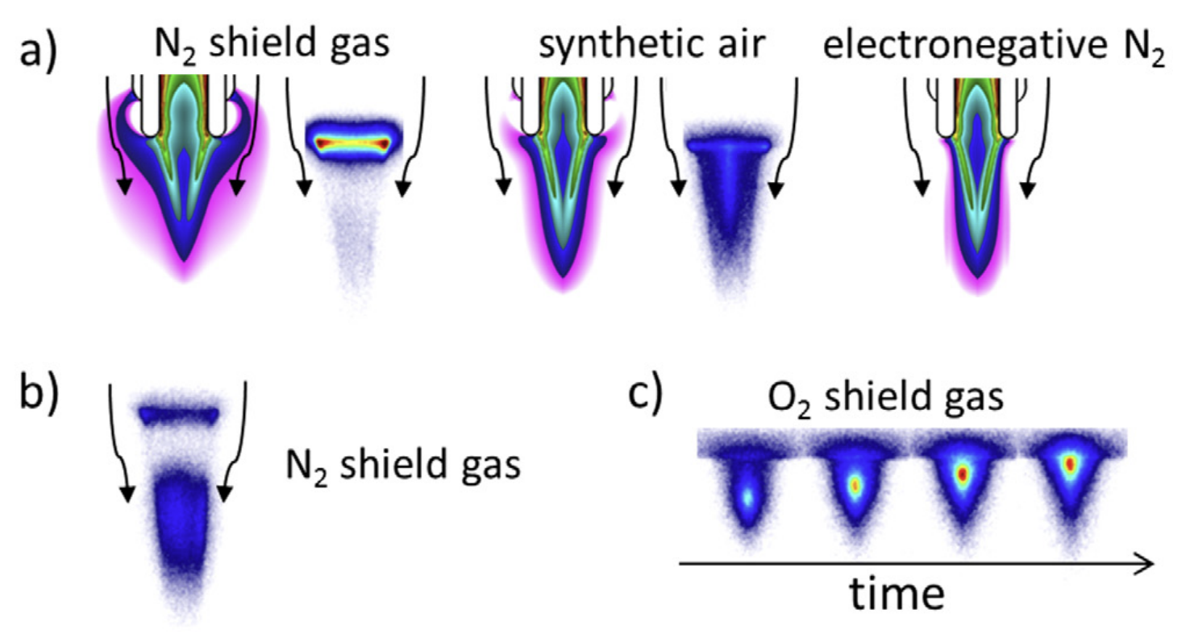
What can we really learn from modeling?
He atmospheric pressure plasma jet
Surrounding gas flow (shield gas) observed to influence plasma dynamics from optical emission measurements.
But why?
Comparison with a fluid model.
A. Schmidt-Bleker, et al., Plasma Sources Sci. Technol., 24, 035022 (2015).
Notes:
What is electronegative N2

Slide 39
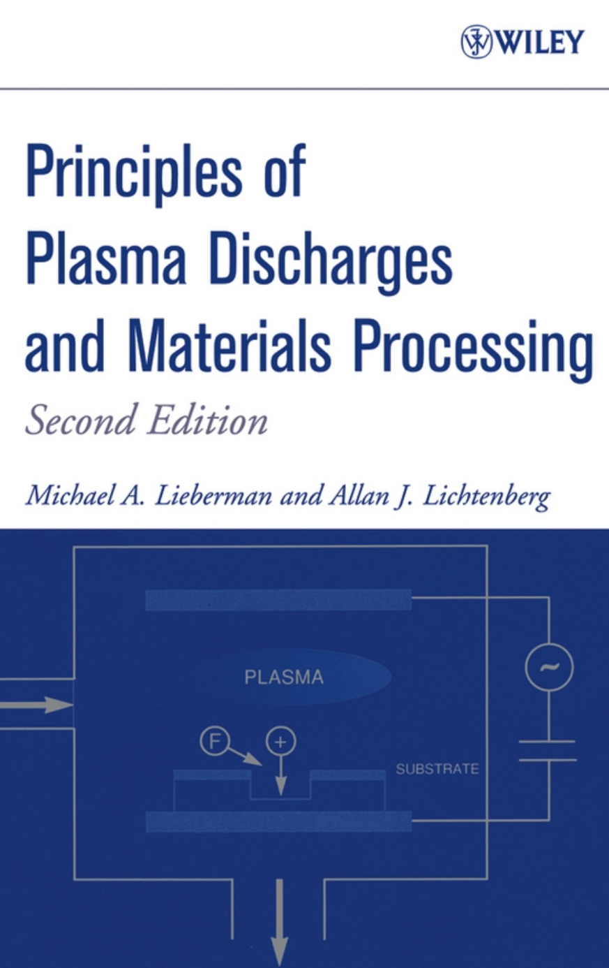
References
“Principles of Plasma Discharges and Materials Processing” M. A. Lieberman and A. J. Lichtenerg

Slide 40
Quick Review
E/N (Reduced Electric field) is the scaling parameter for LTPs.
Acceleration between collisions.
T_{e} >> T_{i} ~ T_{gas}
Electrons are lighter, more energy is transferred to electrons than ions.
We must deposit power to achieve this.
Sheaths form at surfaces, trapping electrons in the plasma, accelerating ions toward surfaces.
These fast ions can be used for etching.
“Principles of Plasma Discharges and Materials Processing” M. A. Lieberman and A. J. Lichtenerg
-
-
-
-
-
-
-
-

