Slide 1
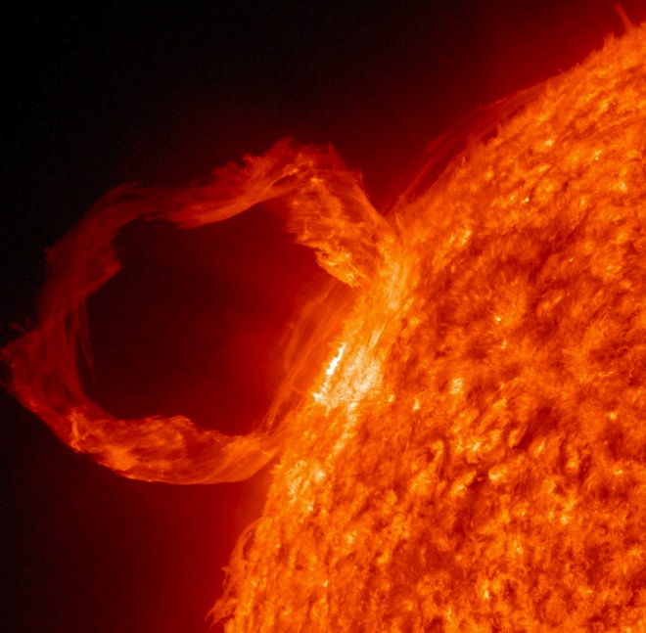
Introduction to Plasma Physics
Vinícius N. Duarte
Theory Department
Princeton Plasma Physics Laboratory
SULI Introductory Plasma Physics Course
June 11th 2024

Slide 2
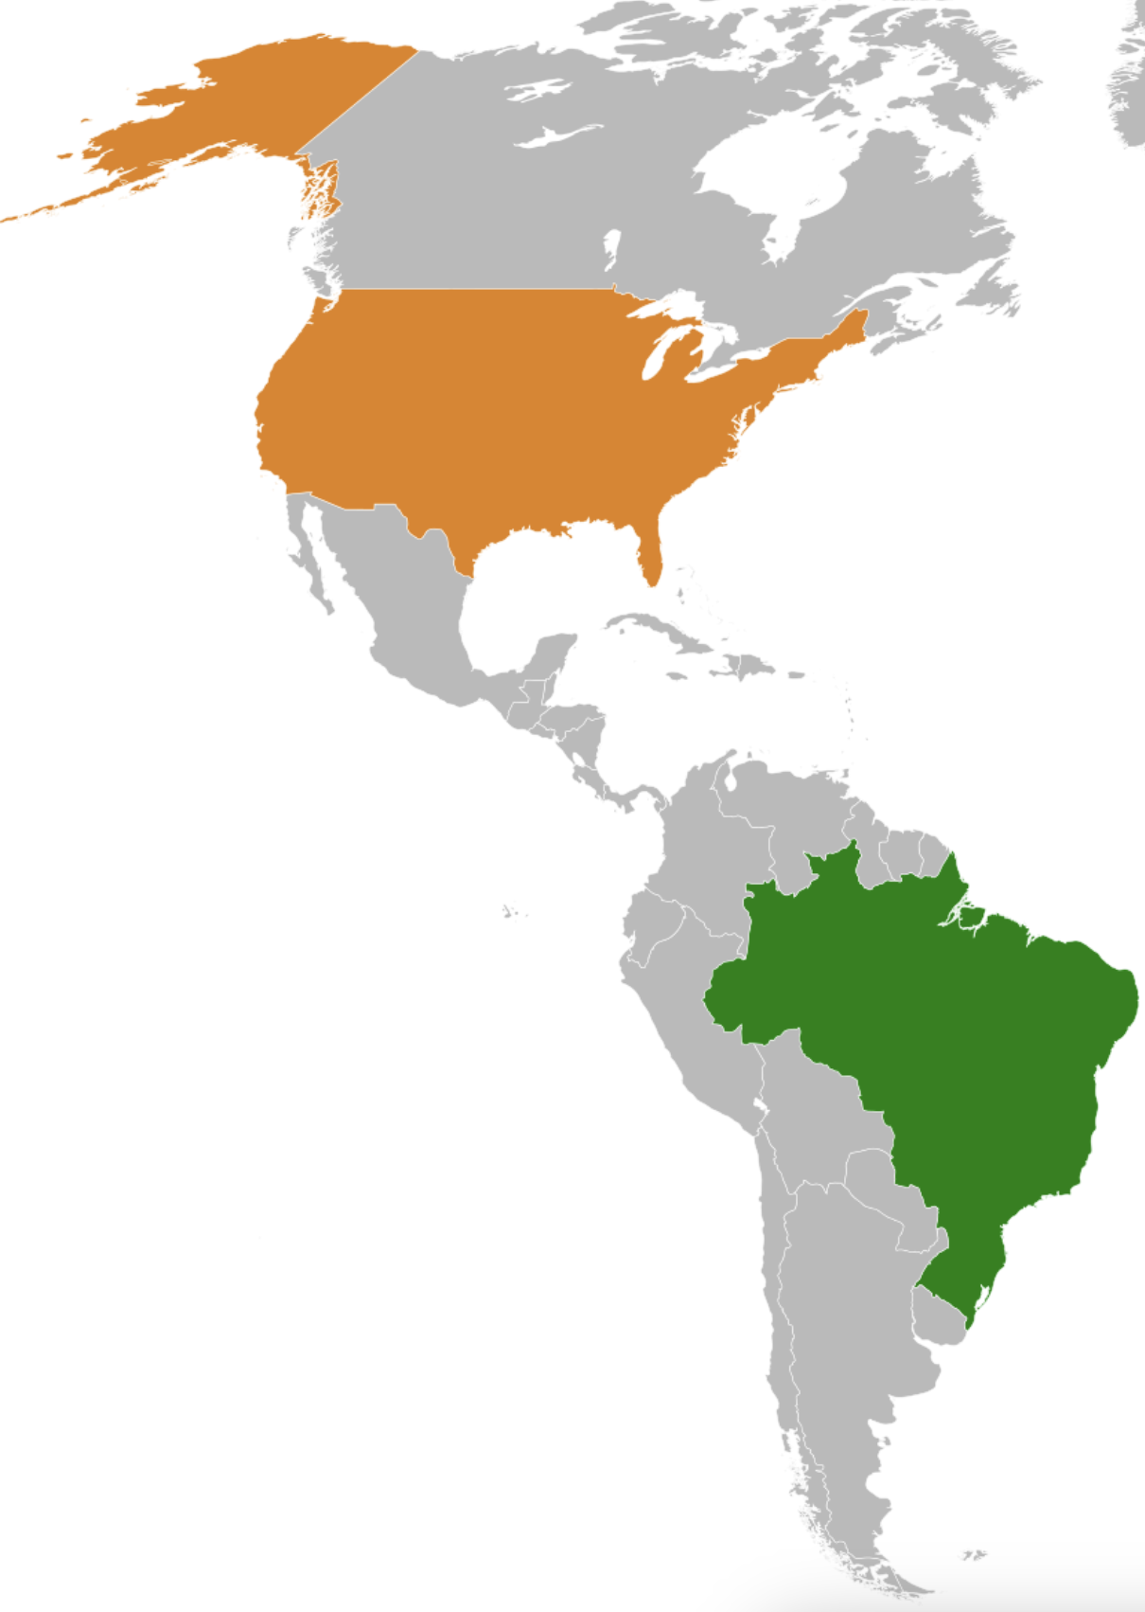
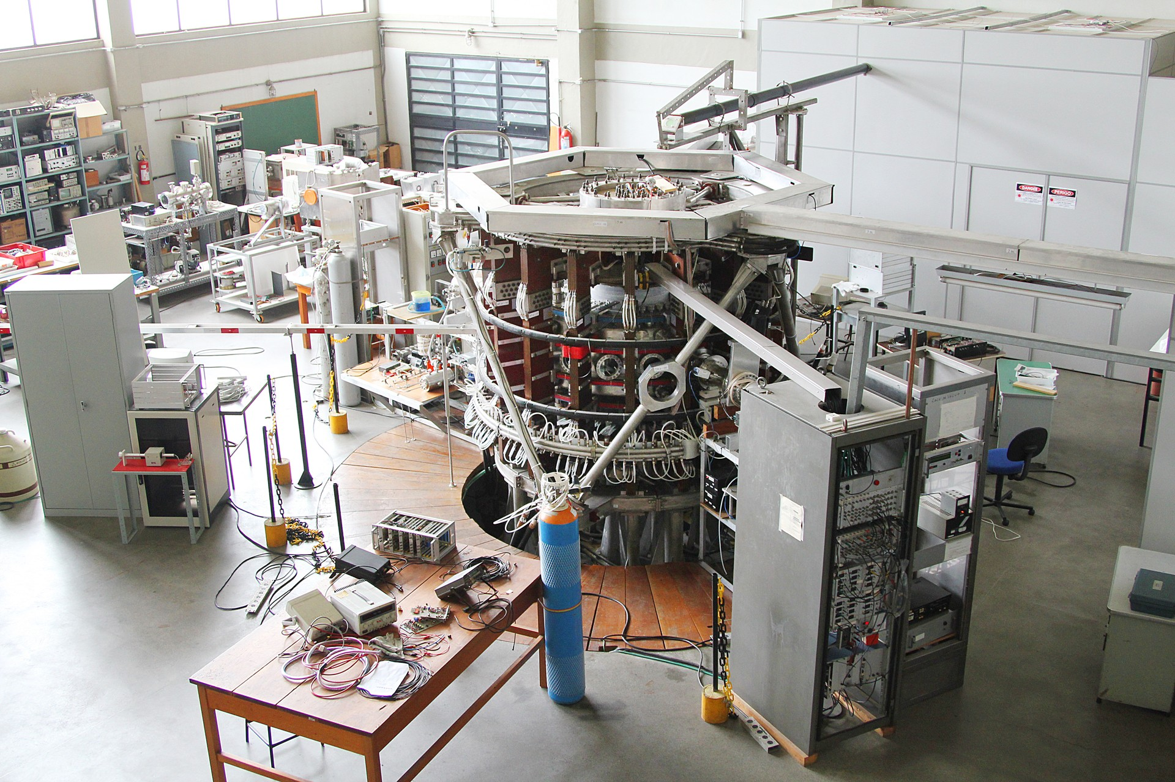
A bit on my personal trajectory
Born and raised in a small town in Brazil
Undergrad and MSc at University of Campinas → worked on theory of current drive in plasmas
PhD at University of São Paulo → worked on the dynamics of Alfvén waves in tokamaks
Came to the US in 2014 on a fellowship to work on my PhD thesis topic at PPPL
Then, postdoc and staff scientist at PPPL
TCABR tokamak
University of São Paulo

Slide 3
Outline
What is plasma?
  Occurrence and applications
  Criteria for plasmas
A few key concepts
  Debye length
  Plasma oscillations
  Gyrofrequency
  Alfvén waves
Summary

Slide 4
Outline
What is plasma?
  Occurrence and applications
  Criteria for plasmas
A few key concepts
  Debye length
  Plasma oscillations
  Gyrofrequency
  Alfvén waves
Summary

Slide 5
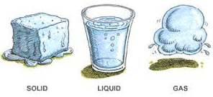

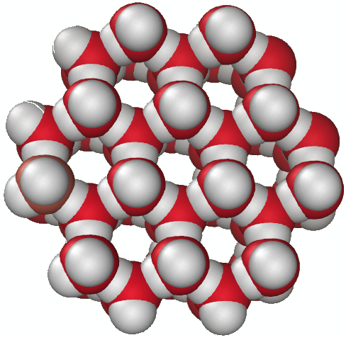
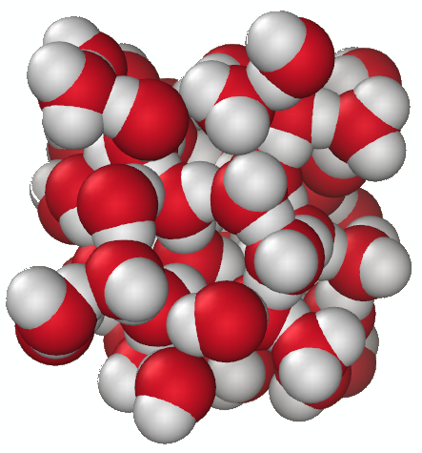
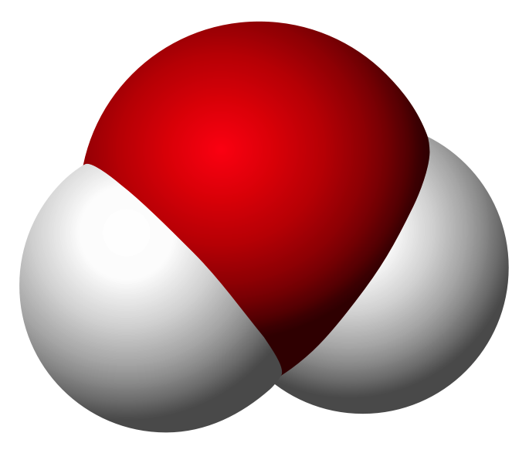

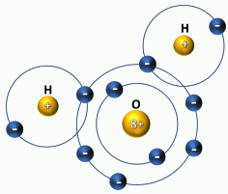
Matter exists in distinct forms
~ 1 eV
(≈ 11 000 K)
solid
liquid
gas
plasma
temperature
Over 99% of the known Universe is in plasma form
Modern telescopes suggest that the Universe is comprised by ~4.6% baryonic (ordinary) matter, ~26.8% dark matter, and ~68.3% dark energy

Slide 6
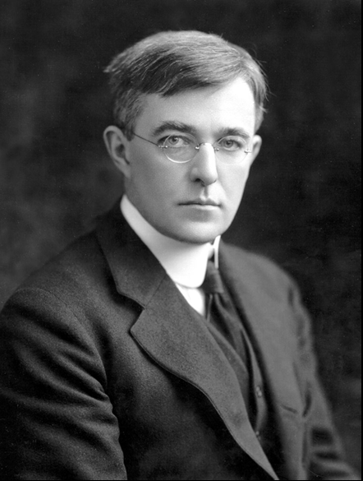
What is a plasma?
In Ancient Greek, πλάσμα (plásma): 'moldable substance’
The term "plasma" for an ionized gas was coined in 1927 by Irving Langmuir, because how an electrified fluid carried ions and electrons reminded him of how blood plasma carried red and white corpuscles.
Irving Langmuir (1881-1957);
Chemistry Nobel Prize 1932

Slide 7
Definitions of plasmas
“Plasma is in some sense the natural, untamed state of matter…”
-Hazeltine and Waelbroeck, The Framework of Plasma Physics
“physical systems whose intrinsic properties are governed by collective interactions of large ensembles of free charged particles.”
-NSF Basic Plasma Science and Engineering Website
A more formal definition will be given towards the end of this lecture

Slide 8
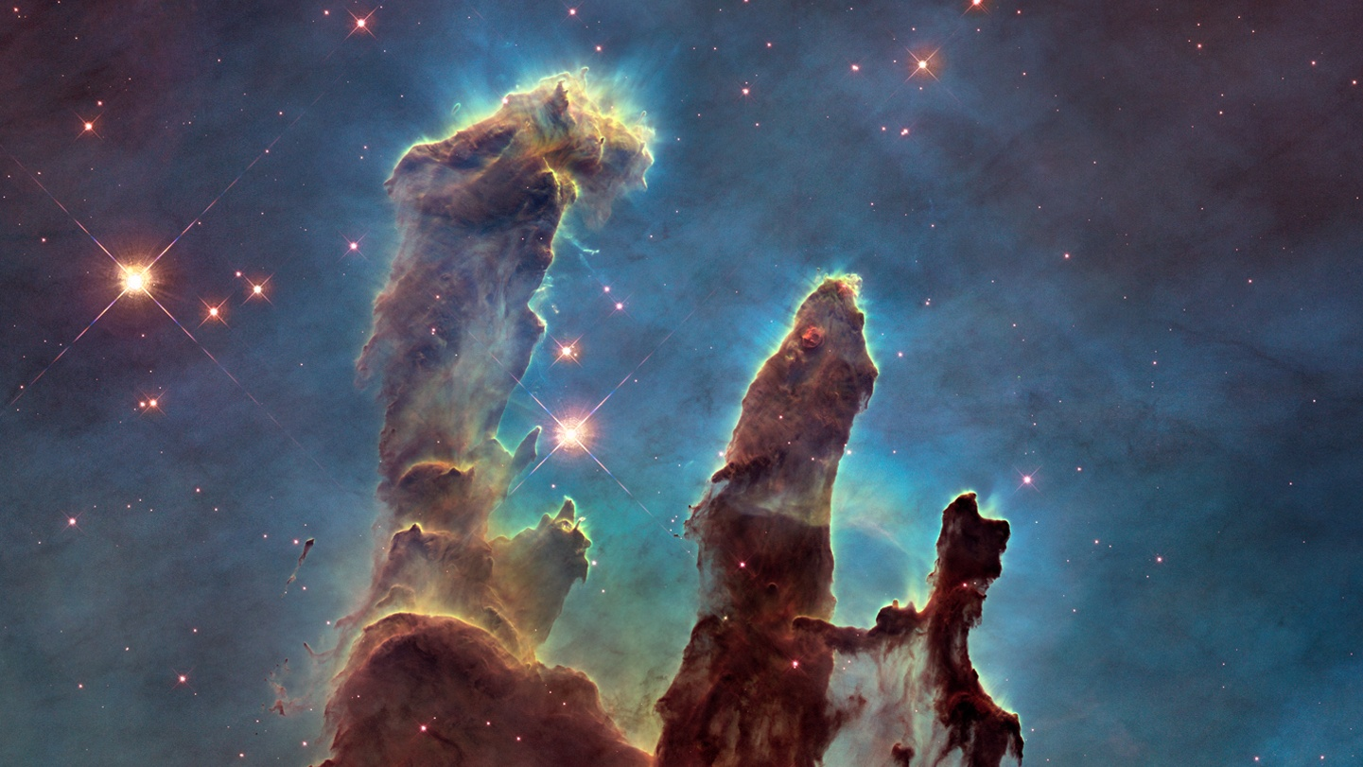
Star Birth - Eagle Nebula
“Pillars of Creation”
Hubble Telescope (2014)
Color pattern corresponds mostly to emissions from singly-ionized sulfur atoms (red), hydrogen (green) and doubly-ionized oxygen atoms (blue).

Slide 9
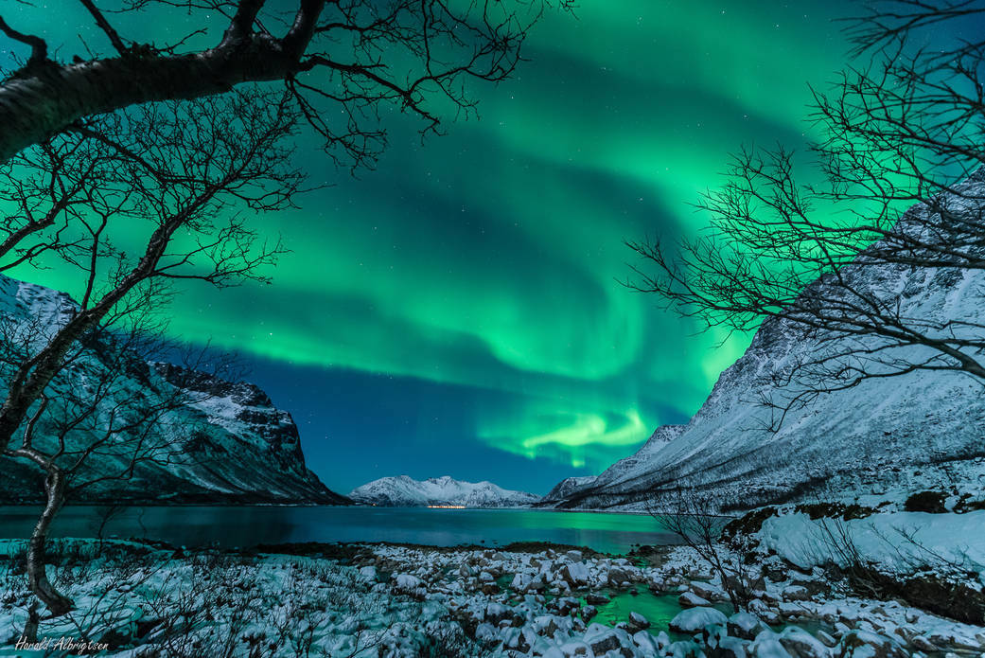
Aurora
Disturbances in the upper atmosphere caused by the solar wind (e.g., due to coronal mass ejections) lead to ionization and of atmospheric constituents that emit light of varying color and complexity

Slide 10
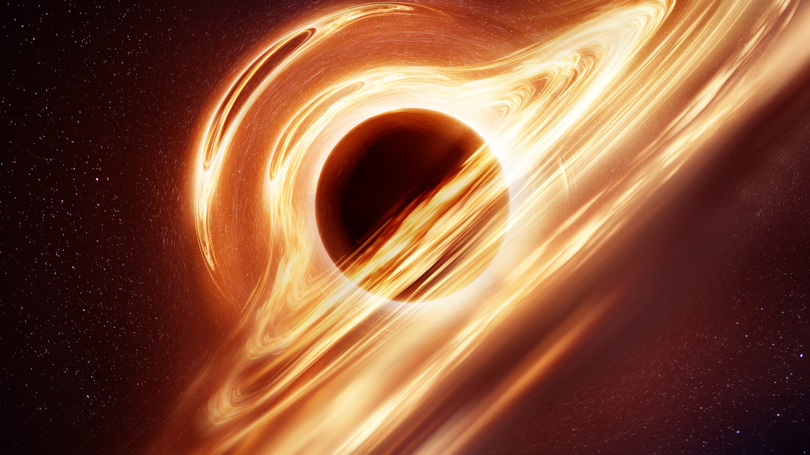
Matter around black holes
As matter is drawn to a black hole, and its immense gravitational influence creates turbulent and violent conditions, heating gas and stripping electrons away from its constituent atoms.

Slide 11
Technological applications
Plasma pencil
Plasma torch
Plasma TV
Fluorescent lamp
Plasma thrusters for space travel
Controlled thermonuclear fusion
…...

Slide 12

Plasma torch
Useful in many applications, such as metal cutting, welding and waste disposal

Slide 13
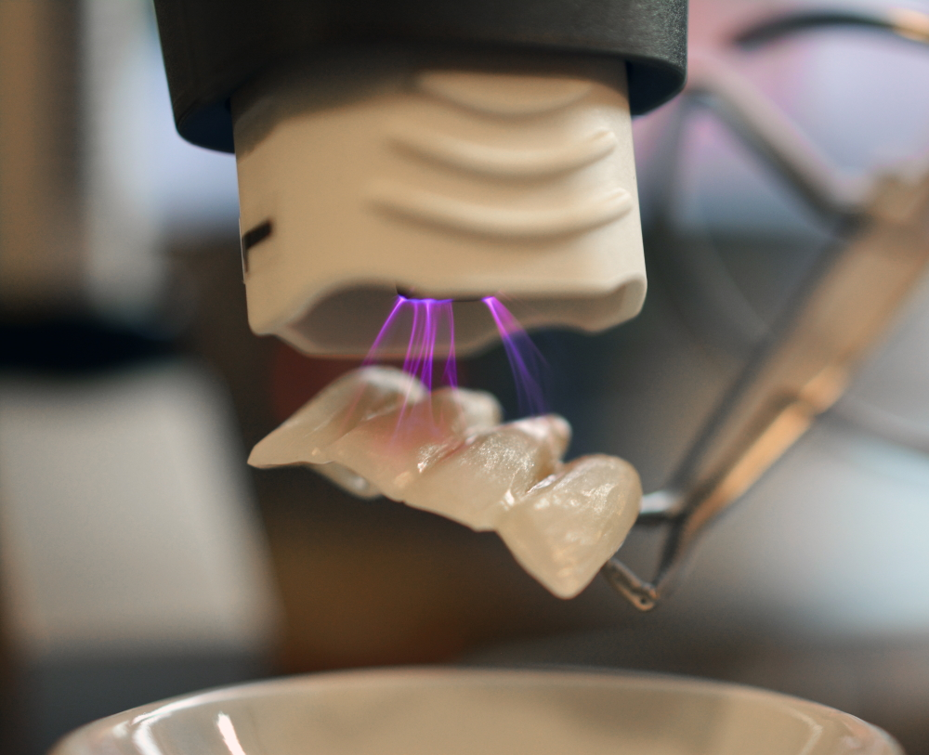
Plasma pencil
Used to treat and sterilize irregular surfaces, making them appropriate for decontaminating dental cavities without drilling

Slide 14
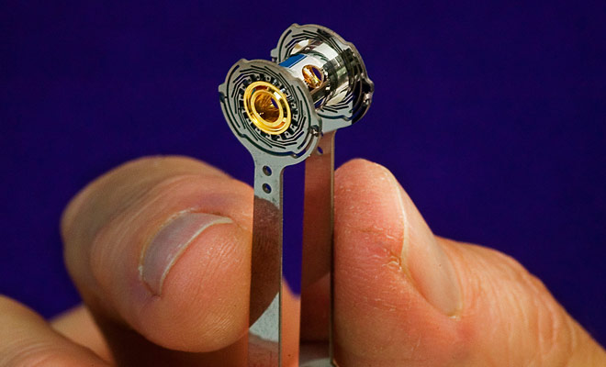
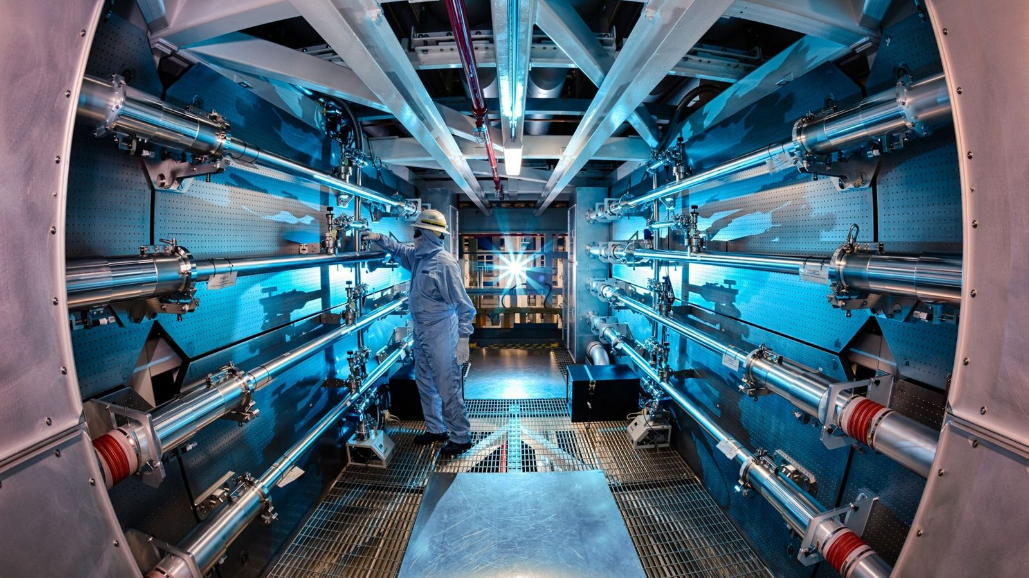
National Ignition Facility (NIF)
Inertial fusion

Slide 15
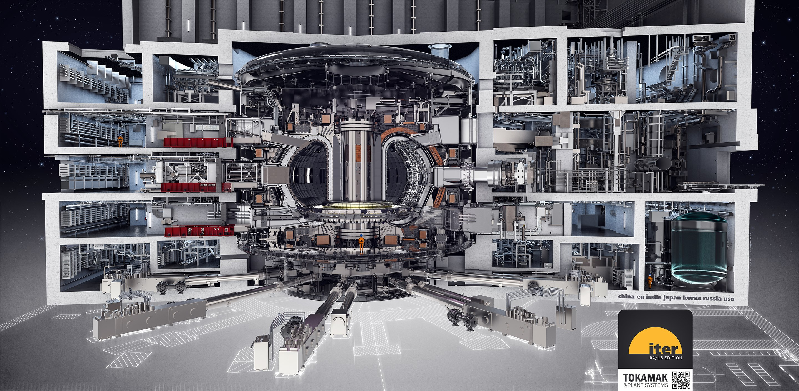
International Thermonuclear Experimental Reactor (ITER)
Magnetic fusion

Slide 16
Plasmas occur within a wide range of parameters
Image credit:
National Ignition Facility,
Lawrence Livermore Nat. Lab.

Slide 17
Outline
What is plasma?
  Occurrence and applications
  Criteria for plasmas
A few key concepts
  Debye length
  Plasma oscillations
  Gyrofrequency
  Alfvén waves
Summary

Slide 18
Studying plasmas involves many disciplines
Electrodynamics
Fluid mechanics
Statistical physics
Thermodynamics
Quantum mechanics
….

Slide 19
Comparison between electric/gravitational forces
The electric and gravitational forces exerted on m₁ by m₂ are:
Assuming one is an ionized deuterium atom and the other is an electron:
Gravity is irrelevant for lab plasmas (but not for astrophysical ones)

Slide 20
Outline
What is plasma?
  Occurrence and applications
  Criteria for plasmas
A few key concepts
  Debye length
  Plasma oscillations
  Gyrofrequency
  Alfvén waves
Summary

Slide 21
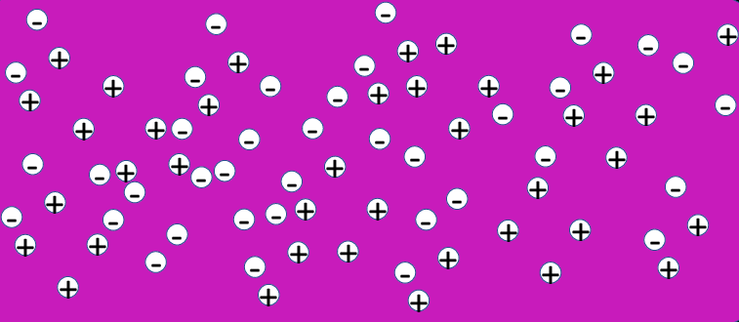
Debye shielding
+++
+++
Place a test charge into a quasi-neutral plasma

Slide 22
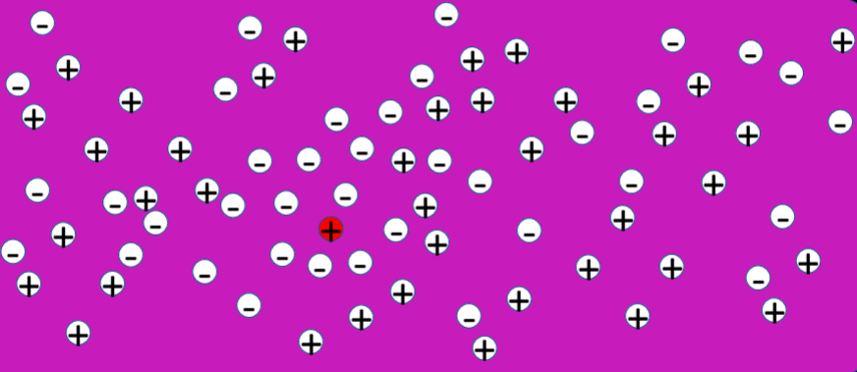
Debye shielding
+++
+++
Key question: What is the radius of the sphere of influence of this extra charge? How far away do you have to be for the extra charge to be completely “shielded” by the plasma?

Slide 23


Debye shielding
  Poisson’s Equation
  $$∇^{2}Φ=−\frac{ρ_{q}}{ε_{0}}$$
  $$∇^{2}Φ=−Zeδ(x)−\frac{e}{ε_{0}}(n_{0}−n_{e})$$
  $$∇^{2}Φ=−Zeδ(x)−\frac{en_{0}}{ε_{0}}(1−e^{−\frac{eΦ}{{kT}_{e}}})$$
$$n_{e}=n_{0}e^{−\frac{eΦ}{{kT}_{e}}}$$

Slide 24

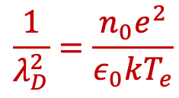
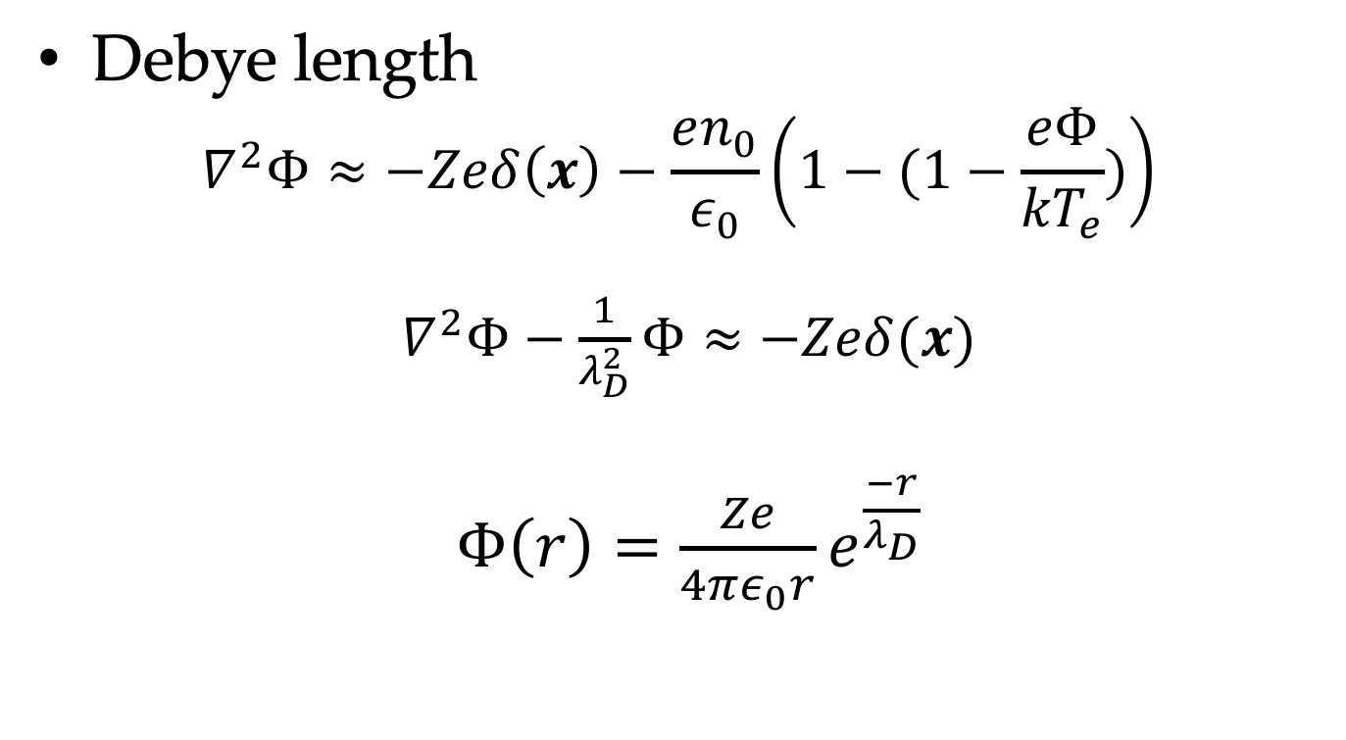
Debye shielding
Debye length
  $$∇^{2}Φ≈−Zeδ\left(x\right)−\frac{en_{0}}{ε_{0}}\left(1−(1−\frac{eΦ}{{kT}_{e}})\right)$$
  $∇^{2}Φ−\frac{1}{λ_{D}^{2}}Φ≈$ $−Zeδ(x)$
$Φ\left(r\right)=\frac{Ze}{4πε_{0}r}e^{\frac{−r}{λ_{D}}}$
Use $eφ≪kT$ to linearize equation
$$\frac{1}{λ_{D}^{2}}=\frac{n_{0}e^{2}}{ε_{0}kT_{e}}$$
Typical Debye lengths:
Solar core: 10⁻¹¹m, Tokamak: 10⁻⁴m, Intergalactic medium: 10⁺⁵m

Slide 25
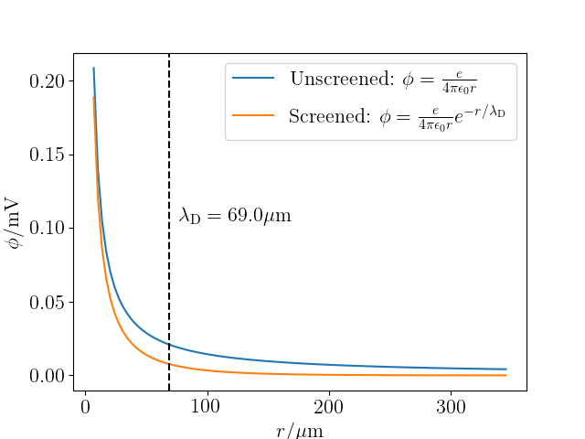
Debye shielding

Slide 26
Outline
What is plasma?
  Occurrence and applications
  Criteria for plasmas
A few key concepts
  Debye length
  Plasma oscillations
  Gyrofrequency
  Alfvén waves
Summary

Slide 27
Plasma oscillations
Plasma frequency

Slide 28

Plasma oscillations
Plasma frequency
$$Δx$$
E
Use Gauss’ Law to find E
Apply Newton’s 2nd Law to find equation of motion

Slide 29




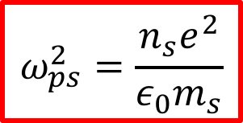


Plasma oscillations
Plasma frequency
$$∫\vec{E}⋅d\vec{A}=Q_{enc}/ε_{0}$$
$$Elz=en_{e}(Δx l z)/ε_{0}$$
$$E=en_{e}Δx/ε_{0}$$
$$ma=F$$
$$m_{e}\frac{d^{2}Δx}{dt^{2}}=−eE$$
$$\ddot{x}=−\frac{n_{e}e^{2}}{m_{e}ε_{0}}x$$
$$Δx$$
E
$$l$$
$$z$$
Compare with Hooke’s Law $\ddot{x}=−ω^{2}x$
$$ω_{ps}^{2}=\frac{n_{s}e^{2}}{ε_{0}m_{s}}$$

Slide 30
Outline
What is plasma?
  Occurrence and applications
  Criteria for plasmas
A few key concepts
  Debye length
  Plasma oscillations
  Gyrofrequency
  Alfvén waves
Summary

Slide 31
How to confine a plasma?
n
n
n
n
n
n
n
n
n
n
n
n

Slide 32
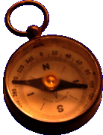
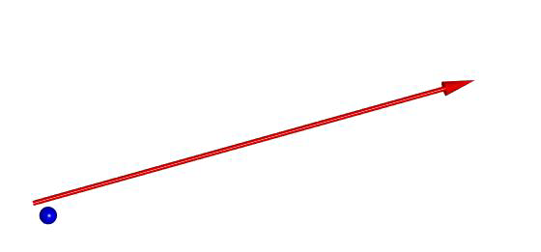
Magnetic fields confine plasmas
n
n
n
n
n
n
n
n
n
n
n
n

Slide 33
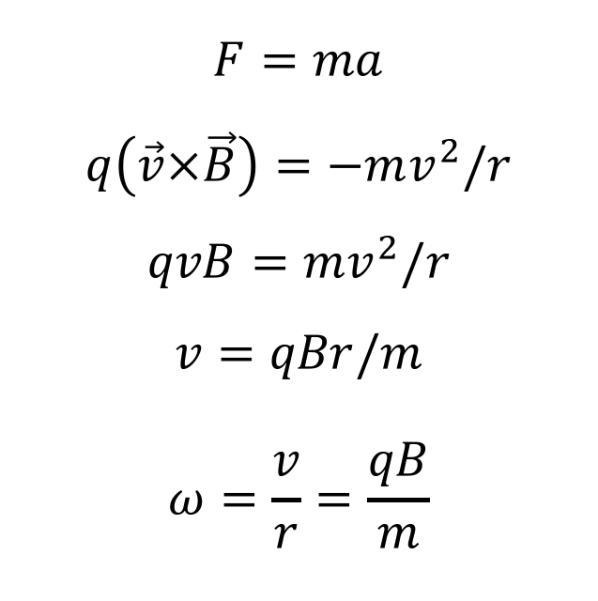


Cyclotron frequency
$$F=ma$$
$$q\left(\vec{v}×\vec{B}\right)=−mv^{2}/r$$
$$qvB=mv^{2}/r$$
$$v=qBr/m$$
$$ω=\frac{v}{r}=\frac{qB}{m}$$
x x x
x x x
x x x
x x x
x x x
$$ω_{cs}=\frac{q_{s}B}{m_{s}}$$
$$v$$
q
B

Slide 34
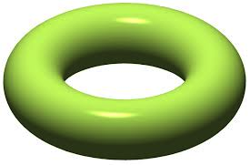
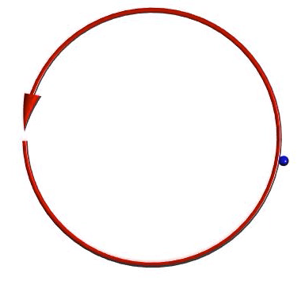
A torus is the simplest configuration needed to confine plasmas
n
n
n
n
n
n
n
n
n
n
n
n
The picture is not simple: particle drifts are ubiquitous → a combination of poloidal and toroidal fields is necessary [see next lecture by Arturo Dominguez]

Slide 35
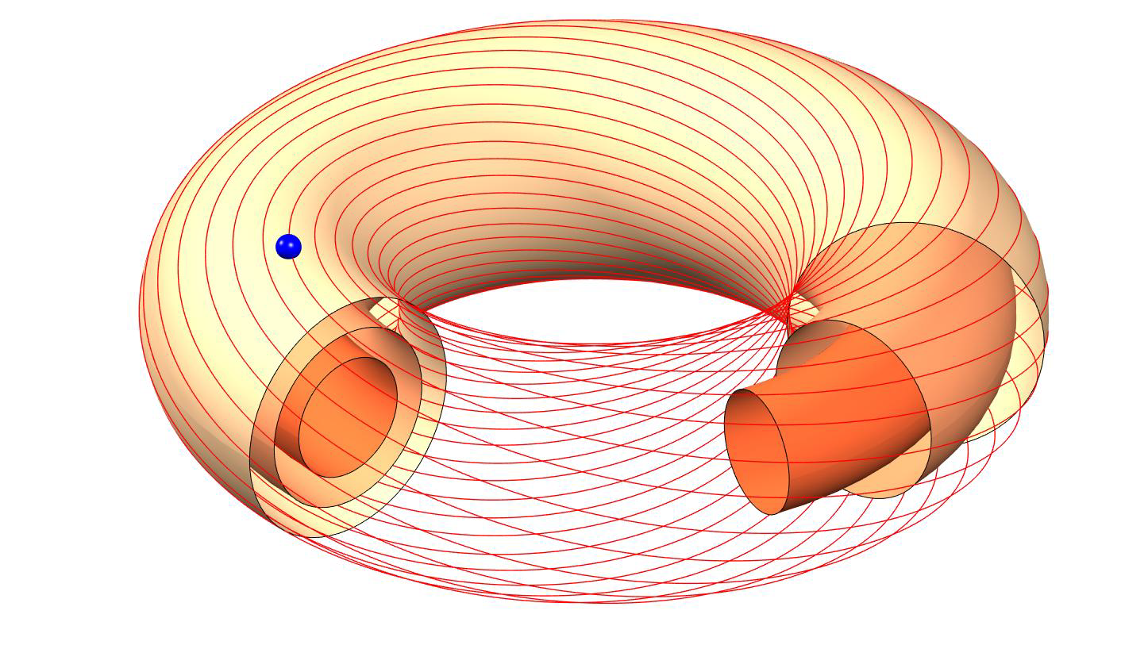
A torus is the simplest configuration needed to confine plasmas
Toroidal field (produced by coils)
Poloidal field (produced by plasma current)
Next lecture, by Arturo Dominguez

Slide 36
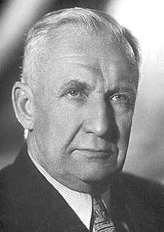
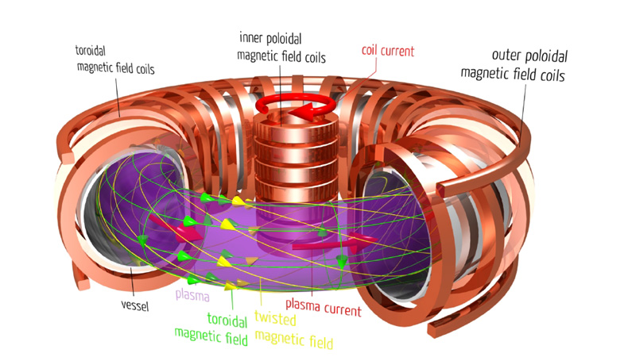
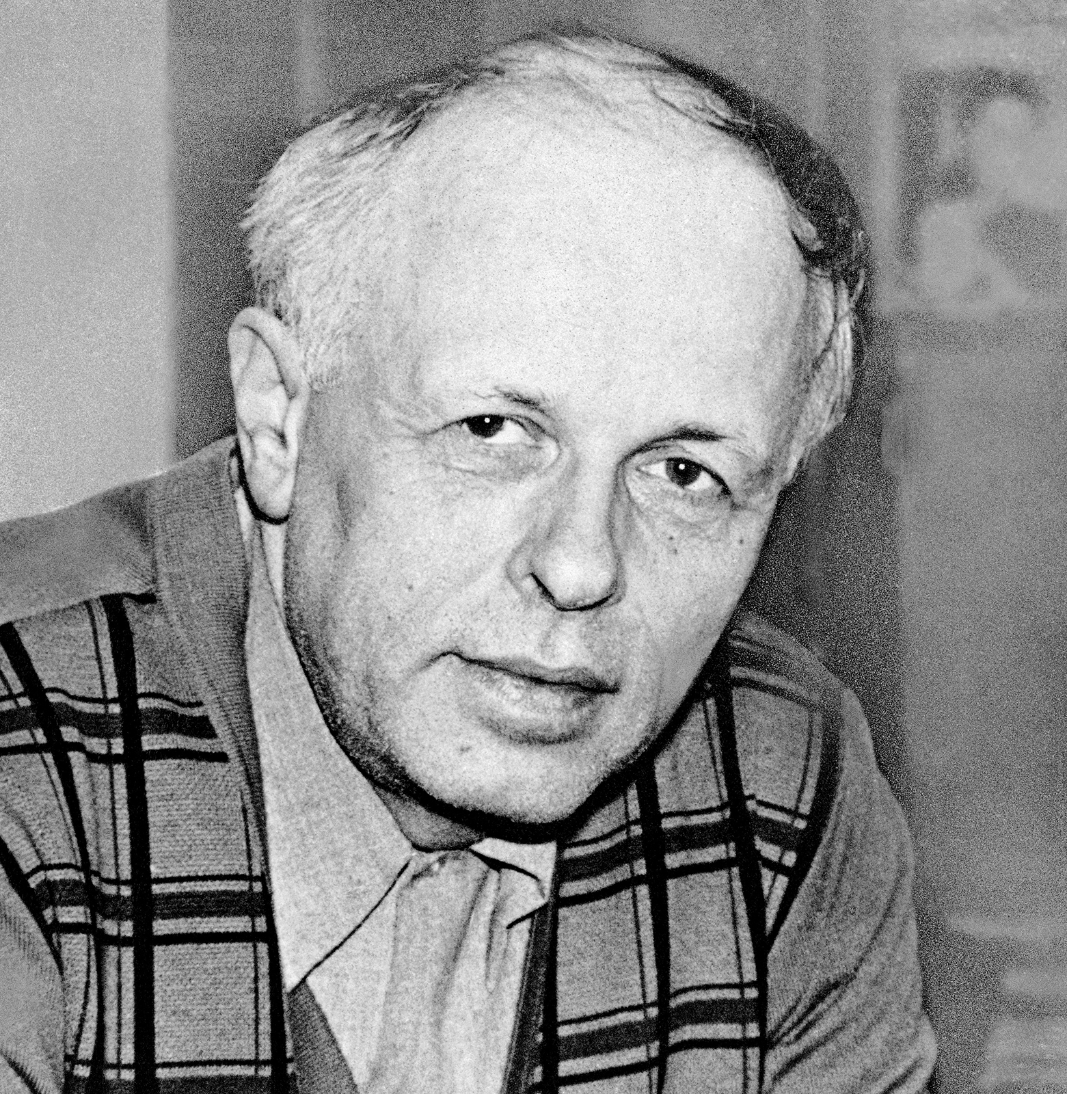
Tokamak: toroidal chamber with magnetic coils
Igor Tamm
Andrei Sakharov

Slide 37
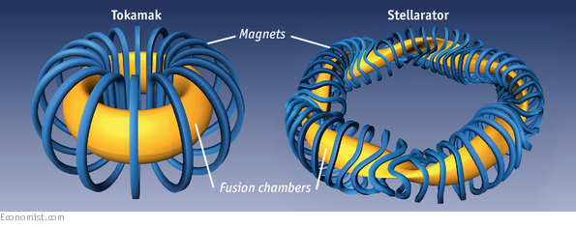
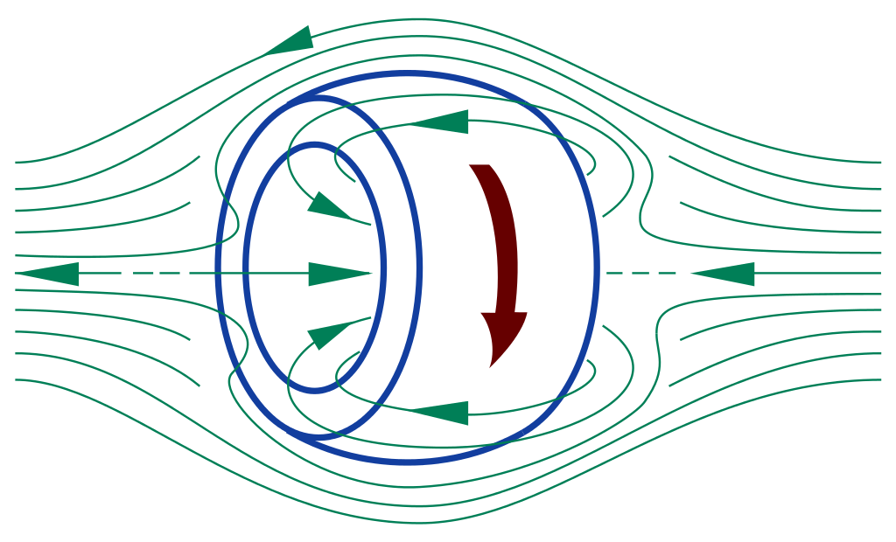
Alternative concepts of plasma confinement
Field reversed configuration
Reversed field pinch

Slide 38
Outline
What is plasma?
  Occurrence and applications
  Criteria for plasmas
A few key concepts
  Debye length
  Plasma oscillations
  Gyrofrequency
  Alfvén waves
Summary

Slide 39
Alfvén waves: a fundamental mode of oscillation in plasmas embedded in a magnetic field
Alfvén waves result from the coupling between fluid dynamics and electromagnetism → birth of magnetohydrodynamics
Hannes Alfvén
(1908-1995)
1970 Physics Nobel Prize
Alfvén waves can lead to serious instabilities
They might explain the solar corona heating
Controlled nuclear fusion may become one solution to the energy problem. Large scale, clean, safe, and inexhaustible.
H. Alfvén, Nature 150, 405 (1942)

Slide 40
Outline
What is plasma?
  Occurrence and applications
  Criteria for plasmas
A few key concepts
  Debye length
  Plasma oscillations
  Gyrofrequency
  Alfvén waves
Summary

Slide 41
Properties of a plasma
1. Conducting medium, with many degrees of freedom
2. Shields electric fields
3. Supports many waves:
  vacuum waves, such as light waves
  gas waves, such as sound waves
  a huge variety of new waves, based on electromagnetic coupling of constituent charged particles, and based on a variety of driving electric and magnetic fields

Slide 42
Definitions of plasmas
(in the beginning of this lecture)
“Plasma is in some sense the natural, untamed state of matter…”
-Hazeltine and Waelbroeck, The Framework of Plasma Physics
“physical systems whose intrinsic properties are governed by collective interactions of large ensembles of free charged particles.”
-NSF Basic Plasma Science and Engineering Website
A more formal definition will be given towards the end of this lecture

Slide 43
A more formal definition of a plasma
Debye length << system characteristic length
2. Large number of particles in a Debye sphere
3. Plasma oscillation period << time between collisions
Plasmas are physical systems whose intrinsic properties are governed by collective interactions of large ensembles of free charged particles

Slide 44
Take-aways
Plasma phenomena appears in a variety of applications: (astrophysics, solar physics, plasma devices, nuclear fusion)
Controlled fusion can be inertial or magnetic
Basic time scale of plasma is the plasma oscillation period
Basic space scale of plasma is the Debye shielding length

Slide 45
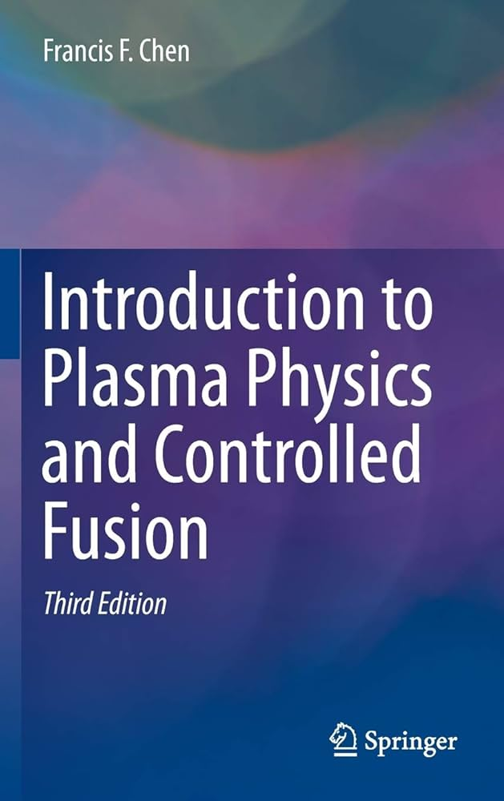
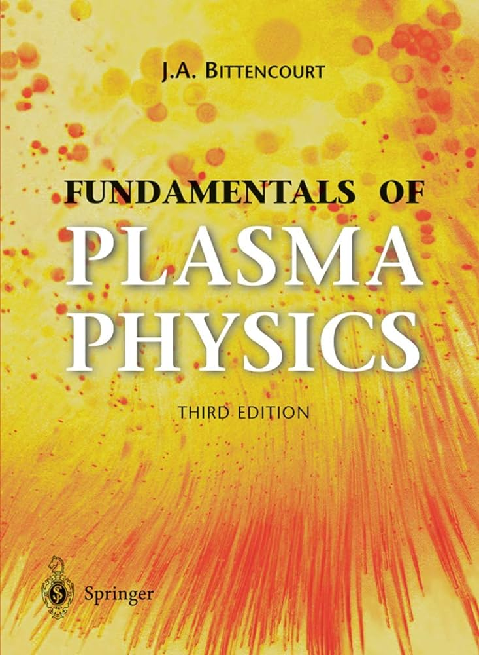
Further reading
Introduction to Plasma Physics,
F. F. Chen
Fundamentals of Plasma Physics,
J. A. Bittencourt

