Slide 1
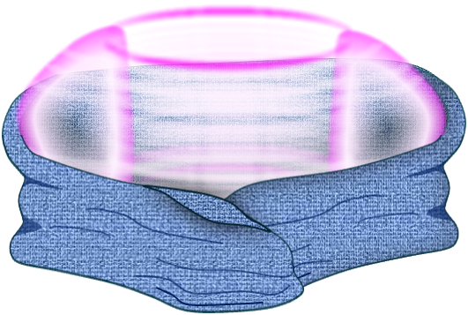
Tritium Breeding Blankets for Nuclear Fusion Reactors
Monica Gehrig, PhD
Paul Humrickhouse, PhD
Blanket and Fuel Cycle Group
Fusion Energy Division

Slide 2
A lot goes into making fusion work

Slide 3
Fusion produces high energy neutrons
D+T → He (3.5 MeV) + n (14.1 MeV)
How can we use those neutrons?
What challenges do those neutrons present?

Slide 4
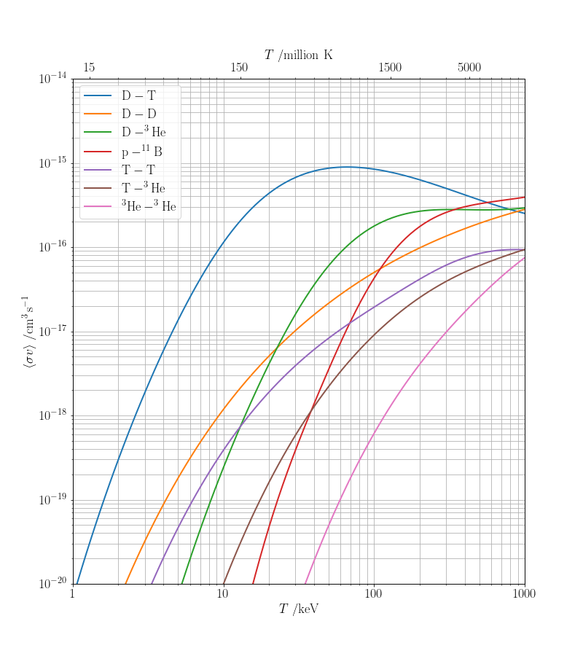
The need for tritium breeding
The D-T fusion reaction is most attainable
Tritium has a (relatively) short half-life
Small amounts produced by fission reactors
Need tritium supply, with a tritium breeding ratio (TBR) > 1*
Notes:
The D-T fusion reaction is most attainable
Tritium decays with a 12.3 year half-life, decays into helium
Small amounts produced by fission reactors can supply short-pulse research devices
- For some context, a fusion reactor will require 55.6 kg of tritium per GW of power per year. The largest supply of tritium comes from Canadian fission reactors (CANDU) which operate with heavy water, which produce 130 g per year
Need tritium supply, with a tritium breeding ratio (TBR) > 1

Slide 5
Fuel Cycle and Blanket Overview
Fueling System
Startup Inventory
Tritium Storage
Hydrogen Isotope Separation
Vacuum Pumping
Fuel Cleanup

Slide 6
Fuel Cycle and Blanket Overview
Fueling System
Tritium Breeding Blanket
Breeding Material
Startup Inventory
Multiplier(n, 2n)
Coolant
Tritium Storage
fast neutrons
+
Hydrogen Isotope Separation
Vacuum Pumping
Fuel Cleanup

Slide 7
Fuel Cycle and Blanket Overview
Fueling System
Tritium Breeding Blanket
Breeding Material
Startup Inventory
Multiplier(n, 2n)
Tritium Extraction
Coolant
Tritium Storage
fast neutrons
Heat Removal/
Power Extraction Cycle
+
Hydrogen Isotope Separation
Vacuum Pumping
Fuel Cleanup

Slide 8
Fuel Cycle and Blanket Overview
Fueling System
Tritium Breeding Blanket
Breeding Material
Startup Inventory
Multiplier(n, 2n)
Tritium Extraction
Coolant
Tritium Storage
fast neutrons
Heat Removal/
Power Extraction Cycle
+
Hydrogen Isotope Separation
Vacuum Pumping
Fuel Cleanup

Slide 9
Fuel Cycle and Blanket Overview
Fueling System
Tritium Breeding Blanket
Breeding Material
Startup Inventory
Multiplier(n, 2n)
Tritium Extraction
Coolant
Tritium Storage
fast neutrons
Heat Removal/
Power Extraction Cycle
+
Hydrogen Isotope Separation
Vacuum Pumping
Fuel Cleanup

Slide 10
Fuel Cycle and Blanket Overview
Fueling System
Tritium Breeding Blanket
Breeding Material
Startup Inventory
Multiplier(n, 2n)
Tritium Extraction
Coolant
Tritium Storage
fast neutrons
New Plants
Heat Removal/
Power Extraction Cycle
+
Hydrogen Isotope Separation
Vacuum Pumping
Fuel Cleanup

Slide 11
Fuel Cycle and Blanket Overview
Waste Treatment
Fueling System
Tritium Breeding Blanket
Breeding Material
Startup Inventory
Multiplier(n, 2n)
Tritium Extraction
Coolant
Tritium Storage
fast neutrons
New Plants
Heat Removal/
Power Extraction Cycle
+
Exhaust/Water Detritiation Systems
Hydrogen Isotope Separation
Vacuum Pumping
Fuel Cleanup
Waste Treatment

Slide 12
Fuel Cycle and Blanket Overview
Waste Treatment
Fueling System
Tritium Breeding Blanket
Breeding Material
Startup Inventory
Multiplier(n, 2n)
Tritium Extraction
Coolant
Tritium Storage
fast neutrons
New Plants
Heat Removal/
Power Extraction Cycle
+
Exhaust/Water Detritiation Systems
Hydrogen Isotope Separation
Vacuum Pumping
Fuel Cleanup
Waste Treatment

Slide 13
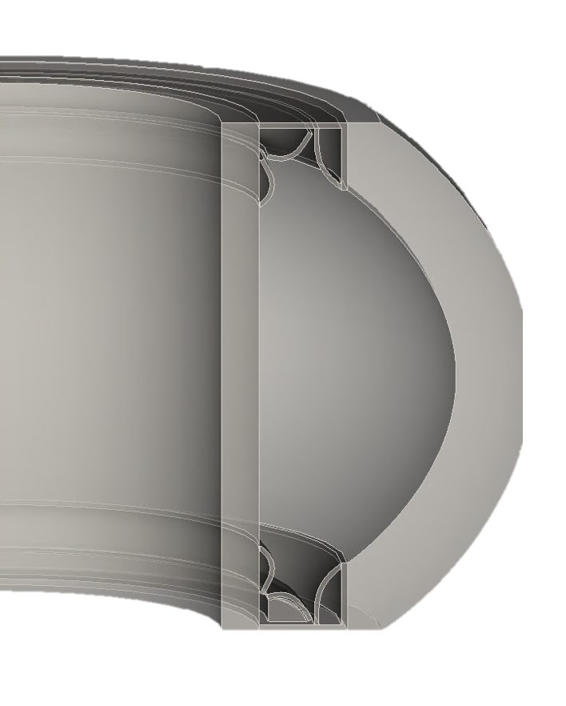
What is a blanket?
Functions
Tritium breeding
Heat generation/removal
Shielding
magnets
diagnostics
Structure

Slide 14
What is a blanket?
Components
Structural Material
Reduced activation materials
Tritium breeding material
n + ⁶Li → ⁴He + T + 4.785 MeV
Large cross section at thermal energies
Exothermic: produces additional energy!
n + ⁷Li → ⁴He + T + n’ - 2.5 MeV
Produces tritium and a neutron
Multiplier material
Elements that undergo (n,2n) reactions
High (n,2n) cross section and low total absorption cross section
Be and Pb are best
Coolant

Slide 15
What is a blanket?
Components
Structural Material
Reduced activation materials
Tritium breeding material
n + ⁶Li → ⁴He + T + 4.785 MeV
Large cross section at thermal energies
Exothermic: produces additional energy!
n + ⁷Li → ⁴He + T + n’ - 2.5 MeV
Produces tritium and a neutron
Multiplier material
Elements that undergo (n,2n) reactions
High (n,2n) cross section and low total absorption cross section
Be and Pb are best
Coolant

Slide 16
Structural Materials
T. Muroga, 3/29/2022

Slide 17
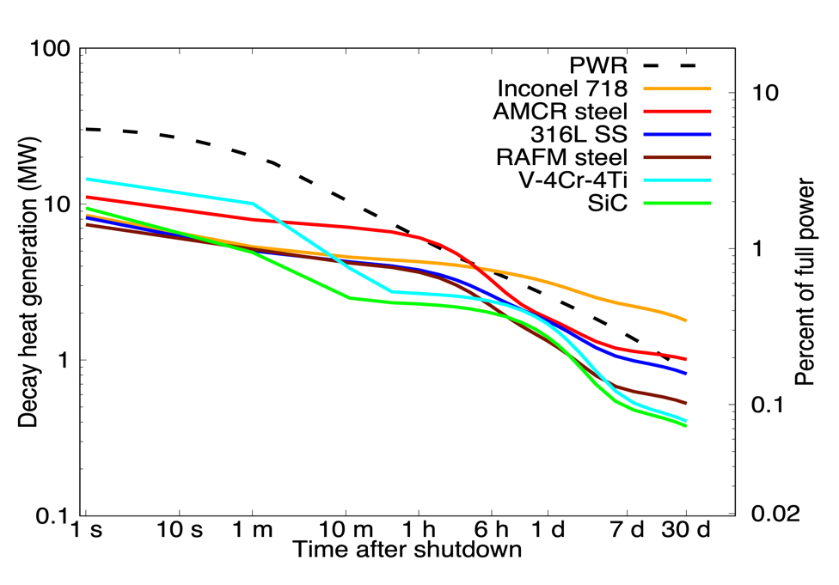
Activation of Structural Materials
7-12 MW at 1 s
D-T fusion creates waste
Goal: Below Class C Low-Level Waste
Common alloying elements with long-lived radioisotopes
Avoid Ni, Co, Mo, Nb, etc.
Dominated by tungsten components, not blankets
P. W. Humrickhouse, Fusion Science and Technology (2024, submitted)
Notes:
When considering other elements in breeder, multiplier, or structural materials, neutron activation is a primary consideration

Slide 18
Decay Heat
1
2
H
DH<10⁻⁴
10⁻⁴<DH<10⁻³
10⁻³<DH<10-²
10⁻²<DH<10⁻¹
10⁻¹<DH<10⁰
10⁰<DH<10¹
He
3
4
kW/kg
5
6
7
8
9
10
Li
Be
Top half of box:
at 10⁻⁵ years
B
C
N
O
F
Ne
11
12
Bottom half of box:
at 10⁻² years
13
14
15
16
17
18
316 Stainless Steel
Na
Mg
Al
Si
P
S
Cl
Ar
19
20
21
22
23
24
25
26
27
28
29
30
31
32
33
34
35
36
K
Ca
Sc
Ti
V
Cr
Mn
Fe
Co
Ni
Cu
Zn
Ga
Ge
As
Se
Br
Kr
37
38
39
40
41
42
no
44
45
46
47
48
49
50
51
52
53
54
Rb
Sr
Y
Zr
Nb
Mo
stable
Ru
Rh
Pd
Ag
Cd
In
Sn
Sb
Te
I
Xe
isotopes
55
56
57
72
73
74
75
76
77
78
79
80
81
82
83
Cs
Ba
La
Hf
Ta
W
Re
Os
Ir
Pt
Au
Hg
Tl
Pb
Bi
58
59
60
no
62
63
64
65
66
67
68
69
70
71
Ce
Pr
Nd
stable
Sm
Eu
Gd
Tb
Dy
Ho
Er
Tm
Yb
Lu
isotopes
Based on C. B. A. Forty, et al., Handbook of Fusion Activation Data; Part 1. Elements Hydrogen to Zirconium, AEA FUS 180, May, 1992. Assumes 4.15 MW/m² for 25 years

Slide 19
Decay Heat
1
2
H
DH<10⁻⁴
10⁻⁴<DH<10⁻³
10⁻³<DH<10-²
10⁻²<DH<10⁻¹
10⁻¹<DH<10⁰
10⁰<DH<10¹
He
3
4
kW/kg
5
6
7
8
9
10
Li
Be
Top half of box:
at 10⁻⁵ years
B
C
N
O
F
Ne
11
12
Bottom half of box:
at 10⁻² years
13
14
15
16
17
18
Inconel 718
Na
Mg
Al
Si
P
S
Cl
Ar
19
20
21
22
23
24
25
26
27
28
29
30
31
32
33
34
35
36
K
Ca
Sc
Ti
V
Cr
Mn
Fe
Co
Ni
Cu
Zn
Ga
Ge
As
Se
Br
Kr
37
38
39
40
41
42
no
44
45
46
47
48
49
50
51
52
53
54
Rb
Sr
Y
Zr
Nb
Mo
stable
Ru
Rh
Pd
Ag
Cd
In
Sn
Sb
Te
I
Xe
isotopes
55
56
57
72
73
74
75
76
77
78
79
80
81
82
83
Cs
Ba
La
Hf
Ta
W
Re
Os
Ir
Pt
Au
Hg
Tl
Pb
Bi
58
59
60
no
62
63
64
65
66
67
68
69
70
71
Ce
Pr
Nd
stable
Sm
Eu
Gd
Tb
Dy
Ho
Er
Tm
Yb
Lu
isotopes
Based on C. B. A. Forty, et al., Handbook of Fusion Activation Data; Part 1. Elements Hydrogen to Zirconium, AEA FUS 180, May, 1992. Assumes 4.15 MW/m² for 25 years

Slide 20
Decay Heat
1
2
H
DH<10⁻⁴
10⁻⁴<DH<10⁻³
10⁻³<DH<10-²
10⁻²<DH<10⁻¹
10⁻¹<DH<10⁰
10⁰<DH<10¹
He
3
4
kW/kg
5
6
7
8
9
10
Li
Be
Top half of box:
at 10⁻⁵ years
B
C
N
O
F
Ne
11
12
Bottom half of box:
at 10⁻² years
13
14
15
16
17
18
Na
Mg
Al
Si
P
S
Cl
Ar
RAFM Steel
19
20
21
22
23
24
25
26
27
28
29
30
31
32
33
34
35
36
K
Ca
Sc
Ti
V
Cr
Mn
Fe
Co
Ni
Cu
Zn
Ga
Ge
As
Se
Br
Kr
37
38
39
40
41
42
no
44
45
46
47
48
49
50
51
52
53
54
Rb
Sr
Y
Zr
Nb
Mo
stable
Ru
Rh
Pd
Ag
Cd
In
Sn
Sb
Te
I
Xe
isotopes
55
56
57
72
73
74
75
76
77
78
79
80
81
82
83
Cs
Ba
La
Hf
Ta
W
Re
Os
Ir
Pt
Au
Hg
Tl
Pb
Bi
58
59
60
no
62
63
64
65
66
67
68
69
70
71
Ce
Pr
Nd
stable
Sm
Eu
Gd
Tb
Dy
Ho
Er
Tm
Yb
Lu
isotopes
Based on C. B. A. Forty, et al., Handbook of Fusion Activation Data; Part 1. Elements Hydrogen to Zirconium, AEA FUS 180, May, 1992. Assumes 4.15 MW/m² for 25 years

Slide 21
Alloy concentrations to meet Class C disposal
316 Stainless Steel
From: Piet, et al., “Initial Integration of Accident Safety, Waste Management, Recycling, Effluent, and Maintenance
Considerations for Low-Activation Materials”, Fusion Technology, Vol. 19, Jan. 1991, pp. 146-161.
Assumes 5 MW/m² for 4 years; and E. T. Cheng, “Concentration Limits of Natural Elements
in Low Activation Materials”, presented at ICFRM-8, Sendai, Japan,October 1997

Slide 22
Alloy concentrations to meet Class C disposal
Inconel 718
From: Piet, et al., “Initial Integration of Accident Safety, Waste Management, Recycling, Effluent, and Maintenance
Considerations for Low-Activation Materials”, Fusion Technology, Vol. 19, Jan. 1991, pp. 146-161.
Assumes 5 MW/m² for 4 years; and E. T. Cheng, “Concentration Limits of Natural Elements
in Low Activation Materials”, presented at ICFRM-8, Sendai, Japan,October 1997

Slide 23
Alloy concentrations to meet Class C disposal
RAFM Steel
From: Piet, et al., “Initial Integration of Accident Safety, Waste Management, Recycling, Effluent, and Maintenance
Considerations for Low-Activation Materials”, Fusion Technology, Vol. 19, Jan. 1991, pp. 146-161.
Assumes 5 MW/m² for 4 years; and E. T. Cheng, “Concentration Limits of Natural Elements
in Low Activation Materials”, presented at ICFRM-8, Sendai, Japan,October 1997

Slide 24
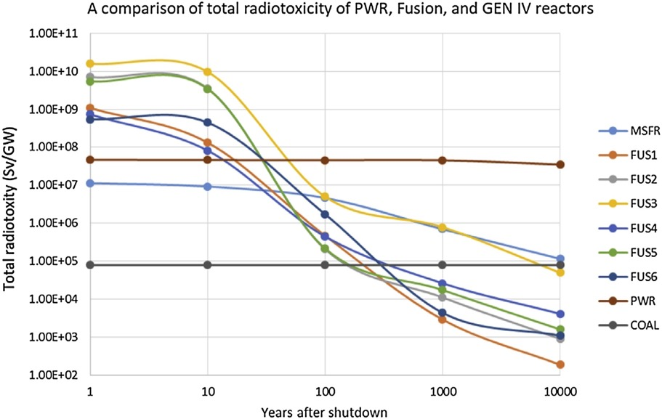
Activation of Structural Materials
Low-activation Materials
Reduced-Activation Ferritic/Martensitic Steel – most mature fusion material ​
Vanadium Alloys – need development​
Silicon Carbide – need development​
= V alloy, Li₂O
= RAFM steel, PbLi
= RAFM steel, Li₄SiO₄
= SiC composite, PbLi
= RAFM steel, PbLi
= SiC composite, Li₄SiO₄
M. Zucchetti, Fusion Engineering and Design 136 (2018) 1529-1533.
Notes:
“No breeder can be developed without considering the combination with the coolant, neutron multiplier, and structural material - and this must be done in an integrated fashion, since the choice of each has an impact on the other”

Slide 25
What is a blanket?
Components
Structural Material
Reduced activation materials
Tritium breeding material
n + ⁶Li → ⁴He + T + 4.785 MeV
Large cross section at thermal energies
Exothermic: produces additional energy
n + ⁷Li → ⁴He + T + n’ - 2.5 MeV
Produces tritium and a neutron
Multiplier material
Elements that undergo (n,2n) reactions
High (n,2n) cross section and low total absorption cross section
Be and Pb are best
Coolant

Slide 26
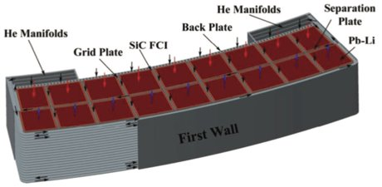
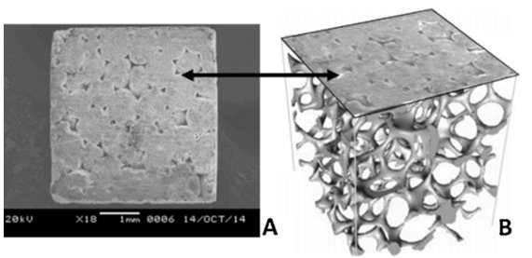
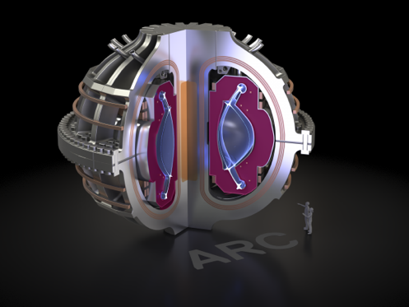
Tritium Breeding Materials
Liquid Metals
Li
PbLi
Solid Ceramics
Li₂TiO₃, Li₄SiO₄, and many others possible
Molten Salts
FLiBe (2LiF + BeF₂)
FLiNaBe (LiF + NaF + BeF₂)
Magnetohydrodynamic challenges
X. R. Wang et al., Fusion Science and Technology, vol. 67, no. 1, (2017) 193-219
Relatively low melt temperature ✓
← More structure required
S. Sharafat et al., Fusion Engineering and Design 109-111 (2016) 119-127 ​
← Highly Corrosive ✕
High melt temperature ✕
Lower TBR ✕
https://www.psfc.mit.edu/news/2022/turning-neutrons-into-fusion-fuel

Slide 27
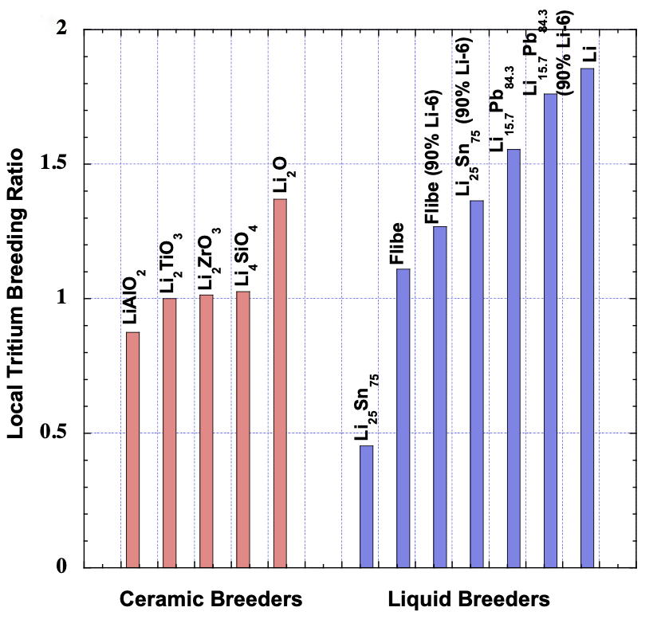
Tritium Breeding Ratio for Different Materials
These go higher with multiplier addition
2m
L. El-Guebaly, in “Fusion Energy and Power: Applications, Technologies and Challenges” (2015)
solid breeder: helium is separate from coolant stream
Notes:
Theoretical maximum TBR: plasma surrounded completely by thick (2m) blanket

Slide 28
Lithium Enrichment
n + ⁶Li → ⁴He + T + 4.785 MeV
Large cross section at thermal energies
Exothermic: produces additional energy
Li⁶ is only 7.5% of natural lithium
n + ⁷Li → ⁴He + T + n’ - 2.5 MeV
Produces tritium and a neutron
How do you get desirable quantities of Li⁶?
→ Enrichment!

Slide 29
Methods of Breeding Tritium
Liquid Metal - Li
Liquid Metal - PbLi
Solid Ceramic
Molten Salt - FLiBe
Good TBR; may not need ⁶Li enrichment
Low T_{melt} = 180 °C
Traditionally paired with Vanadium alloy or RAFM steel structure
Very high chemical reactivity with H₂O and air (safety issue)
High tritium solubility/inventory, different extraction techniques needed
Electrical insulators required for MFE
Good TBR, but with ⁶Li enrichment
Low T_{melt} = 235 °C
Traditionally paired with RAFM steel or SiC structure
Much lower chemical reactivity than pure Li
Low T/high T design options
Material compatibility at high T may require coatings
Electrical insulators required for MFE
Good TBR requires Be multiplier addition, structure minimization
Traditionally paired with RAFM steel structure and He or H₂O coolant
Better material compatibility than liquids
Simpler & more mature tritium extraction
Require replacement
Evolution under irradiation important
Good TBR may require Be multiplier addition
High T_{melt} = 460 °C
Corrosion a significant concern
Structural material solution unclear
Low electrical conductivity
High heat capacity
Low thermal conductivity
High viscosity

Slide 30
What is a blanket?
Components
Structural Material
Reduced activation materials
Tritium breeding material
n + ⁶Li → ⁴He + T + 4.785 MeV
Large cross section at thermal energies
Exothermic: produces additional energy!
n + ⁷Li → ⁴He + T + n’ - 2.5 MeV
Produces tritium and a neutron
Multiplier material
Elements that undergo (n,2n) reactions
High (n,2n) cross section and low total absorption cross section
Be and Pb are best
Coolant

Slide 31
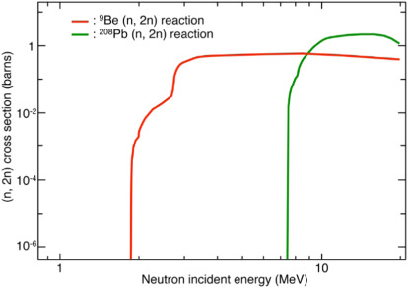
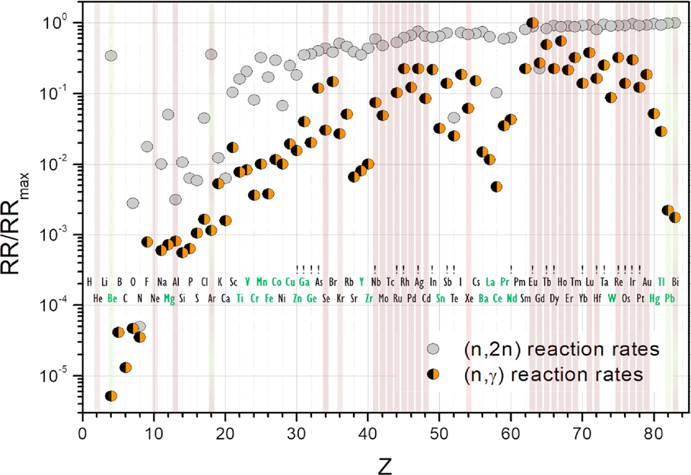
Multiplier Materials
TBR = 1 → every fusion neutron produces tritium (unlikely)
Need more neutrons!
Be
Pb
M. Nakamichi, in Comprehensive Nuclear Materials 2nd ed (2020).
F. Hernandez, Fusion Engineering and Design 137 (2018) 243-256.

Slide 32
Lead, Beryllium and Beryllides
Lead
Beryllium
Beryllides (eg, Be₁₂Ti)
Must be in liquid form
Low radiation damage
Toxic
Impurities (Bismuth)
Activation products
High (n, 2n) cross section
Relatively high total absorption cross section
Solid – high melt temperature
Toxic
Swelling due to irradiation
Tritium breeding; low tritium diffusivity (retention)
Highly exothermic reaction with air and water
Impurities (Uranium)
High (n, 2n) cross section
Low total absorption cross section
Solid – high melt temperature
Toxic
Limits swelling
Limits chemical reactions
Tritium breeding; no retention
Large number of different beryllide compounds; some hard to work with
Impurities (Uranium)
Higher total absorption cross section than Be
Decreased atom density of Be

Slide 33
What is a blanket?
Components
Structural Material
Reduced activation materials
Tritium breeding material
n + ⁶Li → ⁴He + T + 4.785 MeV
Large cross section at thermal energies
Exothermic: produces additional energy!
n + ⁷Li → ⁴He + T + n’ - 2.5 MeV
Produces tritium and a neutron
Multiplier material
Elements that undergo (n,2n) reactions
High (n,2n) cross section and low total absorption cross section
Be and Pb are best
Coolant

Slide 34
Blanket Cooling
First wall heat flux
Heat Removal
Remove heat from First Wall
plasma
neutrons
Remove heat due to volumetric heating
heating in structural materials
heat produced in exothermic reactions
decay heat
Use for power conversation
Volumetric Heating

Slide 35
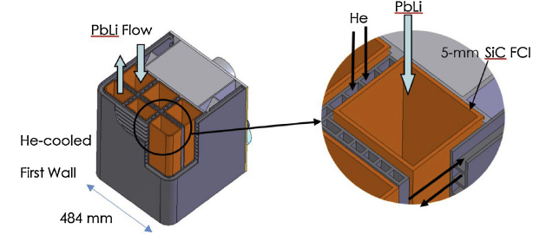
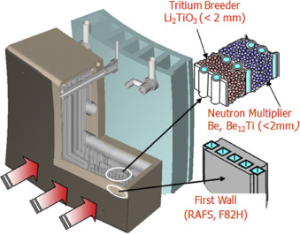
Cooling mechanisms
Dual-Cooled
Uses a separate coolant and breeding material
Examples:
Dual-Cooled Lead Lithium (DCLL)
Helium-Cooled Ceramic Breeder (HCCB)
Water-Cooled Ceramic Breeder (WCCB)
M. S. Tillack and S. Malang, "High performance PbLi blanket," 17th IEEE/NPSS Symposium Fusion Engineering
M. Abdou (2015). Blanket/first wall challenges and required R&D on the pathway to DEMO. Fusion Engineering and Design.

Slide 36
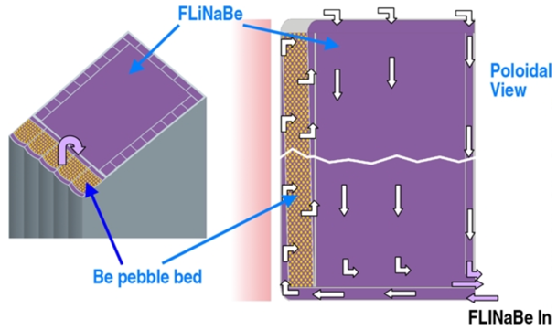
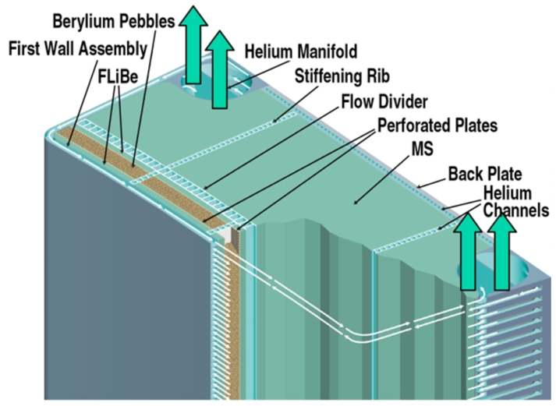
Cooling mechanisms
Self-Cooled
Uses the same coolant and breeding material
Examples
Self-Cooled Lead Lithium (SCLL)
Self-Cooled Molten Salt
C. Wong, Fusion Eng. Des. 72 (2004) 245-275.
C. Wong, Fusion Sci. Technol. 47:3 (2005) 502-509

Slide 37
Coolants and Their Challenges
Helium
Water
Liquid Metal
Molten Salt
(+) Inert
(-) Low thermal conductivity
(+) High specific heat capacity
(-) High pressure system
(-) Bad neutron shield
(-) Steam reactions bad
(-) Tritiated water bad
(-) High pressure system
(+) High specific heat capacity
(+) Well-known pumping systems
(+) Neutron shield
(-) MHD pressure drop
(+) High thermal conductivity
(-) Corrosive
(+) Reasonable melt temperature
Reactivity
(-) Lithium highly reactive with water and air
(+) PbLi Less reactive
Specific Heat Capacity
(-) Low specific heat capacity (PbLi)
(+) High specific heat capacity (Li)
(+) Breeding Material
(-) High viscous pressure drop
(-) Somewhat poor thermal conductivity
(-) Highly Corrosive
(-) High melt temperature
(+) High specific heat capacity
(+) Breeding material
(+) Neutron shield

Slide 38
Conclusion
How can we use those neutrons?
What challenges do those neutrons present?
Breeding tritium from lithium
solid ceramic
liquid metal
molten salt
Make more neutrons with neutron multipliers
Pb
Be/Beryllides
Heating for power conversion
Material activation and decay heat
Requires careful material selection
Damage to solid structures
need to shield sensitive components
Large heat load
Careful selection of Breeding/Multiplier/Coolant material combinations

Slide 39
Extra Slides

Slide 40
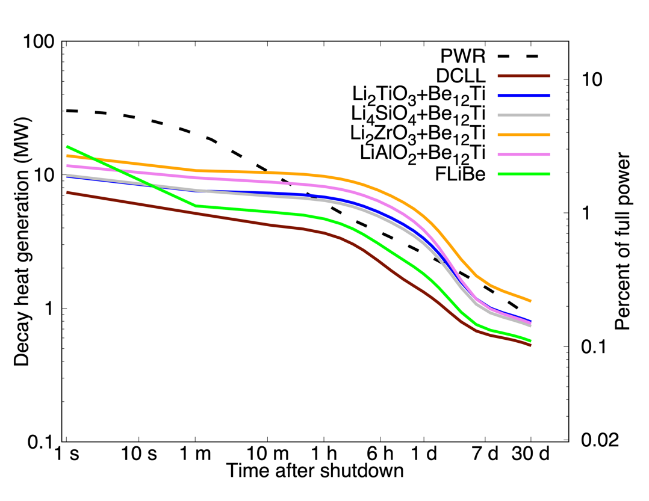
Decay heat dependence on blanket concept
FNSF with PbLi replaced with other breeder/multiplier materials:
Blankets with high beryllium content lead to increased activation of FW and Divertor tungsten through multiplication, moderation of the neutron flux
7-18 MW at 1 s
Dominated by ¹⁶N in FLiBe
⁹⁵Zr, ⁹⁵Nb add significantly in Li₂ZrO₃ breeder
⁴⁶Sc (from Ti in multiplier) adds significantly in solid breeders

Slide 41
Lithium is the only solution
Lithium is the only element that can achieve a TBR > 1:
n + ⁶Li → ⁴He + T + 4.785 MeV
Large cross section at thermal energies
Exothermic: produces additional energy!
n + ⁷Li → ⁴He + T + n’ - 2.5 MeV
Produces tritium and a neutron
A D-T fusion is essentially fueled with deuterium and lithium:
$$T+D→{}_{ }^{4}{He}+n$$
F. Hernandez, Fusion Engineering and Design 137 (2018) 243-256.
$$T+{}_{ }^{4}{He}←Li+n$$

Slide 42
Beryllium as a multiplier
Pb and Be are the only viable multipliers
Pure Be has a number of shortcomings as a multiplier material (aside from toxicity and resultant difficulty in manufacturing):
High swelling under irradiation, especially at high temperature (> 600 °C)
High tritium retention (40% at 600 °C)
A small but significant (<1%) amount of tritium is bred in beryllium
$9Be\left(n,α\right)→6He$ $→6Li+β^{−}$
$9Be\left(n,T\right)→7Li$
Diffusivity of tritium in beryllium metal is low (it would be a decent permeation barrier)
High chemical reactivity…
F. A. Hernández, Fusion Engineering and Design 137 (2018) 243-256.
F. A. Hernández, Fusion Science and Technology 75 (2019) 352-364.

Slide 43
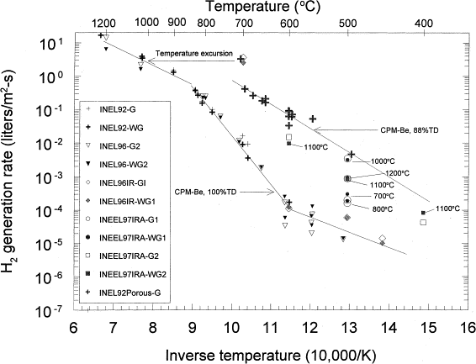
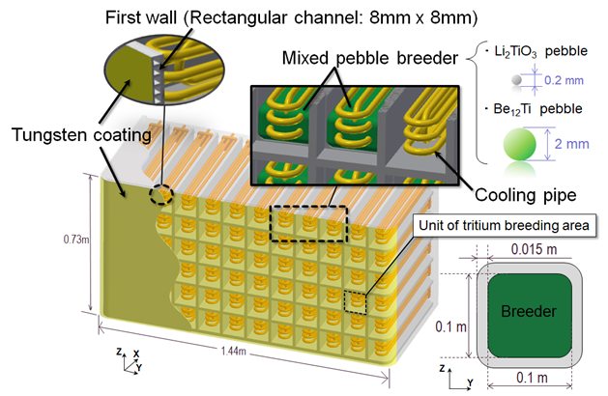
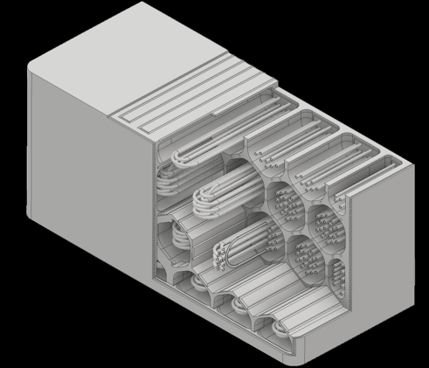
Beryllium Oxidation
R. A. Anderl, Journal of Nuclear Materials 258-263 (1998) 750-756.
Beryllium reacts exothermically with steam and air; at high temperature the possibility for “runaway” reactions exists
For water-cooled ceramic breeder designs, this is a significant safety issue
So also for ITER (water cooling and beryllium PFCs)
Helium cooling avoids steam reactions, hydrogen generation
But should consider the event of air ingress, e.g. as a result of ex-vessel helium pipe break
Y. Someya, 2018 US-JA Workshop

Slide 44
Beryllides
Need to inhibit oxidation led to a search for alternate materials with high beryllium content but better oxidation resistance
Focus on group 4-6 transition metal beryllide intermetallic compounds
Be_{X}M, where X=12 or 13; >92% beryllium
Hard, brittle, high melt temperature (1500-1900 °C)
Early research performed by Brush Wellman (now Materion), funded by the air force, in search of new oxidation-resistant high temperature materials
None apparently found widespread application at that time, but high beryllium density, high temperature, oxidation resistant behavior makes them potentially attractive multipliers for ceramic breeder blankets

Slide 45
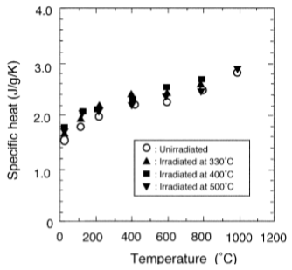
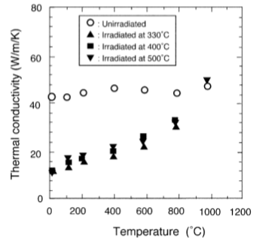
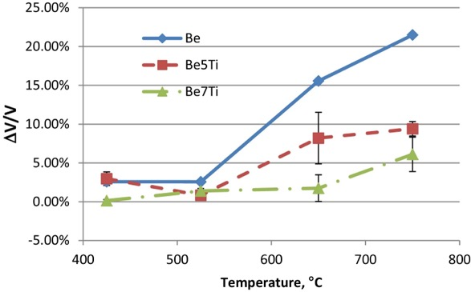
Titanium Beryllide
JMTR, 70 appm He, 0.5 dpa
Titanium beryllide, Be₁₂Ti, is the first and most extensively studied beryllide for fusion applications
Best neutron multiplier among the beryllides¹
$ρ=2.26 \text{g}\text{/}\text{cm}\text{3}\text{, }Tmelt=1538 °\text{C}$
Irradiation to 19.5 dpa, 2740 appm He in HIDOBE-01 revealed much lower swelling and tritium retention compared to pure Be
A. V. Fedorov, Fusion Engineering and Design 102 (2016) 74-80.
M. Uchida, Fusion Engineering and Design 69 (2003) 499-503.
¹C. Dorn, Fusion Engineering and Design 84 (2009) 319-322.

Slide 46
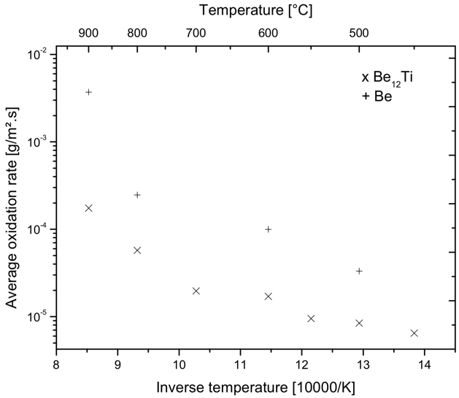
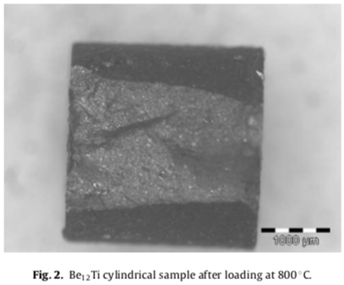
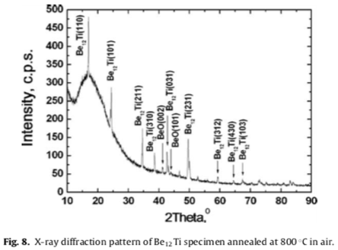
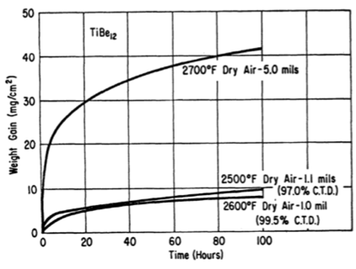
Titanium Beryllide Oxidation
4
Titanium beryllide (Be₁₂Ti) amongst those characterized in early work by Brush Wellman¹; not as extensively characterized as other beryllides, which outperformed it³
Complete oxidation: $Be12Ti+7O2→12BeO+TiO2$
TiO₂ not observed in more recent air oxidation work; Be expected to reduce TiO₂²
Multiple studies suggest lower oxidation rates than pure Be; 6-20x lower in SCK-CEN studies⁴
¹R. M. Paine, Corrosion 20 (1964) 307t-310t.
²P. Kurinsky, Fusion Engineering and Design 86 (2011) 2454-2457.
³C. Dorn, Fusion Engineering and Design 84 (2009) 319-322.
⁴F. Druyts, https://www.osti.gov/etdeweb/servlets/purl/20658771.
2
2
1

