Slide 1
Plasma Waves
R. L. Barnett
Introduction to Fusion Energy and Plasma Physics Course,
SULI, June 12th, 2024.

Slide 2
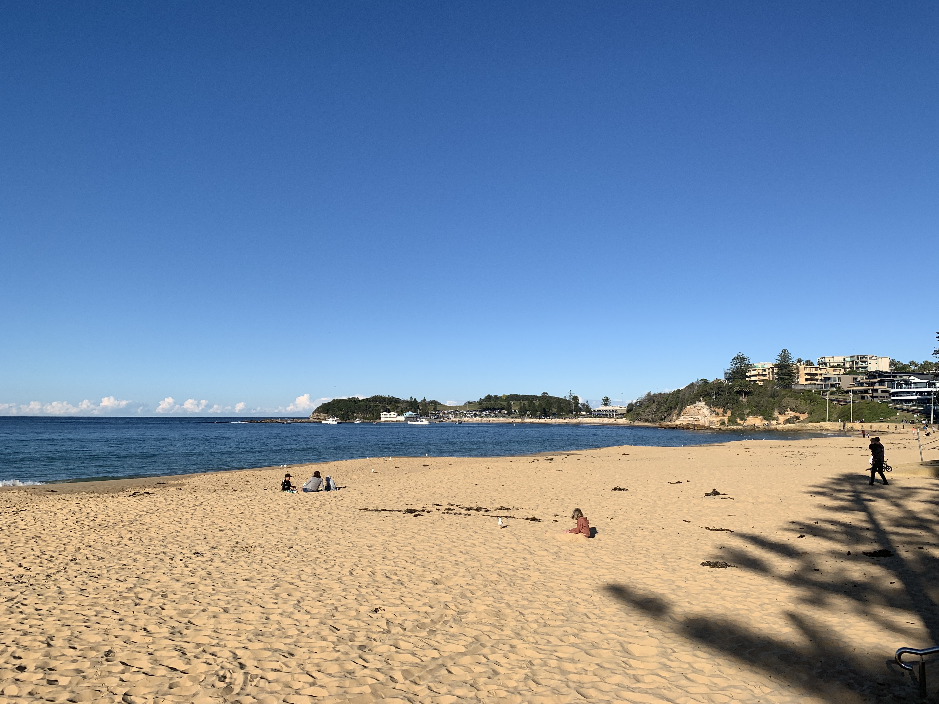
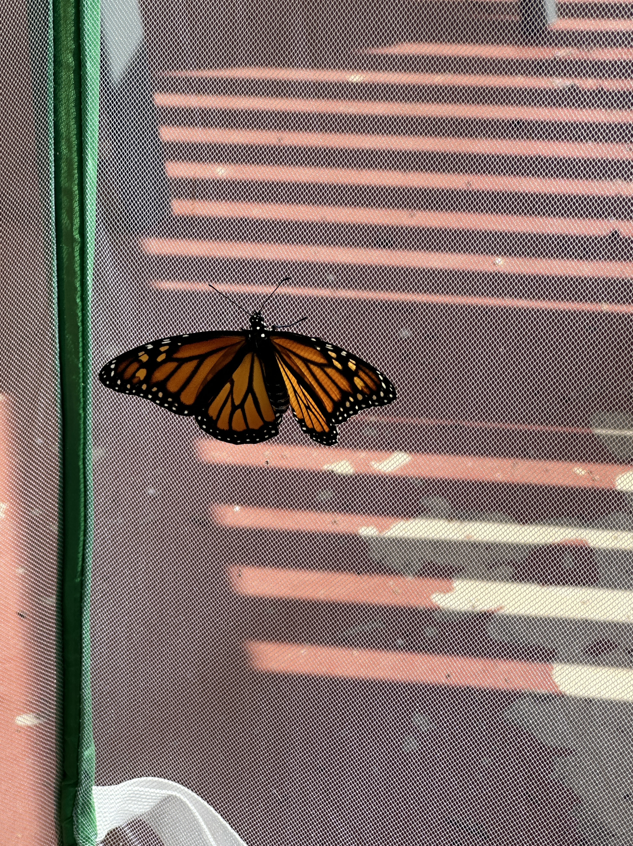
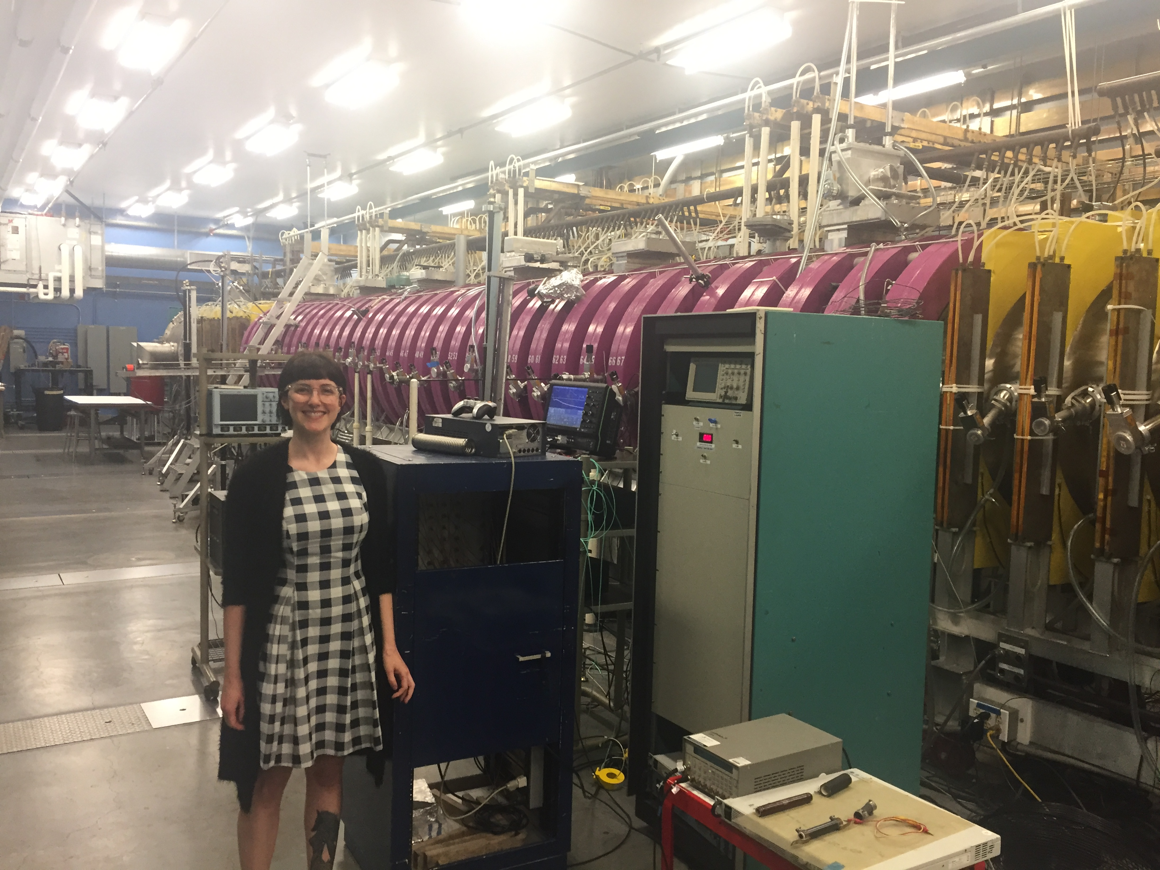
Who am I…
“Winter”
Buster
Marissa
LAPD
Luigi
Notes:
Me with tassie devil, cool fact is that they are very blind! Me at the LAPD, Large Plasma Device, linear device at UCLA. Our first Monarch butterfly, name Marissa (reference to a game npc, let me know if you know who!). One of my favourite things to show off is what we call “winter” where I’m from in Aus. And anyone who knows me knows that these two boys are the centre of my life. Luigi and Buster are both rescued greyhounds, and as you can see Busty has only one eye… which he lost to glaucoma not long after his 2nd birthday. Fun story, he lost his vision in the other eye one week after we adopted him, and it turns out he actually has an autoimmune disorder. But it doesn’t slow him down at all, he is our little wild boy.

Slide 3
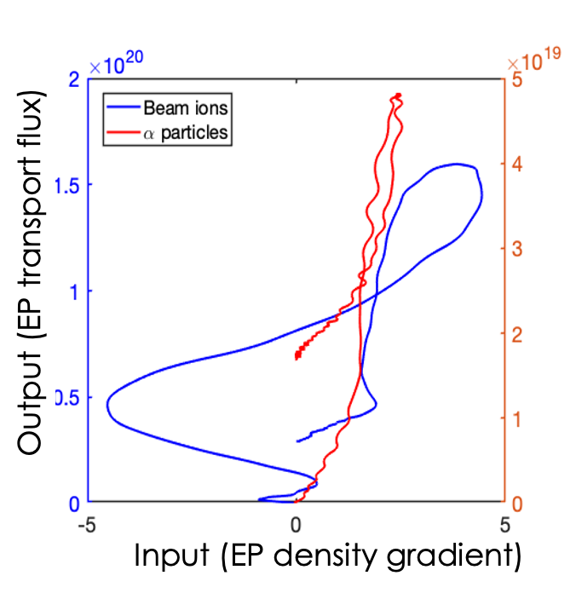
…and how did I get here?
15: Spent a year in Japan as an exchange student
16: Dropped out of high school
16 - 24: Worked a variety of jobs (aesthetician, barista, retail store manager…)
24: Enrolled in night “bridging” course, decided halfway through that I would study physics because “space is cool”
25: Enrolled in BSc, Physics major
33: Awarded PhD in Plasma Physics
I followed a somewhat non-traditional path:
Quite nonlinear, a bit like this energetic particle (EP) transport flux!
Courtesy of Yashika Ghai
(Presenting on 06/21!)

Slide 4
On that note, a word of encouragement before we start
Notes:
As someone who came into my BSc without knowing a lick of trigonometry, I want you to know it’s okay if you don’t understand something the first time you read or hear it, for most of us, it takes time, and how much time is really individual!

Slide 5
Alright enough about me, onto the waves!!

Slide 6
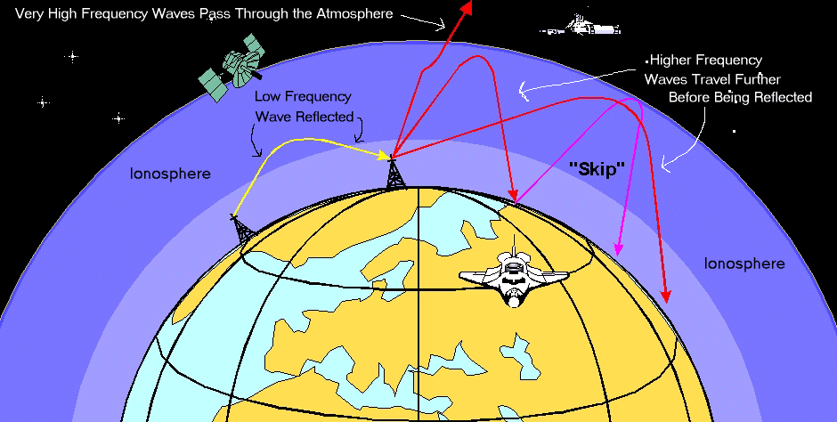
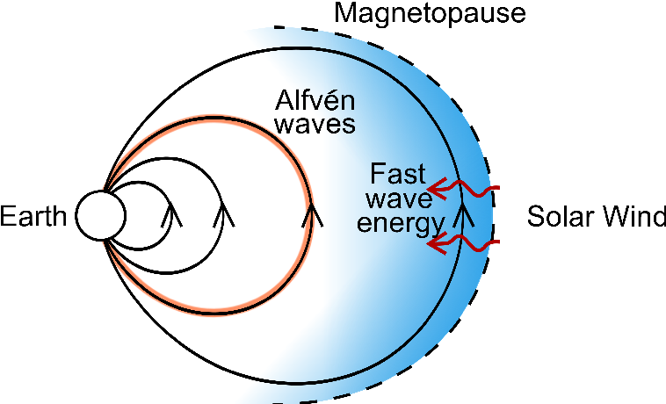
Understanding plasma waves is important for many reasons
Communication
And, of course, heating and current drive in fusion plasmas!
Geomagnetic storms
Notes:
Give some context for the talk. Plasmas are basically everywhere throughout the universe, and close to home we use plasma waves for a bunch of different things. And you can see my bias as someone with a background in space physics! But it’s the plasma in our atmosphere that give us this long-range communication without needing a direct line of sight → these reflections are caused by the plasma properties in the ionospheric layers.
Plasma waves are also responsible for transporting energy from the solar wind into the magnetosphere, driving a lot of geomagnetic storms – but we can also use measurements of the magnetospheric fields to probe regions like the radiation belts, which is important for any satellites that need to pass through the area.
And lastly, the topic of this SULI summer school, waves are used a lot in fusion plasmas. I have one example written here because it’s the one I’m most familiar with, but let me guarantee you this hardly scrapes the surface!

Slide 7
Plasma waves: let’s go back to basics…
How do we describe waves?
Amplitude
Wavelength $λ$
Wavenumber $k=2π/λ$
Frequency $f$
Angular frequency $ω=2πf$
Velocity:
Phase $v_{φ}=\frac{ω}{k}$ Velocity of a wavefront
Group $v_{g}=dω/dk$ Velocity of a wave packet
Notes:
Let’s start with the waves part of plasma waves. So in a vacuum (we call it) there’s a couple of different types of wave: we have the longitudinal wave, or what we would call a compressional wave, that describes something like a sound wave, where the particle motion is in the same direction as the wave; and the transverse wave, or the shear wave, where the motion is perpendicular to the direction of propagation. There are a few pretty standard characteristics we use to describe either type of wave, and you’re probably familiar with them, like the amplitude, the wavelength, and the frequency. So when describing plasma waves we usually the wavenumber k and the angular frequency omega. There’s also the velocity of the wave, well two velocities: the phase velocity, which just tracks the wavefront, and the group velocity, which is useful when you have a wave with multiple frequencies (this is the one that carries information, i.e., can’t be larger than c).

Slide 8
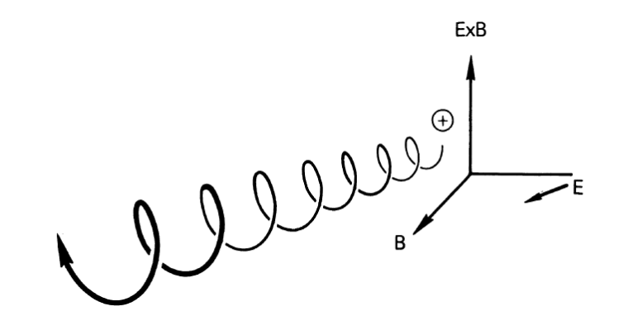
Plasma waves: a lot of the same characteristics apply, but with a bit of extra ✨spice✨
Plasmas can act like they have “a mind of their own”… owing to two key things that make a plasma a plasma.
Quasi-neutrality: neutral enough to assume $Z_{i}n_{i}≈n_{e}$, but not so neutral that it loses the interesting properties.
Collective behaviour: forces from long range electromagnetic fields dominate individual particle interactions.
And it’s not only waves, single particle (guiding centre) drifts and fluid drifts also play a huge role in plasma dynamics.
Notes:
Okay let’s include the “plasma” part of plasma waves. The main difference with a plasma is that collisions aren’t the main force that drives the waves, like the sound wave example from the previous slide. In fact, in a collisionless plasma you can completely neglect any particle collisions and consider only the electromagnetic forces.
Now I know we’re not covering this today, but I want to mention single particle and fluid drifts as well because these are also really important and interesting plasma phenomena that can drive their own set of forces as well! In a fluid description of a plasma, we use what’s called the guiding centre to describe drifts: we leave the rest to full gyrokinetic and gyrofluid codes.

Slide 9
Simple motion in a plasma
Notes:
Okay, let’s talk about the simplest case of motion within a plasma.

Slide 10
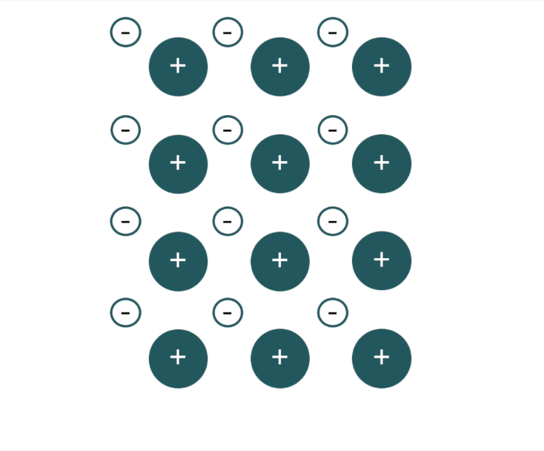
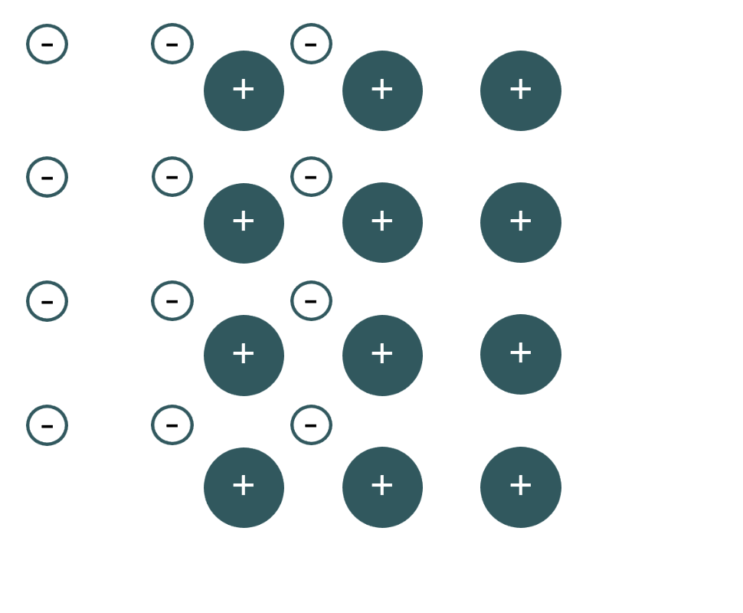
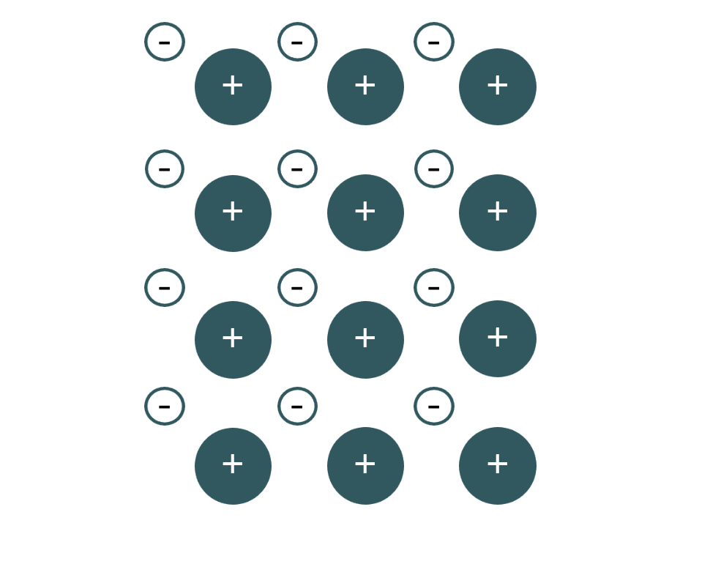
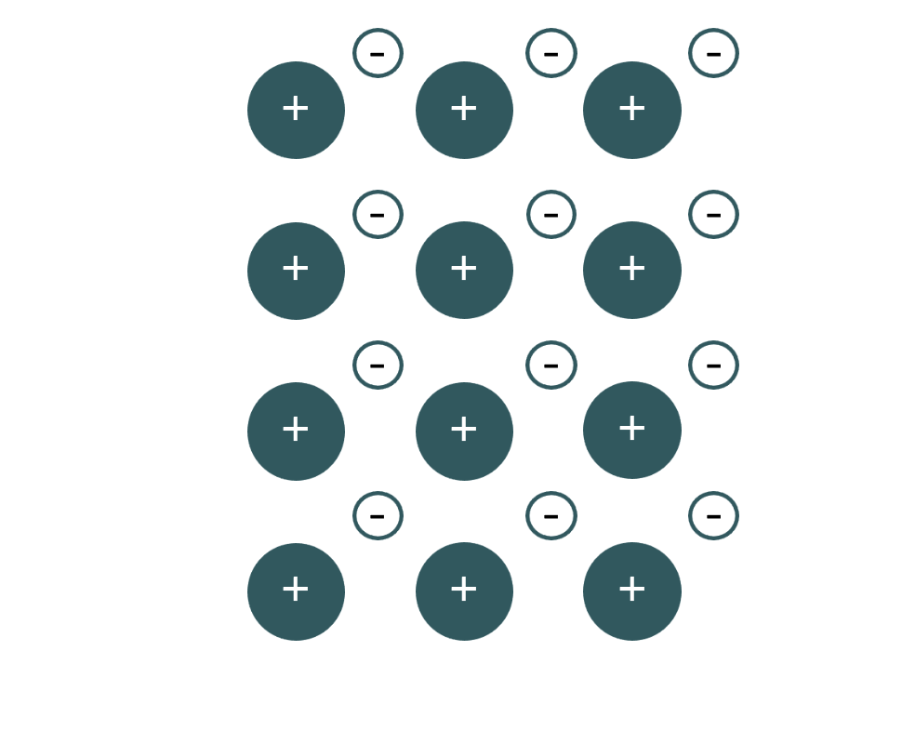
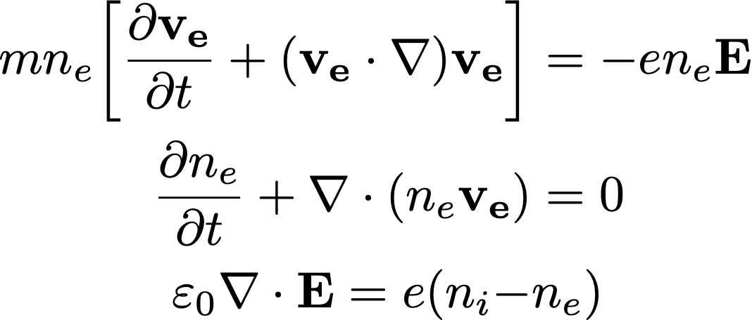
Plasma oscillations
Let’s find the oscillation frequency.
Assumptions:
No thermal motion
No ion motion
Infinite plasma
Motion only in 1D
Need to solve the following:
E
Notes:
Consider these assumptions: if we have no magnetic field, no thermal motion, we have a uniform ion background that’s frozen, only 1D motion, so say “left” and ”right” on this figure, and that the plasma extends forever in both directions. What happens when you displace electrons from a uniform background of ions? Well, the electric field that’s generated from the deviation from the equilibrium to restore the electrons to their original position, thus restoring “neutrality”. But because the electrons now have inertia, they will overshoot, and the repetition of this motion will oscillate at the plasma’s characteristic frequency: also called the plasma frequency. Let’s derive it.
Given all of our assumptions, our set of equations is pretty simple: we need the electron equation of motion, which is just F=ma; the electron continuity equation to guarantee particle balance; and Poisson’s equation.

Slide 11
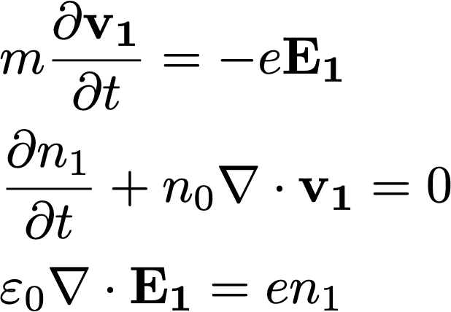
Linearisation is a key concept for deriving plasma quantities
We can assume that the fields are made up of an “equilibrium” (or slow, subscript 0) part, and a “perturbation” (fast, subscript 1) part, and we’ve assumed a neutral, uniform rest plasma, then the only remaining slow time scale quantity is $n_{0}$, so
Linearise
Notes:
The first step is to linearise the equations, and although this is a simple case, linearisation is something we use for cold plasma waves in general. The process of linearisation is to assume that the plasma quantities are made up of two pieces: a ”slow” or stationary piece; and a “fast” or oscillatory piece.
If you substitute the new expressions for the fields into the original equation, and in this case we also assume that the amplitude of the oscillatory part is small enough that we can neglect any higher order expressions, we are left with this set of equations on the right.

Slide 12
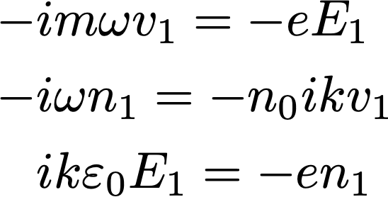
Apply Fourier transform…
Assume sinusoidal oscillations, $\left(v_{1},n_{1},E_{1}\right)=\left(v_{1}x,n_{1},E_{1}x\right)exp\left[i\left(kx−ωt\right)\right]$ and take the Fourier transform, $∇→ikx, ∂/{∂t→−iω}$ so our equations become,
Linearise
Transform
Notes:
Next, because we’re assuming sinusoidal oscillations, we can take the Fourier transform of the fields. This leads to the equation set on the right, which is great, because there are three of them for our three “fast” scale quantities.

Slide 13
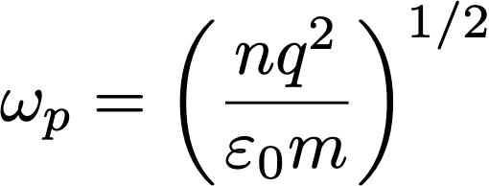
…and finally, we arrive at the plasma frequency
algebra
algebra
Each particle species will have its own characteristic plasma frequency given by $ω_{p}$
Notes:
We can finally throw some algebra at the problem, which I’ll leave as an exercise for anyone who is interested, and we arrive at the expression for the plasma frequency, which only depends on the density. We did the derivation for electron motion because it was simple, but the concept is the same for any charged species.

Slide 14
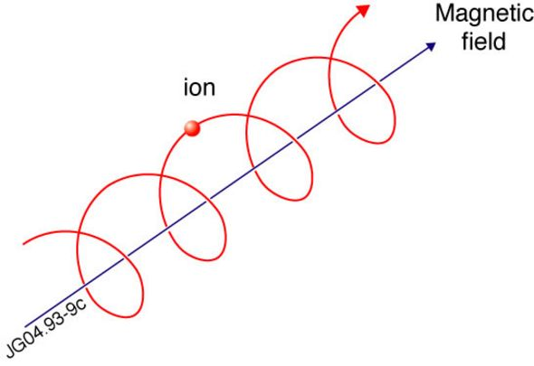
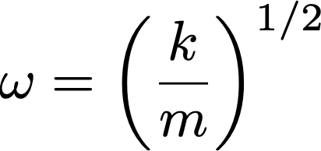
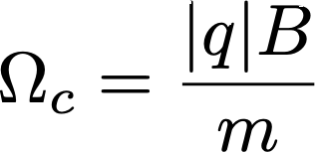
These types of oscillation show up a lot!
Simple harmonic oscillation in a mass-spring system
Plasma oscillations
Oscillations around a B field
Notes:
And you would have seen these types of waves before, it’s the same as the simple harmonic oscillation of a mass-spring system, where in that case it’s mechanical. The other place we see this type of oscillation is for charged particle motion around a B field → that wasn’t relevant for this derivation, but it will play an important role when we consider a magnitised plasma.

Slide 15
These types of oscillation show up a lot
Simple harmonic oscillation in a mass-spring system
Plasma oscillations
Oscillations around a B field
You’ll see these again soon!
Notes:
So take note of these two frequencies!

Slide 16
The fluid description of a magnetised (cold) plasma
Notes:
On that note, let’s throw a strong magnetic field into the system, like we would use in magnetically confined fusion.

Slide 17
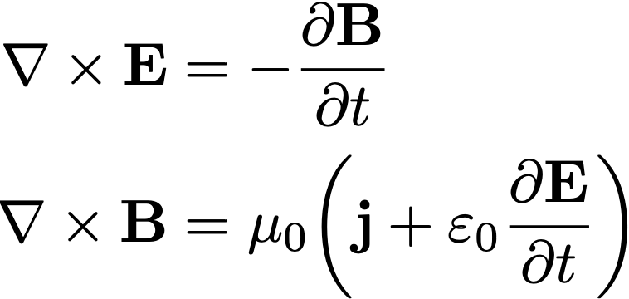
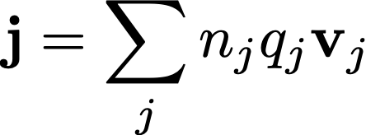
More general derivation will uncover many more waves!
Fluid equation of motion
Maxwell’s equations
Linearise
with
Fourier transform
Do some algebra…
Notes:
This should look a little bit familiar, because we start at the same place as we did for the plasma oscillations, only this time we have a fluid equation of motion for a general species, and often multiple species at once, plus the full set of Maxwell’s equations. I’m not going to go through the full derivation here because it can be quite tedious, but the process is the same: we linearise, fourier transform, perform some algebra…

Slide 18
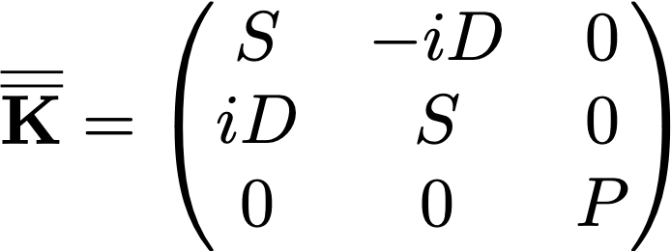
The cold plasma wave equation
Linearise
Fourier transform
Cold plasma dielectric tensor
Do some algebra…
We can expand to get… (where $n=kc/ω$)
Notes:
And come up with the cold plasma wave equation, where this capital K tensor is the cold plasma dielectric tensor, and don’t worry we’ll define these S’s, P’s, and D’s in a couple of slides. So if we expand that wave equation we come up with something that looks like this.

Slide 19
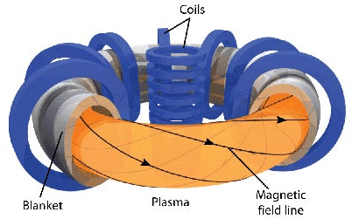
An aside:
For plasmas in a strong background magnetic field, let’s define a convenient coordinate system:
$∥$: Parallel to B0
$⊥$: Perpendicular to B0
Notes:
A quick aside before we move on, regarding the subscripts on the refractive indices, when working in a plasma that has a strong confining field, it’s often convenient to describe the motion in reference to the magnetic field, and this is because the motion along and across fields is generally quite different.

Slide 20
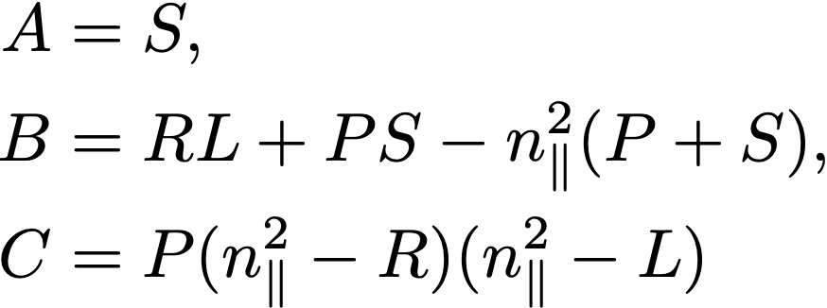
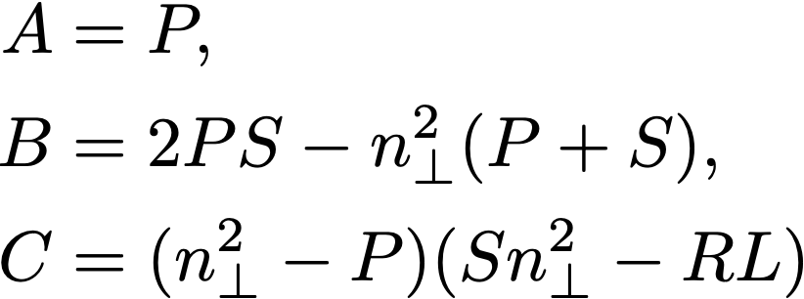
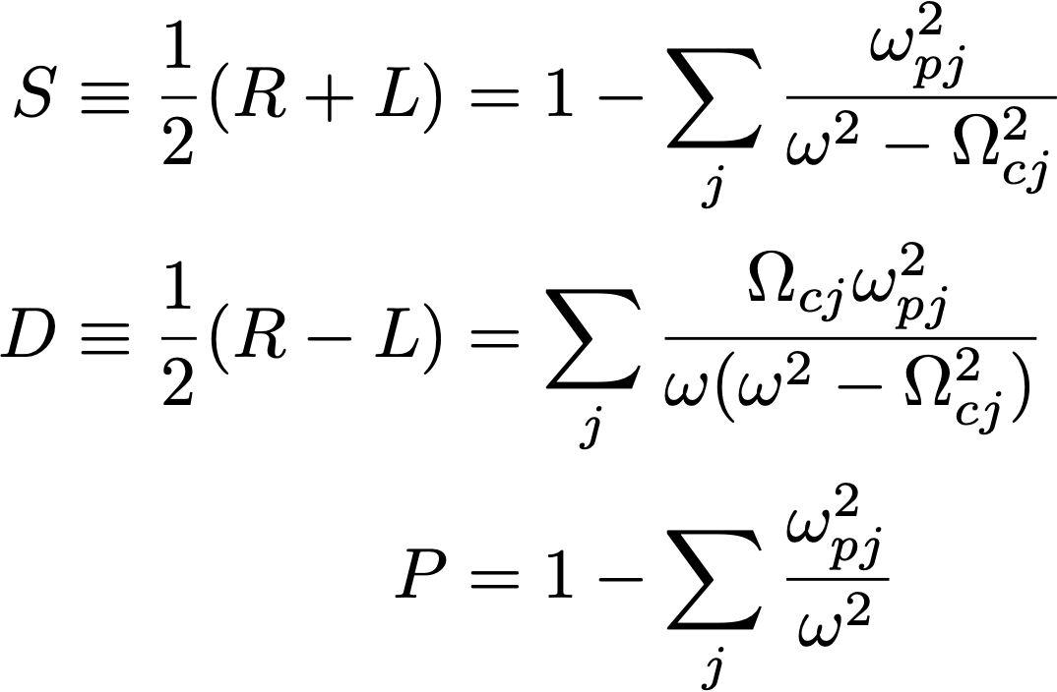
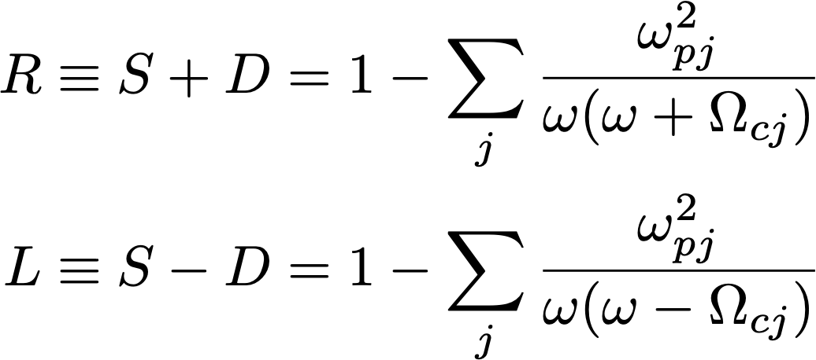
This leads to the cold plasma dispersion relation(s)
Notes:
The nontrivial solution to the matrix wave equation requires the determinant to be zero, and that is how we end up with the cold plasma dispersion relation, and we can find one each depending on whether we’re looking at parallel or perpendicular motions.
So here are these S, P, and D values from the dielectric tensor, and you can also see why I was pointing out the plasma and cyclotron frequencies → they are part of our dispersion relation!

Slide 21
Why the dispersion relation is our favourite (?) tool
The dispersion relation tells us the relationship between the spatial (k) and temporal ($ω$) properties of waves.
The dispersion relation contains a lot of essential information and is the same across disciplines (which often use different jargon!)
Two key pieces of info from the dispersion relation:
Cut off: $n=0, λ=∞$ → the wave is evanescent
Resonance: $n=∞, λ=0$ → wave “piles up” locally
We’ll see a dispersion relation showing these two phenomena in some later slides…
Notes:
Why do we even care about the dispersion relation? Well, it can tell us a lot of important information about wave propagation in the plasma, two critical things being the wave cut-offs and resonances.

Slide 22
Brief summary of plasma waves
Waves with k $∥B_{0}$
Waves with k $⊥B_{0}$
Electrostatic:
Electron plasma waves
Acoustic waves
Electromagnetic:
R waves
L waves
Alfven waves
Electrostatic:
Upper hybrid oscillations
Lower hybrid oscillations
Ion cyclotron waves
Electromagnetic:
O wave
X wave
Magnetosonic wave
Notes:
I’m not going to go through every dispersion relation here, but I do have a list of the cold plasma waves, separated into their propagation direction relative to the B field and whether the wave is electrostatic or electromagnetic.

Slide 23
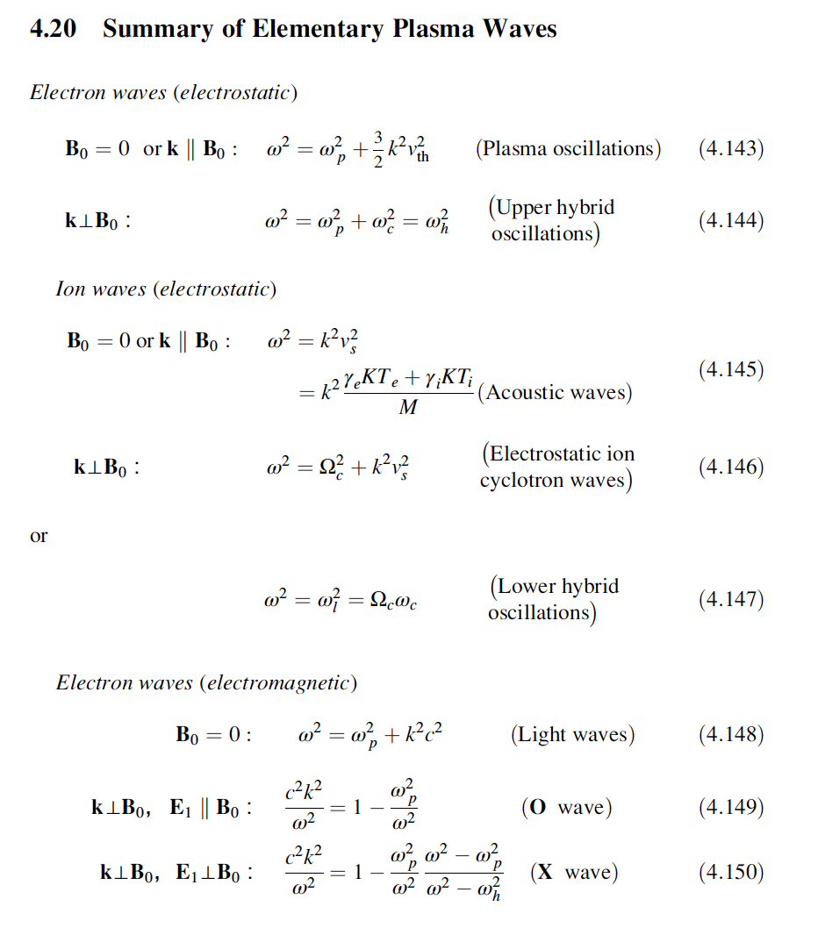
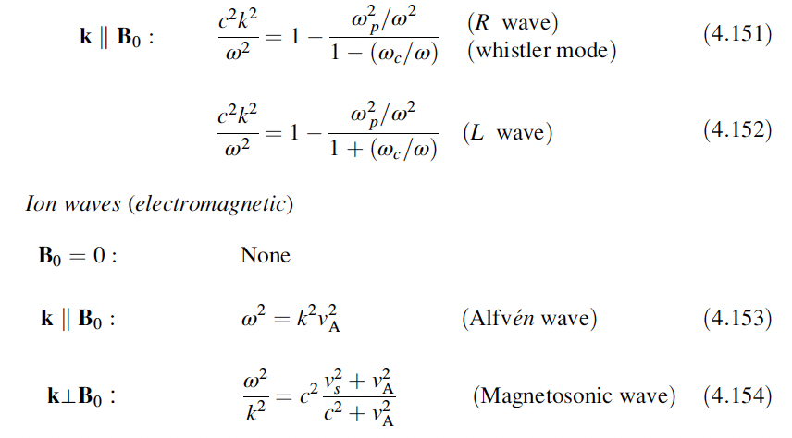
A helpful reference

Slide 24
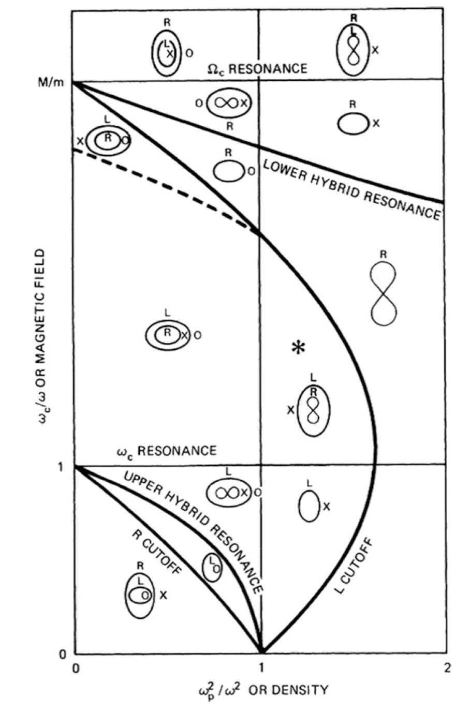
Welcome to the zoo!
Thinking of wave propagation as purely parallel or perpendicular is elegant but can hide some rich dynamics.
Modes can continuously convert into each other.
The Clemmow–Mullaly–Allis (CMA)diagram: best friend or worst enemy?
Don’t forget… this is only for COLD plasma waves!
Notes:
I will take a couple of minutes to talk you through the CMA diagram though, which can be a super useful tool once you know how to read it. So it’s density vs magnetic field, and it shows in which ranges cut-offs and resonances occur. But it also shows something really cool that was hidden by the way we defined our coordinate system → waves aren’t just perpendicular or parallel, their angle to the B field can change. And that’s what these ovals and infinities are telling us: how the wave changes as it’s angle with the magnetic field changes. An example is in the starred region: at 0 degrees to the field, the L mode will propagate, but it transitions into the X mode as the angle approaches pi/2. Whereas the little upways infinity symbol tells us that the R mode will disappear as the angle goes from 0 to pi/2. So yes, the CMA diagram looks a mess, but it can actually be great to help visualise the complex wave dynamics.

Slide 25
Quick example of waves in space plasma

Slide 26
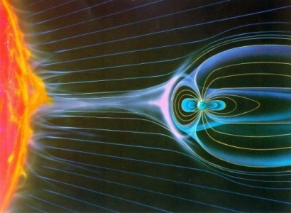
A different kind of resonance!
Solar wind compresses Earth’s B field.
A magnetosonic wave (compressional Alfven) travels towards Earth.
This wave energy can couple to a field line resonance (FLR) in the magnetospheric cavity.
Imagine someone has plucked one of Earth’s magnetic field lines like a guitar string!
We can measure these fluctuations using magnetometers…

Slide 27
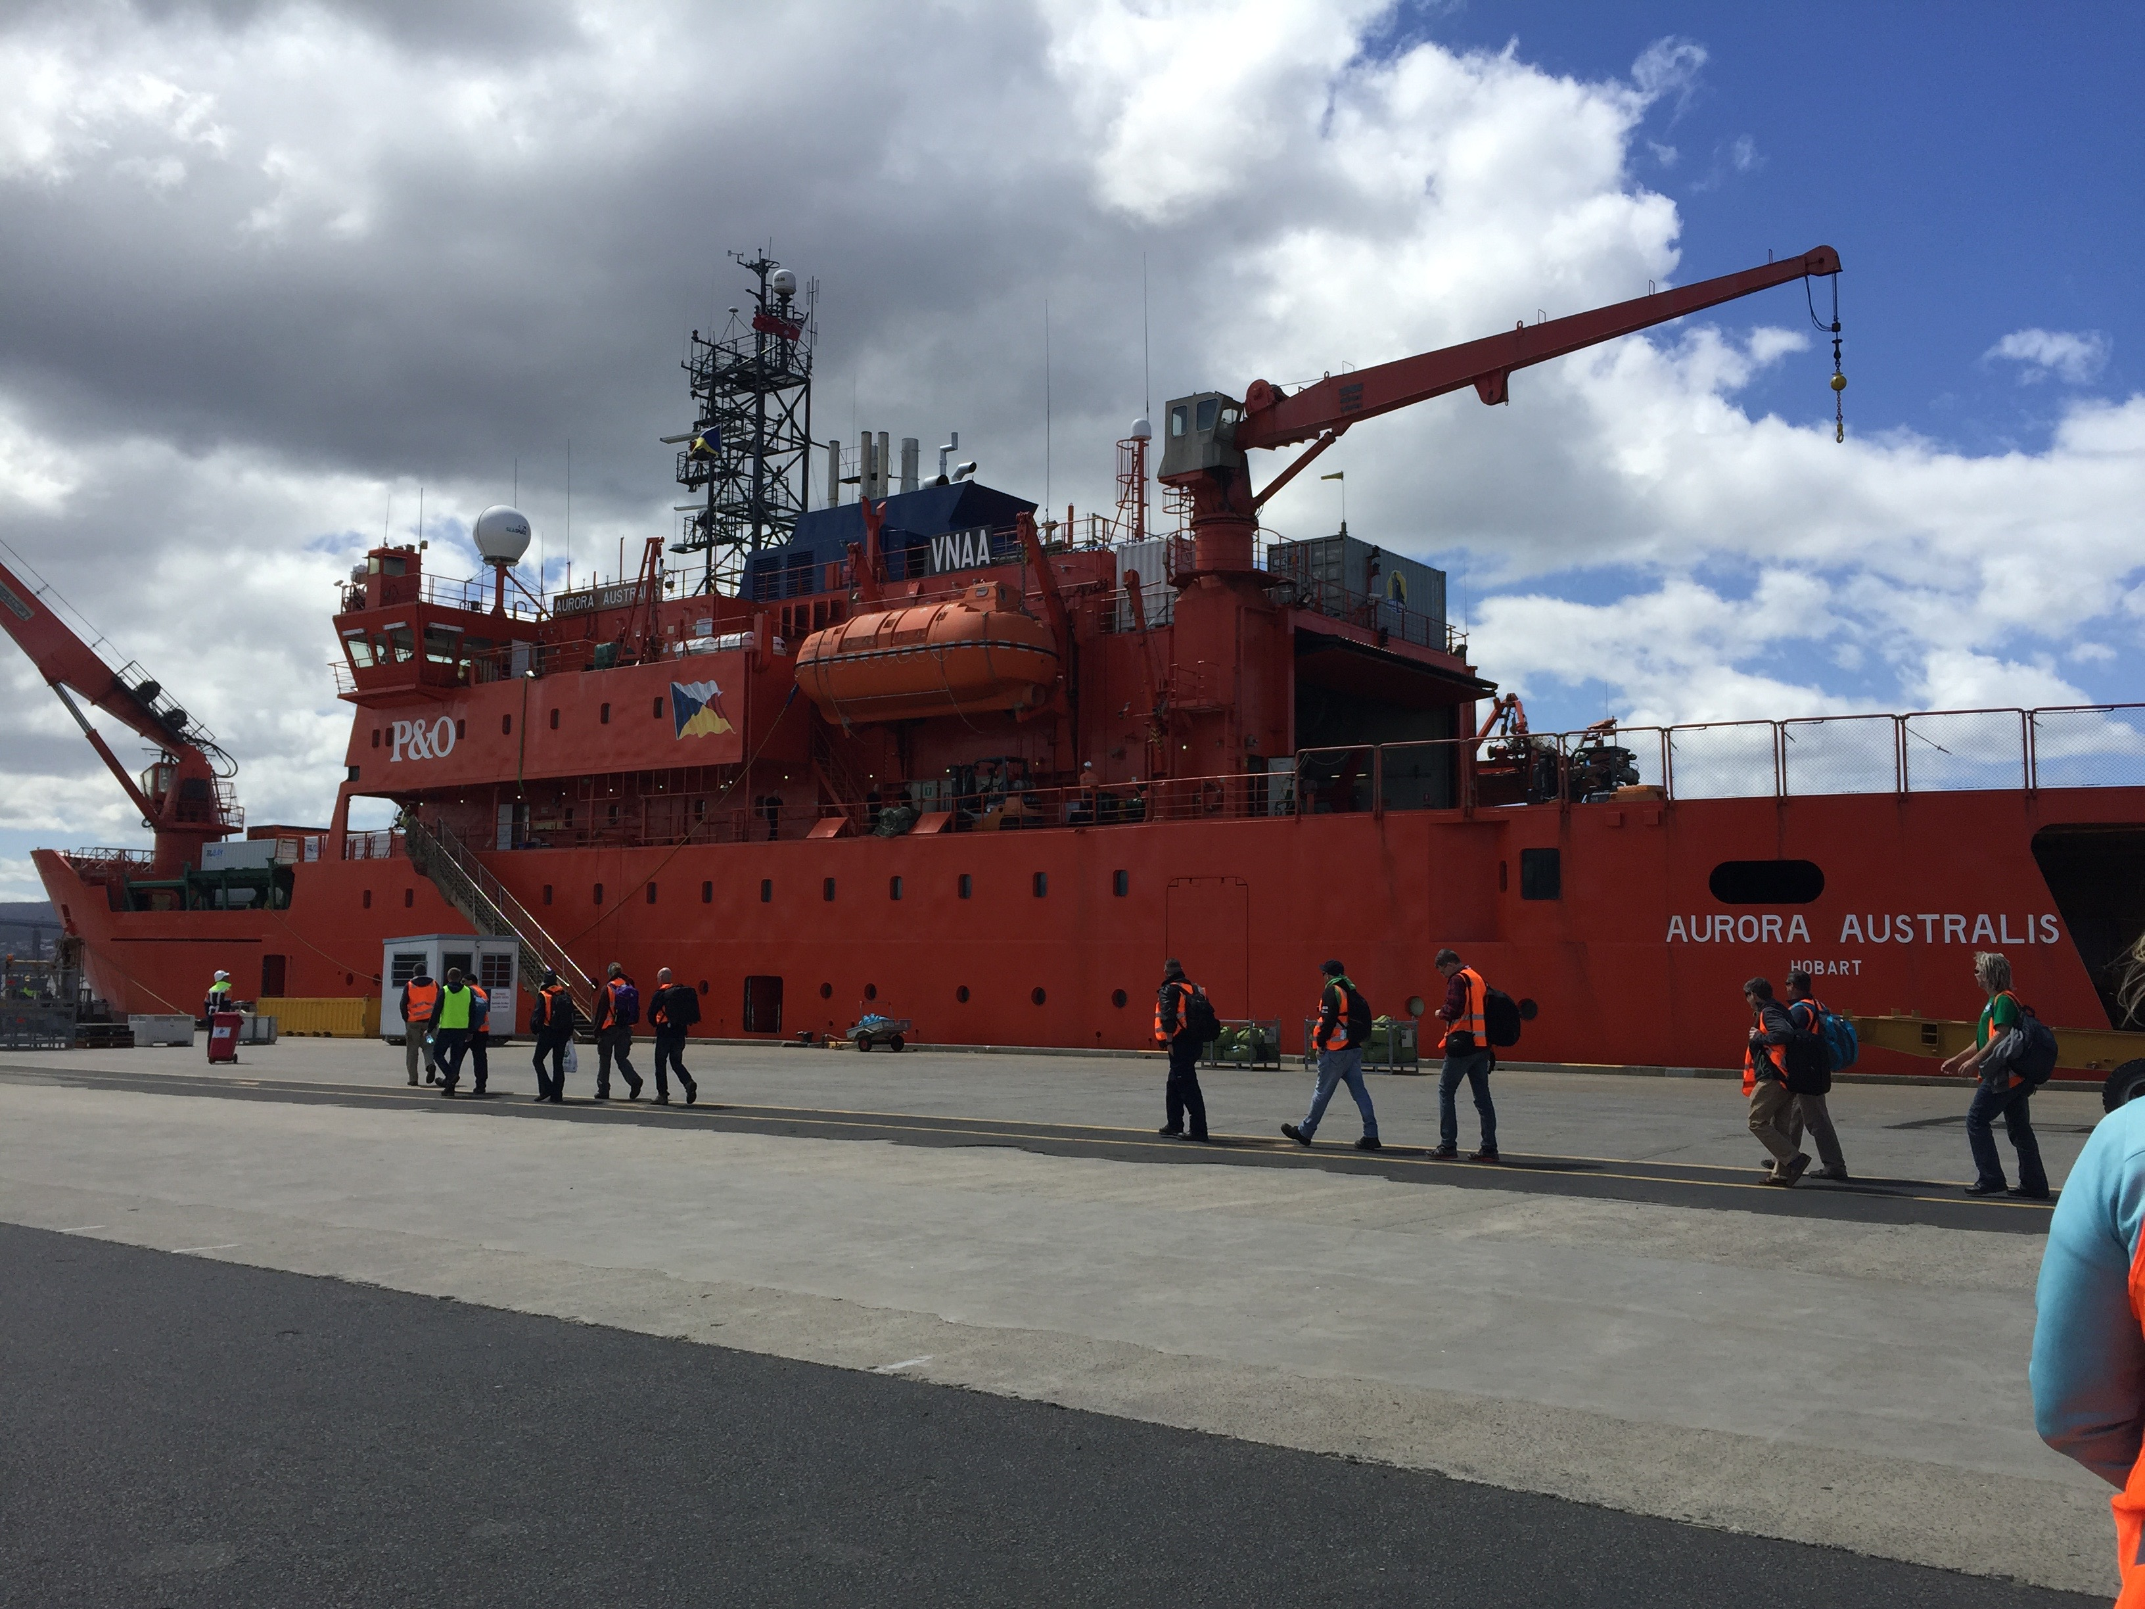
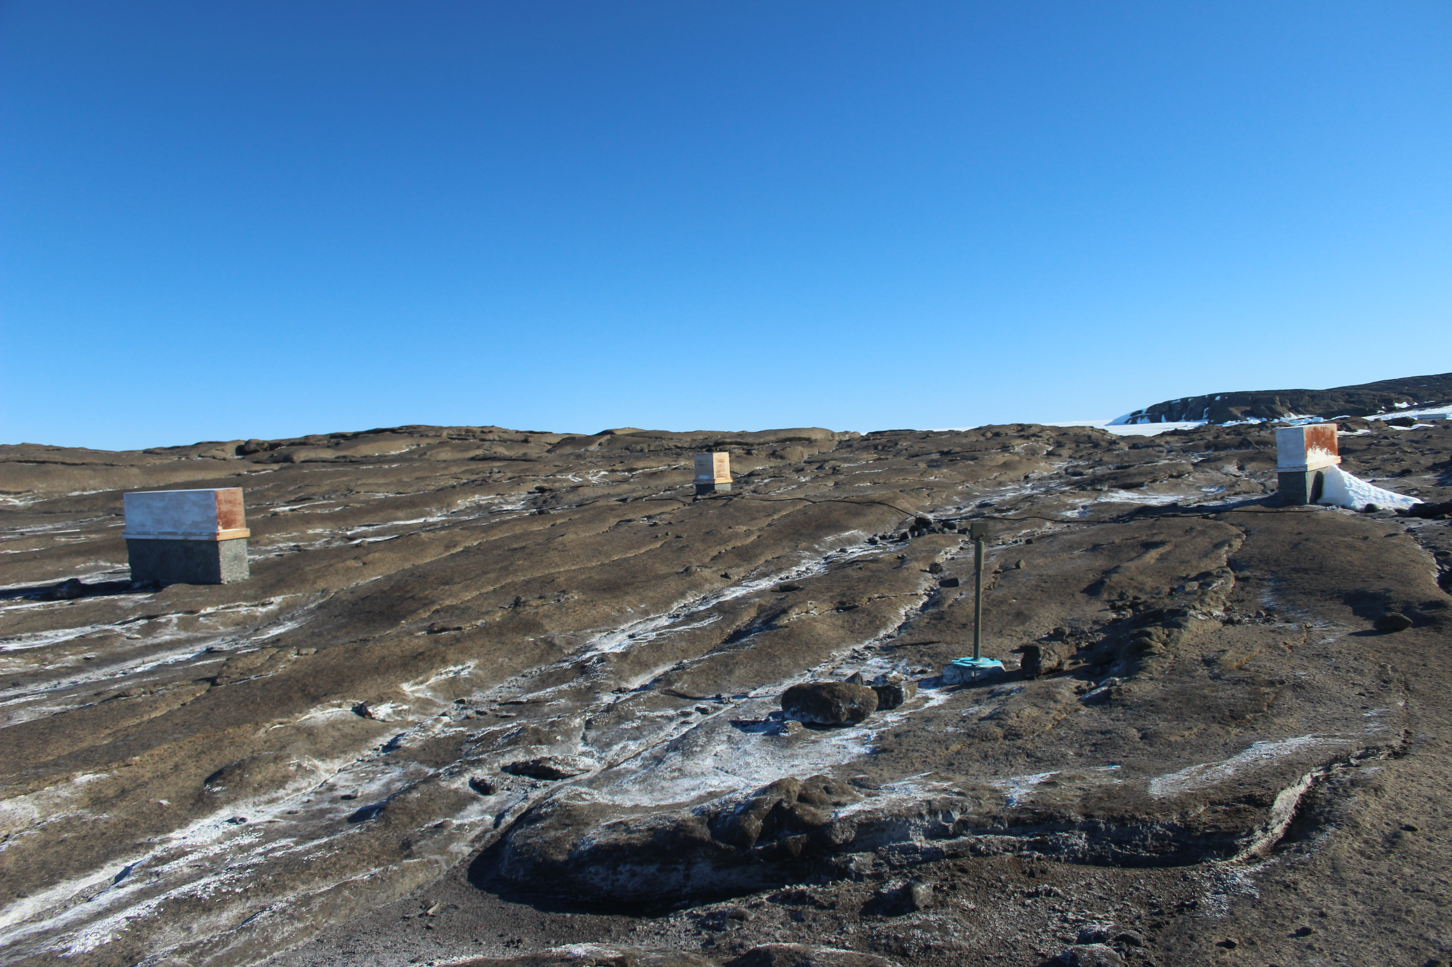
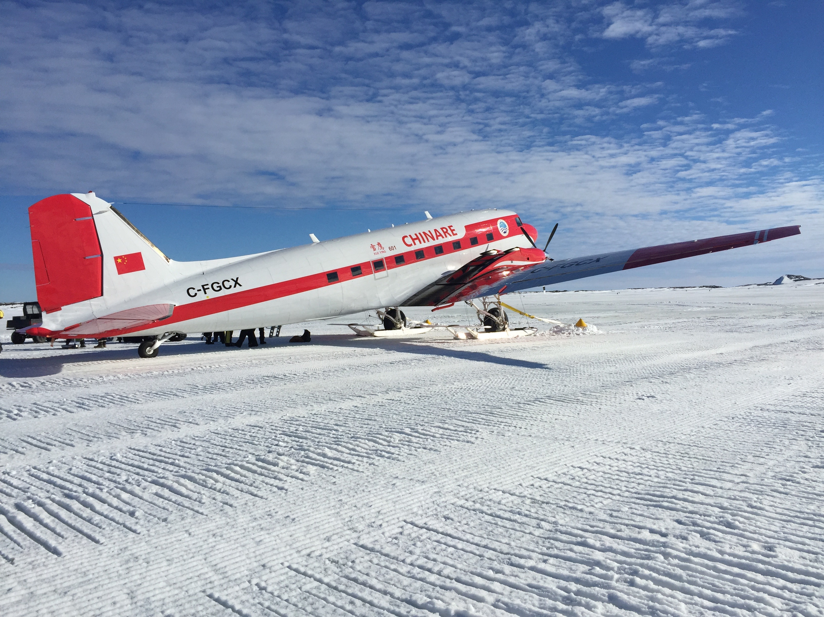
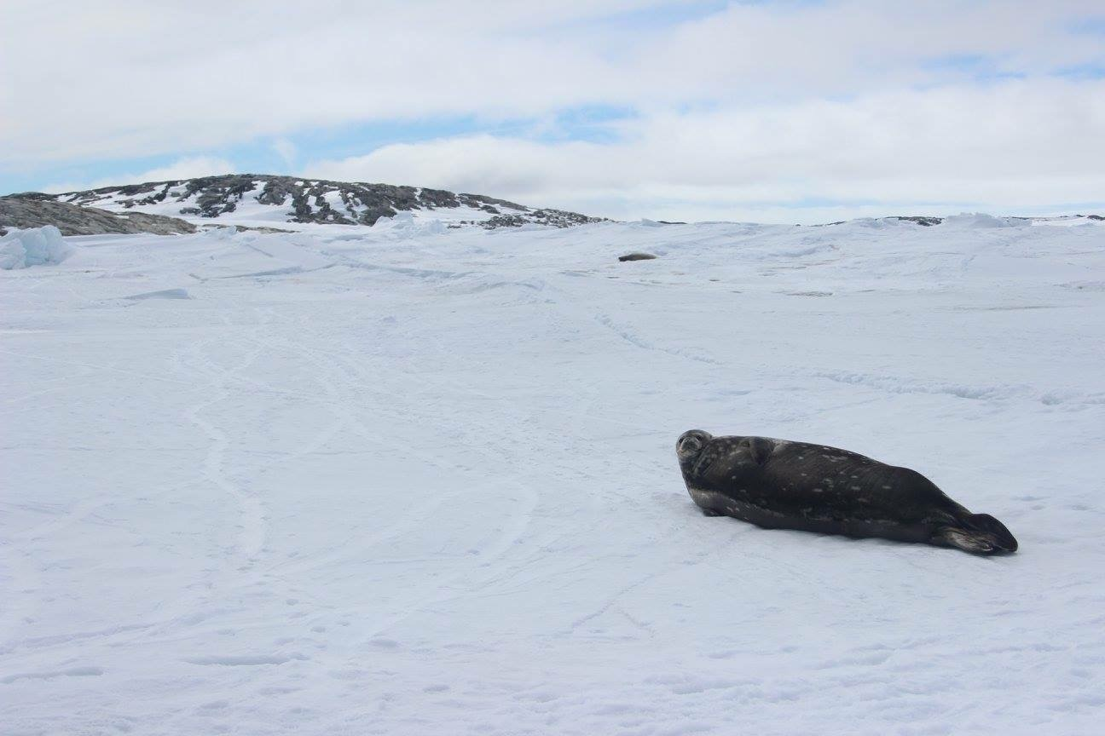
Intermission (aka please let me tell you something cool 😎)
Notes:
Mawson: katabatic wind speeds: mean (annual) 21 knots (24 mph), prolonged periods of 50 knots (just under 60 mph), gusts of 130-140 knots (150-160 mph).

Slide 28
Using waves to heat fusion plasmas

Slide 29
The different radio-frequency (RF) regimes used for heating
Ion cyclotron range of frequencies (ICRF)
High harmonic fast wave (HHFW)
Lower hybrid range of frequencies (LHRF)
Electron cyclotron range of frequencies (ECRF)
~ 30 MHz
30 – 120 MHz
2.45 – 8 GHz
30 – 200 GHz
ICRF
LHRF
ECRF
10⁷
10⁸
10⁹
Hz
10¹⁰
10¹¹
10¹²

Slide 30
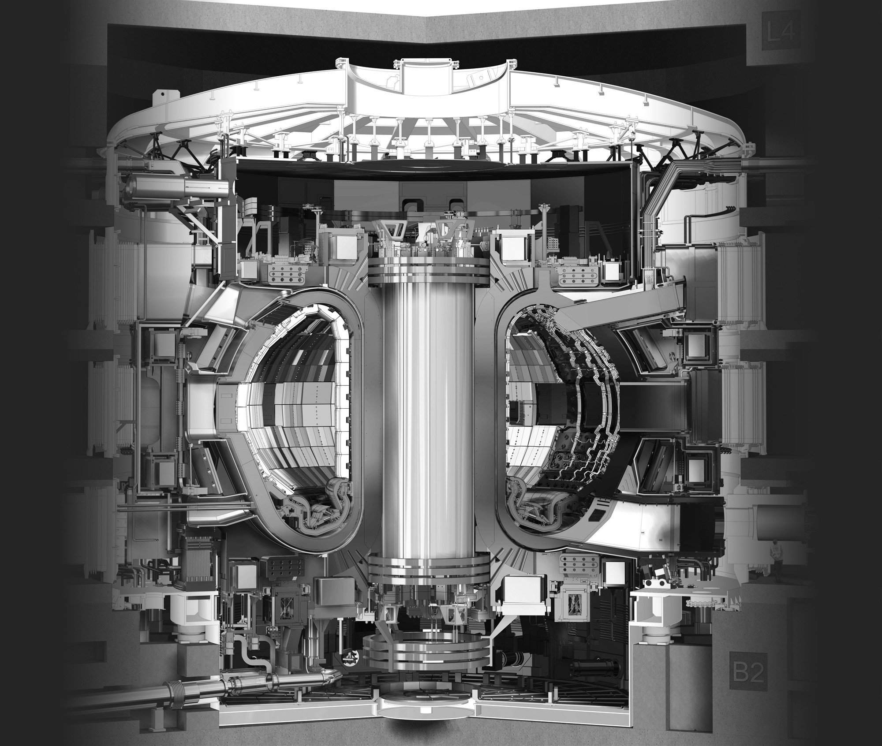
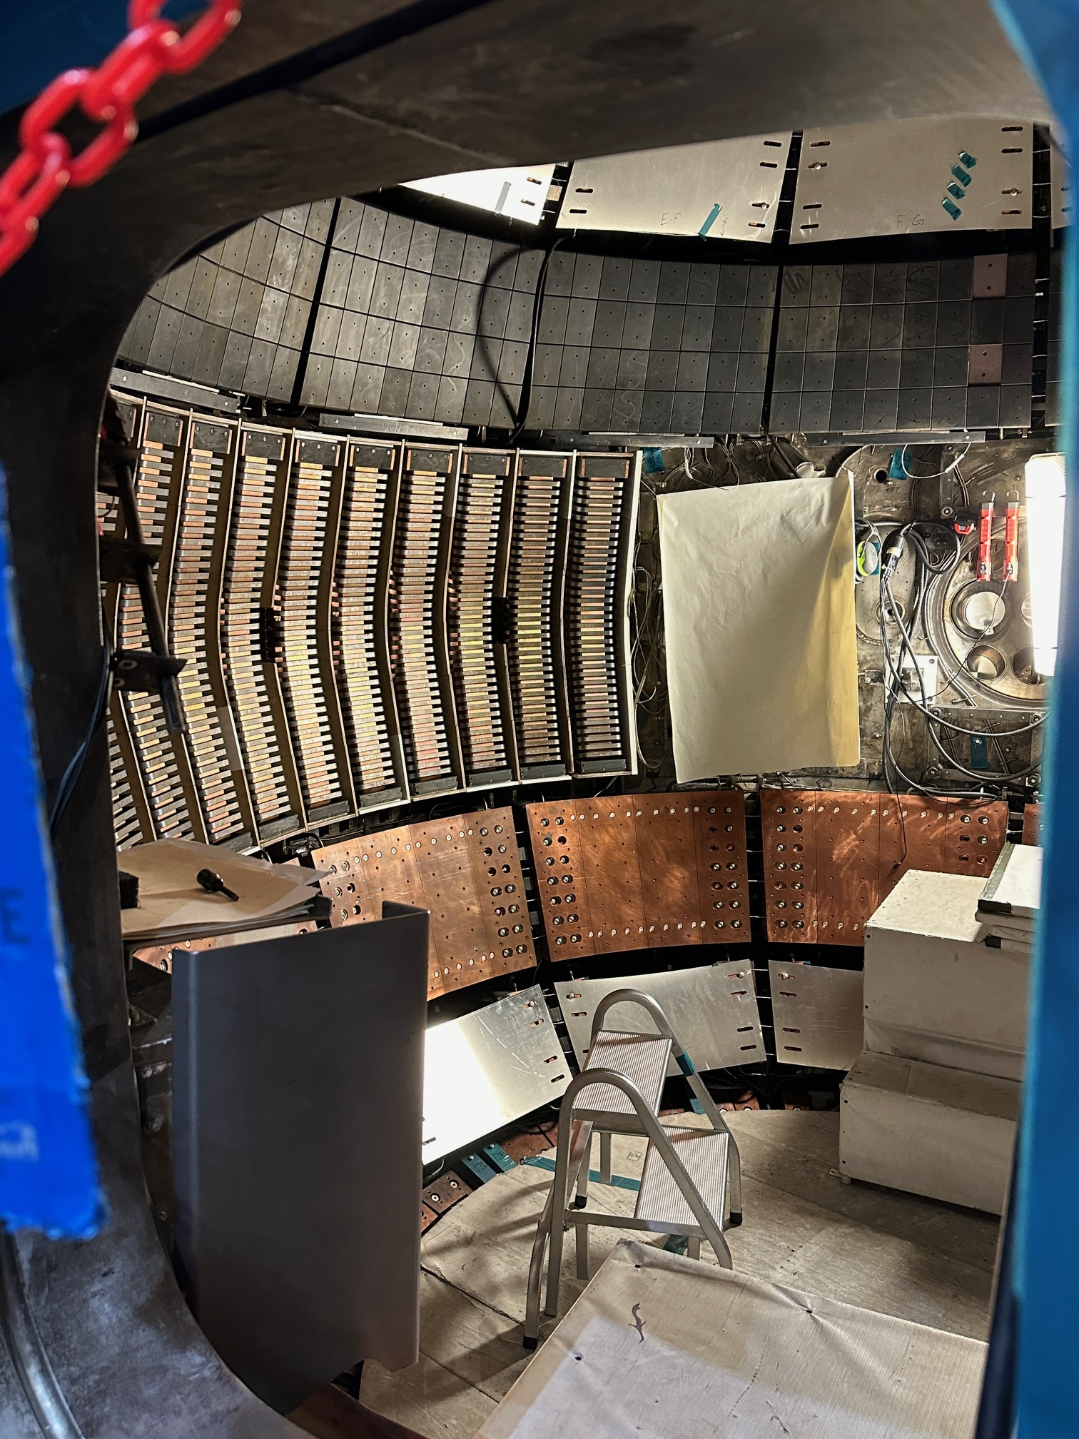
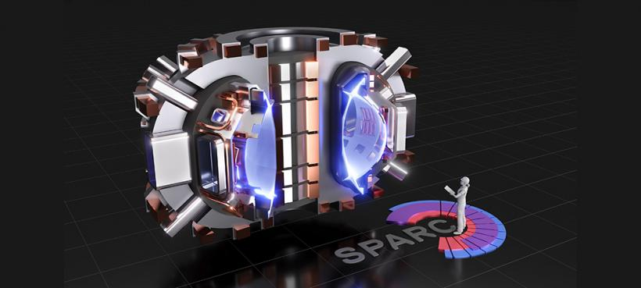
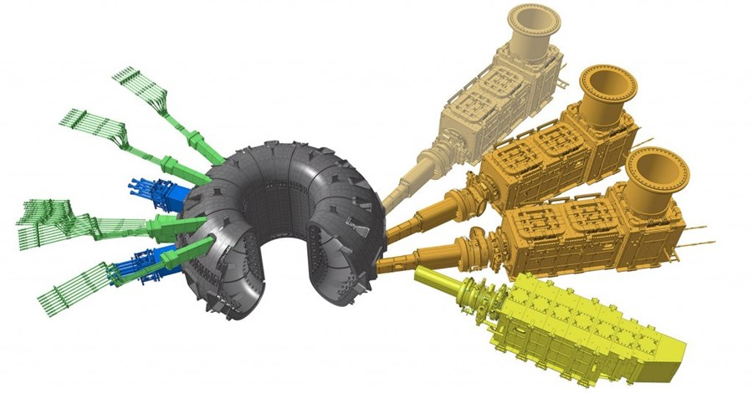
ICRF will continue to play a critical role in fusion devices
Alcator C-Mod
NSTX-U
ITER
SPARC
ICRF systems in blue
Notes:
Aim is to transfer wave energy into kinetic particle energy at the ion cyclotron resonance, similar to the wave we use wave energy to heat up food by resonating with the the vibrations of the molecules.

Slide 31
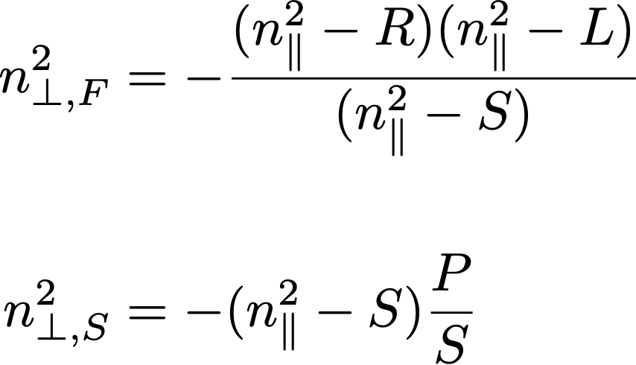
The two ICRF cold plasma wave modes
For waves with $ω≪ω_{p,e}$ (both ICRF and LH waves), the dispersion relation can be simplified.
Now have two wave modes, termed the “fast” and the “slow” waves.
This is thanks to their relative phase velocities.
For ICRF heating, we want to launch a fast wave.

Slide 32
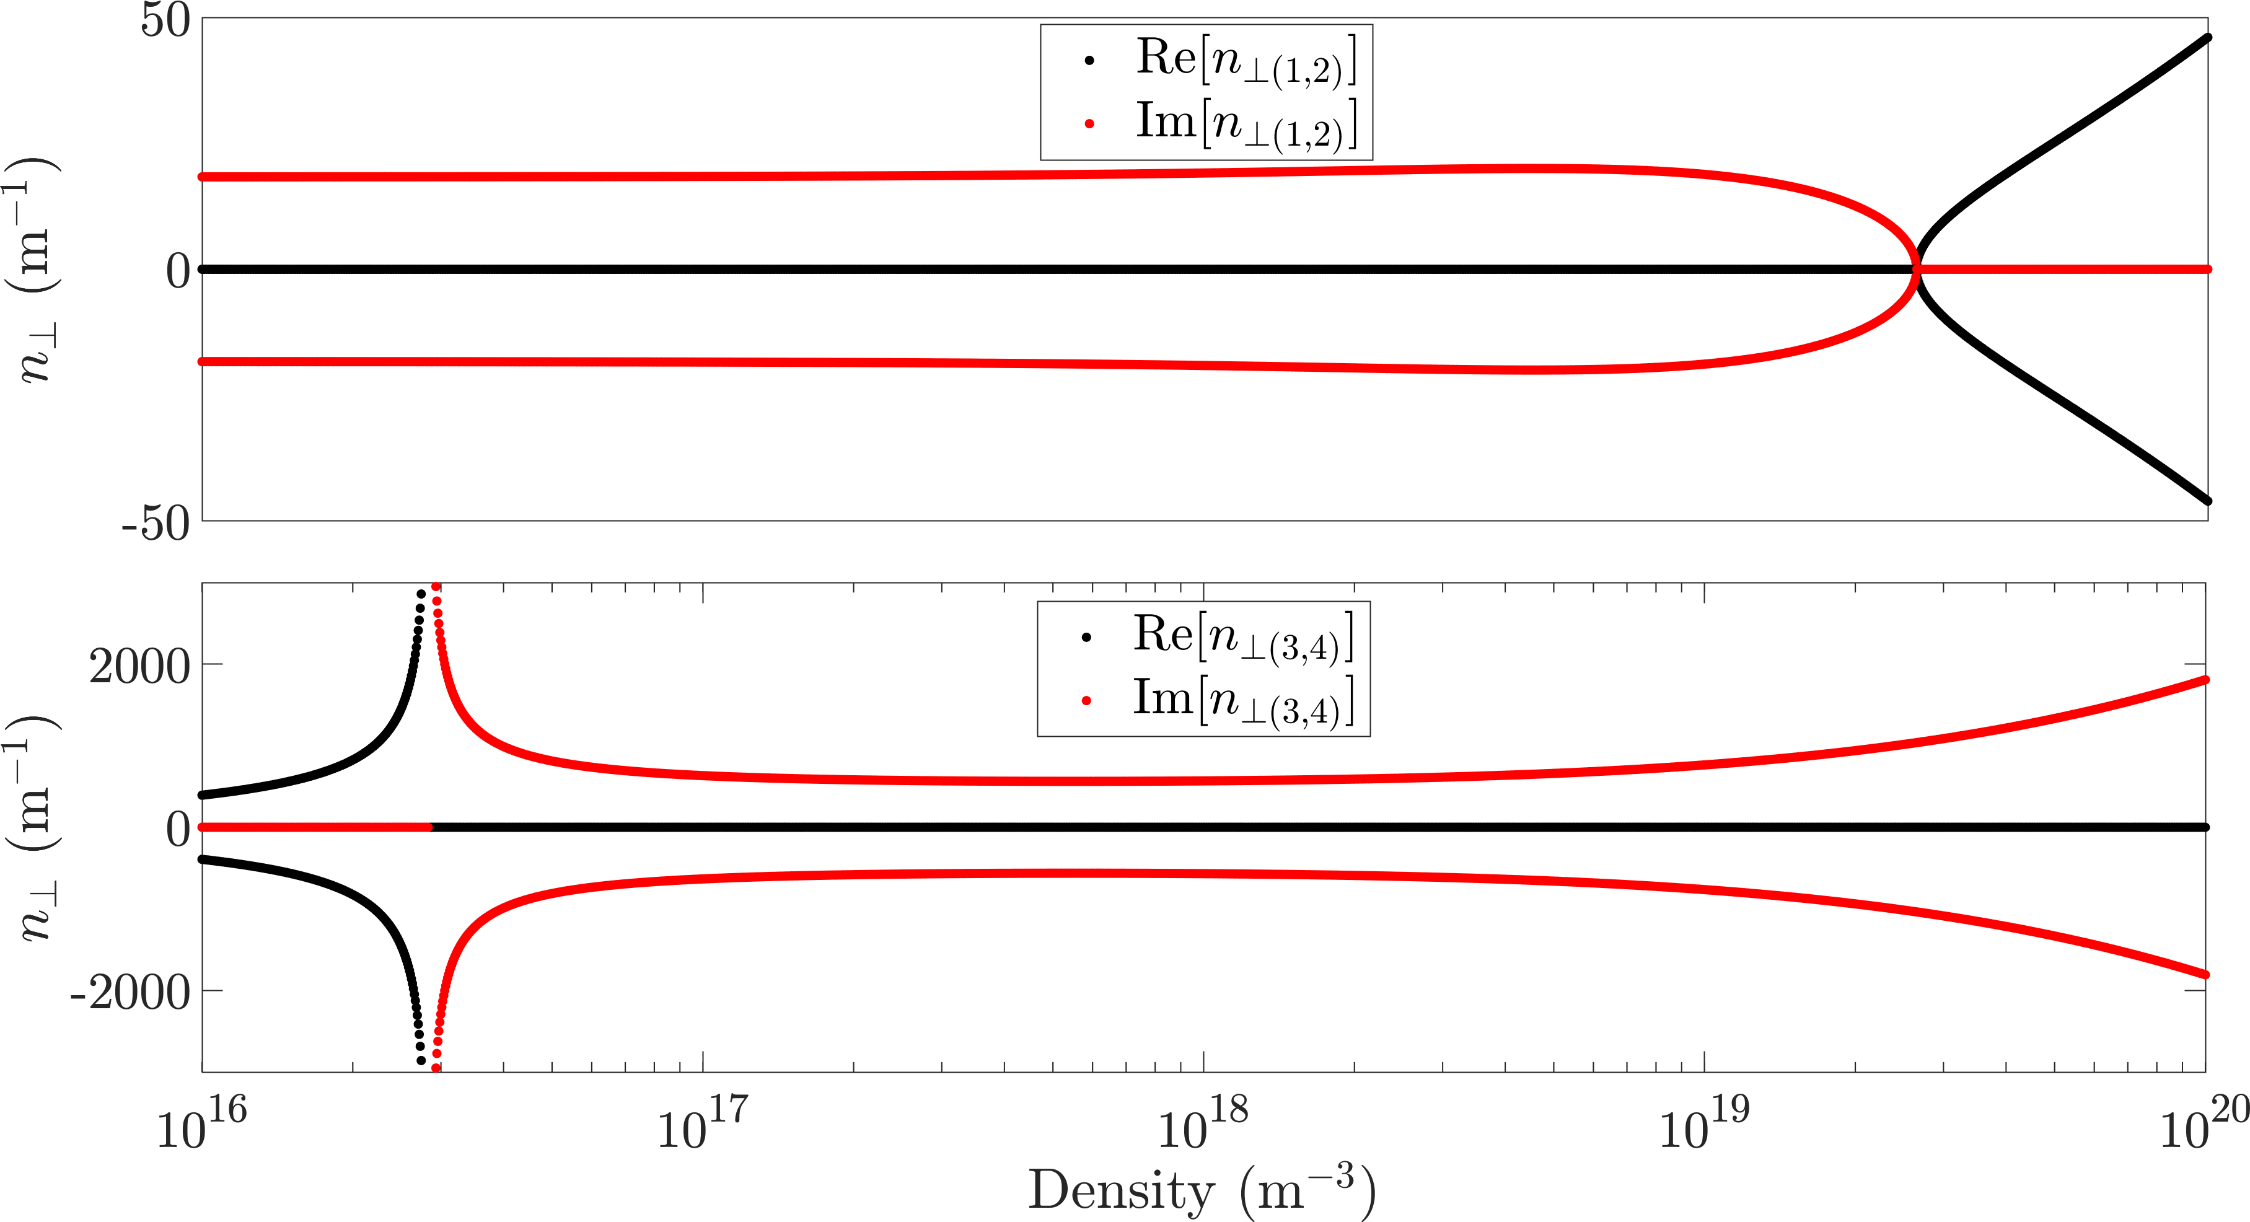
Dispersion relation for the fast and slow waves
$$f=52 MHz, B_{0}=2.5 T, m_{i}=1.67×{10}^{−27} kg$$
Notes:
Point out cut offs and resonances, relative velocities. Typical plasma densities in the core

Slide 33
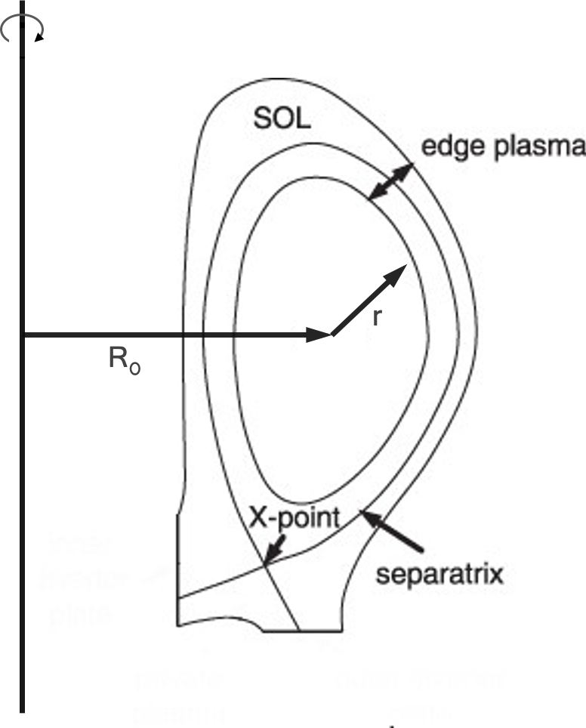
Experiments did not show expected power delivery ☹
Coupling wave power into the core plasma is reasonably well understood…
Getting the power to the core is the challenge!
Nonlinear interactions become important when the stored energy is low.
This is usually the case close to the RF antenna.
Notes:
We made bad assumptions/didn’t have the whole picture

Slide 34
Plasma properties where heating happens are necessarily different than near the device surfaces…
The scrape off layer (SOL) of a tokamak plasma is colder and less dense.
Fast wave cut off
Slow wave resonance
Notes:
Fast wave needs to tunnel through low density region where slow wave can propagate. Why is the slow wave bad? Because it has a large electric field component parallel to the B field…

Slide 35
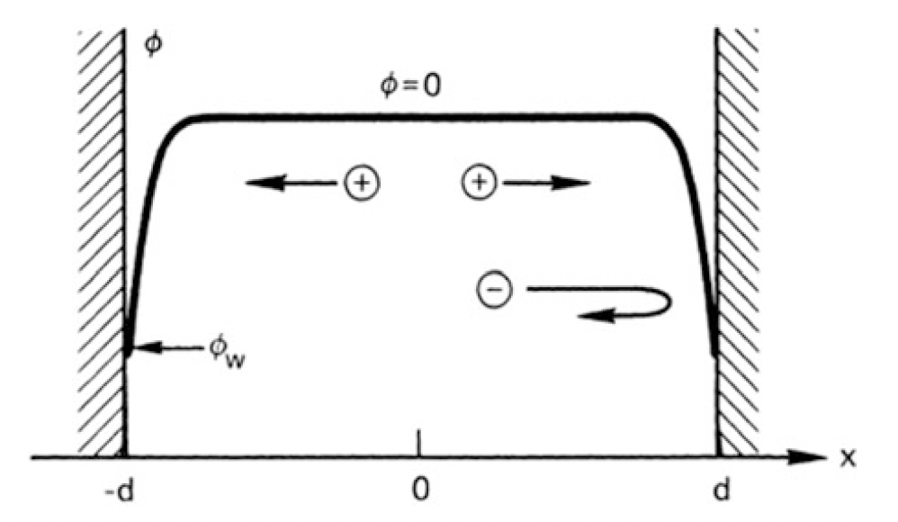
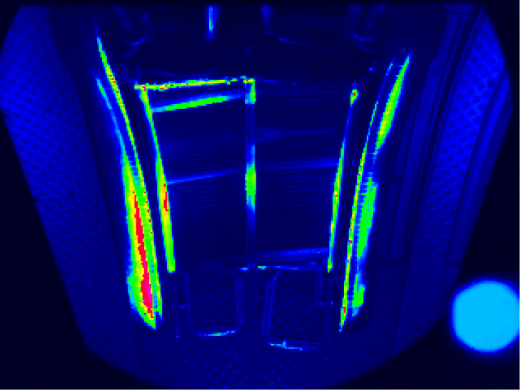
RF rectified sheaths
A region of finite potential is formed wherever the plasma contacts any plasma facing component.
This “sheath” acts to accelerate ions to the wall.
Ensures that equal number of ions and electrons hit the wall at the same time.
This effect is enhanced during RF operation, sometimes on the order of kV!
The increased sheath potential is attributed to a large $E_{∥}$.
Characteristic of the slow wave.
Myra et al., Nucl. Fusion, 2006
IR camera image of the antenna on Tore Supra after 15 s
operation at 8MW ICRF power.

Slide 36
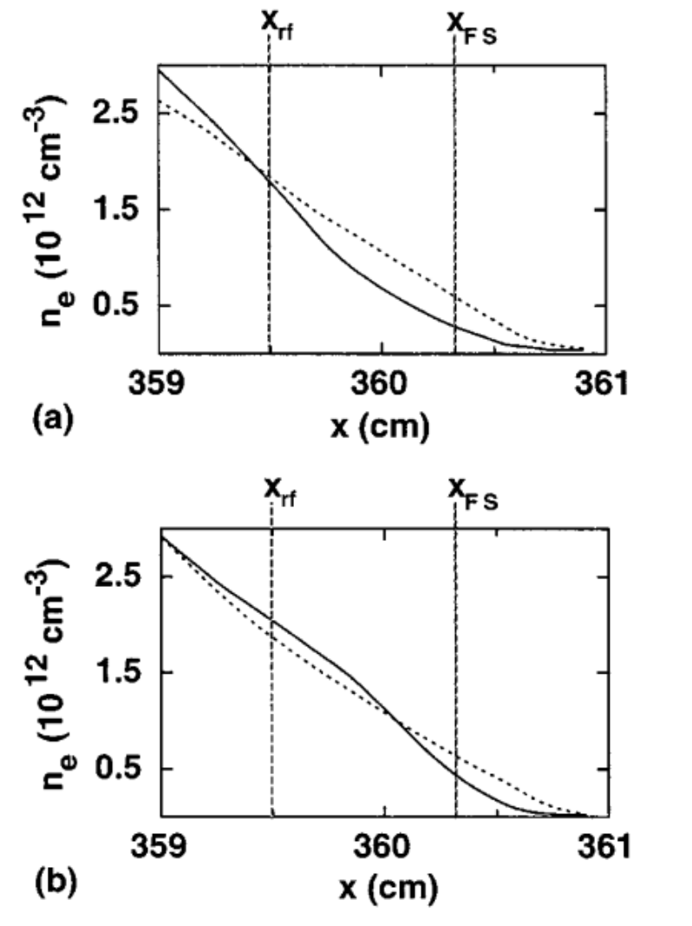
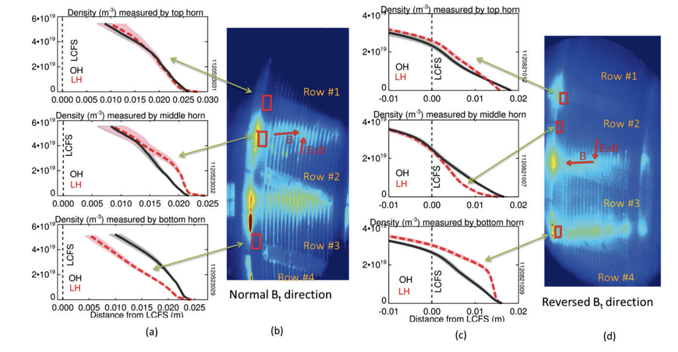
Plasma density modification during ICRF operation
Wave propagation in a plasma is governed by the density.
Turns out that the wave energy can also modify the density!
EXB drifts, ponderomotive force…
Figure (left): Measured density in front of TFTR antenna for ohmic (dotted line) and RF (solid line) operation, for different antenna phasing. From D’Ippolito D.A. et al 1998, Nucl. Fusion 38, 1543.
Reflectometer density profiles from three different reflectometry horns and video camera views of the LH launcher: (a) and (b) are for the normal field direction while (c) and (d) are for reversed field. From Lau et al, 2014, AIP Conf. Proc. 1580, 410–413
Notes:
E parallel is important here too, especially for the ponderomotive force.

Slide 37
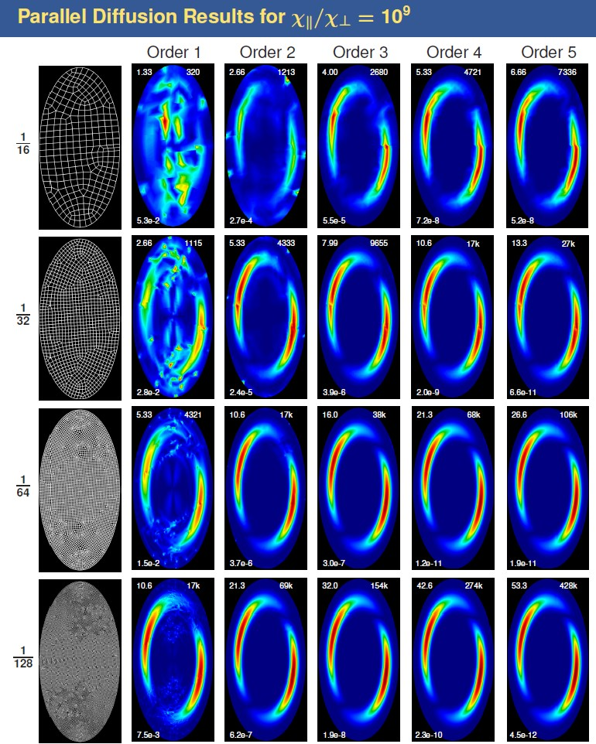
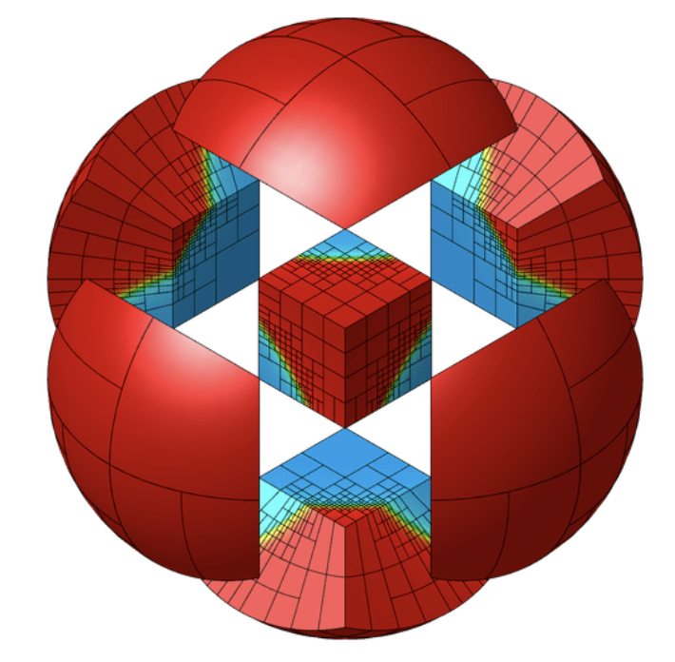
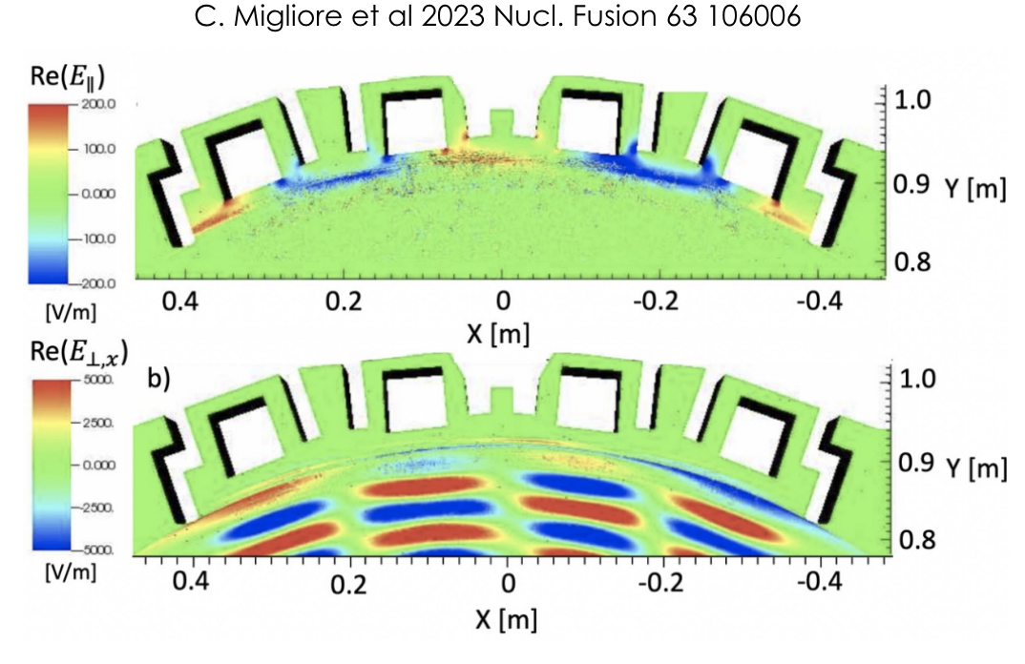
Nonlinear, coupled RF/plasma density system requires dedicated tools to solve
MFEM C++ library for finite element methods
Stix $E(n)$
MAPS $n(E)$

Slide 38
Plasma waves in a cold (or any temp!) plasma are complex and dynamic
But that’s what makes them so fun…
We focused mostly on cold plasma wave propagation, but there are many other types of plasma in magnetically confined fusion devices, e.g., kinetic plasmas.
There are also many nonlinear effects, examples being RF rectified sheath potentials, ponderomotive drifts, EXB drifts…
We didn’t get into the maths for those, it can be quite challenging.

Slide 39
Polarisation of the modes at the ion cyclotron resonance
Ion cyclotron gyromotion is left circular ($E_{+}$).
We can use the dispersion relation to determine a wave’s polarisation
For both branches of the ICRF cold plasma waves,
$${\left(\frac{E_{y}}{E_{x}}\right)}_{F}=−\frac{iS}{D}→i, E_{+}→0 ; {\left(\frac{E_{y}}{E_{x}}\right)}_{S}=−\frac{iD}{S}→i, E_{+}→0$$

Slide 40
Wave-particle resonant interactions
Notes:
Not as simple as it sounds… wave polarisation → minority heating

