Slide 1
Introduction to Plasmas, Part I I Single Particle Motion
Priyanjana Sinha, Princeton Plasma Physics Laboratory
Email: psinha@pppl.gov
SULI Introductory Course on Plasma Physics
6th June 2023

Slide 2
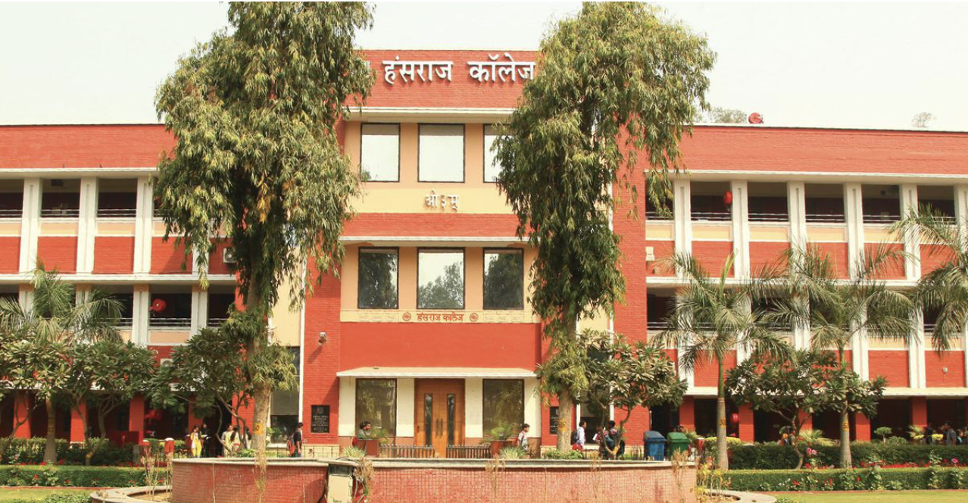
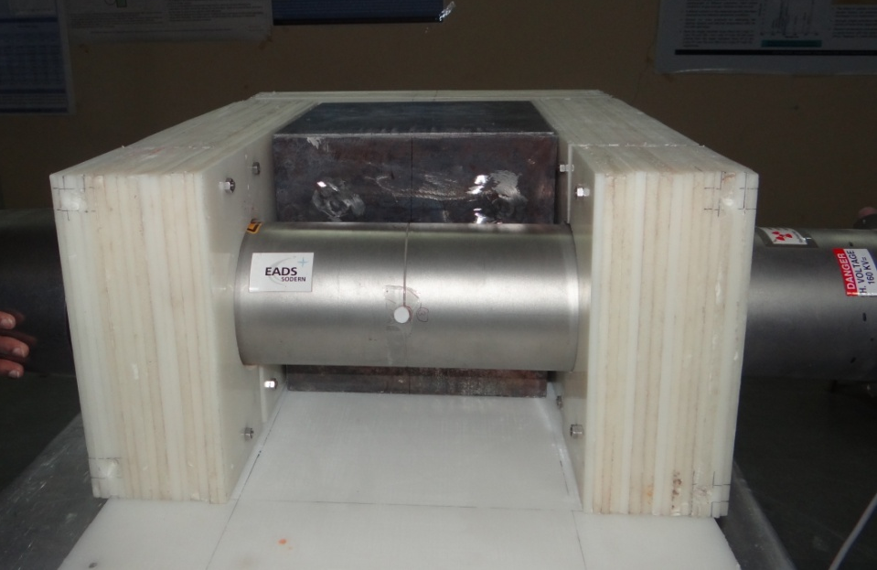
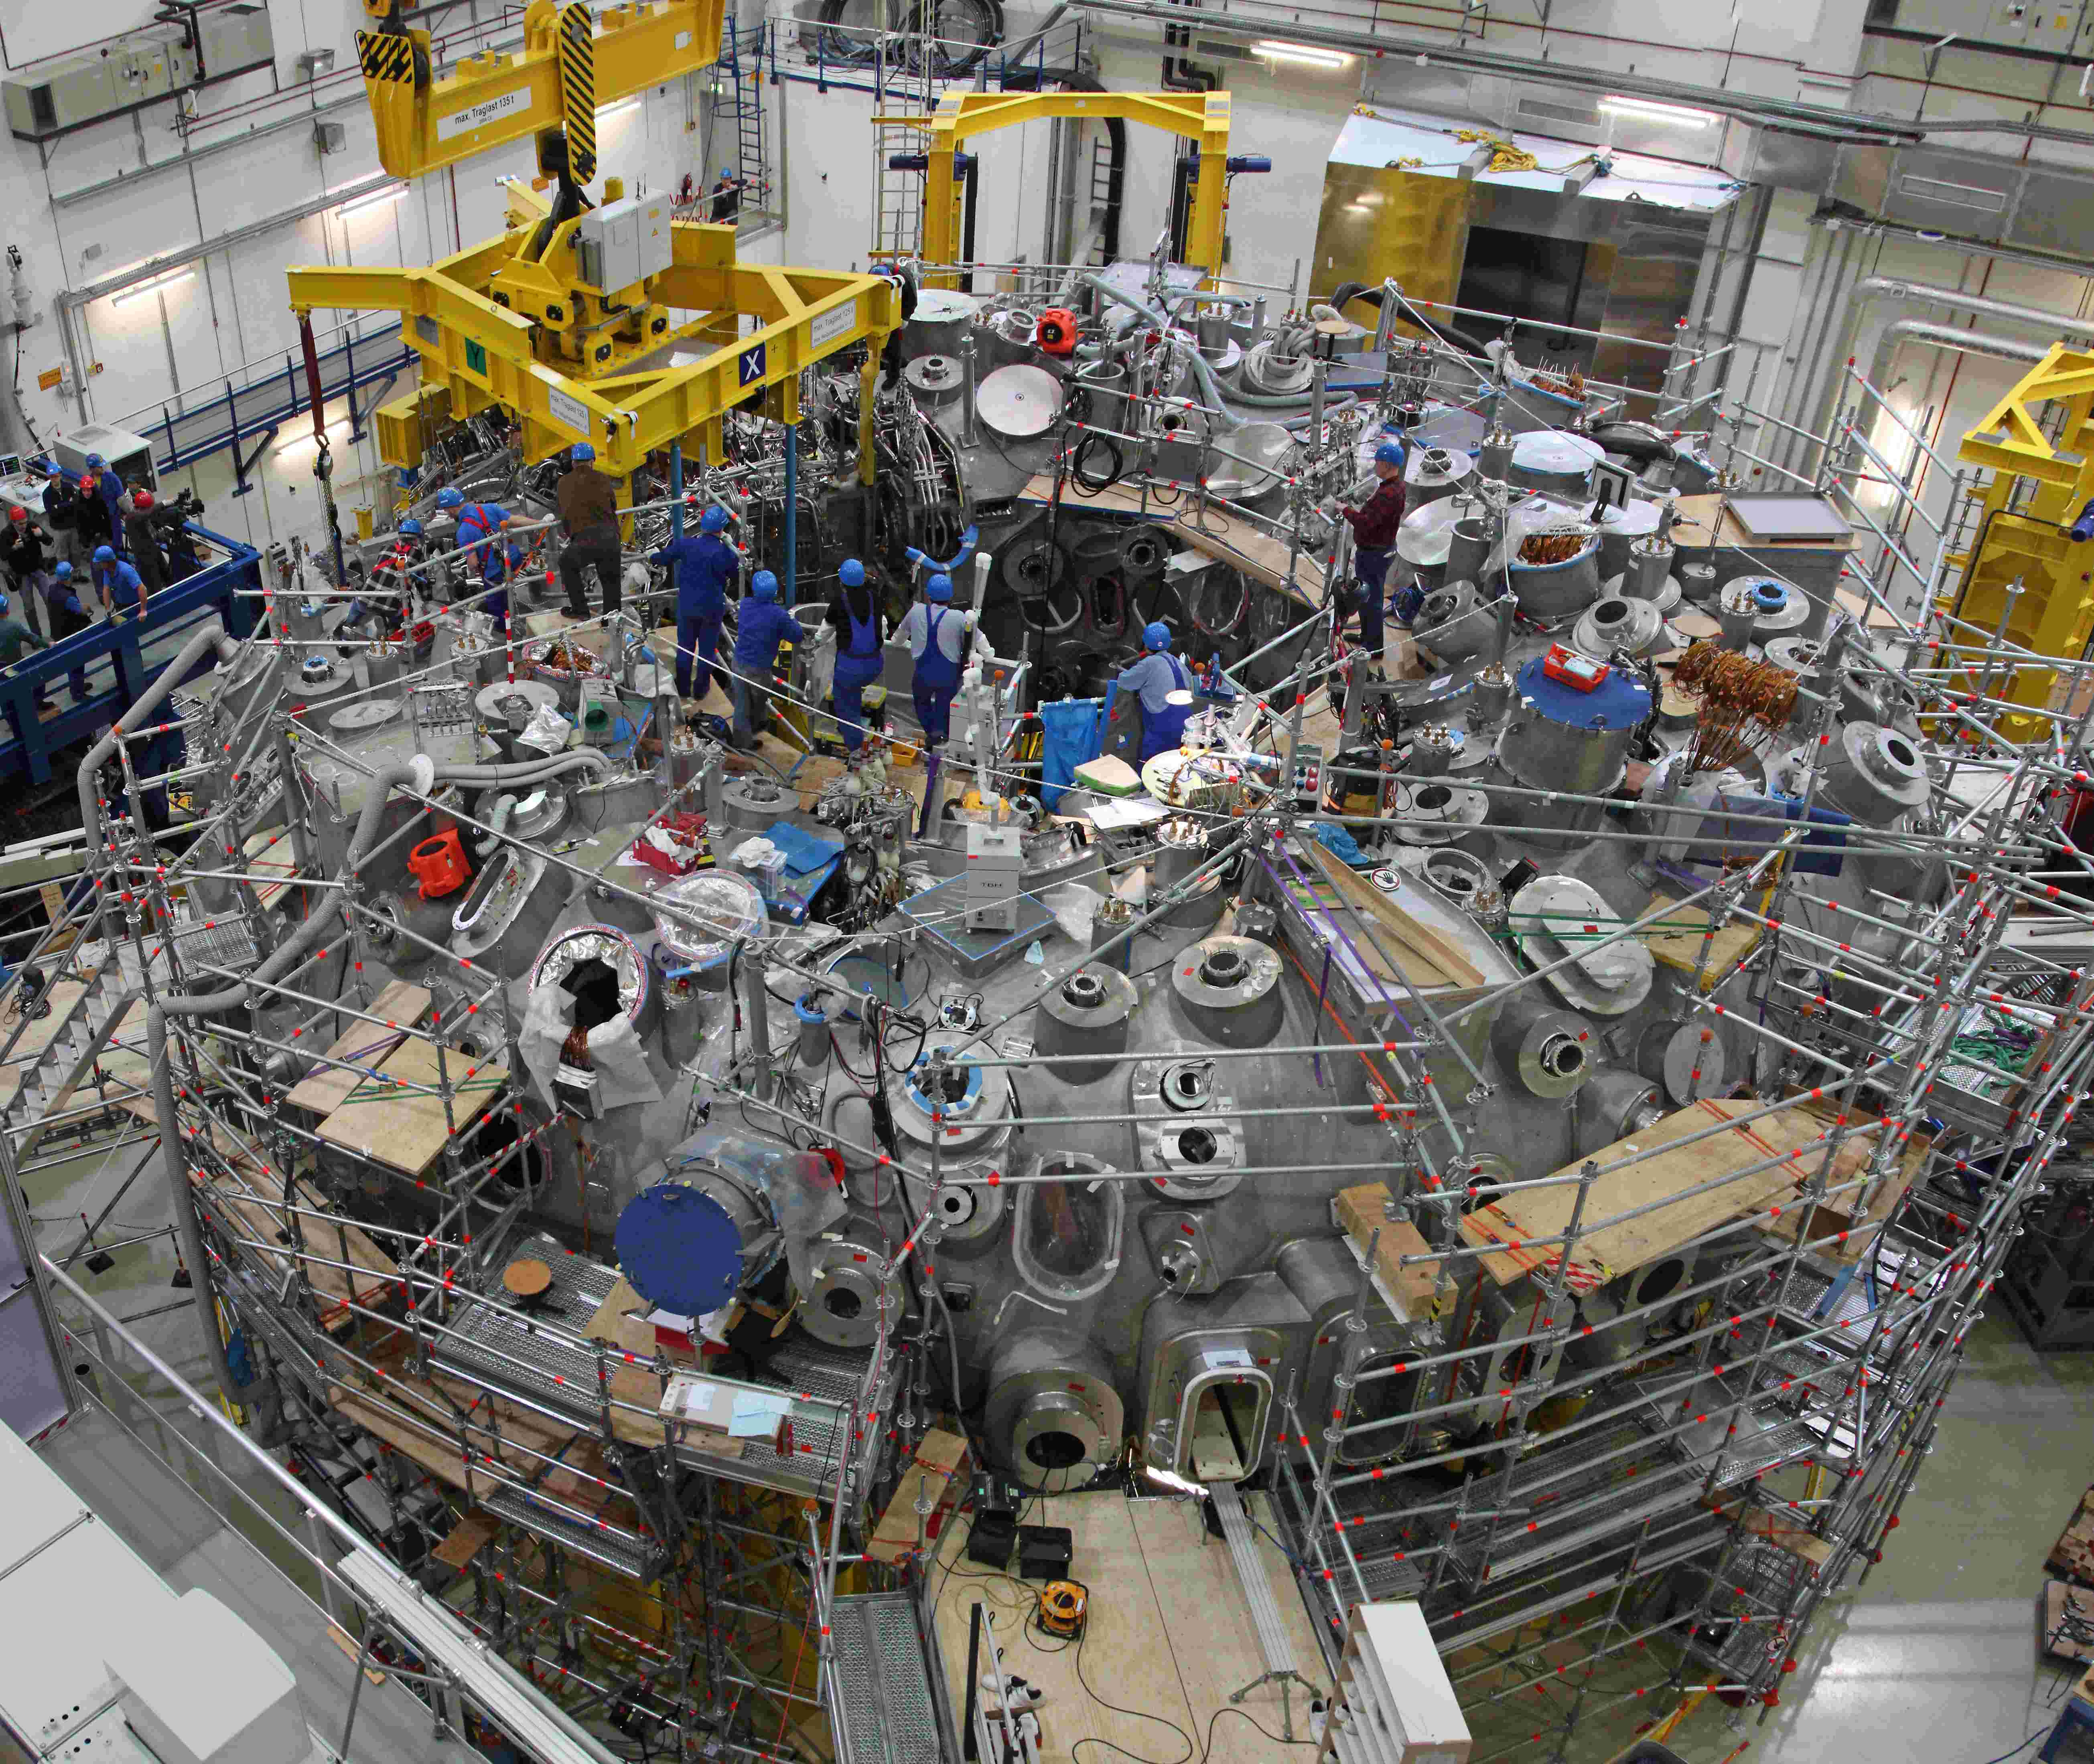
My journey so far….
2009 -2012
2012 -2015
2015-2019
(since Sep. 2019)
Undergrad: Hansraj College, University of Delhi
Masters in Nuclear Sci. & Tech University of Delhi
Ph.D in plasma physics
Associate Research Physicist
Institute for Plasma Research, Gujarat
Master thesis project
Worked on the world’s largest stellarator W7-x located in Germany

Slide 3
Need for plasma confinement!
We require high temperatures for fusion roughly T $∽5 −10 keV or 50 −100 M Kelvin$
$kBT= \frac{1}{2}$
For ions:
$$vth 2$$
$$F=− ∇p$$
$$vth= 6 X 105 m/s$$
very high velocities
Stop the motion from high $p$ to low $p$ region (serious issue!) → confine the plasma
Popular solution: use magnetic field
→ Need to understand e⁻ and ion motion in inhomogeneous magnetic field

Slide 4
Outline
Motion of particle in uniform magnetic field
Magnetic mirrors
Motion of particle in crossed fields
- drift of charged particle in E $⊥$ B
- drift of charge particle due to $∇$B
- drift of charge particle due to curvature in B
Tokamaks

Slide 5
Motion of particles in uniform magnetic field

Slide 6
Motion of particles in uniform magnetic field – Simple case
Force experienced by charged particle ($q$) with velocity $v$ in presence of electric fields and magnetic field
Lorentz force:
$$F=q(E+v X B)$$
For electron: charge = - $e$ mass = $m$
Assuming external magnetic field in z direction:
^
and E =0
$Bs$ || z
Gyro-frequency or cyclotron frequency:
B_{s}
$m \frac{dv}{dt}$ = - $e$ ($v x Bs$)
$$ωc= \frac{eBs}{m }$$
^
$\frac{dv}{dt}$ = - $ωc$ ($v x z$)

Slide 7
Motion of particles in uniform magnetic field – Simple case
$x$ direction :
$\frac{dvx}{dt}$ = - $ωc$ $v$_{y}
v_{y}
coupled
$y$ direction :
$\frac{dvy}{dt}$ = $ωc$ $v$_{x}
$z$ direction :
$\frac{dvz}{dt}$ = $0$
v_{x}
$\frac{d2vx}{dt2}$ = - $ωc2$ $v$_{x}
$\frac{d2vy}{dt2}$ = - $ωc2$ $v$_{y}
$$⊥$$
$vx$ = $v$ cos ($ωc$t + $δ$ )
$vy$ = + $v$ sin ($ωc$t + $δ$ )
$$⊥$$
$$⊥$$
where: $v$² = $v$_{x} ² + $v$_{y} ²
$assume δ=0$
at t = $0$, $vx$ =$v$
$$⊥ ,$$
$vy$ = $0$
at t = $\frac{π}{2}\frac{1}{ωc},$ $vx$ =$0,$
$vy$ =$v⊥$

Slide 8
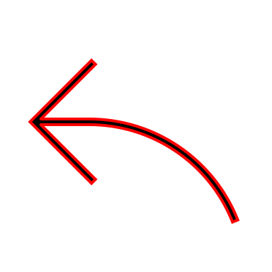
Motion of particles in uniform magnetic field – Simple case
v_{y}
For ions: charge = $e$ mass = $mi$
$mi \frac{dv}{dt}$ = $e$ ($v x Bs$)
Gyro-frequency for ion:
$$ωci= \frac{eBs}{mi }$$
^
v_{x}
$\frac{dv}{dt}$ = $ωci$ ($v$ x z)
→ much smaller than e⁻
x direction :
$\frac{dvx}{dt}$ = $ωci$ $v$_{y}
coupled
y direction :
$\frac{dvy}{dt}$ = -$ωci$ $vx$
z direction :
$\frac{dvz}{dt}$ = $0$
$v$_{x} = v$⊥$ cos ($ωci$t + $δ$ )
$v$_{y} = - $v$ $⊥$sin ($ωci$t + $δ$ )
Taking into account the charge of particle

Slide 9
Motion of particles in uniform magnetic field – Simple case
$\frac{dx}{dt}$ = $v$_{x} = $v⊥$cos ($ωc or ci$t + $δ$ )
y
$$ρi$$
$\frac{ dy}{dt}$ = $v$_{y} = + $v⊥$sin ($ωc or ci$t + $δ$ )
$$ρe$$
-
(x_{g} , y_{g} )
$$v⊥$$
x = x_{g} + $\frac{}{ωc}$ sin ($ωc or ci$t + $δ$ )
$$v⊥$$
x
y = y_{g} - $\frac{}{ωc}$ cos ($ωc or ci$t + $δ$ )
+
$$v⊥$$
²
$$v⊥$$
(x – x_{g})² + (y – y_{g})² =
$$\left(\frac{}{ωc}\right)$$
$$\frac{}{ωc}$$
Larmor radius for e⁻ = $ρe =$
$m$_{e}^{1/2} T_{e}^{1/2}
$$≈$$
$$v⊥$$
$$\frac{}{ωci}$$
Equation of a circle with center (x_{g}, y_{g})
Larmor radius for ion = $ρi=$
$m$_{i}^{1/2} T_{i} ^{1/2}
$$≈$$
$as mi>me →ρi$ > $ρe$

Slide 10
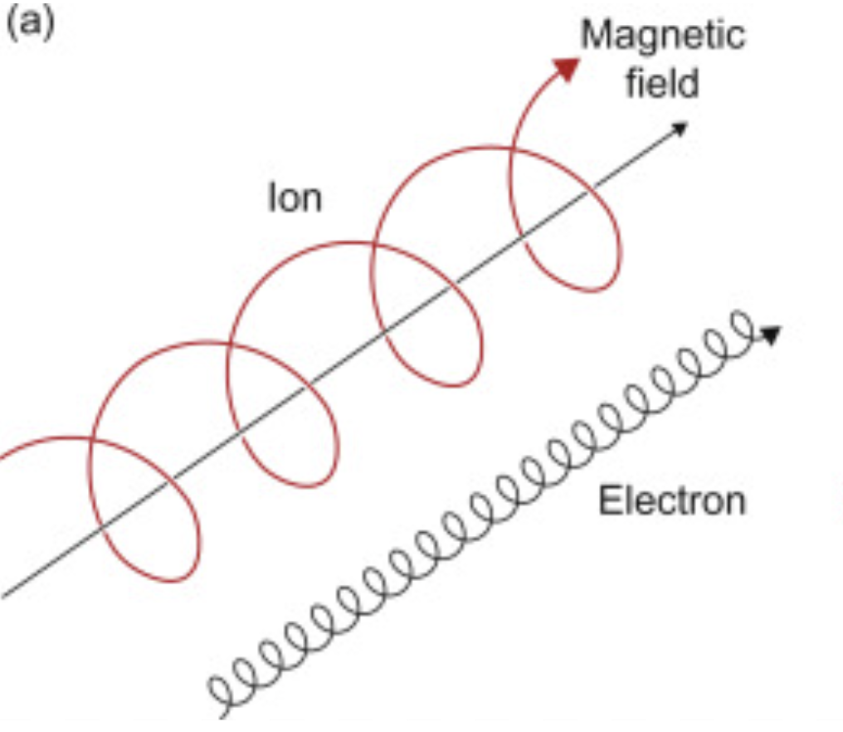
Motion of particles in uniform magnetic field – Simple case
z direction :
$\frac{dvz}{dt}$ = $0$
$$vz=voz$$
$\frac{dz}{dt}$ = $voz$
$$z=zg+ voz t$$
→ Charge particles move freely along z axis
$$r=[ρe or i \text{sin}\text{ (}ωc or ci \text{t}\text{ + }δ\text{ )}\text{ + }\text{xg}\text{ ] }\text{x}\text{ − }[ρe or i \text{cos}\text{ (}ωc or ci \text{t}\text{ + }δ\text{ )}\text{]}\text{ + }\text{y}\text{g}\text{ ] }\text{y}\text{ +}\left[zg+ voz t\right]z$$
^
^
^
+

Slide 11
Some estimates for ITER like machine……
For ITER like machines:
T_{i} = T_{e} = 10 keV and B = 5T
$$For ions :vTi= \sqrt{\frac{kB Ti}{mi}}$$
$$rL= \frac{mvTi}{qB }$$
$≈$ 700 km/s
$≈ \text{3 }\text{mm}$
$For electrons : rL≈ \text{0.05 }\text{mm}$ (60 times smaller)
$$ωc= \frac{eBs}{m }$$
→ frequency of wave to heat plasma for ions is much lower -- 1/1836 times
Gyro-frequency of electrons :
-
$$ωc= \frac{1.6 x 10 19 x 5}{ 9.1 x 10 31 }$$
-
$$ωc=8.5 x 10 11 rad/s$$
$$ωc=135 GHz$$
→ to heat the electrons in plasma the wave should be of this frequency

Slide 12
Magnetic Mirrors

Slide 13
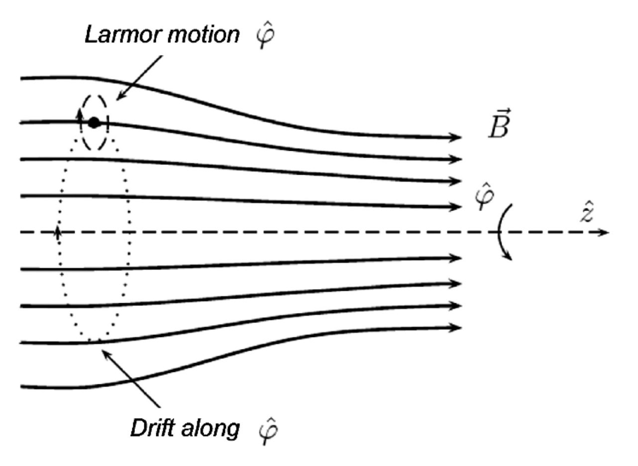
Magnetic mirrors - $role of Br$ field in confinement
$$∇∙B=0$$
$\frac{1}{r}\frac{∂(rBr ) }{∂r}$+ $\frac{∂Bz \left(z\right)}{∂z}=0$
→ B depends on on r and z, no azimuthal dependence
$r Br=$- $\frac{∂Bz \left(z\right)}{∂z}\frac{r2}{2}$+ c₁
$Br=$- $\frac{∂Bz \left(z\right)}{∂z}\frac{r}{2}$
L=0
L= L₀/2
B_{min}
B_{max}
$$B= Br+Bz$$
$m \frac{dvz}{dt}$ = - q (v x B)_{z}
$m \frac{dvz}{dt}$ = - q (v$φ$ B_{r})
Magnetic mirror was one of the earliest major approaches to fusion power
→ exerts a force in - z direction
Here, $Bz is \text{inhomogeneous} \text{and} varying with z$

Slide 14
Magnetic mirrors - $role of Br$ field in confinement
$$I= \frac{q}{T}= \frac{q ωc}{2π}$$
²
Magnetic moment = $μ=IA=\frac{q ωc}{2π} π\left(\frac{v⊥}{ωc}\right)$= $\frac{qv⊥2}{2ωc}$ = $\frac{mv⊥2}{2B z}$
$m \frac{dvz}{dt}$ = - q (v$φ$ B_{r})
$Br=$- $\frac{∂Bz \left(z\right)}{∂z}\frac{r}{2}$
$m \frac{dvz}{dt}=$- $\frac{qv⊥2}{2ωc} \frac{∂Bz }{∂z}$ = - $\frac{mv⊥2}{2B} \frac{∂Bz }{∂z}$
$ρ= \frac{v⊥}{ωc}$
$m \frac{dvz}{dt}$ = - $μ\frac{∂Bz }{∂z}$

Slide 15
Magnetic mirrors – energy conservation
$E= \frac{1}{2}$ $m v⊥$² + $\frac{1}{2}$ $m vz$²
$m \frac{dv}{dt}$ = q (v x B)
$m v∙\frac{dv}{dt}$ = 0
$\frac{1}{2}$ $m v$² = constant of motion
Energy is constant, so $\frac{mv⊥2}{2}$ + $\frac{mvz2}{2B}$ is constant
If $v⊥ increases, then vz decreases$
B = B_{r} + B_{z}
Very small
B $≈$B_{z}

Slide 16
Magnetic mirrors – constant magnetic moment
$\frac{d(μB)}{dt}$ = - $\frac{1}{2}\frac{d(mvz2)}{dt }$
$\frac{d(μB)}{dt}$ = -$mvz\frac{dvz}{dt }$
$\frac{d(μB)}{dt}$ $= mvz$ ($\text{− }μ \frac{dB}{dZ})$
$\frac{d(μB)}{dt}$ $= μ \frac{dB}{dt}$
$$μ \frac{dB}{dt}+B\frac{dμ}{dt}= μ \frac{dB}{dt}$$
$$B\frac{dμ}{dt}=0$$
→ $μ$ is constant = $\frac{mv⊥2}{2B}$
$m \frac{dvz}{dt}$ = - $μ\frac{∂Bz }{∂z}$
B increases, $v⊥$increases → $vz decreases$ (from energy conservation)

Slide 17
Magnetic mirrors – critical angle for confinement
when $v⊥$= $max=v0$, $vz$ = 0 → reverse its direction
→ particles bounce back and forth
→ trapped e/ions → confined
$$vz not always zero at the throat →passing particles$$
What is the minimum value of $θ$ that that will cause reflection?
L=0
L= L₀/2
$$⊥$$
$μ$ = $\frac{mv02}{2Bmax}$ = $\frac{mv02}{2Bmin}$
$v0$ = $\sqrt{v0⊥2 +v0z2}$
$\frac{v0⊥2}{v02}=\frac{Bmin}{Bmax}$ = $\frac{1}{m R}$
S$in θ0=\left(\frac{1}{m R}\right)$
at L = $0$
$v⊥$= $v0⊥$
$vz$ =$v0z$
at L = L₀/2
$v⊥$= $v0$
$vz$ = $0$
$$θ=θc=critical angle$$

Slide 18
Motion of particle in crossed field E $⊥$ B

Slide 19
Motion of particle in crossed field E $⊥$ B
Understand the dynamics of charged particles in inhomogeneous field
^
^
y
External fields:
B_{s} || z
and
E || x
For electron:
$m \frac{dv}{dt}$ = - eE - e ($v$ x B_{s})
E
X- component:
$m \frac{dvx}{dt}$ = - eE_{x} - e ($v$_{y} B_{s})
x
B_{s}
Y- component:
$m \frac{dvy}{dt}$ = - e $v$_{x} B_{s}
z
$$v{y }^{′}=vy+\frac{Ex}{Bs}$$
$$vy=v{y }^{′}−\frac{Ex}{Bs}$$
$$→$$

Slide 20
Motion of particle in crossed field E $⊥$ B
$m \frac{dvx}{dt}$ = - e ($v{y }^{′}$x B_{s})
X- component:
$m \frac{dv{y }^{′}}{dt}$ = e v_{x} B_{s}
Y- component:
$v$_{x} = $v⊥$ cos ($ωc$t + $δ$ )
$v{y }^{′}$ = $v⊥$ sin ($ωc$t + $δ$ )
$v{y }^{}$ = $v⊥$ sin ($ωc$t + $δ$ ) $−\frac{Ex}{Bs}$
Additional force
$vD=−\frac{Ex}{Bs}$ = -$\left(\frac{Ex \text{x} Bs}{Bs 2}\right)$
DC drift of the particle which is independent of charge and mass

Slide 21
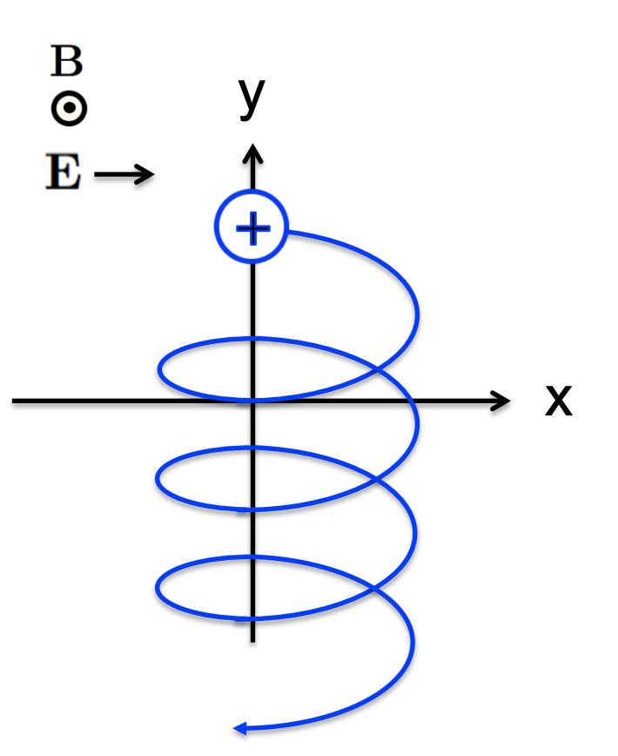
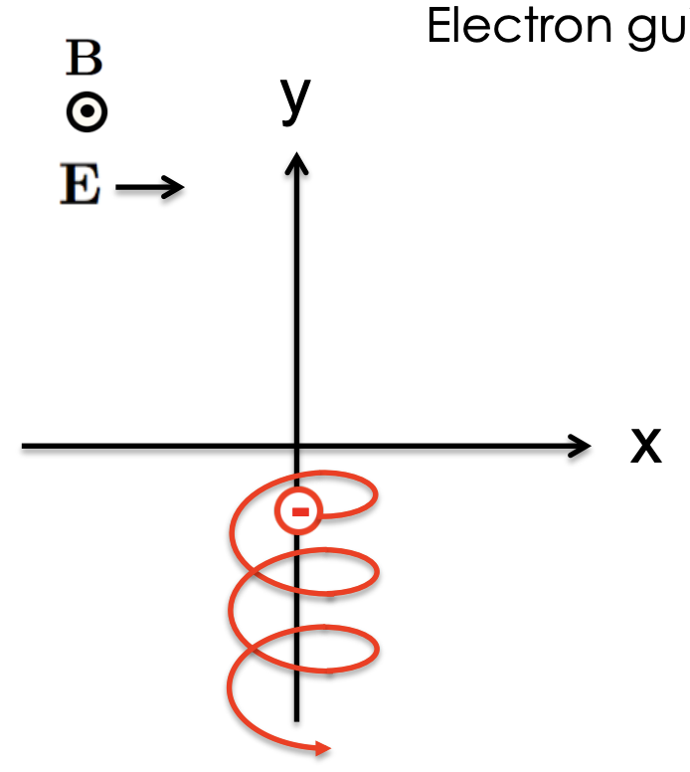
Motion of particle in crossed field E $⊥$ B
$vD=−\frac{Ex}{Bs}$ = $\left(\frac{Ex \text{x} Bs}{Bs 2}\right)$
Takes particle away from lines of force/magnetic field region → serious problem!
Both e⁻ and ions moves together in – y direction
Courtesy: Dr. Cami Collins

Slide 22
Generalized form of drift caused by external force F $⊥Bs$
$m \frac{dv}{dt}$ = - e (v x B_{s}) + F
$$F=$$
$\frac{Bsx (F x Bs) }{Bs2 }=$ $\frac{F(Bs ∙ Bs) }{Bs2 }$ - $\frac{Bs (F ∙ Bs) }{Bs2 }$
$$F=− \frac{\left(F \text{x} Bs\right) \text{x} Bs}{Bs2 }$$
$$assume: v′\text{=}v\text{ +} \frac{F \text{x} Bs }{Bs2 }$$
$m \frac{dv}{dt}$ = -$e\left[\text{v} \text{+} \frac{F x Bs }{Bs2 }\right]$ x$Bs$
$m \frac{dv′}{dt}$ = - e (v’ x B_{s})
$$vd\text{rift} \text{= }\frac{F \text{x} Bs }{qBs2 }$$
general expression

Slide 23
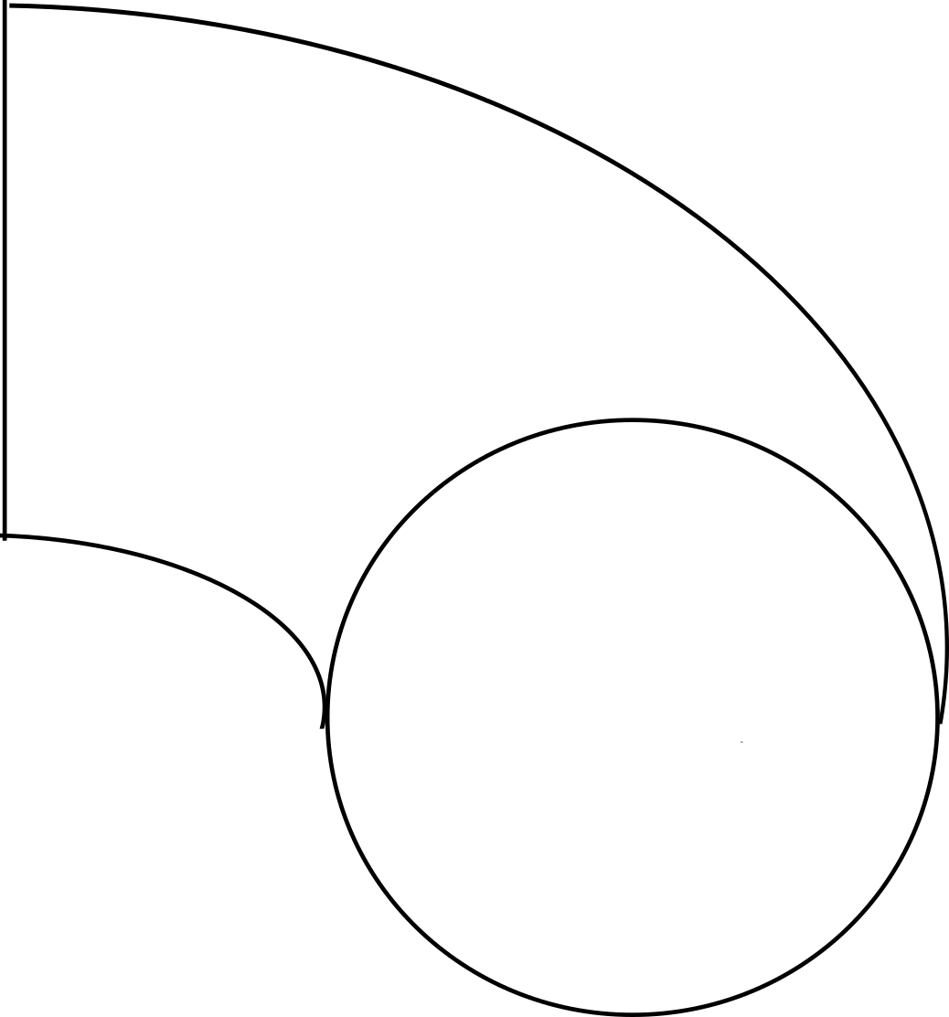
Other forces that can cause drift
$$vd\text{rift} \text{= }\frac{F \text{x} Bs }{qBs2 }$$
Gravitational force = F = mg
m_{i} >> m_{e} →$vdi≫vde$
For electric force, this drift is similar in magnitude
Two other types of drifts that is present in tokamak: curvature drift and $∇$ B
R_{c}
B_{total}$∝$ 1/R
a

Slide 24
Drift of charge particle due to $∇$B

Slide 25
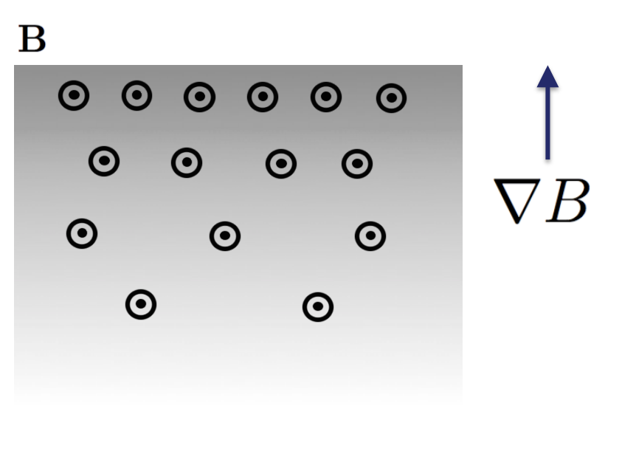
Drift of charge particle due to $∇$ B
^
assume B_{s} = B_{s} (x) z → x dependence
^
For electron:
$m \frac{dv}{dt}$ = - e $v$ x B_{s}(x) z
B_{s} (x) = B_{s} (x_{g} + (x- x_{g}))
= B_{s} (x_{g}) + $\frac{∂Bs}{∂x} | (x −xg)$
at x= x_{g}
$$⊥$$
= B_{s} (x_{g}) + $\frac{∂Bs}{∂x} \frac{v}{ωc} sin(ωc t)$
$$⊥$$
^
$m \frac{dv}{dt}$ = - e $v$ x z $\left(\text{B}\text{s}\text{ (}\text{xg}\text{) + }\frac{∂Bs}{∂x} \frac{v}{wc} sin(ωc t)\right)$

Slide 26
Drift of charge particle due to Grad B drift
X direction:
$m \frac{dvx}{dt}$ = - e $v$_{y} $\left(\text{B}\text{s}\text{ (}\text{xg}\text{) + }\frac{∂Bs}{∂x} \frac{v⊥}{wc} sin(ωct)\right)$
$m \frac{dvx}{dt}$ = - e $v$_{y} $\text{B}\text{s}\text{ (}\text{xg}\text{)− }\text{e} v⊥sin(ωct\text{)} \frac{∂Bs}{∂x} \frac{v⊥}{wc} sin(ωct$)
$m \frac{dvx}{dt}$ = - e $v$_{y} $\text{B}\text{s}\text{ (}\text{xg}\text{)− }\frac{\text{e} v⊥2 }{2ωc}$ $\frac{∂Bs}{∂x}$
$m \frac{dvx}{dt}$ = - e v_{y} $\text{B}\text{s}\text{ (}\text{xg}\text{)}\text{ + } Fx$
Additional force
Y direction:
$m \frac{dvx}{dt}$ = - e $v$_{x} $\left(\text{B}\text{s}\text{ (}\text{xg}\text{) + }\frac{∂Bs}{∂x} \frac{v⊥}{ωc} sin(ωct)\right)$
$vx$ = $v ⊥$cos ($ωc$t)
$vy$ = $v⊥$sin ($ωc$t)
$m \frac{dvx}{dt}$ = - e $v$_{x} $\text{B}\text{s}\text{ (}\text{xg}\text{)} – \text{e} v⊥cos (ωct\text{)} \frac{∂Bs}{∂x} \frac{v⊥ }{ωc} sin(ωct$)

Slide 27
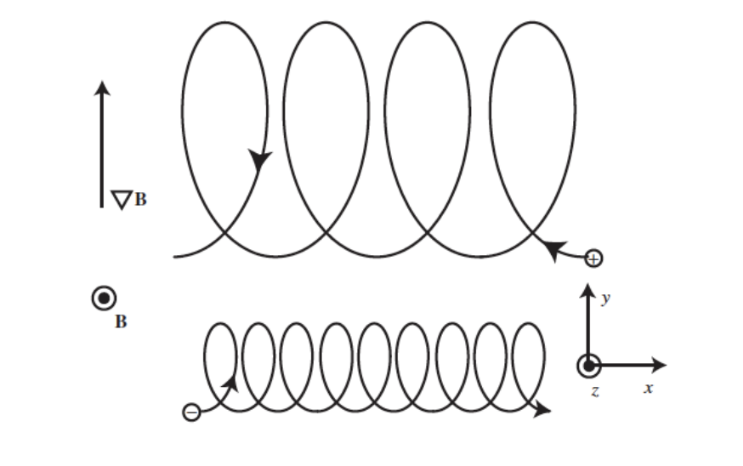
Drift of charge particle due to Grad B drift
F = $\frac{qv⊥2 }{2ωc}$ $∇Bs=\frac{mv⊥2 }{2Bs} ∇Bs$
$$v \text{= }\frac{F \text{x} Bs }{qBs2 }$$
_{D}
$$⊥$$
²
$$v∇ \text{=} \frac{mv\text{i} }{2eBs2} ∇Bs \text{x} BS$$
For ion :
_{B}
$$⊥$$
²
$$v∇ \text{= }−\frac{m\text{i}vi }{2eBs2} ∇Bs \text{x} BS$$
For e⁻ :
_{B}
$$Larmor radius: ρ = \frac{v⊥}{ωc}= \frac{m v⊥}{eBs}$$
$$2$$
$$2$$
$$⊥$$
T_{i}
$$⊥$$
$$miv$$
$$\sim$$
$$mv$$
$$\sim$$
T_{e}
If T_{e} =T_{i} → $v∇$are equal
The gyro-radius will be smaller where B_{s} is larger and vice-versa
_{B}
Space charge separation is created, leads to E XB drift

Slide 28
Drift of charge particle due to curvature in B

Slide 29
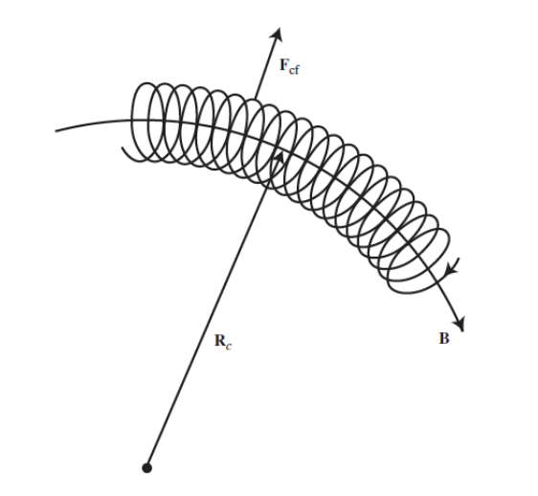
Drift of charge particle due to curvature in B
^
Assume B_{s} $∥$ $φ$
Radial motion
$$∙$$
$m (r −rφ2$)= e (v $\text{x}$ B)_{r}
$$∙$$
$m (r −rφ2$)= e v_{z} B_{s}
$$∙$$
$m \frac{dvr}{dt}$ = e v_{z} B_{s} + mr$φ$²
$$∙$$
$m \frac{dvr}{dt}$ = e v_{z} B_{s} + mr$φ$²
Additional force
$$∙$$
^
$$\text{F}\text{ =} m\text{r}φ\text{2} \text{R}\text{c}$$
$$∙$$
Z motion
$$∙$$
^
$$vφ=r φ=v∥$$
$$\text{F}\text{ =} m\text{R}\text{c} φ\text{2} \text{R}\text{c}$$
$m \frac{dvz}{dt}$ = - e v_{r} B_{s}
^
$$\text{F}\text{ = }\frac{m v∥2}{Rc} \text{R}\text{c}$$

Slide 30
Drift of charge particle due to curvature in B
$$vcurv\text{= }\frac{F \text{x} Bs }{qBs2 }$$
$$\text{For} \text{e}\text{−} \text{:} vcurv \text{= }−\frac{m v∥2}{eRc} \frac{ Rc \text{x} BS}{\begin{aligned}Bs2 \\ \end{aligned}}$$
^
$$\text{For} \text{ion} \text{:} vcurv \text{= }\frac{m vi∥2}{eRc} \frac{ Rc \text{x} BS}{Bs2}$$
^
$vcurv \sim$ $\frac{T}{Rc Bs }$
If T_{e} = T_{i} , $vcurv$ similar in magnitude for e⁻ and ions
Production of magnetic field is expensive

Slide 31
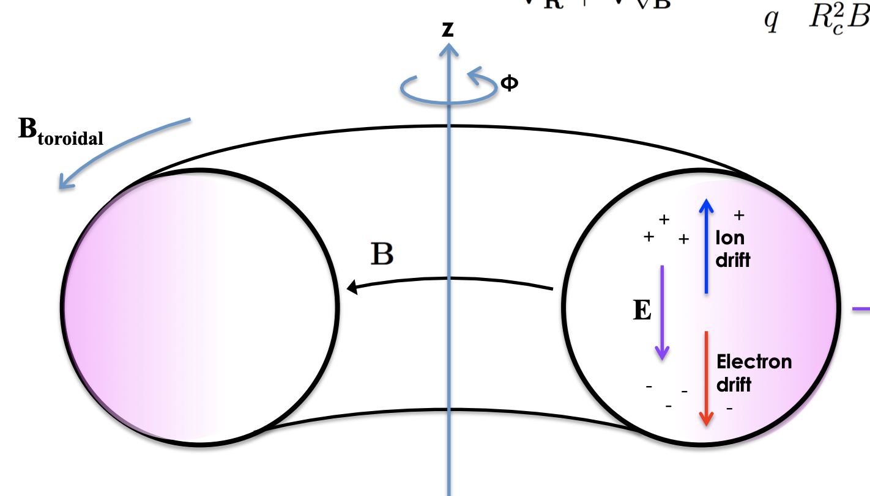
Total drift on charge particle due to curvature in B and grad B
Gradient drift + curvature drift→ in same direction for each species, so they add up
$$vcurv+v∇ =\frac{m }{qRc} \frac{ Rc \text{x} BS}{\begin{aligned}Bs2 \\ \end{aligned}}\left(v∥ + \frac{1}{2}v⊥\right)$$
²
²
_{B}
Charge separation causes E to be generated
$$vD=\left(\frac{E \text{x} Bs}{Bs 2}\right)$$
Suppress the drift → tokamak configuration
Courtesy: Dr. Cami Collins

Slide 32
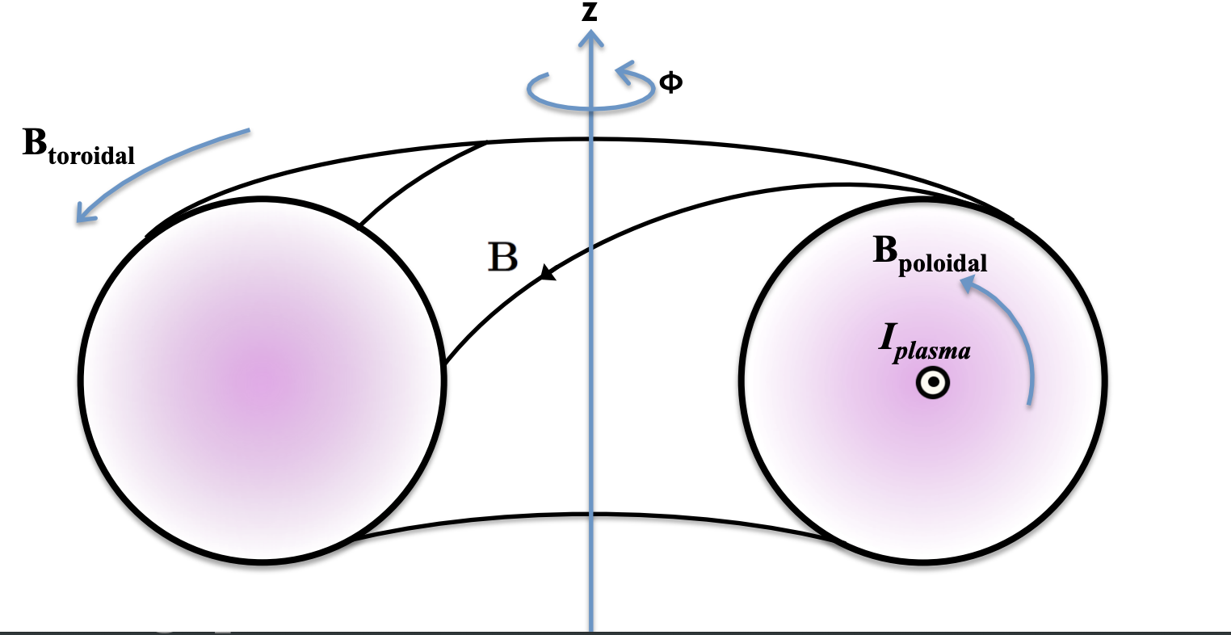
Tokamak solution: Add poloidal magnetic fields
Need to twist field lines helically to compensate particle drifts
Toroidal: long way around
Poloidal : short way around
1. Use external coils to produce toroidal magnetic field
2. Drive toroidal current in plasma to generate a poloidal magnetic field
Issues related to driving plasma current + disruption plasma phenomenon a major problem!
Courtesy: Dr. Cami Collins

Slide 33
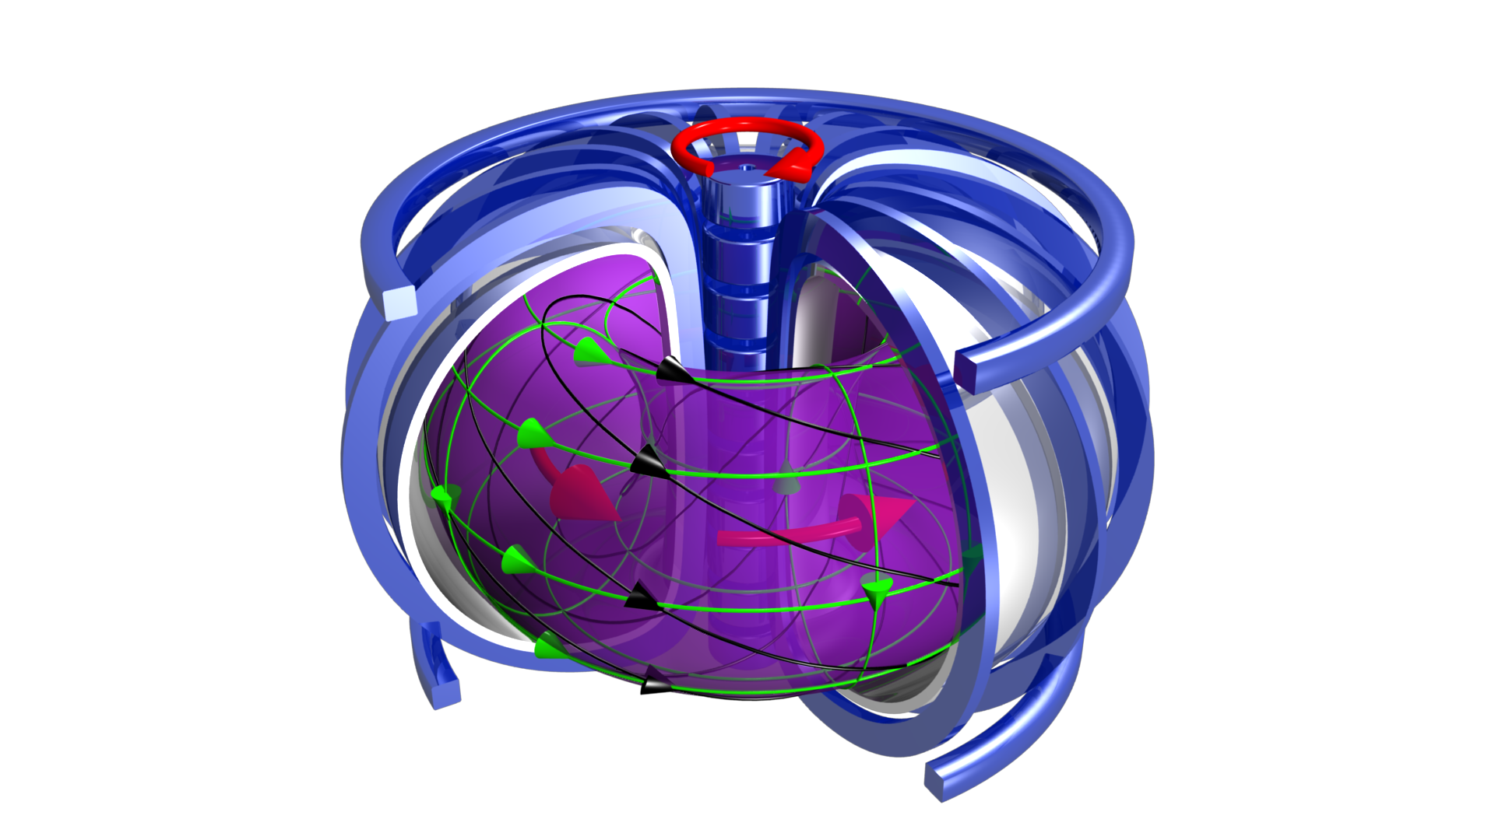
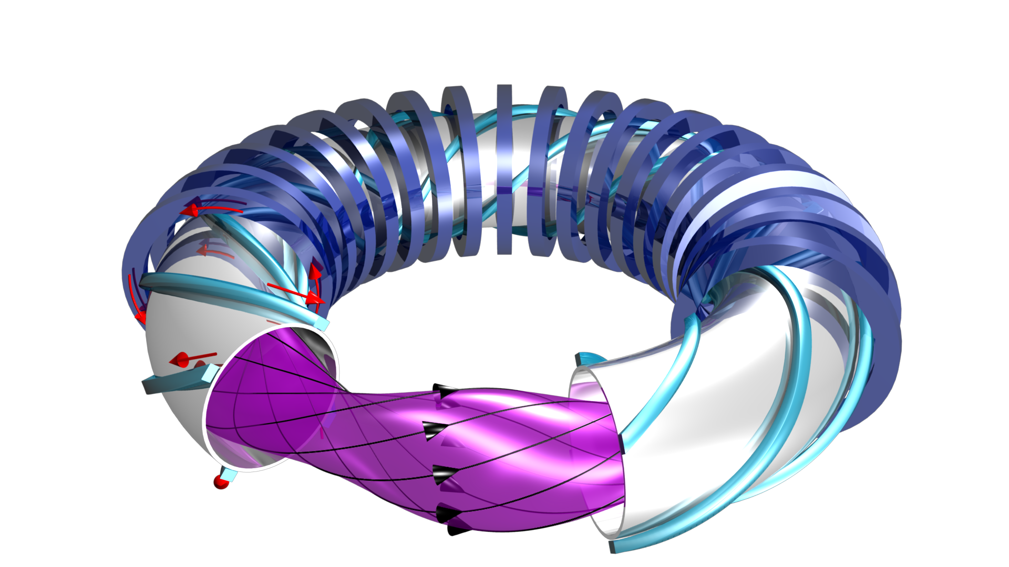
Difference between two leading magnetic confinement concepts
Tokamak (axisymmetric)
Stellarator (3D nonaxisymmetric)
Toroidal Field generated by external coils
Poloidal field generated by plasma current
Total Field has a twisted field structure
Twisted magnetic field is created by external twisted magnetic coils

Slide 34
Conclusions
Charged particles undergo gyromotion about magnetic fields, and are free to move along the magnetic field line
Depending on magnetic field geometry or the presence of other forces like electric fields, particles can drift across field lines (and even leave the system and hit the walls)
Toroidal confinement devices have magnetic fields in both the poloidal and toroidal direction to compensate for these drifts

