Slide 1
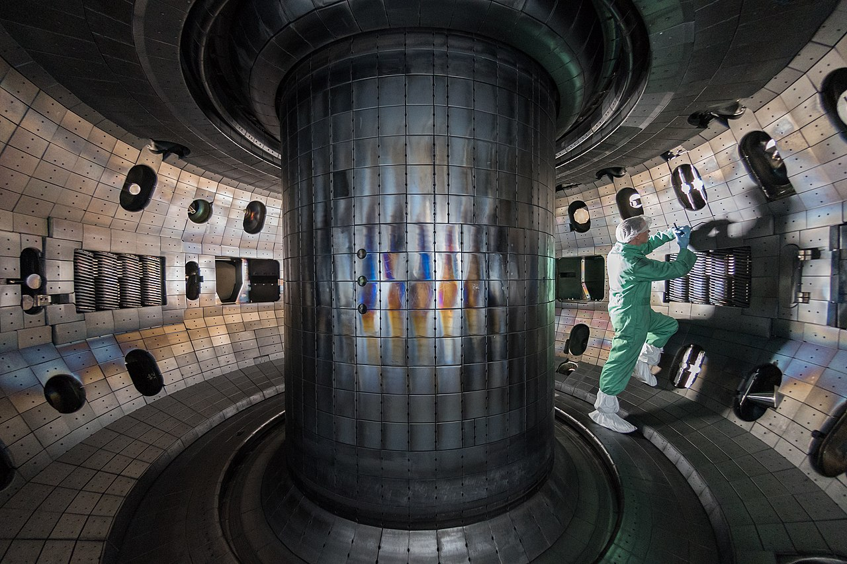

Introduction to tokamaks
Auna Moser
Presented virtually at the
2023 Intro to Fusion Energy
and Plasma Physics Course
June 12, 2023

Slide 2


Who am I?
Caltech, BS in Geology, 2002

Slide 3
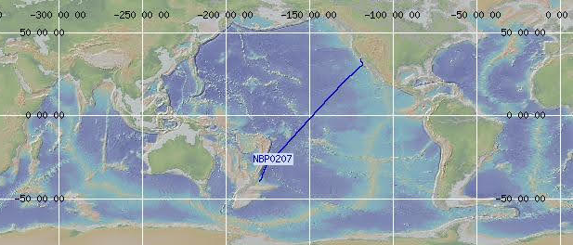

Who am I?
Caltech, BS in Geology, 2002
Two years off from school

Slide 4
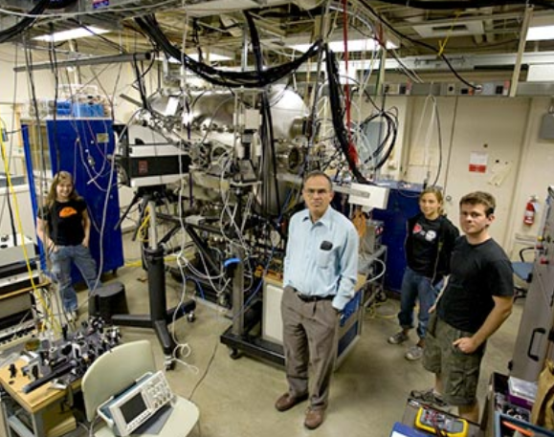
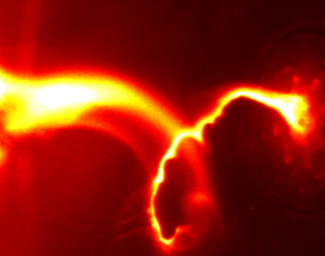
Who am I?
Caltech, PhD in Applied Physics, 2012
Caltech, BS in Geology, 2002
Two years off from school

Slide 5
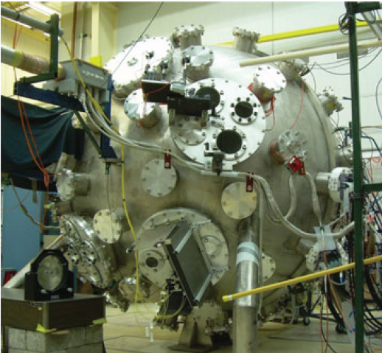

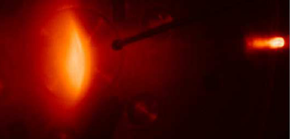
Who am I?
Caltech, PhD in Applied Physics, 2012
Caltech, BS in Geology, 2002
Two years off from school
LANL, Postdoc, 2012-2014

Slide 6
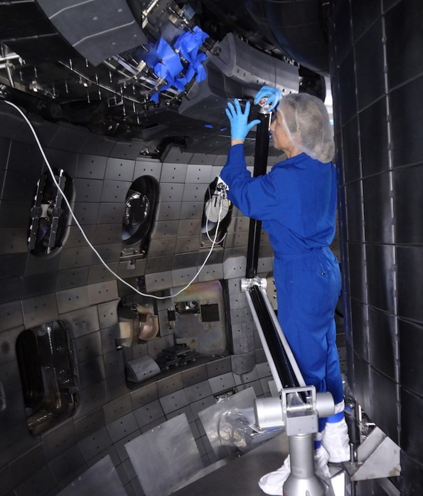
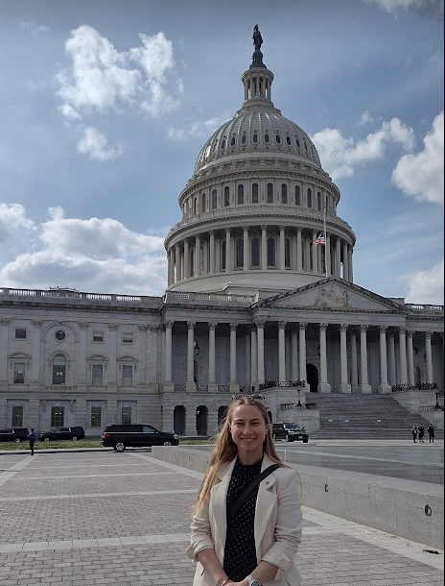
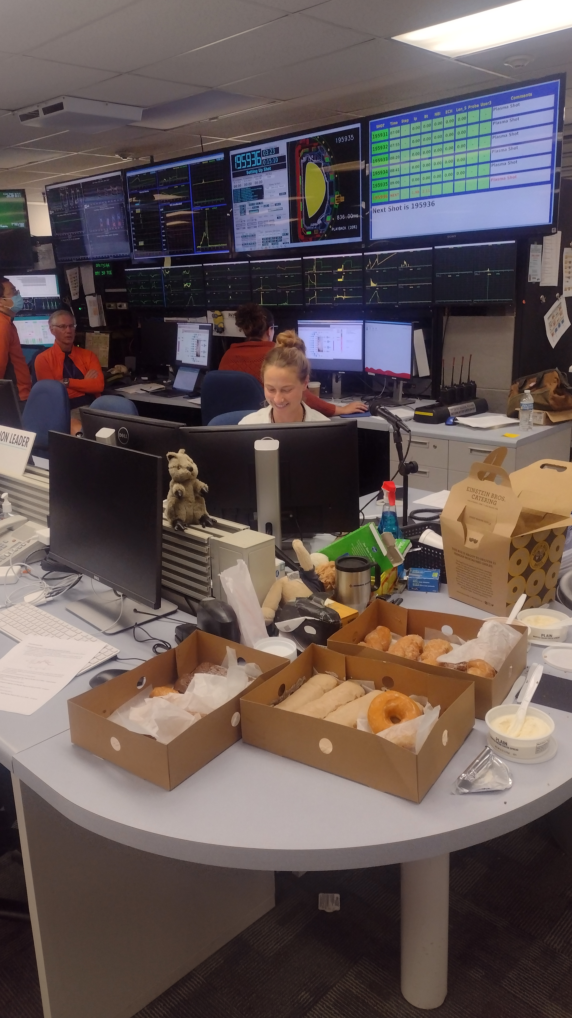
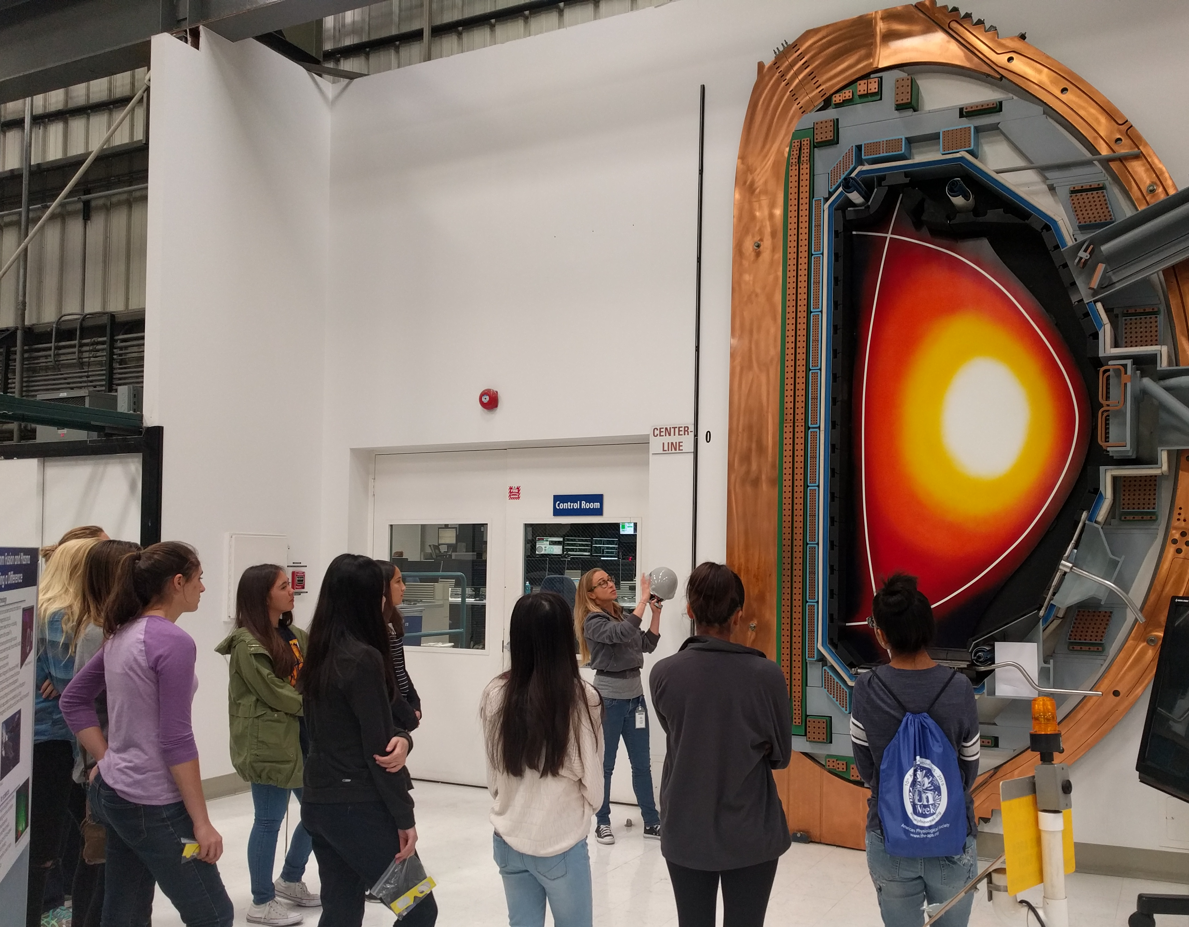
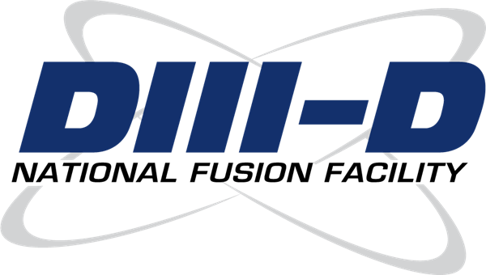
Who am I?
Caltech, PhD in Applied Physics, 2012
Caltech, BS in Geology, 2002
Two years off from school
LANL, Postdoc, 2012-2014
General Atomics,
Staff scientist at DIII-D,
2014-present

Slide 7
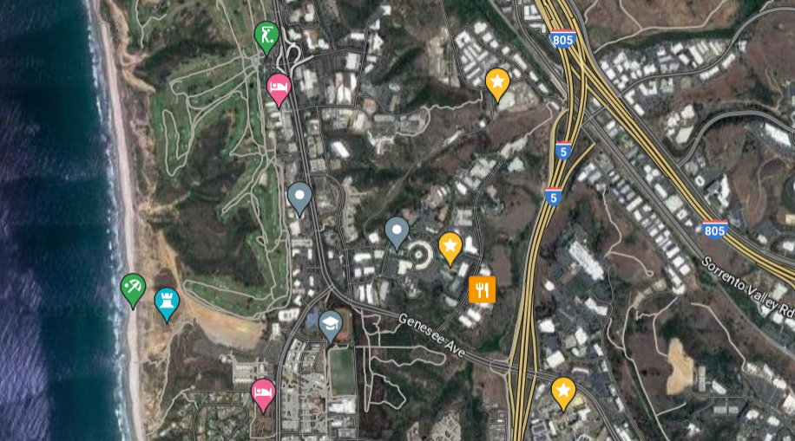
I didn’t get very far!
DIII-D
Office
Born here

Slide 8
Where are we going?
Overview/review of key ideas
How does a tokamak work?
  Nested flux surfaces
  Shaping
  Heating and current drive
Some current research areas
How can you get involved?

Slide 9
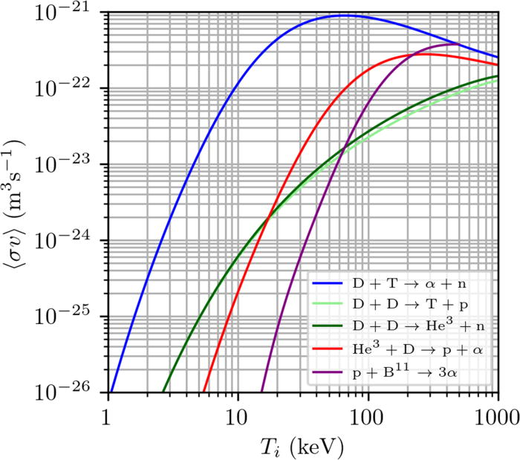
What have you learned so far about fusion?
Fusion is a clean, safe type of nuclear power with abundant fuel
“Easiest” reaction is D-T
See Diaz, 6/5
Wurzel et al, PoP 29, 062103 (2022)

Slide 10
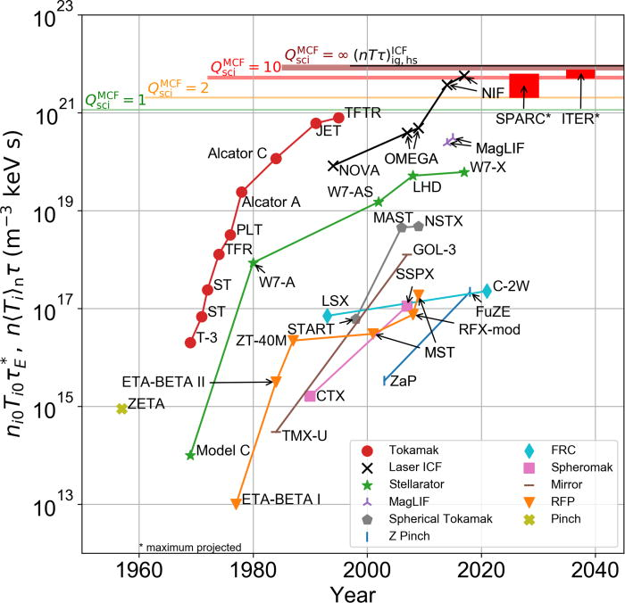
What have you learned so far about fusion?
Fusion is a clean, safe type of nuclear power with abundant fuel
“Easiest” reaction is D-T
Reaction requires a high enough
(Lawson criterion) triple product nTτ_{ε}
  We have made a ton of progress!
Ignition from 12/22 not shown here! See Kritcher, 6/8
Wurzel et al, PoP 29, 062103 (2022)

Slide 11
What have you learned so far about fusion?
Fusion is a clean, safe type of nuclear power with abundant fuel
“Easiest” reaction is D-T
Reaction requires a high enough
(Lawson criterion) triple product nTτ_{ε}
  We have made a ton of progress!
There are different ways to confine a plasma to achieve fusion
  Gravitational, magnetic, inertial
  Stellarator
  Tokamak
  Reversed field pinch, field reversed configuration, magnetic mirror, z-pinch, spheromak....
Ignition from 12/22 not shown here! See Kritcher, 6/8
See Paul, previous talk
This talk
Wurzel et al, PoP 29, 062103 (2022)
See Sutherland, next talk

Slide 12
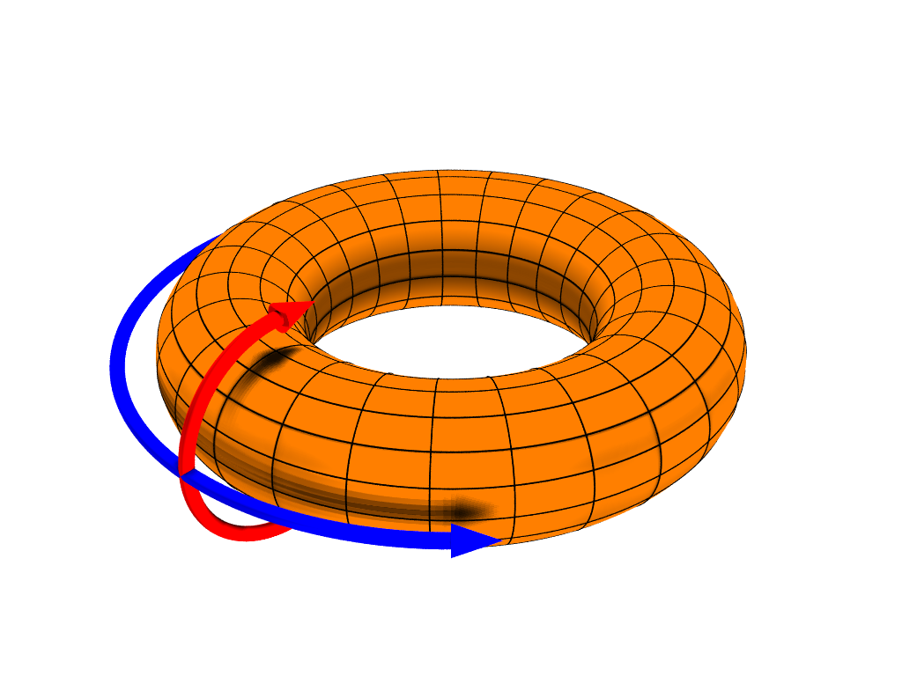
What are the basic ideas behind confinement in a tokamak?
Particles (mostly) stay along field lines
Close those field lines into a torus to confine them
Add twists to keep particles from drifting out
Confine plasma with toroidal and poloidal magnetic fields
See Duarte, Sinha, 6/6
See Sinha, 6/6
Toroidal
Poloidal

Slide 13
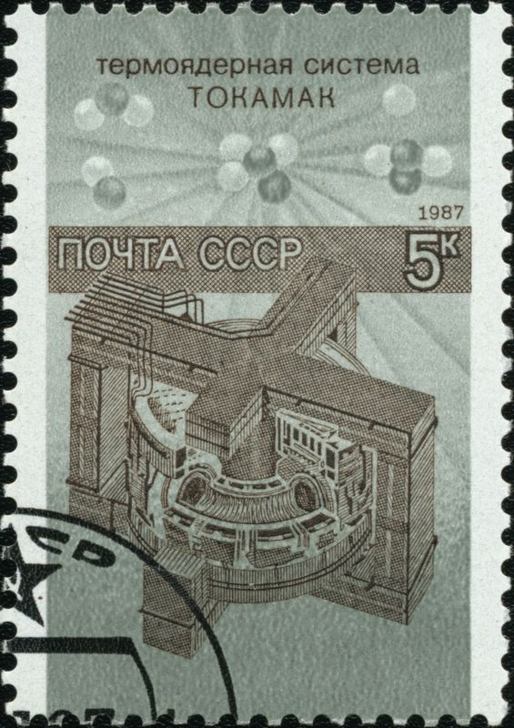
What is a tokamak?
Tokamaks confine with an externally produced
toroidal field and a plasma current produced
poloidal field
TOKAMAK is a Russian acronym:
TOroidal'naya KAmera s MAgnitnymi KAtushkami
“Toroidal Chamber with Magnetic Coils”
Leading magnetic confinement concept in terms of
number of facilities and funding
Caveat!: I only have personal experience with DIII-D, so what I present today will be heavily biased towards DIII-D

Slide 14
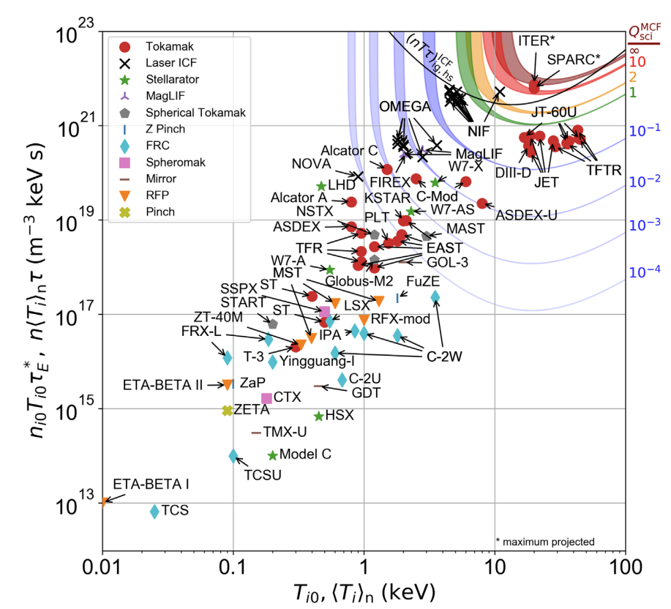
Many tokamaks around the world are making strides towards ignition
Ignition from 12/22 not shown here! See Kritcher, 6/8
Copper magnetic field coils
  DIII-D (USA), JET (UK), ASDEX-U (Germany), COMPASS (Czech Republic), WEST (France), TCV (Switzerland)
Superconducting magnetic field coils
  EAST (China), KSTAR (Korea), JT60-SA (Japan)
Low aspect ratio
  NSTX-U (USA), MAST-U (UK)
Future public sector devices
  ITER (France)
  DEMO class devices: CFETR (China), EU-DEMO (EU), STEP (UK), FPP (US)
Many private sector companies entering the market
  Commonwealth Fusion Systems (SPARC/ARC, US)
  Tokamak Energy (ST40, UK)
Approaching ignition
(self-sustaining reaction)
… and more!
Wurzel et al, PoP 29, 062103 (2022)
https://www.fusionenergybase.com
https://www.energy.gov/articles/doe-announces-46-million-commercial-fusion-energy-development

Slide 15
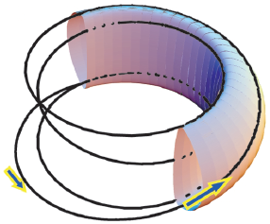
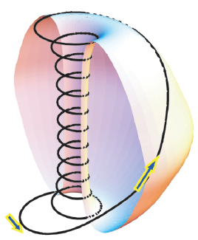
Two types of tokamaks: Conventional aspect ratio and spherical tokamaks
“Donut”
A ≥ 4
“Cored apple”
A ≥ 1.25
Conventional tokamaks
Usually A>2.5
Ex: ITER, ASDEX, JET, DIII-D, EAST, SPARC…
Spherical tokamaks
A=1-2.5
Ex: MAST, NSTX-U…
Peng, Phys. Plasmas, 7, 1681 (2000).

Slide 16
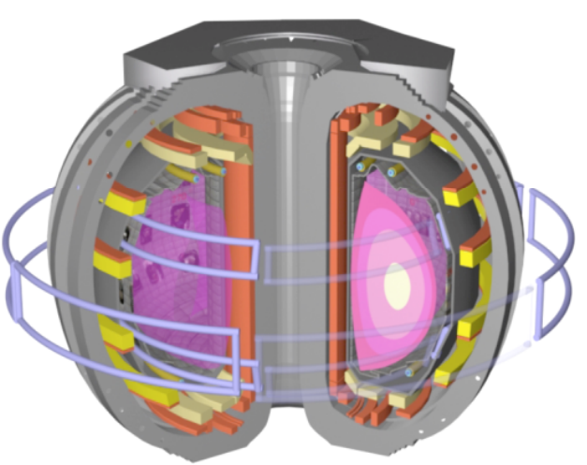
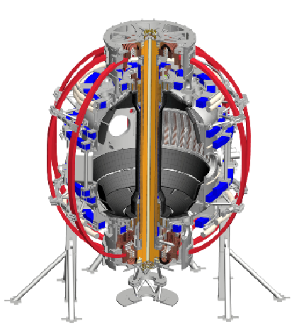
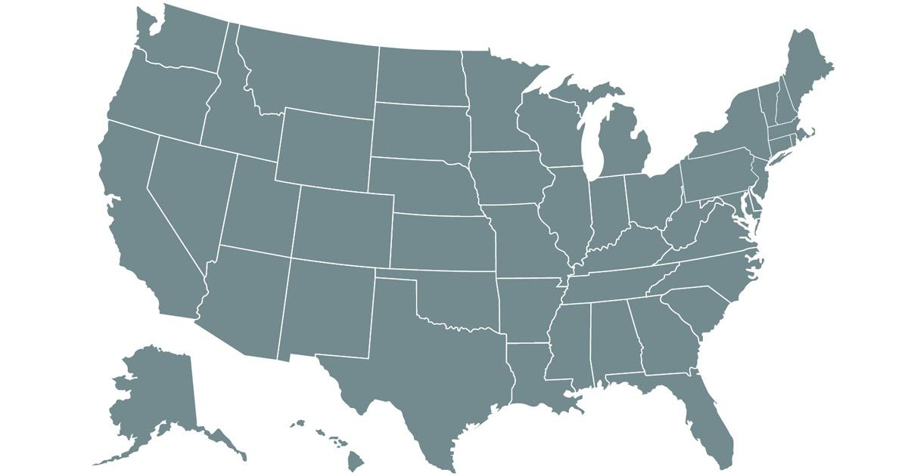
Two major U.S. facilities are DIII-D and NSTX-U, specializing in different aspect ratios
DIII-D,
Conventional tokamak
A=2.7
NSTX-U
Spherical tokamak
A=1.3
NSTX-U
DIII-D

Slide 17


Two major U.S. facilities are DIII-D and NSTX-U, specializing in different aspect ratios
DIII-D,
Conventional tokamak
A=2.7
NSTX-U
Spherical tokamak
A=1.3
NSTX-U
DIII-D

Slide 18
Where are we going?
Overview/review of key ideas
How does a tokamak work?
  Nested flux surfaces
  Shaping
  Heating and current drive
Some current research areas
How can you get involved?

Slide 19
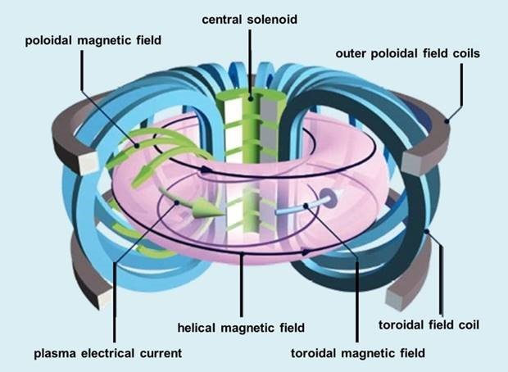
Tokamaks use magnetic fields to confine a plasma in a toroidal vacuum vessel
Notes:
(0) We start with an empty vacuum vessel. Into this we will introduce neutral gas and energy to generate a plasma.
Run a current in the central solenoid. The change of flux induces a toroidal electric field which breaks down the gas into a plasma, and drives a current through that plasma (Ip~1-2 MA) in the toridal direction. This is called ohmic or inductive startup.
We have current running in the toroidal field coils, which generates a toroidal magnetic field (BT~1-2 T) that confines the plasma.
The current in the toroidal direction generates a poloidal magnetic field, which is smaller than the toroidal field. This generates these twisted field lines that you see here.
We also have poloidal field coils that add poloidal field to shape and control the plasma.

Slide 20
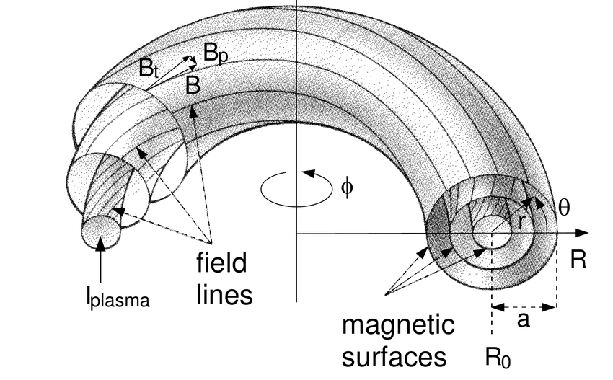

Tokamaks have nested magnetic surfaces
Two very important concepts:
Magnetic field lines lie on nested surfaces of constant magnetic flux, Ψ
Safety factor:
$$q=\frac{toroidal transits}{\begin{aligned}poloidal transits \\ =\frac{dφ}{dθ} or "pitch"\end{aligned}}$$
Tokamaks often use q₉₅ which is just inside
the last closed flux surface

Slide 21
Tokamaks have nested magnetic surfaces
Two very important concepts:
Magnetic field lines lie on nested surfaces of constant magnetic flux, Ψ
Safety factor:
$$q=\frac{toroidal transits}{\begin{aligned}poloidal transits \\ =\frac{dφ}{dθ} or "pitch"\end{aligned}}$$
Tokamaks often use q₉₅ which is just inside
the last closed flux surface

Slide 22
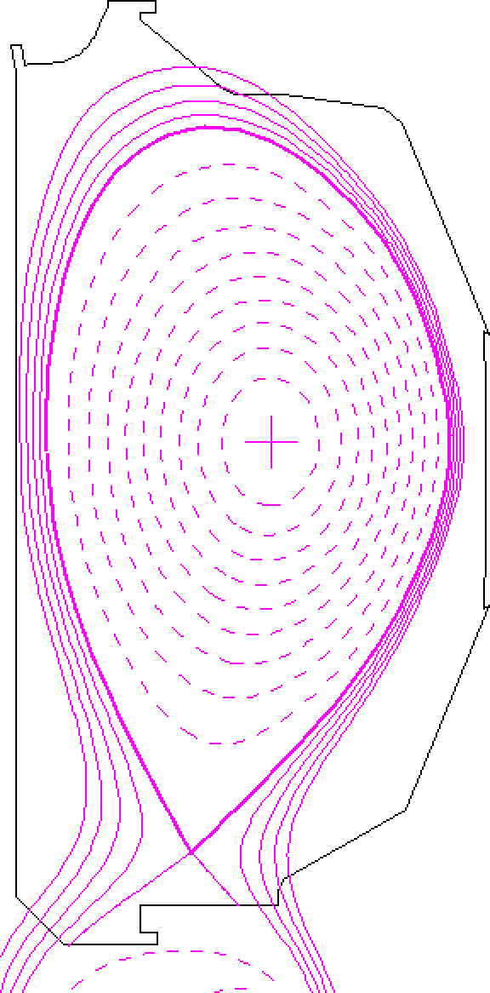
Surfaces described using ideal magnetohydrodynamics (Ideal MHD)
See Thakur, 6/6
MHD equilibrium in toroidally symmetric geometry:
Grad–Shafranov:
Equilibrium equation relates poloidal flux function (Ψ)
Pressure (p) and current flux function (F)

Slide 23
Surfaces described using ideal magnetohydrodynamics (Ideal MHD)
See Thakur, Tue 6/6
MHD equilibrium in toroidally symmetric geometry:
Grad–Shafranov:
Equilibrium equation relates poloidal flux function (Ψ),
pressure (p), and current flux function (F)
Ψ_{N}=0
Ψ_{N}=1
Nested magnetic surfaces of constant flux are called “flux surfaces”
  Pressure, current, q constant on a flux surface
We use flux coordinates to collapse to a 1D system, plotted vs. “normalized flux” Ψ_{N}
Last closed flux surface is called the “separatrix”

Slide 24
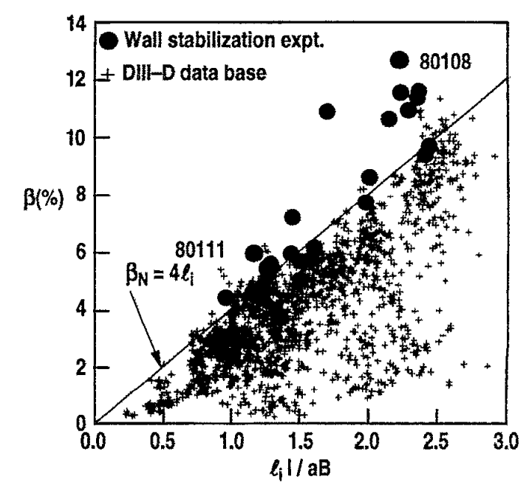

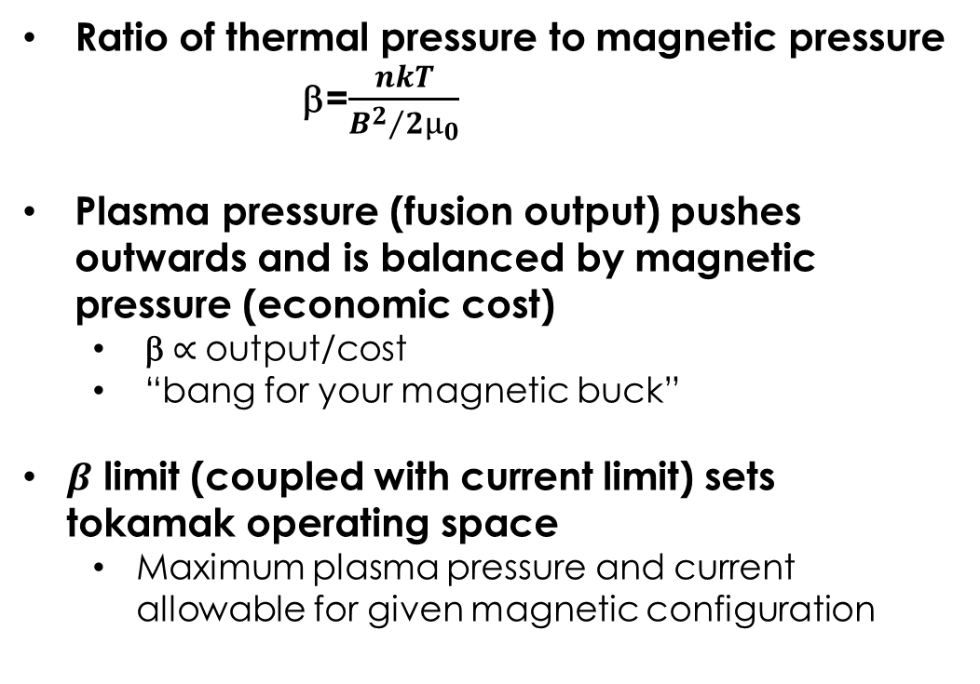
Pressure limit: Plasma “efficiency” can be defined by the parameter β
Ratio of thermal pressure to magnetic pressure
  β=$\frac{nkT}{{B^{2}}/{2μ_{0}}}$
Plasma pressure (fusion output) pushes outwards and is balanced by magnetic pressure (economic cost)
  β $∝$output/cost
  “bang for your magnetic buck”
$β$ limit (coupled with current limit) sets
tokamak operating space
  Maximum plasma pressure and current allowable for given magnetic configuration
Taylor et al, PoP 2, 2390 (1995)
Tokamaks normalize to an empirical current limit:

Slide 25
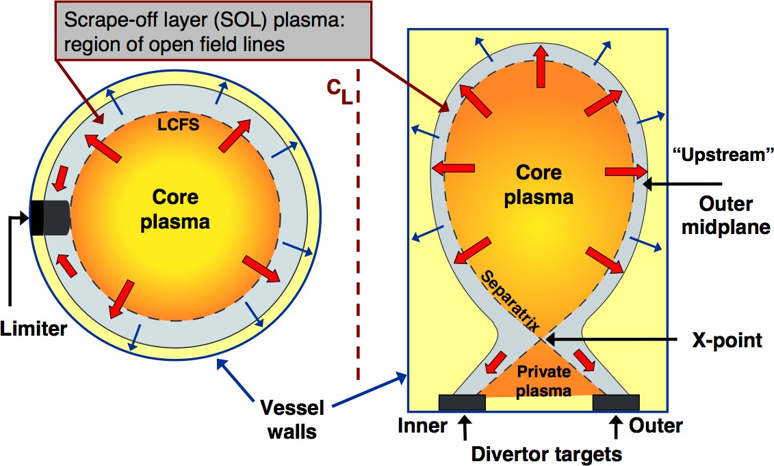
Two general types of tokamak magnetic topologies
Limiter:
A physical structure intentionally intersects a set of flux surfaces
Divertor:
Magnetic structure is created to localize exhaust
R. A. Pitts, “Tokamak edge physics and plasma surface interactions” 2007 crppwww.epfl.ch/~pitts/pitts/pitts_varenna_27_09_2007.pdf

Slide 26
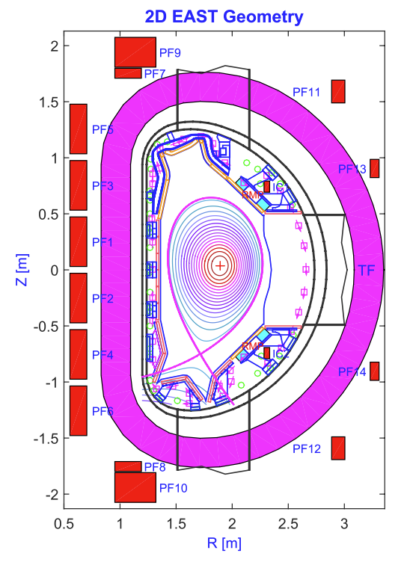
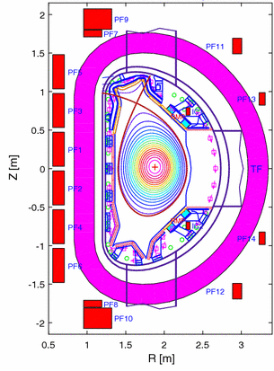
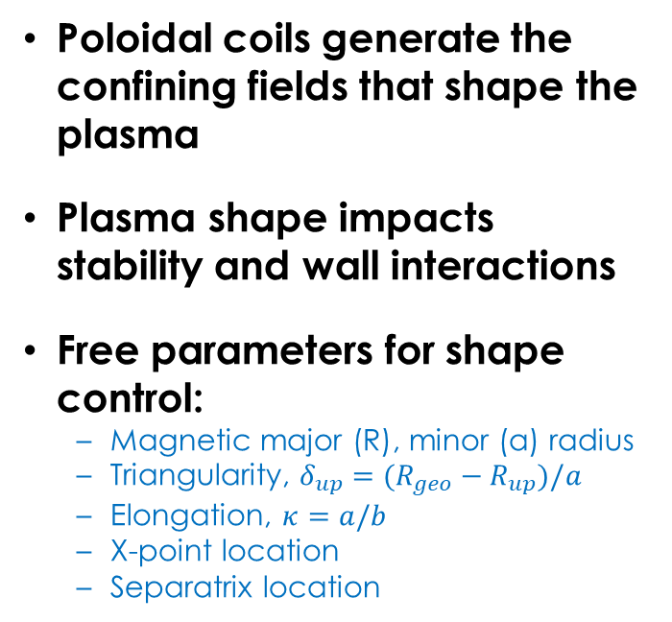


Poloidal field coils control plasma shape
Poloidal coils generate the confining fields that shape the plasma
Plasma shape impacts stability and wall interactions
Free parameters for shape control:
  Magnetic major (R), minor (a) radius
  Triangularity, $δ_{up}=(R_{geo}−R_{up})/a$
  Elongation, $κ=a/b$
  X-point location
  Separatrix location
EAST tokamak cross section
Lower Single Null (LSN)
Upper Single Null (USN)
Vacuum vessel
$$b$$
$$a$$
Poloidal field coils
Toroidal field coil

Slide 27
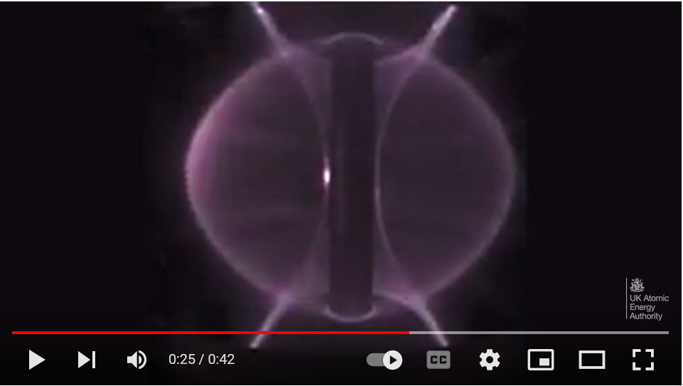
https://www.youtube.com/watch?v=Yu9C5TEhAdQ

Slide 28
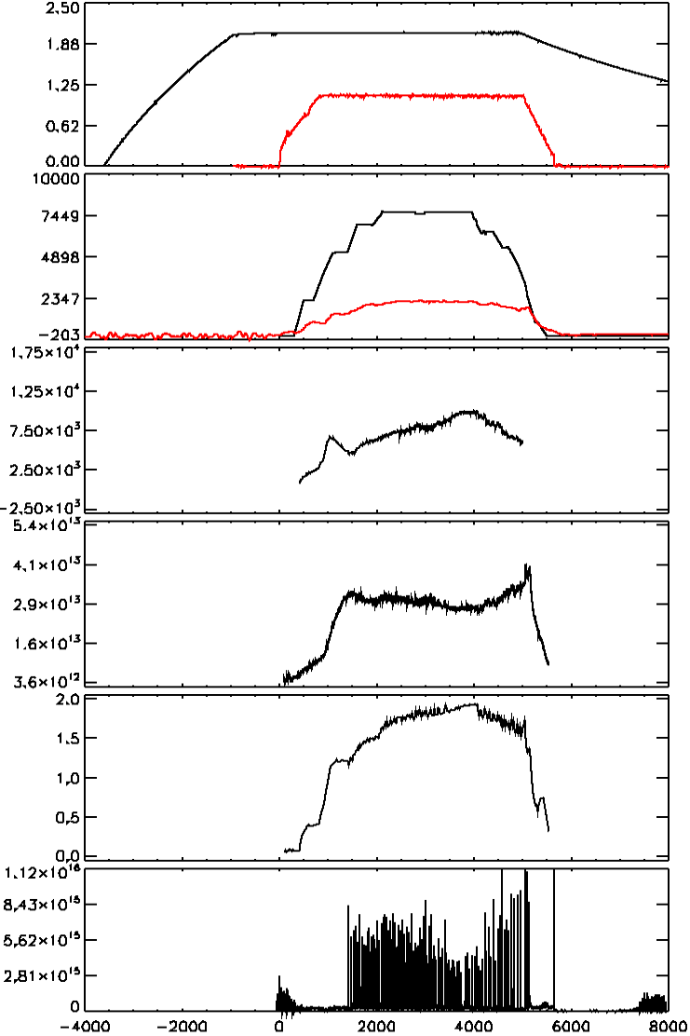

Example of a DIII-D plasma discharge
Toroidal magnetic field ramps up first
Central solenoid ohmically induces plasma current
Auxiliary systems required to heat the plasma and drive more current
Radiated power measures represents energy loss from the system (measured by bolometers)
Bt
“flat top”
Ip
Paux
Prad
Ion Temperature
Electron Density
$$β_{N}$$
Divertor Light

Slide 29
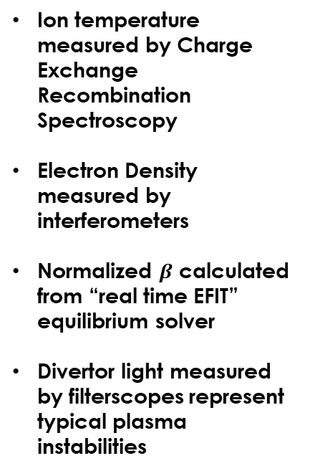
Example of a DIII-D plasma discharge
Toroidal magnetic field ramps up first
Central solenoid ohmically induces plasma current
Auxiliary systems required to heat the plasma and drive more current
Radiated power measures represents energy loss from the system (measured by bolometers)
Bt
“flat top”
Ip
Ion temperature measured by Charge Exchange Recombination Spectroscopy
Electron Density measured by interferometers
Normalized $β$ calculated from “real time EFIT” equilibrium solver
Divertor light measured by filterscopes represent typical plasma instabilities
Paux
Prad
Ion Temperature
Electron Density
$$β_{N}$$
Divertor Light

Slide 30
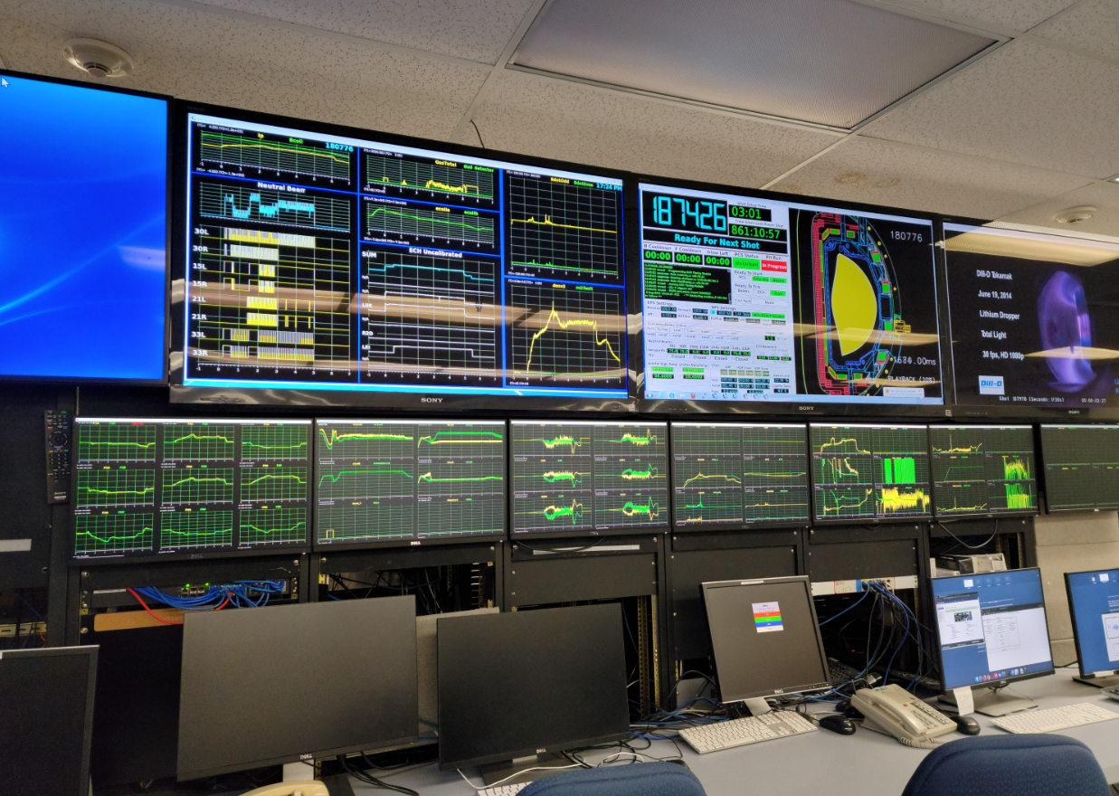
Example of a DIII-D plasma discharge
Toroidal magnetic field ramps up first
Central solenoid ohmically induces plasma current
Auxiliary systems required to heat the plasma and drive more current
Radiated power measures represents energy loss from the system (measured by bolometers)
Bt
“flat top”
Ip
Ion temperature measured by Charge Exchange Recombination Spectroscopy
Electron Density measured by interferometers
Normalized $β$ calculated from “real time EFIT” equilibrium solver
Divertor light measured by filterscopes represent typical plasma instabilities
Paux
Prad
Ion Temperature
Electron Density
$$β_{N}$$
Divertor Light

Slide 31
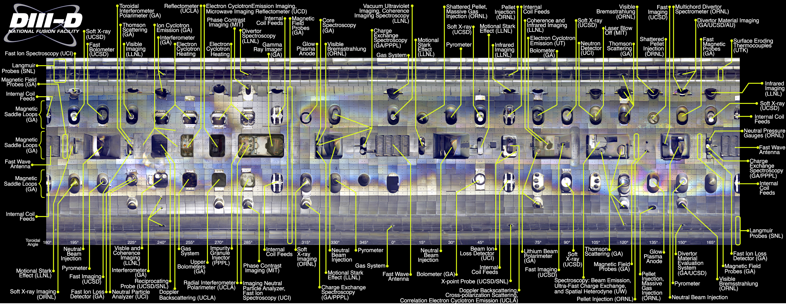
Diagnostics are a key part of tokamak research → How do you diagnose something that is so hot and in vacuum?
See Delgado-Aparicio, 6/15

Slide 32
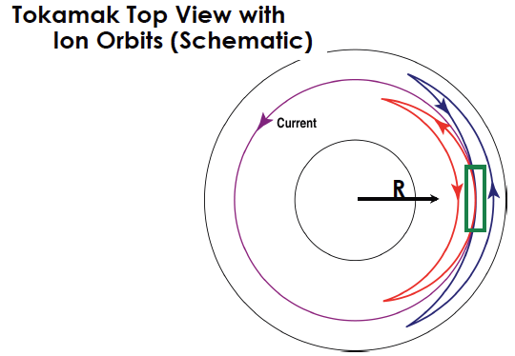
Need both current drive and heating in a tokamak
Heating is required in a reactor to ~15 keV
Non-inductive current drive is required for steady-state operation
Tokamaks naturally generate toroidal current (called bootstrap current) thanks to trapped particles
  Profile gradients mean more trapped particles moving in the current driving direction at any one location
  Trapped particles cannot carry current but transfer current to passing particles via collisions
Physics of heating and current drive is very similar
  If there is current drive, there is also heating
Luce et al PoP 18 030501 (2011)

Slide 33
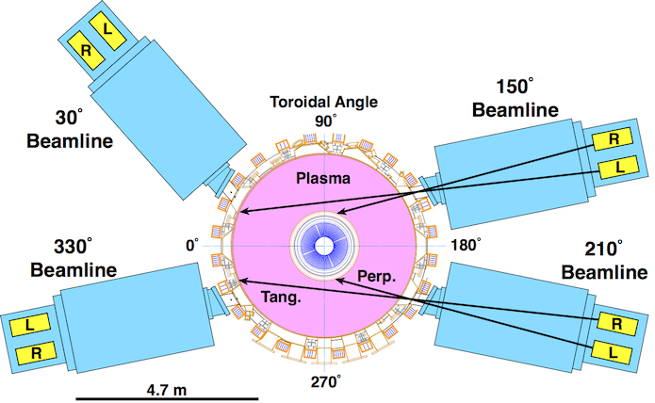
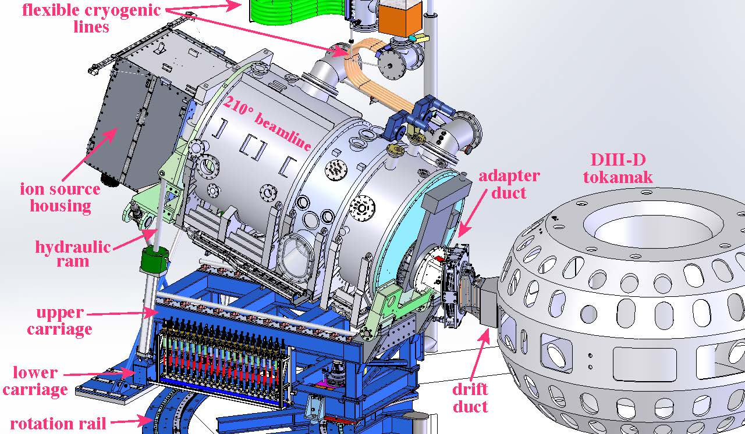
Neutral Beam Injection (NBI) is a primary heating and current drive system in present-day tokamaks
Beamlines accelerate ions to high energies, then neutralize with electrons before injecting into the plasma
Advantage: Drives current in the core of burning plasmas
  Neutral beam energy must be high > 1 MeV to reach center of the plasma in a reactor
Disadvantages:
  Larger aperture required, removing blanket and shielding
  Large addition to volume of plant exposed to tritium
  Could drive fast-ion instabilities
DIII-D beamlines have 2 sources
Each source can deliver ~2MW
Some beamlines can
tilt off-axis or rotate

Slide 34
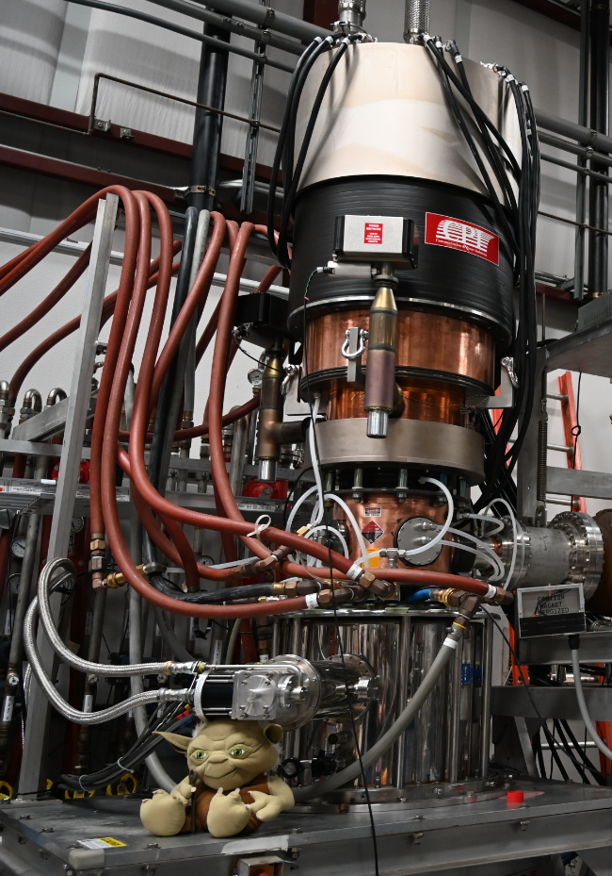
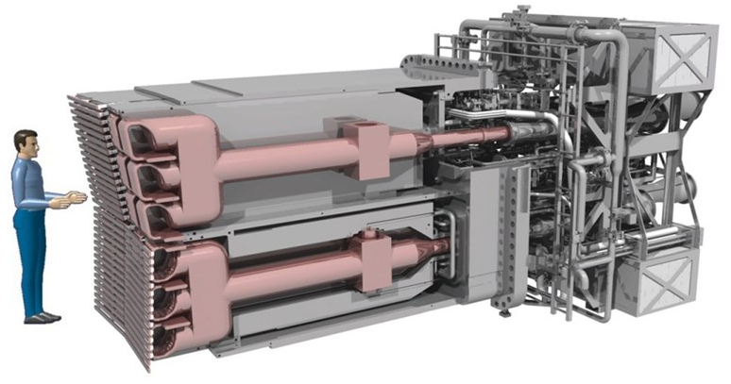
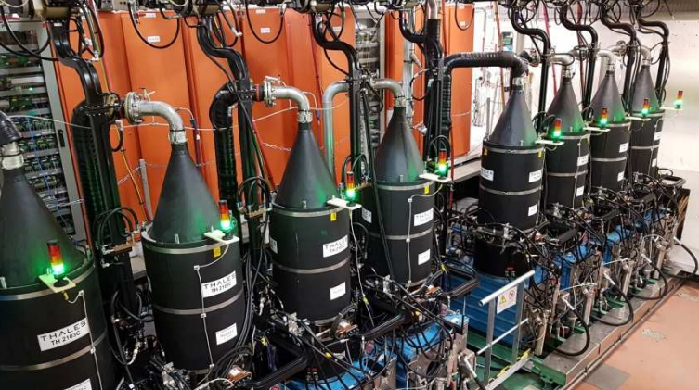
Radio Frequency (RF) is another primary heating and current drive system in tokamaks
Several different types of RF power and current drive:
DIII-D Gyrotron “Yoda”
ITER’s Ion Cyclotron Antenna
WEST Klystrons
Delpech et al, EPJ Web of Conferences 157, 03009 (2017)
Lower Hybrid RF
f<0.5-10 GHz
LH, whistlers/helicon
Klystrons via waveguide
Ion Cyclotron RF
f<200 MHz
Tetrodes to antenna
Electron Cyclotron RF
f<10-300 GHz
Gyrotrons via waveguide

Slide 35
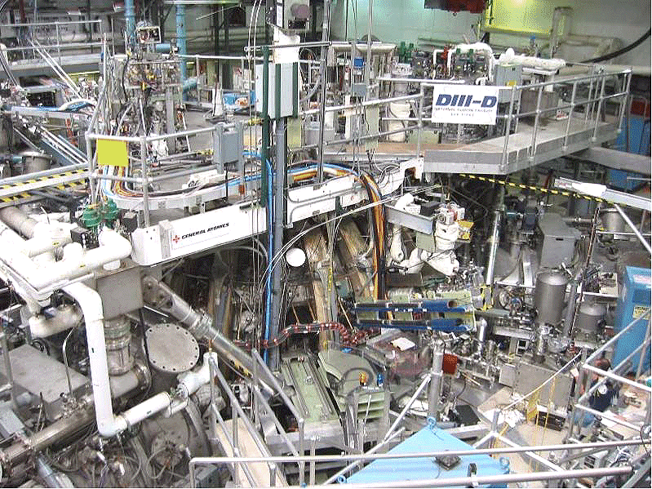
Tokamak is only one part of the machine hall
“The Pit”

Slide 36
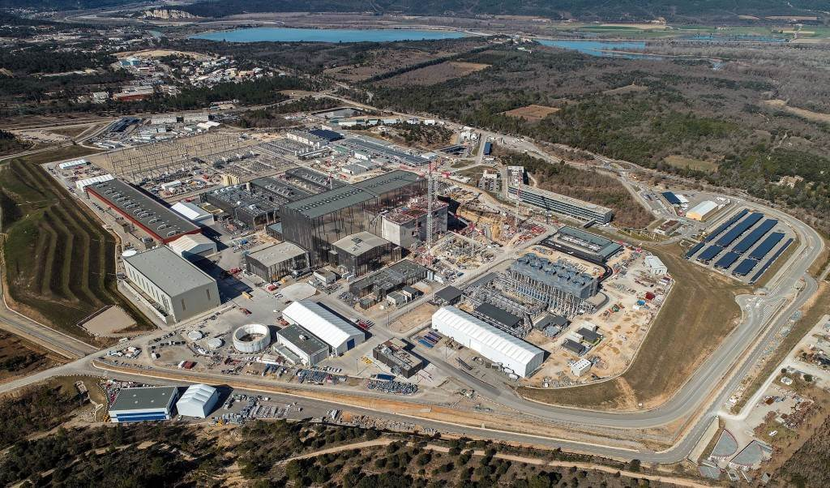
Iter will be the biggest tokamak yet
See Loarte, 6/15
Iter site, 3/2023

Slide 37
What are some of the key ideas we’ve covered so far?
Tokamaks confine plasmas with toroidal and poloidal magnetic fields
Tokamaks have nested flux surfaces, important quantities are conserved on a flux surface
  Normalized flux coordinate ψ_{N}, safety factor q, pressure ratio β
External coils shape and control the plasma
  Separatrix, x-point, SOL, divertor
Tokamaks are complex, integrated facilities
  Heating and current drive, diagnostics

Slide 38
Where are we going?
Overview/review of key ideas
How does a tokamak work?
  Nested flux surfaces
  Shaping
  Heating and current drive
Some current research areas
How can you get involved?

Slide 39
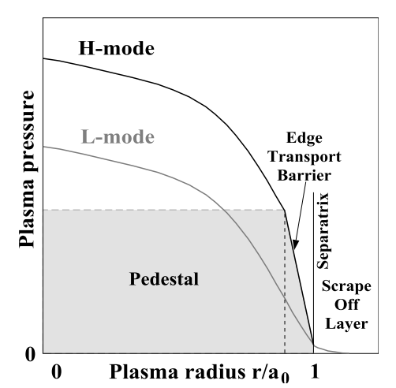
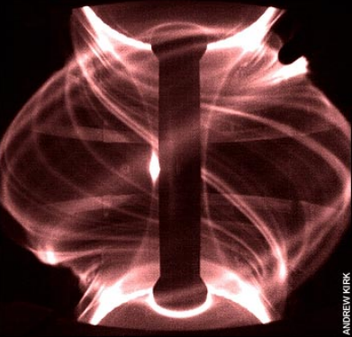
Varied levels of confinement of particles, momentum, and energy depending on the plasma regime
Two common plasma modes of operation
  L-mode = “low” energy confinement
  H-mode = “high” energy confinement, often associated w/ plasma instability called Edge Localized Mode (ELM)
H-mode extrapolates well to future devices because of energy confinement (due to enhanced pressure from pedestal)
Lang et al, NF 53, 043004 (2013)
MAST
Evans et al, Nonlinear Dynamics Ch 3 (image A. Kirk, Culham)

Slide 40
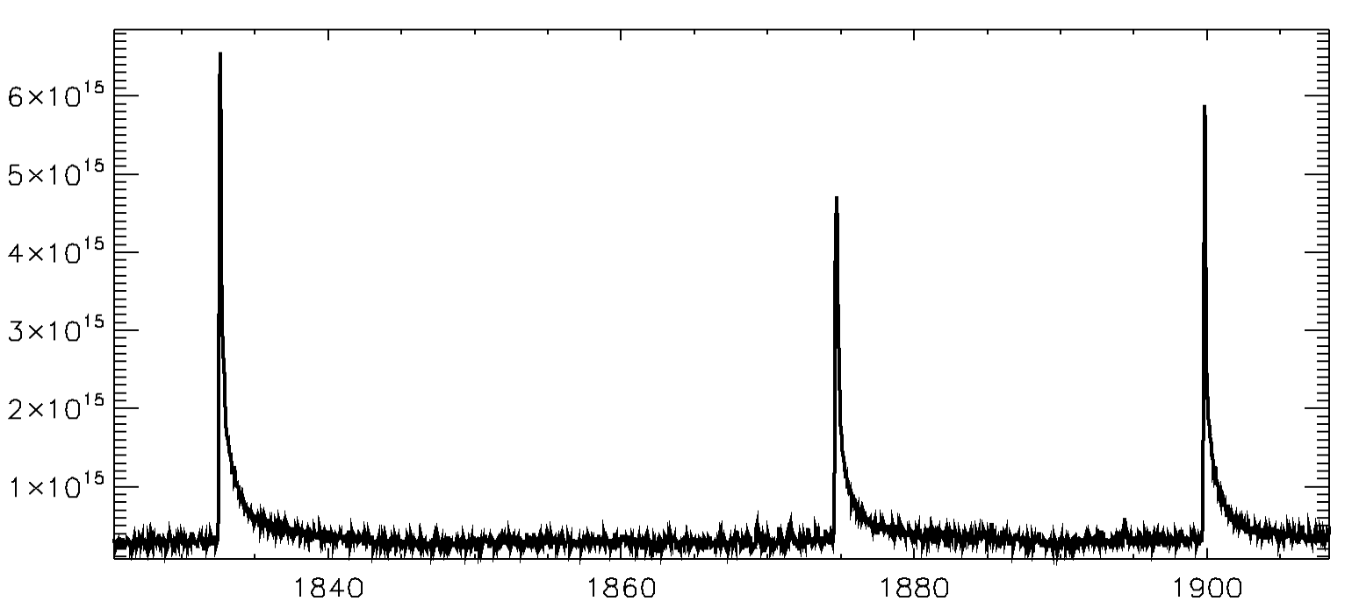
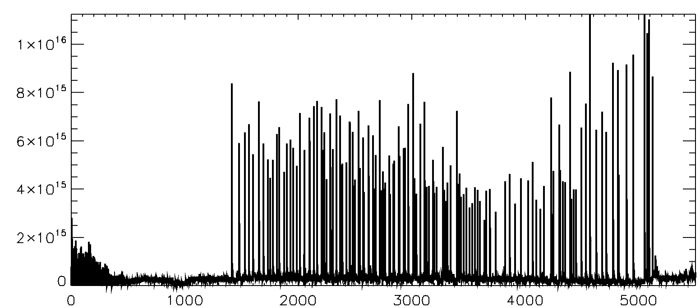
Varied levels of confinement of particles, momentum, and energy depending on the plasma regime
Two common plasma modes of operation
  L-mode = “low” energy confinement
  H-mode = “high” energy confinement, often associated w/ plasma instability called Edge Localized Mode (ELM)
H-mode extrapolates well to future devices because of energy confinement (due to enhanced pressure from pedestal)
ELMs deliver large transient heat fluxes to plasma facing components
Other types of modes are an active area of research → e.g. H-modes w/o ELMs or regimes w/ different confinement scalings
Lang et al, NF 53, 043004 (2013)
MAST
Evans et al, Nonlinear Dynamics Ch 3 (image A. Kirk, Culham)
ELMs
Divertor Light (filterscopes)

Slide 41
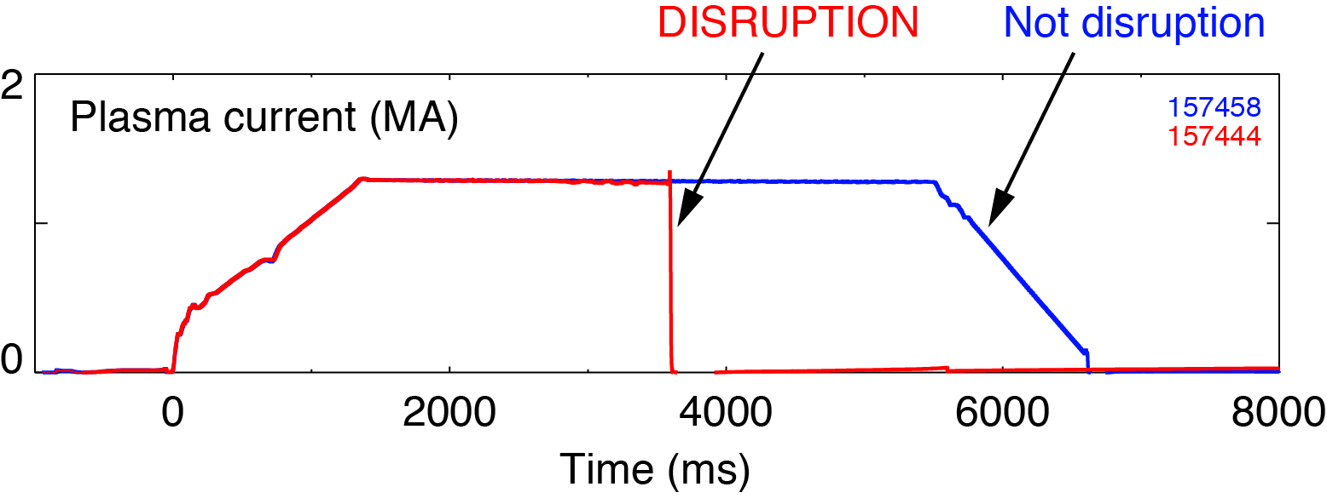
Disruptions are a rapid and complete loss of current and energy
Threat for a tokamak, possible disaster for a reactor
  High heat flux, large thermal load to divertor
  Large electromagnetic forces
  Runaway electrons
Disruption avoidance
  Prediction, active control to avoid
Disruption mitigation
  Shattered pellet injection, massive gas injection
See Rea, 6/15

Slide 42



High heat flux and narrow profile can damage divertor plates
Many strategies to reduce divertor heat flux
  Add impurities to increase radiation in SOL
  Shaping the divertor baffle
  Expand magnetic flux using snowflake and super-X configurations
Core–edge integration is grand challenge
  Have to mitigate heat flux without harming confinement
Plasma facing materials in the divertor and main chamber wall
^{Jaervinen et al NME 19 (2019)}
MAST-U
Morris et al IEEET rans. Plasma Sci. 46 (2018)
See Dennett, 6/13

Slide 43
Where are we going?
Overview/review of key ideas
How does a tokamak work?
  Nested flux surfaces
  Shaping
  Heating and current drive
Some current research areas
How can you get involved?

Slide 44
There are many tokamaks in the world you could work on!
Currently two big tokamak facilities in the US
  NSTX-U and LTX at Princeton Plasma Physics Laboratory (Princeton, NJ)
  DIII-D National Fusion Facility (San Diego, CA)
  Universities have collaborations with PPPL and DIII-D and have on-site grad students
Some university tokamaks: Pegasus III (University of Wisconsin-Madison), HBT-EP (Columbia University)
International facilities
  Iter (France), JET (UK), ASDEX-U (Germany), COMPASS (Czech Republic), WEST (France), TCV (Switzerland), EAST (China), KSTAR (Korea), JT60-SA (Japan), MAST-U (UK)

Slide 45



Major topical areas of open research → You can be part of the team to meet these challenges!
Many open questions and challenges to address to put fusion on the grid
Recent community plan aligned goals and prioritized research objectives (Final report here: https://arxiv.org/abs/2011.04806)
Exciting new opportunities for engagement (ITER, SPARC, EXCITE proposed by NAS and CPP reports)

Slide 46

Tokamaks represent a key path towards achieving fusion energy
Tokamaks are toroidal devices that use toroidal and poloidal magnetic fields to confine the plasma
Tokamaks can meet the energy challenge
Two tokamaks in the US (NSTX-U and DIII-D) used to study and model plasma physics for extrapolation to a fusion pilot plant
Complex environments with many integrated teams and exciting science

Slide 47
Thank you and good luck with your research!

