Slide 1



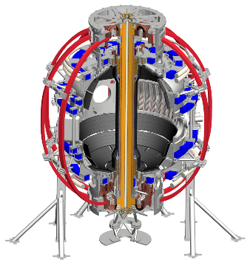











The Z-challenge, radiation & diagnostics
Princeton University
PPPL
Luis F. Delgado-Aparicio (PPPL)
06/15/2023

Slide 2


Outline
Magnetically confined fusion (MCF) plasmas and the Z-challenge
Radiation losses and the basic need of spectroscopy
Take home message: radiated power and x-ray diagnostics
Summary

Slide 3
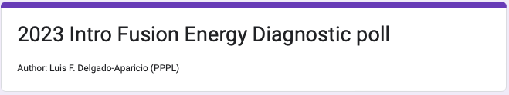
Class-Homework #1 …on the “fly”
https://forms.gle/W6cmsJsyrpWvwRf16
After a good "couple-dozen” lectures in plasma physics and fusion, what do you think are the most important plasma quantities you need to diagnose in your experiments? Remember, diagnostics are "the key” to your access inside the plasma !!!
Challenge: Pick your top 10 (ONLY 10)
Time: Three minutes
Note: Responses cannot be changed after submitted

Slide 4
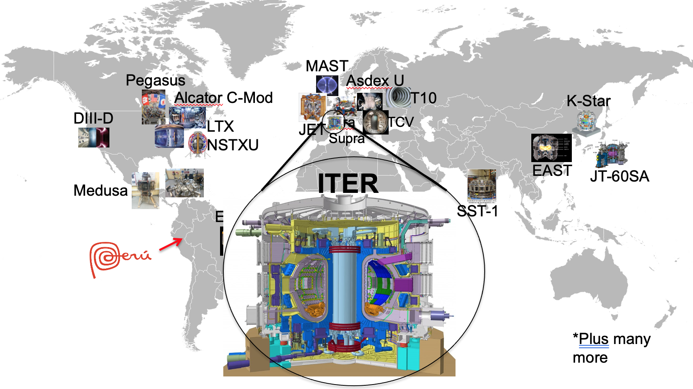
Tokamaks (and stellarators) spread around the world study different plasma parameters and shapes

Slide 5
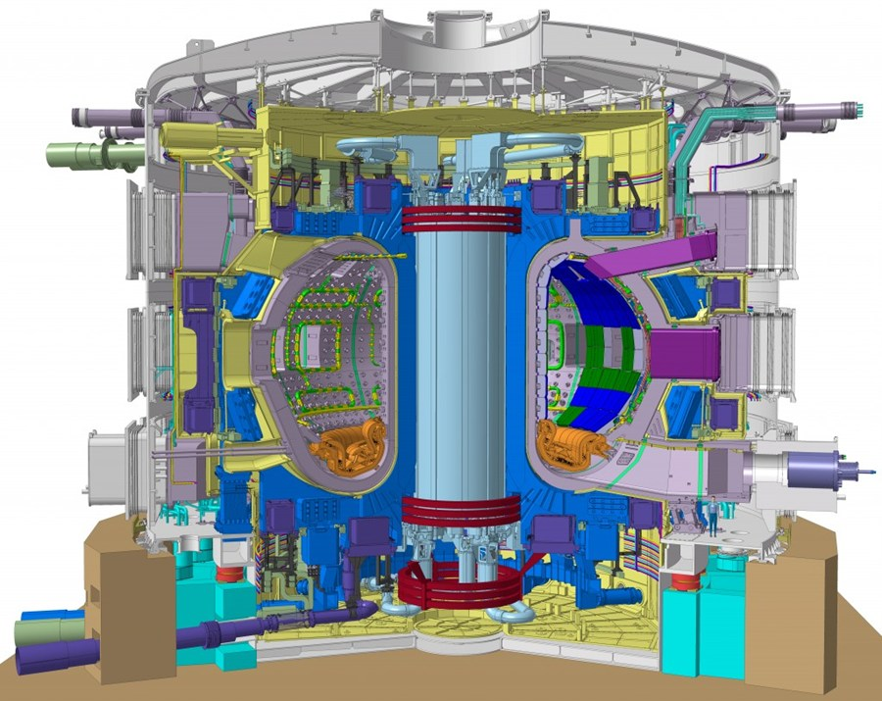
ITER will be the first time we have net energy
(more energy OUT than IN)
ITER is a collaboration between USA, EU, China, Japan, Korea, India and Russia
It’s expected to produce 500MW of power using 50MW to run …this is the 1st time in history where P_{out}>P_{in}
First plasmas “expected” by 2025
Many challenges ahead!
The Z-challenge?
(low-Z vs high-Z)

Slide 6
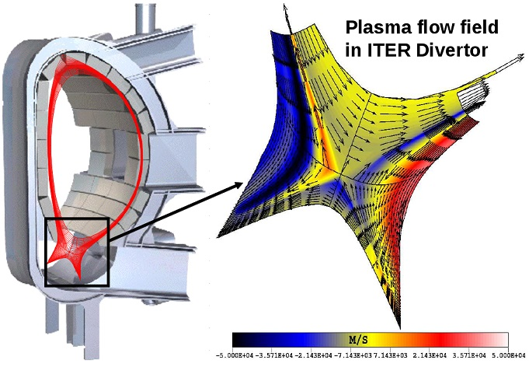
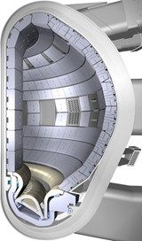
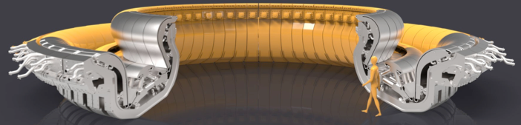
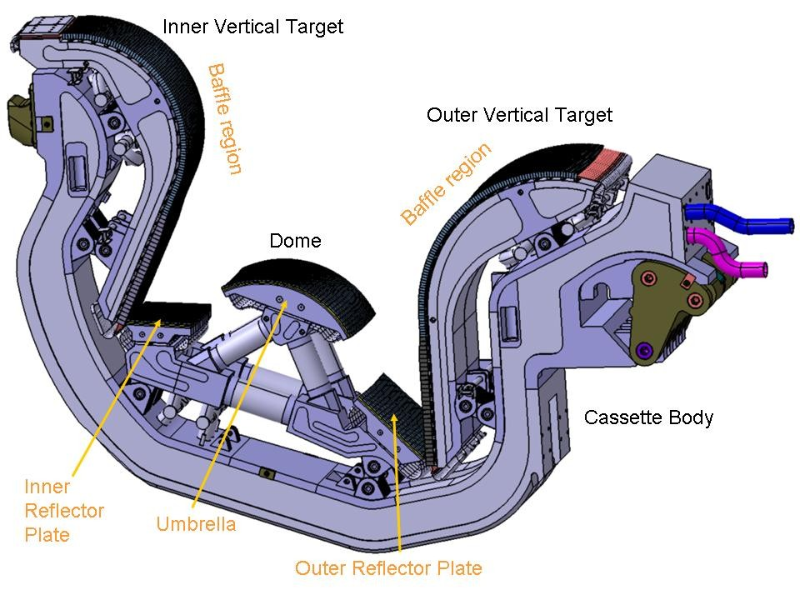
With the help of detailed simulations ITER scientists decided on a wall covered with low- and high-Z PFCs
Simulations of plasma flows and plasma-wall interaction have had a decisive influence on the design of ITER wall
⇒ It’s a decision on the edge conditions which will alter core performance
Be
W
Edge localized modes (ELMs) and disruptions can impact integrity of divertor cassettes

Slide 7
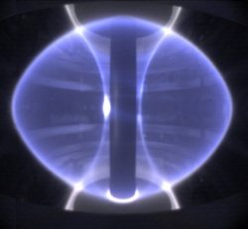
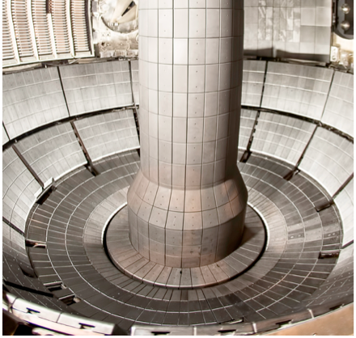
The low-Z (Li, Be, C, B) vs high-Z (Fe, Mo, W) plasma facing component (PFC) challenge
Both low- & high-Z materials are currently being used as plasma facing components (PFCs), but each has technological hurdles.
Low-Z materials:
Typically have higher erosion rates
Their injection into the main chamber will result in an increase of Z_{eff} and collisionality (ν_{e,Z}).
H-, D- & T-retention is a difficult issue! Physics or politics? Both?
Augment of Z_{eff} will lead to:
Reduce fuel purity (n_{D}/n_{e}) and reactivity (S_{n}∝n_{D}² or n_{D}n_{T}).
But contributing less to radiated power density:
P_{rad} = n_{e}n_{D}L_{D}+n_{e}n_{C}L_{c}+Σn_{e}n_{Z}L_{Z}
MAST, CCFE,
Oxfordshire, UK
NSTX-U @ PPPL,
Princeton, NJ
Li, B
& C

Slide 8
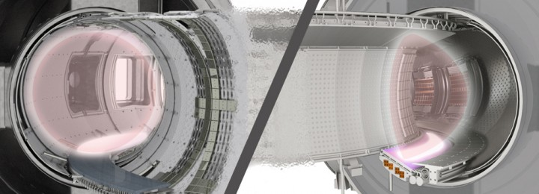
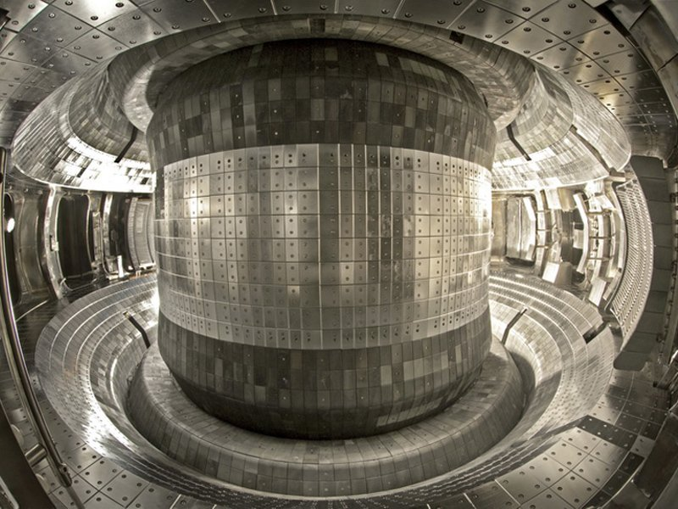
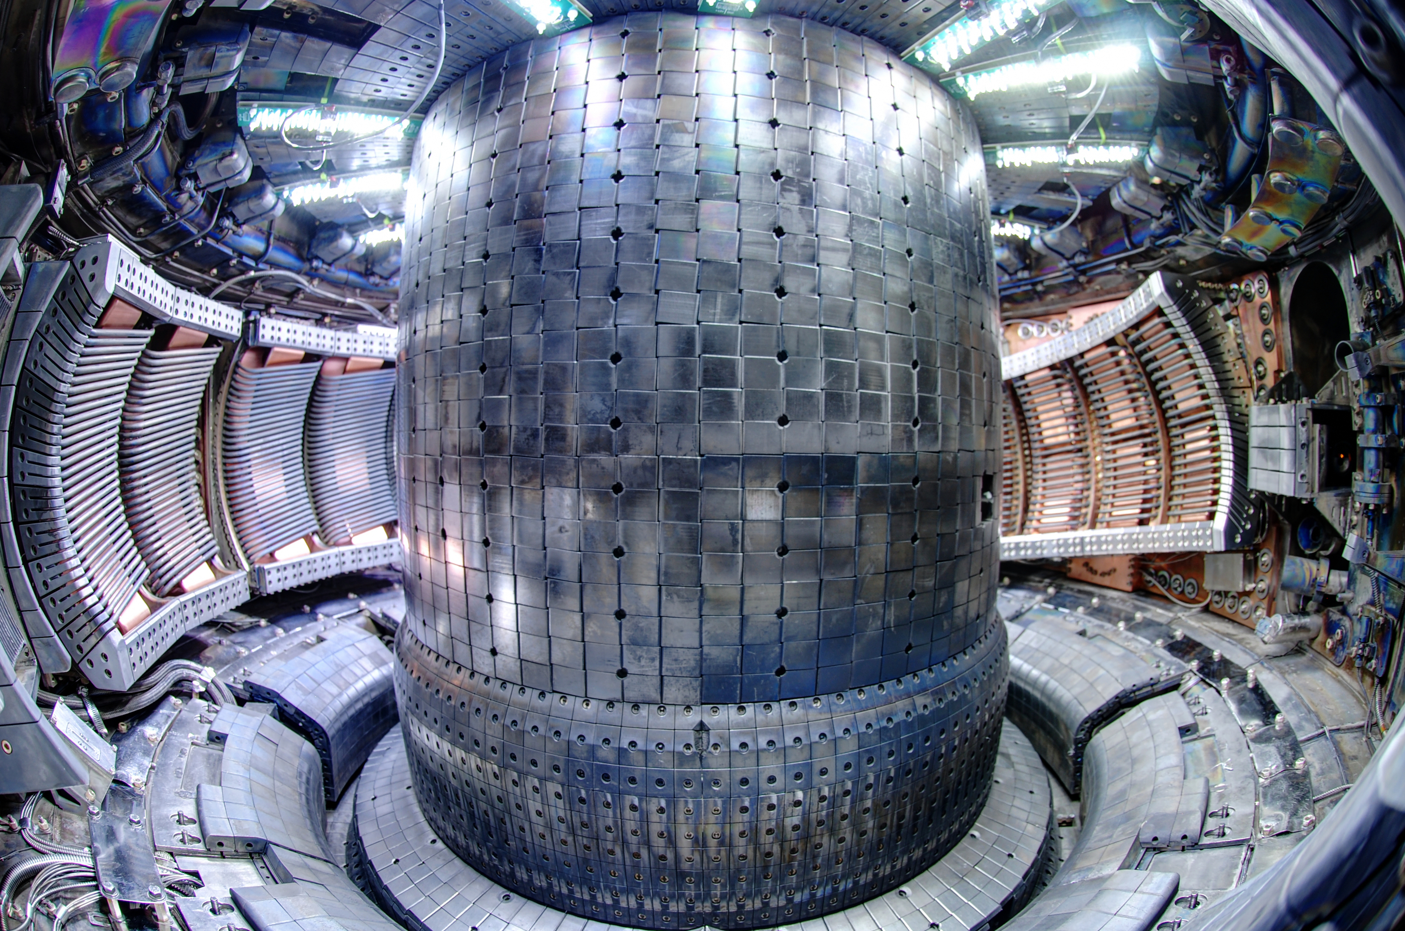
The low-Z (Li, Be, C, B) vs high-Z (Fe, Mo, W) plasma facing component (PFC) challenge
Tore Supra/WEST in France
High-Z materials have good properties as a PFCs:
Low H/D/T retention.
High-heat tolerance (e.g. high melting points)
Low erosion (sputtering) rates.
Small contribution to Z_{eff}:
Z_{eff} ≈ n_{D}/n_{e}+36n_{C}/n_{e}+Σ(n_{Z}/n_{e})Z²
However, if high-Z impurities accumulate to any substantial level (e.g. high-n_{Z}/n_{e}), this will lead to:
Exponentially enhance the radiation power losses (∝Z⁴): P_{rad}=n_{e}n_{D}L_{D}+n_{e}n_{C}L_{c}+Σn_{e}n_{Z}L_{Z}
Reduce the heating efficiency and modifying the overall power balance and possibly even a radiative collapse
C
W
EAST in China
C
Mo
W
C-Mod @ MIT, USA
Mo

Slide 9
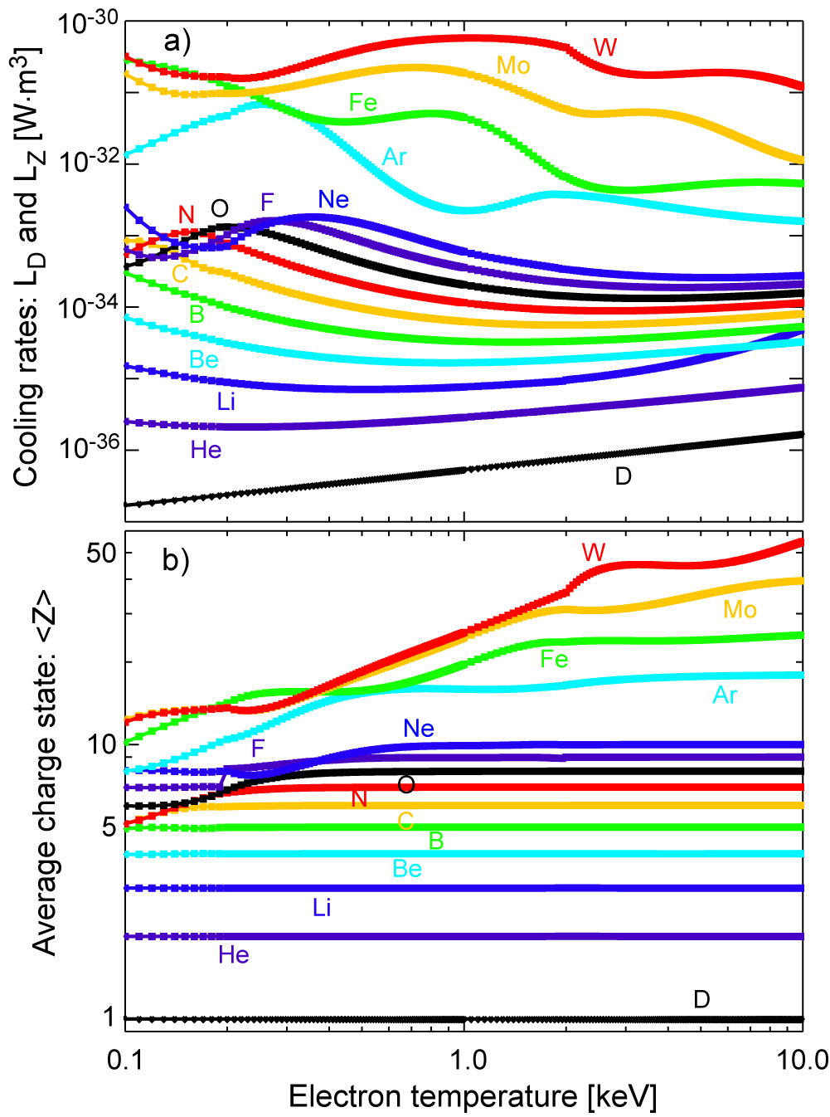
The low-Z (Li, Be, C, B) vs high-Z (Fe, Mo, W) plasma facing component (PFC) challenge
High-Z materials have good properties as a PFCs:
Low H/D/T retention.
High-heat tolerance (e.g. high melting points)
Low erosion (sputtering) rates.
Small contribution to Z_{eff}: Z_{eff}=n_{D}/n_{e}+36n_{C}/n_{e}+Σ(n_{Z}/n_{e})Z²
However, if high-Z impurities accumulate to any substantial level (e.g. high-n_{Z}/n_{e}), this will lead to:
Exponentially enhance the radiation power losses (∝Z⁴): P_{rad}=n_{e}n_{D}L_{D}+n_{e}n_{C}L_{c}+Σn_{e}n_{Z}L_{Z}
Reduce the heating efficiency and modifying the overall power balance and possibly even a radiative collapse

Slide 10
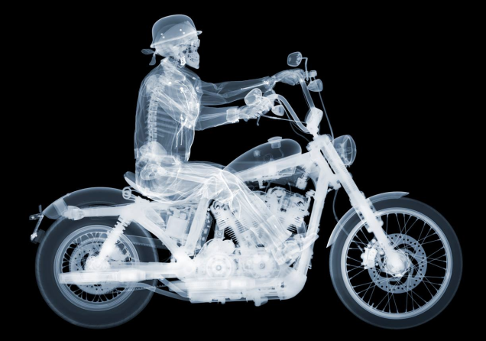
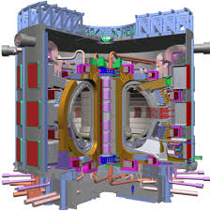

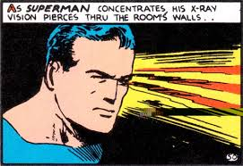
Target of opportunity: diagnose radiation from thermonuclear plasmas
A significant fraction of the ITER input power (50 MW) will be radiated away
Nearly 90% of the radiated power in ITER will be in the x-ray range (V_{ITER}~840 m3)
UV: 10eV < E_{photon}< 200 eV
SXR: 200 eV< E_{photon}< 20 keV
HXR: 20 keV < E_{photon}< 400 keV

Slide 11
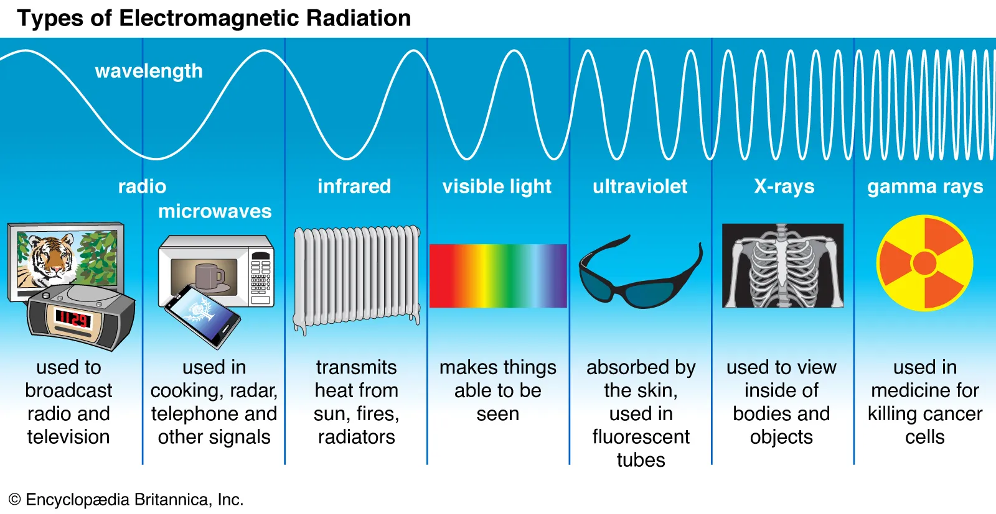
Class-Homework #2: Nature…on the “fly”
3) Can you estimate the mean wavelengths λ (…or type of light) emitted by cold, war, hot and burning plasmas (HINT: assume the photon energy emitted by the plasma scales roughly with its thermal energy… E_{photon}=hν~T_{e}, with h=Plank’s constant and ν=c/λ with c=3×10⁸ m/s; or maybe λ_{photon} [Å]~12398/E_{photon} [eV])?:
Cold plasma: T_{e}=2 eV
Warm plasma: T_{e}=200 eV
Hot plasma: T_{e}=2000 eV
Burning plasma: T_{e}=20000 eV
UV
γ
700
nm
400
nm
SXR
HXR

Slide 12
Why is important to measure radiation emitted from tokamak and stellarator fusion-grade plasmas ?
Free info: A significant fraction of the power delivered to the plasma is lost in the form of radiation [even in an ideal pure H plasma].
In real conditions could be as high as 90%.
X-rays are the most dominant source of radiation from hot plasmas: hν~T_{e}:
Exercise: For 100 eV<T_{e}<20 keV ⇒ 0.5<λ<130 Å ⇒ X-rays!
Measurement of power losses in the x-ray range enable the characterization of parameters such as, n_{e}, n_{Z}, T_{e}, T_{i}, v_{φ}, v_{θ}, to be used in describing/studying:
  MHD and reconection events (from hot core to cold edge).
  Transport coefficients (e.g. diffusivity and pinch velocity).
  Radial electric field (E_{r})
  Magnetic flux-surface reconstructions: T_{e}(ψ)⇒ J and q

Slide 13
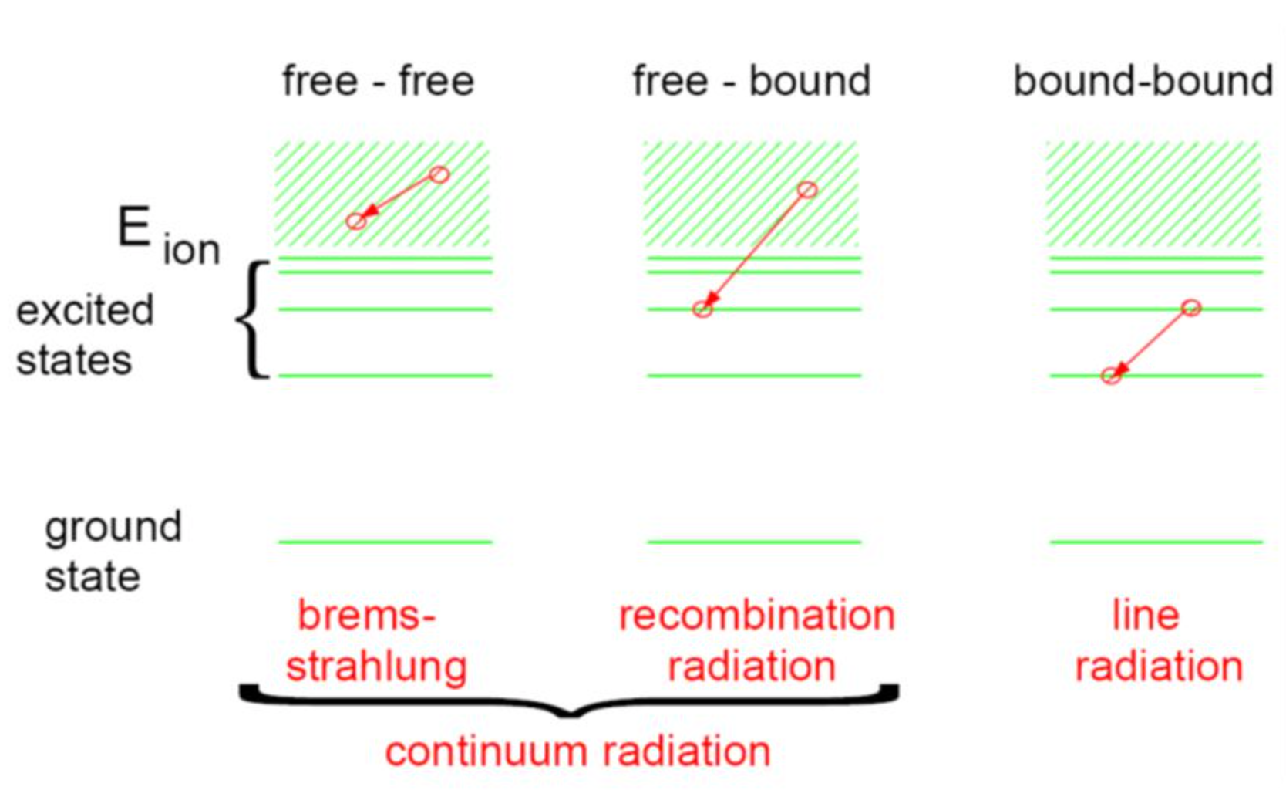
Main radiation mechanisms: Bremsstrahlung (ff), radiative recombination (fb) & line-emission (bb)

Slide 14
Coronal equilibrium (ionization charge balance)
Commonly used in fusion plasmas and in the solar corona
Assumes three body-recombination rate is small
Balance between electron-impact ionization & radiative recombination
Result: Ionization degree is independent of density and increases with T_{e}
Low-Z ions (Be, B, C) are often fully stripped

Slide 15
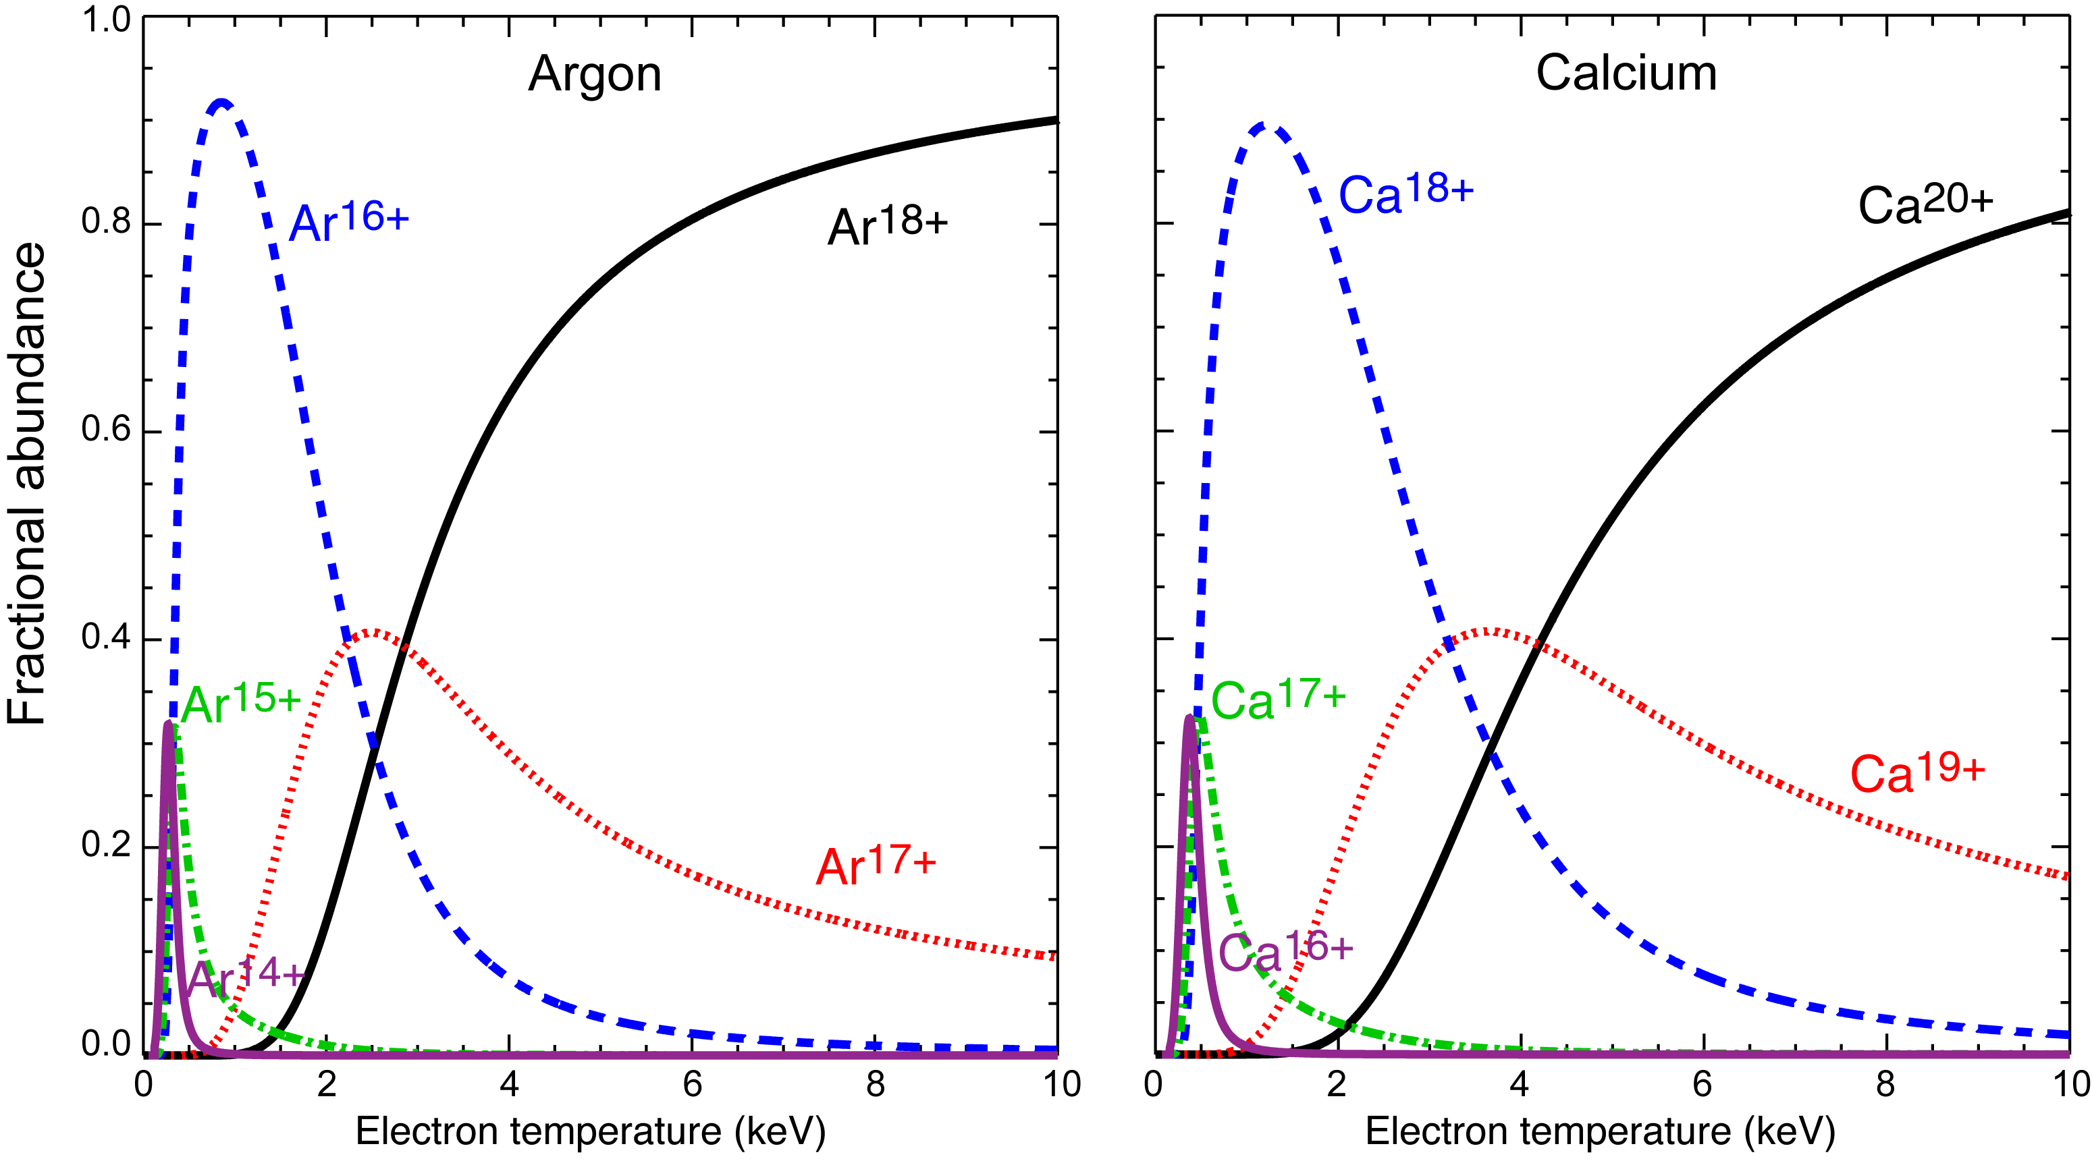
Fractional abundance calculations (n_{ij}/n_{i}) depend only on the local electron temperature (issues with nomenclatures ???)
Argon
Z=18
A~40
18 protons
22 neutrons
Calcium
Z=20
A~40
20 protons
20 neutrons
He-like
He-like
Fully
stripped
Fully
stripped
H-like
H-like

Slide 16
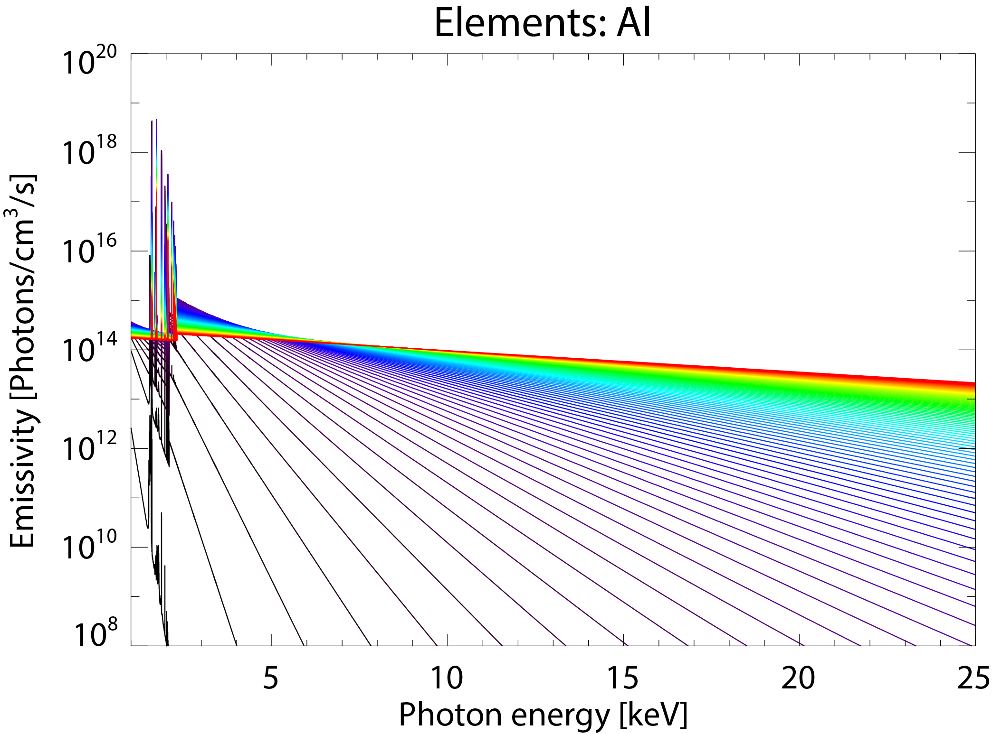
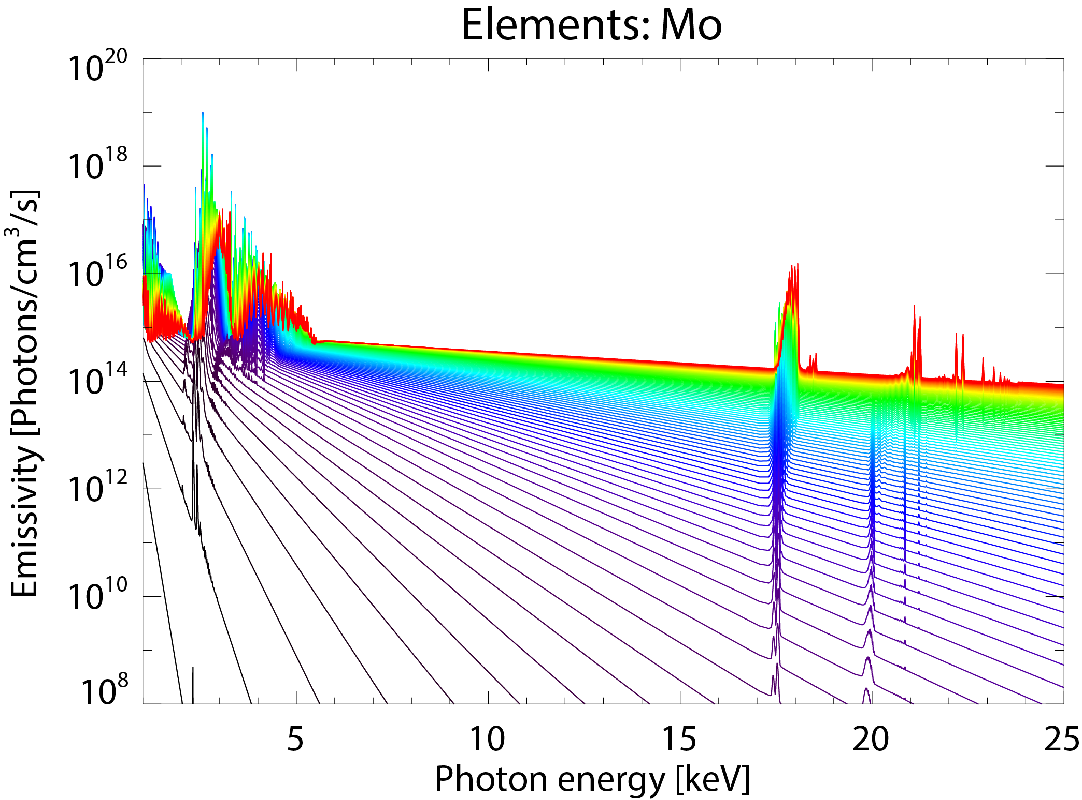

Local emission has to be calculated on plasma parameters [T_{e}, n_{e}, n_{Z}(R,t)]
Line-emission:
∝n_{Al}
Continuum:
exp(-hν/k_{B}T_{e})
Continuum and & line emission:
Bremsstrahlung (ff):
Radiative recombination (fb):
∝n_{Mo}
Continuum:
exp(-hν/k_{B}T_{e})
∝n_{Mo}
Line emission (bb):
0.1
T_{e} [keV]
10

Slide 17
Take home message: You have four basic alternatives to measure radiation from plasmas
Conventional radiated power measurements (integrate all) (e.g., radiated power density ⇒ power balance)
Conventional “broadband/filtered” x-ray measurements (e.g., SXR tomography ⇒ confinement, MHD, equilibrium)
Conventional vs modern broadband PHA & multi-energy measurements (e.g., Z_{eff}, n_{Z}, T_{e}, n_{e,fast})
Doppler line-radiation x-ray measurements (e.g., n_{Z}, T_{e}, T_{i}, v_{φ}, v_{θ}, ⇒ calculation of E_{r})

Slide 18
1) Radiative power densities (vis/UV/x-ray) & charge state <Z> can be obtained using coronal equilibrium
Equations of interest for two-impurity plasma
Quasi-neutrality:
Effective charge:
Normalized radiated power density:
Radiated power in the purely hydrogenic case (Z_{eff}=1)
Hydrogenic cooling rate:

Slide 19
Class-Homework #3: NSTX-U…on the “fly”
1) For a core DD NSTX-U plasma of 1 keV and a typical n_{e,0} of 8.0×10¹⁹ m⁻³, calculate:
The deuterium concentration (n_{D}/n_{e}), plasma effective charge (Z_{eff}) and radiated power density P_{rad} [W/m³] assuming a carbon concentration of 2% (HINT: no other impurities)
How large is P_{rad} if one compares to the purely “ideal” hydrogenic value?
Quasi-neutrality:
Effective charge:
Normalized radiated power density:

Slide 20
Class-Homework #3: NSTX-U…on the “fly”
1) For a core DD NSTX-U plasma of 1 keV and a typical n_{e,0} of 8.0×10¹⁹ m⁻³, calculate:
The deuterium concentration (n_{D}/n_{e}), plasma effective charge (Z_{eff}) and radiated power density P_{rad} [W/m³] assuming a carbon concentration of 2% (HINT: no other impurities)
How large is P_{rad} if one compares to the purely “ideal” hydrogenic value?
The n_{D}/n_{e}, Z_{eff} and P_{rad} if one includes also 0.5% of oxygen
Now, how large is the new P_{rad} if one compares to the purely “ideal” hydrogenic value?
Now, add iron at n_{Fe}/n_{e}~0.1%, and repeat calculations for n_{D}/n_{e}, Z_{eff} and P_{rad}
How large is the new P_{rad} if one compares to the purely “ideal” hydrogenic value?
The change in neutron flux from the ideal case (n_{D}=n_{e}) when adding carbon, oxygen and iron cases (HINT: S_{n}=n_{D}n_{D}σ_{DD}(T_{i}) and use dilution results from a), c) and e))
EXTRA
EXTRA
EXTRA

Slide 21
Class-Homework #4: ITER…for “home”
2) For a typical ITER DD plasma with an average electron density of 1.0×10²⁰ m⁻³ and an average electron temperature of 8.8 keV (see http://fusionwiki.ciemat.es/wiki/ITER) calculate:
n_{D} and Z_{eff} assuming Be and W concentrations of 10% and 0.001%, respectively.
Increase the C_{W} to a more realistic 10⁻⁴ and repeat the calculation in 2-a).
The change in neutron rate when changing the tungsten concentration from 10⁻⁵ to 10⁻⁴
Calculate the core radiated power density [W/m³] from all the ion constituents [e.g. H or D and Be for both cases of c_{W} @ 10⁻⁵ and 10⁻⁴].
What fraction of the total input power is radiated away for the case of 10⁻¹ of Be and 10⁻⁴ of W? Consider an average volume for ITER with an elliptical cross section of the order of V_{ITER}~πab×2πR₀, where “a” is the minor radius (~2m), “R₀” is the major radius of about 6 m and we consider an ellipticity (b/a) of about 1.5.
EXTRA

Slide 22
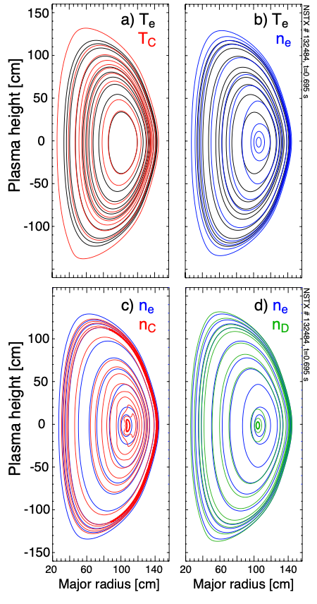
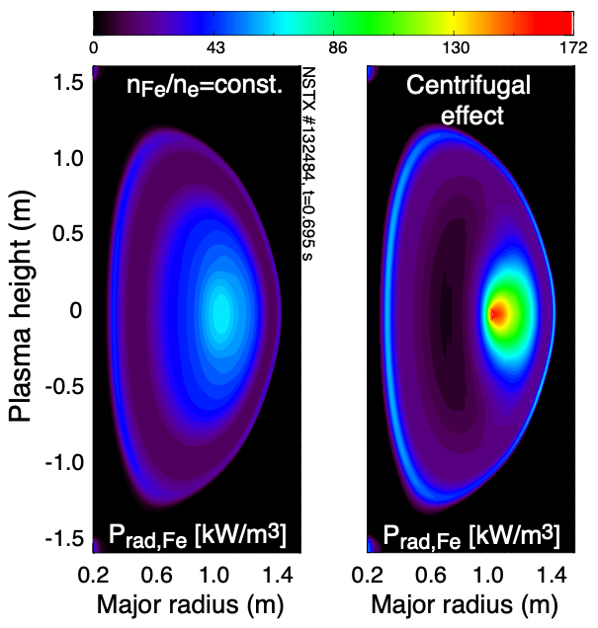
Let's get real…why is this important?
Rotation-induced Δϕ, Er, n_{Z}, Z_{eff} and P_{rad} asymmetries in NSTX

Slide 23
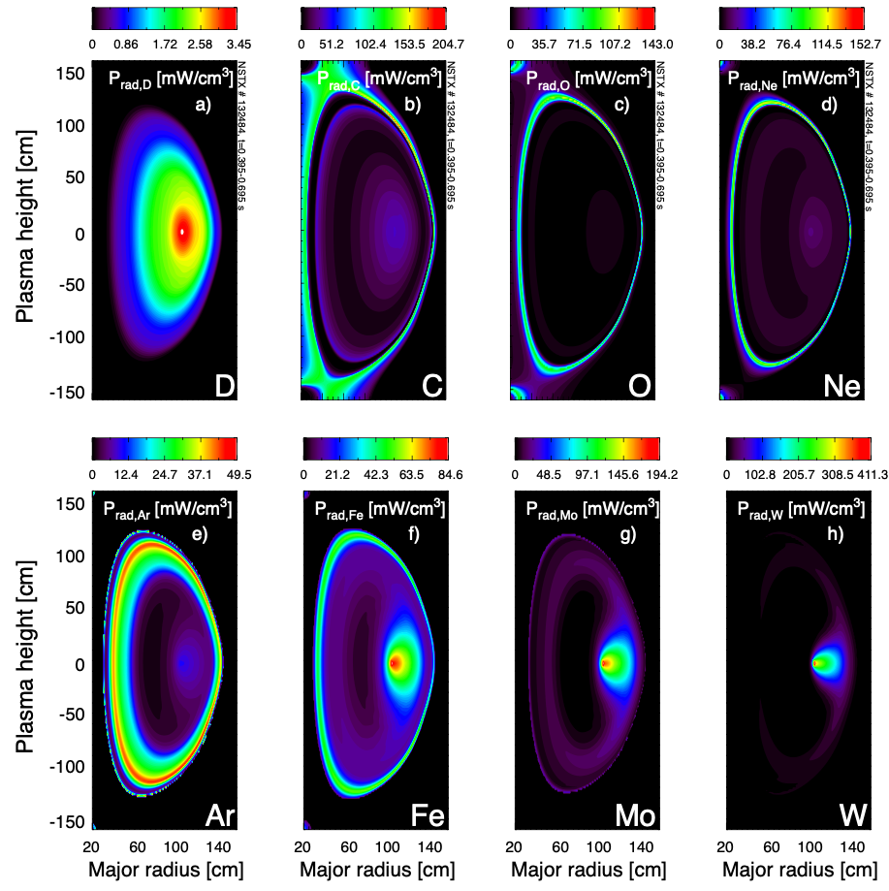
Let's get real…what do we conclude?
While the asymmetry in the core radiated power density from low-Z ions is relatively small, the 2D radiation profiles from medium- to high-Z’s are strongly affected by centrifugal forces.
Rotation-induced Δϕ, Er, n_{Z}, Z_{eff} and P_{rad} asymmetries in NSTX

Slide 24
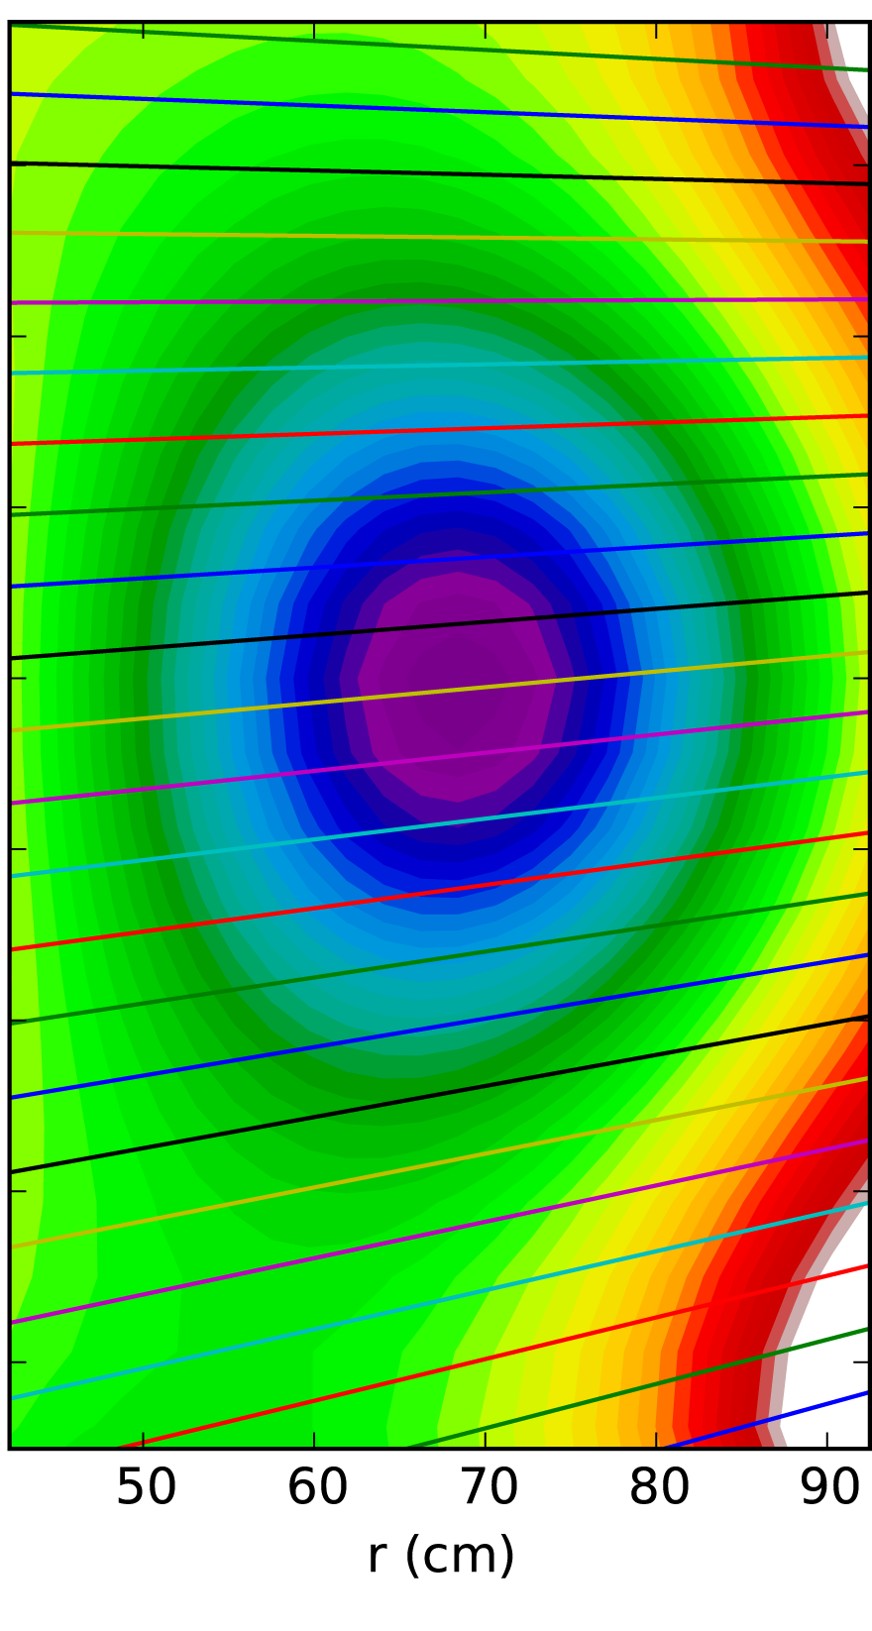
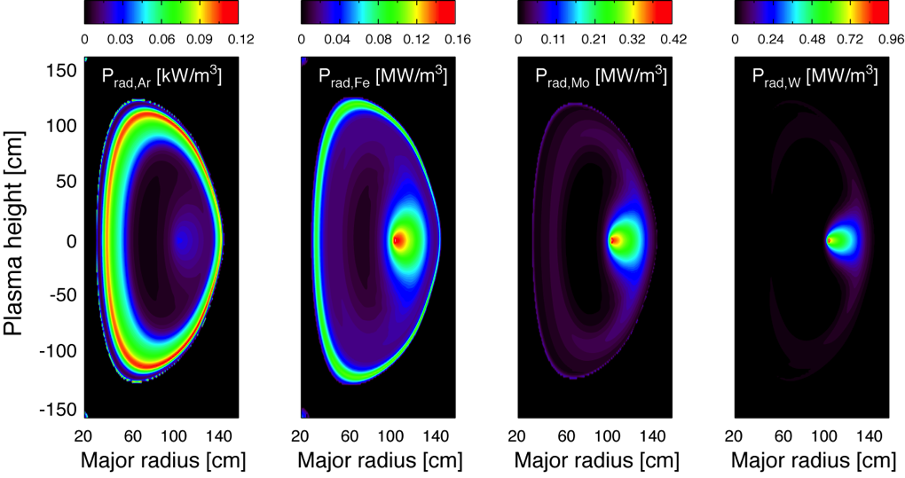
Radiation measurements are line-integrated along detection sightlines
Visible/UV/x-ray radiated power tomography:
Emissivity is a flux-surface function
Inversion (B=M×E ⇒ E=M⁻¹×B)
Transport/heating asymmetries (warning):
Example:
Core radiation from medium- to high-Z will be affected by centrifugal forces

Slide 25
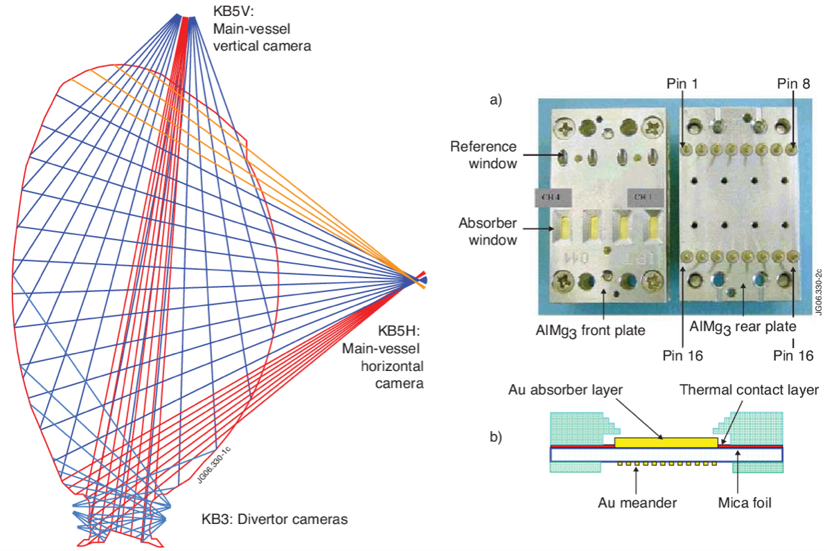
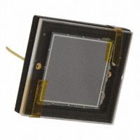
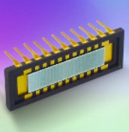
Radiated power density measurements (no spectral resolution) use metal-foils or Si-diodes + electronics
Metal foil bolometers
Si diodes

Slide 26
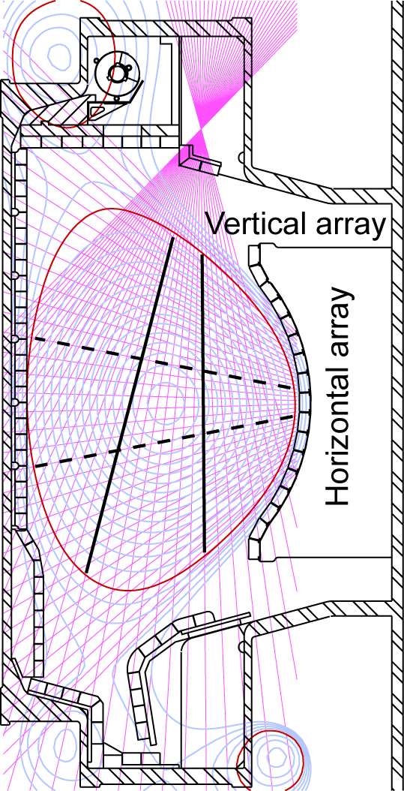
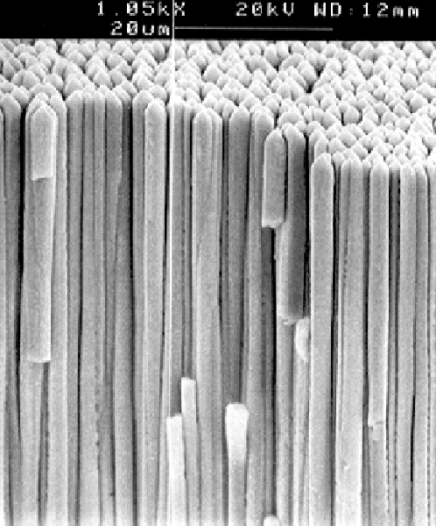
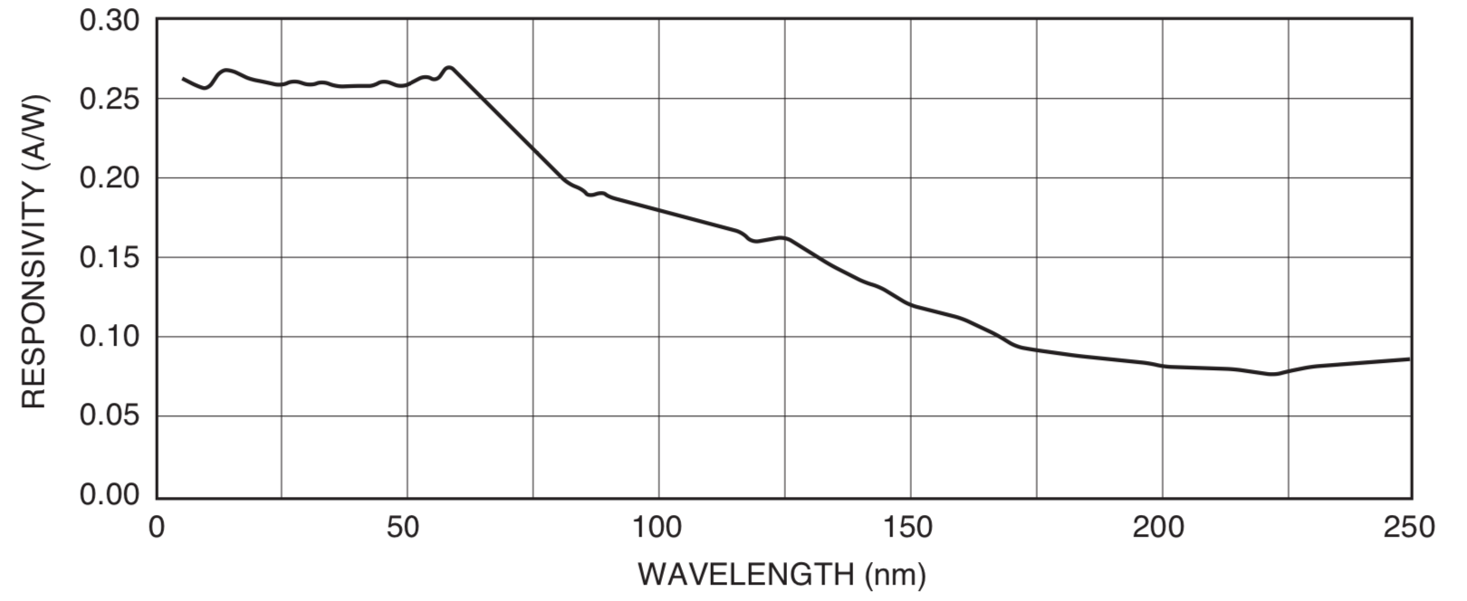
2) Conventional tomography integrates in photon-energy using metal filters, diode arrays and TIAs
Indirect detection
with scintillator
(e.g. CsITl - green)
Example of spatially resolved x-ray spectra from ITER
Conventional tomography integrate in energy-space
Direct x-ray detection
(e.g. Si diodes)
AXUV-100
AXUV-20
1 cm²
Typical EUV-UV Photon Response
MIT
PSFC
SXR

Slide 27
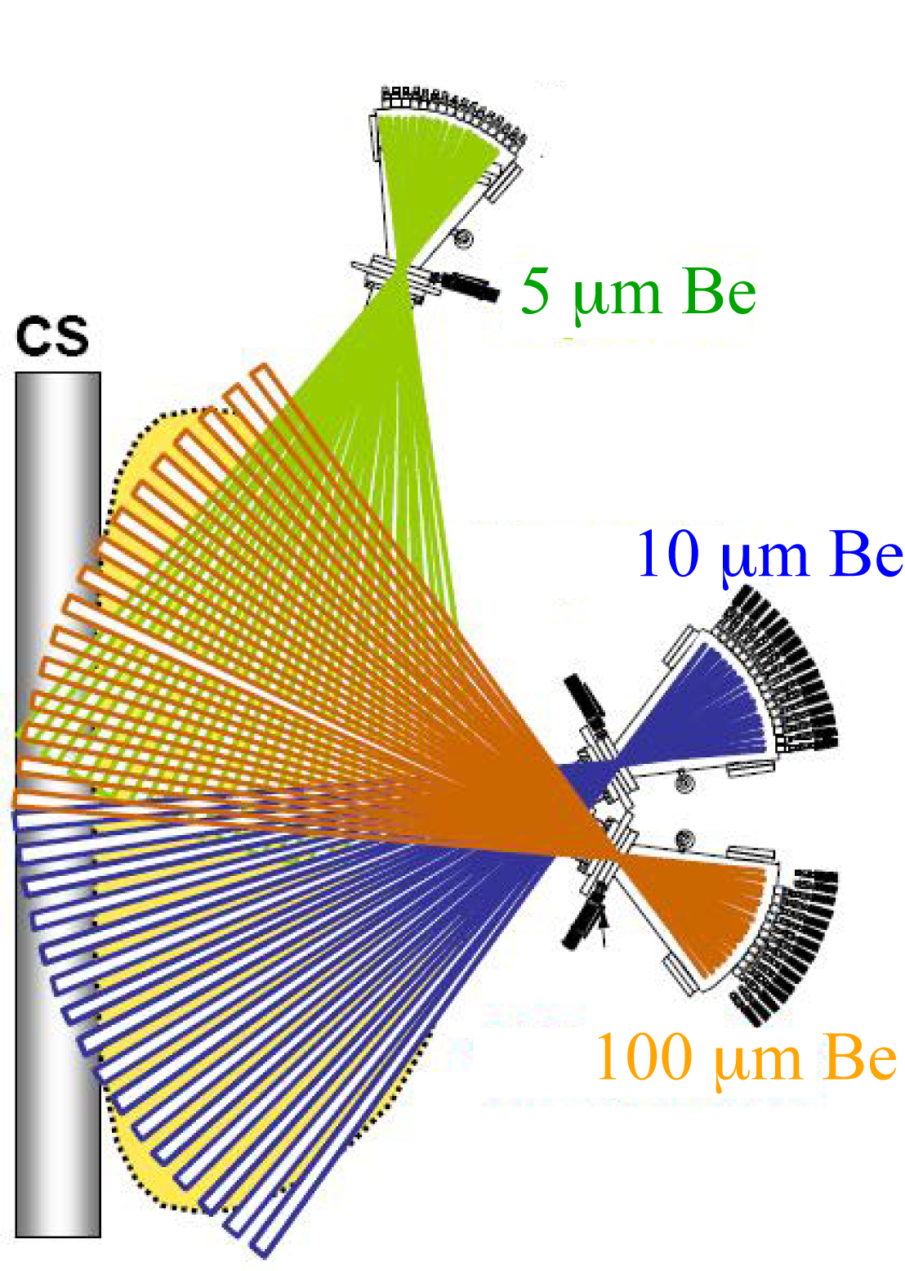


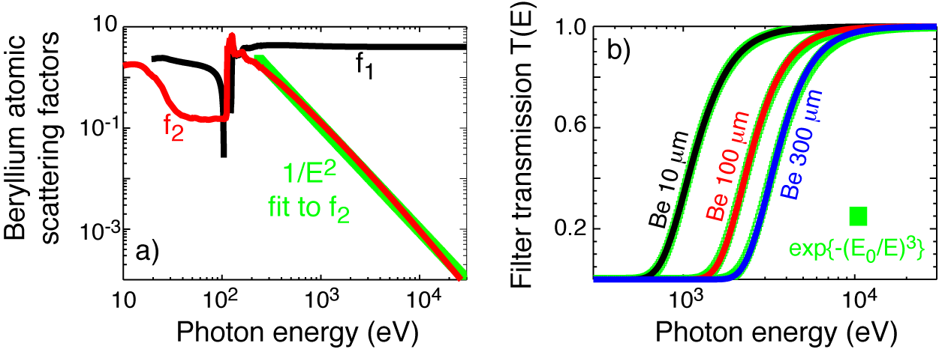
Conventional SXR tomography consists of an array of diodes/detectors integrating the local plasma emissivity
Essential elements:
Pinhole (radial resolution vs integration)
Thin vs thick metallic filters (e.g., Be)
Current mode: SXR Si-based diode or diode-array
Current mode: X-ray scintillator + FoP + FO + PMT
Transimpedance amplifier (10⁴-10⁷ V/A) + DAQ
Metal filters discriminate edge/core effects
(peeling the “onion”)
What happens if we don’t use a filter?
Filters: see CXRO website x-ray database
https://henke.lbl.gov/optical_constants/

Slide 28
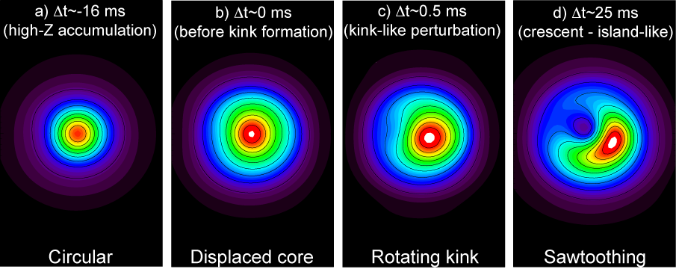
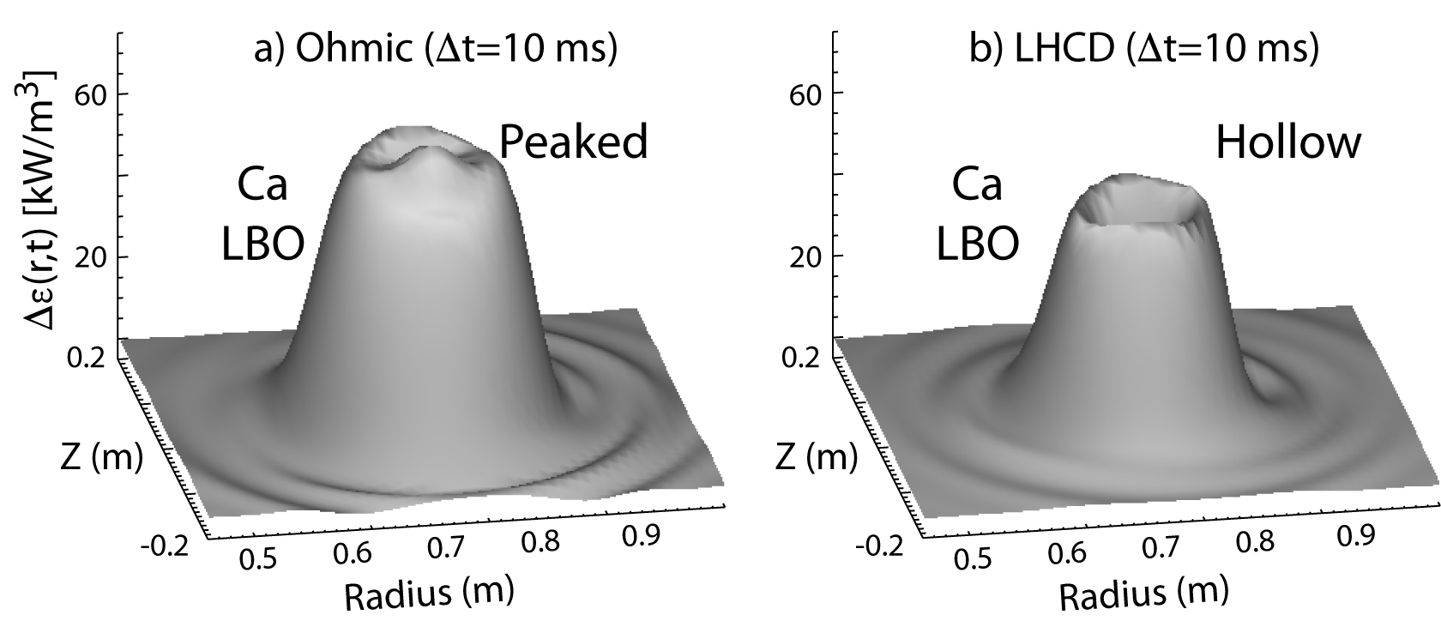
Conventional soft x-ray (SXR) tomography is still being used for stability, MHD & transport studies
a) Stability and MHD [e.g. (m,n) modes and sawteeth]
b) Impurity transport (e.g. using gas injection or LBO)
MIT
PSFC

Slide 29
Take home message: You have four alternatives to measure radiation from plasmas
Conventional radiated power measurements (integrate all) (e.g., radiated power density ⇒ power balance)
Conventional “broadband/filtered” x-ray measurements (e.g., SXR tomography ⇒ confinement, MHD, equilibrium)
Conventional vs modern broadband PHA & multi-energy measurements (e.g., Z_{eff}, n_{Z}, T_{e}, n_{e,fast})
Doppler line-radiation x-ray measurements (e.g., n_{Z}, T_{e}, T_{i}, v_{φ}, v_{θ}, ⇒ calculation of E_{r})

Slide 30
How to extract plasma physics parameters from wide and narrow energy bands ?
3) Wider energy bands
Multi-energy spectroscopy
Low-resolution spectrometers
E/ΔE~10-50
Probes e⁻ and ion channels
T_{e}, n_{Z}, ΔZ_{eff}, Z_{eff}
n_{e,fast} (e.g. LHCD, runaways)
Narrow bands
Wider
band
4) Narrow energy bands
Doppler spectroscopy
High-resolution spectrometers
E/ΔE~5000-200000
Probes mainly the ion-channel
T_{i}, V_{φ,θ}, n_{Z}… T_{e} (line-ratios)
Spatially resolved x-ray spectra from ITER

Slide 31
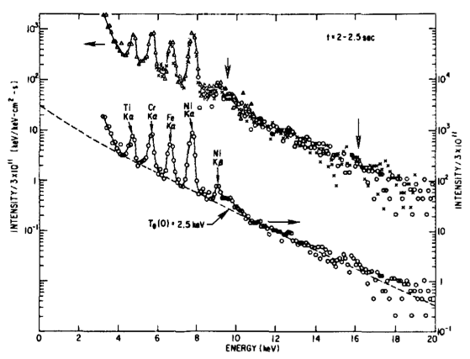
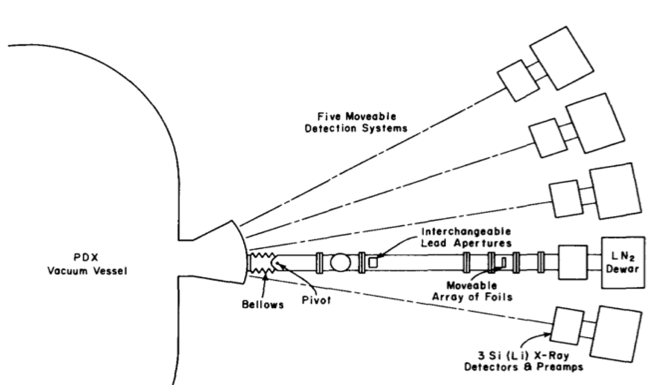
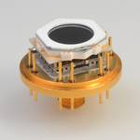
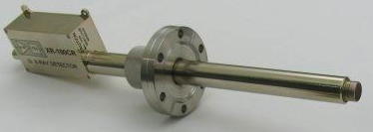
Conventional photon counting ME-SXR systems use Si(Li), HgI₂, Si-Ge-CdTe diodes and SDDs
Detectors in photon-counting mode
(<T_{e}>, <Z_{eff}>, <n_{e,fast}>, <n_{Z}>)
    Pulse height analysis (PHA)
    Good energy resolution (100-200 eV)
    Slow time-response (20-50 ms)
    Low efficiency at high-energies
    Very poor profile definition
    Still used in our community
    (HT7, TCV, HL-2A)
Single-chord spectrometers
One spectrum per instrument
10⁶ CPS
Ketek
Amptek

Slide 32
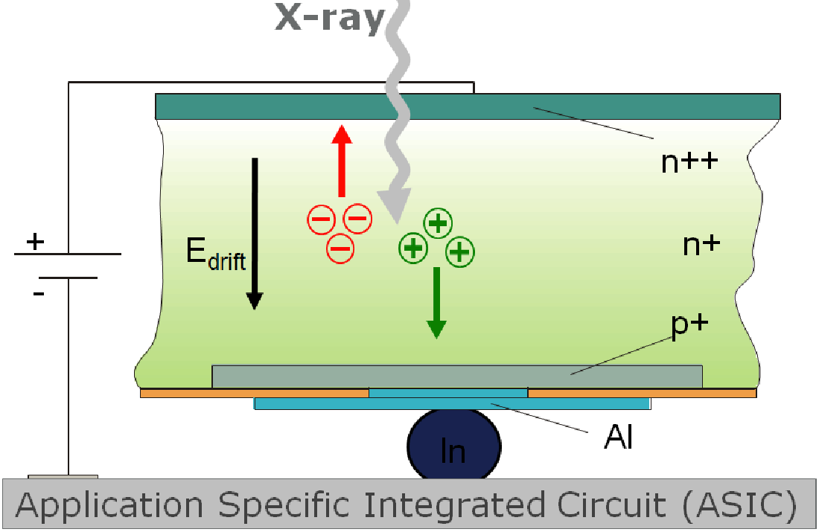
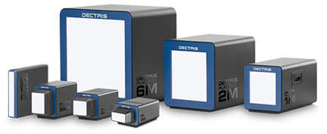
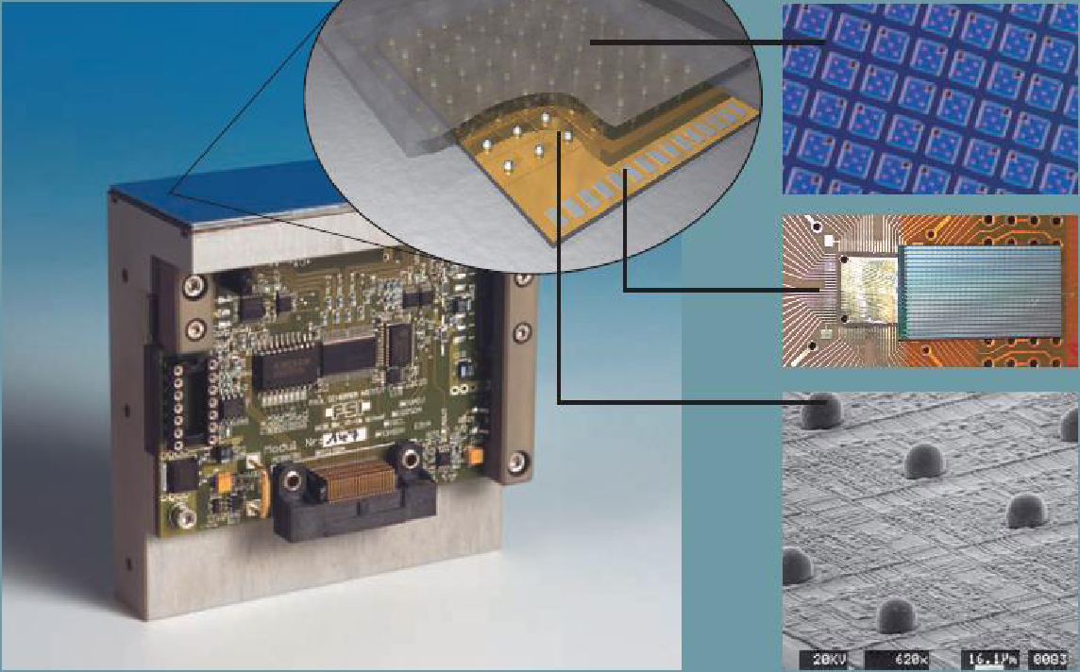
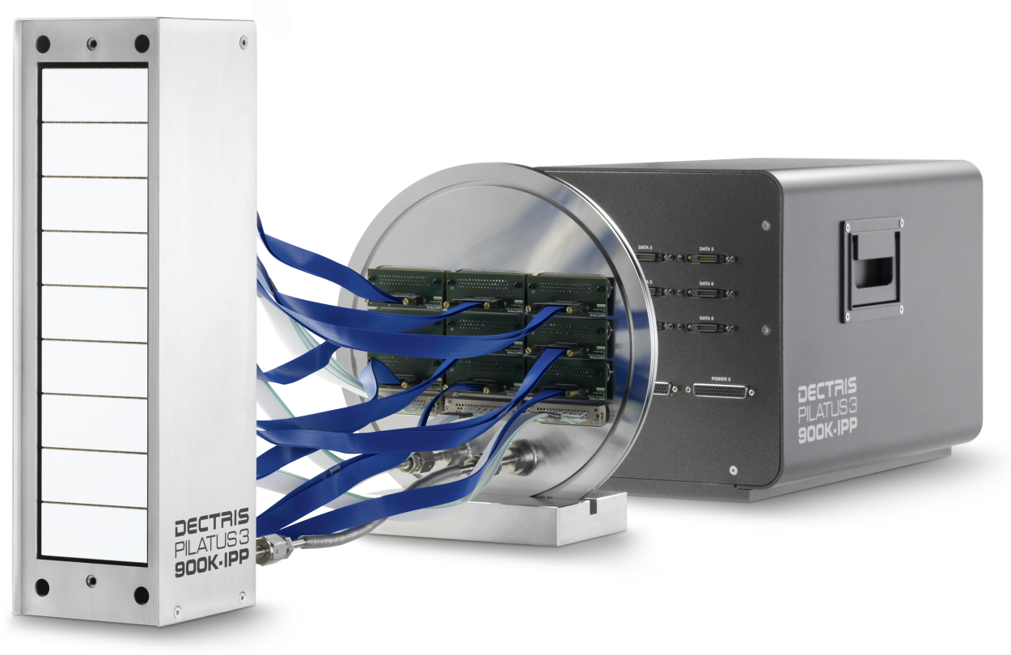
New PILATUS detectors enables breakthrough of 100k pixels (minimum) at single or multiple energy ranges
Thanks to important advances in the x-ray detector technology it is now possible to simultaneously record high resolution images of x-ray photons at single OR multiple energy ranges through direct x-ray detection.
Operates in single photon counting mode
100K to 12M pixels
(PILATUS: 172 μm,
EIGER: 75 μm)
CMOS hybrid pixel technology developed originally for synchrotrons (CERN + PSI + DECTRIS)
10⁶ CPS/p
Si-sensor
2D array pn diodes
PILATUS3 900K-IPP in-vacuum detector for x-ray plasma spectroscopy
(dimensions of a 100K system: 487x195 pixels)
CMOS
readout chip
PILATUS 100K
In
balls

Slide 33
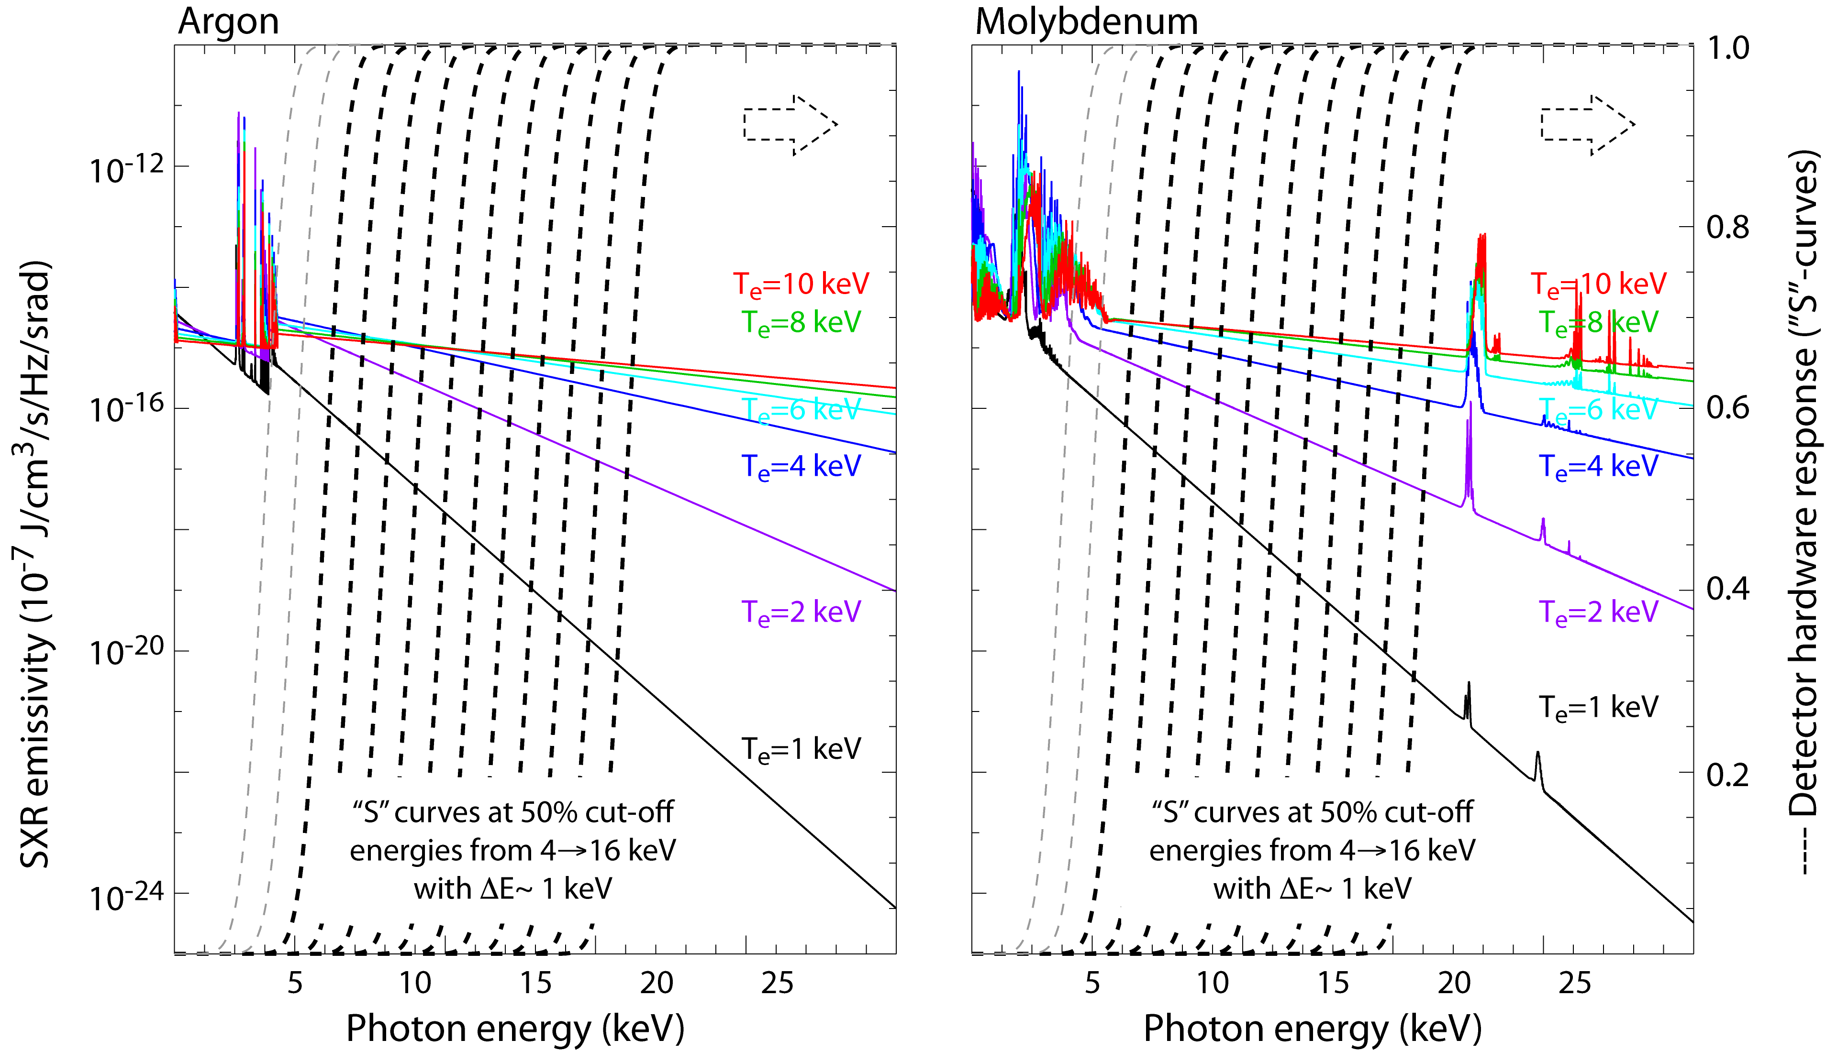

Initial ME-SXR imaging tests in C-Mod (@MIT) combined the best features from PHA & multi-foil methods
Pin-hole camera with multi-energy pixels allowed simultaneous spatial and energy resolution
From sampling the continuum radiation from Ar & Mo one can measure T_{e} & n_{e}²Z_{eff}

Slide 34
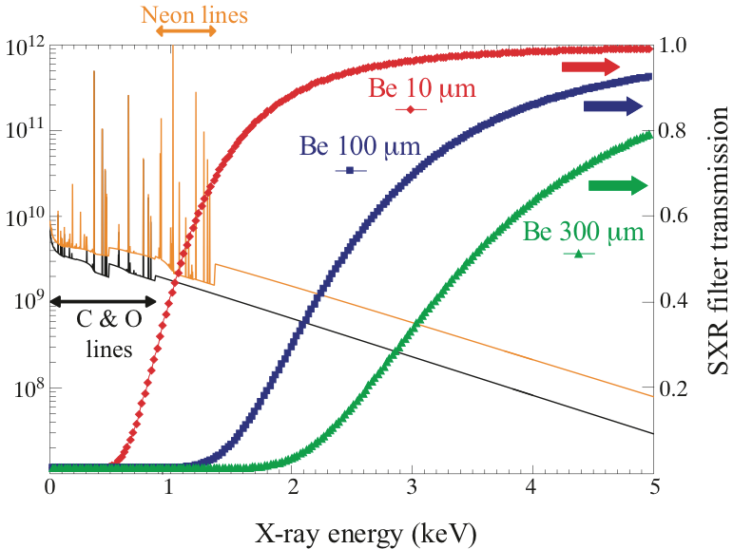
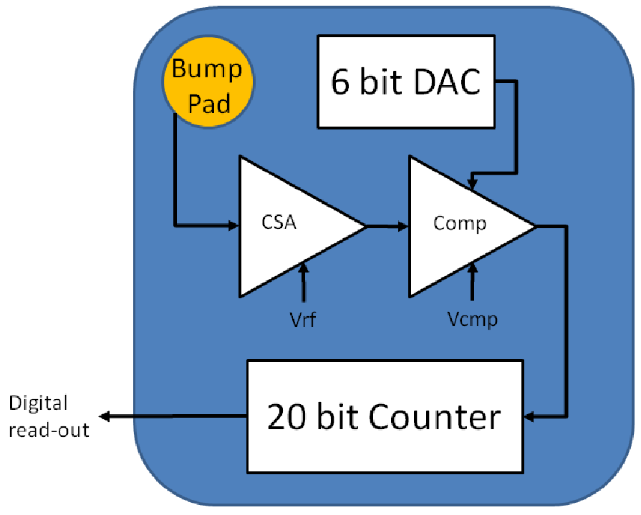
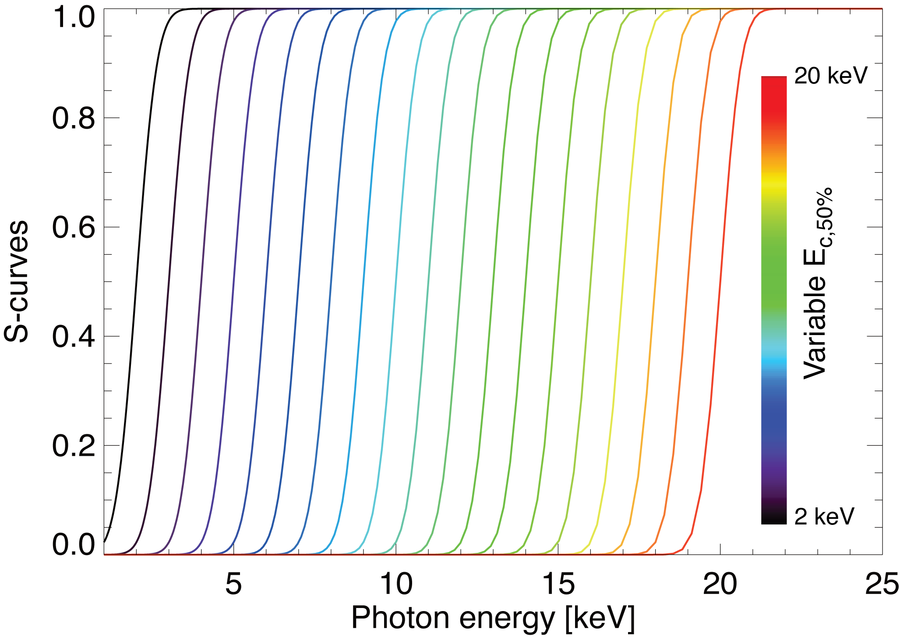
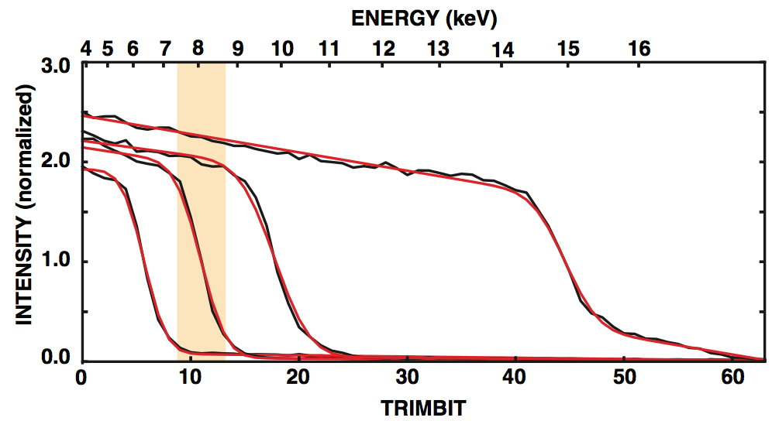
Comparator and triming voltages on each pixel allow individual coarse & fine tuning of energy range
Filters: CXRO website:
X-ray database
PILATUS technology:
photon counting circuit in each pixel
“Constant” width of electronic response is a great improvement over the use of filters
E_{W}~500 eV

Slide 35
How to extract plasma physics parameters from wide and narrow energy bands ?
3) Wider energy bands
Multi-energy spectroscopy
Low-resolution spectrometers
E/ΔE~10-50
Probes e⁻ and ion channels
T_{e}, n_{Z}, ΔZ_{eff}, Z_{eff}
n_{e,fast} (e.g. LHCD, runaways)
Narrow bands
Wider
band
4) Narrow energy bands
Doppler spectroscopy
High-resolution spectrometers
E/ΔE~5000-200000
Probes mainly the ion-channel
T_{i}, V_{φ,θ}, n_{Z}… T_{e} (line-ratios)
Spatially resolved x-ray spectra from ITER

Slide 36

X-ray crystal imaging spectrometers revolutionized our field with T_{i} and V_{φ,θ} profile measurements
Similar systems have been installed in NSTX, KSTAR, EAST, LHD, W7 and in the future, NSTX-U, WEST, JT60SA & ITER

Slide 37


Crystals help achieving high-spectral response (E/ΔE>10⁴) for high-resolution T_{e},_{i} & v_{φ,θ} measurements
Bragg diffraction:
Assuming a constant “d”, the observed relative wavelength shift (DS: Doppler shift) is given by:
v is the relative velocity between the source & detector
The value of Δθ_{max} from Johann error (Je):
Resolving power:

Slide 38




Focusing properties of spherical x-ray crystal
Magnetic axis
Typical distances from the crystal:
Meridional focus:
Sagittal focus:
Rowland circle
(r=R_{c}/2)
f_{s}
f_{m}

Slide 39


Electron temperature T_{e}-profiles can also be obtained using line-ratios between resonance and satellite lines
Te-measurements based on the ratio of the resonance line-w and the dielectronic satellites “n=3” and “k”
He-like Ar
spectra
(L. Delgado-Aparicio, un-published)
Considered to be a secondary diagnostic technique for the electron temperature (T_{e}) JT60SA and ITER.

Slide 40


Summary: Modern radiated power diagnostics can help study and resolve P_{rad}, n_{Z}, T_{e,i}, V_{φ,θ}, Z_{eff} & n_{e,fast} profiles
With the selection of W for the divertor in ITER, understanding the sources, transport and confinement of high-Z impurities is crucial to ITER success.
A significant fraction of the power delivered to the plasma is lost in the form of radiation. In the x-ray range (subset of P_{rad}) could be as high as 90%.
Modern diagnostics for overall radiated power and “filtered” spectroscopy allow us to probe P_{rad}, n_{Z}, T_{e,i}, V_{φ,θ}, Z_{eff} & n_{e,fast} and their profiles!

Slide 41









Join us: New core diagnostics (US-lead) will be installed in NSTX-U, MST, WEST, W7X, JT60SA and ITER
WEST - France
ITER
DEMO ?
JT60SA

Slide 42




Don’t forget about the non-axisymmetric systems and alternative concepts
Stellarators (I_{p}~0)
Magnetic mirrors
LHD
@NIFS
in Japan
WHAM @ UW-Madison
W7X
@MPIPP
in Germany
CMFX @ UMD & UMBC

Slide 43








…And opportunities also in the private sector!
Notable investments in 2021-22
Extraordinary opportunities for public-private-partnerships (PPPs)
GF
Zap
TAE
CFS
TE

