Slide 1
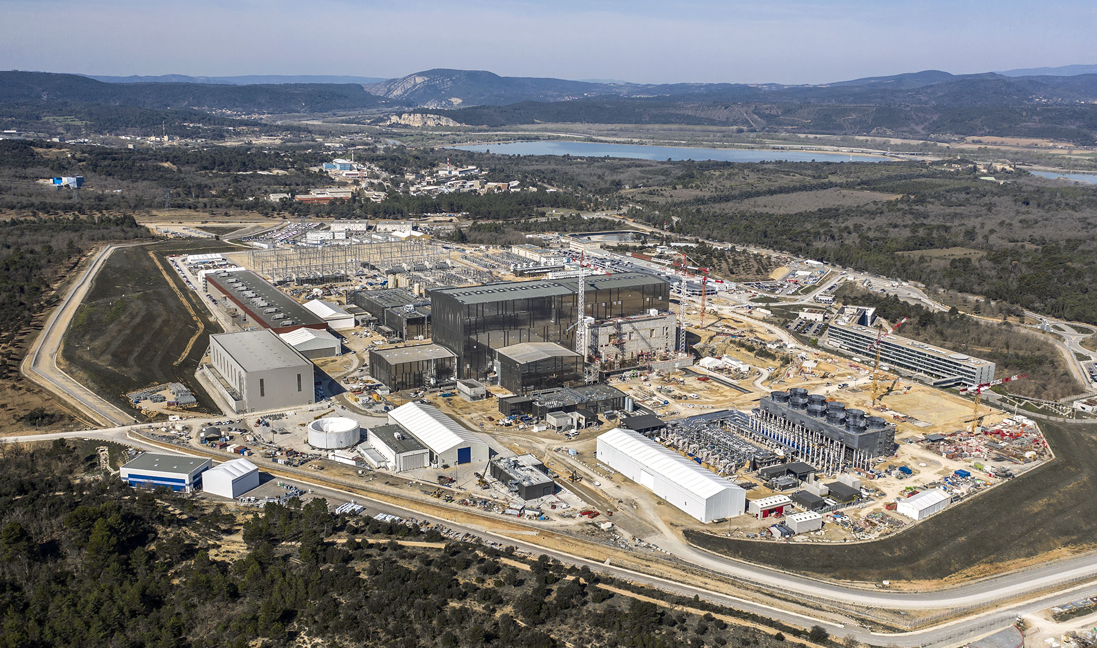
Objectives and status of the ITER Project
Alberto Loarte
Science Division
Science, Controls, and Operation Department
ITER Organization
The views and opinions expressed herein do not necessarily reflect those of the ITER Organization

Slide 2
Outline of talk
Personal Journey
ITER Mission, Basis, Goals, Scenarios and Overall Design
ITER Project and Overview of Construction Status
ITER Research Plan (IRP) and burning plasma physics
Conclusions

Slide 3
Personal Journey
Bachelor in Theoretical Physics (interested in Astrophysics) at UCM – Madrid
PhD in fusion plasma theory at UCM → short stay at JET (2 → 6 months)
Change of PhD topic : edge plasma experiments and modelling at JET
Postdoc at JET 2-D edge modelling and experiment (detachment) → participation in ITER expert groups (International Tokamak Physics Activities)
Move to ITER EU Home Team (IPP-Garching) → R&D for ITER (exp. + modelling - ELMs R&D), EU R&D PWI programme management, ITPA DivSOL
Move to ITER Organization → Science, Controls and Operation Department
  Edge/Pedestal physics and Edge-core plasma integration, Science and Technology Advisory Committee Secretary, ITPA Edge and Pedestal
  Section Leader Confinement & Modelling, STAC Secretary, ITPA Transport & Conf.
  Science Division Head :
    ITER Research Plan, Plasma Control System design, Integrated Modeling and Analysis Suite

Slide 4
ITER Mission, Basis, Goals and overall design

Slide 5
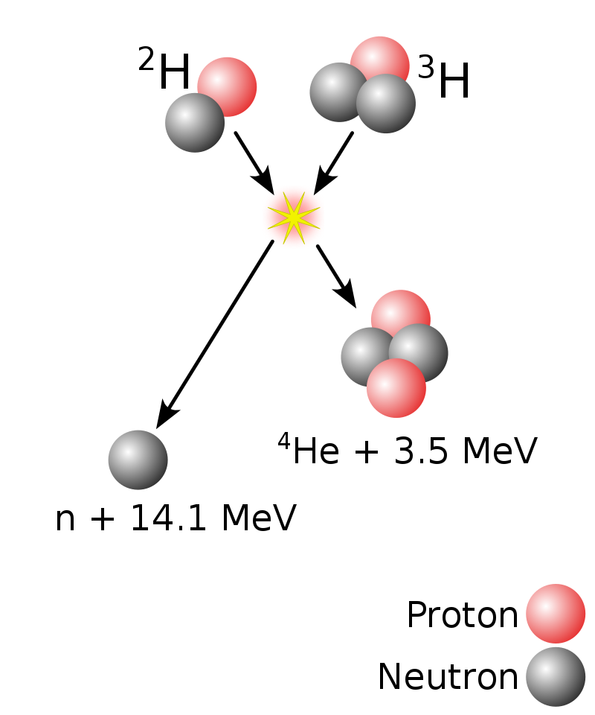
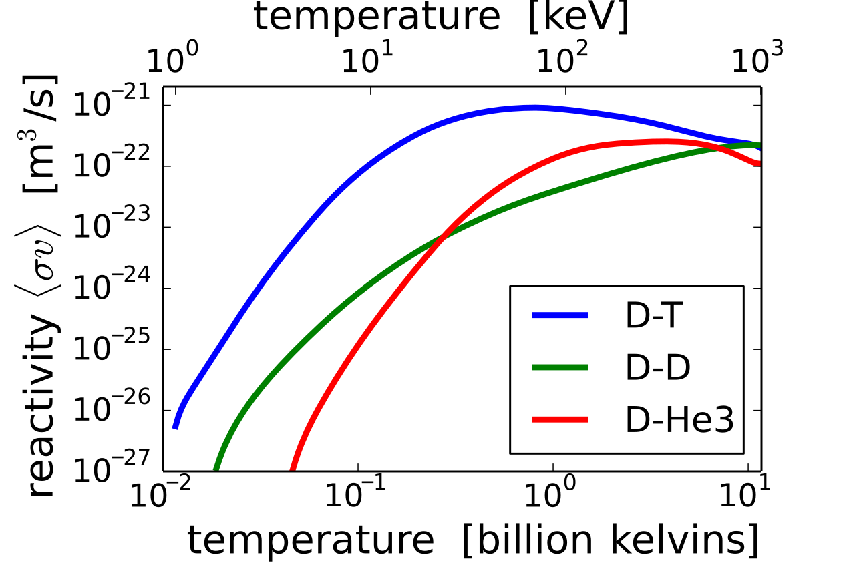
ITER Mission
To demonstrate the scientific and technological feasibility of fusion power as energy source for humankind
  D (²H) + T(³H) fusion
R=6.2 m, a=2.0 m

Slide 6
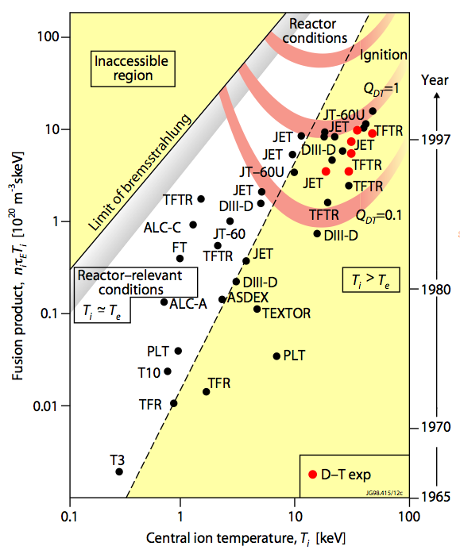
ITER Basis: DT Fusion Power Production
  Net production of fusion energy
  P_{fusion} (⁴He + n) = P_{α}+P_{n} > P_{external-heat}
  Q = P_{fusion} (⁴He + n)/P_{external-heat}
  P_{total-heat} = P_{α} (⁴He) + P_{external-heat}
  P_{α}/P_{external-heat} = Q/5
  To achieve high Q (> 5) requires hot (> 10 keV) plasmas with sufficient density that keep energy for sufficiently long time
  n_{i}τ_{E}T_{i} > 3×10²¹ m⁻³ s keV
ITER

Slide 7
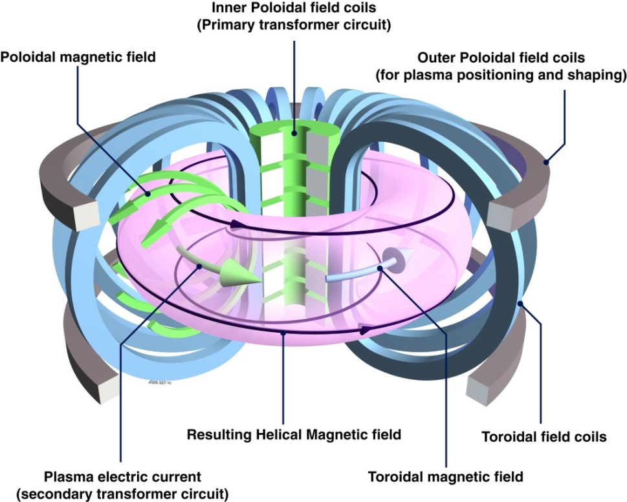

ITER Basis: Magnetic Confinement
At high temperatures required for fusion D and T are ionized (“Plasma”) → hot DT can be contained by magnetic fields
Magnetic fields are used to :
Reduce thermal losses across magnetic field
Provide stabilizing compression force to compensate hot plasma expansion
Tokamak
$$q= \frac{Toroidal turns}{Poloidal turns} ≥2$$
Notes:
utile = “relevant” ?
Pertinente? Réalisable?

Slide 8
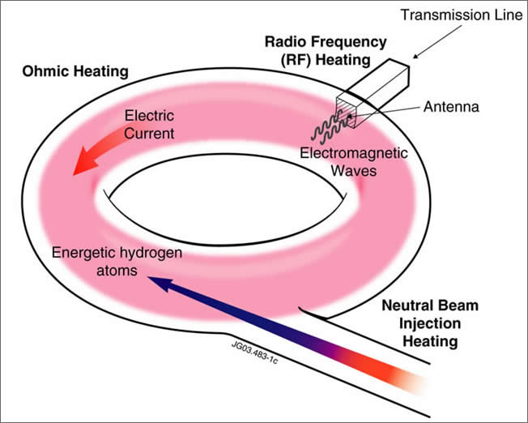
ITER Basis: Plasma Heating
To achieve fusion power production T ~ 10 keV → Heating of Plasma is required :
Ohmic heating = I_{p}² R_{p}; R_{p} ~ T^{-3/2} → insufficient
Radio Frequency Heating
Injection of energetic atoms
Notes:
utile = “relevant” ?
Pertinente? Réalisable?

Slide 9
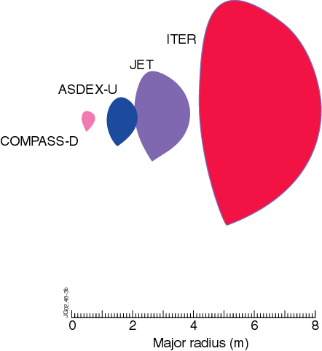
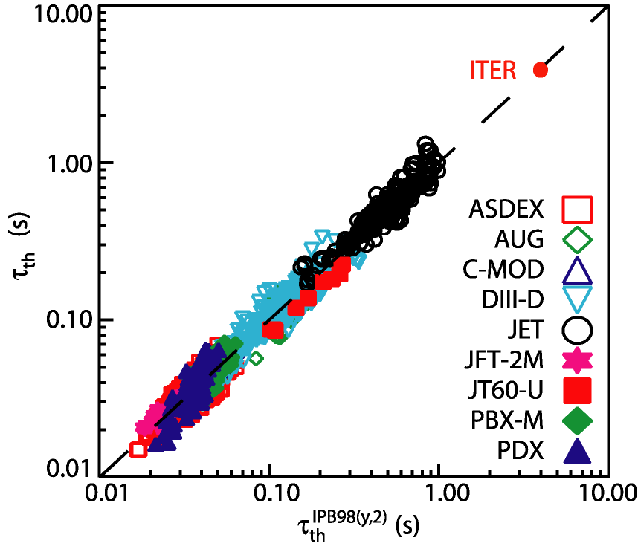
ITER Basis: Energy Confinement (τ_{E})
Energy confinement difficult to predict quantitatively → use scalings from experiments + plasma physics limits to dimension ITER to achieve its goals
Major Radius
Plasma Current
Input Power
b
τ_{th} ∝ I_{p}R²P^{-2/3}
a
R

Slide 10
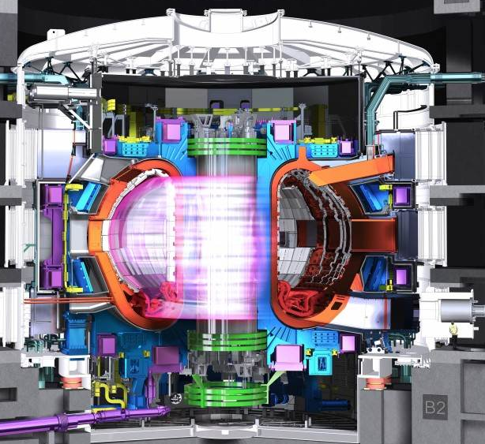
ITER Goals
  Pulsed operation:
  Q ≥ 10 for burn lengths of 300-500 s inductively driven current
  → Baseline scenario 15 MA / 5.3 T
  P_{α} ≥ 2 P_{external-heat}
  Long pulse operation:
  Q ~ 5 for long pulses up to 1000 s
  → Hybrid scenario ~ 12.5 MA / 5.3 T
  Steady-state operation:
  Q ~ 5 for long pulses up to 3000 s, with fully non-inductive current drive
  → Steady-state scenario ~ 10 MA / 5.3 T
R=6.2 m, a=2.0 m

Slide 11
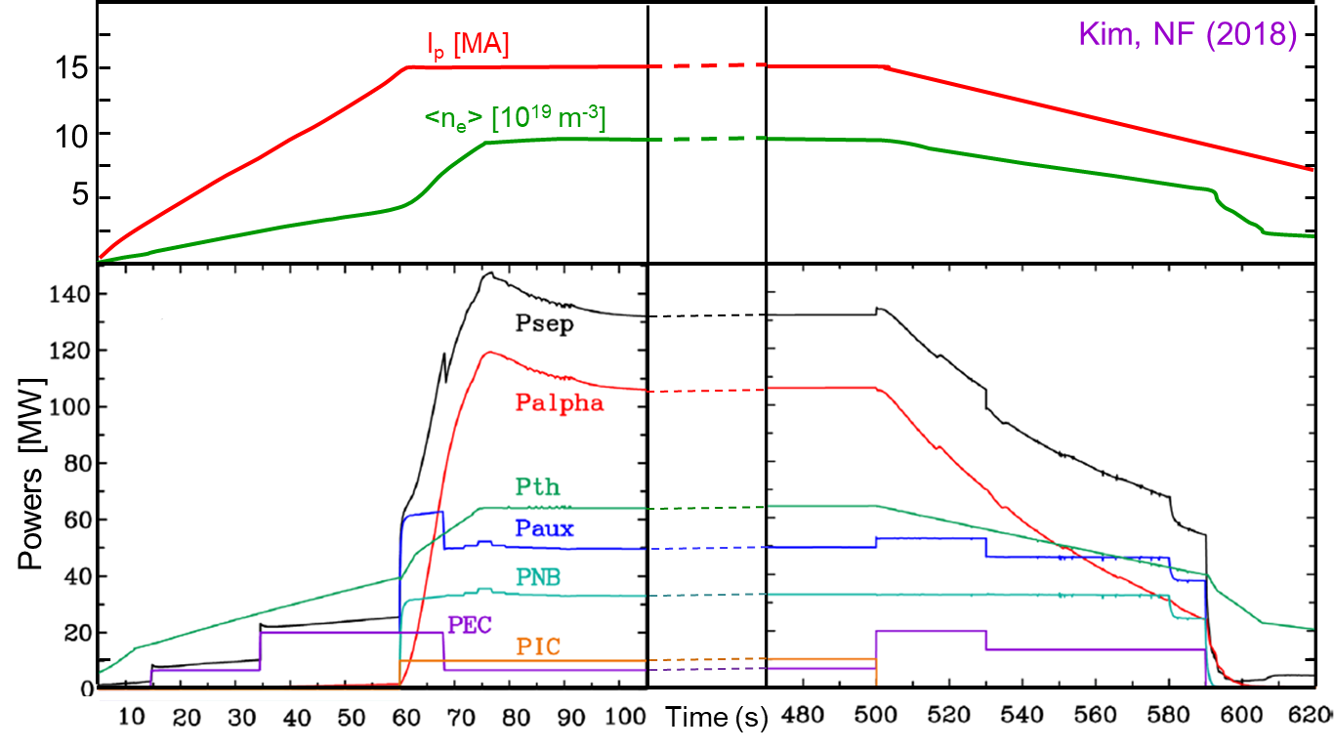
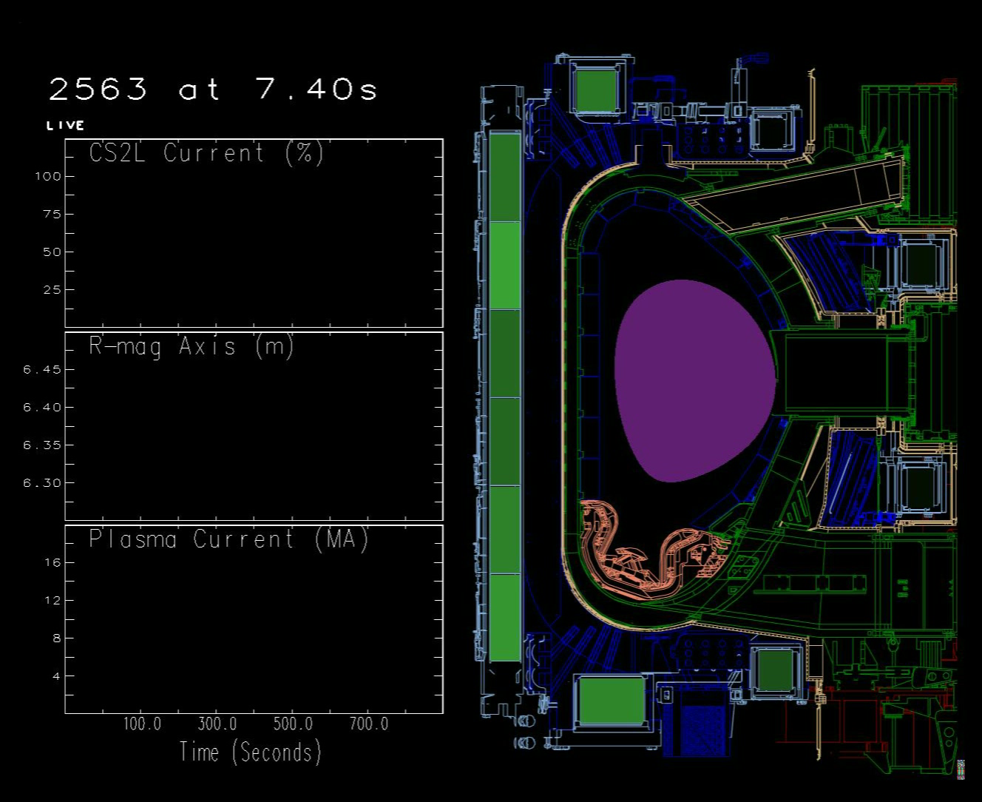
ITER Q = 10 scenario (300 – 500 s burn)
Based on conventional sawtoothing H-mode with H₉₈ = 1 → scenario used for the design of magnets and components (15 MA/5.3 T)
P_{aux} = P_{NBI} + P_{ECH} (+ P_{ICH}) ~ 50 MW → Alpha-heating dominant scenario with non-inductively driven current ~ 35%

Slide 12
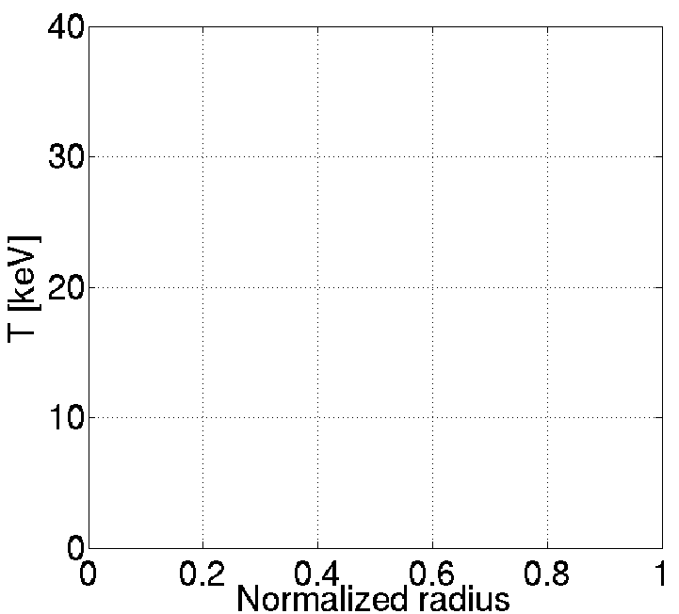

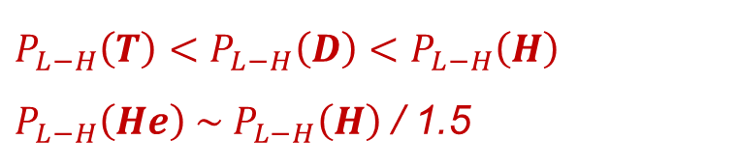
Few key ingredients to achieve ITER’s fusion goals - I
Achievement of high energy confinement plasmas
P_{fusion} ~ W_{plasma-th}²
  Low confinement (L-mode): pulsed operation ($H\sim 0.5$)
  High confinement (H-mode): pulsed operation ($H\sim 1$)
Improved high confinement
  Improved high confinement: long pulse ($H\sim 1.2$) / steady-state ($H\sim 1.6$)
High confinement
Power threshold for transition from L to H-mode:
Plasma Pressure (a.u.)
$$P_{L−H} ∝ {n_{e}}_{}^{0.7}×B^{0.8}$$
(empirical basis)
Low
confinement
$$P_{L−H}\left(T\right)<P_{L−H}\left(D\right)<P_{L−H}\left(H\right)$$
$P_{L−H}\left(He\right) \sim P_{L−H}\left(H\right)$ / 1.5

Slide 13
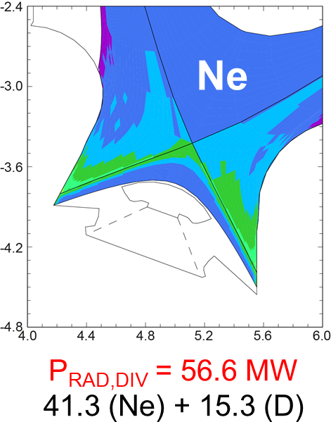
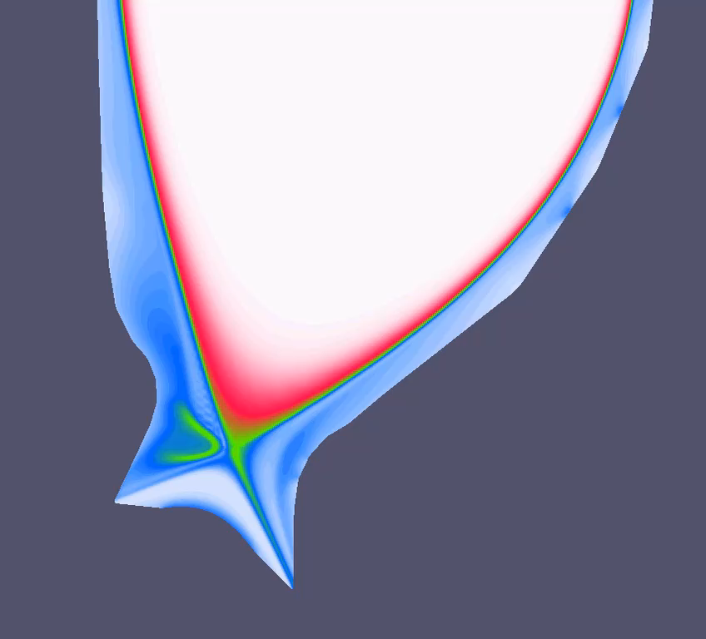
Few key ingredients to achieve ITER’s fusion goals - II
Edge-core integration : stationary and ELM transient power fluxes
Radiative Dissipation
ELM control : Mitigation by f_{ELM} increase and suppression
R. Pitts PSI 2018
JOREK
G. Huijsmans
q_{div} < 10 MWm⁻²

Slide 14
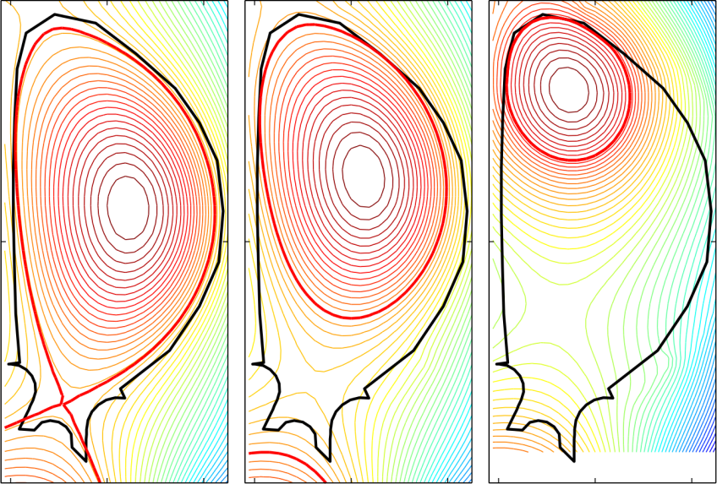
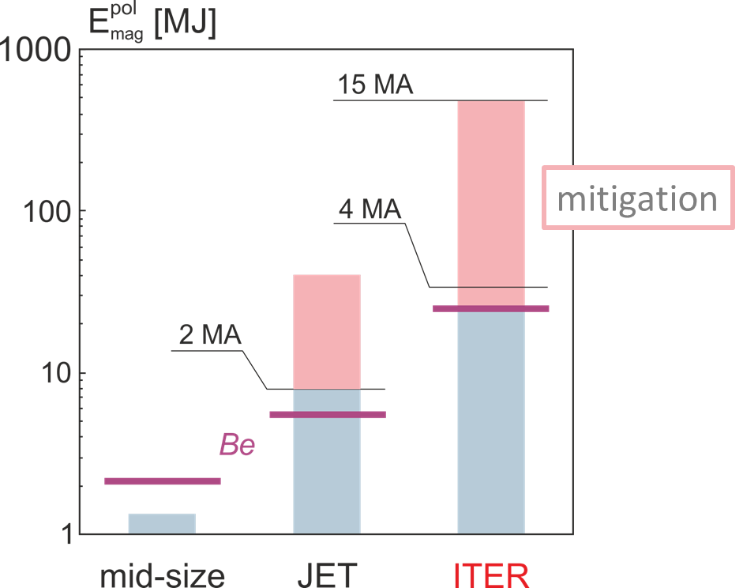
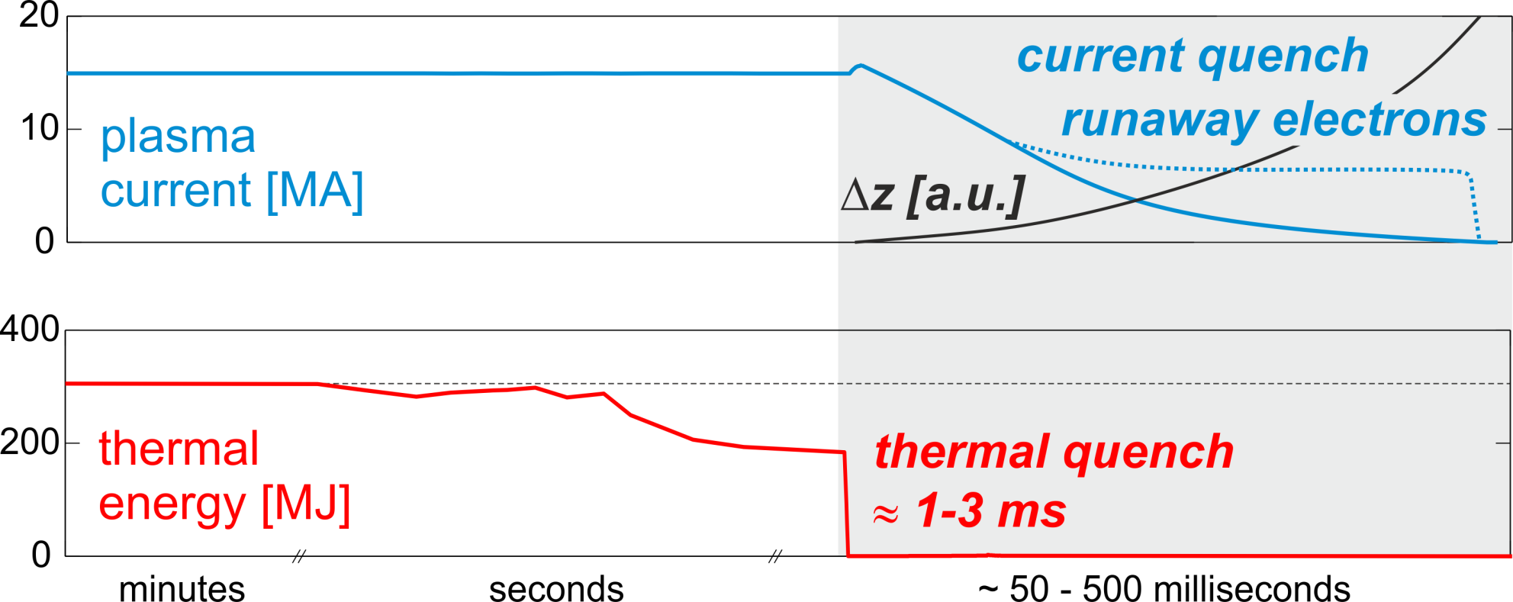
Few key ingredients to achieve ITER’s fusion goals - III
MHD stable plasma operation + mitigation if global instabilities develop (disruptions)
M. Lehnen EPS 2017
W_{plasma-mag}
Large thermal and electromagnetic loads
W_{plasma-th}
W_{plasma-mag}
J_{halo} + J_{eddy} x B forces

Slide 15
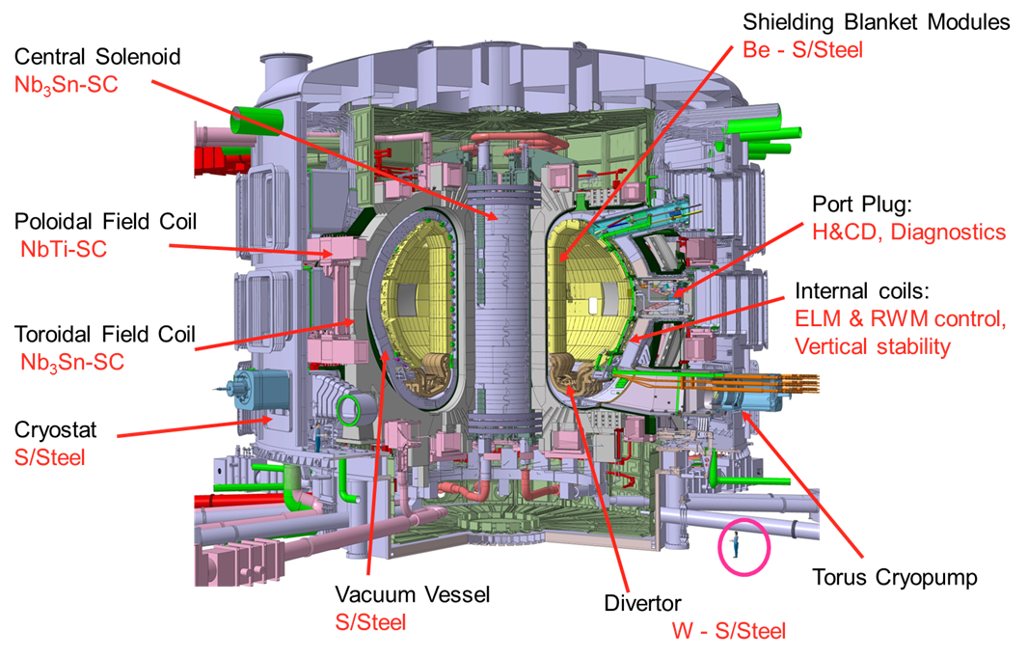
ITER Main Design Features

Slide 16
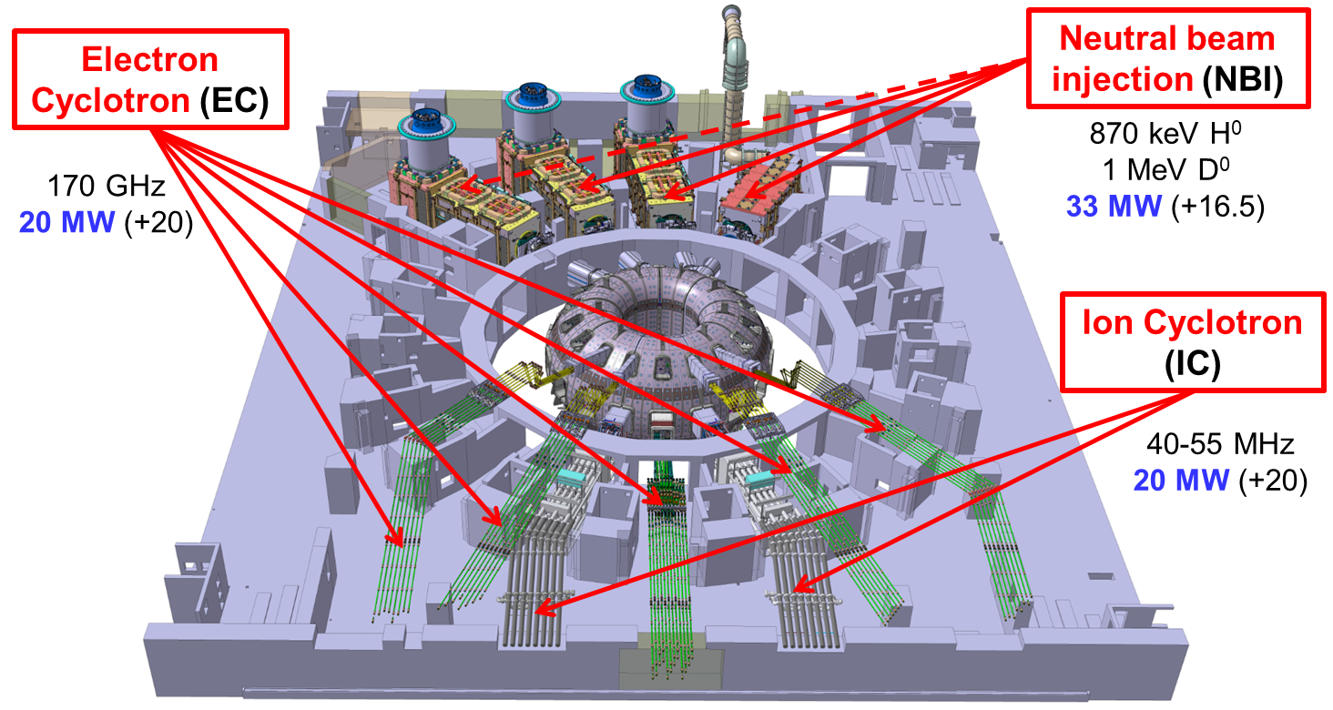
ITER Heating and Current Drive systems

Slide 17
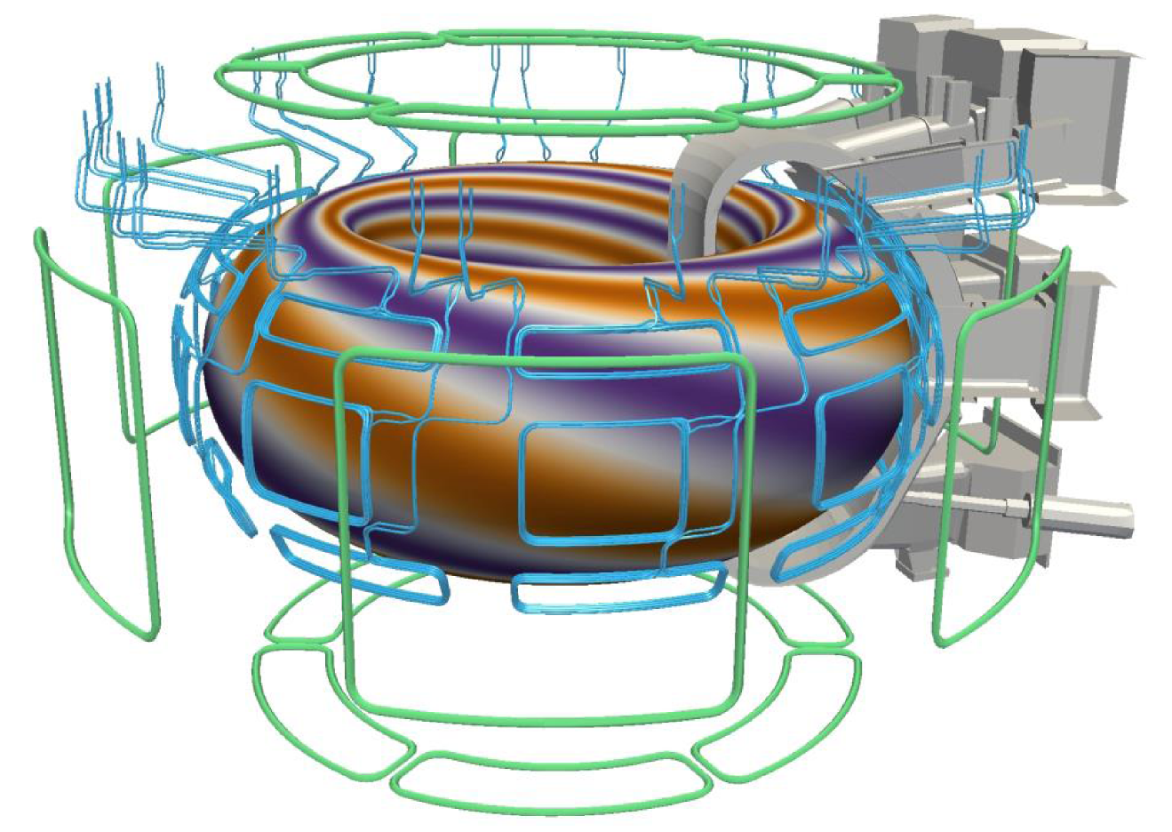
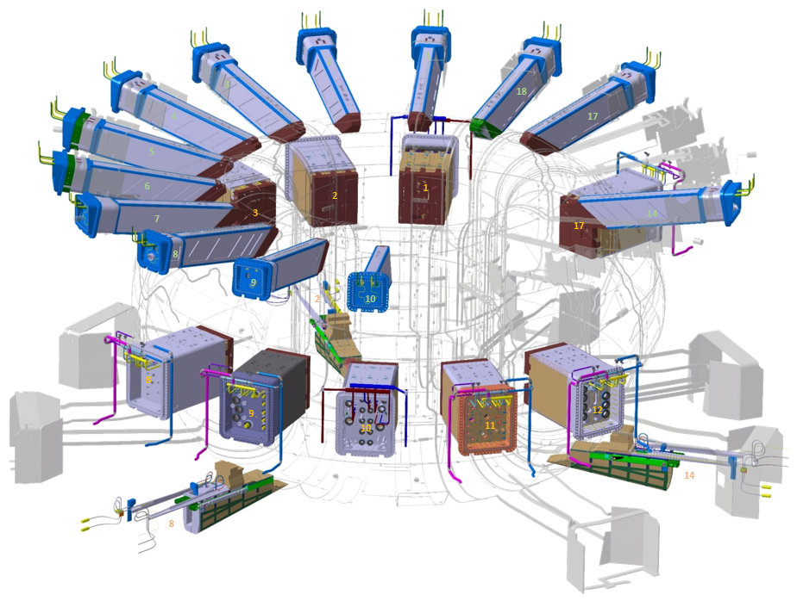
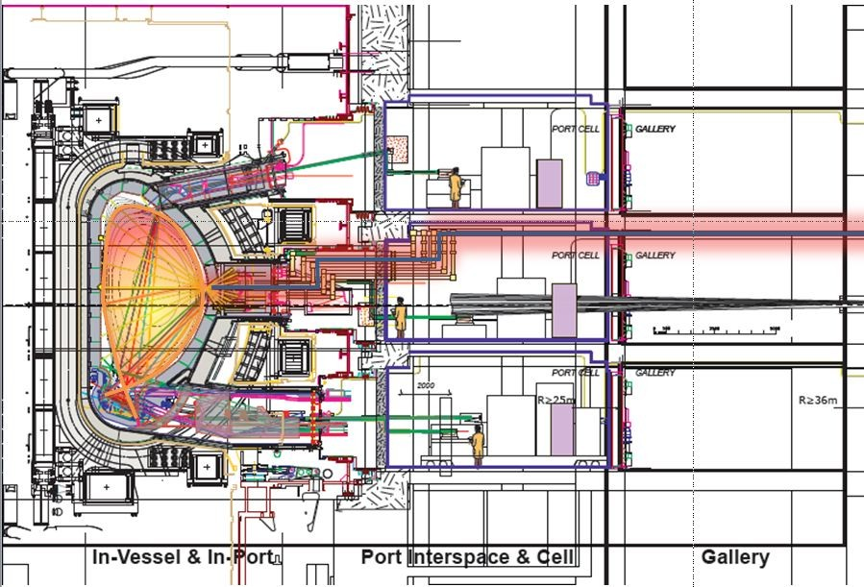
ITER Diagnostics and 3-D coils (Error Field, ELM control)
Diagnostics: ~ 60 instruments measuring ~ 100 parameters
External error field correction coils + internal ELM control coils

Slide 18
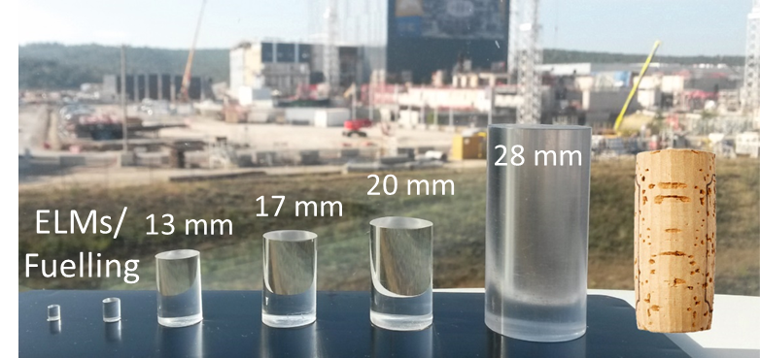
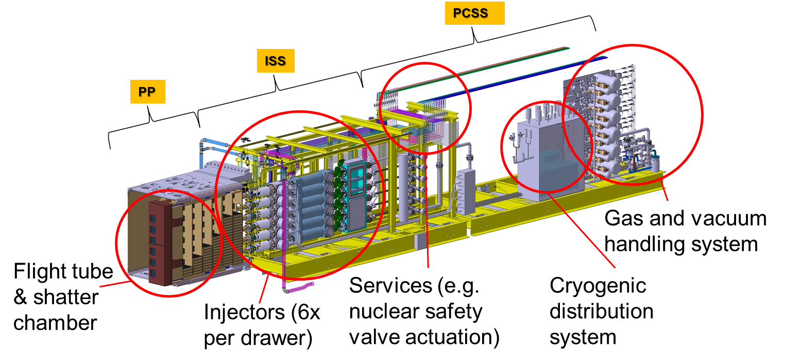
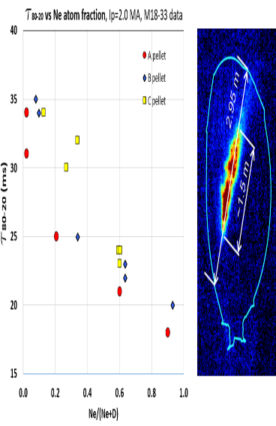
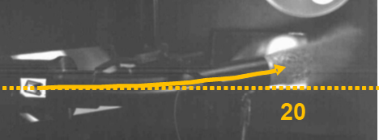
ITER Disruption Mitigation System
JET

Slide 19
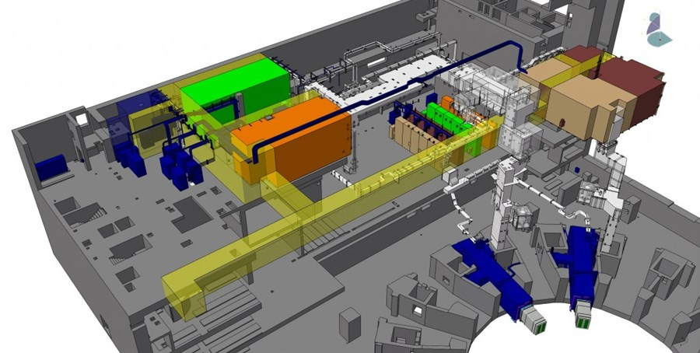
Tritium Breeding : Test Blanket Systems
Tritium not available in sufficient amounts for large scale nuclear fusion energy production → Tritium needs to be produced in-situ (n + Li)
T production schemes will de demonstrated in ITER (at small scale)
Different test blanket systems will be installed in ITER to test different combinations of design options:
Liquid metal breeder
Solid breeder
Helium coolant
Water coolant

Slide 20
ITER as a Project and overview of Construction Status

Slide 21

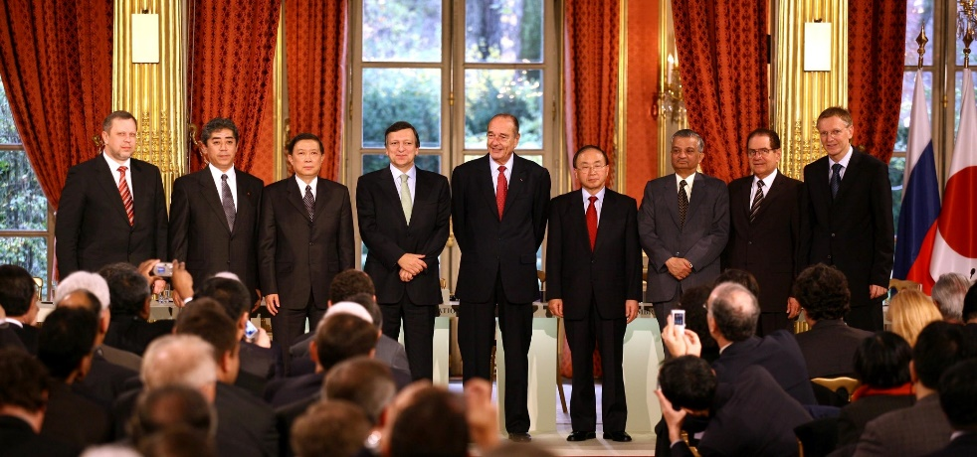
ITER
Global challenge, global response
28 June 2005: The ITER Members unanimously agreed to build ITER on the site proposed by Europe
21 November 2006: The ITER Agreement is signed at the Élysée Palace, in Paris.
The seven ITER Members represent more than 50% of the world’s population and about 85% of the global GDP
China EU India Japan Korea Russia USA
Notes:
KD: “represent” KD: Remove “on” from dates

Slide 22
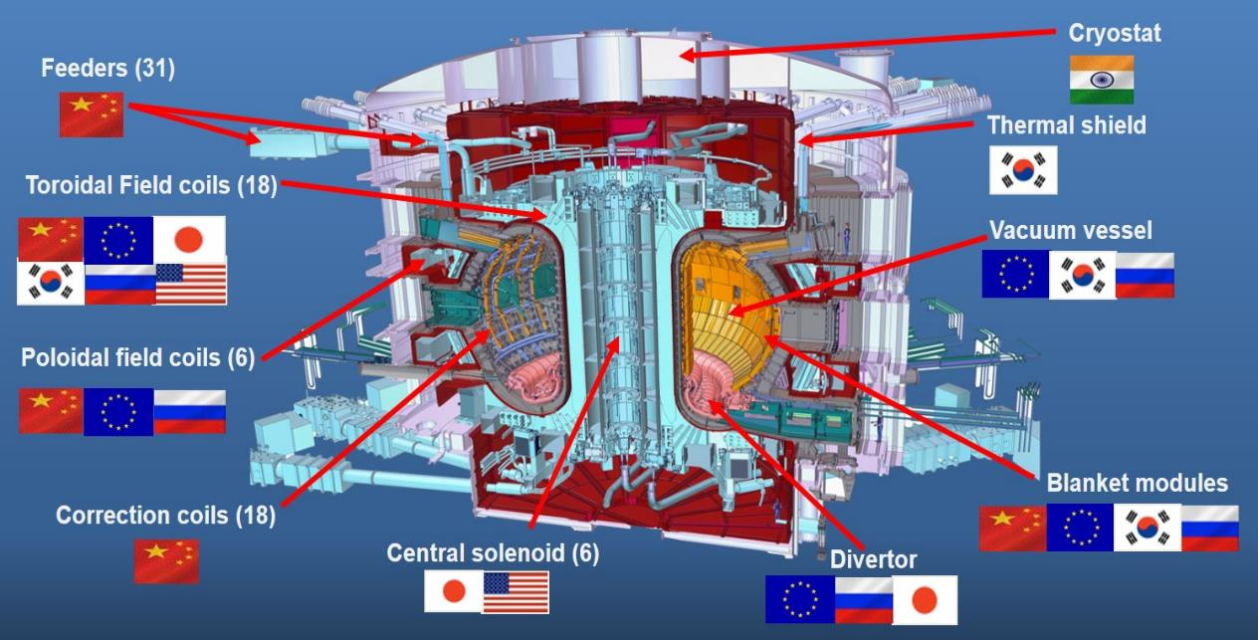
Construction ITER – Who manufactures What ?
Notes:
THE objectives set out for ITER are basically two:
ONE: to obtain and study a plasma where the alfa particle heating is dominating all other forms of heating.
ITER will operate with a value of capital Q greater than 10.
The fusion power in ITER will be about 500MW, the input power about 50MW.
And TWO: it has to integrate the technology required for future use of fusion as an energy source

Slide 23

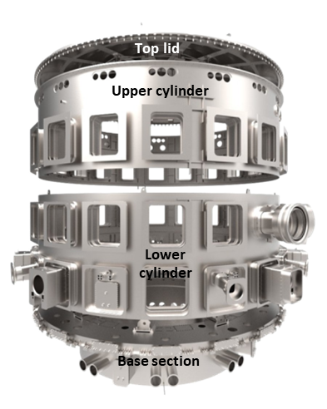
ITER Cryostat
Largest stainless steel high-vacuum pressure container ever built
Provides high-vacuum and ultra-cool environment
Height: 30 m
Diameter: 30 m
Weight: 3,850 t

Slide 24


ITER Vacuum Vessel
Double wall steel container
blanket modules
cooling water
High-vacuum environment
Primary containment barrier
Volume: 1,400 m³
Plasma volume: 840 m³
Weight: 8,500 t

Slide 25

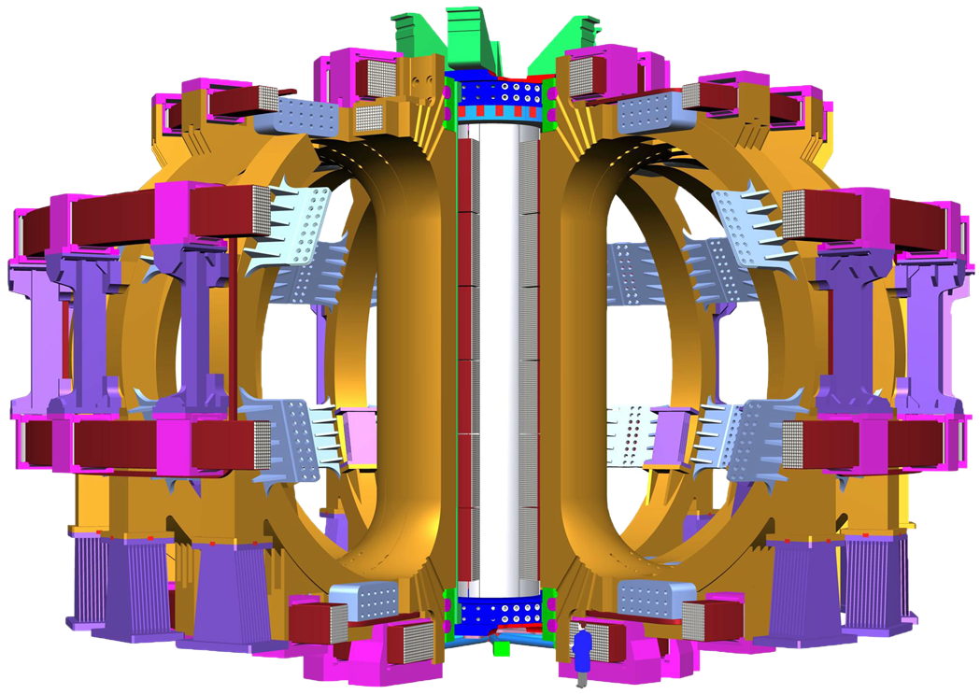
ITER Magnet System
Central solenoid
13 m high
1,000 tons
18 toroidal field coils
17 m high
360 tons each
6 poloidal field coils
8-24 m in diameter
200-400 tons

Slide 26
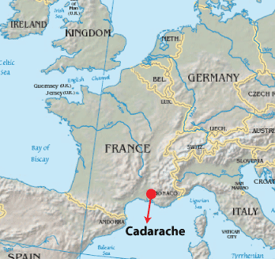
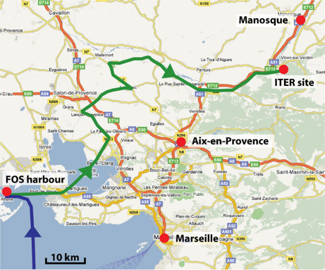
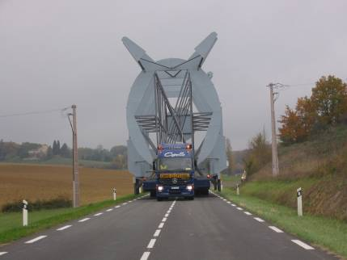
Itinerary of ITER Components
= Itinerary of ITER Components
ITER Site
Notes:
26

Slide 27
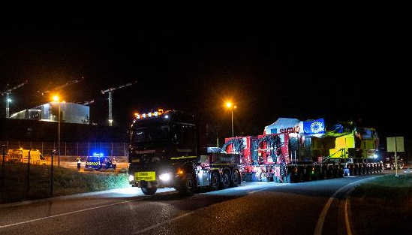
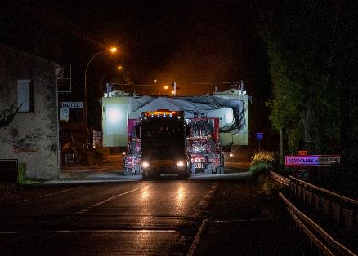
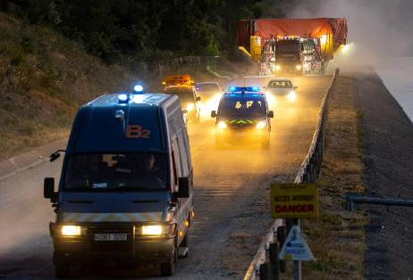

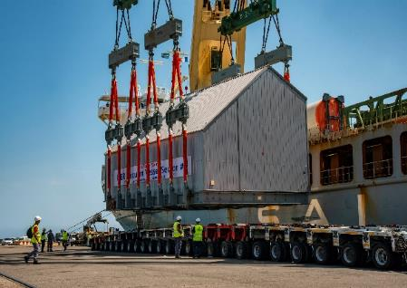
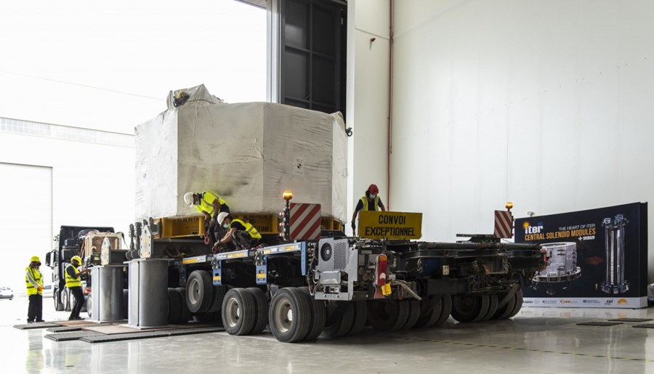
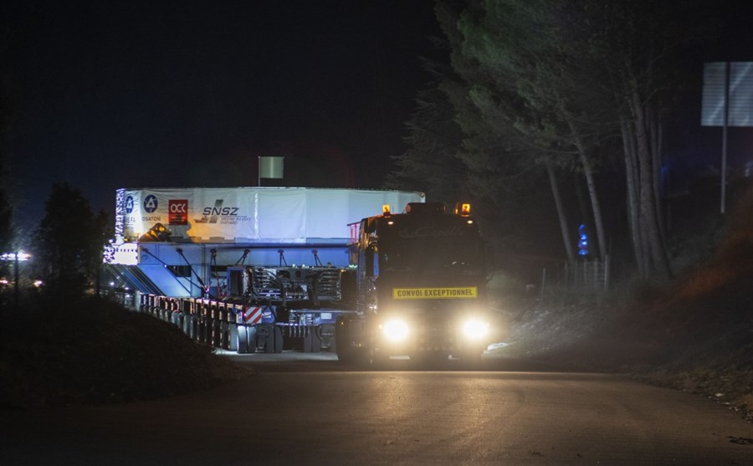

Many massive arrivals in 2020-23 (few shown)
PF6
TF
TF
Vacuum Vessel Sector # 6
First Central Solenoid Module
PF1

Slide 28
ITER Site Construction Status

Slide 29
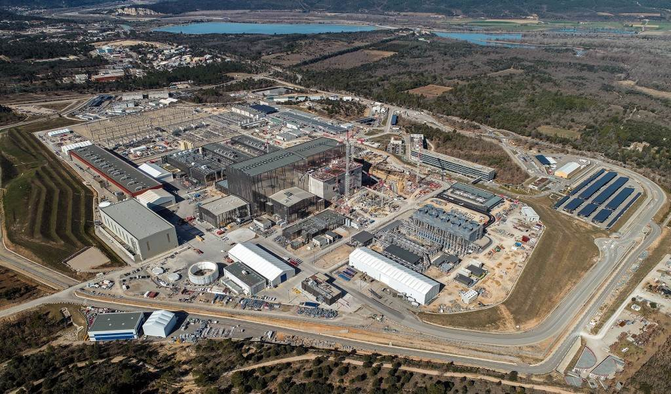
ITER construction site drone view
March 2023

Slide 30
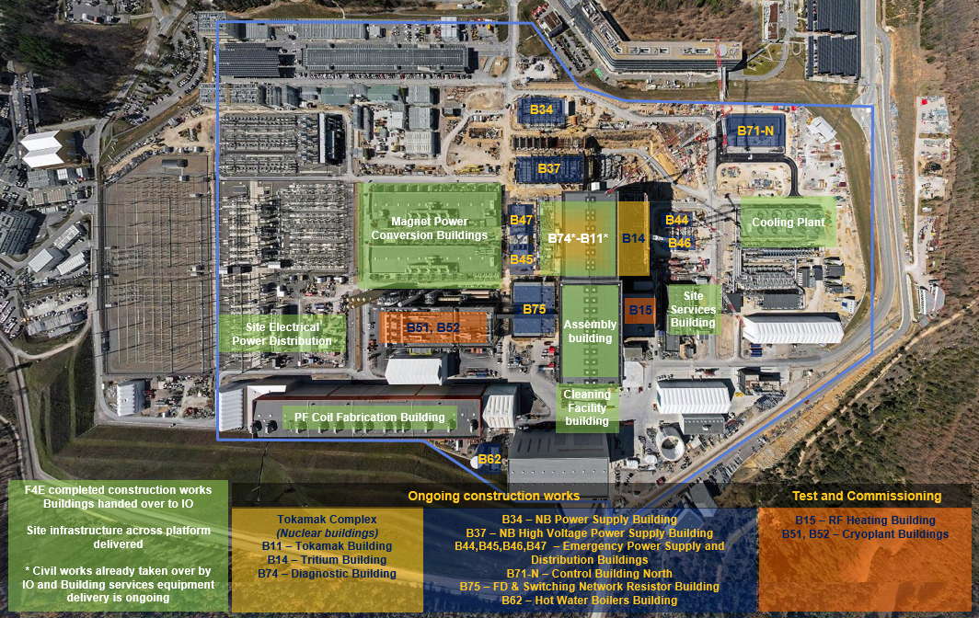
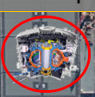
Worksite progress
RTE (France) 400 kV switchyard
Cryoplant
Tokamak Complex
Radiofrequency Bdg.
Cryoplant
Cryostat upper cylinder
(temporary storage)
Cryostat workshop

Slide 31
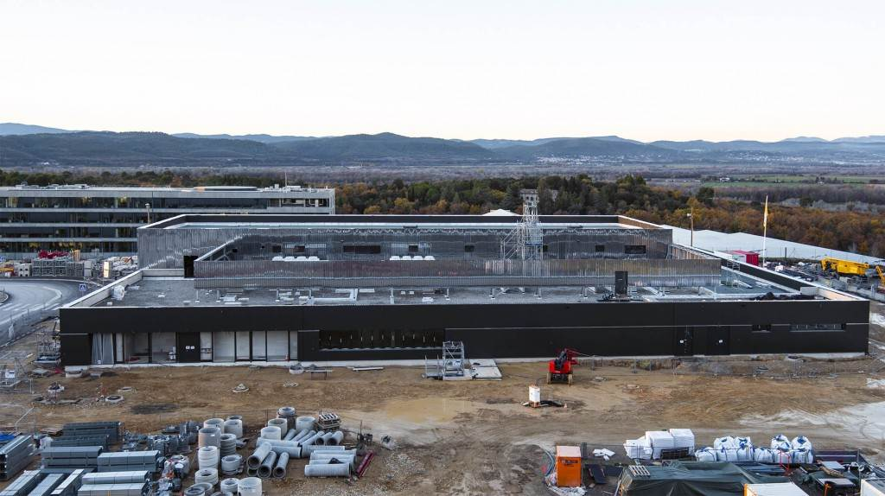
ITER Control Room

Slide 32
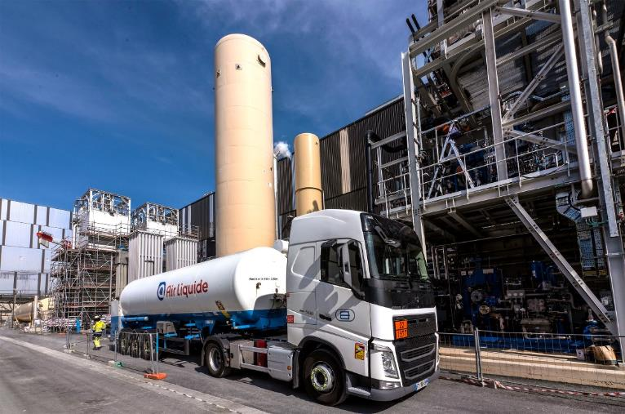
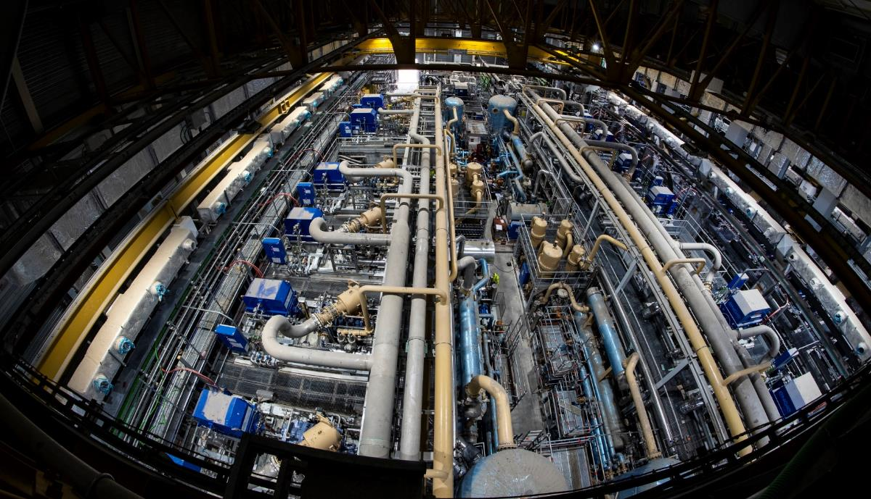
Balance of plant
Towards commissioning
Cryoplant:
5 000 tonnes of equipment
LHe: 25 t
Cooling Power:
75 kW at 4.5 K (Helium)
1300kW at 80 K (Nitrogen)

Slide 33
ITER Tokamak Assembly Status

Slide 34
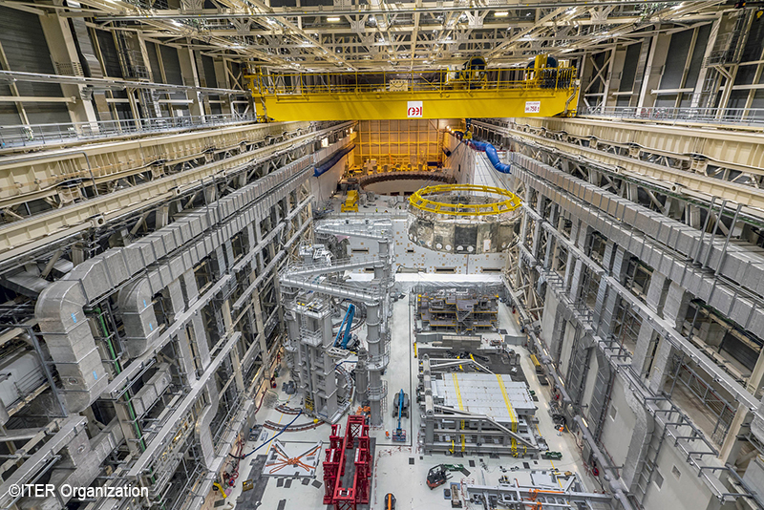
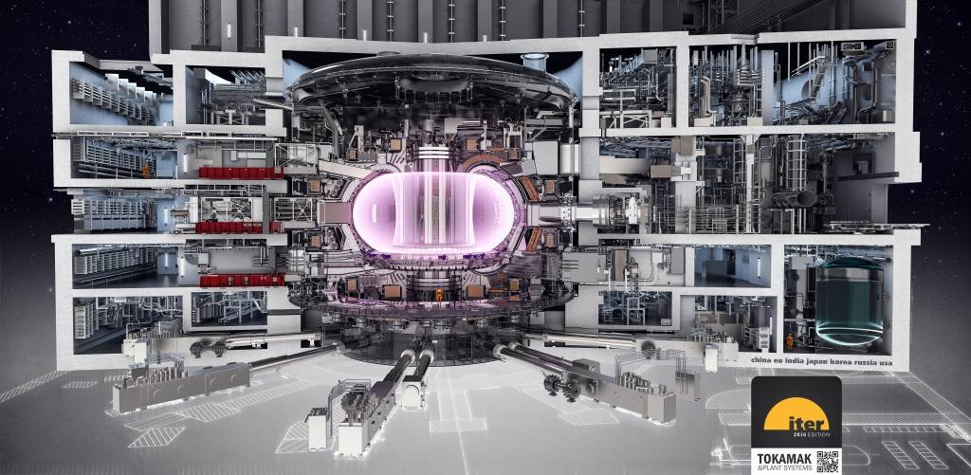
Assembly Hall and Tokamak building
Tokamak components assembled in assembly hall and lifted by cranes into tokamak pit

Slide 35
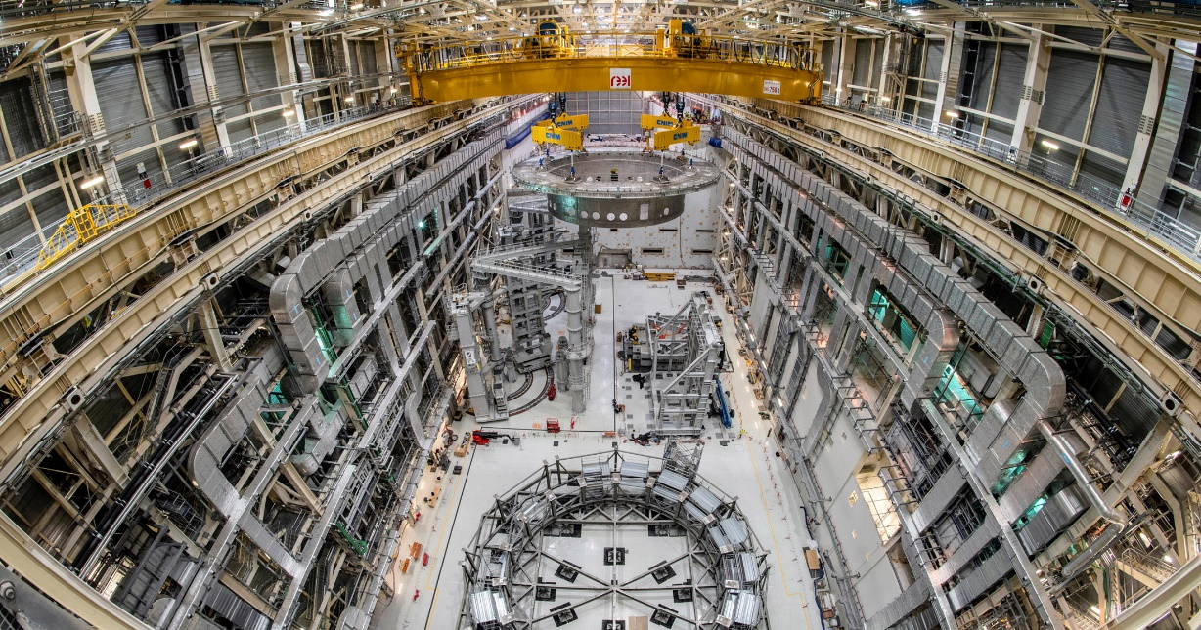


A crucial milestone
On May 26-27 2020, the base of the Cryostat (1,250 t; procured by India) was successfully inserted into the Tokamak Assembly Pit.
28 July 2020: remote celebration by 7 ITER Members Heads of State and French President

Slide 36


Sub-sector assembly
Assembly of Vacuum Vessel, Thermal Shield and 2 Toroidal Field coils
TF Coil Assembly
Finalized Sector Assembly before transfer to pit

Slide 37

VV Sector 7 with TF coil 9 on right arm of SSAT-1

Slide 38

11 May 2022
Sector 6 fully lifted out of SSAT-2 and rotated 90°

Slide 39

11 May 2022
Over the tokamak pit wall: 20 cm gap

Slide 40

11 May 2022
Lowering into the tokamak pit

Slide 41

14 June 2022
In-place and alignment procedure started

Slide 42


Alignment procedure completed
15 October 2022

Slide 43


Alignment procedure guided by physics assessment of error fields
Alignment targets ensure that for 99% of the cases TF assembly will contribute less than 33% of the n = 1 overlap field (ITPA scaling)
(15 MA/5.3T : plasma 1 SOF, plasma 2 EOB)
TFC error field analysis will be extended to other coils and components

Slide 44

September 2022
VV Sector 7 assembly nearly complete
VV Sector 8 in vertical position in the upending tool ready for transfer to SSAT-2

Slide 45


June 2023
First module of the 1000 tonne, 18 m tall central solenoid positioned (to ±1 mm accuracy in plane) on the bespoke assembly platform. Second module awaiting on the right.

Slide 46
Issues found and solutions
more details in
https://www.iter.org/newsline/-/3818
and
https://www.iter.org/newsline/-/3830

Slide 47



Corrosion of cooling pipes in thermal shields

Slide 48

Dimensional non-conformities of VV sectors impacting sector-to-
sector welding

Slide 49
Solution for VV thermal shield → remove old pipes and re-weld new pipes (different steel and welding process/material) + re-manufacture of few panels → requires removal of installed shields from sectors
Solution for Cryostat thermal shield → leave old pipes (unused) and re-weld new pipes (different steel/welding process/material) on-site
Solution to VV non-conformity → remove and add material to meet required dimensions (73 - 400 kg per octant)
Repairs to about to start (contracts will be signed soon) → duration of repairs cannot be precisely estimated at this time

Slide 50
ITER Research Plan (IRP) and burning plasma physics

Slide 51

ITER Research Plan (IRP)
IRP describes strategy for R&D to achieve Project goals starting from First Plasma to Q = 10 (300-500 s),Q = 5 (1000 s) & Q = 5 steady-state
Proposed R&D is supported by available systems in each phase
Initial phase H/He (and D) to demonstrate :
  15 MA/5.3 T plasmas in L-mode
  Low/Medium current plasmas (I_{p} = 5 – 7.5 MA) in H-mode
Main phase (D and DT) to demonstrate :
  Burning Q = 10 plasmas
  Long Pulse Q = 5 plasmas
Details under reconsideration

Slide 52

Fusion Power Operation (D/DT)
Main elements of experimental programme:
  Recommission systems with D plasmas (H&CD, diagnostics)
  Demonstration of D H-mode integrated operation at 7.5 MA/2.65 T and expansion towards higher I_{p}/B_{t}
  Introduction of T in trace levels up to ~ 50% D/ 50% T
  Increase of I_{p}/B_{t} towards 15 MA/5.3T → optimization of Q and extension of burn length
  Development of long pulse scenarios at I_{p} < 15 MA
  Demonstration of Q ≥ 10 goal
  Optimization of Q in long pulses (1000 s) and demonstration of Q ~ 5 goal
  Optimization of Q in steady-state pulses (3000 s) and demonstration of Q ~ 5 goal

Slide 53
ITER burning plasma scenarios

Slide 54
ITER Q = 10 scenario (300 – 500 s burn)
Based on conventional sawtoothing H-mode with H₉₈ = 1 → scenario used for the design of magnets and components (15 MA/5.3 T)
P_{aux} = P_{NBI} + P_{ECH} (+ P_{ICH}) ~ 50 MW → Alpha-heating dominant scenario with non-inductively driven current ~ 35%

Slide 55
ITER Q ≥ 5 scenario (1000s burn)
Main option is based on improved H-mode/hybrid scenario with q(0) > 1 and H₉₈ > 1.2 with burn length limited by q(0) reaching 1 (12.5 MA/5.3 T)
Obtained with P_{aux} = P_{NBI} + P_{ECH} (+ P_{ICH}) ≥ 50 MW with non-inductively driven current ~ 55%
Kim NF 2016

Slide 56

ITER Q ~ 5 scenario (steady-state)
Based on improved H-mode/hybrid scenario with stationary q profile (q > 1) and H₉₈ > 1.5 length limited to 3000s by hardware design (10 MA/5.3 T)
Obtained with P_{aux} = P_{NBI} + P_{ECH} ≥ 70 MW with non-inductively driven current ~ 100%
Kim NF 2021

Slide 57




Q = 5 steady steady-state plasma at 10 MA
Conditions identified by 1.5-D ASTRA modelling
  EPED1+SOLPS used for pedestal and boundary
  Q=5.02, f_{GW}=0.69
  H₉₈=1.52, 𝛽_{N}=3.02
  q_{min}=1.23
  Relatively high l_{i}(3)~0.87 mainly due to 50 MW NBI (+ 20-30 MW ECH)
  Improved confinement is essential
Polevoi – NF 2020

Slide 58
Access to high Q conditions
Access to high Q requires build-up of P_{alpha} since P_{aux} is moderate and P_{L-H} is high
Key to high Q access is density control (gas fuelling for n_{sep} and pellet fuelling for n_{core})
F. Koechl - ITER – JINTRAC - NF 2020
5MA

Slide 59

Exit from high Q conditions
Main issue in exit from high Q is to avoid fast H-L transitions → radial plasma movement difficult to control and large power fluxes to divertor
Adjustment of P_{aux}, fuelling and Ne seeding required to lengthen W_{plasma} decrease phase and avoid too high q_{div} or too deep detachment
F. Koechl - ITER – JINTRAC - NF 2020
5MA

Slide 60
Energetic ions in ITER scenarios - I
Energetic ions impact on ITER burning plasmas
  Can drive MHD Alfvén eigenmodes → energetic ion loss P_{α} ☹
  Can reduce anomalous transport level → higher τ_{E} → P_{α} ☺
  Can increase core plasma β and thus shafranov shift → increased edge stability/pressure → increased τ_{E} → P_{α} ☺
  Alfvén eigenmodes can reduce plasma turbulence → higher τ_{E} but energetic ion loss → P_{α} ? ☺
Coupling between all effects difficult to predict in quantitative way for ITER burning plasmas since P_{α} is dominant

Slide 61

Energetic ions in ITER scenarios - II
Consequences of EP-driven Alfvén eigenmodes range from
  Benign saturation → significant high-amplitude bursting and transport
Extrapolation from present machines difficult due to small
Besides loss of heating, ITER first wall loads acceptable for fast ion losses of a few %
Max power transfer from α’s occurs when drift orbit width ~ mode width → n ~ 30
Many overlapping AE
Radial localisation of TAE gaps in ITER Q = 10 plasmas
ITER will quantify impact of fast ion instabilities in Q = 10 plasmas and explore means for mitigation and control

Slide 62
Conclusions
ITER will demonstrate the scientific and technological feasibility of fusion power as energy source for humankind
ITER construction is progressing despite challenges → commitment from ITER Organization and its Members
ITER Research Plan provides experimental strategy to progress from First Plasma through to achievement of Project’s goals: Q = 10 (300-500 s), Q = 5 (1000 s) & Q = 5 steady-state
ITER high Q scenarios will address key burning plasma issues for reactors:
Coupling of physics processes in self-heated plasmas
Integration of core-edge physics to achieve burning plasma conditions with acceptable edge plasma conditions
Effectiveness of actuators and control schemes for burning plasmas → high Q disruption-free operation
In addition many fusion reactor technologies will be demonstrated (Tritium cycle, TBMs, H&CD, PFCs, etc.)

Slide 63
Thanks for your attention

