Slide 1
Astrophysical Plasmas in the Laboratory
Jack D. Hare, puffin.mit.edu

Slide 2
Introduction
Undergrad at Cambridge University
MA(!) in plasma physics at Princeton
PhD at Imperial College London
Postdocs at Imperial College and IPP Garching
Assistant Professor at MIT since January 2021
Member of APS DPP Pride (LGBTQ+) Committee [1]
DPP Pride Mentoring Program coordinator [1]
Outside of work: hiking, skiing, caving, boardgames
[1] https://engage.aps.org/dpp/programs/plasma-pride

Slide 3
Energy Flows in Plasma are Complex and Fascinating

Slide 4
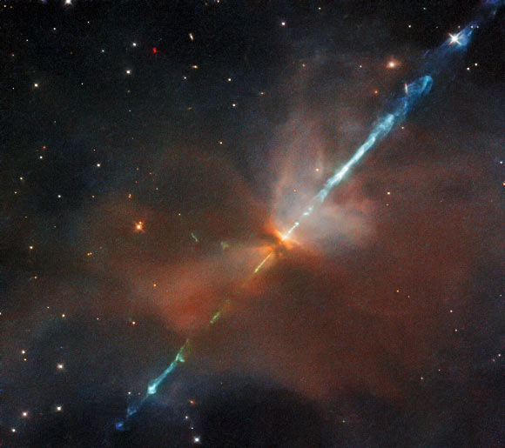
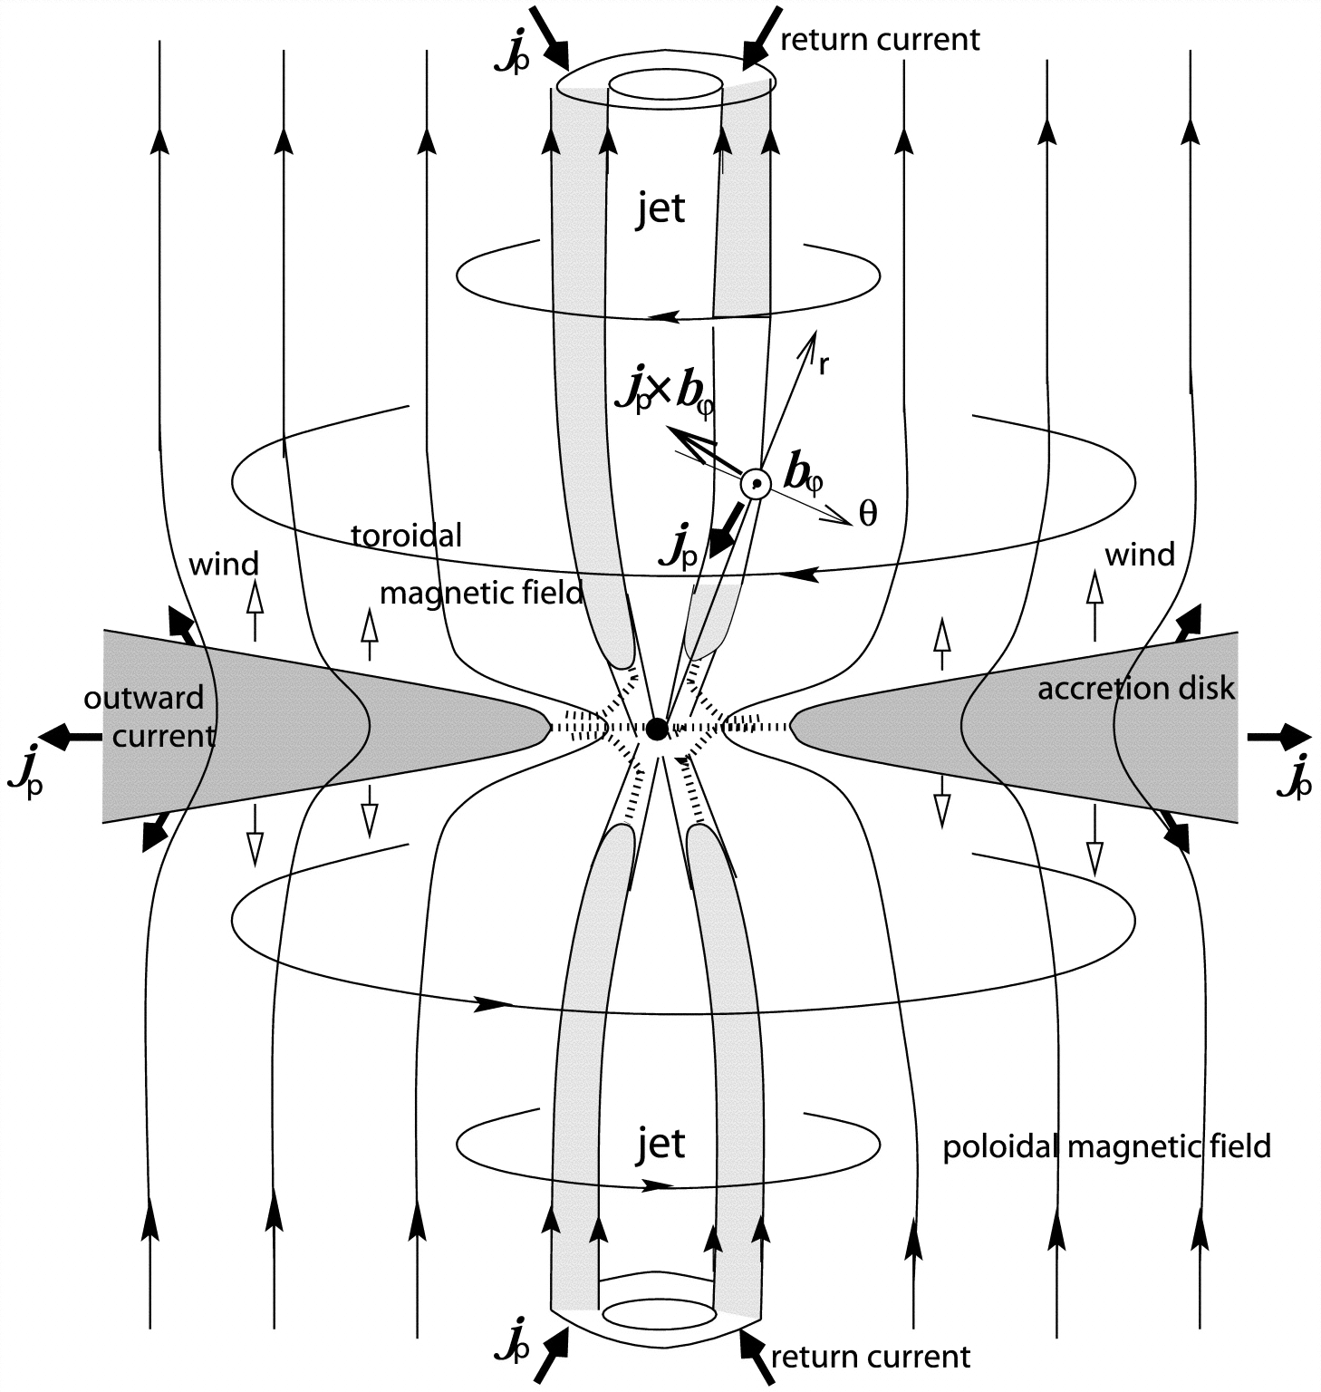
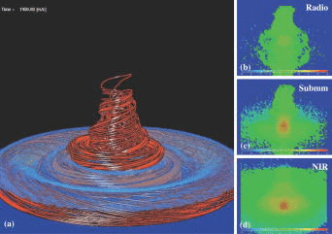
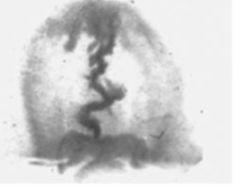
Why Laboratory Astrophysics?
Observation
Theory
Space is very (very) far away, hard to observe
Astrophysical theories poorly constrained by observation
Simulations only have the physics you put in – unknown unknowns
Laboratory experiments are “easy” to diagnose, but less extreme
Hubble/NASA
D Maruta ApJ 2001
Simulation
Experiment
P.M. Bellan, Physics of Plasmas 2009
A. Ciardi, Physics of Plasmas 2007
Combine theory, observations, experiments and simulations!

Slide 5
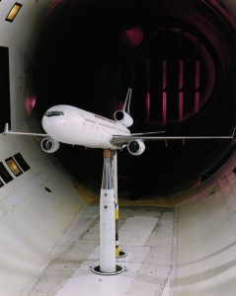
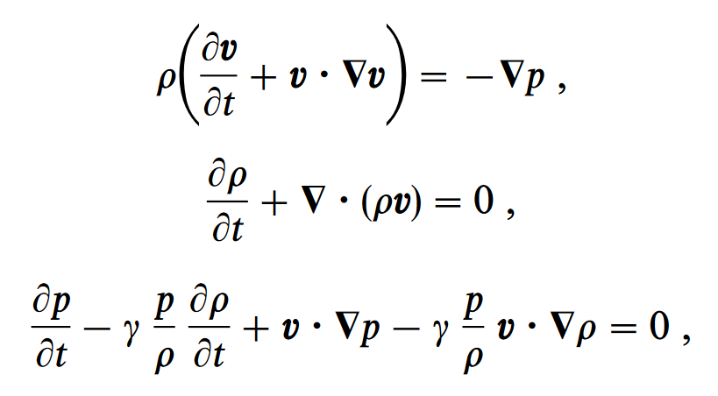
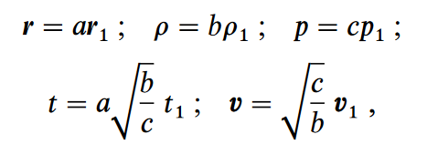
Dimensionless scaling
Rewrite governing equations in dimensionless form
Neglect viscosity, $Re={LV}/ν≫1$
Two systems with matching dimensionless numbers and boundary conditions evolve similarly
In practice, this is very, very hard: Resort to “weak” scaling where dimensionless parameters are either >>1 or <<1 in both systems
3 eqns, 3 scaling variables
Ryutov et al (PoP 2001)
Wind tunnel experiments use dimensionless scaling

Slide 6
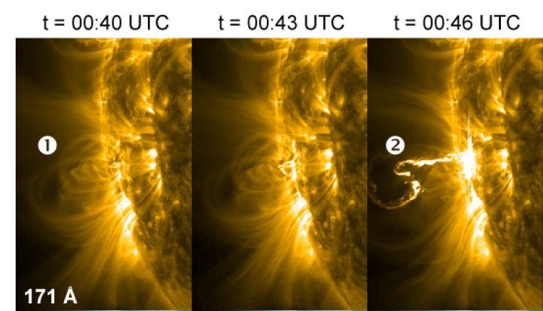
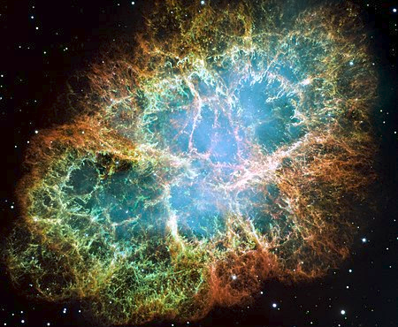
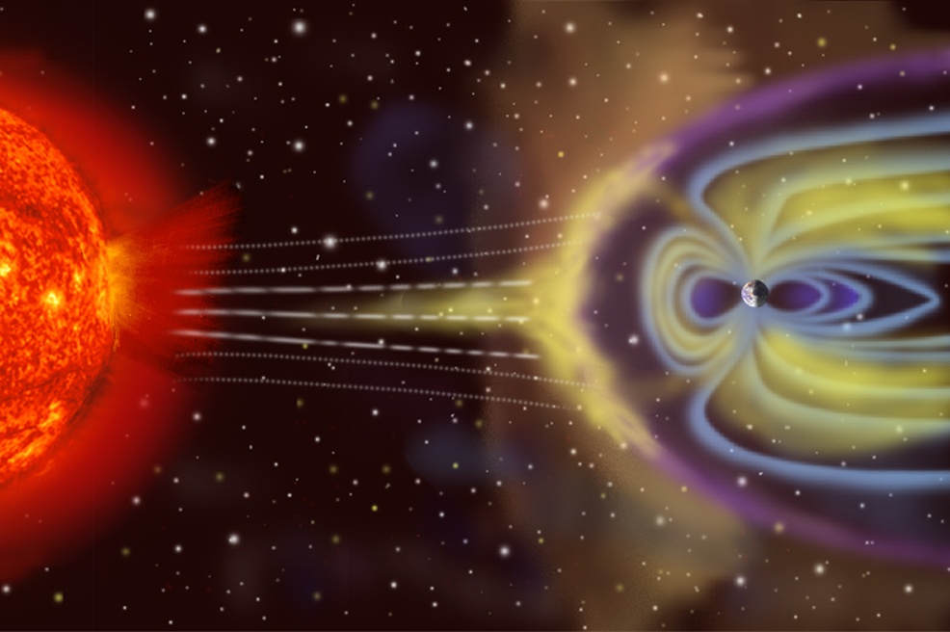
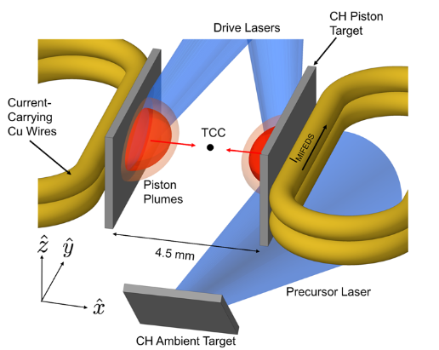
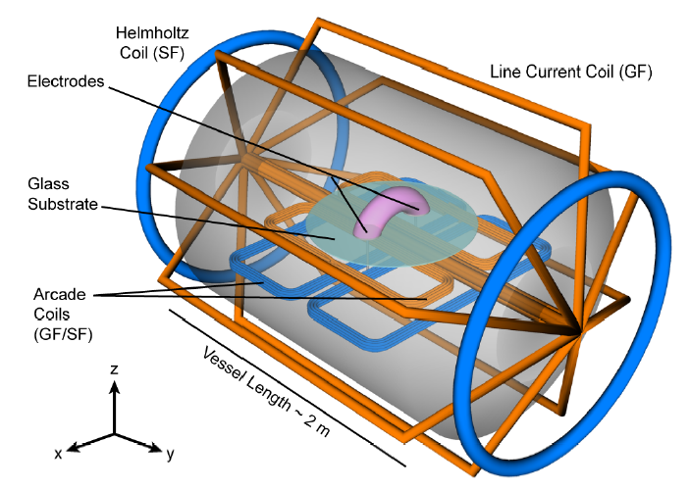
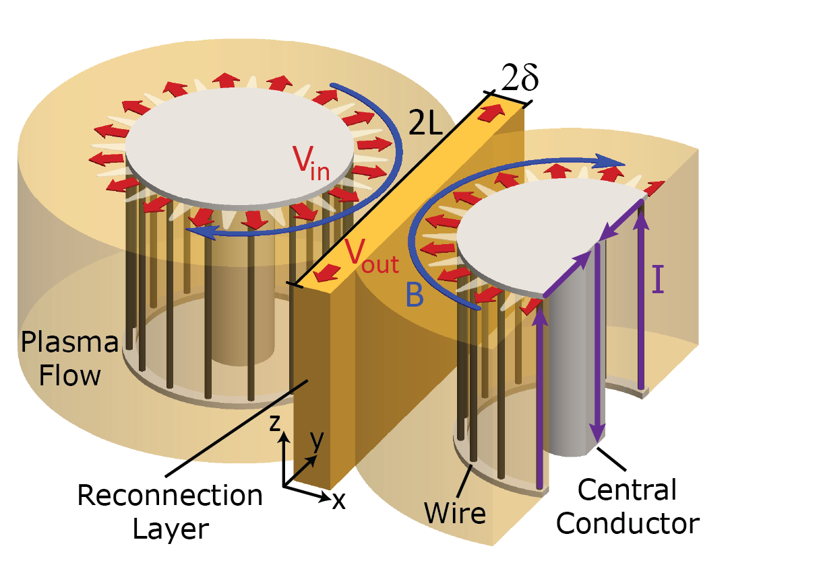
Three laboratory astrophysics experiments
Flux Rope Eruptions
Collisionless Shocks
Magnetic Reconnection
Myers, Nature (2015)
Schaeffer, PRL (2016)
Hare, PRL (2017)

Slide 7
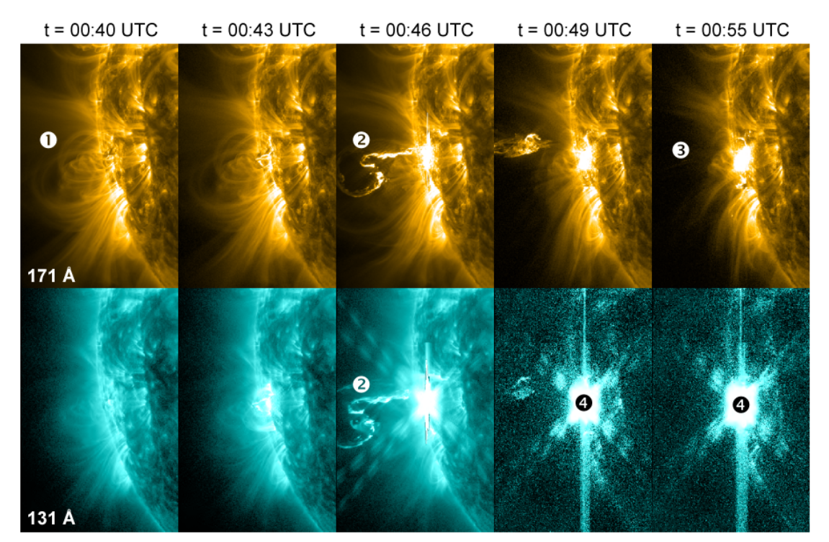
Flux Rope Eruptions: astrophysical system
Astrophysical system:
Satellites observe bright X-ray emission associated with coronal mass ejections
Proposed mechanism is build up of magnetic energy and then sudden eruption through instability
Problem: some theoretically unstable flux ropes appear stable

Slide 8
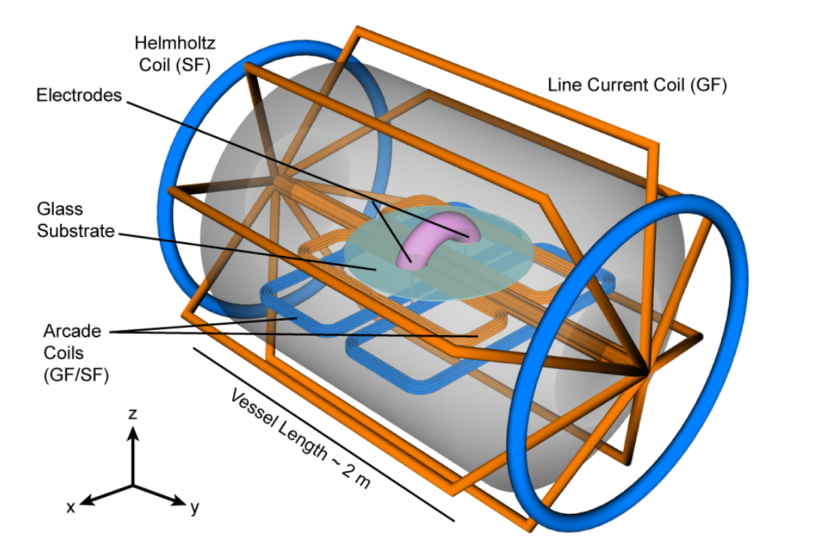
Flux Rope Eruptions: experimental setup
Person for scale
Myers, Nature (2015)

Slide 9
Flux Rope Eruptions: experimental setup
Used the vessel and coils from MRX (Magnetic Reconnection eXperiment, PPPL)
Added new “arcade” coils and electrodes to produce flux rope
Combination of magnetic field coils enables production of theoretical unstable and stable flux ropes
Diagnostics: fast camera, magnetic probe array
Both laboratory and solar plasma dynamics dominated by magnetic field
Myers, Nature (2015)

Slide 10
Flux rope eruptions: experimental results
Magnetic or “b-dot” probe:
Measures $V=Area×\dot{B}$
$∇×E={∂B}/{∂t}= \dot{B}$
$∫∇×E⋅dA=∫E⋅dl=V=A\dot{B}$
Array of three-axis probes measures B(X, t)
Magnetic probe array
Flux rope
B(t)
V(t)
Electrodes
Myers, Nature (2015)

Slide 11
Flux rope eruptions: experimental results
Note: time in “Alfvén times”, so dimensionless – aids comparison to astrophysical object
Myers, Nature (2015)

Slide 12
Flux rope eruptions: experimental results
Myers, Nature (2015)

Slide 13
Flux rope eruptions: experimental results
Myers, Nature (2015)

Slide 14
Flux rope eruptions: experimental results

Slide 15
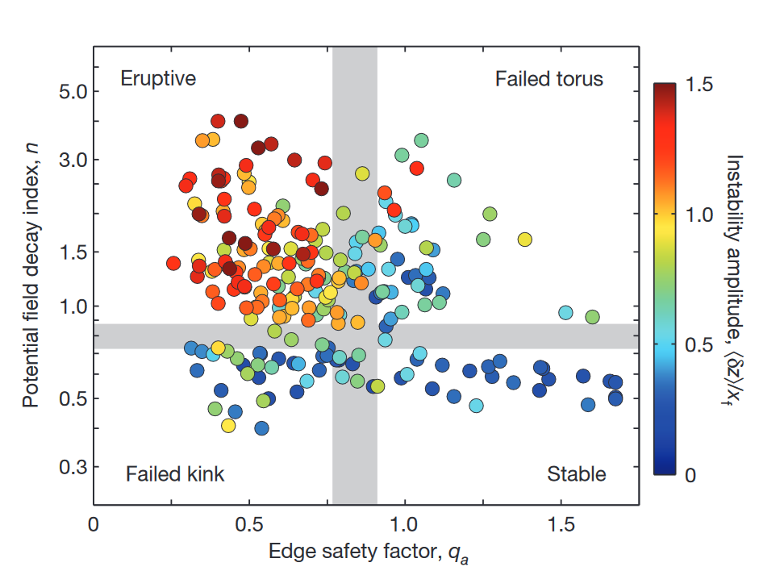
Flux rope eruptions: experimental results
“How quickly field becomes smaller in vertical direction”
“1/Twistiness of magnetic field”

Slide 16
Flux rope eruptions: experimental results
“How quickly field becomes smaller in vertical direction”
New experimentally discovered regime!
Thought to be unstable (q_{a}>0.8), found to be stable
Plasma “self-organizes” and creates additional magnetic field which resists eruption
“1/Twistiness of magnetic field”

Slide 17
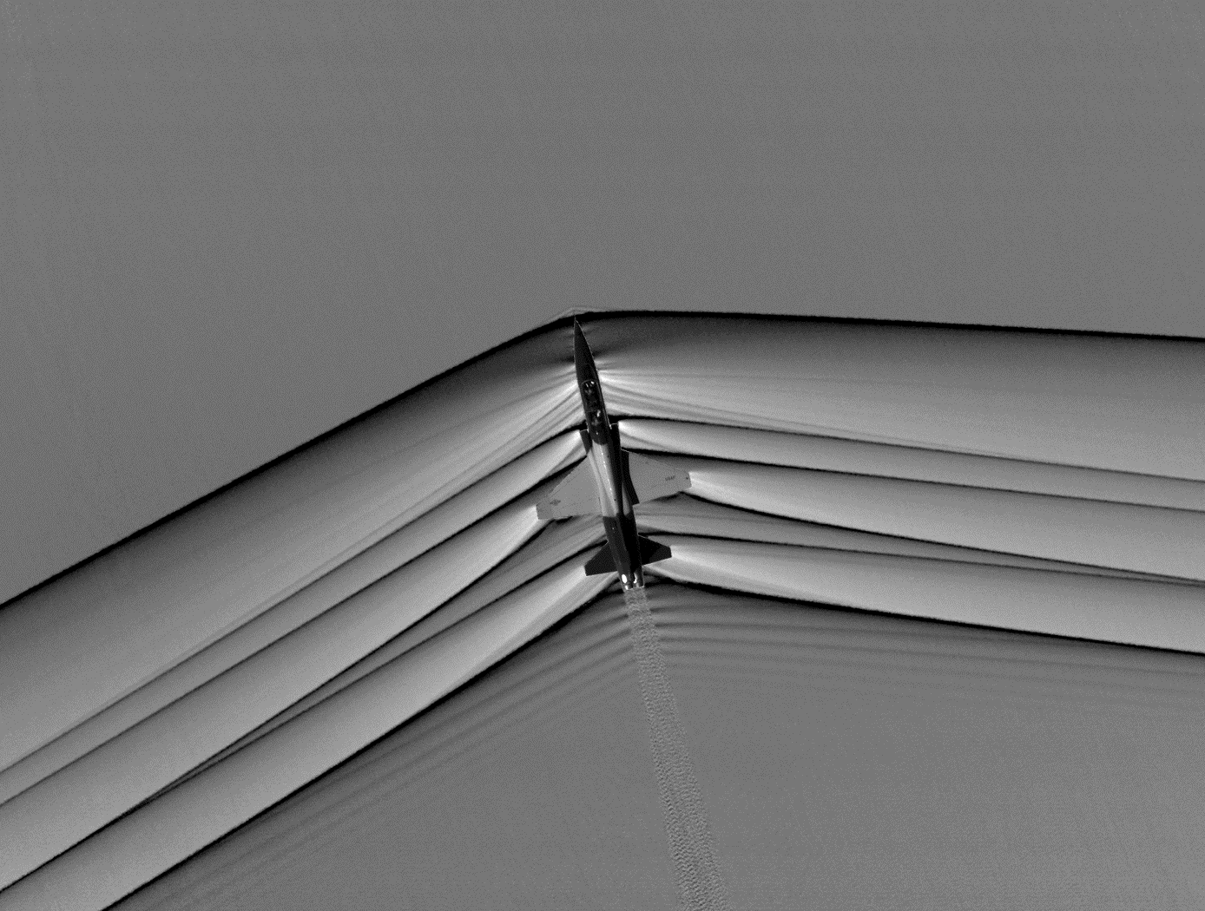
Collisionless shocks: astrophysical setting
Collisional (standard) shock: sudden change in density, velocity and temperature
Shocks mediated by particle collisions on very short length scales
Collisional shocks around a jet aircraft

Slide 18
Collisionless shocks: astrophysical setting
Collisional (standard) shock: sudden change in density, velocity and temperature
Shocks mediated by particle collisions on very short length scales
Collisionless shocks: accelerate particles to very high energies: source of cosmic rays which bombard Earth
Very fast hot plasma: particles do not collide! Shock is mediated by collective electromagnetic effects
Further complicated by existing magnetic fields!
Collisional shocks around a jet aircraft
Collisionless shocks around the Crab Nebula, a supernova remnant

Slide 19
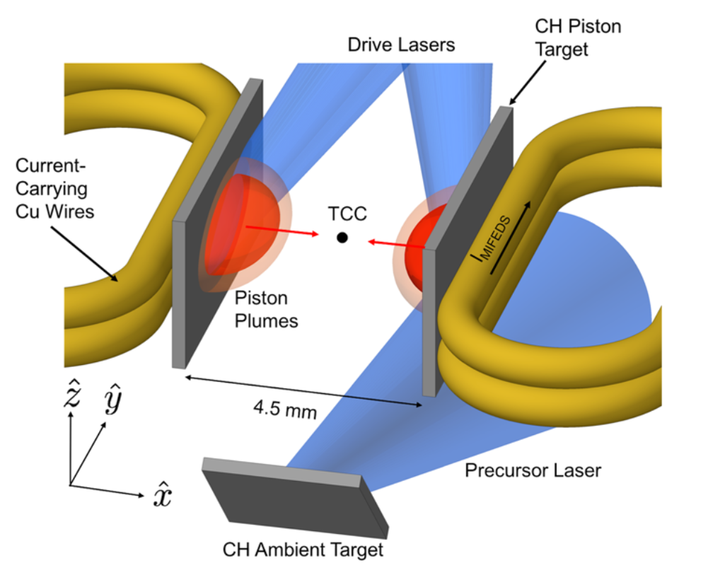
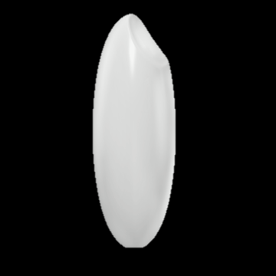
Collisionless shocks: experimental setup
3
Grain of rice for scale
1
2
Schaeffer, PRL (2016)

Slide 20
Collisionless shocks: experimental setup
3
Magnetic coils fill volume with B_{z} = 8 T field
Precursor laser creates ambient plasma between two targets
Drive lasers create counter-propagating pistons which drive collisionless shocks into ambient plasma
1
2
Schaeffer, PRL (2016)

Slide 21
Collisionless shocks: experimental results
Piston plasmas
Angular Fringe Refractometry (AFR)
Plasma refractive index $N≈1−n_{e}/2n_{cr}$
Rays of light deflected by refractive index gradients
AFR filters rays to have specific deflection angles, gives information on electron density gradient
High n_{e}
Laser
$$θ=∫{∇n}_{e}/n_{cr}dl$$
B_{z}
Ambient plasma
Low n_{e}
Schaeffer, PRL (2016)

Slide 22
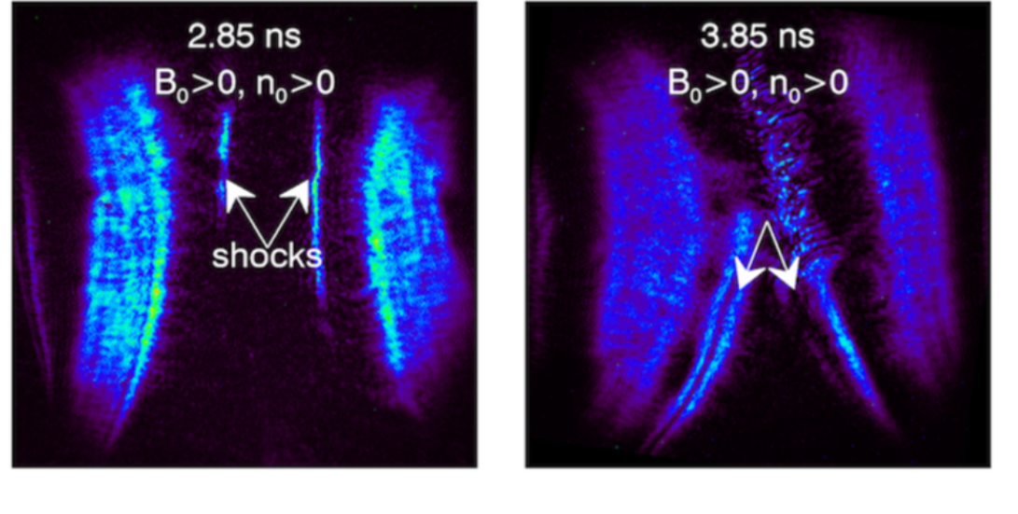
Collisionless shocks: experimental results
Piston plasmas
B_{z}
Ambient plasma
Angular fringe refractometry (AFR): plasma density gradients bend light rays, AFR only allows rays with specific angles (corresponding to specific density gradients) to make it to camera.
Two bright regions correspond to steep density gradient - two shocks!
Track between frames: V = 700 km/s, ions collisionless
Schaeffer, PRL (2016)

Slide 23
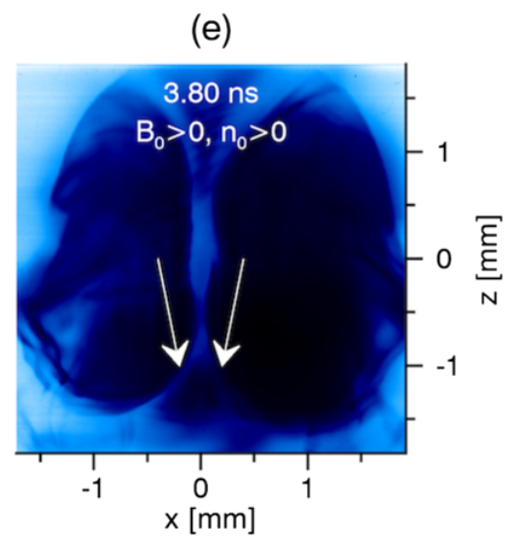
Collisionless shocks: experimental results
Dark = more protons
Proton imaging (or proton radiography)
Charged particles deflected by magnetic fields
Generate proton beam, measure proton location after plasma
Deflection angle gives magnetic field strength (along proton path)
$$F=qv×B$$
Protons
B
Film
Magnetic field jump x2
Density jump x4
= a shock!
Schaeffer, PRL (2016)

Slide 24
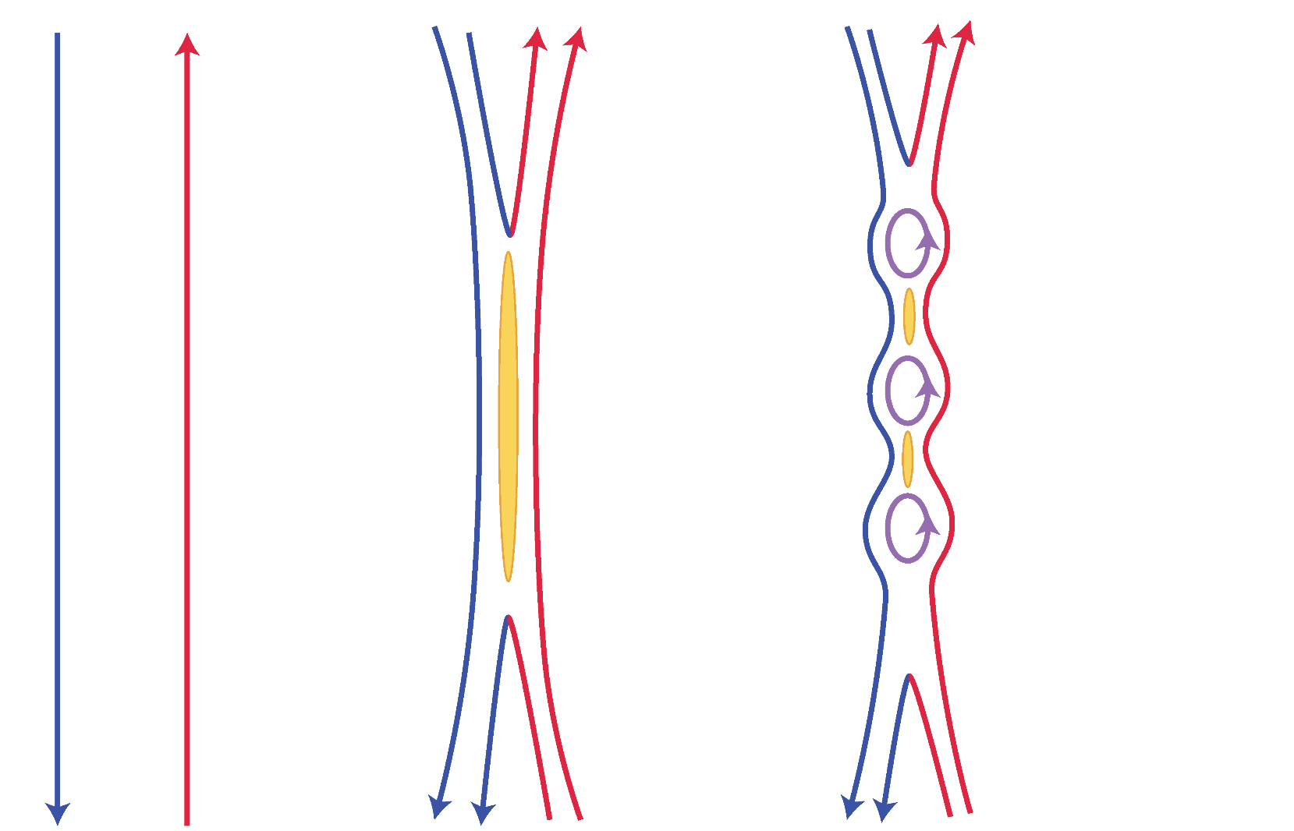
Magnetic Reconnection: astrophysical setting
Current
sheet
B
B

Slide 25
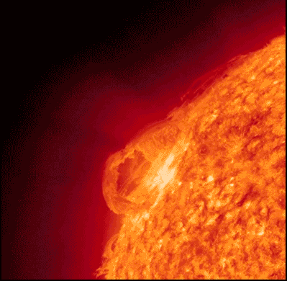
Magnetic Reconnection: astrophysical setting
Prediction: 1000 yrs. Reality: 10 minutes!
Current
sheet
B
B

Slide 26
Magnetic Reconnection: astrophysical setting
Current
sheet
Strongly
sheared
flows
Multiple
current
sheets
B
B
Overview of recent theory:
Loureiro, N. F., & Uzdensky, D. A.(2015).
PPCF, 58, 014021

Slide 27
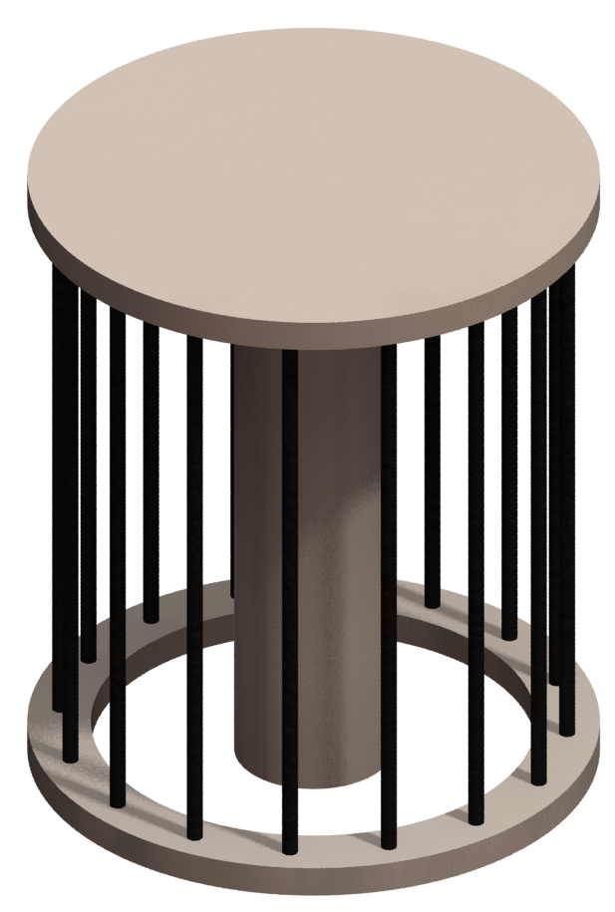
Magnetic reconnection: experimental setup
Dime for scale
Current
I~1 MA, 100-300 ns rise time
Hare, PRL (2017)

Slide 28
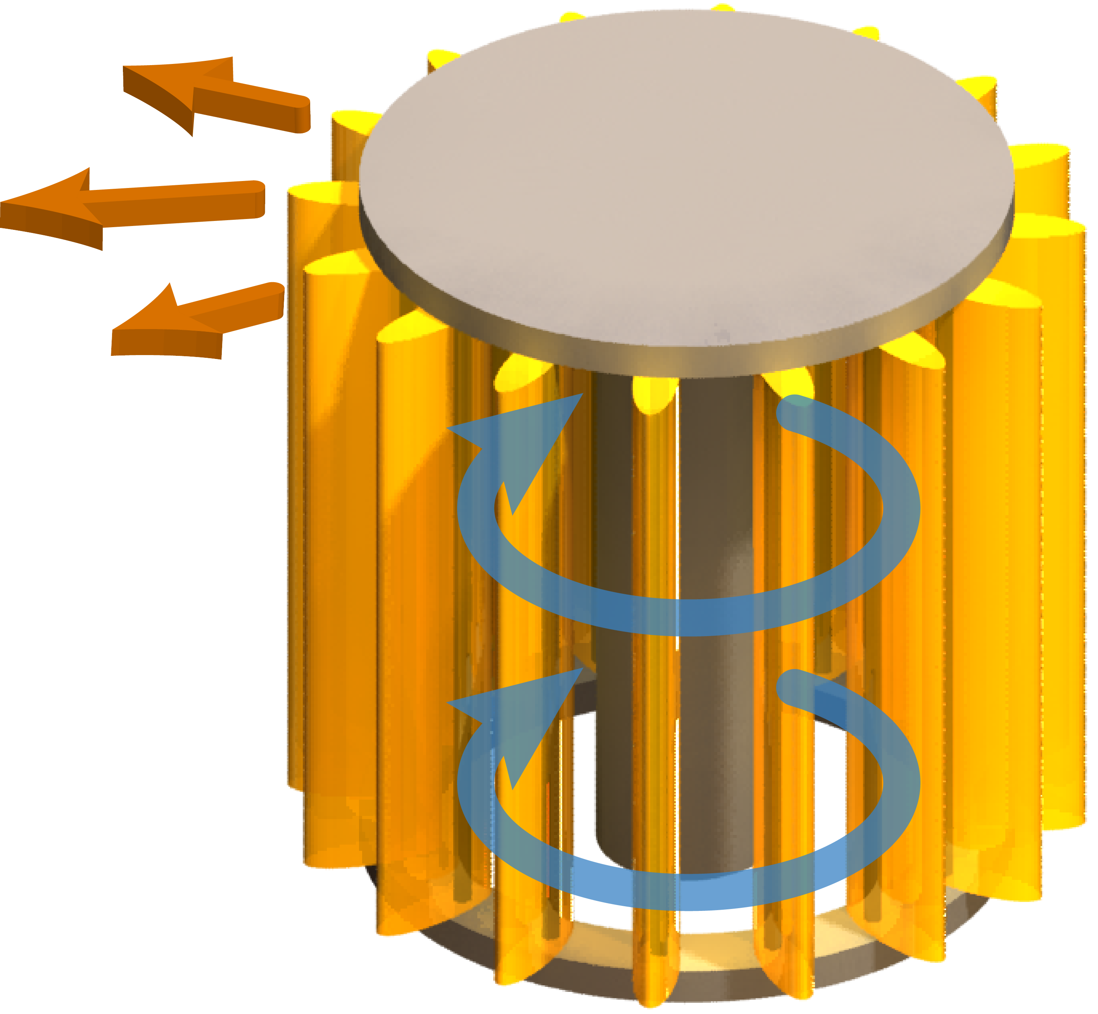
Magnetic reconnection: experimental setup
V
Current
Current heats the wires & generates the magnetic field
which accelerates the plasma
Result: energy components in rough equipartition, $$U_{B}≈U_{th}≈U_{kin}$$
Similar to astrophysical systems
B
I~1 MA, 100-300 ns rise time
Hare, PRL (2017)

Slide 29
Magnetic Reconnection from Double Exploding Wire Arrays
Drive two exploding arrays in parallel: collides flows with opposite magnetic fields, forming a reconnection layer.
Hare, PRL (2017)

Slide 30
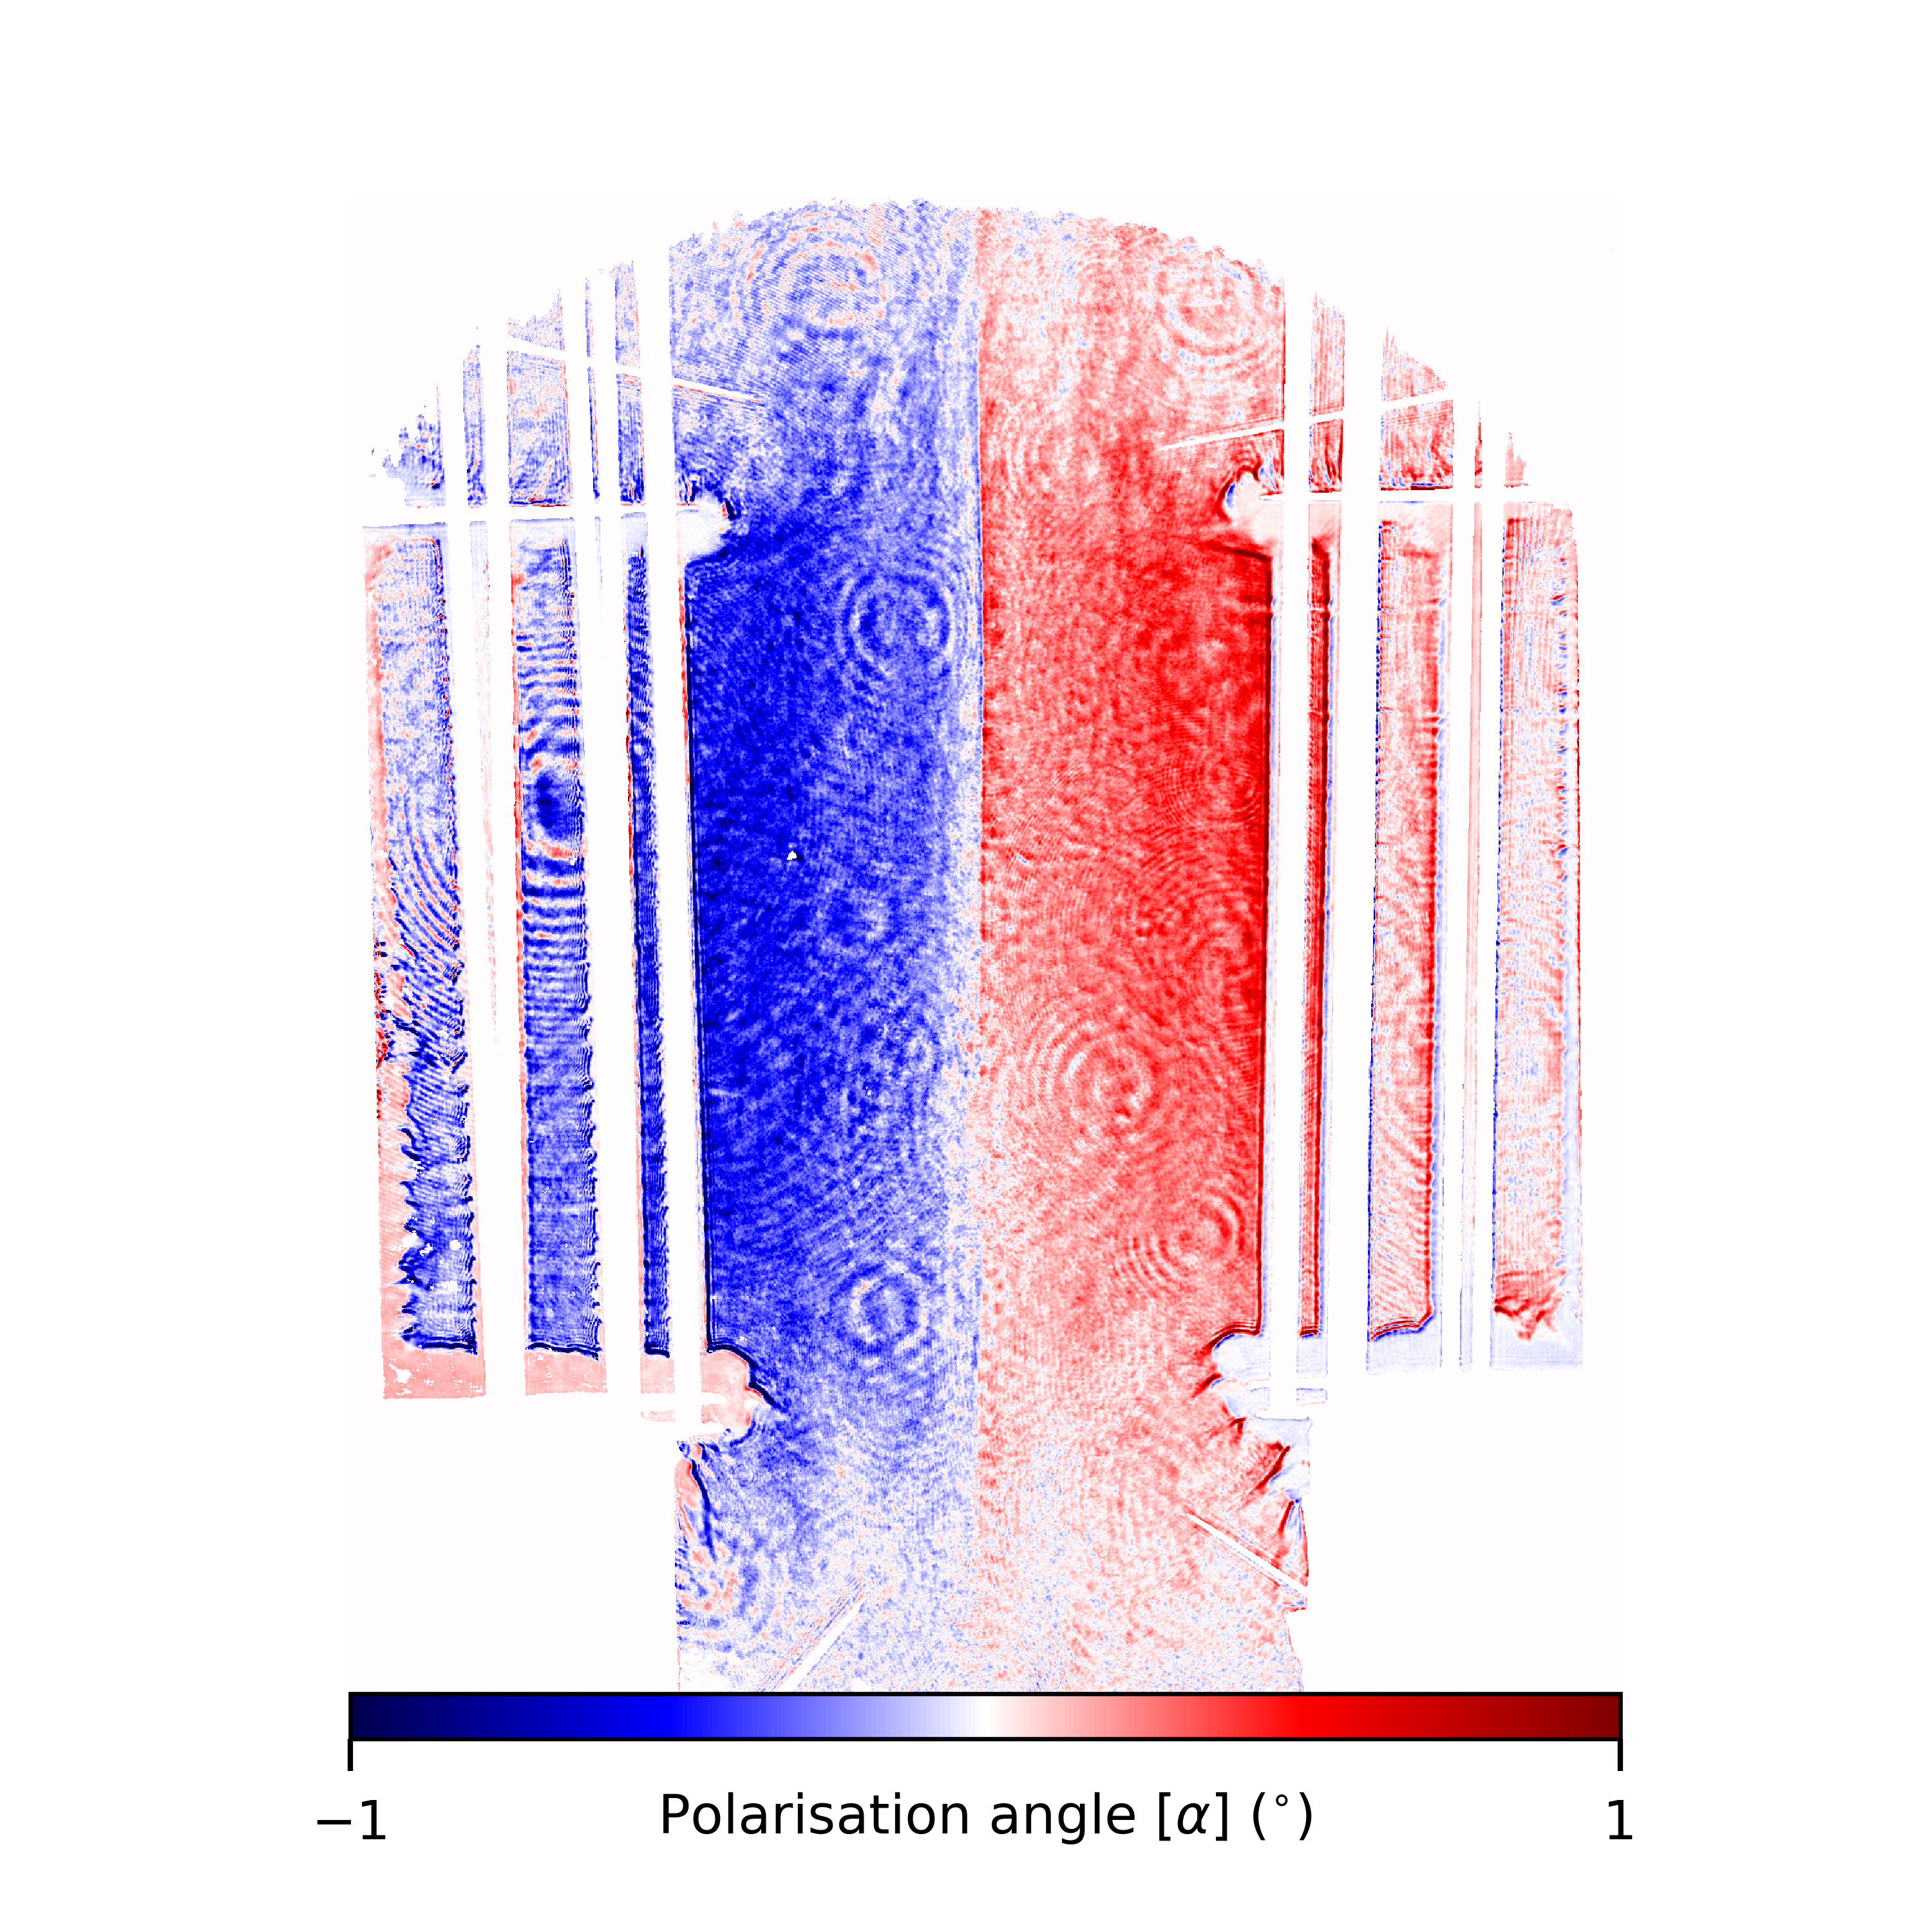
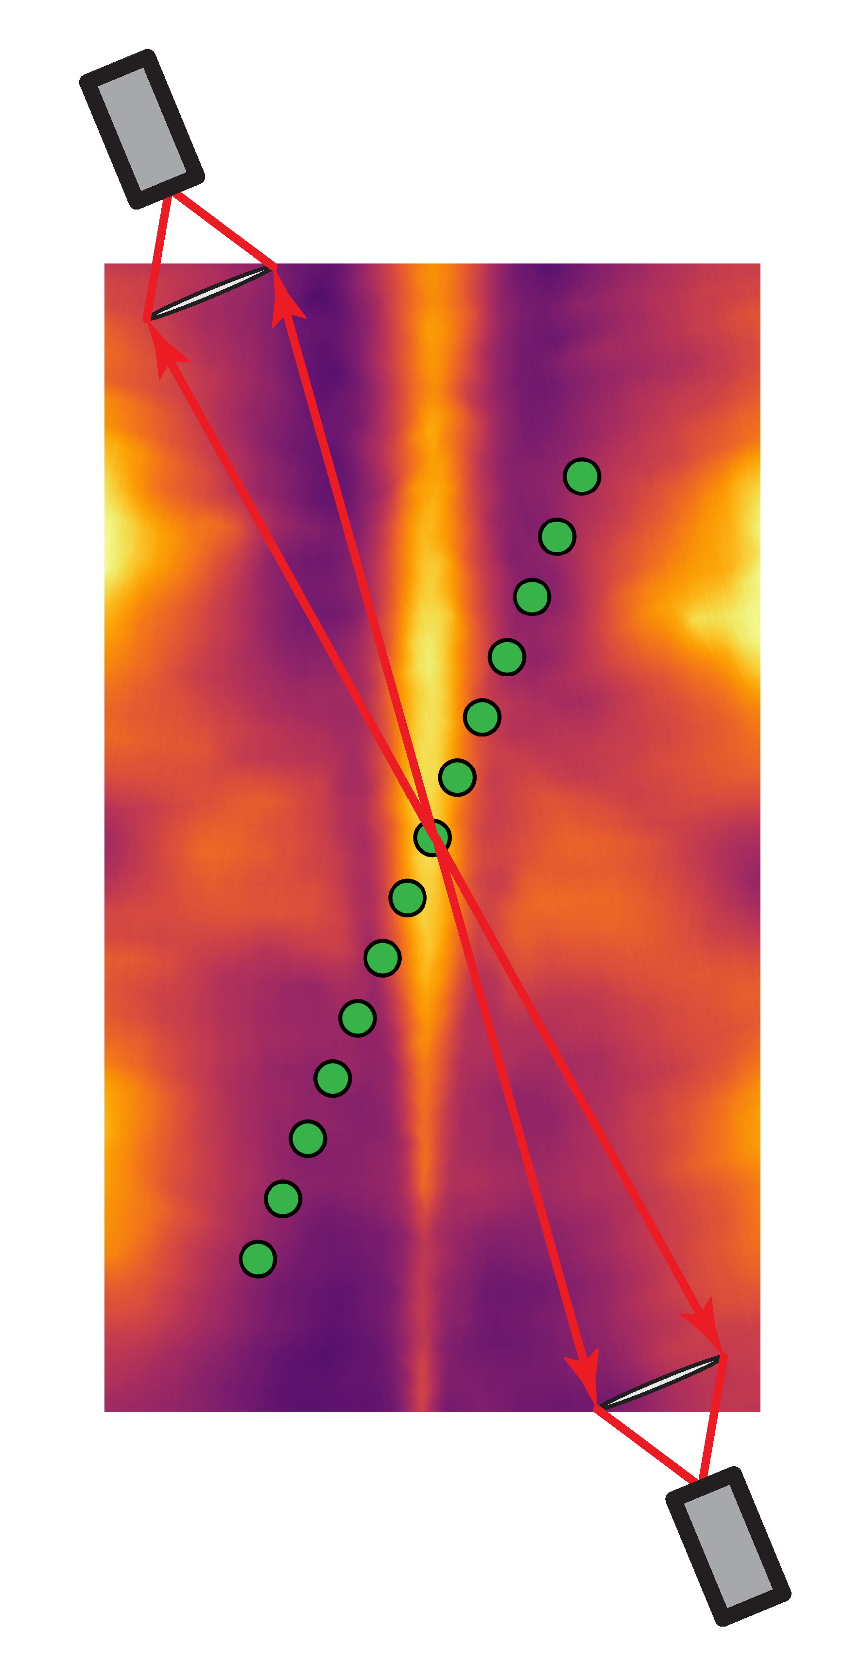
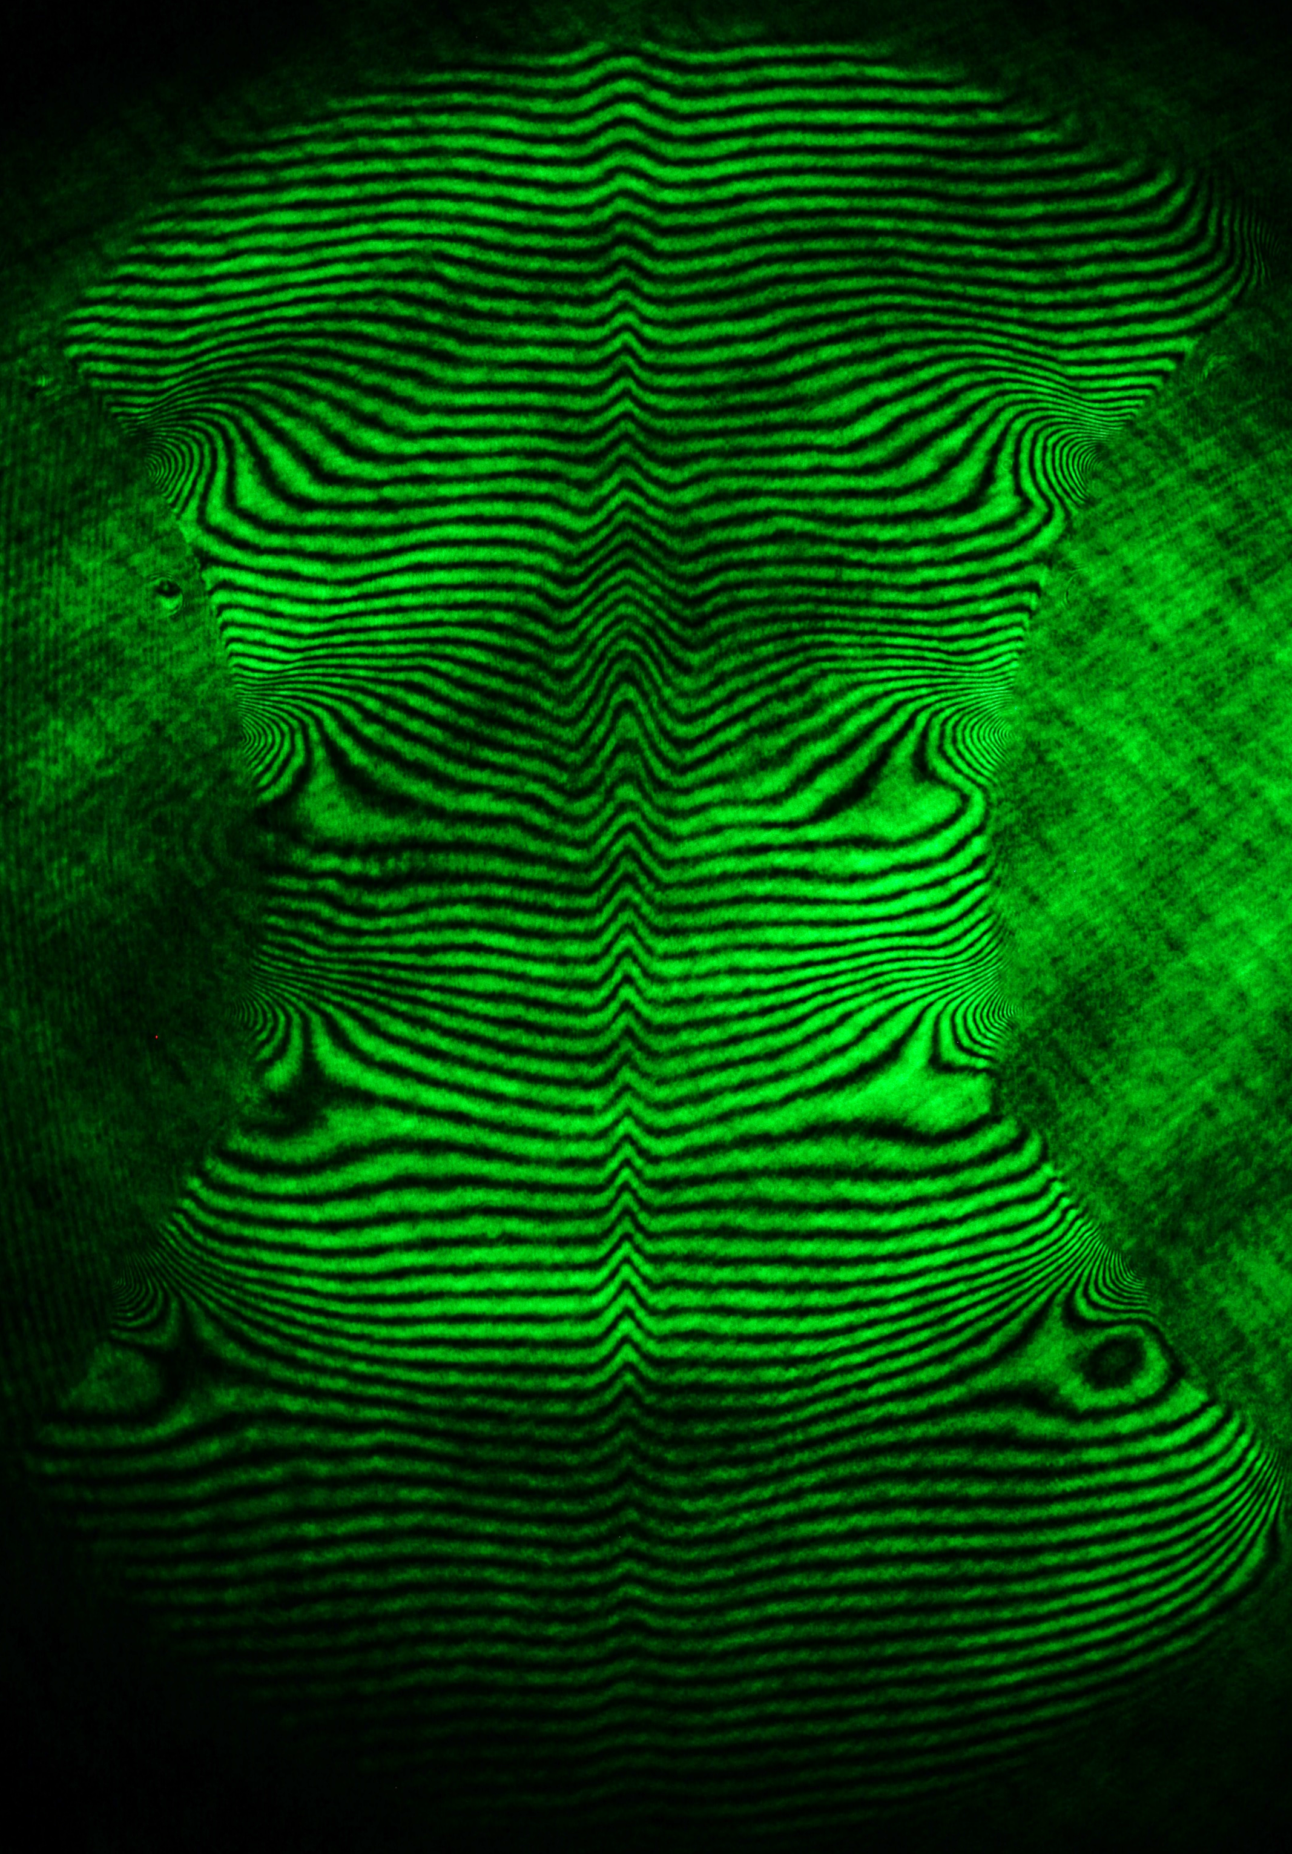
Diagnosing reconnection in the laboratory
Laser interferometry:
$$∫n_{e}dl$$
Faraday Imaging:
$$∫n_{e}B ∙dl$$
Thomson scattering:
$$V, {ZT}_{e}, T_{i}$$
B
B
y
z
x
x
λ₀

Slide 31
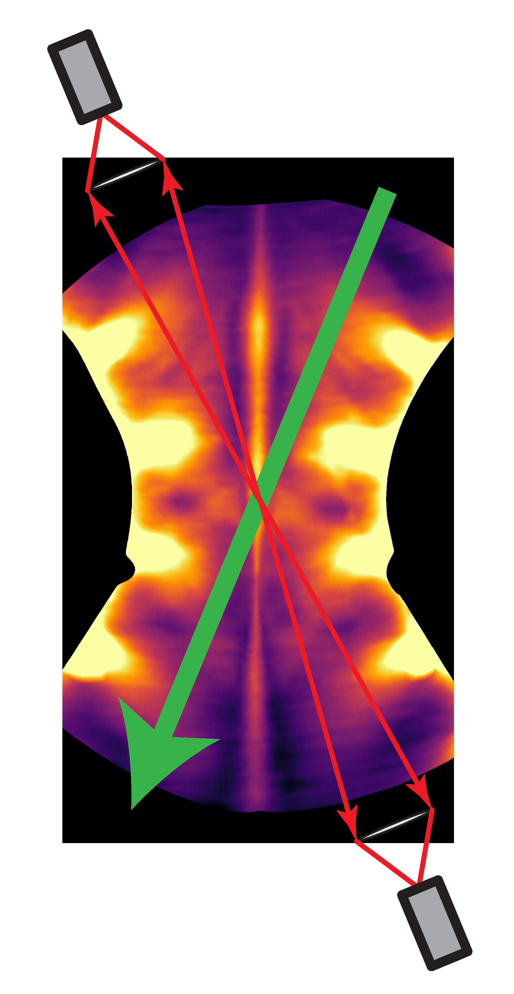
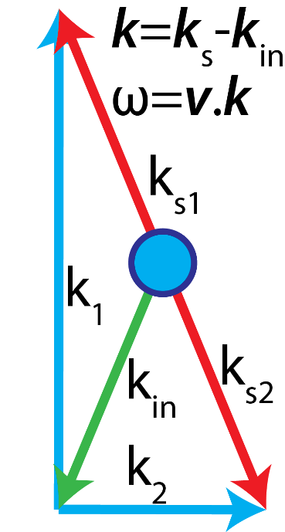
Velocity and Temperature (Thomson Scattering)
Fibre Optic Bundle
Electrons in the plasma scatter light
Light is Doppler shifted and scatters from waves in the plasma
Resonance when $\left(ω,k\right)$ or (energy/momentum) match Ion acoustic waves:
$ω= ±C_{IA}k$ (two peaks) $$C_{IA}= \sqrt{(ZT_{e}+T_{i})/m_{i}}$$
Fibre Optic Bundle

Slide 32
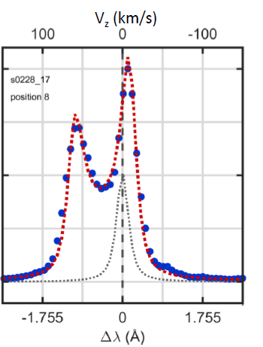
Velocity and Temperature (Thomson Scattering)
Collective scattering from Ion Acoustic Waves
Fibre Optic Bundle
Overall shift: V_{fi}
Fibre Optic Bundle

Slide 33
Velocity and Temperature (Thomson Scattering)
Collective scattering from Ion Acoustic Waves
Fibre Optic Bundle
Separation: ZT_{e}
Overall shift: V_{fi}
Fibre Optic Bundle

Slide 34
Velocity and Temperature (Thomson Scattering)
Collective scattering from Ion Acoustic Waves
Fibre Optic Bundle
Separation: ZT_{e}
Width: T_{i}
Overall shift: V_{fi}
Fibre Optic Bundle

Slide 35
Velocity and Temperature (Thomson Scattering)
Collective scattering from Ion Acoustic Waves
Fibre Optic Bundle
Asymmetry: u_{d}
Separation: ZT_{e}
Width: T_{i}
Overall shift: V_{fi}
Fibre Optic Bundle

Slide 36
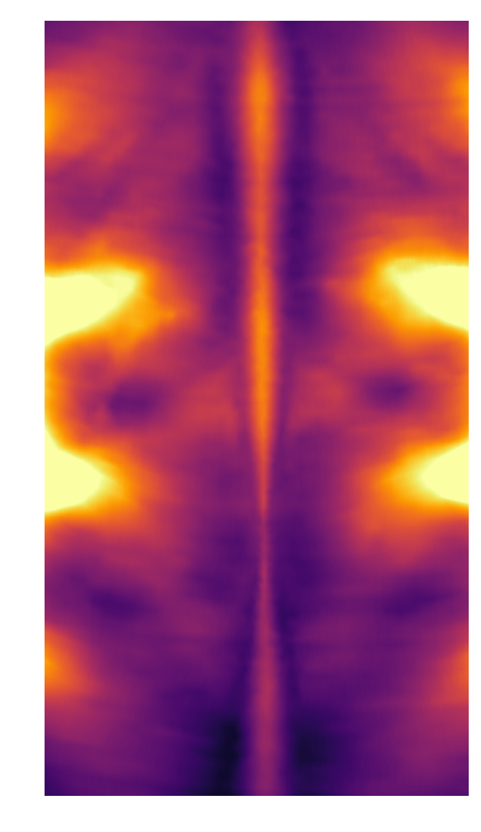
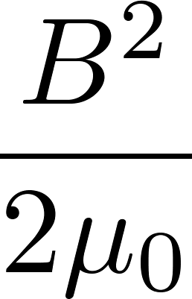
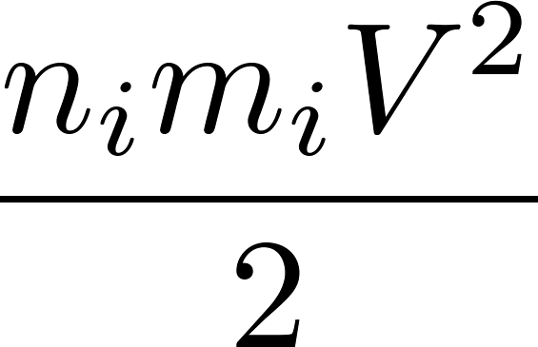
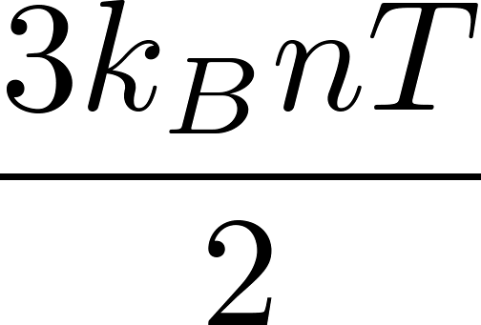
Carbon: Anomalous Heating in the Reconnection Layer
$$V_{in}Lh\left(E_{mag}+E_{kin}+E_{th,i}+E_{th,e}\right)≈V_{out}δh\left(E_{kin}+E_{th,i}+E_{th,e}\right)$$
~50%
~25%
~25%
~40%
~60%
$$P_{out}$$
Classical heating is too slow:
$$τ_{exp}≈50 ns$$
2L
$$P_{in }$$
$$τ_{visc}≈800 ns$$
$$τ_{res}≈350 ns$$
2δ
$τ_{exp}≪τ_{visc}$, $τ_{res}$
Hare, PRL (2017)

Slide 37
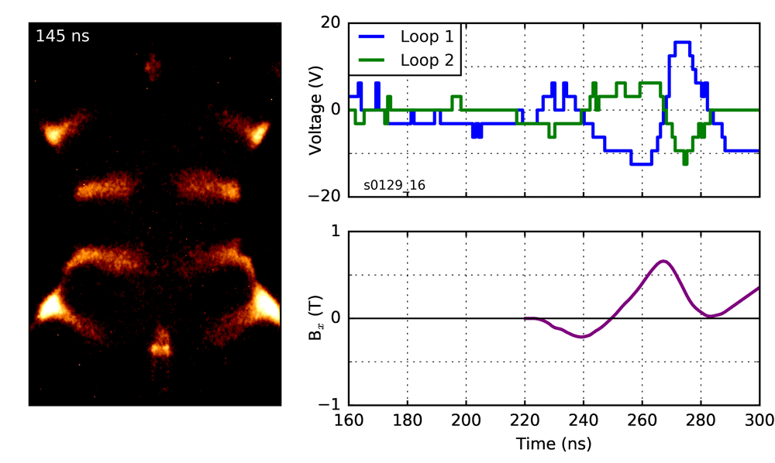
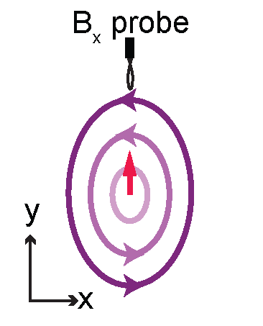
Plasmoids observed in emission, density & B-field
Hare, PRL (2017)

Slide 38
Three laboratory astrophysics experiments
Flux Rope Eruptions
Collisionless Shocks
Magnetic Reconnection
Myers, Nature (2015)
Schaeffer, PRL (2016)
Hare, PRL (2017)

Slide 39
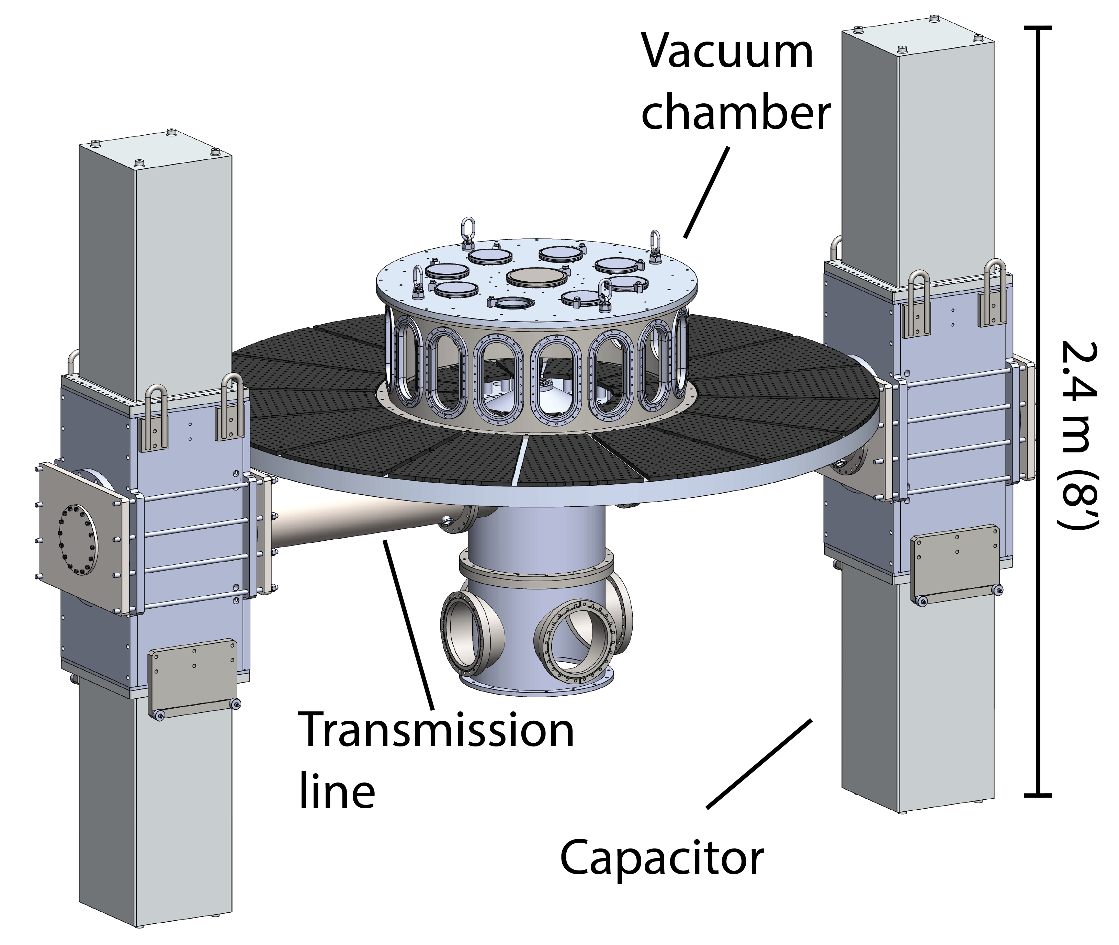
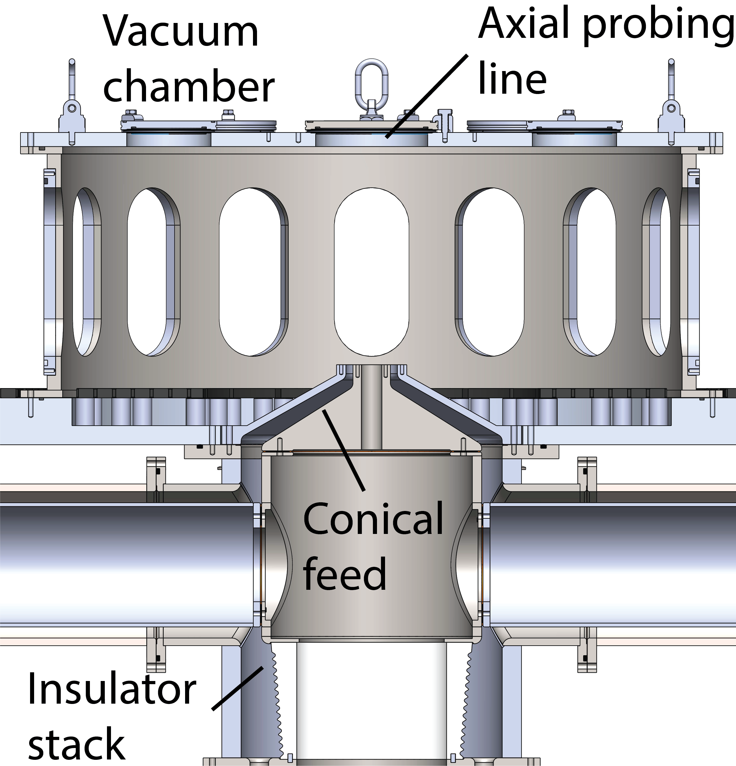
PUFFIN will drive around 1 MA with a 1.5 $μ$s rise time
40 kJ energy to load
puffin.mit.edu

Slide 40
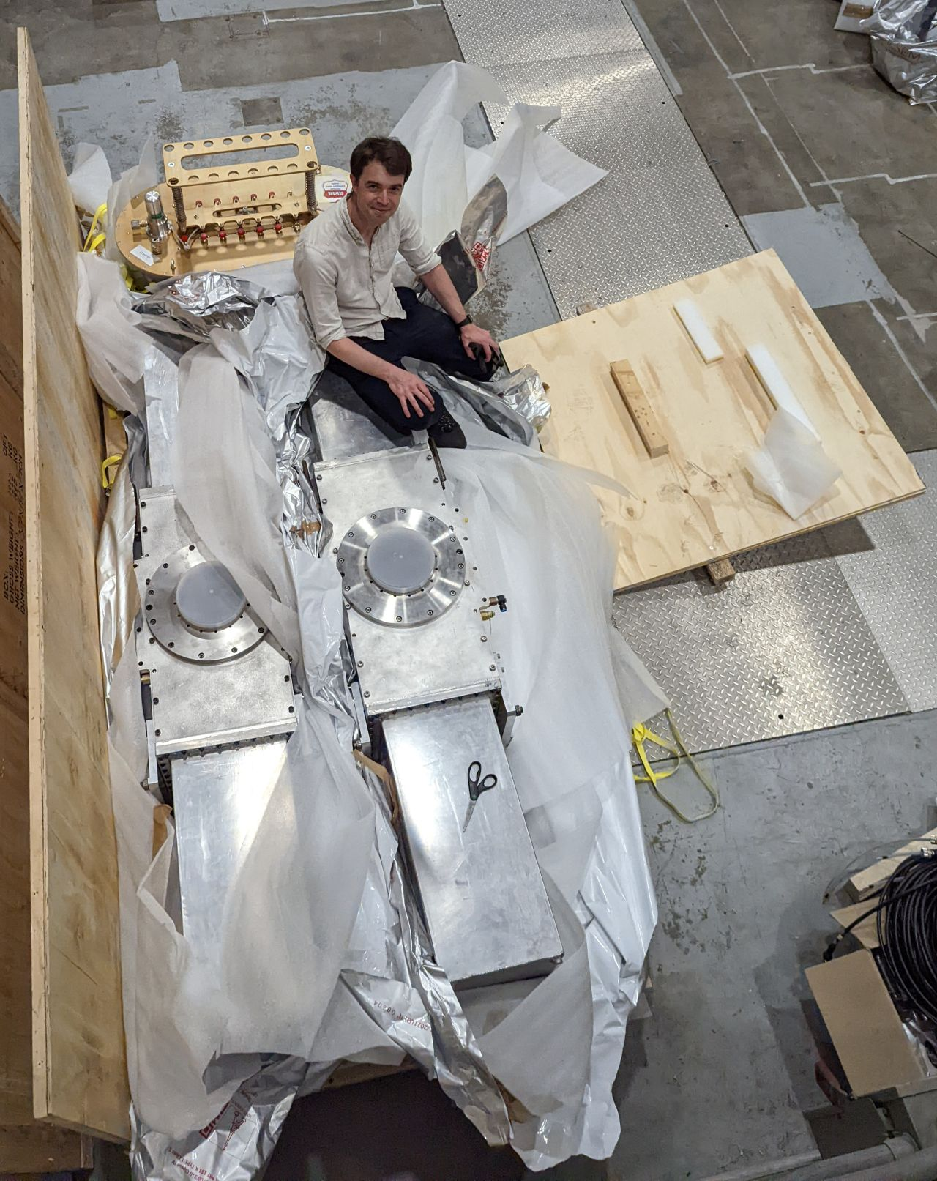
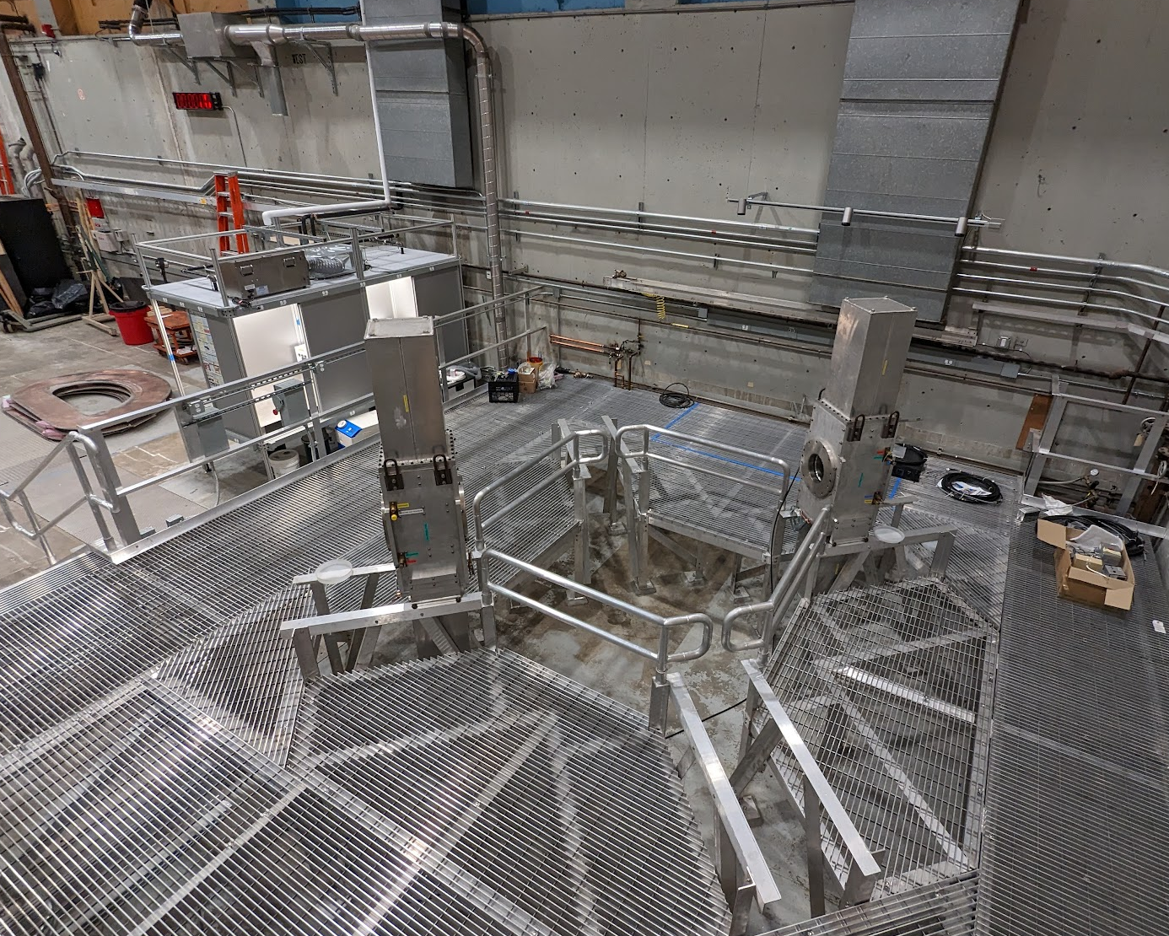
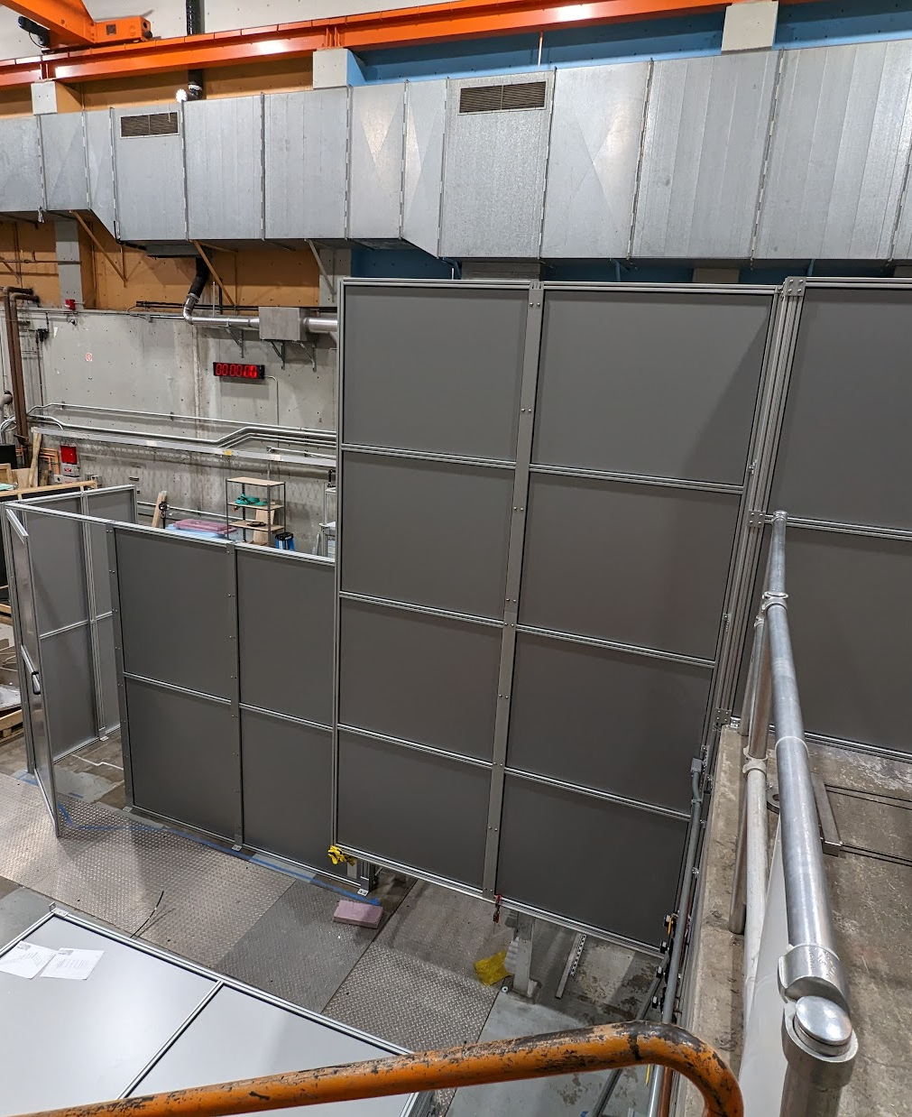
Construction underway, aiming for first plasma in 2023
LTD5 modules arrived May 2022
Mezzanine construction finished September 2022
Laser barrier finished
March 2023
puffin.mit.edu

Slide 41
Conclusions
Hubble/NASA
Laboratory experiments can give insight into astrophysical plasma processes
Failed flux rope eruptions in gas discharge plasmas: a new regime!
Collisionless magnetized shocks driven by lasers: first laboratory evidence!
Magnetic reconnection driven by pulsed-power: fast heating and plasmoids!

