Slide 1


Lane B. Carasik, Ph.D. – Happy Pride Month!
Heat Removal for First Wall Components, Blankets, and Power Conversion
Fluids in Advanced Systems and Technology (FAST) Research Group, Virginia Commonwealth University
Email: lbcarasik@vcu.edu – Group Website: fastresearchgroup.weebly.com
Notes:
Name
Year
School
FAST
Title

Slide 2
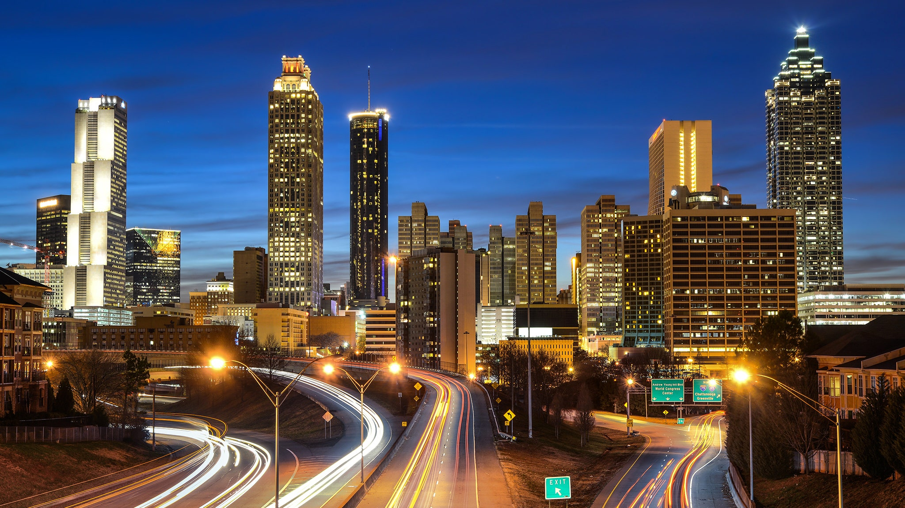



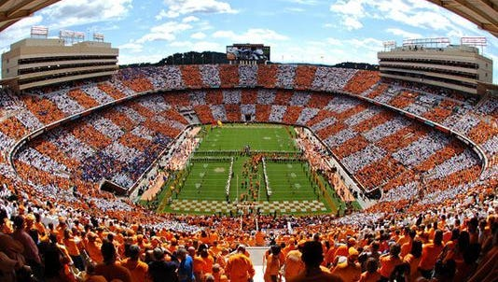
How’d I get here?
ATL - Getty Images
B.S. in Nuclear Engineering
Undergrad research in experimental thermal hydraulics
Ph.D. in Nuclear Engineering
Coursework in Aero, Mech, and Civil
Middle Georgia College
Associates in Math
knoxnews
Notes:
Twisted tubes cause more mixing of the fluid
Cause greater turbulence
More turbulence = better heat transfer
Better heat transfer = more efficient = more power more money/less fuel/less coolant cause salts $$
Specifically were interested in the flow around the outside of the tubes

Slide 3




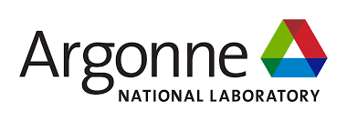



How’d I get here?
Summer REU (NSF CREATE)
Undergrad Research
Summer Intern
Summer Intern
Visiting Researcher
Grad Intern
Grad Intern
CFD Engineer
Nuclear Thermal Fluids Engineer
Notes:
Twisted tubes cause more mixing of the fluid
Cause greater turbulence
More turbulence = better heat transfer
Better heat transfer = more efficient = more power more money/less fuel/less coolant cause salts $$
Specifically were interested in the flow around the outside of the tubes

Slide 4
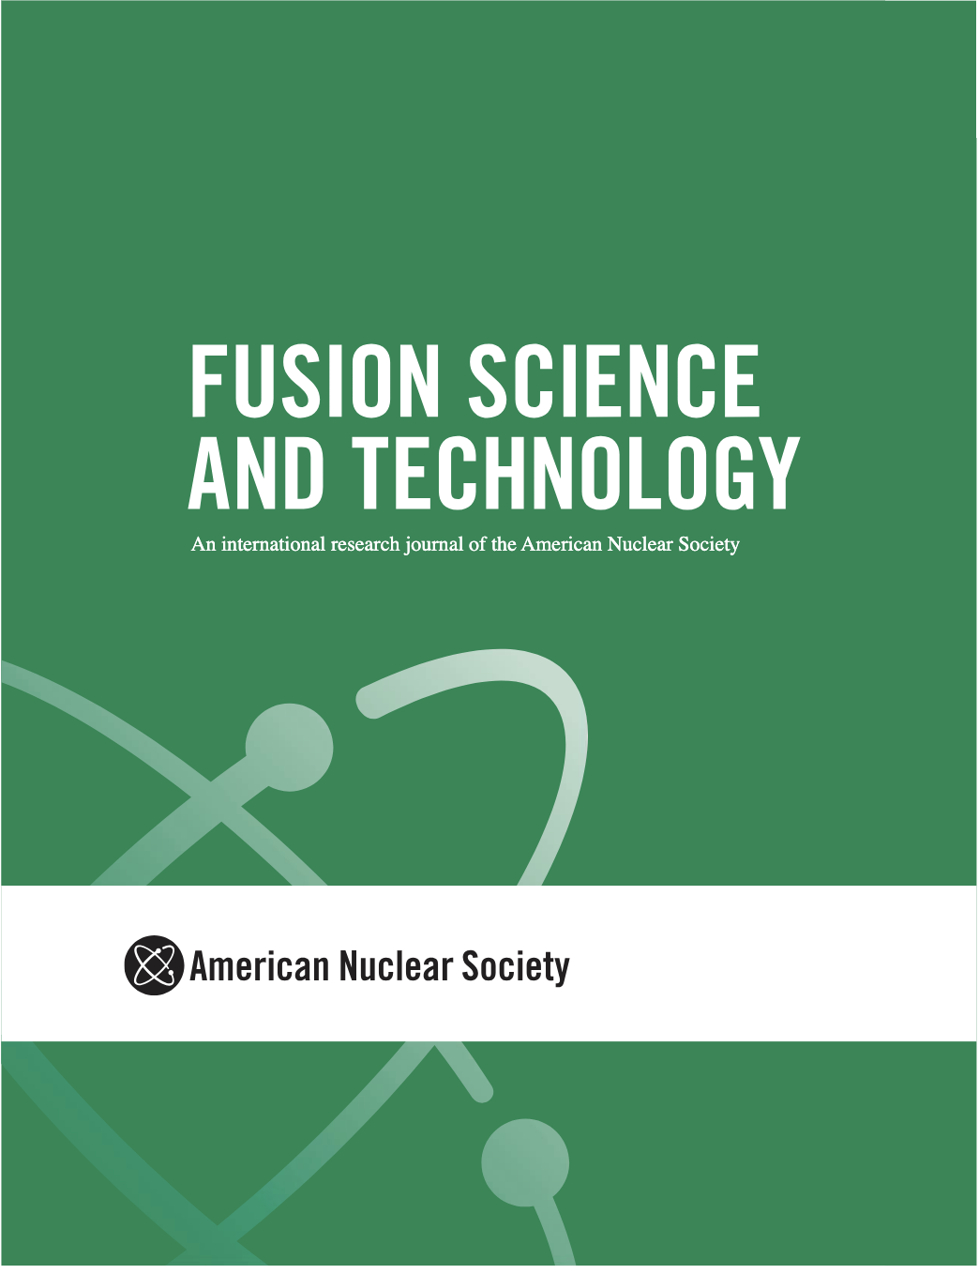

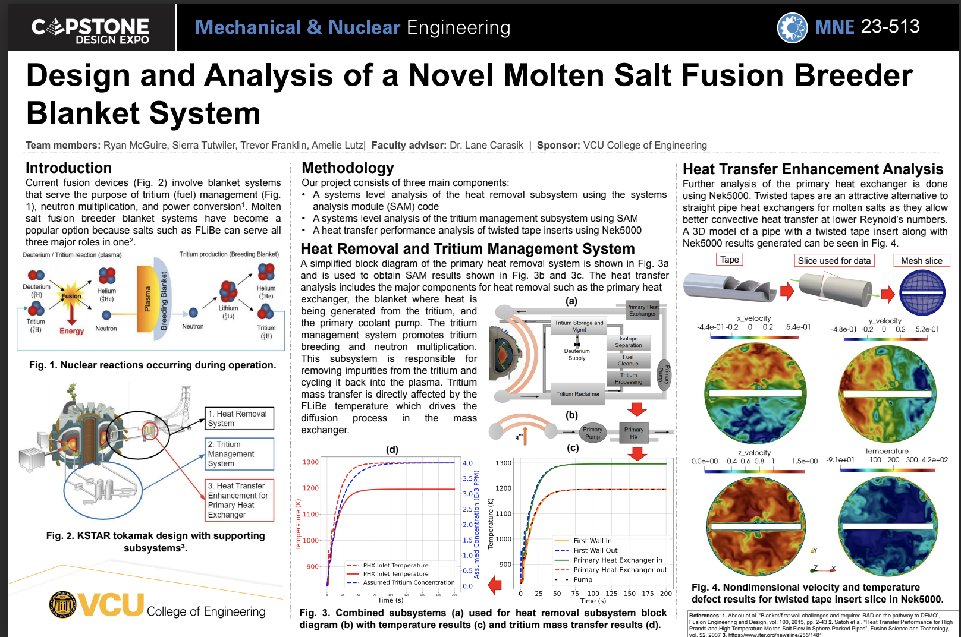
What am I doing in the Fusion Community?
Liquid Immersion Fusion Blanket Senior Design Team!
FS&T Associate Editor (2022-Present)
ITER Workshop Participant and Report Writing Support (2022)
Notes:
Twisted tubes cause more mixing of the fluid
Cause greater turbulence
More turbulence = better heat transfer
Better heat transfer = more efficient = more power more money/less fuel/less coolant cause salts $$
Specifically were interested in the flow around the outside of the tubes

Slide 5
Outline
First Wall Components within Fusion Devices
System Level Viewpoint
Power Conversion Thermodynamic Cycles
Component Level Heat Removal Mechanisms
Notes:
Twisted tubes cause more mixing of the fluid
Cause greater turbulence
More turbulence = better heat transfer
Better heat transfer = more efficient = more power more money/less fuel/less coolant cause salts $$
Specifically were interested in the flow around the outside of the tubes

Slide 6
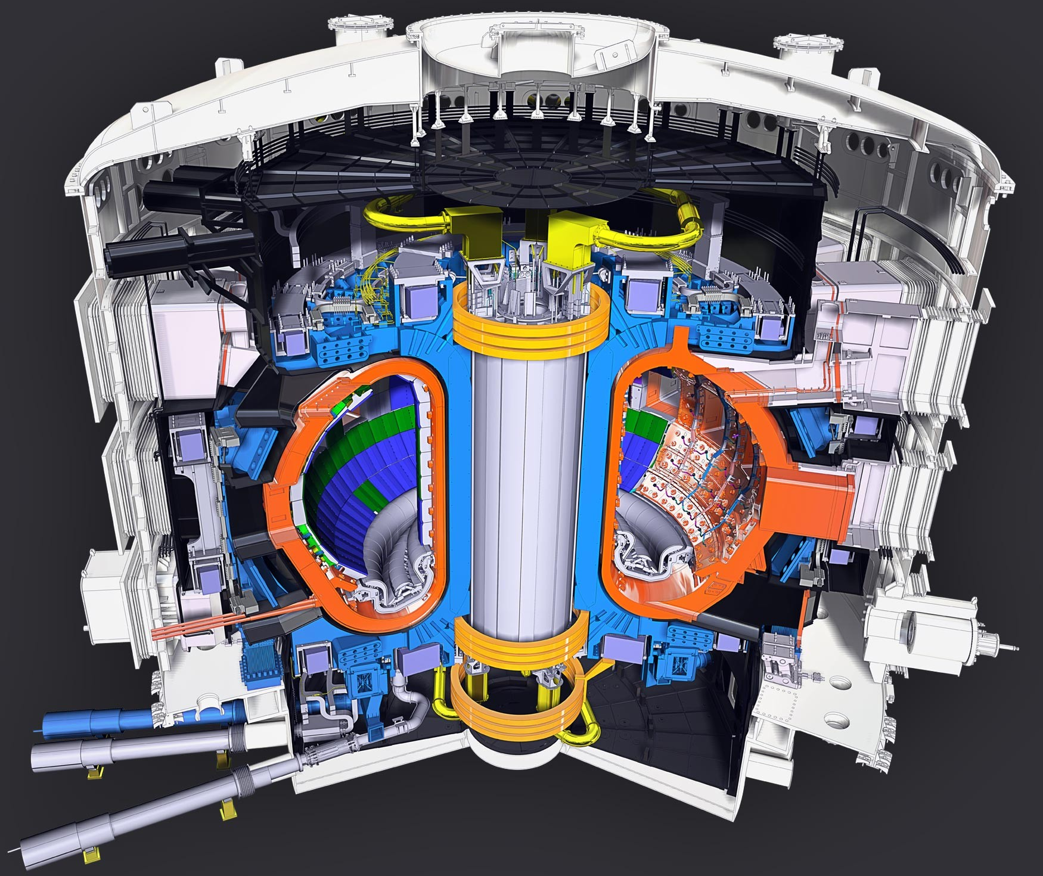
First Wall Components within Fusion Devices
ITER¹
ITER Plasma Facing Component¹
Divertor (Up to 20 MW/m²)
¹ITER Organization, 2021, https://www.iter.org/
Notes:
Twisted tubes cause more mixing of the fluid
Cause greater turbulence
More turbulence = better heat transfer
Better heat transfer = more efficient = more power more money/less fuel/less coolant cause salts $$
Specifically were interested in the flow around the outside of the tubes

Slide 7
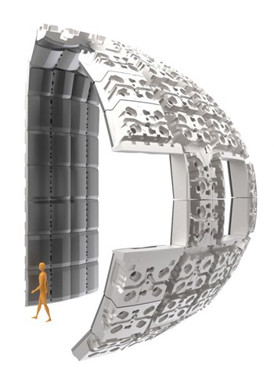
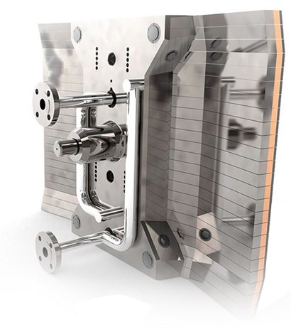
First Wall Components within Fusion Devices
ITER¹
ITER Blanket¹
(~4.5 MW/m²)
¹ITER Organization, 2021, https://www.iter.org/
Notes:
Twisted tubes cause more mixing of the fluid
Cause greater turbulence
More turbulence = better heat transfer
Better heat transfer = more efficient = more power more money/less fuel/less coolant cause salts $$
Specifically were interested in the flow around the outside of the tubes

Slide 8
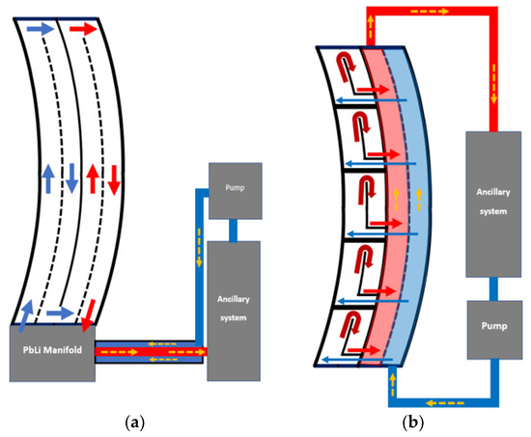
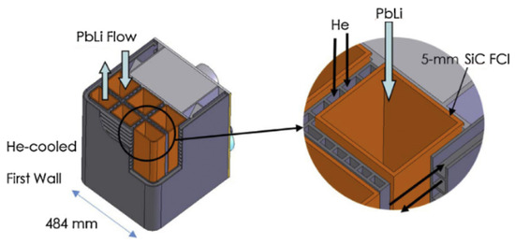
Dual Cooled Lead Lithium Concept
Schematic of the DCLL with PbLi and Helium 1st wall cooling¹
¹S. Smolentsev, Fluids 2021, 6(3), 110; https://doi.org/10.3390/fluids6030110
Notes:
Twisted tubes cause more mixing of the fluid
Cause greater turbulence
More turbulence = better heat transfer
Better heat transfer = more efficient = more power more money/less fuel/less coolant cause salts $$
Specifically were interested in the flow around the outside of the tubes

Slide 9
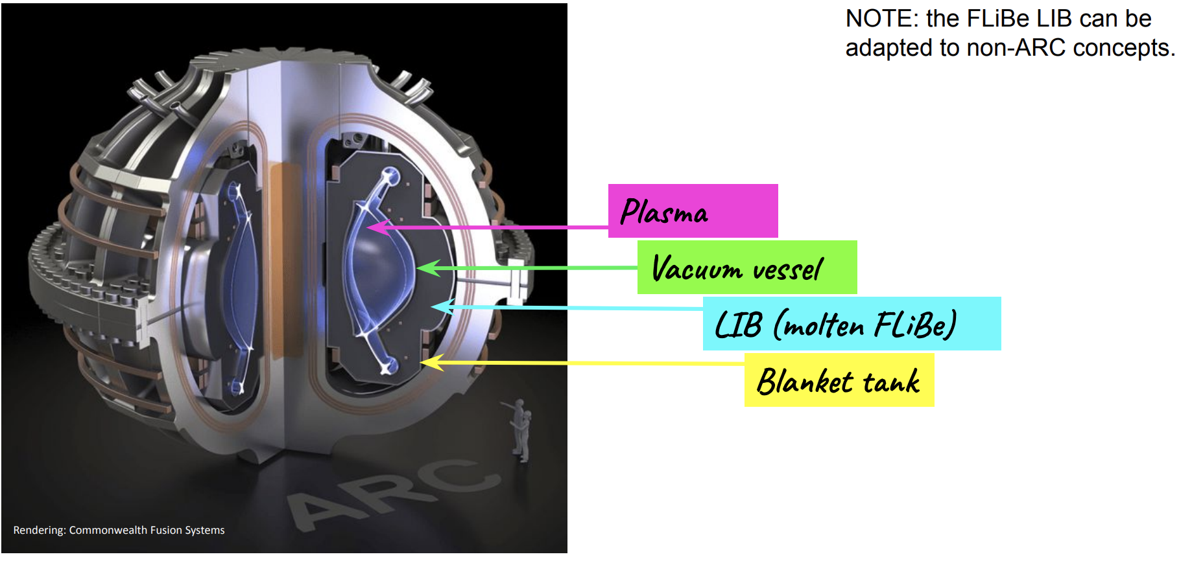
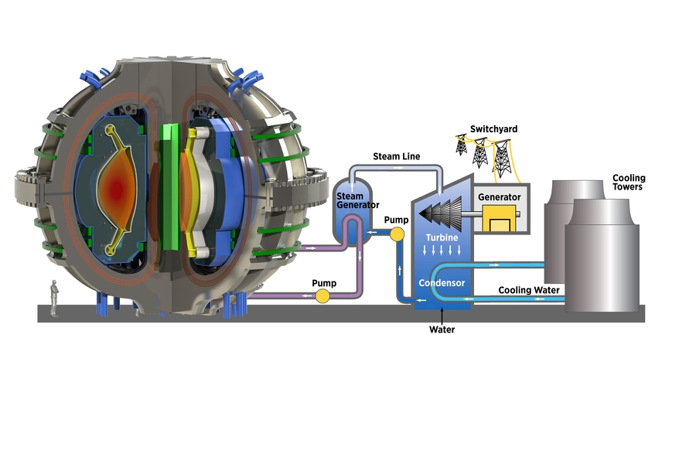
Liquid Immersion Blanket Concept (ARC)
²https://news.mit.edu/2018/nas-report-right-path-fusion-energy-1221
ARC Overview¹
¹S. Ferry, 2023, https://suli.pppl.gov/2023/course/SULI%202023%20presentation.pdf
Notes:
Twisted tubes cause more mixing of the fluid
Cause greater turbulence
More turbulence = better heat transfer
Better heat transfer = more efficient = more power more money/less fuel/less coolant cause salts $$
Specifically were interested in the flow around the outside of the tubes

Slide 10
Why Heat Removal? (System Level)
Cooling of components to prevent degradation and damage
Why use fusion devices at all?
  Power generation
Power Generation Schematic for a Fusion Device - MIT Plasma Science and Fusion Center (PSFC)¹
¹https://news.mit.edu/2018/nas-report-right-path-fusion-energy-1221
Notes:
Simulated and modeled using Nek5000
Open source, CFD code
Mix of Fortran77 and C, uses SEM to solve the unsteady NS eqns
Capable of different modeling techniques such as DNS, and LES/RANS for turbulence modeling
Nek5000 is primarily used for CFD modeling in the nuclear industry and has been extensively verified and validated

Slide 11
System Level – Power Cycles
Based on a Rankine power cycle that is built upon centuries of experience in the power industry
Power Generation Schematic for a Fusion Device - MIT Plasma Science and Fusion Center (PSFC)¹
¹https://news.mit.edu/2018/nas-report-right-path-fusion-energy-1221
Notes:
Simulated and modeled using Nek5000
Open source, CFD code
Mix of Fortran77 and C, uses SEM to solve the unsteady NS eqns
Capable of different modeling techniques such as DNS, and LES/RANS for turbulence modeling
Nek5000 is primarily used for CFD modeling in the nuclear industry and has been extensively verified and validated

Slide 12
System Level – Power Cycles
Regardless of heat source, most power generation results in the same thing, boiling water to spin a turbine that causes a generator to create electricity.
Power Generation Schematic for a Fusion Device - MIT Plasma Science and Fusion Center (PSFC)¹
¹https://news.mit.edu/2018/nas-report-right-path-fusion-energy-1221
Notes:
Simulated and modeled using Nek5000
Open source, CFD code
Mix of Fortran77 and C, uses SEM to solve the unsteady NS eqns
Capable of different modeling techniques such as DNS, and LES/RANS for turbulence modeling
Nek5000 is primarily used for CFD modeling in the nuclear industry and has been extensively verified and validated

Slide 13
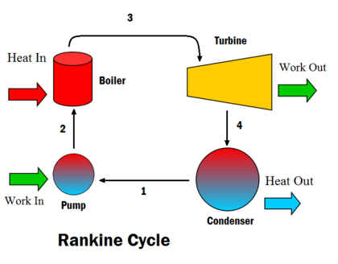
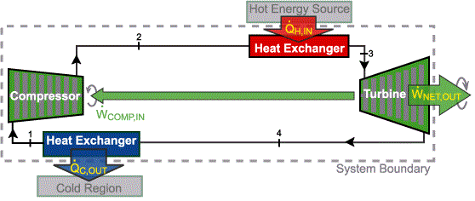
System Level – Power Cycles
There are two common forms of power cycles that could be used:
  Rankine (Liquid - water based)
  Brayton (Gas – helium or others based)
Brayton Cycle
¹https://energyeducation.ca/encyclopedia/Rankine_cycle
²https://energyeducation.ca/encyclopedia/Brayton_cycle
Notes:
Simulated and modeled using Nek5000
Open source, CFD code
Mix of Fortran77 and C, uses SEM to solve the unsteady NS eqns
Capable of different modeling techniques such as DNS, and LES/RANS for turbulence modeling
Nek5000 is primarily used for CFD modeling in the nuclear industry and has been extensively verified and validated

Slide 14
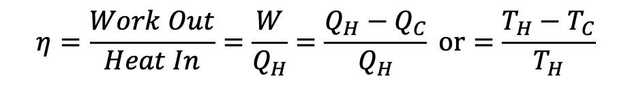
System Level – Power Cycles
Both cycles can be made more complex with reheating, regeneration, multiple stages, to maximize the amount of useful energy out vs. heat in
In this case, the T_{H} or T_{C} are the hottest and coldest reservoir temperatures.
$$η=\frac{Work Out}{Heat In}=\frac{W}{Q_{H}}=\frac{Q_{H}−Q_{C}}{Q_{H}} or=\frac{T_{H}−T_{C}}{T_{H}}$$
¹https://energyeducation.ca/encyclopedia/Rankine_cycle
Notes:
Simulated and modeled using Nek5000
Open source, CFD code
Mix of Fortran77 and C, uses SEM to solve the unsteady NS eqns
Capable of different modeling techniques such as DNS, and LES/RANS for turbulence modeling
Nek5000 is primarily used for CFD modeling in the nuclear industry and has been extensively verified and validated

Slide 15
System Level – Power Cycles
Both cycles can be made more complex with reheating, regeneration, multiple stages, to maximize the amount of useful energy out vs. heat in
We have a few options, lower our final heat sink temperature, raise our operating temperature, but never can reach ideal efficiencies.
$$η=\frac{Work Out}{Heat In}=\frac{W}{Q_{H}}=\frac{Q_{H}−Q_{C}}{Q_{H}} or=\frac{T_{H}−T_{C}}{T_{H}}$$
¹https://energyeducation.ca/encyclopedia/Rankine_cycle
Notes:
Simulated and modeled using Nek5000
Open source, CFD code
Mix of Fortran77 and C, uses SEM to solve the unsteady NS eqns
Capable of different modeling techniques such as DNS, and LES/RANS for turbulence modeling
Nek5000 is primarily used for CFD modeling in the nuclear industry and has been extensively verified and validated

Slide 16
System Level – Heat Removal
A critical aspect of heat removal is ensuring we understand the heat transfer mechanisms that control our power cycle capabilities, material temperature limits, and instrumentation/control schemes.
ITER Blanket¹
(~4.5 MW/m²)
¹ITER Organization, 2021, https://www.iter.org/
Notes:
Simulated and modeled using Nek5000
Open source, CFD code
Mix of Fortran77 and C, uses SEM to solve the unsteady NS eqns
Capable of different modeling techniques such as DNS, and LES/RANS for turbulence modeling
Nek5000 is primarily used for CFD modeling in the nuclear industry and has been extensively verified and validated

Slide 17
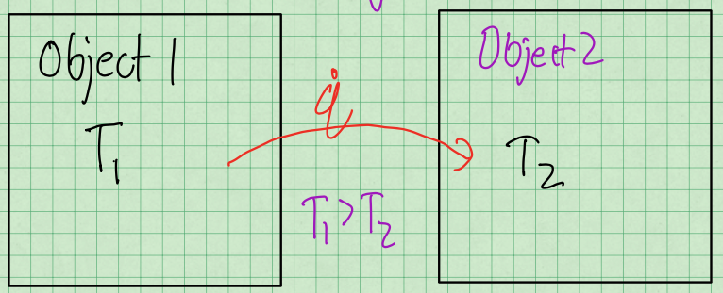
Heat Transfer Mechanisms
Heat Transfer occurs whenever there is a temperature difference between two objects
Notes:
Simulated and modeled using Nek5000
Open source, CFD code
Mix of Fortran77 and C, uses SEM to solve the unsteady NS eqns
Capable of different modeling techniques such as DNS, and LES/RANS for turbulence modeling
Nek5000 is primarily used for CFD modeling in the nuclear industry and has been extensively verified and validated

Slide 18
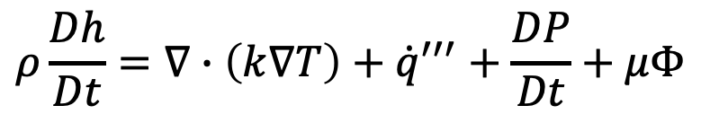
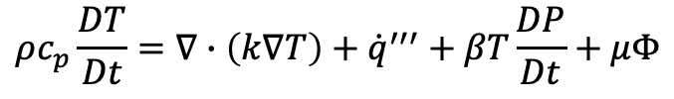
Heat Transfer Mechanisms
Heat Transfer occurs in:
  Solids – Gases – Fluids – Plasmas - Others?
  As a continuum (not individual particles)
Very General Conservation of Energy Equation
Enthalpy Formulation
$$ρ\frac{Dh}{Dt}=∇∙\left(k∇T\right)+{\dot{q}}^{′′′}+\frac{DP}{Dt}+μΦ$$
Temperature Formulation
$$ρc_{p}\frac{DT}{Dt}=∇∙\left(k∇T\right)+{\dot{q}}^{′′′}+βT\frac{DP}{Dt}+μΦ$$
Notes:
Simulated and modeled using Nek5000
Open source, CFD code
Mix of Fortran77 and C, uses SEM to solve the unsteady NS eqns
Capable of different modeling techniques such as DNS, and LES/RANS for turbulence modeling
Nek5000 is primarily used for CFD modeling in the nuclear industry and has been extensively verified and validated

Slide 19
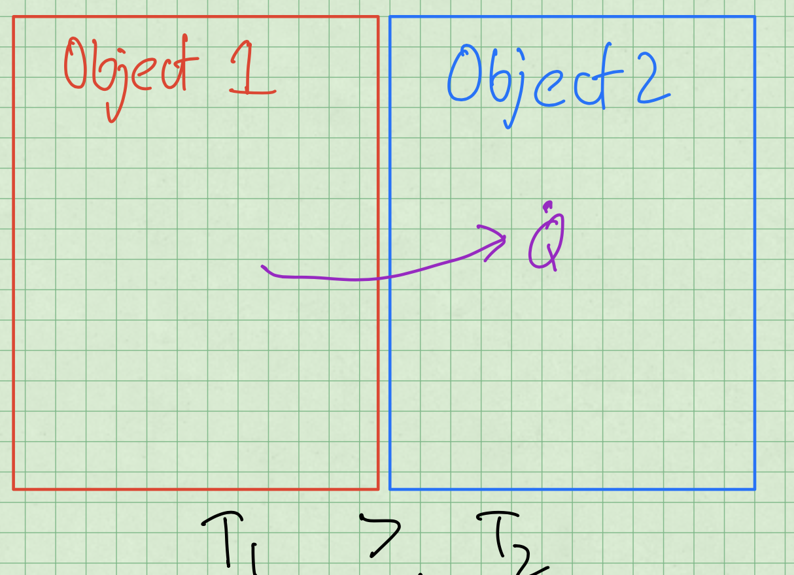

Heat Transfer Mechanisms
Heat Conduction (Conductive Heat Transfer)+
  Can occur within an object and between objects in contact
  Described using diffusion operator ($∇k∇T$) in the energy equation
Notes:
Simulated and modeled using Nek5000
Open source, CFD code
Mix of Fortran77 and C, uses SEM to solve the unsteady NS eqns
Capable of different modeling techniques such as DNS, and LES/RANS for turbulence modeling
Nek5000 is primarily used for CFD modeling in the nuclear industry and has been extensively verified and validated

Slide 20
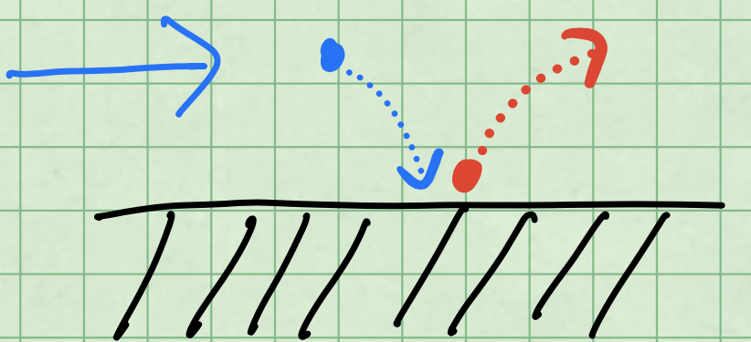

Heat Transfer Mechanisms
Heat Convection (Convective Heat Transfer)
  Involves a fluid (liquid or gas) that is moving due to mechanical or buoyant forces
  Described using the advective operator ($\overset{⃑}{V}∙∇T$ or $\overset{⃑}{V}∙∇h$ )
Notes:
Simulated and modeled using Nek5000
Open source, CFD code
Mix of Fortran77 and C, uses SEM to solve the unsteady NS eqns
Capable of different modeling techniques such as DNS, and LES/RANS for turbulence modeling
Nek5000 is primarily used for CFD modeling in the nuclear industry and has been extensively verified and validated

Slide 21
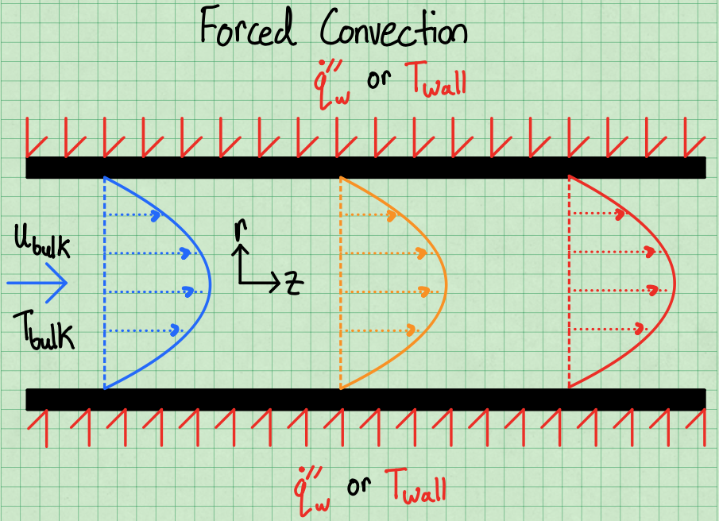





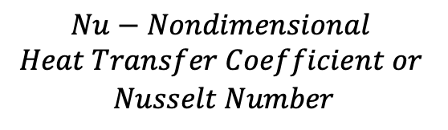

Heat Transfer Mechanisms
Heat Convection (Convective Heat Transfer)
  Two forms (Free/Natural and Forced Convection)
$${\dot{Q}}_{conv.}=HTC\left(T_{wall}−T_{bulk}\right)SA$$
$$HTC=\frac{kNu}{D_{h}}$$
$$HTC−Heat Transfer Coefficient$$
$$T_{wall}−Wall Temperature (°C)$$
$$T_{bulk}−Bulk Fluid Temperature (°C)$$
$$SA −Surface Area (m^{2})$$
$$Nu−Nondimensional$$
$$Heat Transfer Coefficient or$$
$$Nusselt Number$$
Notes:
Simulated and modeled using Nek5000
Open source, CFD code
Mix of Fortran77 and C, uses SEM to solve the unsteady NS eqns
Capable of different modeling techniques such as DNS, and LES/RANS for turbulence modeling
Nek5000 is primarily used for CFD modeling in the nuclear industry and has been extensively verified and validated

Slide 22
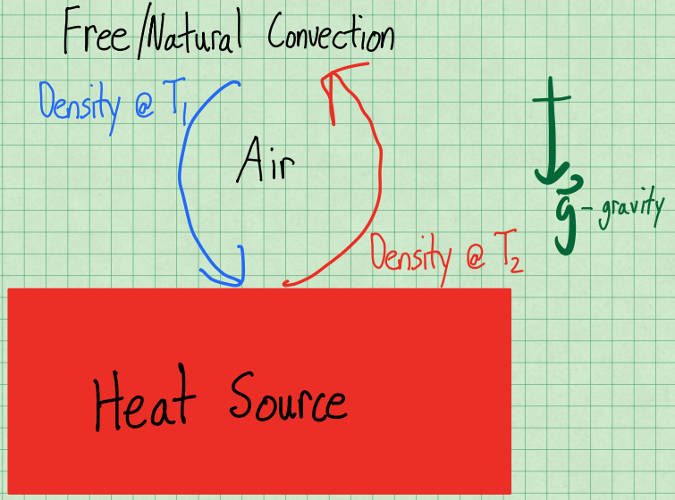




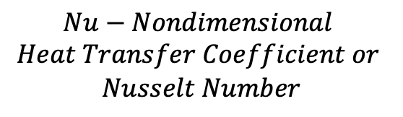
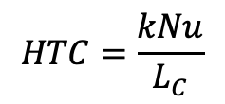

Heat Transfer Mechanisms
Heat Convection (Convective Heat Transfer)
  Two forms (Free/Natural and Forced Convection)
$${\dot{Q}}_{conv.}=HTC\left(T_{wall}−T_{∞}\right)SA$$
$$HTC−Heat Transfer Coefficient$$
$$HTC=\frac{kNu}{L_{C}}$$
$$T_{wall}−Wall Temperature (°C)$$
$$T_{∞}−Ambient Temperature (°C)$$
$$SA −Surface Area (m^{2})$$
$$Nu−Nondimensional$$
$$Heat Transfer Coefficient or$$
$$Nusselt Number$$
Notes:
Simulated and modeled using Nek5000
Open source, CFD code
Mix of Fortran77 and C, uses SEM to solve the unsteady NS eqns
Capable of different modeling techniques such as DNS, and LES/RANS for turbulence modeling
Nek5000 is primarily used for CFD modeling in the nuclear industry and has been extensively verified and validated

Slide 23
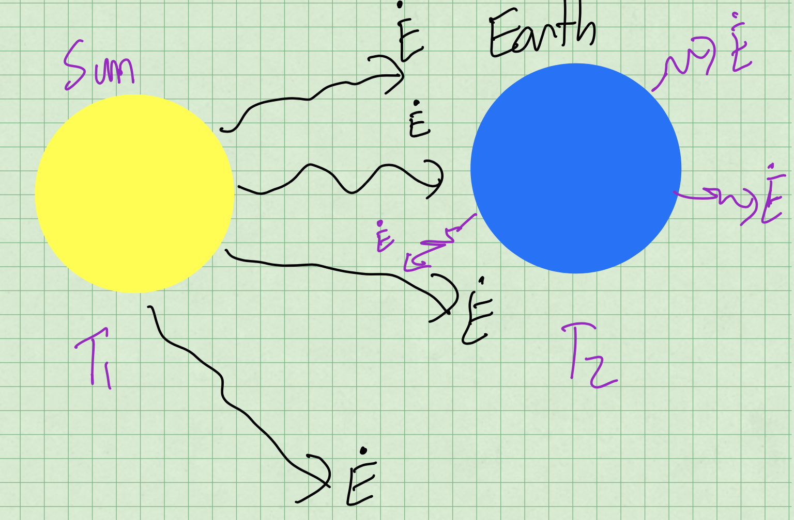






Heat Transfer Mechanisms
Heat Radiation (Irradiative Heat Transfer)
$${\dot{Q}}_{rad}=εσ\left(T_{Hot}^{4}−T_{Cold}^{4}\right)SA$$
$$ε −Emissitivity (−)$$
$$σ −Stefan−Boltzmann$$
$$Constant −5.6703x{10}^{−8} \frac{W}{m^{2}−K^{4}}$$
$$T_{Hot}−Hotter Surface (K)$$
$$T_{Cold}−Colder Surface (K)$$
$$SA −Surface Area (m^{2})$$
Notes:
Simulated and modeled using Nek5000
Open source, CFD code
Mix of Fortran77 and C, uses SEM to solve the unsteady NS eqns
Capable of different modeling techniques such as DNS, and LES/RANS for turbulence modeling
Nek5000 is primarily used for CFD modeling in the nuclear industry and has been extensively verified and validated

Slide 24
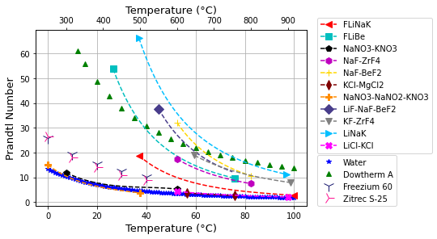




Scaling and Similitude for Fusion Device Design
We take advantage of surrogate fluids for molten salts, liquid metals, and gases to do scaled heat transfer and fluid dynamics experiments.
Relevant scaling parameters/non-dimensional numbers:
Desired Heat Transfer/Fluid Dynamics Design Information:
$$\operatorname{Pr}{= \frac{μc_{p}}{k}}$$
$$Re= \frac{ρuD_{h}}{μ}$$
$$HTC=f (Re,Pr,Geom, BCs)$$
$$dP=f(Re,Geom)$$
Cabral, A., et al., “Identification of Surrogate Fluids for Molten Salt Coolants used in Energy Systems Applications including Concentrated Solar and Nuclear Power Plants,” Int. J. Energy Res., Vol. 46(3), pp. 3554-3571, 2022

Slide 25
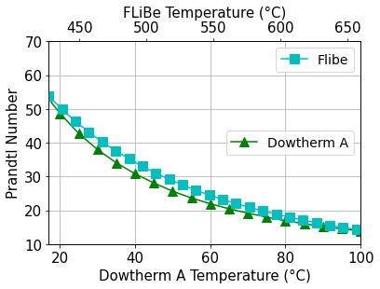
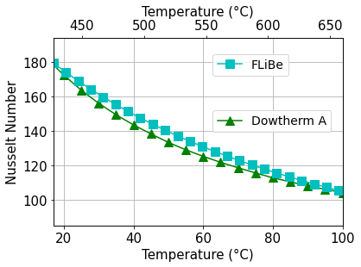
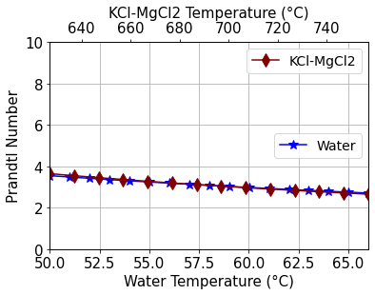
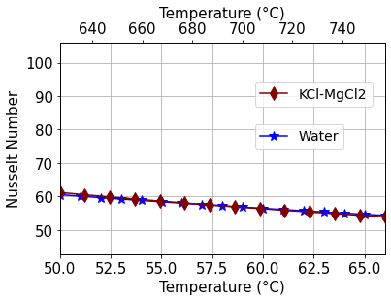
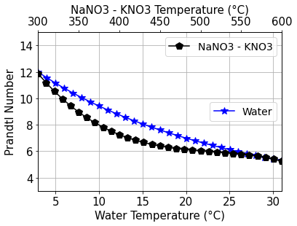
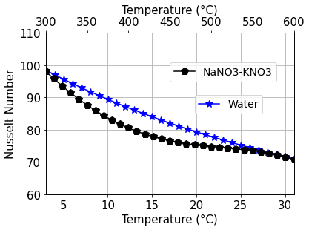



Similitude of Heat Transfer
Fluorides:
$$Re= \frac{ρuD_{h}}{μ}$$
Chlorides:
$$\operatorname{Pr}{= \frac{μc_{p}}{k}}$$
Nitrates:
$$HTC=f (Re,Pr,Geom, BCs)$$
Cabral, A., et al., “Identification of Surrogate Fluids for Molten Salt Coolants used in Energy Systems Applications including Concentrated Solar and Nuclear Power Plants,” Int. J. Energy Res., Vol. 46(3), pp. 3554-3571, 2022

Slide 26
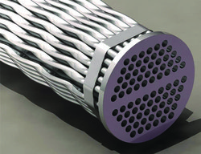
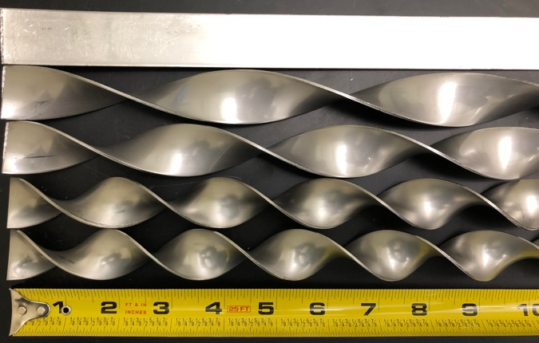
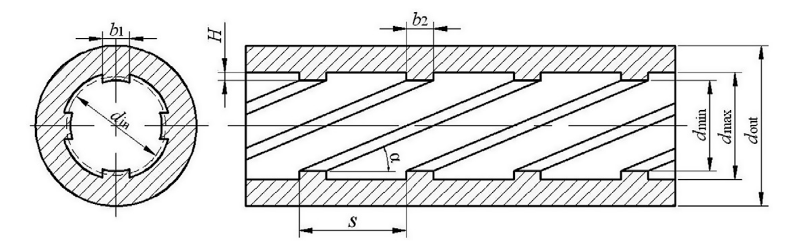
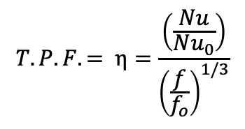
Types of Heat Transfer Enhancements
Different forms of heat transfer enhancements exists:
Swirl flow inserts
Internal fins
Rifling/grooves
Others
Performance quantified by the
Thermal Performance Factor
$$T.P.F. = η=\frac{\left(\frac{Nu}{Nu_{0}}\right)}{{\left(\frac{f}{f_{o}}\right)}^{1/3}}$$

Slide 27
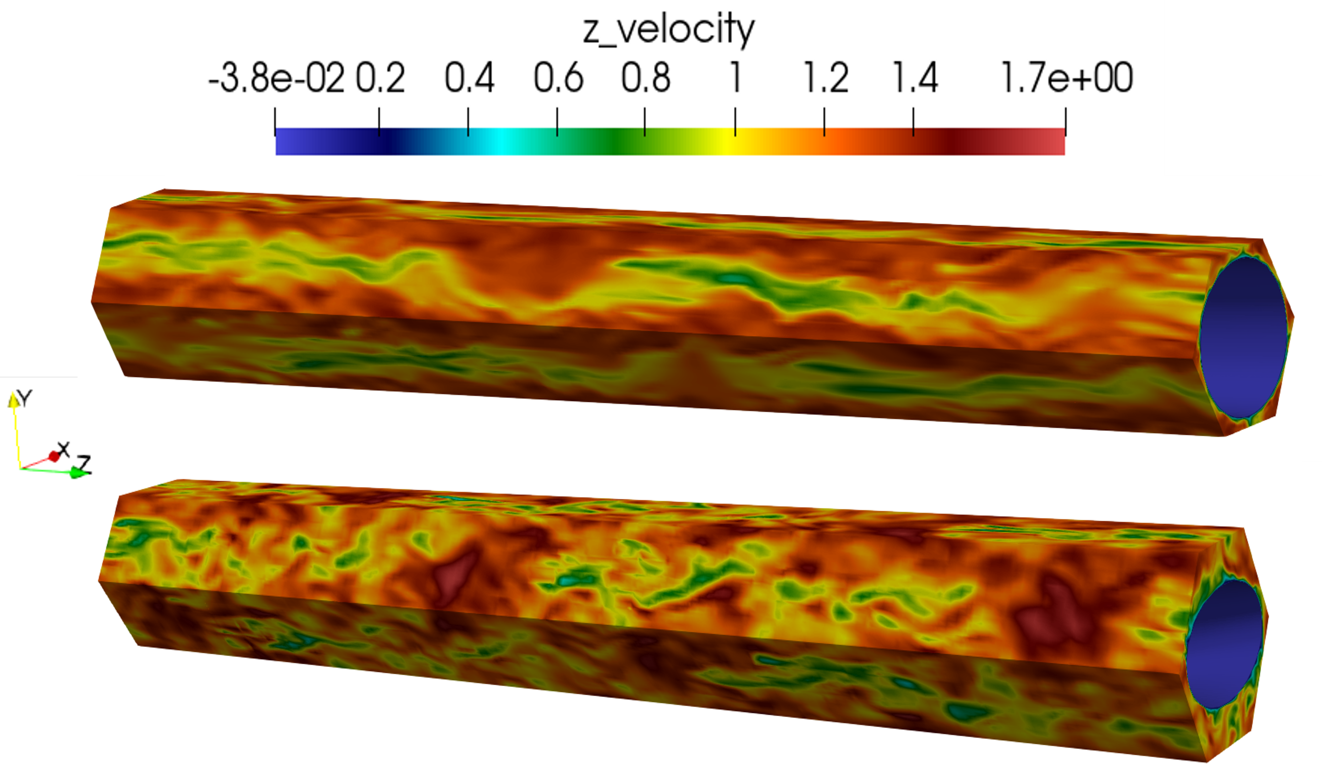
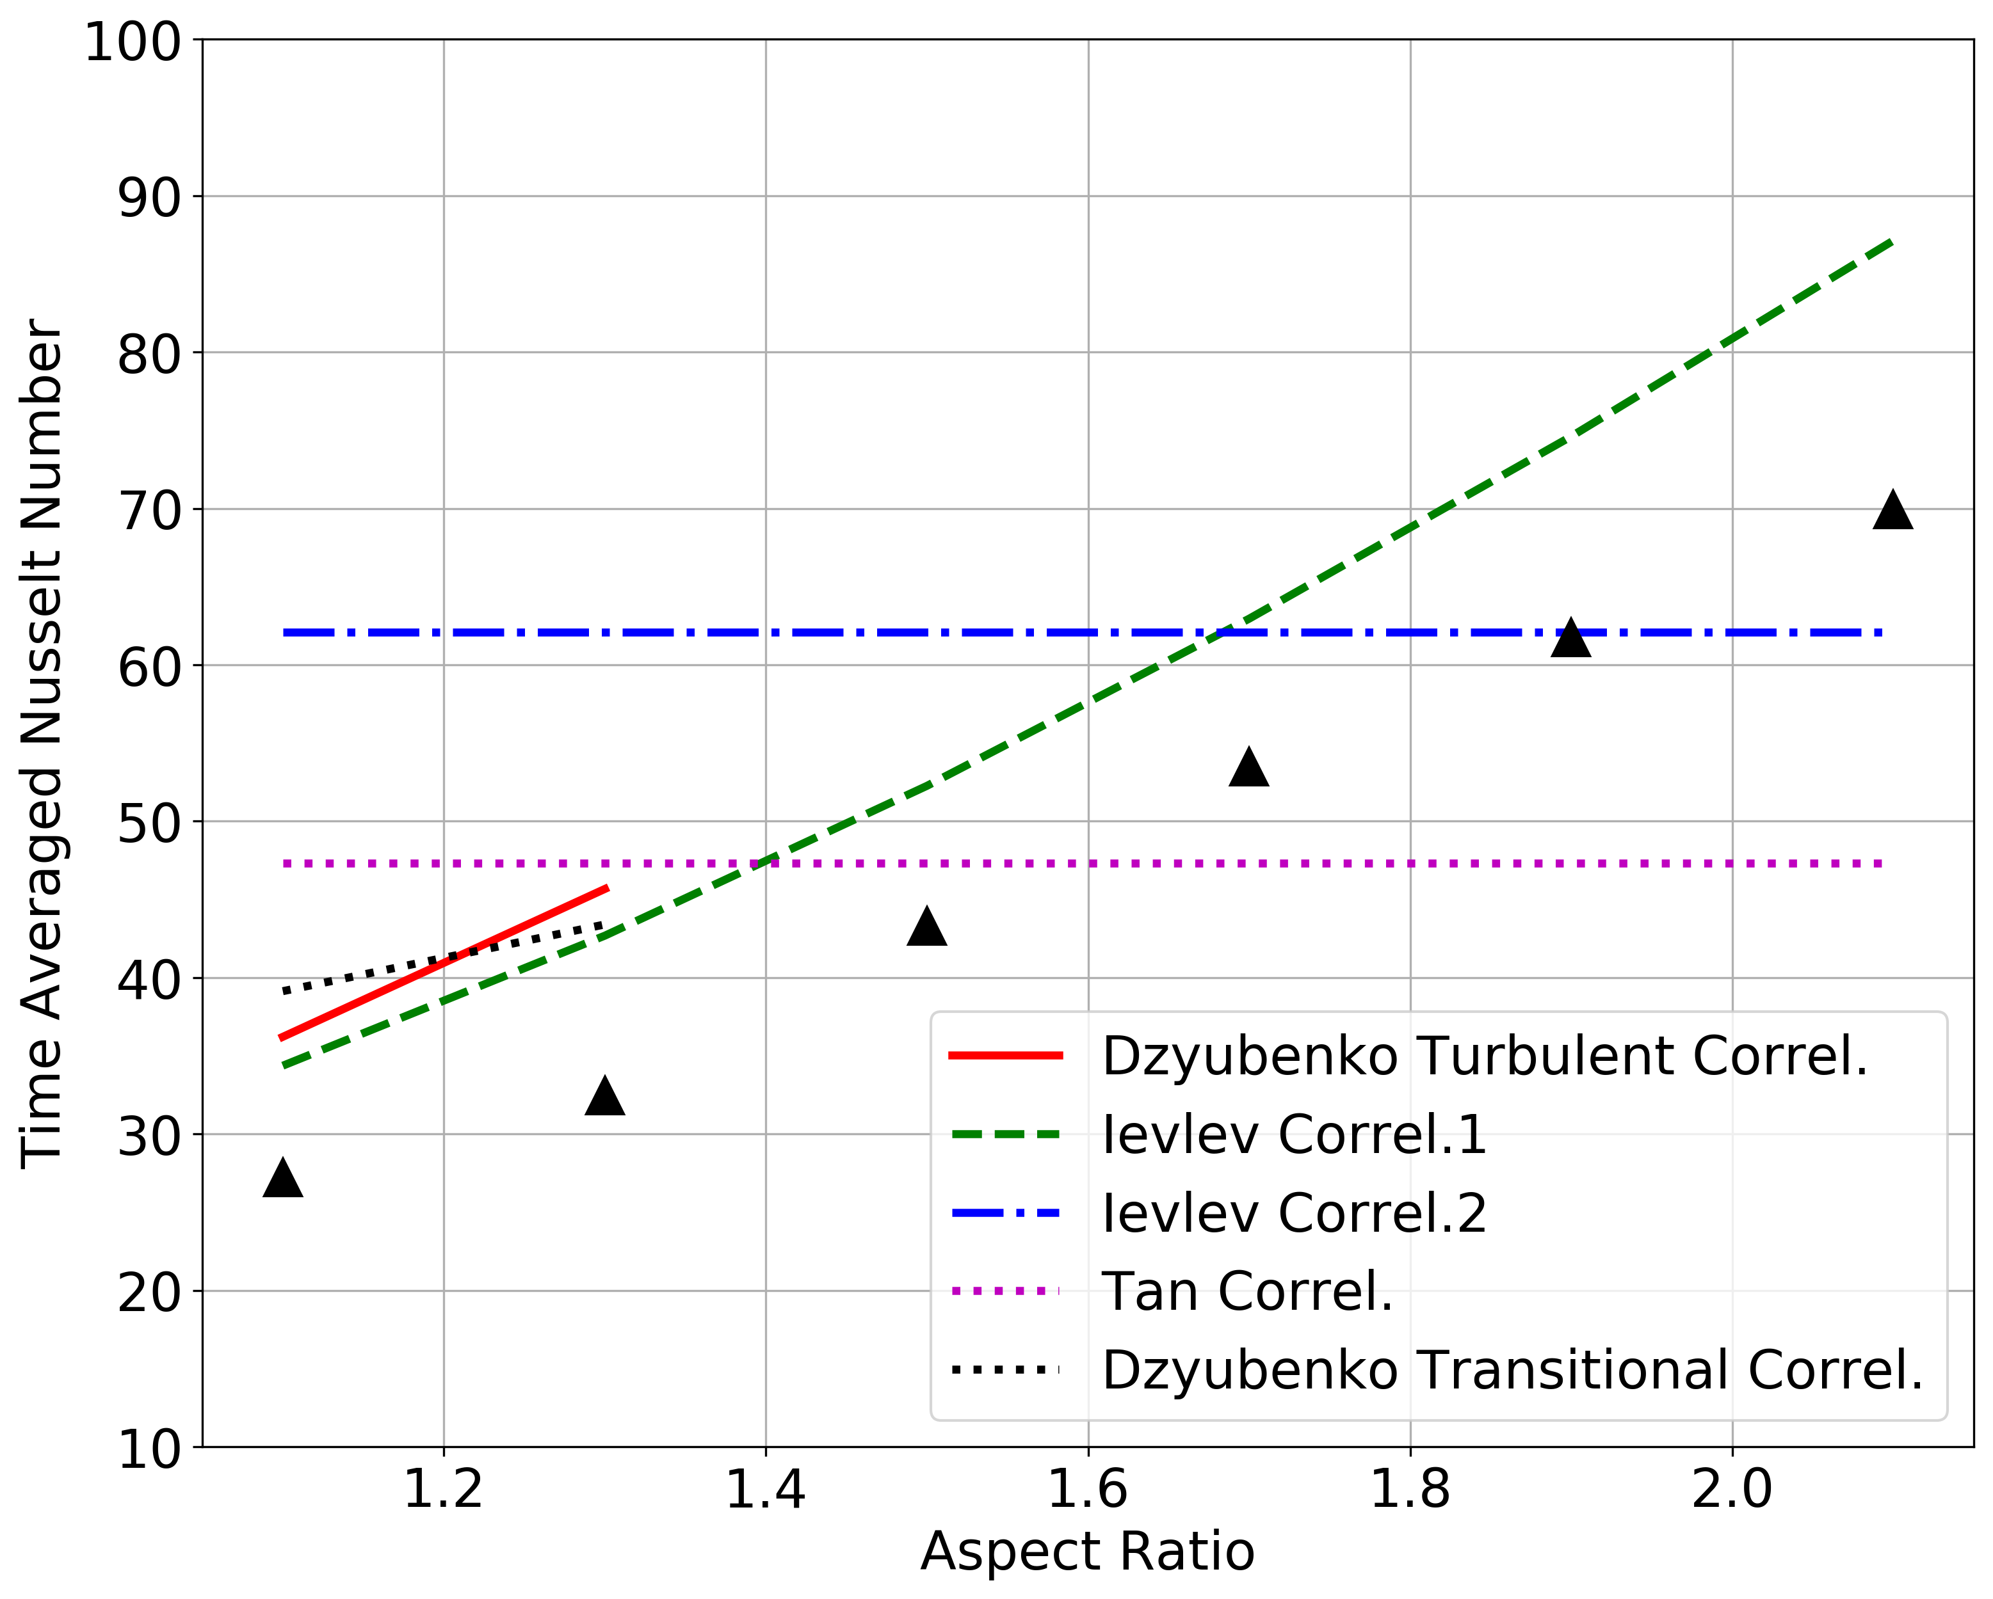
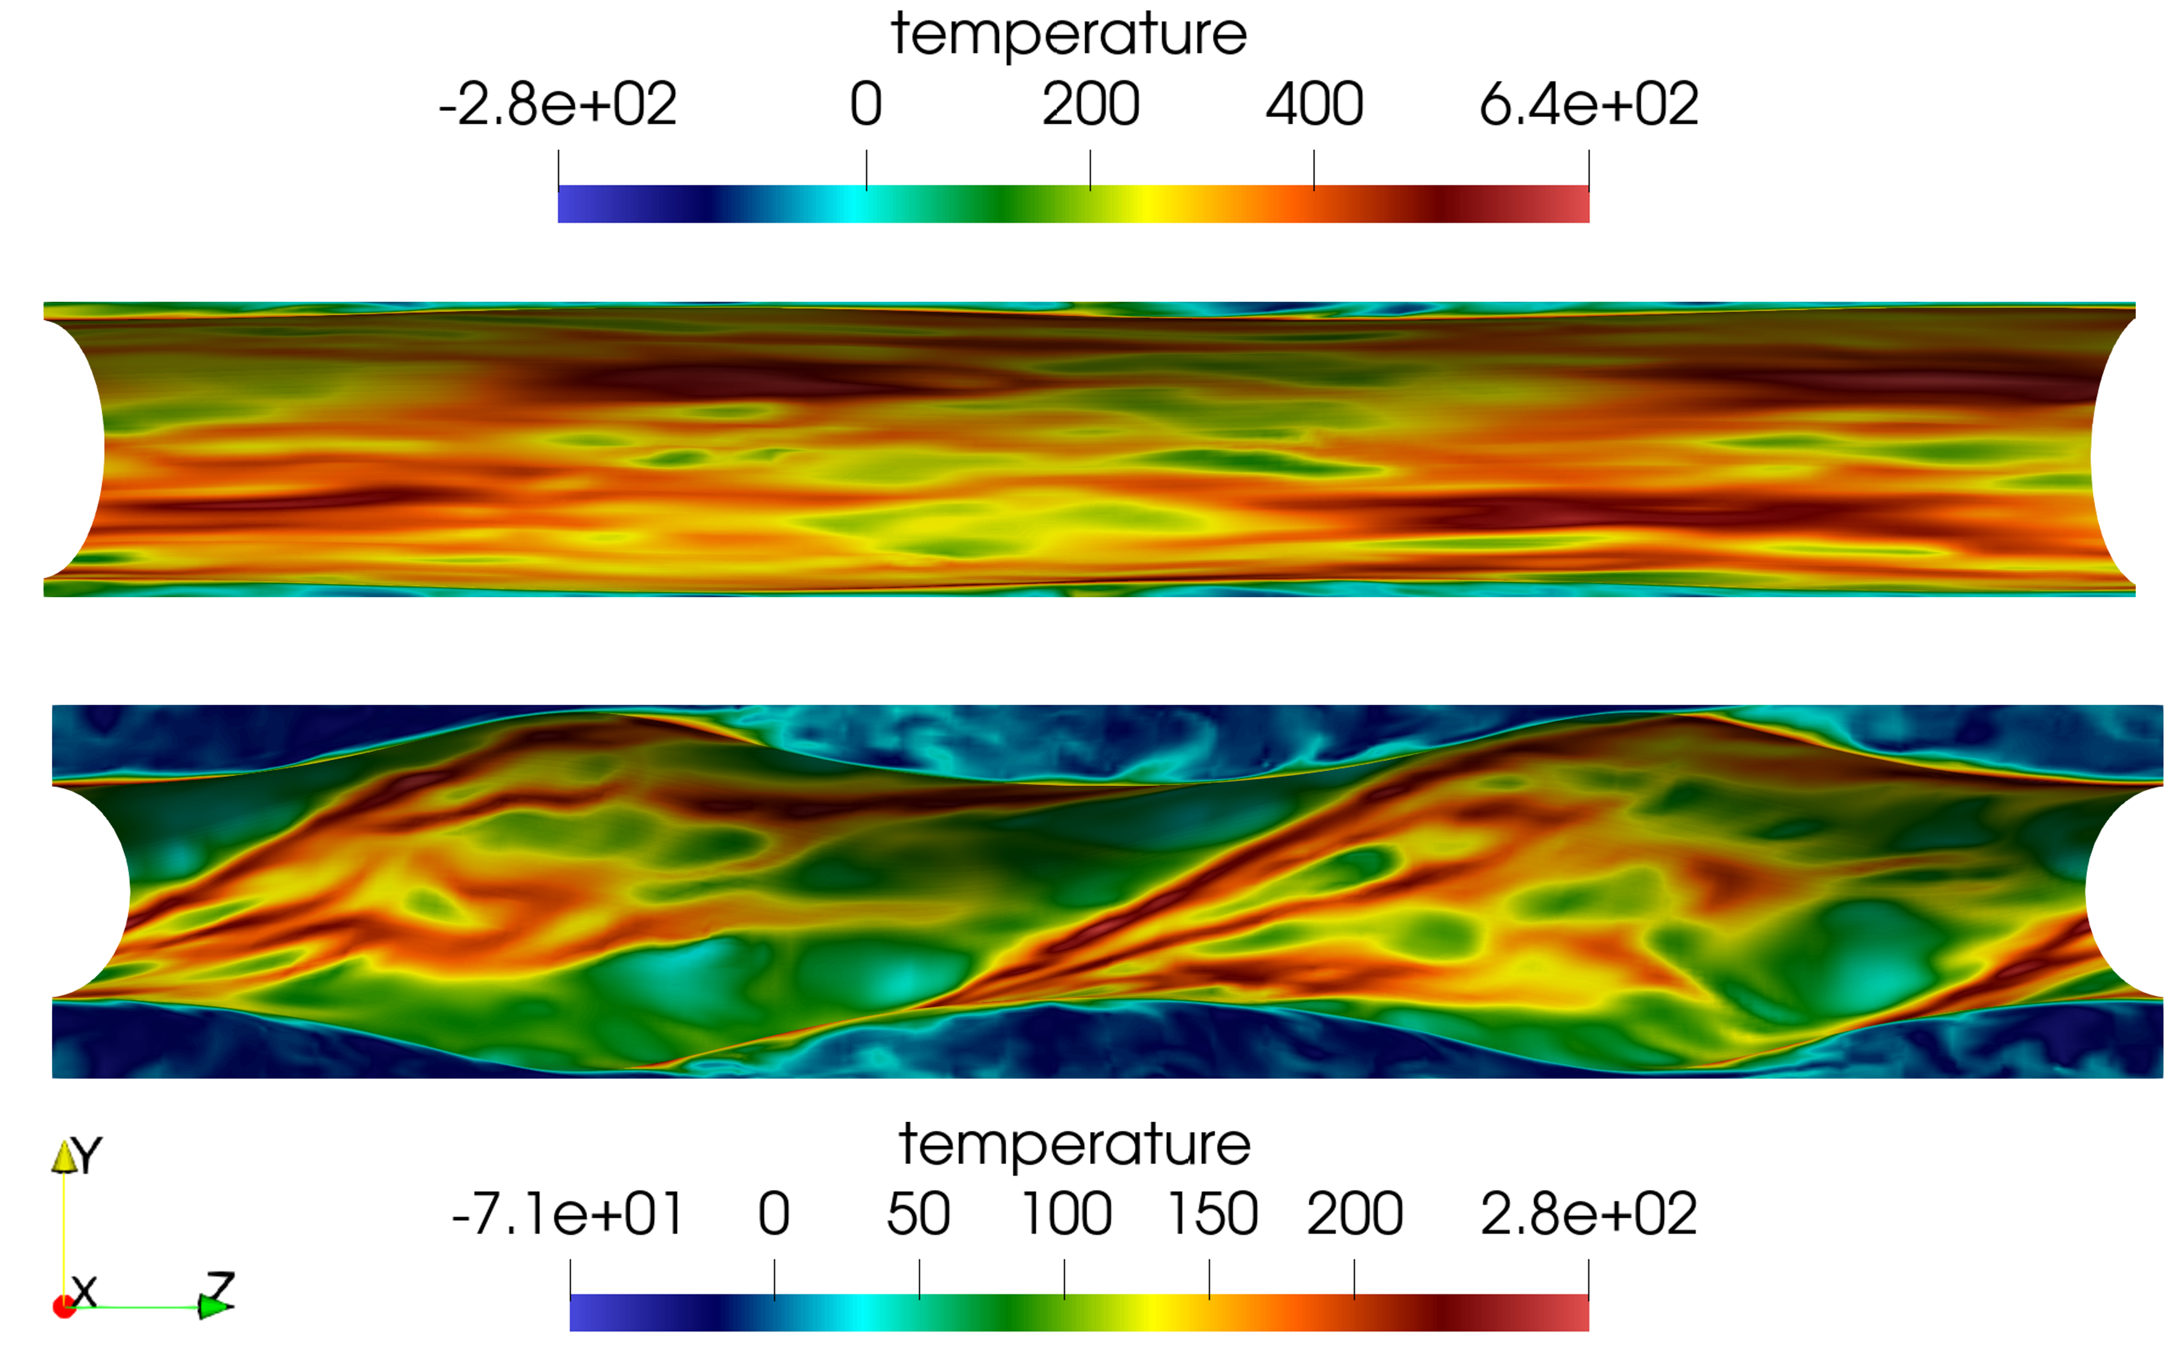
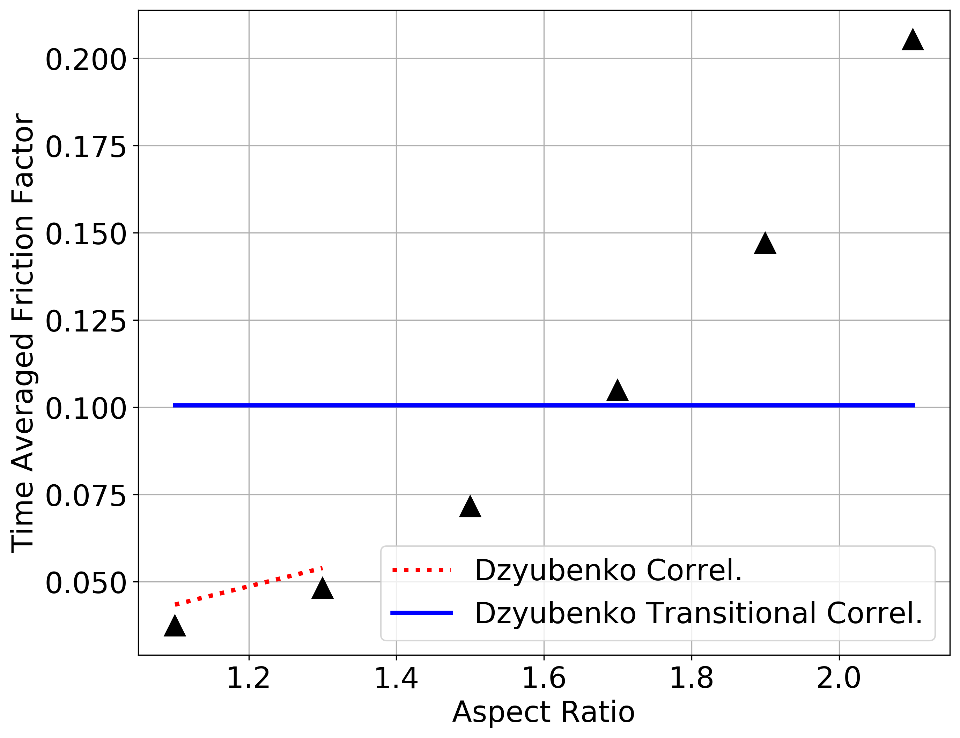
Computational Fluid Dynamics
Data Reduction (Triangles are Simulations)
Tutwiler, S., Shaver, D., Carasik, L. B., “Determination of Aspect Ratio Influence on Flow and Heat Transfer Behavior in Twisted Elliptical Tubes for Molten Salt Applications,” Adv. In Thermal Hydraulics, 2022

Slide 28
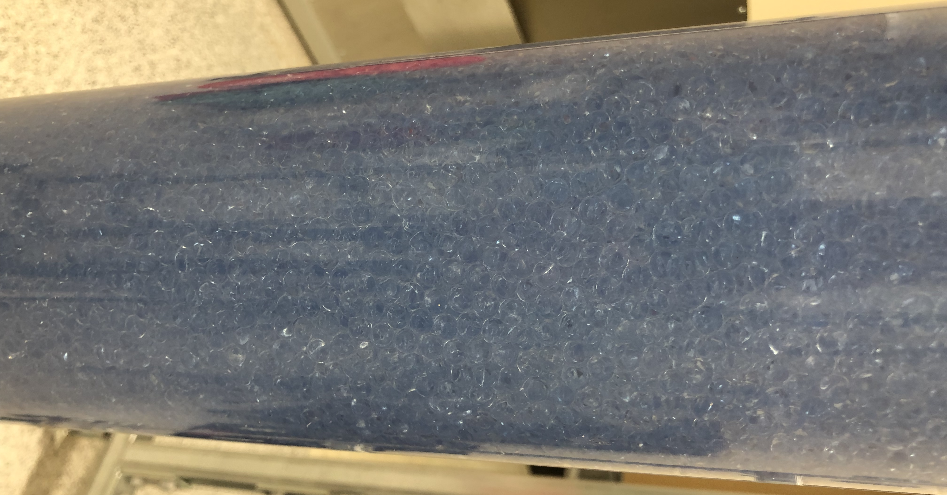
Experimental Fluid Dynamics
Particle tracking within pebble bed fusion device geometries
Wiggins, C., et al., “Noninvasive interrogation of local flow phenomena in twisted tape swirled flow via positron emission particle tracking (PEPT),” Nuc. Eng. Des., Vol. 387, pp. 1116012022, 2022.

Slide 29
Acknowledgements
Thanks to Dr. Arturo Dominguez, PFURO, DOE FES, US DOE Office of Science, and more for this opportunity!

Slide 30
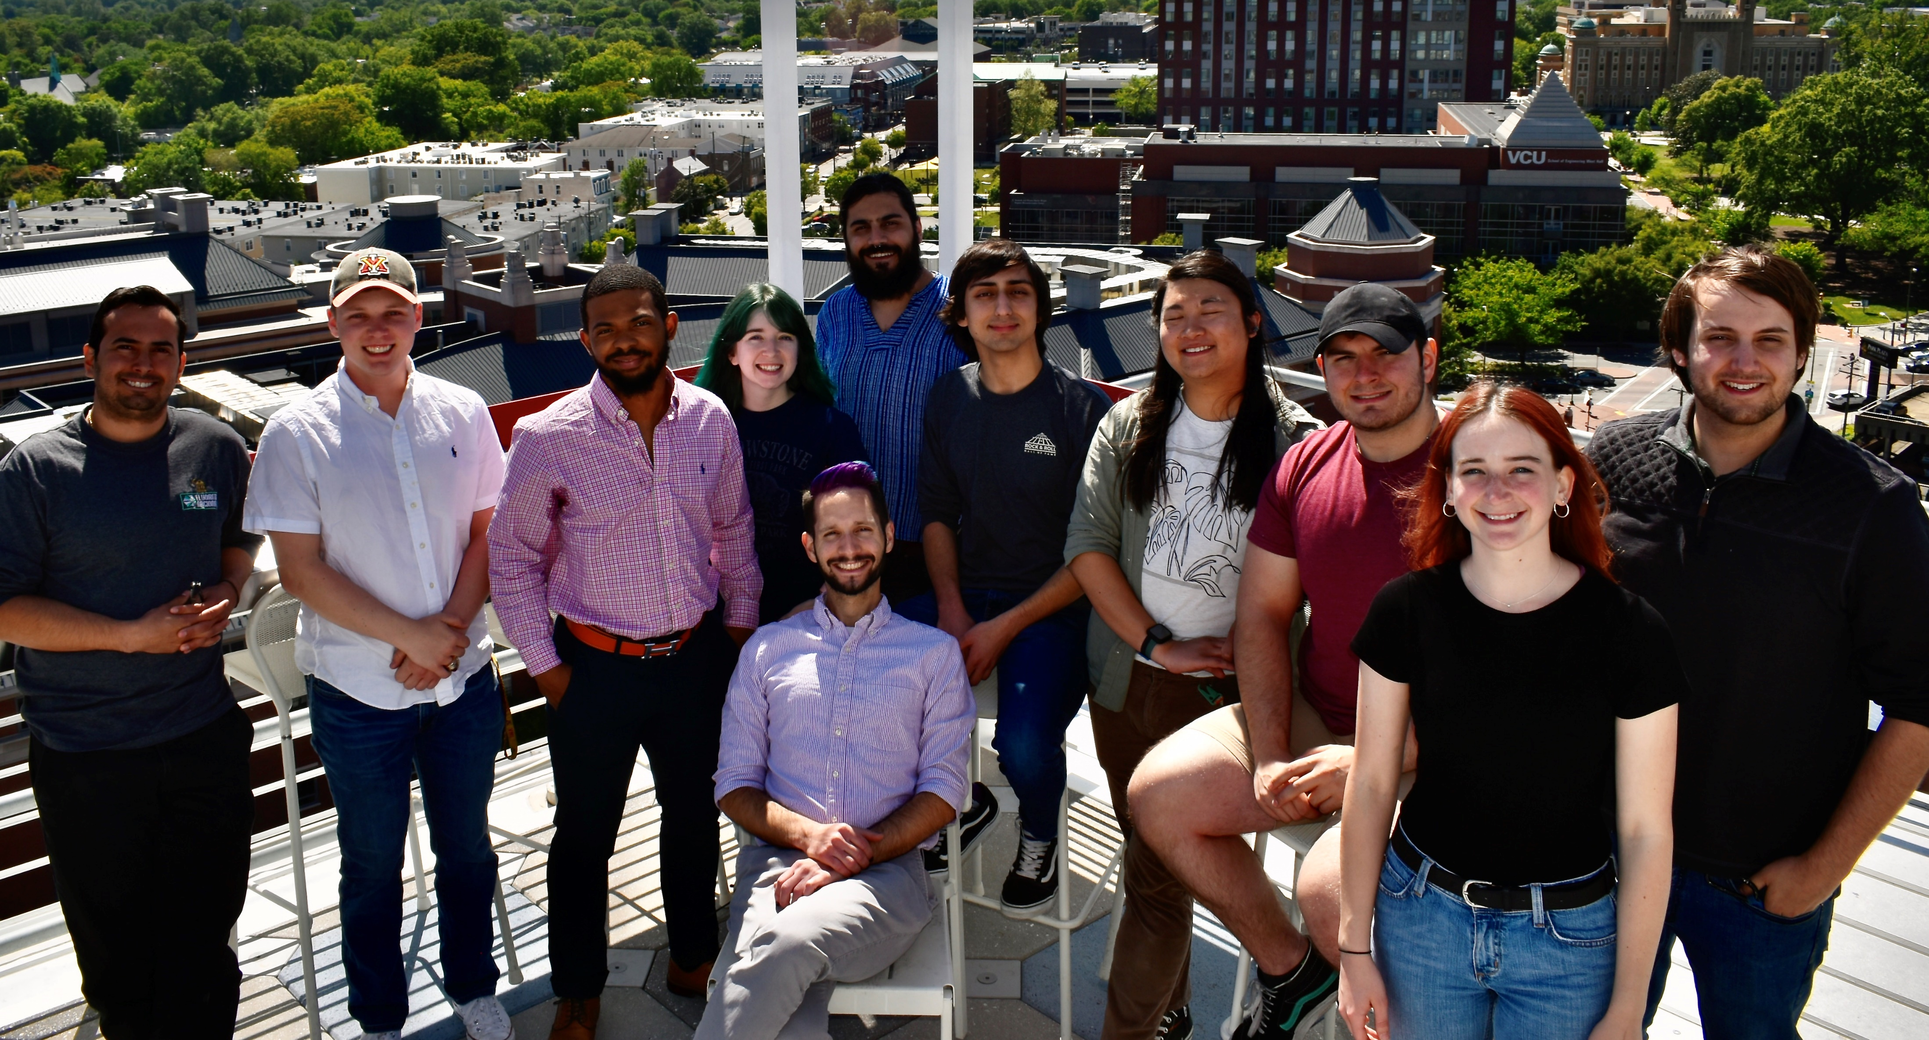
Thank you!

Slide 31
Additional Resources
Heat Transfer Lectures:
https://www.youtube.com/playlist?list=PLZOZfX_TaWAHZOgn8CRjpqRElp5Dd-GaY
Fluid Mechanics Lectures:
https://www.youtube.com/watch?v=clVwKynHpB0&list=PLZOZfX_TaWAGocs2k5QmTL44OKOl7rn34&ab_channel=CPPMechEngTutorials
https://www.youtube.com/watch?v=PXjZ7xEAqsU&list=PLZOZfX_TaWAH0baRhA8OosWVbEsJK5sPe&ab_channel=CPPMechEngTutorials
https://www.youtube.com/watch?v=kxhTMc8tyEo&list=PLZOZfX_TaWAE7uM59dIBr-rH73WTJCcp_&ab_channel=CPPMechEngTutorials

