Slide 1
YOU’VE MADE IT TO THE END!!!
Thank you for joining us on this whirlwind of plasma physics and fusion energy science talks!
We hope these talks gave you a taste of the many challenges that are still out there.
We need you to help us solve them!
Theory and Simulation

Slide 2
How did we do?!
PLEASE fill out this survey (also in the chat)
Please help us gauge what the impact was and help us improve it for next year
Previous feedback has led to changes (e.g. 45m talks vs. 1.5hr talks in the past)
Theory and Simulation

Slide 3
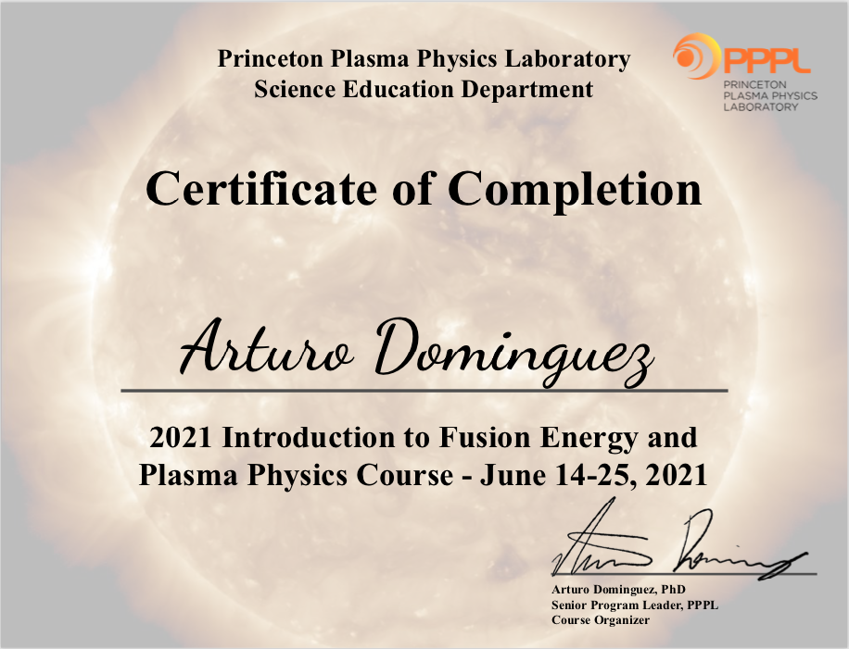
Certificates of Completion
We’ve received several questions about providing a certificate of completion.
We weren’t planning on providing them (and never have in the past), but we have the zoom attendance so it should be doable
If you attended more than 20 talks (i.e. 20 or more hours in the zoom webinar) and would like a certificate like the one shown, please fill out this form
Please be judicious/patient…Deedee and I will be doing it and we’re exhausted.
Theory and Simulation

Slide 4
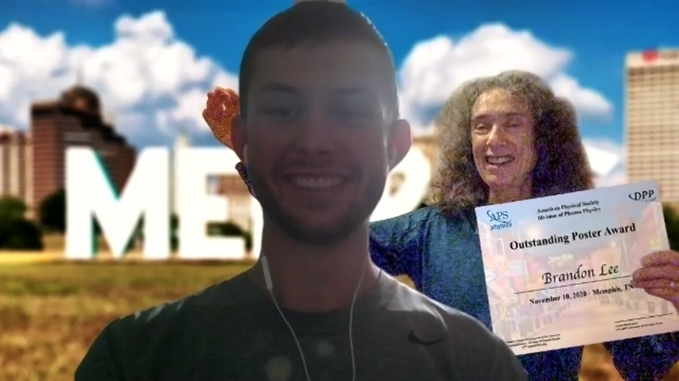
APS-DPP in Pittsburgh or remote
Present your work at the 2021 APS-DPP conference! It will be a hybrid conference so remote presentations will likely still be an option.
All abstract submissions are due July 15th. (APS fees are free the first year, $25 after that for undergrads)
These presentations look good on your resume!
Fellow course participant was awarded an outstanding poster award (“presented” by the 2020 DPP Chair, Prof. Zweibel)
Breaking News: Brandon’s 2021 SULI mentor, Dr. Elizabeth Paul was just awarded the 2021 Marshall Rosenbluth outstanding thesis award!!!
Theory and Simulation

Slide 5
Run with the Discord Server!
I loved seeing so much activity on the Discord Server!
It’s served not only to continue conversations with the speakers, but also for you to meet one another and share professional/personal info. Love it!
We’ll also be putting updates about the talk uploads, seminars, job/internship opportunities throughout the summer and beyond.
But this is meant for you, so please keep on using it and finding ways for it to be useful for you!
Theory and Simulation

Slide 6
2021 APS-DPP Graduate School Day
APS-DPP will be hosting its second Graduate School Day sometime late summer/early fall.
This is a chance to find out where a lot of the research highlighted during the course is being conducted and how to apply.
Also find out some tips about the application process, GRE, qualifiers, fees etc. (e.g. you may be able to wave application fees sometimes)
Find out about fellowships and other graduate opportunities from DOE, NSF, NASA, etc.
Dr. Vanessa Gonzalez-Perez gave a “Demystifying the grad school application process” workshop in 2020

Slide 7
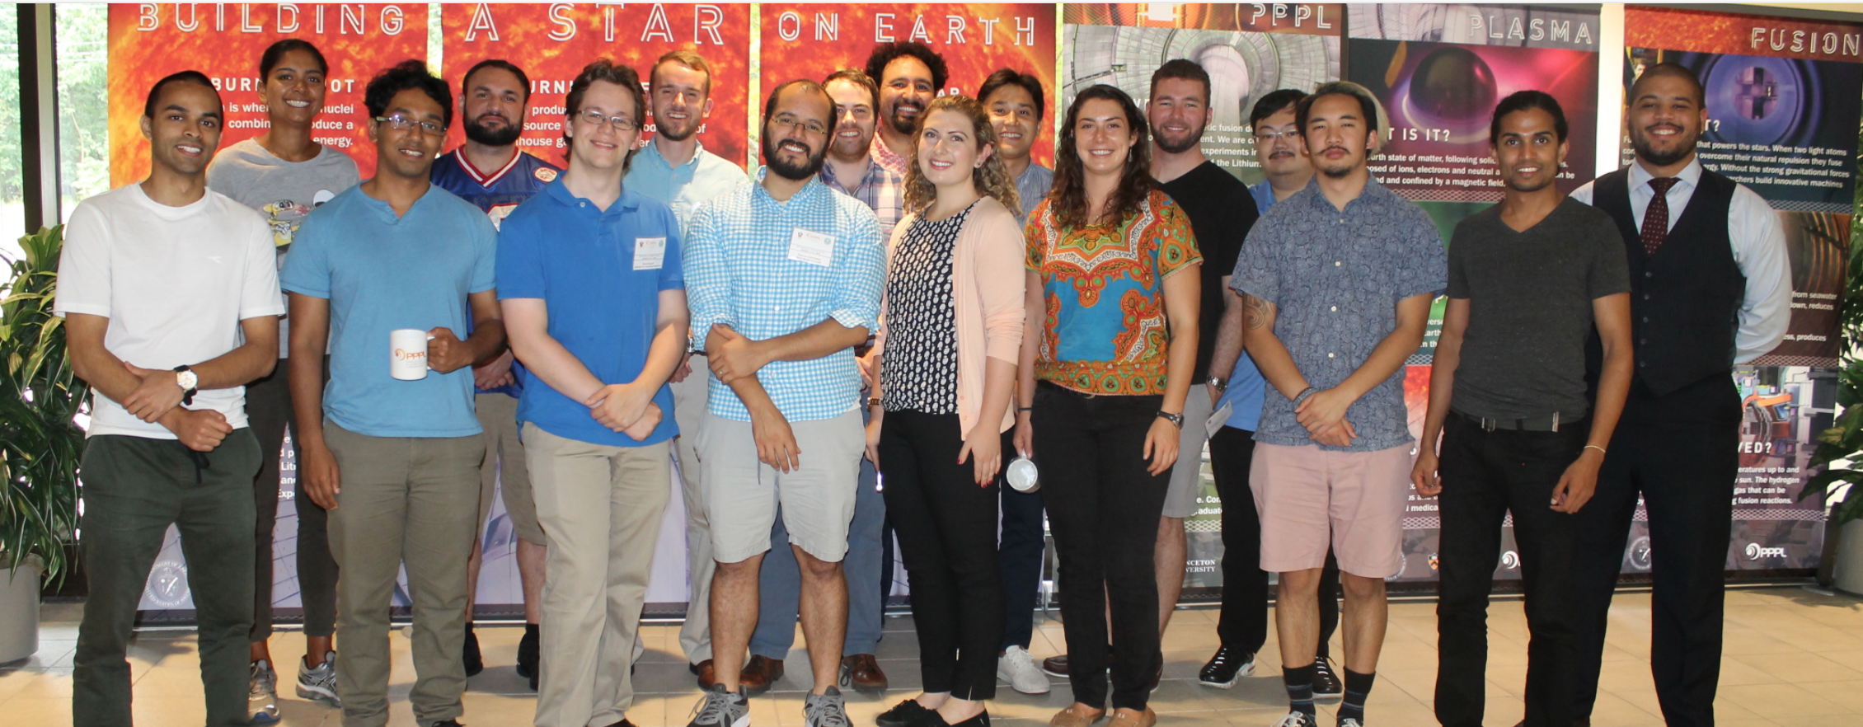
PPPL Graduate Summer School
PPPL will be hosting its 4th annual Graduate Summer School the week of August 16-20.
As with the 2020 version, the summer school will be fully remote.
Topics and agenda are still being developed, but visit site for past talks which are also recorded as with this course.
Target audience is incoming, 1st and maaaybe 2nd year grads (early in graduate school).
Audience is MUCH more limited than this course, application will open soon.
2018 Graduate Summer School Cohort

Slide 8
Sign up to mailing list to find out about all these events and more!
If you registered, you should’ve seen a question asking to sign up for a mailing list.
If you clicked “yes”, you will be getting emails about events, internships, workshops, etc.
If you didn’t register or clicked ”no” and are now regretting it…worry not! You can register to the mailing list here
You can “unsubscribe” at any time and I promise not to sell you stuff

Slide 9
Thanks to the grads for the networking sessions!
Carlos Cartagena
Will DeShazer
Nathan deOliveira
Sam Frank
Oak Nelson
Rebecca Masline
Akash Shah
Tony Qian
Eric Emdee
Alex LeViness
Hima Winarto
Rory Colin
Daniel Dudt
MIchael May
Liona Fan-Chiang
Louise Ferris
Phil Travis
Quinn Pratt
Adrianna Angulo
Jill Peery
Dario Panici
Carolyn Schaefer
Ryan Chaban
Richard Reksoatmodjo
Genevieve DeGrandchamp
Harry Fetsch
Yasmeen Musthafa
Suying Jin
Sophia Sanchez-Maes
Theory and Simulation

Slide 10
Special thanks to my incredible partner
With my son at home during the second week of the course, and both of us working from home, running a course like this means all of the home workload of an energetic dog and a bored toddler fell on her.
THANK YOU CAROLINA!
Theory and Simulation

Slide 11
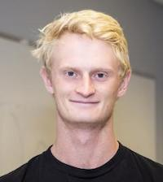
Thanks to the “Intro Course Brain Trust”
The Intro Course Brain Trust is the group of scientists from different topical groups and institutions, that helped with the speaker/topic selection and format of the course. Thank you!
Steffi
Diem
Will
Fox
Walter
Guttenfelder
Eva
Kostadinova
Florian
Laggner
Ane
Lasa
Oak
Nelson
Louise
Ferris
Theory and Simulation

Slide 12
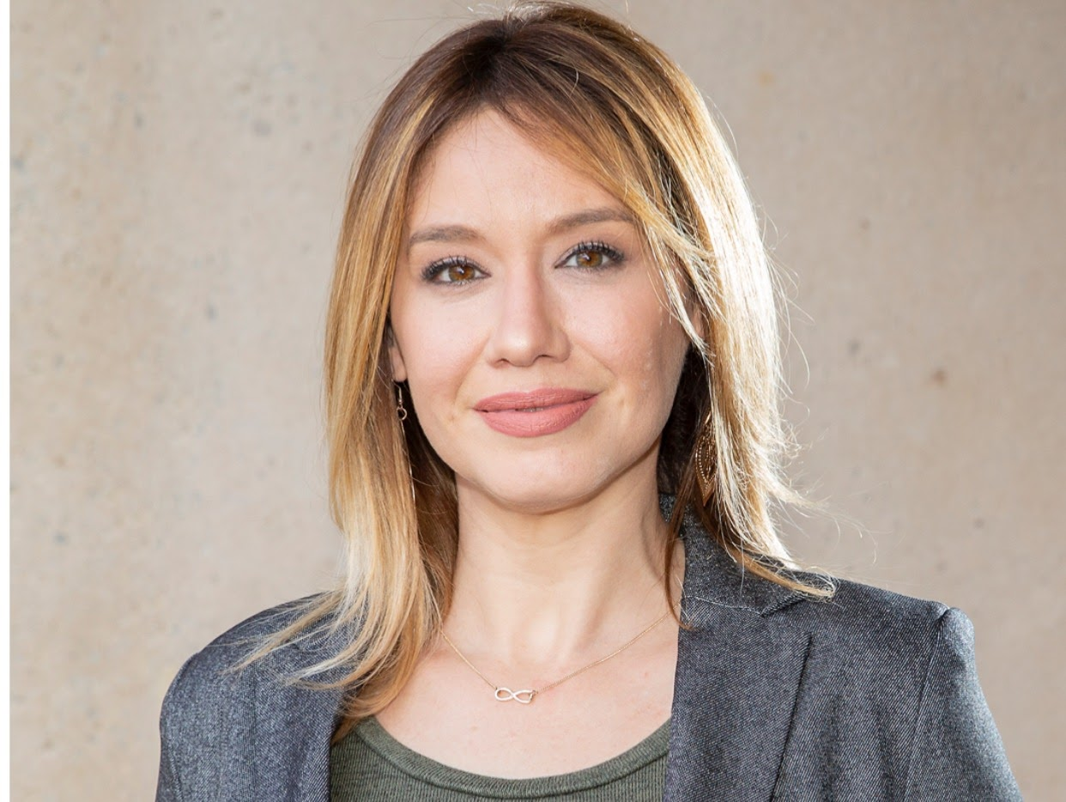
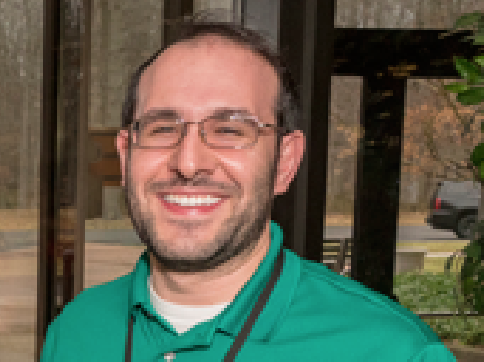
Thanks to Deedee and Harry
Special thanks to my colleagues, Deedee Ortiz, Program Manager at the Science Education Department, and Harry Tsamutalis Jr, A/V Technician.
Theory and Simulation

Slide 13
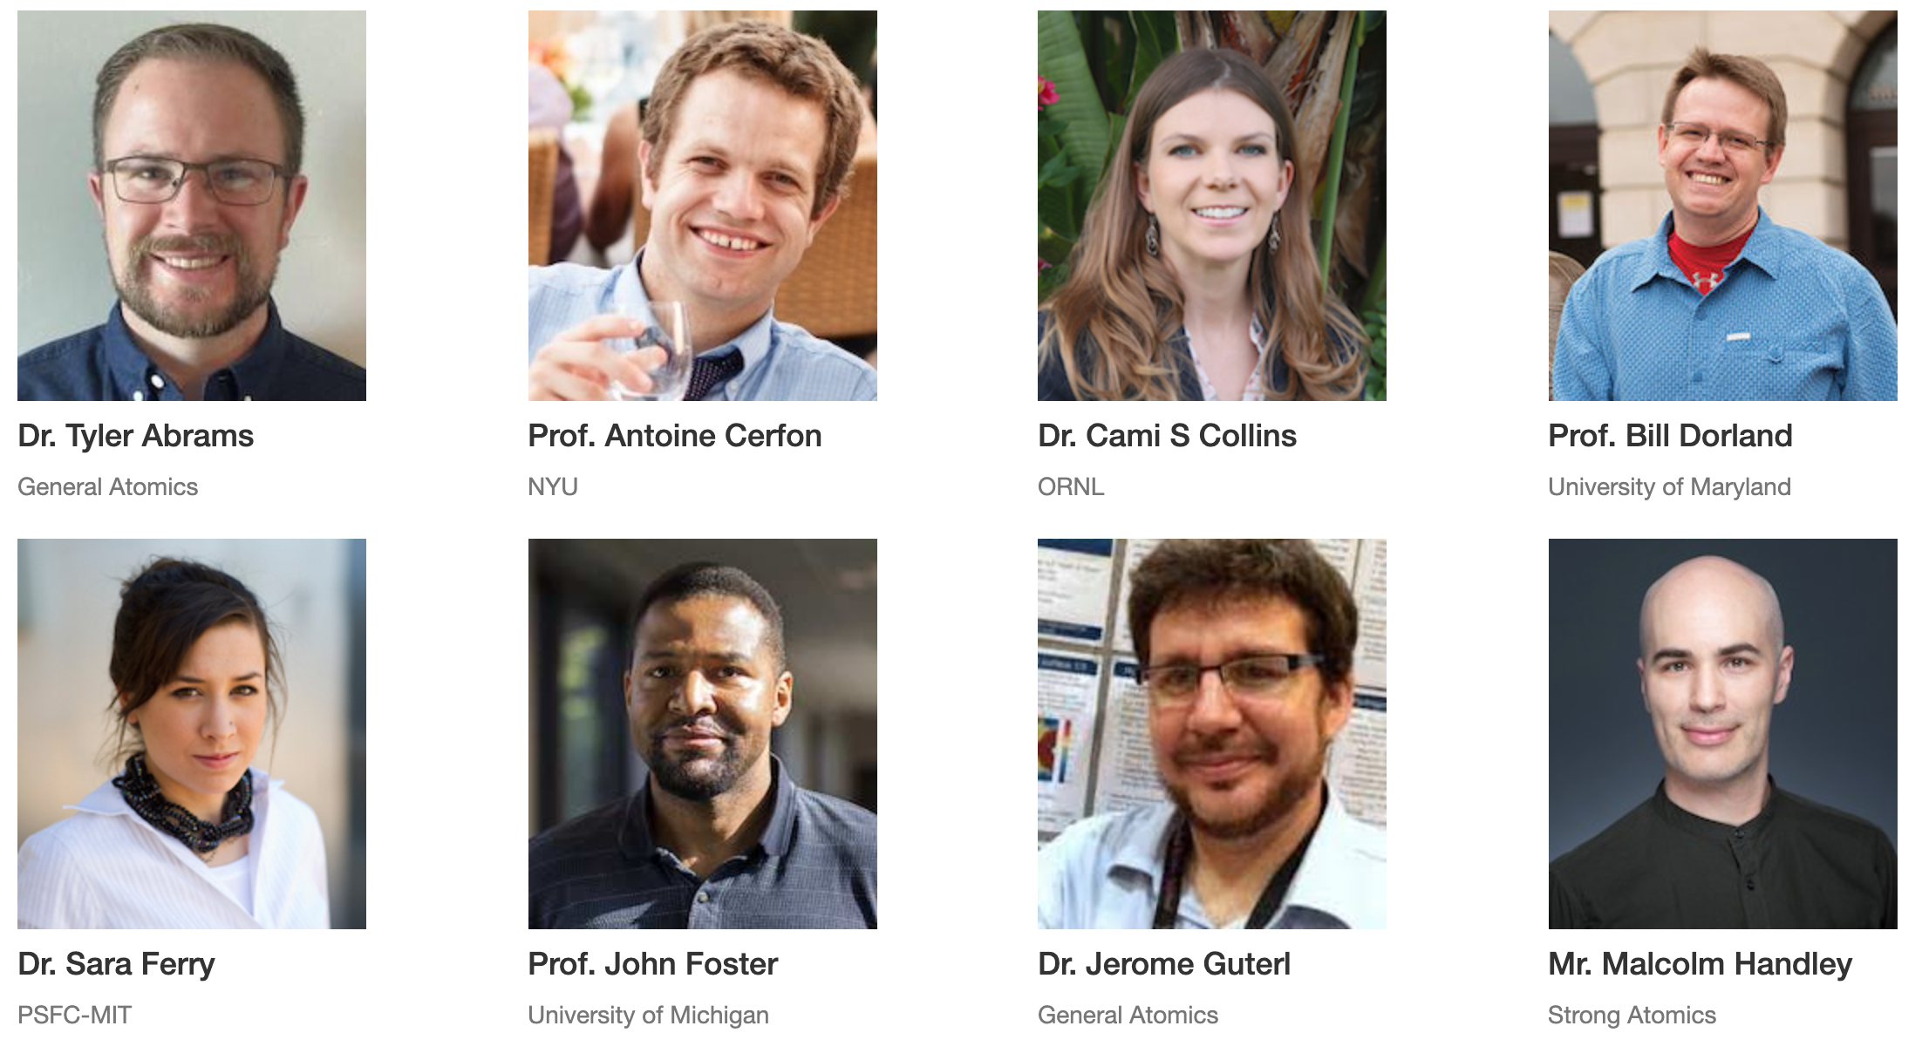
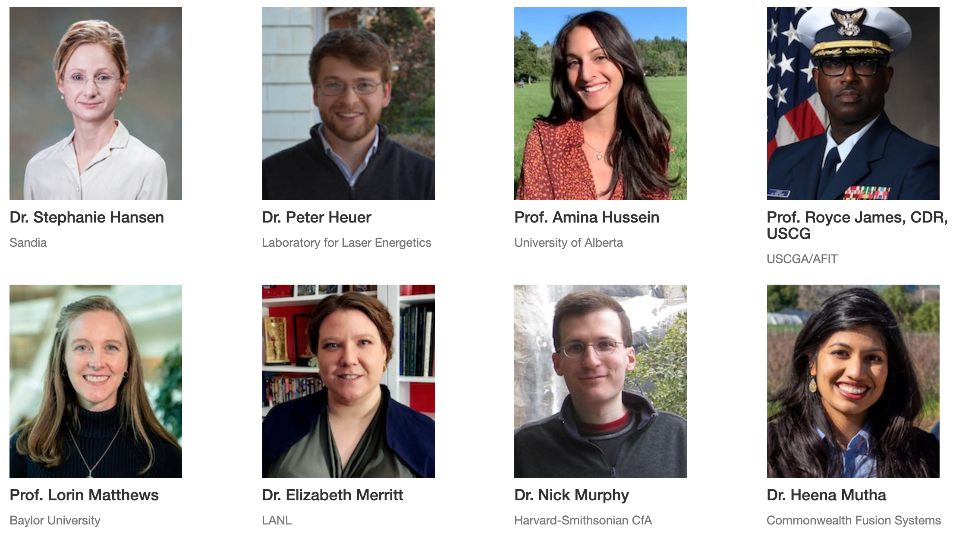
Finally, of course, thanks to all of the speakers!
Theory and Simulation

