Slide 1
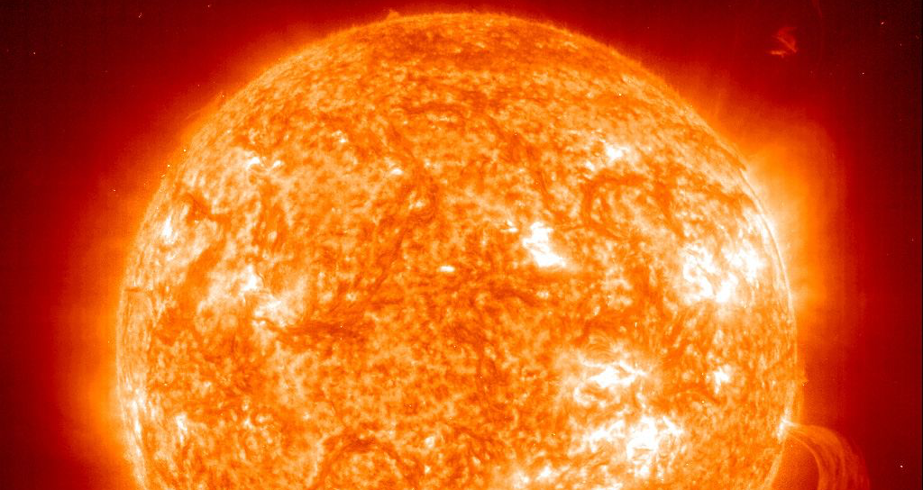
Introduction to the Introduction to Fusion Energy and Plasma Physics Course
Arturo Dominguez
Senior Program Leader, Science Education Department

Slide 2
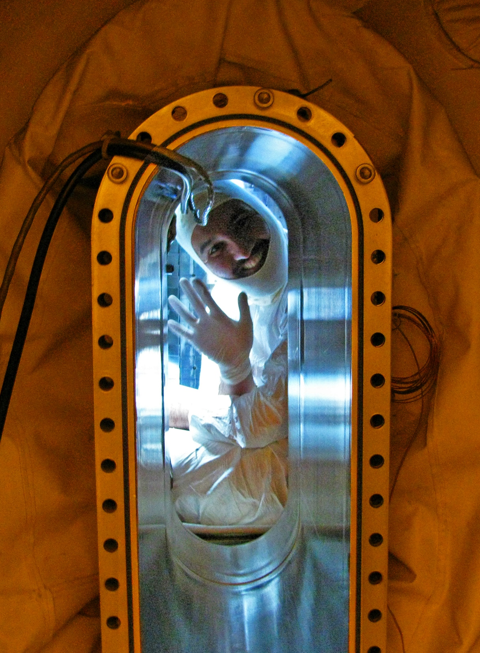
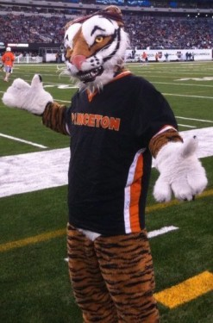
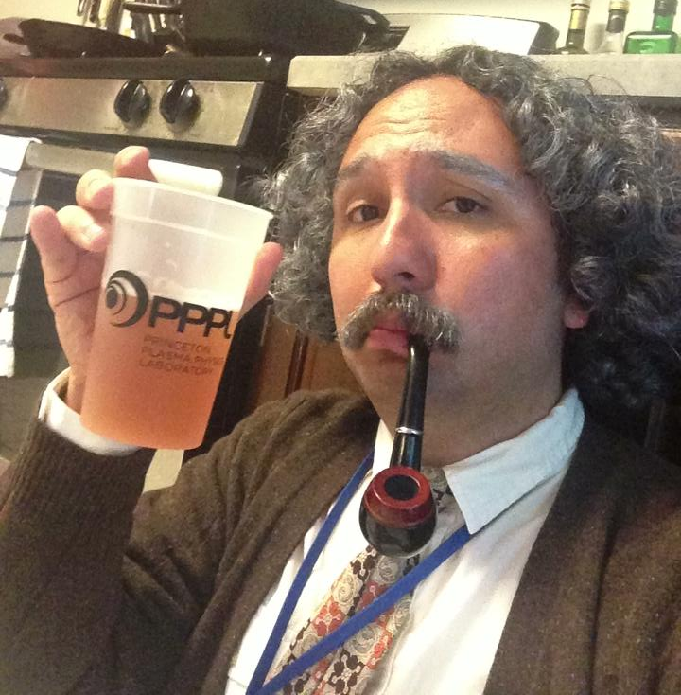
First, a bit about myself
From Bogotá, Colombia
Started studying physics at the National University of Colombia at Bogota.
Did my graduate work at MIT, in Boston on fusion plasmas (GO BEAVERS!)
Now I’m at the Princeton Plasma Physics Lab (GO TIGERS!)
Transferred to University of Texas at Austin where I finished undergrad (HOOK’EM HORNS!)

Slide 3
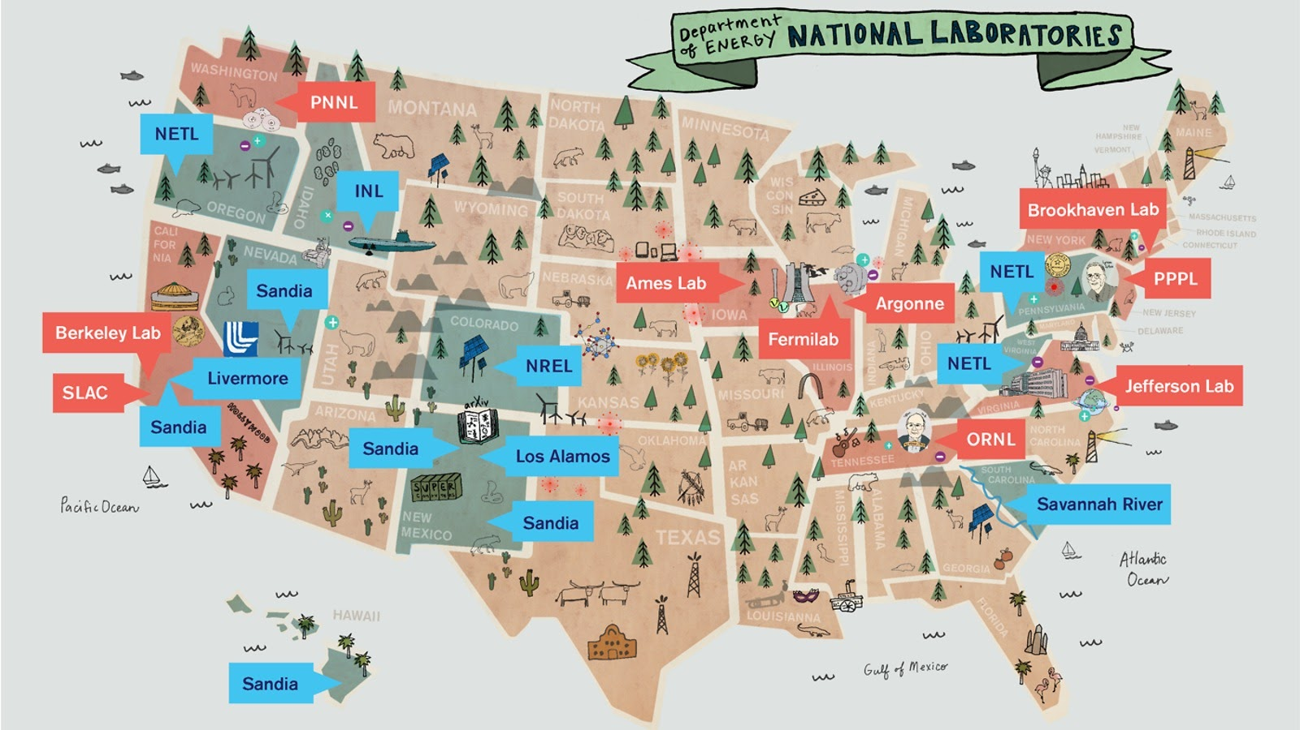
PPPL is one of 17 Department of Energy national laboratories

Slide 4
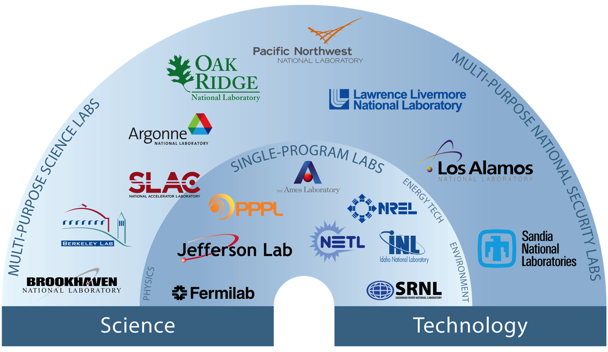
PPPL is one of 17 Department of Energy national laboratories

Slide 5
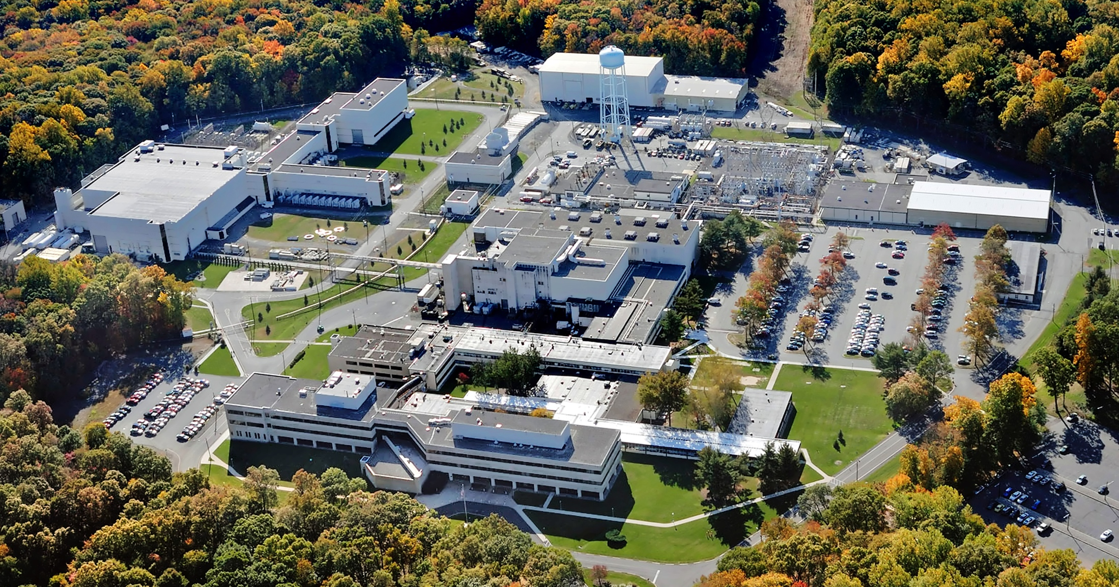
~600 employees
19 faculty (Princeton)
~22 post-docs
~40 grad students
Operated by Princeton U.

Slide 6
~600 employees
19 faculty (Princeton)
~22 post-docs
~40 grad students
Operated by Princeton U.

Slide 7
Lyman Spitzer started PPPL (originally Project Matterhorn) in 1951...Birthplace of US fusion
Inventor of the Stellarator
Founder of the lab
Made countless advances in plasma physics (his name is everywhere)
Lyman
Spitzer
Proposed telescopes in outer space (hence the Spitzer Space Telescope)

Slide 8
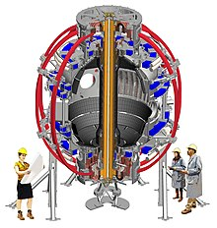
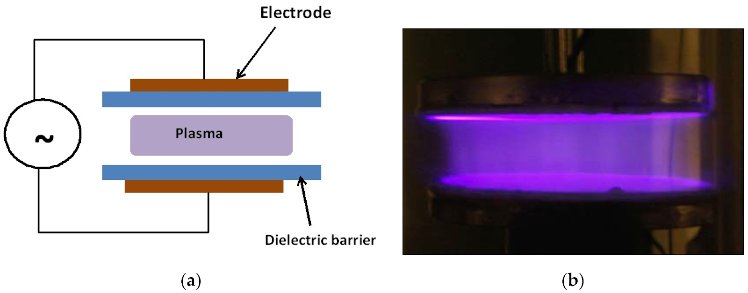
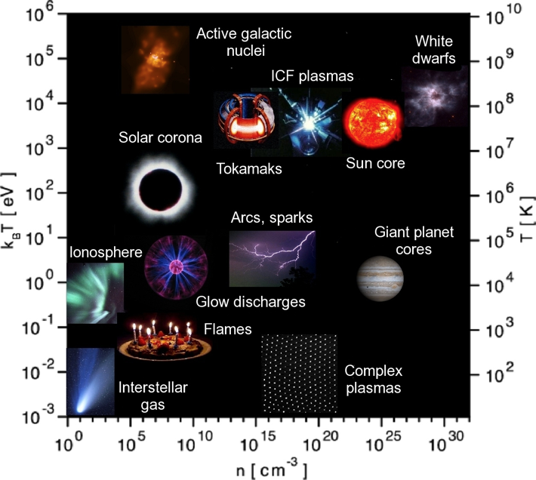
PPPL’s mission goes beyond fusion
The Laboratory has three major missions:
Fusion: To develop the scientific knowledge and advanced engineering to enable fusion to power the U.S. and the world
Plasma Manufacturing: To advance the science of nanoscale fabrication for industries of the future
Frontiers of Plasmas: To further the scientific understanding of plasmas from nano- to astrophysical-scales

Slide 9
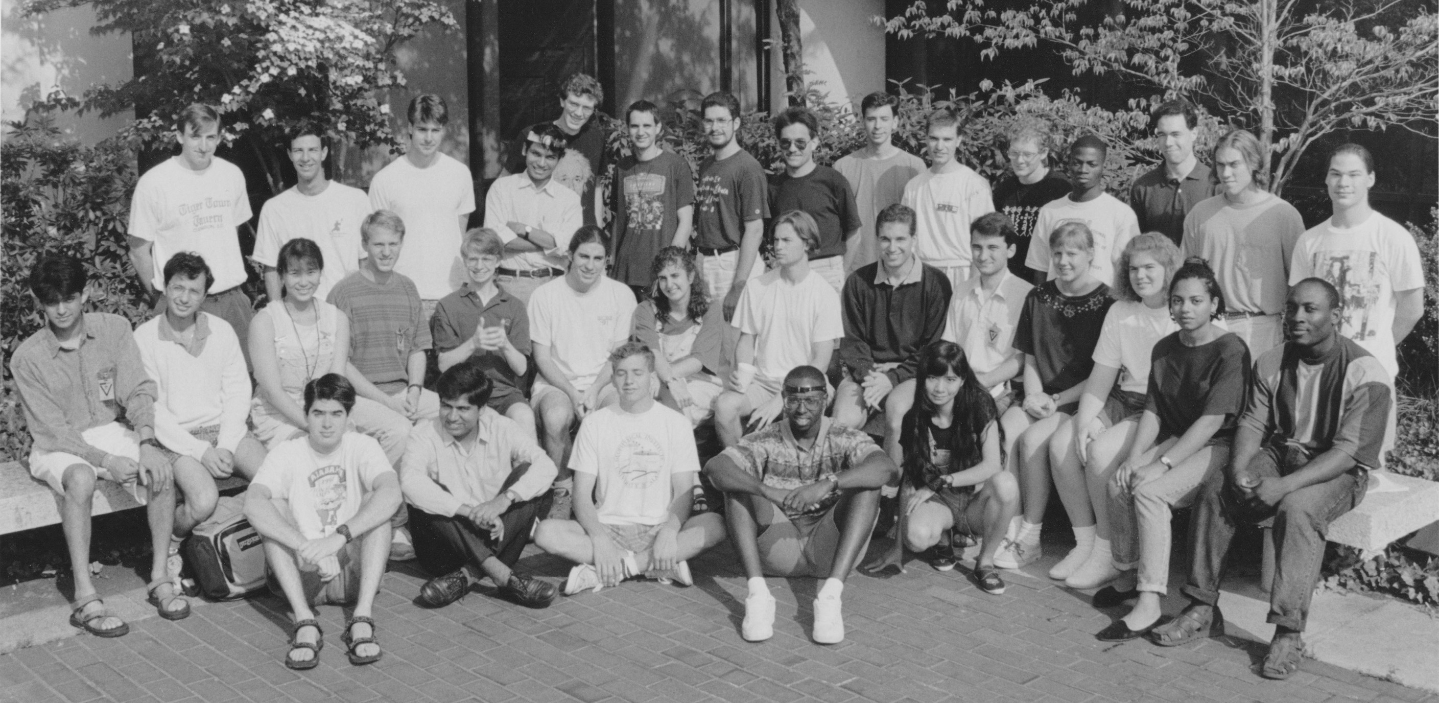
History of the Intro to Fusion/Plasma Course
Originally started in 1992 by Prof. Nat Fisch and former assistant director (and former congressman) Rush Holt, as part of the National Undergraduate Fellowship (NUF).
1994 NUF class
Rush Holt
Nat Fisch

Slide 10
Changes during the pandemic
Fully Remote
2 weeks long, but 4.5 hours a day
Shorter talks (50+10 minutes, vs. 90 minutes)
Many more talks (30 speakers vs. 15 in the past)!
Many more participants!
Broader scope, covering the full spectrum of topics under the Fusion Energy Sciences and Plasma Physics umbrella

Slide 11
All lectures are free to watch and will be posted
All lectures will be streamed via Zoom Webinar. No registration is need.
Enrollees, i.e. those who filled out the google form on the site and which we could fit, will have a Zoom-Brady-Bunch-Square, will get priority for questions, join the hallway discussions, and will join the networking events.
Webinar participants can ask questions using the ask/chat feature.
ALL written questions should be directed at the hosts and we will hold them for the Q/A portion.
As has been done since 2015, the course lectures and the speaker videos will be posted on the site.

Slide 12
We had way more submissions than we could handle!
We were pleasantly surprised by the number and breadth of enrollment submissions (>500)!
Submissions included undergraduate students, grad students, postdocs, researchers, professors and general public.
Because of technical limitations, we could only enroll ~300 participants so priority has been given to undergraduates conducting fusion/plasma research.

Slide 13
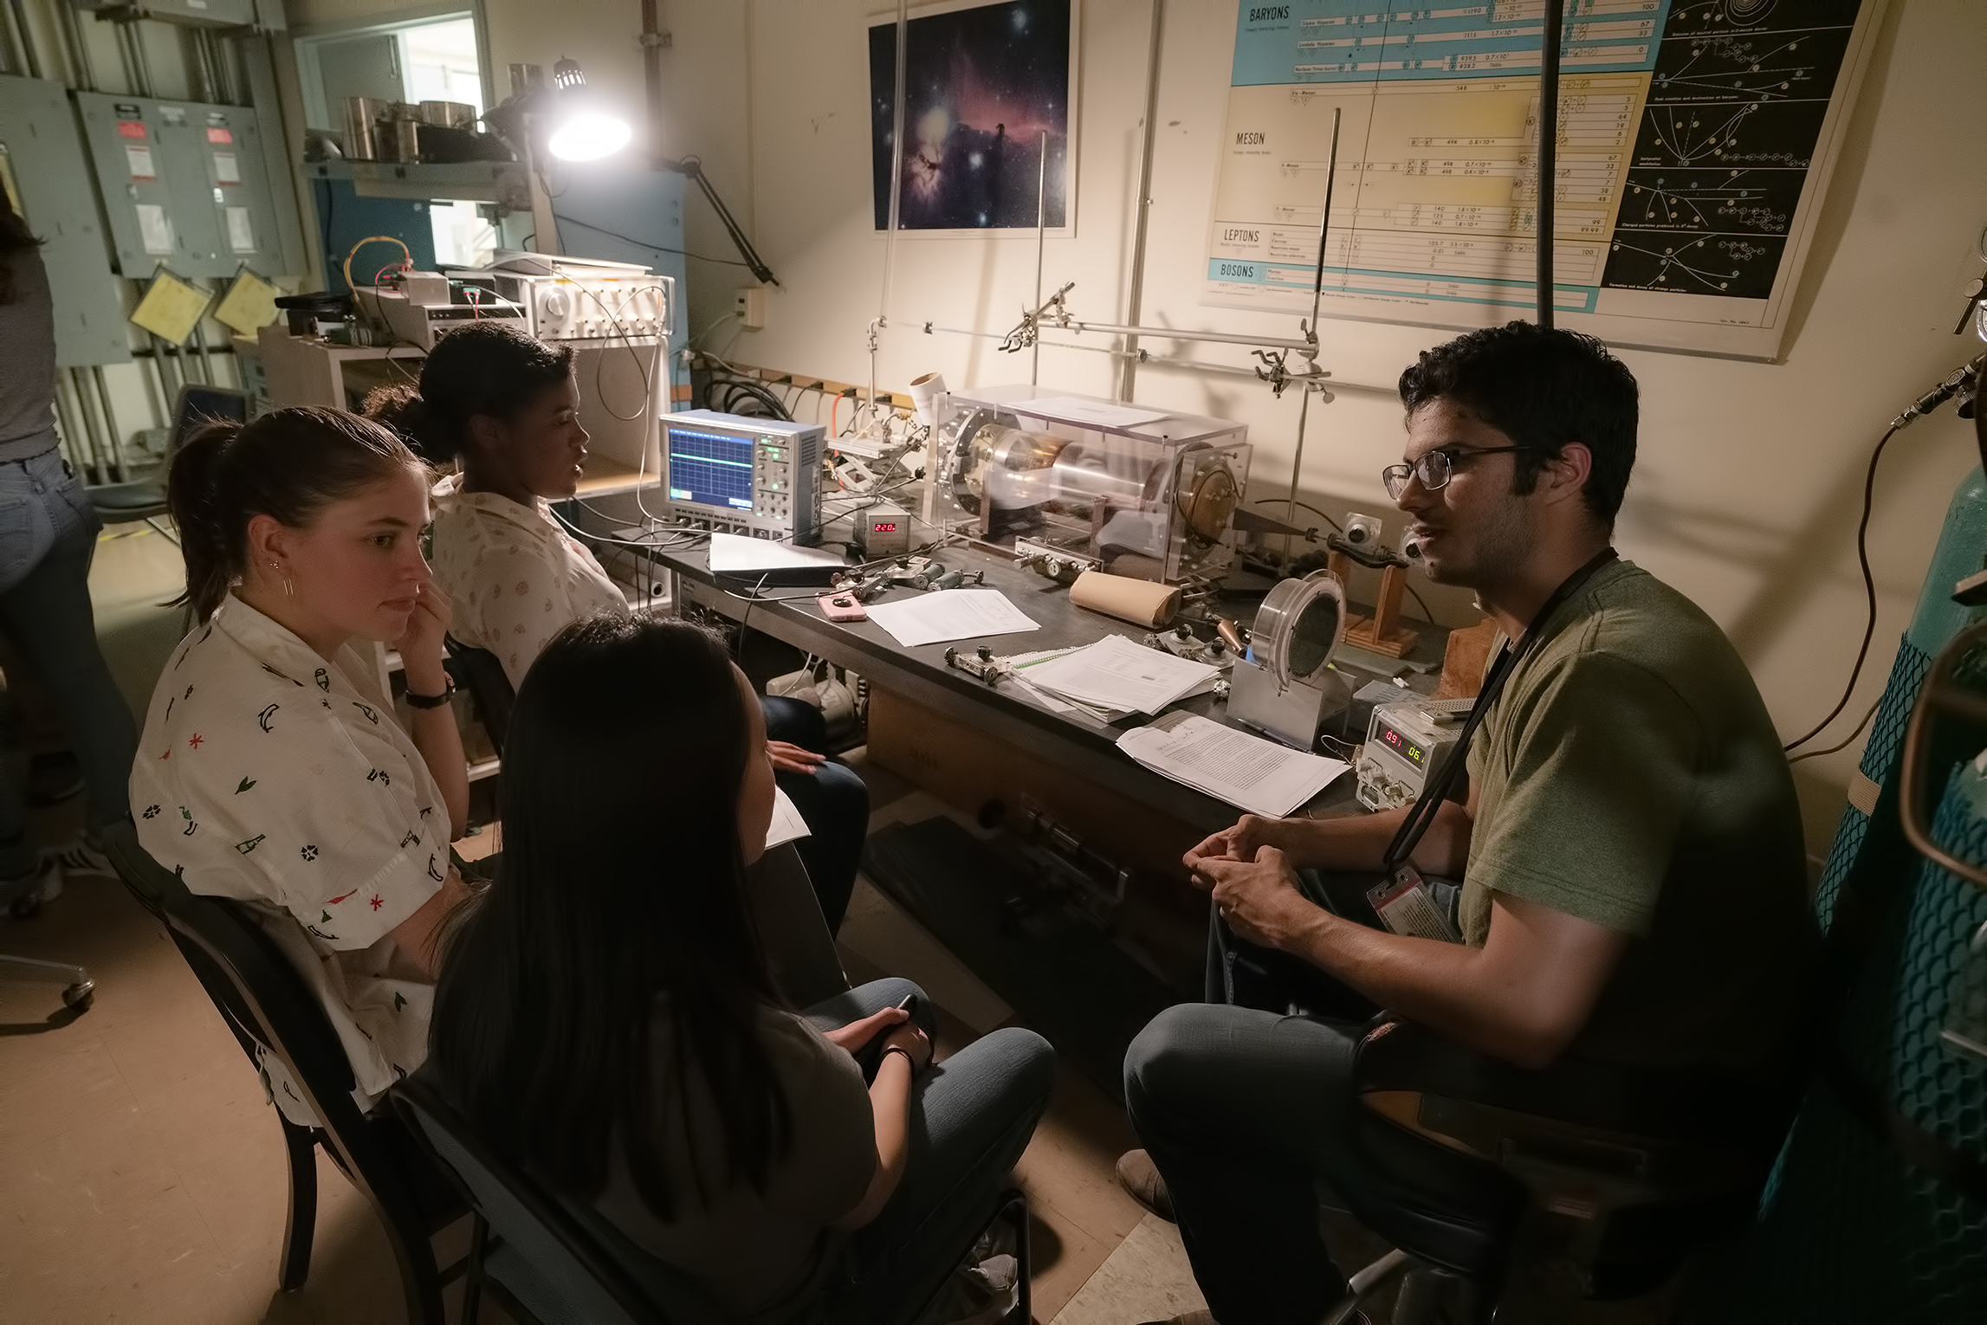
A birds-eye view of the undergrads
Undergraduate enrollees are based in the US and in many other countries, including: Mexico, India, Philippines, Colombia, UK, and many more!
Many enrollees are conducting internships/summer research. Some of the programs are:
Science Undergraduate Laboratory Internship Program (SULI) and Community College Internship (CCI), run by DOE.
NSF funded REUs and the Alabama Plasma Internship Prog.
Students doing internships at their own colleges
Private companies developing fusion
Plasma and Fusion Undergraduate Research Opportunities (PFURO) program
2019 Intro Course Participants

Slide 14
Plasma and Fusion Undergraduate Research Opportunities (PFURO) Program
A new program that we’d like to highlight is Plasma and Fusion Undergraduate Research Opportunities (PFURO).
Funded by the DOE Office of Fusion Energy Sciences
Managed by PPPL and the US Fusion Outreach Team
Students from different schools all over the country were selected to conduct research at universities and other undergraduate institutions.
8 spots were allocated in this pilot year, with the hope of expanding in future years
Fully remote in 2021, hopefully in-person in 2022.
Visit www.pppl.gov/pfuro for more details
2021 participants will conduct research at:

Slide 15
WHAT TO EXPECT IN THE
NEXT COUPLE OF WEEKS

Slide 16
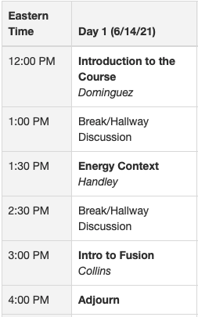
Today (6/14) we’ll begin with Fusion
Mr Malcolm Handley (Strong Atomics)) will motivate the US and global need for fusion energy by discussing the current energy context.
Dr. Cami Collins (ORNL) will present the promise and challenges of fusion energy. And highlight the science and technology to make it happen

Slide 17
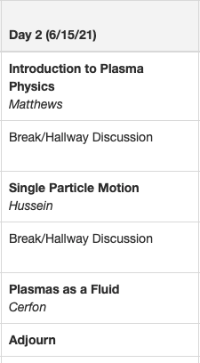
Tomorrow (6/15) we will talk Plasma
Prof. Lorin Matthews (Baylor) will introduce basic concepts in plasma physics and frame the field
Prof. Amina Hussein (University of Alberta) will analyze the motion of ionized particles under the influence of electric and magnetic fields
Prof. Antoine Cerfon (NYU) will explore another analytical approximation of plasmas, their dynamics as a fluid

Slide 18
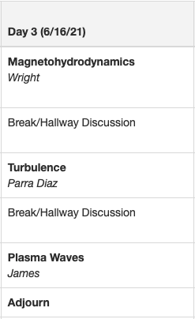
Wednesday (6/16) we will continue to explore plasmas
We continue the introduction to plasmas with Dr. Adelle Wright (PPPL) who will explore the Magnetohydrodynamical (MHD) model of plasmas.
Prof. Felix Parra Diaz (Oxford) will discuss the ubiquitous and important phenomenon of plasma turbulence.
Prof. Royce James will highlight the role of waves in plasmas.

Slide 19
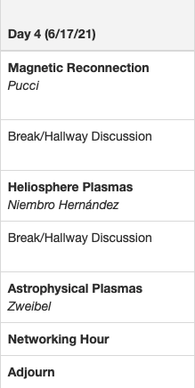
Thursday (6/17) we will concentrate on astrophysical plasmas
Connecting Day 3 and Day 4, Dr. Fulvia Pucci (JPL) will discuss magnetic reconnection
Dr. Rosa Tatiana Niembro Hernández (Harvard Smithsonian CFA) will touch upon plasmas within the solar system.
Prof. Ellen Zweibel (UW Madison) will discuss astrophysical plasmas at larger scales

Slide 20
Thursday (6/17) we will also have the first of two networking sessions
Day 4 will also feature the first of two network sessions in which the group will be divided into groups of ~10-20 and will meet with current graduate students in the field. This is a space to ask questions about grad schools, the grad experience, the field, etc.

Slide 21
Friday (6/18) Princeton and PPPL will be celebrating Juneteenth – NO COURSE
Juneteenth is a holiday commemorating the emancipation of enslaved people in the US.
It commemorates the day in 1865 when enslaved people of Texas, then the most remote region of the Confederacy, finally learned slavery had been abolished.
In celebration of Juneteenth, Princeton U and PPPL will be closed on Friday, June 18th.
We welcome you to take some time to learn about Juneteenth and about ongoing systemic racism in the US and in your own country.
Plaque in Galveston commemorating Juneteenth

Slide 22
Saturday and Sunday, we rest

Slide 23
On Day 5 (6/21) we will explore magnetic confinement fusion
We begin our second week with magnetic confinement schemes. Dr. Kathreen Thome (GA) will discuss the most studied configuration, the tokamak
Dr. Elizabeth Paul (PPPL) will present on the second most studied MFE device, the stellarator
Dr. Simon Woodruff will close the day with the exciting realm of alternative configurations and alternative paths to fusion energy.

Slide 24
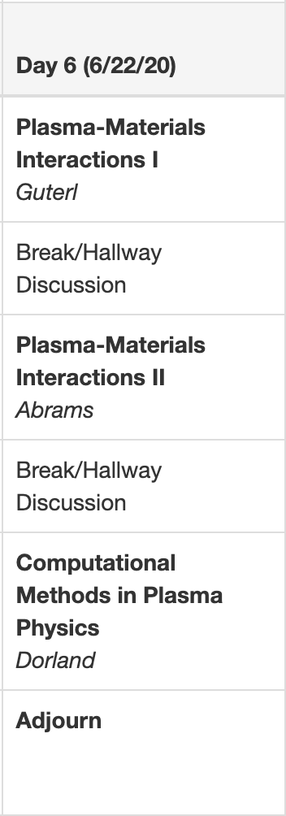
Day 6 (6/22) we will focus on the walls with a detour into computational physics
Dr. Jerome Guterl (GA) will introduce the topic of Plasma-Materials interactions with a physics overview of the challenges
Dr. Tyler Abrams (GA) will continue the PMI conversation and discuss the state of the art in the field.
We switch topics with Prof. Bill Dorland (U. Maryland) who will introduce a topic that will be relevant to the majority of the audience conducting remote research: Computational methods in plasma physics.

Slide 25
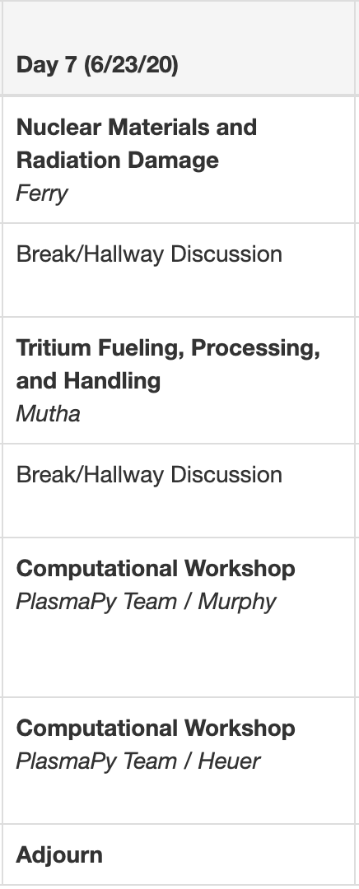
Day 7 (6/23): Structural materials, tritium systems, and computational workshop
Day 7 will start with a discussion of the materials considerations in building reactors led by Dr. Sara Ferry (MIT)
Dr. Heena Mutha (CFS) will discuss the systems necessary to deal with tritium in fusion devices
The second half of the day will be a hands-on computational workshop led by members of the PlasmaPy team: Dr. Nick Murphy (CFA) and Dr. Peter Heuer (LLE).

Slide 26
Computational Workshop
The computational workshop will be a “hands-on” event organized by the PlasmaPy team, led by Dr. Nick Murphy and Dr. Peter Heuer.
This workshop will require you to have the Anaconda Python environment installed in your computer.
In order to ensure the time is spent on the content and not on the setup, we’ve put together this document laying out the steps for installation.
PlasmaPy

Slide 27
Day 8 (6/24): Low temperature plasmas, High energy density, and networking
Day 8 will start with a broad overview of the physics of low-temperature plasmas given by Prof. Amy Wendt (U. Wisconsin)
There will be a brief detour into high-energy density plasmas, specifically laser-driven ones, given by Dr. Elizabeth Merritt (LANL).
We will venture back into low temperature plasmas with a discussion on applications led by Prof. John Foster.
The day will conclude with the second networking session event

Slide 28
Day 9 (6/25): LTP+HEDP part II and closing
Prof. Ed Thomas Jr. (Auburn) will conclude the low temperature plasmas section with a discussion on complex plasmas.
Dr. Stephanie Hansen (Sandia) will continue the HEDP section introducing pulsed-power driven plasmas.
Prof. Louise Willingale (U. Michigan) will conclude the HEDP secition and the course, with a discussion on short-pulse driven relativistic plasmas.

Slide 29
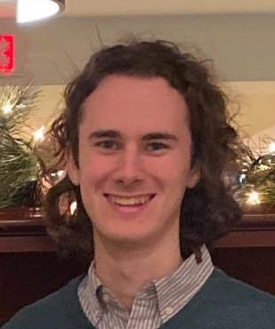
We’ve started a Discord server for the incoming fusion/plasma community!
Last summer, we created a venue to let the participants of this course, and, in general, undergrads and grads just starting out in the road of fusion and plasma physics, talk to each other and learn about summer opportunities. Conversations continued beyond the summer.
With the help of Nigel DaSilva and Louise Ferris, we’ve created and maintained a Discord server for this purpose. Enrollees were all invited to join.
Nigel DaSilva, 2020 PPPL SULI
Incoming Columbia
grad student
Louise Ferris, 2020 LANL SULI
Incoming UW-Madison
grad student
Theory and Simulation

Slide 30
Continue the conversations with the speakers!
Some speakers will be able to stick around after their talks to continue discussions. We will share a “Hallway Discussions” zoom link with enrollees. We will announce if speakers will be available and when.
We will also have Discord channels for each topic to continue discussions and we’re inviting the speakers to join (we’ll also send them the questions that arise there).
Theory and Simulation

Slide 31
APS-DPP abstract submissions
The American Physical Society Division of Plasma Physics (APS-DPP) meeting is scheduled for the week of November 8-12 @ Pittsburgh, PA. The conference will be held as a hybrid in-person/remote event. Visit the meeting website for up to date information.
As with every year, undergraduates are invited to present their research at a dedicated poster session. There were more than 100 undergraduate posters at the 2020 APS-DPP meeting!
All poster abstract submissions are due July 15th and can be submitted on the meeting website
Registration and APS membership is free for undergrads!
Theory and Simulation

Slide 32
These are not normal times and we should acknowledge this
The reason the course is remote is because we are living during a pandemic.
All talks are recorded and will be posted, so practice self-care. Take rests, sit out when you’re exhausted, stretch, stay hydrated, etc.
YOUR HEALTH AND WELL BEING ARE THE PRIORITY!

Slide 33
A healthy culture of diversity, equity and inclusion is needed for the future of fusion energy and plasma physics
The US fusion energy and plasma physics community has a poor record on diversity, equity and inclusion, as evidenced by the few women and underrepresented minorities in the field as compared to other physics and engineering fields.
Recent community-wide strategic plans have, for the first time, acknowledged these problems and put forth initial plans to address them. But an inclusive climate is the only way to start.

Slide 34
Code of conduct
Since this is a public forum we ask speakers and participants to:
Make participation in our community a harassment-free experience for everyone
Act in ways that contribute to an open, welcoming, diverse, inclusive, and healthy community
We align with the Contributor Covenant Code of Conduct

Slide 35
Code of conduct: Unacceptable Behaviors
The use of sexualized language or imagery, and sexual attention or advances of any kind
Trolling, insulting or derogatory comments, and personal attacks
Public or private harassment
Other conduct which could reasonably be considered inappropriate in a professional setting

Slide 36
Code of conduct: Positive Behaviors
Demonstrating empathy and kindness
Being respectful of differing opinions and experiences
Giving and gracefully accepting constructive feedback
Accepting responsibility and apologizing to those affected by our mistakes, and learning from the experience

Slide 37
Code of conduct: Positive Behaviors
Respect the pronouns of others
Recognize that intent is not equal to impact
Self-Care is revolutionary!

Slide 38
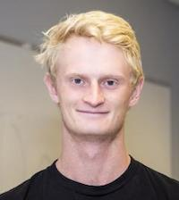
Thanks to the “Intro Course Brain Trust”
The Intro Course Brain Trust is the group of scientists from different topical groups and institutions, that helped with the speaker/topic selection and format of the course. Thank you!
Steffi
Diem
Will
Fox
Walter
Guttenfelder
Eva
Kostadinova
Florian
Laggner
Ane
Lasa
Oak
Nelson
Theory and Simulation

Slide 39
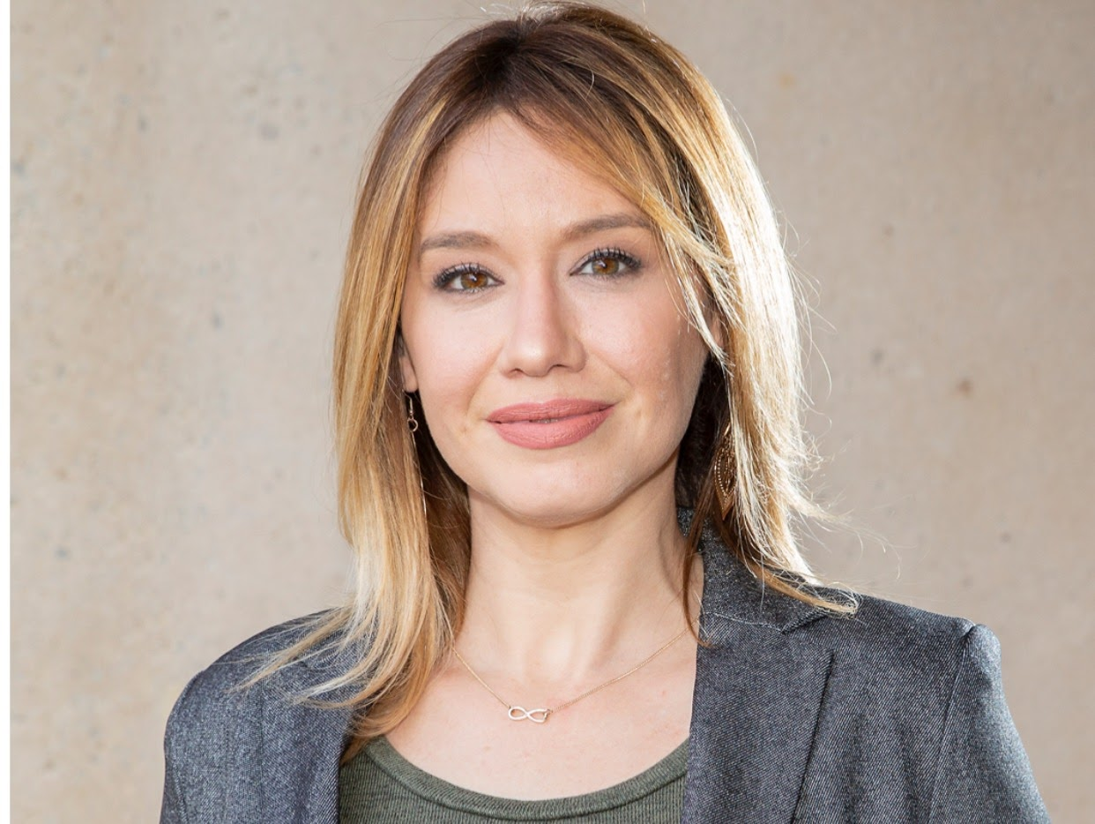
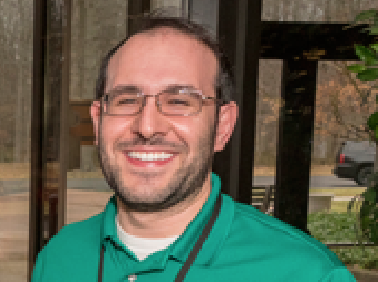
Thanks to Deedee and Harry
Special thanks to my colleagues, Deedee Ortiz, Program Manager at the Science Education Department, and Harry Tsamutalis Jr, A/V Technician.
If the logistics for this course works, it’s because of their hard work.
Theory and Simulation

Slide 40
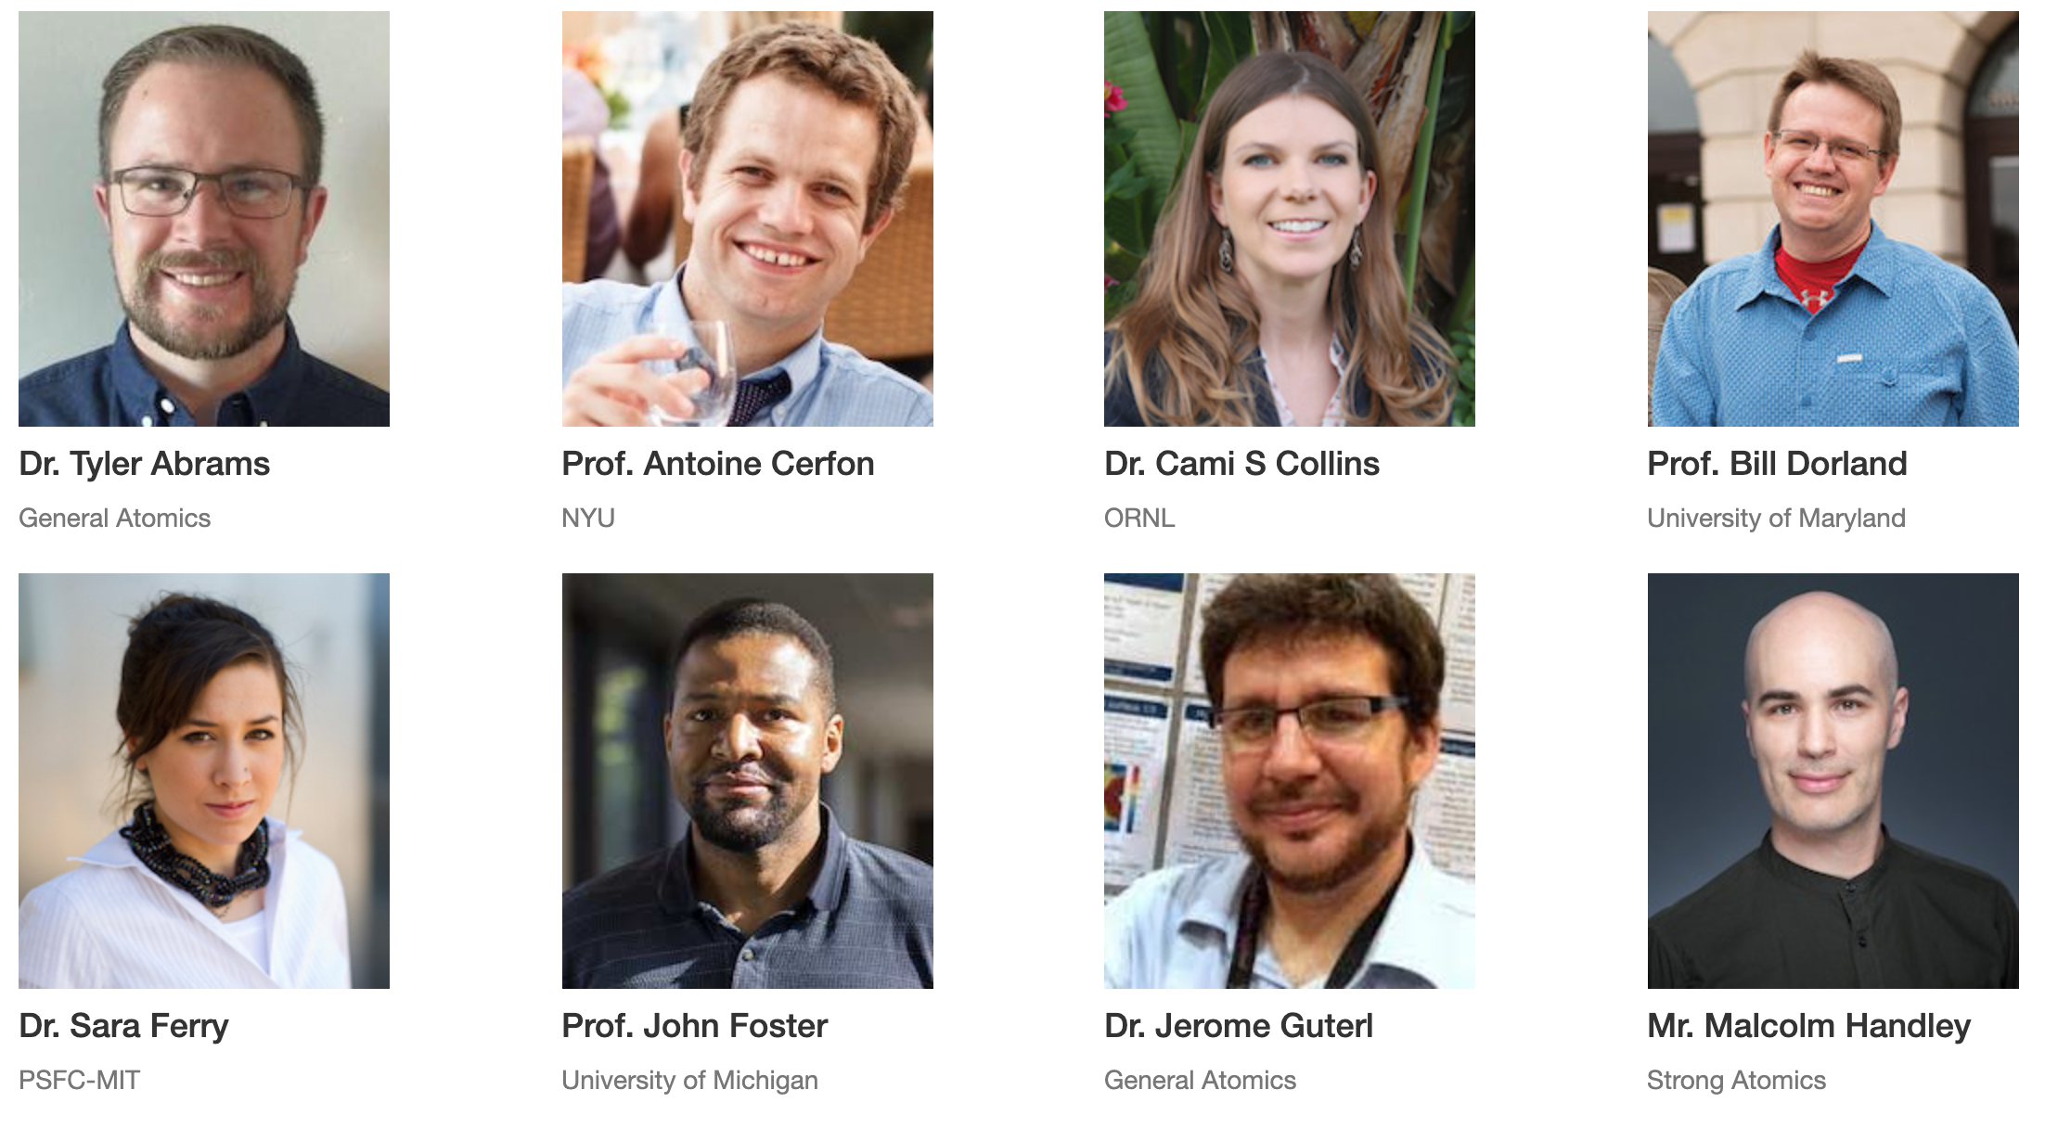
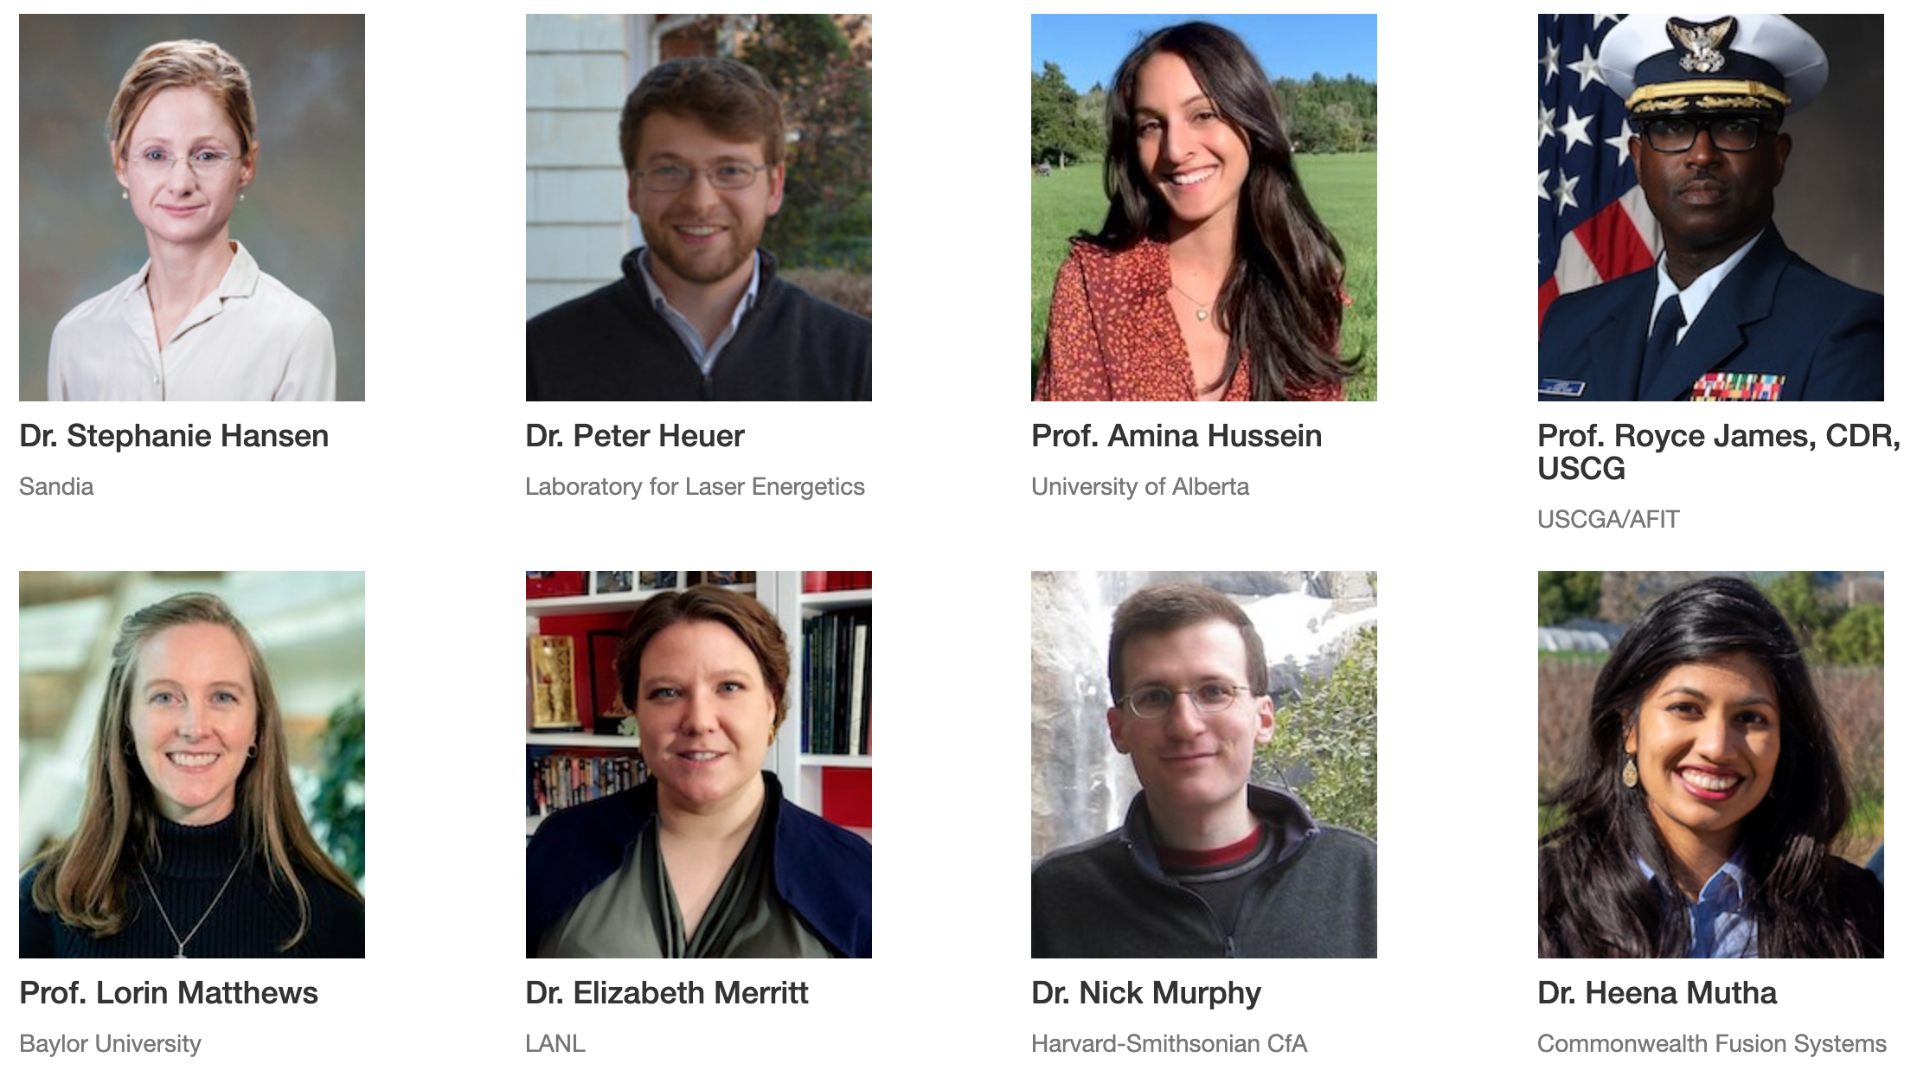
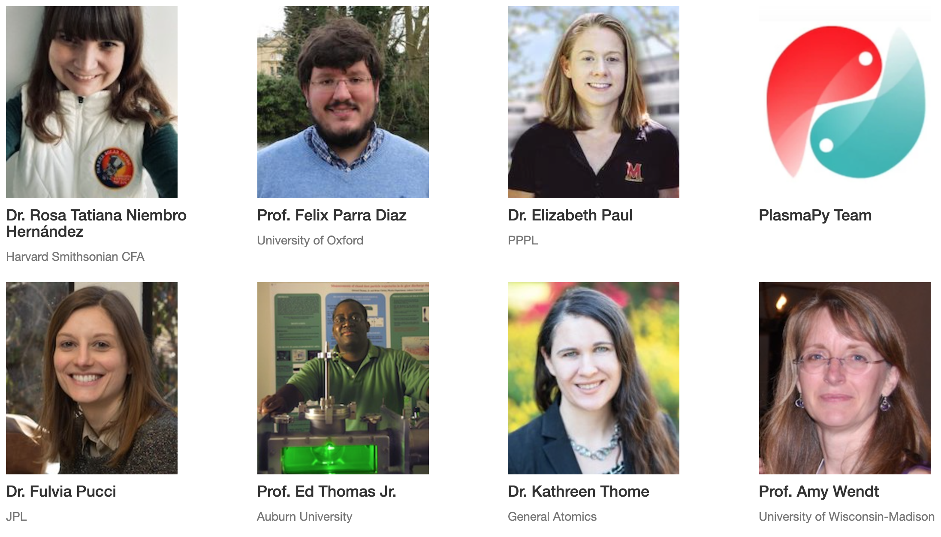
Finally, of course, thanks to all of the speakers!
Theory and Simulation

