Slide 1
Principles of Magnetic Confinement Fusion, including Auxiliary Heating Methods and Spectroscopic Diagnosis
Rajesh Maingi
Princeton Plasma Physics Laboratory
SULI summer lecture
July 11, 2019
Princeton, NJ

Slide 2
We need energy research because we have a looming worldwide energy crisis
World energy use will double by ~ 2045
Continued reliance on fossil fuel will likely cause unacceptable climate changes
A substantial R&D program is needed to develop alternative sources of energy
Nuclear power from fission plants should be the bridge to the future
Improved public education needed
Fusion energy R & D is one of the high-risk, high-reward ventures in the U.S. and abroad

Slide 3
Outline
Fusion reaction basics (interactive Q/A session)
Challenge of managing interactions between the plasma and the surrounding wall - how do you stop the wall from melting?

Slide 4
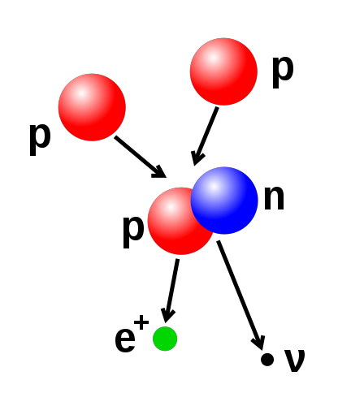
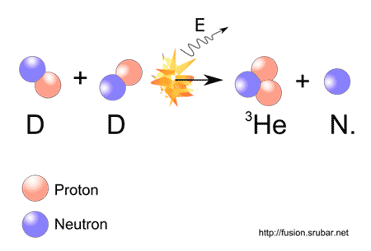
Fusion is a Nuclear Process in which Light Nuclei Fuse into Heavier Ones
During fusion, a small part of the reactant mass is converted to energy through Einstein’s equation: E=mc²

Slide 5
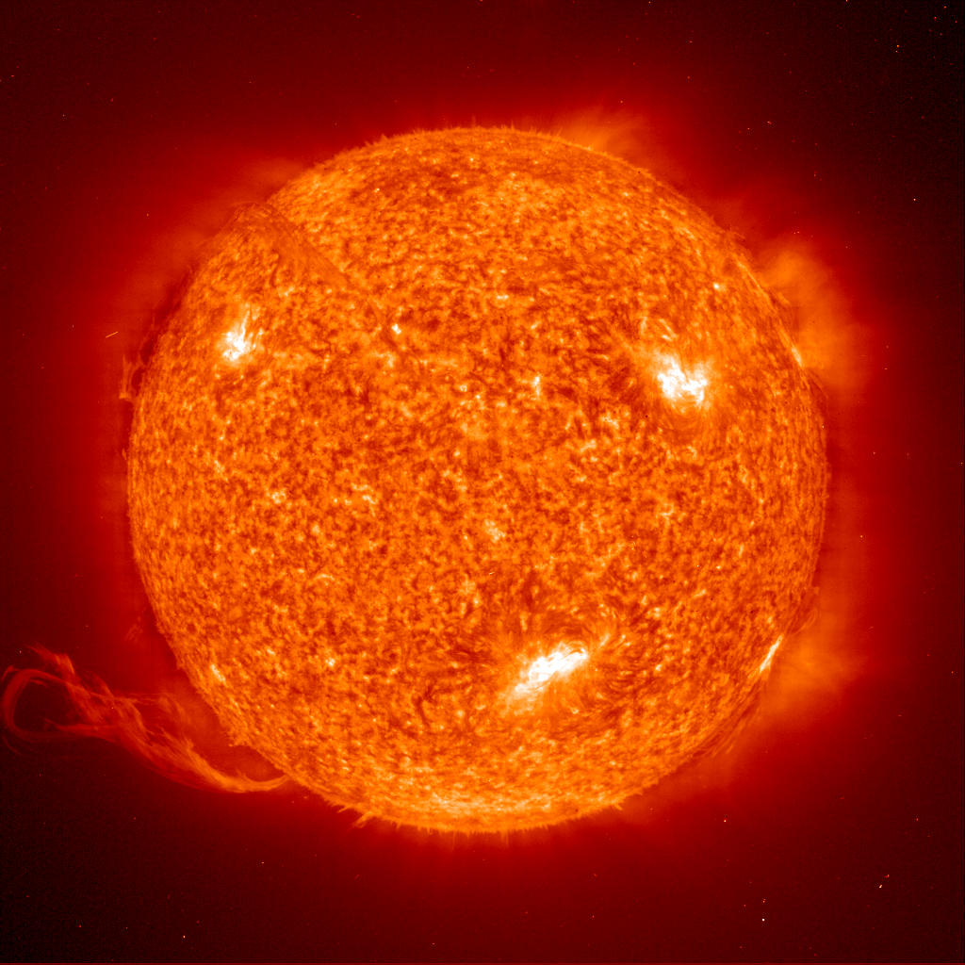
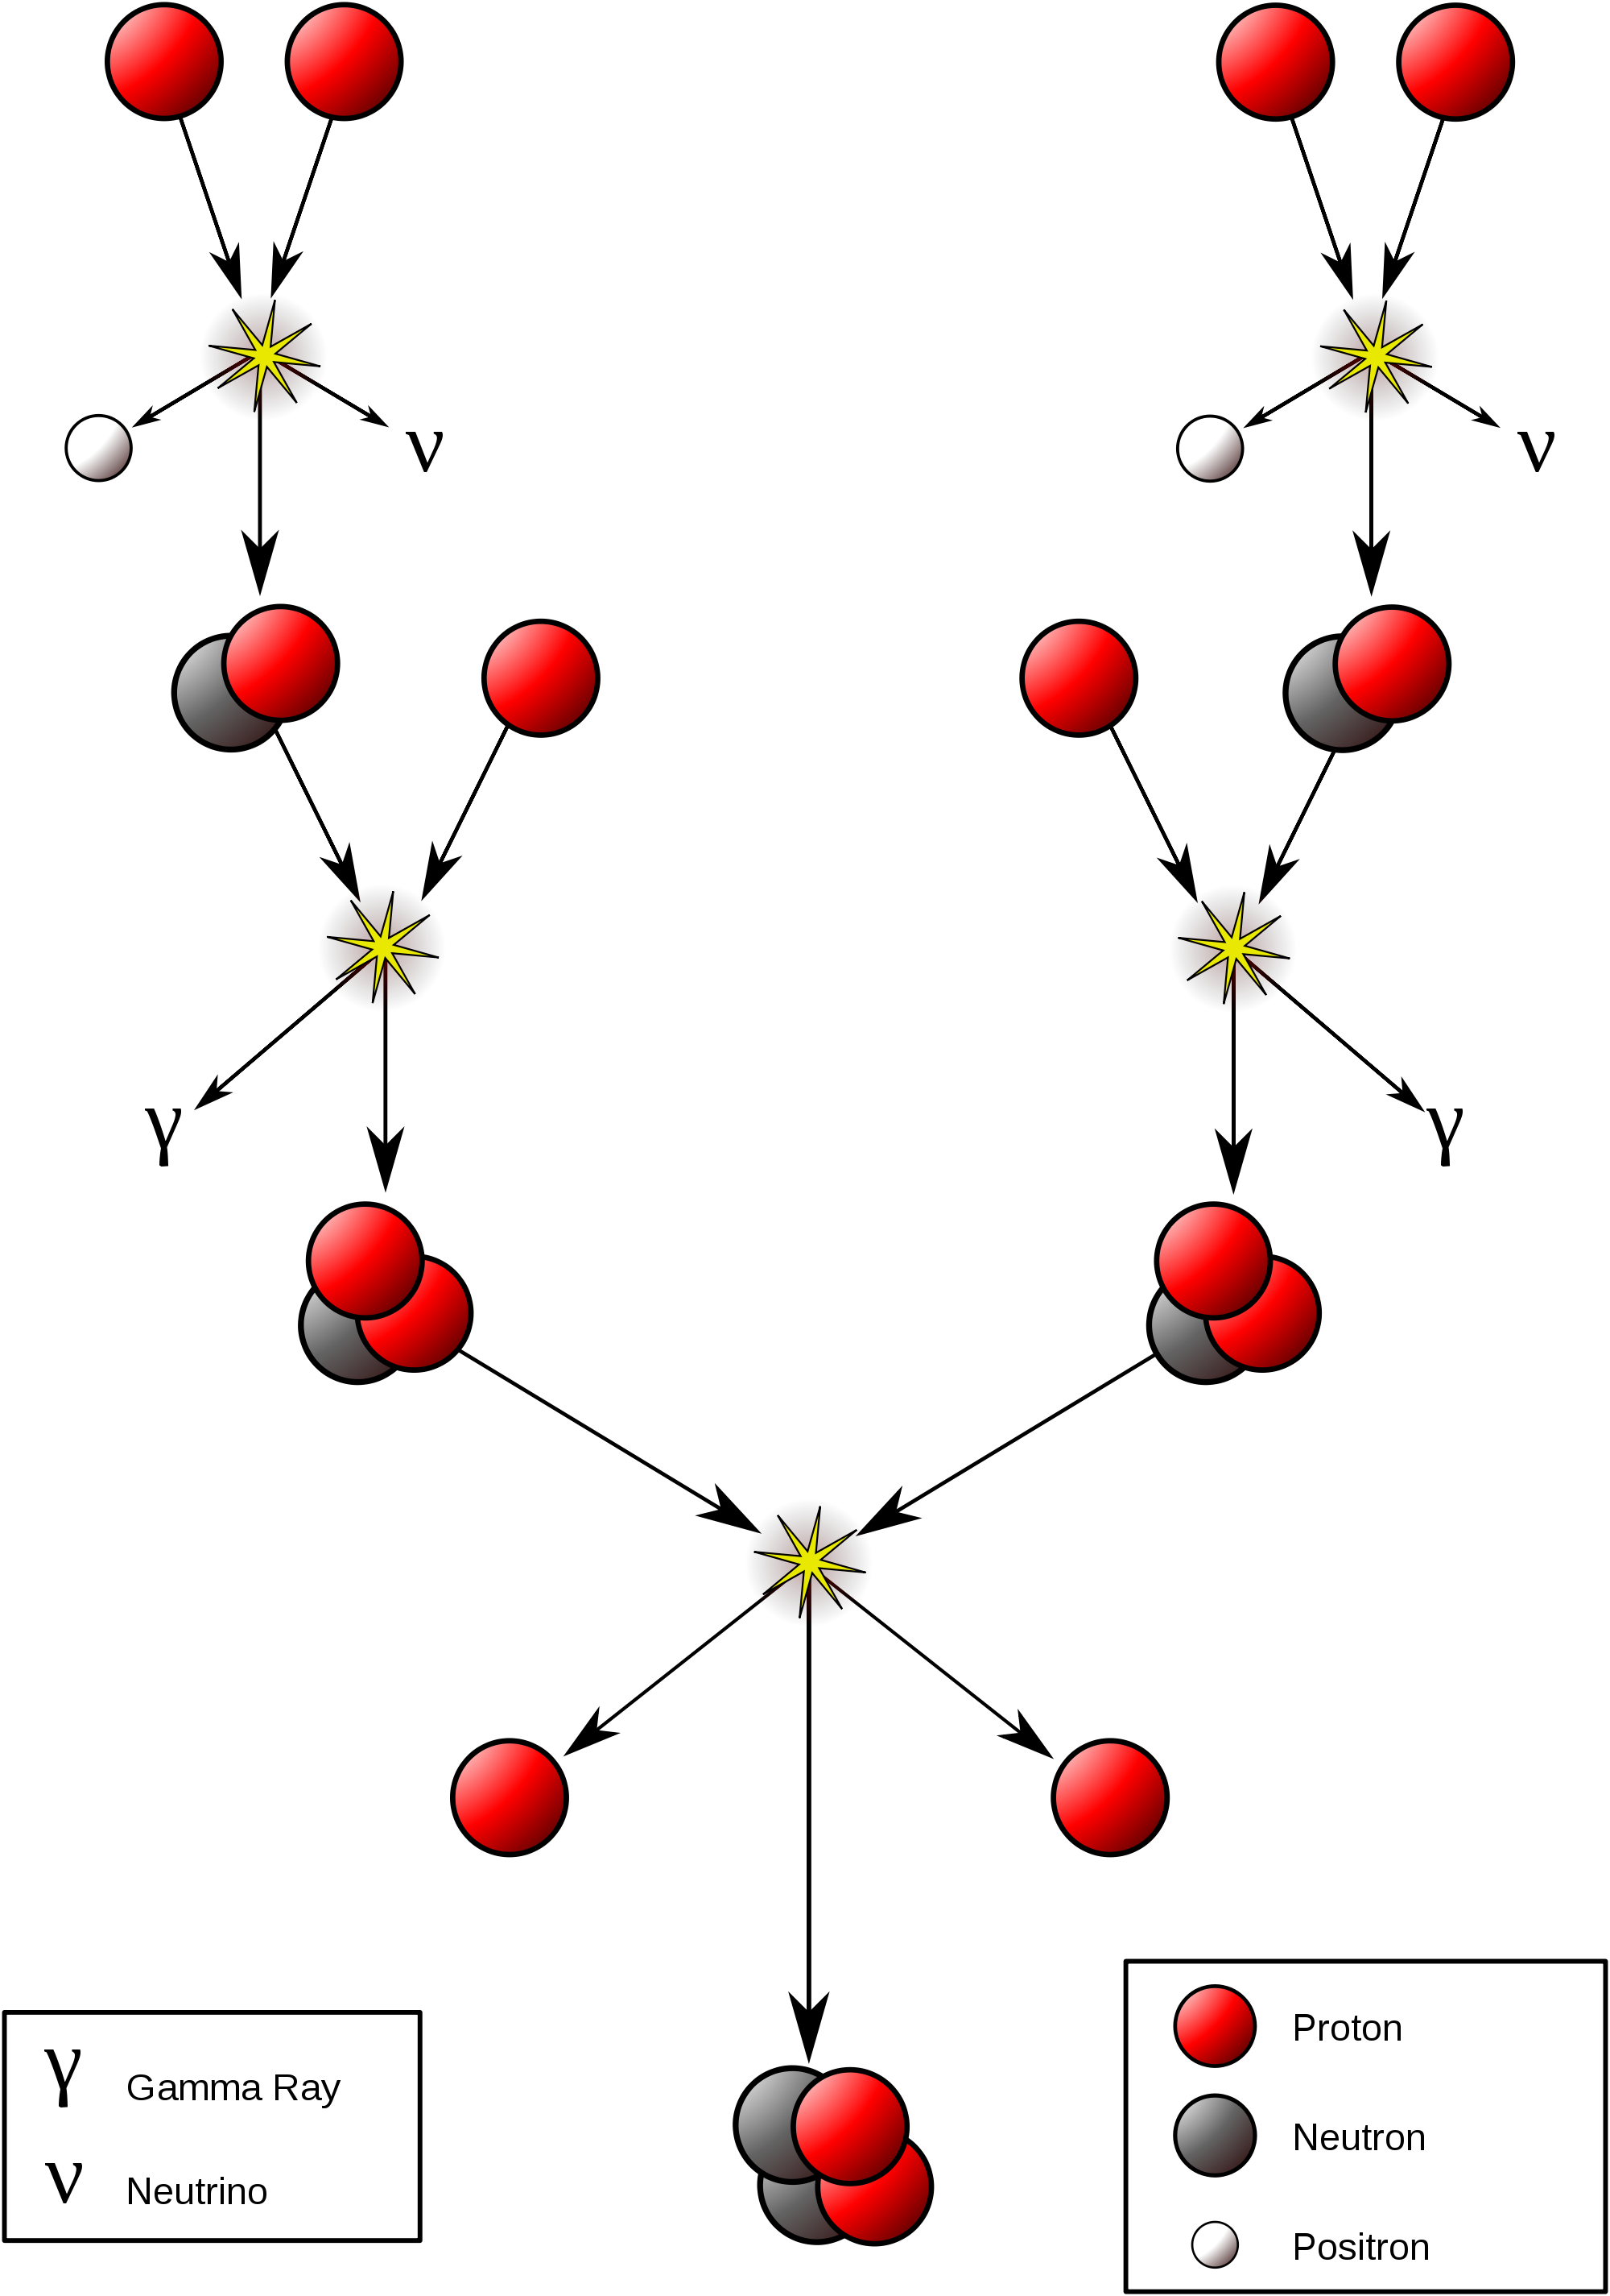
Stellar Fusion is a Naturally Occurring Example
Shown at right is the proton-proton chain, dominant in our sun

Slide 6
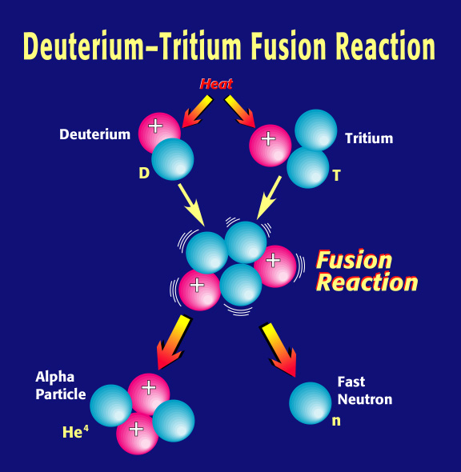
Fusion between deuterium and tritium is the one used in reactor designs
Internal
heating
Tritium
replenishment
Li
Electricity
Hydrogen

Slide 7
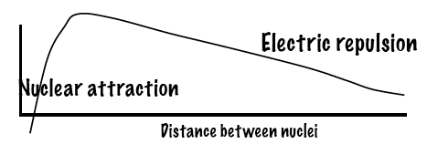
For Conventional Fusion, Atomic Nuclei Must Collide at High Energy
High energy input is required
Atoms heated to high temperatures
Electrons break free from nuclei
Free electrons, ions form a plasma which has ~ zero net charge
Examples: lightning, aurora, fluorescent lights, sun, magnetosphere
Plasma ions must be heated enough to overcome the longer-range electric repulsion force
Ions must be close-enough for nuclear attraction force to dominate
Net force

Slide 8
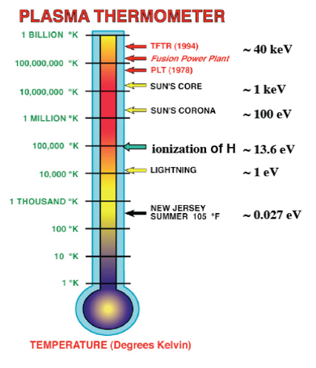
How hot does the plasma need to be for fusion?

Slide 9
There are Several Ways of Confining Plasmas
Requires large
amounts of mass!
Confines the plasma in the direction across the magnetic field
Energy and defense
relevant

Slide 10
Magnetic fields confine the plasma in the direction across the magnetic field
Force on a charged particle in a magnetic field:
F = q v X B
Electromagnetic forces are much stronger than gravity!
F_{elec} ~ q₁q₂/r², F_{gravity} ~ m₁m₂/r²
F_{elec} / F_{gravity} ~ 10²⁶ for two protons!
Another way to express this:
Stars need between 5000 and 25,000 times the mass of the earth for fusion to begin, or about 10²⁹ pounds
A new international fusion device under construction in France (ITER) uses 20 million pounds of electromagnetic coils to confine the plasma for fusion to ‘begin’
M_{ITER_coils} / M_{star} ~ 10²² (mechanical advantage)
How big is that number? Think of it like a ratio of distances:
The size of an atom to the distance between the sun and Pluto
v
F
+
B
+
+
m1 m2 q1 q2
10

Slide 11
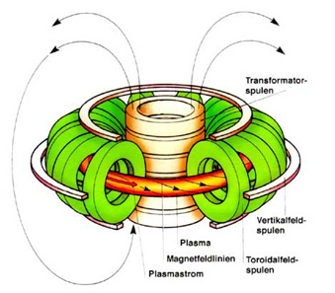
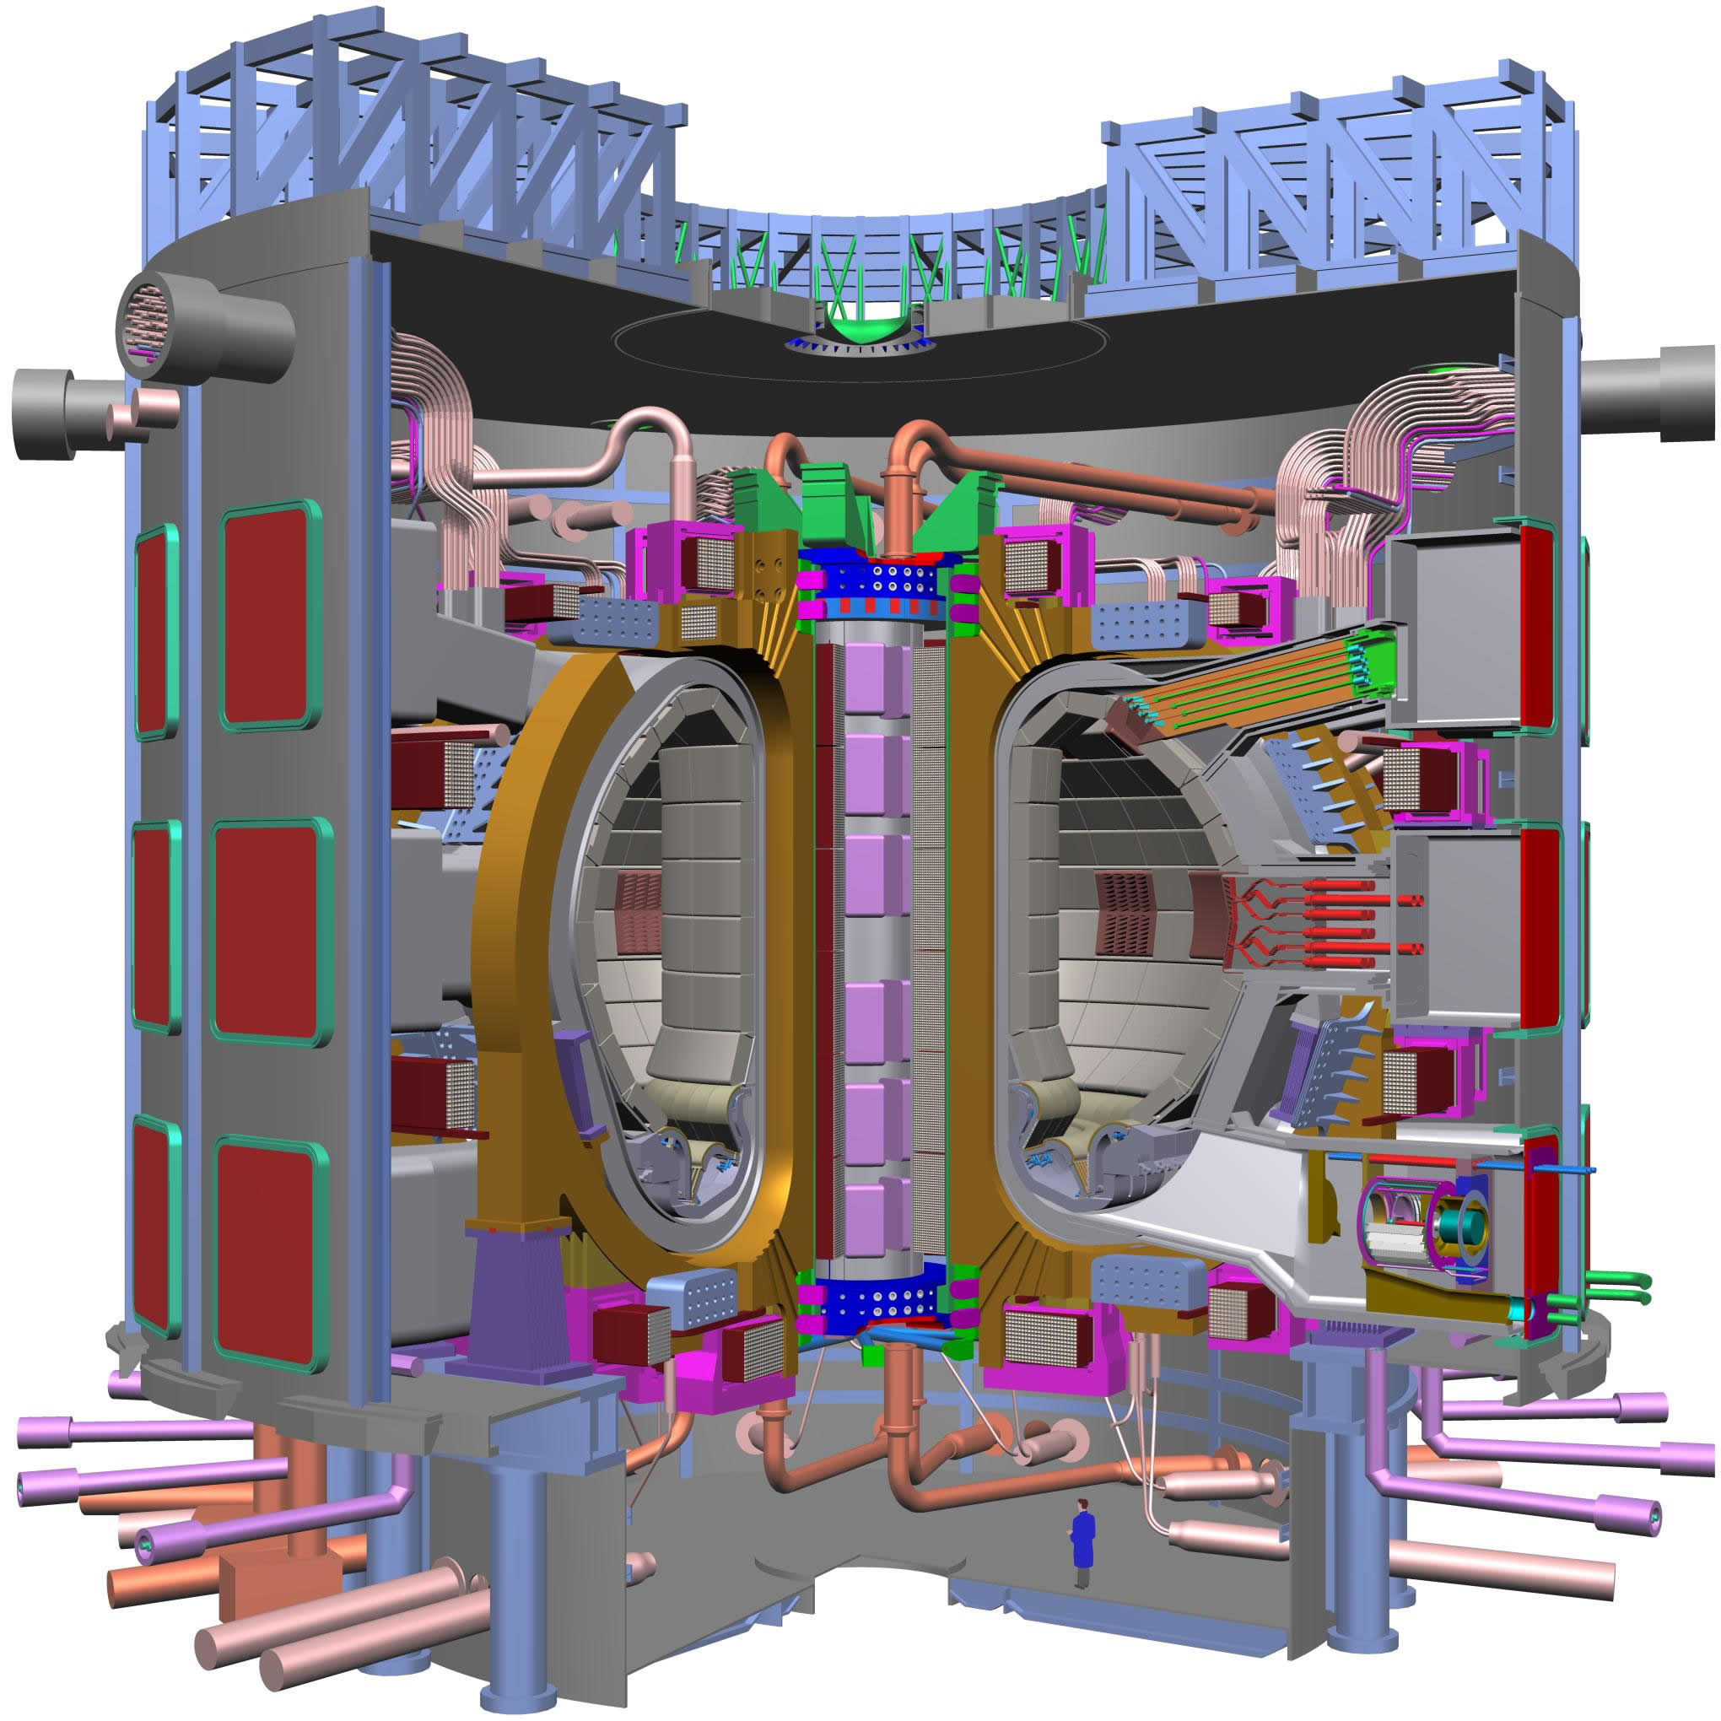
Issue: magnetic fields don’t restrict plasma motion along the field, so plasma leaks out
Force on a charged particle in a magnetic field:
F = q v X B
How to solve problem of end losses in a linear fusion device
Increase the magnetic field strength at the ends relative to center (‘magnetic mirror’), but this is imperfect
Bend the linear device into a circle: no beginning or end!
Better, but still imperfect
ITER

Slide 12
The international fusion community has agreed to build ITER, a giant step toward energy production
Seven international partners
EU
Japan
US
Russia
China
Korea
India
Being built in France
Construction finished ~ 2018
D-T plasmas in 2026
P_{fusion} = 500 MW for 1000 sec discharges
P_{fusion} = 250 MW in steady state
ITER
12

Slide 13
How do we heat up the gas to these astonishingly high plasma temperatures?
Resistive heating
We induce a high current through the plasma (millions of amperes)
The plasma has an electrical resistance, and we get resistive or ‘ohmic’ heating
Analogous to resistive heating in a circuit: P_{heat}= I_{plasma}² R_{plasma}
Issue: as plasma gets hotter, R_{plasma} goes down, less efficient
Wave heating
Like heating food, except that the right wave frequencies are determined by plasma properties and magnetic field
Most effective heating done by radio waves, not microwaves
Heating with energetic neutral beams, like accelerators
Accelerator portion produce charged particles
Those are converted back to neutrals to penetrate magnetic fields
The energetic neutrals transfer energy to plasma inside device

Slide 14
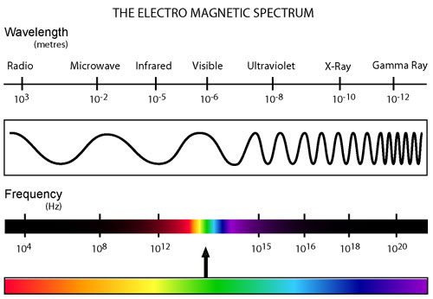
Once we’re successful at heating plasmas, how do we measure their properties?
We measure passive electromagnetic radiation emission
Plasma emits in all parts of the spectrum, from the X-ray to the Infrared
The most energetic emission (X-rays) come from the center, while the least energetic emission (Infrared) comes very near the wall
Visible emission comes from the very edge of the plasma, and can be measured with (fast!) cameras

Slide 15
Once we’re successful at heating plasmas, how do we measure their properties?
We measure passive electromagnetic radiation emission
Plasma emits in all parts of the spectrum, from the X-ray to the Infrared
The most energetic emission (X-rays) come from the center, while the least energetic emission (Infrared) comes very near the wall
Visible emission comes from the very edge of the plasma, and can be measured with (fast!) cameras
We also actively probe the plasma, e.g.
Thomson Scattering: laser beam fired at the plasma, and scattered beam properties tell us local electron density, temperature
Charge Exchange Recombination Spectroscopy and Motional Stark Effect: we examine the interaction of the plasma with the neutral beam for information on the ion temperature, rotation speeds, and magnetic field pitch

Slide 16
Outline
Fusion reaction basics
Challenge of managing interactions between the plasma and the surrounding wall - how do you stop the wall from melting?

Slide 17
Major challenge: plasma core ~ 150 million K, wall must be kept < 2000 K
Fusion plasmas must be kept very pure with hydrogen isotopes
Impurities from the walls cause a lot of (electron line) radiation that cools the plasma and quenches fusion
The radiation gets higher as the atomic number of the impurity increases
On the other hand, the rate at which impurities are generated can decrease as the atomic number increases
Helium is a natural by-product (“ash”) of fusion, and it can be tolerated to 10% concentration in the core
To insure plasma purity, fusion chambers are ultra-high vacuum ~ 10⁻¹¹ atmospheres
17

Slide 18
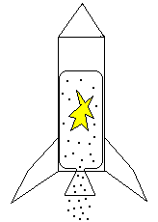
Plasma-material interface: how do you keep the hot part hot and the cold part cold?
Basic answer is mass difference
In ITER, there is less than ½ gram of deuterium and tritium in the core
The total mass of ITER is nearly 50 million pounds; a fraction of this is in the plasma facing components, which will absorb the heat
The internal components of ITER will be actively cooled to keep temperature below melt limits
The present technological heat flux removal limit is about 10 million W/m²
A rocket nozzle has average heat flux of 1 million W/m²!
The sun’s radiant heat flux on earth ~ 1400 W/m²
18

Slide 19
Fusion is an exciting research area with engaging science and technology
Vibrant area with substantial domestic and international effort
Engineering the plasma-material interface is critical to the success of fusion
Students can make meaningful contributions!
Thank you for your attention, and this opportunity!
19
Notes:
19

