Slide 1
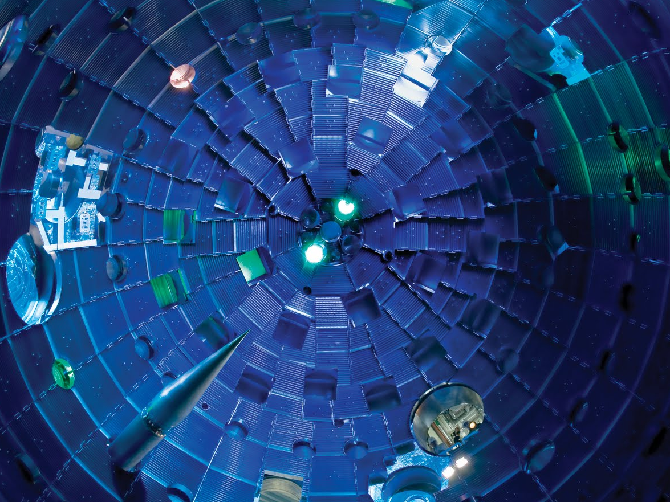
Inertial Confinement Fusion (ICF)
as an Energy Source and for Basic Science
Maria Gatu Johnson
High-Energy-Density-Physics Division
MIT Plasma Science and Fusion Center
SULI Plasma Physics Course,
PPPL, June 15, 2017
Notes:
Introduce myself
Inertial confinement fusion = laser fusion
What we see here is the inside of the target chamber on the National Ignition Facility in Livermore, California. We will get back to this later in the talk so I won’t give you any details now --- POINT OUT TARGET

Slide 2
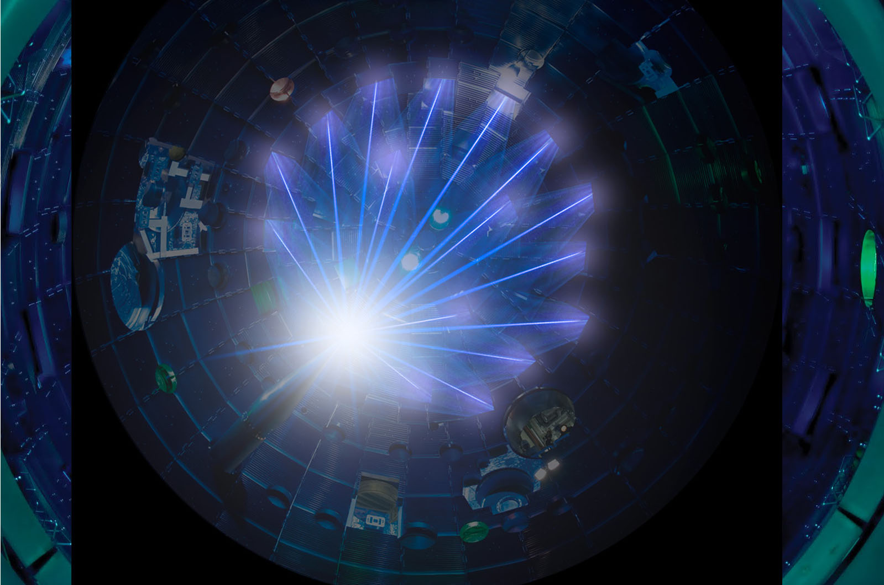
Inertial Confinement Fusion (ICF)
as an Energy Source and for Basic Science
Maria Gatu Johnson
High-Energy-Density-Physics Division
MIT Plasma Science and Fusion Center
SULI Plasma Physics Course,
PPPL, June 15, 2017

Slide 3

Outline
Fusion Basics
The principle of Inertial Confinement Fusion (ICF)
  ICF facilities
  The OMEGA laser facility
  The Z pulsed power machine
  The National Ignition Facility (NIF)
  NIF experiments
  Status
  Engineering and scientific challenges
Basic-science experiments on OMEGA and the NIF
3

Slide 4
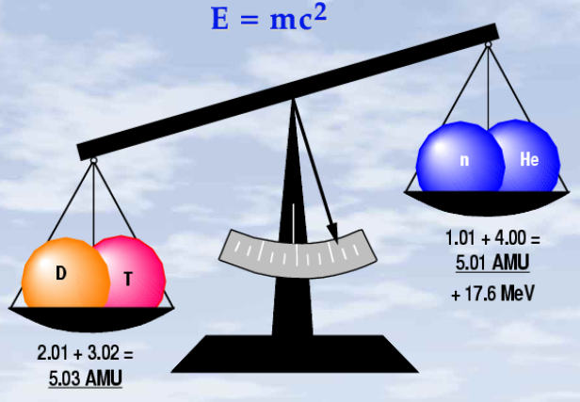
Fusion combines light nuclei to a heavy nucleus and releases
huge amount of energy (~10⁶× more than fossil fuel / AMU)
Fusion basics
D + T → ⁴He + Neutron + Kinetic energy
Triton (T)
⁴He
⁵He
Deuteron (D)
Neutron
In DT fusion, ~0.4 % mass is converted to kinetic energy
4
Notes:
Main laboratory fusion reaction: D+T (most easy to make happen, large energy gain)
Describe image: E=mc^2 -→ Einstein -→ Mass converted to energy

Slide 5
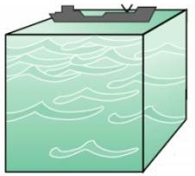
Deuterium is extracted from sea water (~1 part in 5000
of the hydrogen in seawater is deuterium)
Fusion basics
= Total energy of
the oil reserve
1 km
1 km
1 km
Tritium is unstable and does not exist naturally. It must be produced in a reactor via the n+⁶Li and n+⁷Li reactions
5
Notes:
Deuterium is extracted from sea water through an isotope exchange process, using e.g. the Girdler sulfide process.
Girdler-Sulfide exploits the temperature dependence of the exchange of deuterium between water and hydrogen-sulfide gas (H2S). In a typical GS heavy-water extraction tower, ordinary water is passed over perforated trays over which gas is bubbled. In the “hot section” of each tower the deuterium will migrate to the hydrogen-sulfide gas, and in the cold section, the deuterium migrates back into cold feedwater.

Slide 6
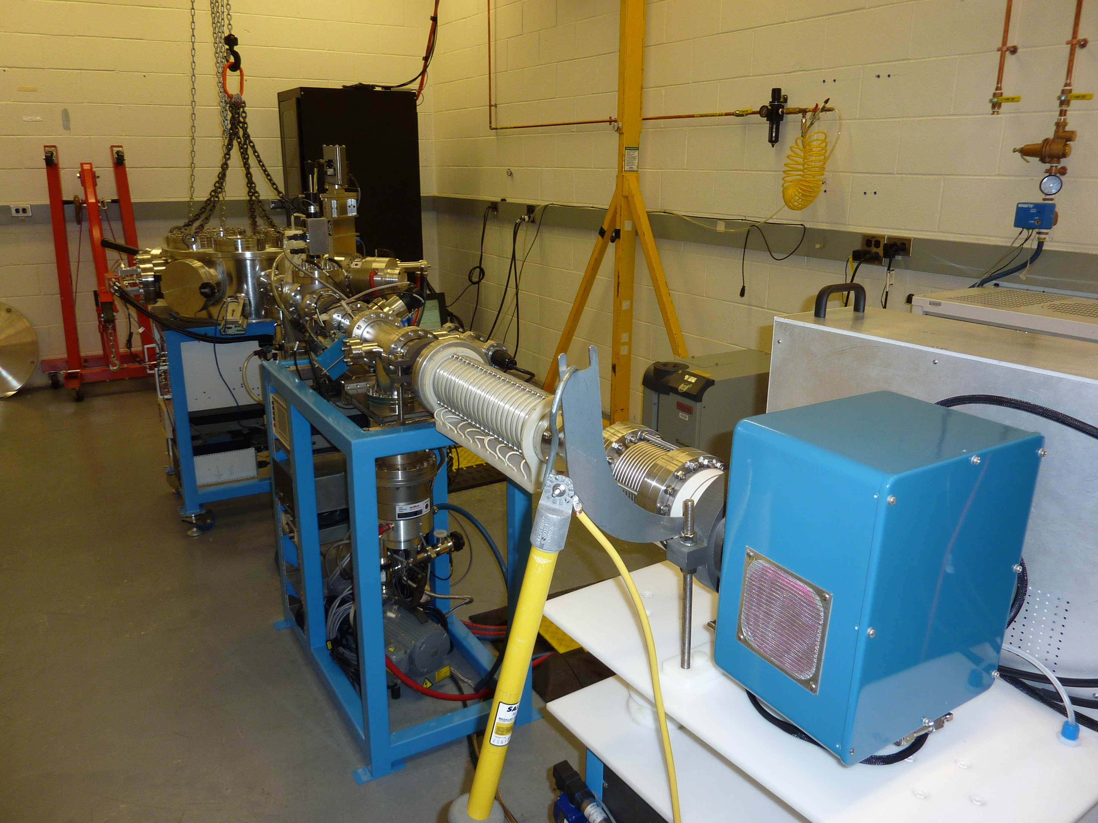
It takes energy to overcome the Coulomb barrier.
Particles can be accelerated (Beam Fusion)
Fusion basics
⁴He
D
Coulomb
repulsion
T
+
+
⁵He
Neutron
MIT accelerator
Very ineffective approach as most energy is lost to heating the cold target electrons
6
Notes:
Anne went over Coulomb repulsion earlier in the course
Particles of the same charge repel each other
To get them to fuse, we have to get them really close together
We actually do use this method to make fusion, but it will never lead to energy gain

Slide 7
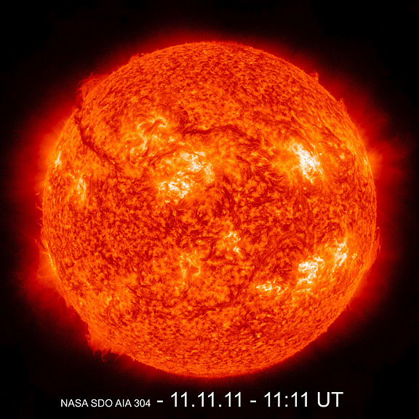
It takes energy to overcome the Coulomb barrier.
Particles can be heated (Thermonuclear Fusion)
Fusion basics
D
HOT PLASMA
+
⁴He
Coulomb
repulsion
⁵He
T
+
Neutron
If the ions are sufficiently hot (i.e. large random velocity), they can overcome the coulomb repulsion and fuse
7

Slide 8
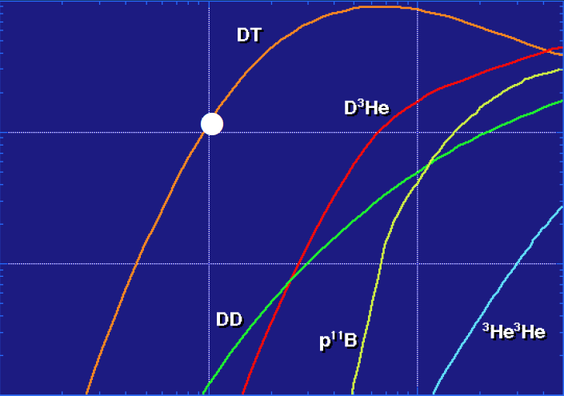
Fusion does not come easy! We need ~100 million Kelvin
for a significant number of fusion reactions to occur
Fusion basics
10⁻²¹
~100 million K
10⁻²²
Reactivity <σv> (m³/s]
10⁻²³
10⁻²⁴
1.0
10
100
Temperature, T [keV]
Yield = n_{i} × n_{j} × <σv>_{ij} × Volume × time
The plasma also needs to be at high enough density and confined for a long enough time…
8
Notes:
This is also a nice illustration of why D+T is the primary target reaction in fusion research

Slide 9
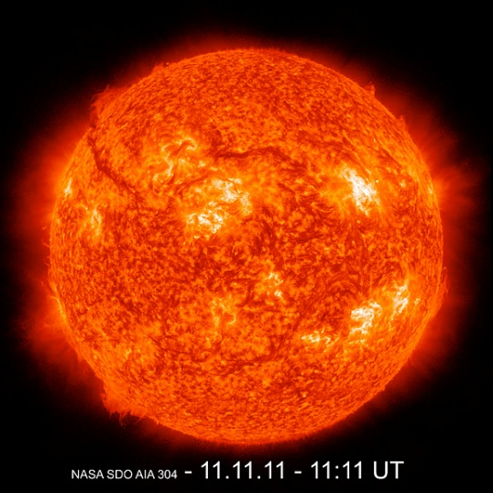
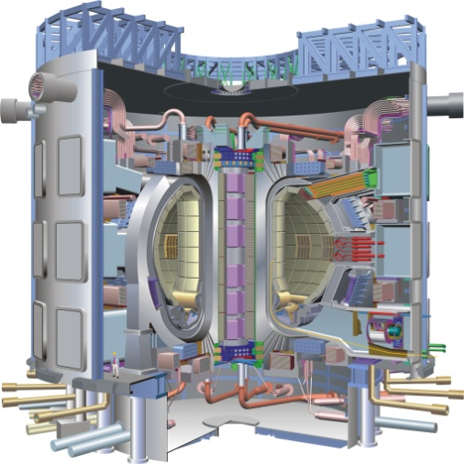
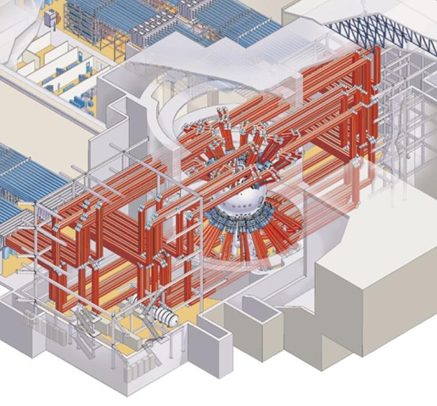
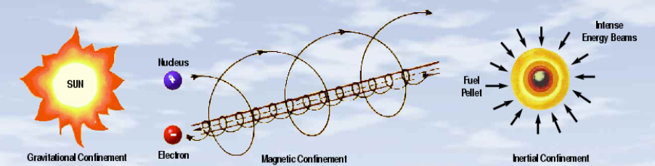
There are three main approaches to confining a fusion plasma
Fusion basics
Gravitational confinement
Magnetic confinement
Inertial confinement
9
Notes:
Gravitational confinement: Used in stars like our sun
Magnetic: you talked a lot about this earlier in the course. Use the fact that charged particles are confined in a magnetic field (spiral around magnetic field lines)
Inertial: Fuel kept together long enough by its own inertia for fusion to happen

Slide 10
The fusion plasma conditions and confinement times
are very different for the three approaches
Fusion basics
Gravitational confinement
Magnetic confinement
Inertial confinement
n ~ 10²⁶ cm⁻³
n ~ 10¹⁴ cm⁻³
n ~ 10²⁶ cm⁻³
T ~ 15 million K
T ~ 100 million K
T ~ 100 million K
τ_{c} ~ 10⁴ years
τ_{c} ~ 1 s
τ_{c} ~ 3×10⁻¹¹ s
10

Slide 11
Outline
Fusion Basics
The principle of Inertial Confinement Fusion (ICF)
  ICF facilities
  The OMEGA laser facility
  The Z pulsed power machine
  The National Ignition Facility (NIF)
  NIF experiments
  Status
  Engineering and scientific challenges
Basic-science experiments on OMEGA and the NIF
11

Slide 12

ICF uses the inertia of a dense shell to confine the plasma before it blows apart under its own pressure
Principle of ICF
High-density DT shell
The confinement time (τ_{c}) can be
expressed in terms of the sound speed c_{s}:
DT gas core
Local confinement time:
R
ρ
Mass average:
Rarefaction propagates into and decompresses the
assembled mass at the sound speed c_{s}
M. Rosen, Phys. Plasmas 6, 1690 (1999)
12
Notes:
The confinement time is the volume over the rate of change of the volume

Slide 13
“Areal density” ρR is a key performance parameter in ICF
Principle of ICF
The confinement parameter (nτ_{c}) can now be expressed as:
Notes:
number density n=density/mass
rhoR is a measurement of the quality of the confinement – a major figure of merit for an ICF implosion

Slide 14
Ignition occurs when fusion energy carried/deposited
by the ⁴He ions balances the energy losses
Principle of ICF
⁴He
Energy losses:
Radiation
Thermal conduction
PdV expansion
⁴He ion energy
= 3.6 MeV
n
Ideal gas law
at ~5 keV
Fusion reactivity
Energy confinement
The ignition criterion for ICF is ~20 times higher than that of MCF due to inefficiencies in assembling the fuel
14
Notes:
START WITH THE IMAGE: Describe the idea. Reactions happen in the hot core, alpha particle reaction products deposit their energy in the fuel, making more fuel hot to generate more reactions
Plasma pressure <p>=niTe+neTe → p~2nT
Ideal gas law pV=NkT=nVkT

Slide 15
The fuel burn fraction (f) depends on ρR
Principle of ICF
Fusion burn rate
Integrate over confinement time
Burn fraction
M. Rosen, Phys. Plasmas 6, 1690 (1999)
15
Notes:
Separation of variables → dn/n^2 = dt/2*<sv>
n=2 x nT
This works because dnT/dt=dn/2dt

Slide 16
A high ρR is required for high nτ_{c} values and for a significant fraction of the fuel to burn before it disassembles
Principle of ICF
If f_{b} = 25% (required for ignition) → ρR_{DT} ~ 2 g/cm²
→
ρ_{DT, solid} = 0.25 g/cm³
For ignition, we need a DT-fuel mass (m_{DT}) of about
16
Notes:
Assume we work with nominal solid DT density, how much mass is required for ignition?

Slide 17
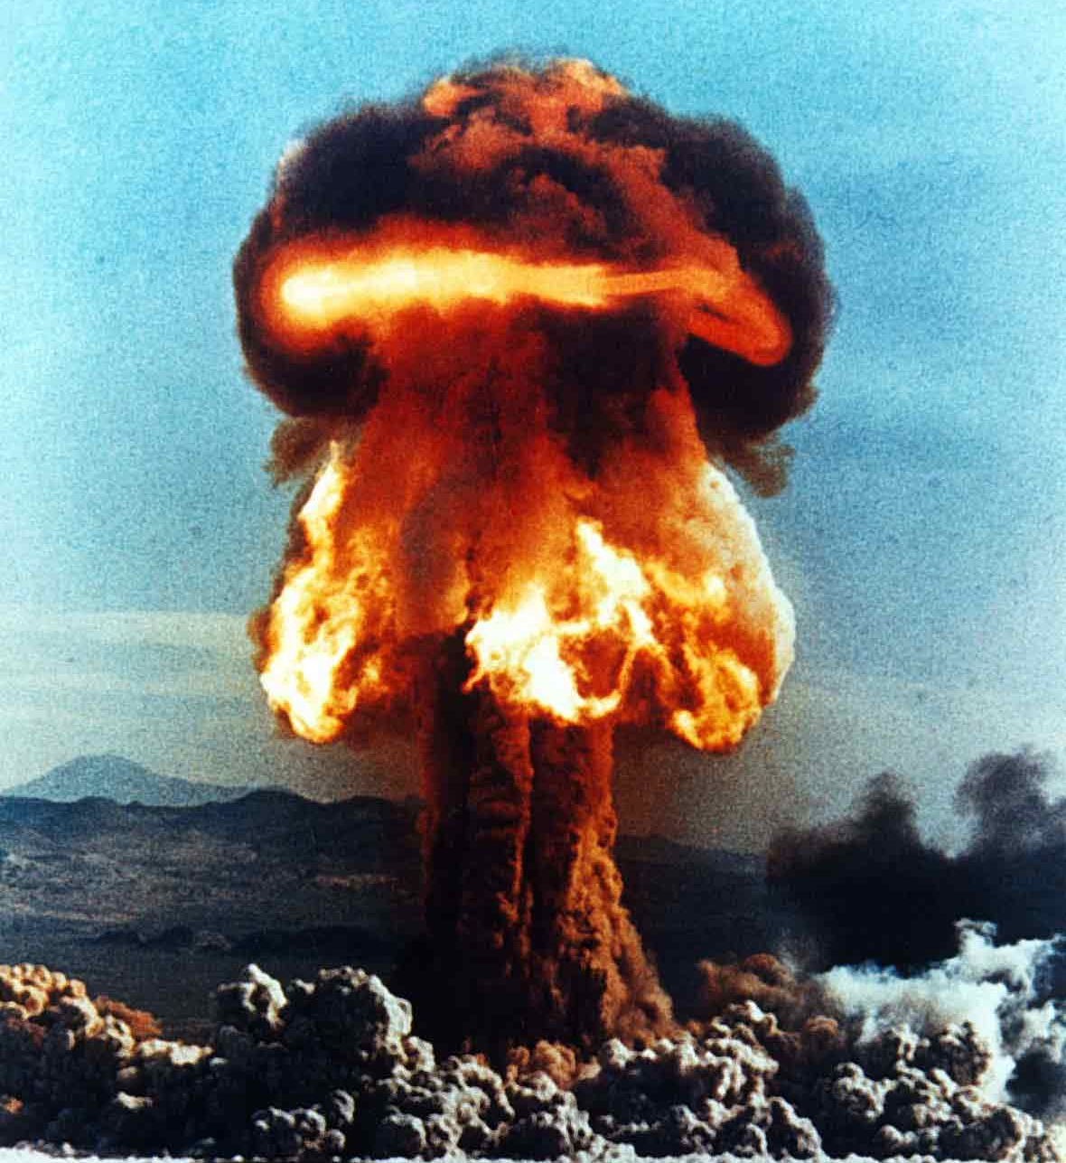
So what’s the problem? Why can we not work with
0.5 kg of DT fuel in a fusion reactor?
Principle of ICF
Burn fraction
DT mass
17

Slide 18
Principle of ICF
Solution: compress the ICF capsule to increase ρ_{DT}
High-density DT shell
CH-ablator
DT gas core
DT
gas
Compression
R
R
ρDT
ρDT
R ~ 1100 μm
R ~ 30 μm
ρ_{DT} = 0.25 g/cm³
ρ_{DT} ~ 700 g/cm³
ρR_{DT} ~ 0.03 g/cm²
ρR_{DT} ~ 2 g/cm²
18

Slide 19
Principle of ICF
Spherical compression is most efficient
Must exploit R³ compression with spheres – R² or R¹ scaling with cylindrical or planar compression is not adequate
In practice, a hollow shell has more surface area and is easier to push with a given pressure than a solid sphere of the same mass
Goal: Convert shell kinetic energy to compression energy

Slide 20

The capsule must be compressed ~35× (δR/R < 1%)
to achieve the right conditions (Basketball → green pea)
Principle of ICF
Green pea
~35×
20

Slide 21
ICF implosion timeline
Principle of ICF
1. Laser irradiates and heats the surface,
increasing the pressure
2. Ablation of the surface material
accelerates the capsule inwards
3. Temperature and density
increase as fuel compresses
n
4. “Bang time” is the time of peak nuclear production
⁴He
~20ns
~30 ps
21
Notes:
1. Radiation energy is absorbed near the outer surface of the capsule
2. Energy deposition causes material to ablate rapidly; ablation produces implosion
3. Fuel is compressed and stagnates around a low-density central hot spot, where shock convergence and compression energy heat the fuel and spark fusion reactions
4. Fusion products deposit energy throughout the bulk of the compressed fuel, igniting the capsule
“In step 1, laser energy is (collisionally) absorbed by electrons as the laser propagates up to and back from the critical surface.”
“That energy is conducted to the ablation surface at the edge of the shell, where material is ablated.”
“That ablation pressure drives the shell inward, assembling the compressed fuel around a low-density hot spot.”
“At that point, the energy imparted by the compression and shock convergence sparks fusion reactions.”
“Provided the compression is good enough, fusion product energy will be deposited in the bulk of the fuel, igniting a burn wave that propagates throughout the fuel.

Slide 22
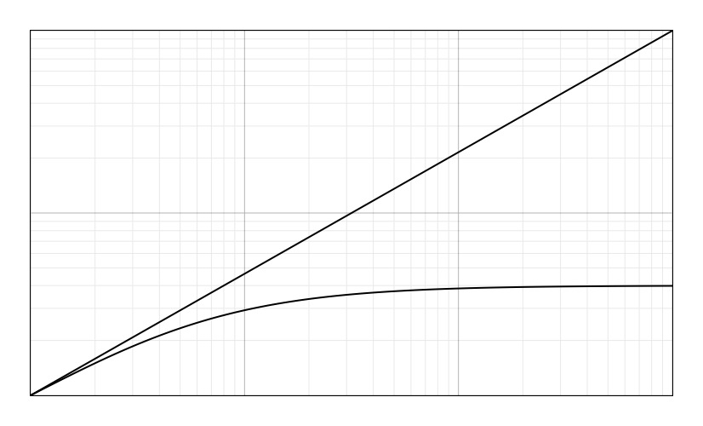
The most efficient compression is isentropic
Principle of ICF
From thermodynamics:
Minimize Work Needed to Compress
Minimize Entropy Generation
Isentropic Compression
Change in Density
10
Shock Compression
1
10
100
Change in Pressure
Notes:
U = internal/thermal energy
T = temperature
S = entropy
P = pressure
V = volume
First law of thermodynamics: The change in energy of a system is equal to the difference between the heat added to the system and the work done by the system, E=Q-W (E=U if potential and kinetic energy can be neglected.)
Second law of thermodynamics: There exists for every system in equilibrium a property called entropy, which is a thermodynamic property of a system. For a reversible process, changes in this property are given by dS = dQ/T.

Slide 23
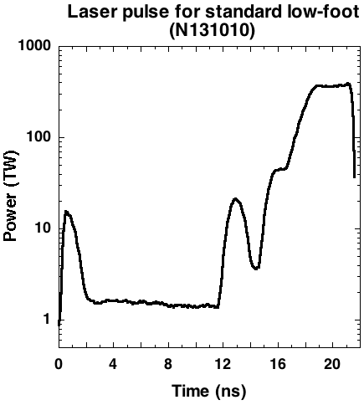
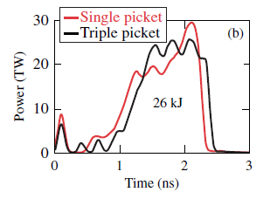
But ICF doesn’t have ideal compression
Principle of ICF
Fast time-scales lead to shocks, which have compression limits
  Solution: Multiple timed shocks to keep implosion as efficient as possible. A “shaped” pulse.
For this reason, shaped laser pulse are used

Slide 24
There are two different laser-drive schemes
Principle of ICF
Direct drive
Indirect drive
Laser produces x-rays inside a hohlraum, which irradiate the capsule
Laser directly
irradiates capsule
∼8% efficiency
∼4% efficiency
The two approaches trade efficiency for uniformity
24

Slide 25
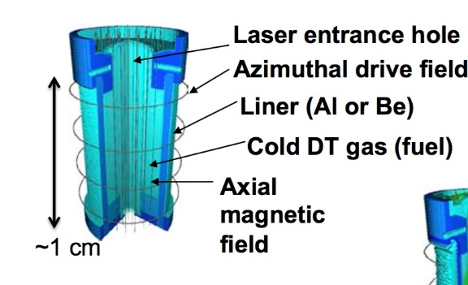
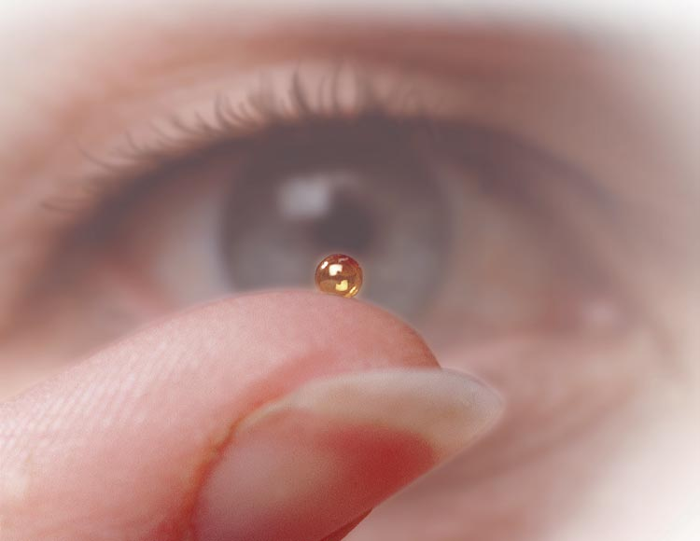
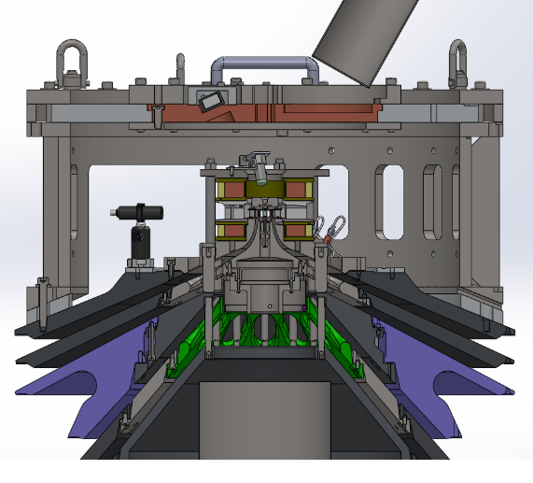
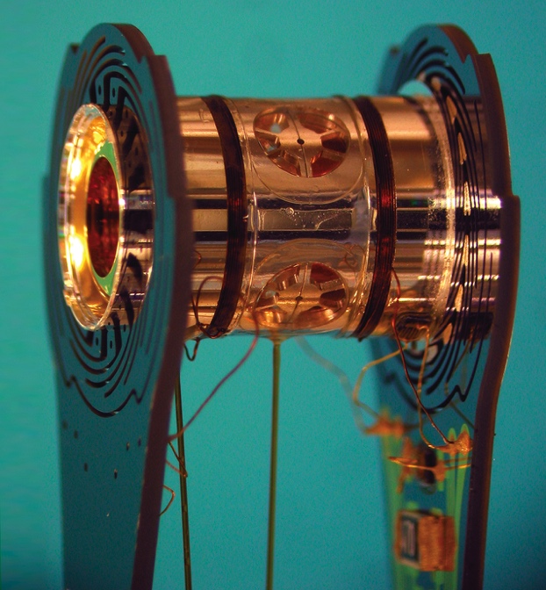
In addition, there is also a magnetic drive scheme, for a total of three primary approaches to ICF
Principle of ICF
Direct Drive
Indirect Drive
Magnetic Drive
Laser Beams
X rays
DT-filled
Capsule
Capsule
A NIF Capsule
(2 mm diam.)
High-Z Hohlraum

Slide 26

Want to know more? A good book on the basics of ICF is
“The Physics of Inertial Fusion” by Atzeni and Meyer-Ter-Vehn
Principle of ICF

Slide 27
Outline
Fusion Basics
The principle of Inertial Confinement Fusion (ICF)
  ICF facilities
  The OMEGA laser facility
  The Z pulsed power machine
  The National Ignition Facility (NIF)
  NIF experiments
  Status
  Engineering and scientific challenges
Basic-science experiments on OMEGA and the NIF
27

Slide 28
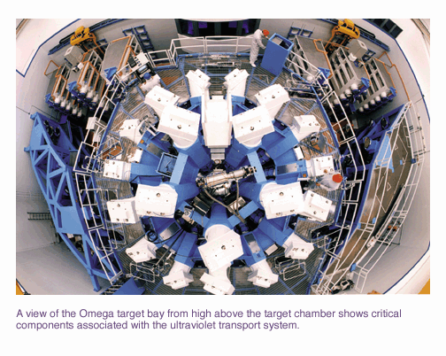
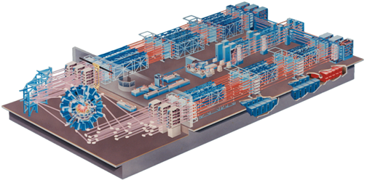
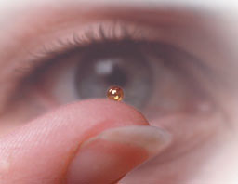
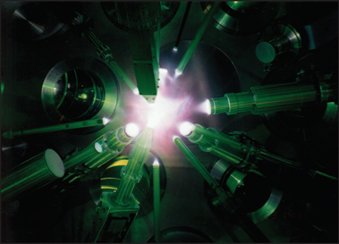
The OMEGA laser facility at University of Rochester
uses the direct-drive approach
ICF facilities
~70 m
Capsule
Direct-drive implosion
60 laser beams delivering 30 kJ
28
Notes:
Go over each image in turn, starting from the facility overview (upper right)

Slide 29
The goal of direct-drive experiments at OMEGA is to demonstrate ignition feasibility for indirect drive
ICF facilities
60 kJ energy available on OMEGA.
If laser energy was scaled up to 2 MJ, would the direct drive implosions ignite?
Currently trying to demonstrate this by reaching 100 Gbar pressure. 50 Gbar demonstrated
S. Regan, Phys. Rev. Lett. 117, 025001 (2016)

Slide 30
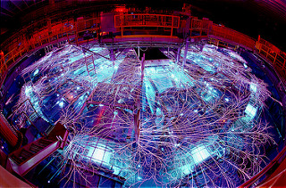
Magnetic drive ICF is being pursued at the Z pulsed power facility at Sandia National Labs, NM
Principle of ICF
80 TW
33 Meter diameter
26 MA
22 MJ Stored Energy

Slide 31
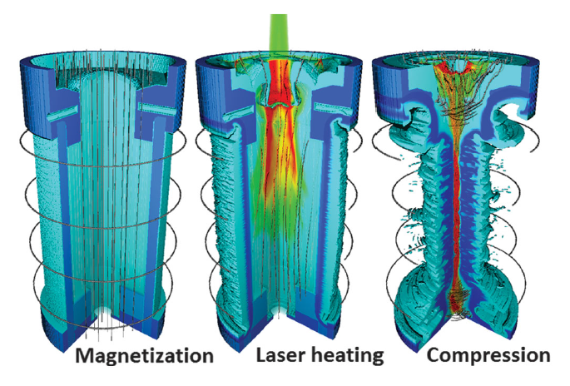

In magnetic drive ICF, an axial current creates a JxB force that is used to implode a gas-filled, pre-magnetized target
Principle of ICF
Goal: Demonstrate ~100kJ DT eq fusion yield
Notes:
An axial current creates a JxB force that is used to implode a gas-filled, pre-magnetized target. Near the start of the implosion, the fuel is heated by the laser. The liner compresses and further heats the fuel to fusion-relevant conditions at stagnation.

Slide 32
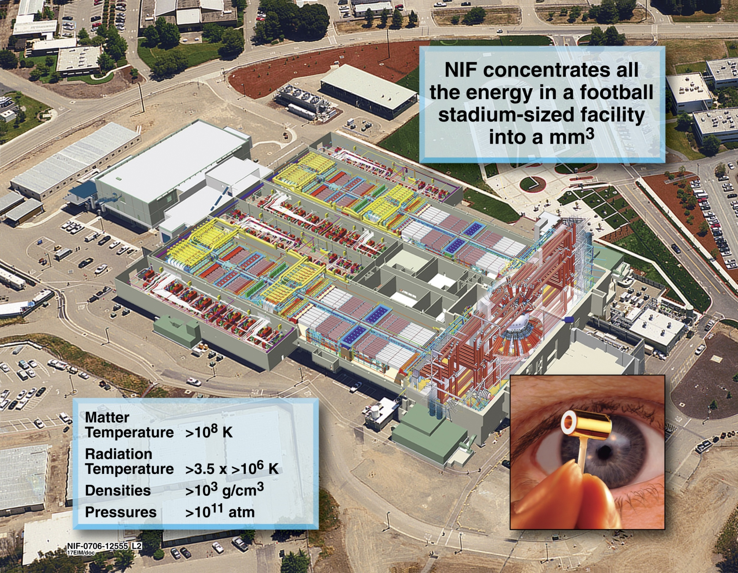

Inertial confinement fusion (ICF) seeks to use lasers or x-rays to compress and ignite a capsule of DT fuel
ICF facilities
The National Ignition Facility (NIF) is a three football stadium-sized laser, which uses the indirect-drive approach
10 m diameter chamber
192 beams
Temperature > 100 MK
Density > 1000× solid
Pressure > 10¹¹ atm

Slide 33
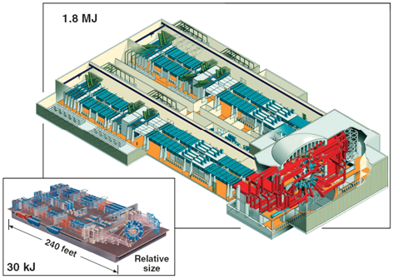
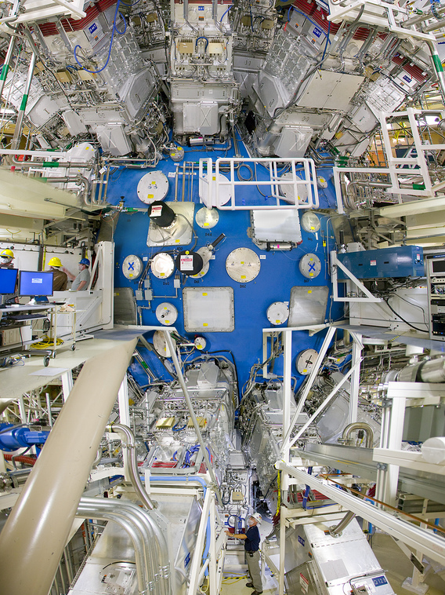

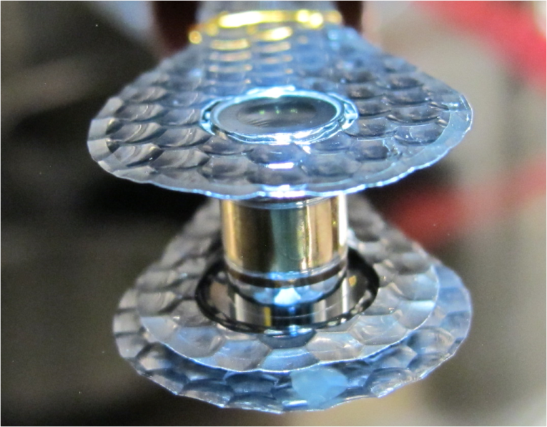
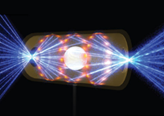
NIF delivers about 1.8 MJ of laser energy
to a cm-scaled hohlraum
ICF facilities
~200 m
Ω
~1 cm
33

Slide 34
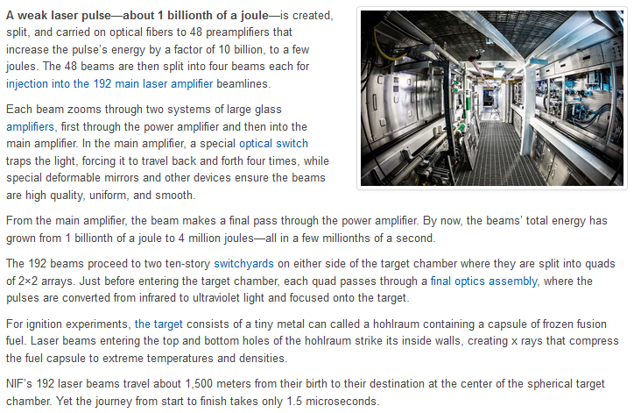
Movie time!
ICF facilities
https://lasers.llnl.gov/about/how-nif-works

Slide 35
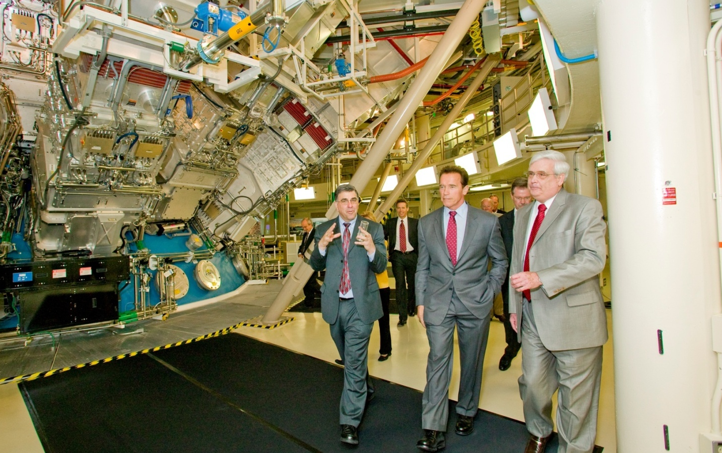
NIF was inaugurated in 2009 and is now being
used for ignition and basic-science experiments
ICF facilities
35

Slide 36
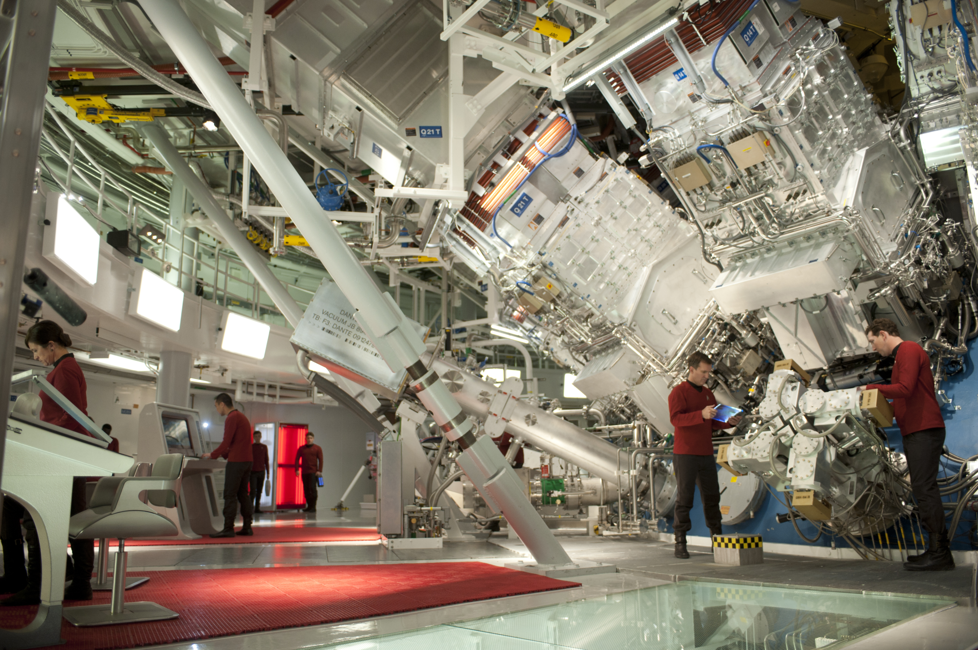
NIF also played an important role
in the movie Star Trek – Into Darkness
ICF facilities
Courtesy of Scott Chambliss, Paramount Pictures and Bad Robot Productions.
36

Slide 37
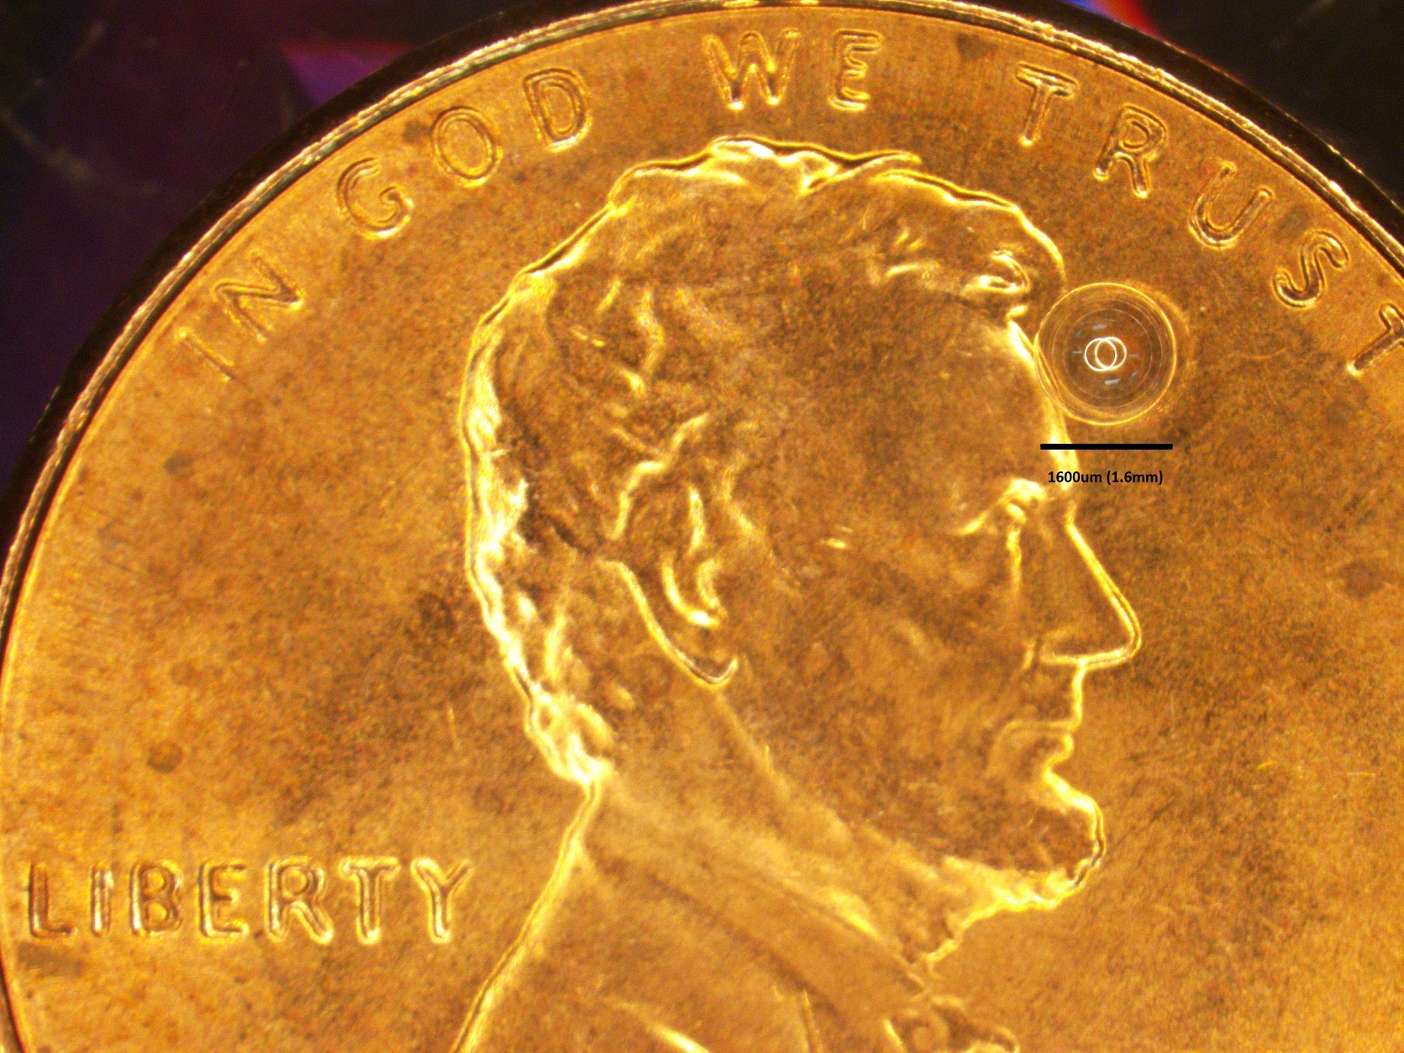
The ICF targets are really small!
ICF facilities

Slide 38
Outline
Fusion Basics
The principle of Inertial Confinement Fusion (ICF)
  ICF facilities
  The OMEGA laser facility
  The Z pulsed power machine
  The National Ignition Facility (NIF)
  NIF experiments
  Status
  Engineering and scientific challenges
Basic-science experiments on OMEGA and the NIF
38

Slide 39
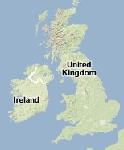

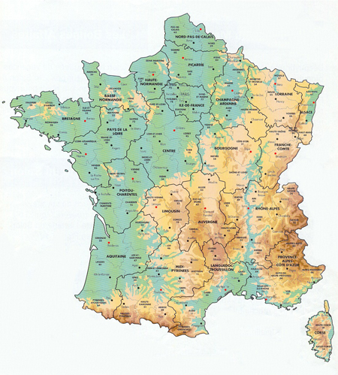
Many institutions are involved in the experiments on the NIF
NIF experiments
NSTec
– Calibration
– NToF
LLE
– NToF
– 4ω fidu system
– MRS, NADS
– SPBT
– HEXRS
AWE
– FFLEX
LLNL
– FABS, NBI
– Dante I & II
– VISAR
– DISC
– RAGS
– hGXI
– ARIANE
– DIXI
– NAD
LBNL
– Calibration
– Rad. Chem.
MIT
– MRS
– WRF
– pTOF
LANL
– GXD
– γ burn
– Rad. Chem. II
– N imaging
CEA
– N imaging
SNL
– SPIDER
– DISC
– NAD (Cu)
– NToF
– RAGS
GA
– NToF
– Capsules
39

Slide 40
A DT implosion is diagnosed with optical, x-ray
and nuclear techniques on the NIF
NIF experiments
Fusion yield:
From DT neutrons
Fuel Ion temperature
From DT-neutron spectrum
Areal density (ρR)
From scattered DT neutrons
Implosion and burn history
X-ray and neutron production
Implosion shape
From x-ray and neutron images
40

Slide 41
A DT implosion is diagnosed with optical, x-ray
and nuclear techniques on the NIF
NIF experiments
Fusion yield:
From DT neutrons
Fuel Ion temperature
From DT-neutron spectrum
Areal density (ρR)
From scattered DT neutrons
Implosion and burn history
X-ray and neutron production
Implosion shape
From x-ray and neutron images
41

Slide 42

The ⁴He ions (or alphas) are confined and heat
the DT fuel, while the neutrons escape
NIF experiments
D + T → ⁴He + n + 17.6 MeV
⁴He
n
The conditions in the implosion can be diagnosed by measuring the spectrum of the emitted neutrons
42

Slide 43
The neutron spectrum provides info on ρR, T_{i} and Y_{n} – Essential info for assessing the implosion performance
NIF experiments
Y_{n}
n
n
D
T
Y_{n’}
n'
n'
n'
n
43

Slide 44
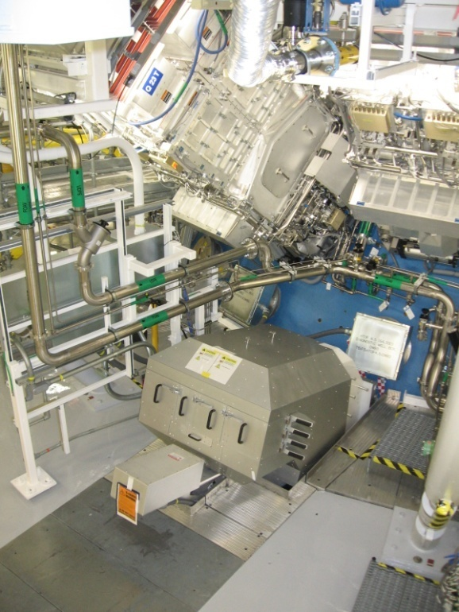
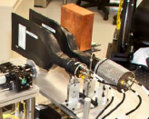
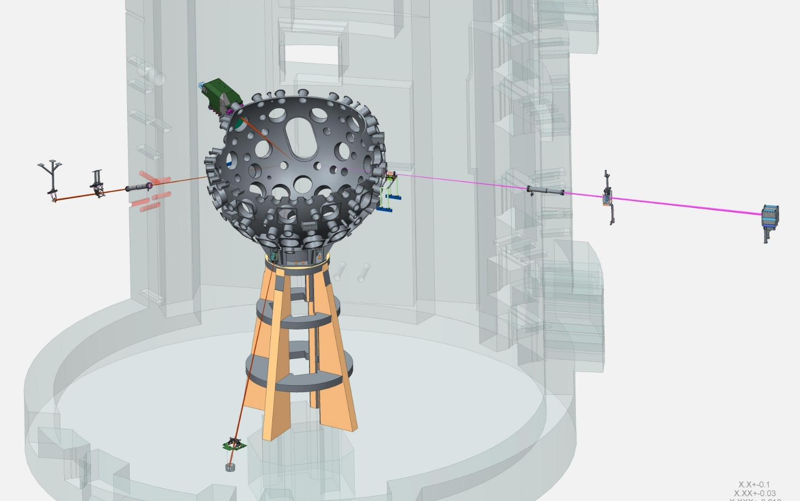
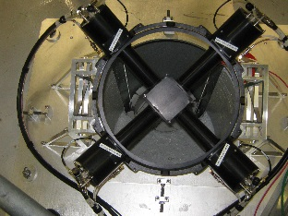
Several neutron spectrometers are fielded
at various locations on the NIF
NIF experiments
NIF target bay
MRS
NITOF
20m-nTOF
(alcove)
20m-nTOF
(equator)
20m-nTOF
(south pole)
This provides good implosion coverage for reliable measurements of Y_{n}, T_{i}, ρR and ρR asymmetries
44

Slide 45
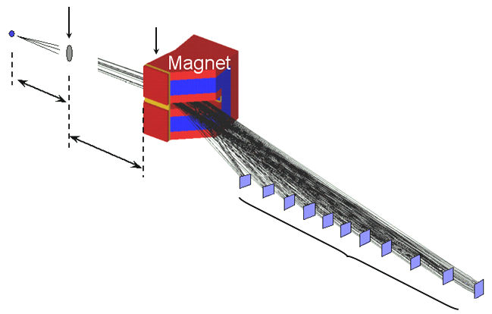

MIT built the Magnetic Recoil Spectrometer (MRS), which
measures the neutron spectrum
NIF experiments
Implosion
CD-foil
n
d
26 cm
570 cm
CR-39
3-18 MeV (d)
MRS
45

Slide 46
Yield and ρR derived from neutron data determine
implosion performance; significant progress has been made
NIF experiments
Y/Y_{no} _{α}
Burn
Alpha-heating
Neutron yield
Yield magnification from alpha heating
0.4
0.6
0.8
1.0
1.2
1.4
Fuel ρR [g/cm²]
46

Slide 47
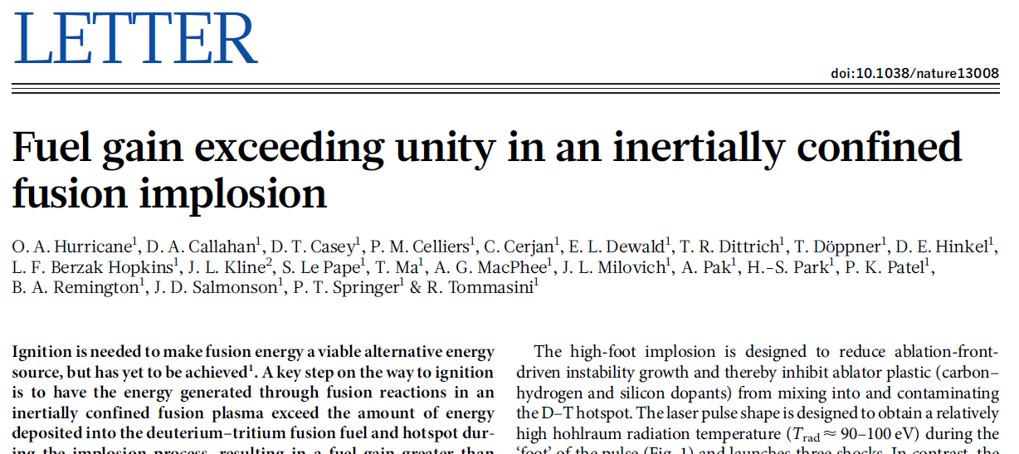
Big news (Nature, Feb 2014):
NIF reached “scientific breakeven”!!
NIF experiments

Slide 48
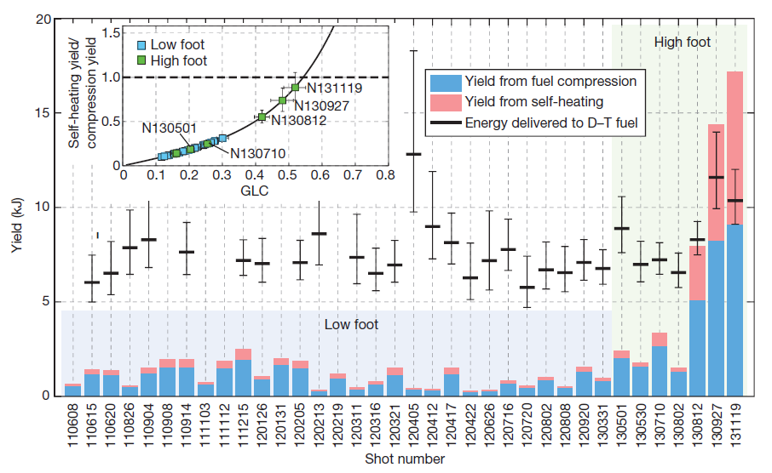
“Scientific breakeven” means that more energy was generated than was coupled into the DT FUEL
NIF experiments
NIF was built to achieve ignition – working definition of ignition is yield higher than input laser energy (>1MJ)
Notes:
We are still ~100 times below the end goal

Slide 49
“Energy generated” is simply calculated from the measured neutron yield
NIF experiments
E_{fusion}=Y_{DT}×17.6 MeV
Total energy release in each D+T reaction
Measured by neutron diagnostics!

Slide 50
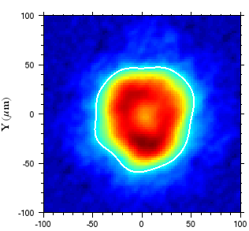
“Energy coupled to the fuel” is calculated based on measured parameters
NIF experiments
Energy lost at time of implosion
Total energy coupled
Energy in hot spot and fuel at time of implosion
Energy deposited through fusion burn at time of implosion
fuel
⁴He
All quantities are calculated from:
hot spot radius/shape, burn duration
(x-rays)
yield, downscattered neutrons, ion temperature (neutrons)
hot spot
n

Slide 51
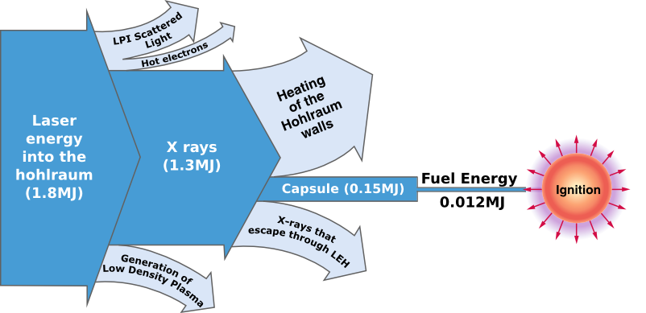
Energy coupling in inertial fusion is very inefficient - there are still many steps remaining before net energy gain is achieved
NIF experiments
However, potential gain is very high (up to ~10s MJ, fuel gain ~10³)
Capacitors ~ 400MJ

Slide 52
More progress has been made since Nature publication – the fuel now has gain ~2
NIF experiments
1.8MJ
laser …
~12kJ heating
fuel
~27kJ fusion energy
New
In Nature

Slide 53
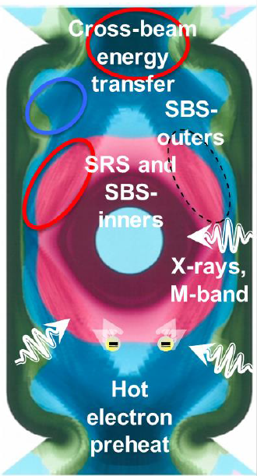

What are the challenges?
Ignition designs must simultaneously manage instability growth, symmetry, fuel entropy, and laser-plasma interactions
Ignition requires:
Good hotspot coupling
High compression
High implosion velocity
Needed for
high V and ρR
Manage LPI
Needed for high hotspot coupling
Needed for high ρR
Manage fuel entropy
Manage
RT growth
Manage hotspot
and shell shape
shell
flows?
hot-spot
Compression

Slide 54
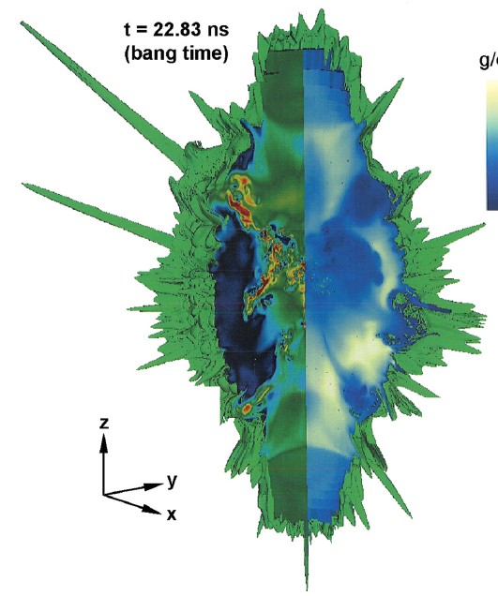
There is growing evidence that NIF implosions are highly 3D in nature at burn
Cartoon concept:
Reality?
Ablator
DT ice
DT gas
D.S. Clark et al., Phys. Plasmas 22, 022703 (2015)
Notes:
Evidence: FNADs, X-ray images, Neutron images, Dsr asymmetry and magnitude, Performance, Tion
Hohlraum drive asymmetry and capsule support tent believed to be the primary causes of the asymmetries

Slide 55
Progress comes from “taking a step back” to improve understanding – more systematic approach
NIF experiments
Y/Y_{no} _{α}
We now understand that hydrodynamic instability growth limited the performance of these implosions
Burn
Alpha-heating
Neutron yield
“High foot”
“Low foot”
0.4
0.6
0.8
1.0
1.2
1.4
Fuel ρR [g/cm²]
55

Slide 56
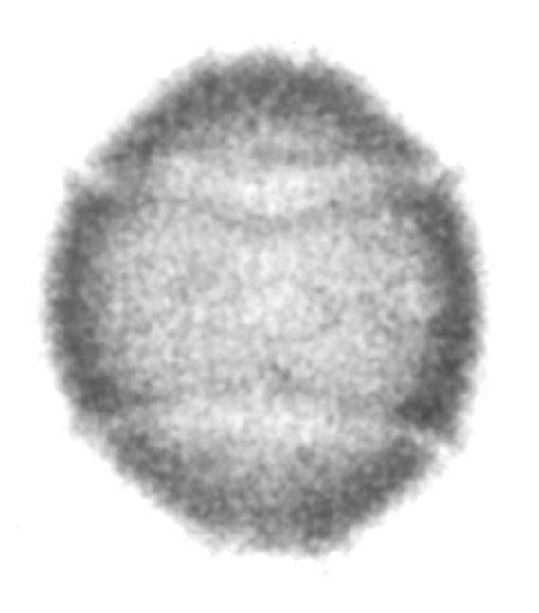
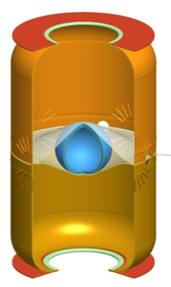
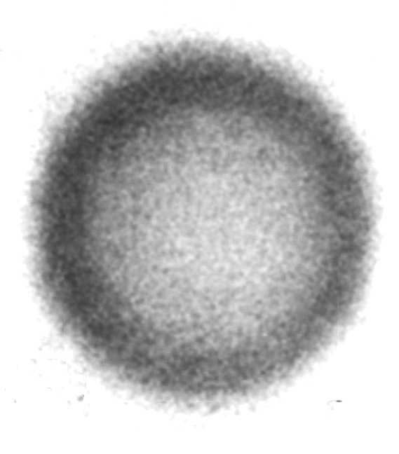


NIF experiments
The difference between the high and low foot experiments are in how isentropically they are compressed
Low foot
α ~ 1.5
High foot
α ~ 2.5
Low foot
Low foot

Slide 57


Hydrodynamic instability leads to mix of highly radiating material into the hotspot, which quenches the burn
NIF experiments
Impurities in target act as seeds for instability growth:

Slide 58




The “tent” used to hold the capsule in the hohlraum is believed to seed instability and break the symmetry
NIF experiments
Optical Depth Image showing tent “scar”
110-nm tent
15°
Stadermann, et al.
Hydra simulation
Expt
45-nm tent
Hammel

Slide 59

The fill tube used to add DT gas to the capsule is also a possible source of instability growth
NIF experiments
59

Slide 60

NIF experiments
Simulations predict perturbations will grow and severely damage the implosion at stagnation
Temperature
Density
3D HYDRA simulation of final stagnation phase
D. Clark –
3D Simulation of low foot N120405
C. Weber –
Postprocessed movie
Simulations are useful to help peer into details of the experiment otherwise inaccessible

Slide 61









The recent, lower convergence implosions are more resilient to small target imperfections due to lower growth rates
NIF experiments
Lo-Foot vs Hi-Foot Growth factor at 650 µm
650
µm
Low foot
Simulation
High
foot
Ripple target
time
X-ray snapshots
Recent implosions have had low mix because they converged less
Now we want to go back to higher convergence without introducing mix

Slide 62
First test: Push these low-convergence implosions to higher velocity using thinner ablator layers
NIF experiments
DT Yield vs. Laser Energy
?
?
DU
165µm
High foot
(no coast)
175µm
195µm
High foot
(coast)

Slide 63
This was demonstrated to work well – implosions did not mix even at very high velocity
NIF experiments
Mix vs. implosion Velocity
Low-foot:
High mix at intermediate velocity
Bremsstrahlung ~ Z²
High-foot:
mix free at high velocity

Slide 64
Another outstanding question concerns inefficiencies in assembling the fuel
NIF experiments
Non-uniformities in hotspot
→ pdV work lost to setting fuel in motion
Non-uniformities in fuel layer
→ less efficient inertial confinement
Notes:
Asymmetries can be on different scale:
-small scale asymmetries are highly related to mix.
-Large scale asymmetries have to do with how efficiently the fuel is assembled
We need to compress symmetrically in order to effectively convert kinetic energy to thermal energy in the hot spot
Nature article: Because most of the quantities associated with inertially confined fusion that we seek to improve to achieve ignition scale as some positive power of stagnation pressure, near-term efforts focus on increasing the implosion speed and controlling the hot-spot shape with the present fuel adiabat.

Slide 65

















X-ray and neutron measurements of hot-spot shape indicate significant hot-spot asymmetry
NIF experiments
Time-integrated x-ray emission (equatorial view)
50
50
50
50
50
50
50
0
0
0
0
0
0
0
-50
-50
-50
-50
-50
-50
-50
-50
0
50
-50
0
50
-50
0
50
-50
0
50
-50
0
50
-50
0
50
-50
0
50
Time-integrated x-ray emission (polar view)
50
50
50
50
50
50
50
0
0
0
0
0
0
0
-50
-50
-50
-50
-50
-50
-50
-50
0
50
-50
0
50
-50
0
50
-50
0
50
-50
0
50
-50
0
50
-50
0
50
Time integrated neutron (equatorial view)
100
13-17 MeV
6-12 MeV
100
13-17 MeV
6-12 MeV
100
13-17 MeV
6-12 MeV
100
13-17 MeV
6-12 MeV
13-17 MeV
6-12 MeV
20
60
50
50
50
50
40
0
0
0
0
60
0
-50
-50
-50
-50
80
-60
-100
-100
-100
-100
100
-50
0
50
-100
-50
0
50
100
-100
-50
0
50
100
-100
-50
0
50
100
-100
-50
0
50
100
20
40
60
80
100

Slide 66

Neutron spectrometry measurements indicate directional motion of the hotspot during burn
NIF experiments
NITOF
DT: -3 ± 4 km/s
Spec E
DT: 4 ± 25 km/s
DD: -4 ± 15 km/s
Spec A
DT: -9 ± 25 km/s
DD: -39 ± 15 km/s
Spec SP
DT: -20 ± 25 km/s
DD:-37 ± 15 km/s
Directional or turbulent motion “steals” kinetic energy from the pdV work on the hotspot and must be minimized
Notes:
Velocity is inferred from shifts in the peak location of the neutron spectrum
Velocities shown in this example (measured on a recent shot) are pretty low, but this is not always the case
Clear illustration of how we need to compress symmetrically in order to effectively convert kinetic energy to thermal energy in the hot spot

Slide 67

Neutron spectrometry measurements indicate substantial, systematic low-mode dense fuel ρR asymmetry
NIF experiments
10-12 MeV
10-12 MeV
MRS
Spec-E
Spec-A
67
Notes:
need to compress symmetrically in order to effectively convert kinetic energy to thermal energy in the hot spot
Confinement is never better than the lowest rhoR region

Slide 68

Directional neutron yield measurements also indicate substantial dense fuel ρR asymmetry
NIF experiments
N141123
N150121
-10% 0% +10%
N150115
N150318
Purposely asymmetrically driven
Fuel maps from neutron activation

Slide 69
So, we are still struggling with symmetry. Current path forward:
NIF experiments
Control asymmetry seeding due to engineering features
Improve understanding of hohlraum physics to control asymmetry seeding due to non-uniform drive

Slide 70

NIF experiments
Engineering features: The best solution would be to eliminate the tent altogether but there are challenges
30 µm free-standing fill-tube
vibration test
capsule
30 µm FT @ 65 Hz
10 µm fill-tube
measurements from GA

Slide 71

A better understanding of and ability to control laser-plasma interactions in the hohlraum is essential
NIF experiments
Cross-beam energy transfer
The hohlraum drive is not yet predictable
Hohlraum physics may impact implosion symmetry
A ~15% loss of drive energy cannot be accounted for in simulations
SBS-outers
SRS and SBS-inners
X-rays,
M-band
Hot electron preheat

Slide 72

The hohlraum must provide a symmetric x-ray drive to enable efficient transfer of the drive to the hotspot
HYDRA Simulation Jose Milovich
Laser entrance hole (LEH)
Laser "Pulse-shape"
Helium gas
~ 1cm
Plastic Ablator
Gold hohlraum wall
Inner cone beams

Slide 73

A better understanding of and ability to control laser-plasma interactions in the hohlraum is essential
NIF experiments
One research direction: low-gas fill hohlraums → better predictability
Gas-filled
Near vac
Other potential options: Different hohlraum shape, e.g., different case-to-capsule ratio, rugby

Slide 74

MIT has been heavily involved in the NIF program
NIF experiments
Alex
Former NIF director
Ed Moses
Mike
Exp. director
Joe Kilkenny
Hans
Dan
Maria
74

Slide 75

1st PhD thesis based on NIF data was presented
by former MIT graduate student Dan Casey
NIF experiments
Alex
Dan
LLNL director Parney
Albright
75

Slide 76
Outline
Fusion Basics
The principle of Inertial Confinement Fusion (ICF)
  ICF facilities
  The OMEGA laser facility
  The Z pulsed power machine
  The National Ignition Facility (NIF)
  NIF experiments
  Status
  Engineering and scientific challenges
Basic-science experiments on OMEGA and the NIF
76

Slide 77


High-Energy-Density Physics (HEDP) involves studies of matter under extreme states of pressure (~ 1 Mbar to ~ 1000 Gbar)
Basic science experiments
Igniting ICF implosion
~ 300 Gbar
Earth’s core ~ 3 Mbar
Solar core ~ 250 Gbar
We exploit the extreme conditions
at the OMEGA and NIF laser facilities and the Z pulsed power machine
for astrophysical, nuclear, ICF and other HEDP experiments
Notes:
These states are created in the lab using high-power lasers
Relevant physics scenarios:
Interior of planets
Interior of stars
Fusion
Collisional/collisionless shocks

Slide 78



The ICF platform lends itself to a wide range of basic science experiments
Basic science experiments
3.
Plasma/WDM stopping power
Collisionless shocks
Astrophysical jets
Magnetic reconnection
Nuclear astrophysics
V-shaped CH target
2.
Jet
Jet
Side-on
Plasma plume
Driven laser beams
5.
1.
4.
x
B
x
.
.

Slide 79














MIT’s own OMEGA experiments include basic science as well as ICF programmatic-relevant work
Basic science experiments
Recent examples include:
Kinetic effects in ICF plasmas
Stopping power in ICF and in Warm Dense Matter
Stellar and Big-Bang Nucleosynthesis
Basic nuclear physics
Astrophysical Jets
Fields in hohlraums
Magnetic reconnection
Rayleigh-Taylor instabilities

Slide 80
MIT has developed a D3He monoenergetic particle platform for radiography of HEDP experiments
3 and 15 MeV protons
Proton source
Subject plasma
Proton detector
Initial capsule
Compressed
capsule
Spatial resolution: ~ 40 μm (FWHM)
Energy resolution: ~ 3%
Temporal resolution: ~ 80 ps
D³He
gas
15 atm
D³He
Thin SiO₂
D + ³He → p(14.7 MeV) + α
D + D → p(3.0 MeV) + T
D + D → n + ³He
C. K. Li et al., Phy .Rev. Lett. (2006)
C. K. Li et al., Rev.Sci.Instrum (2006)
F. Seguin et al., Rev.Sci.Instrum (2003)

Slide 81



MIT has developed a D3He monoenergetic particle platform for radiography of HEDP experiments
3 and 15 MeV protons
Proton source
Subject plasma
Proton detector
Phenomena investigated with monoenergetic proton radiography at OMEGA include:
  Laser-foil interactions
  Magnetic reconnection
  Magnetic flux compression
  RT instability
  Weibel instability
  ICF capsule implosions
  ICF hohlraums
  Charged-particle stopping
Fast-ignition capsule
Laser-foil plasma bubble
ICF hohlraum

Slide 82
Thank you for your attention!
82

Slide 83

Concept for an ICF power plant
Target Injection
Target Fabrication
Laser Driver
Lithium Blanket
Heat Transfer
Laser Light
Tritium Fuel Cycle
Heat Exchg.
12 meters
Turbine

