Slide 1
Single Particle Motion
Cami Collins
General Atomics
Presented at the
SULI Introductory Course in Plasma Physics
Princeton Plasma Physics Laboratory
June 6, 2016
Image credit: Pace et. al.,Physics Today (2015)

Slide 2




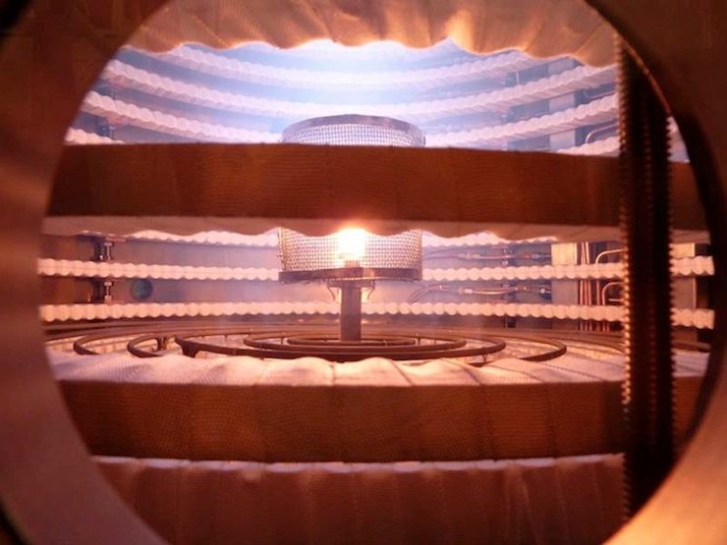
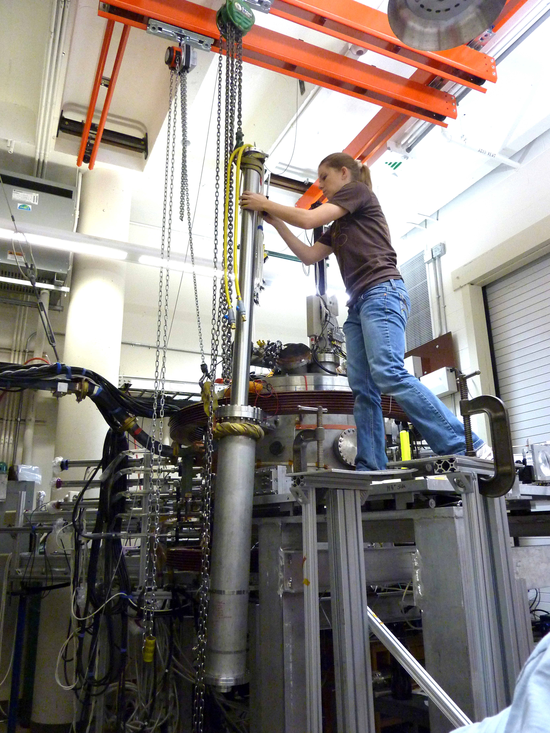
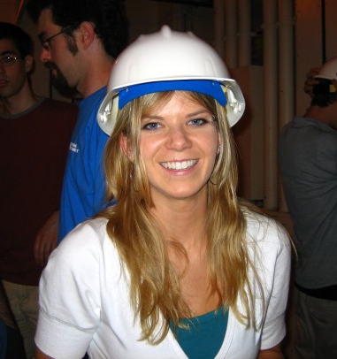
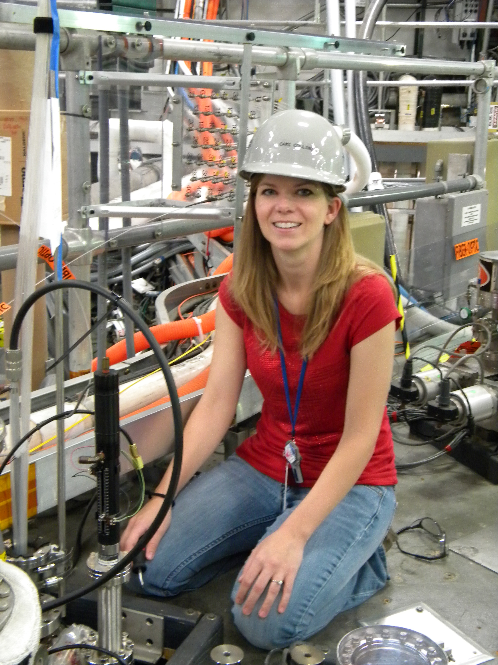
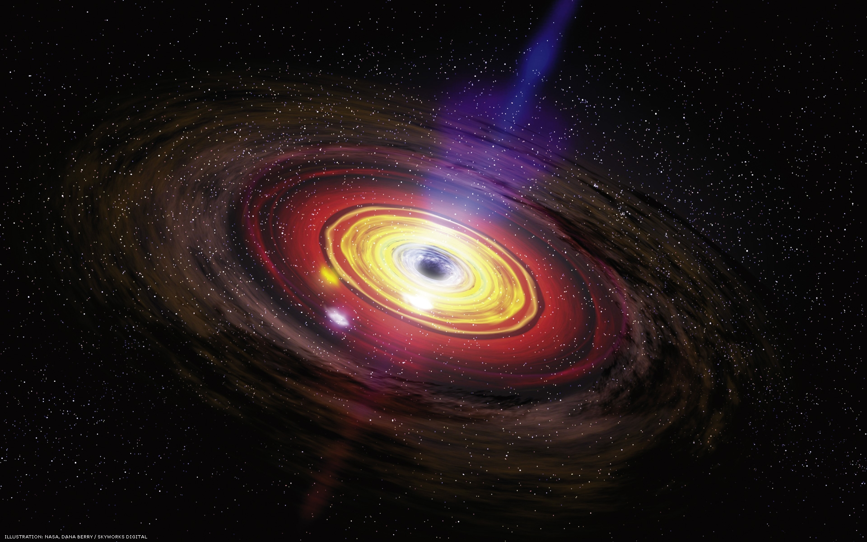
My Path In Plasma Physics
scientist
(permanent student)
2006
2007-2013
2014-2016
🇩🇪
🇫🇷
🇳🇱
🇦🇹
NUF student
postdoc
(~student)
PhD student

Slide 3
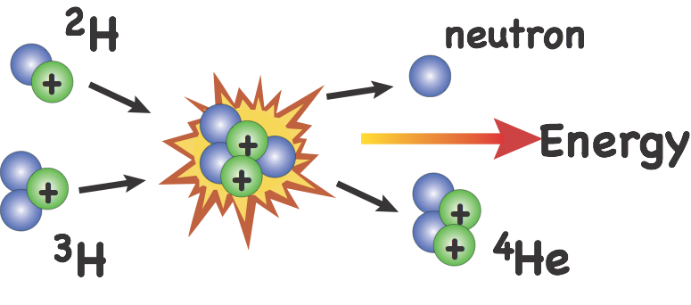

Plasma Physics is the Basis for Fusion Research
Sustained fusion reactions require enough particles (density) that are energetic enough (temperature) and collide often enough (confinement time).
The fusion triple product is the figure of merit:
T~100-200 million K
n~2-3x10²⁰ ions/m³
τ ~1-2 s
D & T is a plasma at these temperatures
Notes:
Much of plasma physics research is focused on solving the problem of fusion energy. For a viable fusion reactor to work you have to have enough fusion reactions occurring. To get particles to fuse, they have to be really hot. The temperature must be hot enough to allow the ions to overcome the Coulomb barrier and fuse the nuclei. This requires temperatures of 100-200 million K. The ions have to be confined together in close proximiity, at density 2-3x10^20 ions/m^3. The ions must be held together in close proximity long enough to allow collisions to happen before the ions cool (1-2 seconds). In order for the plasma to sustain the fusion reaction and self heat (ignition), the triple product must be larger than about 5x10^21 s-keV/m^3.

Slide 4
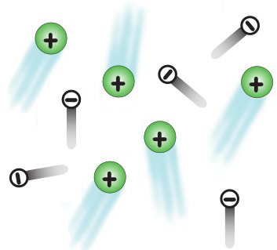
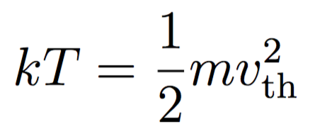
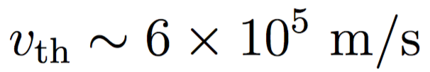
We can understand a lot about how fusion devices confine plasma by studying single particle motion.
Typical velocity of a 100 million K ion:
Even with ~10²⁰ ions/m³ , the ion would travel ~10 km before colliding with another
The ITER tokamak has R_{major}=6.2 m → ~40 m circumference
The trick: use magnetic fields
Notes:
This talk is going to be about how charged particles react to E and B fields, and how you can use these fields to confine them.

Slide 5
Outline of Single Particle Motion Topics
Gyromotion about a guiding center
Forces can cause guiding center drift
Real life consequences:
  Why do tokamaks have helical B fields?
  What is a banana orbit?
References
NRL Plasma Formulary
  www.nrl.navy.mil/ppd/content/nrl-plasma-formulary
Introduction to Plasma Physics and Controlled Fusion by F. Chen

Slide 6


Charged Particles Feel The (Lorentz) Force
A particle with charge (q) moving with velocity (v) in the presence of electric or magnetic fields will experience a force:
We know from Newton’s second law of motion that force causes acceleration:
A charged particle
moving perpendicular to
the magnetic field feels a force
Notes:
The Lorentz force governs the interaction of charged particles with a magnetic field. This interaction happens when the particle is moving at an angle to the magnetic field. Bizarrely the field neither attracts nor repels the particle, but applies to it a sideways force, at right angles to both the direction of travel, and the magnetic field lines.

Slide 7




How Does a Charged Particle Move in a Magnetic Field?
Consider the motion of a particle in a constant, uniform B field
y
Then
+
So we can write
x

Slide 8
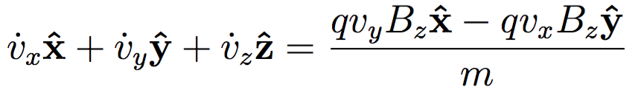

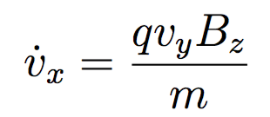
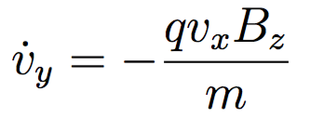

Goal: Solve the Equations of Motion for a Charged Particle In A Magnetic Field
Let’s break this into components:
y
+
The ‘dot’ represents
Matching components:
x
Particles move freely along the field line

Slide 9
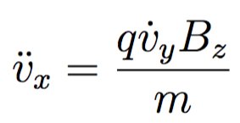
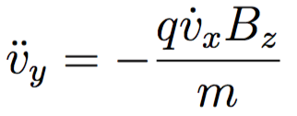
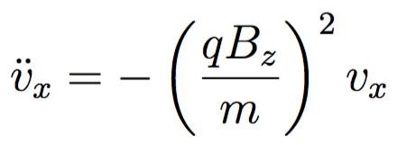
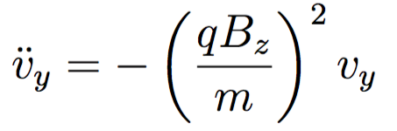
Take Another Time Derivative & Substitute to Obtain Differential Equations For Each Spatial Coordinate
Rewriting, we get
These may remind you of the equations for a simple harmonic oscillator

Slide 10
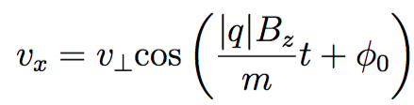
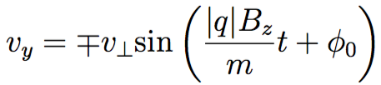
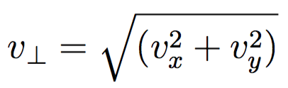
Solve the Differential Equations
These differential equations can be solved using sines and cosines:
account for positive or negative q
an arbitrary phase to match the initial velocity conditions
the magnitude of the initial velocity perpendicular to B

Slide 11

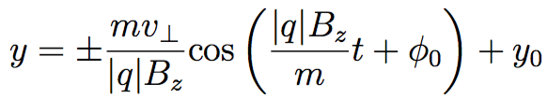

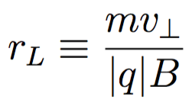
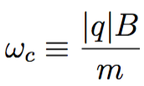
The Result: Circular Motion About A Guiding Center
Integrating, we obtain
Charged particles undergo circular orbits about a guiding center
Larmor radius
Cyclotron frequency

Slide 12





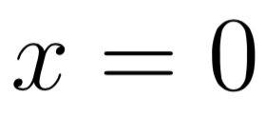

Gyromotion of a Charged Particle In A Magnetic Field
Let’s take and
y
For a positively charged particle:
1. At ,
+
x

Slide 13



Gyromotion of a Charged Particle In A Magnetic Field
Let’s take and
y
For a positively charged particle:
1. At ,
+
x
2. At ,

Slide 14
Gyromotion of a Charged Particle In A Magnetic Field
Let’s take and
y
For a positively charged particle:
1. At ,
+
x
2. At ,

Slide 15

Gyromotion of a Charged Particle In A Magnetic Field
Let’s take and
y
For a negatively charged particle:
1. At ,
x
-

Slide 16

Gyromotion of a Charged Particle In A Magnetic Field
Let’s take and
y
For a negatively charged particle:
1. At ,
x
-
2. At ,

Slide 17
Gyromotion of a Charged Particle In A Magnetic Field
Let’s take and
y
For a negatively charged particle:
1. At ,
x
-
2. At ,

Slide 18
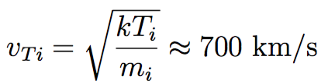
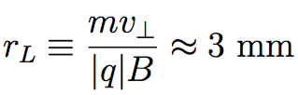

Gyromotion of Ions vs. Electrons
The direction of gyromotion depends on the sign of the charge
Ions generally have a much larger Larmor radius than electrons
In ITER, for a typical deuterium ion
with T_{i}=10 keV and B=5 Tesla would have
y
+
x
-
An electron with T_{e}=10 keV and B=5 Tesla has
(60 times smaller)
Notes:
The direction of the gyration is always such that the magnetic field generated by the charged particle is opposite to the externally imposed field. (Charge particles tend to reduce the magnetic field)

Slide 19
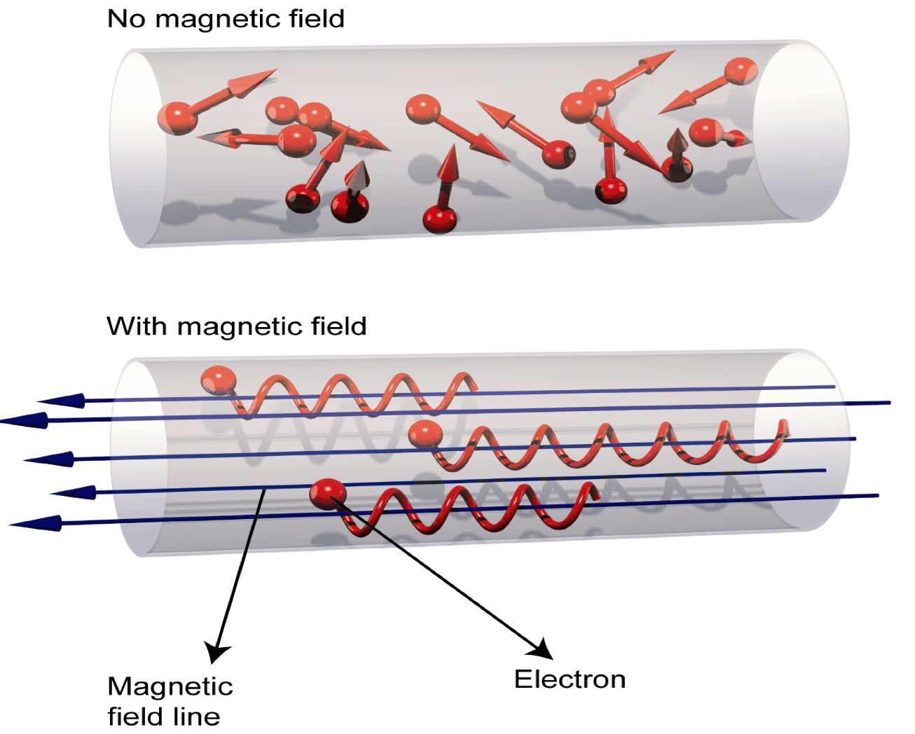
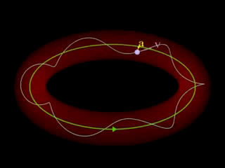
Magnetic Confinement Devices Should Be Much Larger Than the Larmor Radius
Image credit: http://iter.rma.ac.be/en/img/MagneticConfinement.jpg

Slide 20
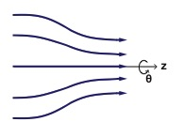


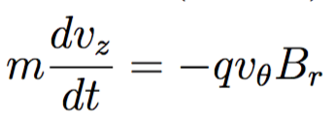




Magnetic Mirrors
The B_{r} ends up causing additional acceleration in the z direction:
Result:
gyromotion + mirror force in the direction
The magnetic moment is
mirror force
Notes:
Particle is free to move along the magnetic field line. As a particle moves from a weak-field region to a strong-field region, it sees an increasing B, and therefore its perpendicular velocity must increase in order to keep mu constant. Total energy must remain constant, so parallel velocity must decrease. If B is large enough, vparallel will eventually become zero and the particle is reflected back to the weak-field region.

Slide 21

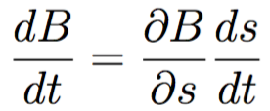

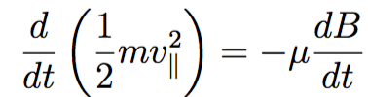
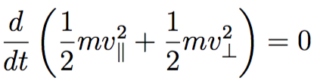


Magnetic Moment Is Conserved
The magnetic moment is a constant of motion
s is the coordinate along the field line
We can write
this is
Then
We also have conservation of energy:
this is

Slide 22
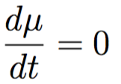



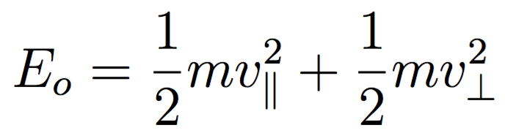
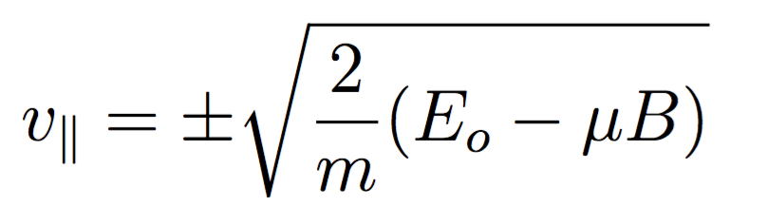

More Insight Into Magnetic Mirrors
1. As the particle moves to stronger B, must increase.
2. Since energy is conserved, must decrease.
3. If B is strong enough, and the particle is reflected.
The particle is reflected when

Slide 23
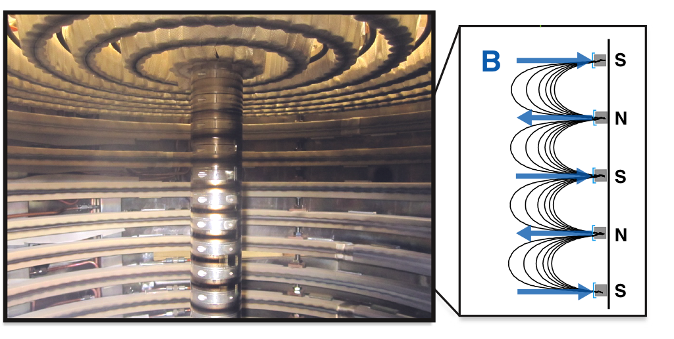
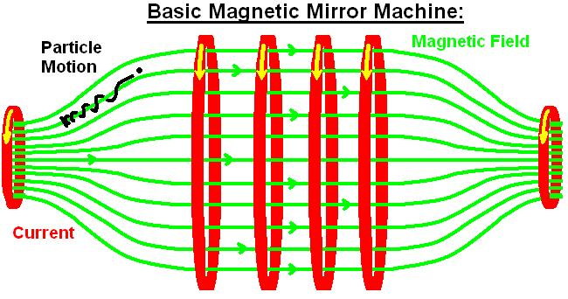
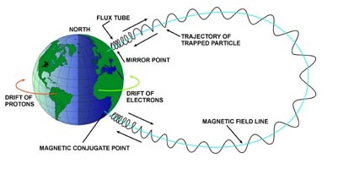
Magnetic Mirror Confinement In Action
Early Fusion Experiments
Ex: Tandem Mirror Experiment (LLNL,1980’s) and other variants (Polywell devices)
Multicusp Confinement Devices
Particles with enough v|| can still escape
Charged particles can be trapped by Earth’s magnetic field
Notes:
Charged particles can be trapped by Earth’s magnetic field, and people study this space weather because it can strongly affect spacecraft or communications, especially during geomagnetic storms so they want to understand how energetic particles precipitate from the radiation belts into the polar region of Earth’s upper atmosphere.

Slide 24
Time-varying Electric and Magnetic Fields Can Be Used To Accelerate & Heat Particles
A high frequency electro-magnetic field can be used to accelerate electrons or ions.
y
x
-

Slide 25


Time-varying Electric and Magnetic Fields Can Be Used To Accelerate & Heat Particles
A high frequency electro-magnetic field can be used to accelerate electrons or ions.
Particle gains energy as the applied electric field component oscillates at the cyclotron frequency (“in-phase” with the gyro-orbit).
Cyclotron frequency
y
x
-
The fluctuating accelerates the electron in the +x direction
Notes:
The transverse electric field oscillates at the cyclotron frequency. The particle velocity changes direction every half period, but so does the applied electric field. SO they remain in phase with each other. Energy is transferred to the charged particle, and the orbit will spiral outward with larger and larger rL.

Slide 26
Time-varying Electric and Magnetic Fields Can Be Used To Accelerate & Heat Particles
A high frequency electro-magnetic field can be used to accelerate electrons or ions.
Particle gains energy as the applied electric field component oscillates at the cyclotron frequency (“in-phase” with the gyro-orbit).
Cyclotron frequency
y
x
-
Now accelerates the electron in the -x direction

Slide 27
Time-varying Electric and Magnetic Fields Can Be Used To Accelerate & Heat Particles
A high frequency electro-magnetic field can be used to accelerate electrons or ions.
Particle gains energy as the applied electric field component oscillates at the cyclotron frequency (“in-phase” with the gyro-orbit).
Cyclotron frequency
y
x
-

Slide 28
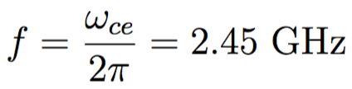

The Cyclotron Frequency is Important for
Cyclotron Resonance Heating
A high frequency electro-magnetic field can be used to accelerate electrons or ions.
Particle gains energy as the applied electric field component oscillates at the cyclotron frequency (“in-phase” with the gyro-orbit).
Cyclotron frequency
y
Ex: For an electron, what B corresponds to 2.45 Ghz (microwave oven frequency)?
x
-

Slide 29
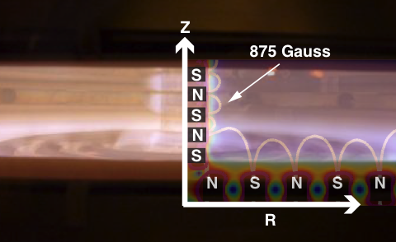
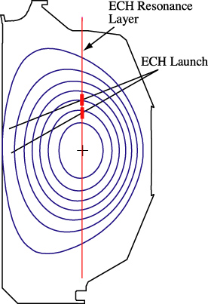
Example of Cyclotron Heating in Action
Electron Cyclotron Heating In A Plasma Experiment at UW-Madison
(2.45 GHz, B=875 Gauss)
In the DIII-D tokamak, use 110 GHz second harmonic heating (B~2 Tesla)

Slide 30


Next Simplest Case to Analyze: Constant, Uniform Electric Field Perpendicular to Magnetic Field
y
+
x

Slide 31
Next Simplest Case to Analyze: Constant, Uniform Electric Field Perpendicular to Magnetic Field
y
Accelerates due to E
+
Faster velocity increases vxB
x

Slide 32
Next Simplest Case to Analyze: Constant, Uniform Electric Field Perpendicular to Magnetic Field
y
Accelerates due to E
+
Faster velocity increases vxB
x
Decelerates

Slide 33
Next Simplest Case to Analyze: Constant, Uniform Electric Field Perpendicular to Magnetic Field
y
Accelerates due to E
+
Faster velocity increases vxB
x
Decelerates

Slide 34
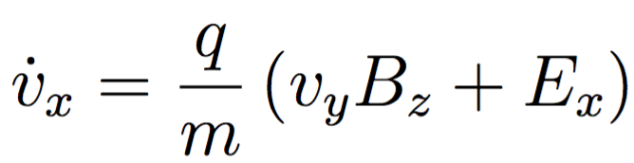
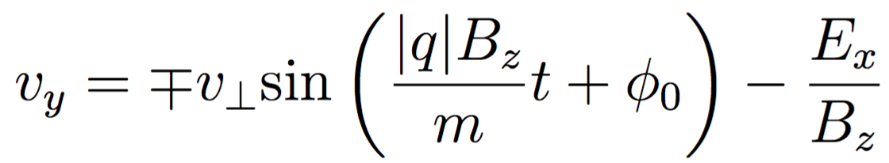

Next Simplest Case to Analyze: Constant, Uniform Electric Field Perpendicular to Magnetic Field
y
+
x
Ion guiding center drifts in the direction

Slide 35
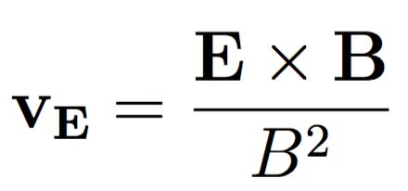
Guiding Center Drift Due to E x B
Electron guiding center also drifts in the direction
y
The ExB drift can be written more generally as
x
-
ExB drift is independent of charge and mass
Both electrons and ions move together

Slide 36
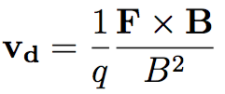

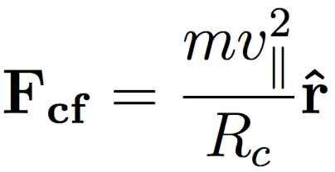
Other Forces Can Cause Guiding Center Drift
Any force perpendicular to B can cause particles to drift
Drift due to force:
Examples of forces:
gravity
centrifugal
R_{c}
Bend the magnetic field into a donut shape
No end losses because the field lines go around and close on themselves
BUT a particle following a toroidal magnetic field would experience F_{cf}

Slide 37
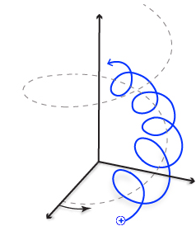
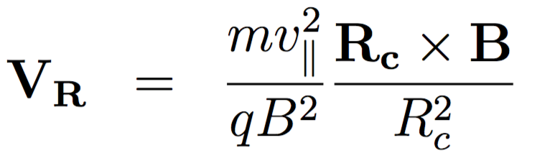
Curvature Drift Due to Bending Field Lines
The outward centrifugal force causes curvature drift
R_{c}
z
A particle moving along a curved field line will drift up or down, depending on the sign of the charge
B_{toroidal}

Slide 38
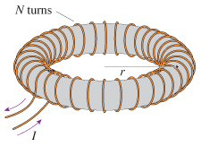



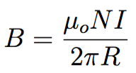
Spatially Varying Magnetic Field Strength Also Causes Drift

Slide 39
Spatially Varying Magnetic Field Strength Also Causes Drift
+
The gyro-radius will be larger where the field is weaker and smaller where the field is stronger

Slide 40

Spatially Varying Magnetic Field Strength Also Causes Drift
+
-
The gyro-radius will be larger where the field is weaker and smaller where the field is stronger
The resulting drift velocity is described by:

Slide 41

What Happens To Charged Particles In A Purely Toroidal Magnetic Field?
Charged particles in a curved magnetic field will experience both ∇B and curvature drift: these effects add
z
ɸ
B_{toroidal}
+
+
+
+
Ion
drift
Electron
drift
-
-
-
-

Slide 42
Charged Particles Will Drift Outward
Charged particles in a curved magnetic field will experience both ∇B and curvature drift
z
ɸ
B_{toroidal}
+
+
+
+
Ion
drift
E
Electron
drift
-
-
-
-
This means that no matter what, particles in a torus with a purely toroidal field will drift radially out and hit the walls.

Slide 43
Tokamak Solution: Add Poloidal Magnetic Field
Toroidal: long way around
Poloidal: short way around
1. Use external coils to apply a toroidal magnetic field
2. Drive toroidal current in the plasma to generate a poloidal magnetic field
z
ɸ
B_{toroidal}
B_{poloidal}
I_{plasma}
The resulting helical magnetic field is much better at confining charged particles.
The challenge: how to drive current in plasma in steady state while keeping the plasma stable and free of disruptions?
Notes:
Addition of toroidal plasma current creates poloidal magnetic field. Guiding center drifts cancel – basically shorts out charge separation electric field due to drifts.
Challenge: how to drive current in plasma in steady state
Plasma stability and control (disruptions, ELMS, NTM’s)

Slide 44

Banana Orbits
Particles that don’t have enough v|| are reflected by the mirror force at the high field side of the tokamak
Trapped particles won’t hit the wall if the banana orbit width Δr is small enough
Image credit: euro-fusion.org
Notes:
If a particle doesn’t have enough vparallel, it is reflected at some value of Bt. The trapped particle precesses toroidally while it executes poloidal banana motion. Turning points defined by E=mu B.
Particles that are not trapped will freely stream along B – called passing particles

Slide 45

There Are Two Main Classes of Particle Orbits In Tokamaks
z
z
ɸ
B_{t}
ɸ
B_{t}
B_{p}
B_{p}
R
R
Passing
Trapped
Particles with sufficient v||will follow the helical magnetic field around the torus
Particles with lower v|| are reflected as they encounter stronger B and therefore execute “banana” orbits as they precess around the torus B

Slide 46
Conclusions
Charged particles undergo gyromotion about magnetic fields, and are free to move along the magnetic field line.
Depending on magnetic field geometry or the presence of other forces like electric fields, particles can drift across field lines (and even leave the system→hit the walls).
The challenge for fusion energy research is to confine enough charged particles that are energetic enough for long enough lengths of time to achieve sustained fusion.

Slide 47
Classifying Particle Orbits In Tokamaks Is Important in Understanding Basic Physics Mechanisms Like Wave-Particle Interactions
Trapped
Lost
Magnetic Moment
Passing
Counter Passing
Toroidal Angular Momentum

Slide 48
Classifying Particle Orbits In Tokamaks Is Important in Understanding Basic Physics Mechanisms Like Wave-Particle Interactions
Trapped
Resonances
(due to interactions with Alfvén Eigenmode Instabilities) can change particle energies and cause transport
Lost
Magnetic Moment
Passing
Counter Passing
Toroidal Angular Momentum

Slide 49

Image credit: Pace et. al.,Physics Today (2015)

