Slide 1



Adam B. Sefkow
Sandia National Laboratories
Special Thanks to
Mike Cuneo, Mark Herrmann, Greg Rochau,
Dan Sinars, Ryan McBride, and Tom Awe (SNL)
Pulsed power, Z-pinches, and Applications
Thanks to
Kyle Peterson, Steve Slutz, Keith Matzen, Bill Stygar, Sasha Velikovich, Marcus Knudson, Ray Lemke, and Sarah Stewart
for material and viewgraphs
Sandia National Laboratories is a multi-program laboratory managed and operated by Sandia Corporation, a wholly owned subsidiary of Lockheed Martin Corporation, for the U.S. Department of Energy’s National Nuclear Security Administration under contract DE-AC04-94AL85000.

Slide 2
Outline
Pulsed-power technology produces large currents (15-27 MA) in
a short pulse (100-600 ns) on the Z machine
Large currents generate large magnetic fields
= tremendous pressure
Large pressures enable access to
High Energy Density regimes ( > ~10¹¹ J m⁻³, or > ~1 Mbar)
There are many interesting applications

Slide 3
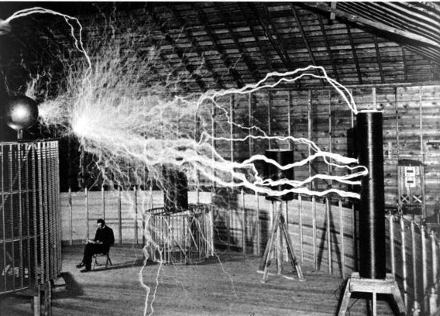
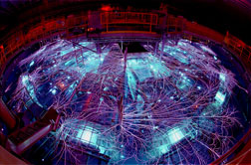
The accumulation and transmission of electromagnetic energy, called “pulsed power”, has been investigated for over a century
Tesla’s Lab (GW)
Z facility {SNL}
Z-pinch (100-330 TW)
Hermes - II {SNL}
e-beam (TW)
PBFA - II {SNL}
Ion Beams (20 TW)
WWII
1900 1920 1940 1960 1980 2000
Radar (MW)
Germany
US
Russia
Great Brittain
DARHT {LANL}
Radiography (10 GW)
Angara - II {Russia}
Simulator (TW)
Notes:
The roots of pulsed power technology date back to the turn of the last century. I found this interesting photo of Tesla’s Colorado Springs laboratory from the early 1900’s where he began experimenting with pulsed electricity and succeeded in producing pulsed powers up to a few GW. Contrast that with a modern pulsed power facility, namely the ZR facility at Sandia laboratories that can produce electrical powers up to 100 TW, 100,000x greater than Tesla’s experiments a century before. I was also struck by the evolution of ES&H requirements of the last century. Note that not only was Tesla’s lab made of wood (I’ll remind you that it did eventually burn down), here he is sitting the corner! Actually, I read that this photo was intended as propaganda to excite the citizens of Colorado Springs about the work going on in Tesla’s lab right outside their city, and this photo was taken as a double exposure, one with him sitting in the chair and another with his ‘device’ turned on. Pulse Power has been mostly developed for military applications starting with Radar in the 1930’s, to electron beams for effects studies and radiography, to ion beams and z pinches for fusion studies. Through most of this history, pulsed power was largely an engineering discipline. It was detailed diagnostics like that provided by applied plasma spectroscopy starting in the 1970’s and 80’s that helped change pulsed power engineering to pulsed power science.

Slide 4
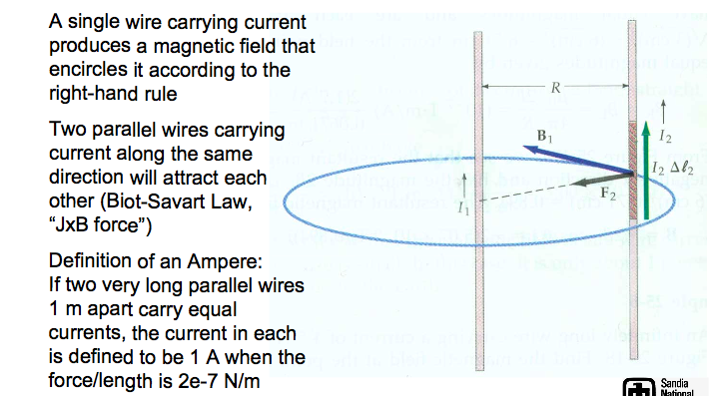
1st year physics refresher

Slide 5
We can incorporate the effect of magnetic fields into our plasma fluid equations as an effective pressure
mass conservation
momentum conservation
(F=ma)
cgs
For slowly varying fields we can approximate:
(Ampere’s law, ignoring
displacement current)
We re-write JxB as:
From vector identities:
So JxB becomes:
fluid
pressure
magnetic
pressure
magnetic
tension
In the case of an axisymmetric z-directed current (B_{θ} field), the magnetic tension is zero
Plasma momentum is affected by magnetic fields

Slide 6
Large currents and the corresponding magnetic fields can create and manipulate high energy density (HED) matter
HED Matter P > 1 Mbar, B > 5 Megagauss
Magnetic fields have some unique advantages when creating HED plasmas:
  Magnetic fields are very efficient at creating HED matter, enabling large samples and energetic sources
  Magnetic fields have very interesting properties in converging geometry
Magnetic fields have interesting contrasts with other ways of generating HED:
  Magnetic fields can create high pressures without making material hot
  Magnetic fields can be generated over long time scales with significant control over the time history
Magnetic fields change the way particles and energy are transported in a plasma

Slide 7
How strong is this pressure?
N = kg m s⁻² (mks) versus dyne = g cm s⁻² (cgs)
So 1 N = 10⁵ dyne, and, in pressure units:
1 N m⁻² (Pa) = 10 dyne cm⁻² = 10⁻⁵ bar
A typical refrigerator magnet is 100 gauss ~ 400 dyne/cm²
A 5000 G (0.5 T) magnetic field ~ 10⁶ dyne/cm² ~ 1 atmosphere ~ 1 Bar
A 5x10⁶ G (500 T) magnetic field ~ 1 Million atmospheres = 1 Megabar (MB)= High energy density physics (“HEDP”)
A 5x10⁹ G (500 kT) magnetic field ~ 1 Trillion atmospheres = 1 Terabar (TB) > pressure in the center of the sun
Note that high explosives have pressure ~ 100,000-300,000 atmospheres
~ 0.1-0.3 Mbar (not “HEDP”) ~ equivalent ~50-150 T or 5x10⁵-1.5x10⁶ G

Slide 8
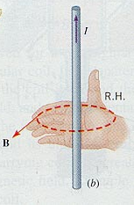
Large currents can create large B fields!
Ampere’s law
For an axial current I:
P_{mag} ~ B² ~ I² r ⁻²
100 A at 2 mm radius is 100 G
1.0x10⁷ A (10 MA) at 4 mm radius is 5x10⁶ G = 1 MBar of pressure!
2.5x10⁷ A (25 MA) at 1 mm radius is 5x10⁷ G = 100 MBar of pressure!! ←Z Machine
(~1000x more than high explosives)
LARGE CURRENTS → LARGE MAGNETIC FIELDS → LARGE PRESSURES!

Slide 9
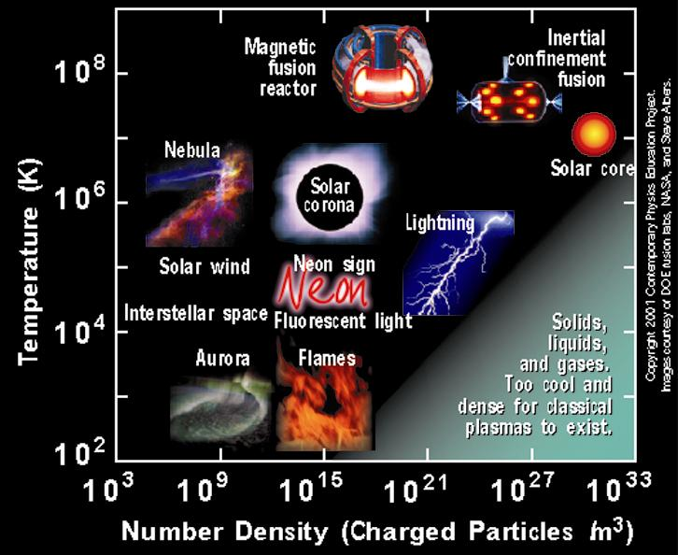
Regimes of high energy density are typically associated with energy density 10¹¹ J/m³ = 1 Mbar
Z-pinches
Copyright 2001 Contemporary Physics Education Project
Notes:
Going back to our phase space plot, these ICE and flyer plate experiments enable material property studies at high density and modest temperatures.

Slide 10


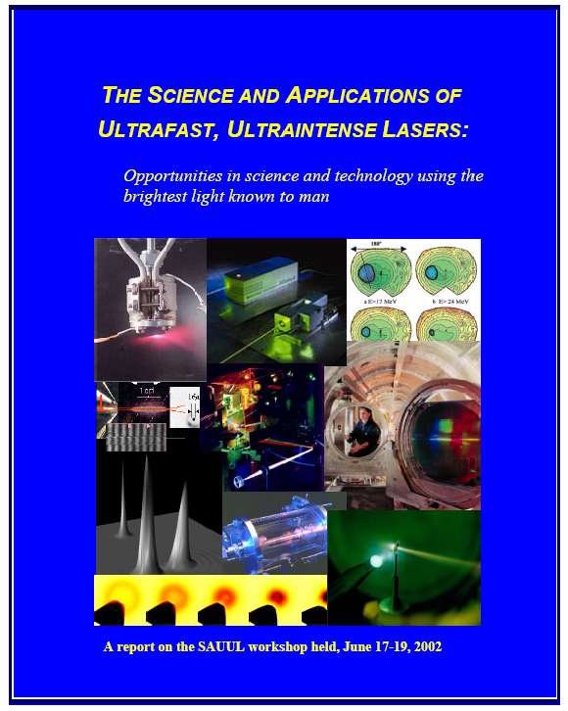
Several recent studies have highlighted
High Energy Density Science
“Frontiers in High Energy Density Physics”,
R. Davidson et al. 2004
“Connecting Quarks with the Cosmos: Eleven Science Questions for the New Century”,
M Turner et al. 2002
Science and Applications of Ultrafast, Ultraintense Lasers

Slide 11

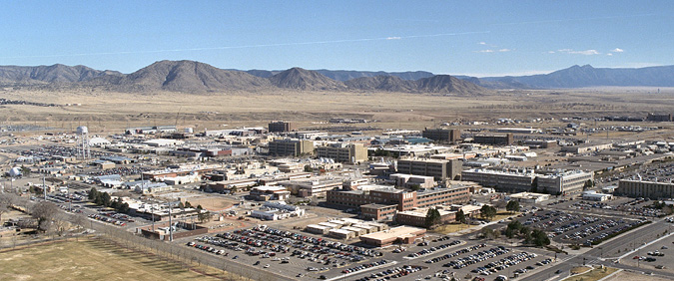

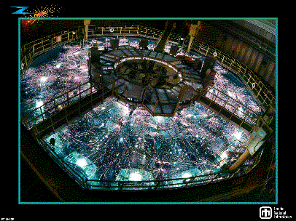
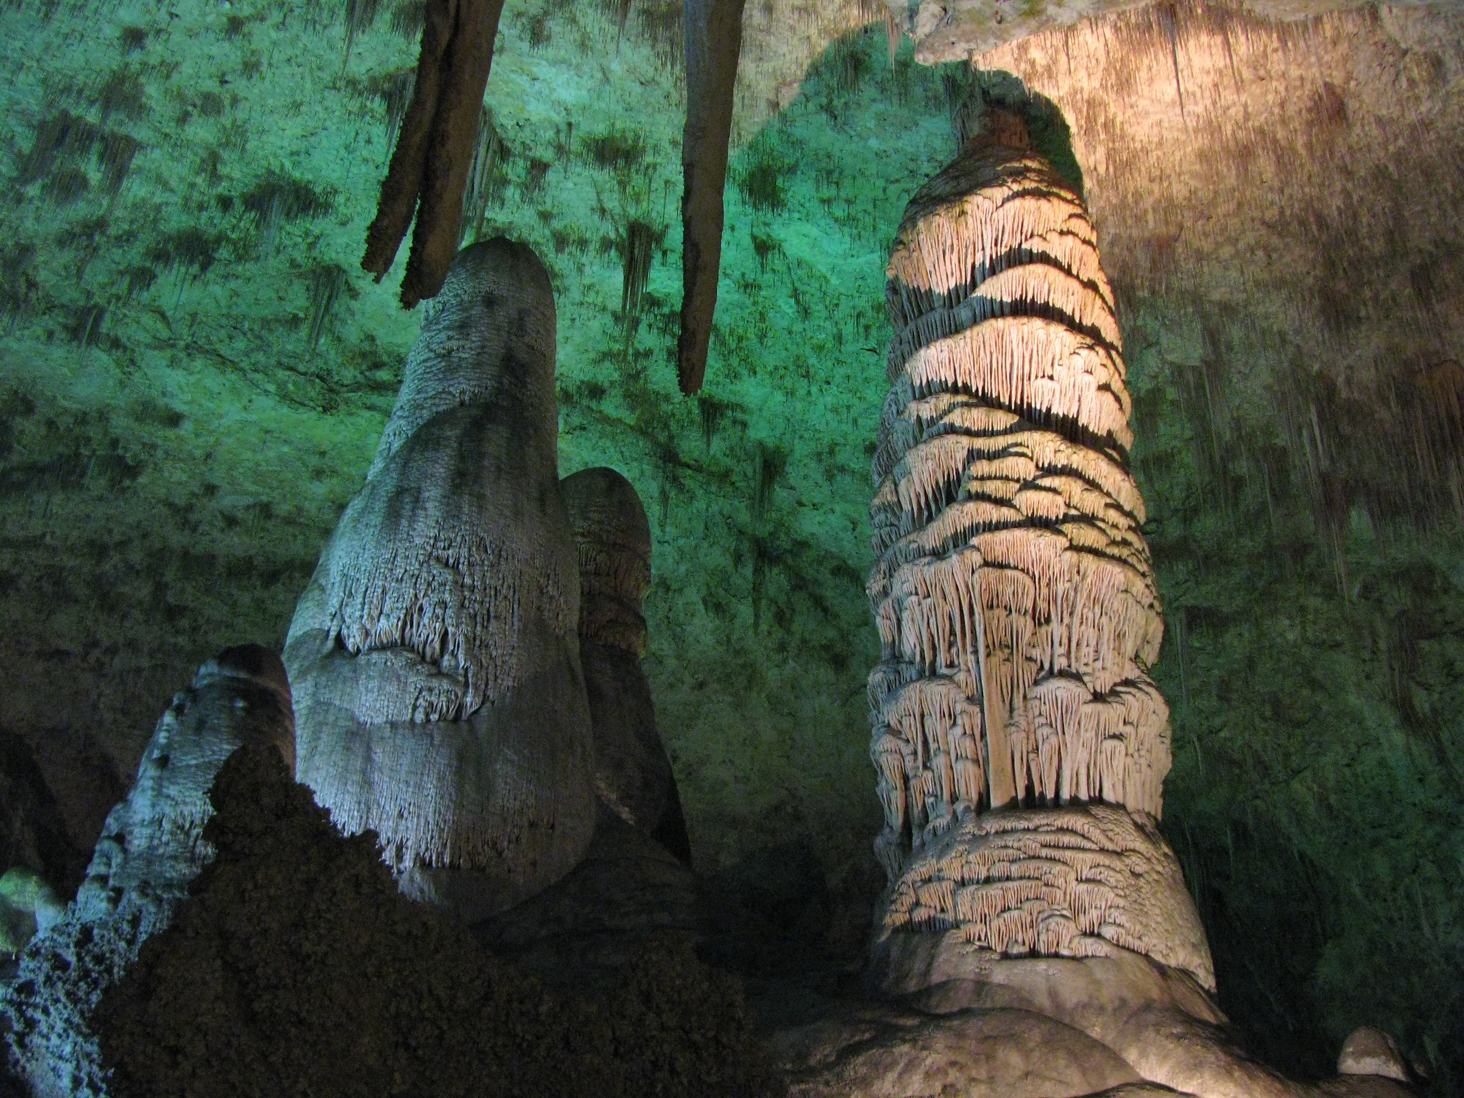
The “Z” pulsed-power facility is located at Sandia National Laboratories in Albuquerque, New Mexico
Youtube.com: search for the BBC TV show:
“Horizon: Can we make a star on earth?”

Slide 12
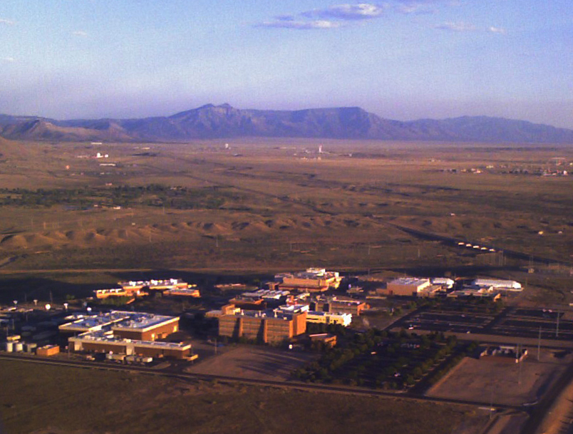
The “Z” pulsed-power facility is located at Sandia National Laboratories in Albuquerque, New Mexico

Slide 13
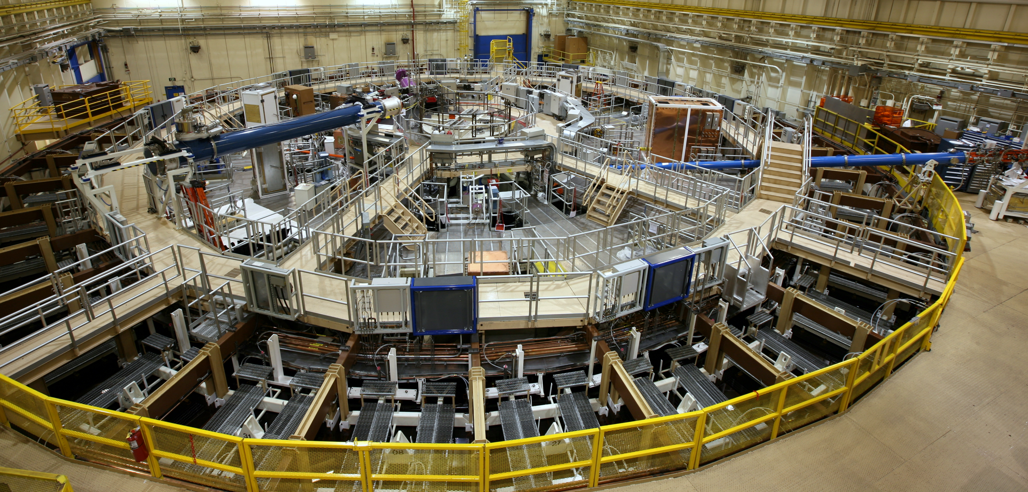
“Z” is the world’s largest pulsed-power facility
Tank~10,000 ft²
22 MJ stored energy
3MJ delivered to the load
27 MA peak current
5 – 50 Megagauss (1-100 Megabar)
100-600 ns pulse length

Slide 14
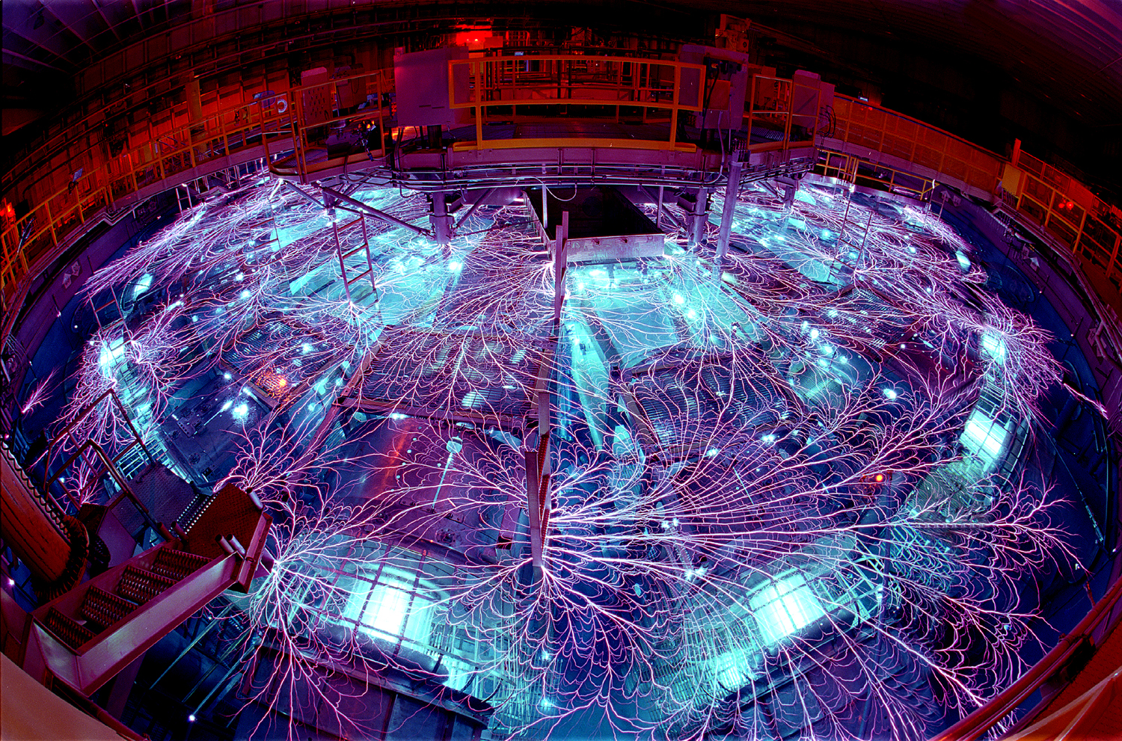
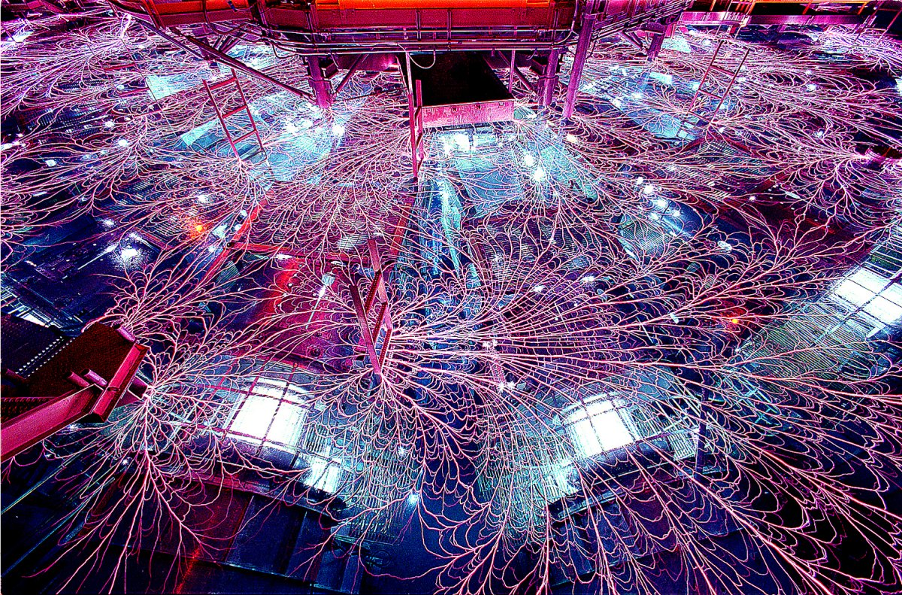
“Z” is the world’s largest pulsed-power facility

Slide 15
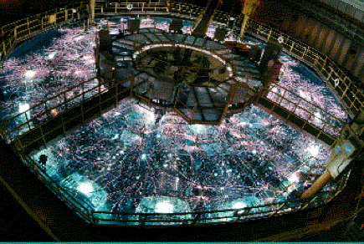
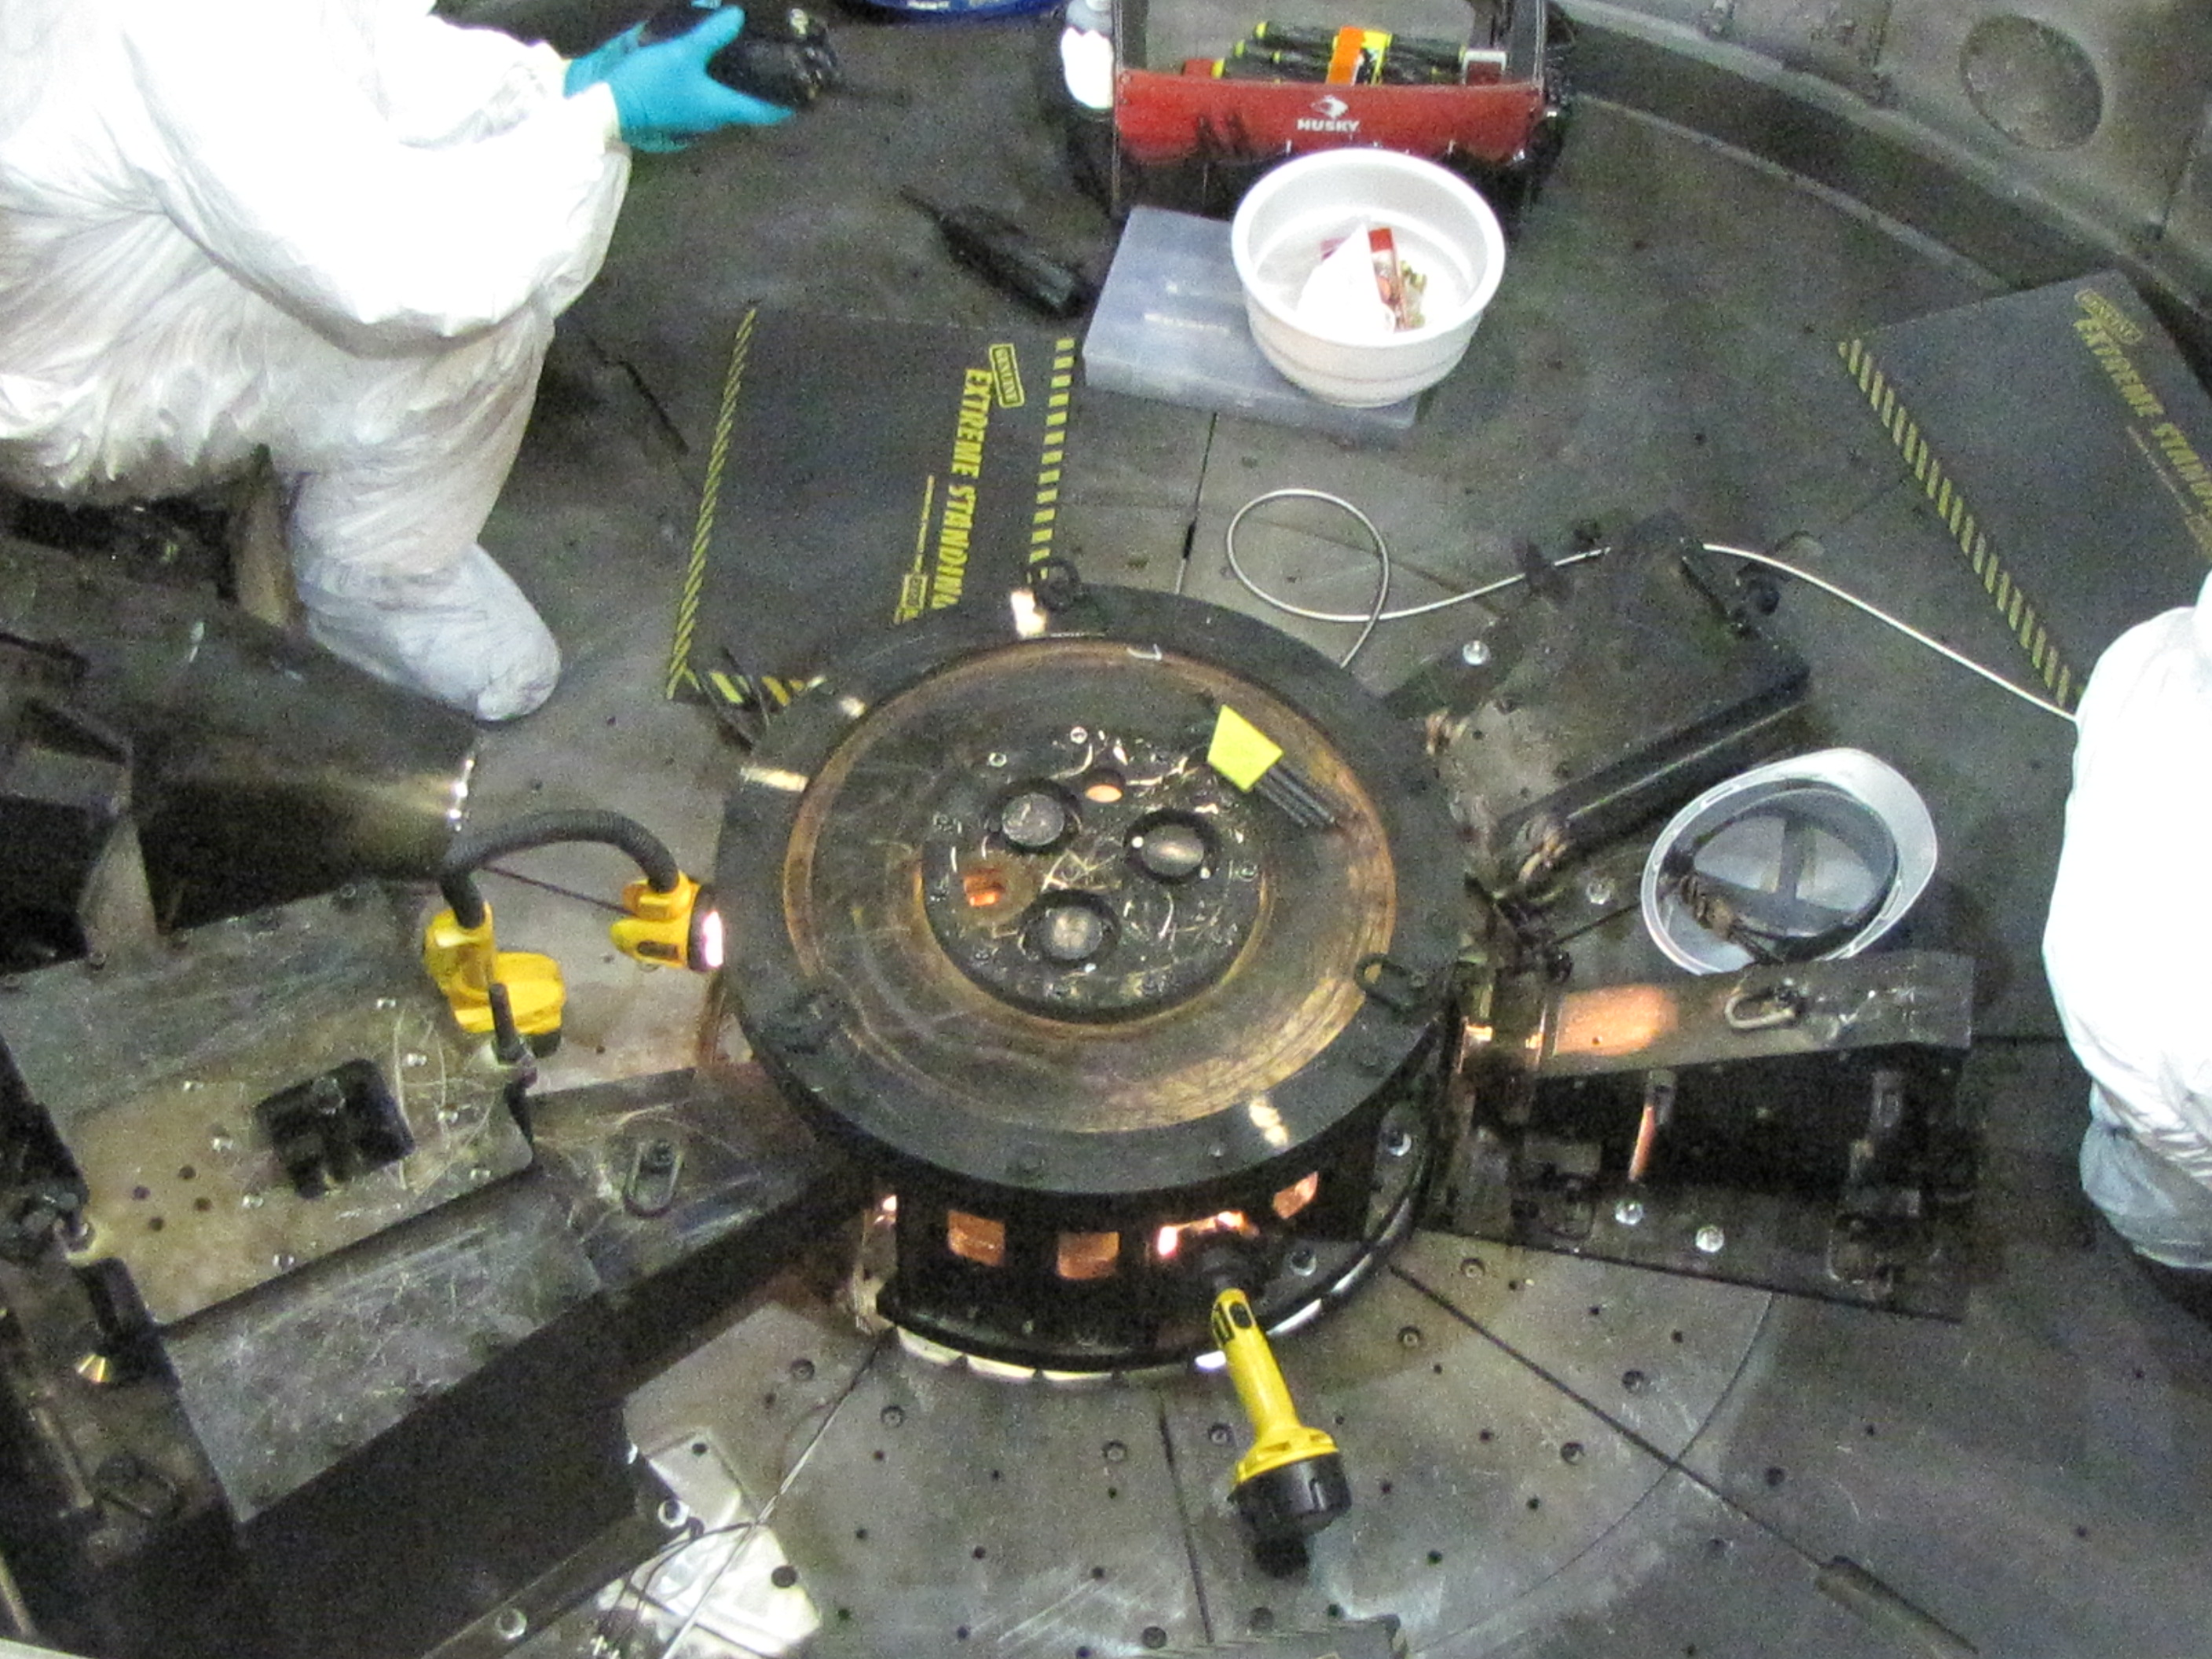
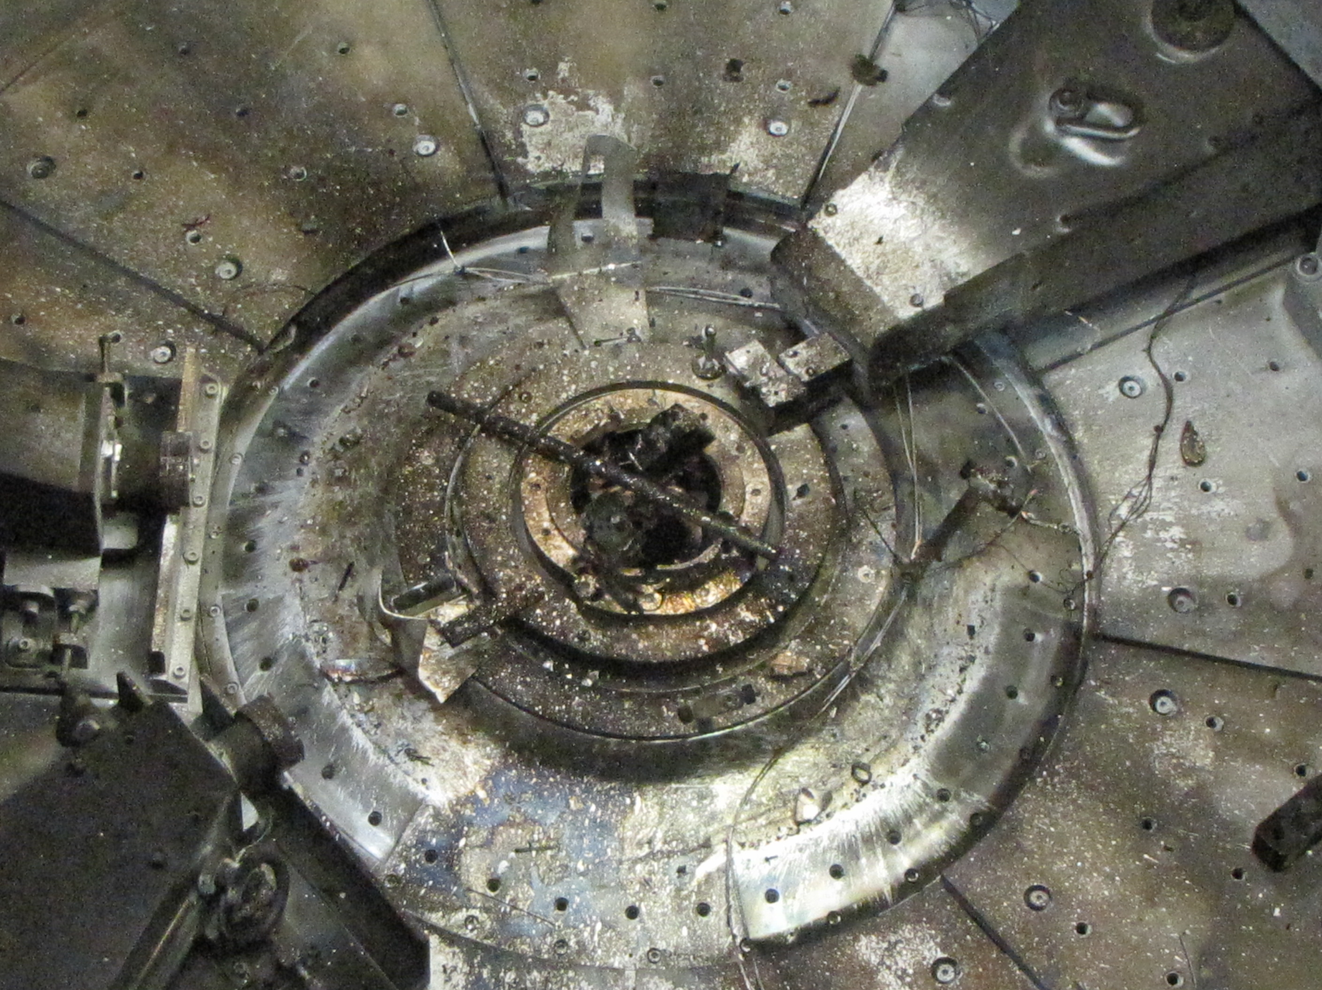
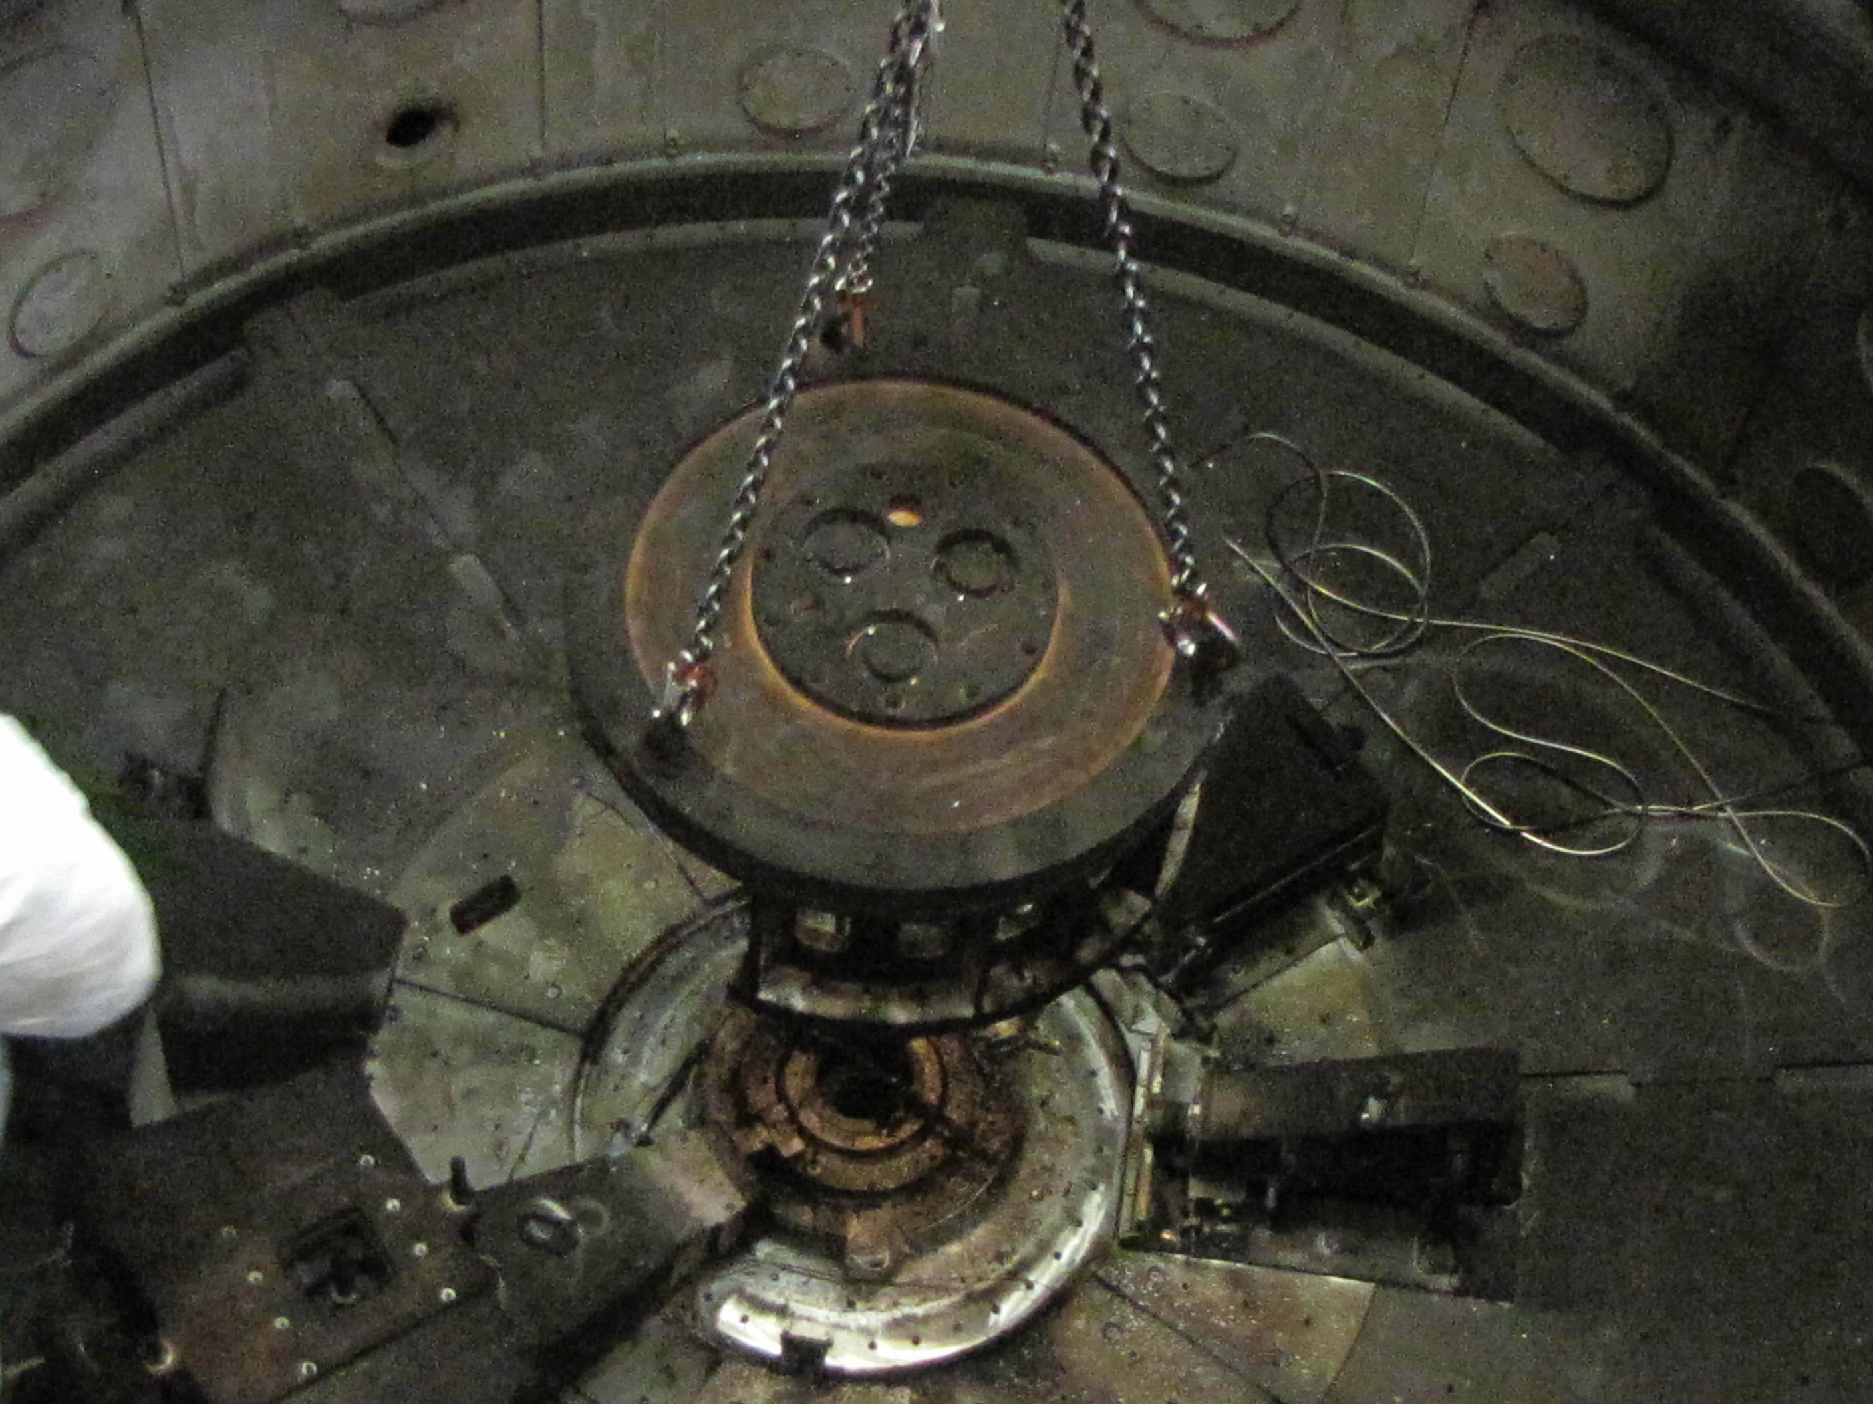
“Z” is a great place to conduct experiments
Setup
Fire!
Cleanup

Slide 16
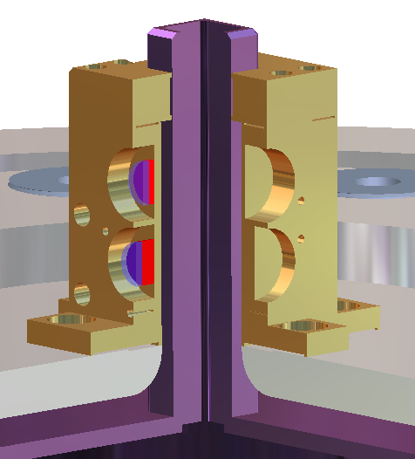
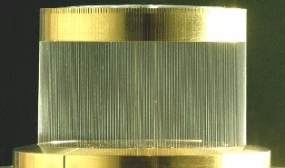
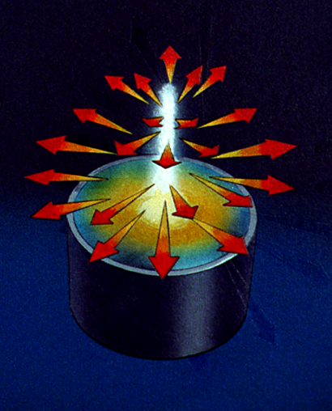
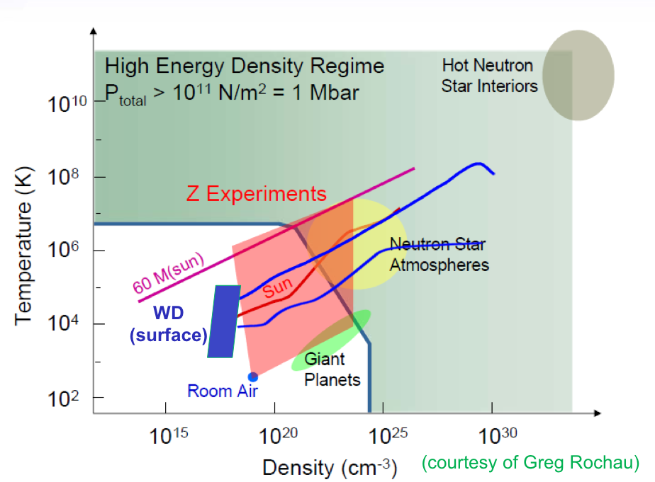
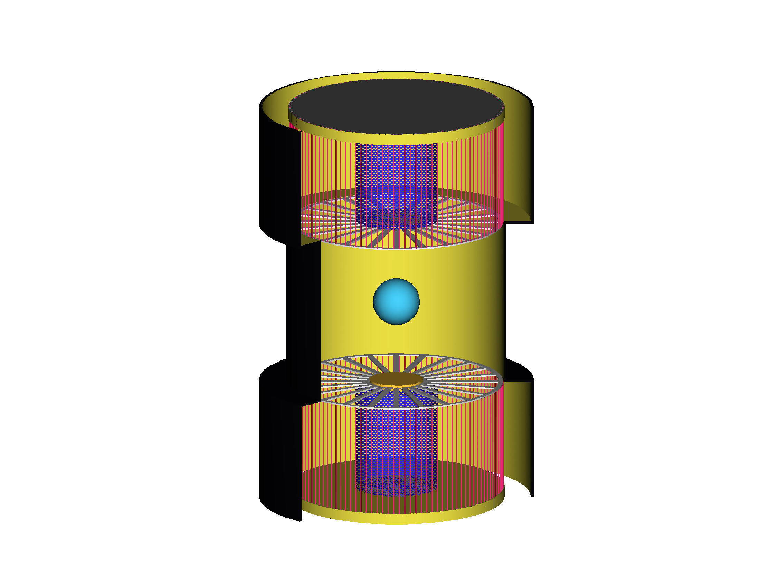
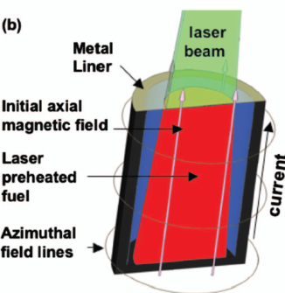
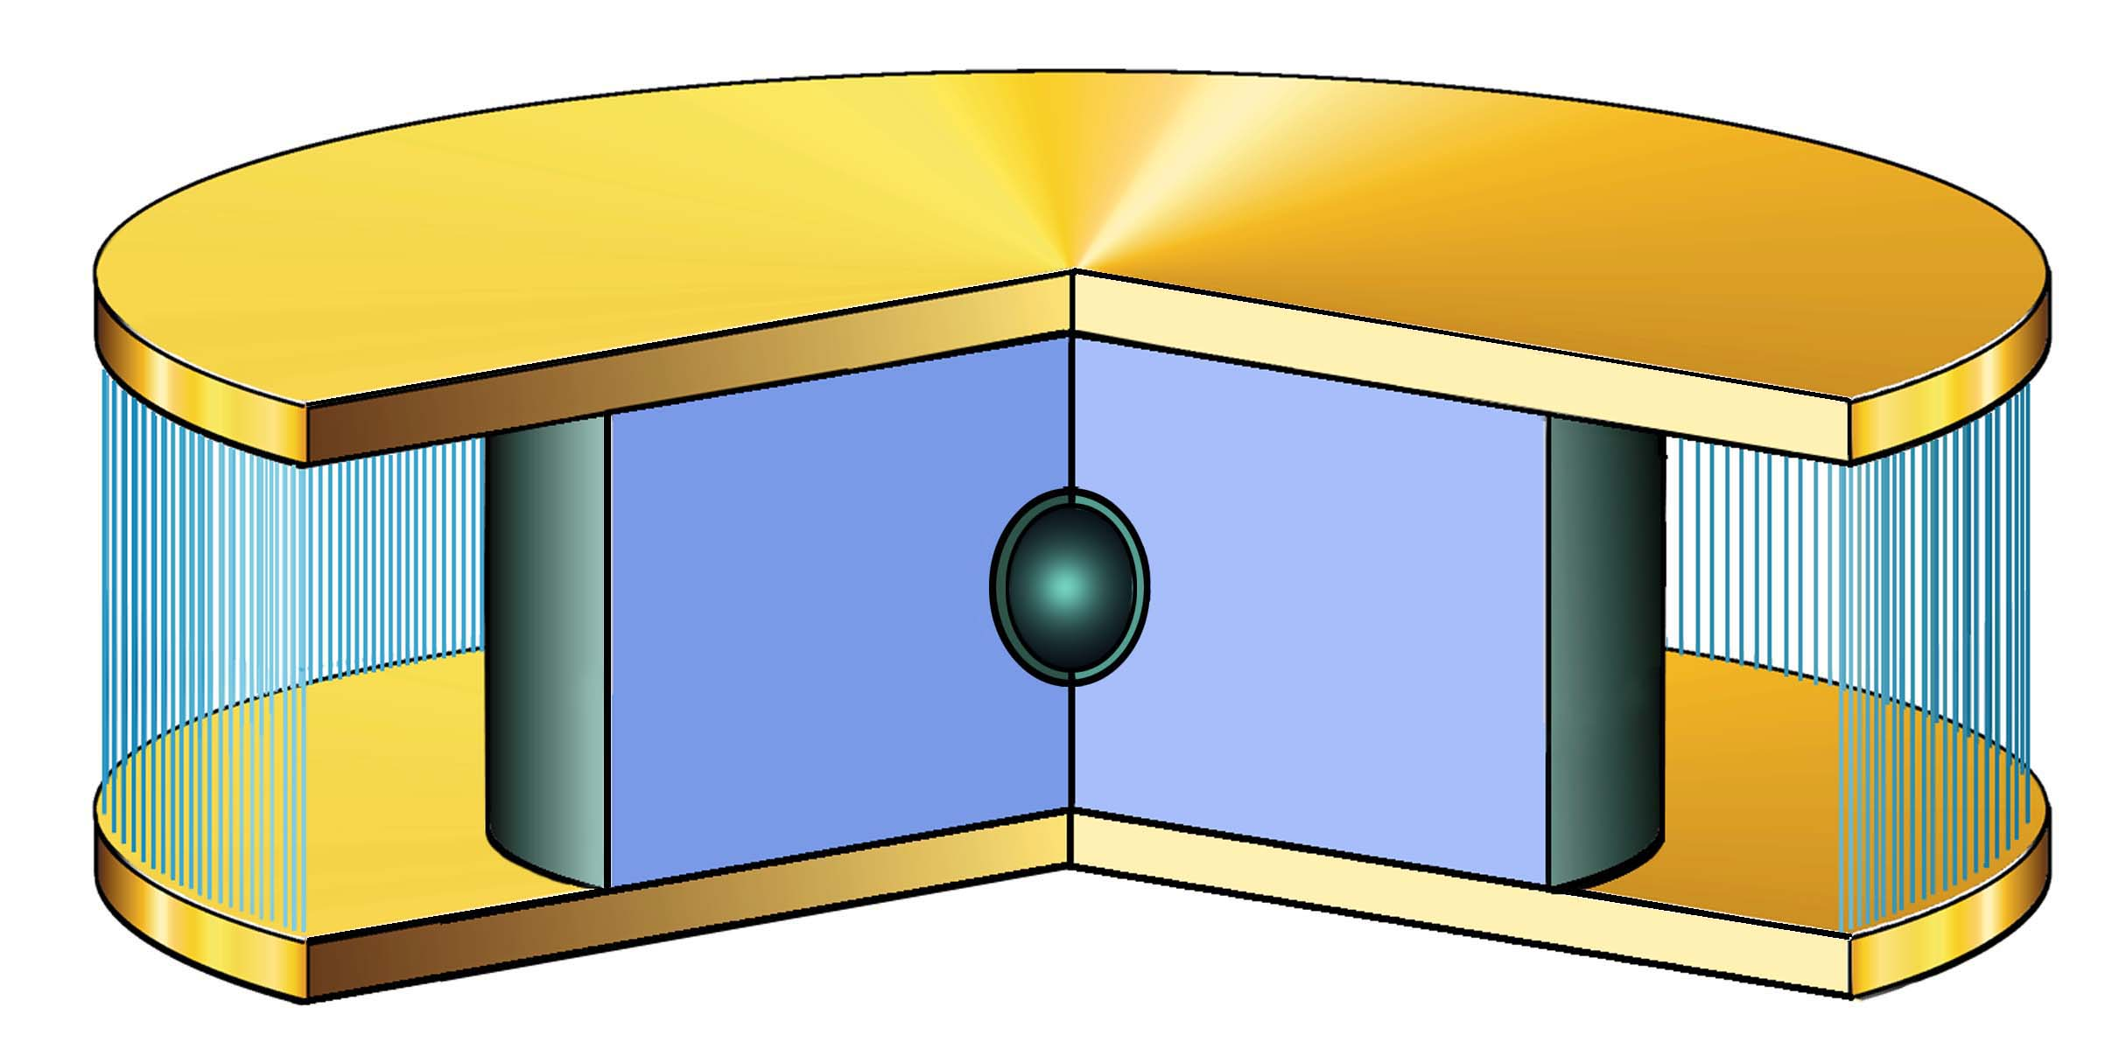
We can use high currents to push plasmas in different ways for different experiments
High Current
Planar magnetic pressure
Cylindrical compression: Z-pinch x-ray source
wire array
Current
B-Field
“ICE” and “flyer” plates:
Accurately measure material properties, e.g. “Equation of State” (how P relates to ρ and T
in the fluid formalism)
JxB Force
Produces intense x-ray sources:
~ few ns timescale, > 1 MJ energy, > 100 TW power
Inertial Confinement Fusion (ICF)
γ ray bursts
supernova
progenitors
1 Mbar
Indirect-drive
(x-rays)
Brown Dwarf
White
Dwarf
Direct-drive
(magnetic field)
Notes:
Another way to look at the this concept of driving the different load configurations is shown here.
Start with high current
LHS – Z-pinch x-ray source
explain how a z-pinch works
there are many different applications that utilize this x-ray source
RHS – magnetic pressure, or direct drive -- come back to this later
I will briefly talk about these three different areas of applications, and start with ICF

Slide 17
Our experiments are well-diagnosed
Z Target Diagnostics
Power & Energy
Spectroscopy
X-ray Imaging
X-ray Diodes
Photo Conducting Diamonds
Motion / Velocity
Neutrons
Silicon Diodes
Bolometer
Time-integrated 0.8-10 keV
Time-resolved 0.8-10 keV
Time-integrated 7-25 keV
1.9 or 6.1 keV Backlighting
Filtered Self-Emission
VISAR
Passive Shock Breakout
D-D Activation
D-T Activation
Time-of-Flight
Imaging
Streaked Visible
277 or 528 eV Self-Emission
Photonic Doppler Velocimetry

Slide 18
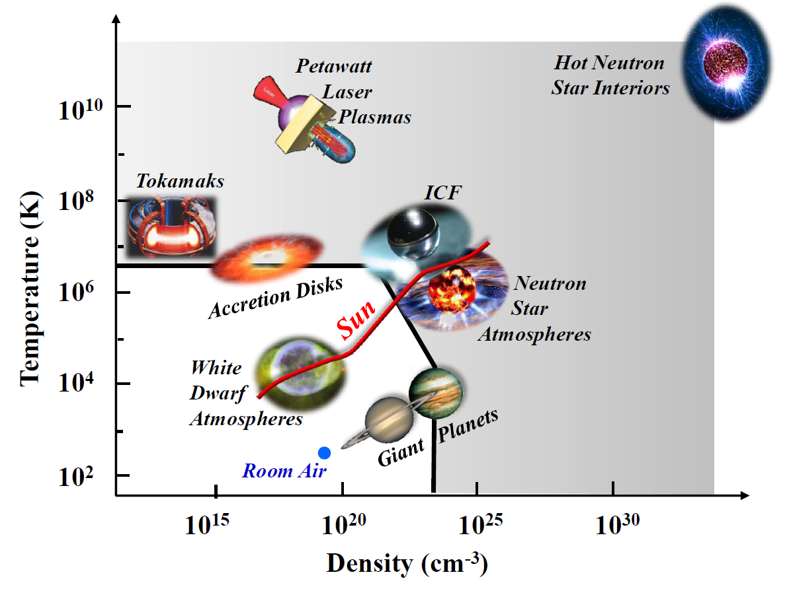
Experiments on Z access a large region of the energy density phase-space
High Energy Density Regime
ε > 10¹¹ J/m³ = 1 Mbar
Notes:
These spectroscopic techniques have been applied to a very broad range of plasmas. This is a phase-space plot of plasma temperature vs. density showing the nominal conditions of a variety of laboratory and space plasmas. In the last 10 years, people have begun delineating a range of plasma conditions called the ‘High Energy Density Regime,’ which has been defined as plasmas with a total energy density of > 1011 J/m3, which corresponds to a pressure of 1 Mbar. Spectroscopy has been successfully applied to determine the conditions of every plasma represented here including those in the high energy density regime. One exception of course being the interior of hot neutron stars.

Slide 19
Experiments on Z access a large region of the energy density phase-space
High Energy Density Regime
ε > 10¹¹ J/m³ = 1 Mbar
Z
Notes:
This review focuses on the application of spectroscopy in pulsed power produced plasmas. This was chosen because Pulsed Power can produce a broad range of plasma conditions from the cool and diffuse to the very hot and dense.

Slide 20
Pulsed-power technology produces high electrical power using fast switching and pulse compression
Electro-
magenetic
Energy
Storage
Slow
Switch
Intermediate
Storage &
Pulse
Forming
Fast
Switch
Pulse
Transmission
and Matching
Load
Target
wall plug
and
charging
supply
Marx capacitor
bank in oil
Water storage
capacitor
Water or
Vacuum
MW → TW
Low Electrical Power
Up to 10⁷ J – 10⁶ W
High Electrical Power
Up to 10⁷ J – 10¹⁴ W
Typically the pulse is compressed in both space and time
The load produces the last step in pulse compression and power gain
You can think of this as a complicated circuit
(whose load is destroyed with each shot)

Slide 21

Multiple modules are used to achieve the highest powers
& etc
& etc
Load
Laser-triggered gas switches are used to synchronize the pulses (to within a few ns) from the individual modules

Slide 22
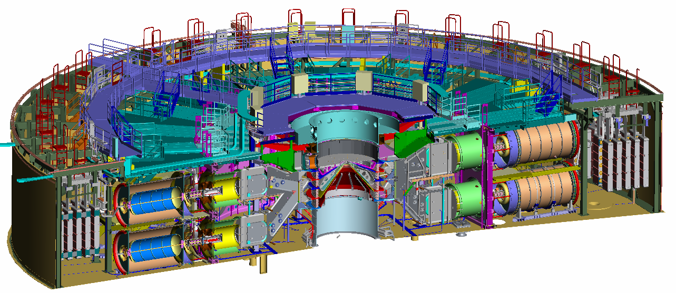
Cross section of the Z facility
at Sandia National Laboratories
25 MJ
Electrical
100 TW
Electrical
27 MA
Current
Laser-triggered Gas Switch
Marx Generator
Notes:
The premier pulsed power facility in the world for studies in HED science is the Z facility at Sandia. It stores up to 25 MJ of electrical energy; produces up to 100 TW of electrical power; Delivers > 24 MA of current to a Z-pinch load; and can produce x-ray powers > 300 TW with a total energy > 2 MJ. This technology is ~10% efficient in the conversion of stored electrical energy to X-ray emission energy.

Slide 23
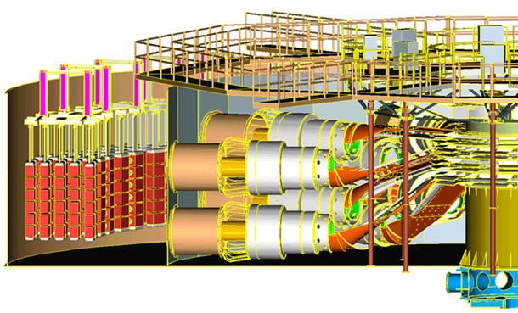
Pulsed-power provides compact, efficient, power amplification
17 m radius
Z
x ray output
~2 MJ
~200 TW in ~5 ns
conversion efficiency
~15%
(wall-plug to x-rays)
vacuum
Marx
11.4 MJ
water
at a velocity of c:
Current pulse: 100 ns (30 m)
x-ray pulse: 5 ns (150 cm)
Time (μs)
This is akin to taking the equivalent electrical energy consumption in one evening’s operation of a TV set (a few MJ) and compress it into more electrical power than provided by all the power plants in the world combined (~13-15 TW).
Notes:
The core is pulsed power – which is basically the compression of energy in space and time.
Read title
The figure is a representation of the Z machine, which you will tour after this presentation.
Plot shows compression in time; figure represents compression in space.
Power vs. time – note different plots
Comment on x-ray output – conversion efficiency – low cost

Slide 24
We compress energy in space and time on Z
Compression in height X 625
  625 cm tank Marx height to 1.0 cm load height
Compression in radius X 1375
  1650 cm in Marx tank radius to 1.2 cm load radius
Compression in time X 2.4 x 10¹⁰
  2 minute Marx charge to 5 ns pinch output
  Total power density compression factor ~8 x 10¹⁵
  (η x area x time, η~0.4)

Slide 25
We can use high currents to push plasmas in different ways for different applications
High Current
Z-pinch X-ray sources
Planar magnetic pressure
wire array
Current
B-Field
JxB Force
Inertial Confinement Fusion (ICF)
Material Properties
J
x
x
x
x
x
x
B
Indirect-drive
(x-rays)
Direct-drive
(magnetic field)
Notes:
Another way to look at the this concept of driving the different load configurations is shown here.
Start with high current
LHS – Z-pinch x-ray source
explain how a z-pinch works
there are many different applications that utilize this x-ray source
RHS – magnetic pressure, or direct drive -- come back to this later
I will briefly talk about these three different areas of applications, and start with ICF

Slide 26
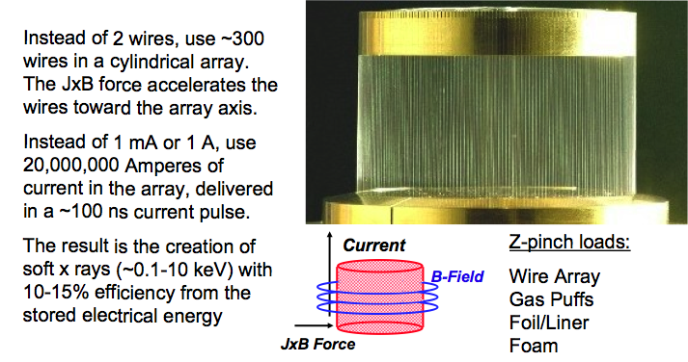
Wire arrays are a “simple” extension of the two wire problem

Slide 27
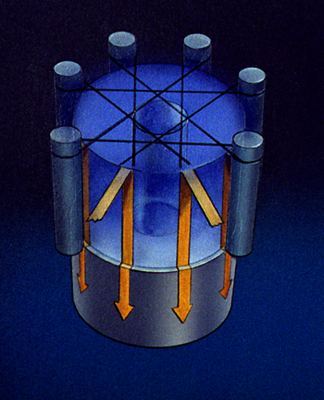
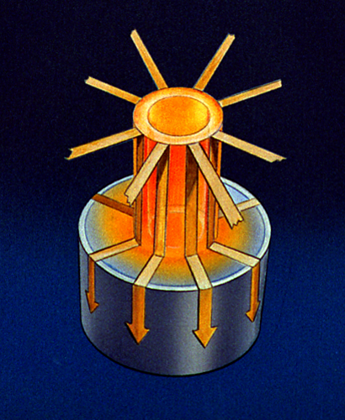
Magnetically-driven fast z-pinch implosions efficiently convert electrical energy into radiation
Current
B-Field
kinetic and magnetic energy
internal energy
x rays
electrical energy
JxB Force
Fast wire z-pinch loads:
Z-pinches are imploded in 60-120 ns, and radiate x-rays in 5 ns
Energy: x-ray ~ 15% of stored electrical
Power: x-ray ~ 2-5 x electrical
kinetic energy
Ablation
Implosion
Stagnation
Notes:
Speak to stages as if this were a wire array-
Wires ablate
They implode storing up kinetic energy for delivery to the axis
At stagnation both magnetic energy and kinetic energy may couple radiation is larger than kinetic energy

Slide 28
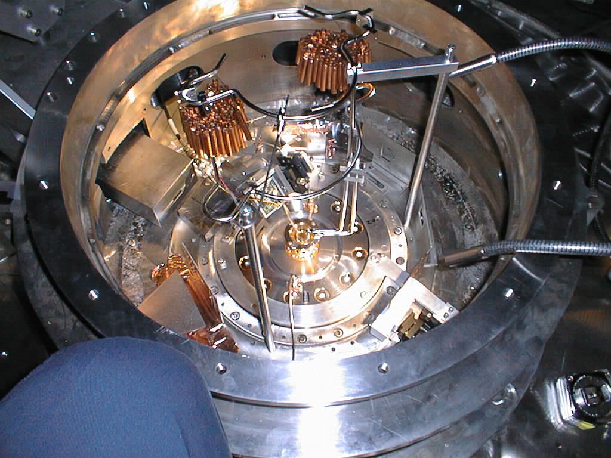
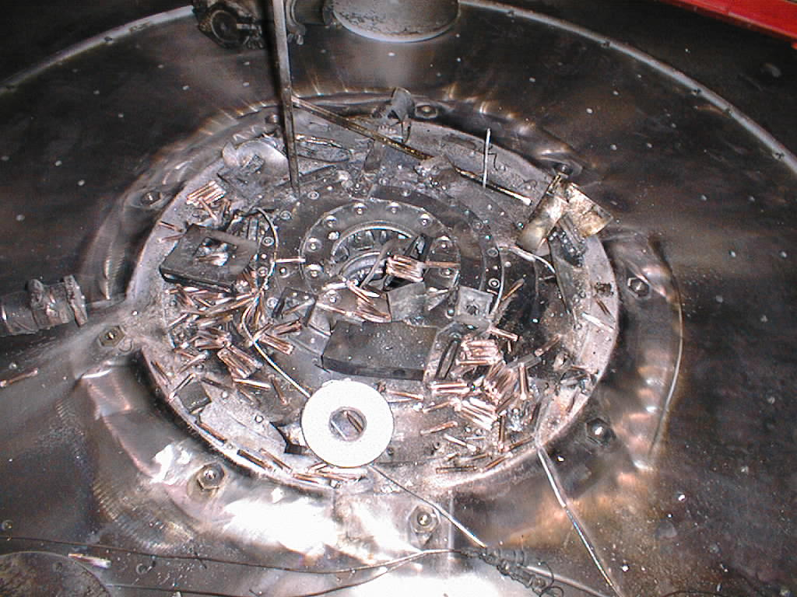
The 2-3 MJ of magnetic energy and radiation destroys the hardware following the pulse
“Hostile” environment
BEFORE
debris, electrical noise,
photon background, plasma
Wire array
AFTER
(Blast shield removed)
Blast shield
Equivalent to 2 lbs high explosive released in a few ns in <1 cm³ volume!

Slide 29
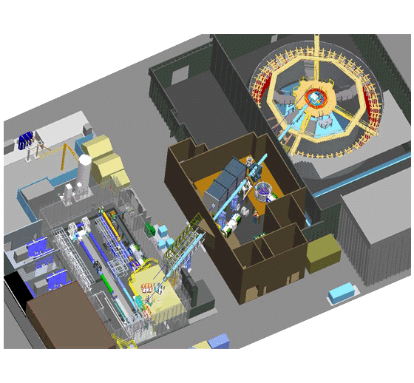
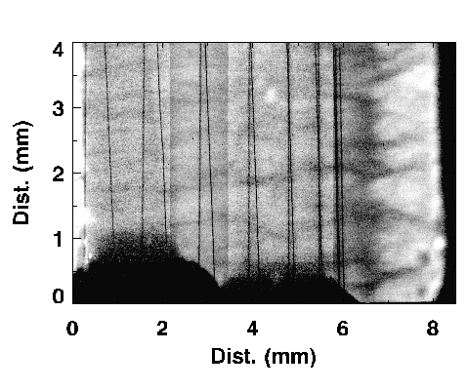
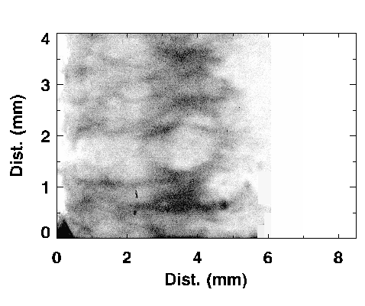
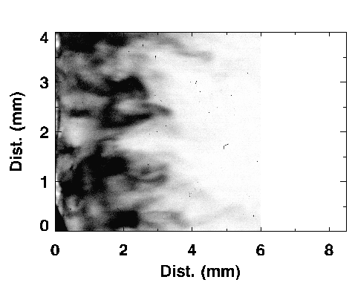
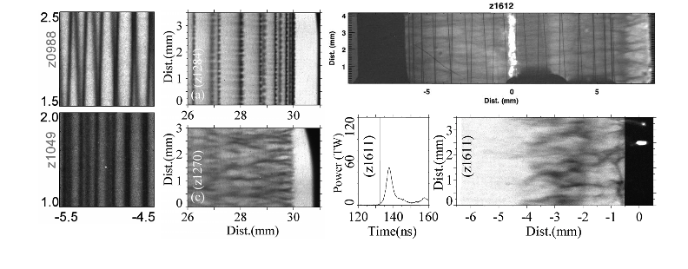
Magneto-Rayleigh-Taylor (MRT) instability limits the quality of the implosion
Xray images of a wire array during its implosion!
Z Machine
Z Beamlet laser
(for radiography)

Slide 30
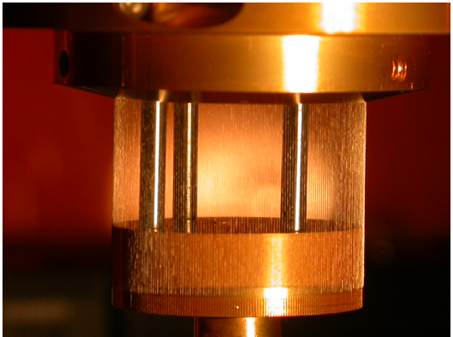
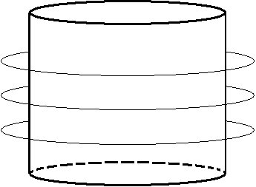
The plasma is the heavy fluid and the
B field is the light fluid → unstable to the MRT
I
P~I²/r²
B_{θ}
20 mm
acceleration
effective
gravity
(in liner/bubble frame)
Our z-pinches are termed “fast” because only the MRT grows during implosion

Slide 31
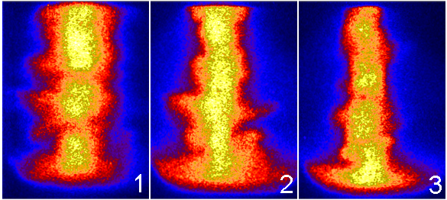
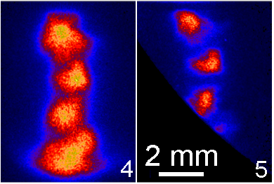
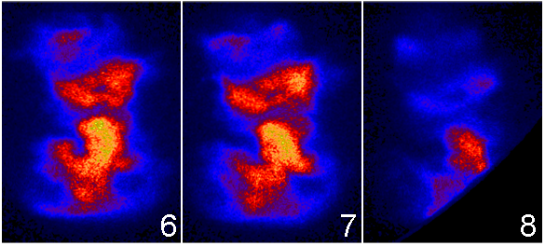
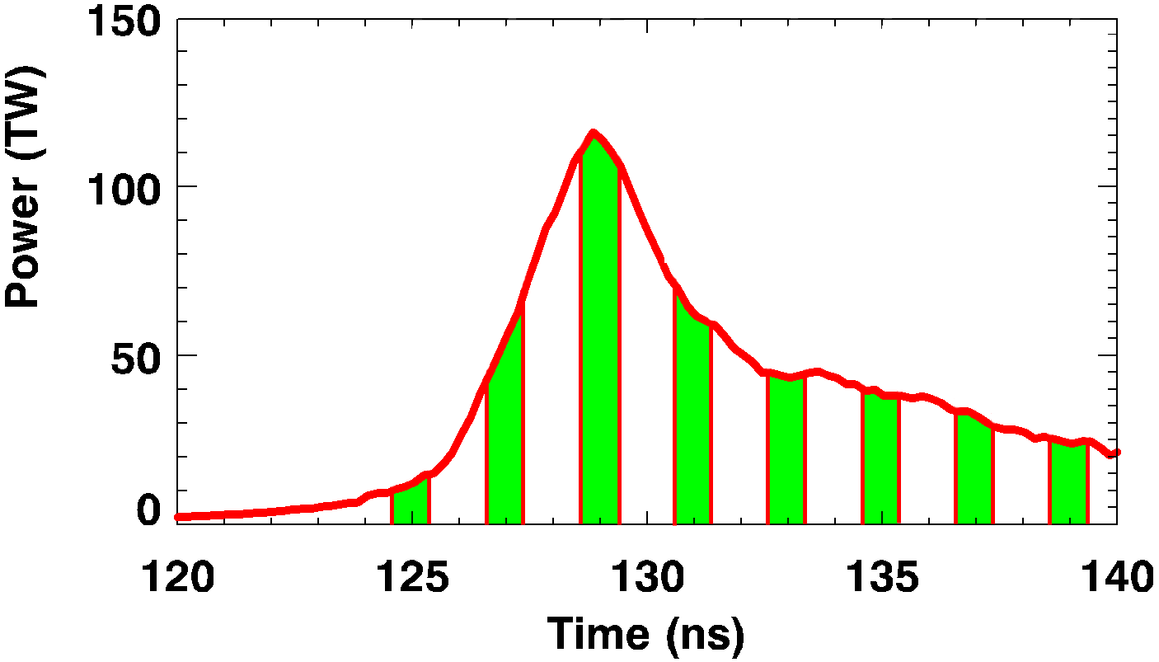
The plasma pinch convergence ratio is commonly estimated using x-ray self-emission imaging
Plasma is relatively stable and axially uniform during main radiation pulse
Most work in literature estimates plasma CR using x-ray pinhole cameras

Slide 32

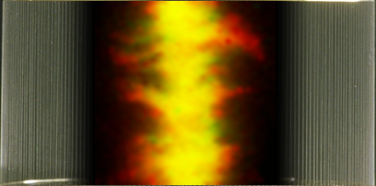
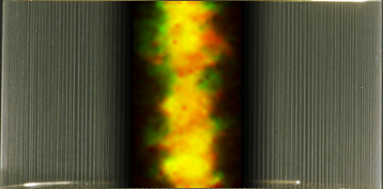
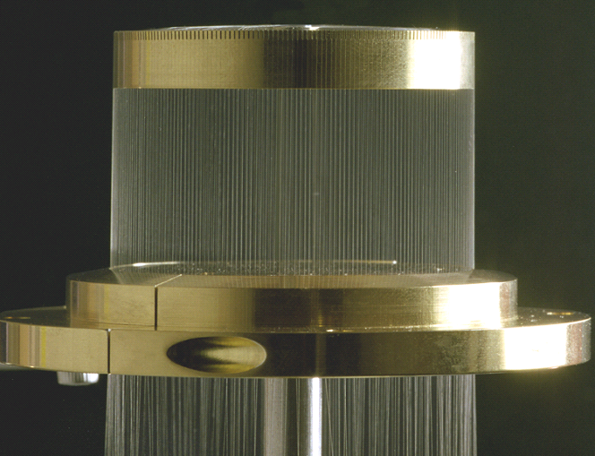
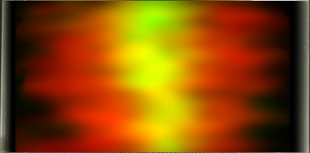
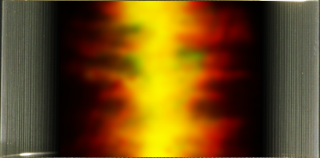
Summary: J x B force pinches wire array into a dense, radiating plasma column
J
JxB
B
Z-pinch wire array x-ray source summary:
E_{rad} ~ 2 - 3 MJ, ~15% wall plug efficiency
P_{rad} ~ 100-330 TW (~330 million million Watts)
T_{rad} ~ 200 eV ~ 2,300,000 °K

Slide 33
A power of 330 TW
25 x global annual power consumption [2008]
104 x US annual power consumption
BUT, remember, it’s just on for 5 ns……..light will only travel 4.9 feet in 5 ns

Slide 34
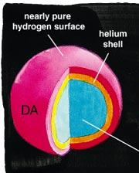
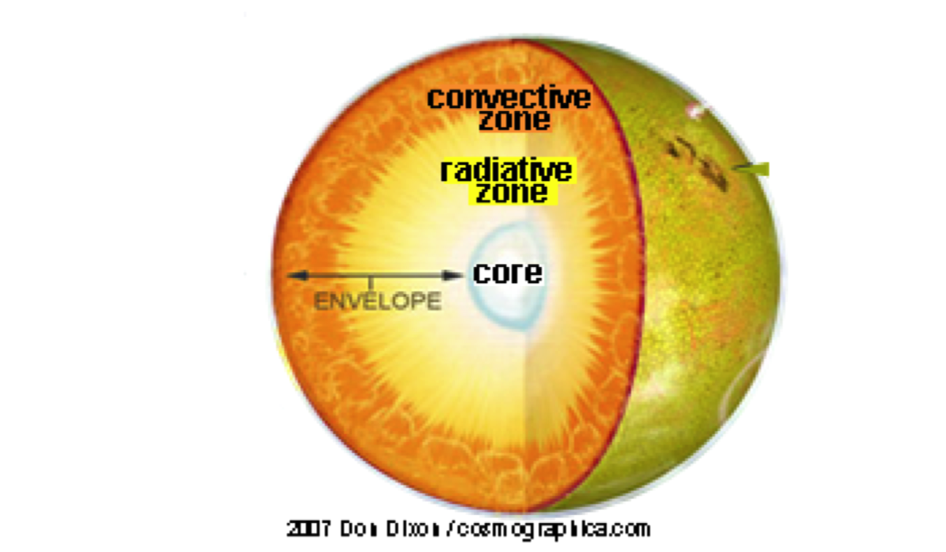



We have established a fundamental science program on Z and have awarded time to university users
We use high magnetic pressures and intense x-ray bursts to create unique matter and plasmas that can help address astrophysical questions
Proposals address exciting scientific issues:
  Do we understand the structure of the sun?
  Can we use white dwarfs as cosmic chronometers?
  How does the accretion disk around a black-hole behave?
  What is the structure of the planets in our solar system (and beyond)?
  How did the Earth and the Moon form?
Earth formation
Photo-ionized plasmas
Planetary structure
White Dwarfs
Solar Opacities

Slide 35




Z Astrophysical Plasma
Properties (ZAPP) project
Photoionized Plasma
White Dwarf Line-Shapes
Solar Opacity
Photoionized Plasma
White Dwarf Line-Shapes
Collaborator:
Ohio State University
Purpose:
Test Fe opacity models at conditions relevant to the convection zone boundary in the Sun.
Required Conditions:
T_{e} ~ 180 eV, n_{e} ~ 10²³ cm⁻³
Collaborators:
UNR / LLNL
Purpose:
Test photo-ionization models and atomic physics at conditions relevant to black hole accretion disks.
Required Conditions:
T_{e} ~ 15 eV, n_{e} ~ 10¹⁸ cm⁻³
Collaborator:
University of Texas
Purpose:
Test line-broadening theory of H at conditions relevant to White Dwarf photospheres.
Required Conditions:
T_{e} ~ 1-4 eV, n_{e} ~ 10¹⁷⁻¹⁹ cm⁻³
Collaborators:
UNR / LLNL
Purpose:
Test photo-ionization models and atomic physics at conditions relevant to black hole accretion disks.
Required Conditions:
T_{e} ~ 15 eV, n_{e} ~ 10¹⁸ cm⁻³
Collaborator:
University of Texas
Purpose:
Test line-broadening theory of H at conditions relevant to White Dwarf photospheres.
Required Conditions:
T_{e} ~ 1 eV, n_{e} ~ 10¹⁷ cm⁻³

Slide 36
We can use high currents to push plasmas in different ways for different applications
High Current
Z-Pinch X-ray Sources
Planar magnetic pressure
wire array
Current
B-Field
JxB Force
Inertial Confinement Fusion (ICF)
Material Properties
J
x
x
x
x
x
x
B
Indirect-drive
(x-rays)
Direct-drive
(magnetic field)
Notes:
Another way to look at the this concept of driving the different load configurations is shown here.
Start with high current
LHS – Z-pinch x-ray source
explain how a z-pinch works
there are many different applications that utilize this x-ray source
RHS – magnetic pressure, or direct drive -- come back to this later
I will briefly talk about these three different areas of applications, and start with ICF

Slide 37




Understanding material properties at high pressure is important for Stockpile Stewardship, ICF, and understanding planets
Nuclear weapons materials
  Behavior of plutonium, uranium, etc.
Inertial confinement fusion (ICF) materials
  Behavior of hydrogen, plastics, beryllium, diamond, etc.
Planetary science
  Giant impacts (e.g. Moon Forming Event)
  Earths and super-earths
    Equation of state of Mg, Fe, Si, C, O, etc.
  Giant Planets (e.g. Uranus & Neptune and exo ice-giants)
    High-pressure mixtures of H, He, C, O, N

Slide 38

Isentropic compression and shock wave experiments map different regions of phase space
Flyer Plate
v up to 40 km/s
Sample
Sample
P > 4 Mbar
P > 10 Mbar
C
C
L
L
Shocks
P
ICE
ρ
Isentropic Compression Experiments:
gradual pressure rise in sample
Shock Hugoniot Experiments:
shock wave in sample on impact

Slide 39

Magnetic pressure can be used to examine fundamental material properties at HED conditions
Dynamic response at temperatures close to static
Entire loading curve from one experiment
principal Hugoniot impact technique
Shock and release
principal isentrope (dS = 0)
room-temperature isotherm: diamond anvil cell (DAC) technique
STP

Slide 40
Z answered important questions about the
properties of diamond at high pressure
stress versus density for diamond
The Z data was
obtained in 1 week
Measurements on Z have an accuracy of ≤ 1%
QMD predicted
region of melt

Slide 41








Z has been used to study material properties
in the multi-Mbar regime for many materials
Be
Quartz
H₂O
Be
C
D₂
H₂O
Tantalum
Notes:
Team has made significant progress and has been able to address several interesting problems in the multi-Mbar regime. Touch on all of these as we go on, but I want to spend a few minutes describing what goes in to performing high-fidelity experiments on a facility like Z

Slide 42

Giant Impacts:
unlocking the mysteries of satellites and planets
Giant impacts:
affect final physical and dynamical properties of a planet
are invoked to explain the large core of Mercury, spin of
Venus, crust asymmetry on Moon and Mars, etc.
result in a diversity of features from possible outcomes
Physical properties of the planets and moons, and
collisions among them, depend on thermodynamics models:
→ EOS (T, ρ, P, S), phase changes, mixtures, strength
The goals are to understand:
planet and satellite formation, structure, and evolution
effects of collisions on planets and satellites
cratering mechanics and morphology
We use flyer plates on the Z machine to gather shock data on relevant
materials, such as MgO and Fe, in support of this research
Credit: S. Stewart (Harvard)

Slide 43




Giant Impacts:
unlocking the mysteries of satellites and planets
Credit: S. Stewart (Harvard)

Slide 44
We can use high currents to push plasmas in different ways for different applications
High Current
Z-pinch X-ray sources
Planar magnetic pressure
wire array
Current
B-Field
JxB Force
Inertial Confinement Fusion (ICF)
Material Properties
J
x
x
x
x
x
x
B
Indirect-drive
(x-rays)
Direct-drive
(magnetic field)
Notes:
Another way to look at the this concept of driving the different load configurations is shown here.
Start with high current
LHS – Z-pinch x-ray source
explain how a z-pinch works
there are many different applications that utilize this x-ray source
RHS – magnetic pressure, or direct drive -- come back to this later
I will briefly talk about these three different areas of applications, and start with ICF

Slide 45



Indirect drive: how can we use this efficient x-ray source to do ICF?
Dynamic Hohlraum
Two methods were proposed
Where do we put the capsule?
We want high intensity (high T_{r})
for high ablation pressure
→ let the capsule see the pinch
Capsule needs high uniformity (~1%)
in x-rays for symmetry
→ hide the capsule from the pinch
Double-Ended Hohlraum
This approach is the most conservative

Slide 46





Integrated simulations demonstrate
400+ MJ fusion yield in a z-pinch driven hohlraum
High yield capsule design
Double z-pinch hohlraum fusion concept
R. A. Vesey, M. C. Herrmann, R. W. Lemke et al., Phys. Plasmas (2007)
Be (0.2% Cu) 190 μm
470 MJ
2D yield
solid DT 280 μm
DT gas 2180 μm
(0.3 mg/cm³)
primary hohlraum
w/ z-pinch
secondary hohlraum
w/ capsule
Fuel density at ignition
primary hohlraum
w/ z-pinch
symmetry control foams
z
z
r
r
Two z-pinches, each with 9 MJ x-ray output
Symmetry control to 1% via geometry, shields
Capsule absorbs 1.2 MJ, yields 400-500 MJ
1D capsule yield 520 MJ
2D integrated yield 470 MJ

Slide 47


The cost effectiveness and efficiency of pulsed power is evident from a size comparison of Z and NIF
Pulsed power is a compact and efficient driver
for high energy density physics experiments
Z: 107’diam x 20’ high
Energy ~2 MJ x-rays
Power~100-330 TW
NIF: 704’ x 403’ x 85’
Energy~ 2 MJ laser (blue)
Power~ 500 TW
HOWEVER:

Slide 48

While Z pinches are more efficient radiators, they need more energy to reach ICF conditions...
…. because they radiate in bigger volumes
10 mm
2 mm capsules
5 mm capsules
35 mm
5.5 mm
20 mm
NIF Laser (192 laser beams)
1-2 MJ X-ray source
$4000 per Joule of x-rays
Z-pinch driven hohlraum (2 Z-pinches)
Z: 2 MJ X-ray source
High Yield requirement ~ 16 MJ x-ray source
$50 per Joule of x-rays

Slide 49

Are there more efficient pulsed power methods for heating and compressing fusion fuel?
advanced concepts
dynamic hohlraum
η ~ 0.5 to 3%
efficiency
(~1/cost)
(~1/driver size)
double-ended hohlraum
η ~ 0.04%
NIF: 422 MJ stored
~20 kJ into fuel
(η ~ < 0.005%)
risk (~1/maturity)
Pulsed power can flexibly drive many target types
Direct fuel compression and heating with the magnetic field could be ~20-50 times more efficient than x-ray indirect drive

Slide 50

Magnetic direct-drive implosions generate high pressures just like radiation indirect-drive implosions
Radiation-driven spherical implosion
(spherical rocket), indirect drive
Magnetically-driven cylindrical implosion,
direct drive
MBar
MBar
140 MBar
at T_{r} = 300 eV
~458 MBar
at I = 27 MA, R = 0.05 cm
X-ray drive temperature
T
Drive
current
I
R
~2.26 GBar
at I = 60 MA, R = 0.05 cm
Need fuel pressures of ~100s Gbar and fuel ρr of ~1 g/cm² for ignition

Slide 51







The parameter space for magnetized ICF is large, allowing for a diverse set of approaches
Los Alamos / Air Force Research Lab
Field Reversed Configuration
Shiva Star generator
~20 μs, 0.5 cm/μs liner implosion
Max Planck / ITEP
Taccetti, Intrator, Wurden et al., Rev. Sci, Instr. 74, 4314 (2003)
Degnan et al., IEEE Trans. Plas. Sci. 36, 80 (2008)
Basko, Kemp, Meyer-ter-Vehn, Nucl. Fusion 40, 59 (2000)
Kemp, Basko, Meyer-ter-Vehn, Nucl. Fusion 43, 16 (2003)
liner
B_{z}
U. Rochester LLE
Sandia National Laboratories
Magnetized Liner Inertial Fusion (MagLIF)
current
Z
Direct drive laser implosion of cylinders
-- shock pre-heating, high implosion velocity
ZBL
Gotchev et al., Bull. Am. Phys. Soc. 52, 250 (2007)
Gotchev et al., Rev. Sci. Instr. 80, 043504 (2009)
Gotchev et al., Phys. Rev. Lett. 103, 215004 (2009)
Knauer et al., Phys. Plasmas 17, 056318 (2010)
S. A. Slutz et al., Phys. Plasmas, 17, 056303 (2010).
D.B. Sinars et al., Phys. Rev. Lett. 105, 185001 (2010)

Slide 52




We are working toward the evaluation of the
Magnetized Liner Inertial Fusion* concept
Liner (Al or Be)
azimuthal
drive field
The initial B_{z}~10-40 T flux is compressed to ~5-15 kT (~50-150 MG)
  to reduce thermal electron conduction losses
  to enable low ρR_{fuel} ignition (B_{z}R_{fuel} and ρR_{liner} required instead)
The fuel is preheated using the Z-Beamlet laser in order to reduce:
  the convergence ratio (CR) needed to obtain T_{ion} > 4 keV
  the implosion velocity needed to ≤ 100 km/s
  the stagnation pressure needed to a few Gbar (not 100s Gbar)
Thermonuclear yields have been measured on Z
cold DD or
DT gas
(fuel)
axial magnetic
field
preheated
fuel
laser
beam
2e+2
2e+1
2e+0
2e-1
2e-2
2e-3
2e-4
2e-5
3e+3
3e+2
3e+1
3e+0
density (g/cc)
ion temperature (eV)
compressed
axial field
* S. A. Slutz, et. al., Phys. Plasmas 17, 056303 (2010).

Slide 53









MagLIF uses the Z facility to compress a liner containing pre-magnetized and pre-heated D₂ gas
B_{z}
Liner
(1 cm height)
Magnets
Power feed for current delivery
Z-Beamlet HiBay
Z HiBay
Applied-B Capacitors

Slide 54

An integrated 2D model seeks to realistically
simulate experiments as they would occur on Z
ZBL
Laser
A number of parameters and constraints must be
self-consistently included and integrated into one simulation:
(1) Laser
(2) Laser entrance hole (LEH) and window
(3) Liner and circuit
(4) Electrode end caps
(5) Component interactions,
timing, and optimization
λ_{laser}= 0.53 μm (2ω)
Initial B_{z} = 10–40 T
everywhere

Slide 55

An integrated 2D model seeks to realistically
simulate experiments as they would occur on Z
ZBL
Laser
A number of parameters and constraints must be
self-consistently included and integrated into one simulation:
(1) Laser
(2) Laser entrance hole (LEH) and window
(3) Liner and circuit
(4) Electrode end caps
(5) Component interactions,
timing, and optimization
λ_{laser}= 0.53 μm (2ω)
Initial B_{z} = 10–40 T
everywhere

Slide 56

Integrated 2D HYDRA simulation of near-term
experiments on Z using available parameters
time
log
ρ
T_{i}
T_{e}
|B|

Slide 57
Comparison between ideal 1D and integrated
2D simulation using available parameters
Parameter 1D ideal 2D integrated
E_{gas}^{abs} 2.20 kJ 1.74 kJ
m_{loss} 0% 43%
Φ_{loss} 36% 38%
CR_{2D} 28 (r_{stag} 84 μm) 37 (r_{stag} 63 μm)
T_{i}^{peak} 5.0 keV 6.5 keV
<T_{i}>^{DD} 2.9 keV 3.2 keV
ρ_{gas}^{stag} 0.6 g cm⁻³ 0.5 g cm⁻³
ρR_{liner}^{stag} 1.0 g cm⁻² 0.9 g cm⁻²
P^{stag} 2.5 Gbar 2.2 Gbar (peak in bottle)
B_{z}^{f}r_{stag} 4.1e5 G cm (r_{stag}/r_{α} 1.5) 5.3e5 G cm (r_{stag}/r_{α} 2.0)
Y_{n}^{DD} 2.6e14 (in 7.5mm) 6.1e13 (24% of 1D)
Y_{n}^{DD}/Y_{n}^{DT} 23 44
t_{burn}^{FWHM} 3.2 ns 2.1 ns

Slide 58




All the necessary capabilities for MagLIF have been commissioned, and experiments are happening now
Externally-Applied
Axial Magnetic Fields
Multi-kJ Laser Preheat
On-axis
B _{z}
Target
Challenges
Maintain magnetic insulation in feeds
Allow diagnostic access
Measure B-field compression
Challenges
Maximize laser energy on target
Protect final optics from debris
Measure preheated fuel conditions

Slide 59





The inner surface of a thick Be liner is observable with 6 keV x-rays generated by the Z-Beamlet laser
Aspect ratio 4 liner, imaged with 2-frame 6.151 keV radiography
Outer Be surface
Inner Be surface
foreground post
Backlighter view of axis blocked by two posts in the return current can
Outer Be surface
foreground object
Inner Be surface
Aspect Ratio 6 liner
return current
can posts
and on-axis rod
removed

Slide 60








foreground object

Slide 61





Recent studies examined a thin Al sleeve placed
inside a Be liner to study the integrity of the inner surface

Slide 62

Recent experiments with B_{z}⁰=7 T and 10 T, and I_{max}~17 MA,
demonstrate excellent inner surface integrity at CR ~ 7

Slide 63



Liner-only flux compression experiments
(with B_{z}, without laser) measure B_{z}(t) and r_{inner}(t)
micro-Bdot
probe
Measured B_{z}
Simulated B_{z}

Slide 64



First integrated (with laser) MagLIF experiments
successfully demonstrated the concept
Thermonuclear neutron generation up to 2e12
Fusion-relevant stagnation temperatures
Stable pinch with narrow emission column at stagnation
Successful flux compression

Slide 65


Estimate for laser energy transmission is
FWHM~450±150 μm gaussian beam with 150±50 J
0.7 mg/cc
CR_{2D} 44
m_{loss} 61%
Φ_{loss} 53%
<T_{i}>^{DD} 3.0 keV
<T_{e/i}> 2.7 keV

Slide 66




Current and implosion time agree within error
Data (BIAVE)
HYDRA simulation
(v_{imp}^{sim} = 70 km/s)
PCD (x-rays)
SiD (x-rays)
HYDRA (neutrons)

Slide 67


Comparison of stagnation column shape
(radial)
μm
(axial)
HYDRA
(radial)
HYDRA
Simulation
μm
μm
μm
μm
μm

Slide 68
Comparison between observables and
post-shot degraded simulations
Parameter Measured/inferred [z2591] Post-shot HYDRA simulations
I_{max} 19 ± 1.5 MA 19 MA
t_{imp}^{5MA} +90 ± 1 ns +90 ns (~70 km/s)
r_{laser} 450 ± 150 μm 450 ± 150 μm
E_{gas}^{abs} ~100-600 J 150 ± 50 J
r_{stag}^{hot} 44 ± 13 μm 40 μm (r_{stag}^{liner} 53 μm, CR_{2D}^{liner} 44)
<T_{i}>^{DD}, <T_{i,e}^{spec}> 2.5 ± 0.75, 3.0 ± 0.5 keV 3.0 ± 0.5, 2.7 ± 0.5 keV
ρ_{gas}^{stag} 0.3 ± 0.2 g cm⁻³ 0.4 ± 0.2 g cm⁻³
ρR_{gas}, ρR_{liner}^{stag} 2 ± 1, 900 ± 300 mg cm⁻² 2.6 ± 1.0, 900 mg cm⁻²
<P^{stag}>, E_{gas}^{stag} 1.0 ± 0.5 Gbar, 4 ± 2 kJ 1.5 ± 0.3 Gbar, 7 ± 2 kJ
<B_{z}^{f}r_{stag}> (4.5±0.5)e5 G cm (r_{stag}/r_{L,α} 1.7) 4.8e5 G cm (r_{stag}/r_{L,α} 1.8) (<B_{z}^{f}> 91 MG)
Y_{n}^{DD} (2.0±0.4)e12 (2.5±0.5)e12
Y_{n}^{DD}/Y_{n}^{DT} 40 ± 20 41-57
DD, DT spectra isotropic, asymmetric isotropic, asymmetric
t_{burn}^{FWHM} 1.6 ± 0.2 ns (neutrons)
Liner emission bounce & peak emission: t_{stag}+5 ns bounce & peak emission: t_{stag} +5 ns
Δz_{burn} shape 5 ± 1 mm, asymmetric Similar (but no helix or liner attenuation)
mix 0 - 10 %, not ≥ 20% 0% (by design)
2.3 ± 0.6 ns (x-rays) [z2591, Y_{n}^{DD}=2e12]
1.5 ± 0.1 ns (x-rays) [z2613, Y_{n}^{DD}=1e12]

Slide 69
MagLIF Summary
MagLIF enables ICF yields
on pulsed-power accelerators
using slow < 100 km/s implosions
Integrated calculations provide realistic design requirements for
MagLIF experiments, as well as “clean 2D” predictions
Detailed comparisons between “post-shot, degraded” simulations
and experimental results are promising and ongoing
Integrated experiments show strong evidence for
thermonuclear neutrons and magnetized fuel

Slide 70


Slide 71


Slide 72





Slide 73


Direct-magnetically-driven targets give high yields (>1 GJ) at 60 MA in simulations
Magnetized Cryogenic Levitated Shell
Yield and Gain
B_{z}
B_{θ}
current
Aluminum liner
DT shell
Reduce difficulty of ignition and high yield
  Large energies to target (> 1 MJ)
  Magnetized fuel
  Pre-heated fuel
S. A. Slutz et al., Phys. Plasmas, 17, 056303 (2010).
S. A. Slutz, R. A. Vesey, Phys. Rev. Lett. 108, 025003 (2012)

Slide 74


Slide 75


Slide 76
Large yields and low rep-rate may be an attractive path for Inertial Fusion Energy
The logic of the integrated system is compelling
Compact, efficient, low cost, long-lifetime, repetitive driver
Advanced, efficient, low cost, robust targets, that are simple to fabricate
Large stored energies, efficient coupling
Very large absorbed target energies
Very large fusion yields
Allows low rep-rate
RTL coupling is feasible, engineering development required
RTL allows thick-liquid-wall (TLW) and vaporizing blanket
TLW provides long lifetime chamber
Key enabling physics: magnetically-driven-targets
Key enabling technologies: LTD’s and RTL’s, Fusion Engineering
Notes:
Hostile
Opposed
Incredulous
Irrelevant
Oblivious
Ignorant
Why are we interested:
1. Low carbon, base load energy is important and there are few options
2. There are not that many options – all options should be looked at
3. Fusion is hard in general – diversity mitigates risk
Diversification, formally: for a given level of expected return, a portfolio minimizes total variance by diversifying amongst assets with poorly correlated risks.
We have a different driver, different target physics and fabrication issues, different coupling method, different first wall, different yield, different rep-rate, different tritium breeding and recovery issues

Slide 77
There are many applications of pulsed power technology – we’ve only discussed some
(and there are more than just these….)
Pulsed electric fields
  Electroporation
  Bacterial decontamination
  Discharges through solids and liquids
Pulsed magnetic fields
  Equation of state measurements
  High energy density physics
  Ultra high field production
High power beams
  Electron beams
  Ion beams
Intense radiation sources
  Laser flashlamps
  Microwave generation
  Z-pinch soft X-ray sources (< 5 keV)
  Z-pinch warm x-ray sources (5-10 keV)
  Hard X-ray sources (>100 keV)
Pulsed power inertial
confinement fusion
  Indirect-drive wire arrays
    Dynamic and double ended hohlraum
  Direct-drive magnetically-driven implosions
    Magnetized Liner Inertial Fusion
  Liner stability experiments
  Inertial Fusion Energy
    High gain targets, linear transformer drivers, chambers, recyclable transmission lines
Fundamental science
  Laboratory astrophysics
  Earth and planetary Sciences

Slide 78
Summary
Large currents create large magnetic fields, and large magnetic fields create large pressures, which are needed to access high energy density regimes
Pulsed power can inexpensively, efficiently, and flexibly drive many different kinds of experiments at large currents and high voltages
The Z machine creates large currents (and is the world’s largest x-ray source), allowing us to address fundamental issues in HED science, laboratory astrophysics, and inertial fusion energy
Lasers have more control than Z-pinches regarding “where”, “how”, and “how long” energy is deposited.
However, Z-pinches are much cheaper and more efficient than lasers, and so provide an attractive option for inertial fusion energy
The upper limits on Z-pinch performance in achieving high energy densities are not known.
There is a lot of room for innovation! (esp. direct drive concepts for fusion)

Slide 79
Some References
    ICF and HEDP
      “The Physics of Inertial Fusion” by S. Atzeni and J. Meyer-ter-Vehn, Clarendon Press, Oxford (2004).
      “High-Energy-Density Physics” by R.P. Drake, Springer, (2006).
      "Inertial Confinement Fusion" by J.D. Lindl, Springer Verlag, NY (1998) ; Phys. Plasmas 2, 3933 (1995)
      M. D. Rosen, Phys. Plasmas 6, 1690 (1999)
      “Physics of Shock Waves & High Temperature Hydrodynamic Phenomena” by Ya. B. Zeldovich & Yu. P. Raizer, (edited by W. D. Hayes & R. F. Probstein) Academic Press, NY (1966).
      HEDP Summer School, August 2005, 2007, and 2009 (see http://hedpschool.lle.rochester.edu)
    Pulsed power and z-pinches
      “Pulsed Power Systems” by H. Bluhm, Springer, (2006)
      “Physics of High-Density Z-pinch Plasmas, Springer, (1999)
      “The physics of fast z-pinches,” D. Ryutov et al., Rev. Modern Physics, 72, 167 (2000).

Slide 80
Thanks for your attention!
Any questions?

