Slide 1
Modeling a tokamak from A to Z
Francesca Poli (fpoli@pppl.gov)
Integrated Modeling and Control group
Princeton Plasma Physics Laboratory

Slide 2
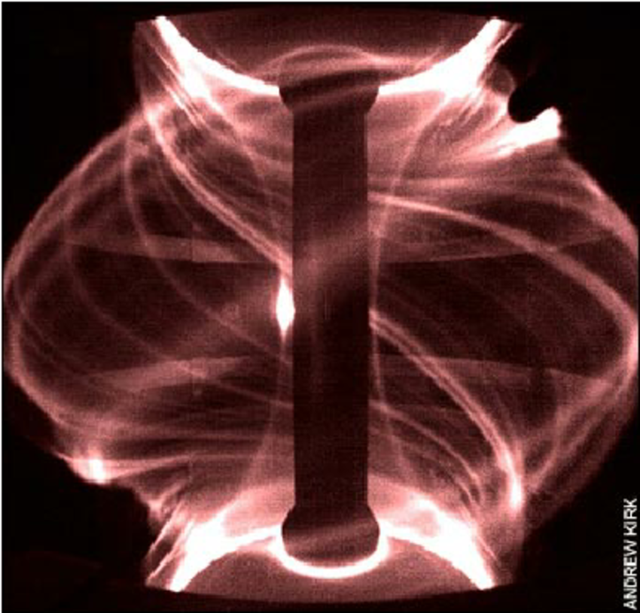
There is a lot going on into a plasma
MAST

Slide 3

There is a lot going on into a plasma (including rubbish)
Courtesy of Filippo Scotti [LLNL]

Slide 4
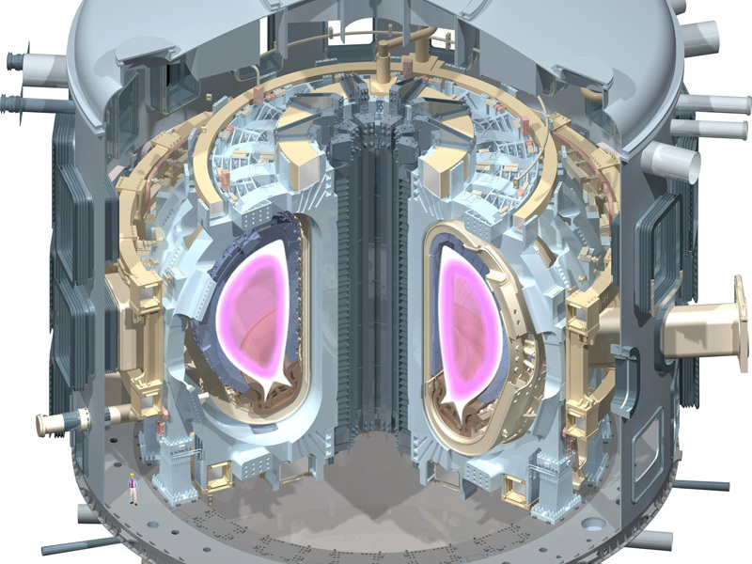
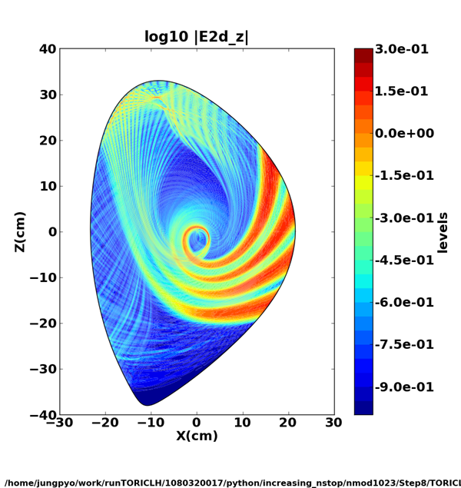
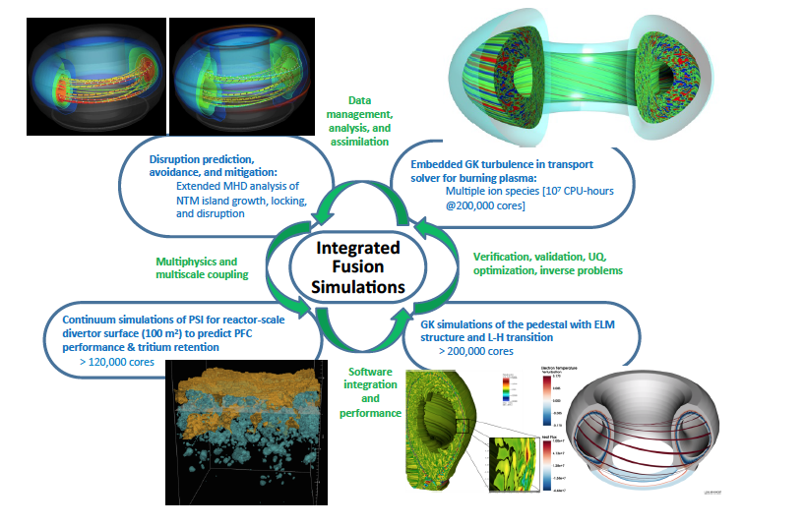
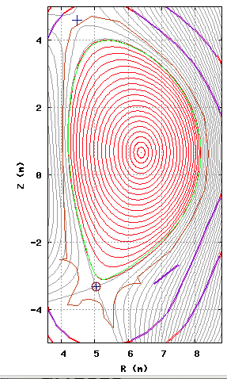
Fusion plasma physics encompasses a wide range of spatial and temporal scales
τ_{E}
τ_{R}
τ_{D}
ω_{EC}⁻¹
ω_{LH}⁻¹
ω_{IC}⁻¹
τ_{A}
ITER
time (s)
10⁻¹⁰
10⁻⁸
10⁻⁶
10⁻⁴
10⁻²
10⁰
10²
10⁴
10⁻⁶
10⁻⁴
10⁻²
10⁰
10²
space (m)
Macroscopic stability
Wave propagation
Transport current diffusion
Plasma turbulence
Full wave solvers
<1M CPU Hours
MHD codes
Equilibrium and
transport solvers
<10² CPU hours
Gyrokinetic codes
<10M CPU hours

Slide 5
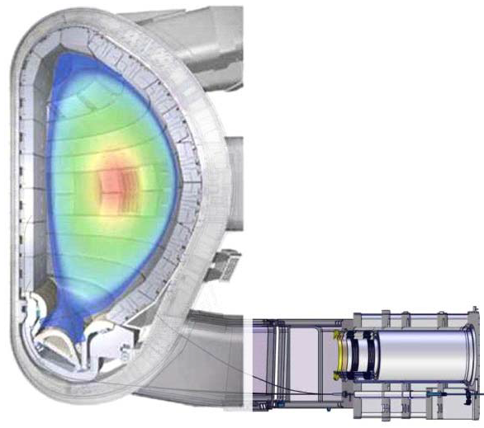
In a tokamak these scales are all coupled
Confined plasma
(closed magnetic field lines)
The plasma is surrounded
by solid structures:
Plasma-material interactions
MHD equilibrium/instabilities,
microturbulence,
energetic particles
External heating
Radiofrequency waves
Neutral beams
Scrape-Off Layer plasma (SOL)
(open field lines)
Microturbulence,
ionization, recombination
radiation
Fueling
Gas injection
Pellets

Slide 6
Particles and energy are ‘confined’ by magnetic fields
Confined plasma
(closed magnetic field lines)
The plasma is surrounded
by solid structures:
Plasma-material interactions
MHD equilibrium/instabilities,
microturbulence,
energetic particles
External heating
Radiofrequency waves
Neutral beams
Scrape-Off Layer plasma (SOL)
(open field lines)
Microturbulence,
ionization, recombination
radiation
Fueling
Gas injection
Pellets

Slide 7
and they can also ‘flow’ along open magnetic field lines
Confined plasma
(closed magnetic field lines)
The plasma is surrounded
by solid structures:
Plasma-material interactions
MHD equilibrium/instabilities,
microturbulence,
energetic particles
External heating
Radiofrequency waves
Neutral beams
Scrape-Off Layer plasma (SOL)
(open field lines)
Microturbulence,
ionization, recombination
radiation
Fueling
Gas injection
Pellets

Slide 8
Plasmas in a tokamak are in contact with the ‘wall’
Confined plasma
(closed magnetic field lines)
The plasma is surrounded
by solid structures:
Plasma-material interactions
MHD equilibrium/instabilities,
microturbulence,
energetic particles
External heating
Radiofrequency waves
Neutral beams
Scrape-Off Layer plasma (SOL)
(open field lines)
Microturbulence,
ionization, recombination
radiation
Fueling
Gas injection
Pellets

Slide 9
Plasmas in a tokamak need to be ‘heated’
Confined plasma
(closed magnetic field lines)
The plasma is surrounded
by solid structures:
Plasma-material interactions
MHD equilibrium/instabilities,
microturbulence,
energetic particles
External heating
Radiofrequency waves
Neutral beams
Scrape-Off Layer plasma (SOL)
(open field lines)
Microturbulence,
ionization, recombination
radiation
Fueling
Gas injection
Pellets

Slide 10
Plasmas need frequent pit stops for ‘re-fueling’
Confined plasma
(closed magnetic field lines)
The plasma is surrounded
by solid structures:
Plasma-material interactions
MHD equilibrium/instabilities,
microturbulence,
energetic particles
External heating
Radiofrequency waves
Neutral beams
Scrape-Off Layer plasma (SOL)
(open field lines)
Microturbulence,
ionization, recombination
radiation
Fueling
Gas injection
Pellets

Slide 11
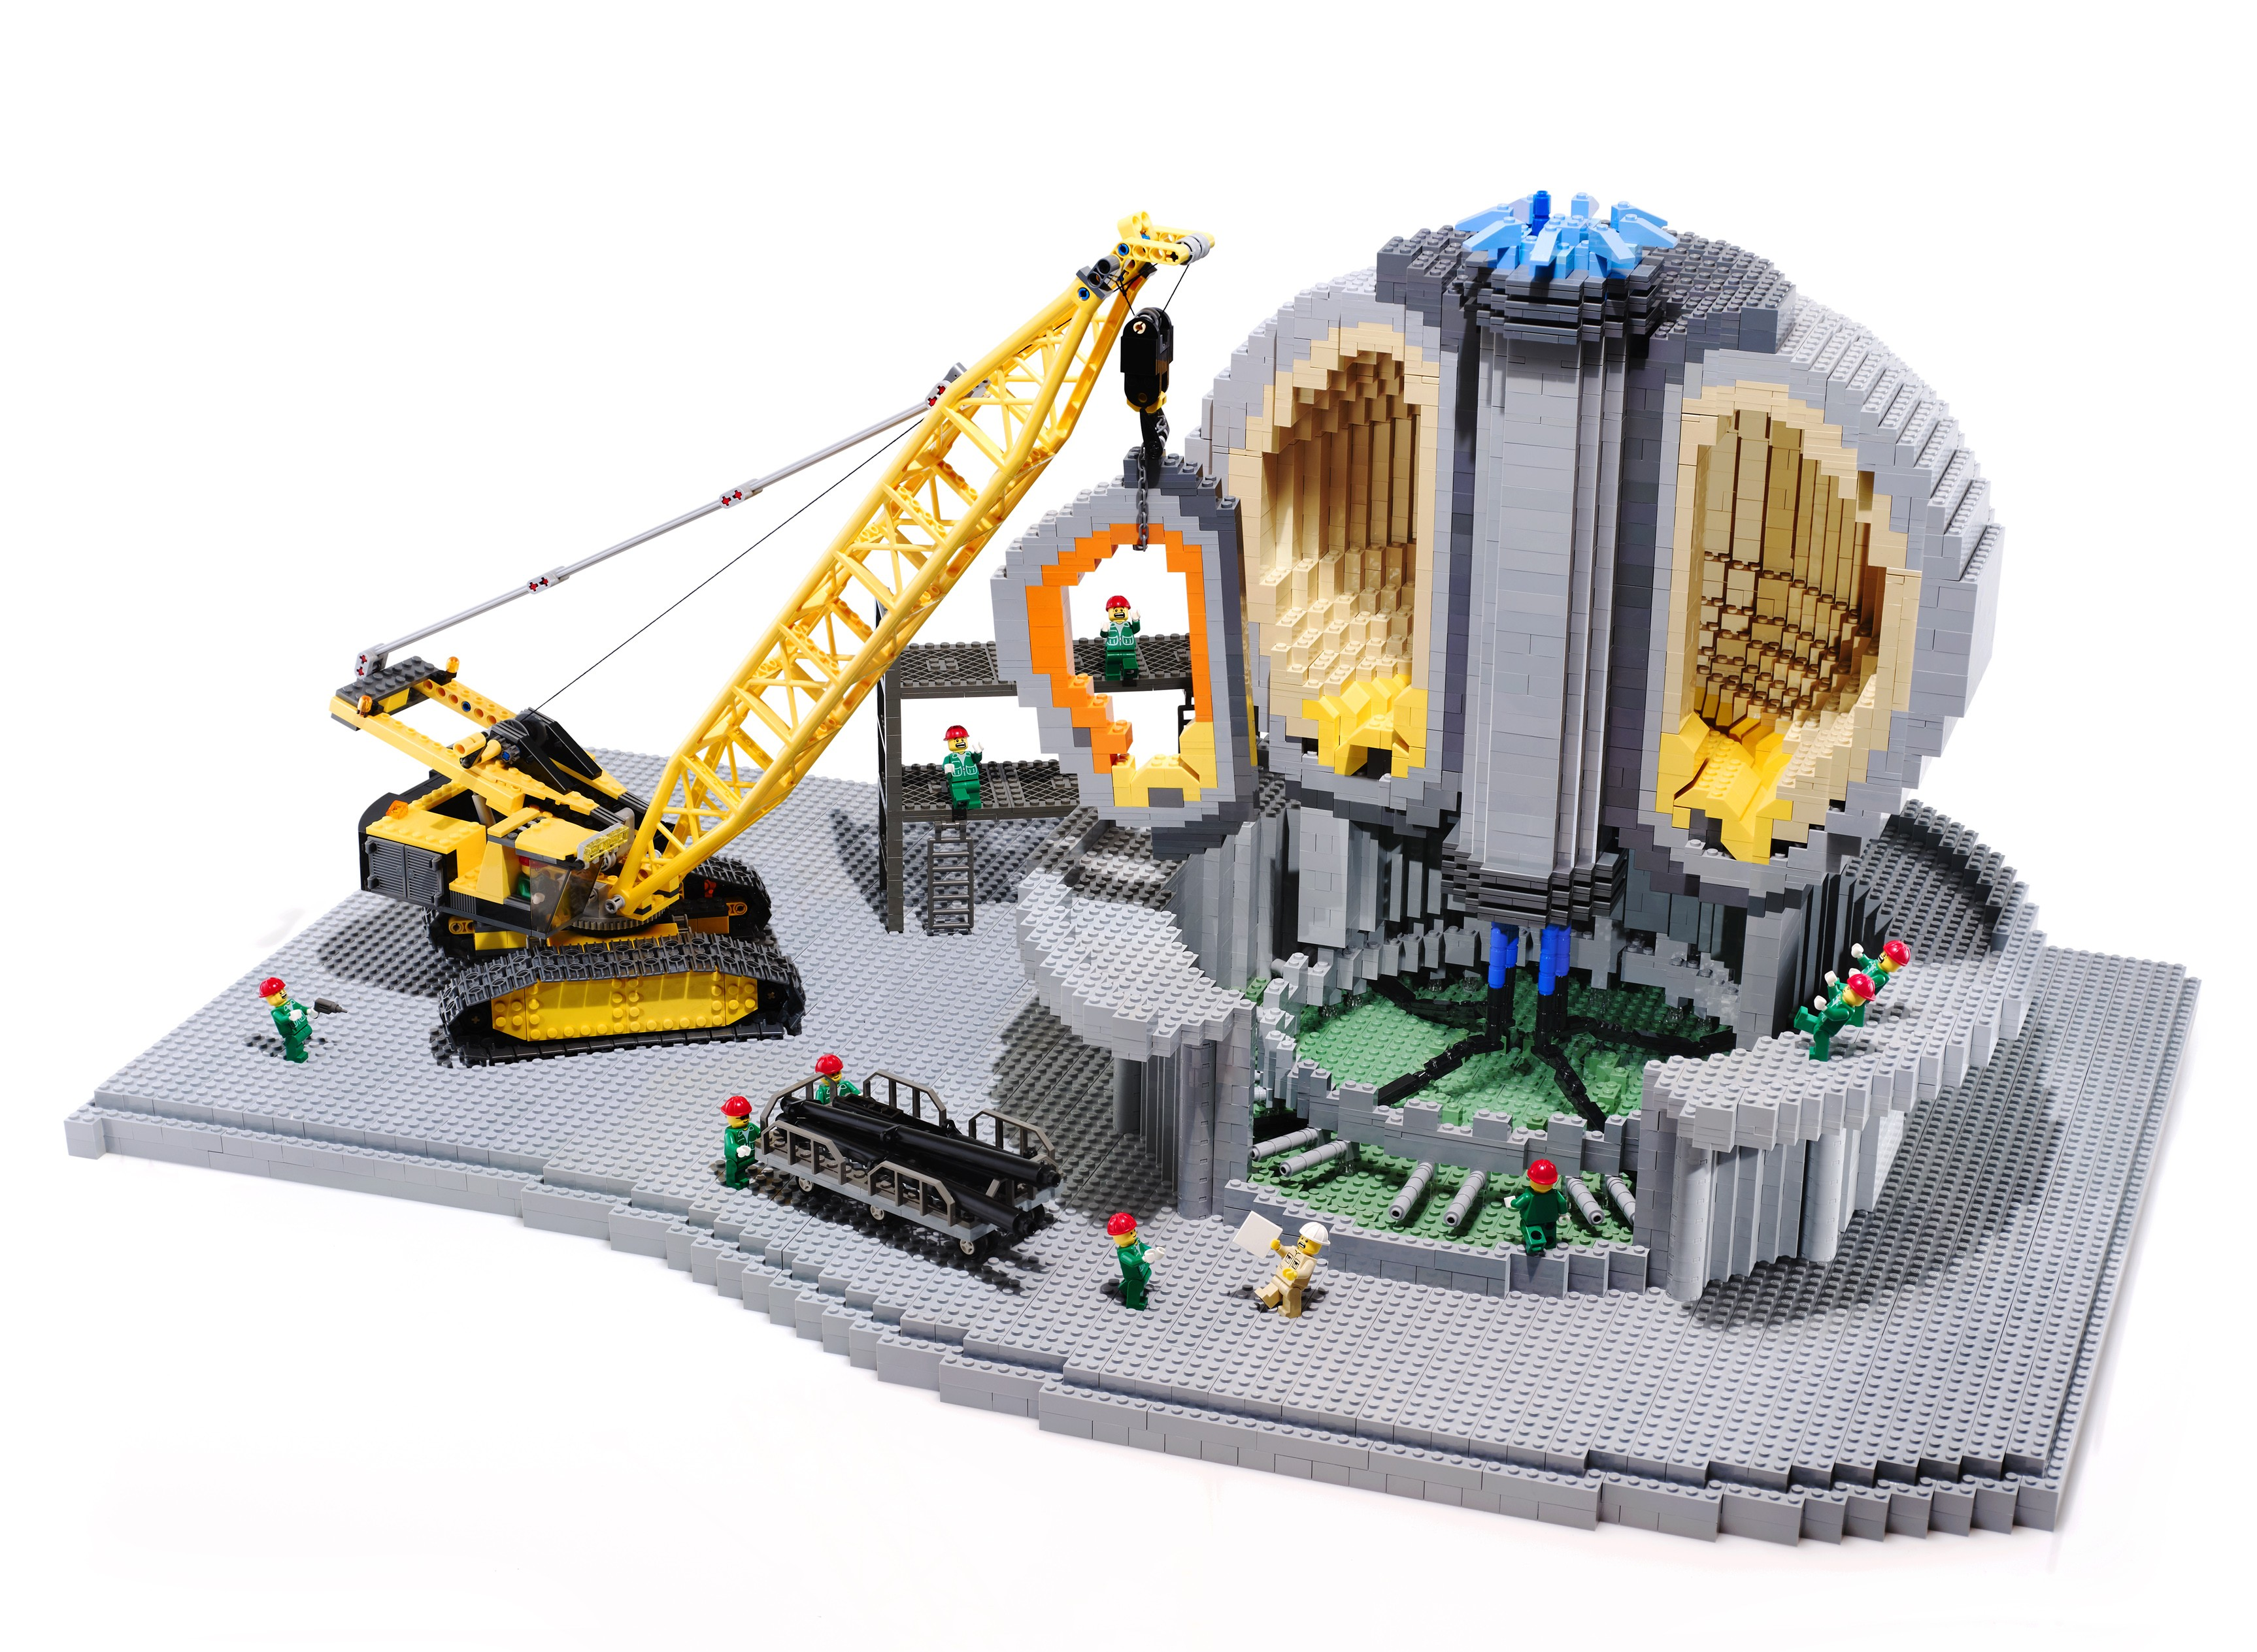
Modeling a tokamak is like playing with LEGO®
… all you need is a lot of bricks, the good ones
www.iter.org

Slide 12
A tokamak simulator needs to connect fast (transport) and slow (current diffusion) time scales
Transformer: source
of poloidal flux
External
momentum
Fuelling
& pumping
Auxiliary
H&CD
H
Actuators (external)
Plasma (internal)
CD
α-heating
Self-generated
current
kinetic profiles
Magnetic flux
diffusion
Heat, particle &
Momentum fluxes
Conductivity
profiles
Wall sources
and sinks
Transport coefficients
Turbulent & neoclassical
Notes:
Fueling with 1 L
Change plasma (internal) color

Slide 13
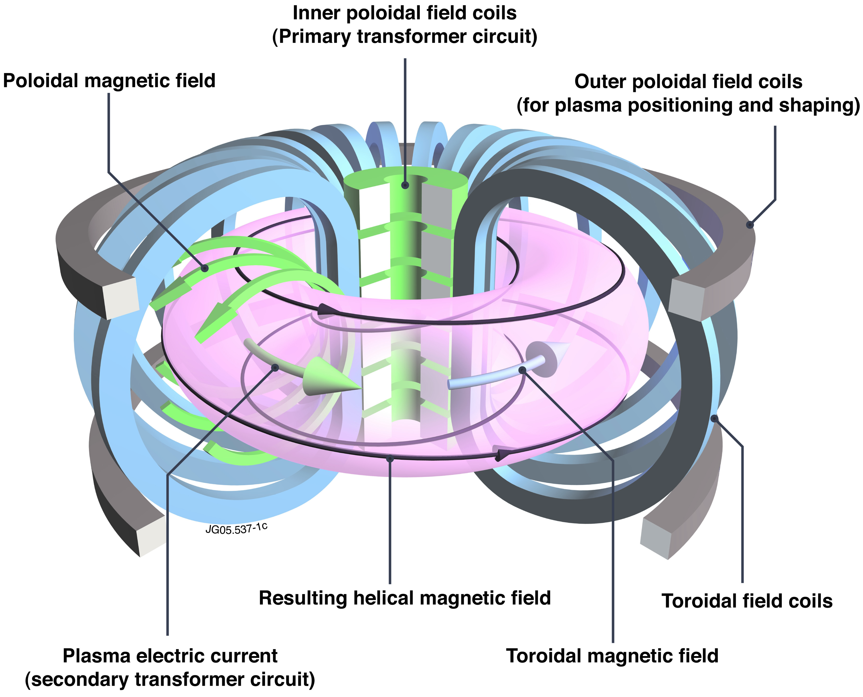
A tokamak is a transformer, but the secondary circuit is a conducting fluid … sooo complicated
Transformer: source
of poloidal flux
Central solenoid
Primary circuit
Actuators (external)
Poloidal field
Plasma (internal)
Magnetic flux diffusion
Plasma current
Secondary circuit
transport
Helical field
Toroidal field

Slide 14
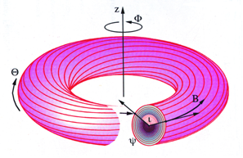
A plasma in equilibrium can be described by ideal MHD
Equilibrium condition:
j, B lie on nested surfaces
j, B, p are described by a flux function ψ
equilibrium entirely defined by:
[Credit, DIFFER website, The Netherlands]
Notes:
Credit: Differ (replace comma)

Slide 15
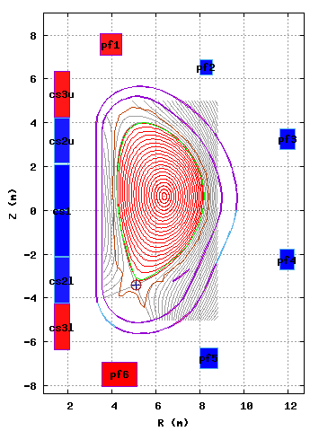

The first step is to get all coil currents and plasma shape right

Slide 16
The second step is a good model for core transport
Transformer: source
of poloidal flux
External
momentum
Fuelling
& pumping
Auxiliary
H&CD
H
Actuators (external)
Plasma (internal)
CD
α-heating
Self-generated
current
kinetic profiles
Magnetic flux
diffusion
Heat, particle &
Momentum fluxes
Conductivity
profiles
Wall sources
and sinks
Transport coefficients
Turbulent & neoclassical
Notes:
Fueling with 1 L
Change plasma (internal) color

Slide 17
Separation of scales enables representing (almost) any transport problem as a diffusion/convection-like problem
The goal is to obtain a set of diffusion-like equations in the form:
for a physical variable Q
identify the flux Γ
and the source and sink terms contained in S

Slide 18
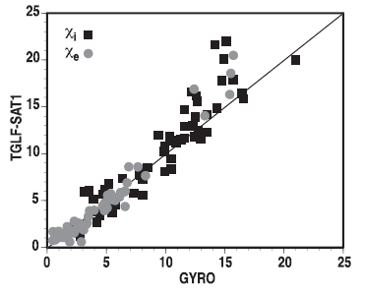
Understanding and modeling tokamak turbulent transport requires theory-based prediction of flux-gradient relationships
GYRO
6D Vlasov equations => 5D nonlinear “gyrokinetic”
State-of-the-art multi-scale (ρ_{i}→ρ_{e})
~50M CPU-hrs for 3-point scan
[N. Howard, Nucl. Fusion (2016)]
Reduced gyrofluid model
TGLF
fluid eq. with right closure =>
Fit over limited set of GK
(< 1 sec with NN)
[Citrin NF 55 (2015), Meneghini, NF 57 (2017)]
G. Staebler, Phys. Plasmas (2016)
Gyrokinetic prediction
Notes:
Add scales involved
Describe figure

Slide 19
The third step is realistic models for heating, current and momentum
Transformer: source
of poloidal flux
External
momentum
Fuelling
& pumping
Auxiliary
H&CD
H
Actuators (external)
Plasma (internal)
CD
α-heating
Self-generated
current
kinetic profiles
Magnetic flux
diffusion
Heat, particle &
Momentum fluxes
Conductivity
profiles
Wall sources
and sinks
Transport coefficients
Turbulent & neoclassical
Notes:
Fueling with 1 L
Change plasma (internal) color

Slide 20
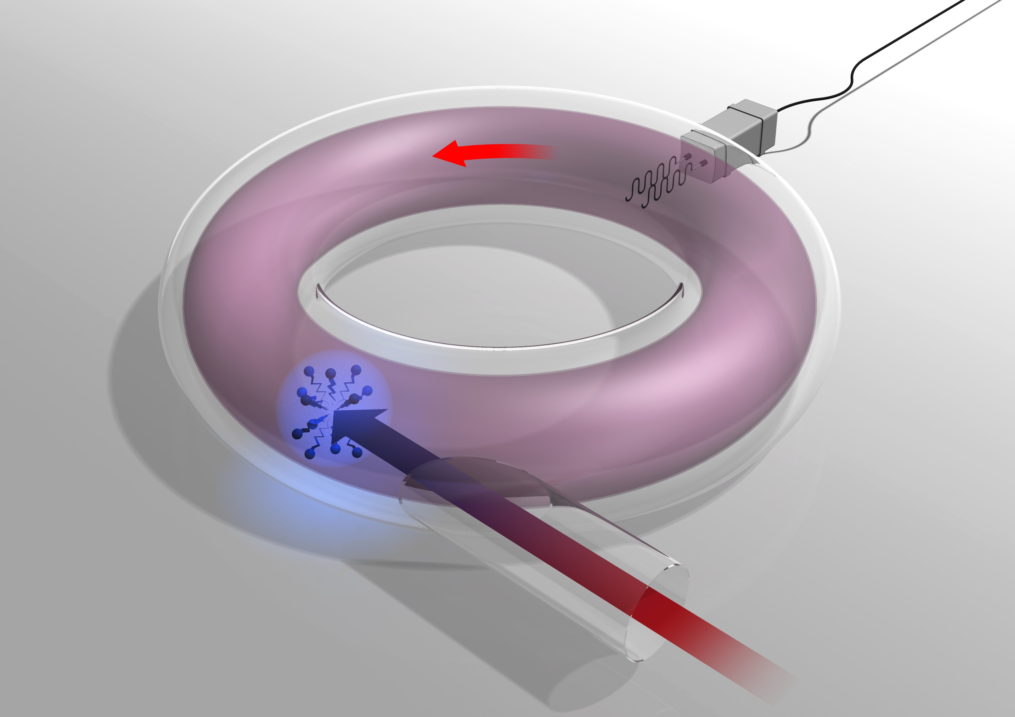
External sources do more than providing heating and current: they can provide momentum and control of MHD instabilities
RF antennas (IC, LH),
Gyrotrons (EC)
NB
IC
LH
collisions
EC
Neutral beams (NB)

Slide 21
Perturbation of equilibrium enables description of waves propagation by representing the plasma with a dielectric tensor
CMod plasma
density, temperature
Dielectric tensor
Heating, current
profiles
Magnetic equilibrium
full wave solver
(TORLH)
<10⁶ CPU Hours
[courtesy of S. Shiraiwa (PSFC), VI2.00003]

Slide 22
Ray-tracing equations are accurate (and fast) approximations of high frequency wave propagation
(another) CMod plasma
density, temperature
Dielectric tensor
Heating, current
profiles
Magnetic equilibrium
ray-tracing
(GENRAY)
<10 minutes
Ray-tracing equations
dispersion relation

Slide 23
Let’s put everything together …

Slide 24

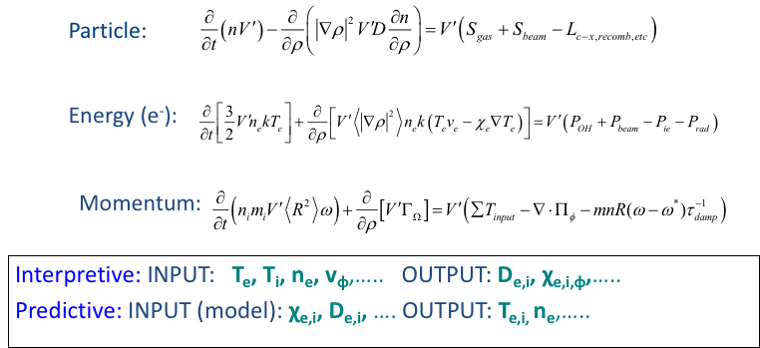
TRANSP is a 1.5D equilibrium and transport solver for tokamak plasma simulations developed at PPPL

Slide 25
We have learnt from modeling of ITER that the ramp-up phase is critical for sustainment of q_{min} as much as a correct choice of H&CD mix
slower current ramp-up rate
Early RF core heating
=> Delay current penetration and q relaxation
Core electron heating and current early
Off-axis current after H-mode formation
Sustains bootstrap current at mid-radius
Prevents q relaxation

Slide 26
Time-dependent modeling of current ramp-up has highlighted the role of RF to heat the plasma
Minimize power needs to obtain the same current
Everything works on paper …
The challenge now is to demonstrate it in experiments.

Slide 27
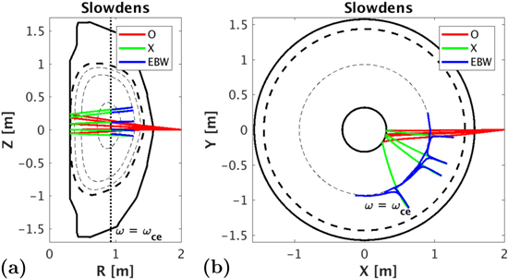
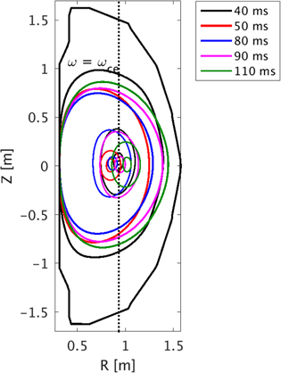
Time-dependent application: assessment of O-X-B startup in NSTX-U
[N. Lopez (Princeton University) PPCF 2016]
Used TRANSP to assess the propagation and conversion of EC waves in NSTX-U
GOAL: find optimal launching geometry
that maximizes both heating and current
that does not make the plasma unstable

Slide 28
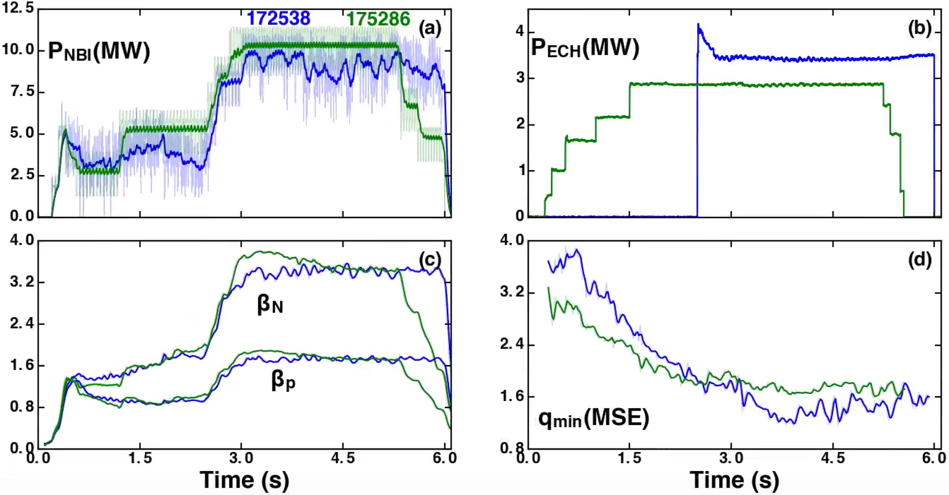

Used integrated modeling to design experiments BEFORE going to the control room
Feed-forward NBI and EC predicted first with TRANSP (no feedback)
Improved access to high beta with little MHD
High β
Early EC step-ups
Improved q_{min} trajectory

Slide 29
What is missing?

Slide 30
What happens close to the plasma wall is very important
Transformer: source
of poloidal flux
External
momentum
Fuelling
& pumping
Auxiliary
H&CD
H
Actuators (external)
Plasma (internal)
CD
α-heating
Self-generated
current
kinetic profiles
Magnetic flux
diffusion
Heat, particle &
Momentum fluxes
Conductivity
profiles
Wall sources
and sinks
Transport coefficients
Turbulent & neoclassical
Notes:
Fueling with 1 L
Change plasma (internal) color

Slide 31
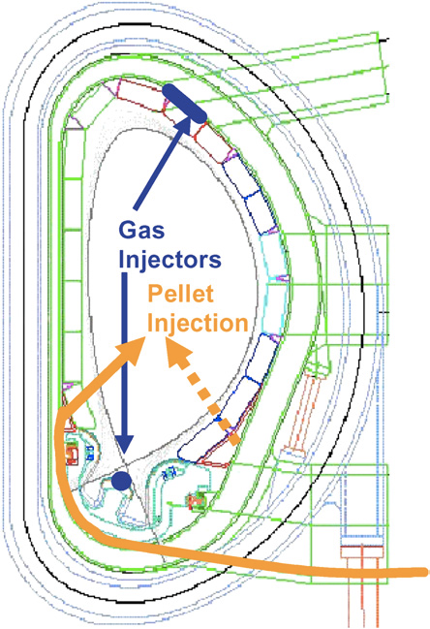
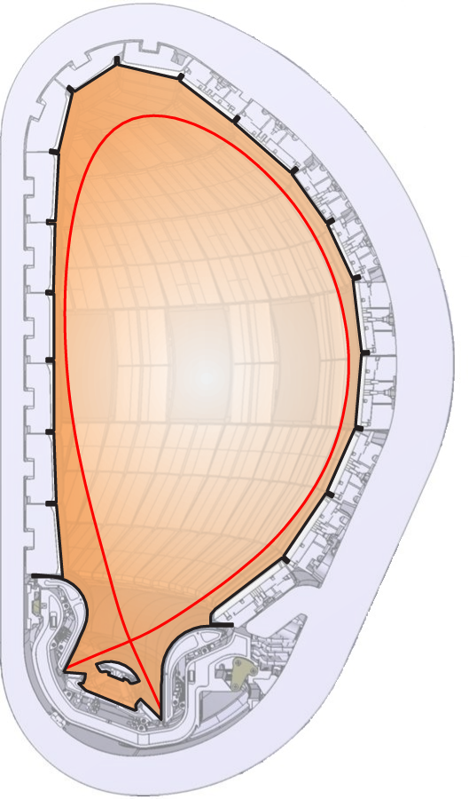
Edge transport and fuelling are critical ingredients to model the plasma evolution in burning plasma conditions
Heat conduction zone
P_{SOL}
Impurity radiation zone
H⁰/D⁰/T⁰ ionization zone
(T_{e}>5eV)
Neutral friction zone
Recombination zone
(T_{e}<1eV)
Courtesy of R. Pitts (ITER Organization)
Notes:
Fueling
put in backup
Correct text color to be consistent with figure (cartoon on the right)

Slide 32
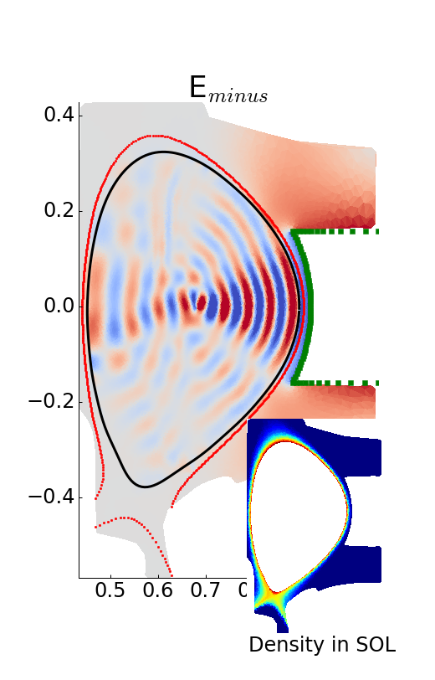
Hybrid approach to modeling of RF wave propagation is a promising avenue towards implementation in tokamak simulator
Core: Axisymmetric flux surface grid
  Hot plasma conductivity
  Dense Matrix Solver
Edge: Unstructured mesh with complicated geometry (either 2D or 3D)
  Cold plasma with collision.
Boundary: matching technique to build integrated solution
Courtesy of S. Shiraiwa (PSFC)
Would benefit from realistic model of SOL

Slide 33
Integrated Tokamak Modeling offers plenty of opportunities to understand and model experiments (we have collaborations all over the world)
… and it is a lot of FUN !
JOIN OUR TEAM fpoli@pppl.gov

