Slide 1

PLASMA EXHAUST VIA A MAGNETIC DIVERTOR
Rajesh Maingi
Princeton Plasma Physics Laboratory
SULI summer lecture
July 11, 2019
Princeton, NJ

Slide 2
Outline
Introduction to magnetic confinement and tokamaks
Plasma exhaust via magnetic X-point divertors
  Particle exhaust
  Momentum and power exhaust
  Recently identified challenges to attractive core-edge plasma scenarios with W walls
Types of transient events, and their impact
2

Slide 3
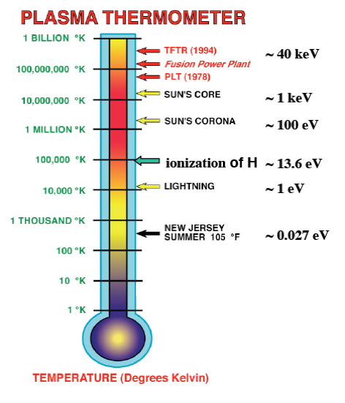
Critical challenge for fusion: keeping the core hot and and the plasma facing components ‘cold’
Need to exhaust
Plasma particles
Plasma momentum
Plasma energy
Solid material limits
1 eV ~ 11,600 K
3

Slide 4
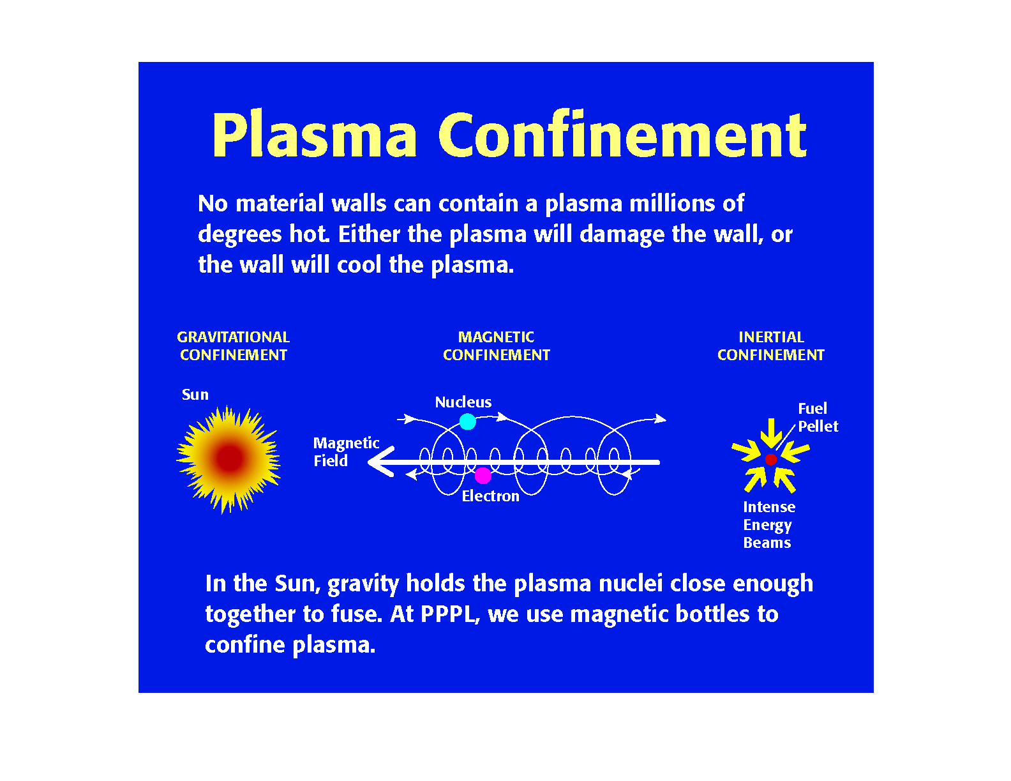
Ways of confining plasmas
Requires large
amounts of mass!
Confines the plasma in the direction across the magnetic field
Energy and defense
relevant
4

Slide 5
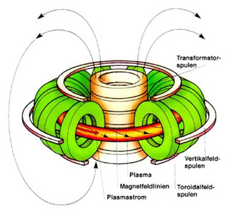
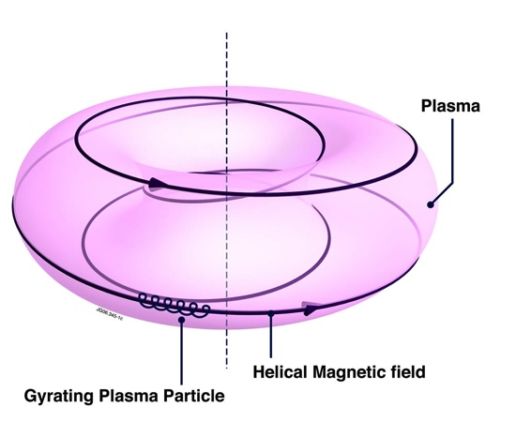
Origin of the tokamak
Original idea was to use a concentrated magnetic field on the end of a linear system, to reflect particles back into main chamber (‘magnetic mirror’)
  Suffered from ‘end loss cone’
In the 1960’s, Russian scientists proposed a doughnut-shaped device with ‘axial’ or toroidal magnetic field for stability, and ‘azimuthal’ or poloidal field for confinement, driven by a current in the plasma
  Particles saw no beginning or end -> high confinement!
Toroidal field coils
Plasma current
5

Slide 6
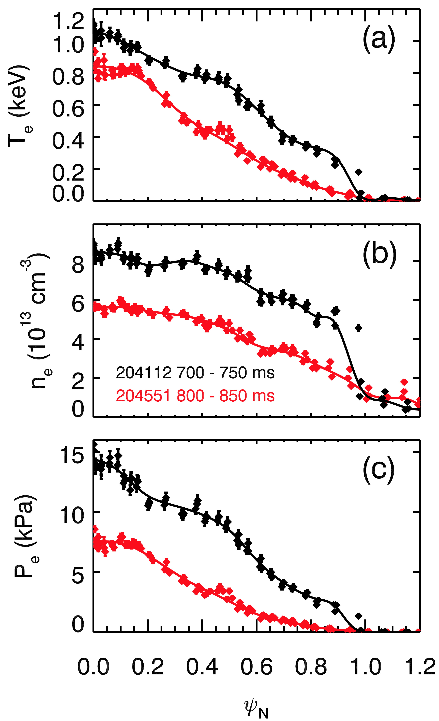
‘H-mode’: a strong gradient of density, temperature & pressure near plasma edge
Sharp increase in edge density, temperature, pressure observed in tokamaks in 1982 – called ‘H-mode’
Core sits on top of a ‘pedestal’ – more stored energy for same input power –> improved energy confinement
NSTX-U data,
Courtesy of D. Battaglia
6

Slide 7
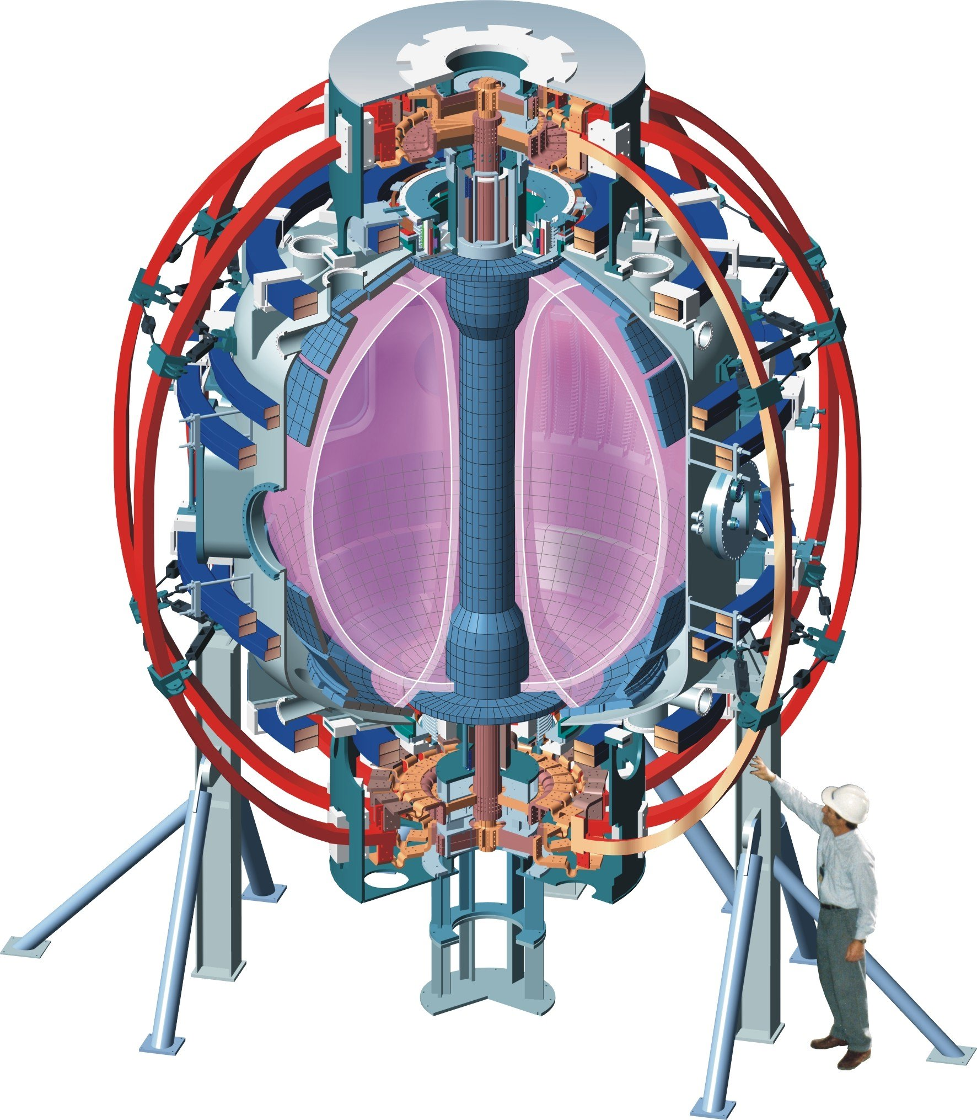
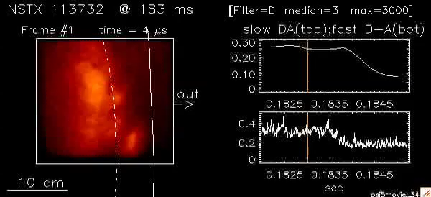
‘H-mode’: a strong reduction in edge plasma turbulence
NSTX data, Courtesy of S. Zweben
7

Slide 8
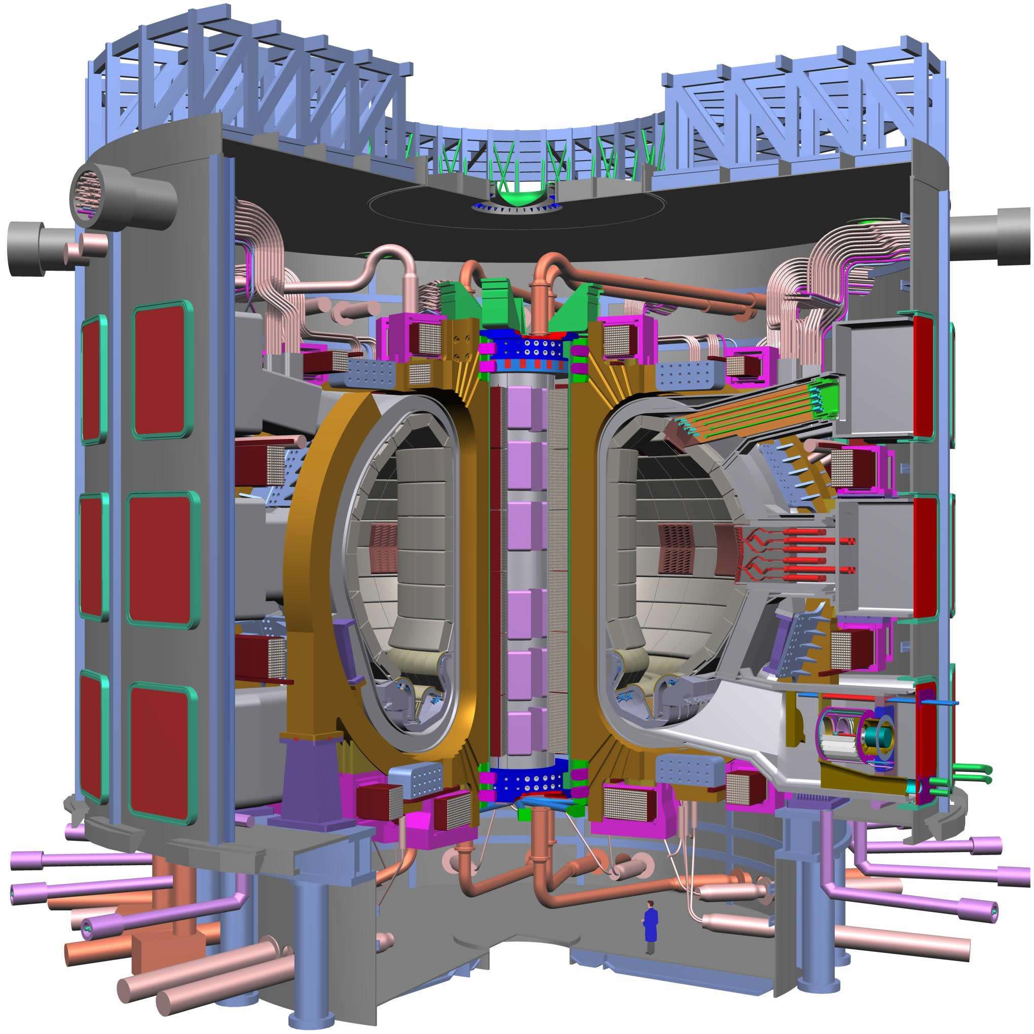
The international fusion community has agreed to build a large tokamak toward energy production
Seven international partners
  EU
  Japan
  US
  Russia
  China
  Korea
  India
Being built in France
  First plasma ~ Dec. 2025
P_{fusion} = 500 MW for 1000 sec discharges
P_{fusion} = 250 MW in steady state
ITER
8

Slide 9
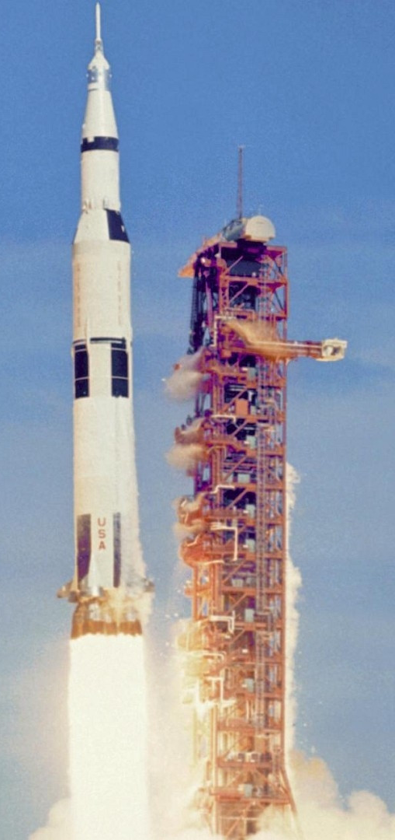


Plasma-material interactions: how do you keep the hot part hot and the cold part cold?
Answer: mass difference!
  In ITER, there is less than ½ gram of deuterium and tritium in the core
  The total mass of ITER is nearly 50 million pounds; a fraction of this is in the plasma facing components, which will absorb the heat
  The internal components of ITER will be actively cooled to keep temperature below melt limits
    The key is to maximize heat dispersal area
The present technological heat flux removal limit for solids is about 10 MW/m²
  A rocket nozzle has average heat flux of 1 MW/m²!
  The sun’s radiant heat flux on earth ~ 1400 W/m²
9

Slide 10
Outline
Introduction to magnetic confinement and tokamaks
Plasma exhaust via magnetic X-point divertors
  Particle exhaust
  Momentum and power exhaust
  Recently identified challenges to attractive core-edge plasma scenarios with W walls
Types of transient events, and their impact
R. Maingi, ‘Plasma Exhaust’, chapter in Magnetic Fusion Energy: from Experiments to Power Plants, G.H. Neilson, editor, Woodhead Publishing, Elsevier Press, (2016) 31-59.
10

Slide 11
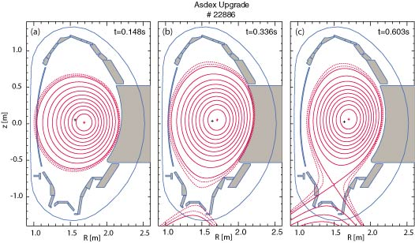
Limiters and divertors used to exhaust plasma
A limiter is a surface in contact with the plasma
  Can be inserted (sacrificial) or part of surrounding wall structure
  Examples of inner wall and outer wall limiters shown at right
If external current is run in the same direction as plasma current outside of the confined plasma, then one component of the field can be canceled, creating an X-point divertor
B_{θ}=I/(2πa)
11

Slide 12
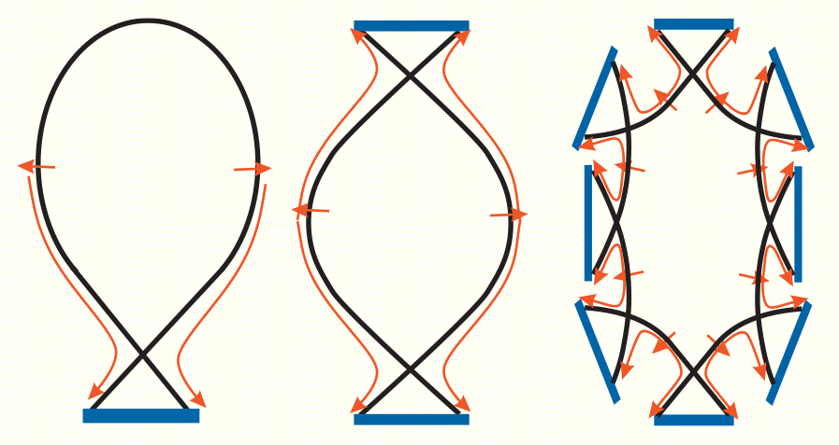
Divertors used to exhaust plasma and reduce PMI at wall
In a divertor, edge plasma flows across closed magnetic flux surfaces into the scrape-off layer
Plasma flows along open magnetic field lines in the SOL to the divertor target
  Can have one or more X-points, e.g. 1, 2, or even 8!
SOL
edge
SOL = Scrape-Off
Layer
Y. Feng et. al., Nucl. Fusion 46 (2006) 807
12

Slide 13
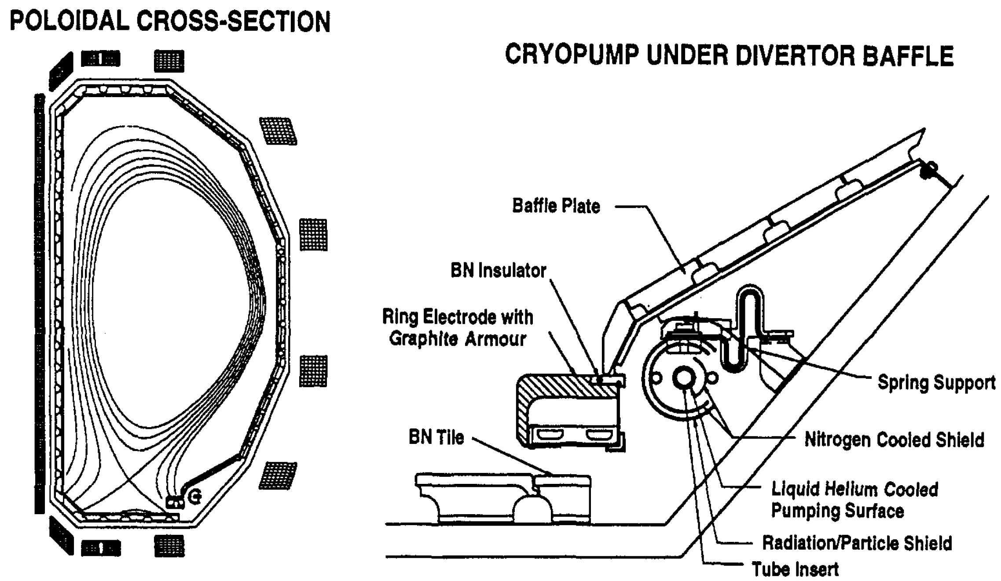
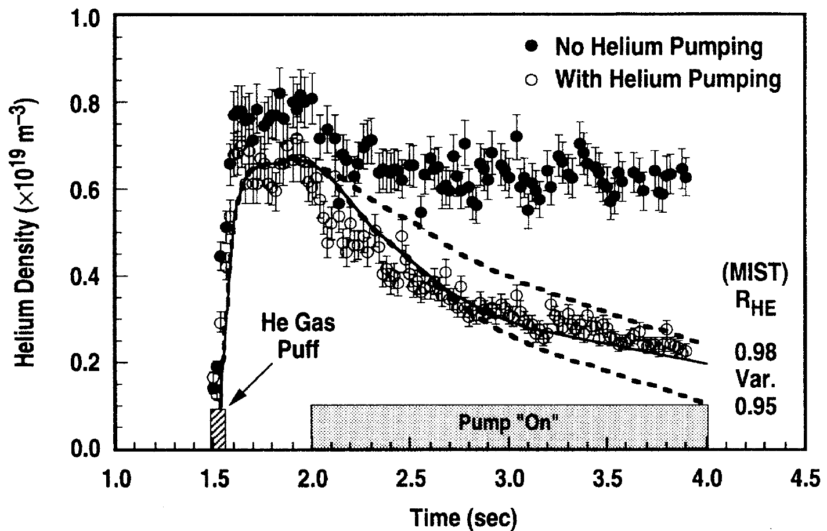
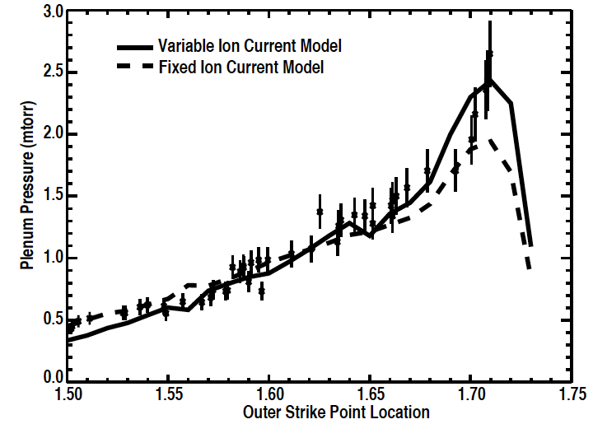
Divertors, cryopumps, and structures to restrict neutral flow (baffles) can provide particle control
Both D/T (fuel) and He (ash) need to be exhausted
In-vessel cryopumps control deuterium and He inventory
  Divertor particle flux can be captured and exhausted
  ITER designed with cryos
M.A. Mahdavi et. al., J. Nucl. Mater. 220-222 (1995) 13
M. Wade et. al., PRL 74 (1995) 2702
R. Maingi et. al., Nucl. Fusion. 39 (1999) 1187
13

Slide 14
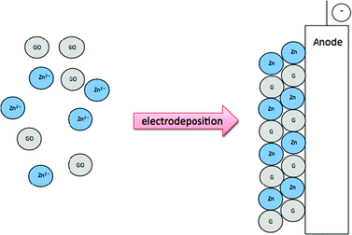
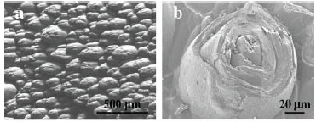
Tritium retention is a central element of particle exhaust, and strongly affected by choice of PFC materials
Graphite was PFC of choice in 90’s, but it captures hyrogenic species via unsaturable co-deposition
  e.g. Graphene & Zn shown on right
C advantages
  Good power handling, good thermal shock and thermal fatigue resistance (low crack propagation)
  Doesn’t melt (but sublimes), low radiated power
  Good joining technology, low-Z
C disadvantages
  Chemical erosion and co-deposition; dust generation
  May require conditioning
  Physical and mechanical properties degrade w/low neutron fluence
Co-deposits in Tore Supra
G. Federici et. al., Nucl. Fusion 41 (2001) 1967
  Roubin et al., J. Nucl. Mater. 390-391 (2009) 49
14

Slide 15
W chosen for divertor & Be for wall of ITER
W advantages
  Low physical sputtering yield; high threshold
  No chemical sputtering with hydrogen
  Low in-vessel tritium retention at T < 500 ºC
  Reparable by plasma spray; good joining technology
W disadvantages
  Low allowable core concentration
  Melts under large transient loads
  High ductile-brittle transition temperature
  Recrystallizes (embrittles) at temperatures >1500 K
  High activation
  Blisters and generates ‘fuzz’ under He bombardment
  Confinement reduced in tokamaks as compared with carbon PFCs
G. Federici, et. al., Nucl. Fusion 41 (2001) 1967
15

Slide 16
Components in present and past fusion devices
Device | Lim/Div | PFC mat’l | Device | Lim/Div | PFC mat’l
JET (2012+) | Divertor | W div. & Be wall | JET | Divertor | Carbon
ASDEX-U | Divertor | W divertor & wall | ASDEX-U | Divertor | Carbon
C-Mod | Divertor | Mo divertor & wall | DIII-D | Divertor | Carbon
NSTX | Divertor | C Wall/Li coating | NSTX-U plan | Divertor | High-Z + Liq. Li
RFX | Limiter | Liq. Li - Mo mesh | LTX | Limiter | Liq. Li on SS
JT-60U | Divertor | Carbon | TFTR | Limiter | Carbon
Tore Supra | Limiter | Carbon | West | Divertor | W wall
EAST | Divertor | W upper, Mo wall, C lower | KSTAR | Divertor | Carbon
MAST-U | Divertor | Carbon | COMPASS | Divertor | Carbon
16

Slide 17
Critical challenge: keeping the core hot and and the plasma facing components ‘cold’ via magnetic divertors
Need to exhaust
Plasma particles
  Recapture tritium
Plasma momentum
  Plasma is spinning in the core, either spontaneously or from momentum injection
  Sheath accelerates ions at PFCs
Plasma energy
  Plasma heated by fusion, simulated with neutral beams & RF heating
B.L. LaBombard et. al., Phys. Plasmas 2 (1995) 2242
Solid material limits
1 eV ~ 11,600 K
17

Slide 18
Plasma momentum exhaust
Plasma spins in the core spontaneously, which is good for stability and confinement
  Problem if rotation goes to zero (locked mode) – confinement loss
Sheath forms at PFC for equal ion and elec. flux
  Pre-sheath accelerates ions to sonic speed
    Bohm criterion: local Mach number υ/c_{s} = 1
  Sheath accelerates ions through a ~ 3kTe potential drop
  This plasma momentum is naturally exhausted at PFCs
Charge exchange between plasma ions and neutrals (recycling, beam input) reduces plasma momentum
  Becomes important for T_{e} < 10 eV
  Manifests as a reduction in plasma pressure at low T_{e}
Courtesy of J.L. Terry
18

Slide 19
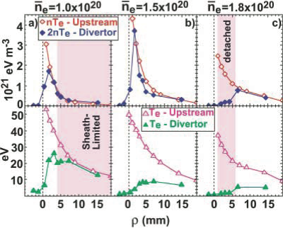
Power flow in the scrape-off layer to the divertor depends on density and collisionality
Sheath-limited: the midplane and divertor T_{e} are about equal
  Pressure is same at midplane and divertor
Flux-limited: the divertor T_{e} is below midplane
  Pressure is same at midplane and divertor
Detached: the divertor T_{e} is ~ 1-2 eV
  Pressure in divertor well below midplane
  Recombination observed
Sheath Flux Detached
B.L. LaBombard et. al., Phys. Plasmas 2 (1995) 2242
19

Slide 20
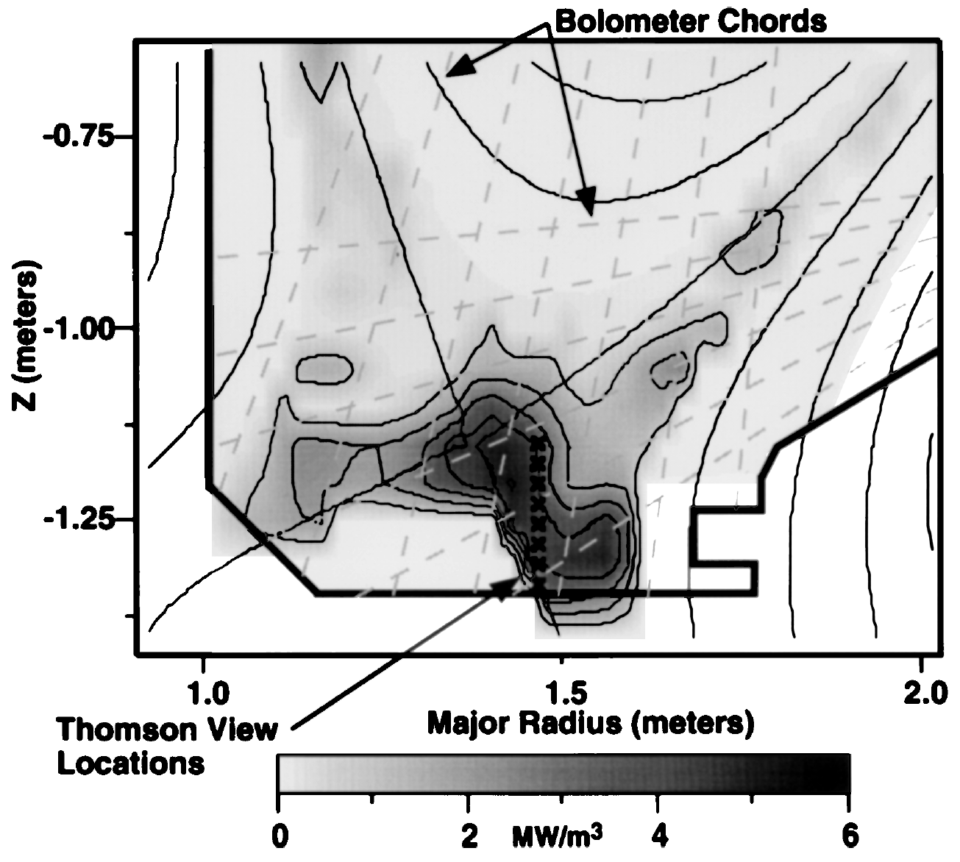
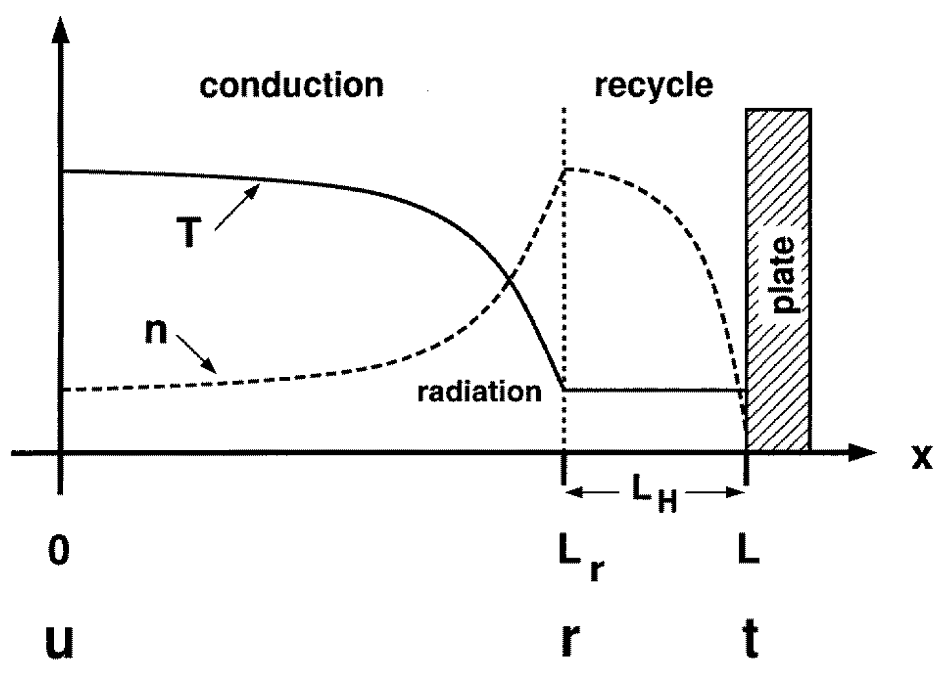
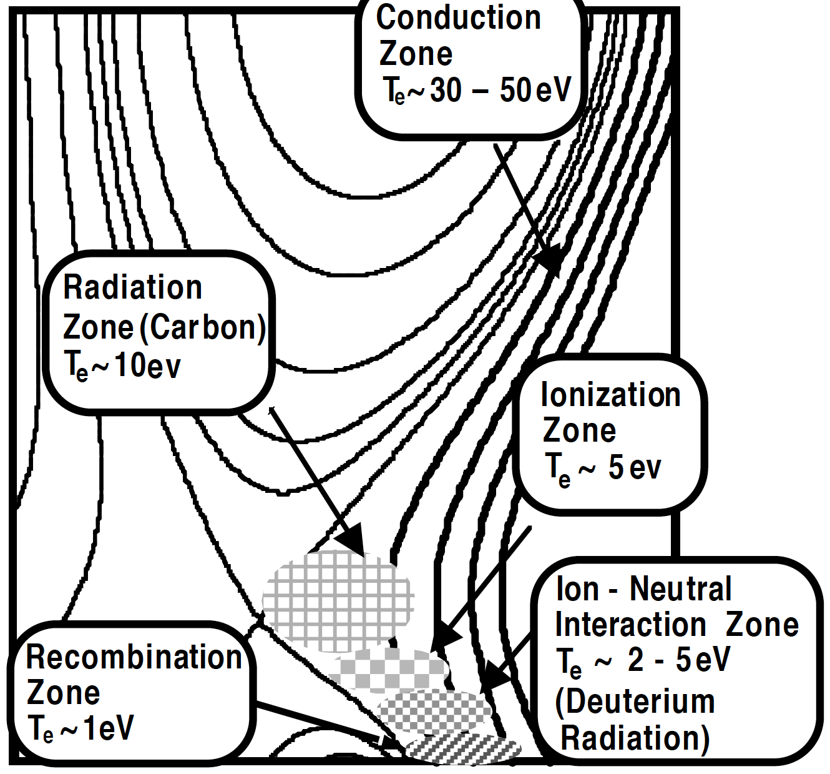
Divertor radiation and detachment used to reduce plasma heat flux onto PFCs
At high density, divertor radiation occurs somewhere between the X-point divertor and PFC
  Low-Z impurity radiation zone: 1-10 eV
  Deuterium ionization front: 5 eV
  Recombination zone: 1-2 eV
Can be represented in 1-D
A.W. Leonard et. al., PRL 78 (1997) 4769
M.E. Fenstermacher et. al., Plasma Phys.
Contr. Fusion 41 (1999) A345
C.S. Pitcher et. al., Plasma Phys. Contr. Fusion 39 (1997) 779
20

Slide 21
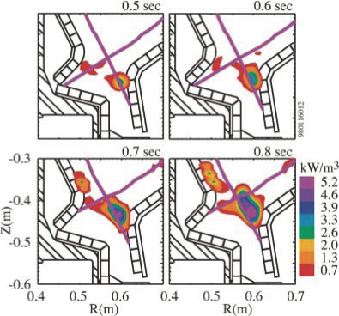

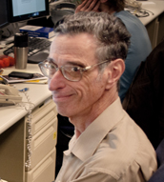
Limit to detachment: intense radiation zone gets to X-point
When impurity radiation is present, certain T_{e} ranges have a positive radiation-temperature feedback
  Lower T_{e} -> more radiation!
  Condensation instability: MARFE
  MARFE = Multi-faceted Axisymmetric Radiation From the Edge, and earl MARmar & steve wolFE (MIT)
Limit to detachment: if MARFE migrates to X-point, τ_{E} reduced
Alcator C-Mod Dγ emission data,
Courtesy of J.L. Terry
21

Slide 22
Difficulties for W PFCs to achieve attractive, self-consistent core-edge scenarios have been identified
Power exhaust challenge harder than thought
  Heat flux footprint decreases with I_{p}; no increase with R
    Both steady and transient loads can exceed solid PFC limits
Confinement difficult with bare high-Z PFCs
  Good confinement is challenging with high-Z walls in e.g. JET
Outline
Plasma exhaust via magnetic X-point divertors
  Particle exhaust
  Momentum and power exhaust
  Recently identified challenges to attractive core-edge plasma scenarios with W walls
22

Slide 23
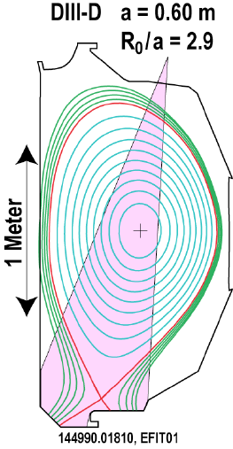
Heat flux profile measured in divertor with infrared thermography & compared to midplane n_{e} and T_{e} profiles
λ_{n}^{mid}
λ_{T}^{mid}
λ_{q}^{div,PFR}
λ_{q}^{div,SOL}
M.A. Makowski et. al., Phys. Plasmas 19 (2012) 056122
23

Slide 24
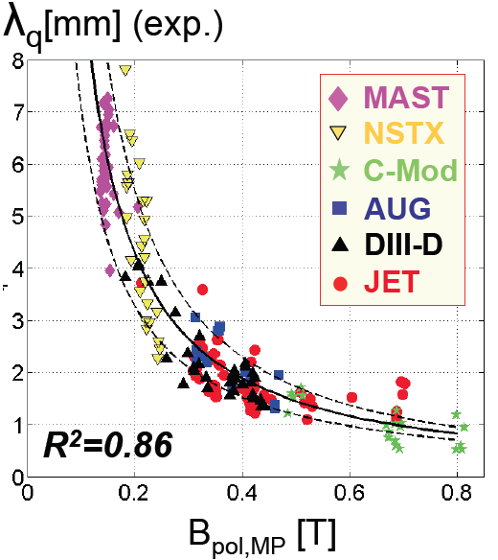
Steady heat flux flows in the SOL in a very narrow channel
Heat flux profile width λ_{q} measured in divertor
  λ_{q} projected to outer midplane with flux expansion
International effort found that λ_{q} varies inversely with B_{pol,MP}
  No increase with R, P_{SOL}
  Low gas puff attached plasmas; some broadening and heat flux dissipation with detachment
Projected width in ITER ~ 1/5 previous value; peak heat flux 5x higher unless mitigated
Much more challenging for reactors, due to higher P_{fusion}
ITER
T. Eich et. al., Nucl. Fusion 53 (2013) 093031
24

Slide 25
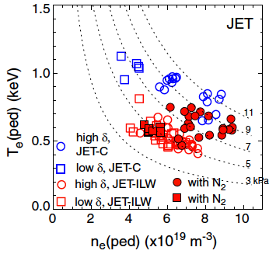
Edge and core plasma temperature and confinement was reduced in JET scenarios with installation of ITER-like wall
M. Beurskens et al., PPCF 55 (2013) 124013
25

Slide 26
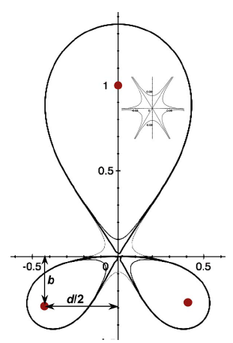
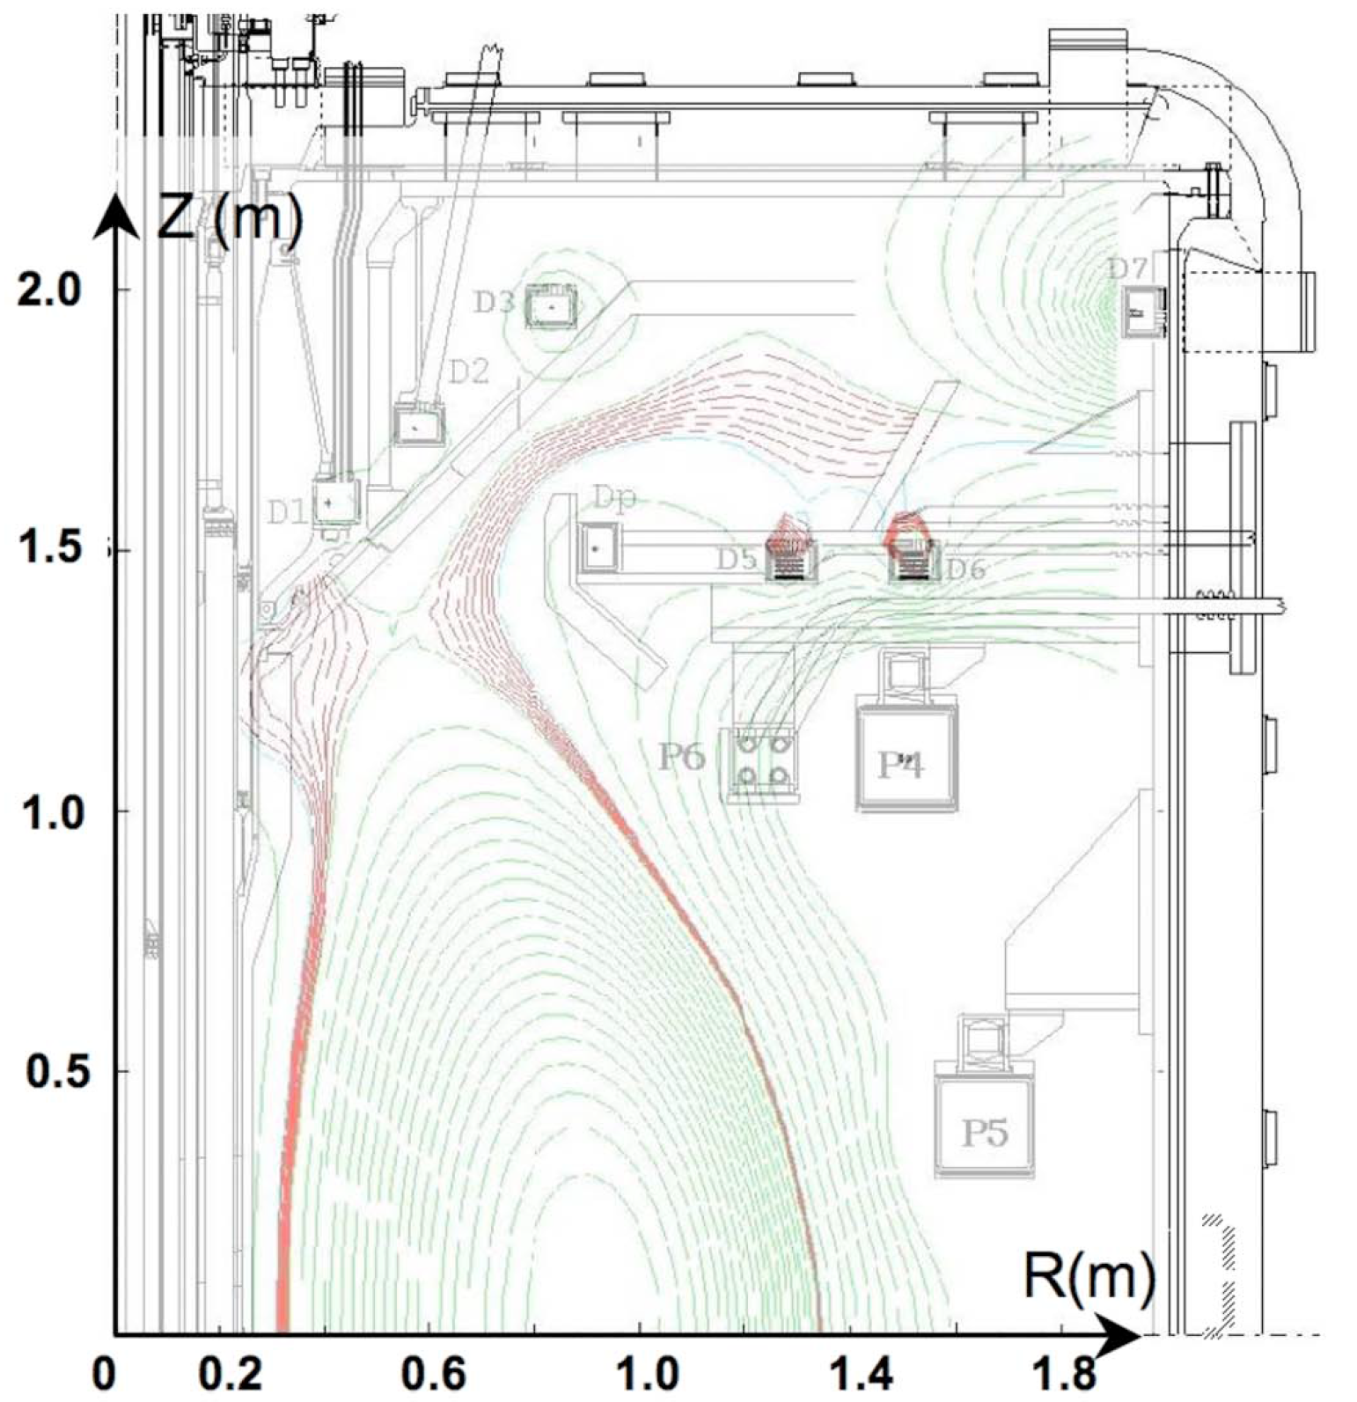
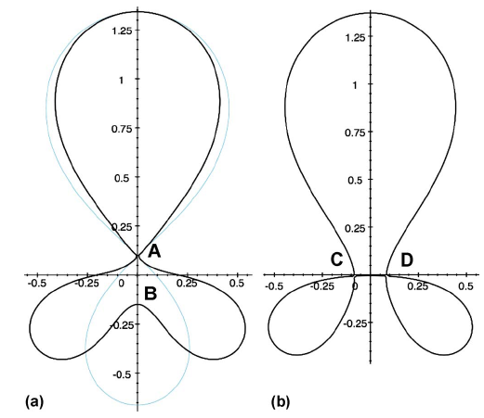
Several divertor innovations may increase the heat dispersal area for future (and present!) devices
Snowflake divertors
+ -
Super-X divertor in MAST-Upgrade
D. Ryutov et. al., Phys. Plasmas 14 (2007) 064502
P. Valanju et. al., Nucl. Fusion 16 (2009) 056110
26

Slide 27

Liquid metal PFCs are an option to solid PFCs, but have substantial R&D needs to assess viability
Advantages
  Erosion tolerable from PFC view: self-healing surface
  No dust; main chamber material and tritium transported to divertor could be removed via flow outside of tokamak
  Liquid metal is neutron tolerant; protects substrate from PMI
  Liquid (and solid) lithium offer access to low recycling, high confinement regimes under proper conditions
  Very high steady, and transient heat exhaust, in principle (50 MW/m² from electron beam exhausted; also 60 MJ/m² in 1 μsec)
Disadvantages and R&D needs
  Liquid metal surfaces and flows need to be stable
  Liquid metal chemistry needs to be controlled
  Temperature windows need optimization
Most of experience in fusion is with Li, but Sn and eutectics (e.g. Sn-Li) offer some promise in terms of broader temperature windows
27

Slide 28
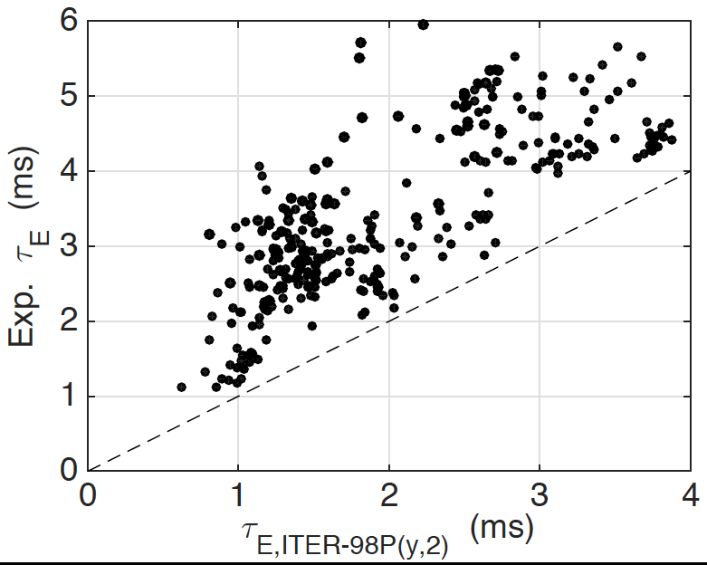
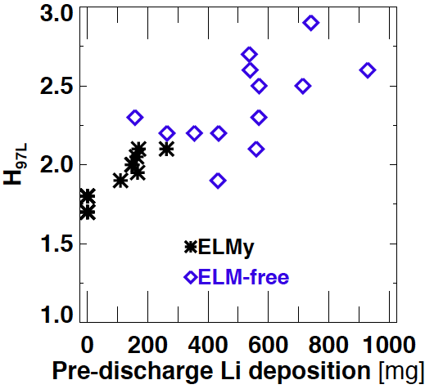
Lithium (solid and liquid) PFCs can enhance confinement
LTX
NSTX
2-4x improvement over ITER98P(y,2)
(H-mode scaling)
H98y2 increased from 0.8 -> 1.4 (H-mode scaling)
J.C. Schmitt et al, Phys. Plasmas 22 (2015) 056112
D.P. Boyle et al., J. Nucl. Mater. 438 (2013) S979
28

Slide 29
Outline
Introduction to magnetic confinement and tokamaks
Plasma exhaust via magnetic X-point divertors
  Particle exhaust
  Momentum and power exhaust
  Recently identified challenges to attractive core-edge plasma scenarios with W walls
Types of transient events, and their impact
29

Slide 30
What if the heat flux from the plasma is time-varying?
The heat flux from the plasma is indeed variable in time, with a ‘DC’ component and periodic eruptions
  The biggest problems are ‘disruptions’, when the plasma current and energy quenches in ~ milliseconds; ITER must either avoid disruptions or mitigate their effects!
  More periodic events include edge localized modes (ELMs), which can eject 10% of the plasma energy in ~ 0.5 msec
  Turbulence (thermodynamic) and other instabilities can regularly release up a few tenths of plasma energy rapidly
Substantial research goes into understanding and controlling transient events in fusion devices
30

Slide 31
NSTX was a fusion research facility at PPPL, presently undergoing a major upgrade
NSTX-U Facility Parameters
Major Radius 0.90 m
Minor Radius ≤ 0.55 m
Plasma Current ≤ 2.0 MA
Toroidal Field ≤ 1.0 T
Neutral Beam Power ≤ 12 MW
RF Heating ≤ 6 MW
Pulse Length ≤ 10 sec
31

Slide 32
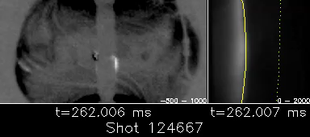
ELMs are periodic eruptions in ‘H-mode’ plasmas (NSTX)
32

Slide 33
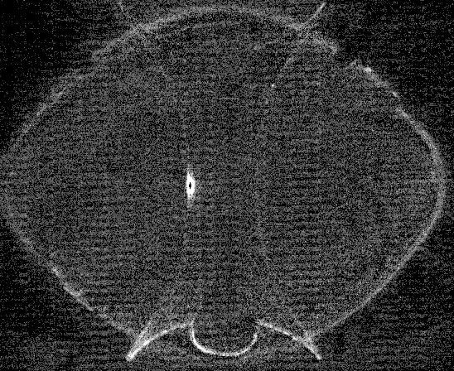
ELMs are periodic eruptions in ‘H-mode’ plasmas (MAST)
33

Slide 34

Solar flares are also periodic eruptions
34

Slide 35
What Are Edge Localized Modes (ELMs)? Most likely violations of ideal or resistive MHD stability limits
Plasmas undergo a transition from low (L-mode) to high (H-mode) when enough heating power is added
The edge plasma pressure develops a stair-step or “pedestal” in H-mode
SOL
edge
L-mode
H-mode
j||
core
Pressure (kPa)
Radius (m)
divertor
SOL = Scrape-Off
Layer
35
Notes:
35
35

Slide 36
ELMs expel plasma from the low field side, which is prone to ballooning-type pressure driven modes
Plasmas undergo a transition from low (L-mode) to high (H-mode) when enough heating power is added
The edge plasma pressure develops a stair-step or “pedestal” in H-mode
The steep edge pressure gradient and/or edge current can destabilize Edge Localized Modes (ELMs), where a portion of the pedestal pressure and energy is periodically expelled
SOL
edge
Pre-ELM
Post-ELM
j||
Pressure (kPa)
ELM
Radius (m)
divertor
SOL = Scrape-Off
Layer
36
Notes:
36
36

Slide 37
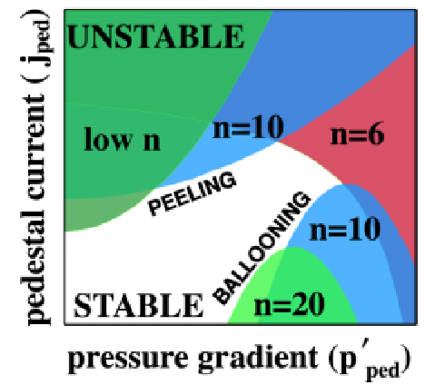
What Are Edge Localized Modes (ELMs)?
Plasmas undergo a transition from low (L-mode) to high (H-mode) when enough heating power is added
The edge plasma pressure develops a stair-step or “pedestal” in H-mode
The steep edge pressure gradient and/or edge current can destabilize Edge Localized Modes (ELMs), where a portion of the pedestal pressure and energy is periodically expelled
Pre-ELM
Post-ELM
j||
Pressure (kPa)
Radius (m)
37
Notes:
37
37

Slide 38
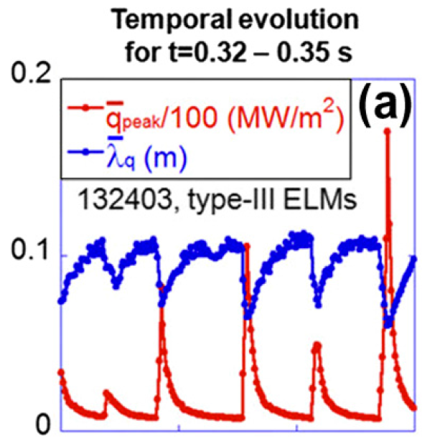
Plasma fluxes from ELMs on outer wall and divertor are 10 times higher than steady inter-ELM fluxes
SOL
edge
ELM
SOL = Scrape-Off
Layer
J.W. Ahn et. al., J. Nucl. Mater. 438 (2013) S317
38
Notes:
38
38

Slide 39
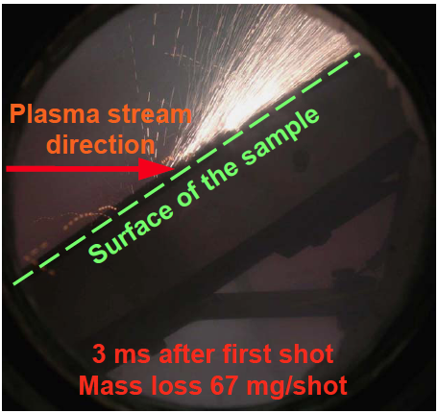
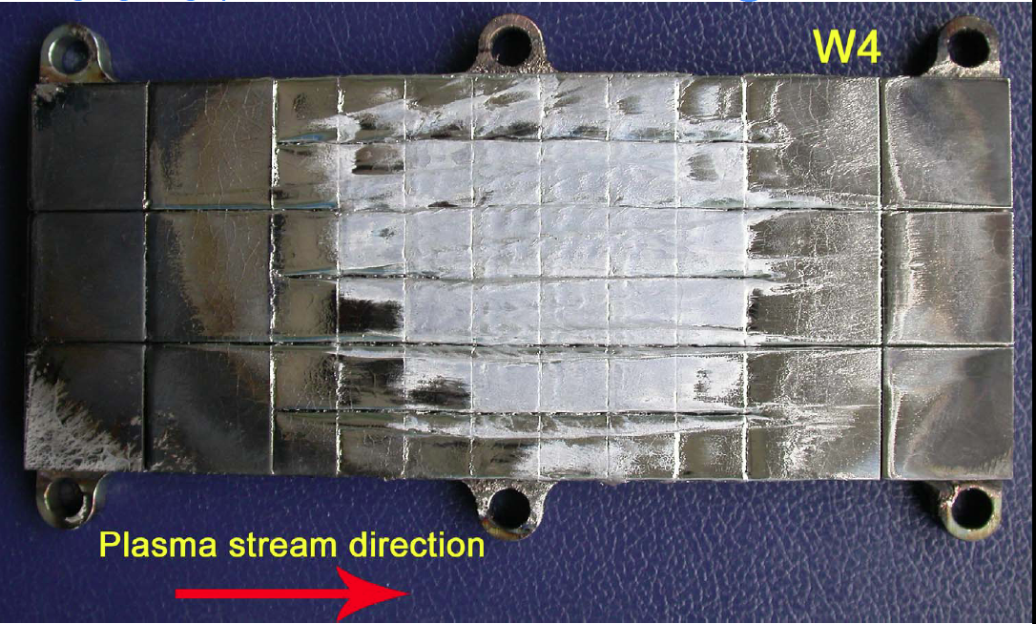
ELM simulators used to assess ELM heating limits in ITER
Russian ELM simulator, showing damage to Tungsten surface with ITER ELM-like plasma bombardment of Tungsten
After 100 simulated 1.6 MJ ELMs, substantial tungsten melting that covers gaps between tiles
Zhitlukhin et. al. J. Nucl. Mater. 363 (2007) 301
39

Slide 40
ELMs can be avoided or mitigated in several ways
ELMs are caused by having too much pressure and/or current near the plasma boundary
Solutions:
Trigger rapid, tiny ELMs with pellets
Apply additional 3-D fields to eliminate ELMs
  Tiny leak in magnetic bottle - pressure relief
Operate with some other instability that relieves the plasma pressure continuously – ‘quiescent’ modes
Operate far away from large, naturally occurring ELM conditions, or in tiny ELM conditions
Widen the ELM-stable operating window
  One way to do this is to change the plasma characteristics responsible for ELMs -> lithium or boron powder injection
Review: R. Maingi, Nucl. Fusion 54 (2014) 114016
40

Slide 41
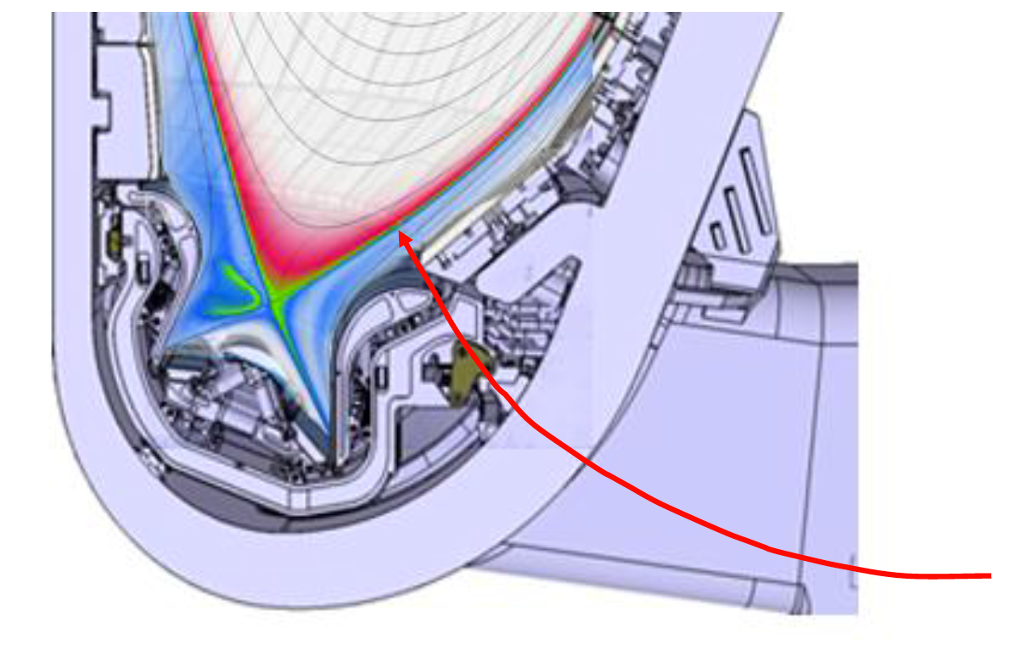
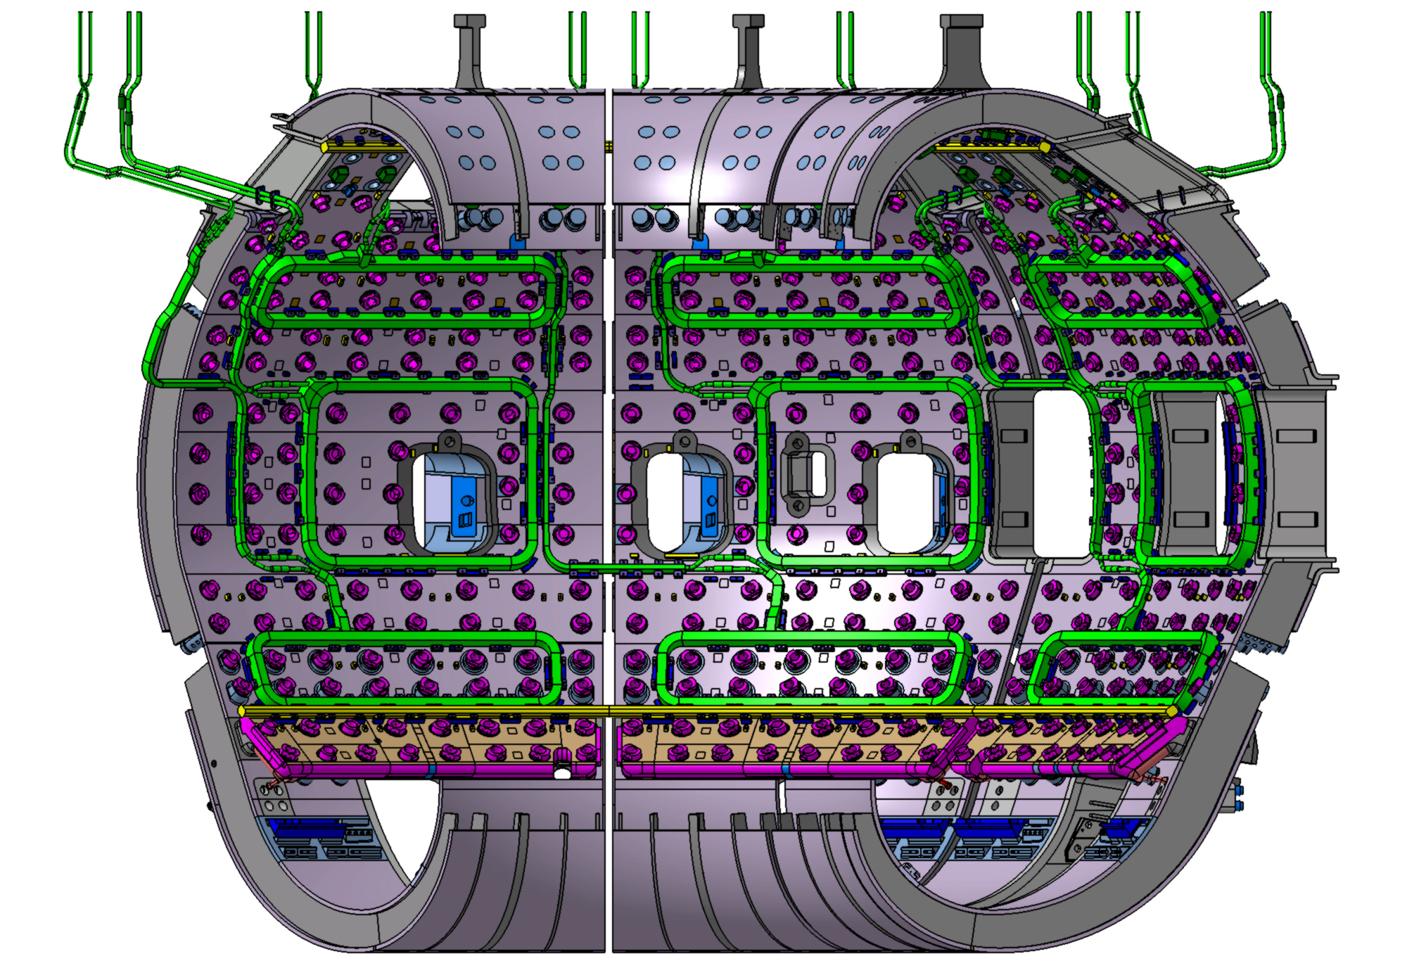
ELM mitigation via pellets and magnetic perturbations to trigger small, frequent ELMs are baseline for ITER
ITER Pacing pellet trajectory schematic
ITER ELM coils, 3 x 9 coils

Slide 42
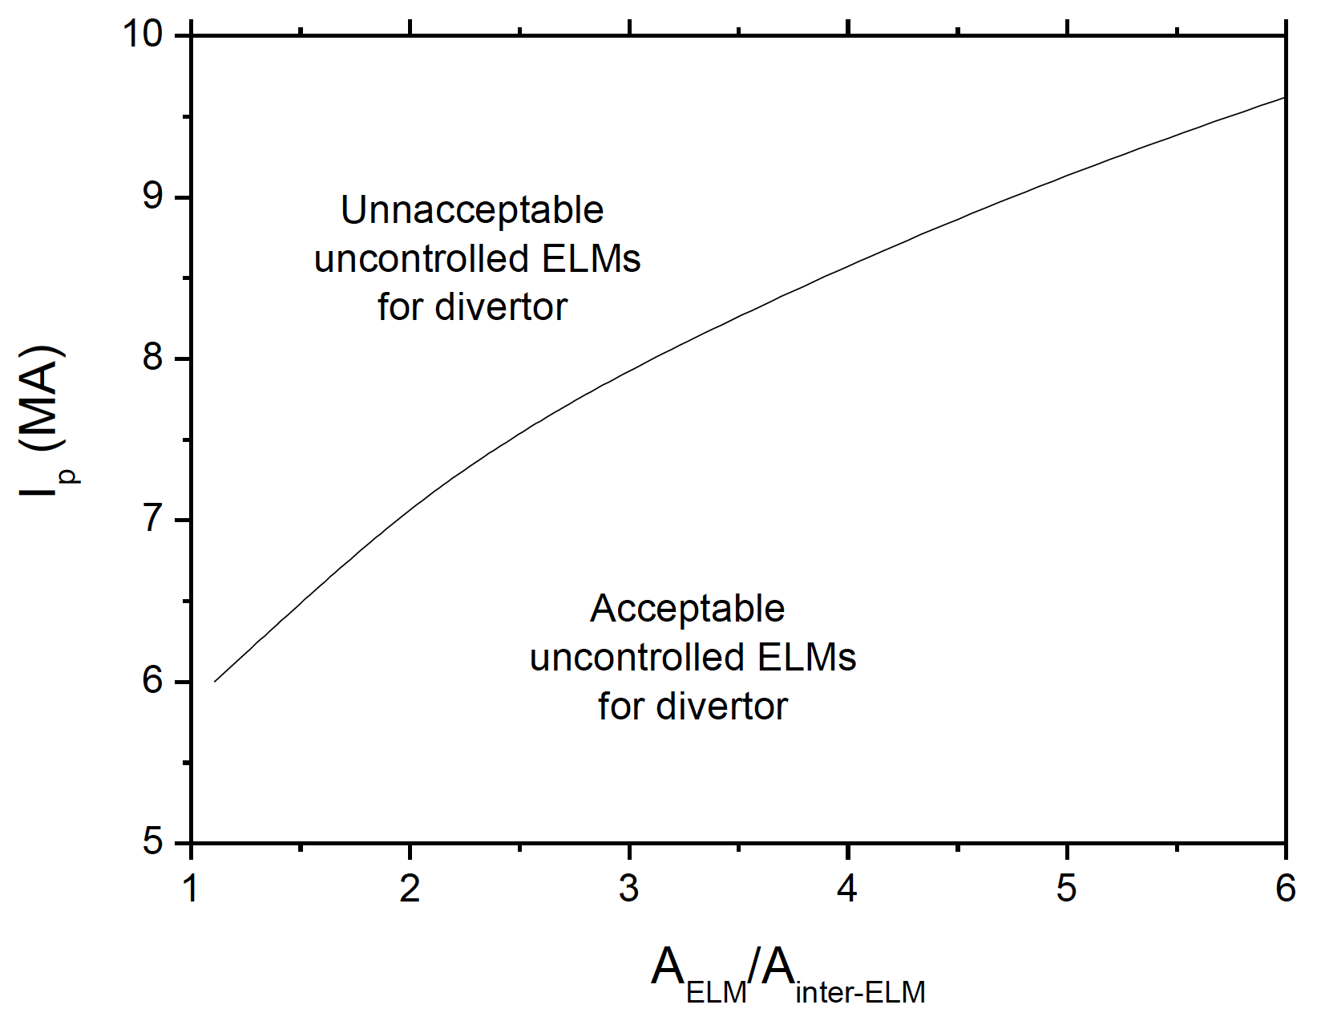
Acceptable ELM size in ITER depends strongly on ELM heat flux deposition region (“wetted area”)
ΔW_{ELM} < 0.7 MJ (0.2% W_{p})
  50% of damage limit, not including fatigue
Inter-ELM heat flux width λ_{q} ~ 1/I_{p}
  ELM wetted area critical
A. Loarte et. al., Nucl. Fusion 54 (2014) 033007

Slide 43
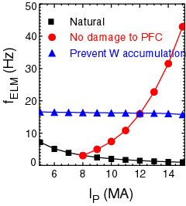
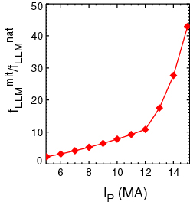
Required ELM frequency for acceptable ELMs in ITER increases with I_{p}
ΔW_{ELM} < 0.7 MJ (0.2% W_{p})
  50% of damage limit, not including fatigue
Inter-ELM heat flux width λ_{q} ~ 1/I_{p}
  ELM wetted area critical
ΔW_{ELM} f_{ELM} = (0.2-0.4) P_{SOL}
New analysis: minimum required f_{ELM} for acceptable heat flux
    (Including Be/W PFCs)
A. Loarte et. al., Nucl. Fusion 54 (2014) 033007

Slide 44
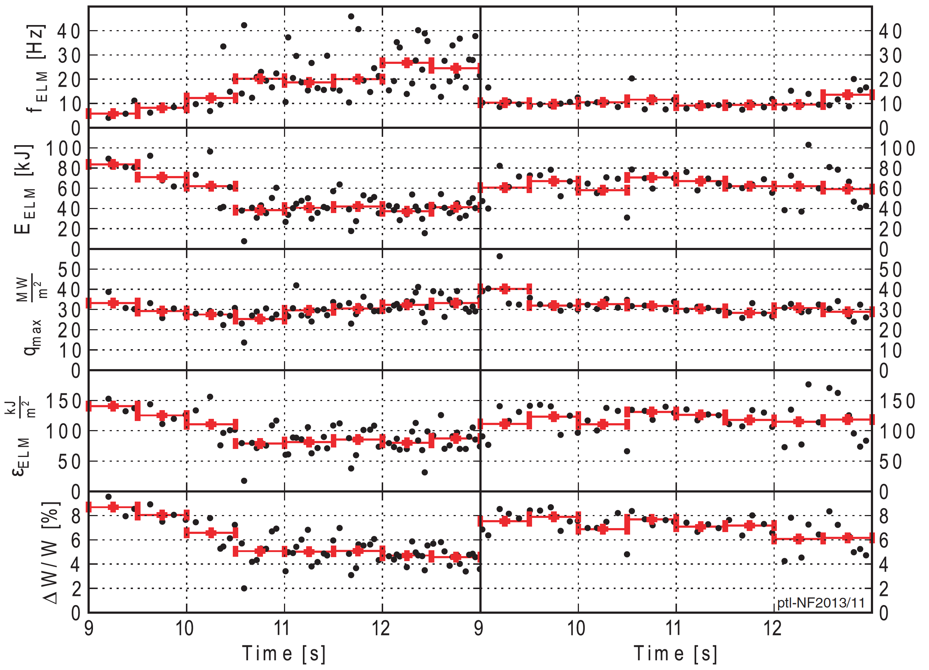
ELM pacing and heat flux reduction with pellets shown in DIII-D, but more complex story from JET and AUG
Paced
Reference
700
600
Natural
Outer
500
Inner
Peak_IR (W/cm²)
400
f_{ELM *} q_{peak}= Const
300
200
Pellet
100
0
0
10
20
30
40
50
60
70
Pellet Frequency (Hz)
L.R. Baylor et. al., PRL 110 (2013) 245001
P.T. Lang et. al., Nucl. Fusion 53 (2013) 073010

Slide 45
Impurity (Li) granules also trigger ELMs and reduce peak heat flux in DIII-D, but not in all conditions
ELM mitigation in High Torque
No ELM mitigation in ITER baseline
A. Bortolon et. al., Nucl. Fusion 56 (2016) 056008
A. Bortolon et. al., Nucl. Mater. Energy 12 (2017) 1030

Slide 46
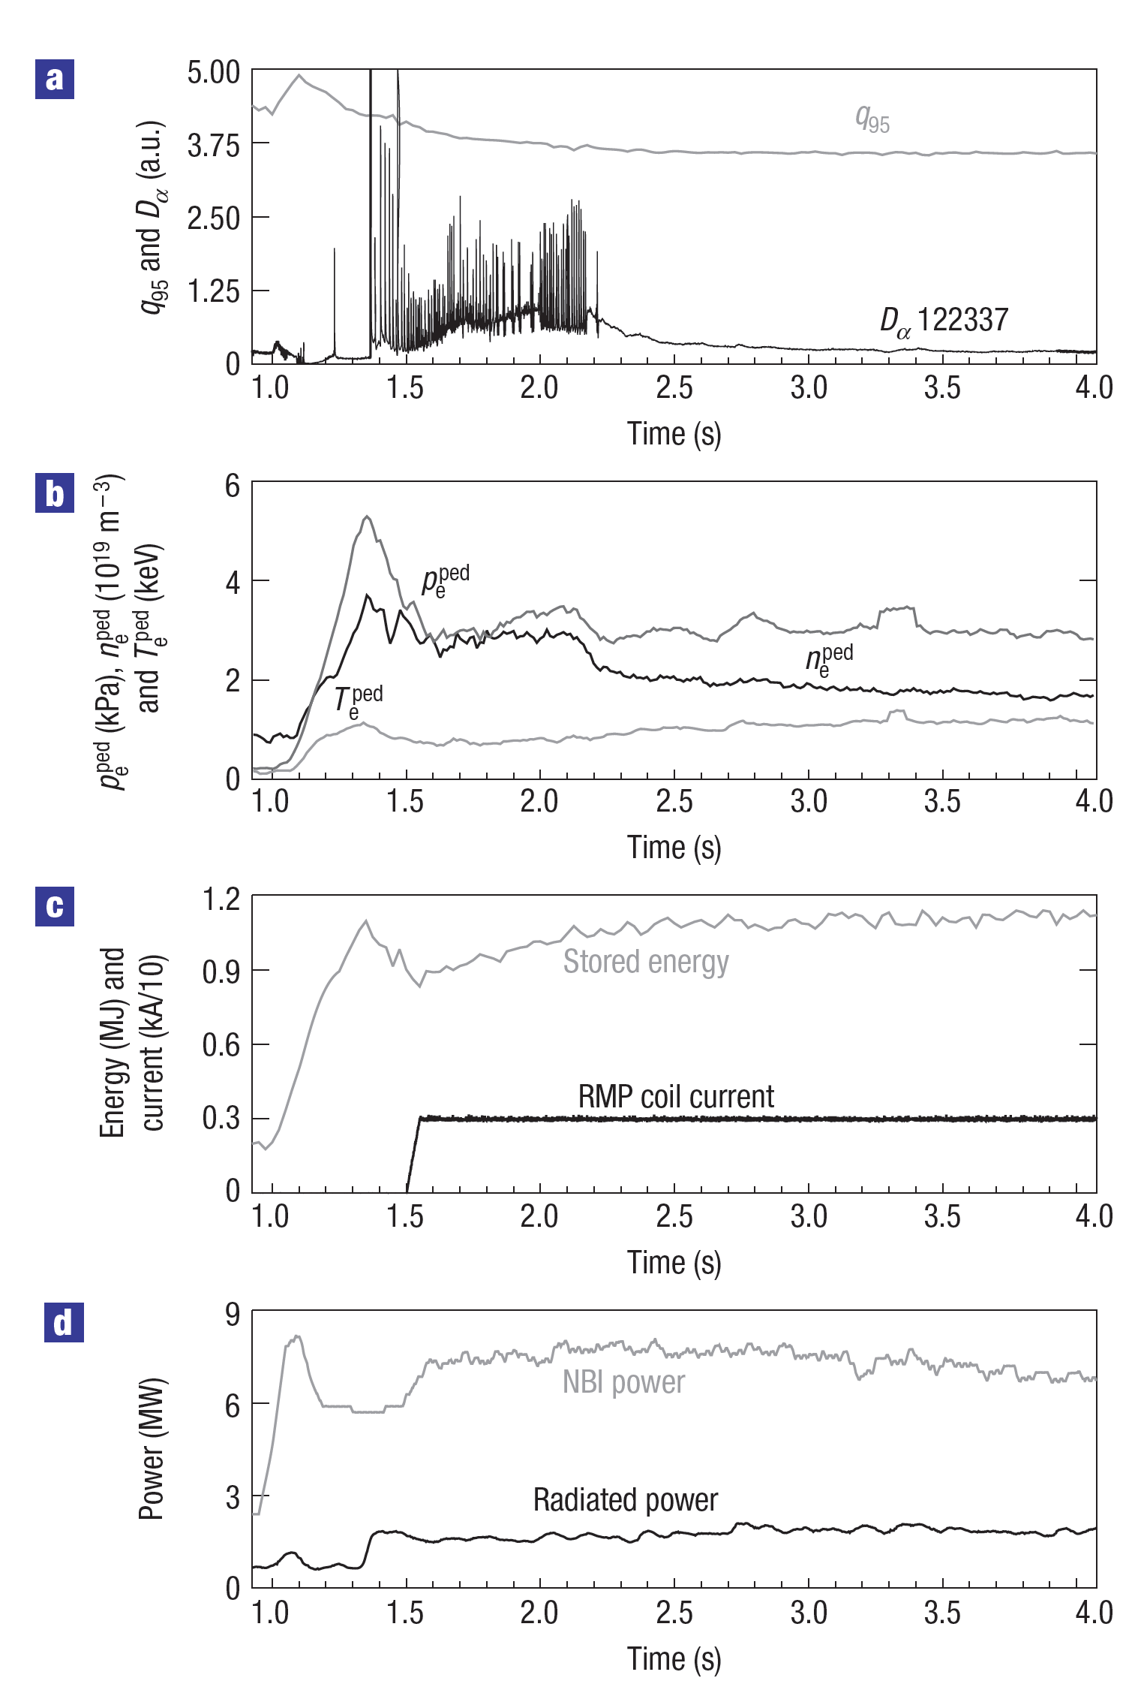
ELMs eliminated with either 3-D magnetic perturbations, or naturally via access to a Quiescent H-mode
Pellet ELM pacing
D3D
Magnetic Perturbations
D3D
no Pellets
Li Pellets
A. Bortolon et al., Nucl. Fusion 56 (2016) 056008
T.E. Evans et al., Nature Phys. 2 (2006) 419
46

Slide 47
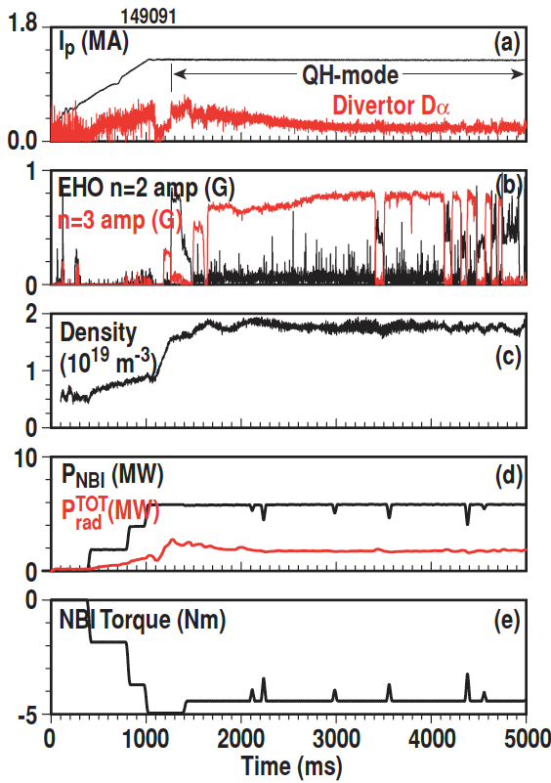
ELMs eliminated naturally via access to a Quiescent H-mode or via boron powder injection triggering quiescence
Quiescent H-mode D3D
B powder injection EAST (May 2019)
B injection
B inj.
No B
Stored Energy [kJ]
Density [10¹⁹ m⁻³]
B-V edge [au]
Z. Sun et al., PRL and A. Diallo et al., NF, both in preparation
K.H. Burrell et al., Nucl. Fusion 53 (2013) 073038
47

Slide 48
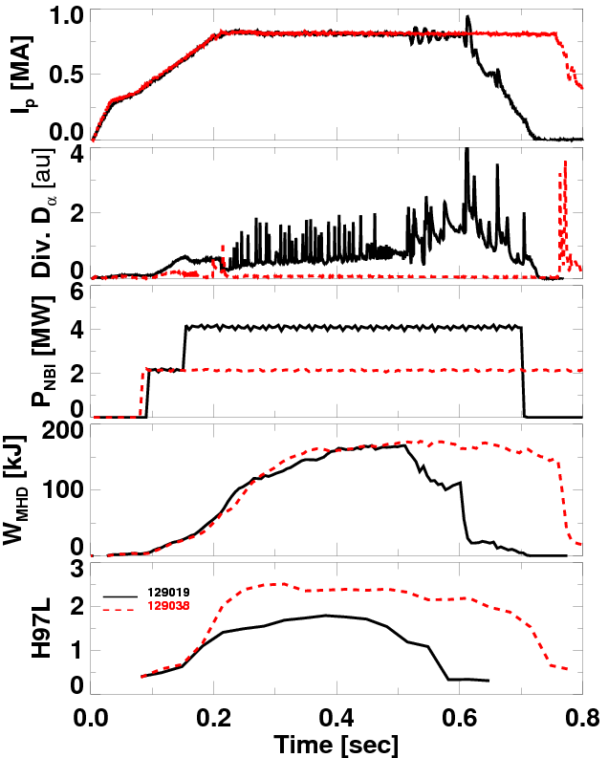
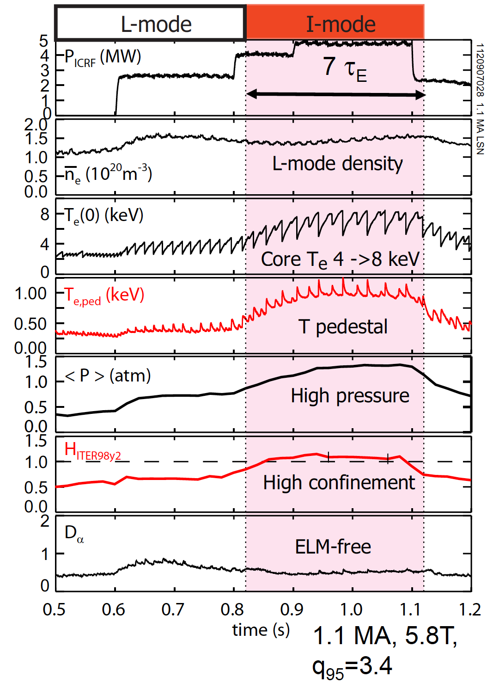
ELMs eliminated by lithium wall conditioning or by operating far from instability boundaries
Lithium conditioning NSTX
I-mode C-Mod
R. Maingi et al., PRL 103 (2009) 075001
A.E. Hubbard et al., IAEA 2012 paper
48

Slide 49
Control of plasma exhaust is an exciting fusion research area with engaging science and technology
Vibrant topic with substantial domestic and international effort
Engineering the plasma-material interface is critical to the success of fusion
Expertise needed in all areas beyond physics and NE: materials science, chemistry, large scale computing…
Early career researchers can make meaningful contributions
49
Notes:
49

Slide 50
THANK YOU FOR YOUR ATTENDANCE
50

