Slide 1
Stellarator Physics and Design
D. A. Gates
SULI Seminar
June 29, 2017

Slide 2
Toroidal Magnetic Confinement
Requires a poloidal (Θ) component of B so that cross-field particle drifts average to zero over the particle orbit
For example, in a tokamak, Bx∇B drift is vertical; discharge would drift out of confinement region without B_{θ}
B_{Φ}
B_{θ}
Bx∇B
Poloidal
direction
ι
flux surface ψ
Two methods to produce magnetic transform
ι = 1/q ~ B_{θ} /B_{φ}
Plasma current
  Tokamaks, reversed field pinches, spheromaks
  All toroidally symmetric
Non-symmetric helically deformed fields
      Stellarators
∇B

Slide 3
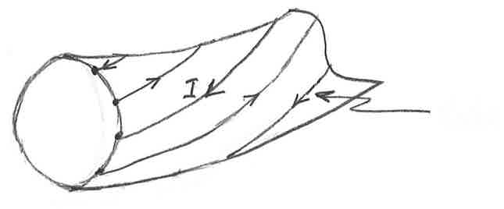
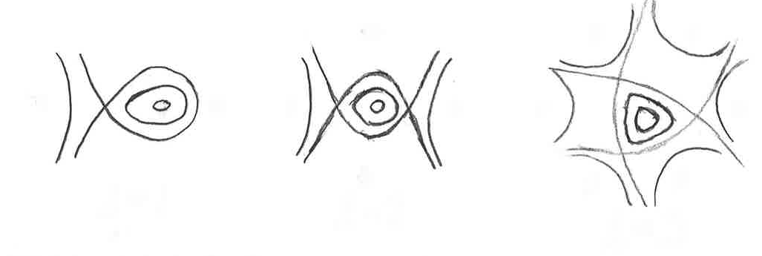
Stellarator history
Concept invented by Lyman Spitzer et al (1958)
  Phys. Fluids 1 (1958) 253.
Helical fields
  B = B_{T} + B_{P}
  Both field components generated by coils
Linear Stellarators
  Helically symmetric system: φ = θ – αz
    2 alternating currents
    Not required to be same amplitude
Produces flux surfaces
Which rotate helically
l=2
l=3
l=1

Slide 4
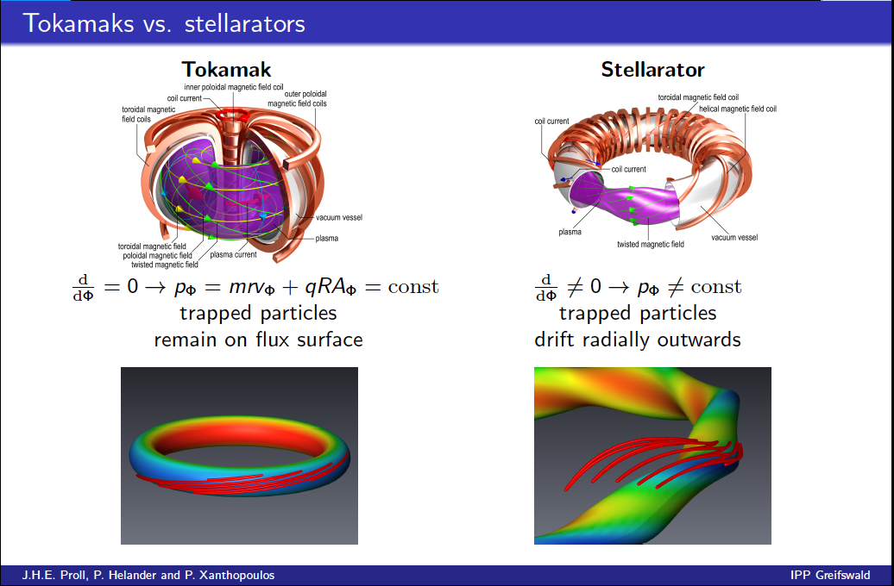
Historically, stellarators had poor confinement when compared to tokamaks

Slide 5
Stellarator history (continued)
To confine plasma axially and eliminate endlosses, bend a linear stellarator into a torus
  This breaks the helical symmetry
  Resultant system will not be toroidally symmetric
Stellarator designs from 1958 through ~1988 attempted to produce configurations that required coils or fields that “looked” symmetric (in one sense or another)
Since ~1988, stellarators have been numerically designed to have the desired plasma characteristics
  E.g. symmetric-like orbits (even though they don’t “look” symmetric)
Stellarators with numerically designed coilsets to produce “symmetric” fields:
  HSX – operating since 1999
  Wendelstein7-X operated this year (quasi-omnigeneous)
  NCSX (mostly constructed, but project cancelled)

Slide 6
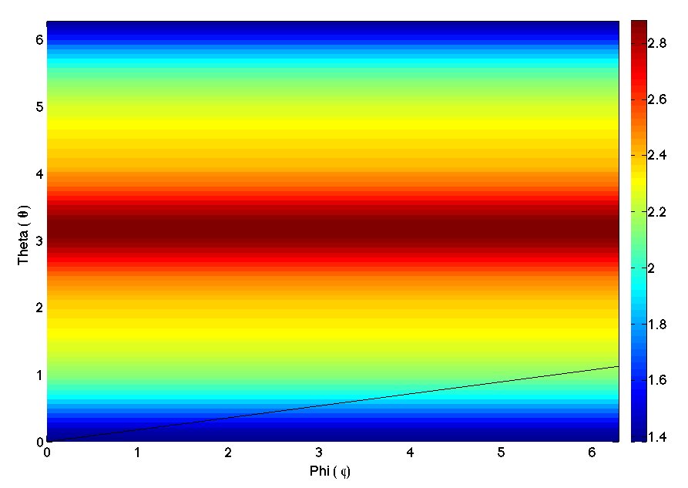
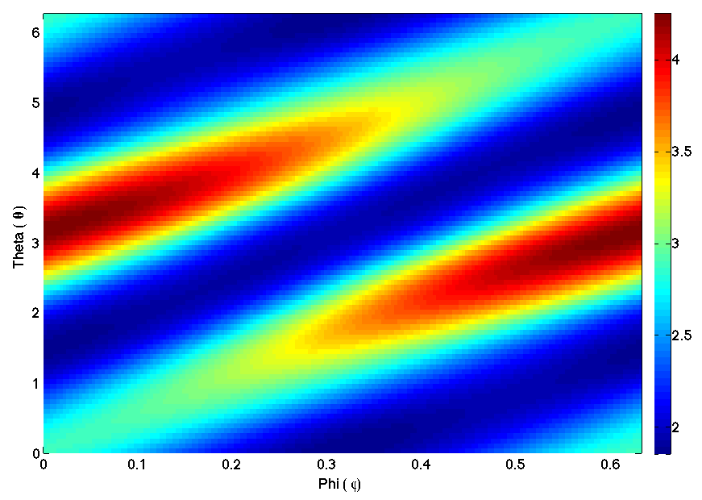
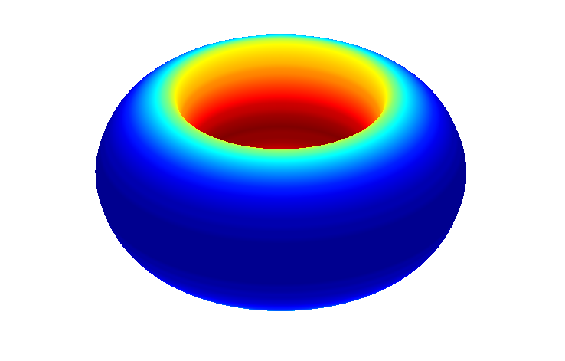
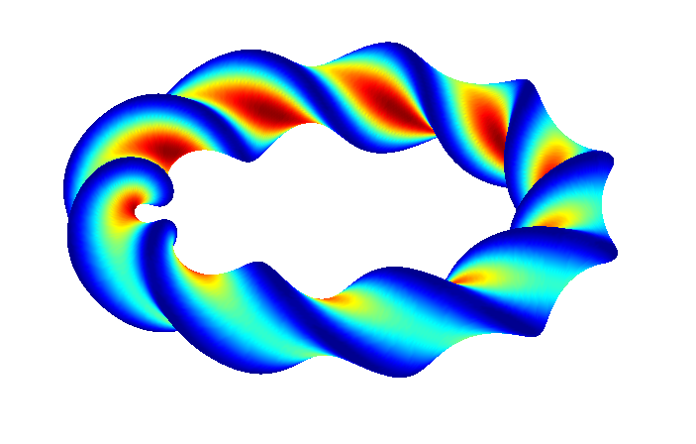
Asymmetric variation in |B| cause for radial drift

Slide 7
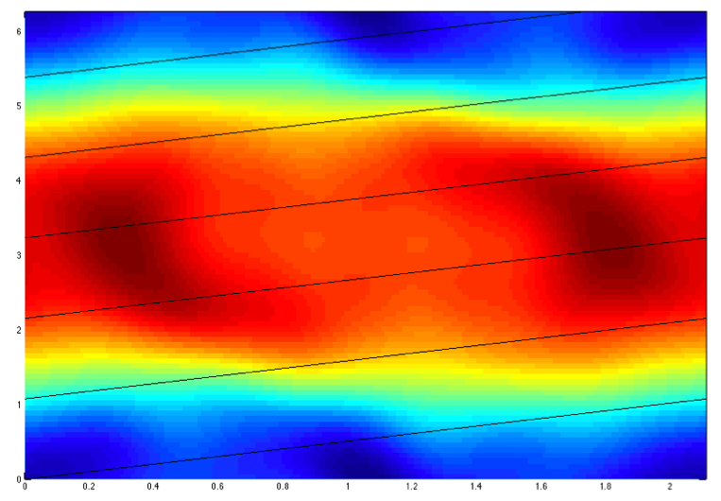
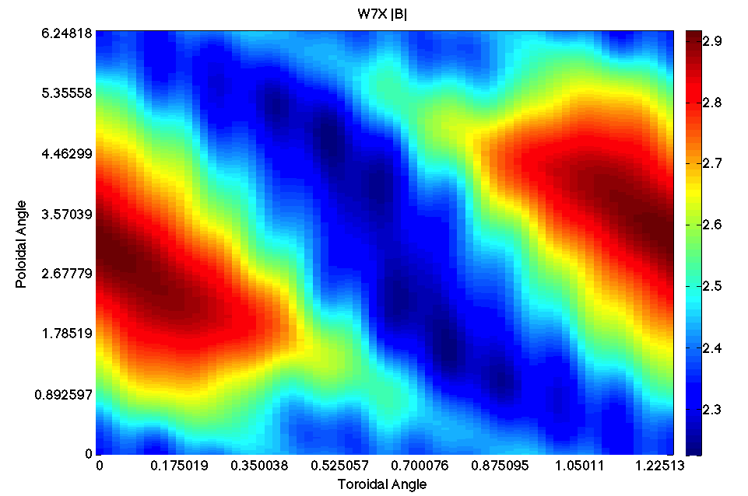
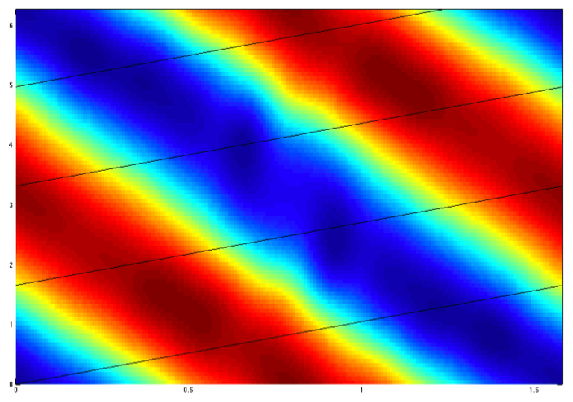
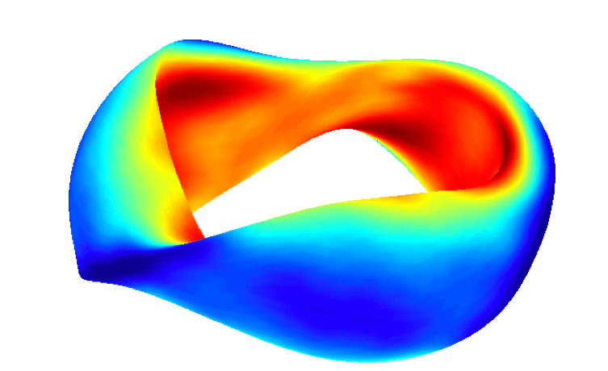
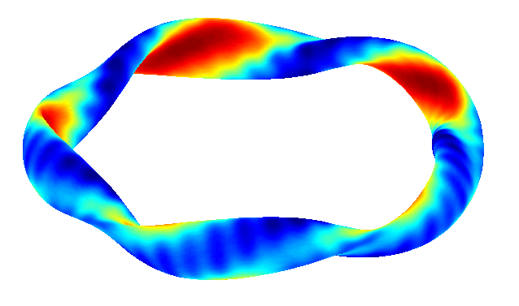
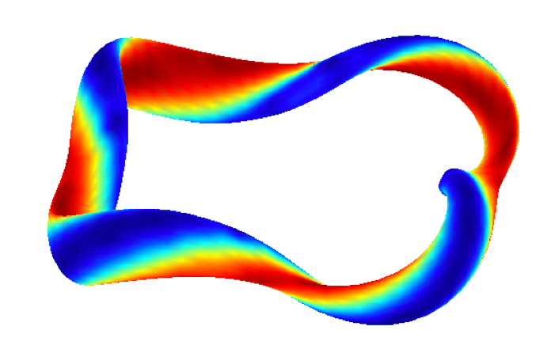
Three different types of optimization
Quasi-Axisymmetry
(QUASAR)
Quasi-Isodynamic
(W7-X)
Quasi-helicalsymmetry
(HSX)

Slide 8
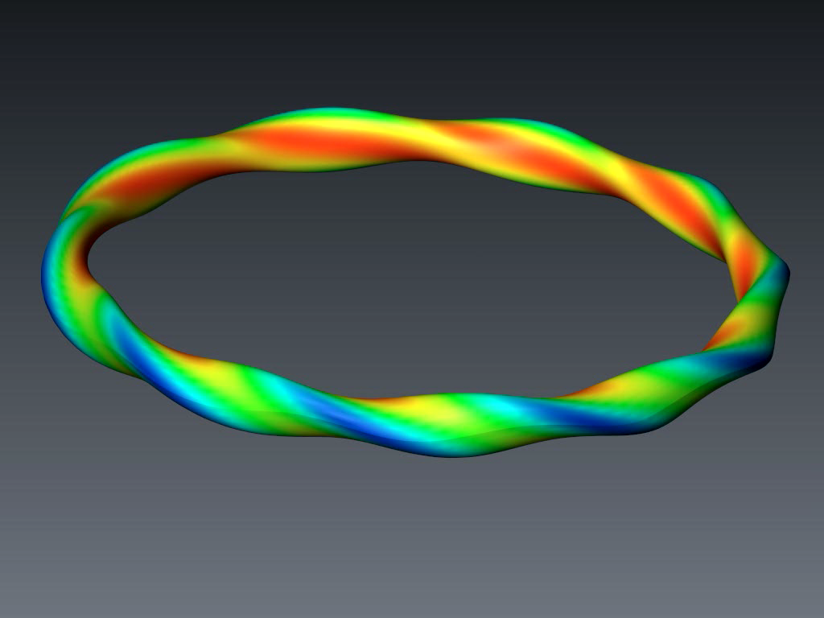
Neoclassical losses in classical stellarators

Slide 9
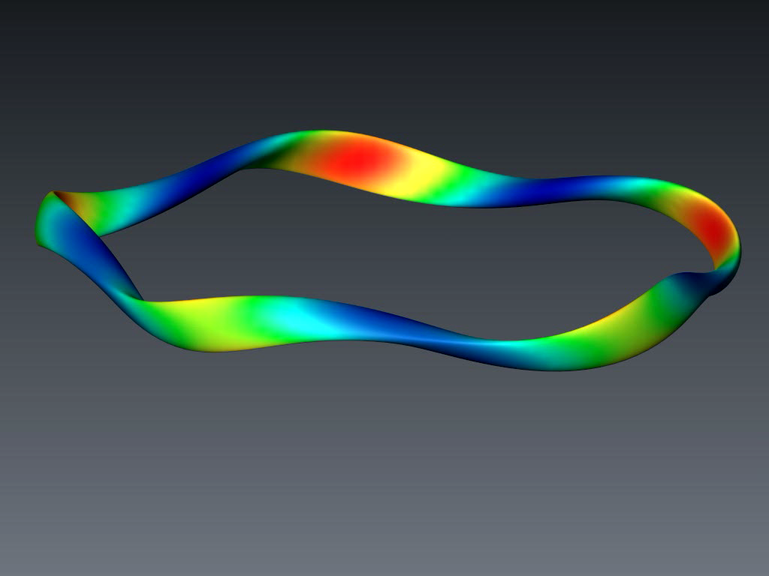
Trajectories in an optimized stellarator

Slide 10
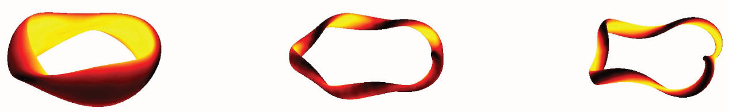
Neoclassically Optimized Configurations
Three types of neoclassical optimization
US has substantial expertise in quasi-symmetry
Quasi-axisymmetry (QA)
NCSX
Bootstrap current increases
transform
Bootstrap current is large
Can be designed at lower
aspect ratio
Quasi-omnigeneity (QO)
W7-X
Bootstrap current can be
made to cancel ~0
High aspect ratio
Quasi-helical symmetry (QH)
HSX
Bootstrap current reduces
transform
Bootstrap current is lower
than QA
High aspect ratio

Slide 11
Stellarator issues
Lack of “natural” symmetry in toroidal stellarators
  Stellarators do not automatically have closed flux surfaces
  Stellarators do not automatically have closed drift surfaces
  Therefore, stellarators must be carefully designed to confine particle orbits
Lack of physical symmetry ➪ lack of symmetry in coil geometry
  Coils are complex
  Complex coil shape must be produced with ~few millimeter accuracy
Field geometry can be beta dependent - pressure driven currents can modify equilibrium
  Solutions:
    Suppress pressure-driven currents (mirror terms, Wendelstein-family solution)
    Optimize design around pressure driven currents (NCSX approach)
No significant Ohmic heating
  Inherently not steady-state, but very inexpensive for tokamaks

Slide 12
Stellarators provide attractive path to electricity production
Energy mission requires efficiency
  Stellarators minimize recirculating power!
The advantages of the stellarator
  Device size and confinement requirements are modest
  Operating space much wider (higher density limit)
Modern stellarator confinement database sufficient for reactor
New design tools being employed to design a mission relevant device

Slide 13
Key metric is overall electrical efficiency: Q_{eng}
Electricity produced
Electricity consumed
η_{th} = thermal conversion efficiency
η_{aux} = injected power wall plug efficiency
Q = fusion power / auxiliary power
M_{n} = neutron energy multiplier
P_{n} = neutron power from fusion
P_{α} = alpha power from fusion
P_{aux} = injected power (heat + CD + control)
P_{pump} = coolant pumping power
P_{sub} = subsystems power
P_{coils} = power lost in coils (Cu)
P_{control} = power used in plasma or plant control that is not included in P_{inj}
P_{extra} = P_{pump} + P_{sub} + P_{coils} + P_{control}
Blanket and auxiliary power efficiency + fusion gain largely determine electrical efficiency Q_{eng}

Slide 14
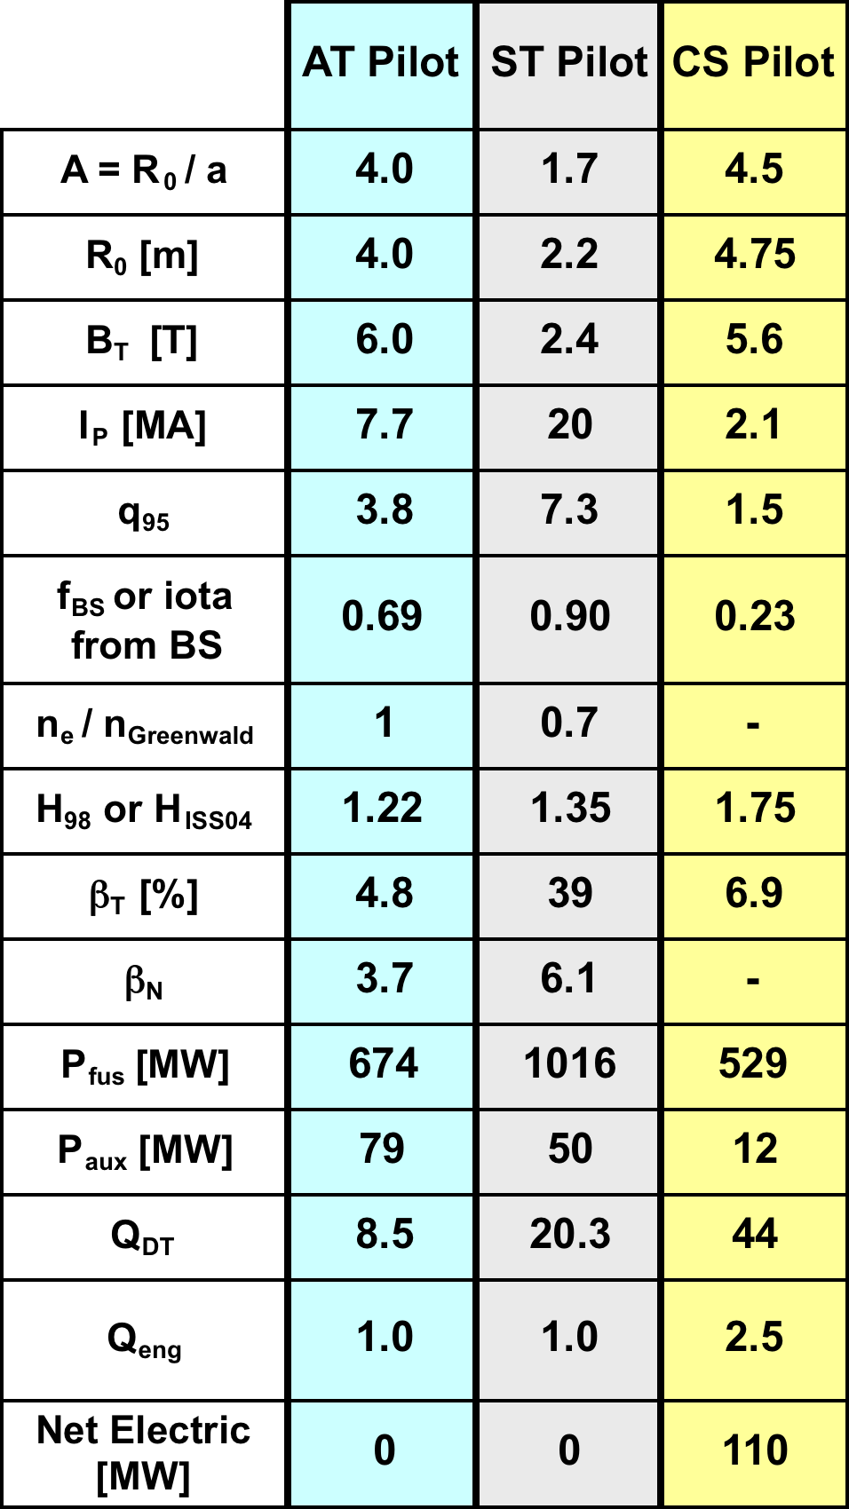
It’s easier to make electricity in a stellarator
Similar sizes
Fixed Magnetic field at the Coil (14T)
Stellarator has the lowest fusion power…
But makes net electricity
“Pilot Plants”, J. Menard, Nucl. Fusion 51 (2011) 103014

Slide 15

Movie Time
The end of a stellarator shot
The end of a tokamak shot

Slide 16
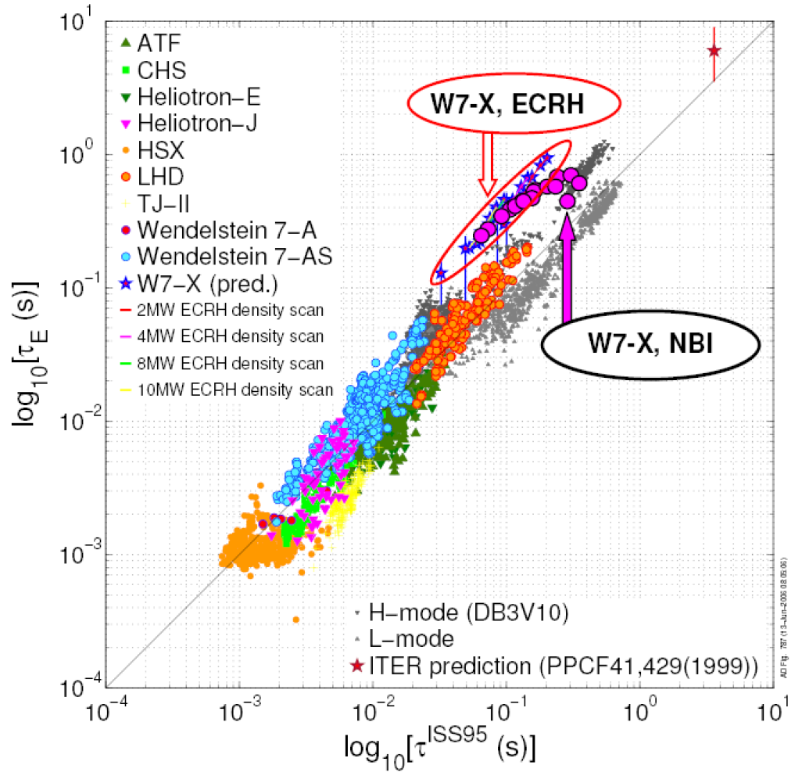
W7-X will operate near the assumed confinement times for CS pilot plant
ISS95 scaling law with tokamak and stellarator data
ISS04 database contains many points that cover the assumed pilot plant multiplier values
The stellarator database only goes up to τ_{E} ~ 200ms
  tokamaks are up to τ_{E} ~ 1s
  W7-X achieve values in this range
  Stellarator extrapolation is larger
CS Pilot Plant

Slide 17
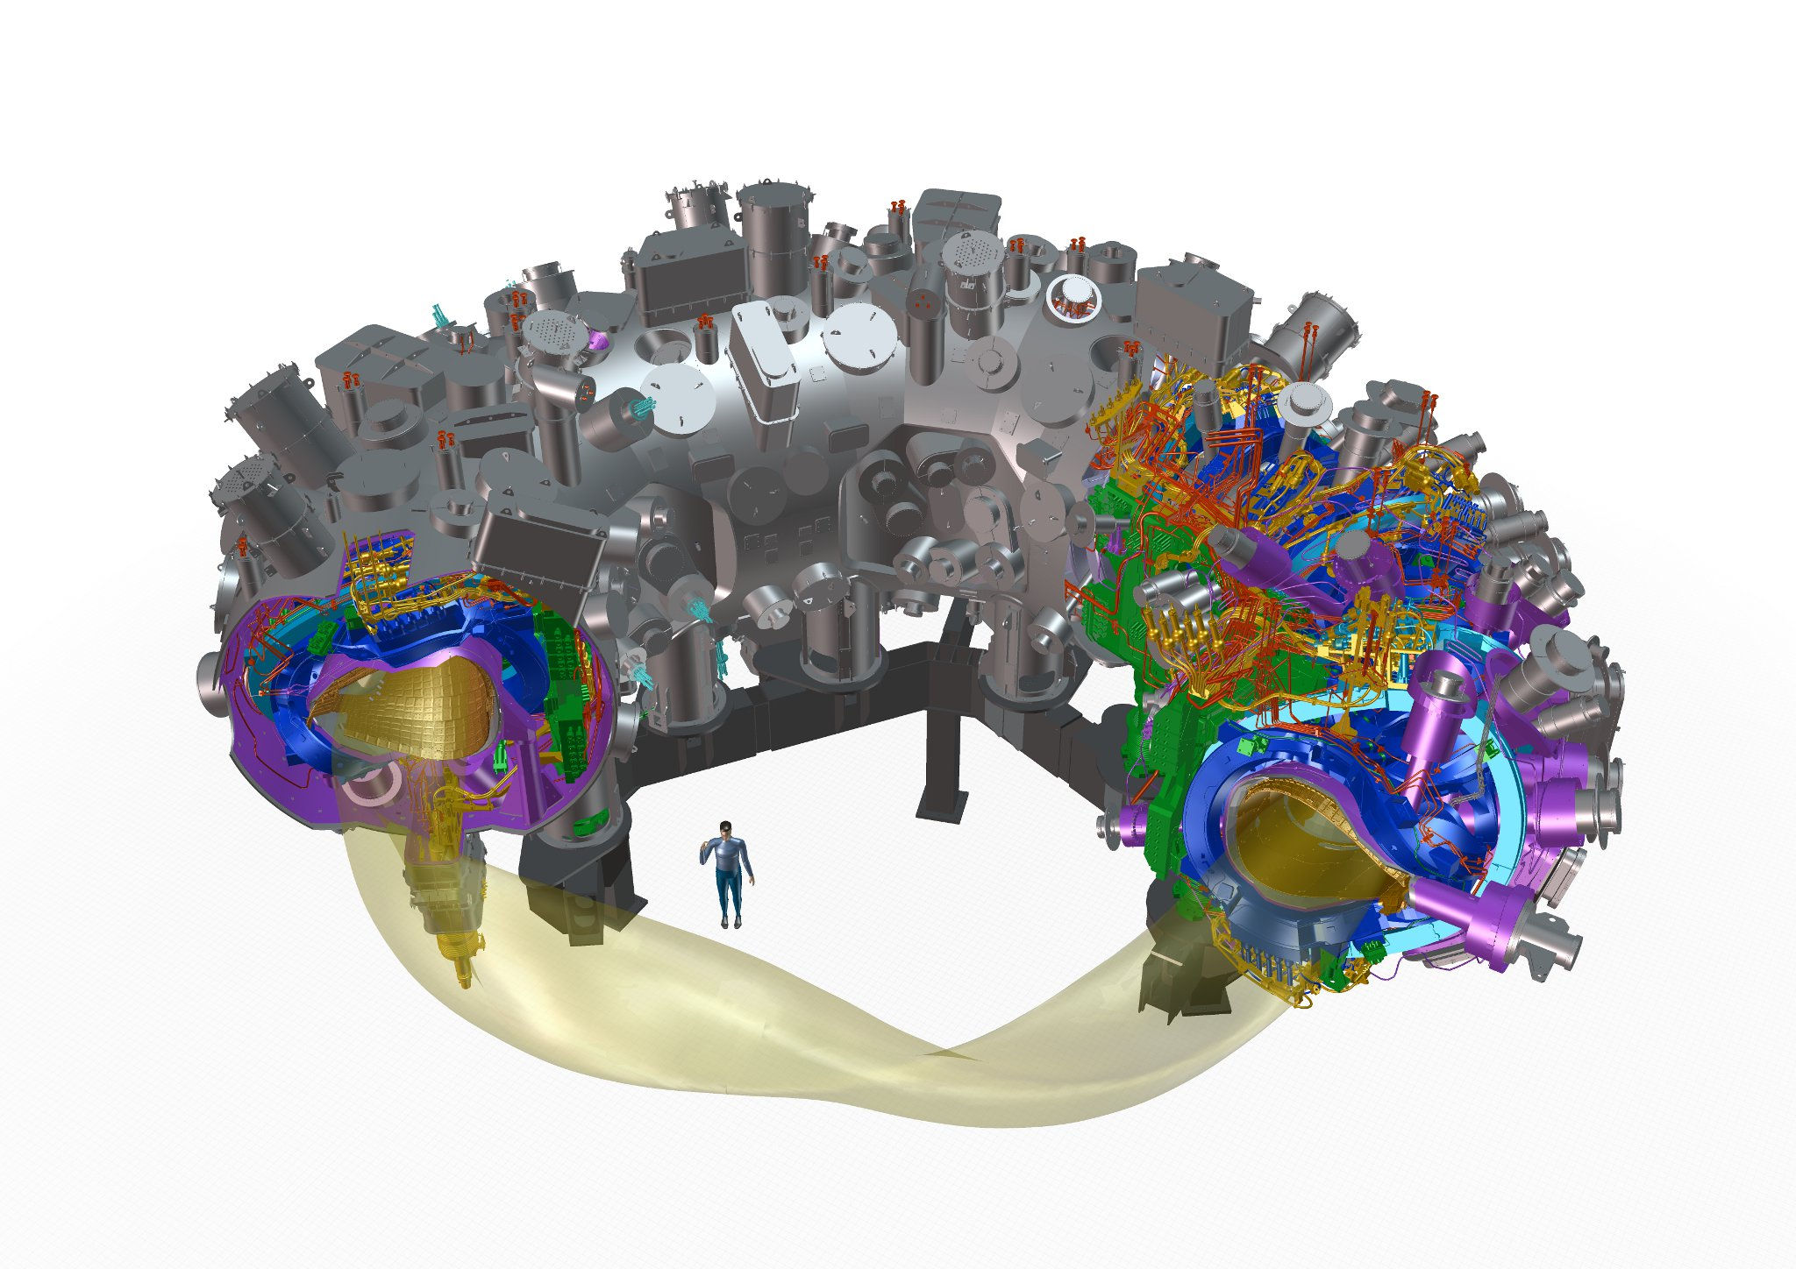
W7-X Major device components
five roughly identical modules
254 ports
access domes and instrumentation plugins
cryostat vessel
~ 500 openings
SC bus bar
3d-shaped
plasma vessel
He pipes
2500 in-vessel
components
cryo feet
machine base
14 HTSC
current leads
plasma
50 non-planar
20 planar SC coils
thermal insulation
MLI and He gas cooled shield
central support ring

Slide 18
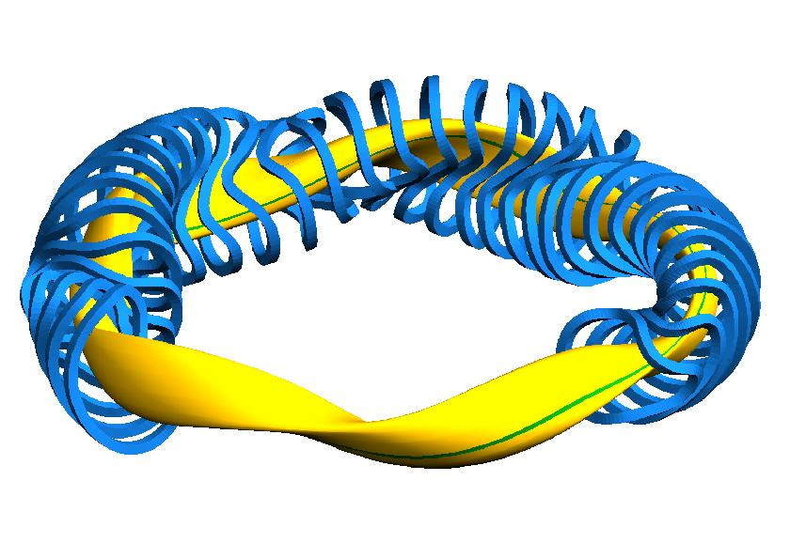

W7-X Facts and figures
five magnetic field periods
modular non-planar coils
quasi-isodynamic equilibrium
low bootstrap current O(10 kA)
high iota and low shear
flexible magnetic field configurations
735 t mass with 435 t cold mass
70 superconducting NbTi coils
3 T magnetic induction on axis
254 ports of 120 different types
30 m³ plasma volume
265 m² in-vessel components
4.5m height and 16 m diameter
T. Klinger on Wendelstein 7-X 18

Slide 19
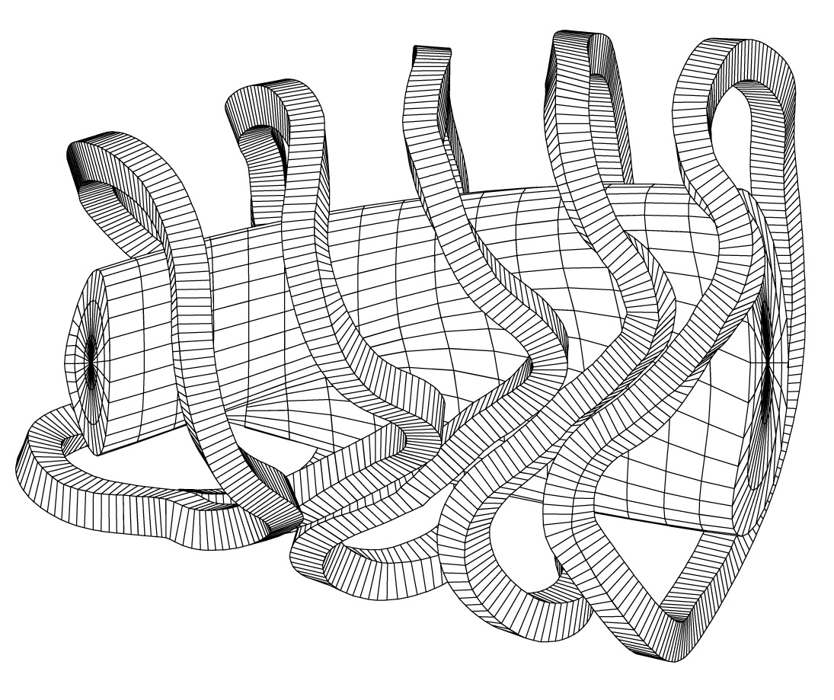
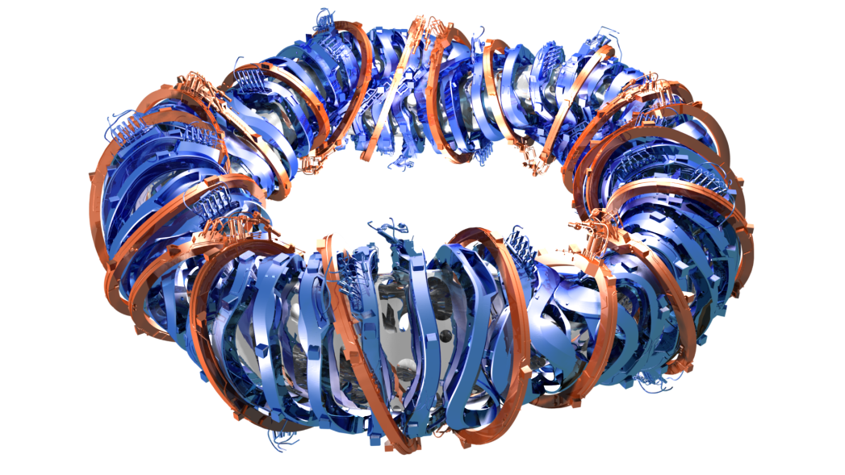
Physics optimisation
seven optimisation criteria
high quality of vacuum magnetic surfaces
good finite equilibrium properties @ <β > = 5%
good MHD stability properties @ <β > = 5%
reduced neoclassical transport in 1/ν -regime
small bootstrap current in lmfp-regime
good collisionless fast particle confinement
good modular coil feasibility
3d computer codes
vacuum field and coils
MHD equilibrium
MHD linear stability
neoclassical transport
Monte Carlo test particle
edge and divertor
T. Klinger on Wendelstein 7-X 19

Slide 20
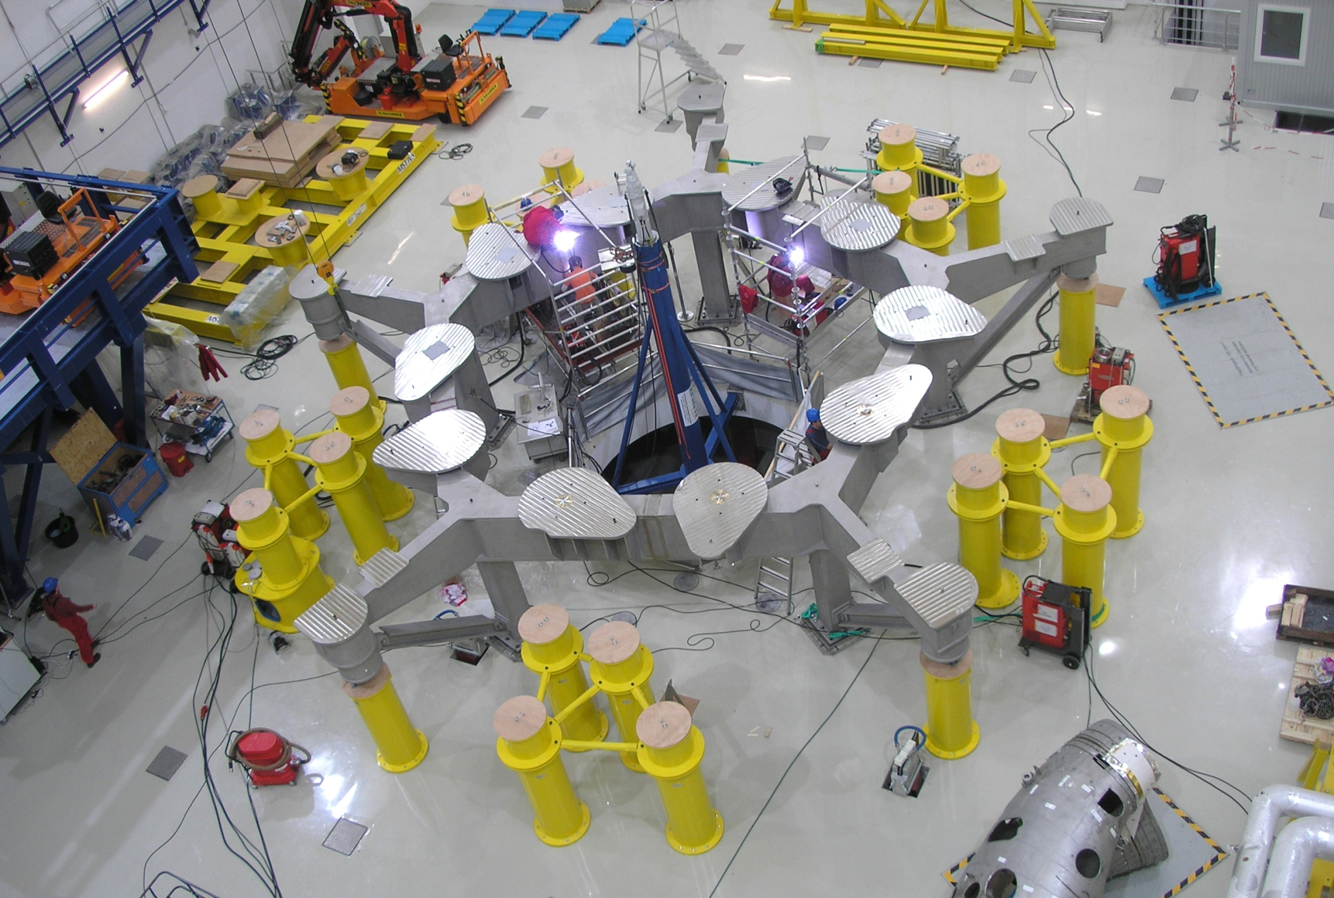
Machine base
T. Klinger on Wendelstein 7-X 20

Slide 21
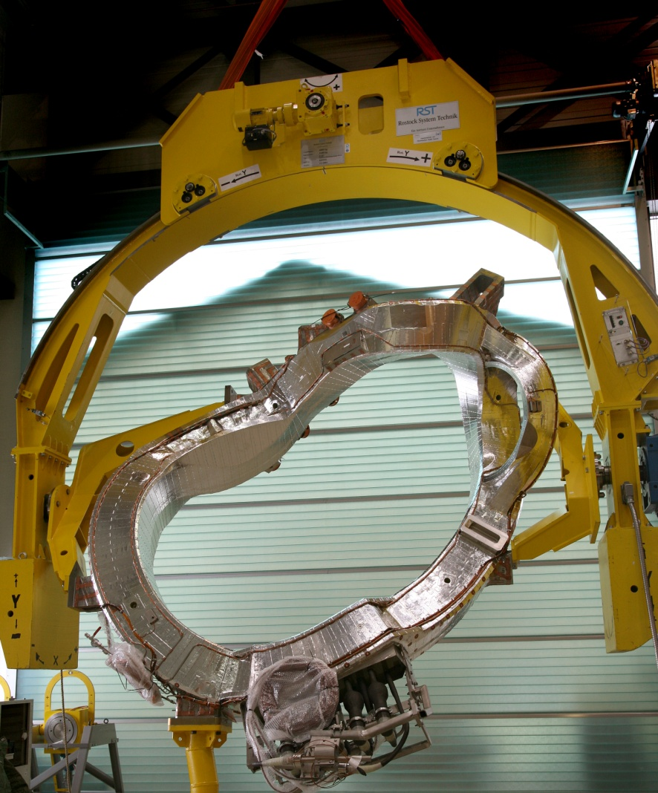
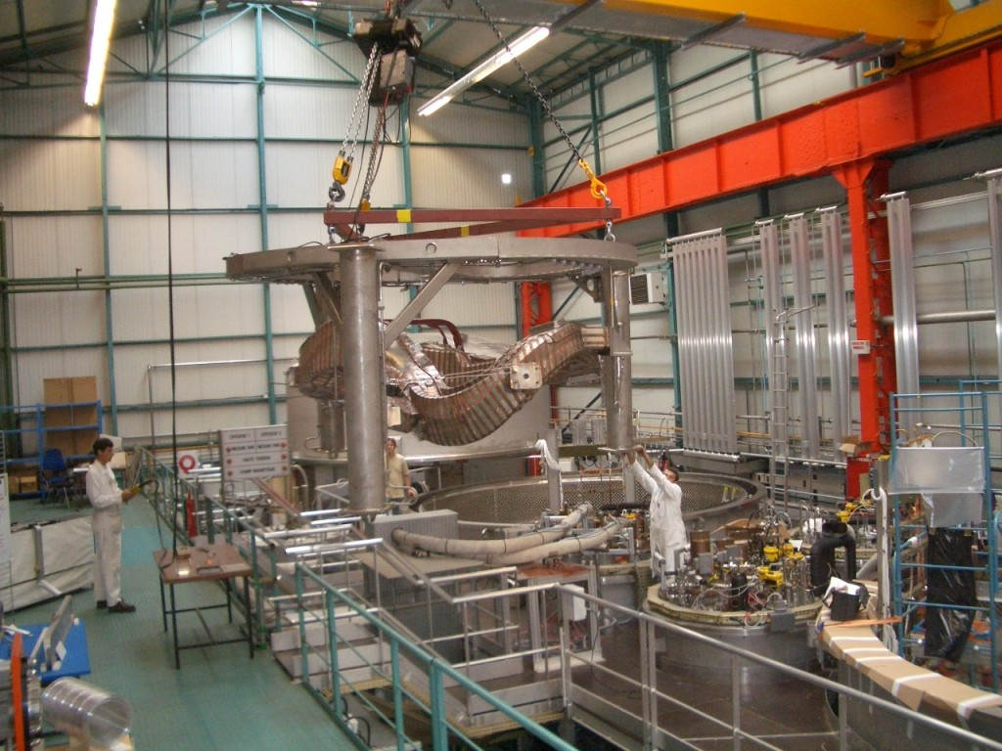
Superconducting magnets
coil in the assembly handling unit
coil in the test bed @ CEA Saclay
T. Klinger on Wendelstein 7-X 21

Slide 22
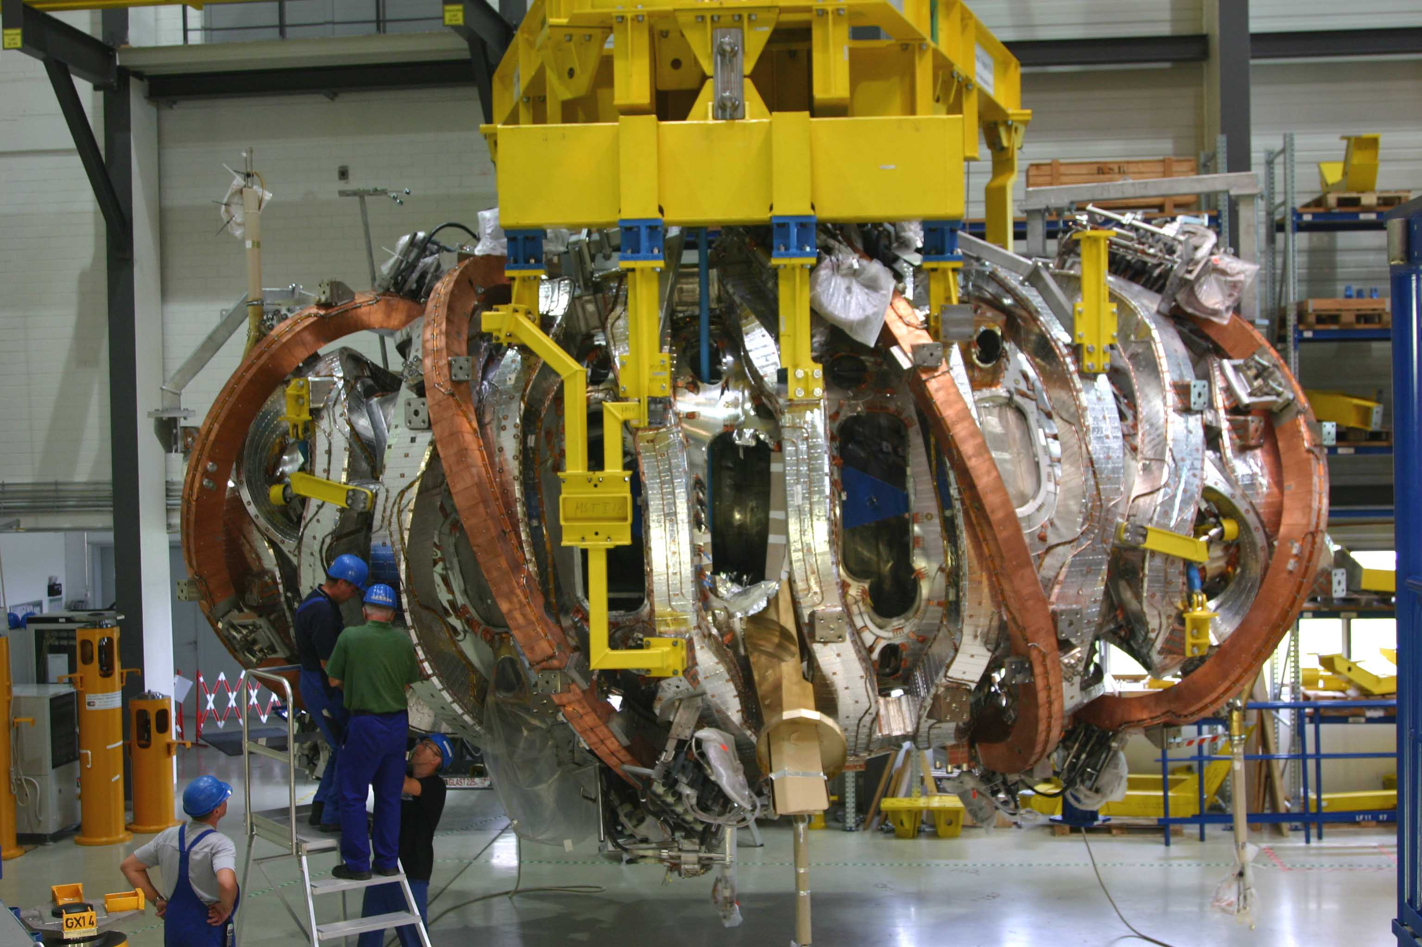
Superconducting magnet module
T. Klinger on Wendelstein 7-X 22

Slide 23
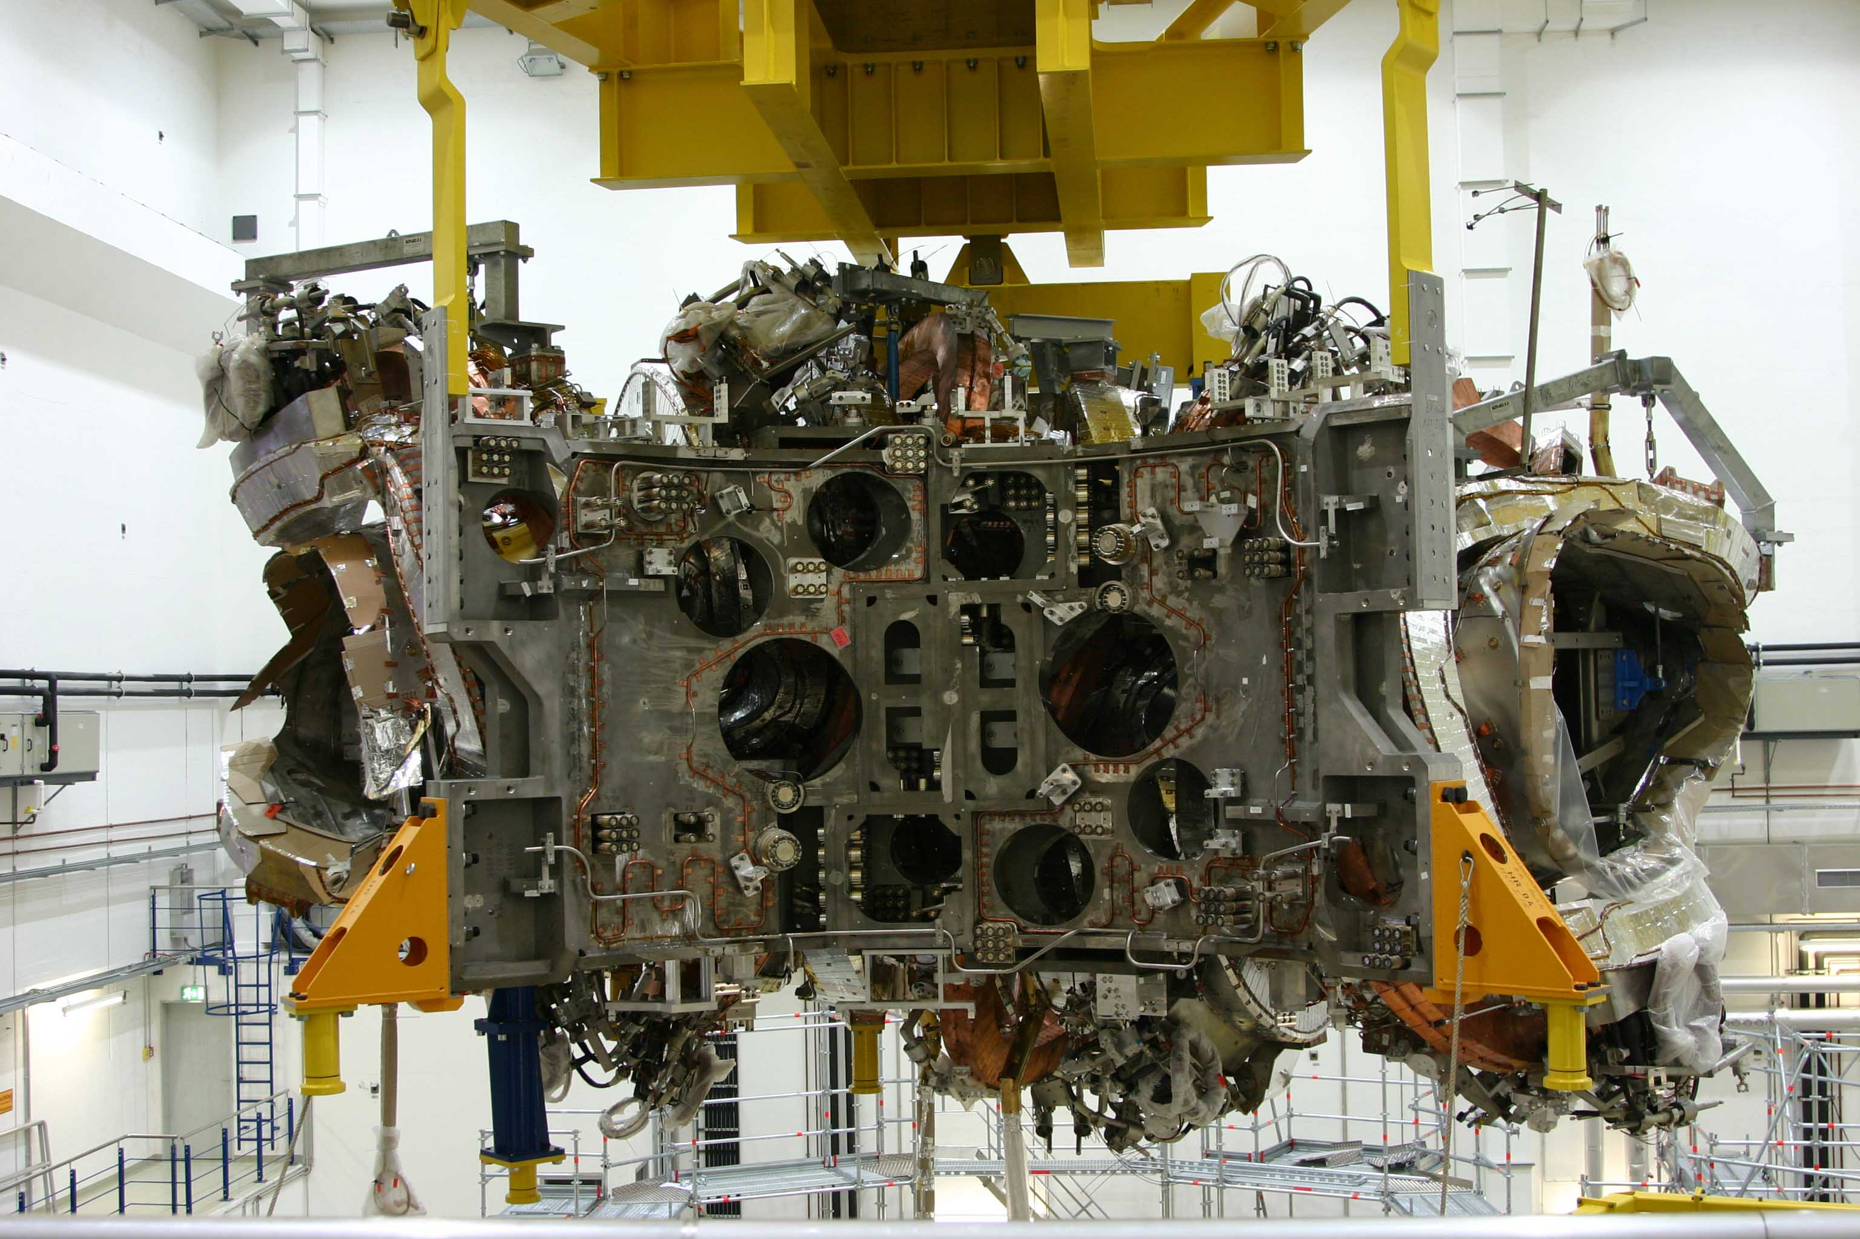
Magnet module with central ring
T. Klinger on Wendelstein 7-X 23

Slide 24
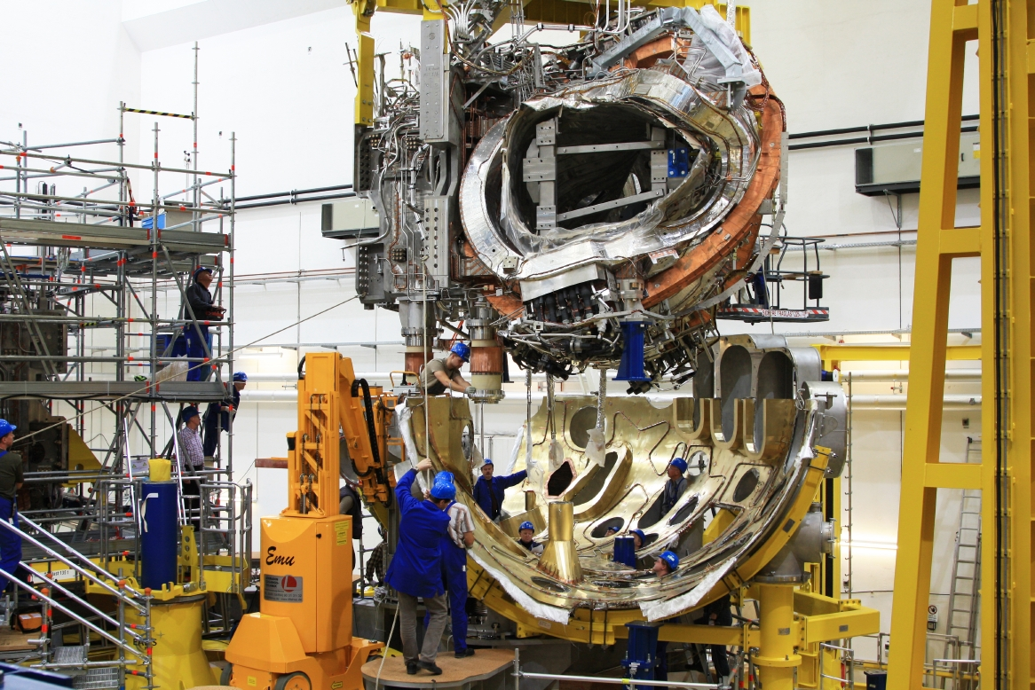
Integation of magnets and cryostat
T. Klinger on Wendelstein 7-X 24

Slide 25
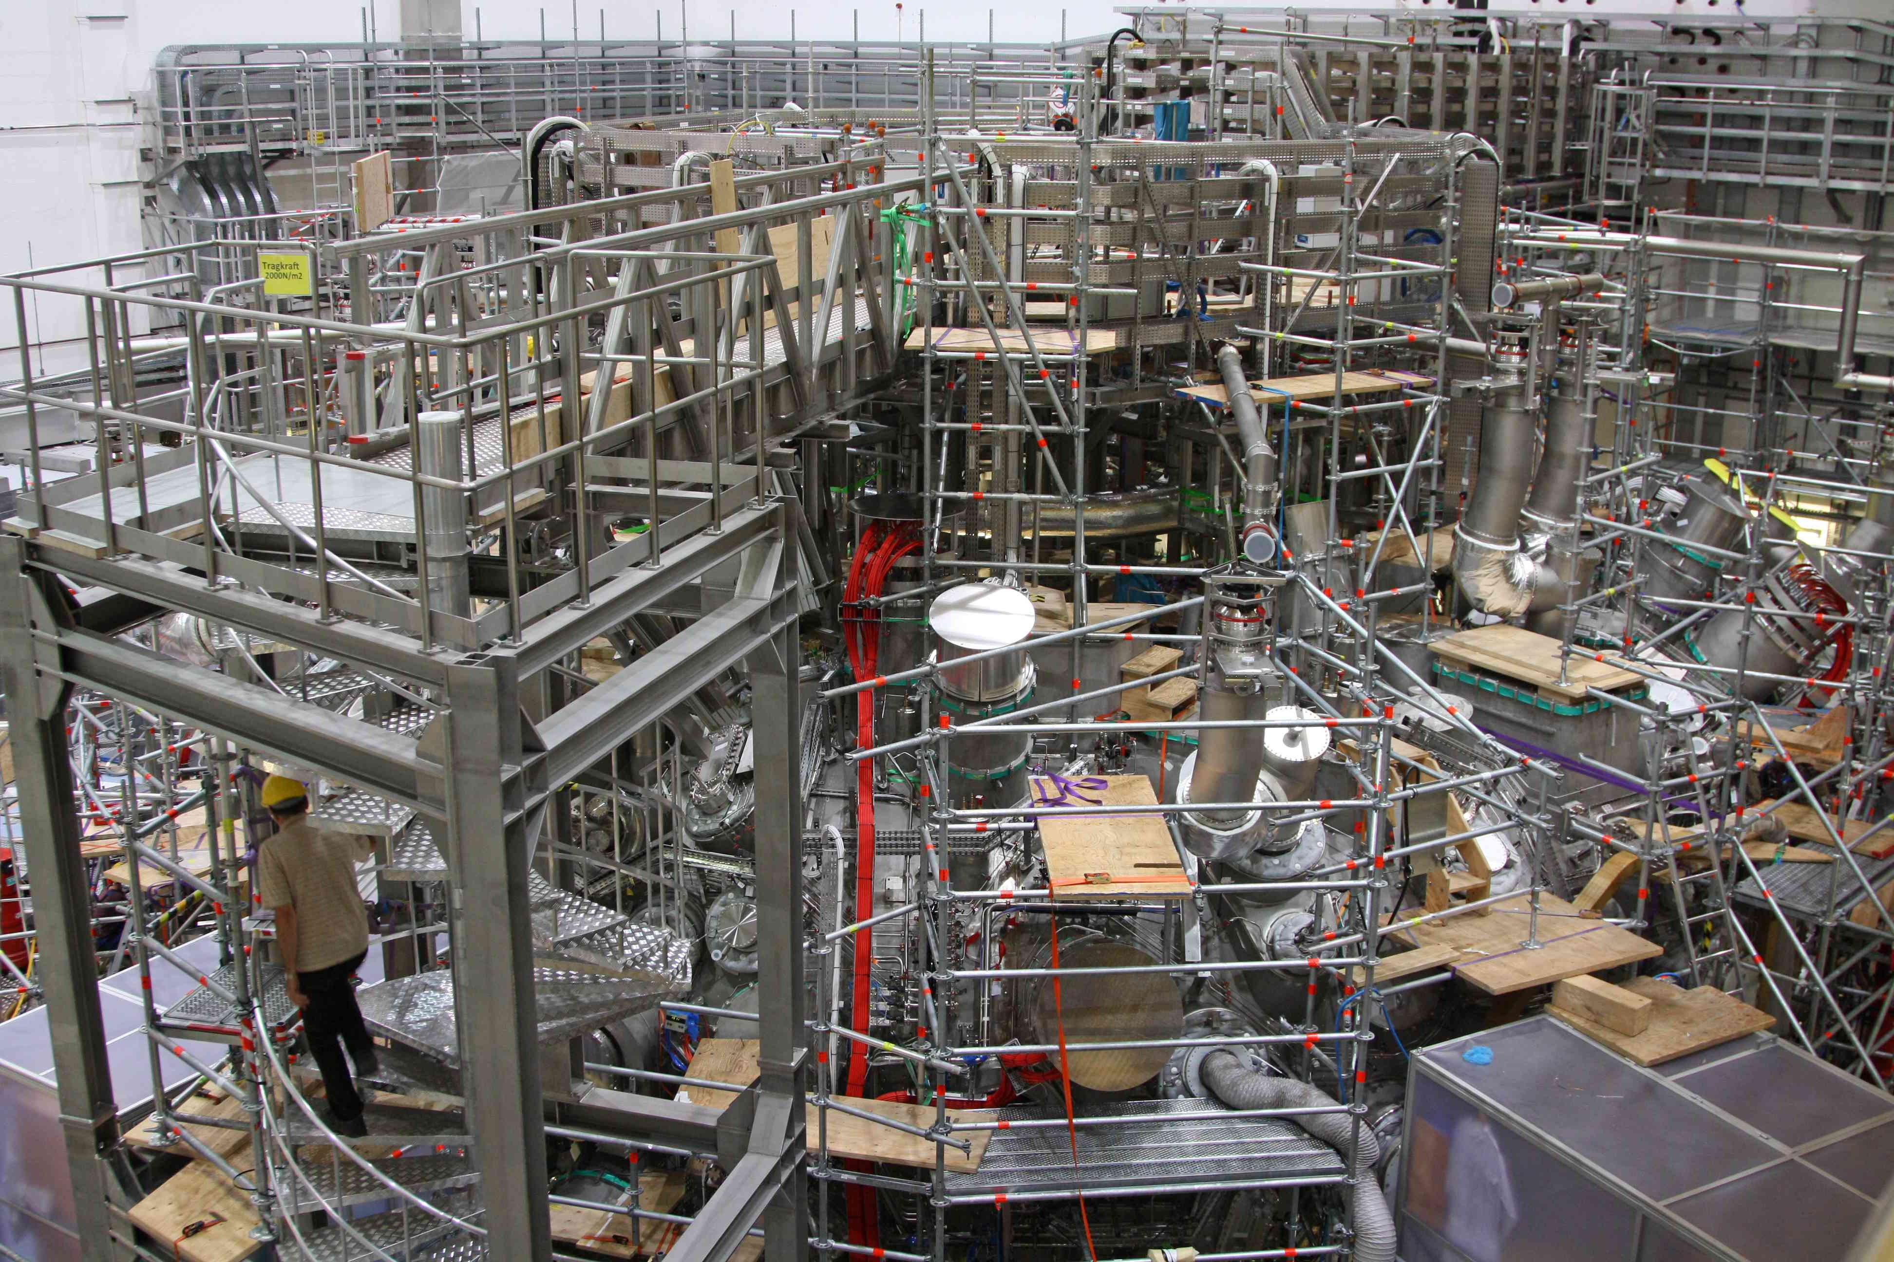
The device is complete
T. Klinger on Wendelstein 7-X 25

Slide 26
Movie Time
W7-X time lapse

Slide 27
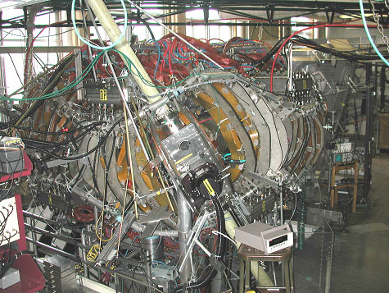
HSX: the Helically Symmetric Experiment
Major Radius | 1.2 m
Minor Radius | 0.12 m
Number of Field Periods | 4
Coils per Field Period | 12
Rotational Transform | 1.05 →1.12
Magnetic Field | 0.5 T
ECH Power (2nd Harmonic) | <100 kW 28 GHz

Slide 28
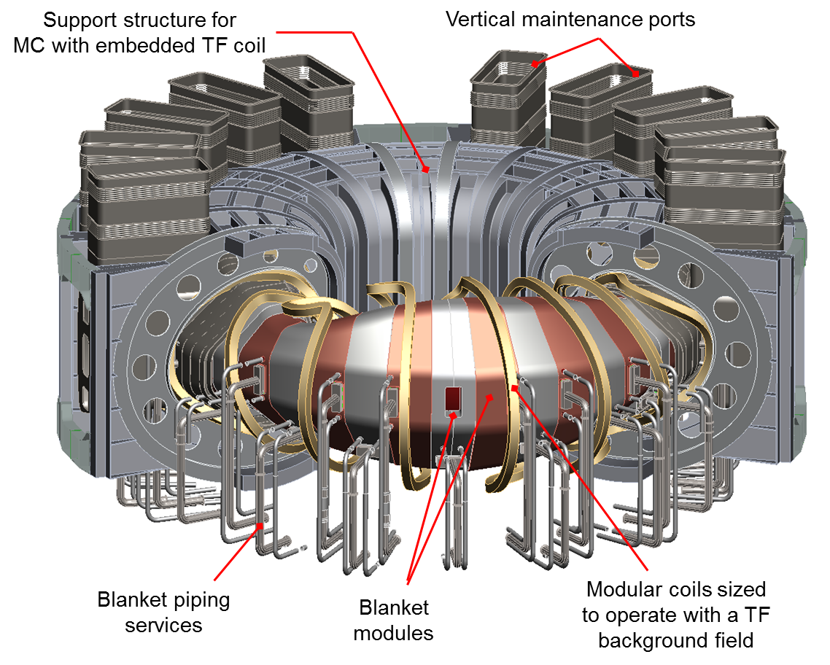
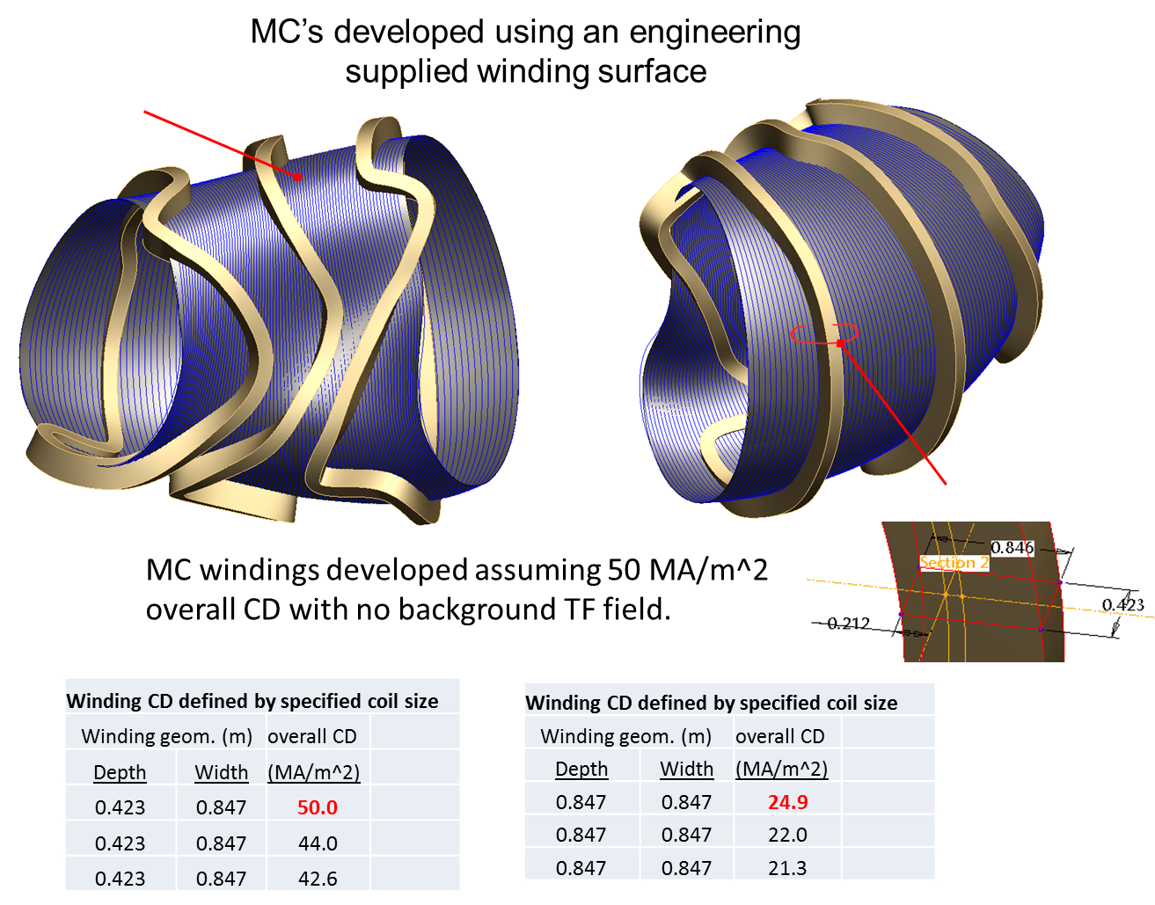
Simplified Coils
Using Improved Algorithms
Coils now represented as splines rather than as Fourier series
  Has been used to design a device with clear access for maintenance
Technique facilitates any set of spatial constraints
Coils and winding surface
Cutaway view of accessible stellarator – straight out legs

Slide 29
Stellarators can solve many of the problems of fusion energy
Good confinement
Steady state operation
High density and temperature
W7-X is leading the way in optimized stellarator operation

Slide 30
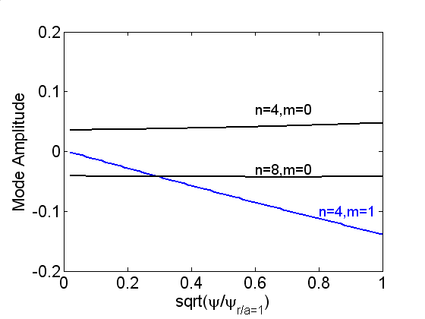
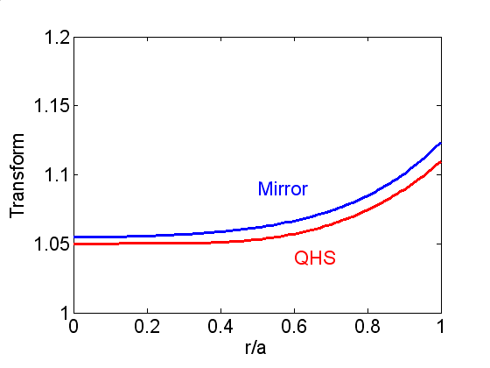
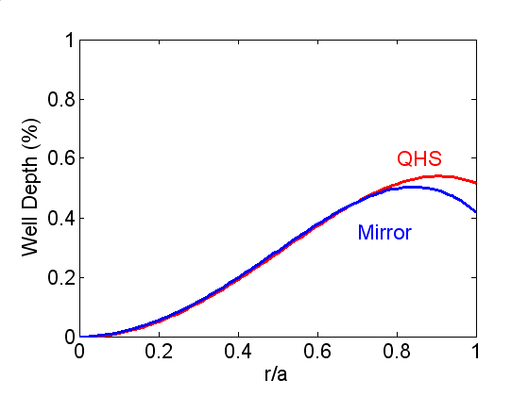
Symmetry can be Broken with Auxiliary Coils
Aux coils add n=4 and 8, m=0 terms to the magnetic spectrum
  Called the Mirror configuration
  Raises neoclassical transport towards that of a conventional stellarator
Other magnetic properties change very little compared to QHS
  Separates the effects of the magnetic spectrum on transport
Mirror Magnetic Spectrum
Rotational Transform
Well Depth

Slide 31
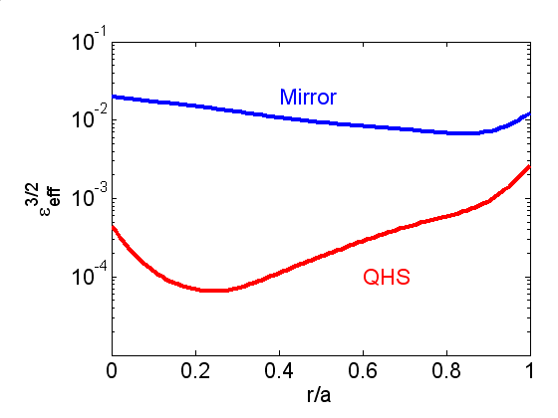
Core Mirror Symmetry Breaking is Large
C.D. Beidler et al., PPCF 36 (1994) 317
ε_{eff} at r/a = 2/3
QHS: 0.005
Mirror: 0.04

Slide 32
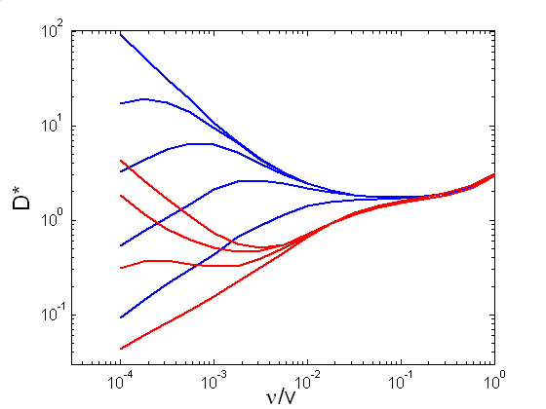
Neoclassical Transport is Reduced in the Quasisymmetric Configuration
Monoenergetic diffusion coefficients calculated with Drift Kinetic Equation Solver (DKES*)
Data is fit to an analytic form, including 1/ν, ν^{1/2}, and ν regimes of low-collisionality transport
Integration over Maxwellian forms thermal transport matrix
Mirror
E_{r}
QHS
HSX Parameters
*W.I. van Rij and S.P. Hirshman, Phys. Fluids B 1, 563 (1989).

Slide 33
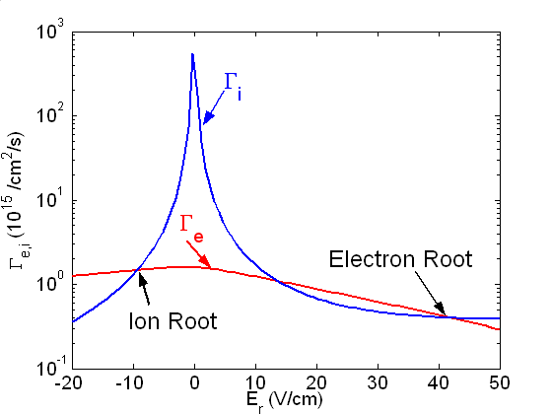
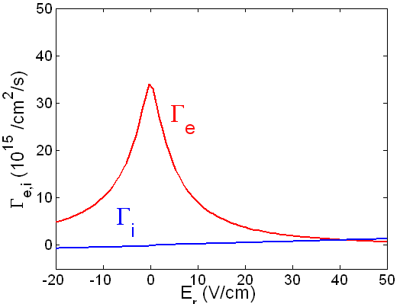
The Ambipolar Electric Field has a Large Effect on Neoclassical Transport
Electric field is determined by ambipolarity constraint on neoclassical fluxes
This has up to three solutions: the ion and electron roots, and an unstable intermediate root
In HSX plasmas T_{e} >> T_{i}
  In Mirror, only electron root exists
  Large electric field reduces Mirror transport/neoclassical differences with quasisymmetric field
T_{e} ~ T_{i}
HSX Parameters:
T_{e} >> T_{i}

Slide 34
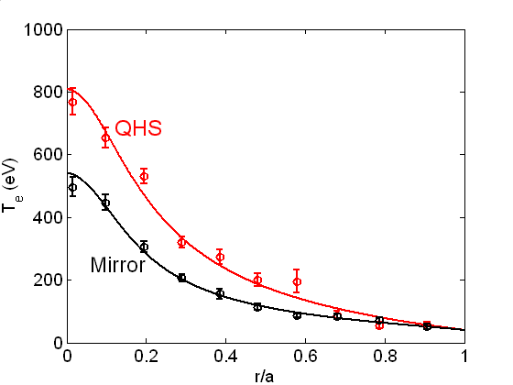
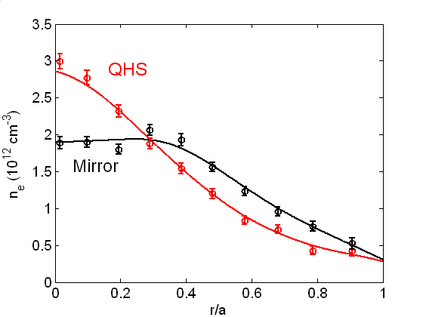
Large Differences are Observed between QHS and Mirror Profiles
Plasma density and temperature profiles are measured with a 10-channel Thomson scattering system
Discharges shown: ~50 kW of ECRH power, central deposition
QHS has higher temperature, more peaked density profile
Electron Temperature
Electron Density

Slide 35

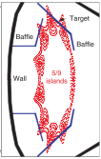
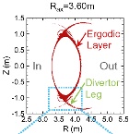
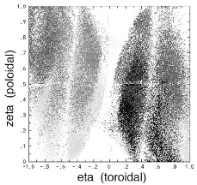
Stellarator Divertor Approaches
LHD
W 7X
NCSX
3 Different strategies for stellarator divertors: islands vs stochastic spreading
Need to test experimentally: exhaust handling, impurity control
Controlled detachment obtained in LHD and W7X.

Slide 36
Smoother Coils at Higher Aspect Ratio
A = 4
A = 6
A = 8
Aspect ratio scan, all have iota-vac=0.3, kink/RWM stable
Shown with constant volume. Larger A ⇒ larger R
Increasing aspect ratio reduces coil distortion, disentangles coils
All these coil designs can likely be built. Which is best?
What aspect of simplicity is important?

