Slide 1

An Introduction to Magnetohydrodynamics for Magnetic Confinement
Carl R. Sovinec
University of Wisconsin-Madison
2017 Summer Science Undergraduate Laboratory Internship, One-Week Course
June 12, 2017 Princeton Plasma Physics Lab

Slide 2
Outline
Introduction
  What MHD describes
  Relation to plasma physics
Examples of macroscopic dynamics
MHD models
  Ideal vs. non-ideal
  Reduced
  Application - Aflvén waves
Paradigm typically used in analysis
  Equilibrium
  Stability
  Nonlinear evolution
  Violation of conventional paradigm
Conclusions
Plasma Physics at UW-Madison

Slide 3
Magnetohydrodynamics describes the interaction of electrically conducting fluid and magnetic field.
Perpendicular compression increases magnetic field and fluid pressure.
Parallel compression only increases fluid pressure.
Perpendicular shear bends magnetic field.
Parallel shear does not excite stress in ideal MHD.

Slide 4
“Frozen magnetic flux” is a fundamental concept.
Magnetic flux is frozen into (or out of) each parcel of an extremely good (“ideal”) conductor.
  Faraday’s law:
  Ideal conductor: E=0 in fluid-parcel reference frame.
B
B
Squeeze
A
A
Magnetic field-lines are tied to electrically conducting fluid parcels.

Slide 5
Electrical current density that is perpendicular to B leads to force-density.
Roughly, bending of B or spatial variation of |B| leads to electrical current density.
  Ampere’s for magneto-’statics’ (or slow wrt c):
  Lorentz force density:
B
B
F
J
F
J
J
F
Magnetic field and conducting fluids interact though Lorentz force density and frozen-flux effects.

Slide 6
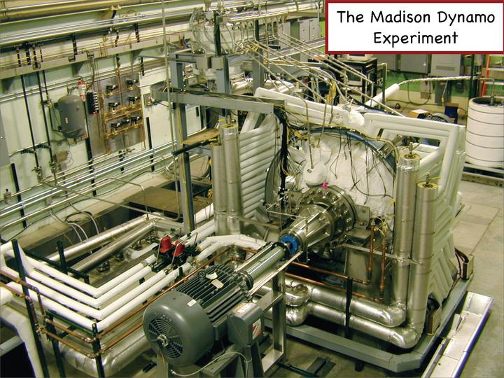
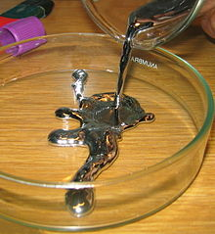
MHD is an excellent model for liquid metal/magnetic field interaction.
Liquid sodium dynamo experiment at Wisconsin [plasma.physics.wisc.edu/viewpage.php?id=mde].
Mercury at room temperature [Wikipedia].

Slide 7
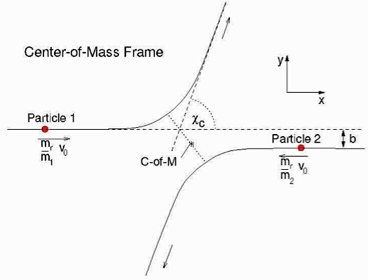
Applying MHD to magnetically confined plasma invokes many simplifications.
Fluid models for plasma species are valid when:
  Particles effectively collide with each other faster than dynamical evolution.
  Effective particle mean-free path is shorter than scales of dynamics.
  Particle gyro-orbits are small relative to spatial scales.
Particle collision sketch from MIT Open Course Ware 22.105.
MHD represents further approximations.
  Plasma remains approximately charge-neutral.
  Dynamics are slow relative to gyromotions and light-wave propagation.
Macroscopic dynamics in magnetic confinement plasma seldom satisfy all of these conditions!
  For example, T_{e}=1 keV, n=5×10¹⁹ m⁻³, mfp ~ 300 m >> L .
Notes:
MHD gyro-orbs -> 0.

Slide 8
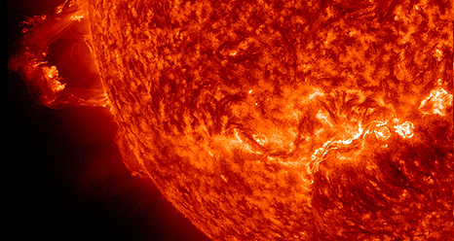
Nonetheless, MHD provides a good starting point for understanding macroscopic plasma dynamics.
Double solar prominence eruption on Nov. 16, 2012 imaged by NASA’s Solar Dynamics Observatory. [See sdo.gsfc.nasa.gov]
You can’t understand plasma dynamics by studying MHD alone, but you probably won’t understand magnetized plasma dynamics without studying MHD.

Slide 9
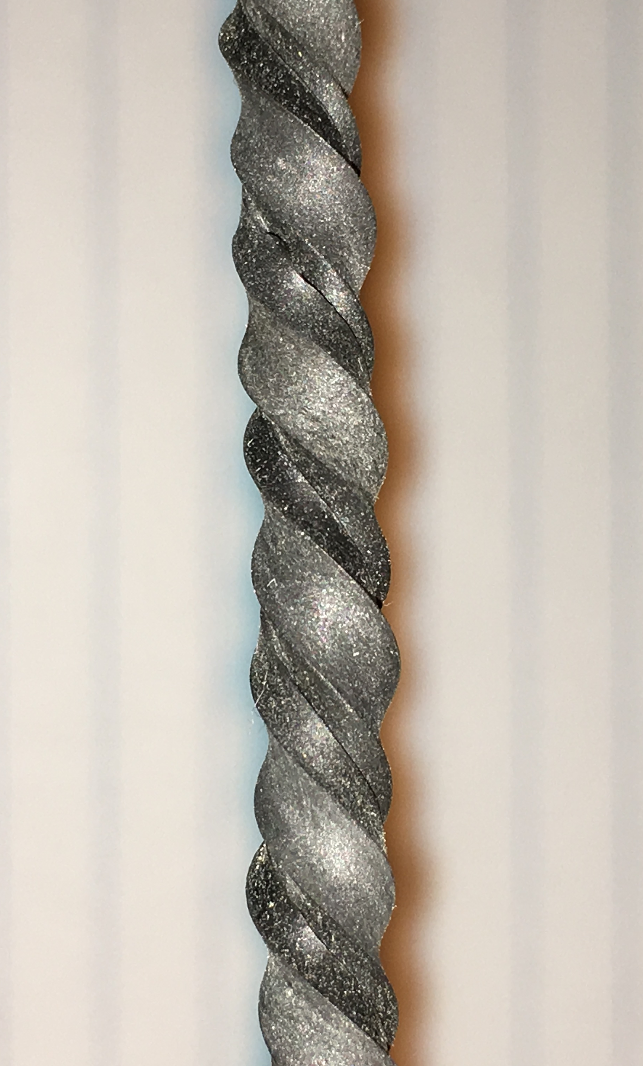
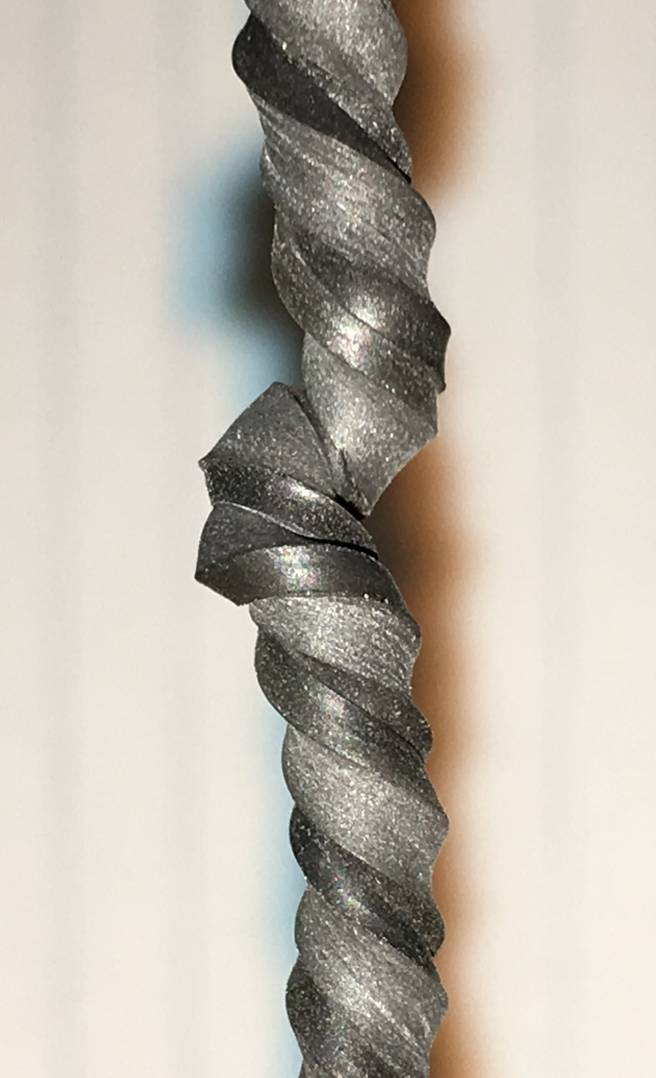
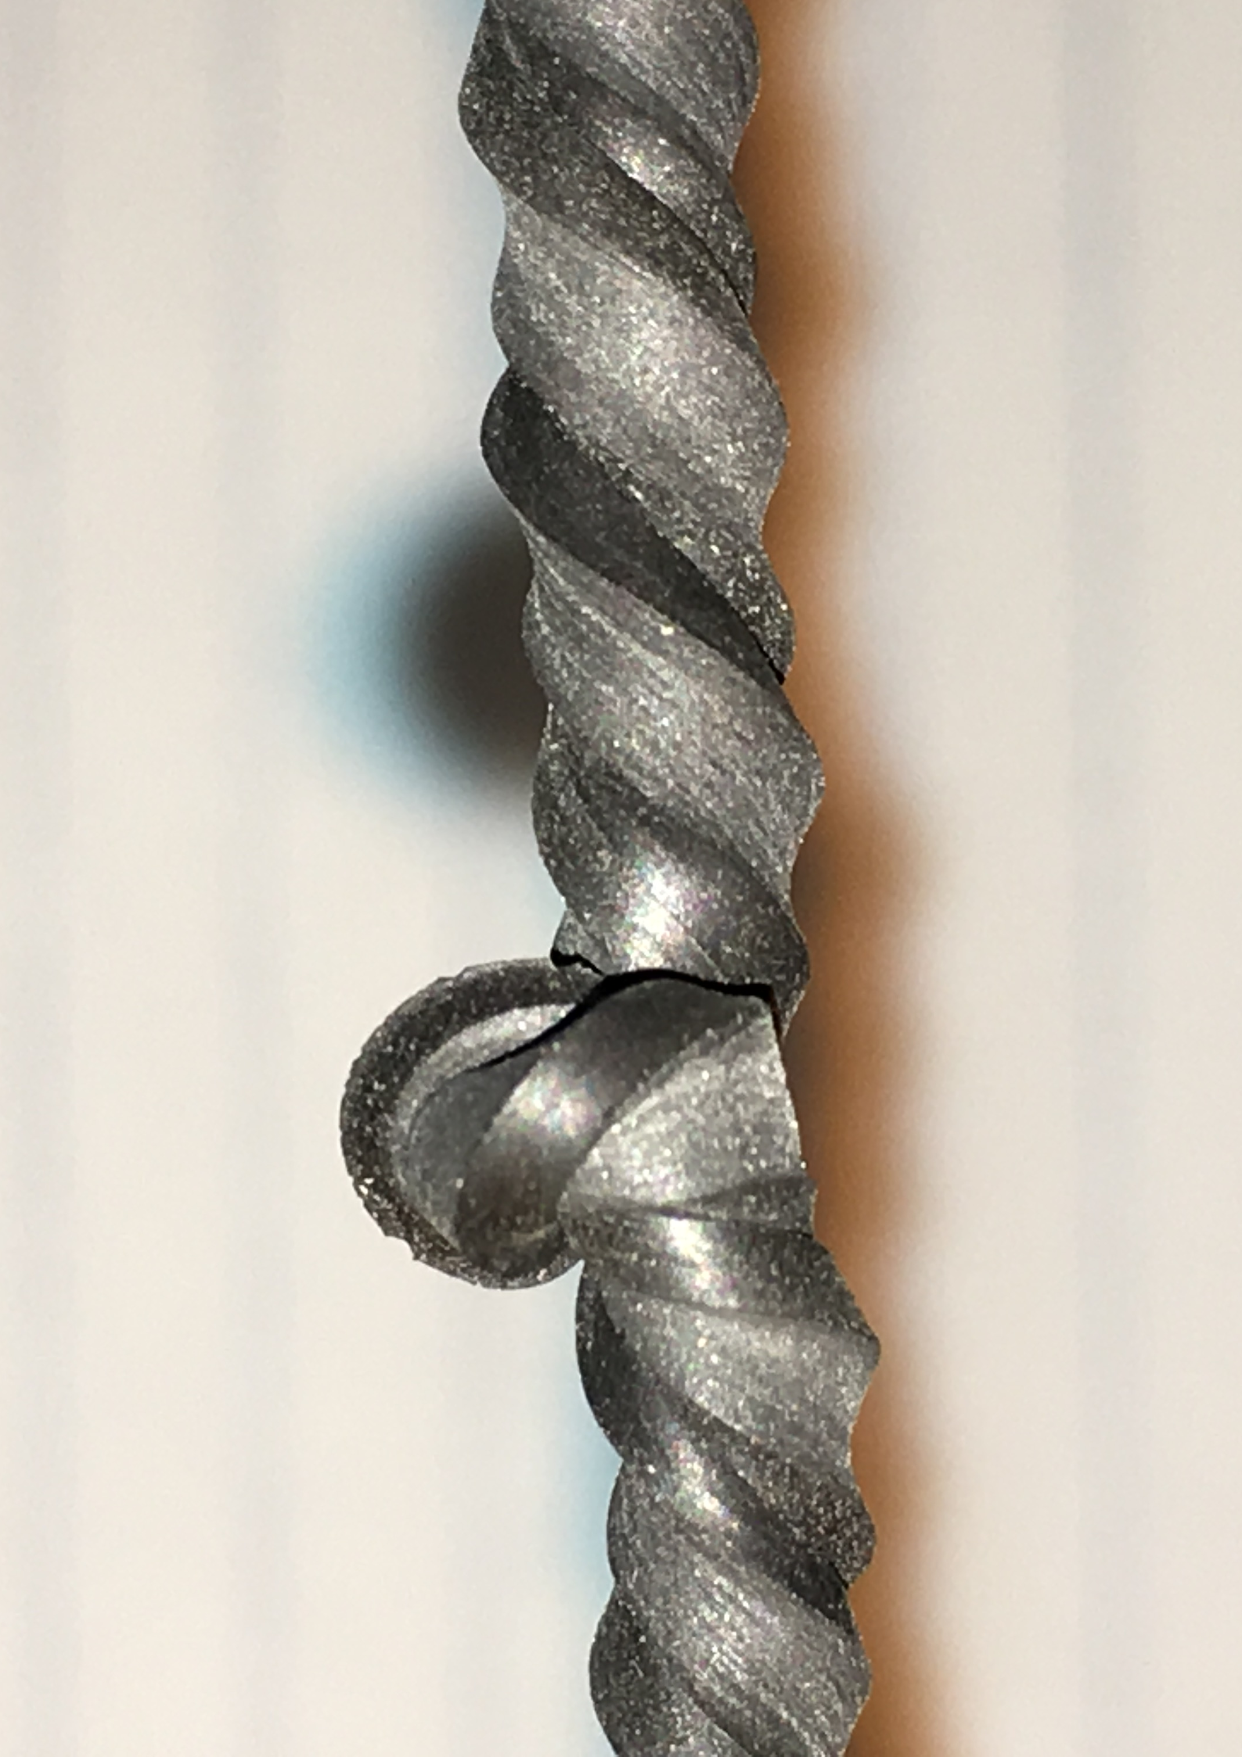
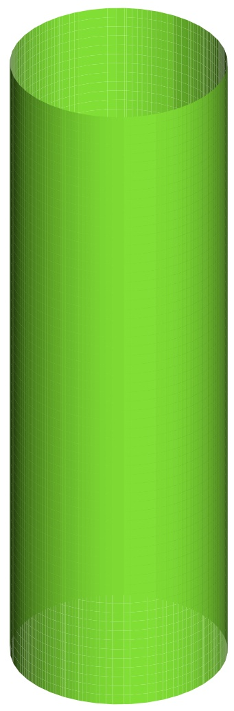
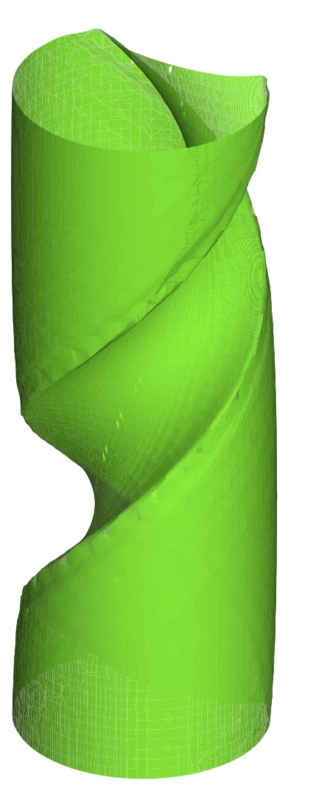
Examples of MHD: 1) External kink deforms the plasma surface or entire plasma shape.
Kink deformation is analogous to the formation of knots on twisted rubber bands.
The deformed state has less potential energy than a symmetric state with the same degree of twist / current density.
Initial Shape
During Kink
Knot formation with increasing twist of a rubber band.
Cylindrical MHD computation of (1,1) external kink.

Slide 10
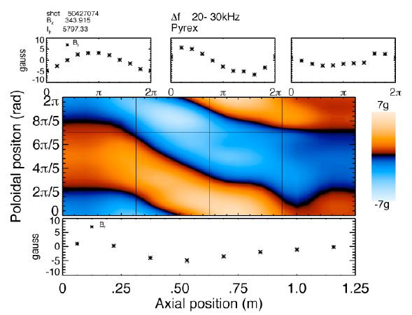
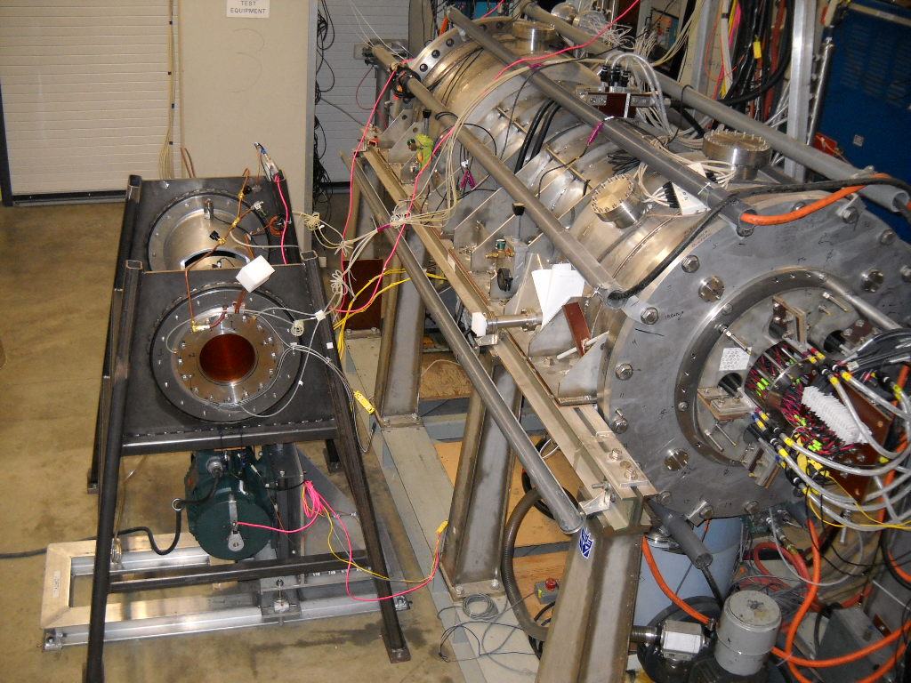
External kink dynamics need to be controlled in experiments.
Discharge profile control is the first step.
Passive conductors and active magnetic feedback can be used.
Rotating plasma relative to conductors helps maintain stabilizing eddy currents.
Kink deformation is evident from surface-B measurements. [See
plasma.physics.wisc.edu/rwm-gallery]
The Rotating Wall Machine investigated relative plasma/conductor motion.

Slide 11
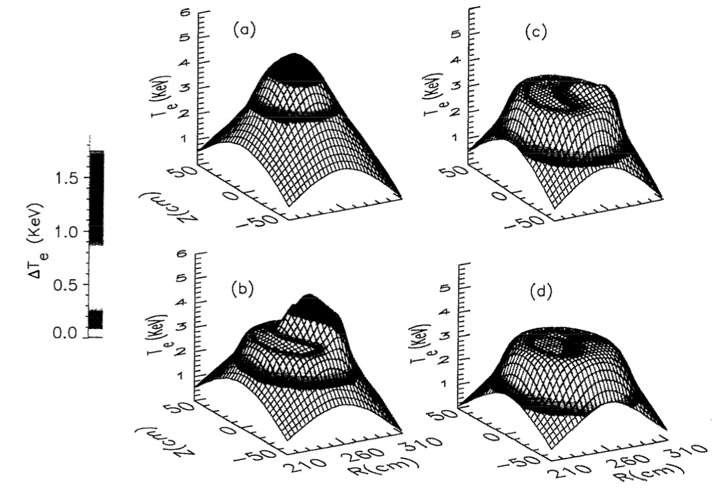
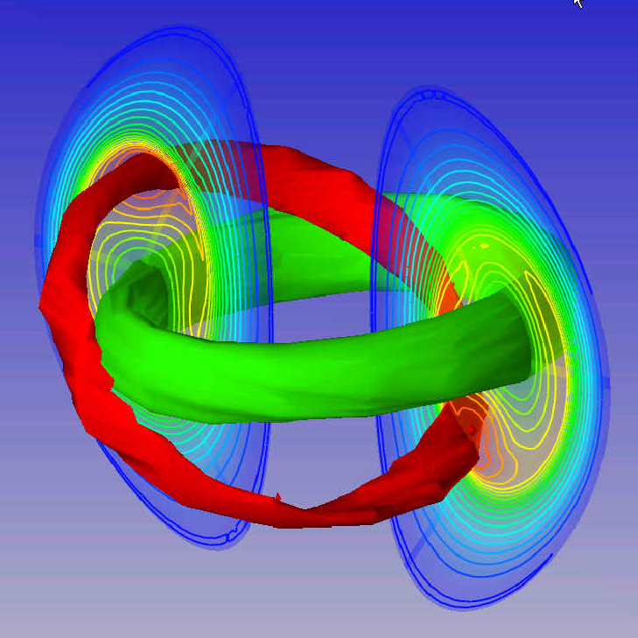
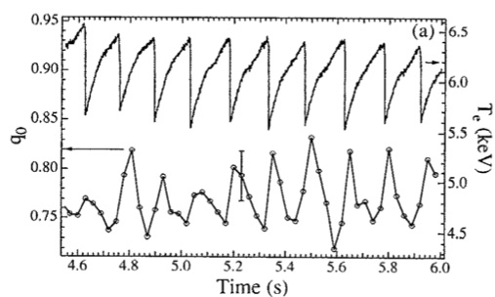
2) Internal kink is related but only affects the core of the plasma.
Simulation of internal kink in NSTX by W. Park, PPPL.
TFTR electron temperature profile is lopped-off by sawtoothing [Yamada, et al., Phys. Plasmas 1, 3269].
Internal kink can be relatively benign.
Repetitive kink behavior is called “sawtoothing” due to its effect on central-T_{e}. [Yamada, et al.]

Slide 12
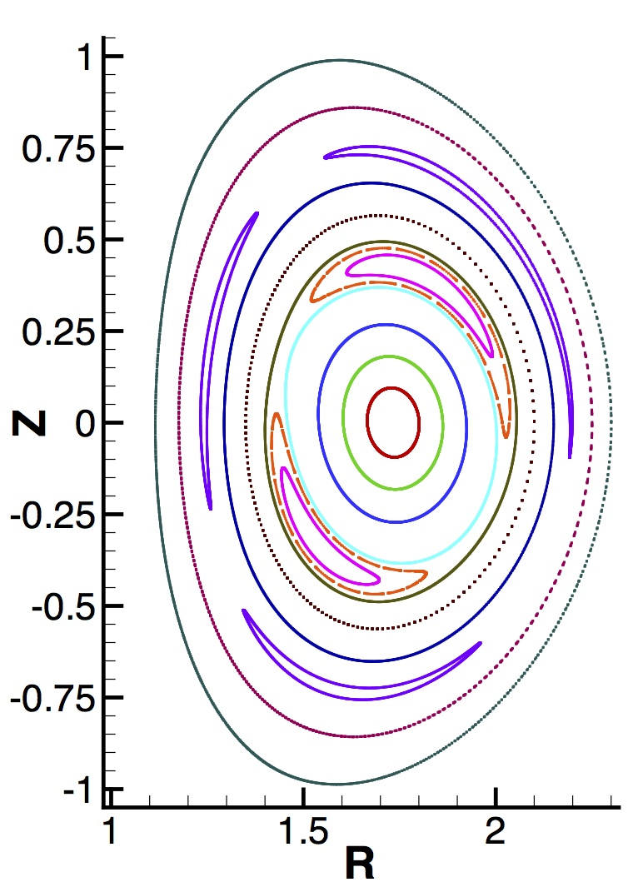
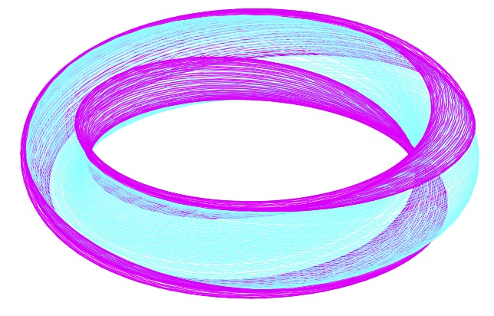
3) The development of large magnetic islands alters confinement.
Magnetic islands are topologically isolated helical structures that result from reconnection. [from NIMROD computation]
Magnetic “reconnection” alters field-line connectivity.
Isolated magnetic islands in tokamaks provide limited short-circuits for heat to escape more readily.

Slide 13
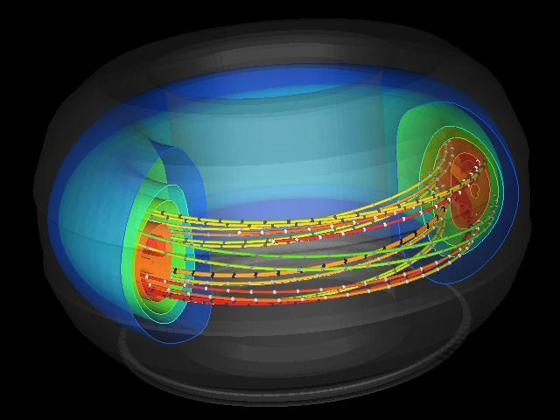

The overlap of magnetic islands in tokamaks is more problematic.
Magnetic-island overlap allows significant and rapid energy loss and changes in electrical conductivity.
This process results in a disruptive termination of a discharge.
High-pressure disruption simulation by S. Kruger and A. Sanderson [Phys. Plasmas 12, 56113].

Slide 14
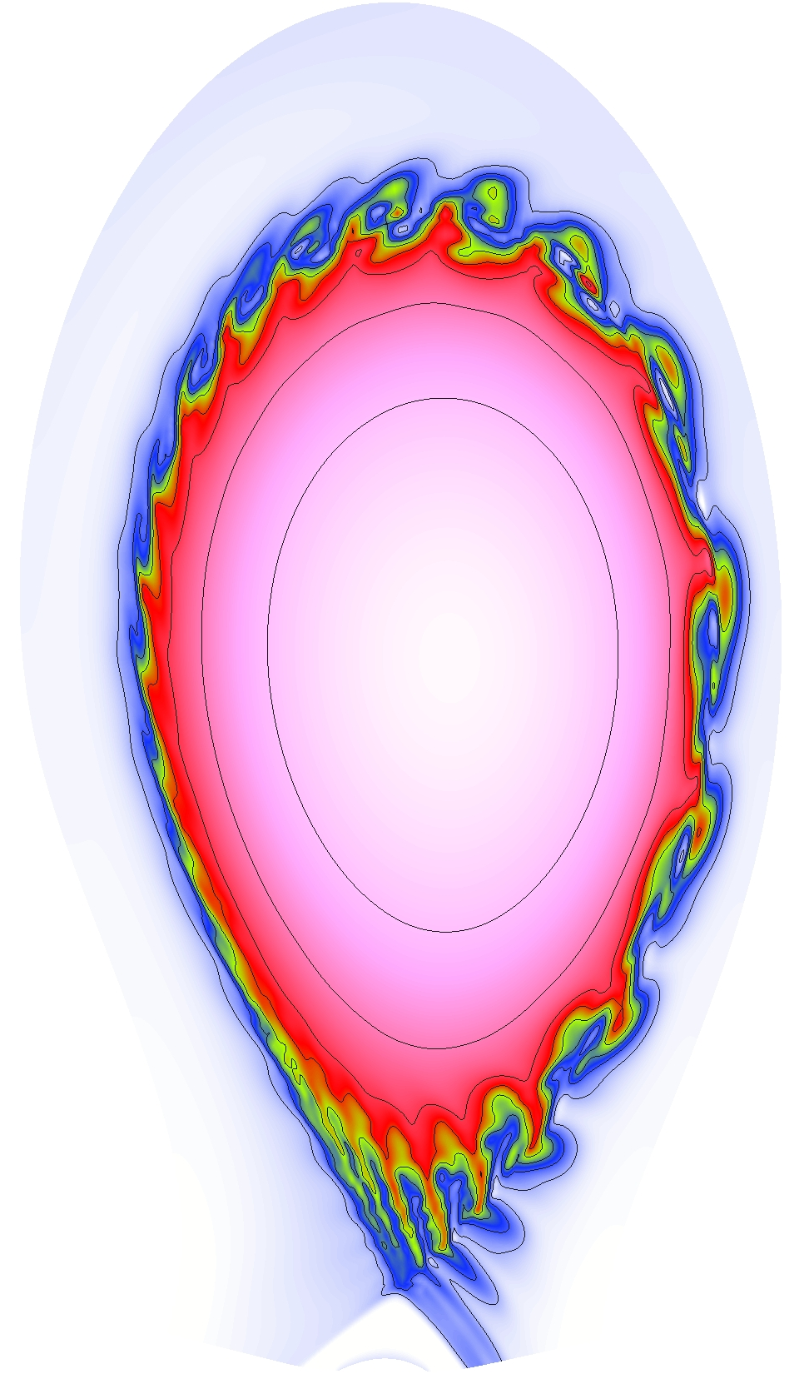
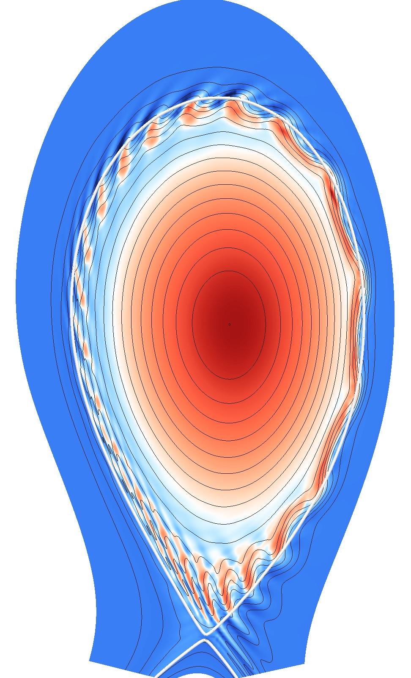
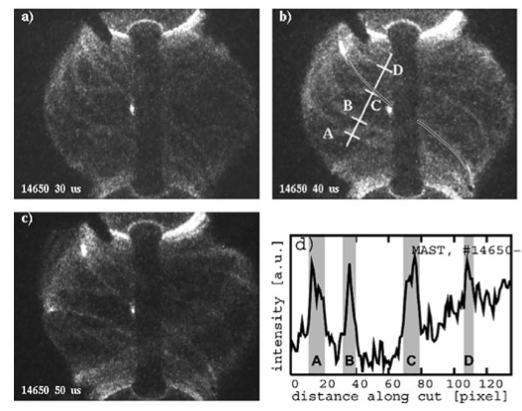
4) Edge-localized modes are a combination of “ballooning” and surface kink.
Edge-localized modes (ELMs) result from large gradients near the edge of the confinement region.
ELMs make heat loading intermittent – a concern for ITER.
Particle and current density from an ELM simulation by G. Huysmans [PPCF 51, 124012].
Framing-camera images of ELMs in the MAST experiment [Koch, et al., JNM 363, 1056].

Slide 15
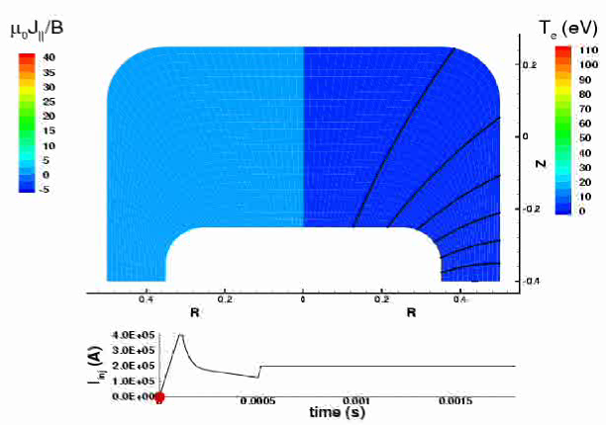
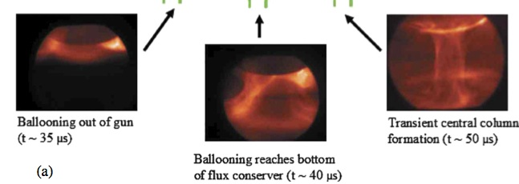
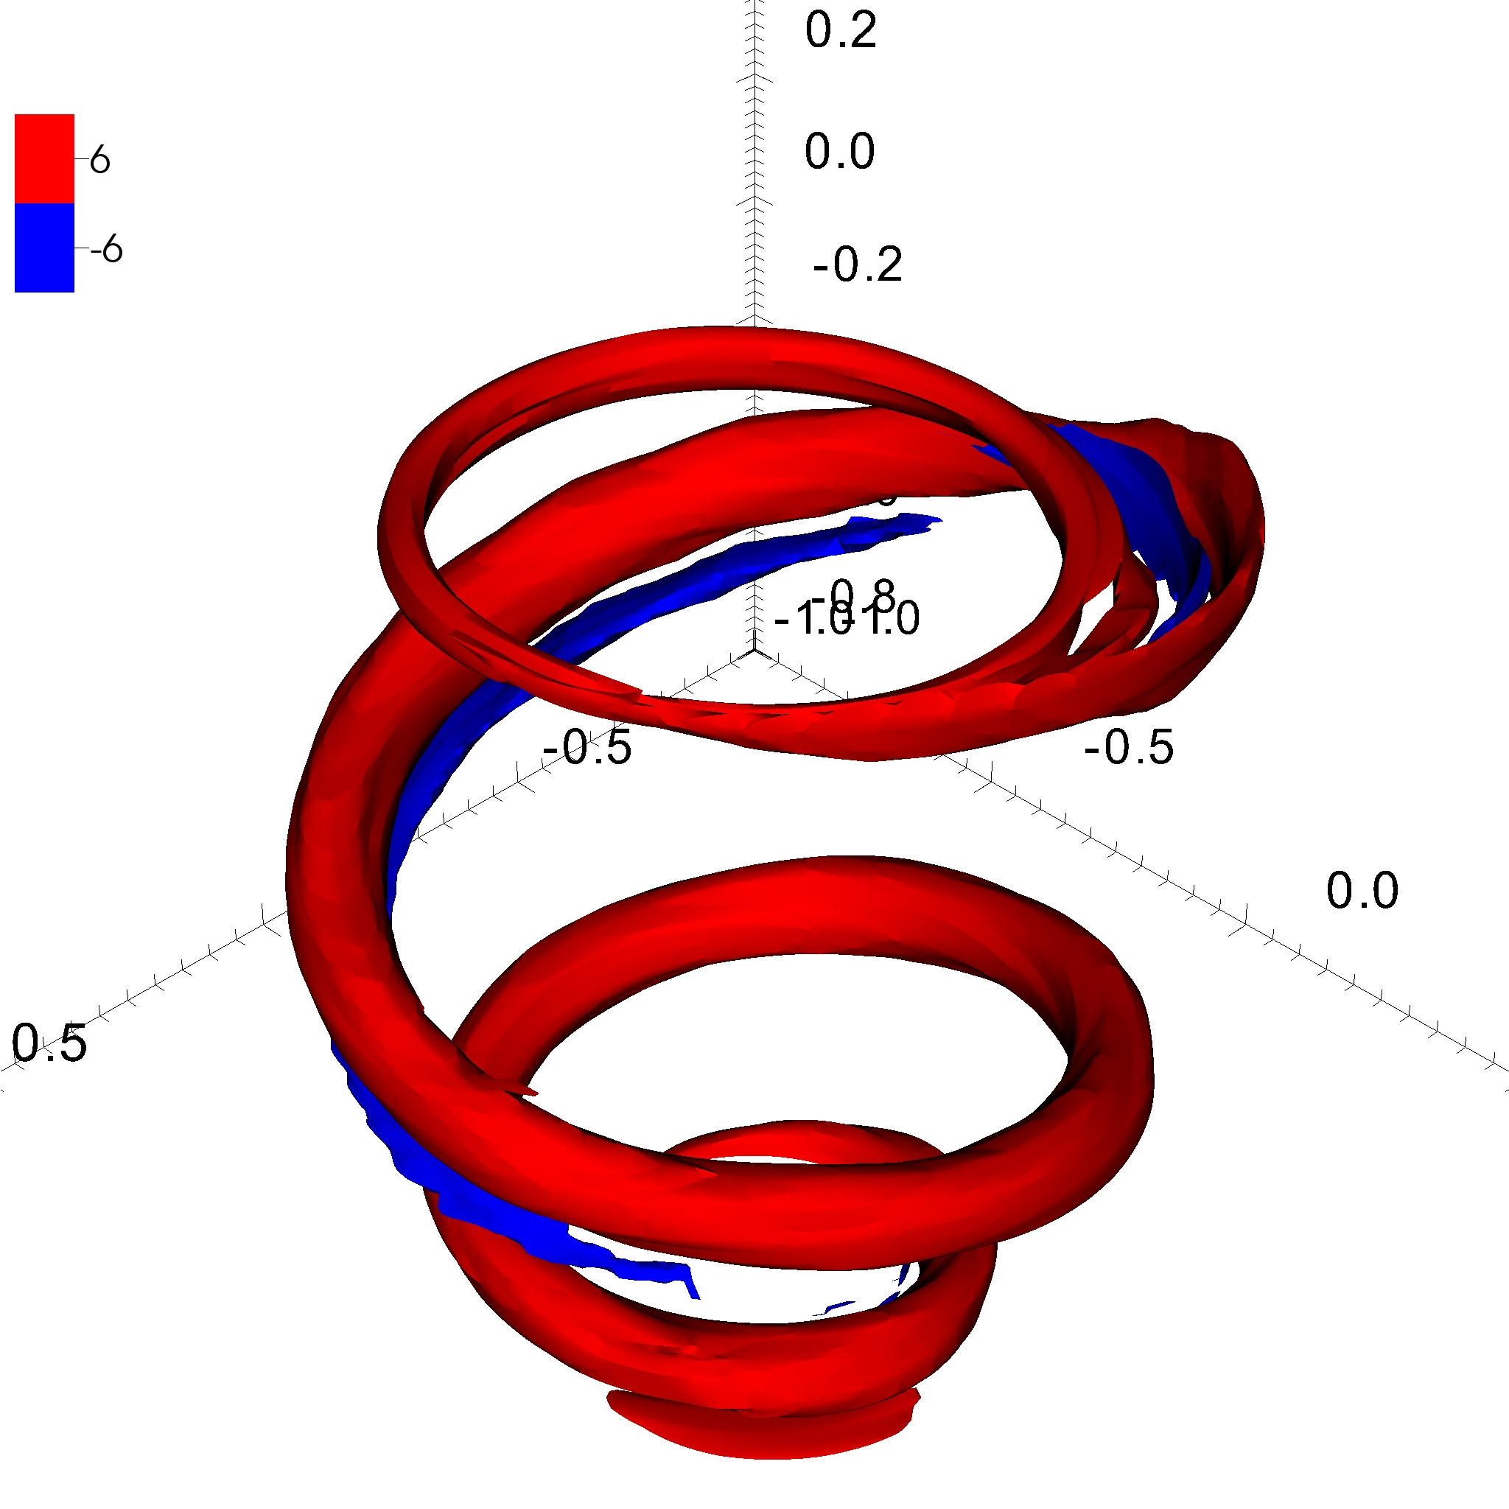
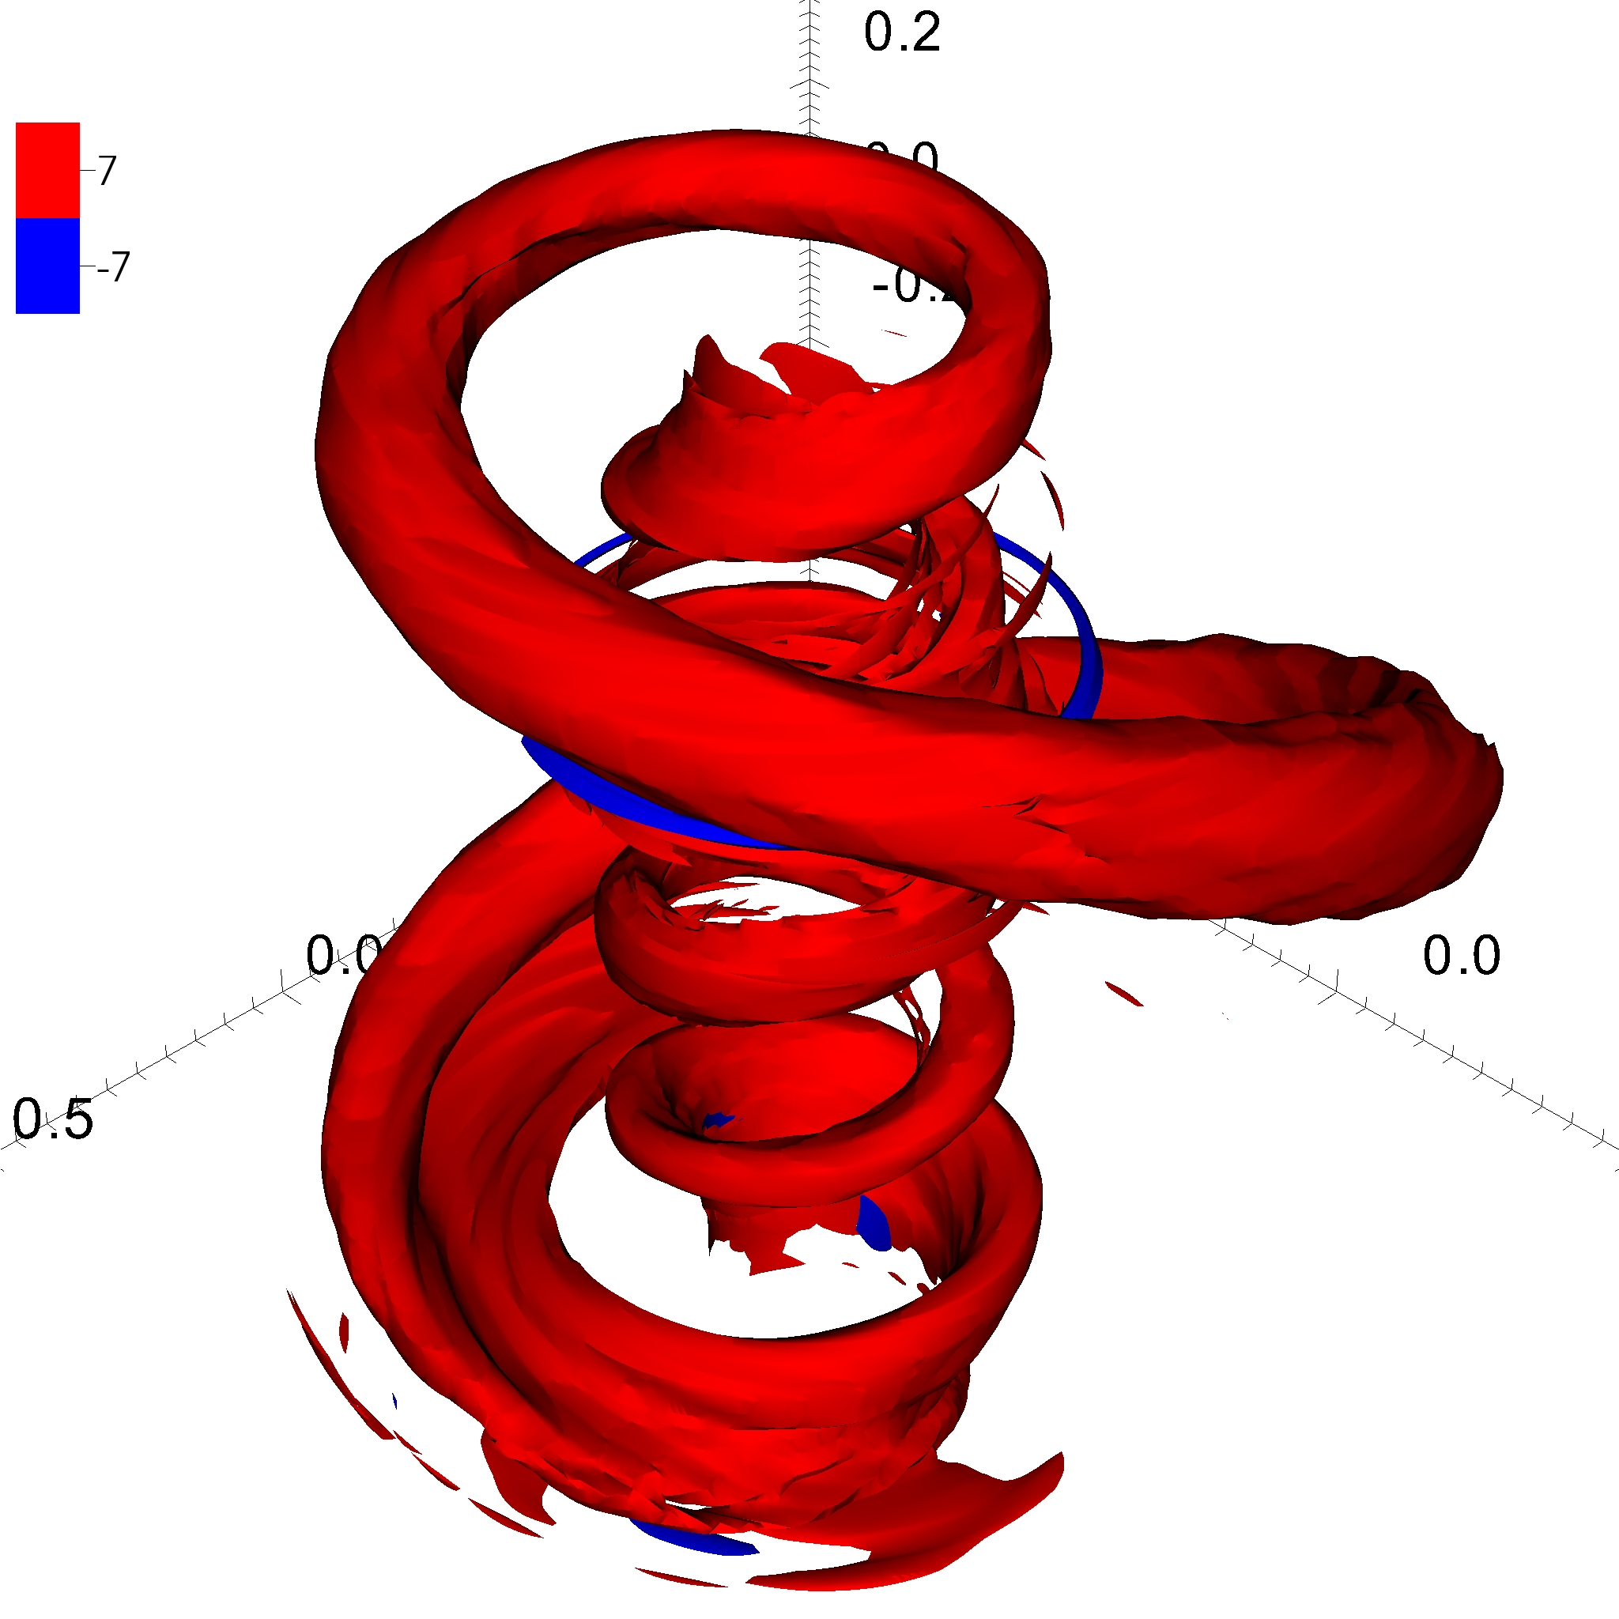
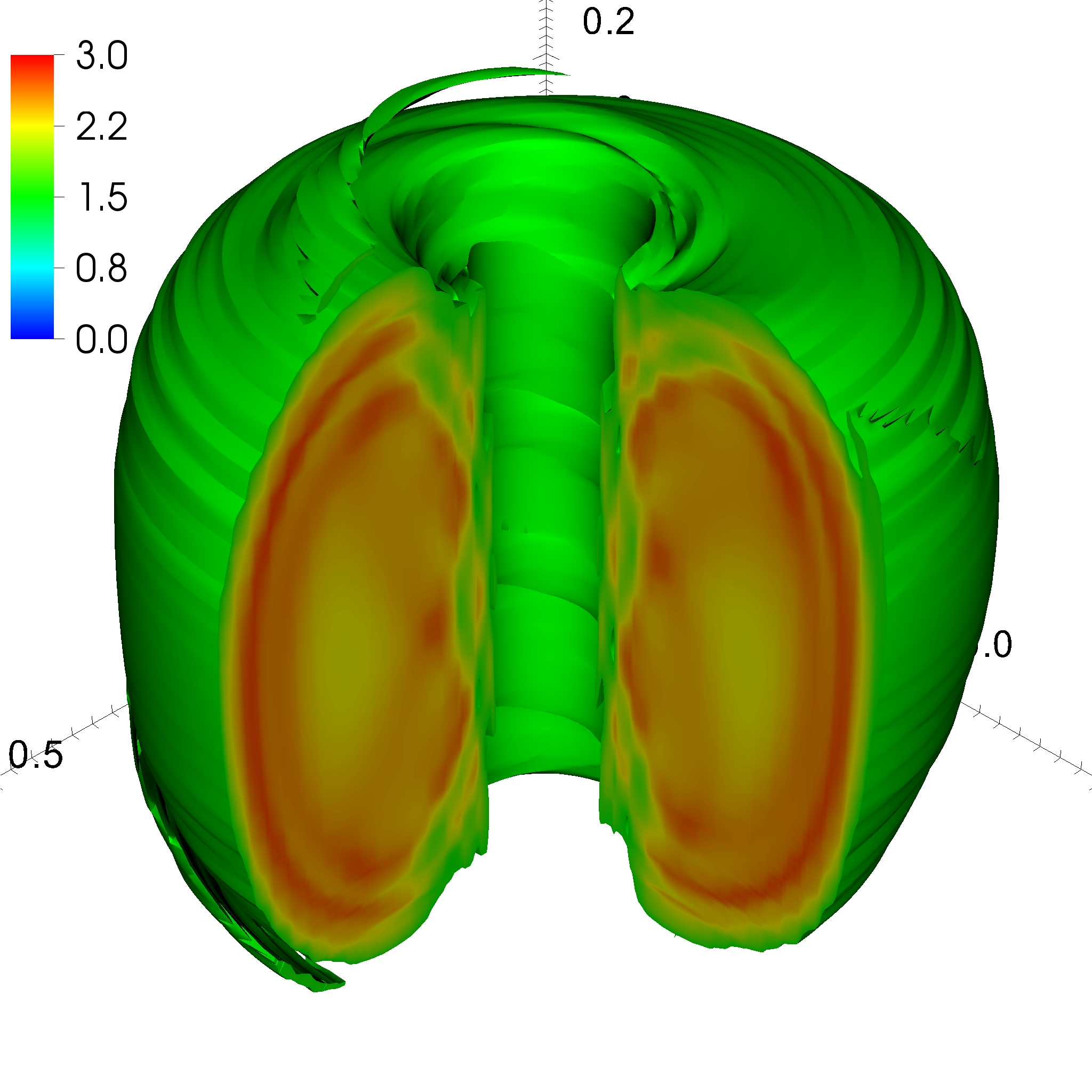
5) Magnetic relaxation is non-disruptive MHD that alters magnetic configurations.
Relaxation involves nonlinear MHD and magnetic reconnection.
Images from SSPX experiment (above) [Hooper, et al., PPCF 54, 113001] and NIMROD simulation (right) [Sovinec, et al., PRL 94, 035003].
Simulation of Pegasus startup by J. O’Bryan [PPCF 56, 064005].

Slide 16
MHD Models: Dependent variables are densities that are related to conserved quantities.
The independent variables are position (x) and time (t).
The dependent variables are:
  Mass density ρ(x,t)
  Momentum density ÷ ρ, i.e. center-of-mass flow velocity V(x,t)
  Internal energy density × (γ – 1), i.e. fluid pressure p(x,t)
  Magnetic induction (“field”), B(x,t)

Slide 17
MHD systems of equations represent conservation laws.
The most basic ideal system excludes dissipative effects.
Mass:
Momentum:
Energy:
Magnetic flux:
Divergence constraint:
Constitutive relation (ideal-E):

Slide 18
Other forms admit alternative interpretation of terms.
Using vector identities, the same system is equivalent to:
Mass:
Flow evolution:
Pressure:
Faraday’s:
Divergence constraint:
Constitutive relations:

Slide 19
Non-ideal MHD systems include dissipative effects.
Adding electrical resistance, viscous stress, and thermal conduction leads to:
Mass:
Flow evolution:
Internal energy:
Resistive-MHD Ohm’s:
Constitutive relations:

Slide 20
Reduced systems build-in approximations to isolate dynamics of interest.
“Reduced MHD” assumes that dynamics avoid perpendicular compression [Strauss, Phys. Fluids 19, 134].
In the limit of large aspect ratio (R/a = 1/ε >> 1) and guide field (B_{φ}), and vanishing pressure (after normalizing):
Stream function evolution
Parallel vector potential
Incompressible Navier-Stokes is a similar reduction for fluid dynamics.

Slide 21
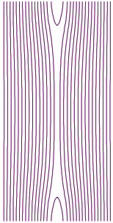
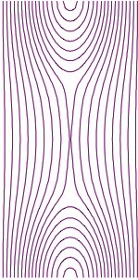
The different MHD systems have different uses.
Ideal MHD describes fast dynamics.
  MHD waves
  Fast instabilities
Resistive MHD describes slippage of B and imperfectly conducting fluid.
  Magnetic reconnection [see Prof. Loureiro’s presentation]
  Slower instabilities
Reduced MHD is an efficient description of subtle dynamics that remain near force-balance.
B
B
Contours of magnetic flux from a simple configuration illustrate magnetic reconnection.

Slide 22
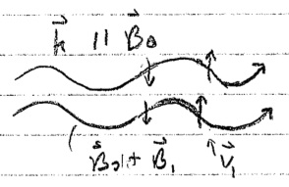
Application of MHD equations - Alfvén waves
Alfvén waves are fundamental to MHD behavior.
They are electromagnetic and wiggle magnetic field.
They can transfer information and energy.
Sketch of Alfvén-wave dynamics.

Slide 23
Sinusoidal perturbations along uniform B₀ allows a quick derivation.
z
Distinguish small perturbations (₁) from uniform background (₀).
Assume oscillatory, sinusoidal flow (justify later).
Evaluate E₁.
Find B₁ by integrating Faraday’s.
y
x
Ampere’s provides J₁.
Find Lorentz force density.
0

Slide 24
Relating force density and acceleration leads to a dispersion relation.
Evaluate acceleration.
Assemble in flow-velocity equations for perturbations – supports V₁ oscillation.
z
J₁
V₁
y
B₁
Relating coefficients, we find the dispersion relation for Alfvén waves:
x

Slide 25


Paradigm: Standard analysis considers equilibrium, linear stability, and nonlinear evolution.
The approximate toroidal or cylindrical symmetry of many configurations motivates analysis about symmetric states.
Equilibrium refers to force-balance of symmetric states.
Linear stability assesses whether equilibrium states that are perturbed infinitesimally tend to return.
Mechanical analogies are insightful.
Stable equilibrium example.
Unstable* equilibrium example.
*nonlinearly due to dimples

Slide 26
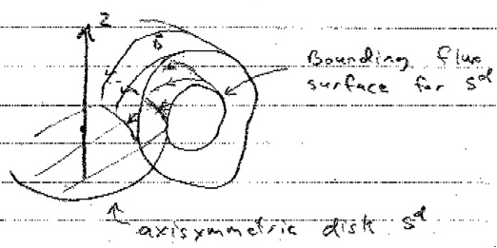
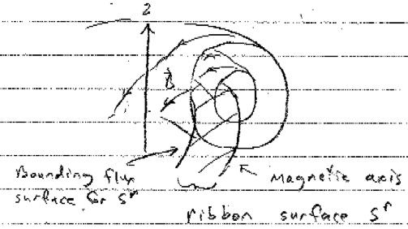
Static force-balance is a reduction of the flow-velocity equation.
In the absence of flows, the pressure gradient balances the Lorentz force density:
Well-posed boundary value problems are formulated in terms of magnetic flux functions.
  B-field lines trace-out surfaces in symmetric configurations
  Magnetic flux functions are integrals of B•dS between surfaces.
Sketch of poloidal disk-flux computation.
Sketch of poloidal ring-flux computation.

Slide 27
The Grad-Shafranov equation is a solvable restatement of the force-balance condition.
The dependent variable is related to the ring flux:
Magnetic field is expressed as
The force-balance relation implies that p₀ and I = RB_{φ} are functions of ψ-only.
Using this information, one can express as the Grad-Shafranov equation:
Boundary conditions fix ψ on a surface or represent ψ from external coils.

Slide 28
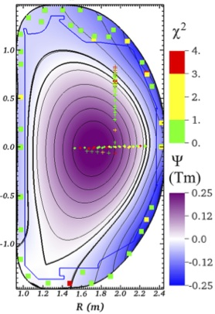
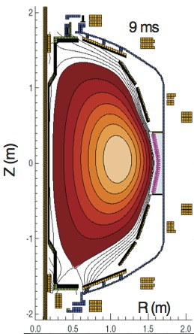
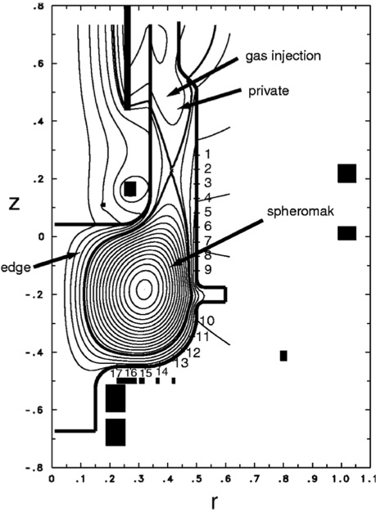
Grad-Shafranov solutions represent a variety of magnetic confinement configurations.
DIII-D tokamak [King, et al., PoP 24, 012504].
NSTX spherical torus during helicity injection [Raman, et al., PRL 97, 175002].
Gun-driven SSPX spheromak [Hooper, et al., PPCF 54, 113001].
Equilibria are often fit to sets of laboratory measurements.

Slide 29
Two general approaches are used assess linear perturbations.
Eigenvalue equations consider solutions for the linearized equations.
  Growth rates (and frequencies) are determined.
  The Alfvén-wave derivation is a simple example.
The ideal-MHD energy principle of Bernstein, Frieman, Kruskal, and Kulsrud [Proc. Royal Soc. A 244, 17 (1958)] focuses on stability.*
  The analysis is related to variational principles of linearized continuum mechanics.
  A system is linearly stable if all physically possible displacements increase potential energy.
*Also see J. P. Freidberg, Rev. Modern Phys. 54, 801 (review paper) and Ideal Magnetohydrodynamics, Cambridge Univ. Press (1993).

Slide 30
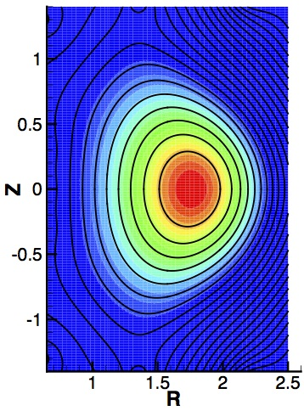
Magnetic confinement has two primary sources of potentially destabilizing energy from MHD.
In toroidal geometry, B₀ must twist to prevent net outward drifts. [See Dr. Collins’ presentation.]
The resulting B₀ has toroidal and poloidal curvature.
#1) The alignment of curvature with leads to free energy; the perturbed ideal-MHD energy contribution is
Cross section of plasma pressure contours (color) and magnetic flux (black lines). κ from B_{pol} (white) and from B_{φ} (magenta).

Slide 31
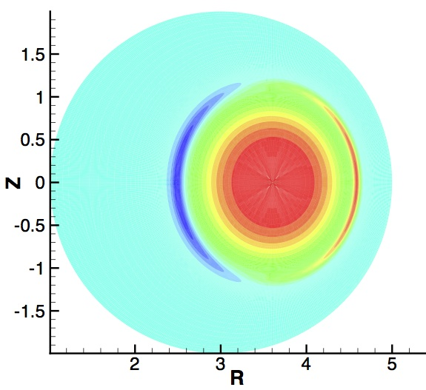
There are two primary sources of free energy (cont).
In axisymmetric systems, twist is provided by charge current running through the plasma.
Except in FRCs, current density is largely parallel to B.
Two surfaces of a toroidal equilibrium show 3/2 (left) and 5/2 (right) twist, i.e. safety factor (q).
#2) Spatial variation of the “parallel” current density, λ = J||/B, also contributes free energy:
Stability is a matter of whether the positive-energy contributions exceed these two negative-energy contributions.
Contour plot of λ for the same configuration shows significant spatial variation.

Slide 32
Resonances for helical shear-Alfvén waves (ω ➔0) play an important role.
Restoring force density from bending is weak where wavefronts align with B₀ , hence susceptibility to instability.
Resonant instability in sheared field leads to spatial localization.
B₀
Background magnetic field is sheared.
Rational-winding wavefronts align with B₀ along the resonant surface (k•B₀ = 0).
k
z
θ
r

Slide 33
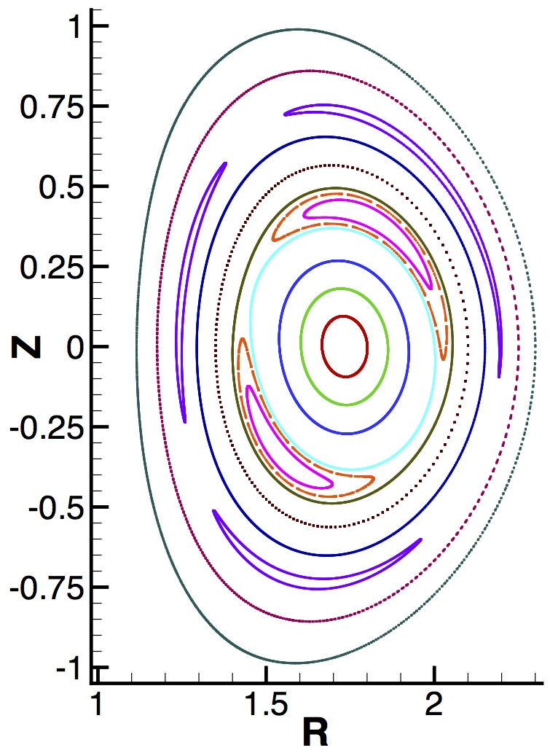
Nonlinear analysis considers how finite perturbations alter the system.
Nonlinear systems are often solved numerically; the magnetic island shown earlier is one example.
Island locations are resonances for helical perturbations.
λ
T
The tearing instability saturates nonlinearly by making λ uniform along B, and strong parallel heat flux equilibrates T over the island.

Slide 34
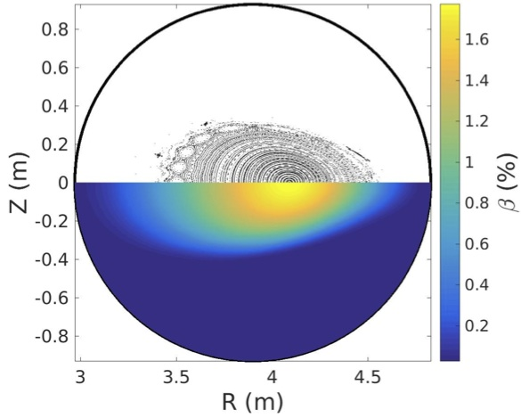
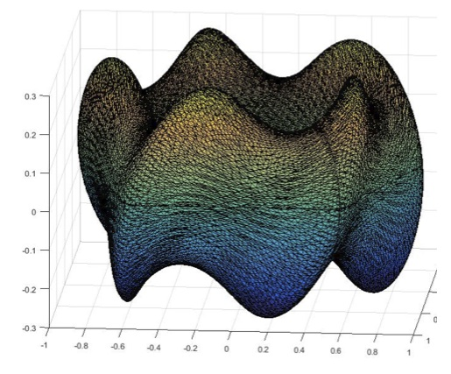
The conventional paradigm does not fit systems that are inherently asymmetric.
Stellarators use toroidally asymmetric external helical coils to twist B.
Increasing pressure often leads to continuous evolution among 3D states.
Flux-surface shape in a 5-field period stellarator configuration.
Computed evolution of magnetic topology and pressure.*
*T. Bechtel, 4/30/17 NIMROD Team meeting presentation [https://nimrodteam.org/meetings]

Slide 35
Conclusions
MHD is a useful starting point for understanding macroscopic dynamics in magnetized plasma.
MHD is a rich topic in itself.
MHD analysis has analogies with continuum mechanics and fluid dynamics.
The equilibrium / linear stability / nonlinear evolution paradigm is useful for many, but not all, configurations.

Slide 37
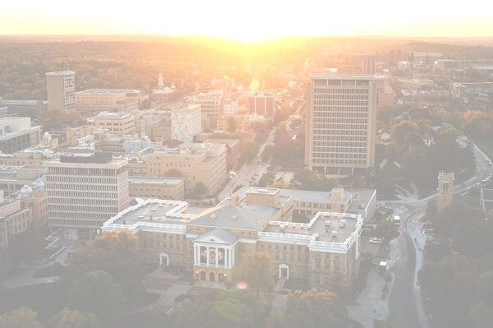
Overview of Plasma Opportunities at
U. Wisconsin-Madison
presented by
Prof. Carl Sovinec, Engineering Physics
From March 3, 2017 Recruiting Presentation
photo by Jeff Miller

Slide 38
Theme: Wisconsin’s breadth in plasma research offers many opportunities for graduate study.
Here, we discuss
  Plasma research areas
  Experiments
  Research centers
  Collaborations
  Plasma classes

Slide 39
Research areas: Wisconsin activities span many plasma sub-fields.
Magnetic confinement
  Conventional
  Alternates
Basic plasma physics
  Magnetic reconnection
  Plasma-surface interaction
  Magnetic dynamos
Theory and computation
  Magnetohydrodynamics
  Turbulence
Naturally occurring plasma
  Astrophysics
  Magnetosphere
Technology
  Fusion neutronics
  Technology transfer
Plasma applications
  Industrial
  Space propulsion
  Oscillators and amplifiers

Slide 40
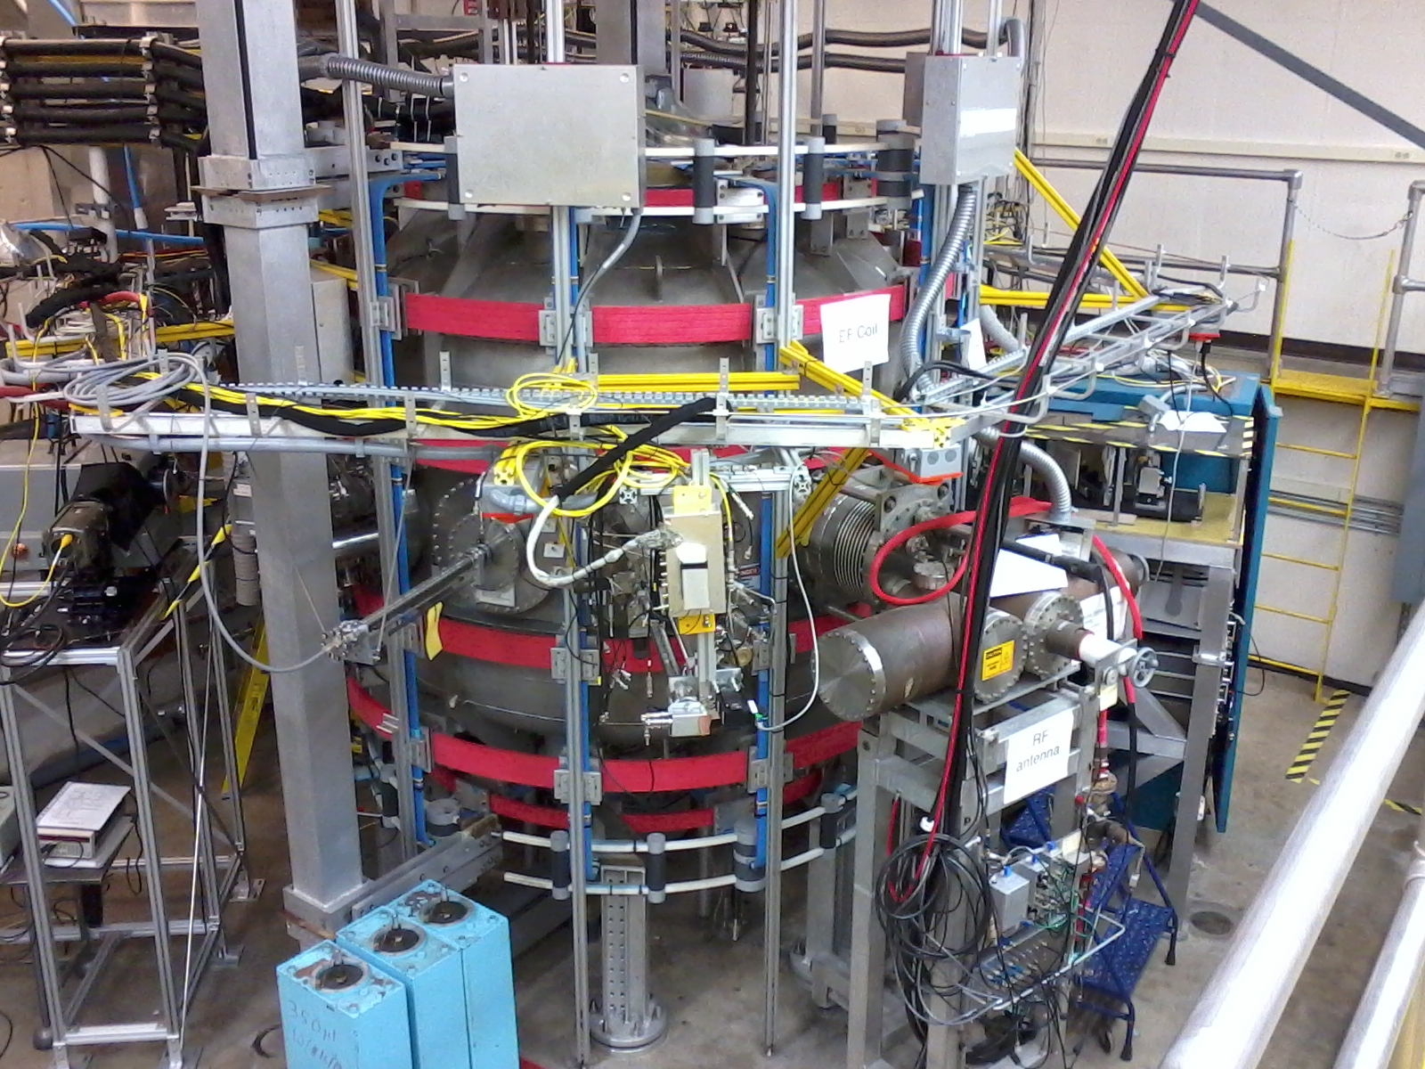
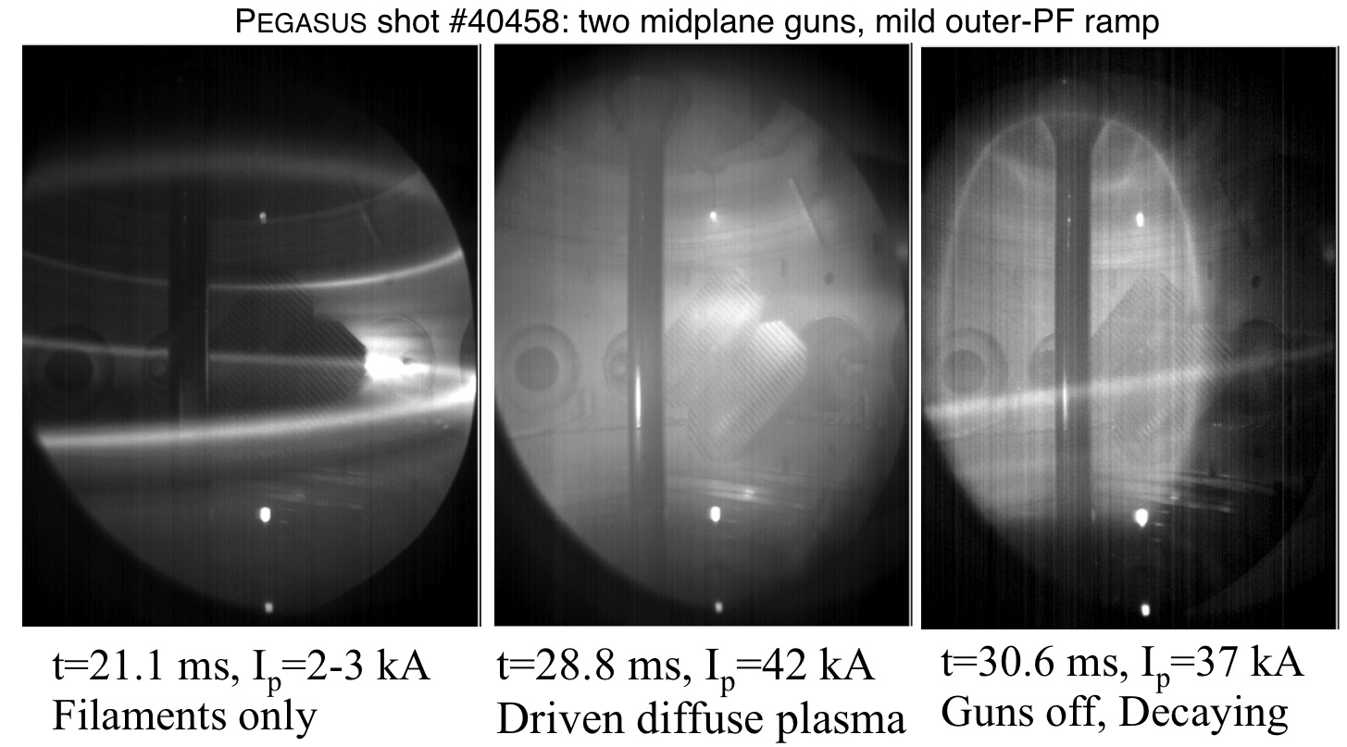
Experiments: Wisconsin is a leader in university-scale plasma experiments.
Pegasus is a spherical tokamak in Engineering Physics.
Prof. Ray Fonck is the principal investigator.
5-10 graduate students, plus undergrads, scientists and engineers
Pegasus is used to study:
Low-aspect ratio MHD
Non-inductive plasma startup

Slide 41
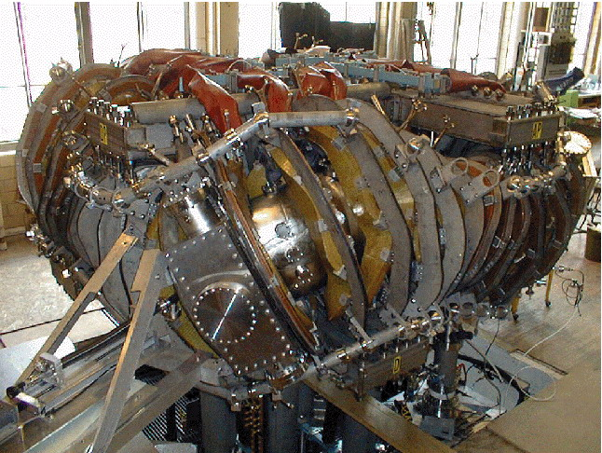
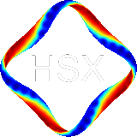
Wisconsin’s magnetic confinement experiments investigate innovative paths to fusion development.
HSX in Electrical and Computer Engineering is the world’s first quasi-symmetric stellarator.
Prof. David Anderson is the principal investigator.
5-10 graduate students, plus scientists and postdocs
HSX is used to study:
Neoclassical and anomalous transport in quasi-symmetry
Plasma confinement without net current

Slide 42
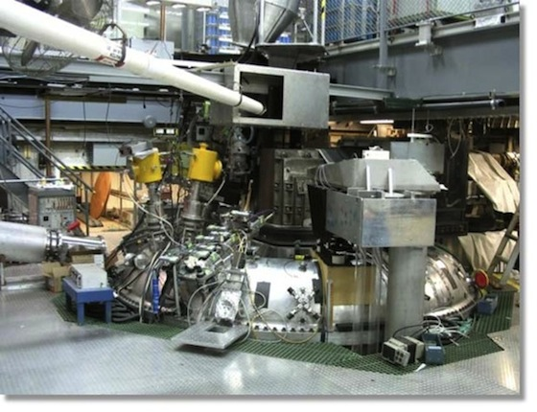
These larger experiments contribute to multiple areas of plasma research.
MST reversed-field pinch in Physics has contributed to plasma and fusion science for more than two decades.
Prof. John Sarff is the principal investigator.
10-20 graduate students, 5+ postdocs, 5-10 scientists, plus engineering staff
MST is used to study:
Fluctuation-induced transport
Magnetic relaxation
High engineering-β
Pulsed and AC current drive

Slide 43
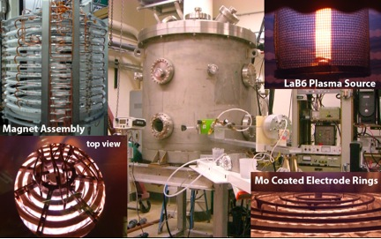
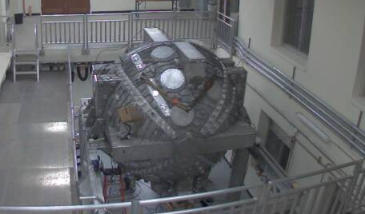
Wisconsin experiments address basic scientific questions for plasmas in nature.
Profs. Cary Forest and Jan Egedal of Physics run several experiments.
The Madison Plasma Dynamo Exp. (MPDX) and MDX (liquid Na) are used to study magnetic field generation.
The Terrestrial Reconnection Experiment (TREX) explores reconnection at low collisionality.
PCX and MPDX investigate mageto-rotational instability.
The Line-Tied Reconnection eXperiment (LTRX) is used to study line-tying and resistive-walls.
Several graduate students per experiment, plus postdocs, scientists and engineers.
Plasma Couette-flow Experiment
MPDX and TREX share this large spherical chamber.

Slide 44
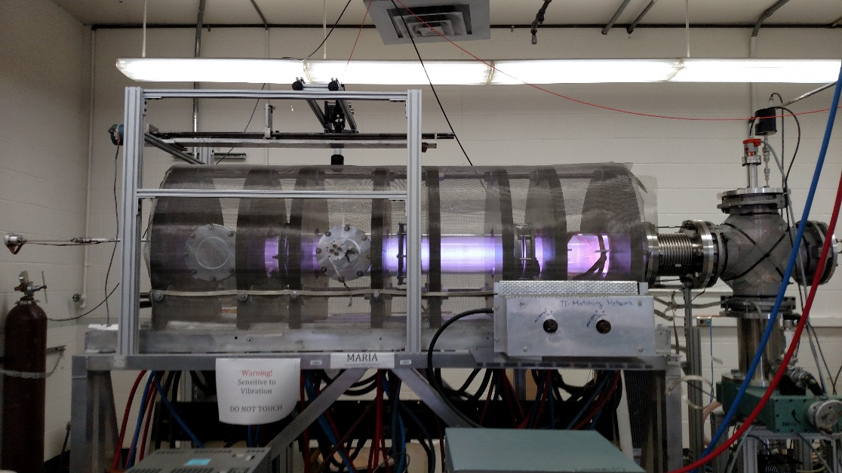
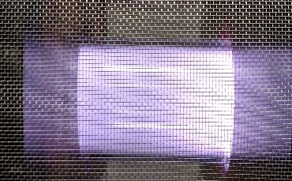
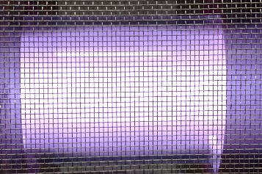
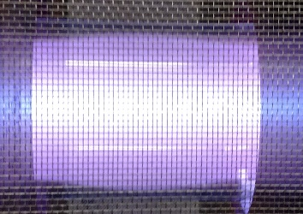
RF-driven experiments provide flexible platforms for science and technology.
Prof. Oliver Schmitz has reconfigured the MARIA experiment.
Basic plasma physics
Development of material-exposure capability
The group presently has 7 graduate students and 2 undergrads.
MARIA was originally developed by Prof. Emeritus Noah Hershkowitz to study helicon plasma and magnetized sheath physics.
LIF Collection Optics
Perpendicular to Injection
Antenna
Emissive Probe
Target Plate
Single/Triple
Langmuir Probe
Capacitively coupled discharge
Inductively coupled discharge
Helicon Mode

Slide 45
Research centers facilitate cooperative efforts in several areas.
Center for Plasma Theory and Computations (CPTC)
  Prof. Chris Hegna, Director
  Highlighted in following slides
Fusion Technology Institute (FTI)
  Prof. Paul Wilson, Director
Center for Plasma in the Laboratory and Astrophysics (CPLA)
  Prof. Cary Forest, Director
  Based in Physics

Slide 46
Plasma theory at Wisconsin includes studies of local experiments, national & international experiments, and independent theoretical topics.
Faculty and senior scientists:
Prof. Stanislav Boldyrev, Physics, turbulence and astrophysical plasmas
Prof. James Callen, EP (emeritus), kinetics and transport
Prof. Chris Hegna, EP (CPTC director), MHD and kinetics
Dr. Vladimir Mirnov, Physics, MHD and kinetics
Prof. Greg Moses, EP (emeritus), ICF theory and computation
Prof. Carl Sovinec, EP, computational MHD
Prof. Paul Terry, Physics, plasma turbulence and transport
Prof. Ellen Zweibel, Physics and Astronomy, astrophysical plasmas

Slide 47

Our study of current-filament relaxation is an example of theory applied to local experiments.
Relaxation theories describe global aspects of Pegasus’ non-inductive startup.
Numerical computation is applied to understand how current mixes into a diffuse discharge.
Simulation results from the NIMROD code. (J. O’Bryan)

Slide 48

UW theorists have significant connections to the broader national and international programs.
Example: Configuration studies of LHD (Japan)
Theory modeling correctly
predicts transition onset.
- Hegna et al
Experiments show abrupt
transitions of plasma flow
and magnetics.
Hegna is also leading a theory/modeling effort to improve the stellarator concept.

Slide 49
Collaborations: Wisconsin has a strong tradition in plasma-related collaboration.
On campus:
  Theory/experiment collaborations across campus
  Students and scientists working on projects located in departments other than their own
Nationally:
  Experimental research on national facilities such as DIII-D and NSTX (Fonck, Schmitz, McKee, Smith and students, for example)
  Large-experiment theoretical support (Callen, Hegna)
  Computational collaborations on code development and application (NIMROD Code Team, CEMM)
Internationally:
  Tokamak experimental contributions to DIII-D and TEXTOR (Schmitz)
  Neutronics for ITER (Wilson)
  Stellarator theory for LHD in Japan (Hegna)
  Stellarator edge physics in LHD and W7-X (Schmitz)
  Computational collaboration with Max Planck Institute (Terry, Forest)

Slide 50




Prof. Oliver Schmitz brings strong collaborative ties to DIII-D and European experimental programs.
Experiment and modeling investigate 3D transport in edge plasma.
Group contributes to control of ELM activity in tokamaks / ITER.
Field line connection length L_{c} compared to (a) Kolmogorov Length L_{K} and (b) electron mean free path λ_{e}
Laminar Zone: L_{c} < L_{K} ~ λ_{e} (Ψ_{N}>0.95)
Stochastic Layer: L_{c} > L_{K} ~ λ_{e} (Ψ_{N}>0.8)

Slide 51
Plasma classes: Classroom instruction provides important background and skills for research.
ECE/NE/Physics 525 - Introduction to Plasmas
ECE/NE 526 - Laboratory Course in Plasmas
ECE/NE/Physics 527 - Plasma Confinement and Heating
ECE/NE 528 - Plasma Processing and Technology
ECE/NE/Physics 724 - Wave and Instabilities in Plasmas
ECE/NE/Physics 725 - Plasma Kinetic Theory
ECE/NE/Physics 726 - Plasma Magnetohydrodynamics
NE 903 - Special Topics in Plasma Physics
ECE/NE/Phyisics 922 - Seminar in Plasma Physics

Slide 52

In summary …
There are a lot of great reasons to learn, research, and apply plasmas at Wisconsin!
photo by Bryce Richter

