Slide 1
Plasma-material interactions in magnetic fusion devices
Robert Kolasinski
Sandia National Laboratories, Livermore, CA
Chemistry, Combustion & Materials Center
SULI Introductory Course in Plasma Physics / PPPL / June 16, 2017

Slide 2
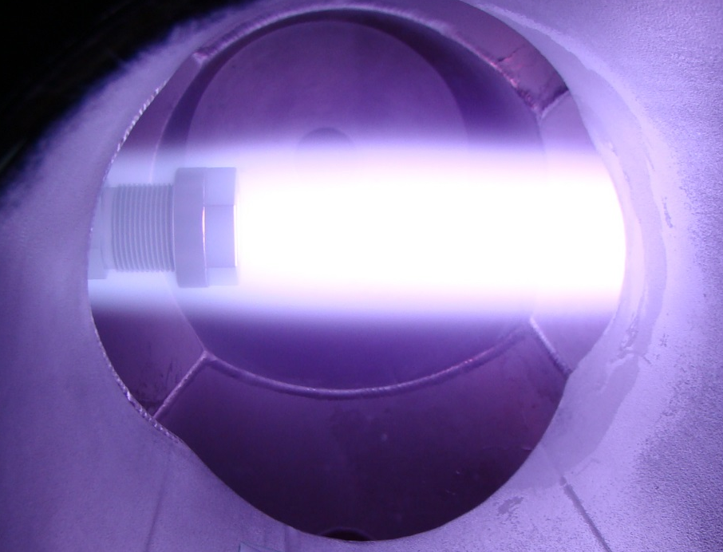
Outline
The magnetic fusion program at Sandia
Underlying physics of plasma-materials interactions (PMI)
  PMI experimental techniques
  Simulation tools
  Recent research directions
Advanced concepts

Slide 3
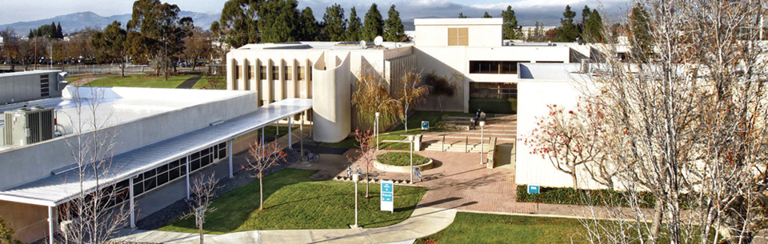
Hydrogen in materials research at Sandia/CA
Chemistry, Combustion, & Materials Center
~200 research staff
Combustion Research Facility
Office of Science-funded DOE user facility
Livermore Valley Open Campus (SNL-LLNL)

Slide 4
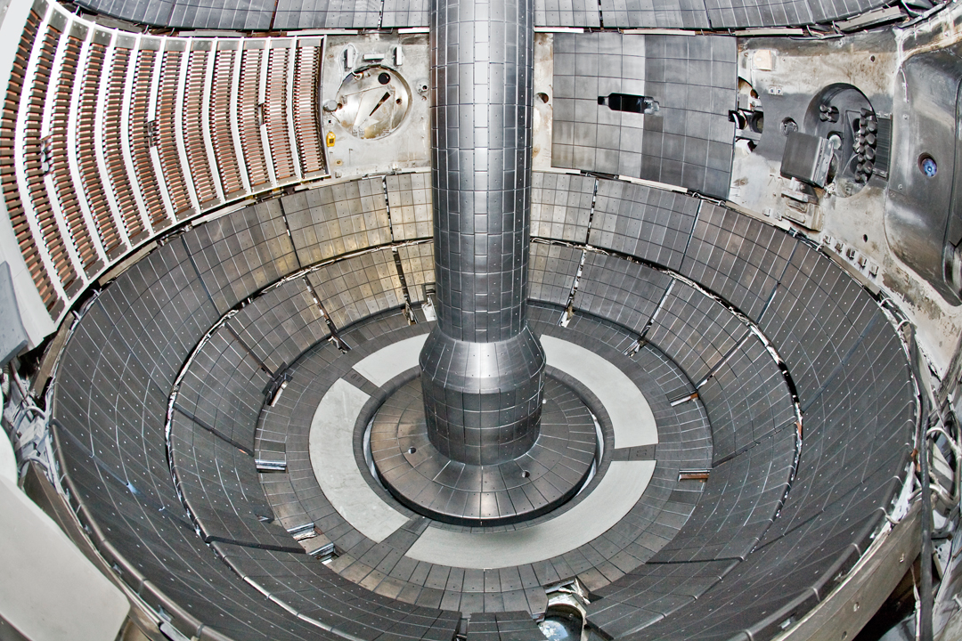
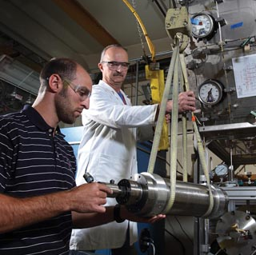
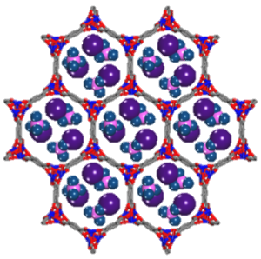
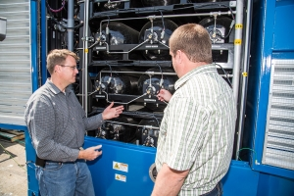

Hydrogen in materials research at Sandia/CA
Magnetic Fusion Energy
Hydrogen Effects on
Structural Materials
Hydrogen
Storage
Fuel Cell Electric Vehicle
Infrastructure

Slide 5
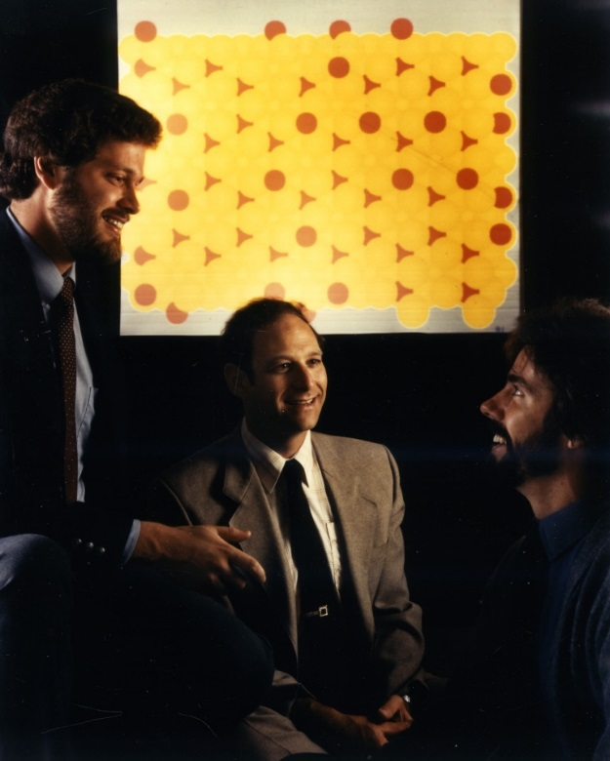
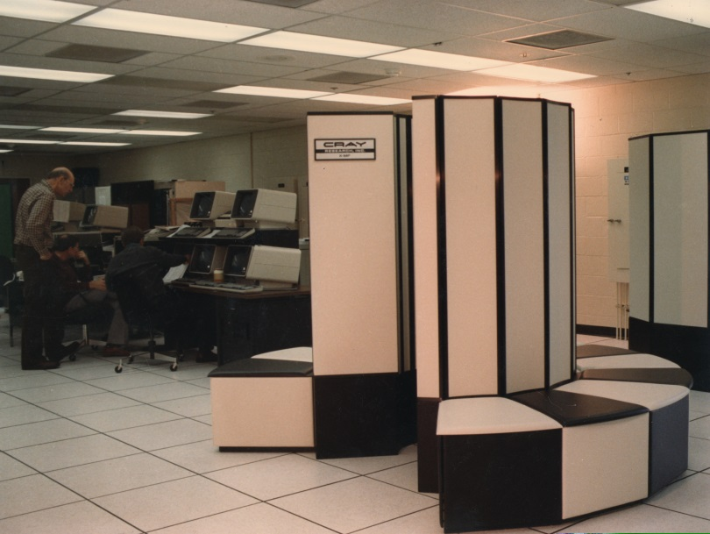
Magnetic fusion research at Sandia/CA
Sandia scientists have made fundamental contributions to hydrogen science and PMI
Walter Bauer gives a tour of Sandia/CA’s ion beam laboratory during the 2nd PSI meeting (1976)
Repulsive interatomic potentials developed at Sandia formed basis for TRIM model (1980)
Inventors of the embedded atom method: Mike Baskes, Murray Daw, and Stephen Foiles (1982)
5

Slide 6
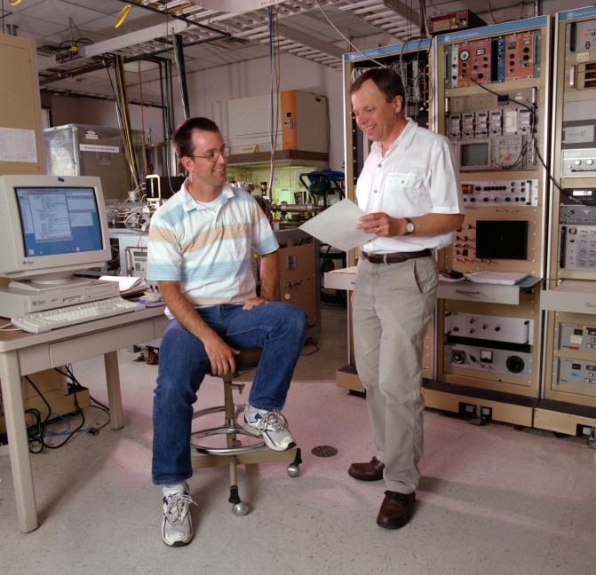
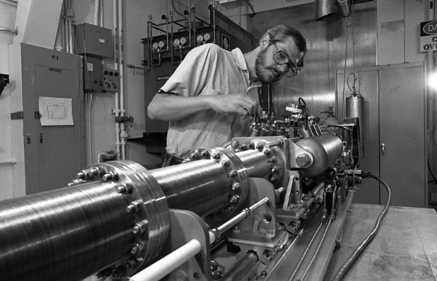
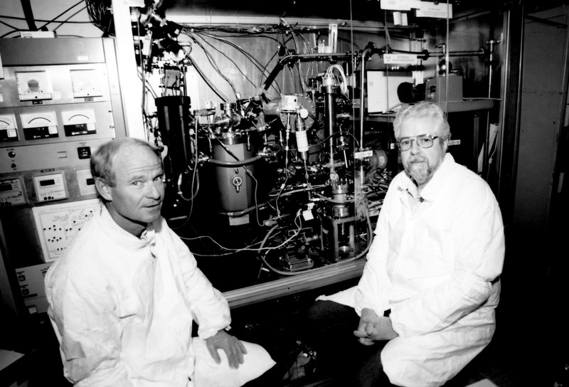
Magnetic fusion research at Sandia/CA
Sandia scientists have made fundamental contributions to hydrogen science and PMI
Innovative plasma diagnostics: Jonathan Watkins inspects a fast-scanning probe for installation on DIII-D (1990)
Tritium Plasma Experiment developed at Sandia/CA: Rion Causey and Wayne Chrisman depicted with tritium TDS system (1993)
Characterization of liquid metal surface composition; hydrogen sensor development: Robert Bastasz and Josh Whaley confer in the Sandia/CA ion beam laboratory (2000)

Slide 7
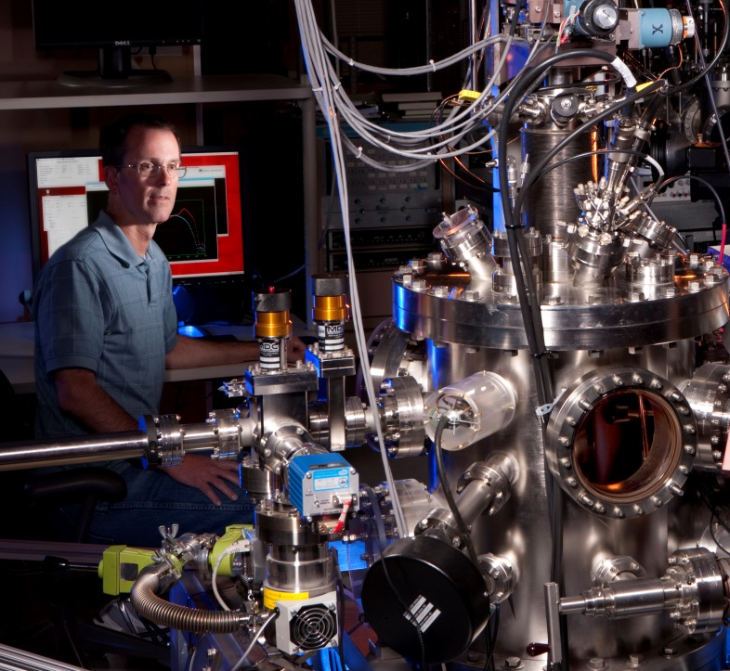
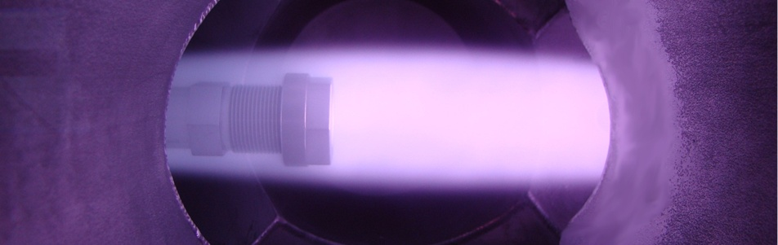
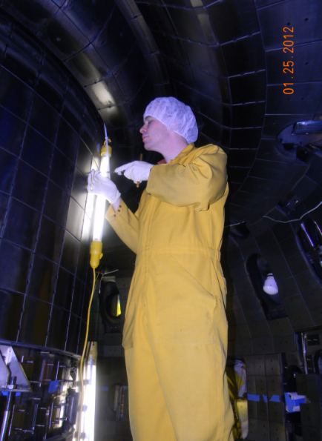
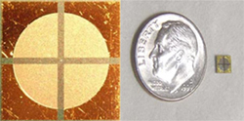

Magnetic fusion research at Sandia/CA
Tritium Retention / Permeation (INL / PHENIX)
In-situ surface analysis / PSI Research
Edge Plasma Measurements (DIII-D)
Surface Effects: H adsorption kinetics, composition of liquid metal surfaces (University of Tennessee, Princeton University, University of Illinois)
H Micro-sensor Development (DIII-D, PPPL)

Slide 8
Underlying physics of plasma-material interactions

Slide 9
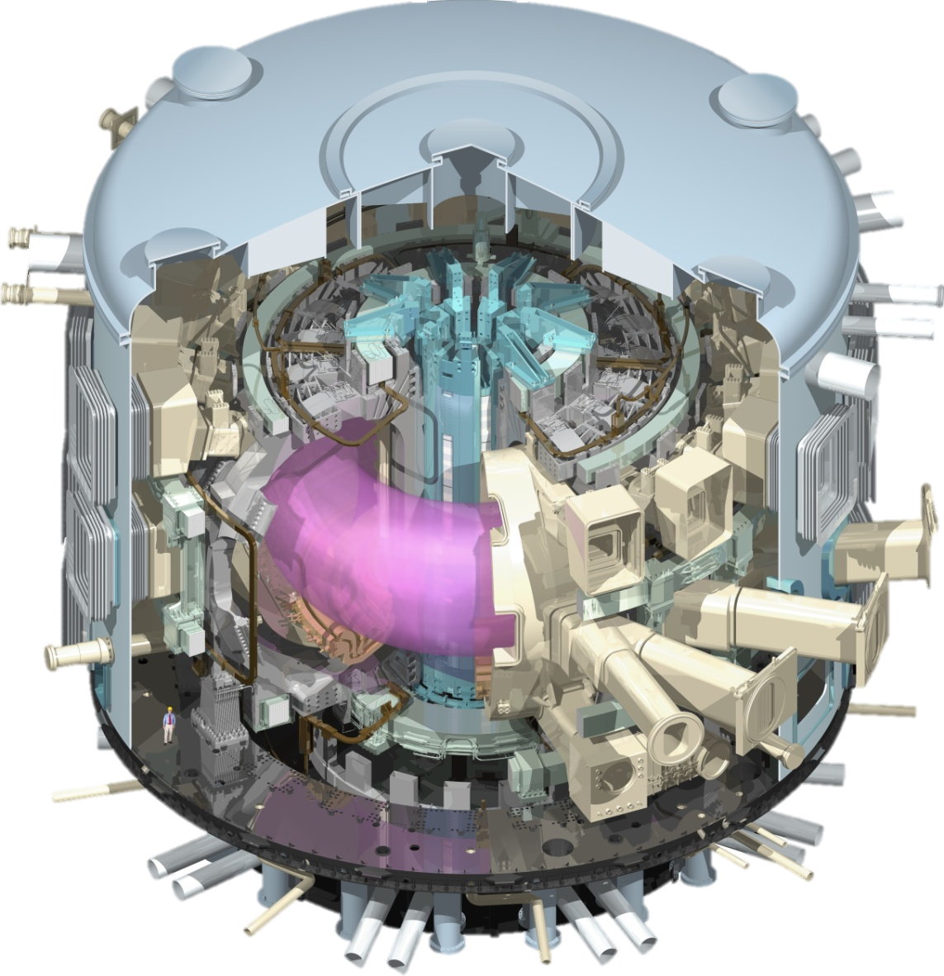
Motivation: plasma-materials interactions for magnetic fusion
ITER goals:
Achieve Q > 5 for D+T plasmas.
Demonstrate technologies needed for power reactor
Project details:
7 Member Organizations
Construction underway at Cadarache facility
Expected first plasma: 2027
Projected Cost: $20 B
(45 % EU, 9% ea. from remaining partners.)
ITER

Slide 10

Considerable progress in understanding of fusion plasmas over past decades
Bhremsstrahlung Limit
FIGURES OF MERIT:
triple product: n_{i}τ_{E}T_{i}
ion temperature: T_{i}
USSR
1970
ENERGY MULTIPLICATION FACTOR:
Q=P_{fusion}/P_{heating}

Slide 11
Considerable progress in understanding of fusion plasmas over past decades
Bhremsstrahlung Limit
Tokamak design adopted by most major laboratories
(1970-1980)
T10 : USSR
TFR: France
T10
PLT
TFR
TFR

Slide 12
Considerable progress in understanding of fusion plasmas over past decades
Bhremsstrahlung Limit
DIII-D
Better understanding of underlying physics improves plasma confinement [H-mode] (1980’s)
DIII-D : USA
ASEDEX: Germany
Alcator C: USA
DIII-D
ASDEX
ASDEX

Slide 13
Considerable progress in understanding of fusion plasmas over past decades
JET
Bhremsstrahlung Limit
JT-60
TFTR
Large tokamaks achieve record density, confinement
JET: EU
JT-60: Japan
TFTR: PPPL

Slide 14
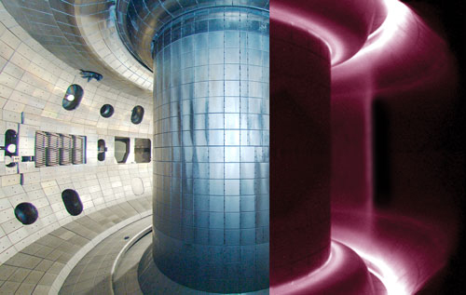
Primary challenges associated with fusion have increasingly focused on materials
Magnetic field lines diverted into secondary chamber where they interact with the wall to reduce impurities, known as the “divertor”.
Interior view of the DIII-D tokamak.

Slide 15
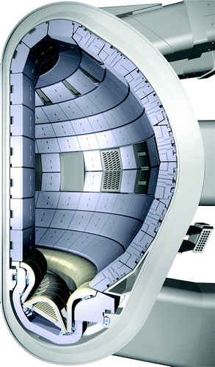
Plasma exposure conditions are very demanding
Exposure conditions:
High-flux D-T plasmas
High-energy fusion products (14 MeV n, helium ash)
Impurities
High transient heat and particle loads
Relevant Materials:
DIII-D: C; NSTX: Mo, C, Li
ITER: Be & W
DEMO: Advanced W or liquid metals
Be
W

Slide 16
Relevant processes span many orders of magnitude in length and time scales
Many simultaneous processes
Relevant length and time scales span several orders of magnitude
Image from: B. D. Wirth, K. Nordlund, D. G. Whyte, and D. Xu, MRS Bull. 36 (2011) 216

Slide 17
Relevant processes span many orders of magnitude in length and time scales
What experiments would enable us to decipher the complex physics occurring at the surface?
Can we model how the surfaces evolve with plasma exposure?

Slide 18
Principal U.S. sites with PMI Activities
Fusion Energy Sciences
U.S. Dept. of Energy
MIT
INL
Wisc.
PPPL
LLNL
Illinois
SNL
UCLA
SNL
Univ. Tenn. /
ORNL
GA
Georgia Tech
UCSD
U.S. ITER Project Office

Slide 19
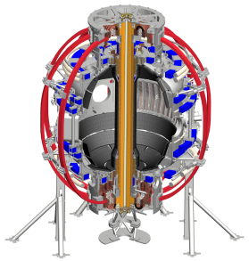
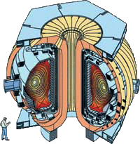
Principal U.S. sites with PMI Activities
Fusion Energy Sciences
U.S. Dept. of Energy
MIT
INL
Wisc.
PPPL
LLNL
Illinois
SNL
UCLA
SNL
Univ. Tenn. /
ORNL
GA
Georgia Tech
NSTX
UCSD
U.S. ITER Project Office
DIII-D

Slide 20
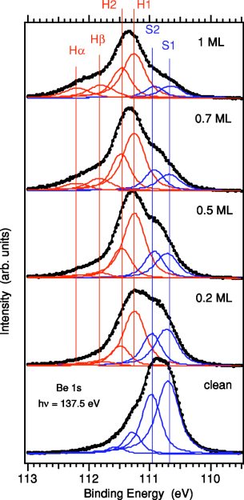

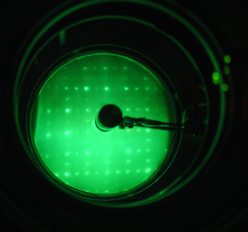
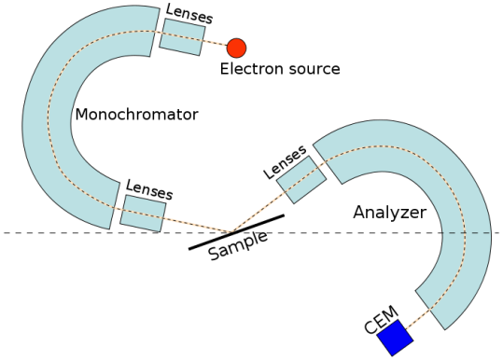
Fundamental changes to surface chemistry & structure derived from surface analysis techniques
Auger Electron Spectroscopy
AES
Thermal desorption spectroscopy
“Single effect” devices enable us to isolate specific physical processes
Examine response of surfaces to well-controlled exposure conditions
Involve the use of simplified material geometries (e.g. single crystals)
Scanning tunneling microscopy
High-resolution electron energy loss spectroscopy
X-ray photoelectron spectroscopy
Low energy electron diffraction

Slide 21
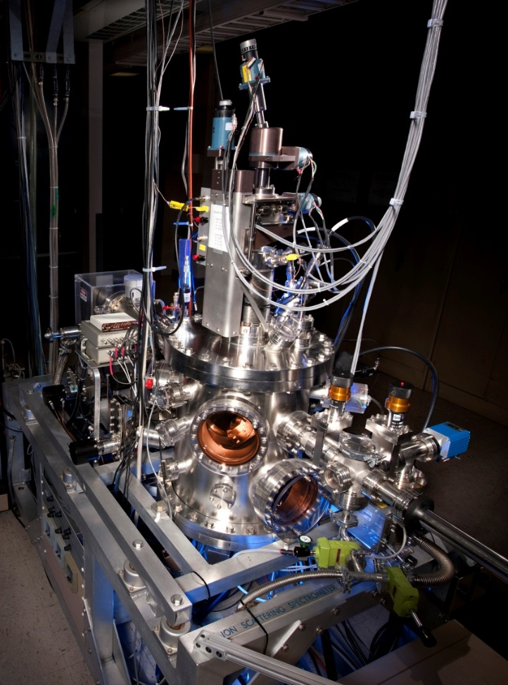
Example: use of ion energy spectrometer to study hydrogen chemisorption
Angle-resolved ion energy spectrometer
  Mass-separated beam (< 5 keV He⁺, Ne⁺)
  Tungsten capillary for atomic hydrogen dosing.
  Load-lock / clean transfer system available for air-sensitive samples

Slide 22
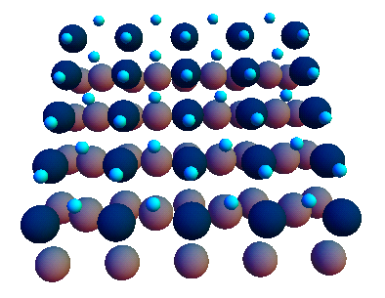
W(110) substrate configuration determined from large angle scattering map
Map created by varying 1 keV Ne⁺ incidence angle and crystal azimuth.
Scattering pattern consistent with non-reconstructed, clean surface.
W atoms are effective at deflecting Ne⁺ along open surface channels.

Slide 23
Chemisorbed hydrogen can be mapped in the same manner

Slide 24




Chemisorbed hydrogen can be mapped in the same manner
Hydrogen readily chemisorbs on W(110) surface without a dissociation barrier.
Recoiled hydrogen observed along
$<001>$ and $<\overline{1}11>$ channels
No recoils observed along $<\overline{1}10>$ channels.
Consistent with binding to three fold hollow sites.
$$<\overline{1}10>$$
$$<\overline{1}11>$$
$$<001>$$

Slide 25
Confinement device-based exposure platforms: In-situ PMI studies in LTX / NSTX-U
Materials Analysis and Particle Probe (MAPP)
In-vacuum PMI diagnostic to determine material composition and surface chemistry
Up to 4 samples can be exposed to divertor plasma
Diagnostics
X-ray photo electron spectroscopy
Low energy ion scattering
Thermal desorption spectrometry

Slide 26
Confinement device-based exposure platforms: DiMES / MiMES on DIII-D
In-situ exposure platform for PMI studies
Erosion measurements carried out via post-mortem RBS
Can also be used as a means of inserting probes into the plasma
Recent work includes:
Studies of local erosion / redeposition
In-situ beta backscattering to map metal contamination on graphite tiles
Support of metal ring campaign
DiMES
MiMES

Slide 27
Work with DiMES is an example of the collaborative nature of PMI research in the U.S.
SNL-L Sample preparation and diagnostics development (Langmuir probe)
SNL-NM Surface analysis after exposure (RBS)
U of Toronto Edge physics and modeling
U Tenn / ORNL Surface analysis (ICPMS)
GA – Chemistry and surface analysis (SEM, EDX)
Supported by DIII-D Diagnostic Group and technical staff
UCSD – Sample preparation

Slide 28

Tritium migration and retention: use of “multi-effect” linear plasma devices
Tritium Plasma Experiment
Creates a well-defined plasma column, flux is approx. 1 A / cm²
Simulates the plasma-flux conditions encountered in tokamaks in a highly-controlled manner.
Highest flux D+T linear plasma generator world-wide
TPE plasma at target

Slide 29
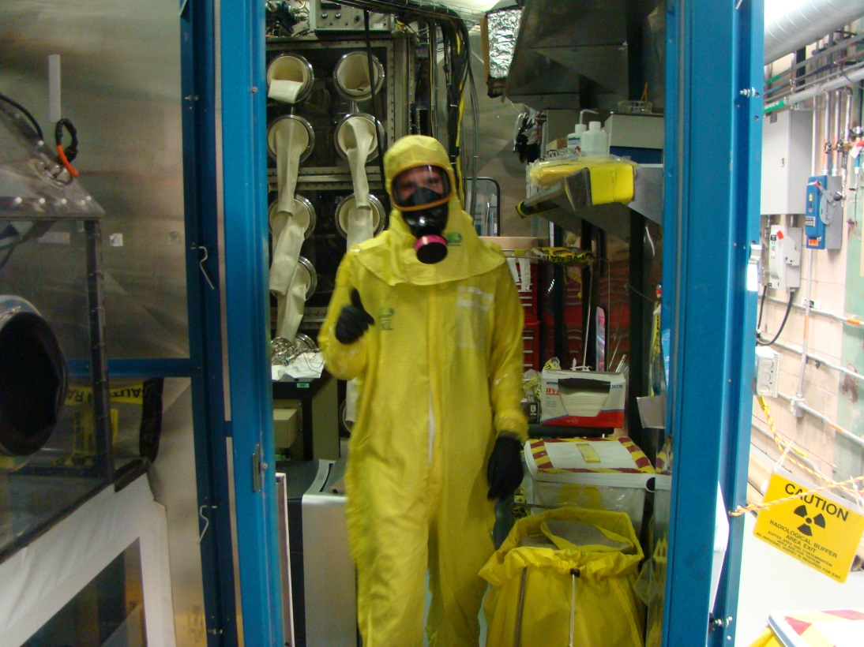
Working with tritium is … fun?
Tritium Plasma Experiment
Idaho National Laboratory and Sandia/CA collaboration
Maximum facility inventory: 1.5 g (15000 Ci)
Typical use: < 100 mCi per plasma exposure
Provides 100 x sensitivity improvement
Unique capabilities:
neutron-activated materials
beryllium
tritium imaging plate

Slide 30
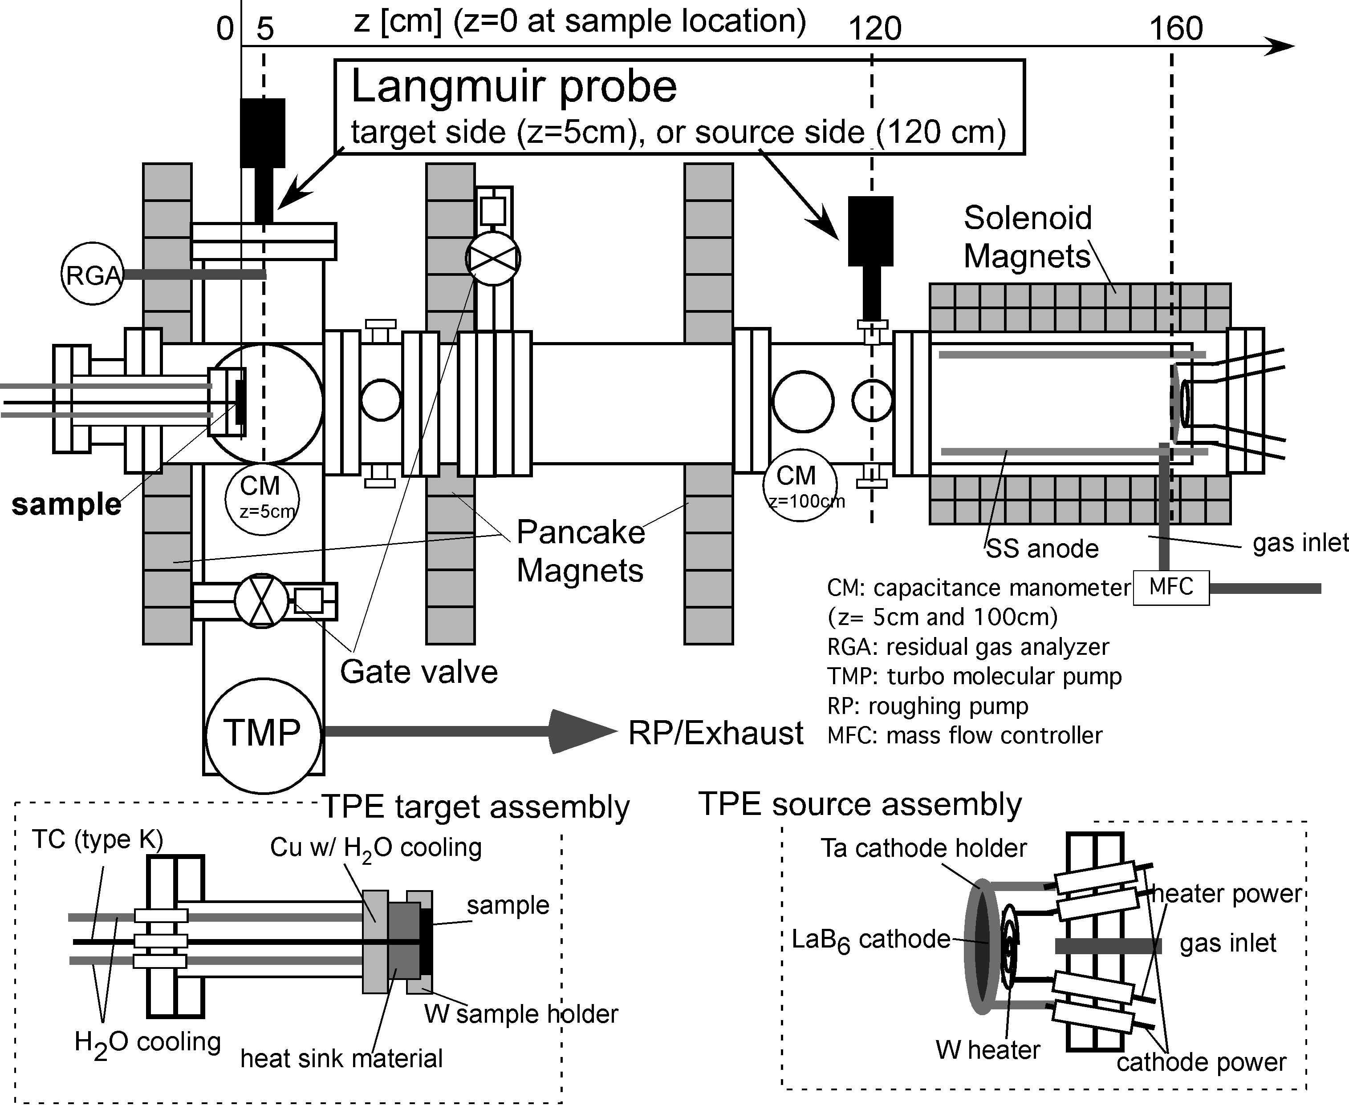
Working with tritium is … fun?
Tritium Plasma Experiment
Idaho National Laboratory and Sandia/CA collaboration
Maximum facility inventory: 1.5 g (15000 Ci)
Typical use: < 100 mCi per plasma exposure
Provides 100 x sensitivity improvement
Unique capabilities:
neutron-activated materials
beryllium
tritium imaging plate

Slide 31
CFC materials perform poorly from a tritium inventory standpoint
High BET surface area for 3D CFC weave used in Tore Supra
High surface porosity → high retention.
Tritium rich co-deposits

Slide 32
Diffusion and trapping modeled in tungsten with continuum-scale approach
Diffusion
1-D diffusion, uniform temperature.
Point defects
1.4 eV saturable traps, no nucleation. Approach of Ogorodnikova [J. Nucl. Mater. 2009] used for trapping and release.
Bubbles:
Modeled using a simple approach developed by Mills [J. Appl. Phys. (1959)].
H_{m}=0.39 eV
H_{t}=1.4 eV
½ H₂
vacancy
H_{s}=1.04 eV
H_{ads}=0.5 eV
void
Energy diagram for H migrating through tungsten.
Dissolution of H in W is highly endothermic.

Slide 33
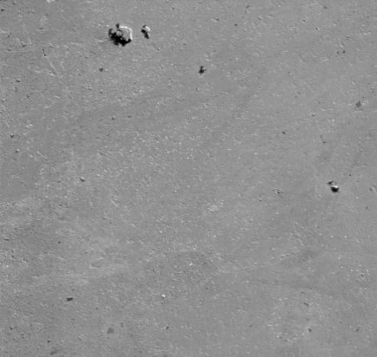
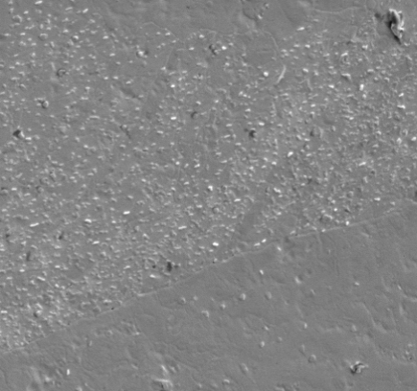
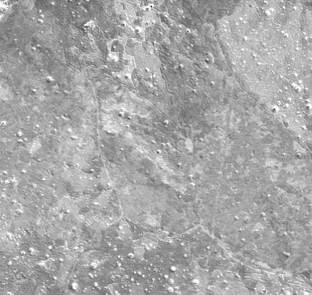
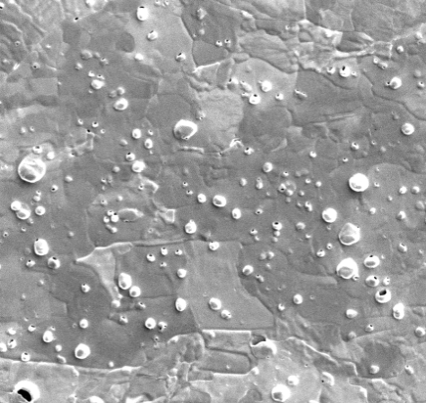
Near-surface formation of H-filled bubbles leads to surface degradation
Microscopy reveals near-surface H precipitates
Density/size temp. dependence
Growth determined by grain orientation
103 °C
20 μm
5 μm
231 °C
W 4f
20 μm
5 μm
355 °C
XPS reveals negligible WC
20 μm
5 μm

Slide 34
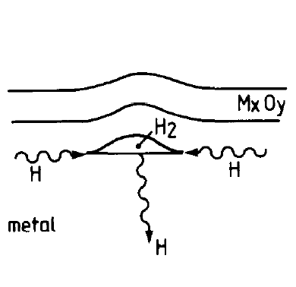
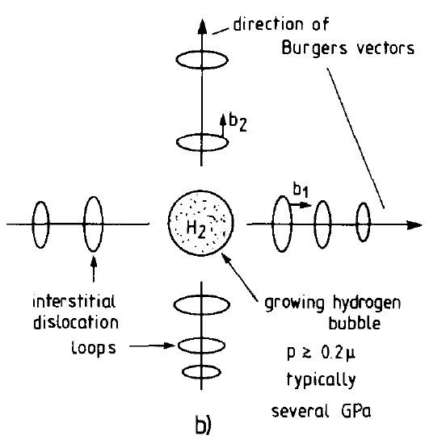
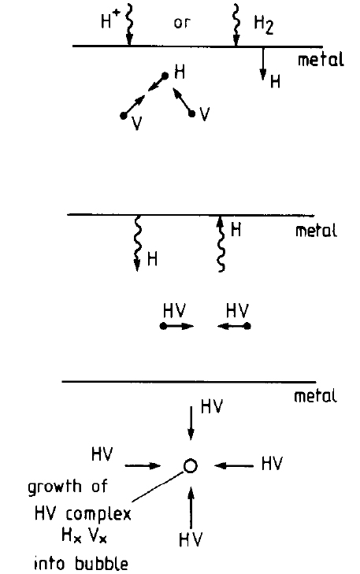
How do near-surface bubbles grow?
near-surface plastic deformation
dislocation loop punching
vacancy clustering
J. B. Condon & T. Schober, J. Nucl. Mater. 207 (1993) 1.
Mechanism that is active depends on exposure conditions as well as material microstructure

Slide 35
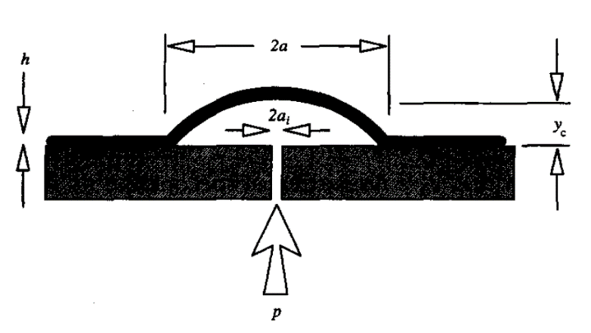

Focused ion beam profiling reveals the nature of near surface precipitates
Nucleation: platelet-shaped cracks
Expansion due to internal gas pressure (> 1 GPa)
Proposed model:
$$p≥{\left({4T{\left(Eh\right)}^{1/3}}/{5C_{1}C_{2}}\right)}^{3/4}/r_{b}$$

Slide 36
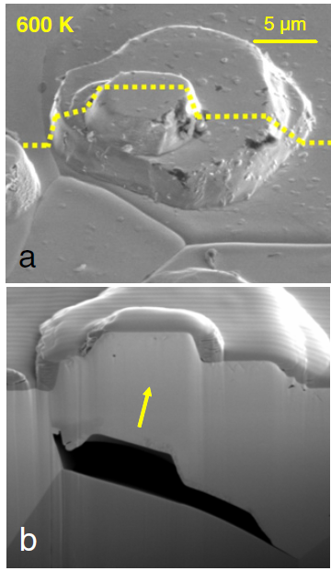
Dislocation loop punching enables precipitate growth far from the plasma exposed surface
Stability condition
p_{LP} ≥ 2γ/r_{b}+μb/r_{b}
γ = surface energy
r_{b} = bubble radius
b = Burgers vector
μ = shear stress
S. Lindig, et al Phys. Scr. (2011)

Slide 37
The internal pressure within D₂ - filled bubbles can exceed 1 GPa
H₂ equation of state (EOS):
P > 1 GPa expected within small bubbles.
At 300 K, H₂ solidifies at p=5.7 GPa.
Tkacz’s [J. Alloys & Compounds (2002)] EOS to provide the best fit:
San Marchi’s EOS better at low pressure:

Slide 38
Implications for tritium retention in ITER
T < 200 °C
Precipitation and trapping active, but slow diffusion
200 °C ≤ T ≤ 300 °C
Precipitation and trapping active, with fast diffusion
T > 300 °C
Small fraction of traps occupied, bubble expansion not favored.

Slide 39
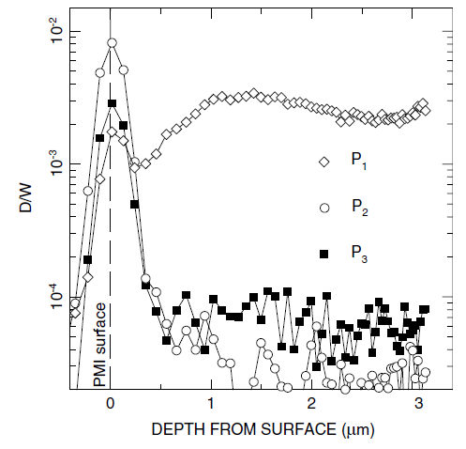
Helium effects: formation of near-surface nano-bubble structure leads to material degradation
Structure of first 100 nm – 1 μm of the surface governs:
transport of T fuel through material
sputtering → impurity transport into core plasma
fuel recycling
M. J. Baldwin, R. P. Doerner, W. R. Wampler, et al., Nucl. Fusion 51 (2011) 103021.

Slide 40
Near-surface structure and composition integral to many aspects of fusion plasmas
Structure of first 100 nm – 1 μm of the surface governs:
transport of T fuel through material
sputtering → impurity transport into core plasma
fuel recycling
Hypothesis: network of closely-spaced, nm-sized bubbles prevents deeper diffusion of implanted D into bulk.
M. J. Baldwin, R. P. Doerner, W. R. Wampler, et al., Nucl. Fusion 51 (2011) 103021.

Slide 41
Comparison: low-energy, high flux D₂ and
He plasma-exposure
Differences between D₂ and He precipitates in W:
He pair formation energetically favorable
D migrates into the structure and nucleates blisters at pre-existing defects
Depends strongly on existing microstructure
Blistering in D2 plasma
Near-surface bubble growth (He exposure)
R. D. Kolasinski, M. Shimada, Y. Oya, D. A. Buchenauer, J. Appl. Phys. 118 (2015) 073301.
M. J. Baldwin, R. P. Doerner, W. R. Wampler, et al., Nucl. Fusion 51 (2011) 103021.

Slide 42
At high temperatures, high-flux He plasma exposure creates nm-sized filaments …
Advanced microscopies provide detailed insight into defects contained within different surface morphologies.
Image courtesy of F. Allen (U. C. Berkeley / LBNL)
Images from: C. M. Parish, R. P. Doerner, M. J. Baldwin, D. Donovan, K. G. Field, and Y. Katoh, Microsc. Microanal. 22 (2016) 1462.

Slide 43
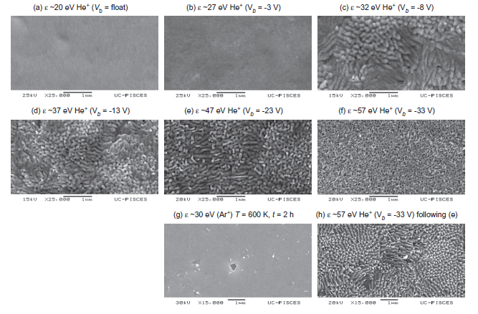
…whereas at lower temperatures / fluxes a dense layer of interconnected He bubbles forms.
M. J. Baldwin, T. C. Lynch, R. P. Doerner, J. H. Yu, J. Nucl. Mater.. 415 (2011) S104.

Slide 44
…whereas at lower temperatures / fluxes a dense layer of interconnected He bubbles forms.
M. J. Baldwin, T. C. Lynch, R. P. Doerner, J. H. Yu, J. Nucl. Mater.. 415 (2011) S104.
C. M. Parish, R. P. Doerner, M. J. Baldwin, D. Donovan, K. G. Field, and Y. Katoh, Microsc. Microanal. 22 (2016) 1462.
Notes:
Case 1 (Matt’s study) was performed using an RF Helicon discharge, six different targets exposed at 1120 K for 6 hr to pure He plasmas.

Slide 45
Advanced Concepts:
(a) W alloy development
(b) Liquid metal alloys
(c) In-situ diagnostic development

Slide 46
Tungsten alloys may offer superior resistance to neutron damage and high heat loads
PMI Community Report emphasis on: Novel materials and advanced manufacturing methods
W-Ti alloy developed at
Univ. of Utah (Z. Fang)
Microstructure offers possible resistance to neutron damage
Response to plasma unknown
Collaboration with UCSD for high-flux exposure

Slide 47
Analysis of ultra-fine grained alloy produced by University of Utah
XPS reveals dispersoids are TiO₂, unlikely to contribute to H diffusion
EBSD data used to determine average grain size (960 nm), no preferred texture.

Slide 48
W-Ti alloy exhibits improved resistance to surface modification, modestly increased retention
Retention ~ 3 x higher than reference polycrystalline W
Within typical range of variability for W grades
Surface modification negligible
R. Kolasinski, D. A. Buchenauer, R. Doerner,
et al., Jnt. J. Ref. Met. (2016).

Slide 49
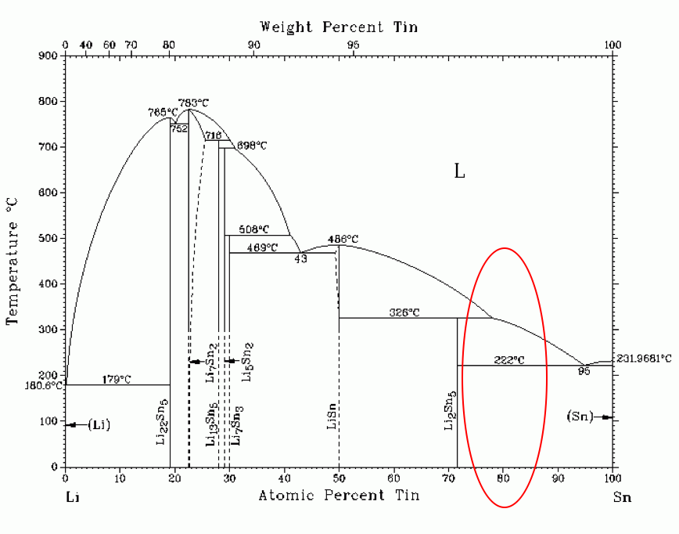
Liquid metal alloys offer possibility to avoid many problems associated with solid surfaces
Low melting Sn-Li eutectic has been proposed as an alternative to pure Li as a plasma facing surface
Sn-Li 80:20 mixture projected to be able to handle the projected heat loads
Due to lower surface energy, Li segregates to the surface during melting, and would act as a low-recycling wall, with improved retention characteristics.
Sn-Li has fewer chemical reactivity issues and higher material compatibility.
Currently under investigation at University of Illinois / Princeton

Slide 50
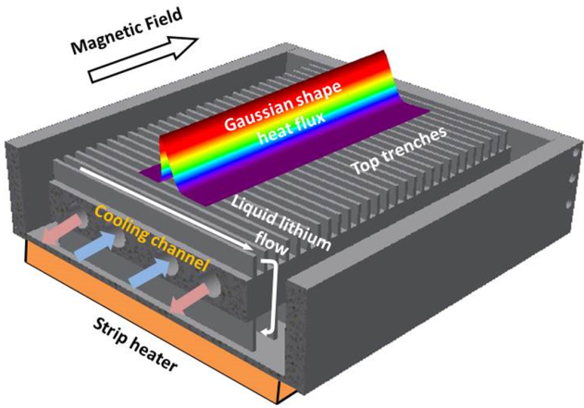
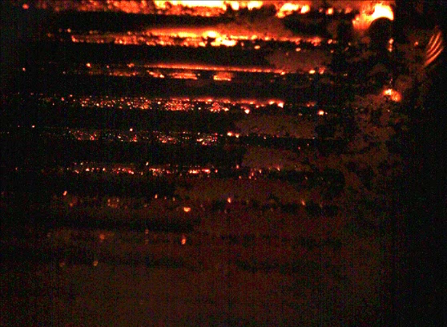
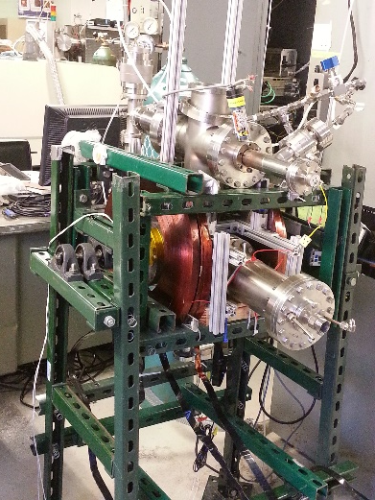
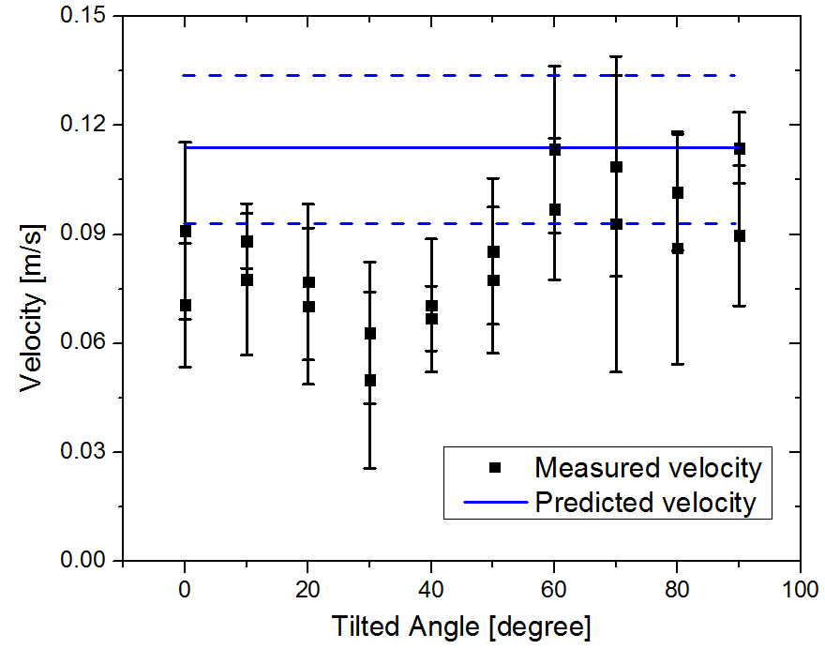
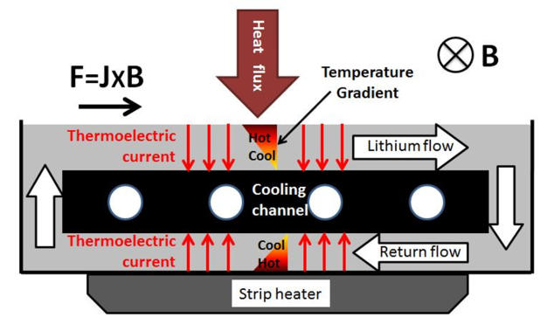
Liquid metal infused trenches (LiMIT)
LiMIT is a versatile system for testing liquid metal flows for PFC applications
Vertical Flow (and arbitrary angle)
Sustained flow demonstrated at arbitrary angle from horizontal (0º to 180º)
Horizontal Flow
Utilizes TEMHD drive for propulsion of liquid lithium through a series of trenches
PI: David Ruzic (University of Illinois)

Slide 51
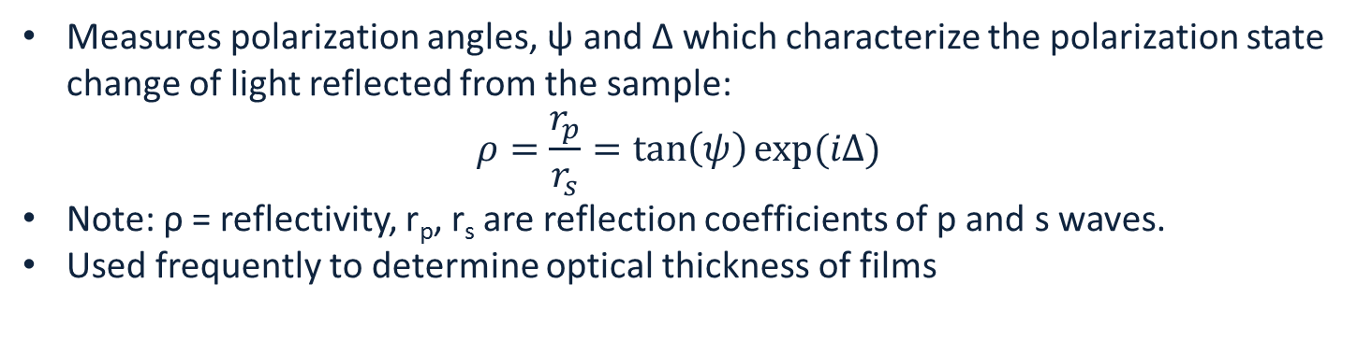
In-situ optical diagnostics: spectroscopic ellipsometry
Measures polarization angles, ψ and Δ which characterize the polarization state change of light reflected from the sample:
$$ρ=\frac{r_{p}}{r_{s}}=\tan\left(ψ\right)exp⁡(iΔ)$$
Note: ρ = reflectivity, r_{p}, r_{s} are reflection coefficients of p and s waves.
Used frequently to determine optical thickness of films

Slide 52
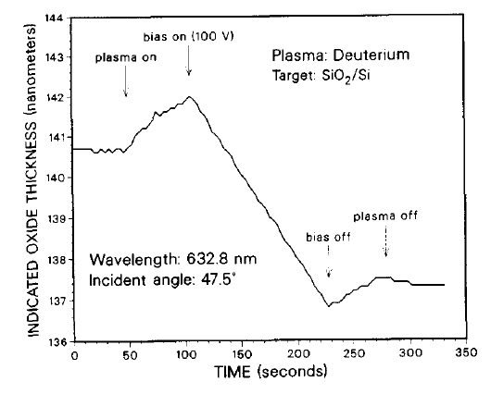
Previous demonstration on PISCES-B
Prior work by Bastasz tested feasibility:
Used single-wavelength ellipsometer to measure SiO₂ erosion from Si substrate.
Achieved 1 nm depth resolution, with 1 Hz sampling frequency.
No adventitious effects of the plasma on ellipsometer signal observed.
Alignment of the optical hardware posed the largest practical issue
R. Bastasz, Y. Hirooka, and M. Khandagle, J. Nucl. Mater. 220 (1995) 352.

Slide 53
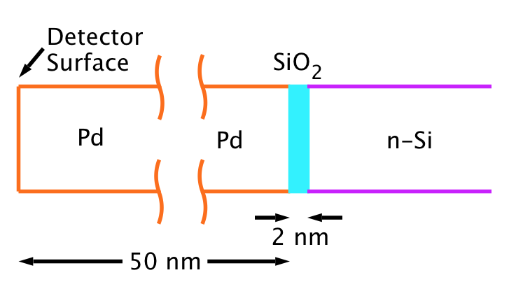
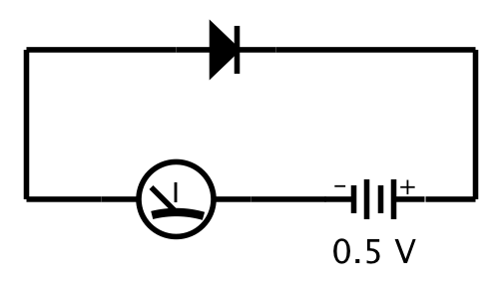
In-situ diagnostics: Hydrogen micro-sensor development
C-X measurements on existing tokamaks are limited to high energies and usually one location
Pd-MOS detector development
• Small size, low voltage, high sensitivity detectors provide dosemetric measurements
• Energy resolution can be obtained through Au overlayers
• Partner with Mesafab at SNL-NM to develop radiation resistant detectors
• Characterize using m&E filtered ion beam at SNL-CA

Slide 54
Concluding Remarks
Plasma material interactions likely to be a key focus for fusion research going forward:
Key issues
  Tritium retention / migration
  Degradation of near-surface structure due to shallowly implanted D and He
  Sputtering / redeposition
  Neutron damage
Future directions
  Development of advanced PFC concepts (tungsten alloys or liquid metal systems)
  New in-situ diagnostics will bring further insight into physics underlying PMI

Slide 55
Acknowledgements
I would like to express my appreciation to:
My colleagues at Sandia/CA:
  Dean Buchenauer, David Donovan, Richard Nygren, Josh Whaley, Jon Watkins, Thomas Felter
Our collaborators:
  Brian Wirth (Univ. of Tenn.), David Donovan (Univ. of Tenn.), Masa Shimada (INL), Brad Merrill (INL), Matt Baldwin (UCSD), Russ Doerner (UCSD), Dmitry Rudakov (UCSD), Clement Wong (GA), Bruce Koel (Princeton), David Ruzic (Univ. of Illinois)
Sandia National Laboratories is a multi-program laboratory managed and operated by Sandia Corporation, a wholly owned subsidiary of Lockheed Martin Corporation, for the U.S. Department of Energy's National Nuclear Security Administration under contract DE-AC04-94AL85000.

