Slide 1
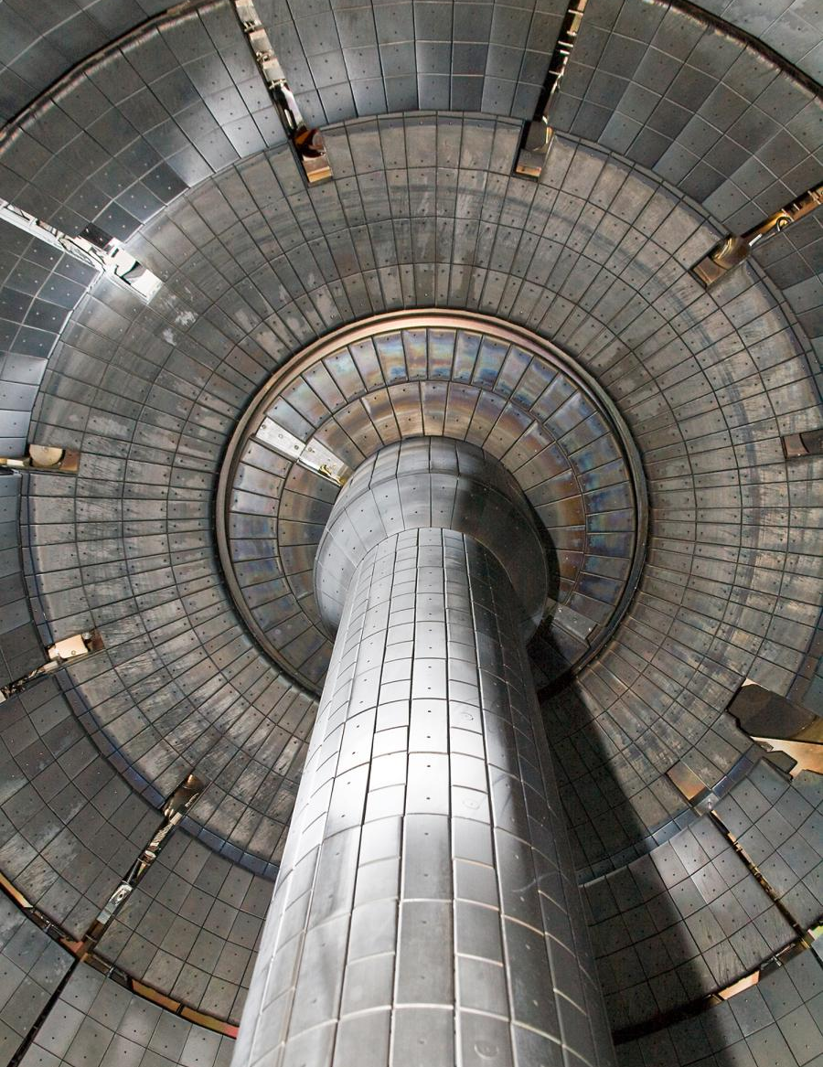

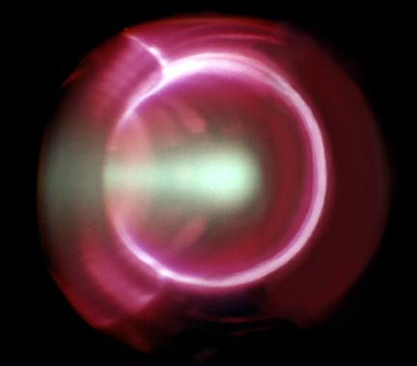
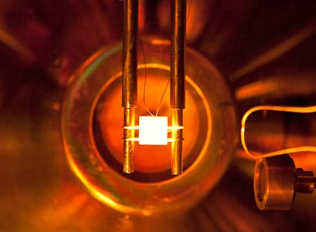
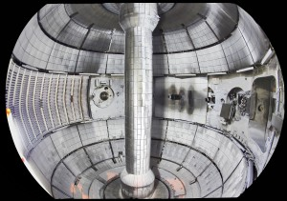
Materials Science in Fusion Devices
Angela M. Capece
Department of Physics
The College of New Jersey
SULI Introductory Course
in Plasma Physics, PPPL
June 10, 2016

Slide 2
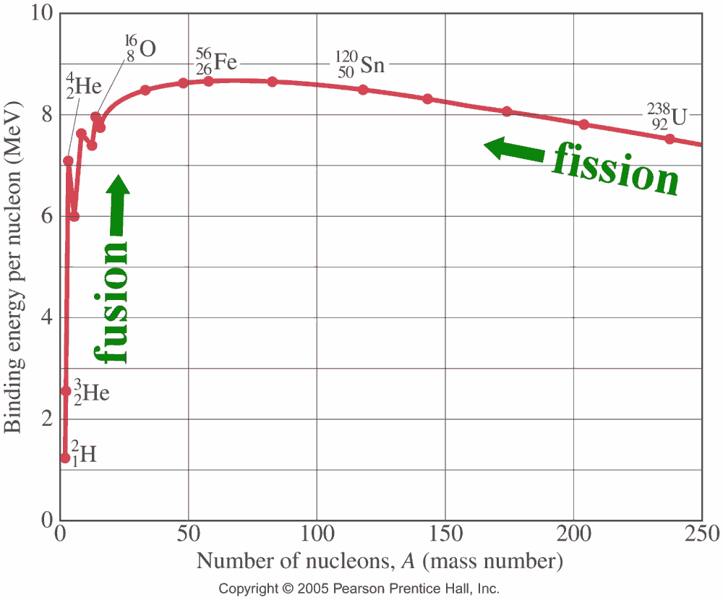
Nuclear energy (fission & fusion) comes from the mass defect of the nucleus
Advantages of fusion energy:
Clean
Green
Safe
Abundant
MASS DEFECT:
The whole < the sum of the parts!
(e.g., mass of He nucleus is less than mass of 2p + 2n)
Larger mass defect → greater BE
Going from low BE to higher binding energy releases energy
SULI Introductory Course, 6/10/16
A.M. Capece
2/51
Notes:
Hydrogen fuel extracted from seawater
D-D fusion can power the world for 2 billion years
Coal – 200 yr
Natural gas – 20 yr
U235/Th232 breeder reactors – 20,000 yr
Fuel efficient
City of 1 million, need 60 kg of H₂

Slide 3
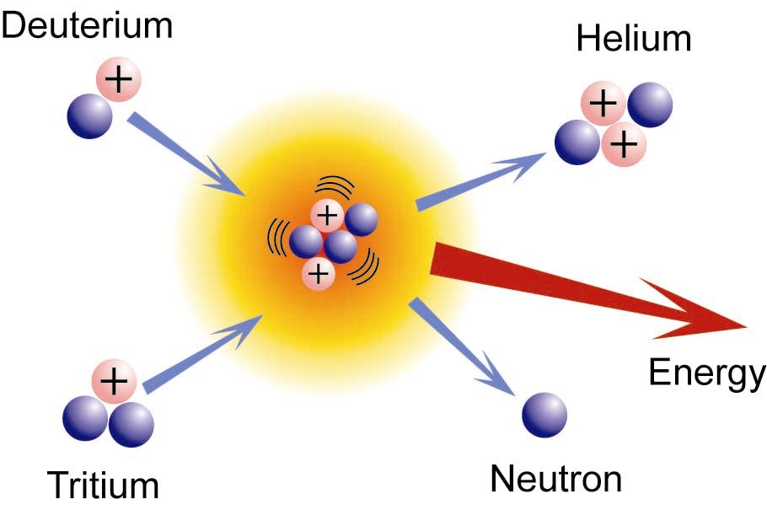
We need fusion to survive
Advantages of fusion energy:
Clean
Green
Safe
Abundant
H fuel extracted from seawater
D-D fusion can power the world for 2x10⁹ yr
  Coal: 200 yr
  Natural gas: 20 yr
  U235/Th232 breeder reactors: 20,000 yr
Fuel efficient
  City of 1 million, need 60 kg of H₂
SULI Introductory Course, 6/10/16
A.M. Capece
3/51
Notes:
Hydrogen fuel extracted from seawater
D-D fusion can power the world for 2 billion years
Coal – 200 yr
Natural gas – 20 yr
U235/Th232 breeder reactors – 20,000 yr
U – 200 yrs
Fuel efficient
City of 1 million, need 60 kg of H₂

Slide 4
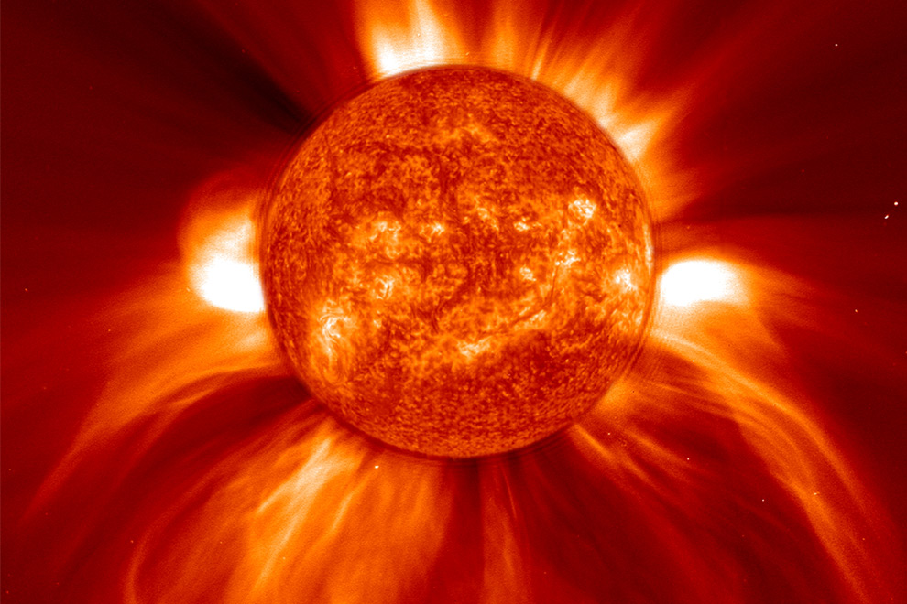
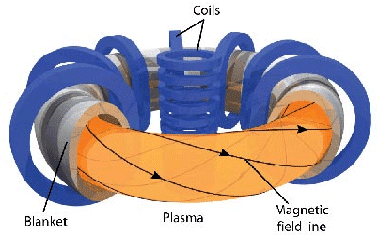
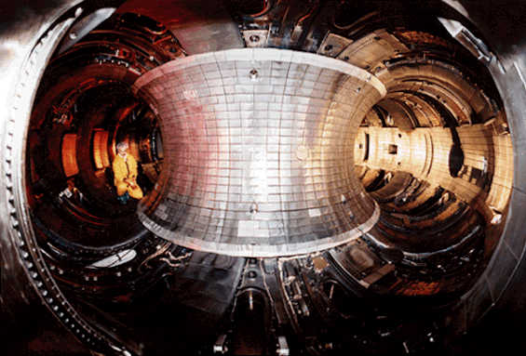
Hydrogen fusion requires high temperature & pressure → Plasma!
Temperatures of 100 million K are required (and have been achieved!)
The sun uses gravity to confine the plasma
We use magnetic fields
Is it possible on Earth?
YES! We’ve done it before. In fact, we did it here.
(Nov 2, 1994 – 10 megawatts of fusion power)
Magnets
Plasma
SULI Introductory Course, 6/10/16
A.M. Capece
4/51
Notes:
Hydrogen fuel extracted from seawater
D-D fusion can power the world for 2 billion years
Coal – 200 yr
Natural gas – 20 yr
U235/Th232 breeder reactors – 20,000 yr
Fuel efficient
City of 1 million, need 60 kg of H₂

Slide 5
Hydrogen fusion requires high temperature & pressure → Plasma!
So why don’t we have it yet?
The trouble with fusion is…
  Confining enough hydrogen
  For long enough times
  At sufficiently high temperatures
Magnets
Plasma
SULI Introductory Course, 6/10/16
A.M. Capece
5/51
Notes:
Hydrogen fuel extracted from seawater
D-D fusion can power the world for 2 billion years
Coal – 200 yr
Natural gas – 20 yr
U235/Th232 breeder reactors – 20,000 yr
Fuel efficient
City of 1 million, need 60 kg of H₂

Slide 6
Hydrogen fusion requires high temperature & pressure → Plasma!
So why don’t we have it yet?
The trouble with fusion is…
  Confining enough hydrogen
  For long enough times
  At sufficiently high temperatures
We need…
Better magnets
Better materials
Magnets
Plasma
SULI Introductory Course, 6/10/16
A.M. Capece
6/51
Notes:
Hydrogen fuel extracted from seawater
D-D fusion can power the world for 2 billion years
Coal – 200 yr
Natural gas – 20 yr
U235/Th232 breeder reactors – 20,000 yr
Fuel efficient
City of 1 million, need 60 kg of H₂

Slide 7
Hydrogen fusion requires high temperature & pressure → Plasma!
So why don’t we have it yet?
The trouble with fusion is…
  Confining enough hydrogen
  For long enough times
  At sufficiently high temperatures
We need…
Better magnets
Better materials
Magnets
Plasma
SULI Introductory Course, 6/10/16
A.M. Capece
7/51
Notes:
Hydrogen fuel extracted from seawater
D-D fusion can power the world for 2 billion years
Coal – 200 yr
Natural gas – 20 yr
U235/Th232 breeder reactors – 20,000 yr
Fuel efficient
City of 1 million, need 60 kg of H₂

Slide 8
What happens when you try to contain a plasma?
The plasma affects the surface
The surface affects the plasma
  Physical & chemical properties of the material can change
Plasma
Wall Material
  Chemical composition of the plasma can change
Wall Material
Plasma
SULI Introductory Course, 6/10/16
A.M. Capece
8/51

Slide 9
How plasma affects the surface:
Plasma
Wall Material
What do we have in the plasma?
SULI Introductory Course, 6/10/16
A.M. Capece
9/51

Slide 10
How plasma affects the surface:
Plasma
Wall Material
What do we have in the plasma?
  High energy electrons
  H₂, H, H₂⁺, H⁺, He, He⁺
  neutrons
We have high energy particles & reactive species
SULI Introductory Course, 6/10/16
A.M. Capece
10/51

Slide 11
How plasma affects the surface:
Plasma
Wall Material
What do we have in the plasma?
  High energy electrons, H₂, H, H₂⁺, H⁺, He, He⁺, neutrons
What do these species do?
  Impart energy to the wall (heating): ave loads are 10 MW/m²
  Erode the wall material
  Implant themselves in the wall – Limit on tritium retention!
  Do chemistry on the wall – form different compounds
  Can weaken the material – material swelling / embrittlement from neutrons, fuzz formation
SULI Introductory Course, 6/10/16
A.M. Capece
11/51

Slide 12
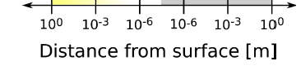
How the surface affects the plasma:
Plasma
Wall Material
What do we have at the surface?
  A thermal sink (results in temperature gradients near the wall)
10⁸
10⁶
10⁴
10²
Temperature (K)
Plasma
Material
Distance from the surface (m)
SULI Introductory Course, 6/10/16
A.M. Capece
12/51

Slide 13
How the surface affects the plasma:
Plasma
Wall Material
What else do we have at the surface?
  A thermal sink (results in temperature gradients near the wall)
  A nearly infinite source of impurities
  A source of electrons (from the atoms in the surface)
SULI Introductory Course, 6/10/16
A.M. Capece
13/51

Slide 14
How the surface affects the plasma:
Plasma
Wall Material
What do we have at the surface?
  A thermal sink (results in temperature gradients near the wall)
  A nearly infinite source of impurities
    Impurities enter at low temps → reduction in plasma temperature!
    Dilute the fuel → leads to reduction in fusion power!
    Material deposited where it is not wanted (e.g., on an expensive diagnostic)
SULI Introductory Course, 6/10/16
A.M. Capece
14/51

Slide 15
How the surface affects the plasma:
Plasma
Wall Material
What do we have at the surface?
  A thermal sink (results in temperature gradients near the wall)
  A nearly infinite source of impurities
  A source of electrons (from the atoms in the surface)
    Electron emission from the wall: cools the edge plasma & changes electric potential
    Results in gradients in temperature and potential → drives instabilities & reduced confinement
SULI Introductory Course, 6/10/16
A.M. Capece
15/51

Slide 16
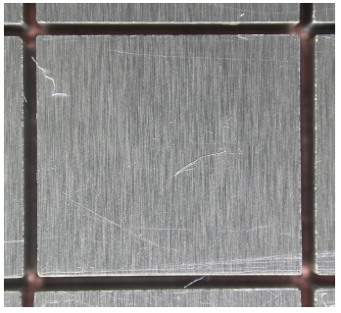
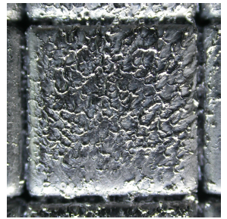
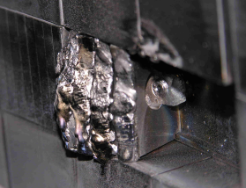
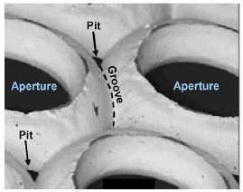
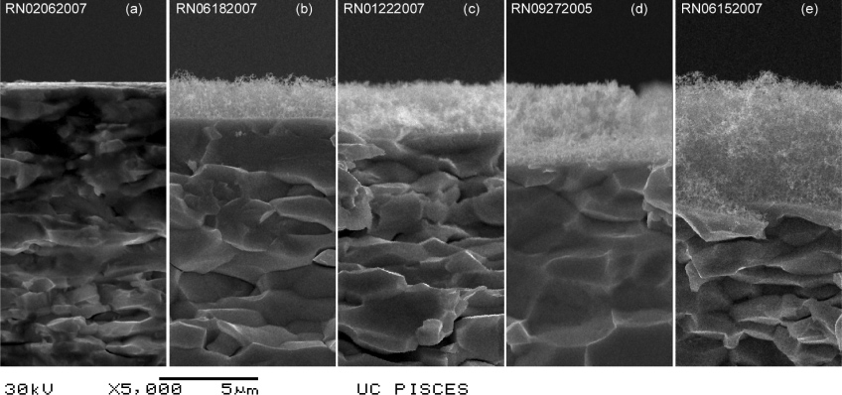
Plasmas can be spectacularly destructive!
Tungsten tile in fusion device, before & after plasma exposure Z. Hartwig, MIT
Melted tungsten tile
B. Lipschultz, Nucl. Fusion (2012)
Erosion of molybdenum
ion thruster grid
R.E. Wirz, IEEE Trans. Plasma Sci. (2008)
Tungsten fuzz
M.J. Baldwin & R.P. Doerner, Nucl. Fusion (2008)
SULI Introductory Course, 6/10/16
A.M. Capece
16/51

Slide 17
Five main processes that occur at the plasma-materials interface
SULI Introductory Course, 6/10/16
A.M. Capece
17/51

Slide 18
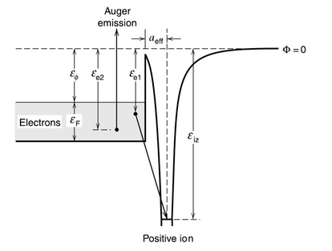
Five main processes that occur at the plasma-materials interface
Positive Ion Neutralization (Recombination)
Occurs for all energies (10-1000 eV, typical)
All ions immediately neutralized
2 options:
-Electron enters excited state (radiates a photon as it transitions to lower state)
-Electron enters ground state & 2nd electron absorbs excess energy – Auger Neutralization also secondary electron emission (SEE)
M.A. Lieberman, Principles of Plasma Discharges & Materials Processing
SULI Introductory Course, 6/10/16
A.M. Capece
18/51

Slide 19
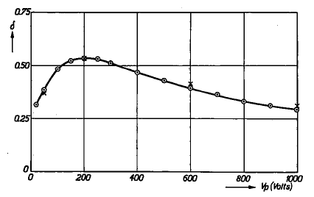
Five main processes that occur at the plasma-materials interface
Positive Ion Neutralization (Recombination)
SEE yield of Be
SEE depends on the ion species and the composition of the solid
Bruining, Physica 5 (1938) 17.
SULI Introductory Course, 6/10/16
A.M. Capece
19/51

Slide 20
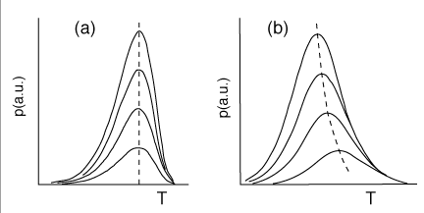
Five main processes that occur at the plasma-materials interface
2. Absorption/Desorption (low energy, 1 eV)
Rate equation for desorption:
(dependent on binding energy & temperature)
Desorption of 1st order (a) & second order process (b)
http://users-phys.au.dk/philip/pictures/physicsfigures/node18.html
SULI Introductory Course, 6/10/16
A.M. Capece
20/51

Slide 21
Five main processes that occur at the plasma-materials interface
3. Physical Sputtering (10-100 eV)
Higher energy transfer when masses are similar:
Rate equation:
Yield (empirical) = number sputters per incident ion
Sputtering
SULI Introductory Course, 6/10/16
A.M. Capece
21/51

Slide 22
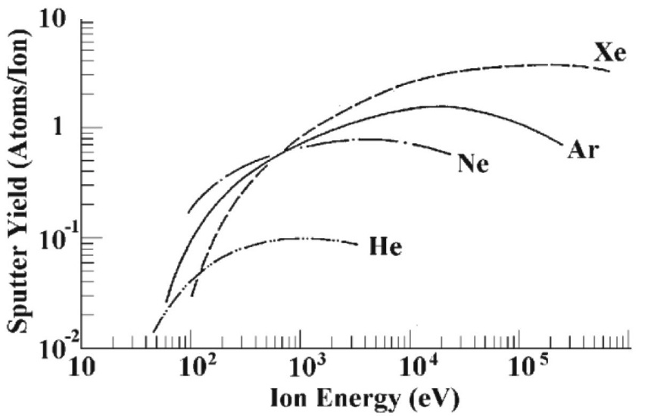
Five main processes that occur at the plasma-materials interface
3. Physical Sputtering (10-100 eV)
Sputter yields of silicon as a function of ion energy for noble gas ions:
Sputtering
http://xpssimplified.com/depth_profiling.php
SULI Introductory Course, 6/10/16
A.M. Capece
22/51

Slide 23
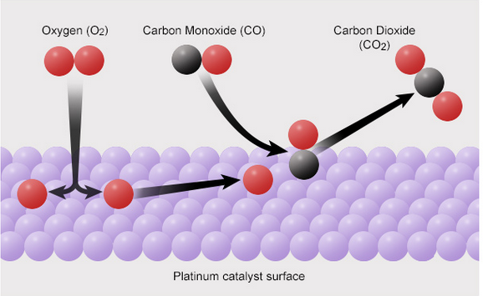
Five main processes that occur at the plasma-materials interface
4. Implantation (1000 eV)
5. Reactions with/on a surface
Implantation
http://www.abc.net.au/science/articles/2015/05/25/4229949.htm
SULI Introductory Course, 6/10/16
A.M. Capece
23/51

Slide 24
Five main processes that occur at the plasma-materials interface
Positive Ion Neutralization (Recombination)
Ions that hit the surface are neutralized
e + A⁺ + S→ A + S
Absorption/Desorption (low energy, 1 eV)
  Evaporation rate increases exponentially with temperature
Physical Sputtering (10-100 eV)
  Independent of surface temperature
Implantation (1000 eV)
Reactions with/on a surface
  Dependent on surface temperature
Absorption/Desorption
Sputtering
Implantation
SULI Introductory Course, 6/10/16
A.M. Capece
24/51

Slide 25
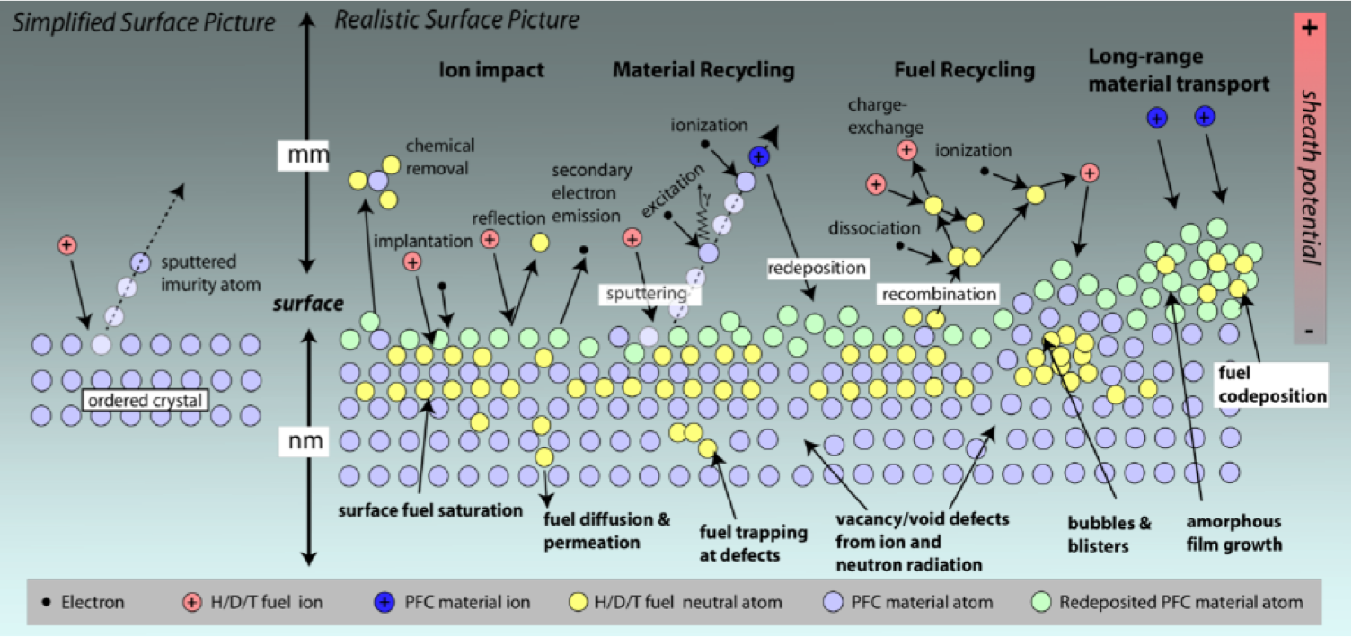
Reality is much more complex!
Image from D. Whyte, http://psisc.org/mission
SULI Introductory Course, 6/10/16
A.M. Capece
25/51

Slide 26
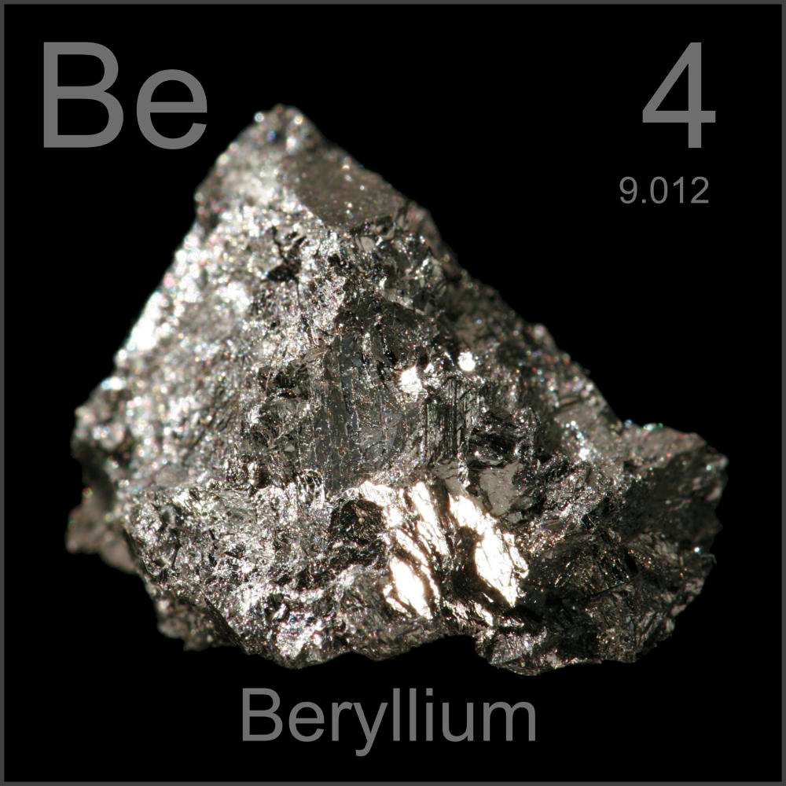
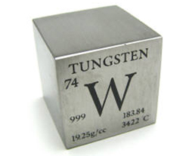
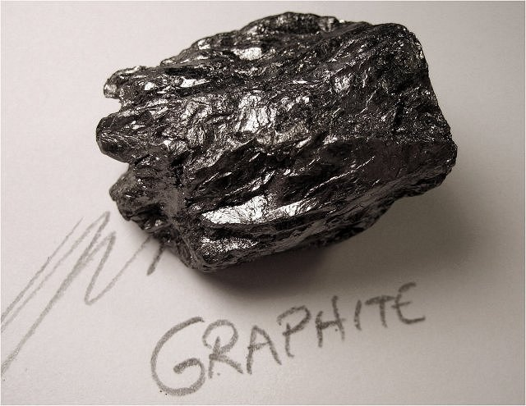
Some candidate materials and their properties
Graphite:
Does not melt (sublimes)
Erosion and transport occurs easily leading to C deposits
Can trap large amounts of tritium
Beryllium:
Low Z material
Good thermal conductivity
High sputter yields
Low melting point
Tungsten:
High Z material
Low sputter yield
High melting point
High Z materials (e.g. W, Mo):
Poison the plasma
Moderate uptake of tritium
Good thermo-mechanical properties
Low or negligible erosion at low plasma temperatures
SULI Introductory Course, 6/10/16
A.M. Capece
26/51

Slide 27
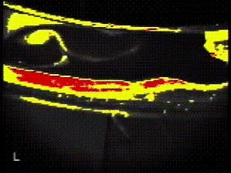
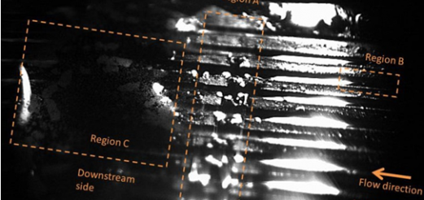
Liquid metals
Advantages of liquid metals (lithium):
No erosion
No thermal fatigue
No neutron damage
Resilient again high heat fluxes
Refreshes the surface
Li concentration in the plasma is low
Infrared image of liquid lithium a fusion device at PPPL.
Li has shown to improve the plasma performance!
Improved confinement time → Very important for fusion!
Flowing liquid Li experiment at University of Illinois at Urbana-Champaign
SULI Introductory Course, 6/10/16
A.M. Capece
27/51
Notes:
H will be re-emitted at low temp
Find material that will resist damage, while not allowing H to go back to the plasma
Flowing liquid Li!
Li improves plasma performance by absorbing all the H
Our experiments show that we can keep D in the walls until 700 K, so as long as we can control the walls to be at this temperature, we should be good!
Conclusions…. Plasma materials does two things
Renumber the pages
Check titles!
Save talk to jump drive

Slide 28
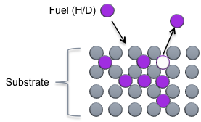
But why does Li help?
Working hypothesis: Deuterium retention
Li absorbs D⁺ ions and “retains” them better than other materials
But how is D retained in Li?
High D retention → Low recycling → High edge temperature → Reduced temperature gradients
Recycling Process:
Through volumetric conversion of Li to LiD (Baldwin & Doerner)
2. Through complexes that involve oxygen (Krstic, Allain, Taylor)
SULI Introductory Course, 6/10/16
A.M. Capece
28/51
Notes:
H will be re-emitted at low temp
Find material that will resist damage, while not allowing H to go back to the plasma
Flowing liquid Li!
Li improves plasma performance by absorbing all the H
Our experiments show that we can keep D in the walls until 700 K, so as long as we can control the walls to be at this temperature, we should be good!
Conclusions…. Plasma materials does two things
Renumber the pages
Check titles!
Save talk to jump drive

Slide 29
Which material is best? We need to understand what happens at the surface!
Atoms at the surface behave differently than atoms in the bulk material.
The surface provides an environment where unique chemistry can occur.
So, how do we study surfaces?
Challenge: Detect 10¹⁴ cm⁻² signal on a 10²³ cm⁻³ background
Surfaces contain ~10¹⁴ atoms/cm²
SULI Introductory Course, 6/10/16
A.M. Capece
29/51

Slide 30
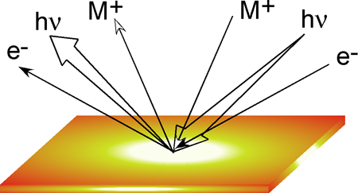
Which material is best? We need to understand what happens at the surface!
Atoms at the surface behave differently than atoms in the bulk material.
The surface provides an environment where unique chemistry can occur.
So, how do we study surfaces?
Challenge: Detect 10¹⁴ cm⁻² signal on a 10²³ cm⁻³ background.
Solution: Use probes that strongly interact with matter, such as as electrons, ions, and photons (X-rays, UV light).
Surfaces contain ~10¹⁴ atoms/cm²
SULI Introductory Course, 6/10/16
A.M. Capece
30/51

Slide 31
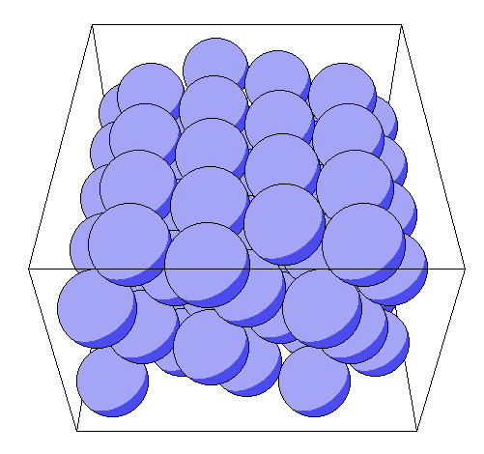
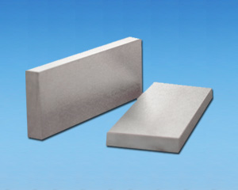
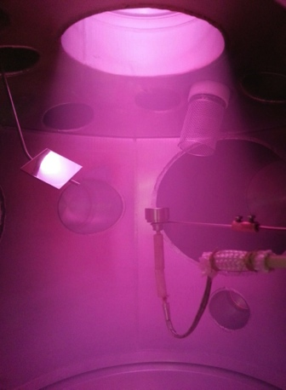

From the simple to the complex
Simple Model Experiments
More Complex Systems
Grain boundaries
Alloying elements: Ti, Zr, C
Surface roughness
Single crystal
TZM (Engineering materials)
H₃⁺
H₂⁺
Multiple species, increased fluxes, atoms/ions/electrons/radicals
H⁺
Monoenergetic ion beam
(Image of He ions on phosphor screen)
Plasma sources / fusion devices
SULI Introductory Course, 6/10/16
A.M. Capece
31/51

Slide 32
From the simple to the complex
Simple Model Experiments
More Complex Systems
Laboratory surface science experiments
Linear plasma devices
Fusion devices
SULI Introductory Course, 6/10/16
A.M. Capece
32/51

Slide 33
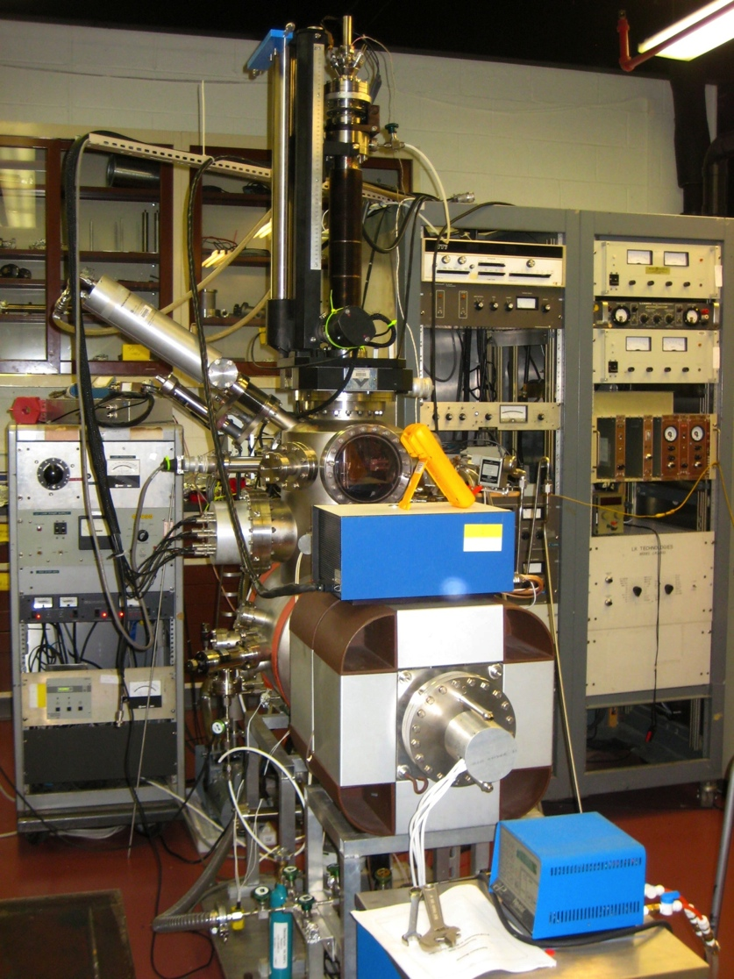
Laboratory surface science experiments
simple
complex
Key variables affecting chemistry at surface:
  Pressure
  Temperature
  Composition
Lab-based surface science experiments enable independent control of all variables
  …something we cannot achieve in a tokamak or linear plasma device!
Isolate effects of:
  Chemistry
  Incident particle fluxes and energies
  Substrate temperature
  Surface composition
  Morphology
Test stand instrumentation in the
Surface Science & Technology Lab
SULI Introductory Course, 6/10/16
A.M. Capece
33/51

Slide 34
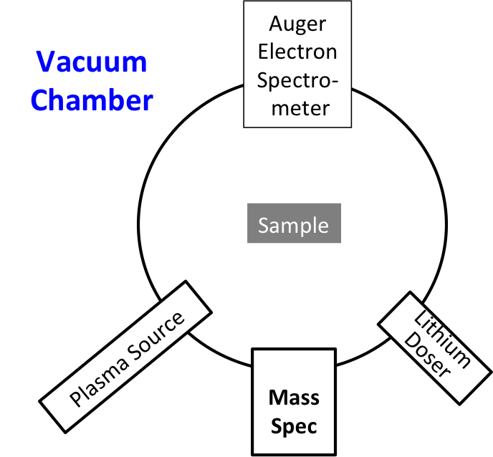
Laboratory surface science experiments
simple
complex
Li
Li
Test stand instrumentation in the
Surface Science & Technology Lab
SULI Introductory Course, 6/10/16
A.M. Capece
34/51

Slide 35
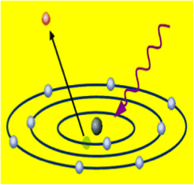
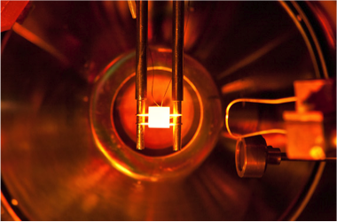
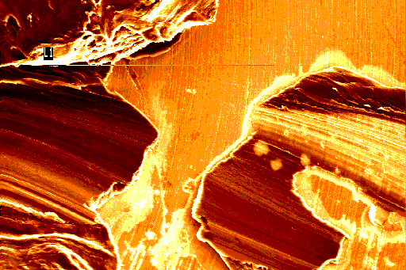
Atomic-Level Diagnostics
 | Technique | Info Obtained | Additional Notes
 | X-ray Photoelectron Spectroscopy (XPS) / Auger Electron Spectroscopy (AES) | Chemical composition Oxidation state | Cannot detect H/D or He Probe depth ~10 nm
 | Temperature Programmed Desorption (TPD) | Desorption energy Rate constants | Detects H Can determine the total amount of an adsorbed species on the surface
 | Scanning Auger Microscopy (SAM) | 2D elemental map of surface Ion etching SEM images | Cannot detect H/D or He Can use ion etching to probe into deeper layers
 | Ion Scattering Spectroscopy (ISS) | Atoms/molecules in top 1-3 layers | Can use direct recoil spectroscopy to detect H/D
SULI Introductory Course, 6/10/16
35/51

Slide 36
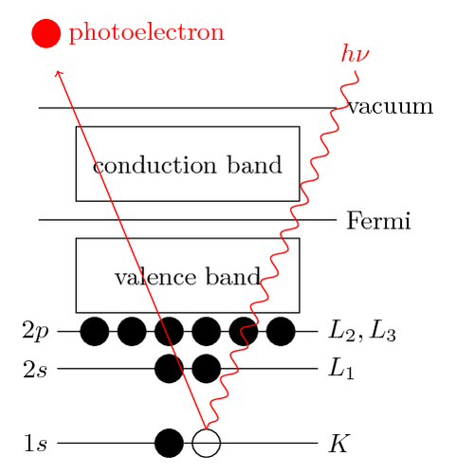
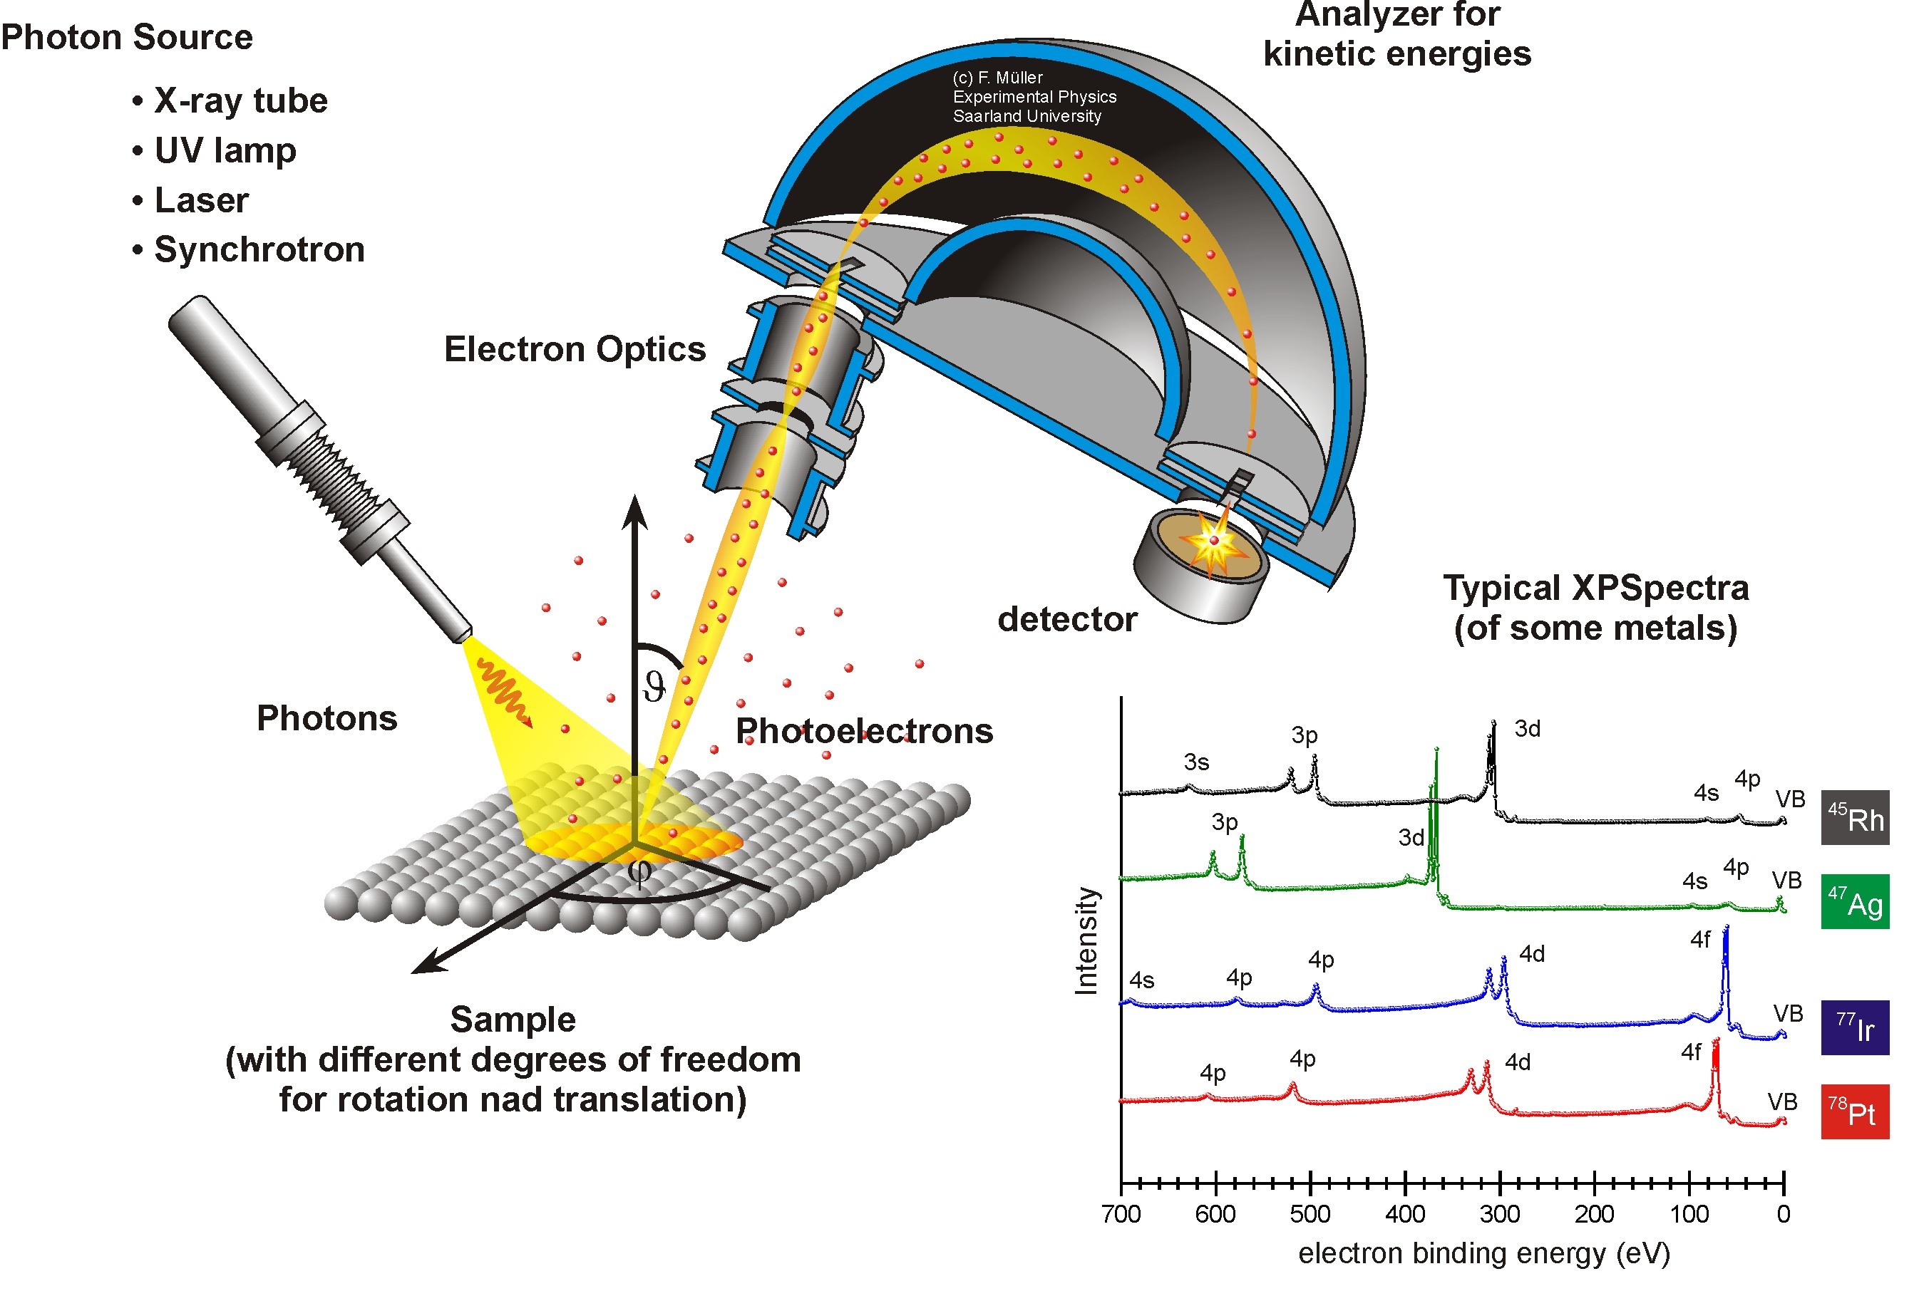
X-ray Photoelectron Spectroscopy (XPS)
Gives composition of top 5-10 nm
http://jacobs.physik.uni-saarland.de/english/instrumentation/uhvl.htm
SULI Introductory Course, 6/10/16
A.M. Capece
36/51

Slide 37
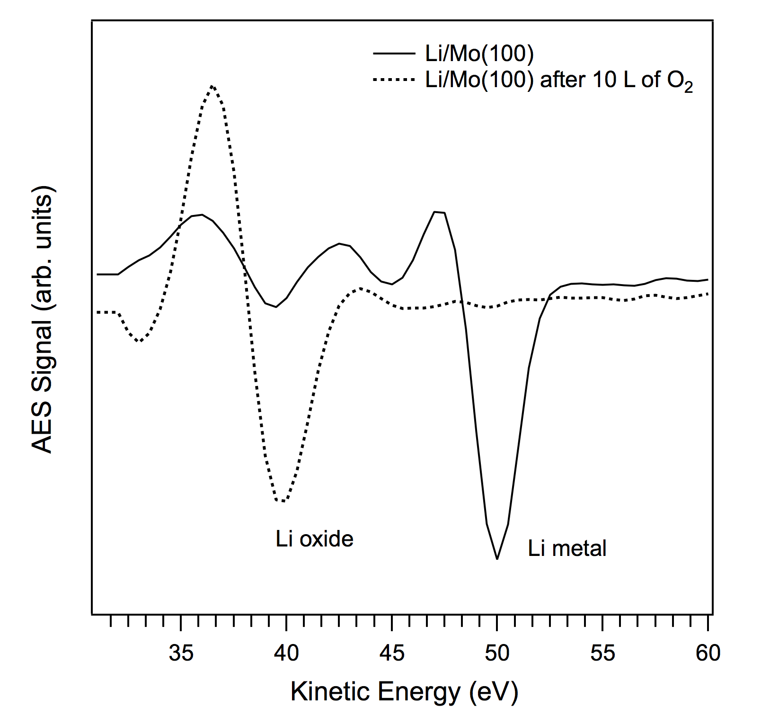
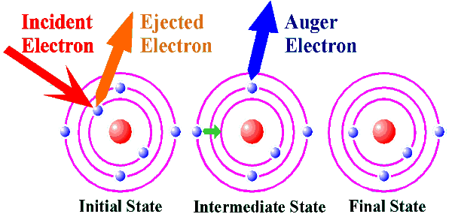
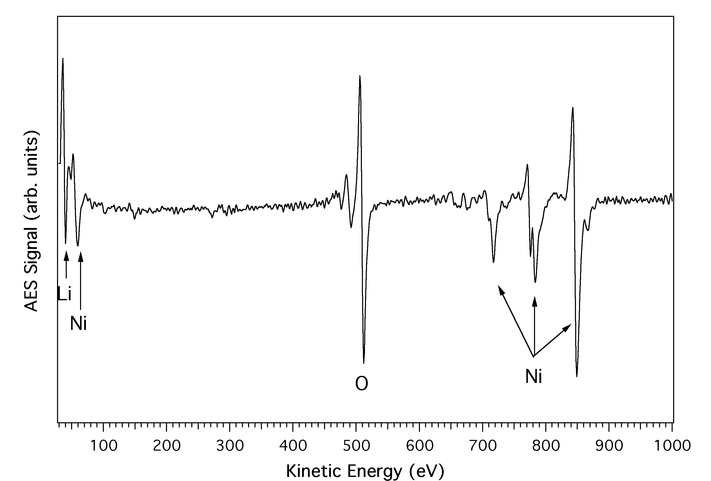
Auger Electron Spectroscopy
SULI Introductory Course, 6/10/16
A.M. Capece
37/51

Slide 38
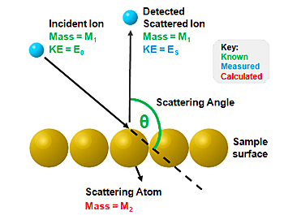
Low-energy Ion Scattering Spectroscopy (LEISS)
Very surface sensitive
(probes top 1-3 layers)
He usually used for incident ion
SULI Introductory Course, 6/10/16
A.M. Capece
38/51

Slide 39
Low-energy Ion Scattering Spectroscopy (LEISS)
Very surface sensitive
(probes top 1-3 layers)
He usually used for incident ion
SULI Introductory Course, 6/10/16
A.M. Capece
39/51

Slide 40
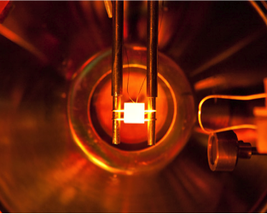
Temperature programmed desorption
Sample
1 cm
Temperature Programmed Desorption (TPD) Technique:
Linear temperature ramp applied to sample
Partial pressure of desorbing species measured
Temperature of desorption peak relates to binding energy
Area under pressure vs. time curve proportional to number of atoms desorbed
SULI Introductory Course, 6/10/16
A.M. Capece
40/51
Notes:
H will be re-emitted at low temp
Find material that will resist damage, while not allowing H to go back to the plasma
Flowing liquid Li!
Li improves plasma performance by absorbing all the H
Our experiments show that we can keep D in the walls until 700 K, so as long as we can control the walls to be at this temperature, we should be good!
Conclusions…. Plasma materials does two things
Renumber the pages
Check titles!
Save talk to jump drive

Slide 41
Temperature programmed desorption
Sample
1 cm
Area under pressure vs. time curve → # of atoms desorbed
TPD can be used to measure D retention!
SULI Introductory Course, 6/10/16
A.M. Capece
41/51
Notes:
H will be re-emitted at low temp
Find material that will resist damage, while not allowing H to go back to the plasma
Flowing liquid Li!
Li improves plasma performance by absorbing all the H
Our experiments show that we can keep D in the walls until 700 K, so as long as we can control the walls to be at this temperature, we should be good!
Conclusions…. Plasma materials does two things
Renumber the pages
Check titles!
Save talk to jump drive

Slide 42
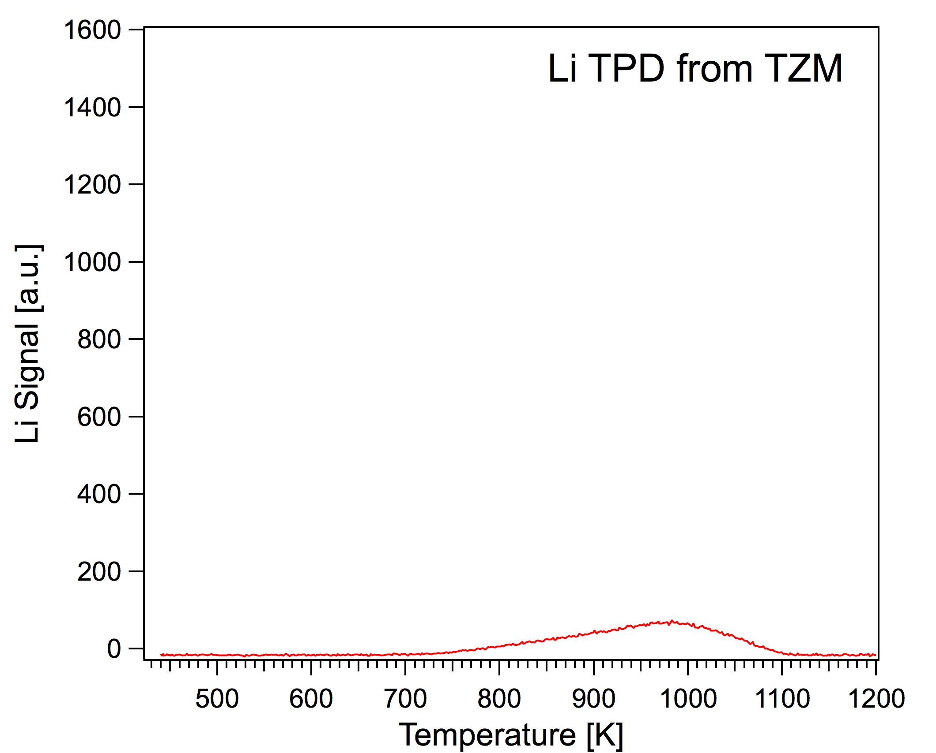
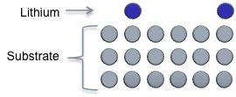
Example: Desorption of Li from Mo
simple
complex
Submonolayer Li film on TZM stable up to 1000 K
Represents Li-Mo bonding
Desorption energy ~2.7 eV
Submonolayer Li Film
C.H. Skinner et al., JNM 438, S647 (2013)
SULI Introductory Course, 6/10/16
A.M. Capece
42/51

Slide 43
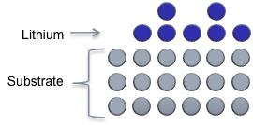
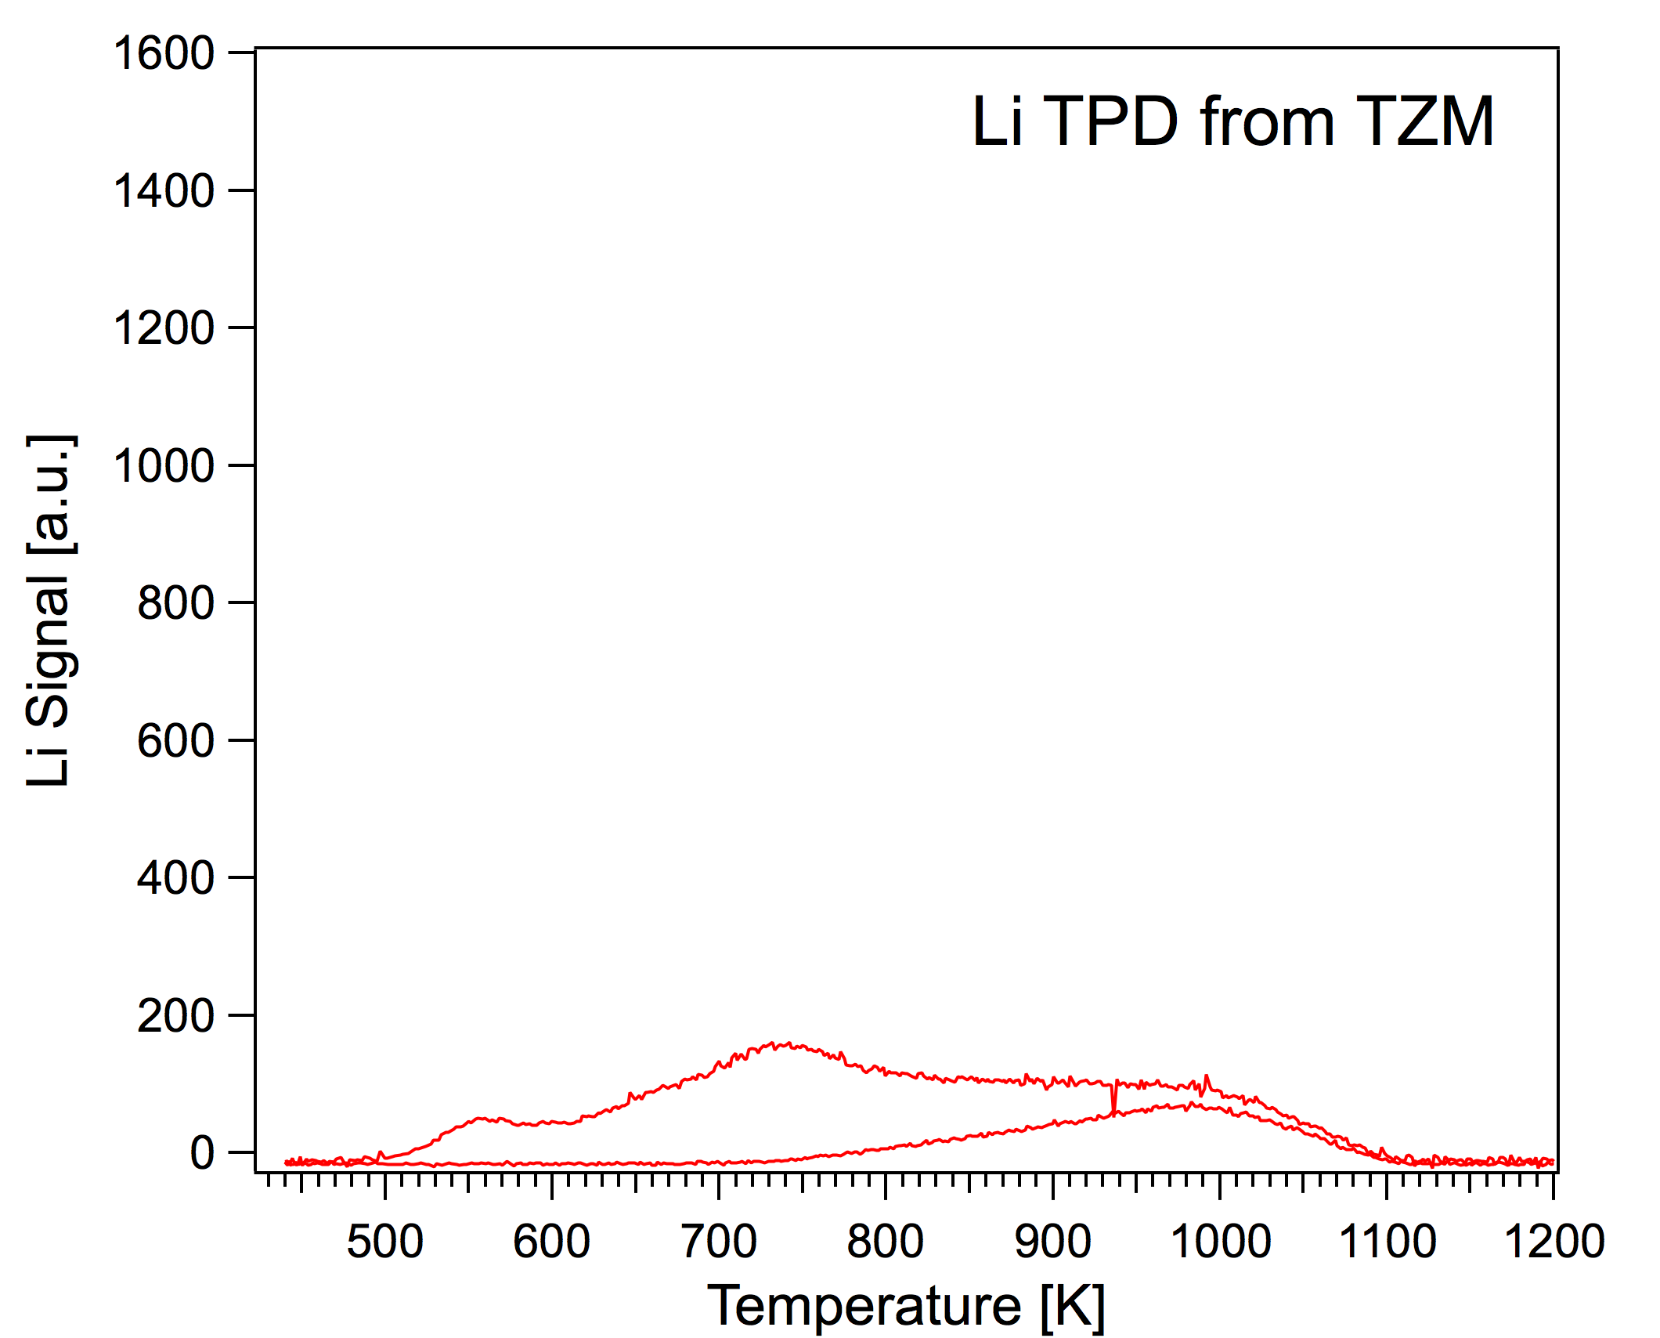
Example: Desorption of Li from Mo
simple
complex
Area under Li TPD curve increases with Li dose
Dipole interactions lower the desorption energy (~2 eV)
E_{d} is a function of coverage
Monolayer
Submonolayer
C.H. Skinner et al., JNM 438, S647 (2013)
SULI Introductory Course, 6/10/16
A.M. Capece
43/51

Slide 44
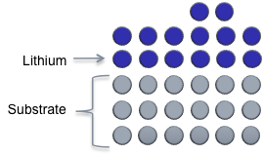
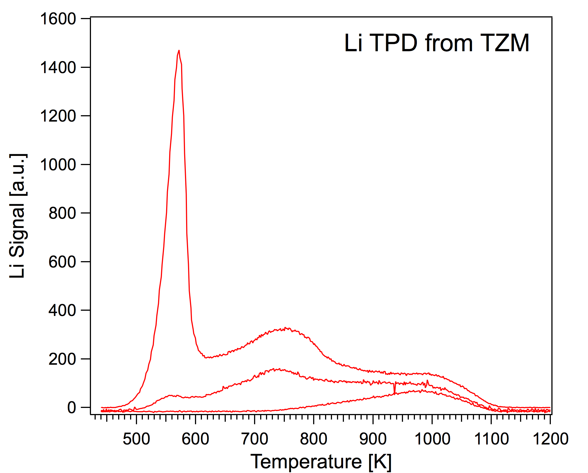
Example: Desorption of Li from Mo
simple
complex
Multilayer
Complete
Monolayer
Thick Li films (multilayer) evaporate at 500 K
Multilayer film represents Li-Li bonding
Cohesive energy of metallic Li ~1.7 eV
Submonolayer
C.H. Skinner et al., JNM 438, S647 (2013)
SULI Introductory Course, 6/10/16
A.M. Capece
44/51

Slide 45
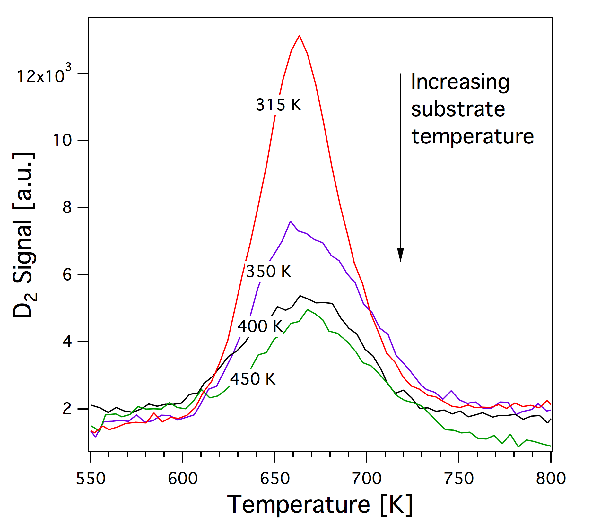

TPD can be used to determine D retention
simple
complex
In lithium films as function of temperature:
A.M. Capece, et al., JNM (2015)
SULI Introductory Course, 6/10/16
A.M. Capece
45/51

Slide 46

TPD can be used to determine D retention
simple
complex
In tungsten as function of fluence:
Lipschultz et al., (2010) MIT Report PSFC/RR-10-4
SULI Introductory Course, 6/10/16
A.M. Capece
46/51

Slide 47

SEM used to understand fuzz & bubble formation in W
simple
complex
Tungsten fuzz
M.J. Baldwin & R.P. Doerner, Nucl. Fusion (2008)
S. Kajita, Nucl. Fusion 49 (2009) 095005
SULI Introductory Course, 6/10/16
A.M. Capece
47/51

Slide 48

SEM used to understand fuzz & bubble formation in W
simple
complex
S. Kajita, Nucl. Fusion 49 (2009) 095005
SULI Introductory Course, 6/10/16
A.M. Capece
48/51

Slide 49

Materials Analysis Particle Probe (MAPP)
simple
complex
Provides in-vacuo analysis of surface exposed to fusion plasma
Correlates plasma performance with the surface state
Provides immediate analysis
XPS: Elemental/chemical composition
TPD: Gives binding energies, desorption products
Ion Scattering Spectroscopy:
IDs surface species
Direct Recoil Spectroscopy: Can detect H
Courtesy of F. Bedoya
SULI Introductory Course, 6/10/16
A.M. Capece
49/51

Slide 50


Materials Analysis Particle Probe (MAPP)
SULI Introductory Course, 6/10/16
A.M. Capece
50/51

Slide 51
Key takeaway messages
The plasma and material are strongly coupled!
Key PMI issues in fusion devices include: heat loading, erosion, fuel dilution, tritium retention, nuclear embrittlement
So far, no perfect fusion material exists. Candidates are graphite, tungsten, beryllium, lithium
Surface science can help to understand and diagnose the surface in model experiments that can help simulate the tokamak environment
A variety of experiments of differing complexity are needed
SULI Introductory Course, 6/10/16
A.M. Capece
51/51

