Slide 1
Introduction to Stellarators
David A. Maurer
SULI Lecture • PPPL • 9 June 2016
Notes:
Thank you. I’m presenting research carried out at Auburn University in collaboration with my colleagues.

Slide 2
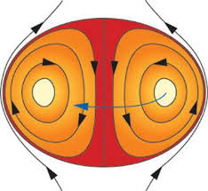
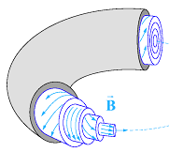
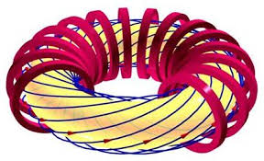
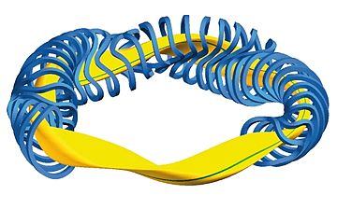
The continuum of magnetic confinement configurations
Confining magnetic fields can be supplied/generated by internal plasma currents or external coils
Compact
tori
RFP
Tokamak
Stellarator
See M. Mauel 2015 SULI lecture for further discussion of other configurations
Notes:
Disruptions are still a big concern for toroidally confined plasmas and their avoidance and mitigation is considered essential for future fusion devices such as ITER.
Disruptions, however, do not routinely occur in current free stellarators, although, they require a more complicated external coil set to get their rotational transform, which is the amount of twist in the magnetic fields lines.
More generally, the total rotational transform can come from both currents running internal to the plasma (iota-bar current) and from external magnet coils, also referred to as vacuum transform (iota-bar vac). Throughout this talk I’ll use the vacuum transform as a descriptor for the amount of 3D filed that is applied.
On one end of the spectrum are configurations, such as tokamaks, with zero vacuum transform, and on the other end are current free stellarators with 100% vacuum transform. But in between there are configurations with both.
So the question remains, Can the application of 3D magnetic shaping suppress tokamak instabilities and disruptions? And if so, what amount and with what profile must vacuum transform be applied.

Slide 3
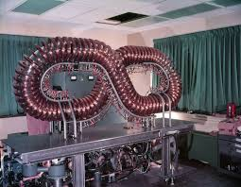
Stellarators were first conceived at Princeton
Generation of rotational transform or field line twist without plasma current
Proposed by Lyman Spitzer Jr in 1951
as part of Project Matterhorn
Called a stellarator or “star generator”
Project Matterhorn was later declassified
and renamed PPPL in 1961
Notes:
Disruptions are still a big concern for toroidally confined plasmas and their avoidance and mitigation is considered essential for future fusion devices such as ITER.
Disruptions, however, do not routinely occur in current free stellarators, although, they require a more complicated external coil set to get their rotational transform, which is the amount of twist in the magnetic fields lines.
More generally, the total rotational transform can come from both currents running internal to the plasma (iota-bar current) and from external magnet coils, also referred to as vacuum transform (iota-bar vac). Throughout this talk I’ll use the vacuum transform as a descriptor for the amount of 3D filed that is applied.
On one end of the spectrum are configurations, such as tokamaks, with zero vacuum transform, and on the other end are current free stellarators with 100% vacuum transform. But in between there are configurations with both.
So the question remains, Can the application of 3D magnetic shaping suppress tokamak instabilities and disruptions? And if so, what amount and with what profile must vacuum transform be applied.

Slide 4
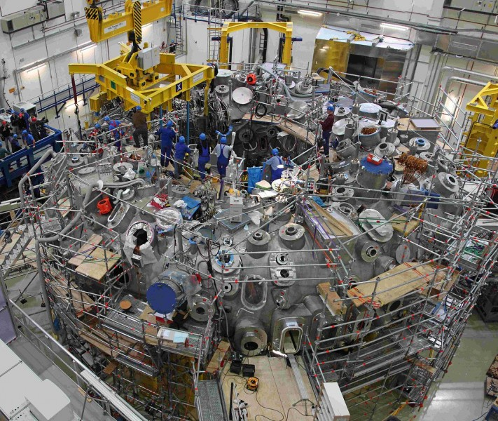
It is an exciting time to be studying stellarator physics: W7-X
First experimental test of stellarator optimization to produce tokamak like neoclassical transport
Wendelstein 7-X
Notes:
Disruptions are still a big concern for toroidally confined plasmas and their avoidance and mitigation is considered essential for future fusion devices such as ITER.
Disruptions, however, do not routinely occur in current free stellarators, although, they require a more complicated external coil set to get their rotational transform, which is the amount of twist in the magnetic fields lines.
More generally, the total rotational transform can come from both currents running internal to the plasma (iota-bar current) and from external magnet coils, also referred to as vacuum transform (iota-bar vac). Throughout this talk I’ll use the vacuum transform as a descriptor for the amount of 3D filed that is applied.
On one end of the spectrum are configurations, such as tokamaks, with zero vacuum transform, and on the other end are current free stellarators with 100% vacuum transform. But in between there are configurations with both.
So the question remains, Can the application of 3D magnetic shaping suppress tokamak instabilities and disruptions? And if so, what amount and with what profile must vacuum transform be applied.

Slide 5
Some Stellarator advantages...
Intrinsically steady-state, without the need to drive plasma current
Lack of plasma current removes large class of instabilities that are seen in tokamaks
Magnetic configuration given by external coils is rigid, no disruptive loss of confinement
Potential for greater range of designs and optimization of fusion performance
Notes:
Disruptions are still a big concern for toroidally confined plasmas and their avoidance and mitigation is considered essential for future fusion devices such as ITER.
Disruptions, however, do not routinely occur in current free stellarators, although, they require a more complicated external coil set to get their rotational transform, which is the amount of twist in the magnetic fields lines.
More generally, the total rotational transform can come from both currents running internal to the plasma (iota-bar current) and from external magnet coils, also referred to as vacuum transform (iota-bar vac). Throughout this talk I’ll use the vacuum transform as a descriptor for the amount of 3D filed that is applied.
On one end of the spectrum are configurations, such as tokamaks, with zero vacuum transform, and on the other end are current free stellarators with 100% vacuum transform. But in between there are configurations with both.
So the question remains, Can the application of 3D magnetic shaping suppress tokamak instabilities and disruptions? And if so, what amount and with what profile must vacuum transform be applied.

Slide 6
Some Stellarator disadvantages...
Complicated coil configurations that are difficult to design, need to be precisely built, and are expensive as a result
Achieving good particle confinement is more difficult than in tokamaks
Divertor and heat load geometry is more complicated than in tokamaks
Notes:
Disruptions are still a big concern for toroidally confined plasmas and their avoidance and mitigation is considered essential for future fusion devices such as ITER.
Disruptions, however, do not routinely occur in current free stellarators, although, they require a more complicated external coil set to get their rotational transform, which is the amount of twist in the magnetic fields lines.
More generally, the total rotational transform can come from both currents running internal to the plasma (iota-bar current) and from external magnet coils, also referred to as vacuum transform (iota-bar vac). Throughout this talk I’ll use the vacuum transform as a descriptor for the amount of 3D filed that is applied.
On one end of the spectrum are configurations, such as tokamaks, with zero vacuum transform, and on the other end are current free stellarators with 100% vacuum transform. But in between there are configurations with both.
So the question remains, Can the application of 3D magnetic shaping suppress tokamak instabilities and disruptions? And if so, what amount and with what profile must vacuum transform be applied.

Slide 7
Outline
Confining a plasma in a torus and the need for rotational transform
Generating magnetic surfaces without net plasma current
New directions in stellarator research
Auburn University fusion program
Notes:
Disruptions are still a big concern for toroidally confined plasmas and their avoidance and mitigation is considered essential for future fusion devices such as ITER.
Disruptions, however, do not routinely occur in current free stellarators, although, they require a more complicated external coil set to get their rotational transform, which is the amount of twist in the magnetic fields lines.
More generally, the total rotational transform can come from both currents running internal to the plasma (iota-bar current) and from external magnet coils, also referred to as vacuum transform (iota-bar vac). Throughout this talk I’ll use the vacuum transform as a descriptor for the amount of 3D filed that is applied.
On one end of the spectrum are configurations, such as tokamaks, with zero vacuum transform, and on the other end are current free stellarators with 100% vacuum transform. But in between there are configurations with both.
So the question remains, Can the application of 3D magnetic shaping suppress tokamak instabilities and disruptions? And if so, what amount and with what profile must vacuum transform be applied.

Slide 8
Outline
Confining a plasma in a torus and the need for rotational transform
Generating magnetic surfaces without net plasma current
New directions in stellarator research
Auburn University fusion program
Notes:
Disruptions are still a big concern for toroidally confined plasmas and their avoidance and mitigation is considered essential for future fusion devices such as ITER.
Disruptions, however, do not routinely occur in current free stellarators, although, they require a more complicated external coil set to get their rotational transform, which is the amount of twist in the magnetic fields lines.
More generally, the total rotational transform can come from both currents running internal to the plasma (iota-bar current) and from external magnet coils, also referred to as vacuum transform (iota-bar vac). Throughout this talk I’ll use the vacuum transform as a descriptor for the amount of 3D filed that is applied.
On one end of the spectrum are configurations, such as tokamaks, with zero vacuum transform, and on the other end are current free stellarators with 100% vacuum transform. But in between there are configurations with both.
So the question remains, Can the application of 3D magnetic shaping suppress tokamak instabilities and disruptions? And if so, what amount and with what profile must vacuum transform be applied.

Slide 9
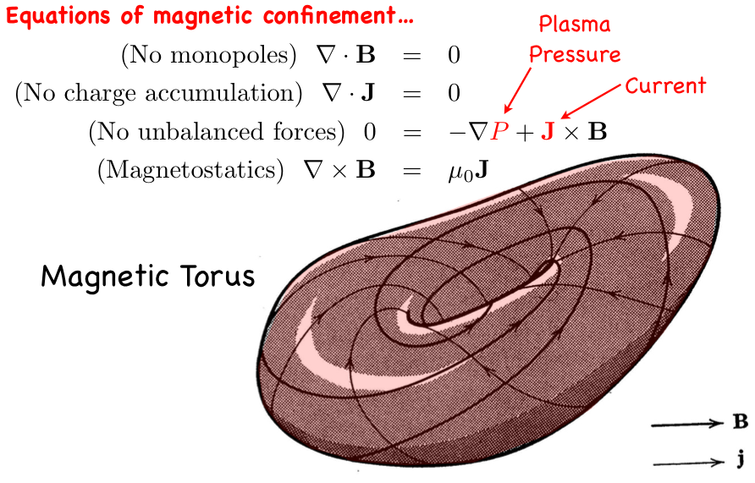
How do magnetic fields confine ionized matter?
Notes:
Disruptions are still a big concern for toroidally confined plasmas and their avoidance and mitigation is considered essential for future fusion devices such as ITER.
Disruptions, however, do not routinely occur in current free stellarators, although, they require a more complicated external coil set to get their rotational transform, which is the amount of twist in the magnetic fields lines.
More generally, the total rotational transform can come from both currents running internal to the plasma (iota-bar current) and from external magnet coils, also referred to as vacuum transform (iota-bar vac). Throughout this talk I’ll use the vacuum transform as a descriptor for the amount of 3D filed that is applied.
On one end of the spectrum are configurations, such as tokamaks, with zero vacuum transform, and on the other end are current free stellarators with 100% vacuum transform. But in between there are configurations with both.
So the question remains, Can the application of 3D magnetic shaping suppress tokamak instabilities and disruptions? And if so, what amount and with what profile must vacuum transform be applied.

Slide 10
How do magnetic fields confine ionized matter?
Notes:
Disruptions are still a big concern for toroidally confined plasmas and their avoidance and mitigation is considered essential for future fusion devices such as ITER.
Disruptions, however, do not routinely occur in current free stellarators, although, they require a more complicated external coil set to get their rotational transform, which is the amount of twist in the magnetic fields lines.
More generally, the total rotational transform can come from both currents running internal to the plasma (iota-bar current) and from external magnet coils, also referred to as vacuum transform (iota-bar vac). Throughout this talk I’ll use the vacuum transform as a descriptor for the amount of 3D filed that is applied.
On one end of the spectrum are configurations, such as tokamaks, with zero vacuum transform, and on the other end are current free stellarators with 100% vacuum transform. But in between there are configurations with both.
So the question remains, Can the application of 3D magnetic shaping suppress tokamak instabilities and disruptions? And if so, what amount and with what profile must vacuum transform be applied.

Slide 11
How do magnetic fields confine ionized matter?
Notes:
Disruptions are still a big concern for toroidally confined plasmas and their avoidance and mitigation is considered essential for future fusion devices such as ITER.
Disruptions, however, do not routinely occur in current free stellarators, although, they require a more complicated external coil set to get their rotational transform, which is the amount of twist in the magnetic fields lines.
More generally, the total rotational transform can come from both currents running internal to the plasma (iota-bar current) and from external magnet coils, also referred to as vacuum transform (iota-bar vac). Throughout this talk I’ll use the vacuum transform as a descriptor for the amount of 3D filed that is applied.
On one end of the spectrum are configurations, such as tokamaks, with zero vacuum transform, and on the other end are current free stellarators with 100% vacuum transform. But in between there are configurations with both.
So the question remains, Can the application of 3D magnetic shaping suppress tokamak instabilities and disruptions? And if so, what amount and with what profile must vacuum transform be applied.

Slide 12
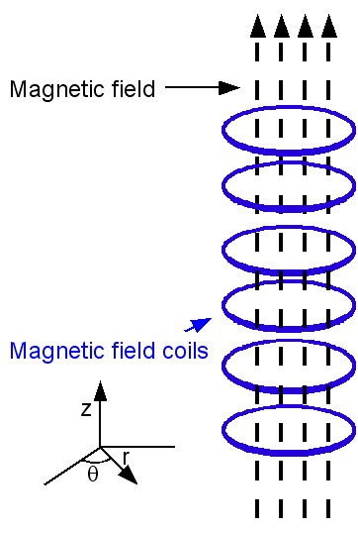
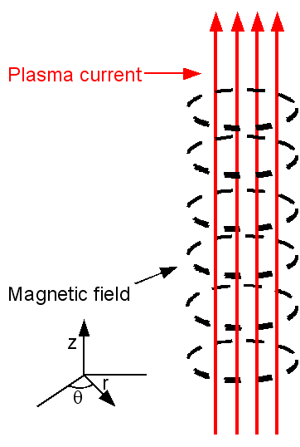

Start with simple cylindrical equilibria
The theta-pinch
The z-pinch
Notes:
The disruptive behavior of current-carrying discharges in CTH can be reproducibly modified by the presence of modest levels of externally generated rotational transform, but both the amount of vacuum transform required and the character of the observed disruption suppression depend on the type of disruption. Three types of disruptions are being investigated on CTH: Density limit disruptions, low q disruptions and disruptions caused by vertically unstable plasmas.

Slide 13
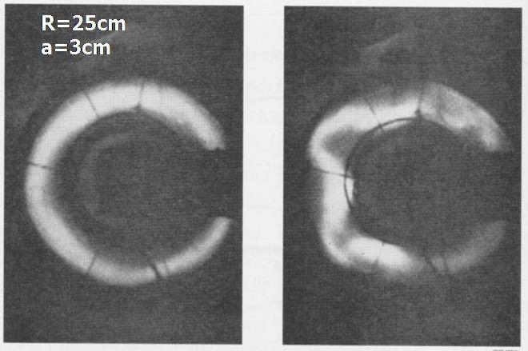
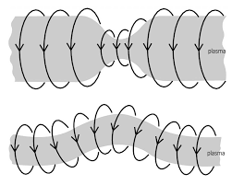
Why do we need twisting field lines for confinement?
Bend Z pinch or Theta pinch into a torus
Z pinch is very MHD unstable...
Notes:
The disruptive behavior of current-carrying discharges in CTH can be reproducibly modified by the presence of modest levels of externally generated rotational transform, but both the amount of vacuum transform required and the character of the observed disruption suppression depend on the type of disruption. Three types of disruptions are being investigated on CTH: Density limit disruptions, low q disruptions and disruptions caused by vertically unstable plasmas.

Slide 14
Why do we need twisting field lines for confinement?
Bend Theta pinch into a torus: guiding center picture
No equilibrium!
Notes:
The disruptive behavior of current-carrying discharges in CTH can be reproducibly modified by the presence of modest levels of externally generated rotational transform, but both the amount of vacuum transform required and the character of the observed disruption suppression depend on the type of disruption. Three types of disruptions are being investigated on CTH: Density limit disruptions, low q disruptions and disruptions caused by vertically unstable plasmas.

Slide 15
Why do we need twisting field lines for confinement?
Spitzer’s insight/solution
Twist causes “up” to be away from the midplane half the time and
towards it the other half, thus averaging the vertical drift out
Notes:
The disruptive behavior of current-carrying discharges in CTH can be reproducibly modified by the presence of modest levels of externally generated rotational transform, but both the amount of vacuum transform required and the character of the observed disruption suppression depend on the type of disruption. Three types of disruptions are being investigated on CTH: Density limit disruptions, low q disruptions and disruptions caused by vertically unstable plasmas.

Slide 16
Outline
Confining a plasma in a torus and the need for rotational transform
Generating magnetic surfaces without net plasma current
New directions in stellarator research
Auburn University fusion program
Notes:
Disruptions are still a big concern for toroidally confined plasmas and their avoidance and mitigation is considered essential for future fusion devices such as ITER.
Disruptions, however, do not routinely occur in current free stellarators, although, they require a more complicated external coil set to get their rotational transform, which is the amount of twist in the magnetic fields lines.
More generally, the total rotational transform can come from both currents running internal to the plasma (iota-bar current) and from external magnet coils, also referred to as vacuum transform (iota-bar vac). Throughout this talk I’ll use the vacuum transform as a descriptor for the amount of 3D filed that is applied.
On one end of the spectrum are configurations, such as tokamaks, with zero vacuum transform, and on the other end are current free stellarators with 100% vacuum transform. But in between there are configurations with both.
So the question remains, Can the application of 3D magnetic shaping suppress tokamak instabilities and disruptions? And if so, what amount and with what profile must vacuum transform be applied.

Slide 17
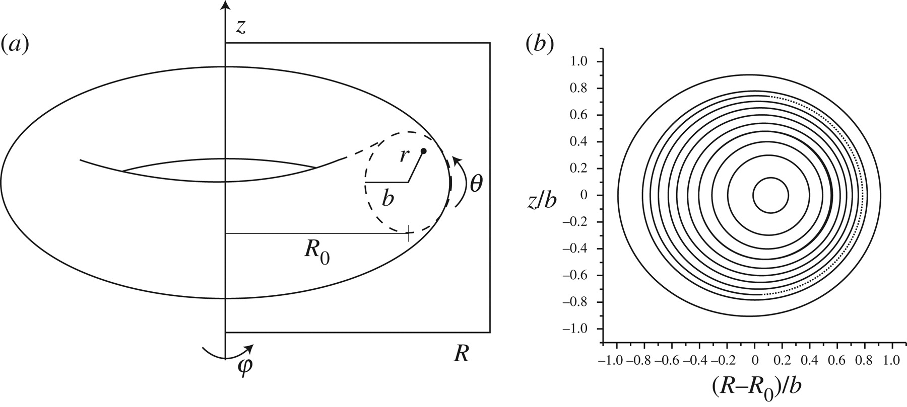
Rotational transform is a measure of field line twisting
For a screw pinch equilibrium:
  Pitch:
  Rotational transform:
  Field lines and magnetic surfaces
Notes:
The disruptive behavior of current-carrying discharges in CTH can be reproducibly modified by the presence of modest levels of externally generated rotational transform, but both the amount of vacuum transform required and the character of the observed disruption suppression depend on the type of disruption. Three types of disruptions are being investigated on CTH: Density limit disruptions, low q disruptions and disruptions caused by vertically unstable plasmas.

Slide 18
The three ways to generate rotational transform
Net toroidal plasma current like in the tokamak
Torsion (non-planar) magnetic axis like the original figure eight stellarator
Non-circular deformation of the magnetic surfaces in resonance with field line motion
Notes:
The disruptive behavior of current-carrying discharges in CTH can be reproducibly modified by the presence of modest levels of externally generated rotational transform, but both the amount of vacuum transform required and the character of the observed disruption suppression depend on the type of disruption. Three types of disruptions are being investigated on CTH: Density limit disruptions, low q disruptions and disruptions caused by vertically unstable plasmas.

Slide 19
Equations for field line motion
Simple example field:
For motion along the field direction:
Notes:
The disruptive behavior of current-carrying discharges in CTH can be reproducibly modified by the presence of modest levels of externally generated rotational transform, but both the amount of vacuum transform required and the character of the observed disruption suppression depend on the type of disruption. Three types of disruptions are being investigated on CTH: Density limit disruptions, low q disruptions and disruptions caused by vertically unstable plasmas.

Slide 20
Equations for field line motion
Simple example field:
For motion along the field direction:
Some algebra yields...
Notes:
The disruptive behavior of current-carrying discharges in CTH can be reproducibly modified by the presence of modest levels of externally generated rotational transform, but both the amount of vacuum transform required and the character of the observed disruption suppression depend on the type of disruption. Three types of disruptions are being investigated on CTH: Density limit disruptions, low q disruptions and disruptions caused by vertically unstable plasmas.

Slide 21
Equations for field line motion
Our field line “equations of motion” for this simple model are
Identifying
and setting
Notes:
The disruptive behavior of current-carrying discharges in CTH can be reproducibly modified by the presence of modest levels of externally generated rotational transform, but both the amount of vacuum transform required and the character of the observed disruption suppression depend on the type of disruption. Three types of disruptions are being investigated on CTH: Density limit disruptions, low q disruptions and disruptions caused by vertically unstable plasmas.

Slide 22
Magnetic field lines are a Hamiltonian system!
Our field line “equations of motion” for this simple model are
Identifying
and setting
These are Hamilton’s equations of classical mechanics
Notes:
The disruptive behavior of current-carrying discharges in CTH can be reproducibly modified by the presence of modest levels of externally generated rotational transform, but both the amount of vacuum transform required and the character of the observed disruption suppression depend on the type of disruption. Three types of disruptions are being investigated on CTH: Density limit disruptions, low q disruptions and disruptions caused by vertically unstable plasmas.

Slide 23
Magnetic field line structure exhibits all the complexity of Hamiltonian chaos
Magnetic surfaces are fragile unless properly made
Notes:
The disruptive behavior of current-carrying discharges in CTH can be reproducibly modified by the presence of modest levels of externally generated rotational transform, but both the amount of vacuum transform required and the character of the observed disruption suppression depend on the type of disruption. Three types of disruptions are being investigated on CTH: Density limit disruptions, low q disruptions and disruptions caused by vertically unstable plasmas.

Slide 24
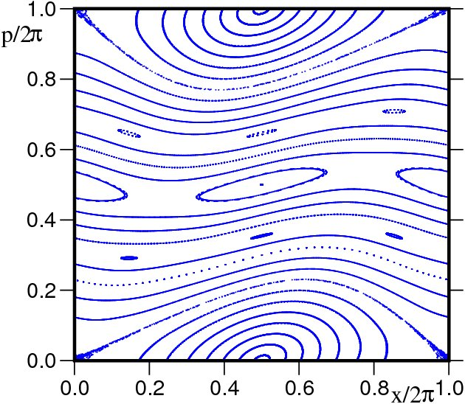
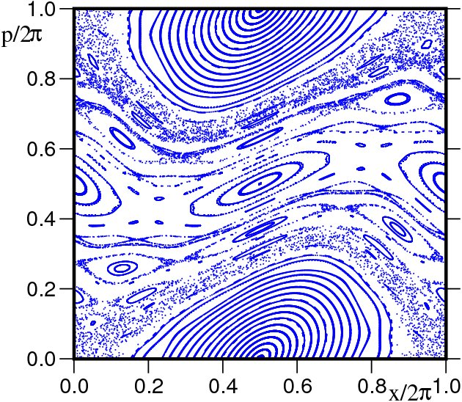
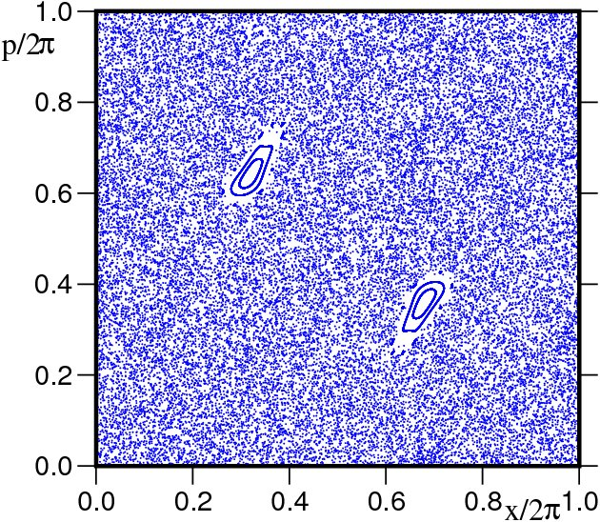
Magnetic field line structure exhibits all the complexity of Hamiltonian chaos
Magnetic surfaces are fragile unless properly made
Increasing perturbation strength
Standard map exhibits this generic behavior
Notes:
The disruptive behavior of current-carrying discharges in CTH can be reproducibly modified by the presence of modest levels of externally generated rotational transform, but both the amount of vacuum transform required and the character of the observed disruption suppression depend on the type of disruption. Three types of disruptions are being investigated on CTH: Density limit disruptions, low q disruptions and disruptions caused by vertically unstable plasmas.

Slide 25
Magnetic islands and your friend the simple pendulum
Notes:
The disruptive behavior of current-carrying discharges in CTH can be reproducibly modified by the presence of modest levels of externally generated rotational transform, but both the amount of vacuum transform required and the character of the observed disruption suppression depend on the type of disruption. Three types of disruptions are being investigated on CTH: Density limit disruptions, low q disruptions and disruptions caused by vertically unstable plasmas.

Slide 26
Ways to construct good magnetic surfaces without net current have been devised
There are several “classical” stellarator device types that can do it
Notes:
The disruptive behavior of current-carrying discharges in CTH can be reproducibly modified by the presence of modest levels of externally generated rotational transform, but both the amount of vacuum transform required and the character of the observed disruption suppression depend on the type of disruption. Three types of disruptions are being investigated on CTH: Density limit disruptions, low q disruptions and disruptions caused by vertically unstable plasmas.

Slide 27
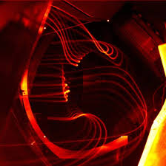
Suitably good magnetic surfaces can be constructed experimentally
Measurement of flux surface integrity using electron beam mapping
Notes:
The disruptive behavior of current-carrying discharges in CTH can be reproducibly modified by the presence of modest levels of externally generated rotational transform, but both the amount of vacuum transform required and the character of the observed disruption suppression depend on the type of disruption. Three types of disruptions are being investigated on CTH: Density limit disruptions, low q disruptions and disruptions caused by vertically unstable plasmas.

Slide 28
Suitably good magnetic surfaces can be constructed experimentally
Measurement of flux surface integrity using electron beam mapping
Notes:
The disruptive behavior of current-carrying discharges in CTH can be reproducibly modified by the presence of modest levels of externally generated rotational transform, but both the amount of vacuum transform required and the character of the observed disruption suppression depend on the type of disruption. Three types of disruptions are being investigated on CTH: Density limit disruptions, low q disruptions and disruptions caused by vertically unstable plasmas.

Slide 29
Outline
Confining a plasma in a torus and the need for rotational transform
Generating magnetic surfaces without net plasma current
New directions in stellarator research
Auburn University fusion program
Notes:
Disruptions are still a big concern for toroidally confined plasmas and their avoidance and mitigation is considered essential for future fusion devices such as ITER.
Disruptions, however, do not routinely occur in current free stellarators, although, they require a more complicated external coil set to get their rotational transform, which is the amount of twist in the magnetic fields lines.
More generally, the total rotational transform can come from both currents running internal to the plasma (iota-bar current) and from external magnet coils, also referred to as vacuum transform (iota-bar vac). Throughout this talk I’ll use the vacuum transform as a descriptor for the amount of 3D filed that is applied.
On one end of the spectrum are configurations, such as tokamaks, with zero vacuum transform, and on the other end are current free stellarators with 100% vacuum transform. But in between there are configurations with both.
So the question remains, Can the application of 3D magnetic shaping suppress tokamak instabilities and disruptions? And if so, what amount and with what profile must vacuum transform be applied.

Slide 30
Helical coils used in classical stellarators are continously wound
Motivation for modular coil design
Coil currents in (θ, φ) space
Notes:
The disruptive behavior of current-carrying discharges in CTH can be reproducibly modified by the presence of modest levels of externally generated rotational transform, but both the amount of vacuum transform required and the character of the observed disruption suppression depend on the type of disruption. Three types of disruptions are being investigated on CTH: Density limit disruptions, low q disruptions and disruptions caused by vertically unstable plasmas.

Slide 31
Modular coils have advantages
Coils can be built independently, harder to design, but allow easier assembly/disassembly of device and access
(θ, φ) space
Notes:
The disruptive behavior of current-carrying discharges in CTH can be reproducibly modified by the presence of modest levels of externally generated rotational transform, but both the amount of vacuum transform required and the character of the observed disruption suppression depend on the type of disruption. Three types of disruptions are being investigated on CTH: Density limit disruptions, low q disruptions and disruptions caused by vertically unstable plasmas.

Slide 32
Modular coils mapped back into physical space have non-trivial shape
Coils can be built independently, harder to design, but allow easier assembly/disassembly of device and access
(θ, φ) space
Physical space
Notes:
The disruptive behavior of current-carrying discharges in CTH can be reproducibly modified by the presence of modest levels of externally generated rotational transform, but both the amount of vacuum transform required and the character of the observed disruption suppression depend on the type of disruption. Three types of disruptions are being investigated on CTH: Density limit disruptions, low q disruptions and disruptions caused by vertically unstable plasmas.

Slide 33
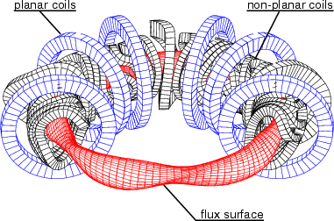
Modular coils allow “plasma first” design
We can design the plasma equilibrium based on physics considerations (equilibrium, stability, transport) and then design a set of coils to produce the required field.
Modular coils
of W7-AS
“Advanced” rather
than classical stellarator
Notes:
The disruptive behavior of current-carrying discharges in CTH can be reproducibly modified by the presence of modest levels of externally generated rotational transform, but both the amount of vacuum transform required and the character of the observed disruption suppression depend on the type of disruption. Three types of disruptions are being investigated on CTH: Density limit disruptions, low q disruptions and disruptions caused by vertically unstable plasmas.

Slide 34
Outline
Confining a plasma in a torus and the need for rotational transform
Generating magnetic surfaces without net plasma current
New directions in stellarator research
Auburn University fusion program
Notes:
Disruptions are still a big concern for toroidally confined plasmas and their avoidance and mitigation is considered essential for future fusion devices such as ITER.
Disruptions, however, do not routinely occur in current free stellarators, although, they require a more complicated external coil set to get their rotational transform, which is the amount of twist in the magnetic fields lines.
More generally, the total rotational transform can come from both currents running internal to the plasma (iota-bar current) and from external magnet coils, also referred to as vacuum transform (iota-bar vac). Throughout this talk I’ll use the vacuum transform as a descriptor for the amount of 3D filed that is applied.
On one end of the spectrum are configurations, such as tokamaks, with zero vacuum transform, and on the other end are current free stellarators with 100% vacuum transform. But in between there are configurations with both.
So the question remains, Can the application of 3D magnetic shaping suppress tokamak instabilities and disruptions? And if so, what amount and with what profile must vacuum transform be applied.

Slide 35
Given 3D equilbrium magnetic surfaces, how leaky are they in terms of plasma transport?
Trajectories in axisymmetry: passing and trapped particles
Canonical momentum conservation due to axisymmetry also bounds excursion from flux surfaces:
Notes:
The disruptive behavior of current-carrying discharges in CTH can be reproducibly modified by the presence of modest levels of externally generated rotational transform, but both the amount of vacuum transform required and the character of the observed disruption suppression depend on the type of disruption. Three types of disruptions are being investigated on CTH: Density limit disruptions, low q disruptions and disruptions caused by vertically unstable plasmas.

Slide 36
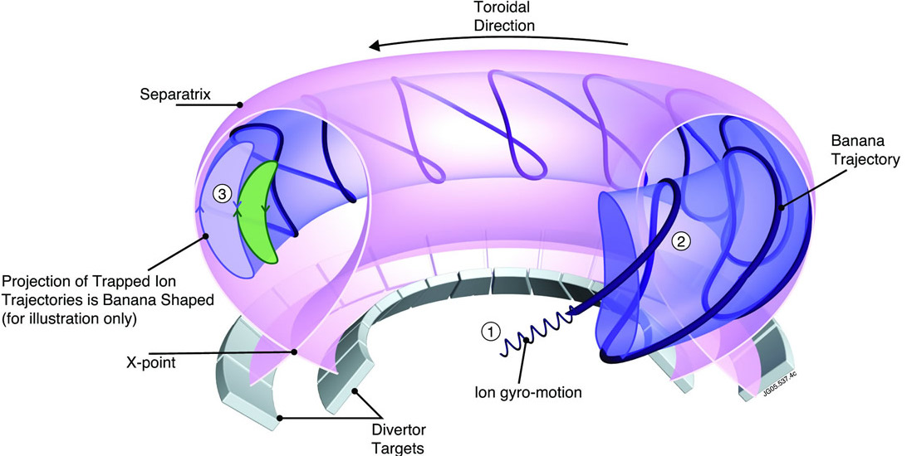
Particle trapping leads to so-called banana orbits in tokamaks
Trapped trajectories projected to a poloidal plane are banana shaped
Increases effective step size for collisional transport, with trapped particles dominating transport rate
Notes:
The disruptive behavior of current-carrying discharges in CTH can be reproducibly modified by the presence of modest levels of externally generated rotational transform, but both the amount of vacuum transform required and the character of the observed disruption suppression depend on the type of disruption. Three types of disruptions are being investigated on CTH: Density limit disruptions, low q disruptions and disruptions caused by vertically unstable plasmas.

Slide 37
Particle trajectories in a stellarator
As in a tokamak, particles can be passing or trapped due to toroidicity
There are also particles which get trapped in local minima due to the helical periodicity
These particles trapped in local minima are confined to regions on the upper or lower half of the flux surface
Notes:
The disruptive behavior of current-carrying discharges in CTH can be reproducibly modified by the presence of modest levels of externally generated rotational transform, but both the amount of vacuum transform required and the character of the observed disruption suppression depend on the type of disruption. Three types of disruptions are being investigated on CTH: Density limit disruptions, low q disruptions and disruptions caused by vertically unstable plasmas.

Slide 38
Direct orbit loss
As a result their vertical drifts don’t cancel out, and they drift straight out of the machine.
This drift is different for electrons and ions, and so leads to electric fields also
No conserved canonical momentum without axisymmetry to help limit excursions also
Notes:
The disruptive behavior of current-carrying discharges in CTH can be reproducibly modified by the presence of modest levels of externally generated rotational transform, but both the amount of vacuum transform required and the character of the observed disruption suppression depend on the type of disruption. Three types of disruptions are being investigated on CTH: Density limit disruptions, low q disruptions and disruptions caused by vertically unstable plasmas.

Slide 39
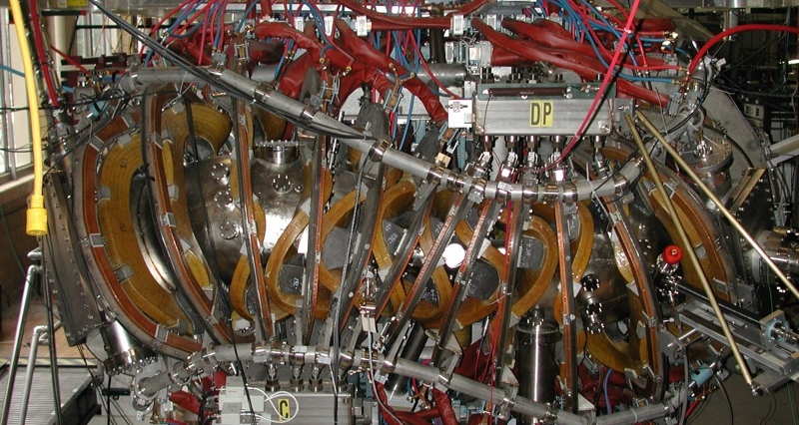
Stellarator optimization: Quasi-symmetry
Particle drift orbits only depend on magnetic field strength, so symmetry in it gives rise to canonical momentum conservation
Helically Symmetric eXperiment (HSX) at University of Wisconsin-Madison confirmed reduction in direct loss orbits through use of quasi-symmetry
Notes:
The disruptive behavior of current-carrying discharges in CTH can be reproducibly modified by the presence of modest levels of externally generated rotational transform, but both the amount of vacuum transform required and the character of the observed disruption suppression depend on the type of disruption. Three types of disruptions are being investigated on CTH: Density limit disruptions, low q disruptions and disruptions caused by vertically unstable plasmas.

Slide 40
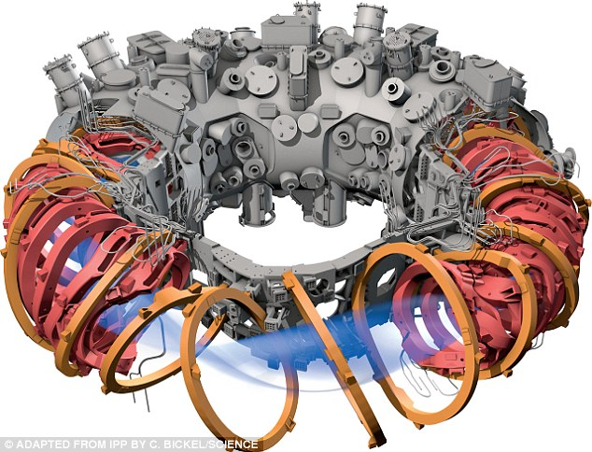
Stellarator optimization: Isodynamic
W7-X
Notes:
The disruptive behavior of current-carrying discharges in CTH can be reproducibly modified by the presence of modest levels of externally generated rotational transform, but both the amount of vacuum transform required and the character of the observed disruption suppression depend on the type of disruption. Three types of disruptions are being investigated on CTH: Density limit disruptions, low q disruptions and disruptions caused by vertically unstable plasmas.

Slide 41
Outline
Confining a plasma in a torus and the need for rotational transform
Generating magnetic surfaces without net plasma current
New directions in stellarator research
Auburn University fusion program
Notes:
Disruptions are still a big concern for toroidally confined plasmas and their avoidance and mitigation is considered essential for future fusion devices such as ITER.
Disruptions, however, do not routinely occur in current free stellarators, although, they require a more complicated external coil set to get their rotational transform, which is the amount of twist in the magnetic fields lines.
More generally, the total rotational transform can come from both currents running internal to the plasma (iota-bar current) and from external magnet coils, also referred to as vacuum transform (iota-bar vac). Throughout this talk I’ll use the vacuum transform as a descriptor for the amount of 3D filed that is applied.
On one end of the spectrum are configurations, such as tokamaks, with zero vacuum transform, and on the other end are current free stellarators with 100% vacuum transform. But in between there are configurations with both.
So the question remains, Can the application of 3D magnetic shaping suppress tokamak instabilities and disruptions? And if so, what amount and with what profile must vacuum transform be applied.

Slide 42
Disruption avoidance and mitigation essential for future current carrying tokamaks
Context: Small amounts of 3D fields are used for a variety of purposes on present day tokamaks with B_{3D}/B₀ ~ 10⁻³
Can application higher levels of 3D magnetic shaping, B_{3D}/B₀ ~ 0.1, suppress tokamak instabilities and disruptions?
Work informs experimental basis for:
--- Stability properties of compact quasi-axisymmetric stellarators
--- Possible use of external transform on tokamak systems
--- Shed light on tokamak disruption physics and 3D MHD
Notes:
Disruptions are still a big concern for toroidally confined plasmas and their avoidance and mitigation is considered essential for future fusion devices such as ITER.
Disruptions, however, do not routinely occur in current free stellarators, although, they require a more complicated external coil set to get their rotational transform, which is the amount of twist in the magnetic fields lines.
More generally, the total rotational transform can come from both currents running internal to the plasma (iota-bar current) and from external magnet coils, also referred to as vacuum transform (iota-bar vac). Throughout this talk I’ll use the vacuum transform as a descriptor for the amount of 3D filed that is applied.
On one end of the spectrum are configurations, such as tokamaks, with zero vacuum transform, and on the other end are current free stellarators with 100% vacuum transform. But in between there are configurations with both.
So the question remains, Can the application of 3D magnetic shaping suppress tokamak instabilities and disruptions? And if so, what amount and with what profile must vacuum transform be applied.

Slide 43
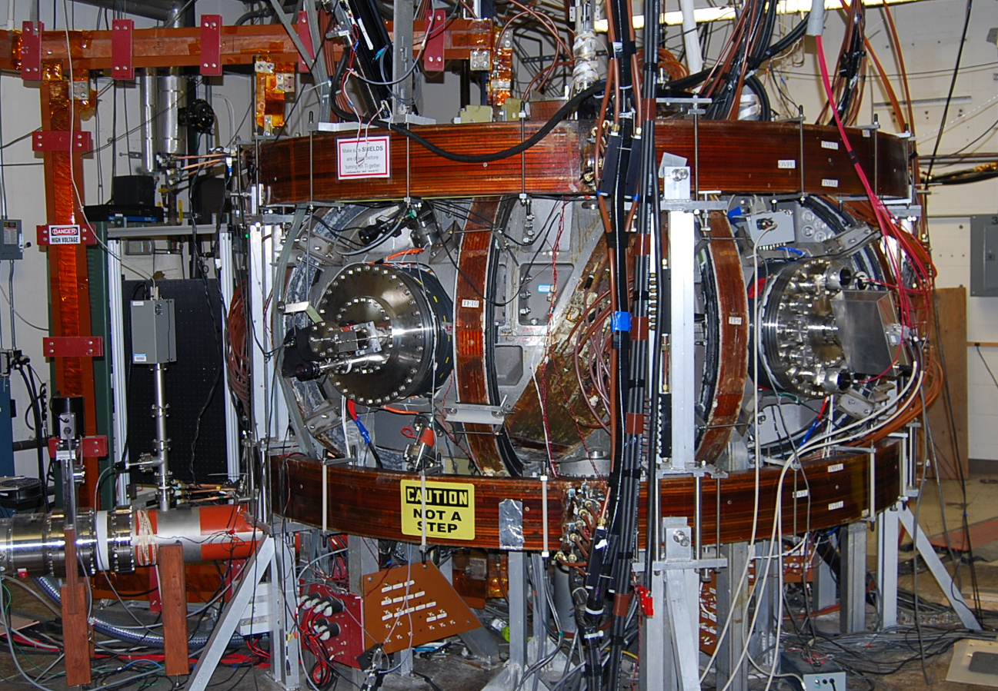
The Compact Toroidal Hybrid (CTH) was designed to address these issues
Hybrid: current driven
within 3D equilibrium
of a stellarator plasma
Can vary the relative
amount of externally
applied transform
  I_{p} provides up to 95%
Previous hybrids showed evidence of disruption avoidance and improved positional stability
(W7-A team, Nucl. Fusion. 1980, H. Ikezi et al, Phys. Fluids. 1979)
Notes:
The Compact Toroidal Hybrid was designed to address these issues. It is a stellarator/tokamak hybrid, that is to say, plasma current is driven within the pre-established 3D equilibrium of a stellarator plasma. And in a controlled way, we can vary the relative amount of externally applied transform, with the plasma current providing up to 95% of the total transform. I’ll note that previous hybrids have also showed evidence of disruption avoidance and improved positional stability.

Slide 44
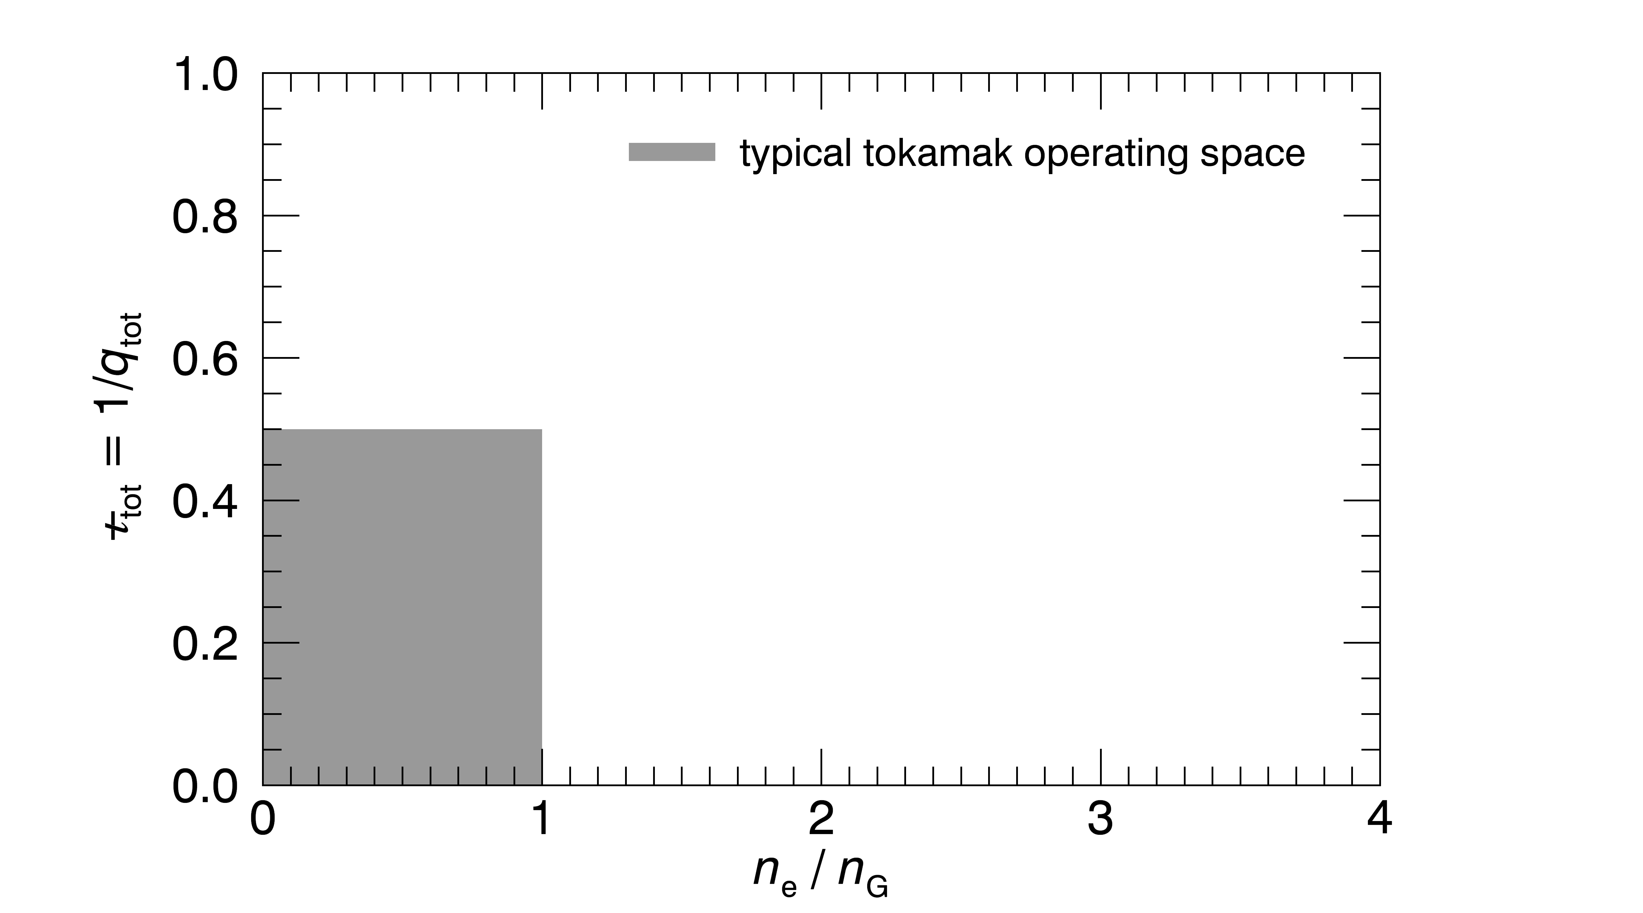
Overview of CTH operational space and the 3 types of disruptions observed
Notes:
I first want to give an overview of CTH operational space and where the 3 types of disruptions are observed, and later I will go into more detail. When you plot the edge transform (or equivalently 1/q) versus the experimental density normalized to the Greenwald limit, tokamaks typically operate in this grey region, which is bounded to the right by the Greenwald density limit and above by the q=2 current limit. Not shown is the runaway limit at low density.

Slide 45
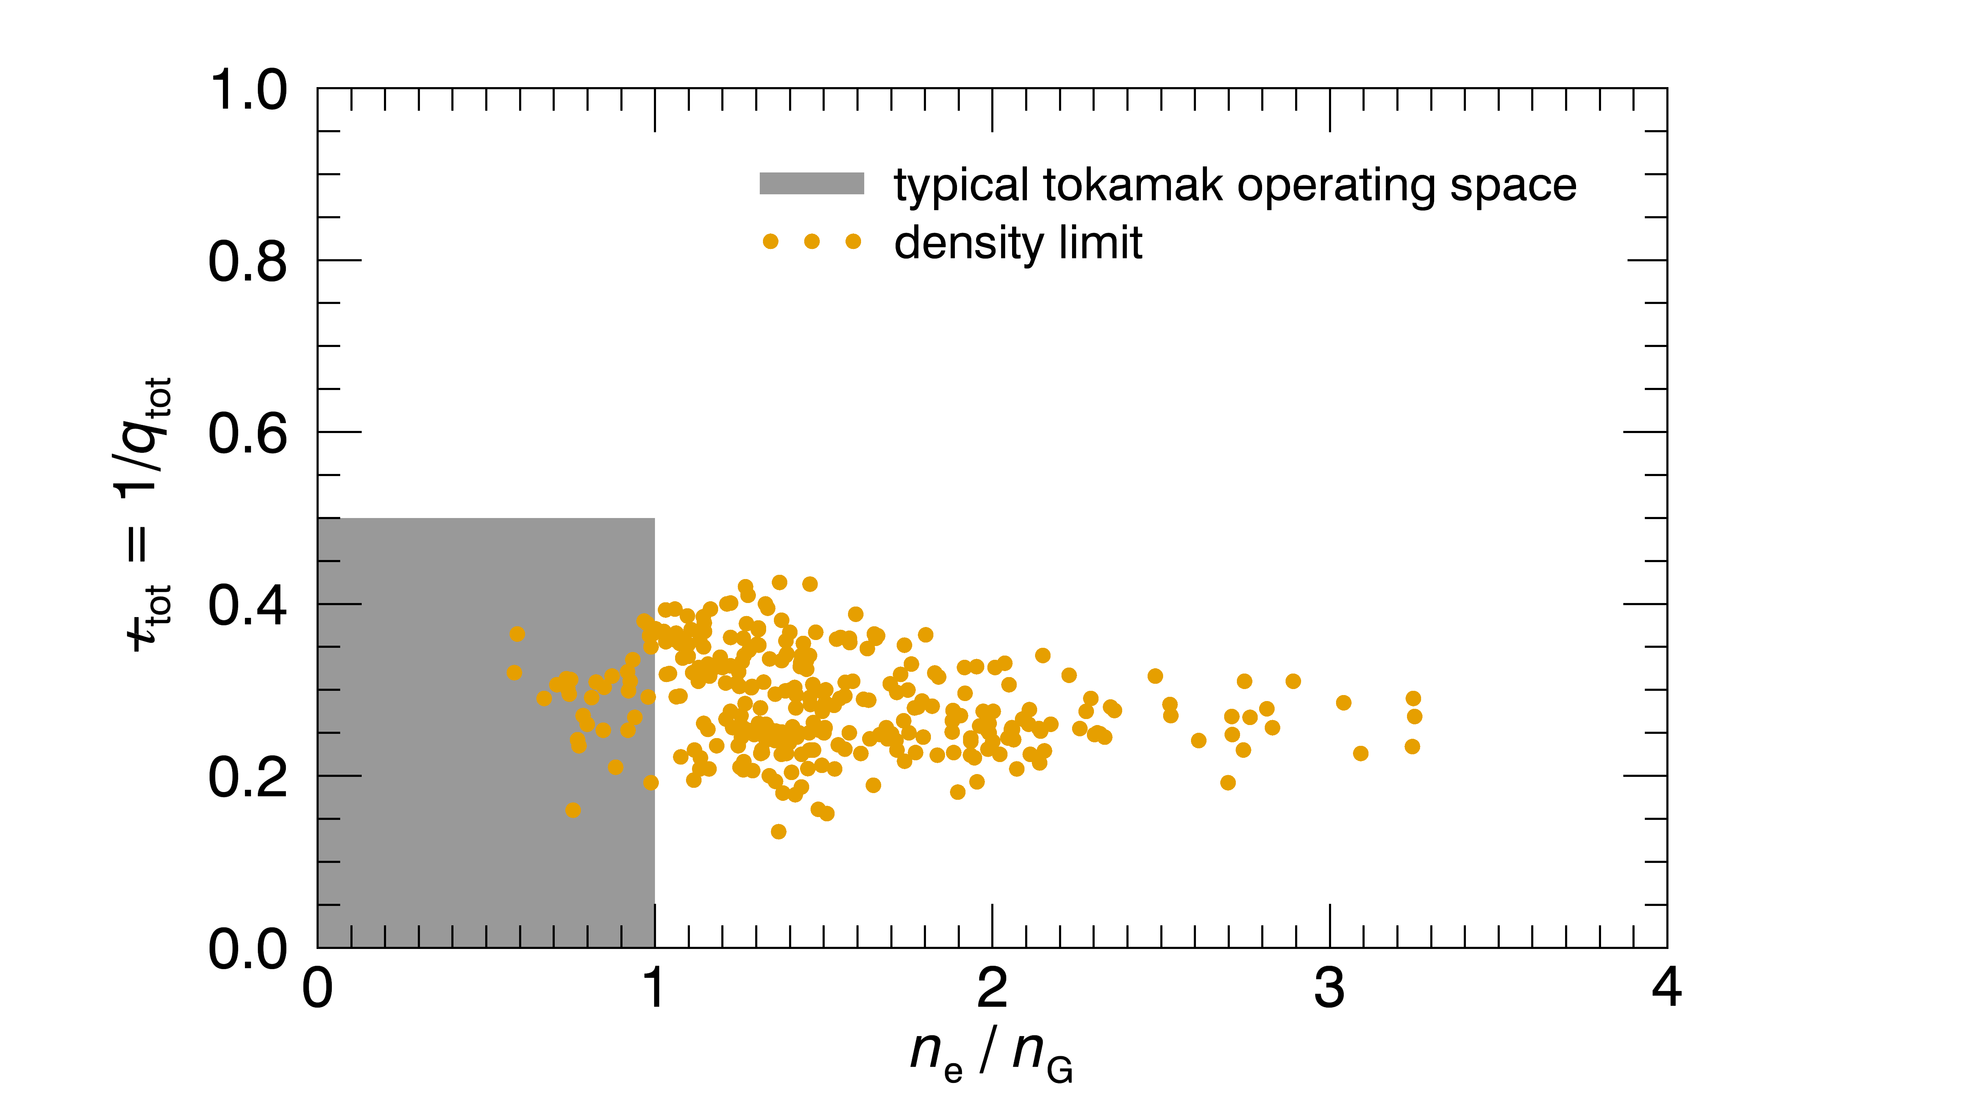
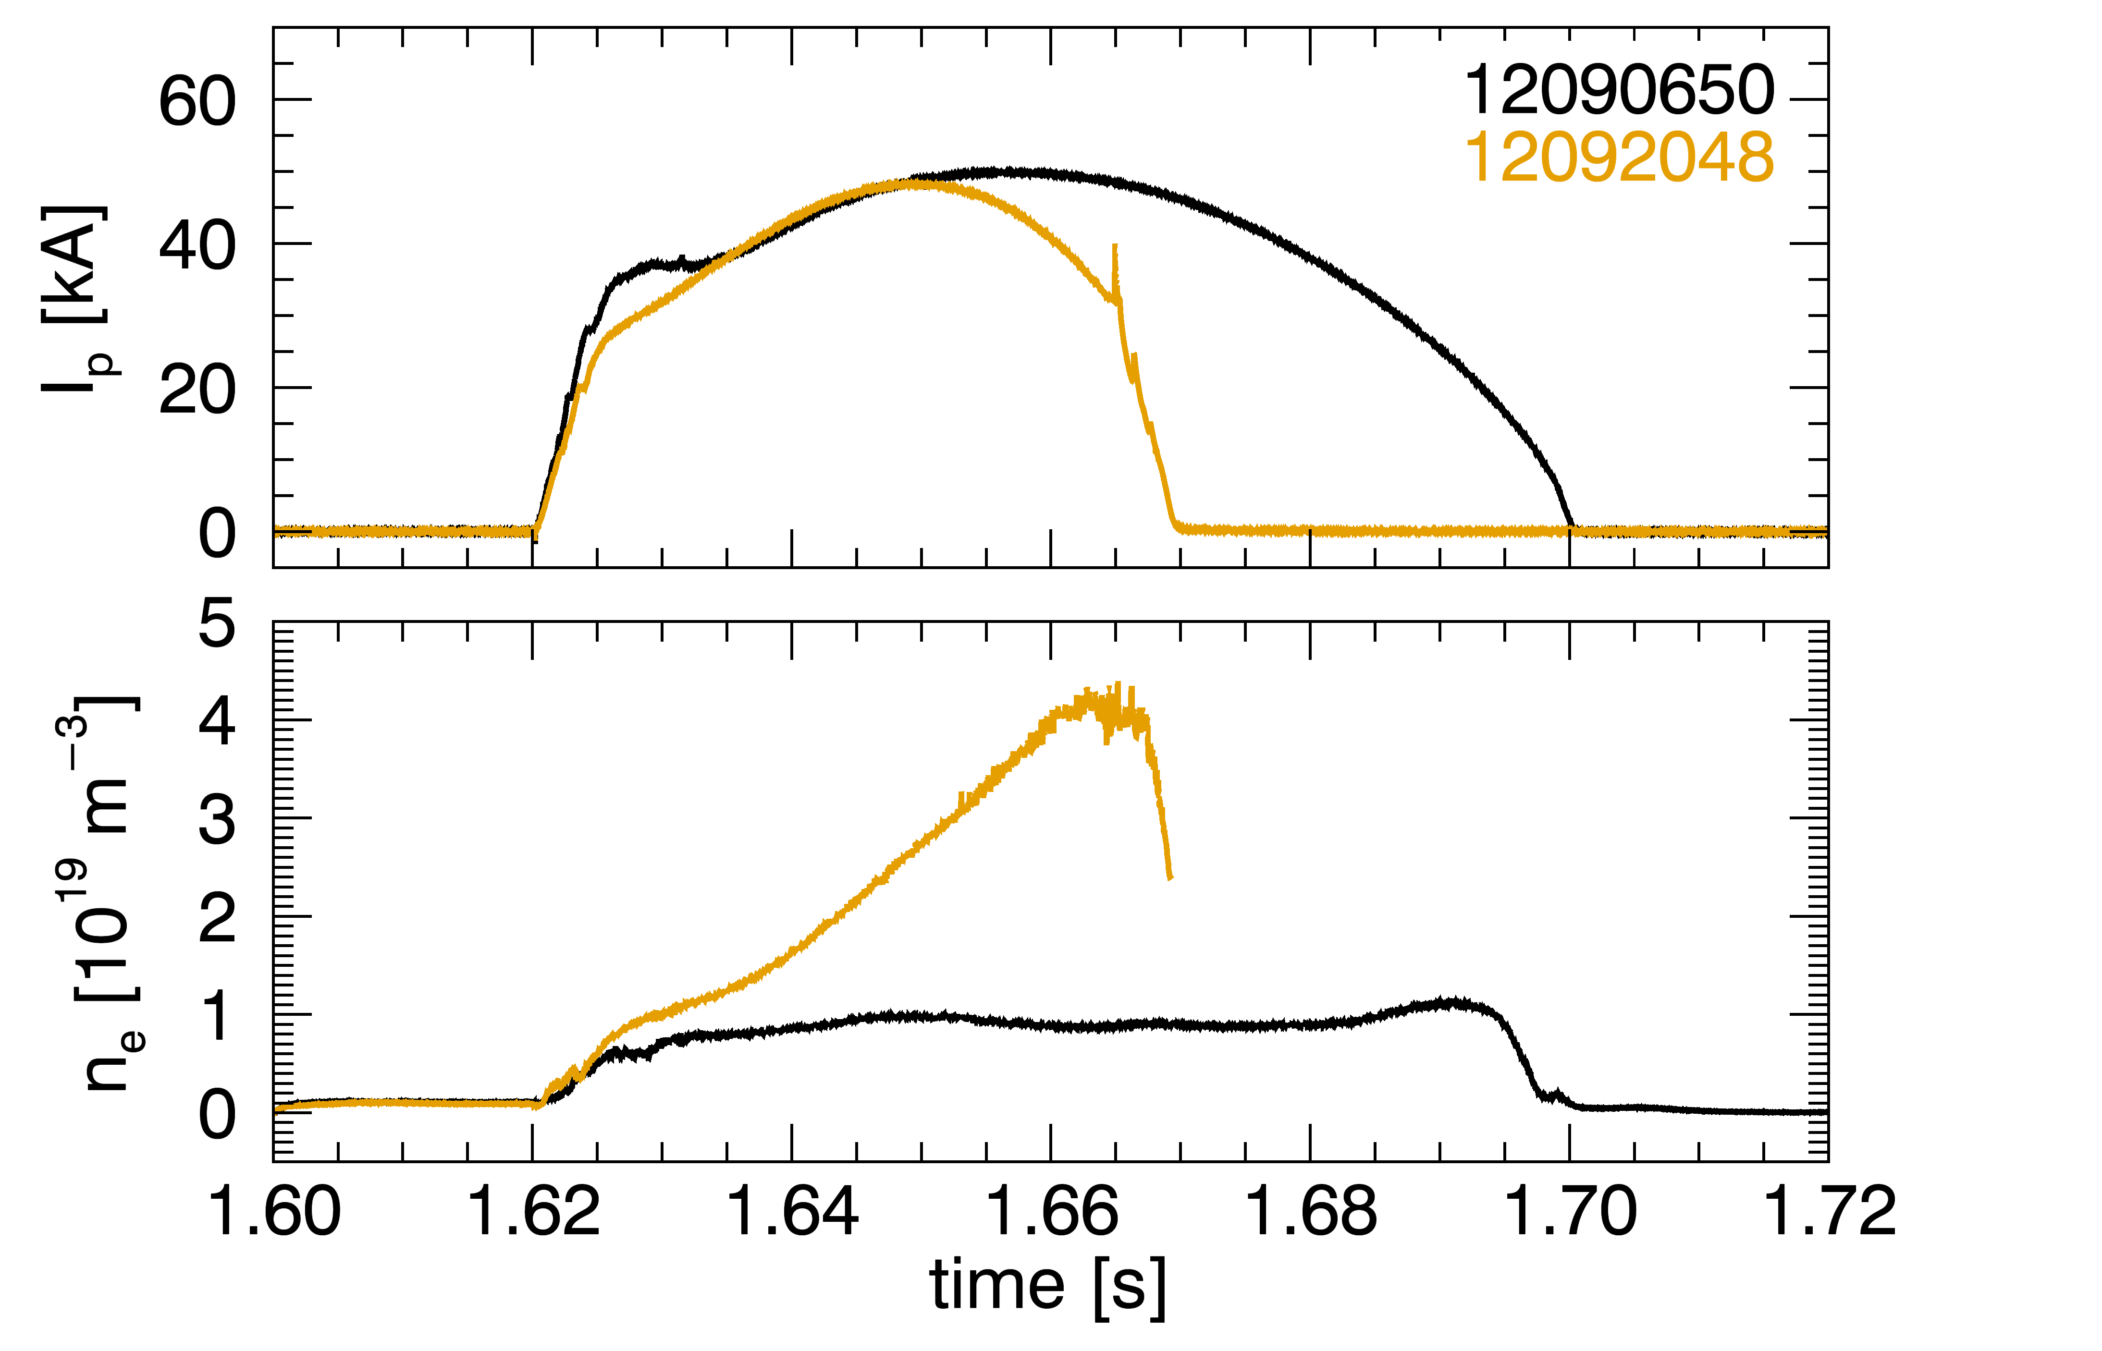
CTH can operate beyond the Greenwald density limit
Density-limit disruptions
Notes:
CTH can operate beyond the Greenwald density limit. Plotted here is the density at the time of disruption for discharges that ended in a density limit disruption. This is what a typical density limit disruption looks like. On top is a plot of the plasma current and below is a plot of the plasma density. In the orange trace, the density was ramped up until the plasma disrupted.

Slide 46
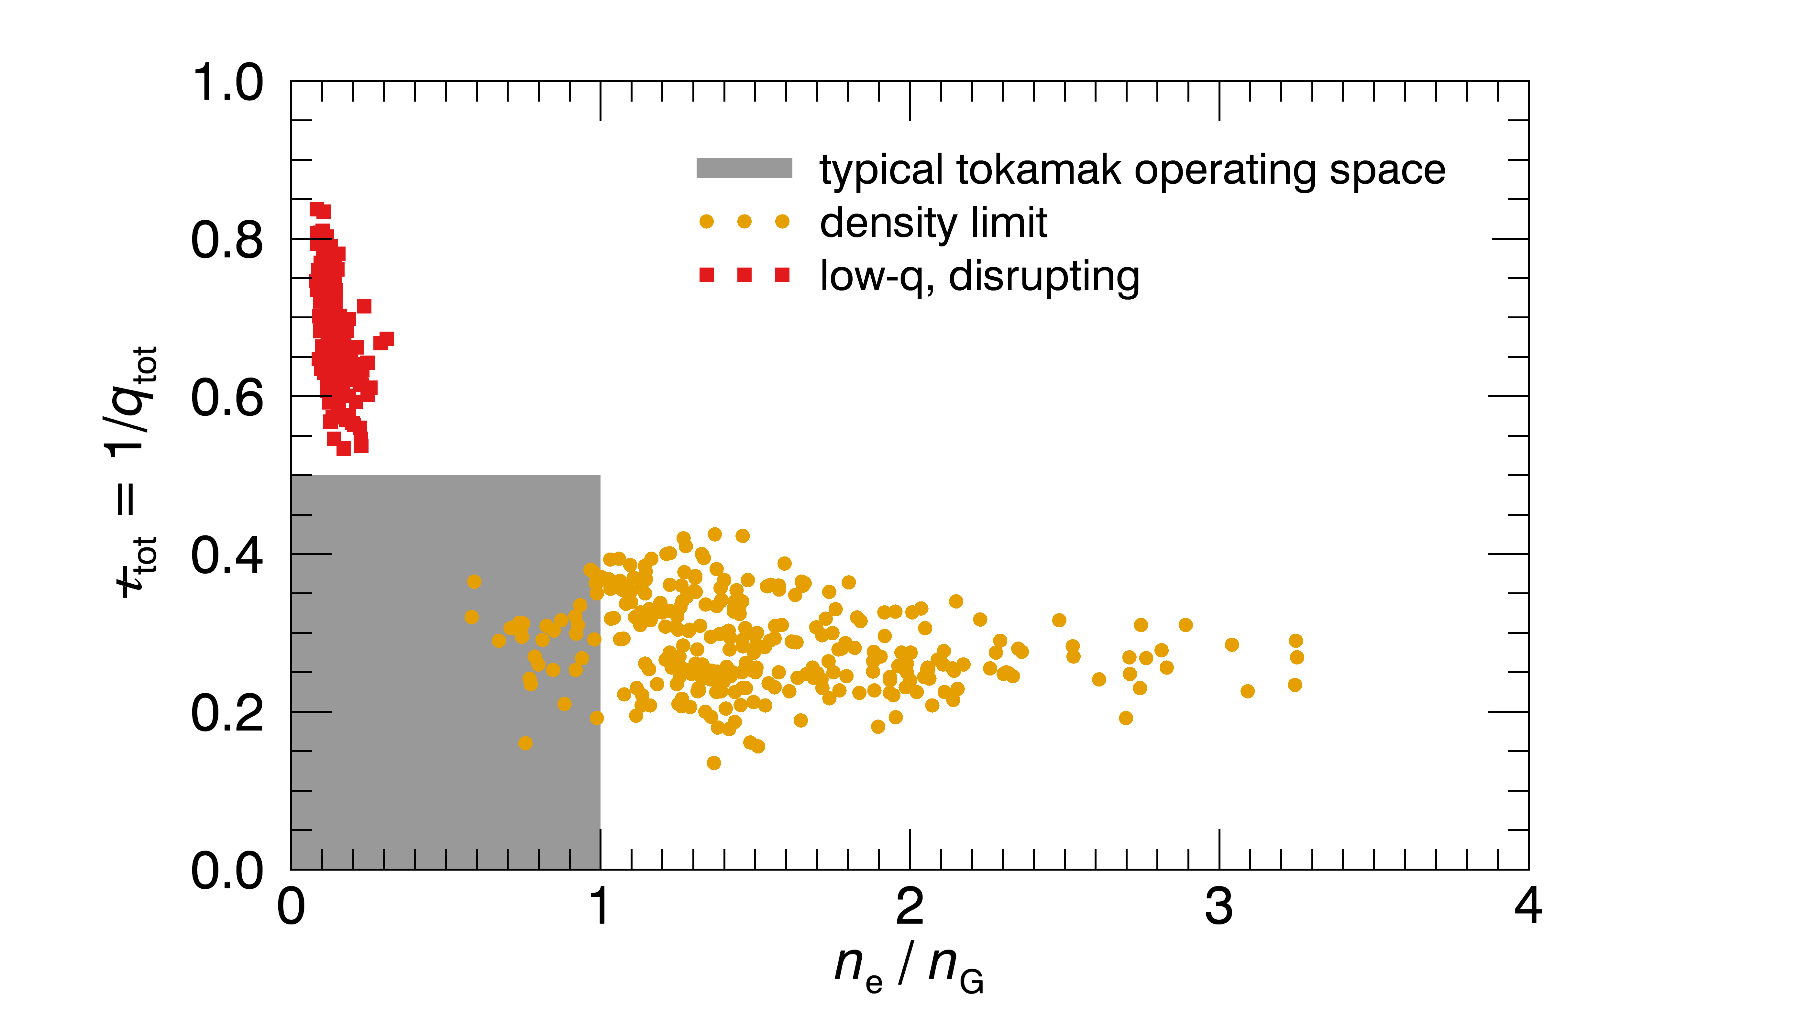
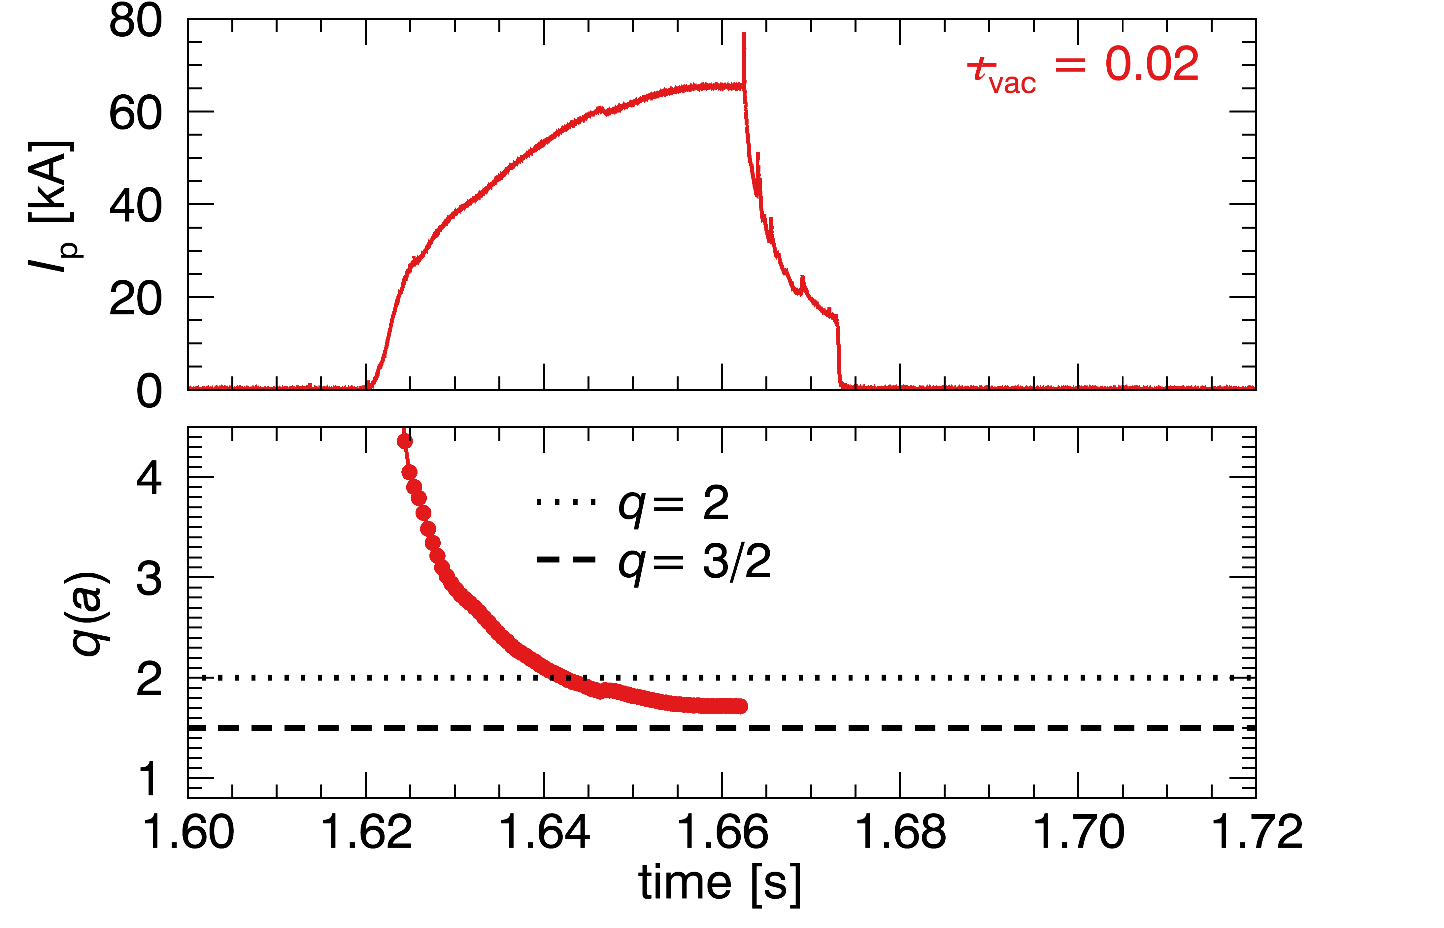
Low-q disruptions can occur when CTH operates with q(a) < 2
Density-limit disruptions
Low-q disruptions
Notes:
Low-q disruptions can occur when CTH operates with an edge q less than 2. In the top plot you can see the disruption in the trace of the plasma current. Below that is plotted the value of the edge q as reconstructed with V3FIT.

Slide 47
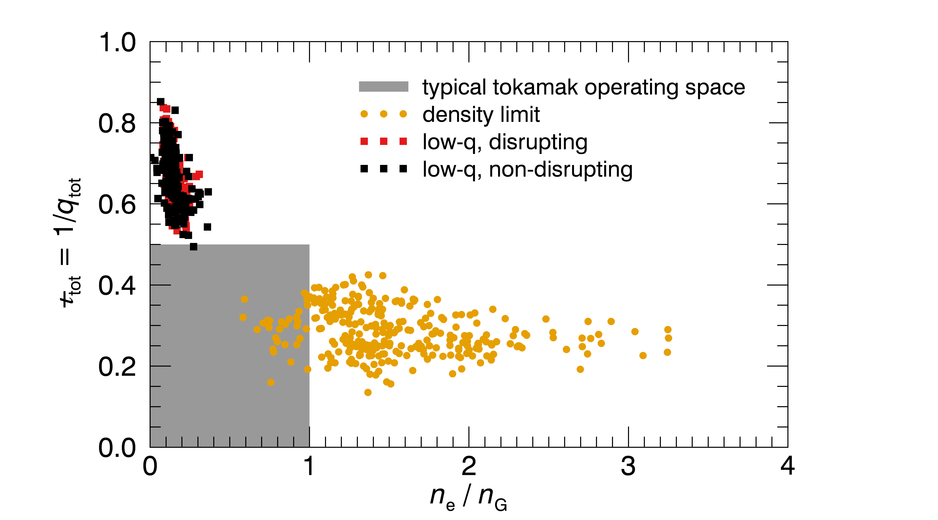
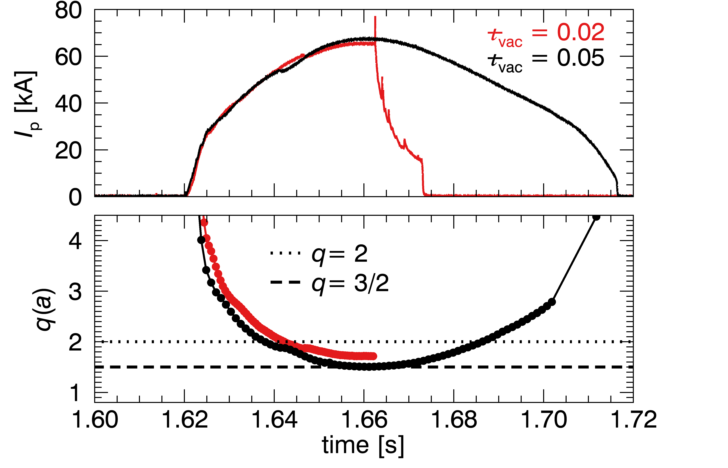
CTH can operate beyond the q(a) = 2 current limit, with a slight increase in ι_{vac}
Density-limit disruptions
Low-q disruptions
Notes:
However, if the vacuum transform is increased slightly, low-q discharges no longer disrupt, and CTH can operate beyond the q=2 limit disruption free.

Slide 48
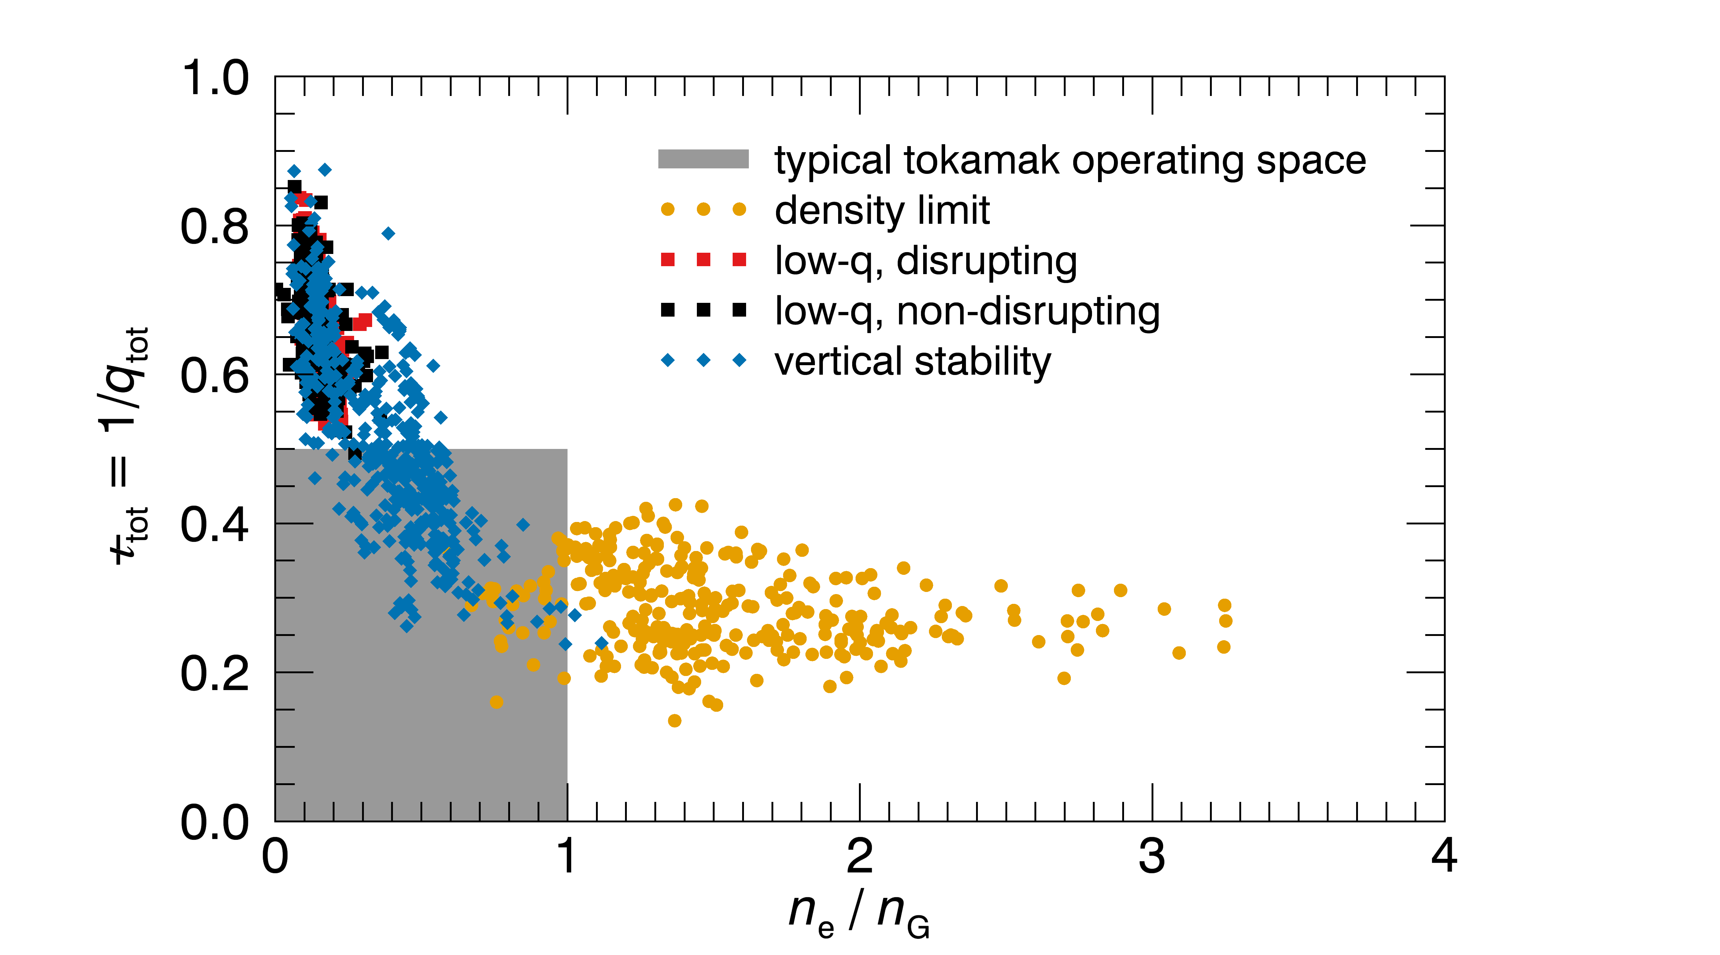
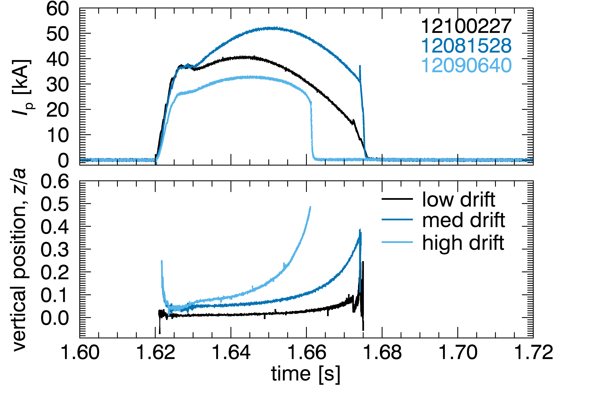
Vertically unstable plasmas can result in a disruption if uncompensated
Density-limit disruptions
Low-q disruptions
Vertically unstable plasmas
Notes:
Finally, CTH plasmas can be vertically unstable and if the vertical position is not controlled, plasmas can drift vertically causing a disruption. The top plot is again the plasma current, and below that is plotted the plasma vertical position for plasma with varying levels of vertical instability.

Slide 49
Outline
Compact Toroidal Hybrid
3D equilibrium reconstruction
Disruption avoidance:
  Density limit disruptions
  Low-q disruptions
  Vertically unstable plasmas
Summary
Notes:
Here is an outline for the rest of my talk. I’ll first talk about the CTH device. Then I’ll discuss our methods of 3D equilibrium reconstruction. Then I will get into the main topic of disruption avoidance for three classes of disruptions seen in CTH.

Slide 50
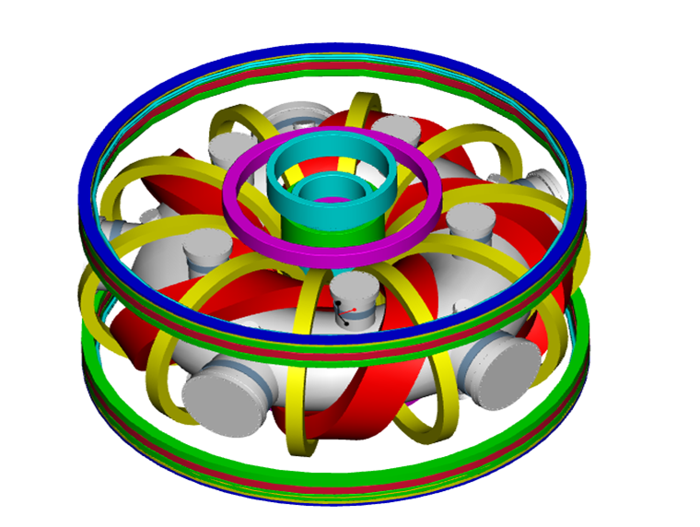
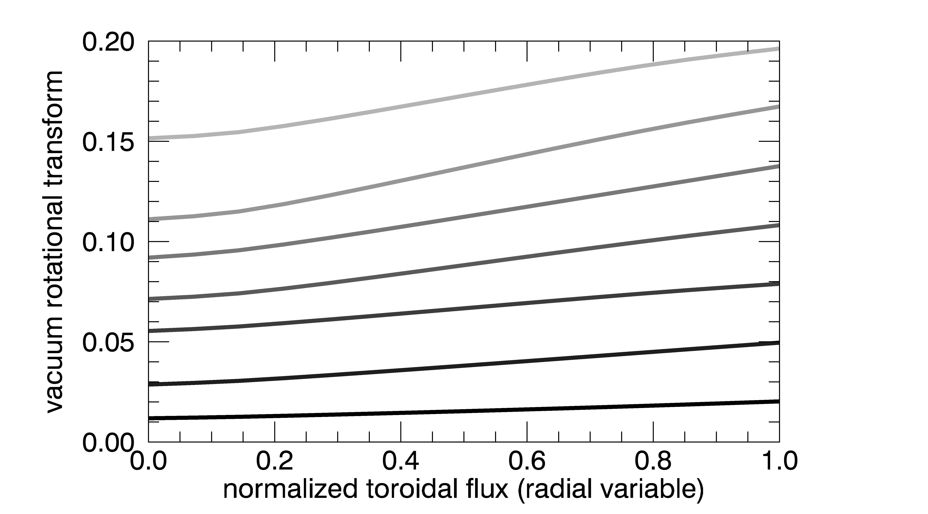
CTH: Flexible magnetic configuration in low aspect ratio stellarator/tokamak hybrid
Helical Field coil and Toroidal Field coil currents adjusted to modify vacuum rotational transform ι_{vac}
R₀ = 0.75 m R/a ~ 4 n_{e} ≤ 5×10¹⁹ m⁻³ T_{e} ≤ 200 eV |B| ≤ 0.7 T
-TF
+HF
+TF
Notes:
CTH was designed to to have a flexible magnetic configuration as a low aspect ratio stellataror/tokamak hybrid, here are some basic CTH parameters. The primary magnet is a continuously wound helical field coil shown in red, and together with toroidal field coils (shown in yellow), we can change the vacuum rotational transform. This is a plot of the vacuum transform versus the normalized toroidal flux, which you can think of as a radial coordinate. The profiles are pretty flat, and by adjusting the coil currents we can vary the rotational transform.

Slide 51
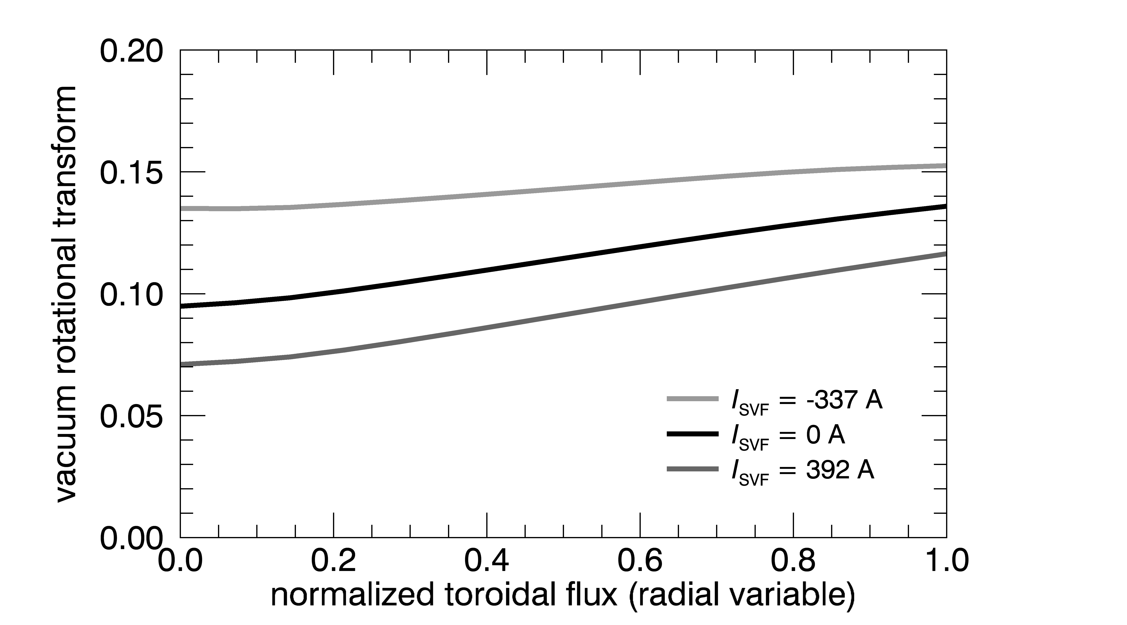
CTH: Flexible magnetic configuration in low aspect ratio stellarator/tokamak hybrid
Helical Field coil and Toroidal Field coil currents adjusted to modify vacuum rotational transform ι_{vac}
Shaping Vertical Field coil varies elongation κ and shear
R₀ = 0.75 m R/a ~ 4 n_{e} ≤ 5×10¹⁹ m⁻³ T_{e} ≤ 200 eV |B| ≤ 0.7 T
Notes:
A shaping vertical field coil, shown in purple, is used to vary the elongation of the plasma and the shear, which is shown in this plot of the vacuum rotational transform profile for different amounts of SVF current.

Slide 52
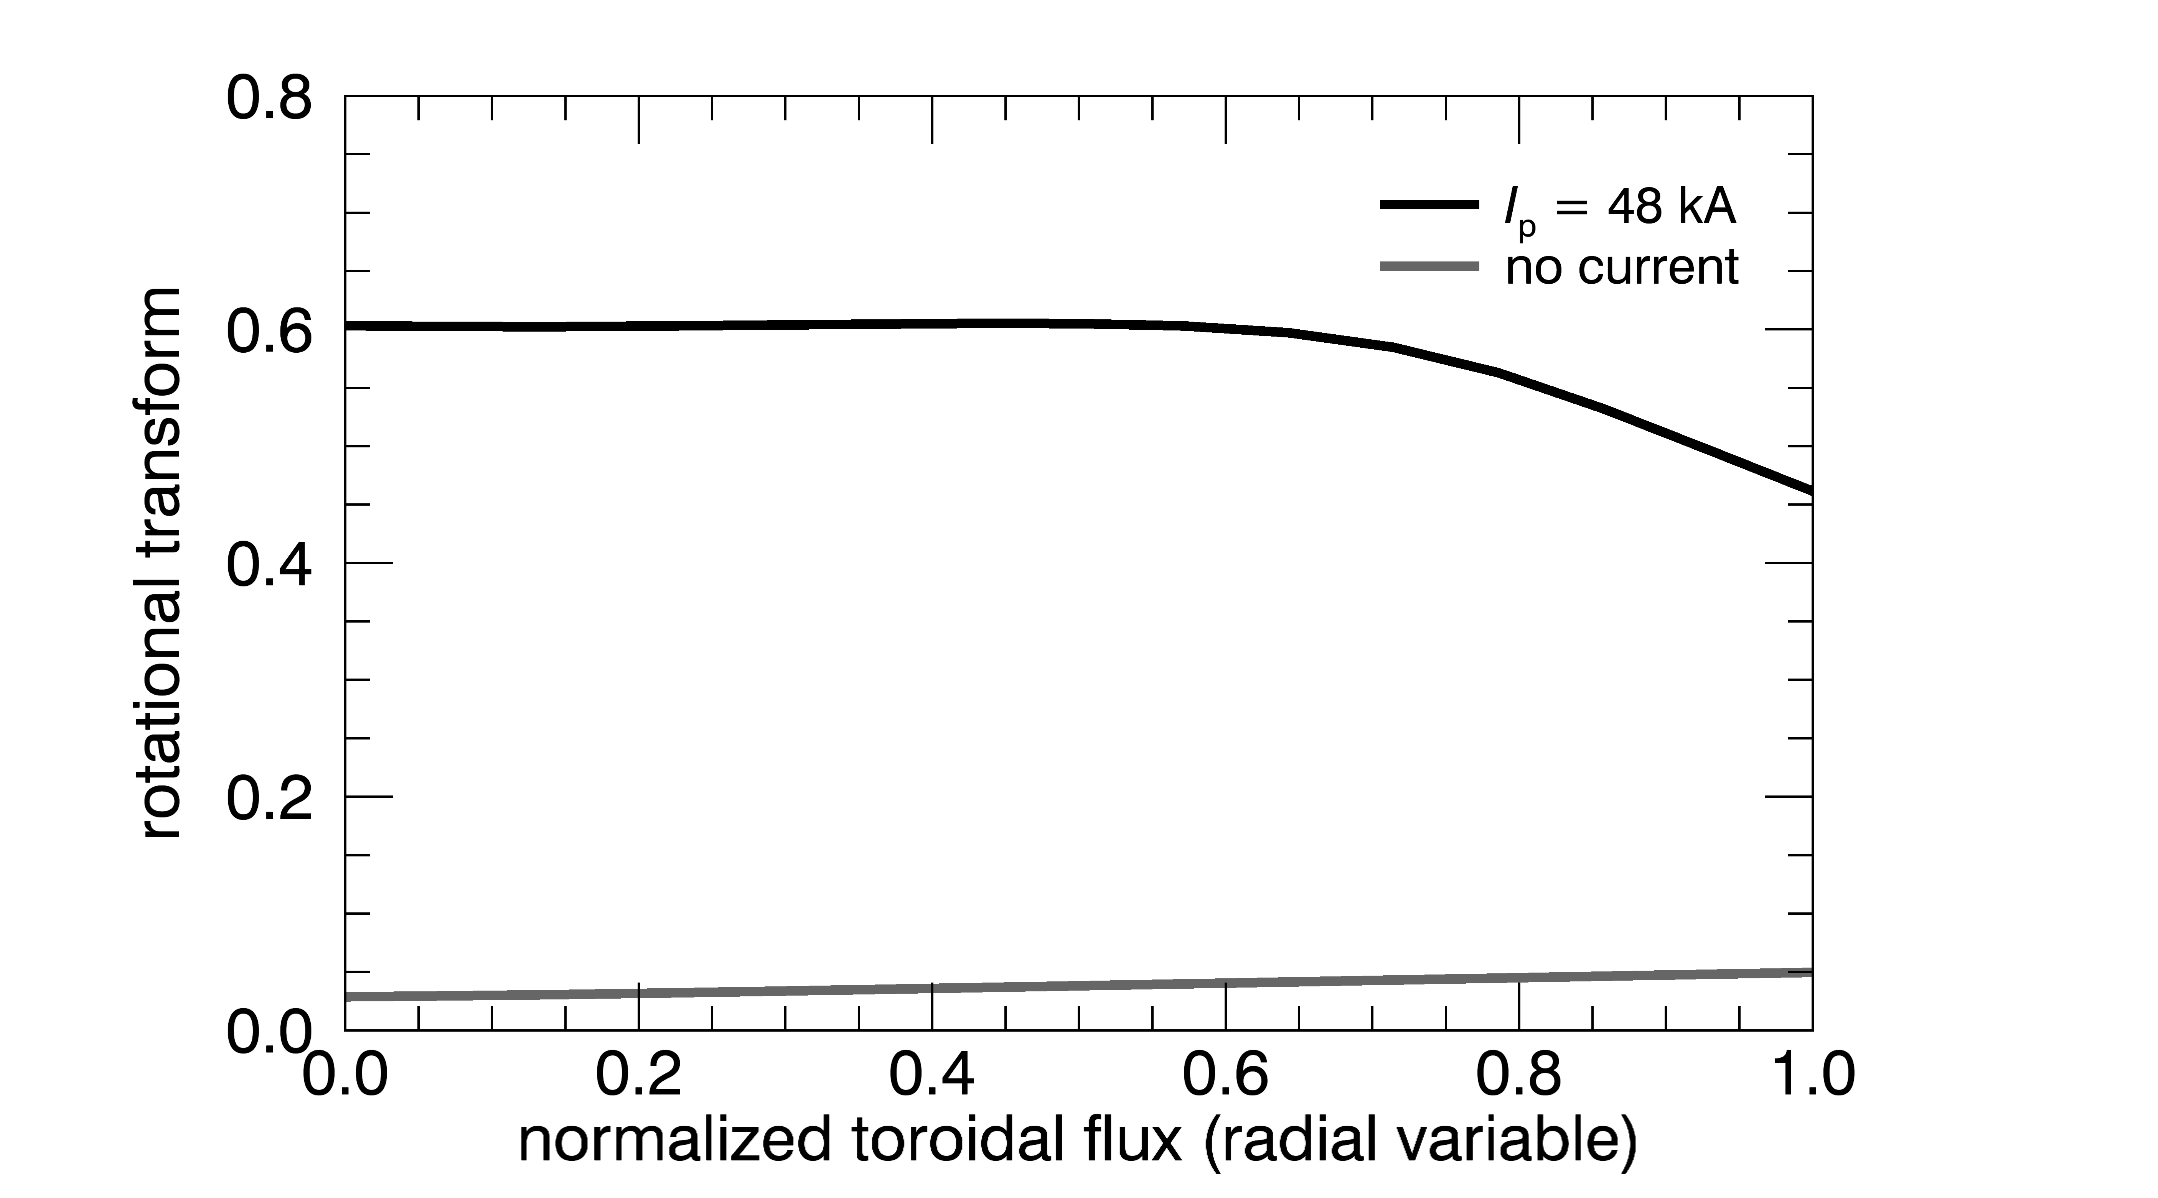
CTH: Flexible magnetic configuration in low aspect ratio stellarator/tokamak hybrid
Helical Field coil and Toroidal Field coil currents adjusted to modify vacuum rotational transform ι_{vac}
Shaping Vertical Field coil varies elongation κ and shear
Central solenoid drives I_{p} ≤ 80 kA, adding to total transform
R₀ = 0.75 m R/a ~ 4 n_{e} ≤ 5×10¹⁹ m⁻³ T_{e} ≤ 200 eV |B| ≤ 0.7 T
Notes:
What really makes this device a hybrid is the central solenoid, which is used to drive up to 80 kA of toroidal plasma current. As you drive plasma current you add to the total transform. The trace at the bottom of this plot is the vacuum transform that we started the discharge with, and at the top is the total transform with 48 kA of plasma current.

Slide 53
CTH: Flexible magnetic configuration in low aspect ratio stellarator/tokamak hybrid
Helical Field coil and Toroidal Field coil currents adjusted to modify vacuum rotational transform ι_{vac}
Shaping Vertical Field coil varies elongation κ and shear
Central solenoid drives I_{p} ≤ 80 kA, adding to total transform
Trim Vertical Field coil and Radial Field coil control position
R₀ = 0.75 m R/a ~ 4 n_{e} ≤ 5×10¹⁹ m⁻³ T_{e} ≤ 200 eV |B| ≤ 0.7 T
Notes:
There is also a trim vertical field coil and a radial field coil which we use to position the plasma, and in particular we preprogram the radial field coil to keep the plasma vertically centered, although for the vertical stability experiments I’ll show you later, the radial field coil was intentionally disabled.

Slide 54
Outline
Compact Toroidal Hybrid
3D equilibrium reconstruction
Disruption avoidance:
  Density limit disruptions
  Low-q disruptions
  Vertically unstable plasmas
Summary and conclusions
Notes:
Next I would like to talk about 3D equilibrium reconstruction because these techniques will be used throughout the remainder of the talk.

Slide 55
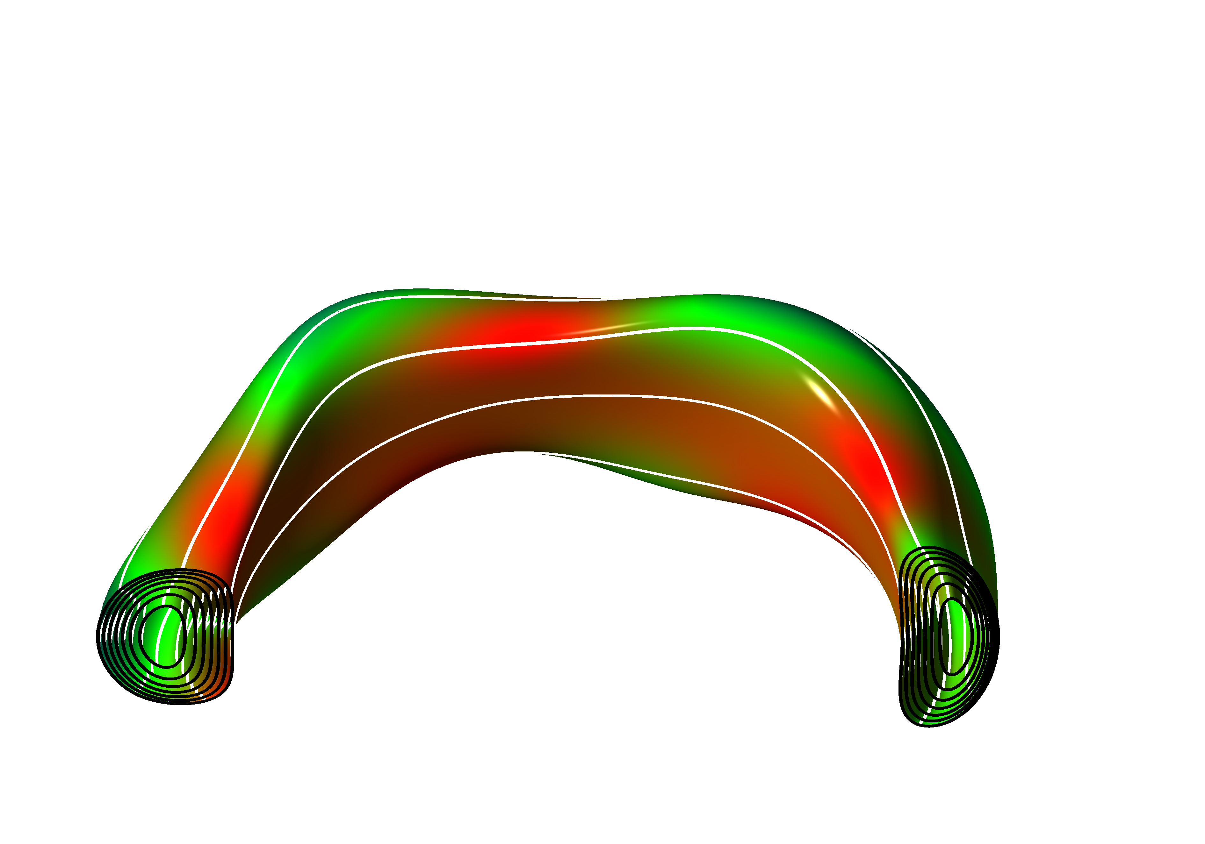
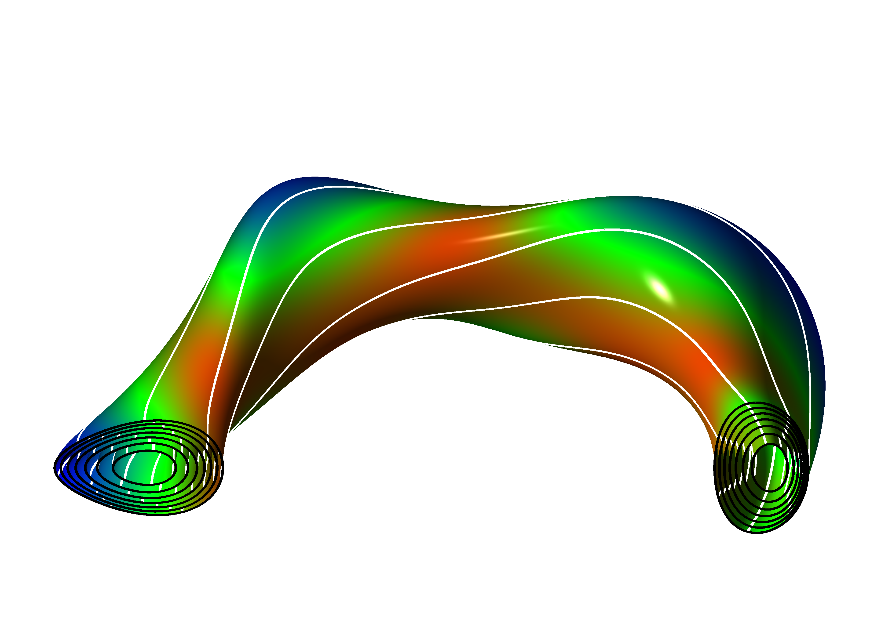
Experimental 3D equilibria reconstructed with V3FIT code (J.D. Hanson et al., Nucl. Fusion, 2009)
Addition of I_{p}
Vacuum
Hybrid
Equilibrium strongly modified by plasma current
Find MHD equilibrium most consistent with data
  Over 40 external magnetic diagnostics as input
Reconstructions using only external magnetics provide accurate information on: plasma shape, enclosed toroidal flux, rotational transform near the edge
Notes:
3D equilibrium reconstruction is an essential tool that we use to interpret CTH plasmas. CTH plasmas are highly 3 dimensional, and furthermore, unlike conventional low beta stellarators, the equilibrium is strongly modified by plasma current, which is illustrated here. These figures are cross sections of reconstructed equilibria in the vacuum phase and the hybrid phase. The flux surfaces are shown on the ends and example magnetic field lines are shown in white. The colors represent magnetic field strength with red high and blue low.
The V3FIT code, which uses VMEC as its 3D equilibrium solver, is used to reconstruct CTH equilibria. Its goal is to find the MHD equilibrium that is most consistent with experimental measurement. For reconstructions done in this talk, over 40 external magnetic diagnostics are used as input. Using external magnetics alone as input, these reconstructions provide accurate information on the plasma shape (such as the elongation), the toroidal flux enclosed within the last closed flux surface, and the rotational transform near the edge.
----------------------------
These include full and segmented Rogowski coils, saddle coils and integrated magnetic pickup coils.

Slide 56
Outline
Compact Toroidal Hybrid
3D equilibrium reconstruction
Disruption avoidance and mitigation:
  Density limit disruptions
  Low q(a) disruptions
  Vertically unstable plasmas
Summary and conclusions
Notes:
Now, let’s move to the main results of the talk, I’ll start with a discussion of density limit disruptions

Slide 57
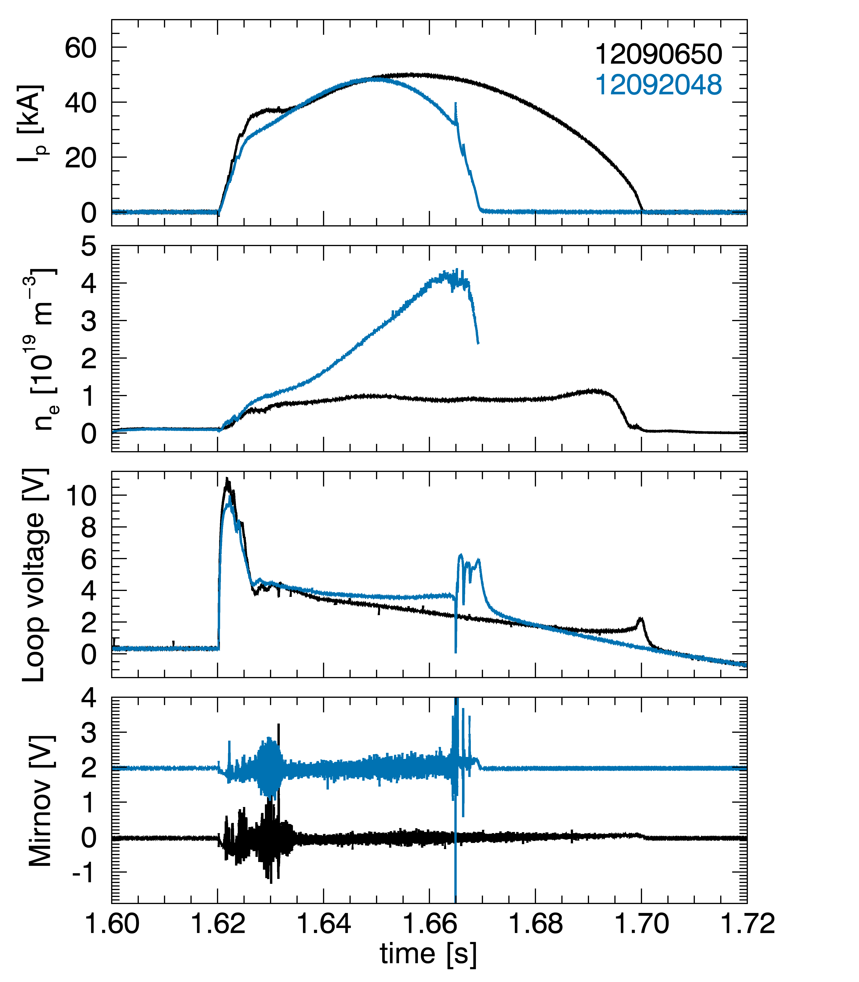
Density limit disruptions triggered by ramping density with edge fueling
Discharges with similar low transform ι_{vac} = 0.05
Phenomenology of hybrid discharge terminations similar to tokamak disruptions
  Negative loop voltage spike
  Current spike followed by rapid decay
  Strong coherent MHD precursor
Notes:
Density limit disruptions can be triggered on CTH by ramping the density using fueling from the edge. Here are two discharges with similar low vacuum transform of 0.05. For the black non-disrupting discharge, we kept the density constant and at a low value. For the blue discharge, we ramped the density up until we got a disruption. The phenomenology of these terminations are similar to tokamak disruptions. There is a negative loop voltage spike coincident with a plasma current followed by a rapid decay of the plasma current. Before the disruption, there is a strong coherent MHD precursor.

Slide 58
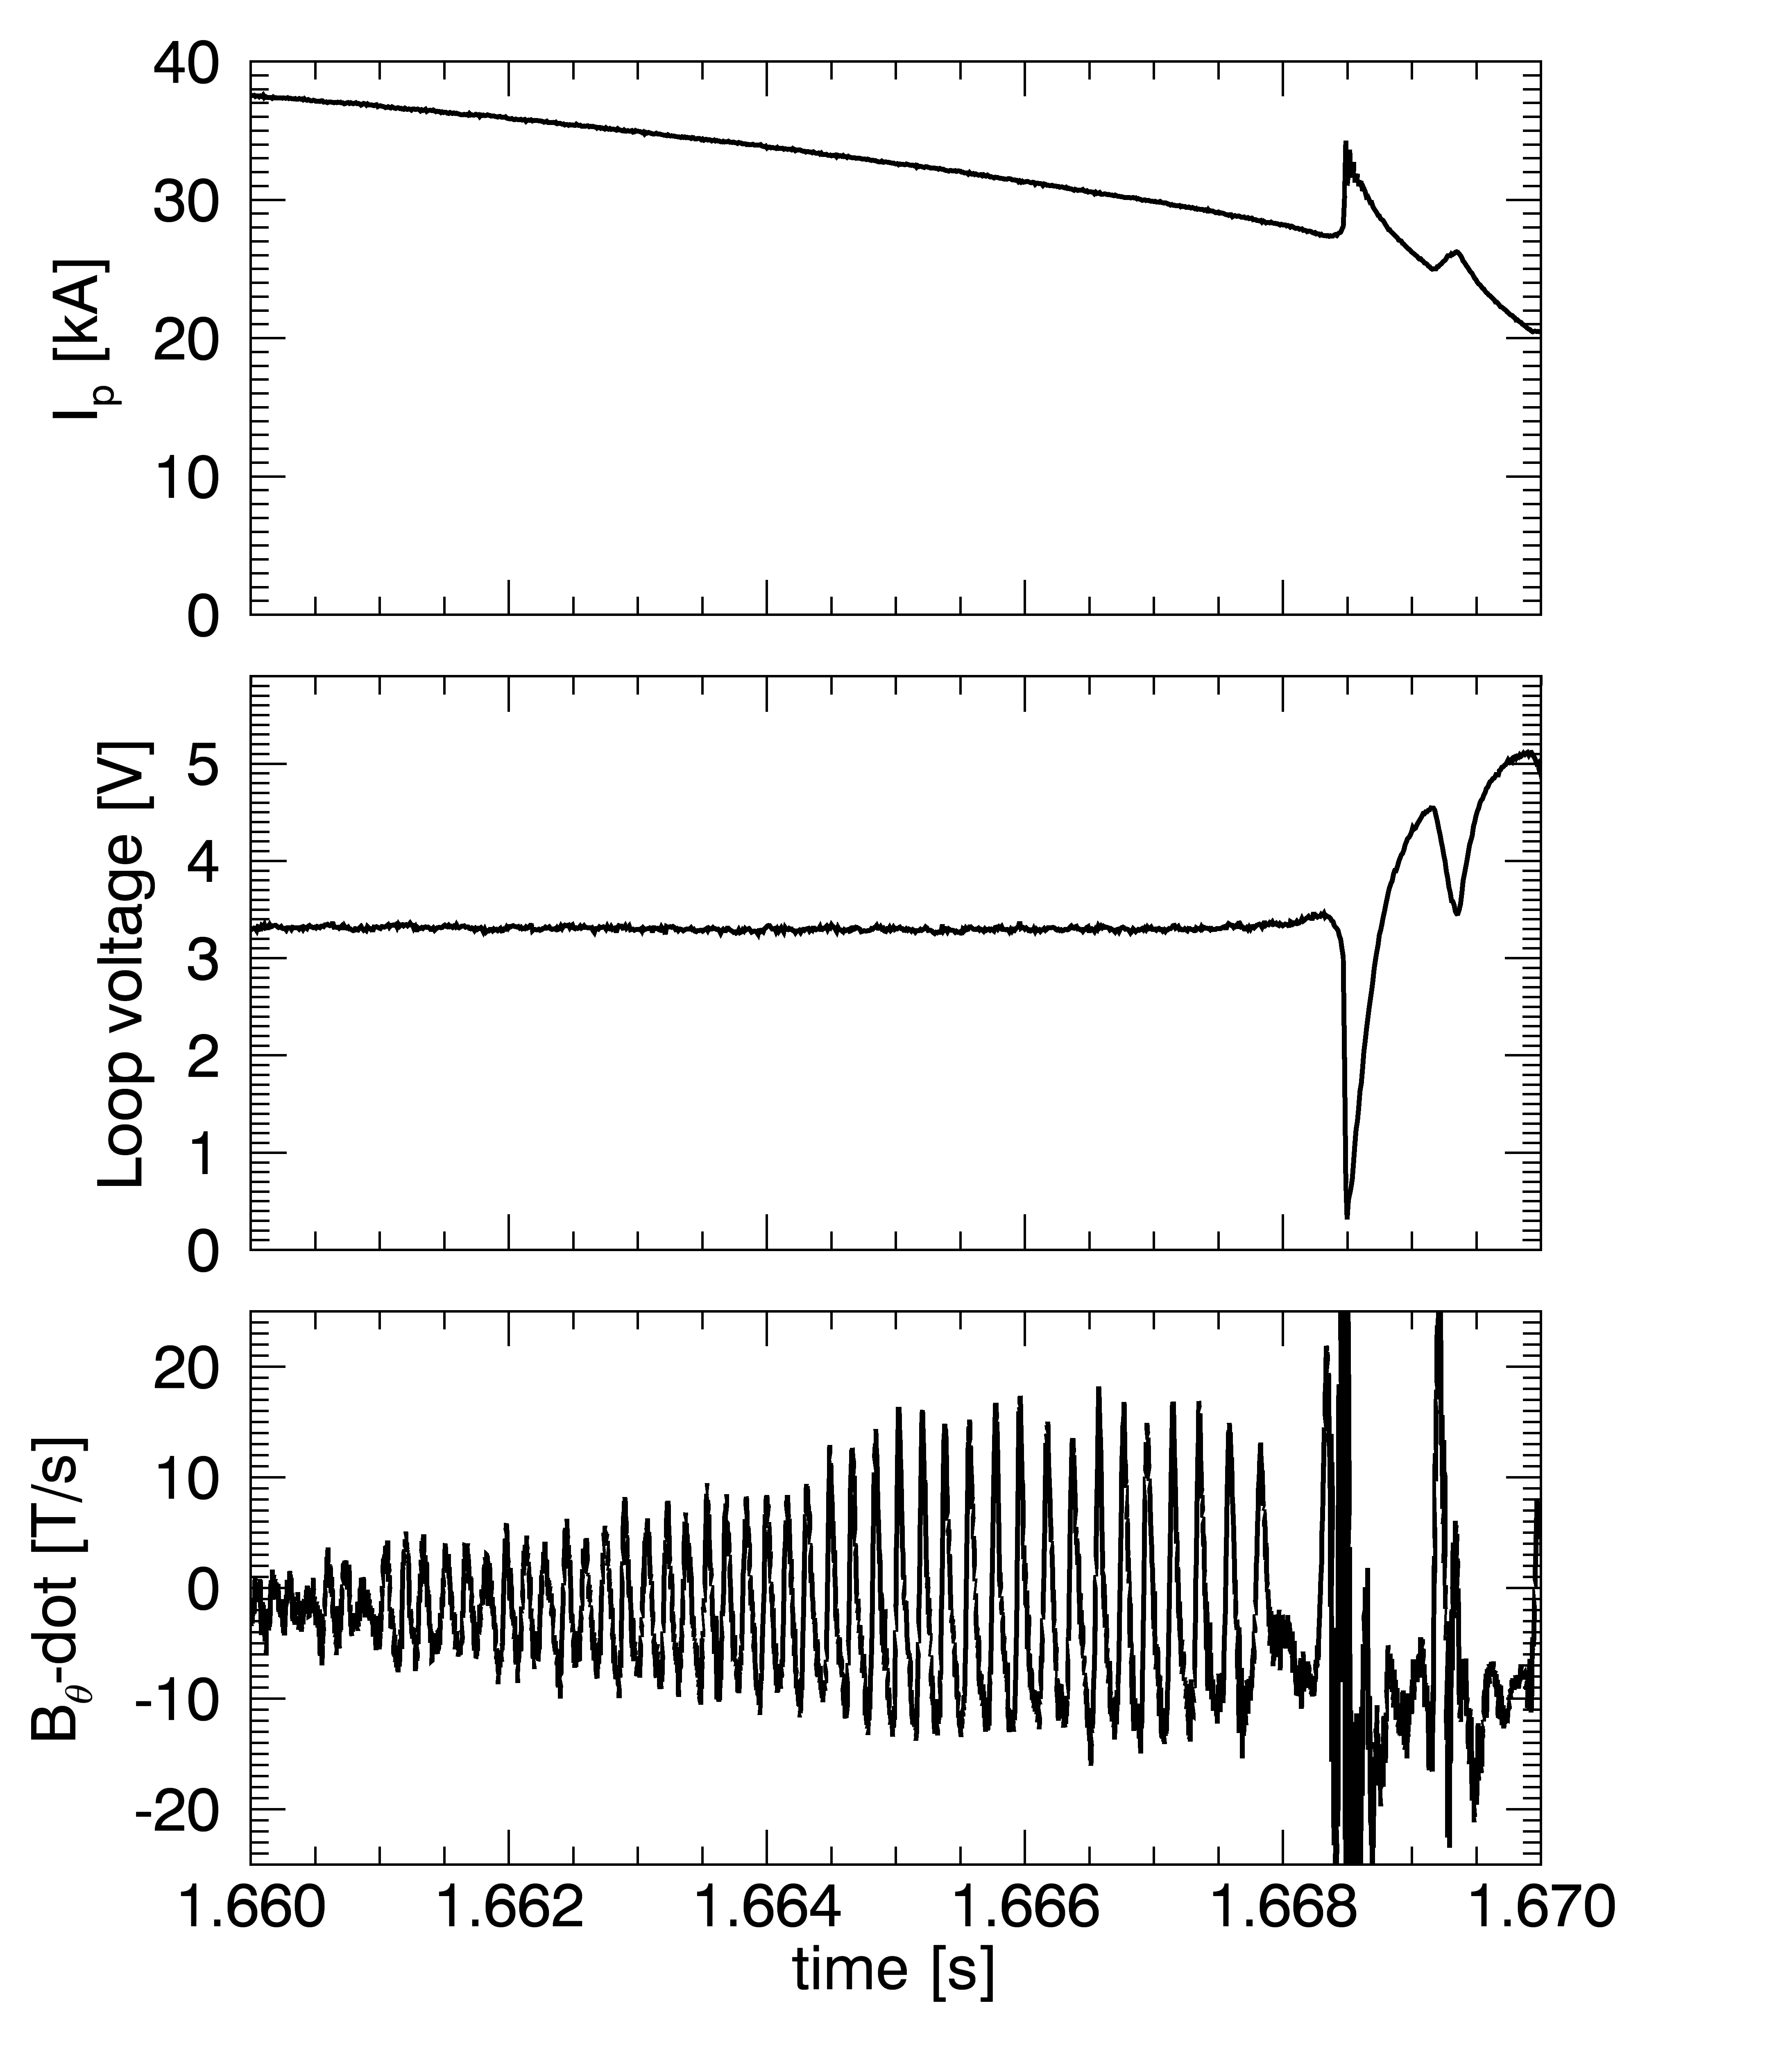
Disruption precursor fluctuations similar to those seen in tokamaks
Notes:
This is a closer look at the density limit precursor. At the top is the plasma current showing the spike, next is the loop voltage which shows the negative spike, and in the last figure is the signal from a B-dot pickup coil, very clearly shows an oscillation growing to large amplitude prior to the disruption.

Slide 59
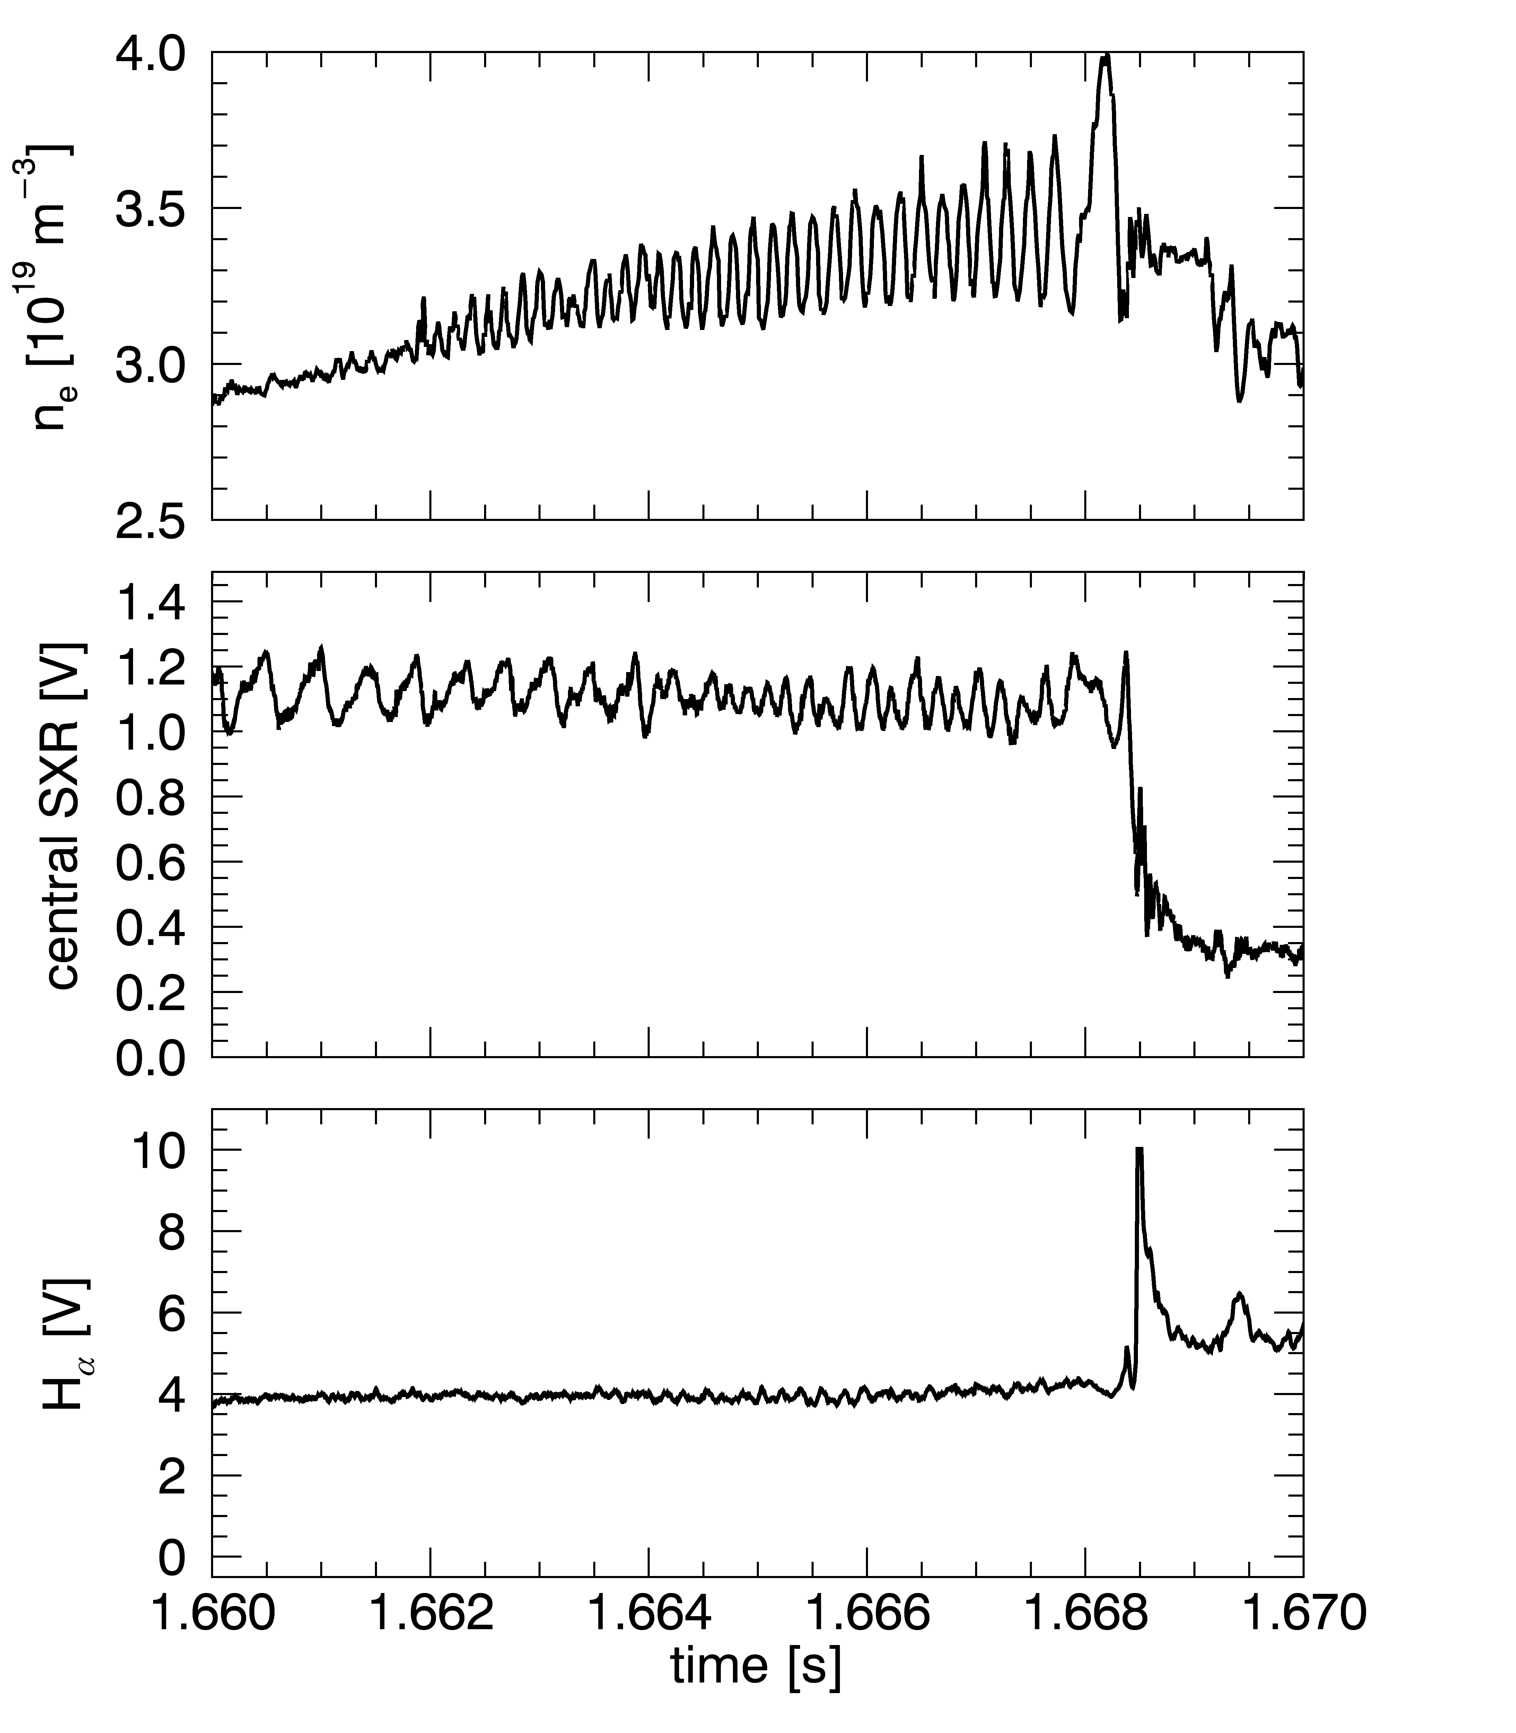
Disruption precursor fluctuations indicate internal tearing mode
MHD modulates density and SXR emission
Notes:
We also see strong oscillations grow up in the plasma density as shown in the top plot. The sawtooth oscillations in the SXR signal turn into sinusoidal oscillations. But we don’t see strong oscillations in the H_alpha signal which indicates that this is an internal mode.

Slide 60
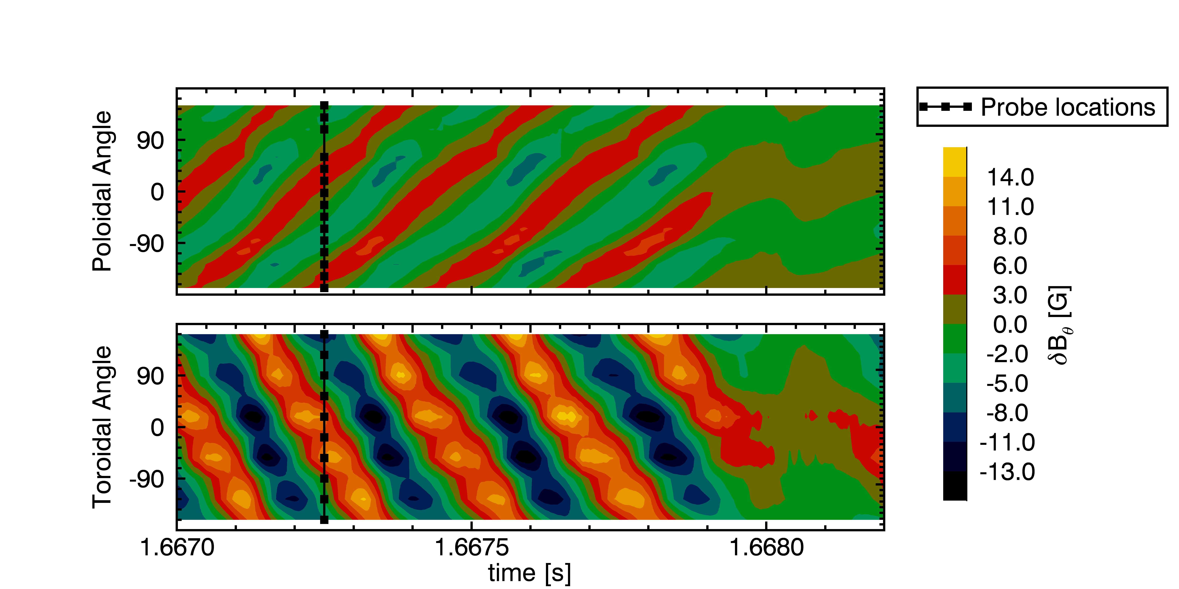
Disruption preceded by rotating m/n = 2/1 tearing mode that locks
poloidal array
of B_{θ} probes
mode locking
m = 2
n = 1
toroidal array
of B_{θ} probes
disruption
Notes:
Here are contour plots of the magnetic fluctuations leading up to the disruption. The top plot is data from a poloidal array of poloidal field pickup coils, the y axis is poloidal angle, and the colors represents field strength. The bottom plot is data from a toroidal array. The data shows a clear m=2, n=1 structure to the mode which locks prior to disruption.

Slide 61
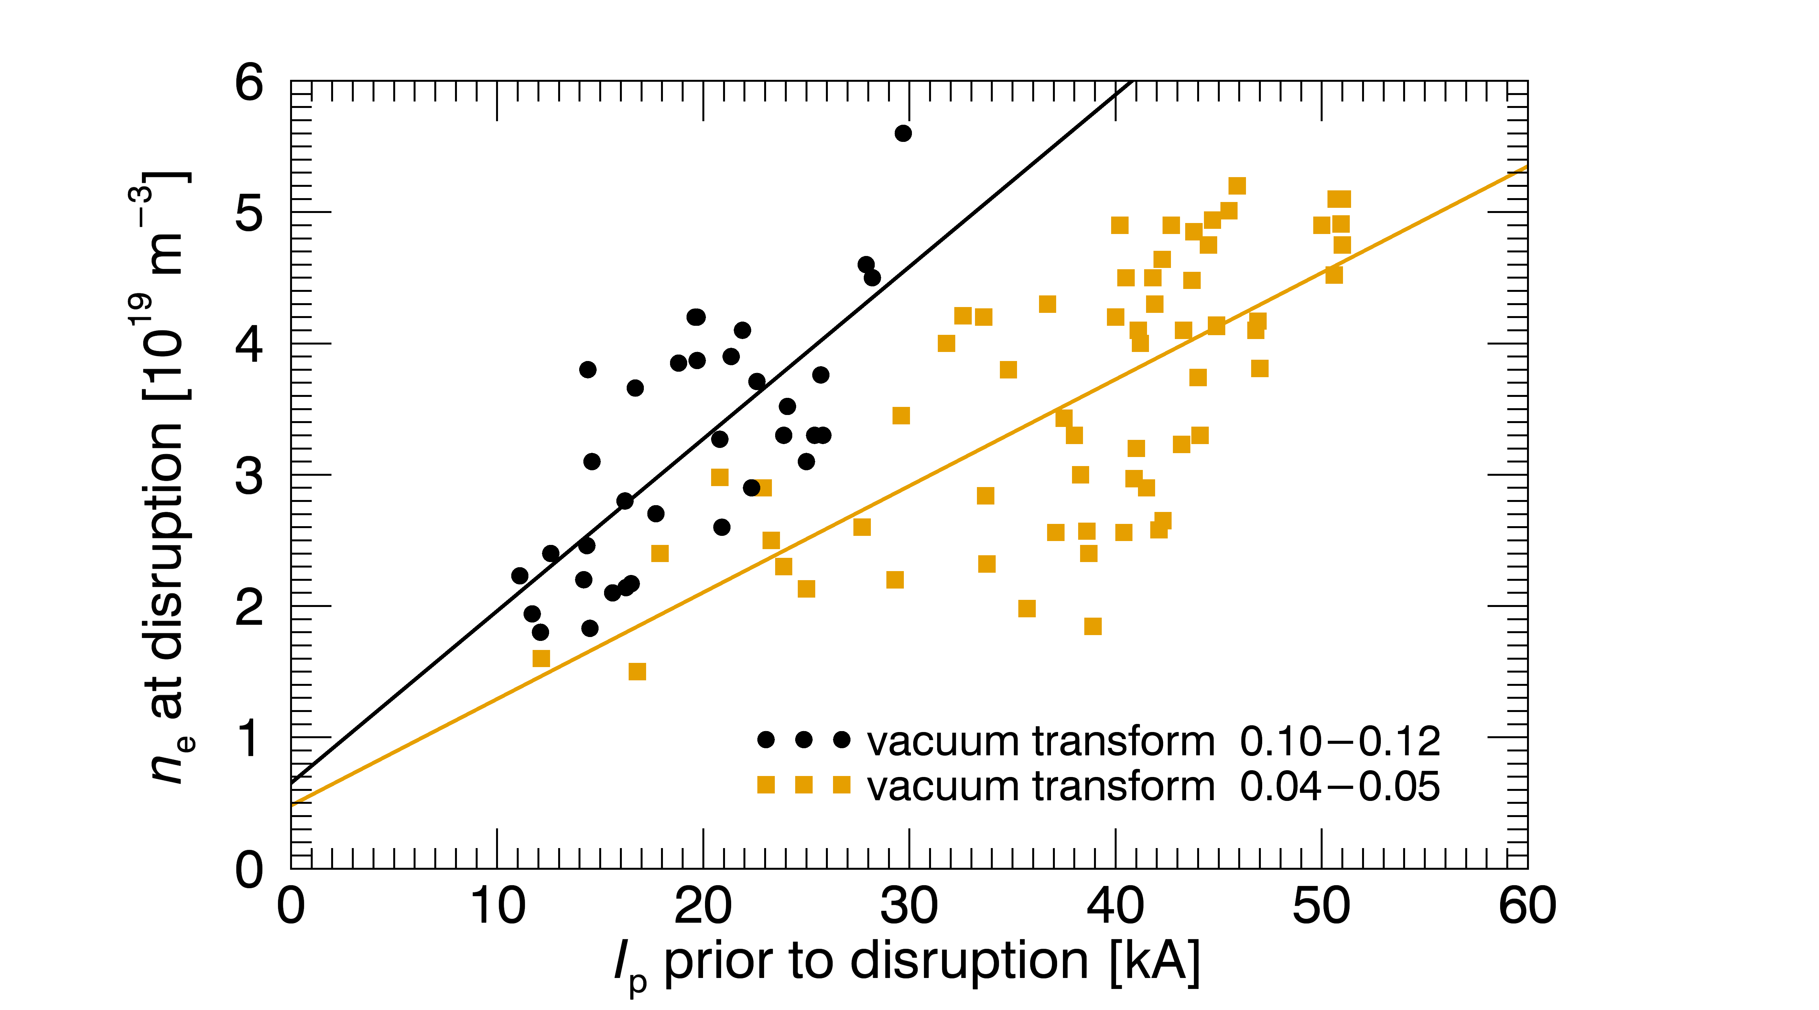
Density at disruption scales with the plasma current and vacuum transform
Follows trend of Greenwald limiting behavior:
Additional dependence on applied level of vacuum transform
(M. Greenwald et al., Nucl. Fusion, 1988)
Notes:
This is a plot of density limit disruptions. Plotted is the density at disruption versus the current just prior to disruption. In the orange squares, are disrupting discharges with a vacuum transform of .04-.05. The density at disruption follows the trend of Greenwald limiting behavior in that it scales with the plasma current. However, there is an additional dependence on the applied level of vacuum transform. The black points are disrupting discharges with a vacuum transform of .1-.12. When we increase the vacuum transform, the slope of the relationship increases. In other words, for a given current, we can achieve higher density with the addition of vacuum transform.

Slide 62
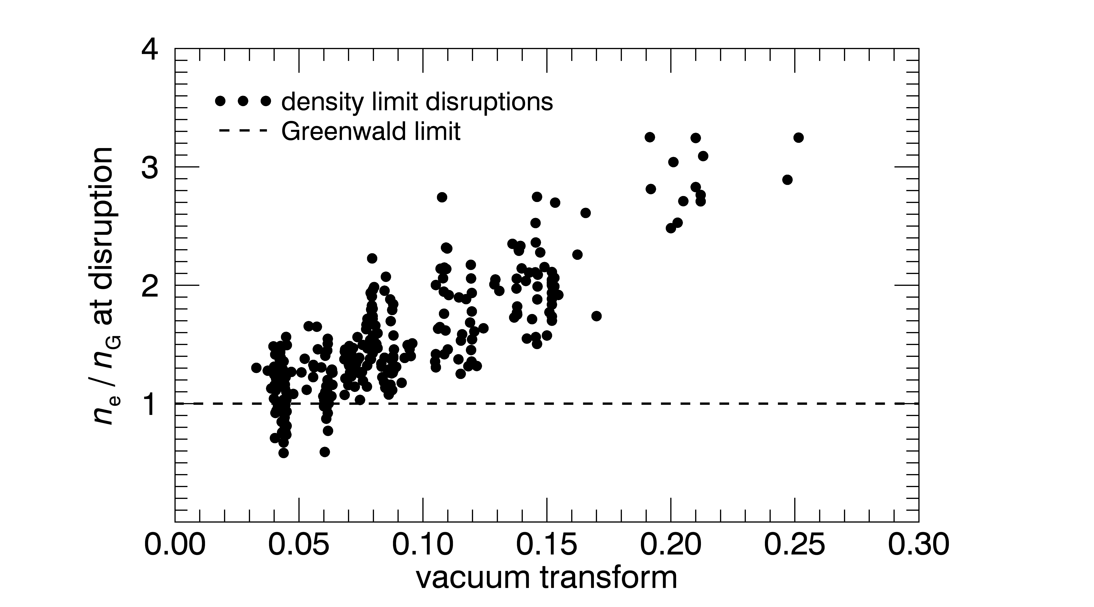
Density at disruption exceeds Greenwald limit as vacuum transform is increased
Have not found a threshold value of vacuum transform that eliminates these disruptions
Notes:
This is a plot of density-limit disruptions. On the y-axis is the line-averaged density normalized to the empirical Greenwald density limit for tokamaks. On the x-axis is the vacuum transform. The results show reasonable agreement near the tokamak limit of zero vacuum transform, but as the vacuum transform is increased we observe an increase in the disruptive density limit by up to a factor of 3 over the range of vacuum transforms that we’ve applied. However, we have not found a threshold value of vacuum transform that eliminates these disruptions.
------------------------------------
Points to keep in mind, but not say:
Value of ‘a’ taken from horizontal radius in symmetry plane.
Experimentally, we find that the we can achieve similar density w/o disruption at lower plasma current when the vacuum transform as raised.
Discharges at high transform tend to have lower current for given ohmic drive (not sure why, maybe plasma size).
Difficult to distinguish from SUDO stellarator density limit because all input power to CTH is ohmic. That is, results are NOT clearly DISTINGUISHABLE from SUDO density limit for stellarators.

Slide 63
Outline
Compact Toroidal Hybrid
3D equilibrium reconstruction
Disruption avoidance:
  Density limit disruptions
  Low-q disruptions
  Vertically unstable plasmas
Summary and conclusions
Notes:
Now I would like to move on to my second major topic, low q disruptions.

Slide 64
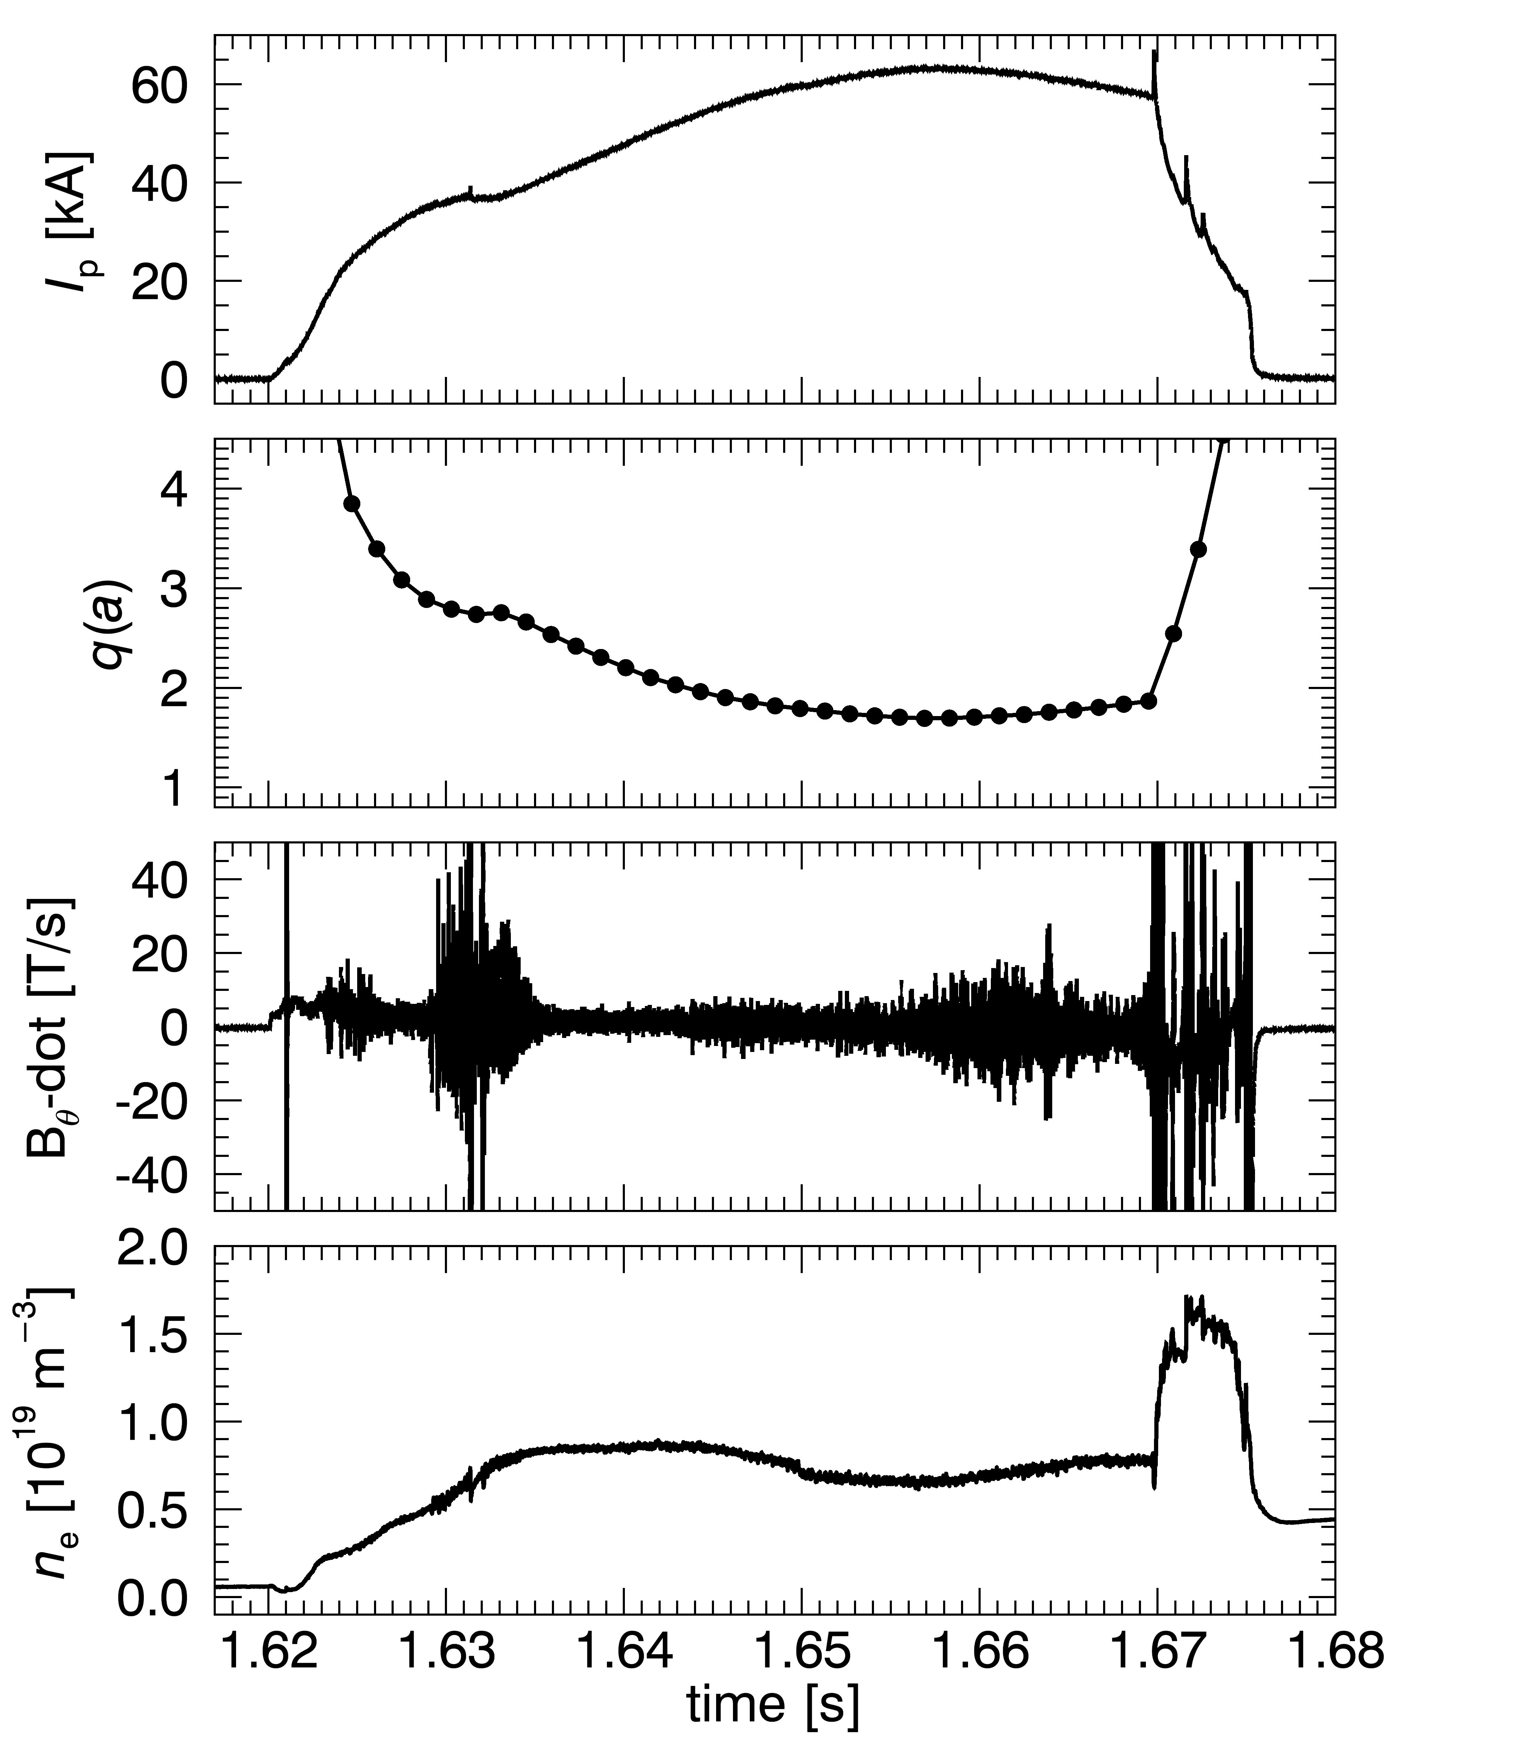
High current plasmas disrupt with q(a) below 2 and vacuum transform low
Example with ι_{vac} = 0.02 (q_{vac} = 50)
Disruption does not occur on initial crossing of
q(a) = 2
Bursts of magnetic fluctuations are detected throughout the discharge
Density kept low and roughly constant
Notes:
We observe low q disruptions of high current plasmas with an edge q below 2 and a low initial vacuum transform. This is an example where the initial vacuum transform was .02 (or equivalently a vacuum q of 50), and you see the disruption here in the plasma current trace. The next plot is the value of q at the edge and it drops below 2 well before the disruption. Throughout the discharge, we observe bursts of magnetic fluctuations which are picked up by poloidal and toroidal detector arrays. The third plot is the B-dot signal from one such pickup coil. And as opposed to the density limit experiments, in these discharges the density is kept low and roughly constant.

Slide 65

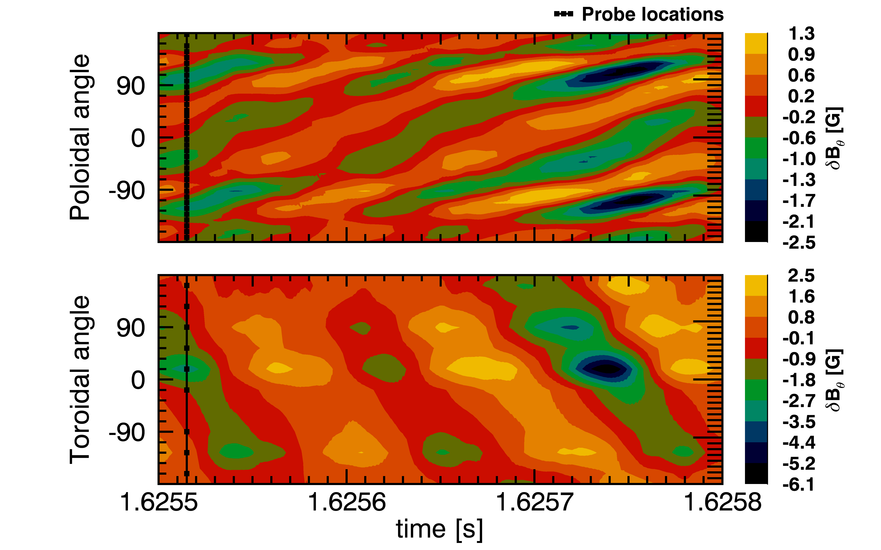
Hesitations in current rise as resonant surfaces move through the plasma edge
q = 4 surface exits the plasma edge
m = 4, n = 1 mode detected
4/1
Notes:
Hesitations in the current rise occur as resonant surfaces move through the plasma edge. The first burst of magnetic fluctuations corresponds to when the q=4 surface exits the plasma edge. This is a contour plot of the magnetic fluctuations picked up by poloidal and toroidal arrays of pickup coils of the time window indicated in with this grey vertical bar. During this time the mode has a clear m=4, n=1 structure.

Slide 66
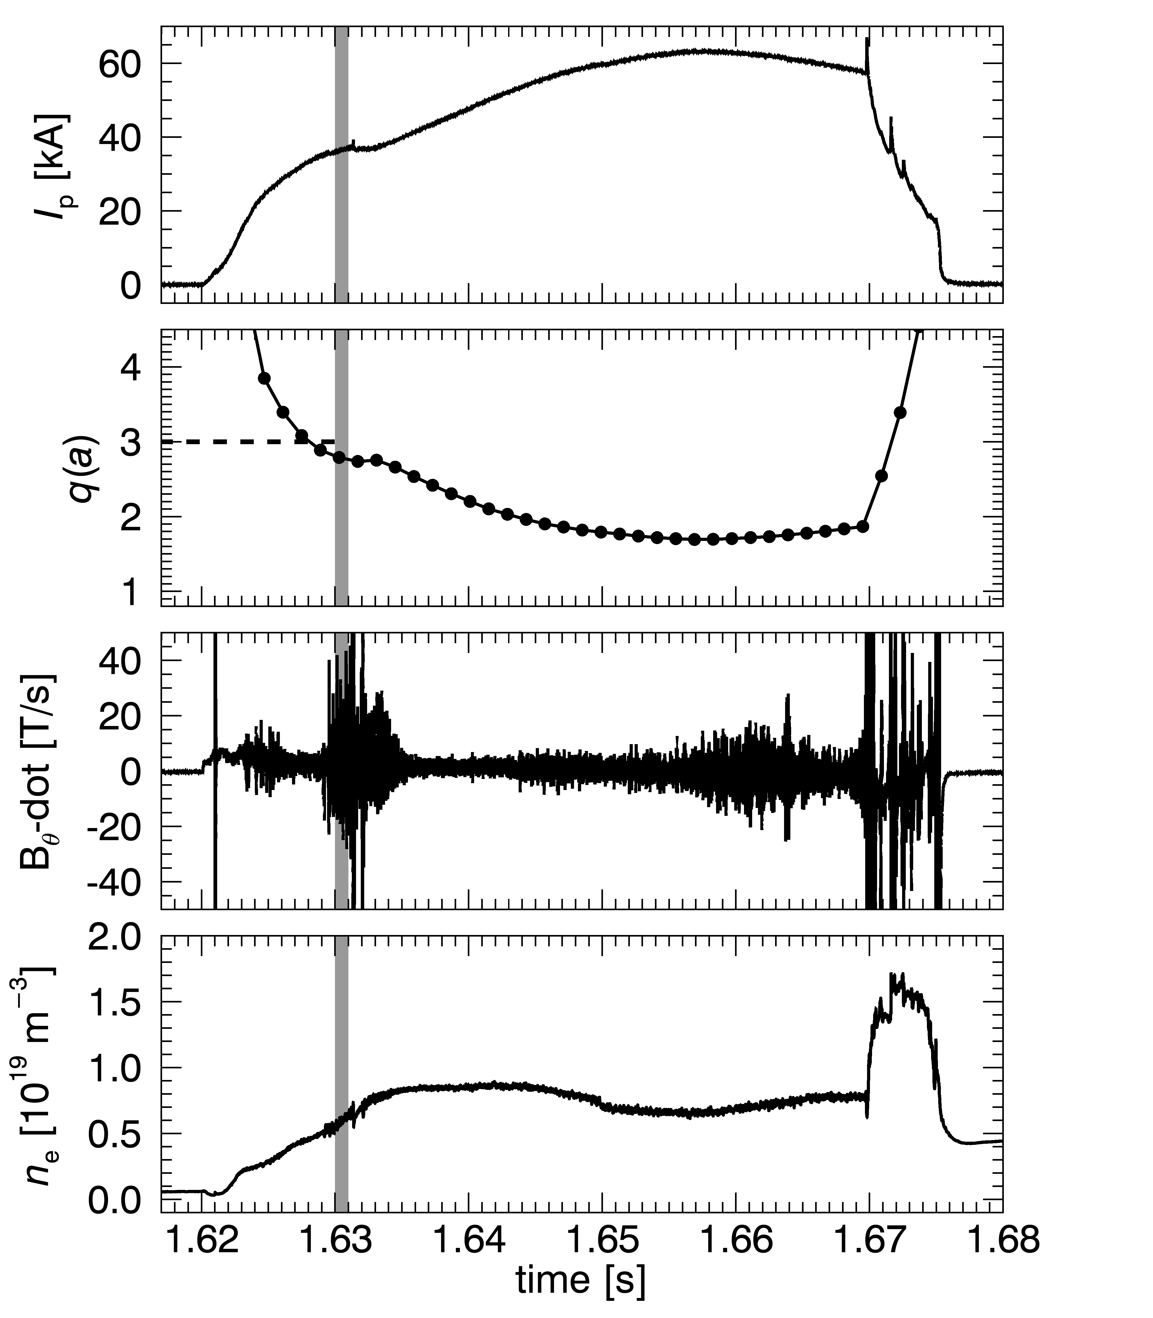
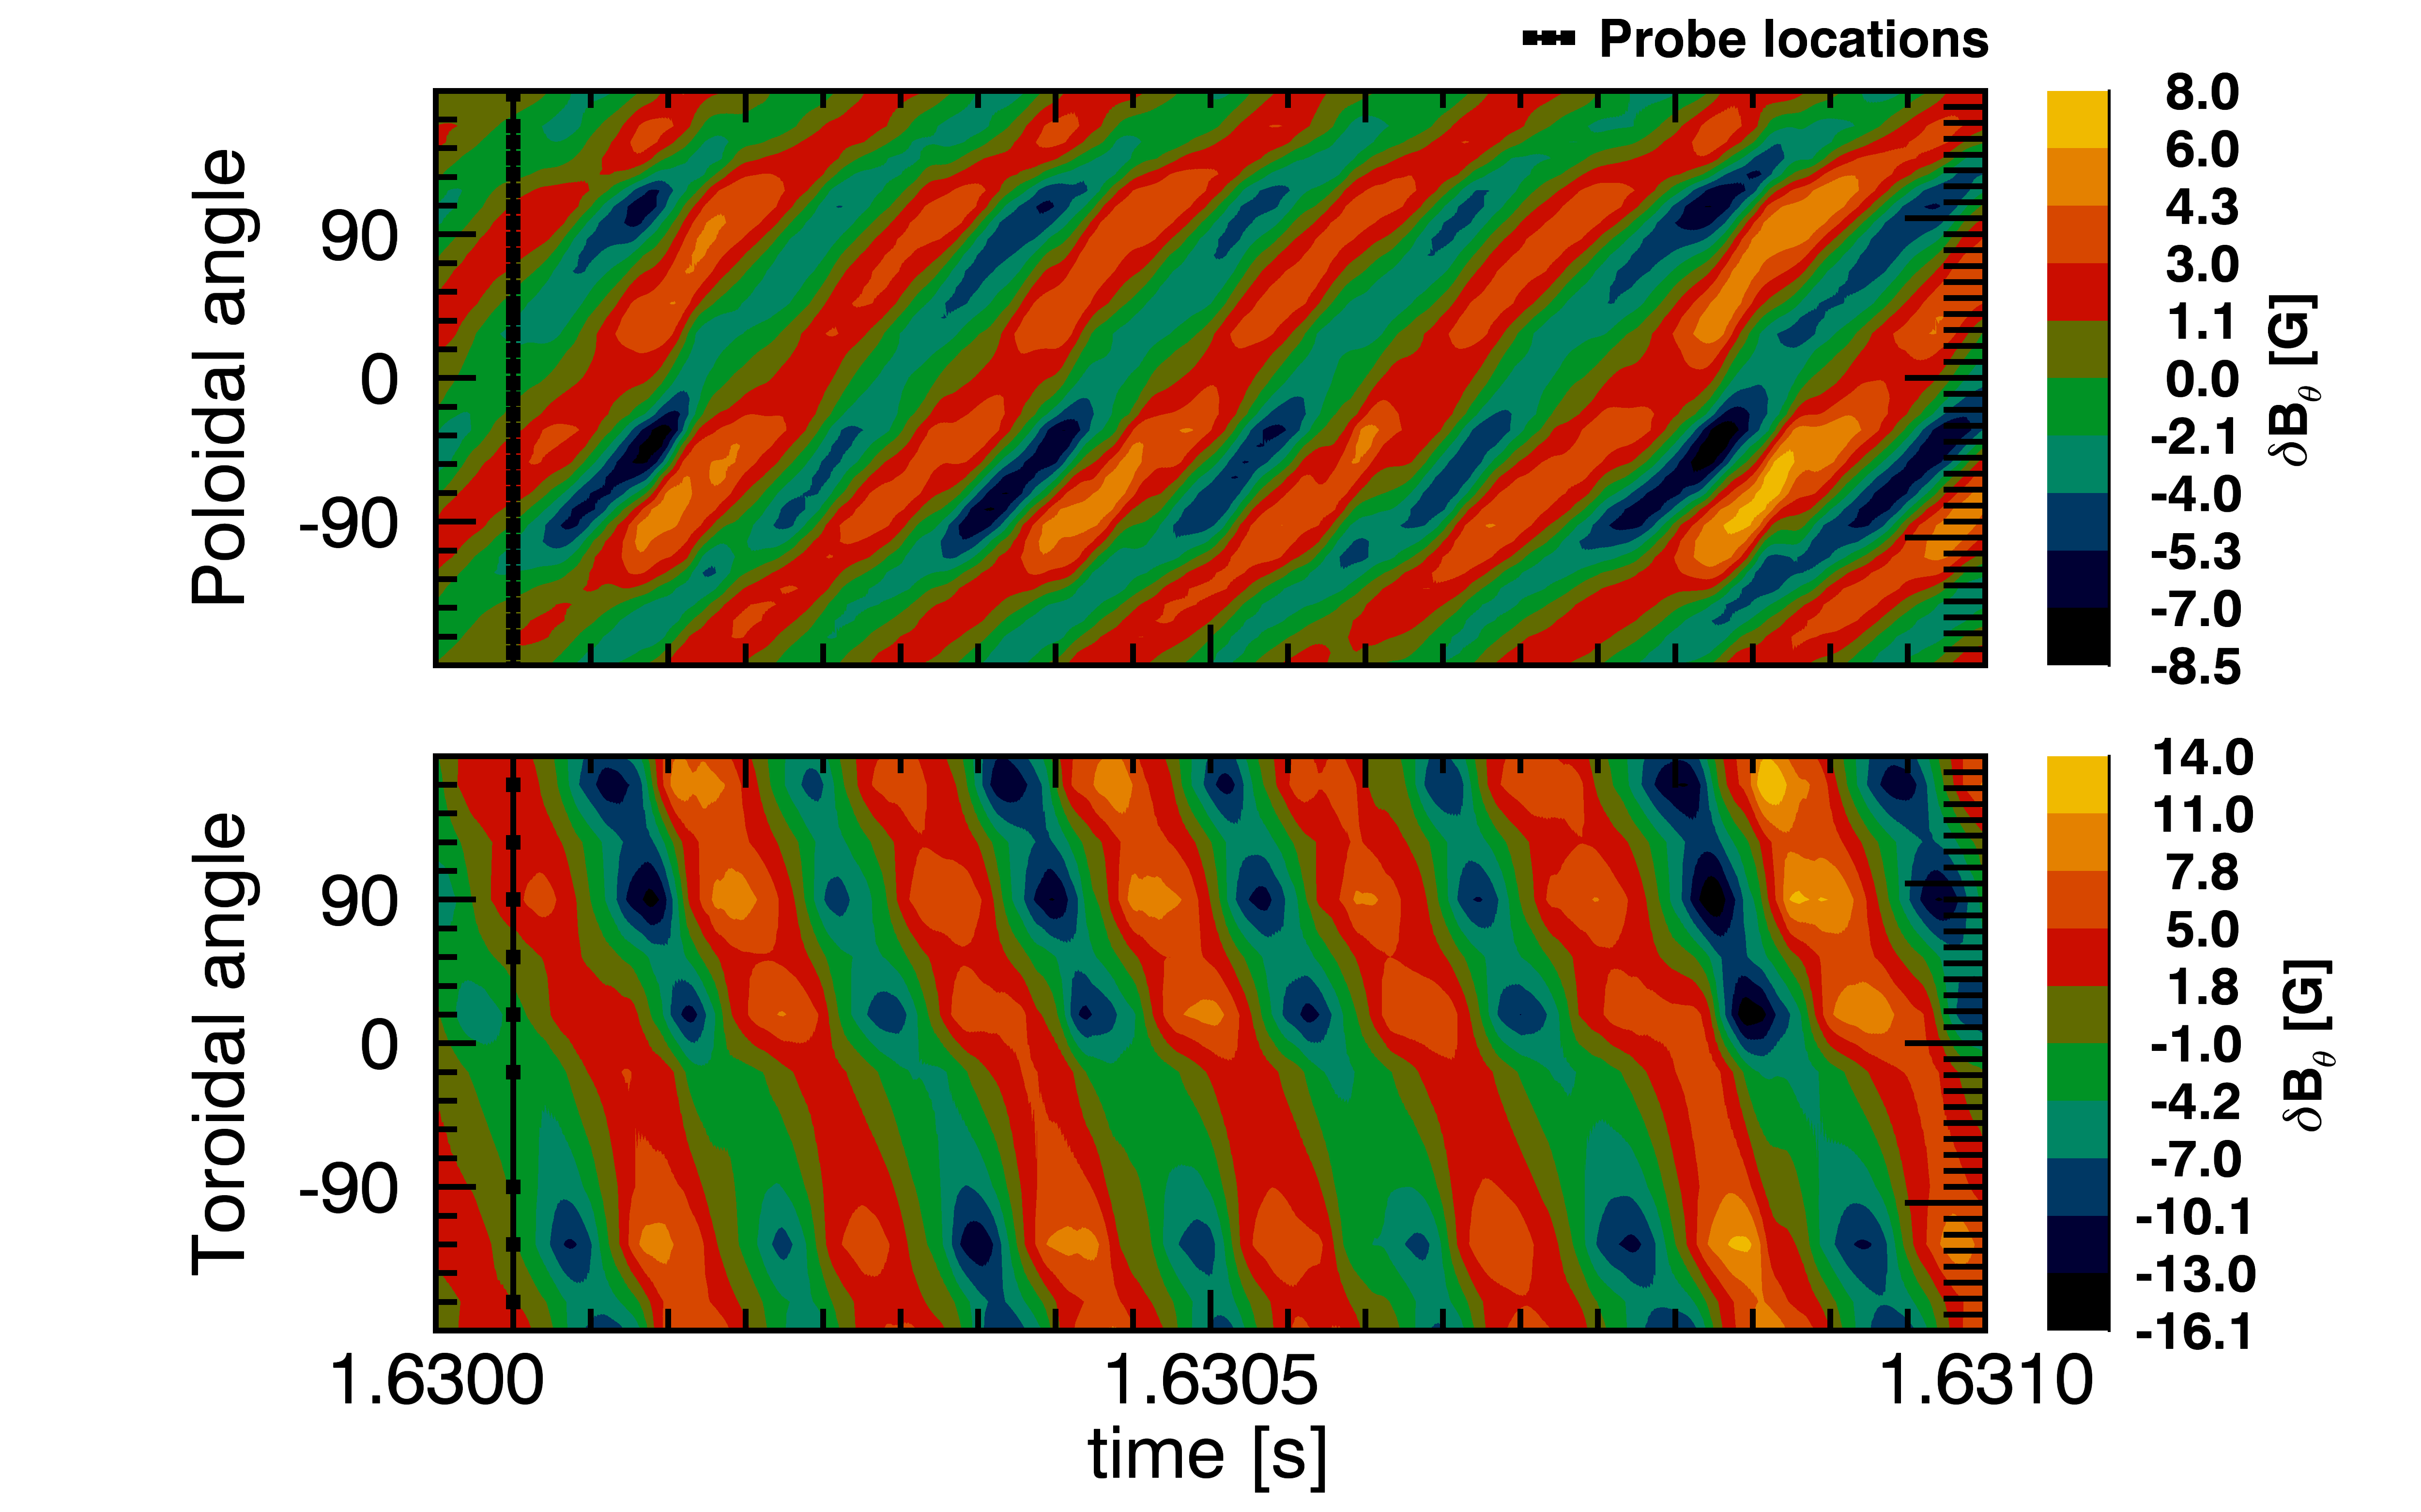
Hesitations in current rise as resonant surfaces move through the plasma edge
q = 3 surface exits the plasma edge
m = 3, n = 1 mode detected
3/1
Notes:
Later during the current rise, there is another prominent hesitation as the q=3 surface exits the plasma. The magnetic fluctuations during this time show a clear m=3, n=1 structure. This mode isn’t always so prominent, but its amplitude doesn’t seem to affect the disruption dynamics at the end.

Slide 67
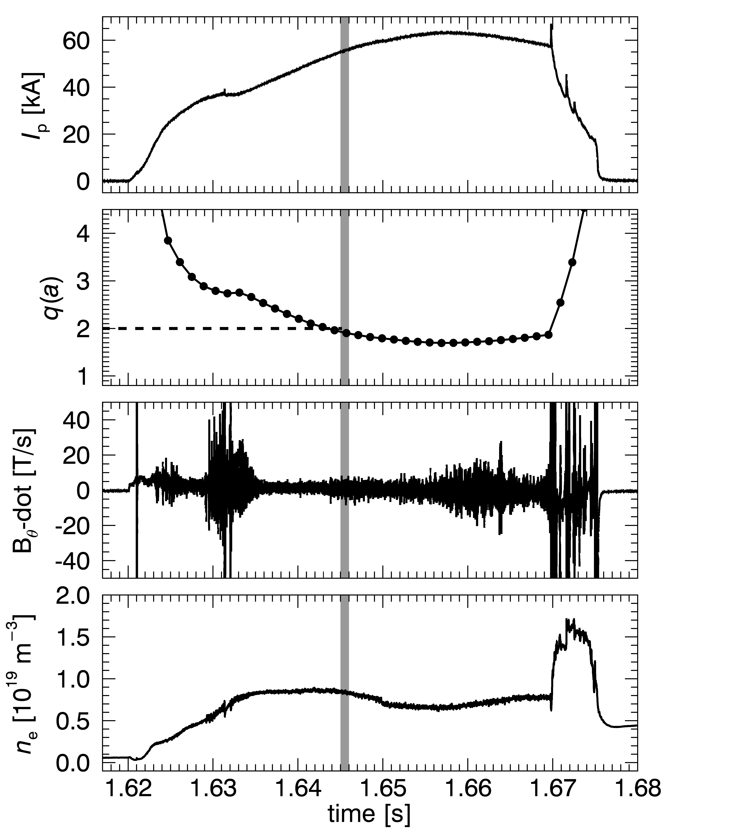
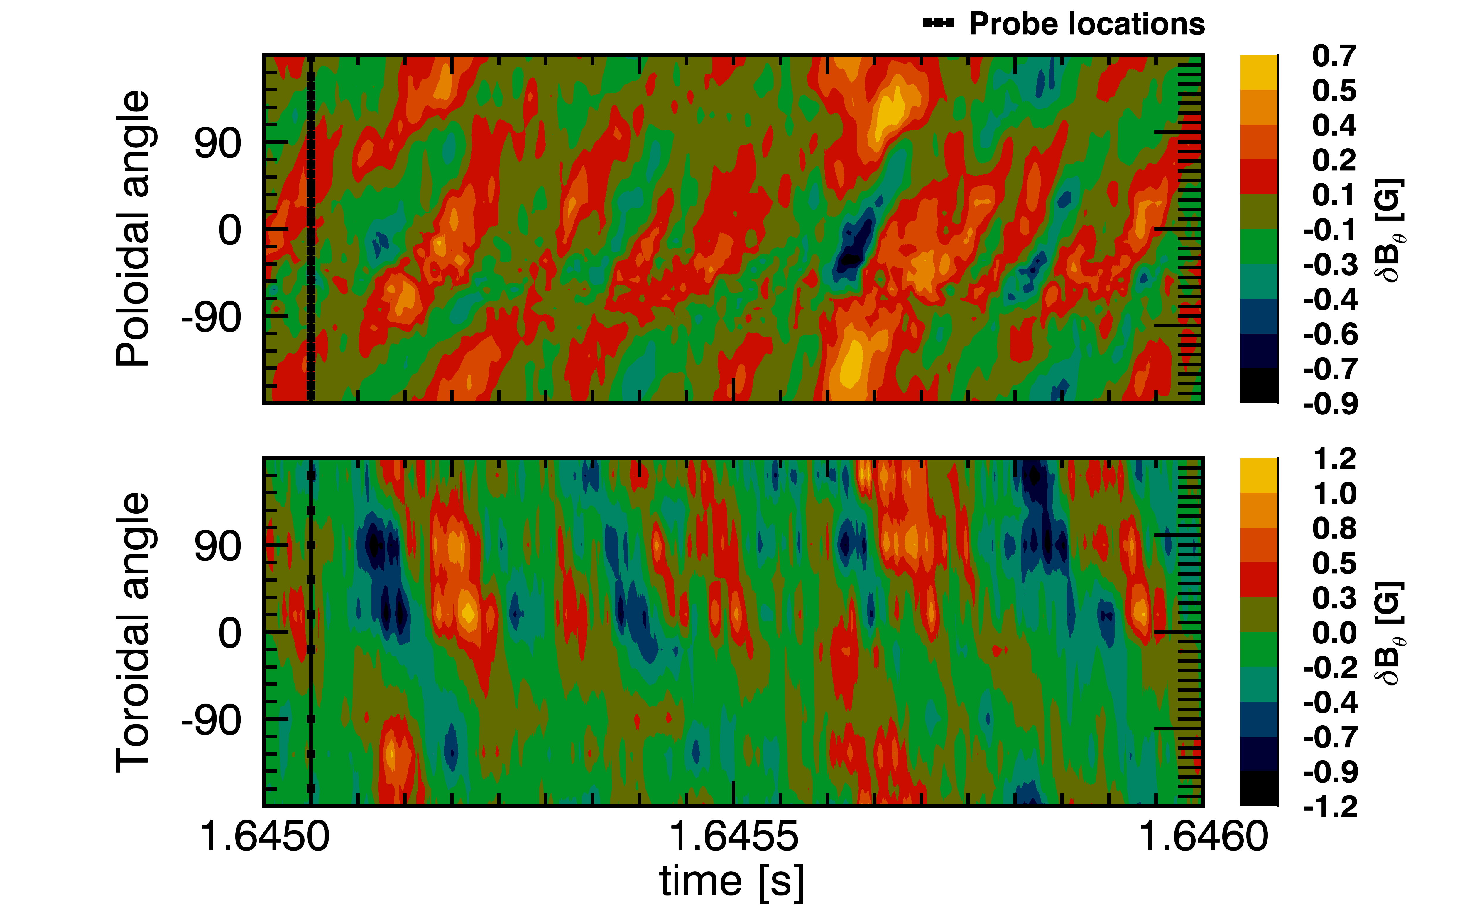
Hesitations in current rise as resonant surfaces move through the plasma edge
q = 2 surface exits the plasma edge
m = 2, n = 1 mode detected
Remains at low amplitude
2/1
Notes:
The shot continues on, the current begins rising again, and the q=2 surface moves out to the edge of the plasma and goes out into the vacuum. It is interesting that there is a minimal amount of m=2 n=1 activity as the q=2 surface approaches the edge of the plasma and moves out into the vacuum. Doesn’t seem implicated in the disruption.

Slide 68
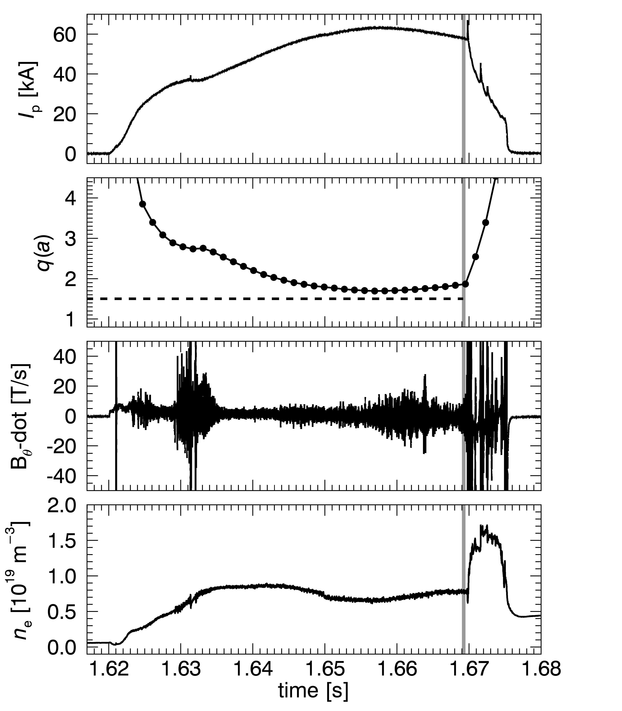
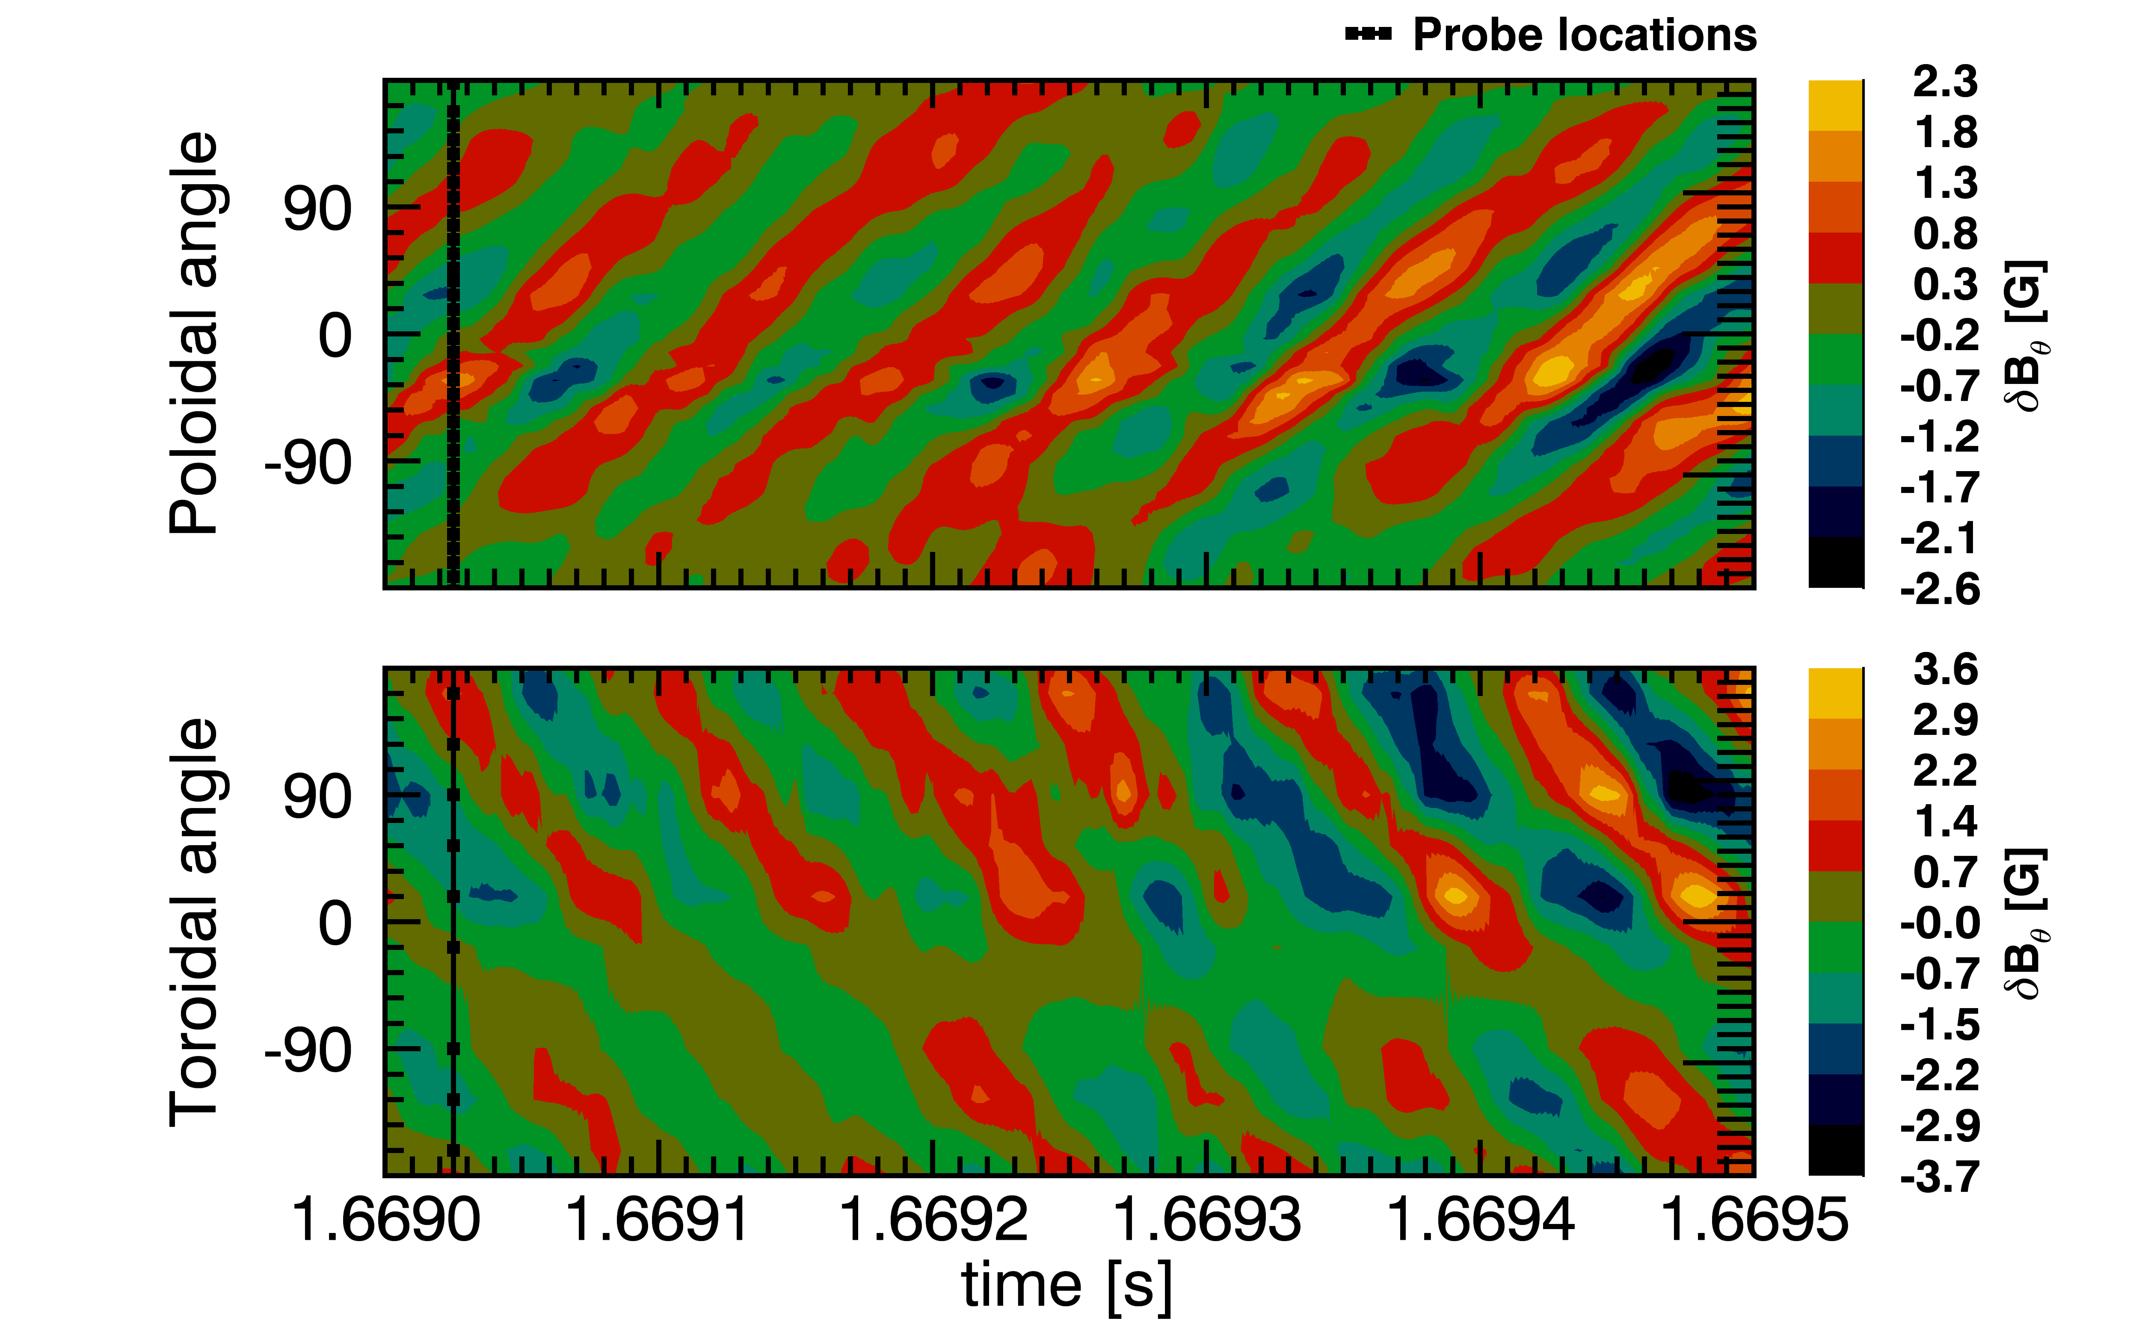
An m = 3, n = 2 mode grows to large amplitude just prior to disruption
q = 3/2 surface near edge but remains inside plasma
m = 3, n = 2 mode detected
3/2
Notes:
At this point a 3/2 mode shows up. The 3/2 mode, however, does grow to large amplitude prior to the disruption, and since the value of q at the edge stays above 3/2, the 3/2 resonant surface is just inside the plasma.

Slide 69

Low-q disruptions cease to occur if vacuum transform raised above ~ 0.07
Notes:
We have taken a large ensemble of low-q discharges where we have varied the amount of vacuum transform while keeping the total transform approximately constant. This is a plot of q at the edge versus vacuum transform for the ensemble, notice that the y-axis goes from 2.5 to 1.0. On the right hand side the total transform (which is just one over q) is indicated for reference. What we observe, is that as the vacuum transform is increased, the likelihood for the discharge to disrupt decreases, and if the vacuum transform is raised above about .07, these disruptions cease to occur.

Slide 70

Low-q disruptions cease to occur if vacuum transform raised above ~ 0.07
Notes:
The same data can be plotted as a histogram with number of shots on the y-axis and vacuum transform on the x-axis. This shows that the fraction of disrupting discharges decreases as the vacuum transform is increased. The amount of vacuum transform added is actually quite modest, .07 an order of magnitude less than the total transform.

Slide 71
Low-q disruptions cease to occur if vacuum transform raised above ~ 0.07
Possible explanation: Applied ι_{vac} shifts 3/2 resonance outward to where the current profile is less steep, stabilizing the 3/2 tearing mode
  Invoked for the stabilization of 2/1 tearing mode in W7-A
  (W7-A team, Nucl. Fusion. 1980)
Lack of strong n = 1 kink mode activity seen computationally
(Fu, et al., Phys. Plasmas. 2000)
Notes:
A possible explanation is that the applied vacuum transform shifts the 3/2 resonance outward in radius to where the current profile gradient is less steep, thereby stabilizing the 3/2 tearing mode. This was also the mechanism invoke for the stabilization of the 2/1 tearing mode in W7-A.
Lack of strong n=1 kink mode activity also seen computationally. It is not clear at present that the same stabilization mechanism is at work in our discharges. This will be the subject of future work.
-------------------------
However, our ability to reconstruct the current and q profiles are limited using external magnetics alone. We are in the process of equipping CTH with internal diagnostics (such as Thomson Scattering) to gain a better understanding of these profiles.

Slide 72
Outline
Compact Toroidal Hybrid
3D equilibrium reconstruction
Disruption avoidance:
  Density limit disruptions
  Low-q disruptions
  Vertically unstable plasmas
Summary and conclusions
Notes:
Finally, I will talk about vertically unstable plasmas.

Slide 73




CTH discharges naturally elongated and can be susceptible to vertical instability
ECRH plasma I_{p} = 0 kA
  Mean κ = 2.77
  Fractional transform
  f = ι_{vac}(a)/ι_{tot}(a) = 1
At peak I_{p} = 75 kA
  Mean κ = 1.48
  Fractional transfrom
  f = 0.0634
Notes:
CTH discharges are naturally elongated and can be susceptible to vertical instability. On the left, is a pure stellarator equilibrium with zero plasma current. The flux surfaces for this discharge were very elongated with a mean elongation of 2.77. I’d also like to take this time to define a term I’ll use later, the fractional transform, which is defined as the vacuum transform divided by the total transform that includes the contribution from the plasma current. Since there is no current in this left figure, the fractional transform is 1. On the right is the same discharge during the hybrid phase with 75 kA of plasma current. The flux surfaces are more circular, but on average they are still elongated with a kappa of 1.48, a value of one would be circular. In this example, the plasma current is providing most of the total transform, the fractional transform is about 6%

Slide 74

Elongated plasmas are measured to be vertically unstable
Vertical position inferred from magnetic diagnostics
Notes:
We measure elongated plasmas to be vertically unstable, and they usually drift upwards. Here are three discharges with different drift rates. The vertical position has been inferred from magnetic diagnostics and is plotted in the lower plot.
No need to mention disruptions

Slide 75




Vertical motion is also detected by interferometry and SXR cameras
1mm wave interferometer
SXR pinhole camera
Notes:
The vertical motion is al detected by a 3 chord 1mm wave interferometer that measures the line-integrated plasma density. The top chord shown in orange shows in increasing density, while the bottom chord shows a decreasing density, indicative of an upward drift. CTH is also equipped with SXR pinhole camera, and here again, the top channel shows an increasing SXR signal, while the lower channel shows a decreasing signal, indicating and upward drift.
------------------------
(We can estimate the drift rate by the centroid in the SXR channels, and that measurement of the vertical position is consistent with the magnetic estimates.)

Slide 76

Discharges exhibit faster drift at high elongation and low fractional transform
Large ensemble of discharges with varied elongation and fractional transform
Notes:
A large ensemble of discharges were taken while varying the elongation and the fractional transform. In this figure, I’ve plotted the drift rate versus the mean elongation. The fastest drifting plasmas are color coded in red, and they all occur at high elongation.

Slide 77

Discharges exhibit faster drift at high elongation and low fractional transform
Large ensemble of discharges with varied elongation and fractional transform
Notes:
When I plot the same data set versus fractional transform, you’ll see that the fastest drifting plasmas occur at low fractional transform.

Slide 78

Plasmas with high elongation stabilized by addition of vacuum transform
(M.C. ArchMiller, et al., Phys. Plasmas. 2014)
Notes:
Now let’s look at a top projection of these discharges, and plot fractional transform versus mean elongation. The blue scale is the average drift rates of discharges falling within each pixel, excluding the red points. At the light end of the scale, plasmas essentially don’t drift at all. The data shows clearly that the most unstable region is in the lower right at high elongation and low fractional transform. Furthermore, for a given elongation, the plasmas are stabilized by the addition of vacuum transform.

Slide 79

Qualitative agreement with analytic criterion for vertical stability
Energy principle used to derive fraction of vacuum transform needed to stabilize vertical mode in a current-carrying stellarator (G.Y. Fu, Phys. Plasmas, 2000)
Large aspect ratio,
low-β stellarator
Uniform profiles of
current density and
vacuum rotational
transfrom
STABLE
UNSTABLE
Notes:
Back in 2000, Fu used the energy principle to derive the fraction of vacuum transform needed to stabilize the vertical mode in a current-carrying stellarator, given by this expression in terms of the mean elongation. Some assumptions are of a large aspect ratio low beta stellarator, with uniform current density and vacuum rotational transform profiles. I have over-plotted the analytic criterion on top of the contoured data. The stable is above the line and the unstable region is below the line. Our data shows very good qualitative agreement with this analytic stability criterion.

Slide 80
Summary
Disruptive density limit exceeds Greenwald limit as vacuum transform is increased
  Threshold for avoidance not observed
Low-q disruptions cease to occur if vacuum transform raised above ~ 0.07 (q_{vac}(a) ~ 14)
  m = 2, n = 1 mode not implicated in disruption
Vertical stability of elongated plasmas improved by stellarator transform
  Qualitative agreement with analytic theory
This work supported by U.S. Department of Energy grant DE-FG-02-00ER54610

Slide 81
Thank you

Slide 82

Density at disruption observed to be independent of plasma current evolution
Discharges with similar transform ι_{vac} = 0.07
Different programmed loop voltage
Disruption occurrence correlates with plasma current and density as in tokamaks
Notes:
Mention point: The disruption depends on the equilibrium parameters and not the evolution of the discharge.

Slide 83



Slide 84


Slide 85


Slide 86
Drift orbit optimization
Notes:
The disruptive behavior of current-carrying discharges in CTH can be reproducibly modified by the presence of modest levels of externally generated rotational transform, but both the amount of vacuum transform required and the character of the observed disruption suppression depend on the type of disruption. Three types of disruptions are being investigated on CTH: Density limit disruptions, low q disruptions and disruptions caused by vertically unstable plasmas.

