Slide 1
Single Particle Motion
Alexis Briesemeister
Oak Ridge National Lab
Presented:
June 8th 2015
SULI Introductory Course in Plasma Physics
Notes:
Post-Doc at Oak Ridge National Lab, but I currently live in San Diego and work on the DIII-D tokamak

Slide 2
Motivation: Single particle motion and collisions limit plasma confinement
Plasma transport can be described as a “random walk”
single particle motion gives the step size
collision frequency tells you how often steps are taken
If care isn’t taken to optimize your magnetic field geometry particles can have trajectories which cause them to leave the system even without collisions
High energy particles are the most susceptible and the most damaging

Slide 3
The 3 things you should walk away from this talk with:
Charged particles move freely along a constant magnetic field, but any velocity perpendicular to the field causes them to orbit around the field lines
When the magnetic field strength isn’t constant it will change parallel velocity of the charged particle and cause it to drift off the field line
A force perpendicular to your field lines will cause the particle to move perpendicular to both the force and the magnetic field lines

Slide 4
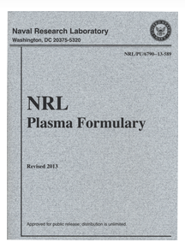
Resources Available Online
NRL Plasma Formulary
www.nrl.navy.mil/ppd/content/nrl-plasma-formulary
Magnetic Fusion Energy Formulary
www.psfc.mit.edu/research/MFEFormulary/
Fusionwiki
fusionwiki.ciemat.es/
Introduction to Plasma Physics and Controlled Fusion by F. Chen
Notes:
Knowing where to find things can be more important than knowing thngs.

Slide 5
Section 1: Neutral particles

Slide 6
Section 1: Neutral particles
Ballistic.

Slide 7
Section 1: Neutral particles travel ballistically
Not confined by magnetic fields
Neutrons generated by the D+T fusion process travel directly to the wall
Neutral particles are very relevant near material interfaces
But their single particle motion is not very interesting

Slide 8
Section 2:(AKA The rest of this talk) CHARGED particles
Electrons
Ions
Very highly charged, extremely small dust particles

Slide 9
Lorentz force equation forms the basis for single particle motion
Lorentz force describes the forces on a charged particle moving in a the presence of an electric field and magnetic field
=force on the particle
=charge on the particle
= electric field
=velocity of the particle
=magnetic field

Slide 10
Newton’s law second law of motion also important
Newton’s second law of motion
=force on the particle
=mass of that particle
= acceleration of that particle

Slide 11
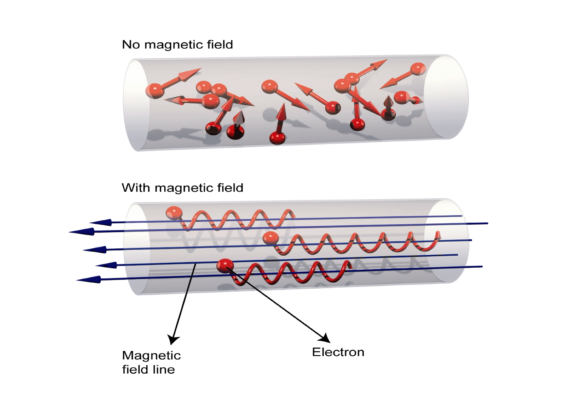
Charged particles move freely ALONG magnetic fields
0
Particles are free to stream along magnetic field lines
…when the magnetic field is constant
Figure from: http://iter.rma.ac.be/en/img/MagneticConfinement.jpg

Slide 12
Cyclotron-frequency and Larmor radius
Cyclotron-frequency (aka gyro-frequency) the frequency at which a particle moves around the magnetic field:
Larmor radius the radius of the orbit the particle:

Slide 13
Charged particles in a magnetic field
y
z
x
Figure from: http://iter.rma.ac.be/en/img/MagneticConfinement.jpg

Slide 14
Charged particles in a magnetic field
y
z
x
Figure from: http://iter.rma.ac.be/en/img/MagneticConfinement.jpg

Slide 15
Charged particles in a magnetic field
y
z
x
Figure from: http://iter.rma.ac.be/en/img/MagneticConfinement.jpg

Slide 16
Charged particles in a magnetic field
y
z
x
Figure from: http://iter.rma.ac.be/en/img/MagneticConfinement.jpg

Slide 17
Charged particles in a magnetic field
y
z
x
Figure from: http://iter.rma.ac.be/en/img/MagneticConfinement.jpg

Slide 18
Charged particles in a magnetic field
y
z
x
Charged particles move freely along the magnetic field!
Figure from: http://iter.rma.ac.be/en/img/MagneticConfinement.jpg

Slide 19
Charged particles in a magnetic field
y
z
x
Figure from: http://iter.rma.ac.be/en/img/MagneticConfinement.jpg

Slide 20
Motion perpendicular to the magnetic field

Slide 21
Drop the unit vectors

Slide 22
Take another derivative with respect to time

Slide 23
The goal: differential equations which involve a single spatial coordinate

Slide 24
Repeat for the terms involving x

Slide 25
2 equations each with involving a single spatial coordinate

Slide 26
2 differential equations can be solved using sines and cosines
could be an arbitrary coefficient, but is constrained by the initial velocity perpendicular to
An arbitrary phase is used to match the initial velocity

Slide 27
Integrate to find the position
2 equations to describe the particle’s position in the plane perpendicular to the magnetic field

Slide 28
Particles make circular orbits, with a handedness that depends on charge
y
z
x
r_{L}

Slide 29
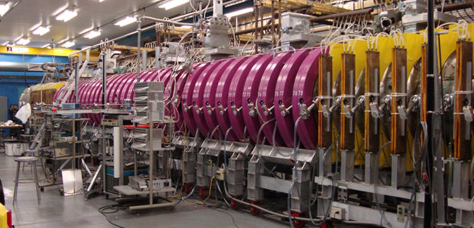
Larmor radius set the MINIMUM size for a confinement device
y
z
x
Devices must be much larger than the Larmor radii of the particles they are confining
r_{L}
Picture: LAPD linear plasma device

Slide 30
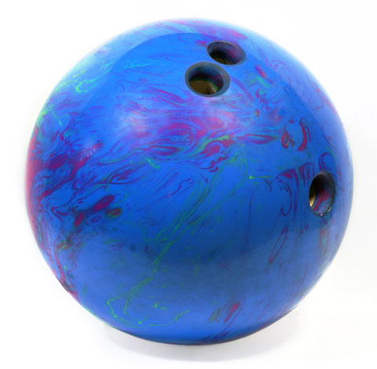
Ions are a lot heavier than electrons
protons are about 1800 times heavier than electrons

Slide 31
Ions generally have much larger Larmor radii than electrons
Energy tends to equilibrate in the system

Slide 32
Cyclotron frequency
Important for particle heating
Electron cyclotron frequency in a 1 Tesla magnetic fields is 28.0 GHz
Ion cyclotron frequency in a 1 Tesla magnetic fields is 14.2 MHz
Your microwave oven operates at 2.45 GHz
The FM radio band is from 88 to 108 MHz

Slide 33
Electric field parallel to magnetic field
If the electric field is parallel to the magnetic field the charge particles are accelerated just like they would be if there was no magnetic field

Slide 34
Electric field PERPENDICULAR to the magnetic field
Particles are accelerated when traveling along the electric field direction and decelerated when traveling against it
This alters the gyromotion causing the particles to drift
B
Diagram from: http://www.newworldencyclopedia.org/entry/File:Charged-particle-drifts.svg#file

Slide 35
Other forces cause drifts which push positive and negative particles in opposite directions
One example of this is drift caused by the gravitational force:
Is given by:
…but will generally be much weaker than the other forces in your system

Slide 36
Particle motion in a non-uniform magnetic field
In gyro-radius will be larger where the field is weaker and smaller where the field is stronger
The resulting velocity is described by:

Slide 37
Total particle motion in a curved magnetic field
The resulting velocity is described by:

Slide 38
3 invariant quantities
These quantities don’t change unless something does work on the particle
Magnetic fields do not do work on the particles
Energy:
Magnetic moment:
Adiabatic invariant:

Slide 39
The magnetic moment of a gyrating particle is a conserved quantity
Magnetic moment
As a particle moves to a region of larger magnetic field, the particles velocity perpendicular to the field must also increase

Slide 40
The conservation of the magnetic moment and conservation of energy creates the mirror effect
The particle’s energy at any given time
The particle’s initial energy
As the particle’s increase to conserve the particle’s must decrease to conserve energy

Slide 41
Adiabatic invariant
The integral of the parallel velocity as a particle bounces between two points stays constant

Slide 42
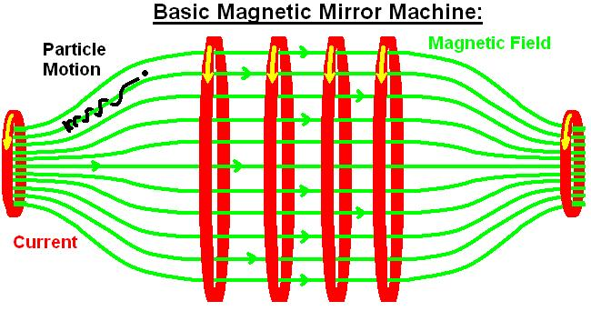
Magnetic mirrors were one of the first plasma confinement devices
The magnetic field prevents the particles from traveling radially towards the wall
Particles are reflected by in the regions of higher magnetic field
Picture from http://en.wikipedia.org/wiki/Magnetic_mirror#/media/File:Basic_Magnetic_Mirror.jpg

Slide 43
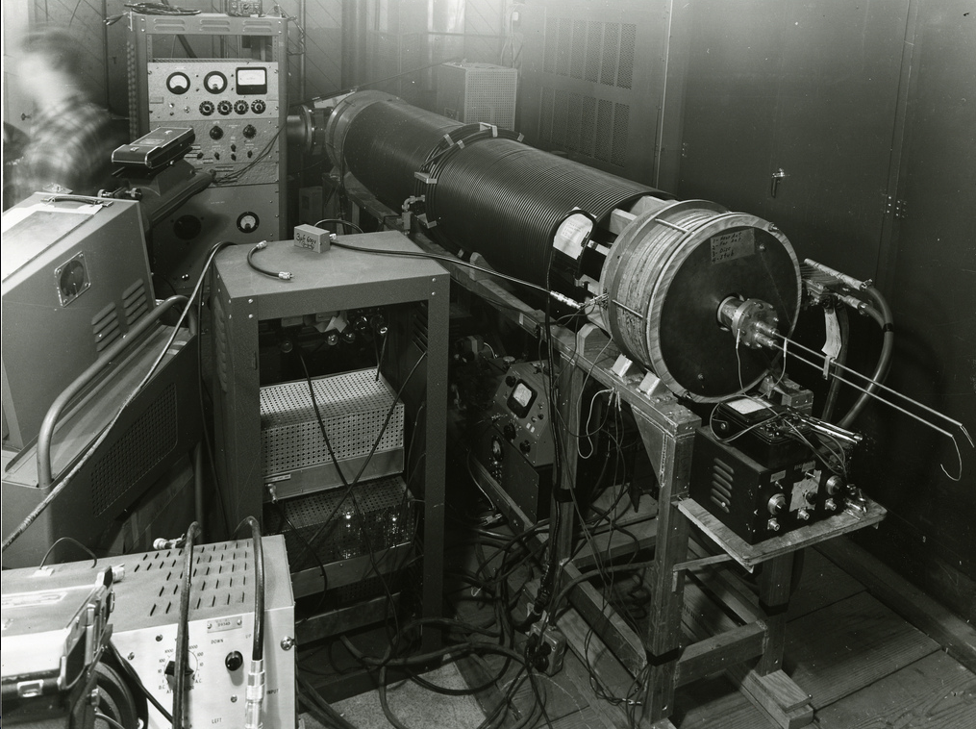
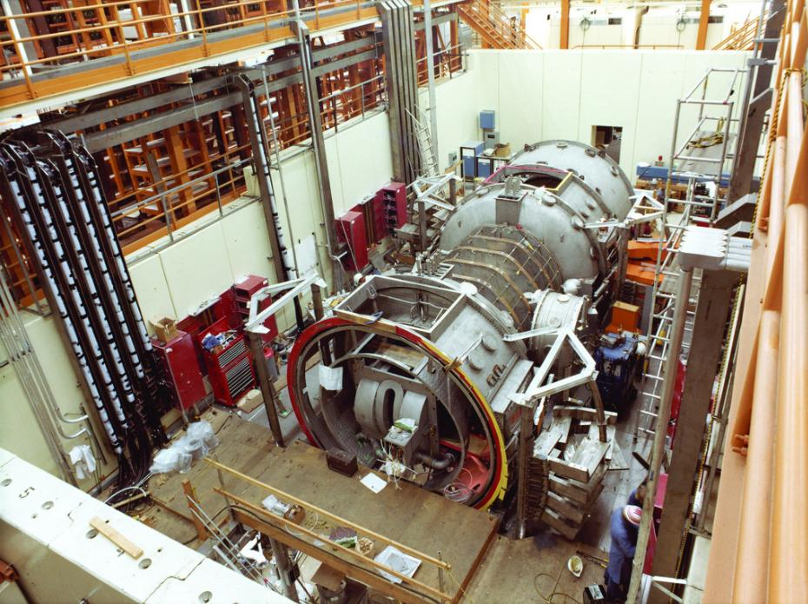
Non-uniform magnetic fields in mirror machines can be used to confine particles
Q-cumber 1955
Tandem mirror 1979
Both machines were at Lawrence Livermore National Lab
http://en.wikipedia.org/wiki/Tandem_Mirror_Experiment
https://www.flickr.com/photos/llnl/page4

Slide 44
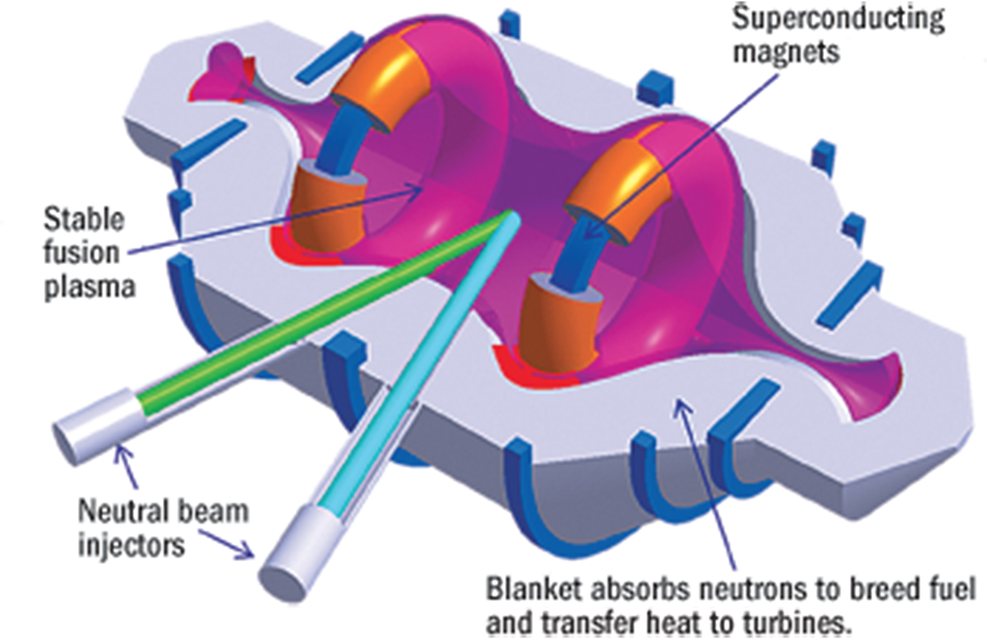
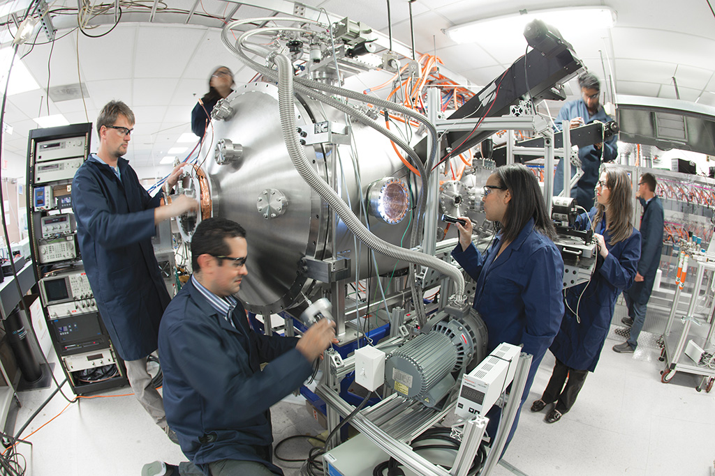
Lockhead Martin’s “compact fusion reactor”
Figures released show a confinement scheme similar to previous magnetic mirror confinement devices
Pictures from:
http://aviationweek.com/technology/skunk-works-reveals-compact-fusion-reactor-details

Slide 45
Some particles will always escape
Any particles with sufficient parallel velocity will escape
Loss cone can be narrowed by increasing the magnetic field at the throat of the device
Collisions constantly replenish the loss cone
Lost
Confined
Confined
Lost
Picture from: http://en.wikipedia.org/wiki/Magnetic_mirror#/media/File:Basic_Magnetic_Mirror.jpg

Slide 46
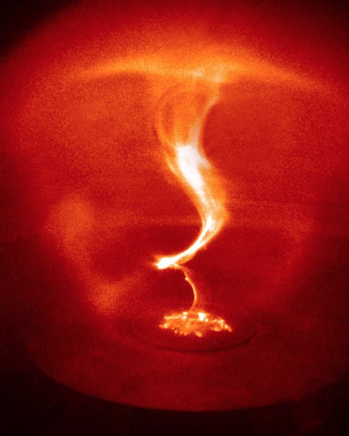
A circular magnetic field doesn’t have end loss problems…but it does have other problems
Electrical Current
A kink instability
B
Plasma
Z-pinch: a current is driven in the plasma to create a the confining magnetic field
These configurations are unstable to kink modes
Picture from: https://www.thunderbolts.info

Slide 47
Curved fields cause particles to drift off the field lines
B
R_{C}
Drift direction
Particles will drift in a direction normal to both the magnetic field and the radius of curvature
These drifts always add

Slide 48
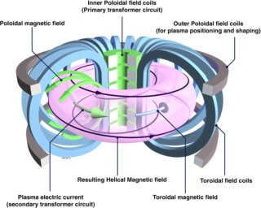
Magnetic fields that wrap both the short and long way around a toroidal device compensate for drifts off a surface
Tokamaks have both and externally generated toroidal field
And a poloidal field generated by driving a current through the plasma
Poloidal B
Toroidal
Coils
Total B
Toroidal Current
Toroidal B
Picture from: http://www.alternative-energy-action-now.com/tokamak-fusion-reactor.html

Slide 49
Poinecaré Plot
R_{C}
A slice of the tokamak at a given toroidal angle

Slide 50
Passing particle
+
R_{C}
V_{D}
Particles with sufficient velocity will leave their original flux surface but will make a full poloidal transit

Slide 51
Trapped particles
+ the mirror force
+
R_{C}
V_{D}
Particles with lower parallel velocity will become trapped in “banana” orbits
This increases plasma diffusion

Slide 52
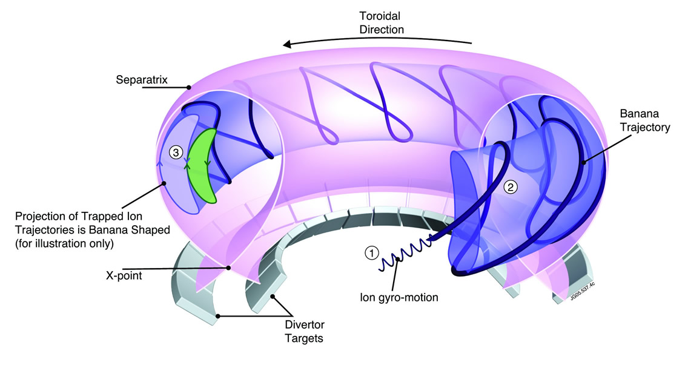
Banana orbits move around the torus
dfd
Picture from: https://www.euro-fusion.org/wpcms/wp-content/uploads/2011/09/jg05-537-4c.jpg

Slide 53
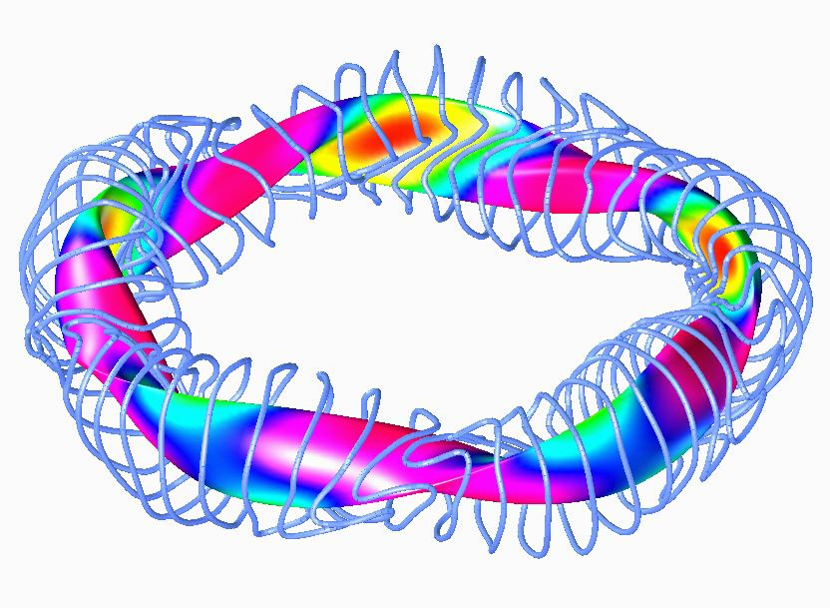
Stellarator: both poloidal and toroidal field are generated using external coils
Complicated coil structure leads to more complicated field structure and more complicated particle orbits
Picture W7-X: physics.ucla.edu/icnsp/Html/spong/spong.htm

Slide 54
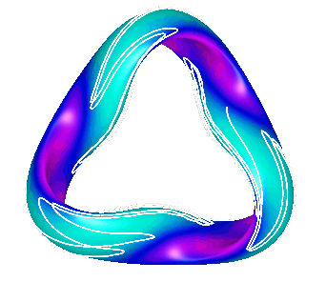
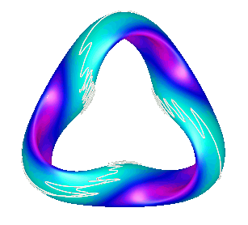
Stellarator have super bananas
Passing
Deeply Trapped
Trapped
Trapped particles can precess poloidally around stellarators
If stellarator fields are not optimized these particles will end up trajectories which intersect the wall
Picture from: http://web.ornl.gov/sci/fed/mhd/QOS_Orbits.html

Slide 55
Conclusion
Although particles are free to move along magnetic field lines, drifts push particles way from their original field lines
Toroidal confinement devices have magnetic fields in both the poloidal and toroidal direction to compensate for these drifts
Regions of strong magnetic fields can reflect particles with with insufficient velocity to overcome the mirror effect

